Slide 1
Synthesis and Physicochemical properties of Dimer Acid 2-EthelhexylEsters as Potential Bio-lubricant
Shehu Isah
STLE Presentation

Slide 2
Outline
Introduction
Synthesis of Dimer Acid 2-EH Ester
Characterization: NMR, MS-MS, FTIR
Physical Properties: Density, Viscosity and Kinematic viscosity
Blending and Cold flow properties
Conclusion
Acknowledgement

Slide 3

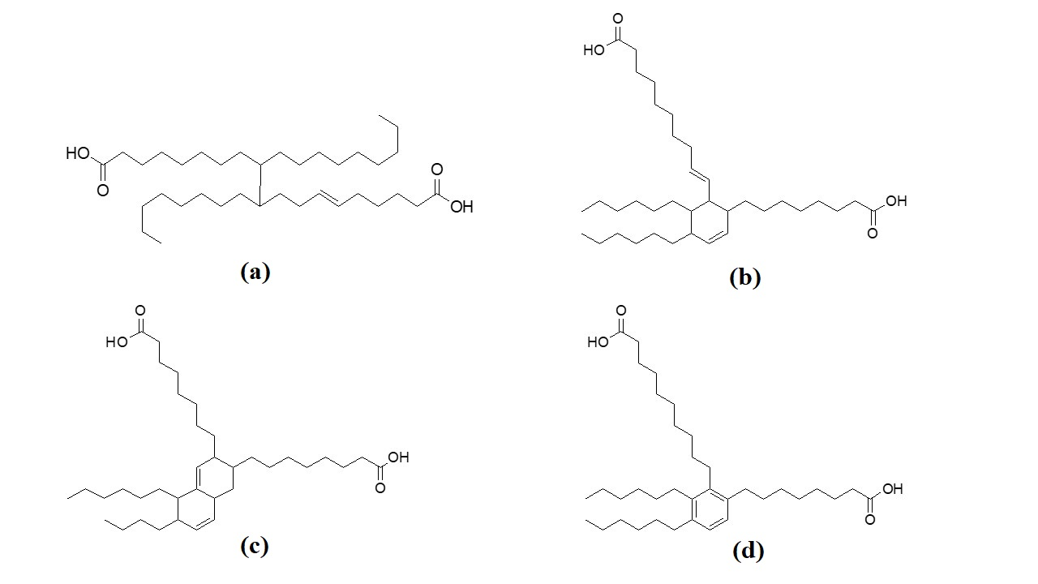
Introduction
Derived from C36-Dimer acid, which were in turn a polymerized product of Oleic acid
Typically dicarboxylic acids from thermal polymerization of fatty acids
Commercially available from lower end as Azelaic acid (C9), Sebacic (C10), Undecanoic acid (C11) and C18 unsaturated fatty acids
C₃₆ dimer acid

Slide 4
Introduction
Applications of Dimer acids/esters
synthesis and production of polyamide,
lubricants hydraulic fluid, transmission oils and greases,
surface acting agent, corrosion inhibitors,
polyurethane resins or
cold flow improver (CFI) additives (Yasi et al., 2017).

Slide 5
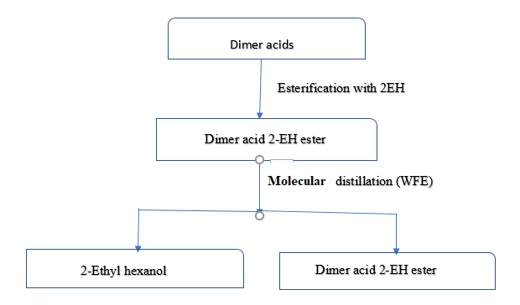
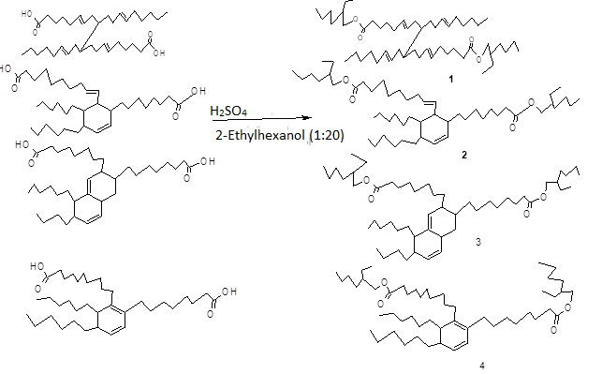
Synthesis of Dimer Acid 2-EH Ester
Optimized Large-scale Batch Process
synthesized from concentrated sulfuric acid catalyzed esterification C38 dimer acid at a ratio of 1:20 excess alcohol
The mixture was heated to 120 ^{O}C for 72 h and neutralized with 1.2 eq KOH in 90% ethanol /water
Excess 2-ethylhexanol via molecular distillation (wiped film evaporation)
Yield: 97 %

Slide 6
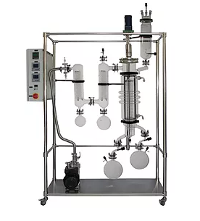
Synthesis of Dimer Acid 2-EH Ester
Molecular Distillation
Evaporator Temp: 105 ^{O}C
Feed funnel Temp: 60 ^{O}C
Condenser Tender: 25 ^{O}C
Vacuum: 0.937 mmHg
Drop Rate: 20 drops/min.

Slide 7
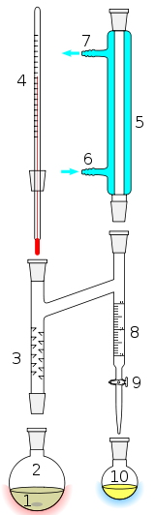
Synthesis of Dimer Acid 2-EH Ester
Application of Dean Stark Apparatus/Toluene
Dimer acid : 2-Ethyl hexanol (1:2.2 mol ratio)
Toluene (solvent)
H₂SO₄ (30% mole ratio of dimer acid)
Reflux under Nitrogen atm @ 140 ^{O}C for 48 h
Extracted with ethyl acetate
Yield 96.7 %

Slide 8
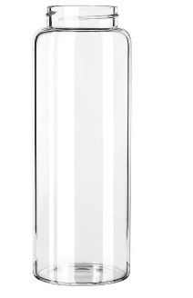

Synthesis of Dimer Acid 2-EH Ester
Use of enclosed vial reactor without solvent
vial bottle lined with a teflon-lined capping
Dimer acid : 2-Ethyl hexanol (1:20 mol ratio)
H₂SO₄ (30% mole ratio of dimer acid)
Flush with Nitrogen @ 120 ^{O}C for 48 h
Extracted with ethyl acetate
Yield 97 %

Slide 9
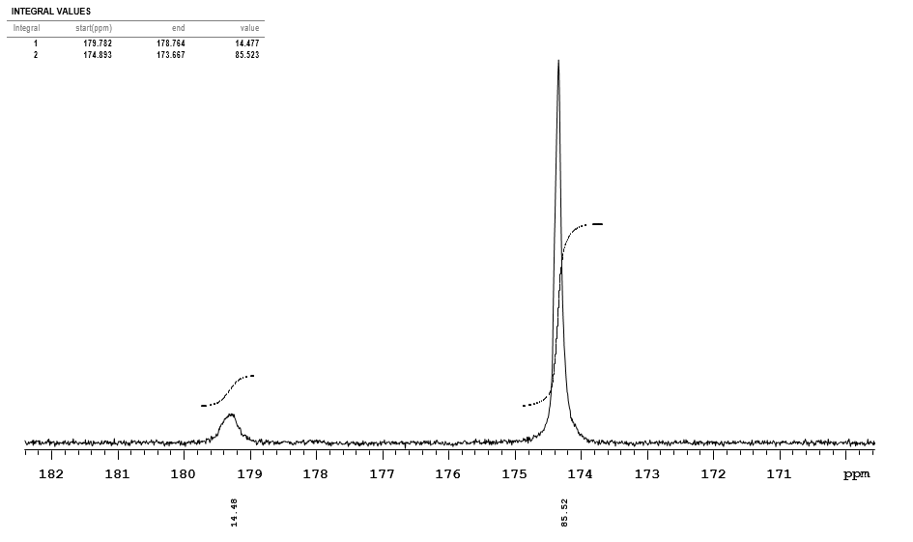
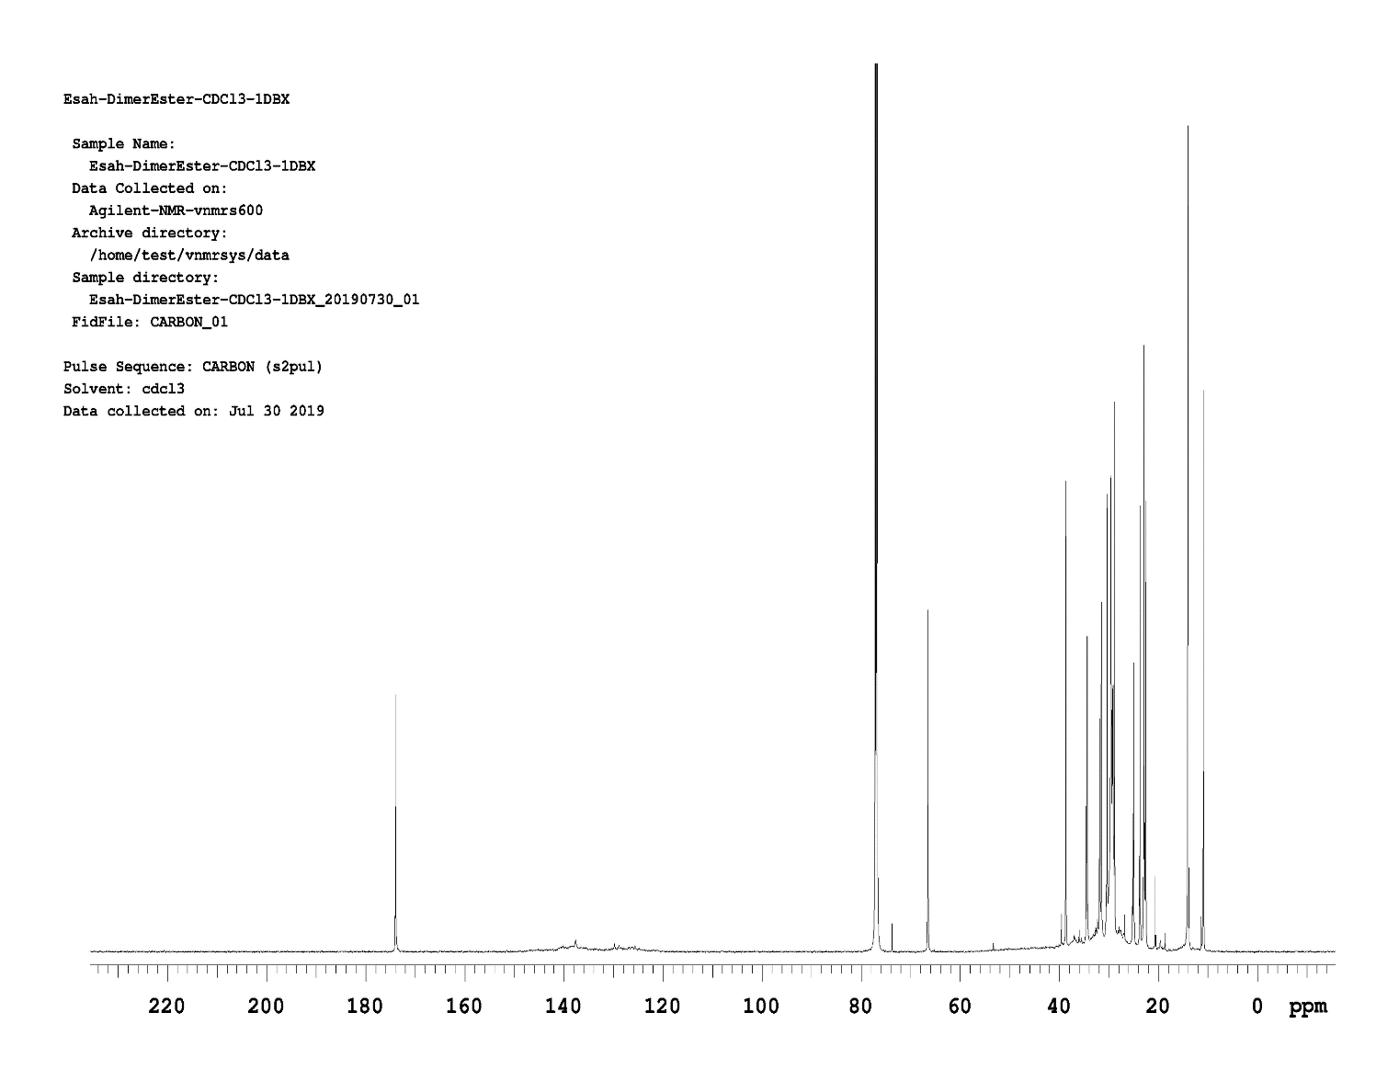
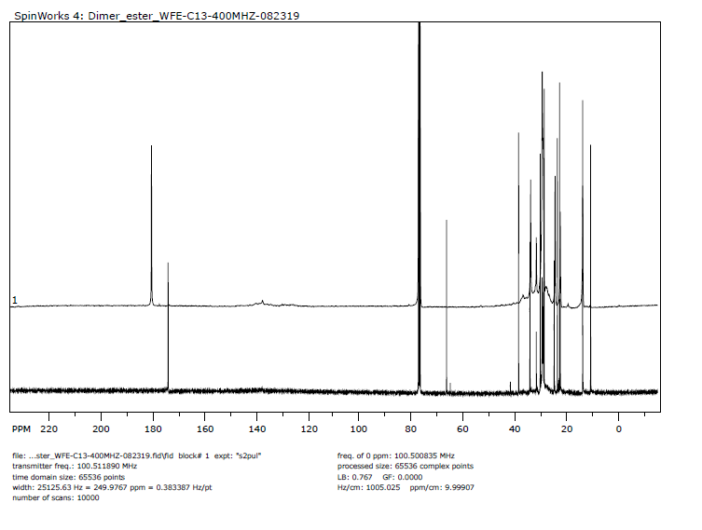
Characterization
¹³C NMR
Structural identification and
Monitor rate of conversion

Slide 10
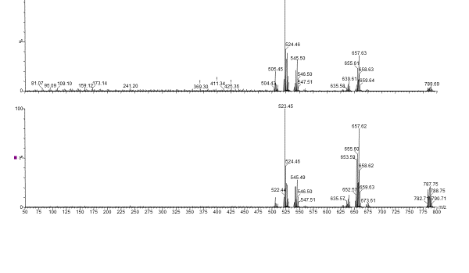
Characterization
MS-MS
Determination of molecular mass: m/z = 783.7g mol-1

Slide 11
Characterization
MS-MS: Fragmentaion

Slide 12
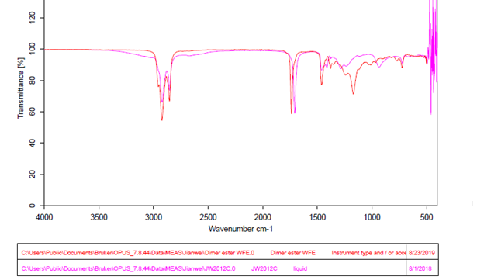
Characterization
FTIR

Slide 13
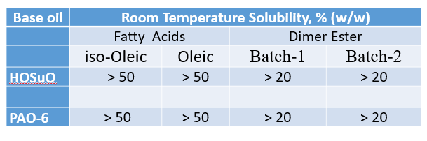
Physical properties
Solubilities in Base Oils
Excellent solubility in both base oils: HOSuO and PAO-6

Slide 14
Physical Properties
Dimer acid
Dimer acid ET ester
Microscale using Dean stark trap 184 | 5.55 (2.8) % FFA
Large scale batch 1 180 | 7.08 (3.57) %FFA
Large scale Batch 2 183 | 6.09 (3.55) % FFA
Total acid number
Total acid number decreased from ~ 180 to ~ 5 upon esterification
% FFA was approximately 3 % upon esterification

Slide 15
Physical properties
 | Fatty Acid |  | Dimer Ester
 | iso-Oleic | Oleic | Batch-1 | Batch-2
density, g/mL
40 °C | 0.8818 ± 0.0001 | 0.8777 ± 0.0001 | 0.9102 ± 0.0002 | 0.9128 ± 0.0001
100 °C | 0.8410 ± 0.0001 | 0.8368 ± 0.0000 | 0.8717 ± 0.0001 | 0.8739 ± 0.0000
kVis, mm2/s
40 °C | 28.01 ± 0.10 | 19.61 ± 0.01 | 161.79 ± 0.10 | 148.50 ± 0.14
100 °C | 5.82 ± 0.03 | 4.91 ± 0.01 | 19.10 ± 0.02 | 17.66 ± 0.01
dVis, mPa-s
40 °C | 24.70 ± 0.08 | 17.21 ± 0.01 | 147.26 ± 0.07 | 135.56 ± 0.14
100 °C | 4.89 ± 0.03 | 4.11 ± 0.01 | 16.65 ± 0.01 | 15.44 ± 0.01
VI | 158 ± 1 | 189± 0 | 134± 0 | 131. ± 0
Relative to oleic acid, dimer 2-EH esters displayed:
  Higher density (Batch-1 > Batch-2)
  3- to 8-fold higher kinematic viscosity (Batch-1 > Batch-2)
  Lower VI, which was comparable to PAO-6 ~ 137 (Batch-1 > Batch-2)

Slide 16
Physical properties
Neat PAO-6 has poor viscosity and VI properties
Blends with 0-10 % w/w dimer 2-EH esters were investigated:
  Higher density that increased with increasing [2-EH ester]
Density (g/cm3) of Dimer Ester blends in PAO-6

Slide 17
Physical properties
Neat PAO-6 has poor viscosity and VI properties
Blends with 0-10 % w/w dimer 2-EH esters were investigated:
  Slight increase or no change in Kvis with increasing [2-EH ester]

Slide 18
Physical properties
Neat PAO-6 has poor viscosity and VI properties
Blends with 0-10 % w/w dimer 2-EH esters were investigated:
  Slight increase or no change in VI with increasing [2-EH ester]

Slide 19
Cold Flow properties
Neat HOSuO has poor cold flow
Blends with 0-10 % w/w dimer esters investigated
  Lower pour point that was independent of [2-EH ester]
  Slight reduction in cloud point that decreased with increasing [2-EH ester]
Pour Point and Cloud Point of Dimer Ester-2 blends in HOSuO

Slide 20
Physical properties: Oxidation Stability
PDSC onset (OT) and peak (PT) oxidation temperatures of Dimer Ester-1 blends in HOSuO (°C)
Slight reduction in oxidation OT and PT that was independent of [2-EH ester

Slide 21
Physical Properties
Findings
Good solubility profiles in commercial base oils: > 20 % (w/w)
Kinematic viscosity and viscosity index compared favorably well with commercial base oil (PAO-6): 134 v 137
Improved CP, PP, density and kinematic viscosity upon blending with commercial base stock
Potential for bio lubricant formulation or
Candidate for CFI additive

Slide 22
Conclusion
Dimer acid 2-EH esters were synthesized from sulfuric acid catalyzed esterification of C36 dimer acid with 2-ethylhexanol
Reaction parameters optimized for scale up production of two batches of dimer esters obtained from two set of dimer acids catalyzed by different zeolite catalysts.
Reaction progress and conversion were monitored ¹³C NMR spectroscopy.
Dimer acid 2-EH esters compared favorably well with commercial base oil (PAO-6) as potential candidate for base stock formulation.
Blends of dimer acid 2EH ester with HOSuO base stock showed improvement in cloud point and pour point as potential cold flow property improver (CFI) additive.
The OT and PT oxidative temperatures were slightly lower than the HOSuO base stocks.

