Slide 1
Synthesis of Thiophene and Thiolane Derivatives Found in Biodiesel Produced from Brown Grease Lipids
By
Isah Shehu
07/25/2019

Slide 2
Outline of Presentation
Synthesis of Methyl 8-(2’,5’-hexylthienyl)octanoate (1)
Synthesis of epithiostearate (2)
Synthesis of cross-linked disulfide (3)
Synthesis of cross-linked sulfide (4)
Synthesis of epidithiostearate (5)
Synthesis of 5-butyl dihydrthiophen-2-one (6)

Slide 3
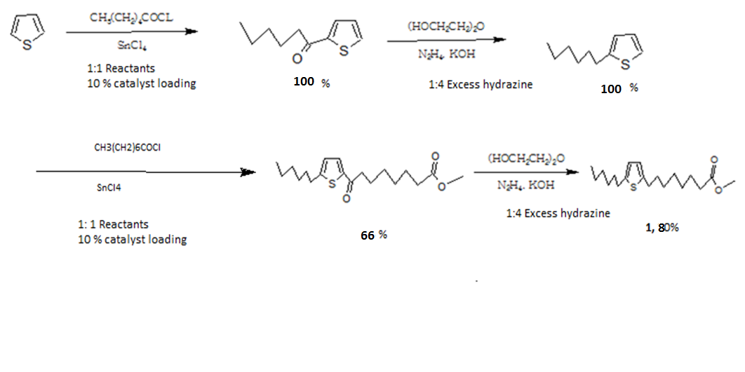
Synthesis of Methyl 8-(2’,5’-hexylthienyl)octanoate (1)
The synthesis is according to the procedure described by Gunstone et al., (1973) with some modifications. The multi-step synthesis is shown in scheme 1.

Slide 4
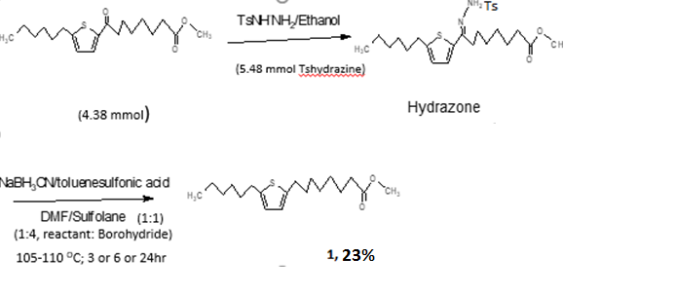
Synthesis of Methyl 8-(2’,5’-hexylthienyl)octanoate (1)
Modification:
Henbest Reduction: toluene @ 110 ^{O}C and use of Dean Trap Distillation
  Modified Solvent from Ethylene Glycol to Toluene to easier work up. Product was soluble in Ethylene Glycol.
Caglioti Reduction: synthesis and reduction of tosyl hydrazine (Bouhadir et al (2012); Hutchins et al (1973).
Scheme 2: Caglioti Reduction: Synthesis and reduction of tosyl hydrazone

Slide 5
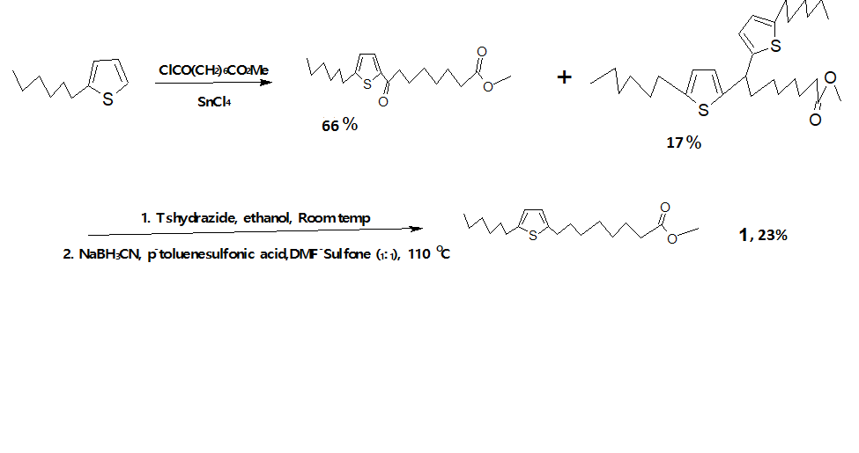
Synthesis of Methyl 8-(2’,5’-hexylthienyl)octanoate (1)
Scheme 3: Caglioti reaction (Hydrazone reduction) over 24 hr

Slide 6
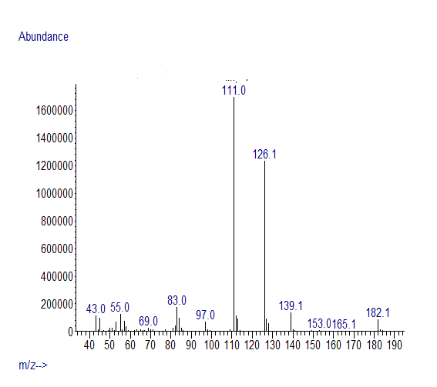
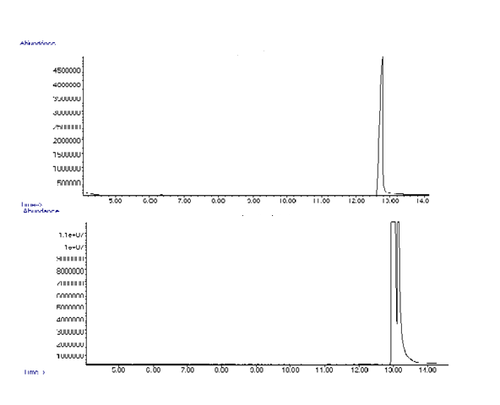

Scheme 1. Intermediate #1
C-Detector
MM 182 g/mol
MM 182g/mol
S-Detector

Slide 7
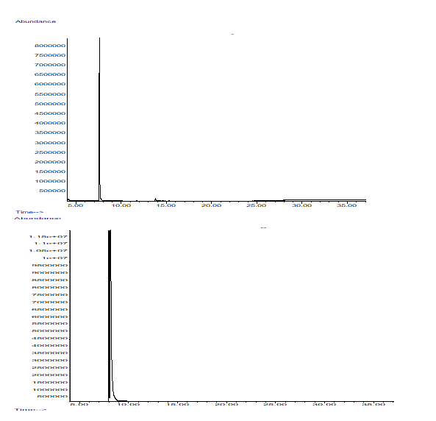
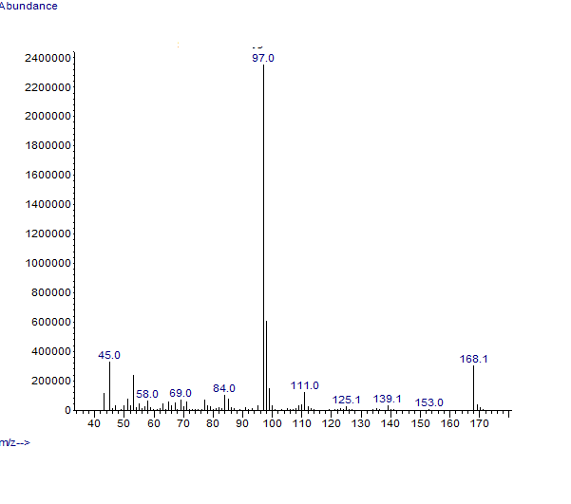

Scheme 1. Intermediate #2
C-Detector
168g
MM 168g/mol
S-Detector

Slide 8

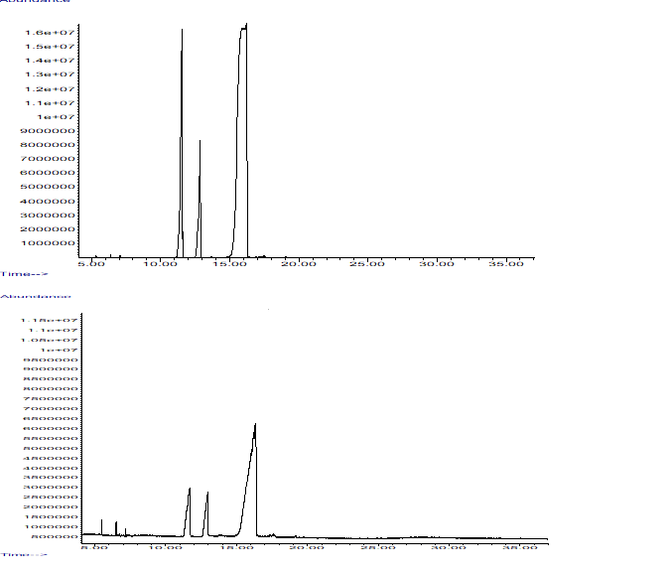
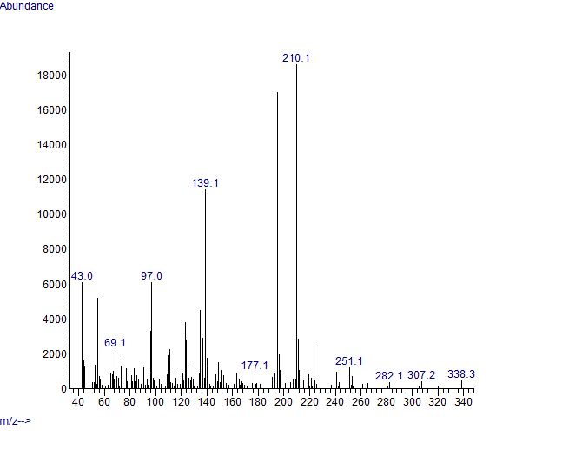
Scheme 1. Intermediate #3
MW: 338 g/mol
C-Detector
MW: 338 g/mol
S-Detector

Slide 9
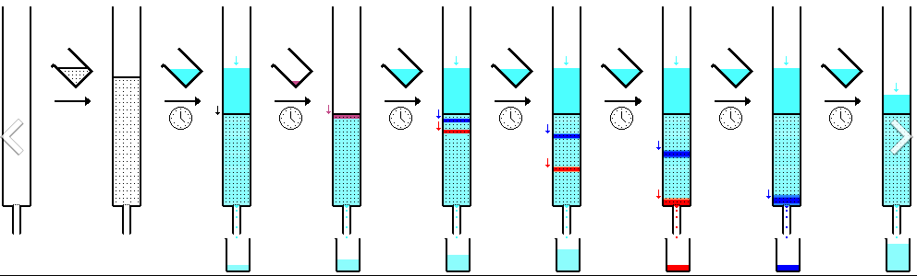
Preparative Separation of Reaction Products
TLC
Short column Chromatography
Thin layer chromatograms (TLC) were carried out on glass support silica gel 60 plates (0.25 mm layer, F-254) (E.Merck No. 5765) and developed using varied solvent mixtures as follows.
n-hexane (100 %);
n-hexane: ethyl acetate: acetic acid (80:20:1);
n-hexane:ethyl acetate (90:10):
n-hexane:ethyl acetate (95:5);
n-hexane: ethyl acetate (99:1);
n-hexane:diethyl ether (95:5) and
n-hexane:diethyl ether (99:1).
A suitable solvent system is chosen from the results of analytical TLC with acceptable ∆R_{f} for product separation
20 mm x 5 in column of 10 g of silica gel 60 for sample loading of 1 g each and solvent elution of 10 ml, 5 ml or 2 ml
Conditioned with 2 x 10 ml of appropriate solvent before application of sample. Elution carried out under gravity except on rare occasions were vacuum pressure is applied for effective elution.
The last component is usually flushed using either diethyl ether or ethyl acetate

Slide 10
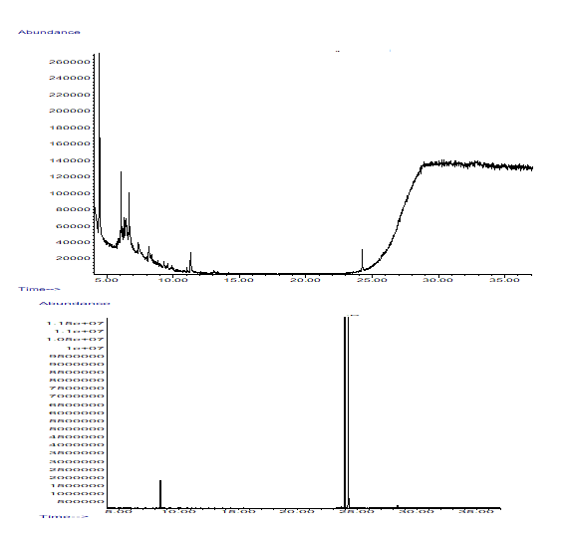
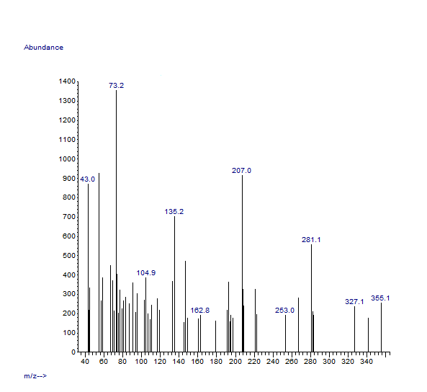

Gunstone Reaction Unsuccessful
C-Detector
MW: 324 g/mol
SW-Detector

Slide 11
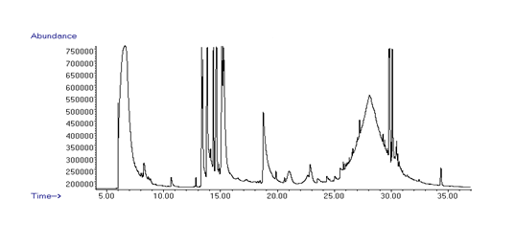
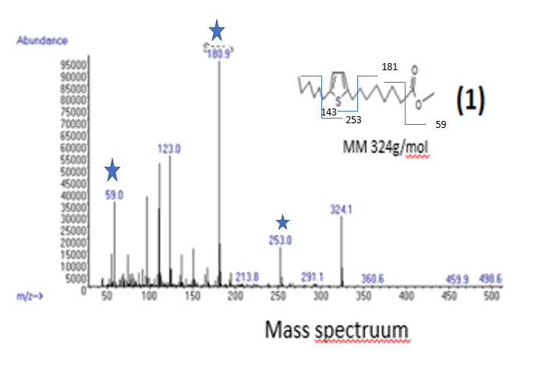
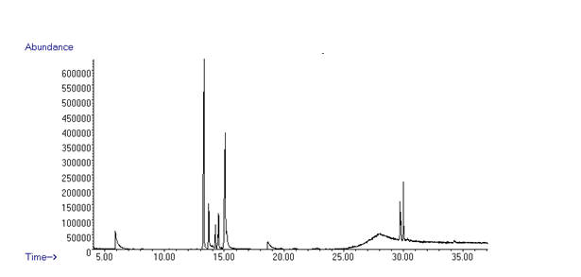
Methyl 8-(2’,5’-hexylthienyl)octanoate (1) via Caglioti Reaction
C-Detector
S-Detector

Slide 12
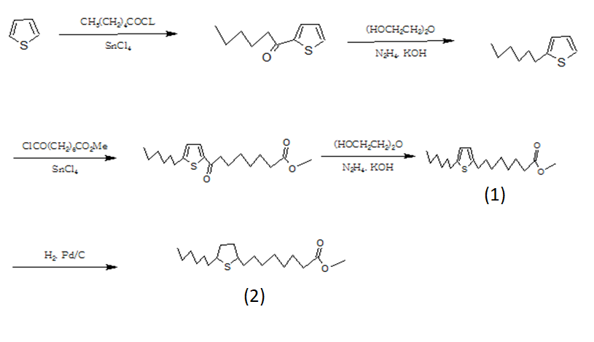
Synthesis of Epithiostearate (2)
The synthesis is according to the procedure described by Gunstone et al., (1973) with some modifications. The multi-step synthesis is shown in scheme 1a.
This proposed procedure was abandoned due to the unsuccessful attempts to synthesis target #1

Slide 13
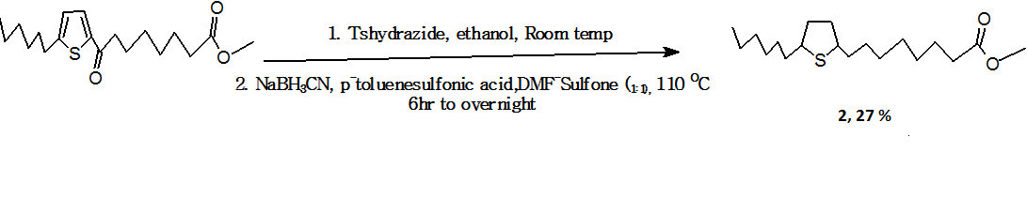
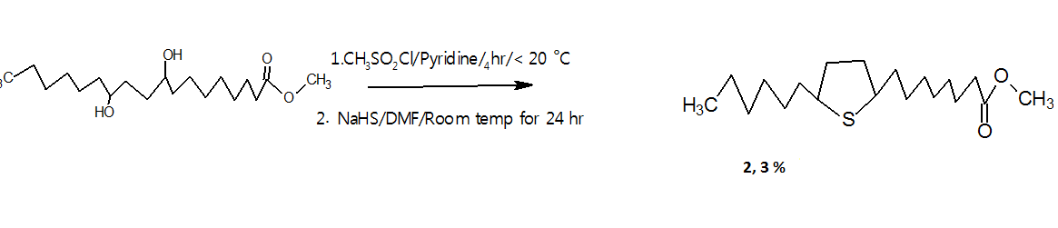
Synthesis of Epithiostearate (2)
Scheme 4a. Via Caglioti reduction (Hutchins et al., 1973):
(Gunstone intermediate)
Scheme 4b. Via Methylsulfonyl (mesyl) ester (Gunstone et al., 1973);
(from Oxy-mercuration and
de-mercuration of Methyl-Ricinoleate

Slide 14
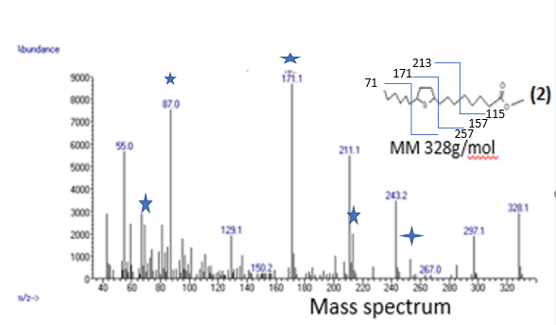

Methyl 9, 12-Epithiostearate (2)
C-Detector
S-Detector

Slide 15
Scheme 5. Synthesis of cross-linked disulfide (3) from methyl 12-hydroxystearate
(1:2)
Me 12-hydroxystearate
(1:10)
3, 10%

Slide 16
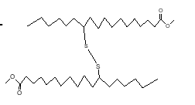
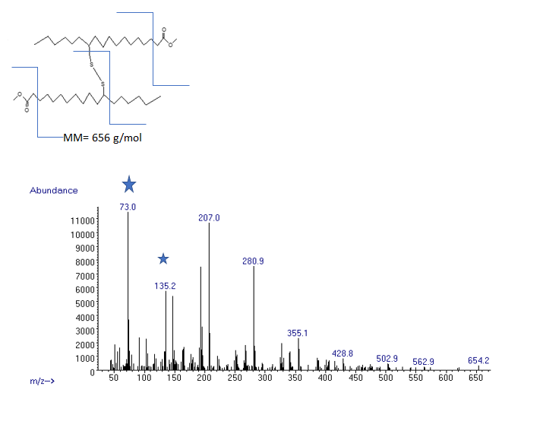
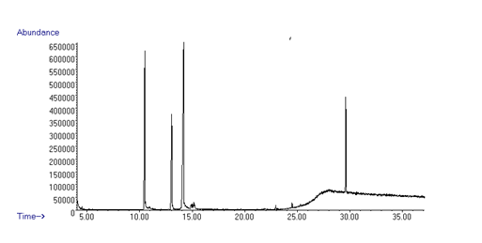
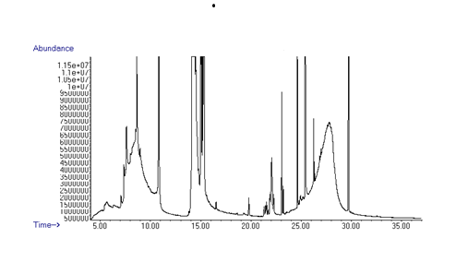
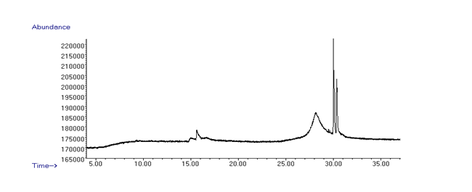
Cross-linked Disulfide
S-Detector
C-Detector

Slide 17
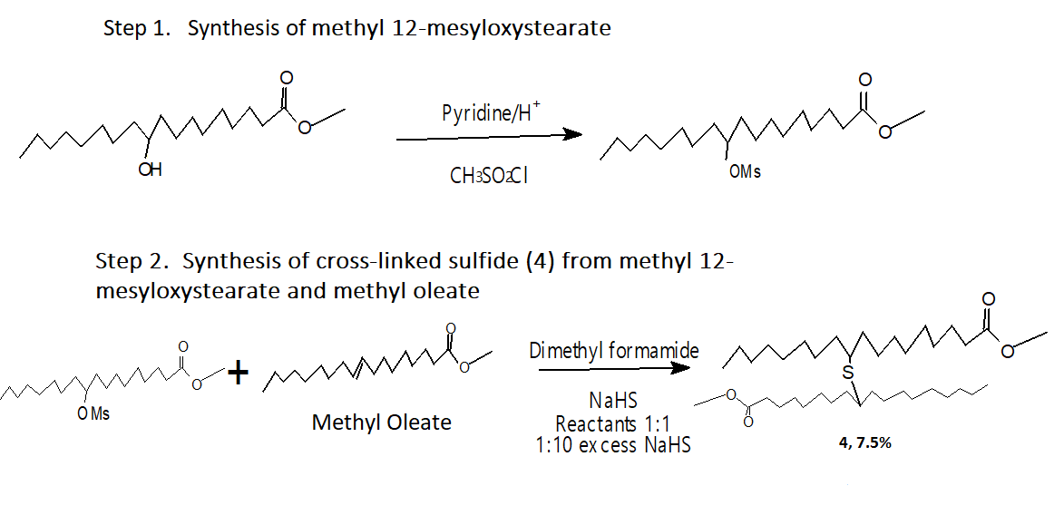
Scheme 6. Synthesis of Cross-linked Sulfide (4)

Slide 18
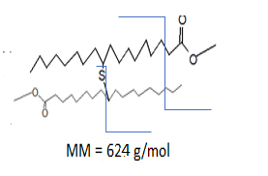
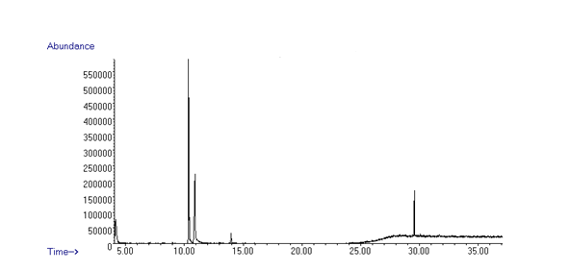
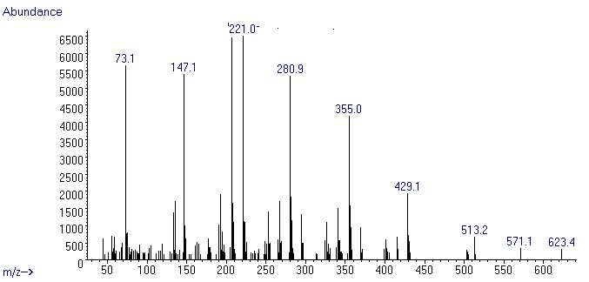
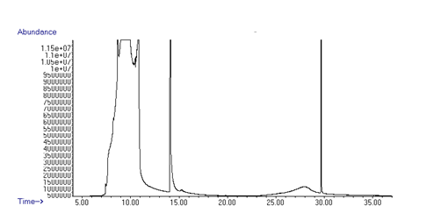
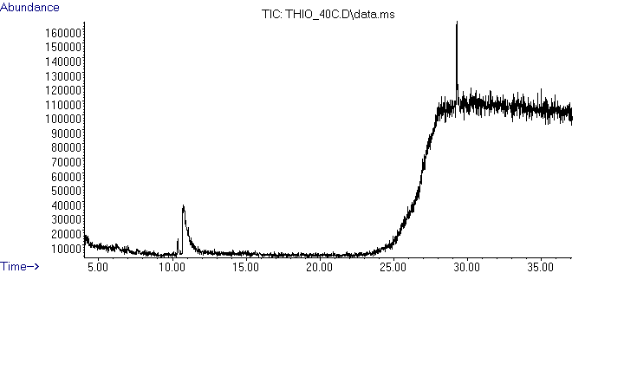
Crossed-linked Sulfide
S-Detector
C-Dtector

Slide 19
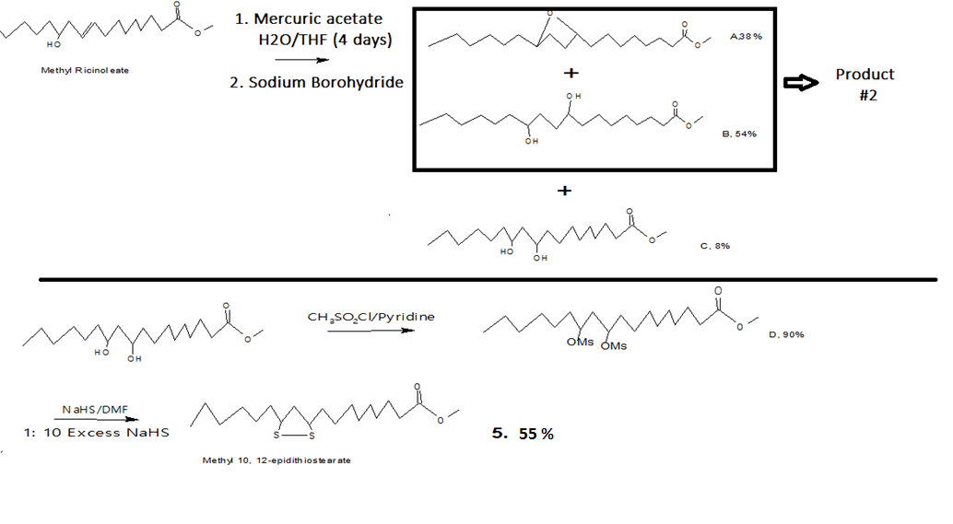
Scheme 6 :Methyl 10,12-epidithiostearate (5) obtained from treating the corresponding mesylate ester (D) with excess NaHS.

Slide 20
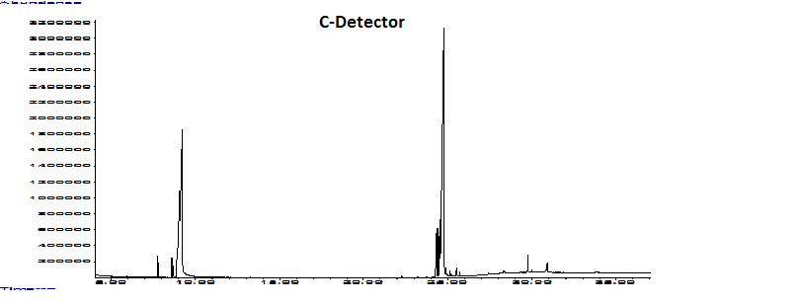
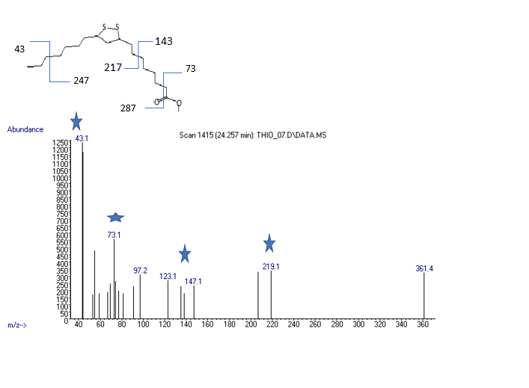
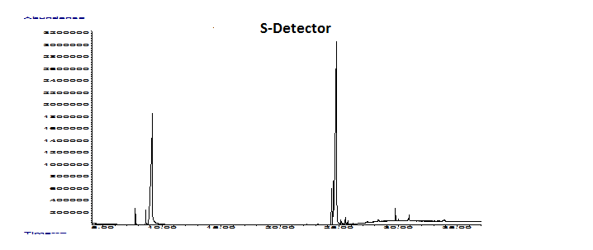
Epidithiosterate
S-Detector

Slide 21
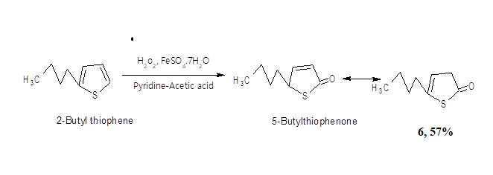
Synthesis of 5-butyl dihydrothiophen-2-one (6)

Slide 22
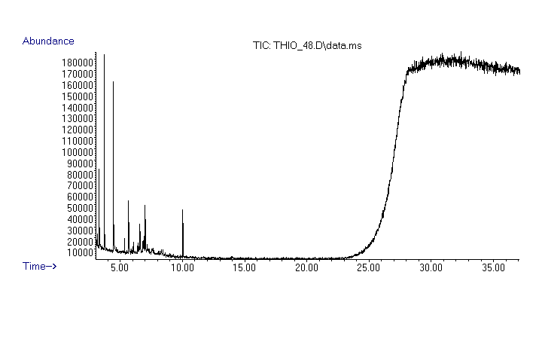
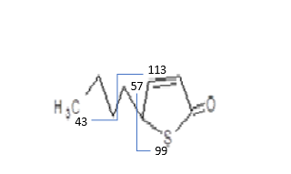
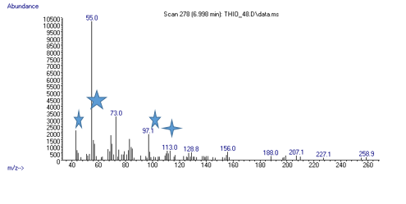
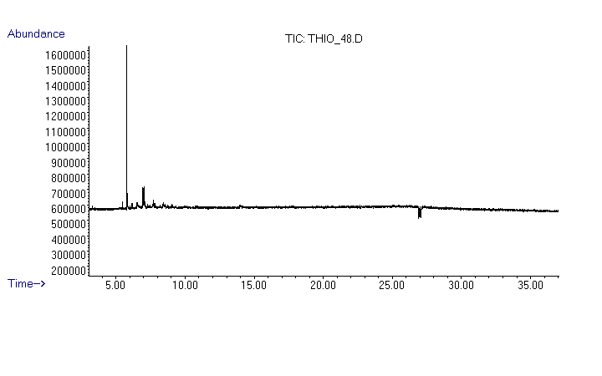
5-butyl dihydrothiophen-2-one (6)

Slide 23
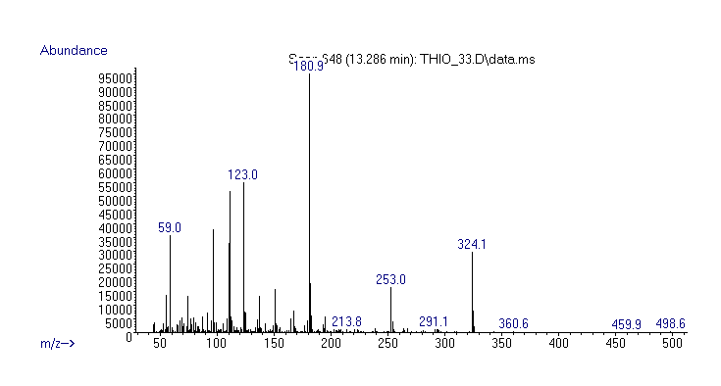
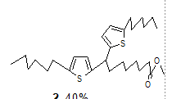
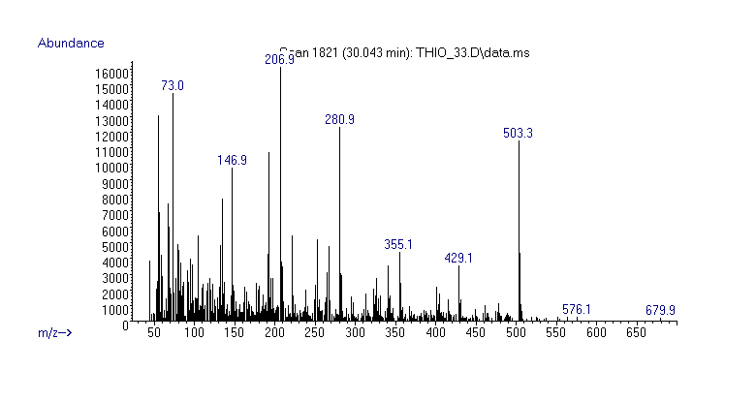
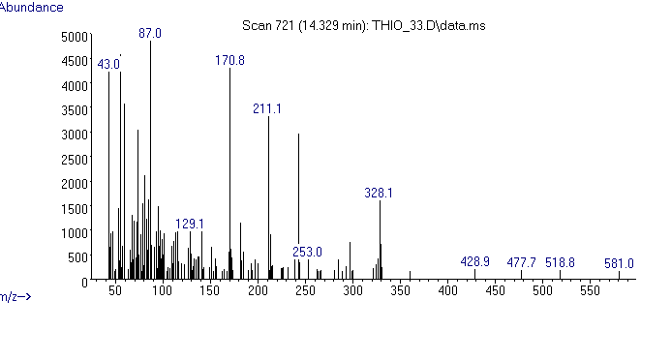
Results
Mass spectra

