Slide 1
EO Component | Concentration (mg/ml) | Zone of inhibition (mm)
 |  | 24 hr | 48 hr | 72 hr
Cuminaldehyde | 200 | 42 | 13 | 11
 | 100 | 18 | 11 | 10
 | 10 | 8 | 6 | 6
Carvacrol | 100 | 35 | 23 | 13
 | 10 | 6 | 6 | 6
 | 1 | 8 | 6 | 6
β-pinene | 100 | 10 | 6 | 6
 | 10 | 6 | 6 | 6
 | 1 | 9 | 6 | 6
α-terpinene | 100 | 11 | 6 | 6
 | 10 | 9 | 6 | 6
 | 1 | 6 | 6 | 6
Terpinolene | 100 | 6 | 6 | 6
 | 10 | 6 | 6 | 6
 | 1 | 6 | 6 | 6
β-citronellol | 100 | 26 | 21 | 16
 | 10 | 12 | 10 | 10
 | 1 | 6 | 6 | 6
Thymol | 100 | 38 | 32 | 32
 | 10 | 10 | 9 | 9
 | 1 | 9 | 8 | 8
Trans-cinnamaldehyde | 100 | 62 | 62 | 49
 | 10 | 26 | 11 | 11
 | 1 | 6 | 6 | 6
p-anisaldehyde | 100 | 15 | 10 | 10
 | 10 | 10 | 6 | 6
 | 1 | 6 | 6 | 6
Table 1. Zones of C. pseudotuberculosis inhibition by essential oil components after 24-, 48-, and 72-hours (hr) incubation.

Slide 2
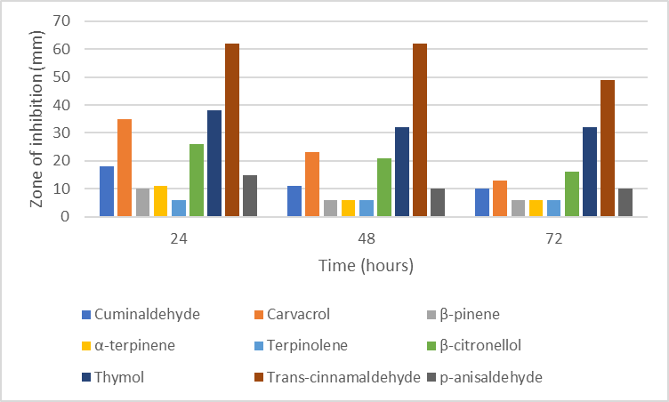
Figure 1. Zones of C. pseudotuberculosis inhibition at final essential oil component concentrations of 100 mg/ml (maximal effect; n=1). Zero effect equals the disk diameter of 6 mm.

Slide 3
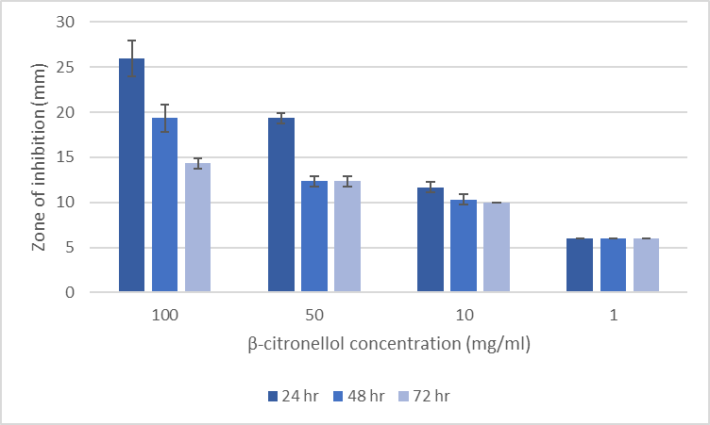
Figure 2. Zones of C. pseudotuberculosis inhibition by β-citronellol after 24-, 48-, and 72-hours (hr) incubation. Values are the mean of 3 replicates; error bars are the standard deviations of the replicates. Zero effect equals the disk diameter of 6 mm.

Slide 4
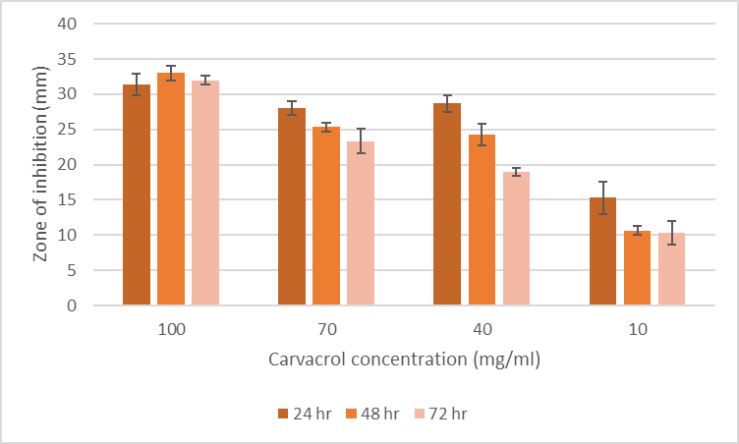
Figure 3. Zones of C. pseudotuberculosis inhibition by carvacrol after 24-, 48-, and 72-hours (hr) incubation. Values are the mean of 3 replicates; error bars are the standard deviations of the replicates. Zero effect equals the disk diameter of 6 mm.

Slide 5
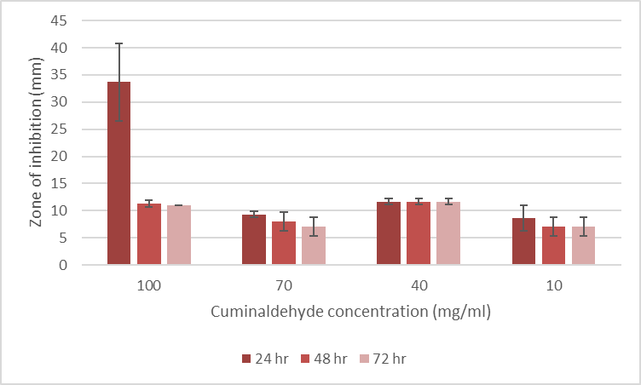
Figure 4. Zones of C. pseudotuberculosis inhibition by cuminaldehyde after 24-, 48-, and 72-hours (hr) incubation. Values are the mean of 3 replicates; error bars are the standard deviations of the replicates. Zero effect equals the disk diameter of 6 mm.

Slide 6
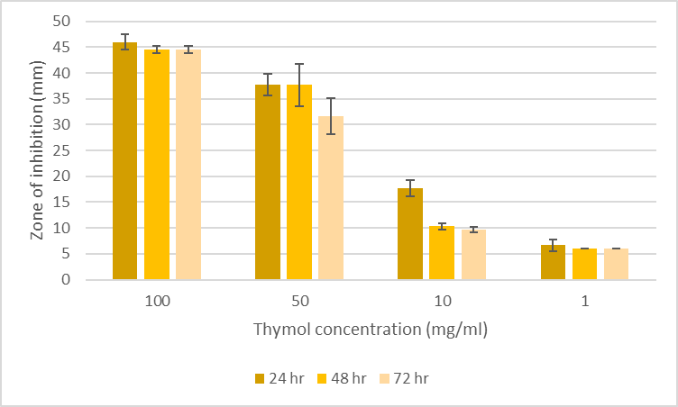
Figure 5. Zones of C. pseudotuberculosis inhibition by thymol after 24-, 48-, and 72-hours (hr) incubation. Values are the mean of 3 replicates; error bars are the standard deviations of the replicates. Zero effect equals the disk diameter of 6 mm.

Slide 7
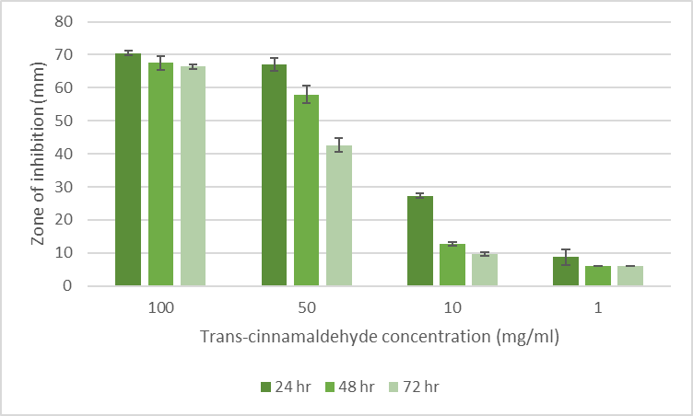
Figure 6. Zones of C. pseudotuberculosis inhibition by trans-cinnamaldehyde after 24-, 48-, and 72-hours (hr) incubation. Values are the mean of 3 replicates; error bars are the standard deviations of the replicates. Zero effect equals the disk diameter of 6 mm.

Slide 8
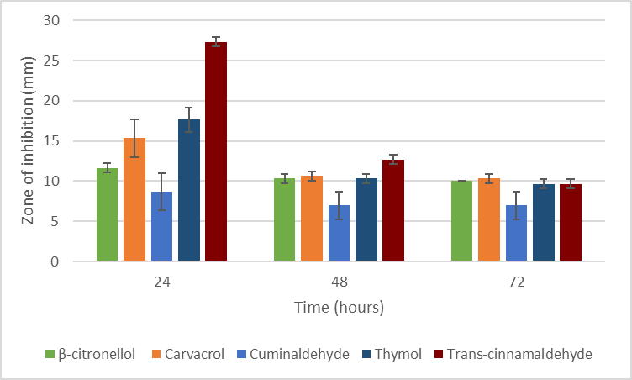
Figure 7. Zones of C. pseudotuberculosis inhibition at final essential oil component concentrations of 10 mg/ml. Values are the mean of 3 replicates; error bars are the standard deviations of the replicates. Zero effect equals the disk diameter of 6 mm.

Slide 9
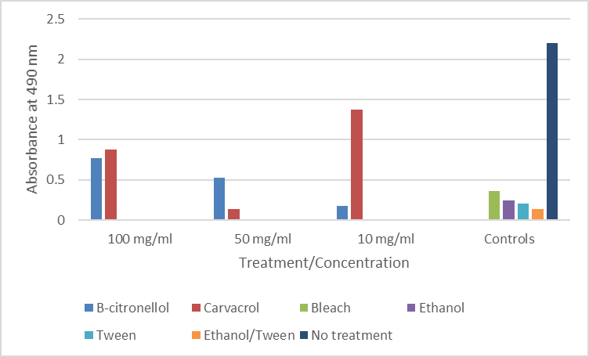
Figure 8. Viability of BRL cells treated with EO components and controls (higher absorbance readings indicate more viable cells). Values are the mean of 3 replicates.

Slide 10
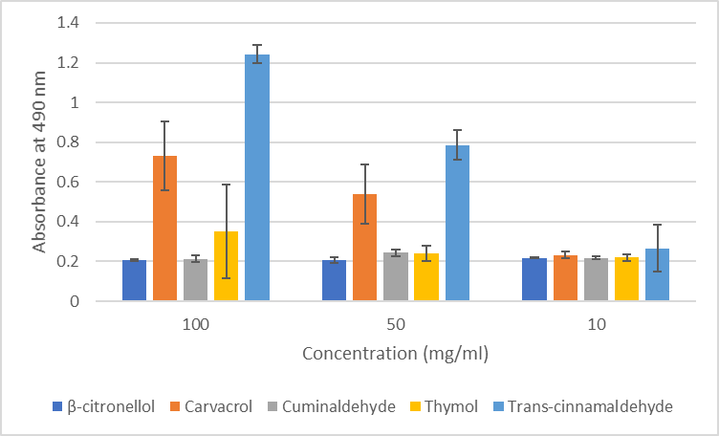
Figure 9. Viability of BRL cells treated with EO components (higher absorbance readings indicate more viable cells). Values are the mean of 3 replicates; error bars are the standard deviations of the replicates.

Slide 11
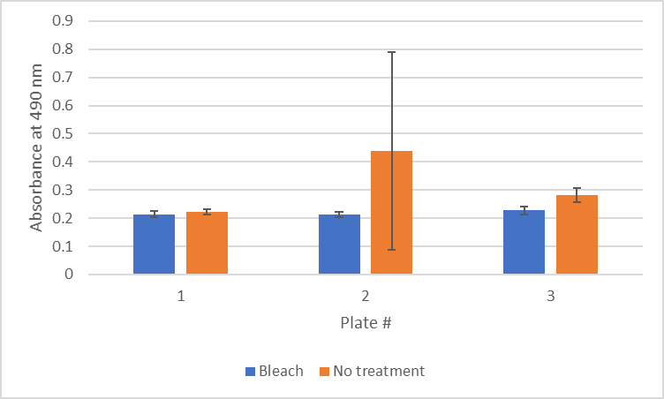
Figure 10. Viability of BRL cells treated with bleach and untreated (higher absorbance readings indicate more viable cells). Values are the mean of 3 replicates; error bars are the standard deviations of the replicates.

