Slide 1
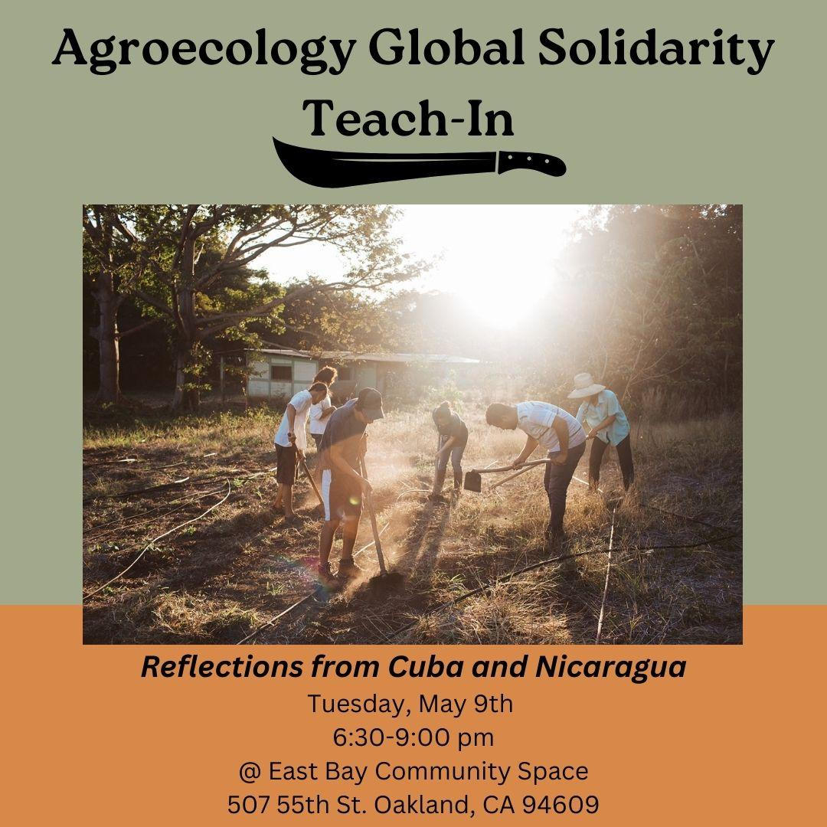

Slide 2
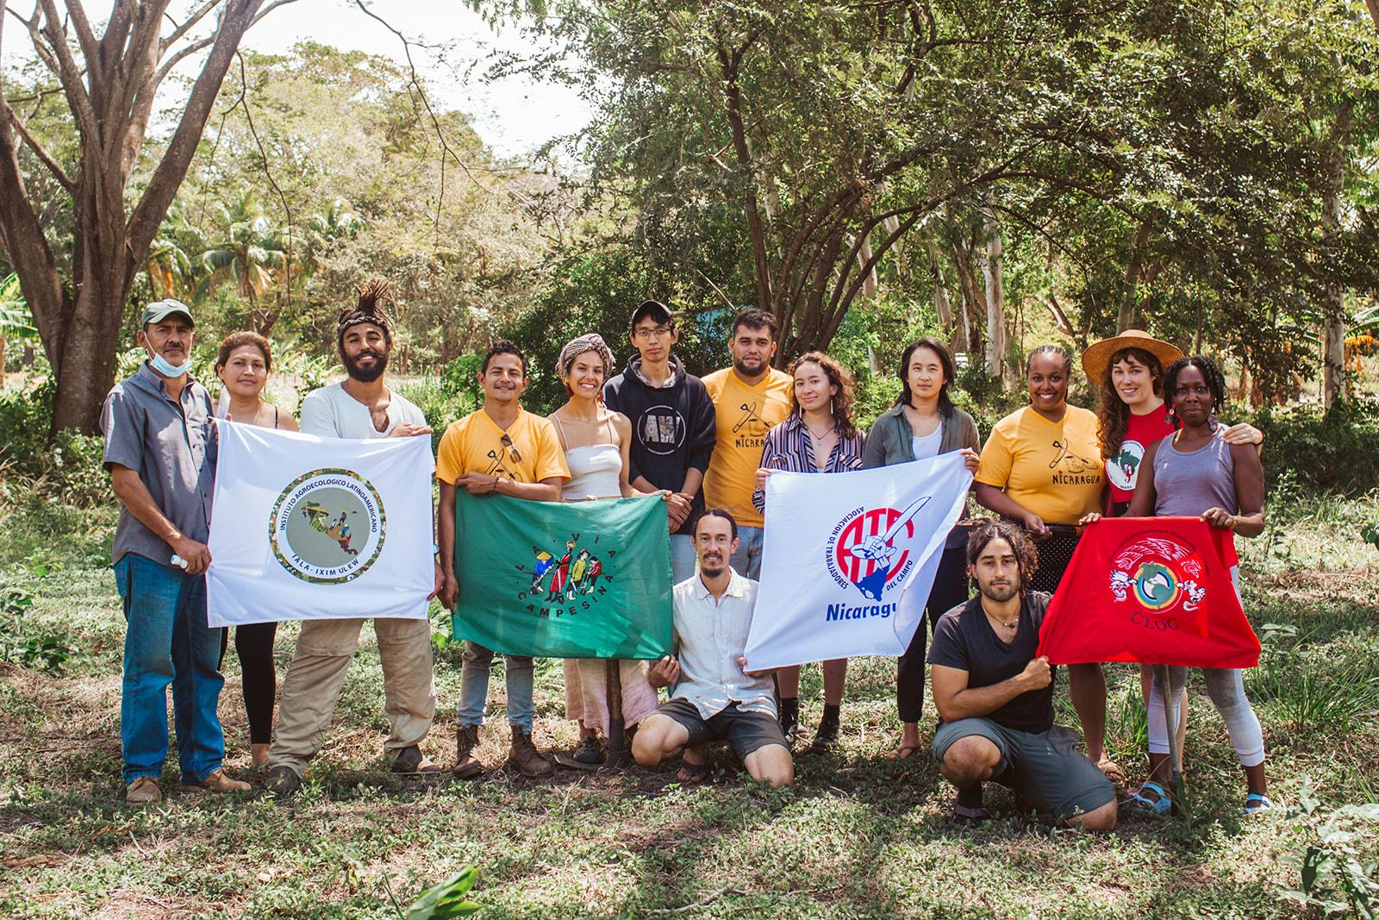
Teach-In Flow:
6:30 - 7:00 - Food and Mingling
7:00 - 7:15 - Welcome & Mistica
7:15 - 7:25 - AC Overview
7:25 - 8:20 - Cuba Teach-In and Story-telling
8:20 - 9:00 - Nicaragua Teach-in and Story-telling
9:00 - 9:20 - Table Conversations
9:20 - 9:30 - Ways to learn more and calls to action!

Slide 3

Tonight we’ll focus on sharing struggles, strategies, & stories for:
  Agroecology, land justice, and food sovereignty
  Farmer-to-farmer exchange and organizing
  Relationship building and values-aligned cooperation
  Ways to building solidarity for social change
Notes:
Invitation to write down questions during the presentations for table talks
Cuba Presenters: Kata, Kevin, Wangui, Alexa, Adrionna, Leah, Alejandro

Slide 4

Not going to focus on:
  Comprehensive socio-political history or an overarching analysis
  Deep dives into particular topics

Slide 5

Mística
Yorlis Gabriela Luna, Red de Meliponicultores de Nicaragua, Finca Agroecologica La Panteras, and the Cooperative Madre Tierra

Slide 6
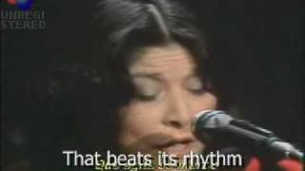
Gracias a la Vida-Violeta Parra covered by Mercedes Sosa

Slide 7
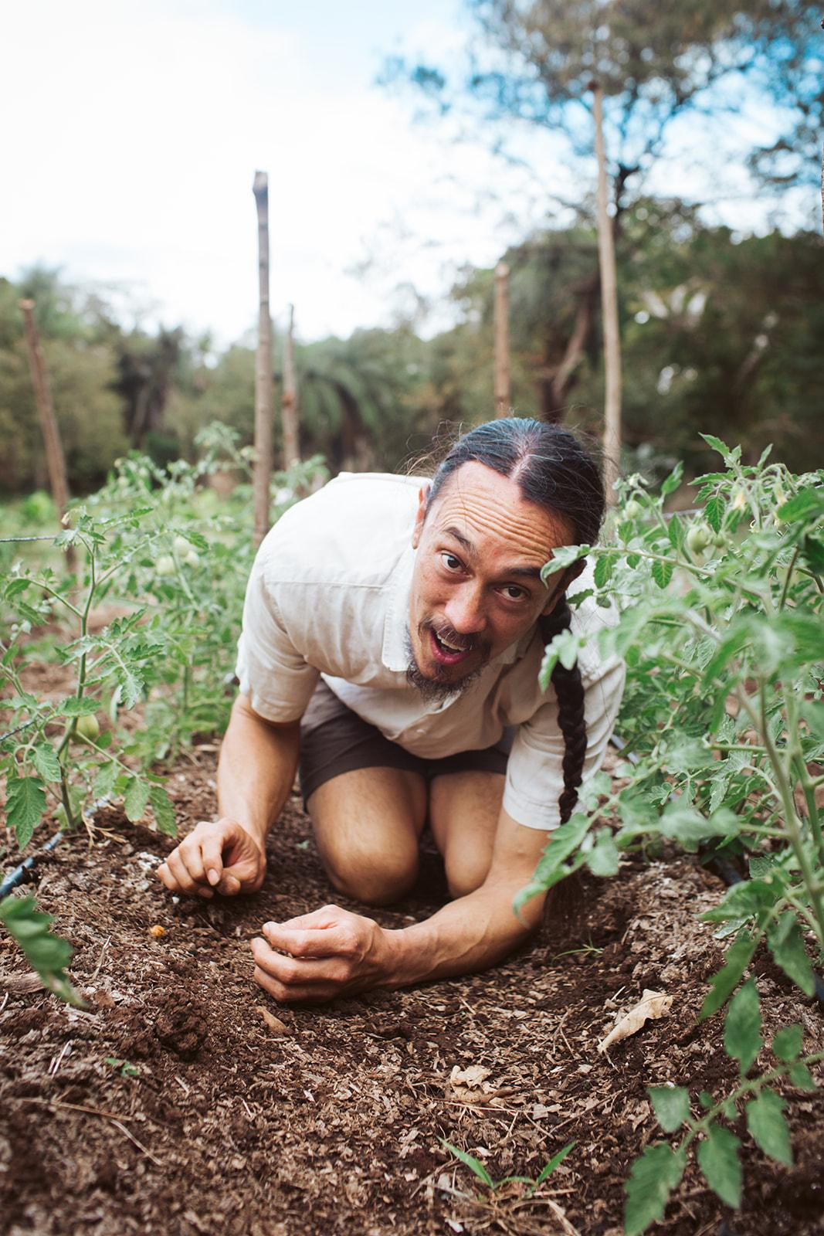
“Mi Tierra Linda Nicaragua”
Original Song by Farmer and BAFFT Educator, Kanoa Dinwoodie

Slide 8

Our Purpose
We cultivate knowledge sharing, community action, and global solidarity for decolonized land stewardship, collective healing, and justice within the food movement.
Notes:
Statement of purpose and vision - Jeneba
30 sec

Slide 9
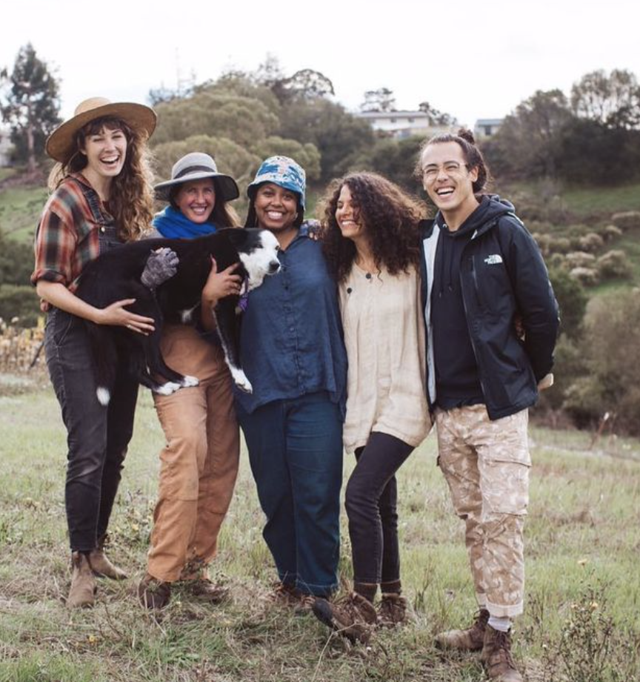

Agroecology Commons Collective
Coming from backgrounds as farmers, educators, artists, and cooperative business owners, we share deep resonance for the connection between land, healing, and liberation.
Notes:
30 sec

Slide 10
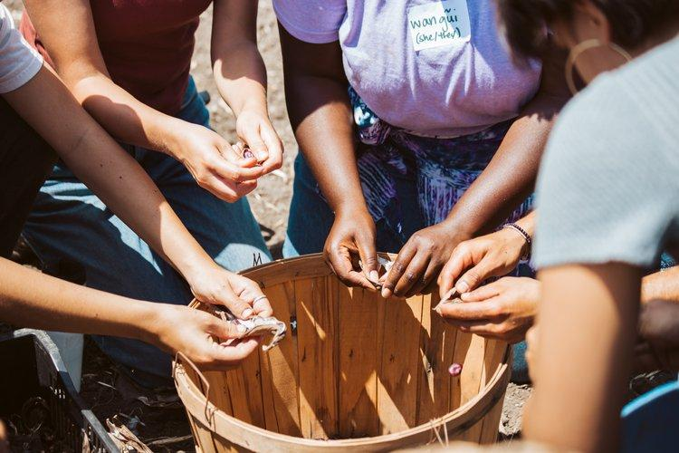
Collective Organizing and Wellness
Worker-self directed nonprofit
Cooperative admin and liberatory decision making
Participatory budgets and finance
Wellness and liberatory practices
Notes:
Accountability and Restorative Justice?
1.5 min

Slide 11
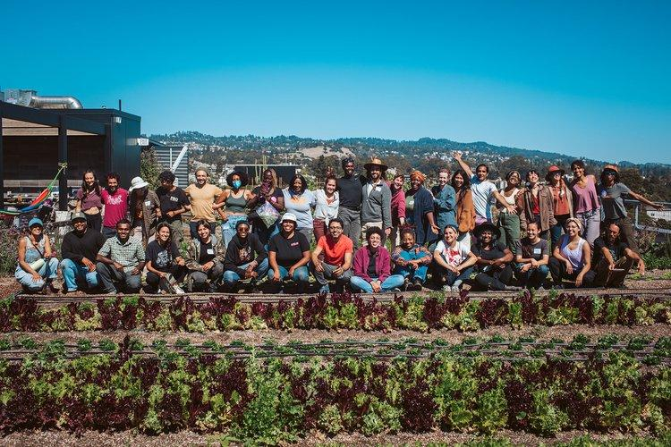
Community Education
Bay Area Farmer-to-Farmer Training
Farmer Mobilization Paid Apprenticeship Program
Farmer-to-Farmer Skillshares
Notes:
1.5 min

Slide 12
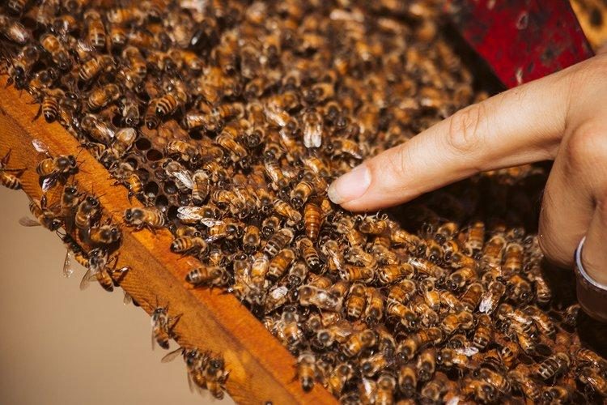
Land Stewardship and Food Sovereignty
Cooperative Incubator Farm
Food Sovereignty Tool Lending Library
Apiary
Goat and Sheep Shepherding Collaboration
Notes:
1.5 min

Slide 13
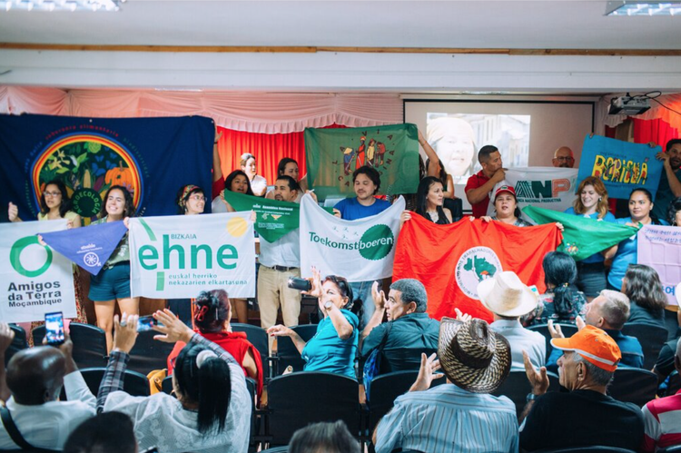
Networks and Solidarity
Global Solidarity and International Delegations
Food Sovereignty Seed Grants
Mentorship Network
Farmer Wellness and Mutual Care Networks
Notes:
1.5 min
Through organizing efforts and fundraising, we have supported three delegations in the past three years, to Cuba and Nicaragua and Colombia. A big part of why we do this work is to learn from one another, learn about the overlapping struggles caused by colonial-minded extractive racialized capitalism and patriarchy, to share strategies and stories and weave relationships based in reciprocity, land stewardship, community care, and justice. In the face of centuries of land based oppression, we need land-based healing. Land stewardship work can feel very isolating at times, being connected in these ways helps us feel and remember we’re a part of something bigger than ourselves.
-Another network aspect of our work is supporting food sovereignty and land justice seed grants
-mentorship network to build intergenerational and peer-to-peer learning and relationship building

Slide 14
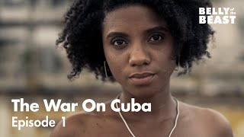
Belly of the Beast - The War on Cuba
\
Notes:
https://www.youtube.com/watch?v=ACpnOqga_CA

Slide 15
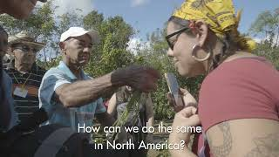
ANAP Cuba Agroecology Encounter 2022 US Delegation Video
\
Notes:
https://www.youtube.com/watch?v=ACpnOqga_CA

Slide 16
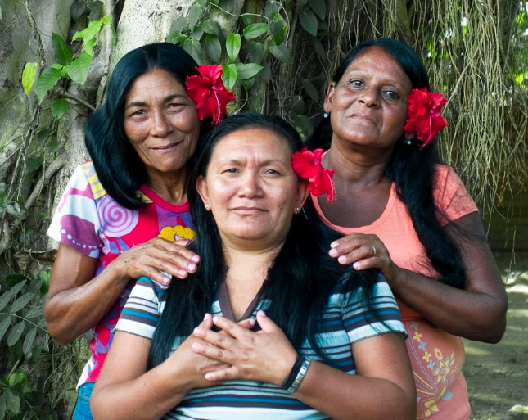
The Indigenous People of Cuba
The land of the Taíno and Guanahatabey people who faced the brunt of colonization and genocide
Living ancestors often invisibilized by the narrative of extinction
Notes:
*Kata*
-https://www.americanindianmagazine.org/story/indigenous-cuba-hidden-plain-sight
-https://www.bbc.com/travel/article/20190205-cubas-tano-people-a-flourishing-culture-believed-extinct
-https://ictnews.org/news/caciques-advice-learn-to-live-from-mother-earth
-https://www.smithsonianmag.com/travel/taino-indigenous-culture-pre-columbian-roots-archaeology-cuban-identity-cultural-travel-180960975/
-https://www.newyorklatinculture.com/latin/indigenous/taino/
-https://stthomassource.com/content/2021/02/02/taino-today-part-2-phillips-seeks-to-raise-awareness-of-taino-ancestry/
-The Taíno had a matrilineal system of kinship, descent, and inheritance
-Connection of indigenous genocide across Americas, notion fueled by racialized capitalism, that Indigenous people are no longer present

Slide 17
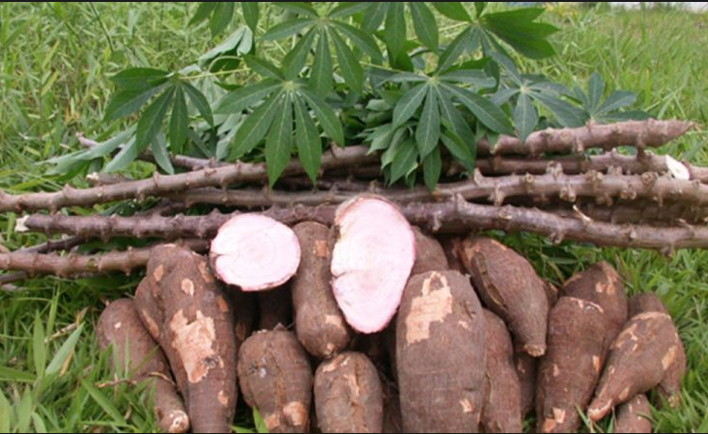
Notes:
Yuca and it’s wonders!

Slide 18
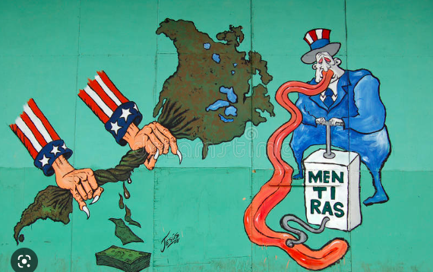
US Imperialism and Neo Colonialism
73% of land in the hands of 9.4% of people
Foreign capital controlled 40% of Cuban farm land
80% of Cuba's sugarcane exported to U.S.
Notes:
Cata, Leah
Prior to revolution Cuban agriculture was plagued by its colonial legacy and the influence of US capital
To share the extent of US neocolonialsm we wanted to share some stats with you:
Sugar caned owned by US
Quote from US Government- understand the extent of US imperialism
Fidel’s quote when he was 27
-Forest cover was reduced to 13%

Slide 19
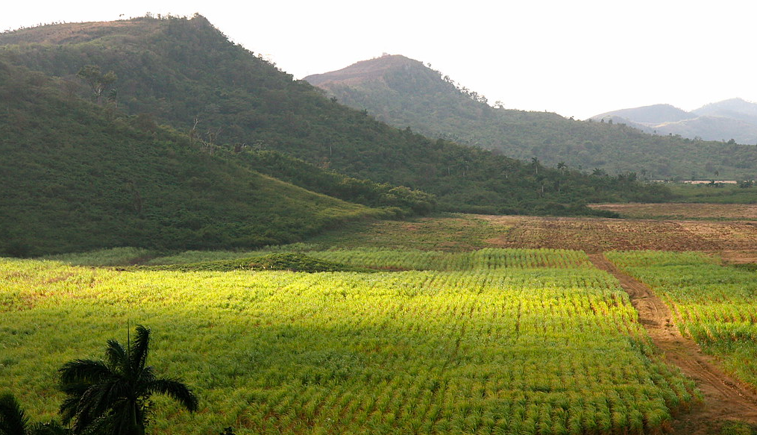
75% of Cuba’s farm land was planted as monoculture between 1930 and the Cuban revolution
Notes:
In the 1960’s is when the US began to ramp up high fructose corn syrup
Monocultures on 75% of farm land
85% of the small farmers in Cuba pay rent and live in constant threat of being evicted from the land they till. More than half of our most productive land is in the hands of foreigners. We export sugar to import candy. We export hides to import shoes. We export iron to import plows. 400k families in countryside and cities live without any sanitation services. 2 million people lack electricity. If the state proposes the lowering of rents, wealthy landlords threaten to freeze all construction. 90% of the children in the countryside are consumed by parasites which filter through their bare feet. There are no schools for them. Public hospitals are full and only accept patients recommended by powerful politicians who in return demand votes.

Slide 20
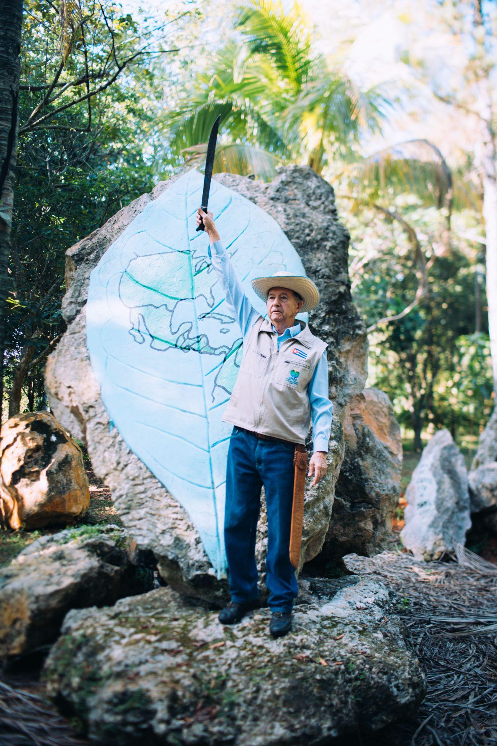
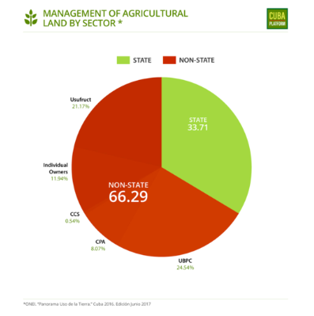
Agrarian Reform of 1959
Bans foreign land ownership
Government expropriates farm lands > 1,000 acres
Within 1 year 60% of farmland were redistributed to landless farmers
250k acres shifted to diversified farming
Notes:
*Leah*
-To redistribute land more fairly, gov
Intentions of Cuban Revolution for social and economic justice, public health, equal opportunity for all people, improve livelihoods of poor people, national independence and unity. Today, Cuba continues to explore how to utilize and distribute land in a way that will maintain a vibrant small-farming class, while adapting to the changing economy and the population’s needs for a healthier and more diversified diet.
As Fidel Castro explained in his famous History will Absolve Me speech, agrarian reform was intended to increase the overall prosperity and health of the nation by equalizing land distribution and providing the campesino class with economic opportunities and an acceptable standard of living.
No private ownership of land
20 year government bonds with 4.5% interest

Slide 21
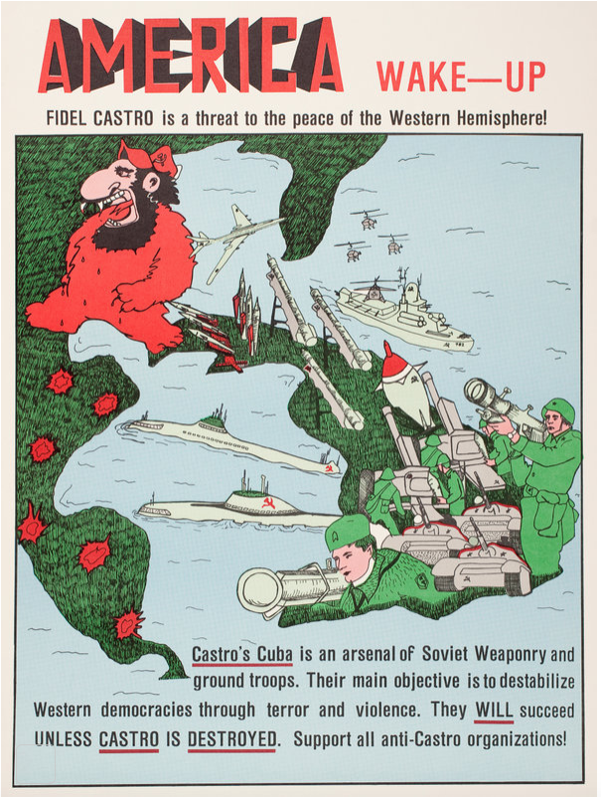
In 1960, the Deputy Secretary of State for Inter-American Affairs under Eisenhower, said the goal of the Cuba embargo was to… "weaken the economic life of Cuba" by “denying money and supplies, to decrease monetary and real wages, to bring about hunger, desperation and overthrow of government."
Notes:
This quote is shared to show the extent of the U.S. government's intent to cause suffering in Cuba through the imposition of economic sanctions.
Also the US State Sponsors of Terrorism List
Premeditated destruction
No trade ships allowed at US Ports if they have landed in Cuban ports in the last 90 days
Trump introduced 90 new sanctions near the end of his term that resulted in a loss of $US 5 billion, the biggest annual cost of the blockade for Cuba since its inception in 1962.
Not just no lending from US banks, but because the the US control over foreign banks, they won’t provide capital to Cuba either

Slide 22
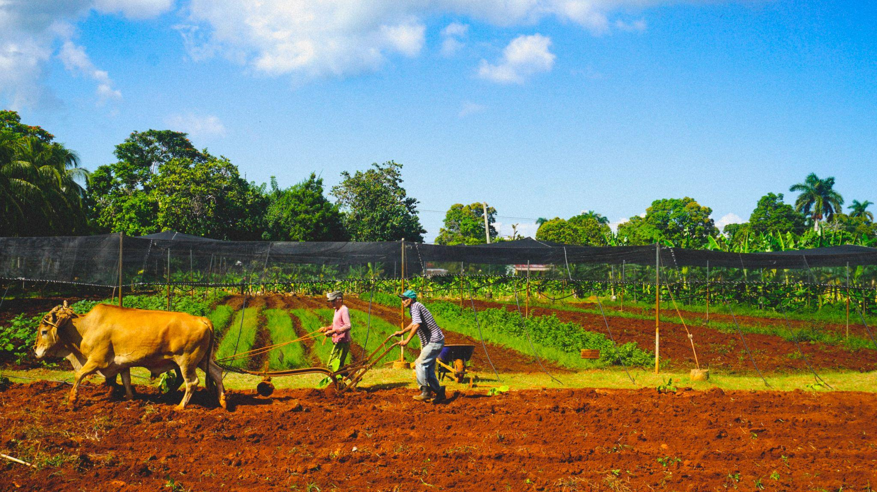
Food Sovereignty
Notes:
The global peasant movement La Vía Campesina popularized the term “food sovereignty” in 1996. Unlike food security, which means to have access to sufficient, nutritious food, food sovereignty also covers people’s right to decide what food they eat and how the food is grown, including access to land, water, seeds, and other resources.
- In 1991, Cuba was cut off from their mainstay of international trade when the Soviet Union fell, marking the beginning of what was called the special period which lasted until 2000. Cuban farmers demonstrated rapid innovation and adaptation to agroecological methods without imported agrochemicals and minimal fossil fuel . Eliminating 80% of Cuba’s fertilizer and pesticide inputs, cut oil use by over 50%. This forced over-night change as Cuba completely retooled its farming strategies, re-adopting agroecological and ancestral practices with results that are unique in the world. Average Cuban lost 10-15 pounds.
-although they are still importing, once the world cut them off, they managed to keep everyone fed and did not succumb to the Eisenhower administration’s
Perseverance during and adaptation during the Special Period in the 90s when Cuba could no longer trade with the Soviet Union and the US enacted

Slide 23
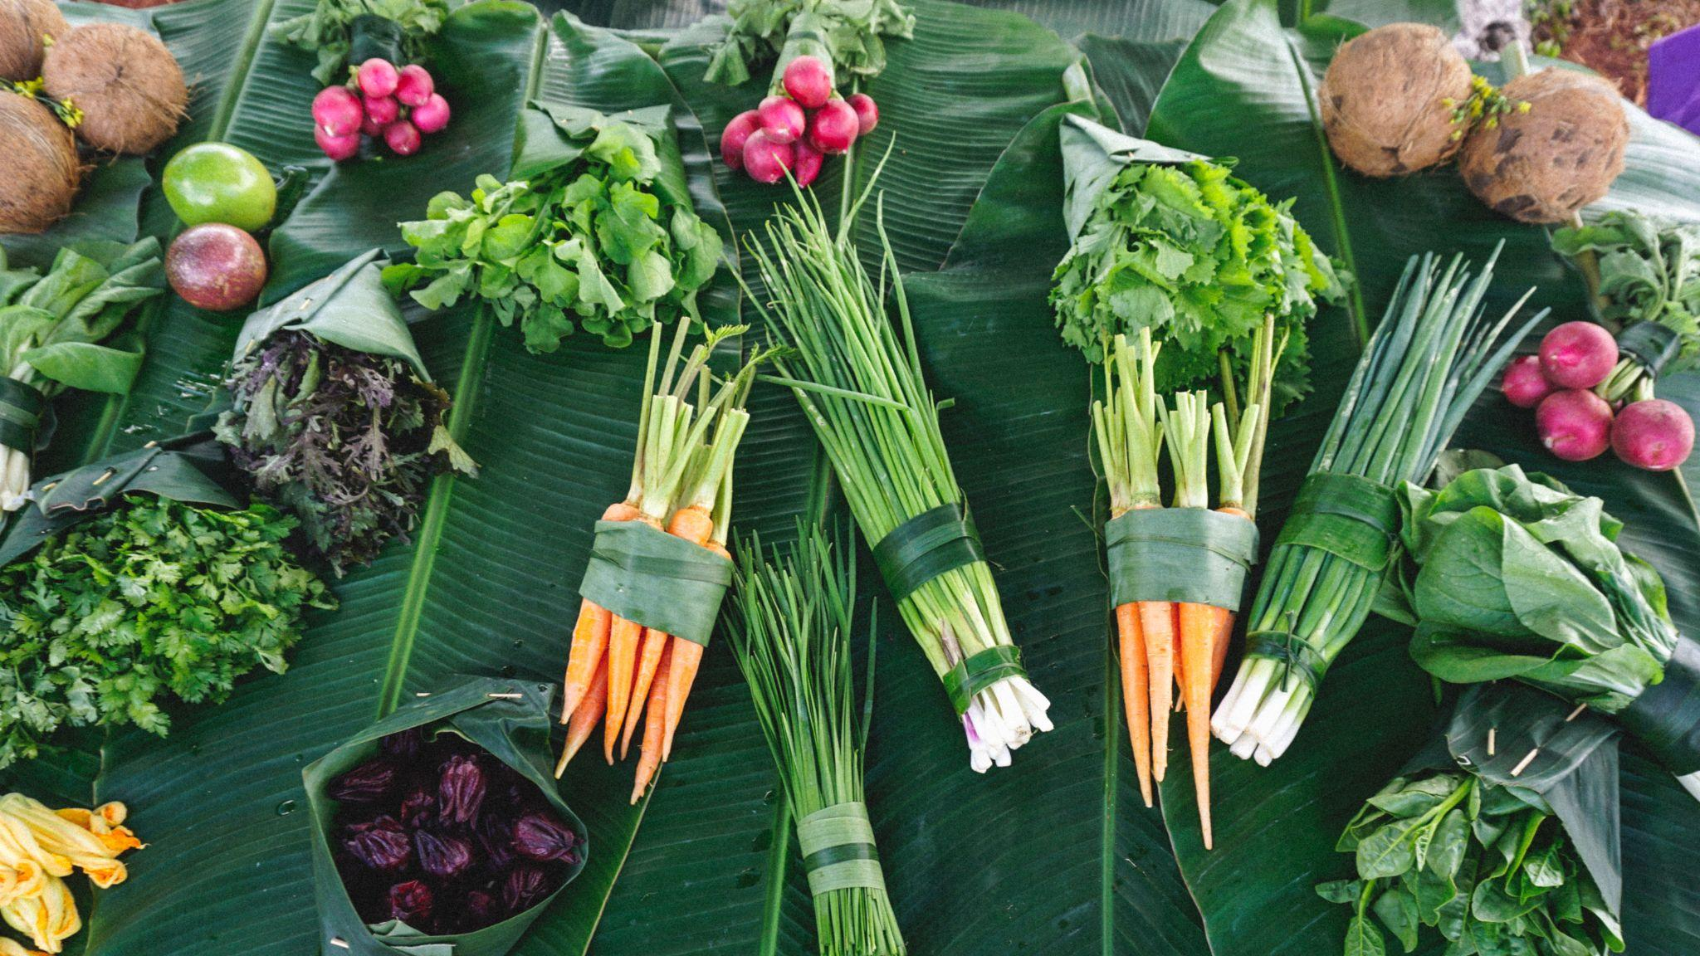
Notes:
Urban Farming and Food Sovereignty
From 1997 to 2005, vegetable production in Havana increased by over 1000%;
“Organiponicos”, (intensively-planted, raised container beds) and “huertos intensivos” (city plots planted for maximum yield) keep Cubans fed and employed, with as many as 70 workers on each small, inner-city farm. Some organiponicos even incorporate innovative arrangements where members of the co-operatives share in profits and sell excess production for personal gain in the free market
by 2013, urban farmers in Havana alone were producing over 60,000 tons of vegetables and 1,700 tons of meat each year.

Slide 24
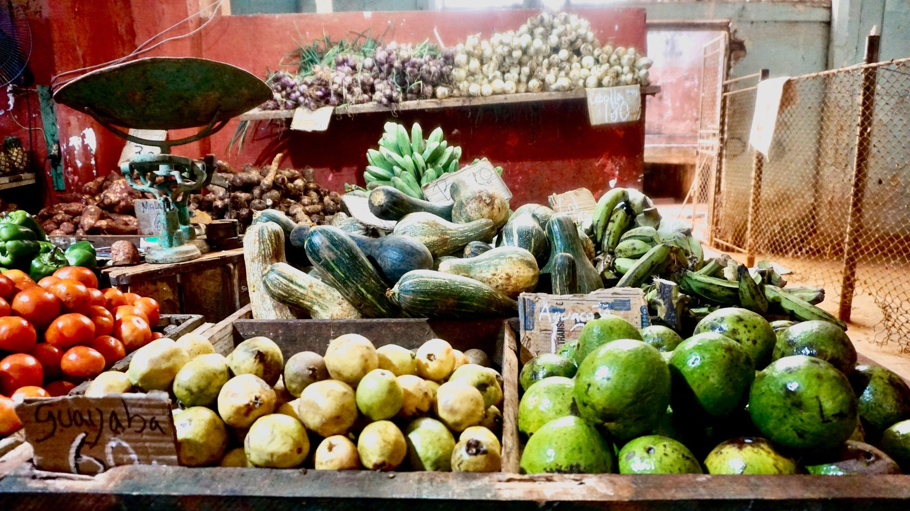
Notes:
Havana province is home to 8000 organic farms, totaling 3.7 million acres.
In the city of Havana, 26,000 people work on urban organic gardens, supplying 50% of the city’s fresh vegetables.
From 1997 to 2005, vegetable production in Havana increased by over 1200%; by 2013, urban farmers in Havana alone were producing over 60,000 tonnes of vegetables and 1,700 tonnes of meat each year.

Slide 25
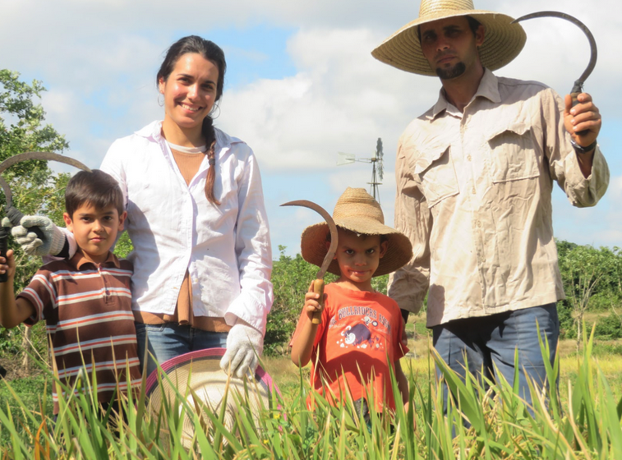

Slide 26
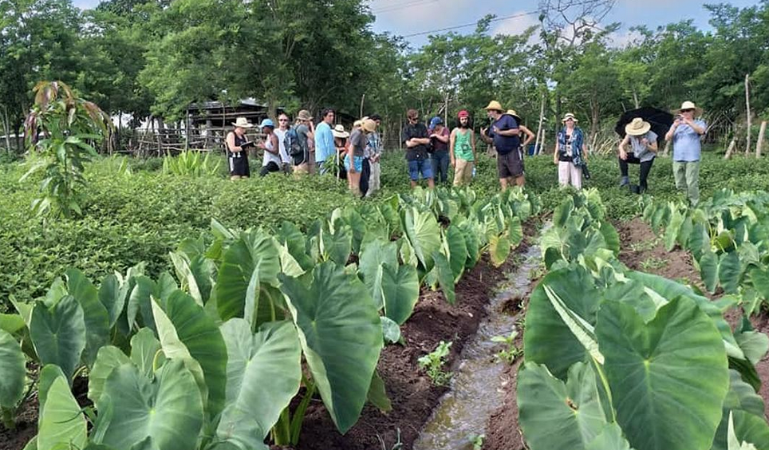

Slide 27
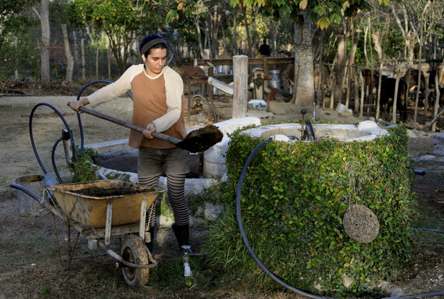

Slide 28
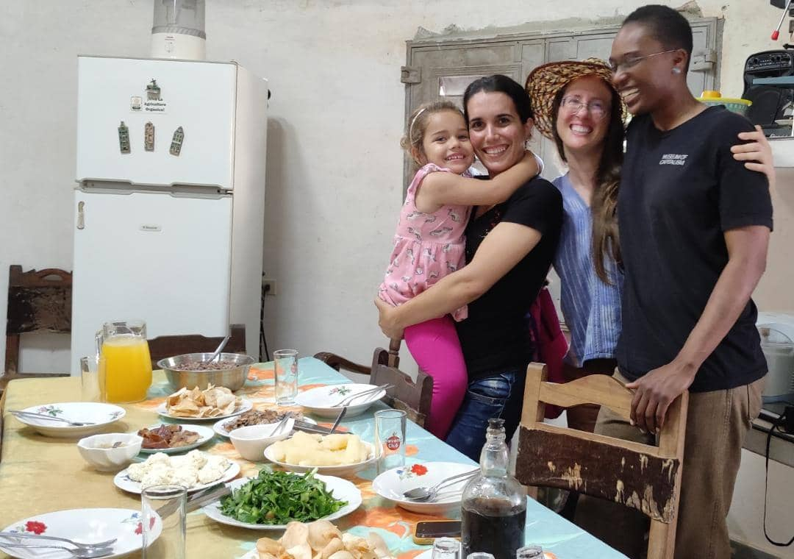

Slide 29
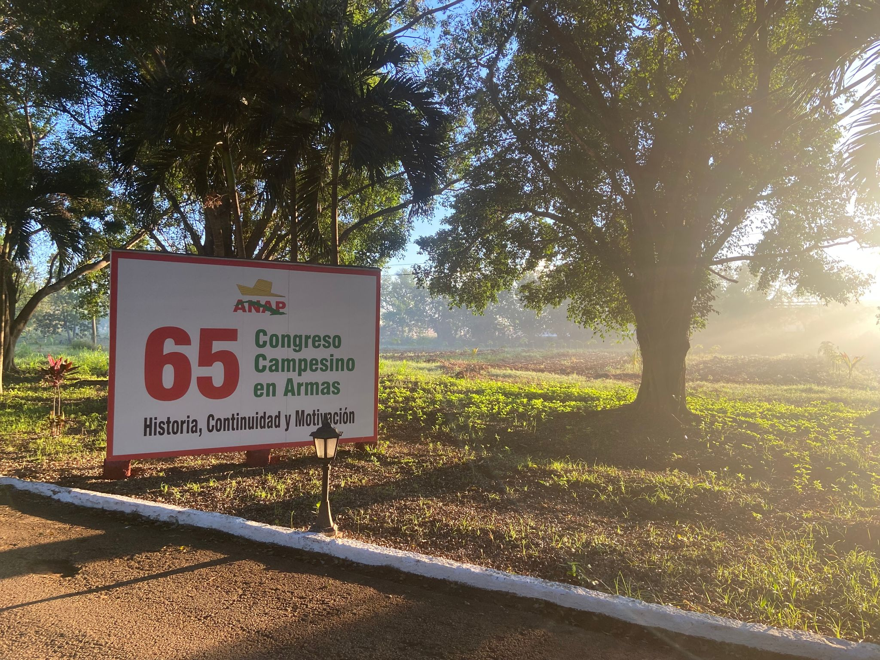
National Association of Small Farmers (ANAP)
Our host for the encuentro!
In 1961 the Cuban government formed ANAP to support small farmers
Over 300,000 farmer members
About 25% farm agroecologically
Notes:
Wangui
Asociacion Nacional de Agricultores Pequeños
About 25% farm agroecologically compared to about 10% in the US
ANAP offered guaranteed markets and Institutional support for small farmers
Less than 10% of farms in US are organic or agroecological … what percent of farms in Cuba are agroecological?

Slide 30
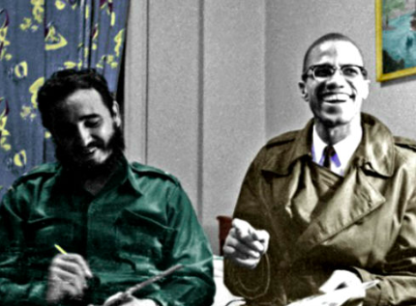
Racism and Anti-Blackness in Cuba
Between 1959- 1962 Castro enacted anti-discrimination laws to end racism and promote equality
Met with Malcolm X in Harlem in 1960
Frequent claim of Cuba as colorblind
Up to 60% of Cubans are Afro Cuban
Lack of Afro Cuban-led farms and leadership positions
Notes:
Castro also took steps to address racial inequality in education and healthcare. In 1961, the Cuban government launched a massive campaign to eradicate illiteracy, which disproportionately affected Afro-Cubans, and by 1962, the literacy rate in Cuba had risen to over 96%. The government also established a free and universal healthcare system, which provided access to medical care for all Cubans regardless of their race or socioeconomic status.
In 1962, the Cuban government passed the Law Against Racial Discrimination, which outlawed discrimination based on race, ethnicity, and national origin. The law also established penalties for those who violated its provisions. These early efforts to promote racial equality in Cuba were significant, given the long history of racism and discrimination on the island, and they helped to lay the groundwork for further progress in the decades to come.
90% of enslaved Africans taken to Caribbean and South America in the transatlantic trade of human enslavement
Cuba was the 2nd to last country in the Americas to end slavery
Castro announced that racism was “over” in Cuba in 1962, three years after anti-discriminations laws
Castro’s anti-discrimination organizing
What future literary giant was present at the party that took over the streets of Harlem when Fidel visited Malcolm?

Slide 31
Question for a prize!
What future literary giant was present at the party that took over the streets of Harlem when the people heard Fidel was visiting Malcolm?
Notes:
In the 1960’s is when the US began to ramp up high fructose corn syrup
80% of Cuba's sugarcane production exported to U.S.

Slide 32
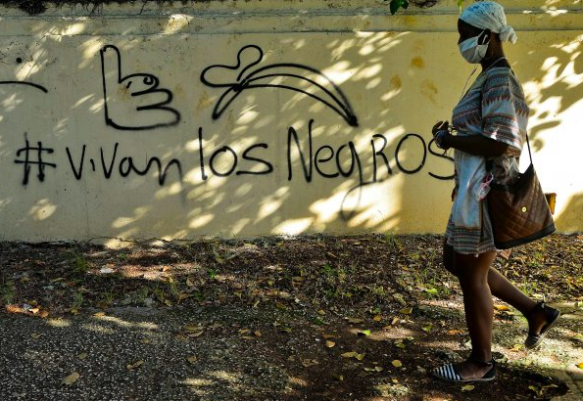
Possible Reflections on Racism and Anti-Blackness in Cuba
Notes:
Possible Reflections:
How many farmers, ANAP Members or government officials who were Afrocuban did we hear from?
What instances of racism and anti-Blackness were witnessed or experience?
What instances of anti-racism or pro-Blackness were witnessed or experienced?

Slide 33
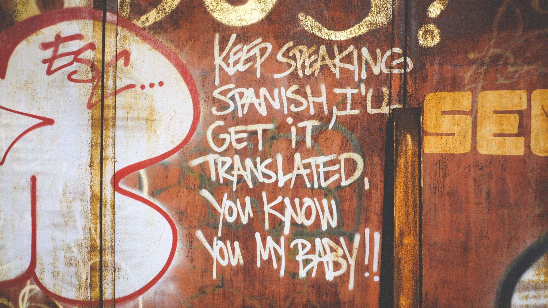
Notes:
adrionna

Slide 34
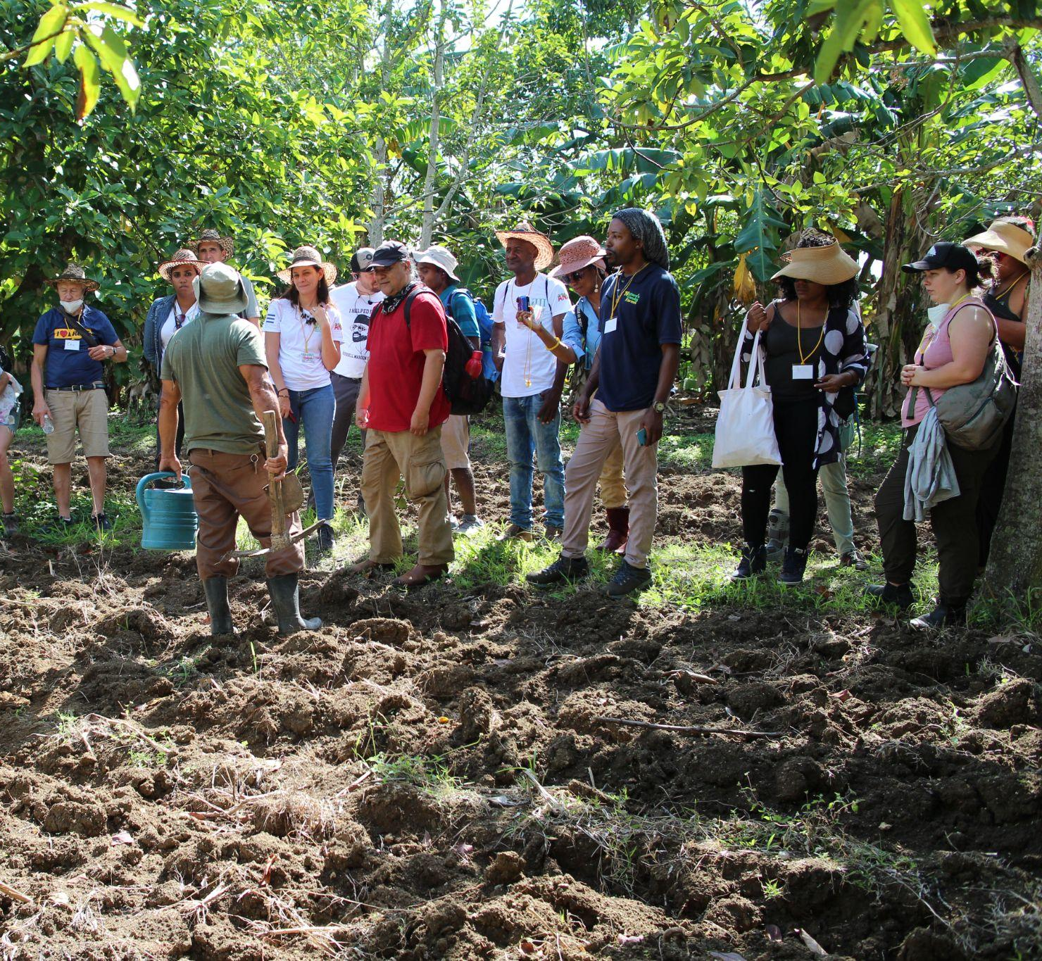
Cooperatives as Commonplace
Cooperatives for Agricultural Production (CPA)
  Farmers pool their land and share collective ownership and responsibility.
Cooperatives for Credits & Services (CCS)
  Farmers form associations to access markets and services (e.g. machinery, fertilizers, and loans).
Notes:
Adrionna
Early in the revolutionary period, the government encouraged small farmers to join cooperative structures, and commissioned two types of co-ops
Every farmer has a representative to support crop planning, production, marketing, and distribution. Farmers don’t have to seek them out, they come to them!

Slide 35
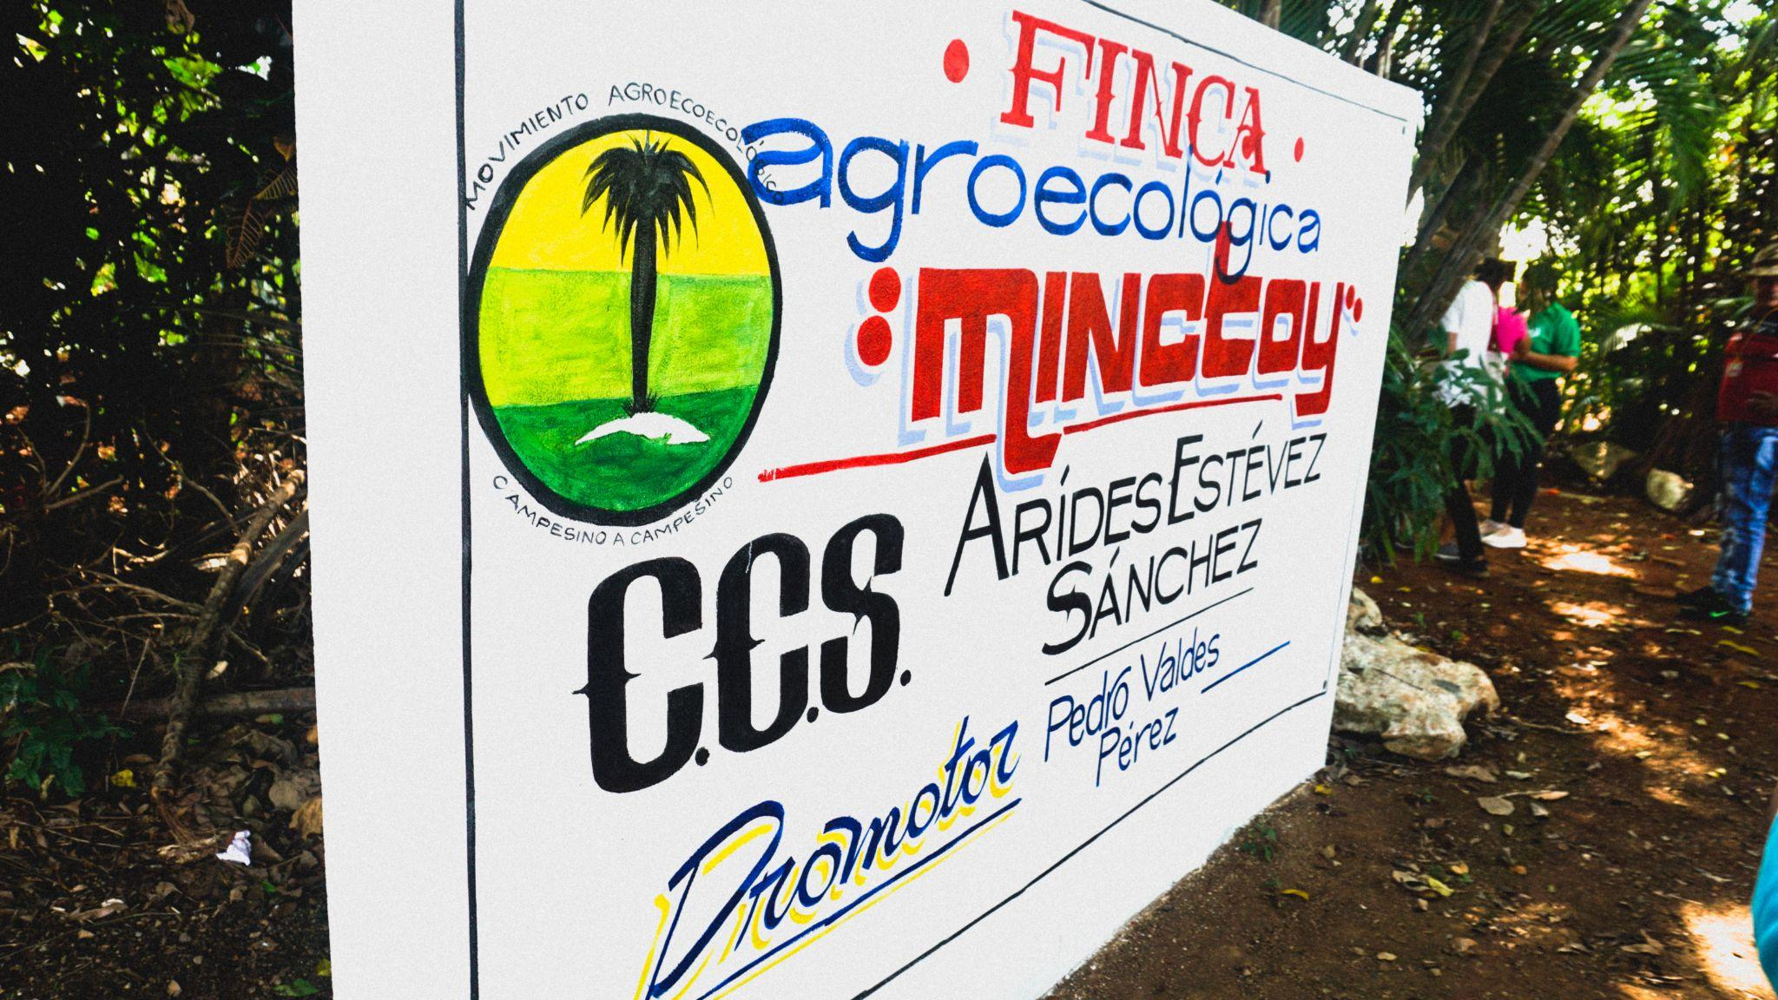
Notes:
Adrionna

Slide 36
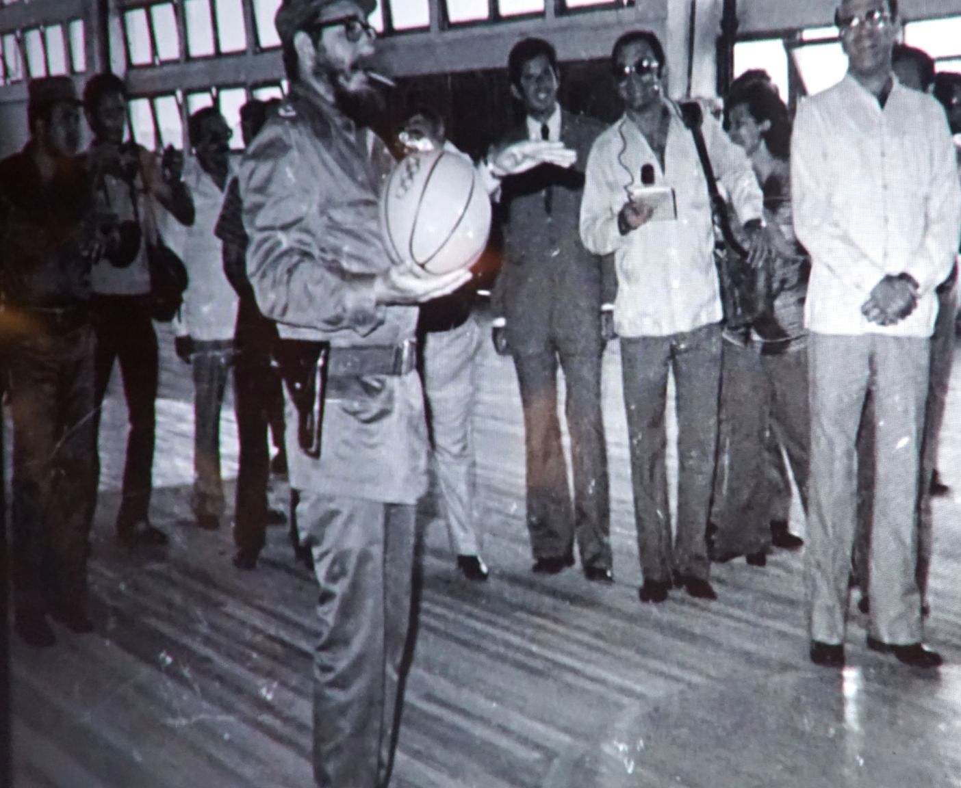
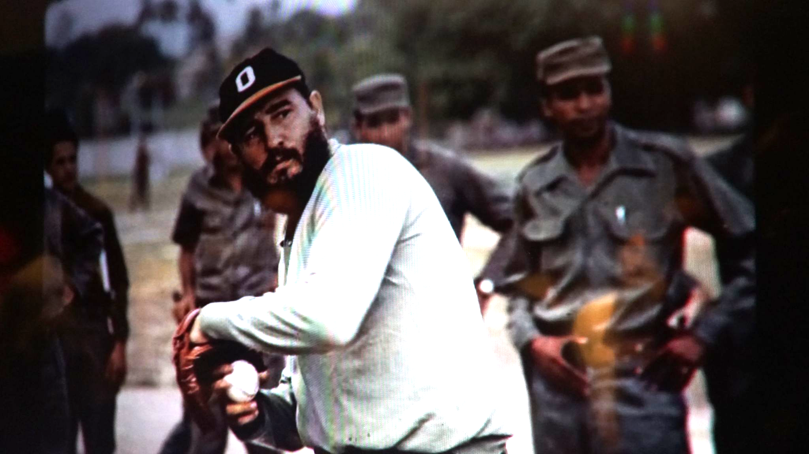
Sports and Revolutionary Politics
Notes:
Adrionna

Slide 37
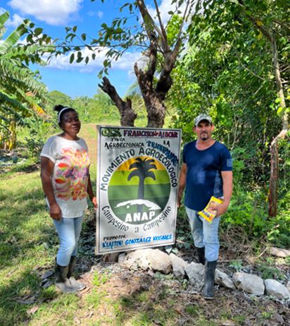
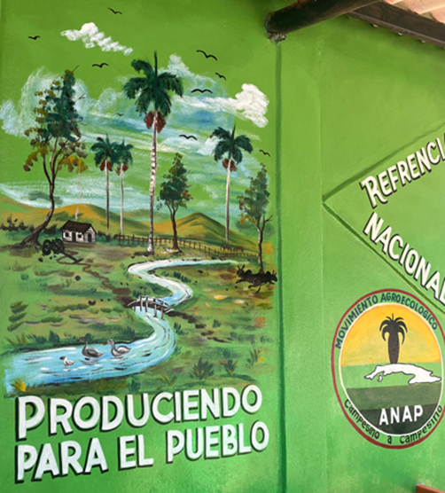
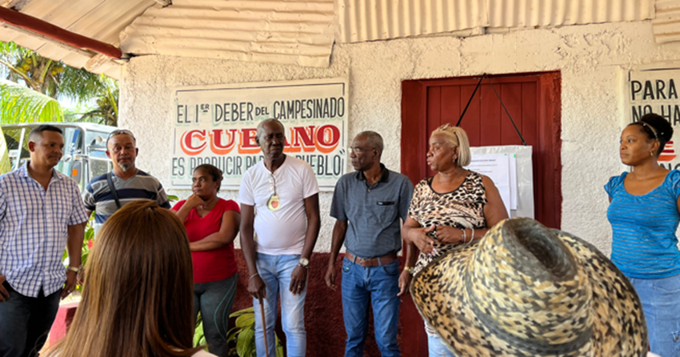
Social Sense
Farmer to Farmer methodology is based in building community
Notes:
Alejandro

Slide 38
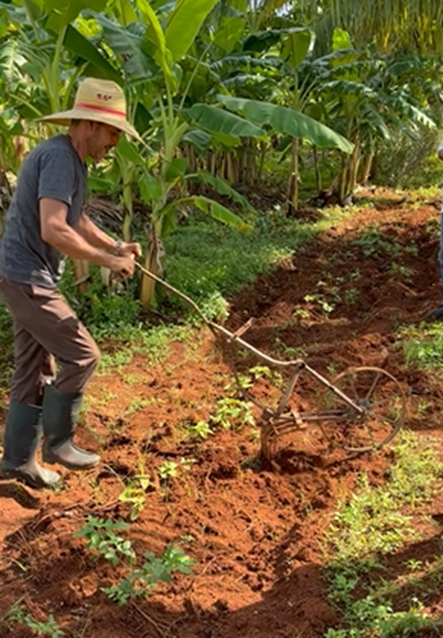
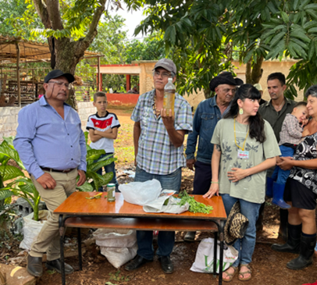
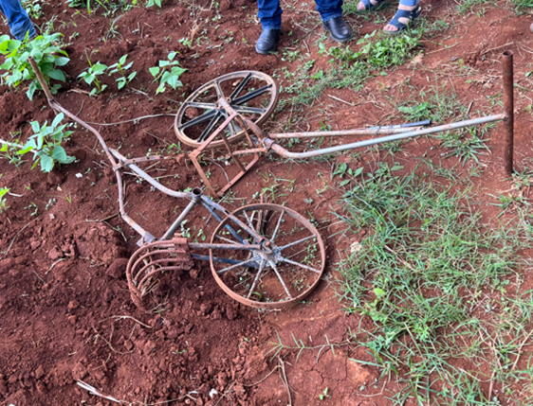
Back to basics
Resourcefulness, basics could be enough
Notes:
Alejandro

Slide 39
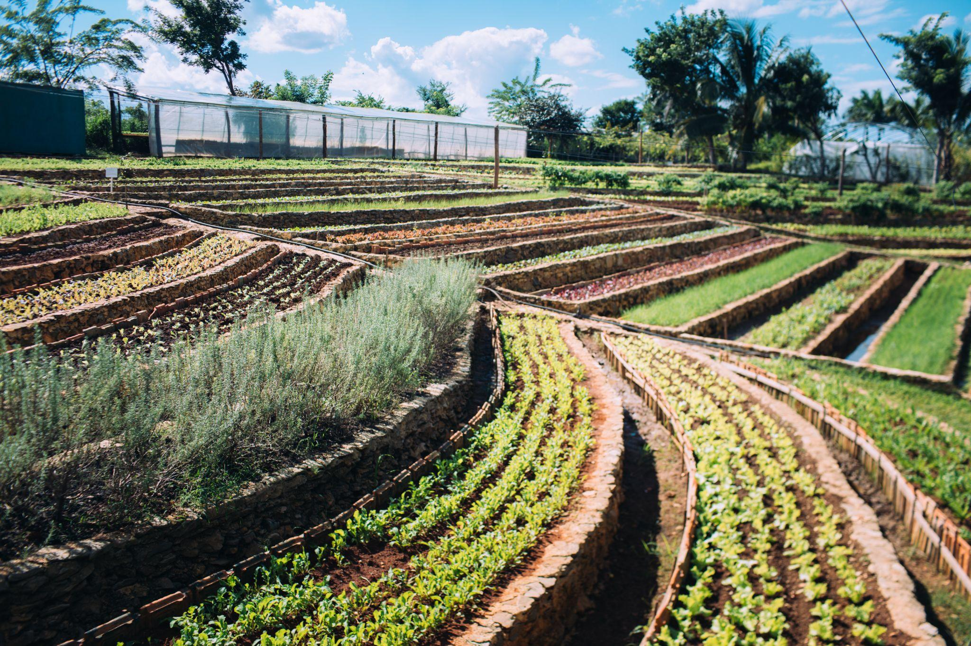
Biodiversity
Notes:
Jeneba

Slide 40
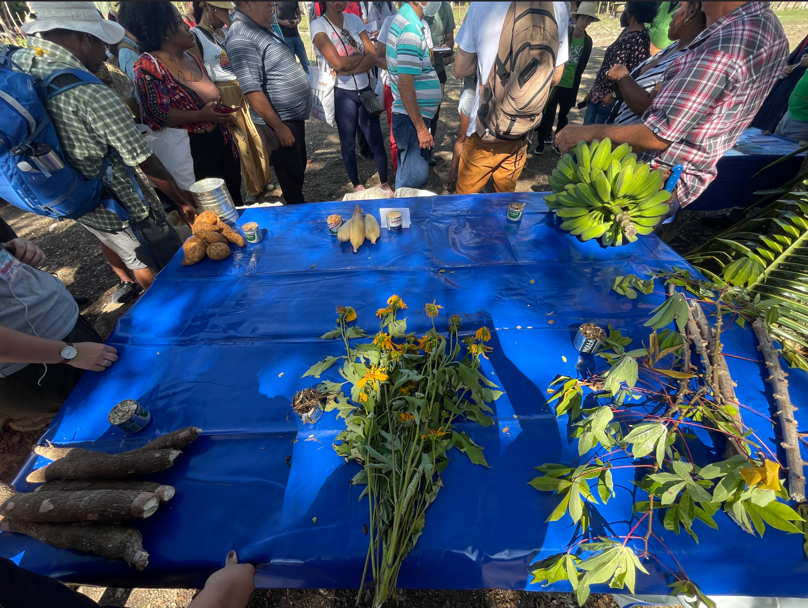
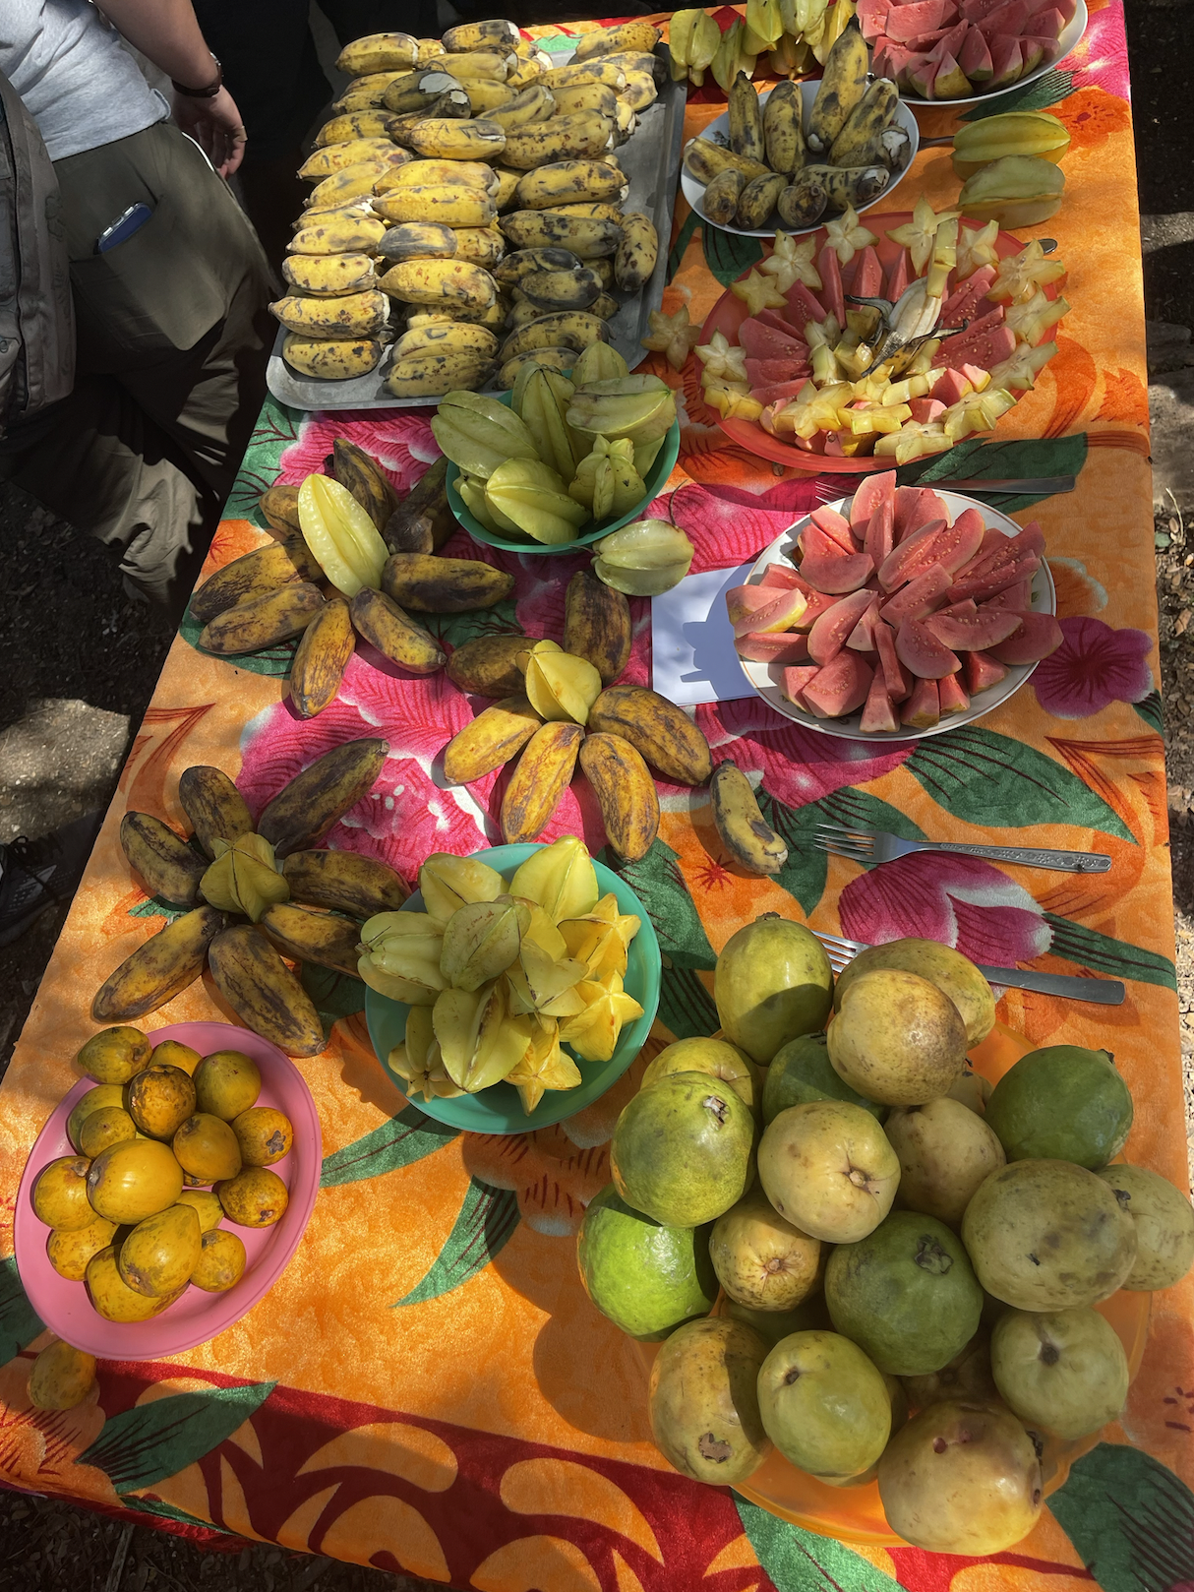
Harvested biodiversity for livestock and guests.
Notes:
Jeneba

Slide 41
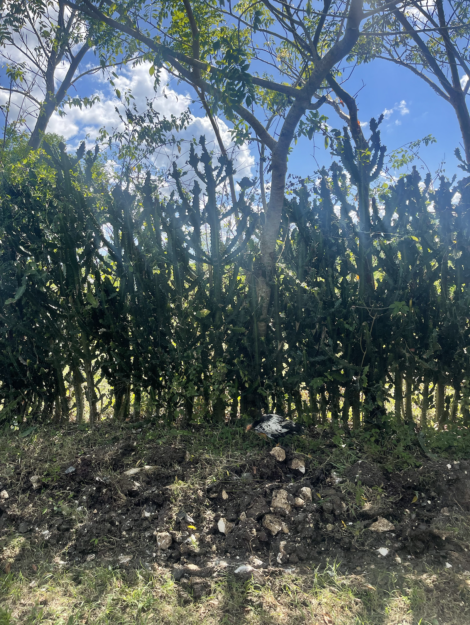
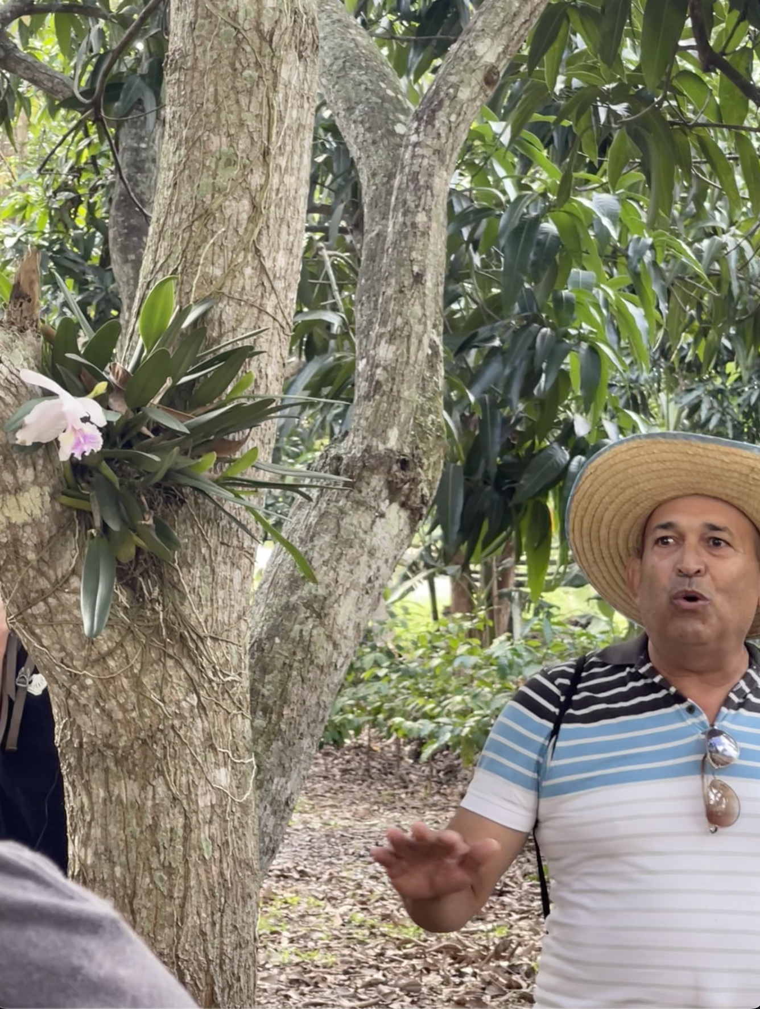
Biodiversity = Beauty
Everything has a purpose and supports the ecosystem.
Notes:
Jeneba

Slide 42
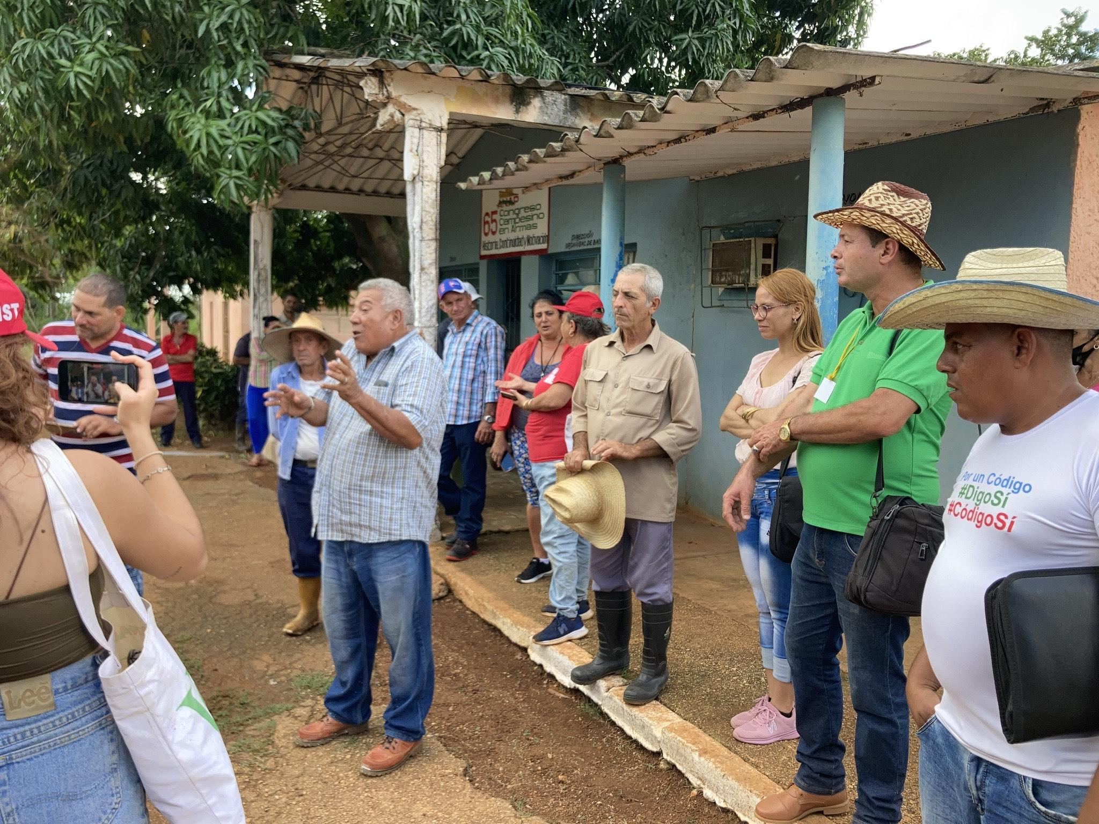
Paola’s
Reflections
Notes:
Paola

Slide 43
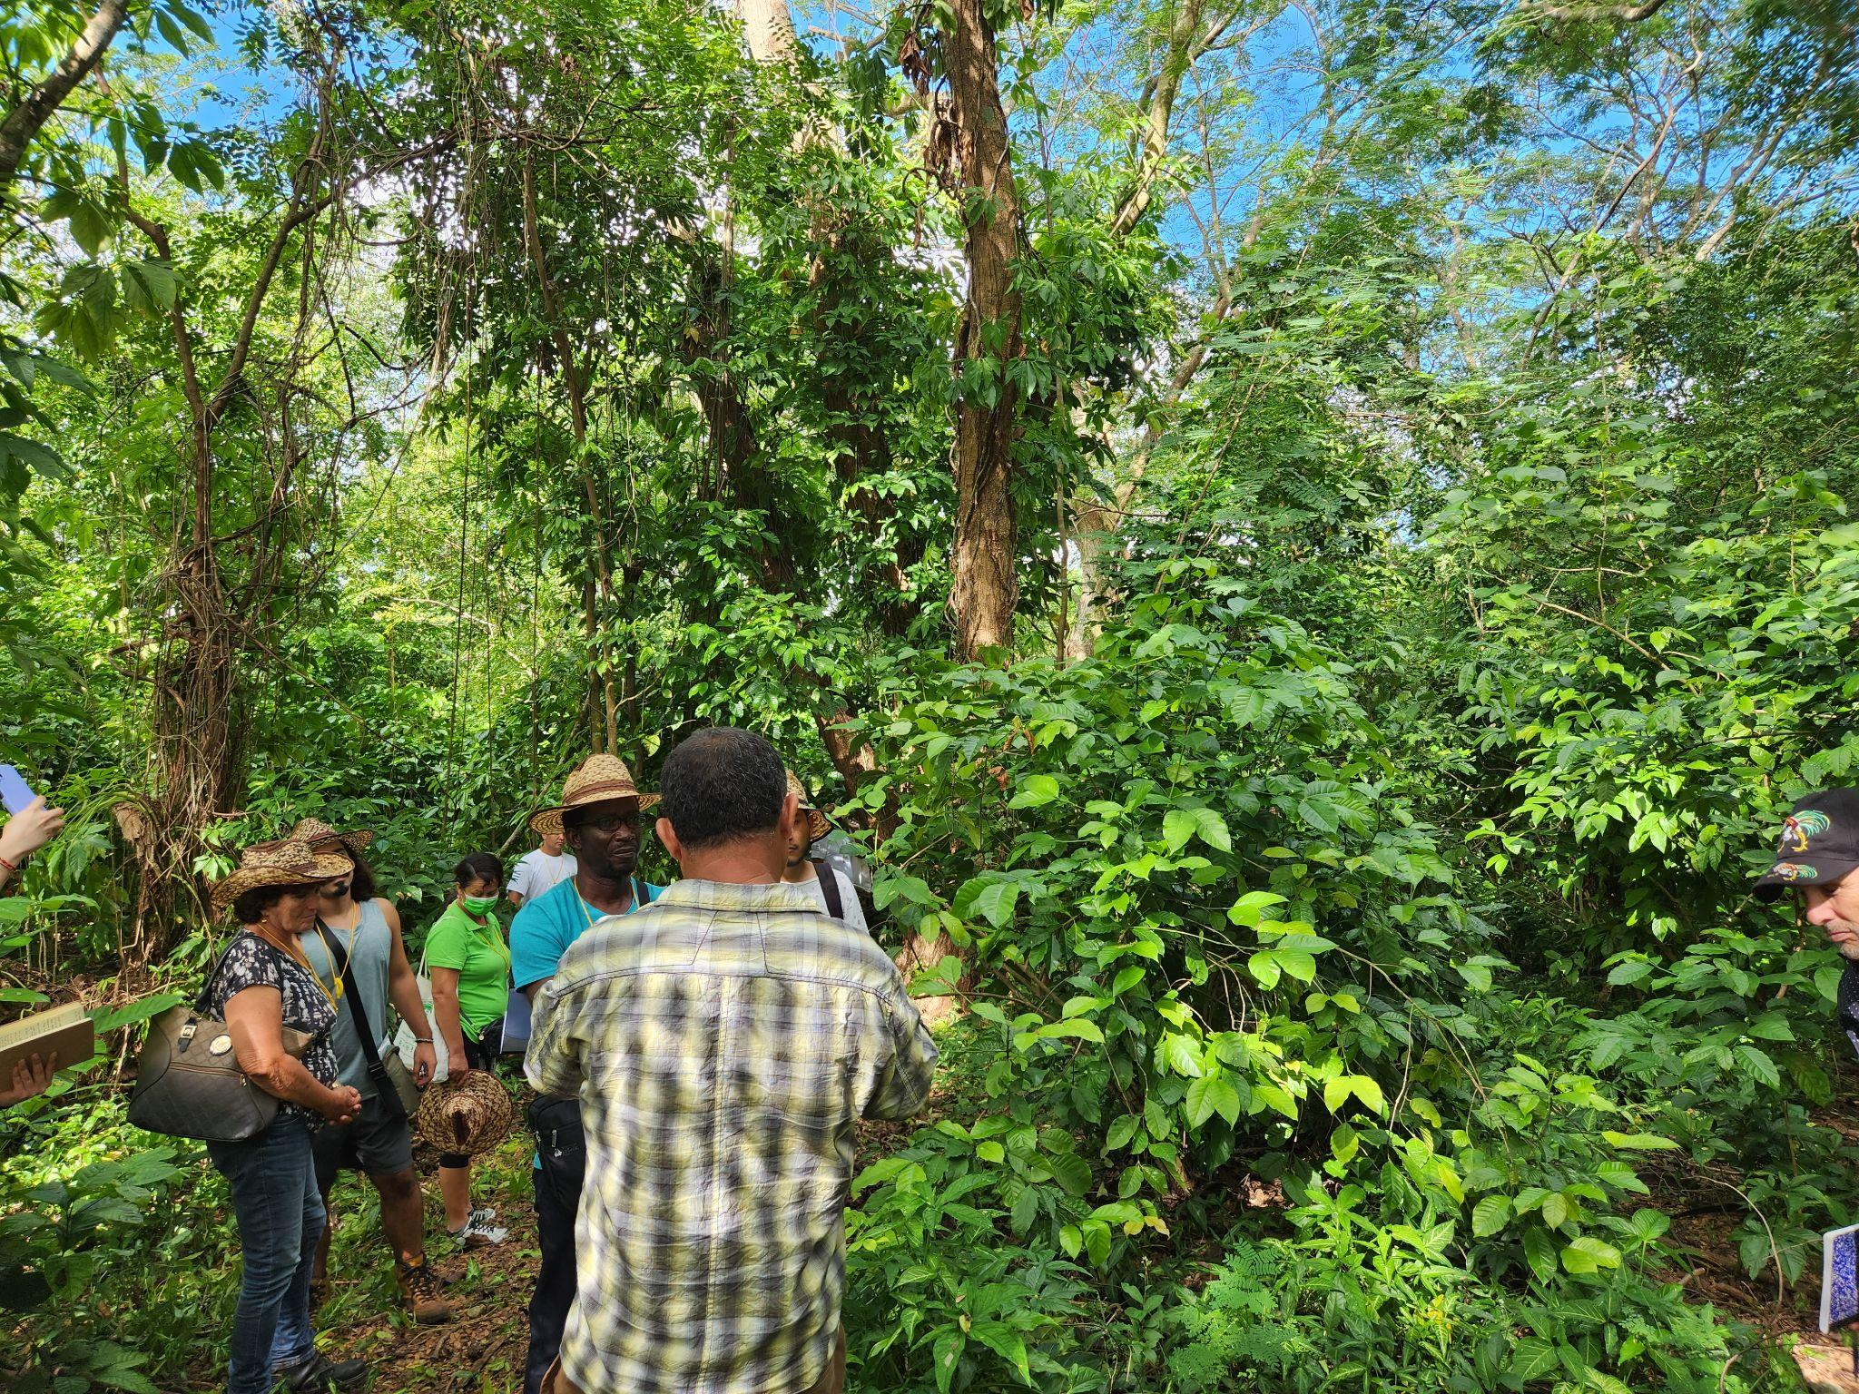
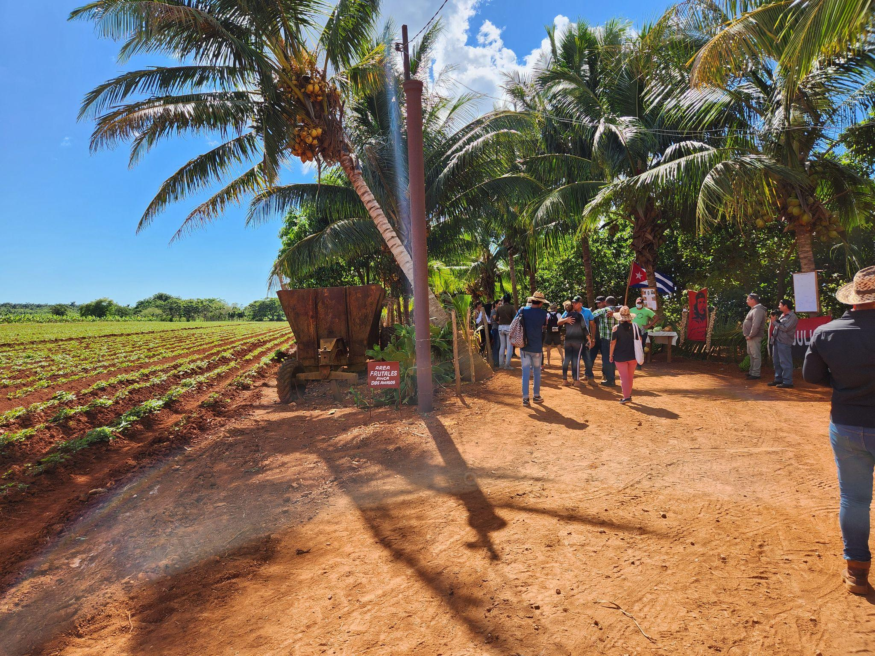
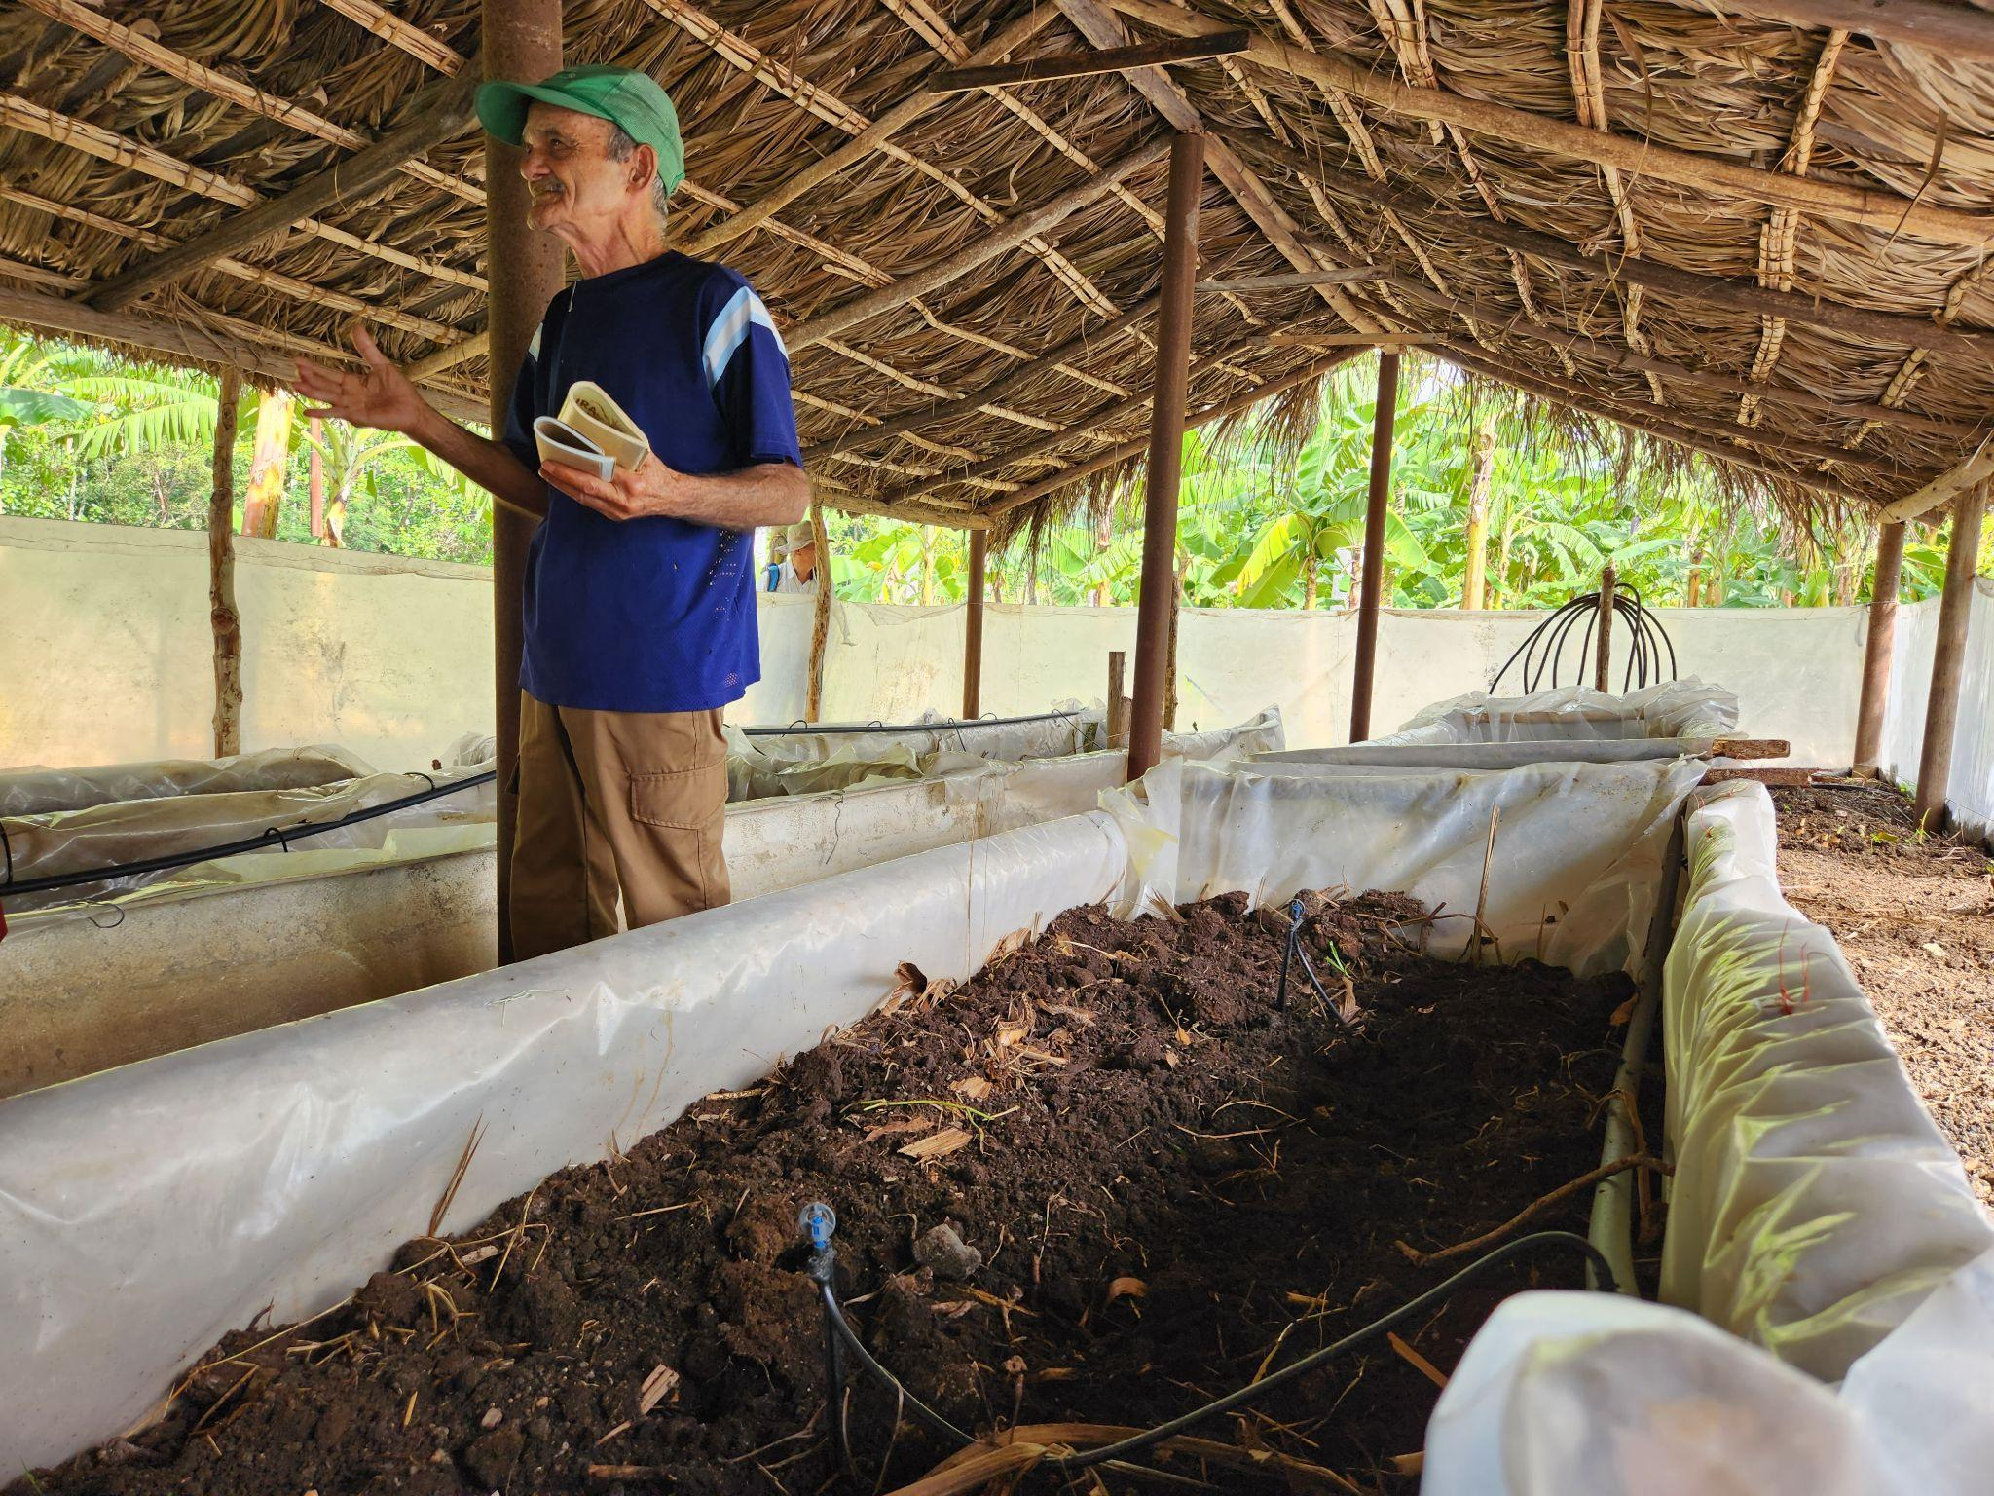
Kevin’s Photos and Reflections

Slide 44
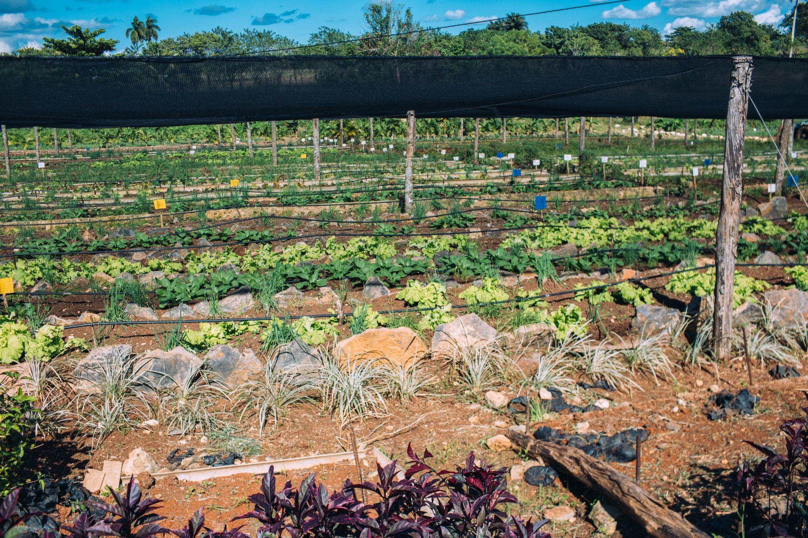
Integrated Pest Management
Notes:
Kevin? Blue, yellow, white colors to attract coordinating pest management.

Slide 45
Photos and Reflections on Agroecology Practices
- Crop Diversity
- Worm Compost (vermicomposting)
- Soil Fertility
- Cover Cropping
- Water Conservation
-Integrated Pest Management
Notes:
In 1991, Cuba was cut off from their mainstay of international trade when the Soviet Union fell. Cuban farmers demonstrated rapid innovation and adaptation to agroecological methods without imported agrochemicals and minimal fossil fuel .

Slide 46
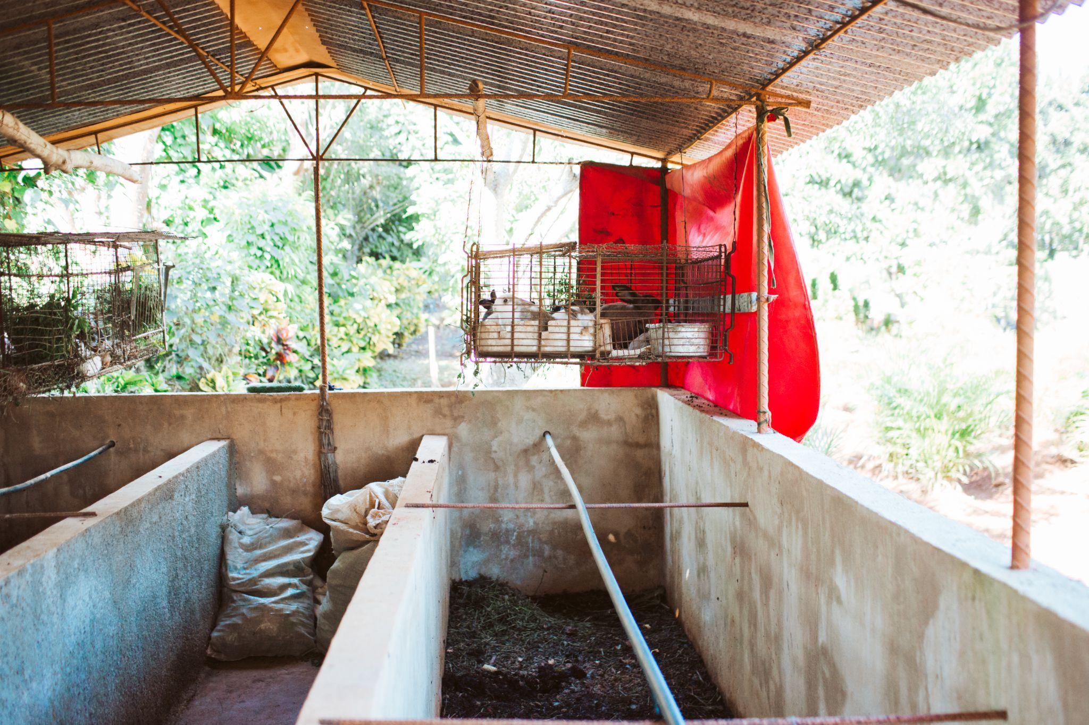
Vermicompost/ Lombricultura Integrated with Rabbits

Slide 47

Notes:
Kevin?

Slide 48


Native Melipona Bees
Notes:
Wangui?
Mayan temple

Slide 49

Beehive Artistry

Slide 50

Biodiversity
Notes:
Jeneba

Slide 51

Paola’s
Reflections
Notes:
Paola

Slide 52






Alexa’s Photos

Slide 53






Slide 54






Slide 55







Slide 56




Kata’s Photos and Reflections
@

Slide 57
Quotes from Other Delegation Participants That Couldn't be Here Tonight
“The Cuba delegation inspired me to continue my work as a farmer and by commitment to strengthening food sovereignty and agroecological networks. I was amazed to learn about the Cuban farmer cooperatives which work across the whole country and feel spirit of cooperation instead of market-oriented production. Visiting so many farms, learning about their agroecological practices, and enjoying the amazing diversity of fruits was a definite highlight!” -Tushar
“My experience on the delegation, we had an excellent time, I learned a lot. Really enjoyed and was grateful for the hospitality we received from ANAP and the farmers who greeted us so graciously. The delegation gave an excellent job covering agroecological practices and techniques which I was very grateful for as a land steward in CA. It allowed me to be in and learn from a country that has resisted U.S. imperialism for more than 60 years and to understand better the complexities that exist in Cuba, what hey have been able to achieve and what they have endured, and even some of the shortcomings present. Good to be in dialogue about our privileges and shortcomings here. If possible, would like to add more time for US delegates to be in dialogue how we can support LVC and how we can build a stronger movement for our future generations. Also more preparations on the front end to understand historical contexts and ongoing struggles to inform our process, also would like to visit more Afro-Cuban farms.” - Cyrus

Slide 58
Other delegate members’ organizations:
https://viacampesina.org/en/
http://saafon.org/
https://www.ruralvermont.org/
https://www.organizacionboricua.org/
https://whyhunger.org/

Slide 59

Nicaragua

Slide 60

Historical Context: Sandino
Augusto César Sandino broke the tradition of elite politics by organizing a guerrilla army to defend worker, peasant, and Indigenous interests against the U.S. Marines that occupied Nicaragua from 1927 to 1933.
The US,.-trained head of the National Guard, Anastasio Somoza, assassinated Sandino, disappeared his body, and massacred his army
With the backing of the U.S., the Somoza regime ruled
Nicaragua for the next 45 years.
Resources: https://friendsatc.org/nicaragua-overview/
Notes:
Kanoa will share this part

Slide 61

Sandinista National Liberation Front
The Sandinista National Liberation Front (Frente Sandinista de Liberación Nacional [FSLN]), was founded in the early 1960s, inspired by the Cuban Revolution. After years of repression by the National Guard, the FSLN successfully led an insurrection that resulted in the triumph of the Sandinista Popular Revolution on July 19, 1979.
The emblematic literacy campaign (which reduced illiteracy rates from around 50% to 12.7% in a matter of months), land reform (which redistributed 5 million acres to 120,000 previously landless peasant families), and a powerful cultural movement of music and art accompanied the Sandinista Revolution.
Resources: https://friendsatc.org/nicaragua-overview/
Notes:
Kanoa will share this part

Slide 62

ATC (Asociación de Trabjadores del Campo, or Nicaraguan Rural Workers Association)
Formed in 1978 the ATC, 44 years of defending worker and peasant rights in the countryside and was born out of the Popular Sandinista Revolution.
The ATC is a member of the Via Campesina and represents for than 50,000 farmers, union workers, and cooperatives in Nicaragua
The ATC worked hard for Nicaragua’s agrarian reform redistributing over half the countries farmland putting into the hands of 120,000 peasant families
Resources: https://viacampesina.org/es/nicaragua-asociacion-de-trabajadores-del-campo-comemos-lo-que-cultivamos/
Notes:
Kanoa will share this part

Slide 63
The Contras
The Reagan administration was committed to overthrowing the revolution and supported a war using Contras.
The term “Contra” is short for “Counter-revolutionaries”
Without the support of the U.S.congress to fund a war against revolutionary Nicaragua, Reagan needed money to fund the Contras with cash, weapons, training, and other supplies
The CIA helps Contra drug traffickers sell millions of dollars worth of cocaine into major U.S cities including Oakland, South Central LA, Detroit, and New York to raise money to fund the Contra war
Dark Alliance: The CIA, the Contras, and the Crack Cocaine Explosion by Gary Webb
Notes:
Kevin will speak about this part

Slide 64

Nicaragua and Oakland in the 1980’s - 1990’s
The Contra War involved more than 1,300 acts of terrorism, mostly against civilian targets such as health clinics, schools, and volunteers
Over 10 years, some 50,000 Nicaraguans were killed, as workers, students, and peasants participated in the defense of the Revolution.
Crack Cocaine - Highly addictive and in high supply - directly impacts Black communities:
Homicide rates more than doubled for Black male youth and disproportionately incarcerated for drug related offenses
Sex trafficking of Black women via sex-for-crack barter system
Black youth born addicted to cocaine and youth admitted into foster care systems
Crack cocaine addictions
Notes:
Kevin will speak to this section.

Slide 65

Transnational Solidarity - Nicaraguan People and Black Liberation
This is some context to elaborate on how the CIA orchestrated the simultaneous funding of the Contra War in Nicaragua while destabilizing Black communities in the U.S. via cocaine trafficking and the War on Drugs
CIA operations took place on the heels of the Nicaraguan Revolution and the Black Panther Party for Self Defense and the Black Power Movement

Slide 66


Reflections on Popular Education and the IALA Ixim Ulew
The Latin American Institute of Agroecology (IALA Mesoamerica) is an educational initiative of the rural social movements that make up La Vía Campesina (LVC)
ATC Acquires land in 2014 to build the IALA Ixim Ulew
The IALA Ixim Ulew trains youth throughout Mexico, the Caribbean, and Central America

Slide 67

Deep Beds:
Notes:
Jeneba

Slide 68

Notes:
Jeneba

Slide 69

Notes:
Kevin added this photo

Slide 70



Notes:
Kevin and anyone else?
(Kevin added these)

Slide 71



Slide 72


Slide 73


Slide 74


Slide 75

Notes:
Kevin will speak about this experience

Slide 76

Notes:
Speak about vetiver and soil preservation around the edges of the beds

Slide 77


Slide 78

Mística

Slide 79


Slide 80


Slide 81


Slide 83
Ways to Engage and Support the Movement:
Scan QR code located in this space for additional information, podcasts, videos, articles, etc.
Participate in Nicaraguan international brigade delegations with the ATC: Agroecology & Revolution mini-internship Solidarity School in the summer 2023
Participate in the Cuba ANAP Encuentro in 2024
Encourage representatives to vote no on HR 314
Donate to ANAP and the ATC (links to follow)
Purchase coffee through the ATC Café Revolución
Stay tuned in for future teach-ins!
Notes:
Call to Action + other resources (for Cuba & Nicaragua) in QR code!

Slide 84


Slide 85

Calls to Action and Additional Learning Materials

Slide 86
Make A Donation
ATC Nicaragua Venmo: @Friendsatc
*Donations support the 3rd cohort of students participating in the IALA
ANAP Paypal: @Caribbean Agroecology Institute
*Donations support purchasing materials and supplies for farming families

Slide 87
Community Dialogue
In what ways do you see the movement for agroecology, food sovereignty, and land justice in the US, Nicaragua, and Cuba being interconnected?
As we struggle for land justice and agrarian reform here in the US what are ways in which we can learn from our comrades in Nicaragua and Cuba?
What types of agroecological farming practices did you see demonstrated here tonight that you would like to see implemented here in California?
What other ways can we build solidarity and cooperation for agroecology, food sovereignty, and land justice?
What was one of your biggest takeaways from the evening and why?

Slide 88

Gracias- Thank you!
“Globalizar la lucha! Globalizar la esperanza!”- “Globalize the struggle! Globalize hope!”

