Slide 1
Why Teach Agroforestry?
Agriculture is a dynamic field
You are charged with preparing young agricultural professionals with up-to-date content
High school is their foundation
You have tremendous power!
Agroforestry has the potential to improve farm sustainability (economic, ecological)
This Professional Development Program is supported by North-Central SARE: Sustainable Agriculture Research and Education (2017-2019)
Notes:
How many of you follow your students careers or education paths following graduation?
What is your sense of the degree of influence you have on them?

Slide 2
Goals of the Agroforestry Modules are to
Enhance teacher and student access to agroforestry resources
Increase teacher and student understanding of agroforestry systems
Promote the long-term implementation of agroforestry practices, encouraging partnerships that facilitate this process
Notes:
Access: What are the first places you go for classroom content materials when you need to do some updating or revising of your curriculum?
Understanding: How do you go about learning new material for a class you haven’t taught before?
Implementation:
Partnerships: Savanna Institute Perennial Map, UMCA visits and facilitating funding and hands-on projects
Around the room: what drew you to come to this workshop, and how do you think you might integrate agroforestry into your program?
What kinds of hands-on / demonstration practice spaces do you have and use at your school site?

Slide 3
What is Agroforestry?
Notes:
What are your thoughts? Write on white board easel.
Maybe some of you are already teaching some agroforestry content? If so, what areas?

Slide 4
What is Agroforestry?
Agroforestry is the intentional integration of trees and/or shrubs with crops and/or livestock, where biological interactions are managed intensively to produce environmental conservation benefits and diverse economic opportunities.
(AFTA, 2013)(USDA, 2013).

Slide 5
What is Agroforestry? Think of the Four “I”s
Intentional
Systems designed based on site conditions, marketable products, and landowner objectives
Integrated
Integrates TREES and/or SHRUBS with CROPS and/or LIVESTOCK
Intensive
Managed with great care for tree-crop/ tree-livestock productivity and health
Interactions
Above and belowground interactions between plants and animals must be considered

Slide 6
Key terms
Agroforestry
Alley cropping
Forest farming
Riparian and upland forest buffers
Silvopasture
Windbreaks
+ Food forests / “home gardens”

Slide 7
Agroforestry in Action
Module 1:
What is Agroforestry?
Practices and Pathways for Diversified farms

Slide 8
Module 1: What is Agroforestry?
Enabling objectives
Students will be able to...
Recognize attributes of canopy and understory trees, shrubs and herbaceous plants common to Missouri agroforestry systems
Plant Bio Cards activities
“Meet and Greet” plant interactions above and below ground
Regional tree products lab
Describe each of the recognized agroforestry practices in a professional presentation or report
Agroforestry in Action worksheets
Professional presentation or report
Invite a professional to class
Connect agroforestry concepts in a hierarchical model of understanding
Concept map creation, review, reflection

Slide 9
Agroforestry in Action
Module 2:
Agroforestry Applications
Planning and Design for Sustainable Systems

Slide 10
Module 2: Agroforestry Applications
Enabling objectives
Students will be able to...
Recognize the conservation value of perennial crops in agroforestry systems
Red Rover Runoff activity
Working Trees for Conservation
Identify biophysical components of plant interactions typical in agroforestry systems
Plant interactions “’meet and greet”
What is overyielding
Evaluate landowner objectives for agroforestry design opportunities
Riparian buffer or windbreak plant arrangements
Agroforestry site designs
Handbook for Agroforestry Planning and Design
Trial practices on site (mushroom cultivation, tree planting, etc.)

Slide 12
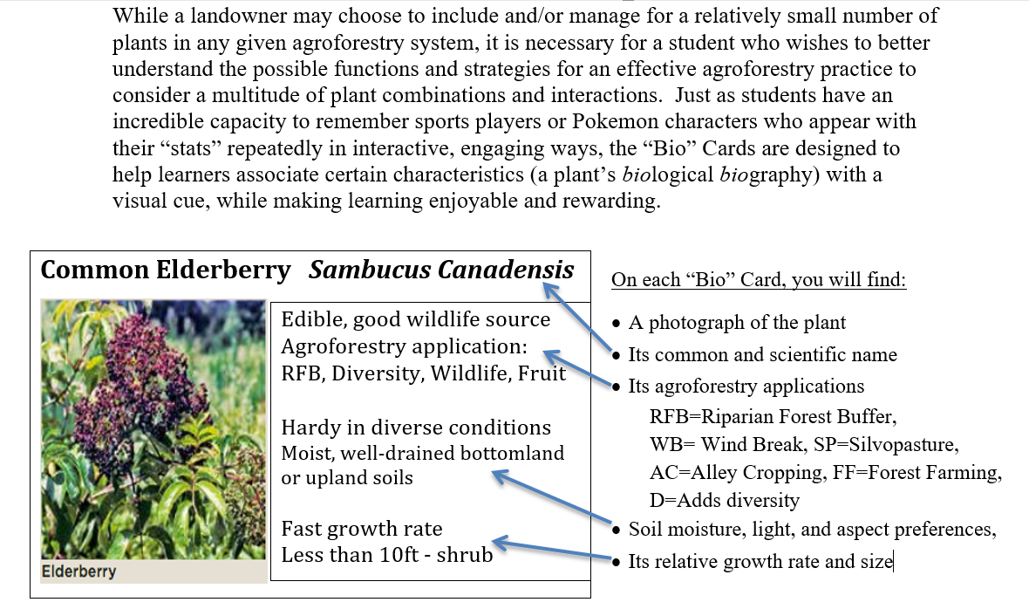
Agroforestry “Bio” Cards

Slide 13
Working Trees make your own list based on the trees you know
Tree name Sugar maple White oak Paper birch Spruce or Fir Sycamore Black walnut | This tree needs… Moist, fertile soil Sunlight, time Cool climate Space Moist soil conditions Well-drained soil | This tree contains/ provides… Sap → Syrup, mushroom logs, fall color aesthetic Habitat, timber, acorn mast Bark (historically for canoes, homes, baskets) Christmas trees, winter foliage, wind protection Bird nesting habitat, ground water filter Edible nuts for humans and wildlife, high-value timber
Notes:
If trees are so useful and productive, why don’t we use them more IN our agricultural systems? What are your ideas about this?

Slide 14
Key terms
Agroforestry
Alley cropping
Forest farming
Riparian and upland forest buffers
Silvopasture
Windbreaks

Slide 15
Alley cropping
http://belovedplanet.com/2013/06/ (France – wheat and walnut)

Slide 16
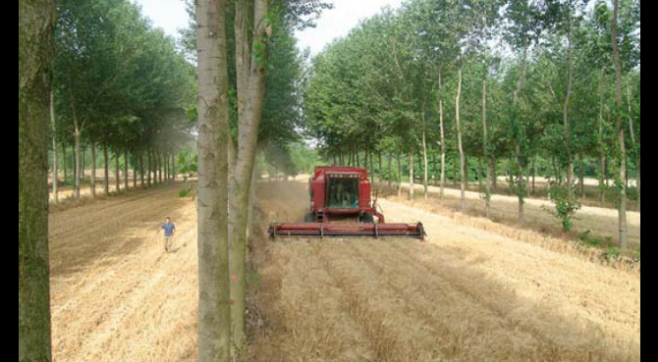
Alley Cropping
The planting of two or more sets of single or multiple rows of trees or shrubs at wide spacings, creating alleys within which agricultural, horticultural, or forage crops are cultivated.
Video: http://www.youtube.com/watch?v=b8Kwb5yInPM

Slide 17
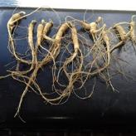
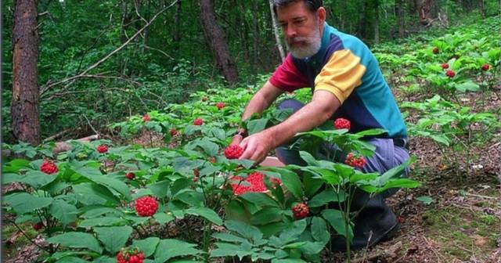
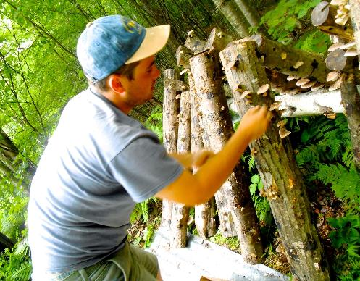
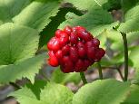
Forest farming
http://ourtinyfarmnc.blogspot.com/search/label/ginseng
(North Carolina)
http://greenhillcollectivefarm.blogspot.com
(New Hampshire)

Slide 18
Forest Farming
The intentional and sustainable cultivation of marketable non-
timber forest products (NTFPs) in woodlands with suitable shade and site conditions.
Video: http://www.youtube.com/watch?v=ssFQXgGbwTE

Slide 19
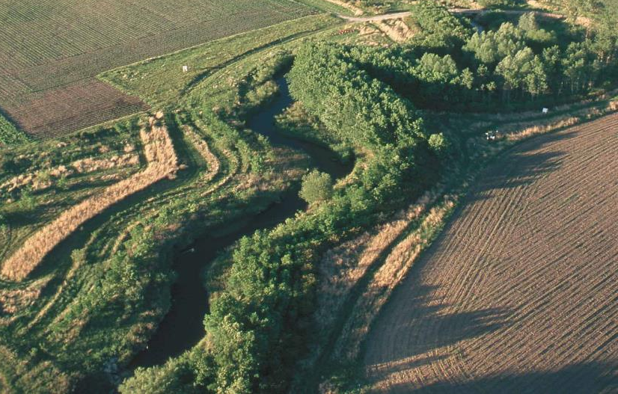
Riparian forest buffers
https://en.wikipedia.org/wiki/Riparian_buffer (Story County, IA)

Slide 20
Riparian Forest Buffers
Designed combinations of trees, shrubs, grasses, forbs and bioengineered structures adjacent to, or within, a stream channel designed to mitigate the impact of land use on the stream.
Video: http://www.youtube.com/watch?v=8HDnyV1ViHw

Slide 21
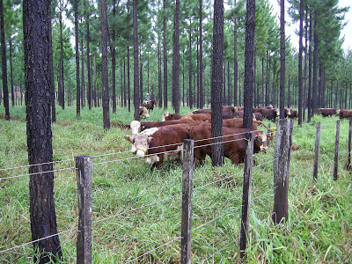
Silvopasture
http://silvopasture.blogspot.com/ (Florida)

Slide 22
Silvopasture
The intentional integration of trees, forages, and grazing livestock for mutual benefit using management intensive rotation practices.
Allowing livestock to graze in a natural woodland area without active livestock/ forage grazing management is NOT agroforestry
Video: http://www.youtube.com/watch?v=hprobEqBUMY

Slide 23
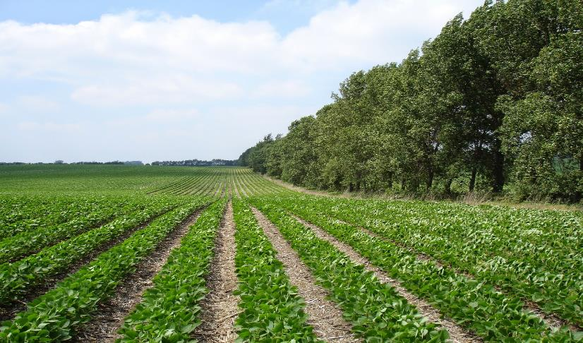
Windbreaks
http://blog-crop-news.extension.umn.edu/2015/04/windbreak-and-crop-yield-study.html (Canada)

Slide 24
Windbreaks
Also known as shelterbelts, timberbelts, hedgerows, and living snowfences, they are barriers that reduce troublesome winds by creating a wind shadow down- wind of the windbreak that can protect crops, soil, and livestock.
Video: http://www.youtube.com/watch?v=JRv4ylL3bs0

Slide 25
Agroforestry Conference
Once each member of your group has completed the agroforestry practice worksheet, share the responsibility of using worksheet notes, and other information provided to give a 5-minute presentation describing:
Why a landowner might be interested in planning, designing, and maintaining the practice
What environmental services and diversified farm income enterprises he or she might expect to obtain from the practice
How-to design and management considerations

Slide 26
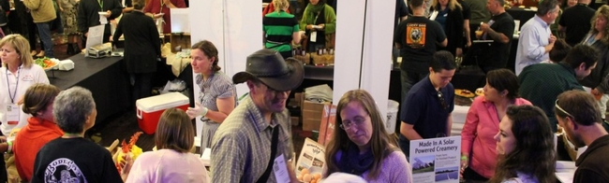
Role of the Audience
You are landowners, ready to learn new ideas to improve your farming practice
Give your full attention to the presenters
Ask relevant questions, express your concerns, and take detailed notes for future use

Slide 27
Making a CONCEPT MAP
Create hierarchy between sets of lines
Keep adding as you go
Make new connections!
Environmental services
Alley cropping
What is
AGROFORESTRY?
Forest farming
Riparian buffers
Marketable products
Silvopasture
Windbreaks

Slide 28
Alley cropping
http://belovedplanet.com/2013/06/ (France – wheat and walnut)

Slide 29
Silvopasture
http://silvopasture.blogspot.com/ (Florida)

Slide 30
Riparian forest buffers
https://en.wikipedia.org/wiki/Riparian_buffer (Story County, IA)

Slide 31
Windbreaks
http://blog-crop-news.extension.umn.edu/2015/04/windbreak-and-crop-yield-study.html (Canada)

Slide 32
Forest farming
http://ourtinyfarmnc.blogspot.com/search/label/ginseng
(North Carolina)
http://greenhillcollectivefarm.blogspot.com
(New Hampshire)

Slide 33
Review
Make any last additions and connecting lines to your agroforestry concept map
Trade your concept map with a person sitting next to you
What do you notice that’s different about this person’s concept map?
What new connections do you see?
Hand in your concept map, and create one large class concept map on the board, collecting what each student recalls without use of the completed maps.

Slide 34
Classroom-Ready Resources
The latest in Agroforestry:
http://midamericanagroforestry.net/resources-links/journals/
15-min video for each practice:
http://www.centerforagroforestry.org/pubs/videos.php
PwrPt presentations for each practice:
https://nac.unl.edu/multimedia/presentations.htm
In-depth text resource
http://centerforagroforestry.org/pubs/training/index.php
Savanna Institute Perennial Map:
Find farmers, educators, and other resources for perennial crops
https://www.perennialmap.org/map.pl

Slide 36
Working Trees 0.1
A review of Missouri trees and shrubs
commonly used in agroforestry systems
To connect prior knowledge for
Agroforestry in Action
A presentation prepared with media from:

Slide 37
Forest structure and composition
Canopy
Understory
Shrubs
Herbaceous groundcover
Canopy
Understory
Shrubs
Herbaceous groundcover

Slide 38
Test your Tree and Shrub ID skills with this slide series
Leaf, bark, flower, fruit
Common and scientific name
Information about range, growth, and uses

Slide 39
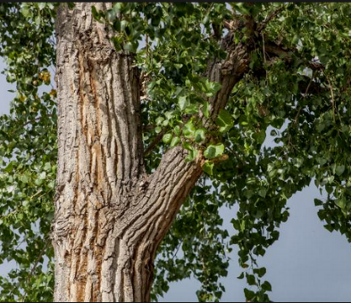
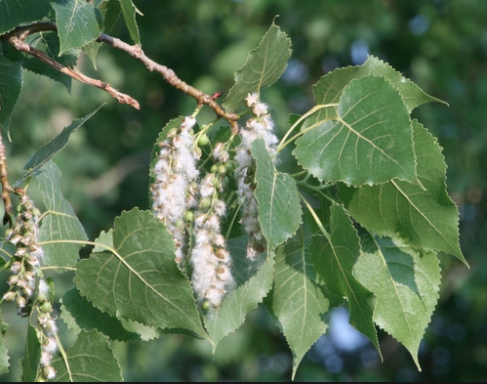
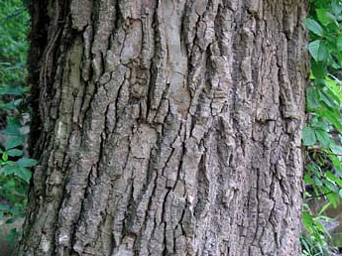

Slide 40
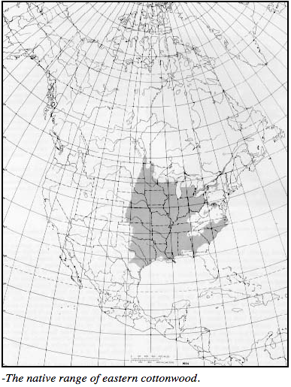
Eastern cottonwood: Populous deltoides
Missouri native
Wildlife, low-value wood products, biomass
Moist silty or sandy loam soils, full sun
Very fast growth rate
80-100ft

Slide 41
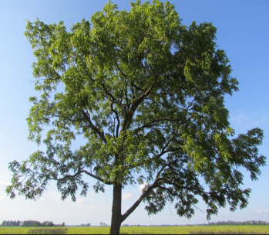
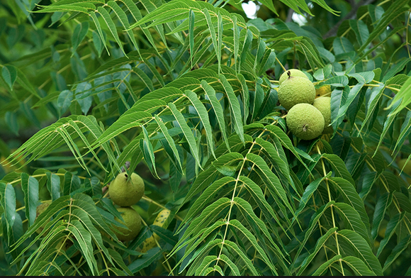
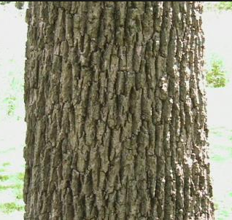
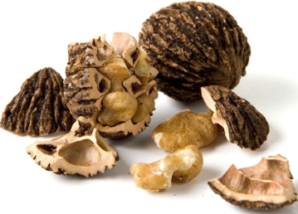

Slide 42
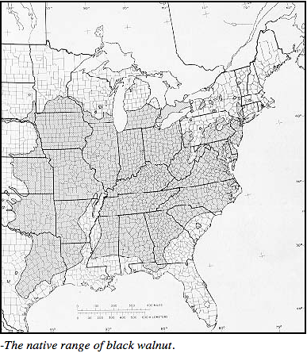
Black walnut: Juglans nigra
Missouri native
Allelopathic inhibitor
High-value wood products, nuts
Prefers deep, well-drained,
neutral pH soils
Intermediate growth rate
70-90+ft

Slide 43
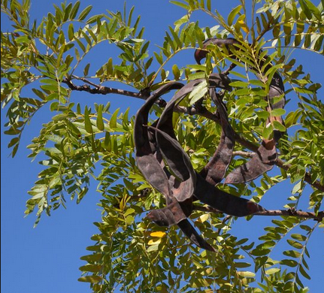
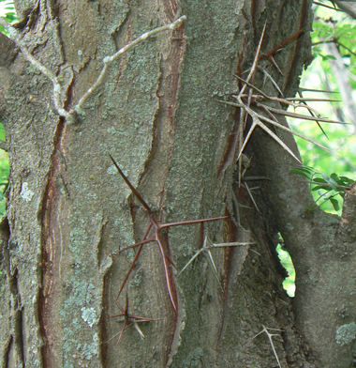
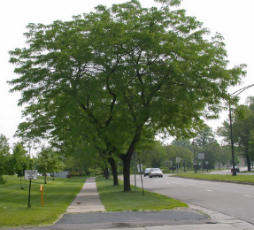

Slide 44
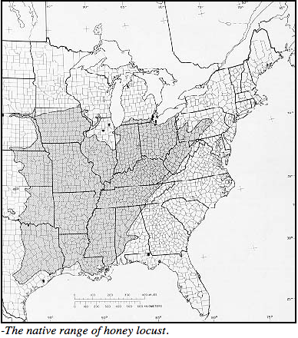
Honeylocust: Gleditsia triacanthos
Missouri native
Pods, leaves can be used as cattle fodder
Low-value wood product
Hardy to diverse conditions,
tolerates soil pH 6.0-8.0
Moderate growth rate
70-80ft

Slide 45
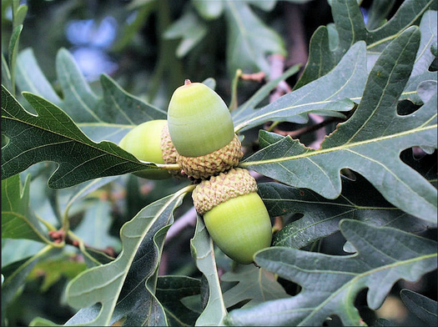
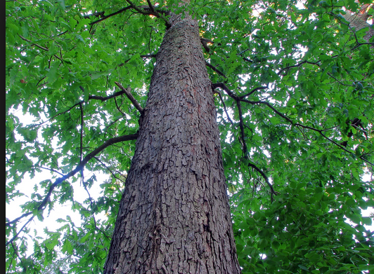

Slide 46
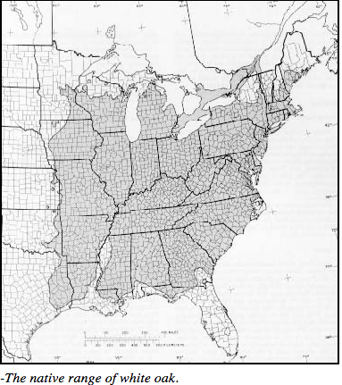
White Oak: Quercus alba
Missouri native
High-value and low-value wood products, wildlife mast
Prefers coarse, moist, well-drained soils
Moderate growth rate
80-100ft

Slide 47
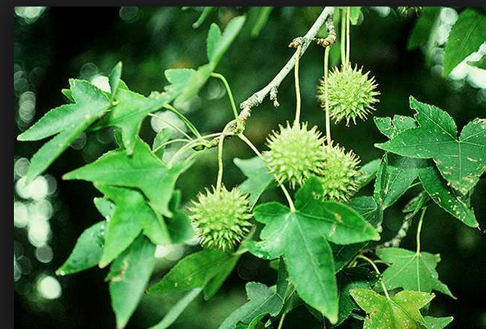
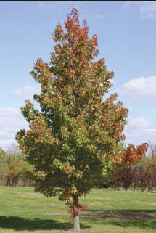
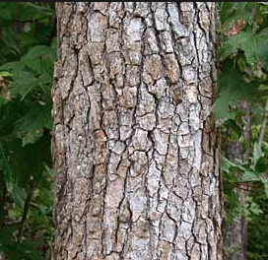

Slide 48
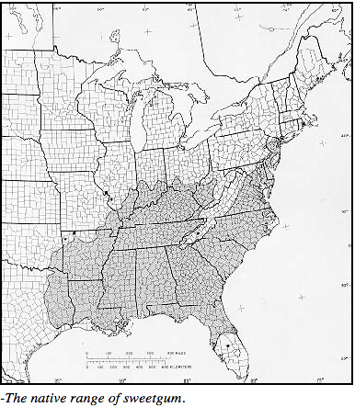
Sweetgum: Liquidambar styraciflua
Missouri native
Wildlife, low-value wood products, biomass
Prefers moist silty or sandy loam soils, full sun
Very fast growth rate
80-100ft

Slide 49
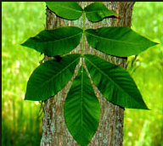
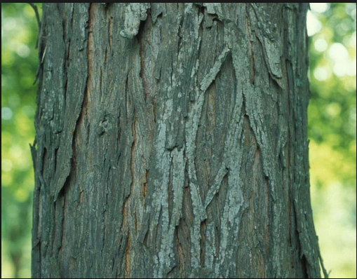
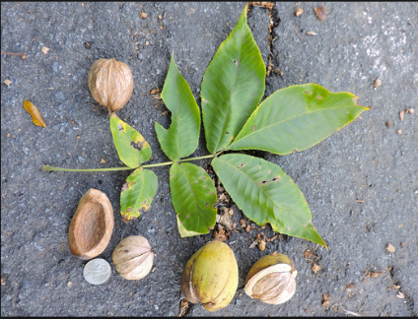
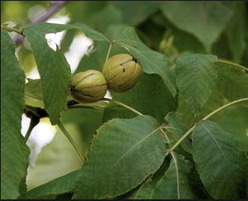

Slide 50
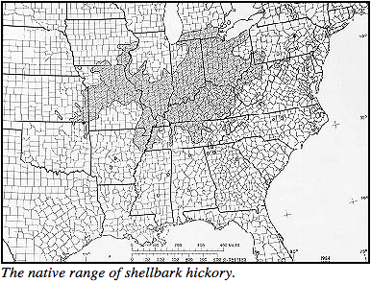
Shellbark hickory: Carya laciniosa
Missouri native
Wildlife, firewood, bbq wood, nuts
Prefers deep, fertile, moist soils
Slow growth rate
80-100ft

Slide 51
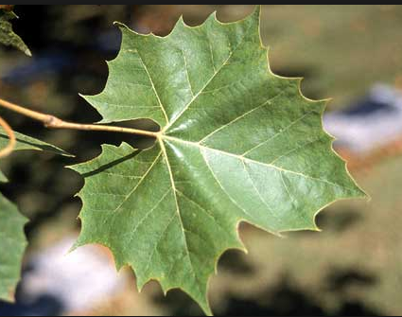
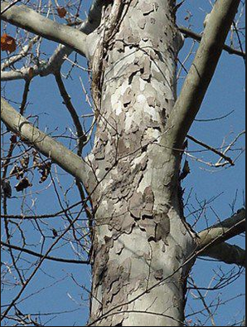
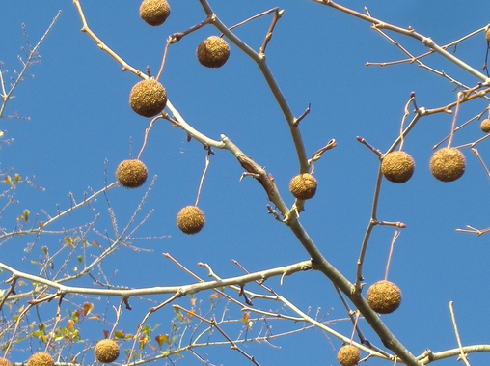

Slide 52
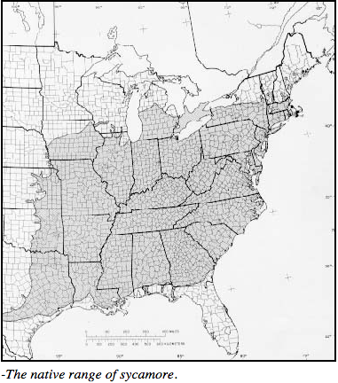
American sycamore: Platanus occidentalis
Missouri native
coppice regeneration
Wildlife, low-value wood products, biomass
Moist sites, tolerates soil pH 4.4-7.5
Fast growth rate
100+ft

Slide 53
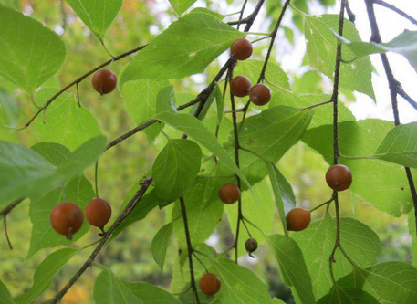
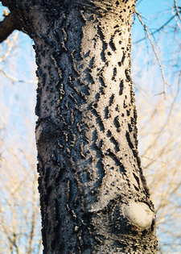
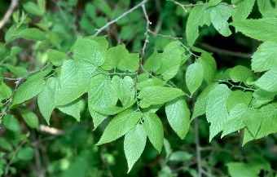

Slide 54
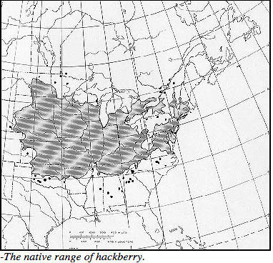
Common hackberry: Celtis occidentalis
Missouri native
Low-value wood products, wildlife benefit
Hardy to diverse soil conditions
Fast growth rate
30-50+ft

Slide 55
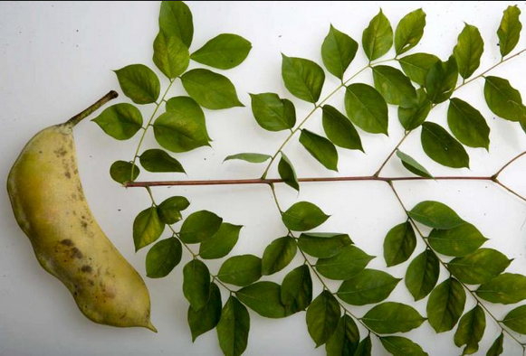
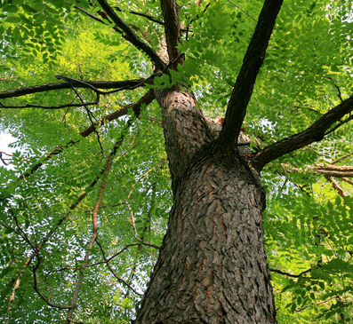
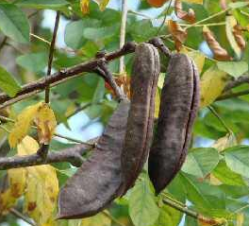

Slide 56
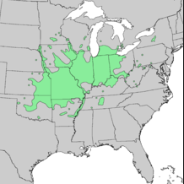
Kentucky coffeetree: Gymocladus dioicus
Missouri native
Ring shake can be problem
Low- and High-value wood products, ornamental
Urban-tolerant, adaptable to wide range of sites
Intermediate/ Fast growth rate
100ft

Slide 57
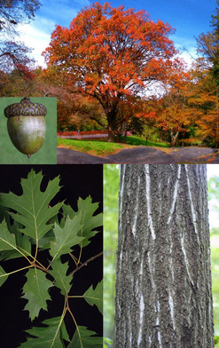

Slide 58
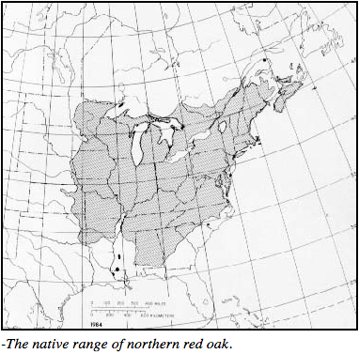
Northern red oak: Quercus rubra
Missouri native
Susceptible to oak wilt
High- and low-value wood products, wildlife
Well-drained upland sites,
does not tolerate pH >7.5
Intermediate growth rate
60-80ft

Slide 59
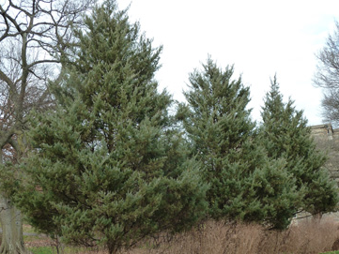

Slide 60
Eastern redcedar: Juniperus virginiana
Missouri native
Spreads/ naturalizes easily
Wildlife benefit, Low- and High-value wood products, windbreaks
Tolerates thin, alkaline soils
Slow, moderate growth rate
<50ft

Slide 62
Persimmon: Diospyros virginiana
Missouri native
Wildlife, Fruit, Low- and High-value wood products
Hardy to diverse soil types, prefers soil pH 6-6.5
Slow growth rate
30-50ft

Slide 64
Silver maple: Acer saccharinum
Missouri native
Prone to ice/wind damage
Low-value wood products,
biomass, ornamental
Widely adaptable pioneer,
tolerates moist,
poorly-drained soils

Slide 66
Red mulberry: Morus rubra
Missouri native
Fruit, Wildlife
Moist, well-drained,
bottomland sites
Intermediate growth rate
40-50ft

Slide 68
River birch: Betula nigra
Missouri native
Low-value wood products, ornamental, environmental services
Tolerant of very wet soils
Intermediate growth rate
50ft

Slide 70
Bur oak: Quercus macrocarpa
Missouri native
Commonly used in CRP
High-value wood products, wildlife benefit
Hardy to diverse soil conditions
Slow, moderate growth rate
70-80ft

Slide 72
Osage orange: Maclura pomifera
“Hedge apple”
Low- and high-value wood products, wildlife benefit, hedgerows
Hardy to diverse soil conditions, tolerates draught and wide pH range
Intermediate/fast growth rate
10-40ft

Slide 74
Pecan: Carya illinoensis
Missouri native
Use cultivars for nut production
Wildlife, High-value wood products, Nuts
Deep, bottomland, moist soils
Intermediate growth rate
110-140ft

Slide 76
Chinese chestnut: Castanea mollissima
Best adapted for Midwest nut production
Alley cropping, High-value nuts, specialty timber products
Well-drained upland, can be slightly acidic pH soils
Intermediate growth rate
30-40 ft

Slide 78
Pawpaw: Asimina triloba
Missouri native
Site specific
Wildlife, fruit product
Moist, fertile, slightly acidic soils
Moderate growth rate
15-30ft

Slide 80
Redosier dogwood: Cornus stolonifera
Thicket forming
Wildlife, Non-timber forest products, ornamental floral
Moist, bottomland sites
Intermediate growth rate
6-10ft

Slide 82
Gooseberry: Ribes spp.
Missouri native
Thicket forming
Moist, well-drained soils, tolerates shade
Fast growth rate
3ft

Slide 84
Hazelnut: Corylus americana
Missouri native
Difficult to establish from seed
Wildlife, ornamental, nut products
Full sun, well-drained soils, draught tolerant
Fast growth rate
7-15ft

Slide 86
Serviceberry: Amelanchier spp.
Missouri native
Wildlife, Ornamental, Fruit products
Hardy to diverse soil types, tolerates some shade
Intermediate/Fast growth rate
<30ft

Slide 88
Ninebark: Physocarpus opulifolius
Missouri native
Wildlife, Env. Services
Hardy to diverse conditions, tolerates shade
Fast growth rate
10ft

Slide 90
Blackberry, raspberry: Rubus spp.
Missouri native
Thicket forming
Wildlife, Fruit
Hardy to diverse conditions, prefers well-drained soils
Fast growth rate
6-10ft

Slide 92
Common elderberry: Sambucus canadensis
Missouri native, shrub
Edible, good wildlife food source
Forest buffers, Diversity, Wildlife, Fruit, Medicinals
Hardy in diverse conditions
Moist, well-drained bottomland or upland soils
Fast growth rate
Less than 10ft - shrub

Slide 93
Reflect
Why is it important to know the native range of trees used in agroforestry and forestry systems?
What species presented here do you think have the most marketability?
Research this questions to understand what trees a landowner might be most interested in selecting for a given management objective.

Slide 94
Tree and Shrub Resources
Missouri Dept. of Conservation
https://www.treeswork.org/
https://nature.mdc.mo.gov/discover-nature/field-guide/search
USDA Forest Service
https://www.srs.fs.usda.gov/pubs/misc/ag_654/table_of_contents.htm
Center for Agroforestry
http://www.centerforagroforestry.org/pubs/
Cornell Woody Plants Database
http://woodyplants.cals.cornell.edu/plant/search
USDA Plant Database
https://plants.sc.egov.usda.gov/java/

Slide 95
Agroforestry in Action
Module 2:
Agroforestry Applications:
Planning and Design for Sustainable Systems

Slide 96
Objectives
Identify biophysical components of plant interactions typical in agroforestry systems.
Evaluate landowner objectives for agroforestry design opportunities.

Slide 97
Agroforestry “Bio” Cards

Slide 98
Agroforestry Plant Interactions Meet and Greet
How well do we get along?
Space (above and below ground)
Plant height and radius
Foliage density/ deciduous or coniferous
Root depth and growth pattern
Light
Shade tolerant or full sun
C3/ C4 plants
Soil moisture and nutrients
Bottomland or upland site preference

Slide 101
Given these positive and negative effects of tree-crop interactions, what measures could be taken to maximize benefits, and minimize losses?
World Agroforestry Center

Slide 102
The Concept of Overyielding
Overyielding is the concept that the yield (e.g. biomass) of an ecological community is greater than the yield of a monoculture of any one species within the community.
Models can illustrate how the increased yield of combined canopy, understory, and herbaceous crops in an agroforestry system can outweigh any losses that may occur from negative interactions :

Slide 105
In the case of windbreaks, as the prior example showed, annual crop yield may increase, despite shade and root competition from edge trees.
Based on what you know about above and below ground tree-crop interactions, how do you think overyielding plays a role in the other temperate agroforestry practices?
USDA National Agroforestry Center

Slide 107
Individual Agroforestry Site Design
Complete an agroforestry site design that includes applications of at least 2 of the 5 agroforestry practices summarized in this lesson, including:
A) How the farmer’s objectives are met,
B) Why the practices and plant combinations are appropriate given ecological considerations,
C) What marketable products and environmental services may be derived, and
D) Long-term management considerations.
Notes:
Figure 1—There are five main categories of agroforestry practices in the United States: (A) alley cropping, (B) windbreaks, (C) riparian forest buffers, (D) silvopasture, (E) forest farming, and an emerging sixth category (F) special applications (e.g., short-rotation woody crops or biomass). (Photos by USDA Forest Service and Natural Resources Conservation Service (B, C, D, F), the University of Missouri (A), and Catherine Bukowski (E)).

Slide 108
Consider an Advanced Design and Implementation Project
Financial Decision Support Tools (model farm systems for advanced design)
http://www.centerforagroforestry.org/profit/elderberryfinance.php
NTFP Calculator
https://nac.unl.edu/tools/ntfp.htm
CanVis simulations
https://nac.unl.edu/simulation/index.htm
Use the Handbook for Agroforestry Planning and Design as a guide
www.centerforagroforestry.org/pubs/training/handbookp&d13.pdf

Slide 109
Trial agroforestry practices to consider at your farm or school
Cultivate mushrooms
Visit Field and Forest Products at www.fieldforest.net for supplies and instructions for mushroom inoculation
Plant a food forest
Install a windbreak or riparian buffer
Visit Forrest Keeling nursery at www.fknursery.com for improved cultivars of fruit and nut trees and shrubs for MO
Market value-added agroforestry products
Contact the Center for Agroforestry www.centerforagroforestry.org for assistance

Slide 110
Reflect
Which of the 5 temperate agroforestry practices do you find most appealing? Why?
How might a farmer decide which agroforestry practice would be most suitable for them?
What tree, shrub, or NTFP species do you think would be most desirable in this area?

