Slide 1


Evaluating Novel Techniques for Bird
Management in Sweet Corn
Darcy E. P. Telenko and Robert Hadad
CCE Cornell Vegetable Program
Building Strong and Vibrant New York Communities
Cornell Cooperative Extension is an employer and educator recognized for valuing AA/EEO, Protected Veterans, and Individuals with Disabilities and provides equal program and employment opportunities.

Slide 2
Background
Bird damage continues to be persistent problem for vegetable growers
Wildlife damage leads to yield loss and potential for microbial contamination
In 2014 survey of sweet corn growers 84% reported bird damage with an average loss of 16% in yield
Single farm with 20 acres could have >$10,000 loss in revenue
Many proactive measures being deployed have had mixed results
A grower stated “had problems from the day seed hit the ground”
Single farm reported a loss of over 5,000 ears even with multiple tactics being utilized (nuisance permits and gas-fired canons)

Slide 3
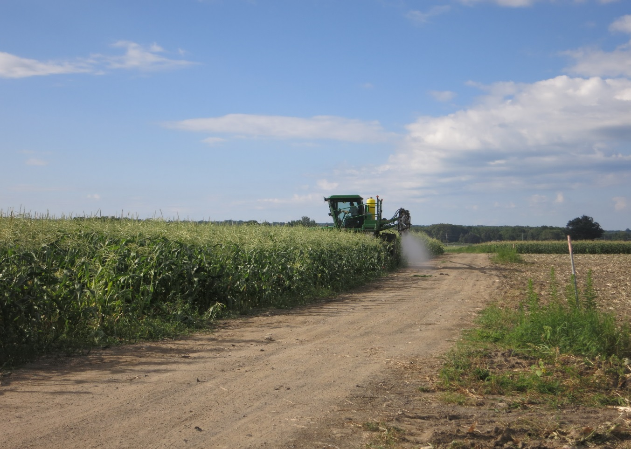
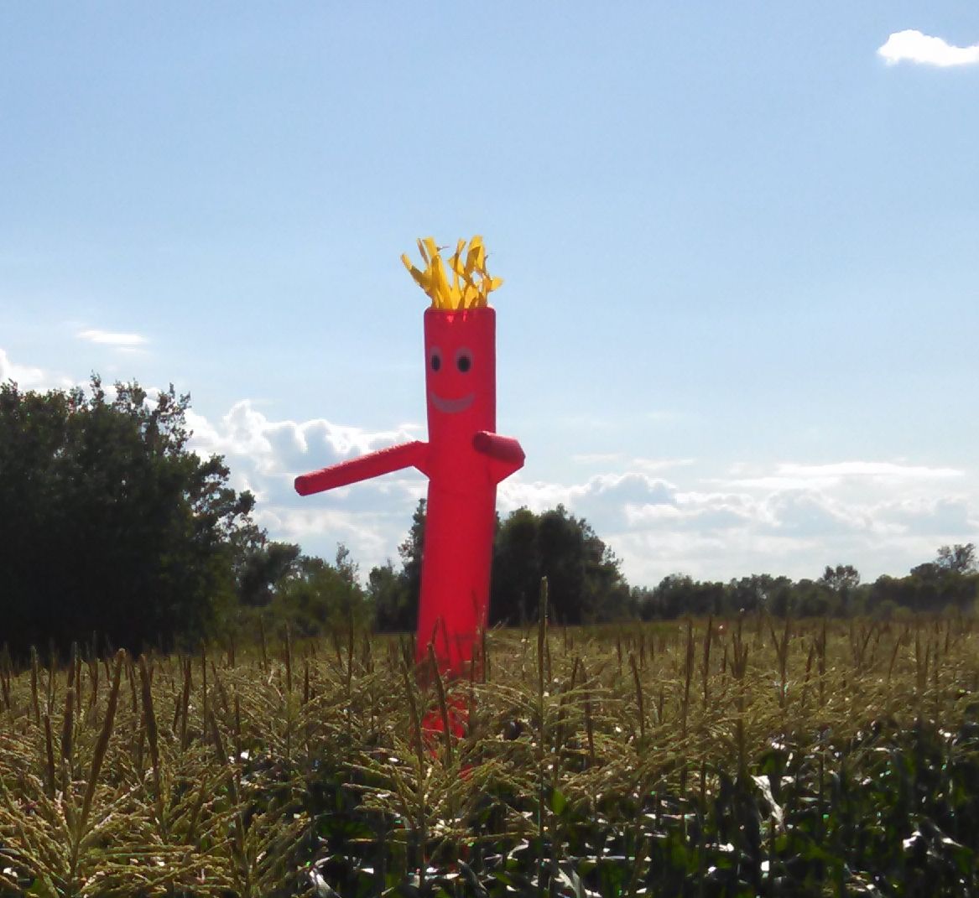
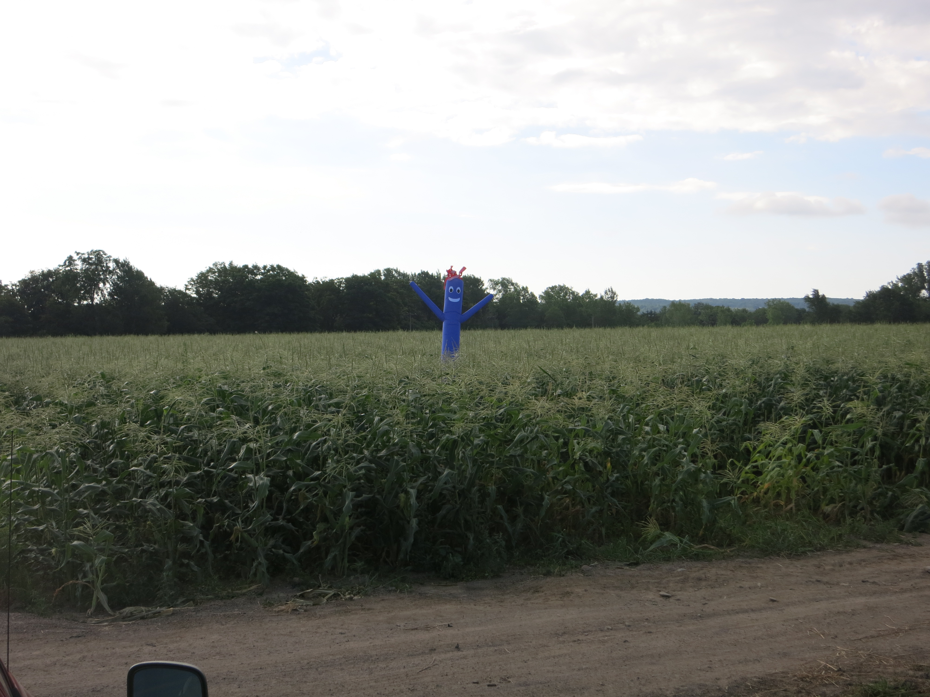
Evaluating New Techniques
Avian control (methyl anthranilate) registered for unrestricted use in NY
A novel “air-dancer”

Slide 4
Can these bird repellants reduce damage? Are they economical?
Evaluation in multiple locations (4 farms)
Treatments:
  Avian Control (methyl anthranilate)- 32 oz/A - $36/application
  Mylar hawk-eye balloons ($10/balloon) – 3 per location
  “Air-dancer” – ($200 for fan and dancer, plus $400 for generator) ~$862 to set-up and run
  Untreated

Slide 5
Data collection
  Monitor crop maturity starting at silking
  Monitor bird activity – counts
  Determine crop maturity –100 plants determine number with brown silk
  Index bird activity – counts of bird droppings (20 locations) on ground and in plants, number of ears damaged and extent of damage (# kernals)
  Number of harvestable ears
  Post trial survey with cooperators on their thoughts of utility of treatments, perceived effectiveness and future uses.

Slide 6
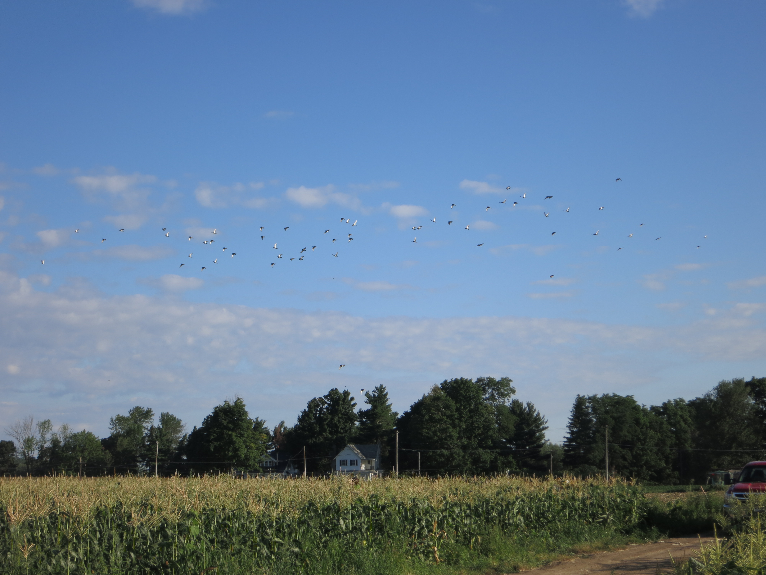
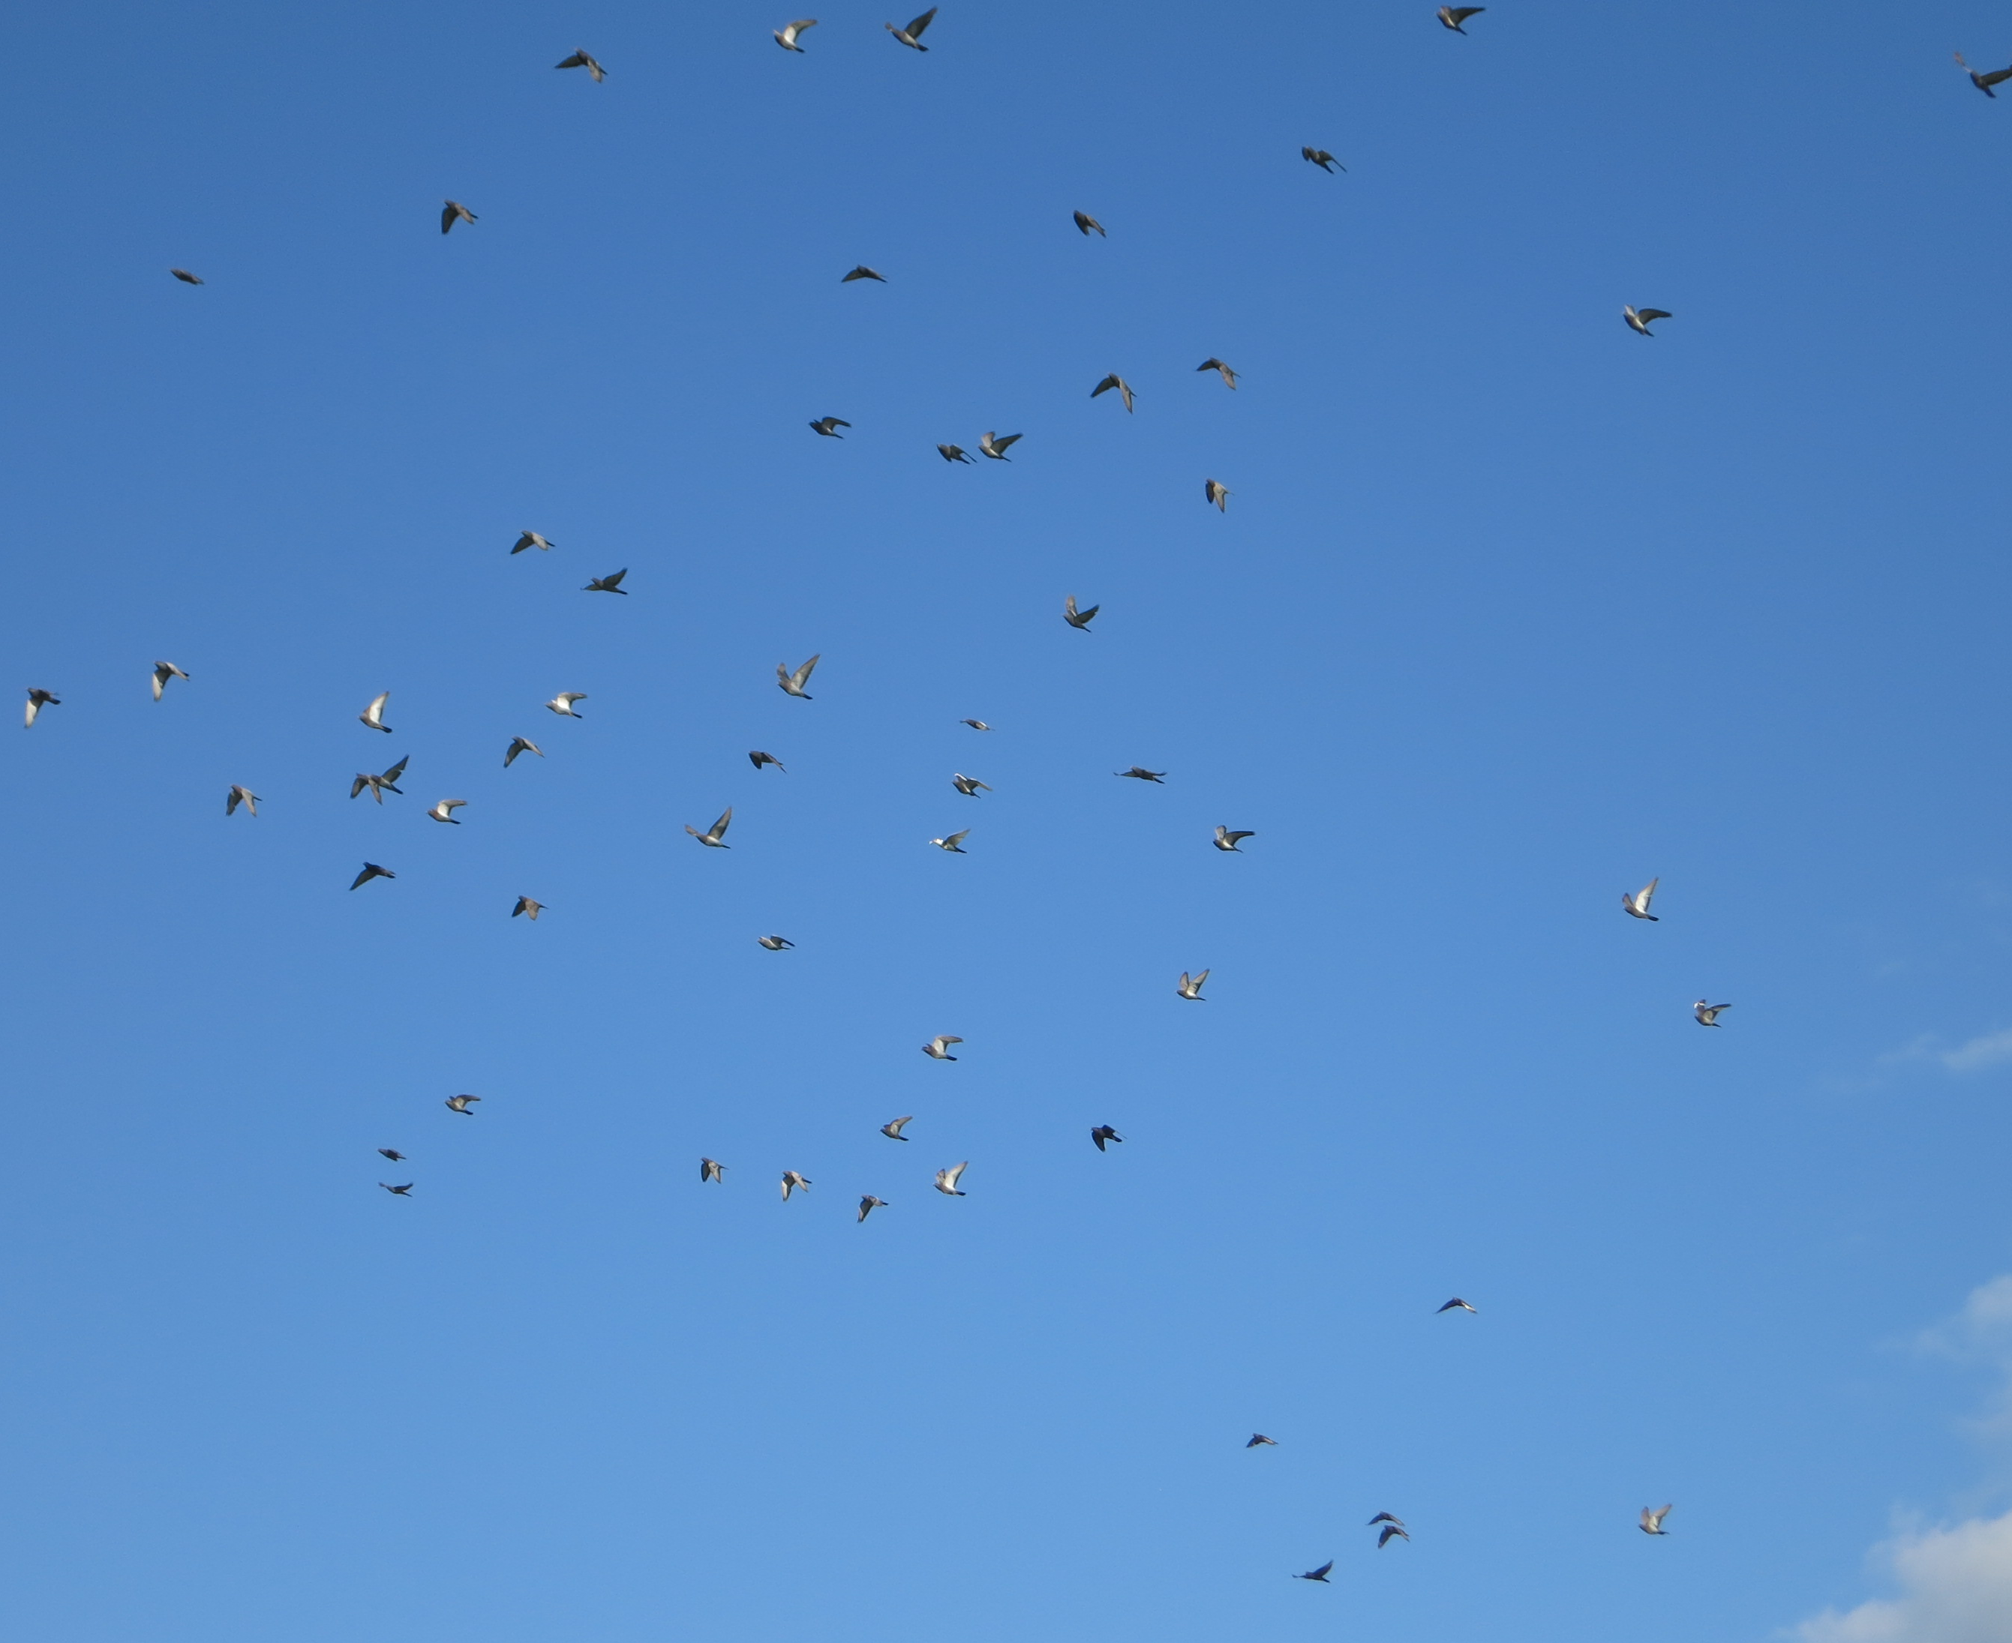

Slide 7
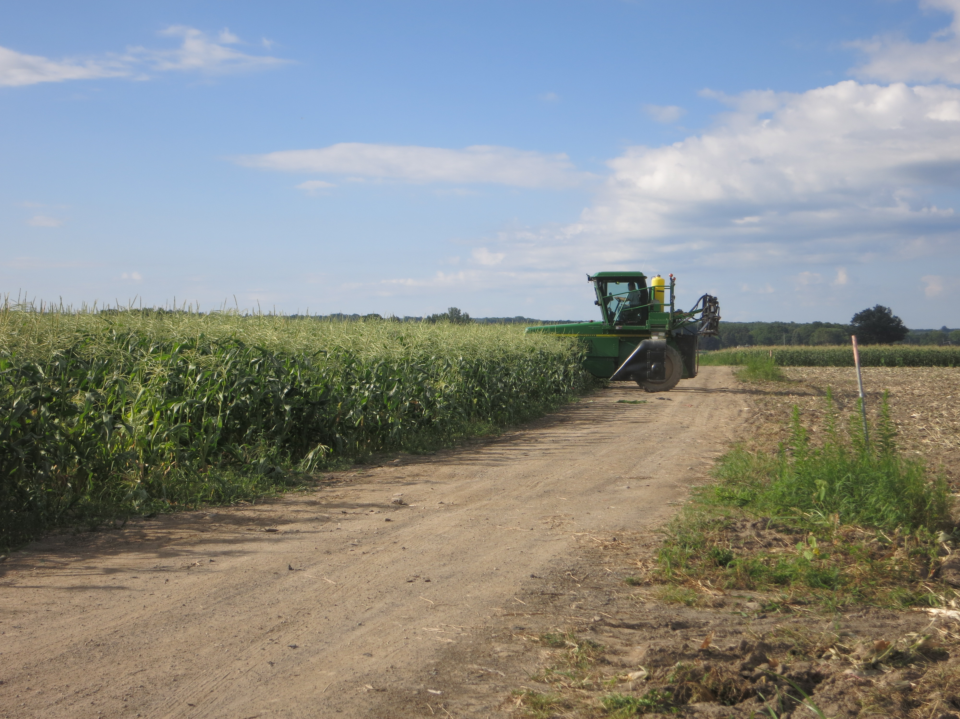

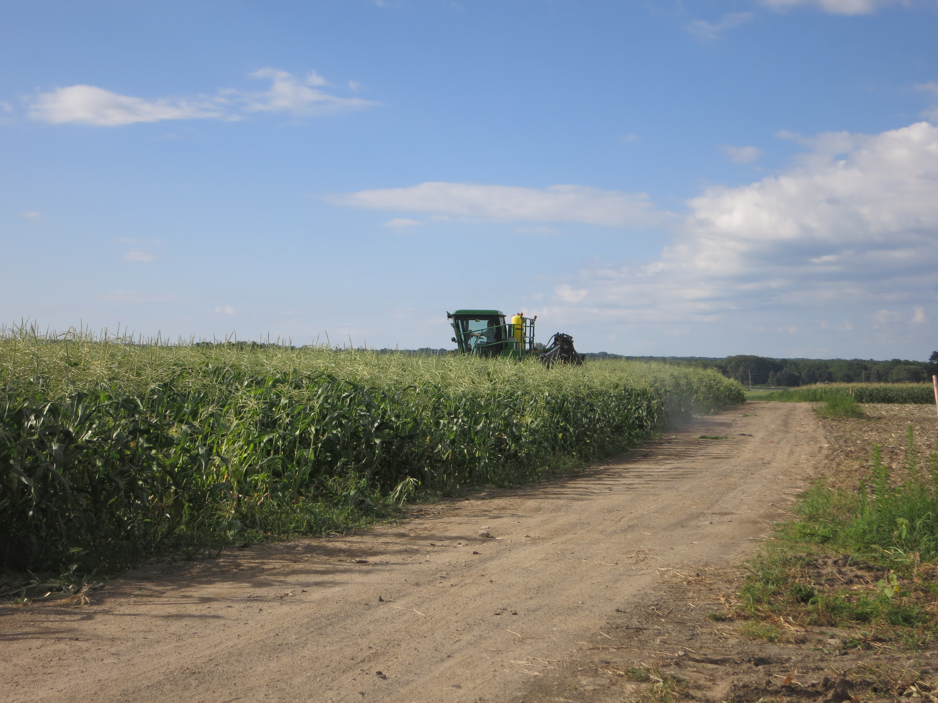

Slide 8
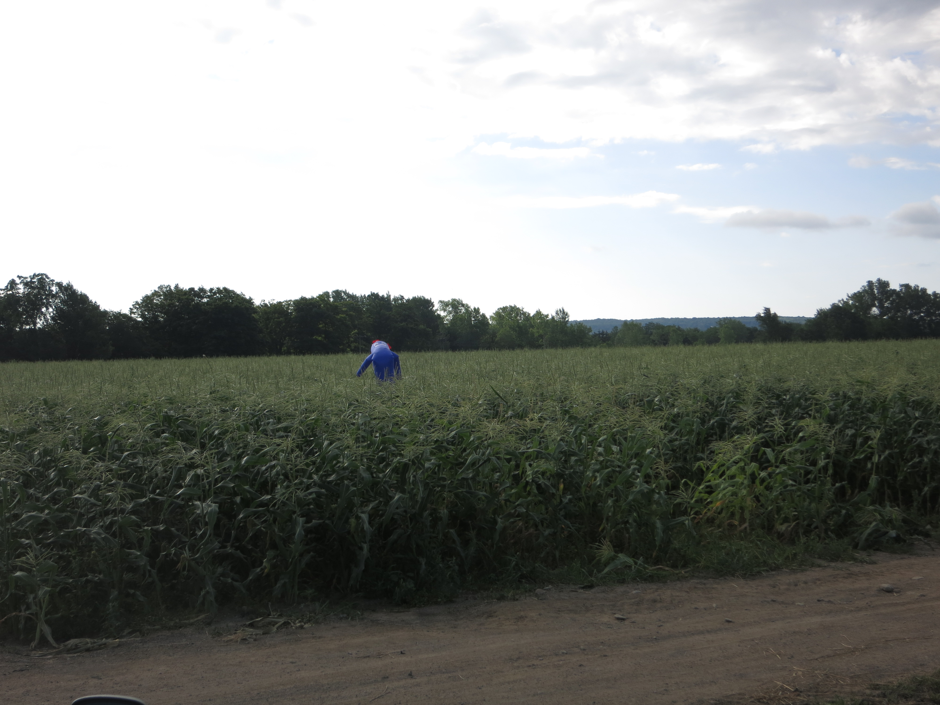
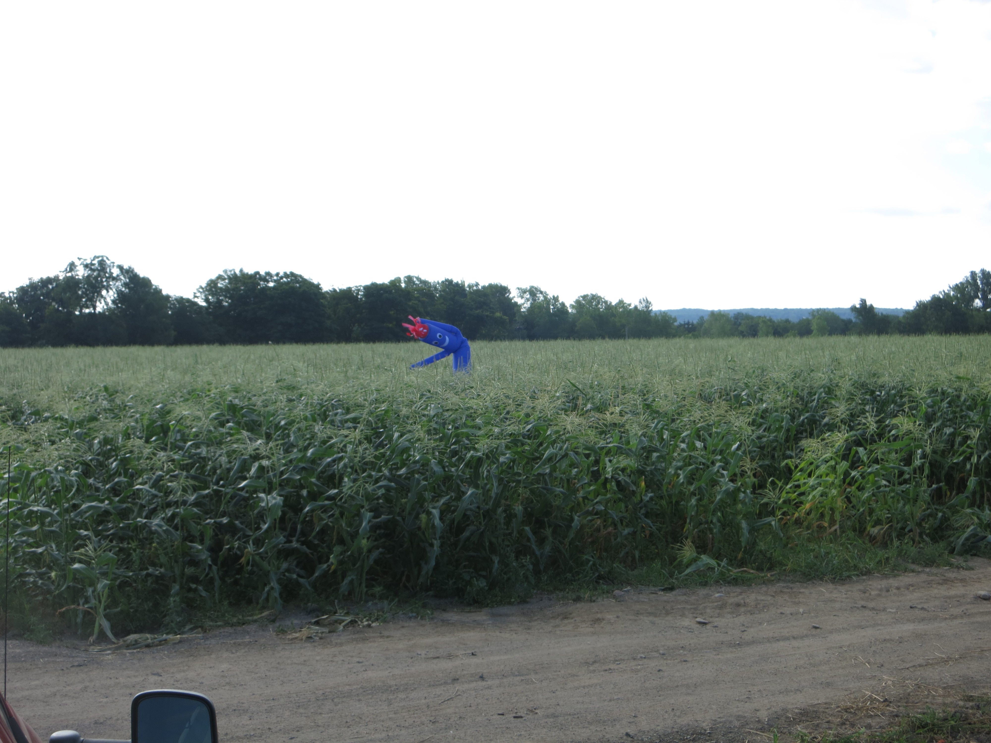
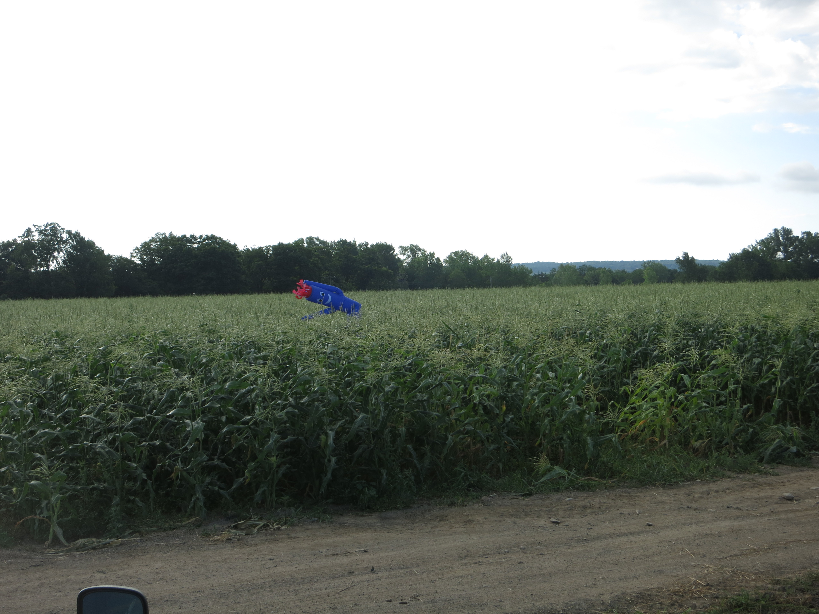
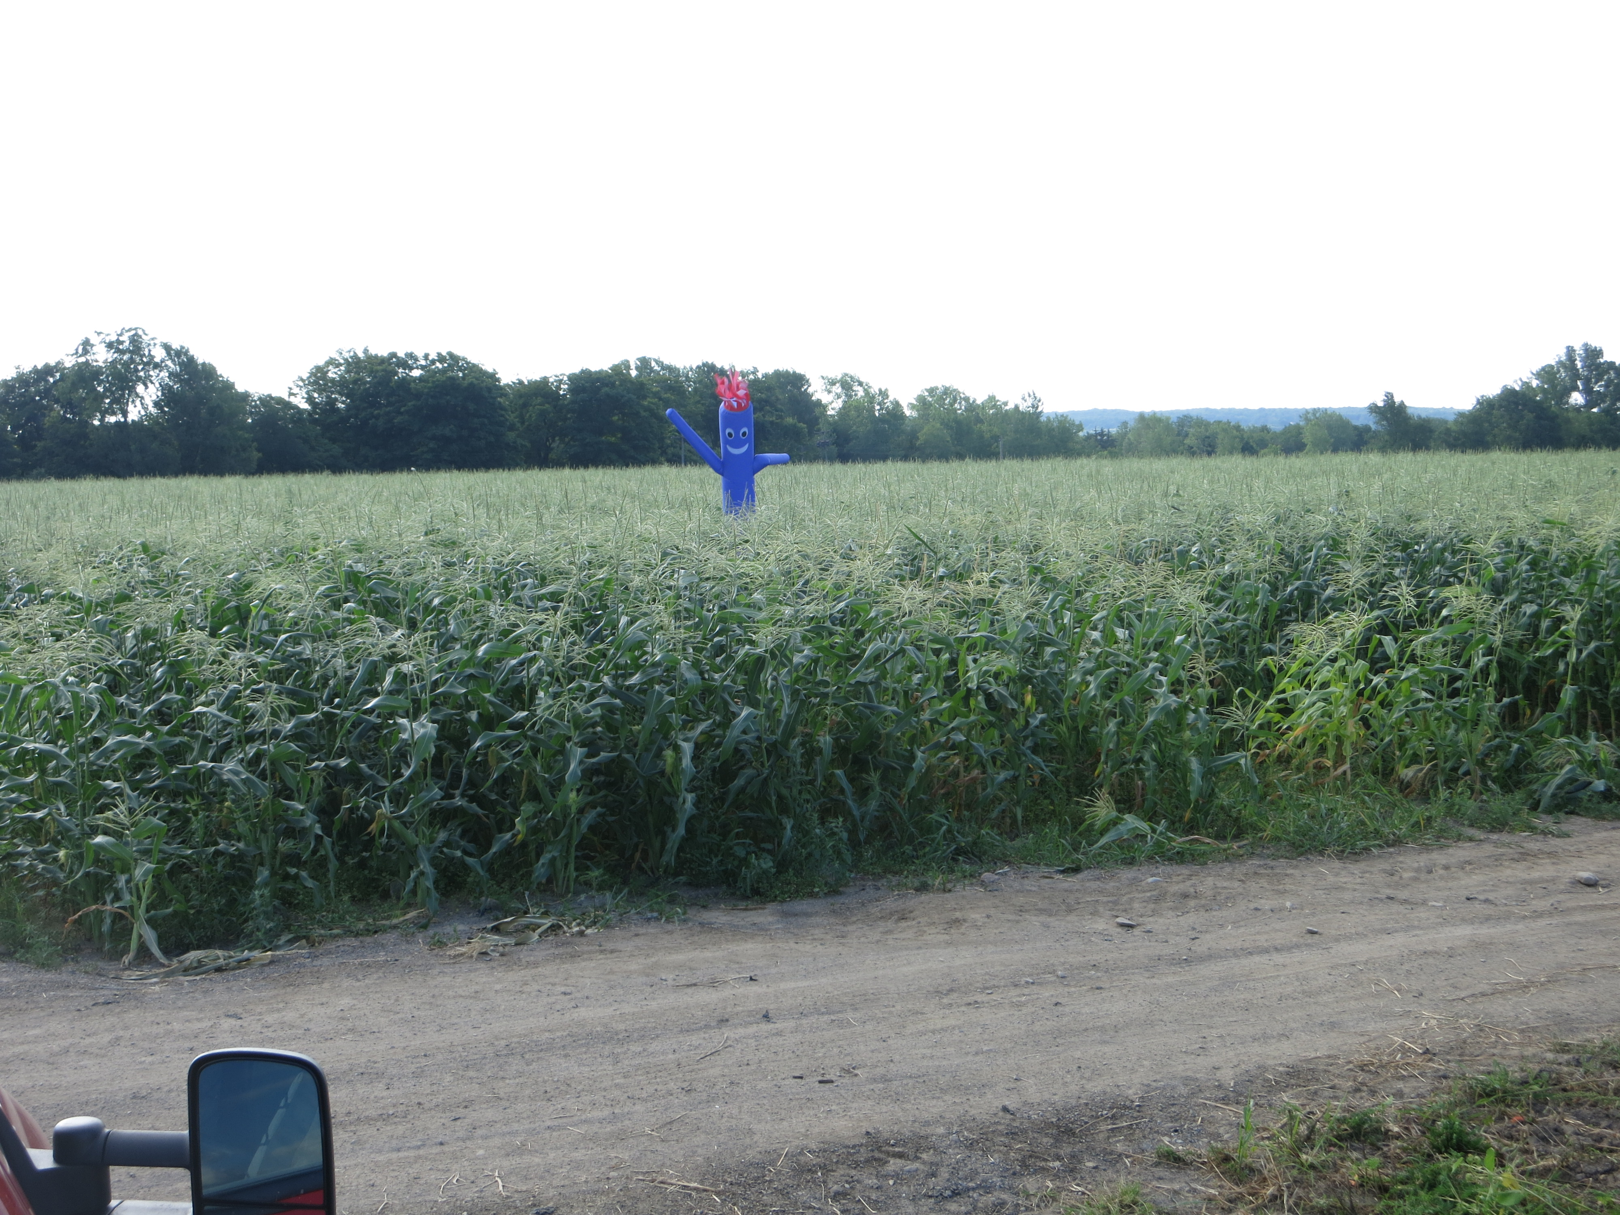
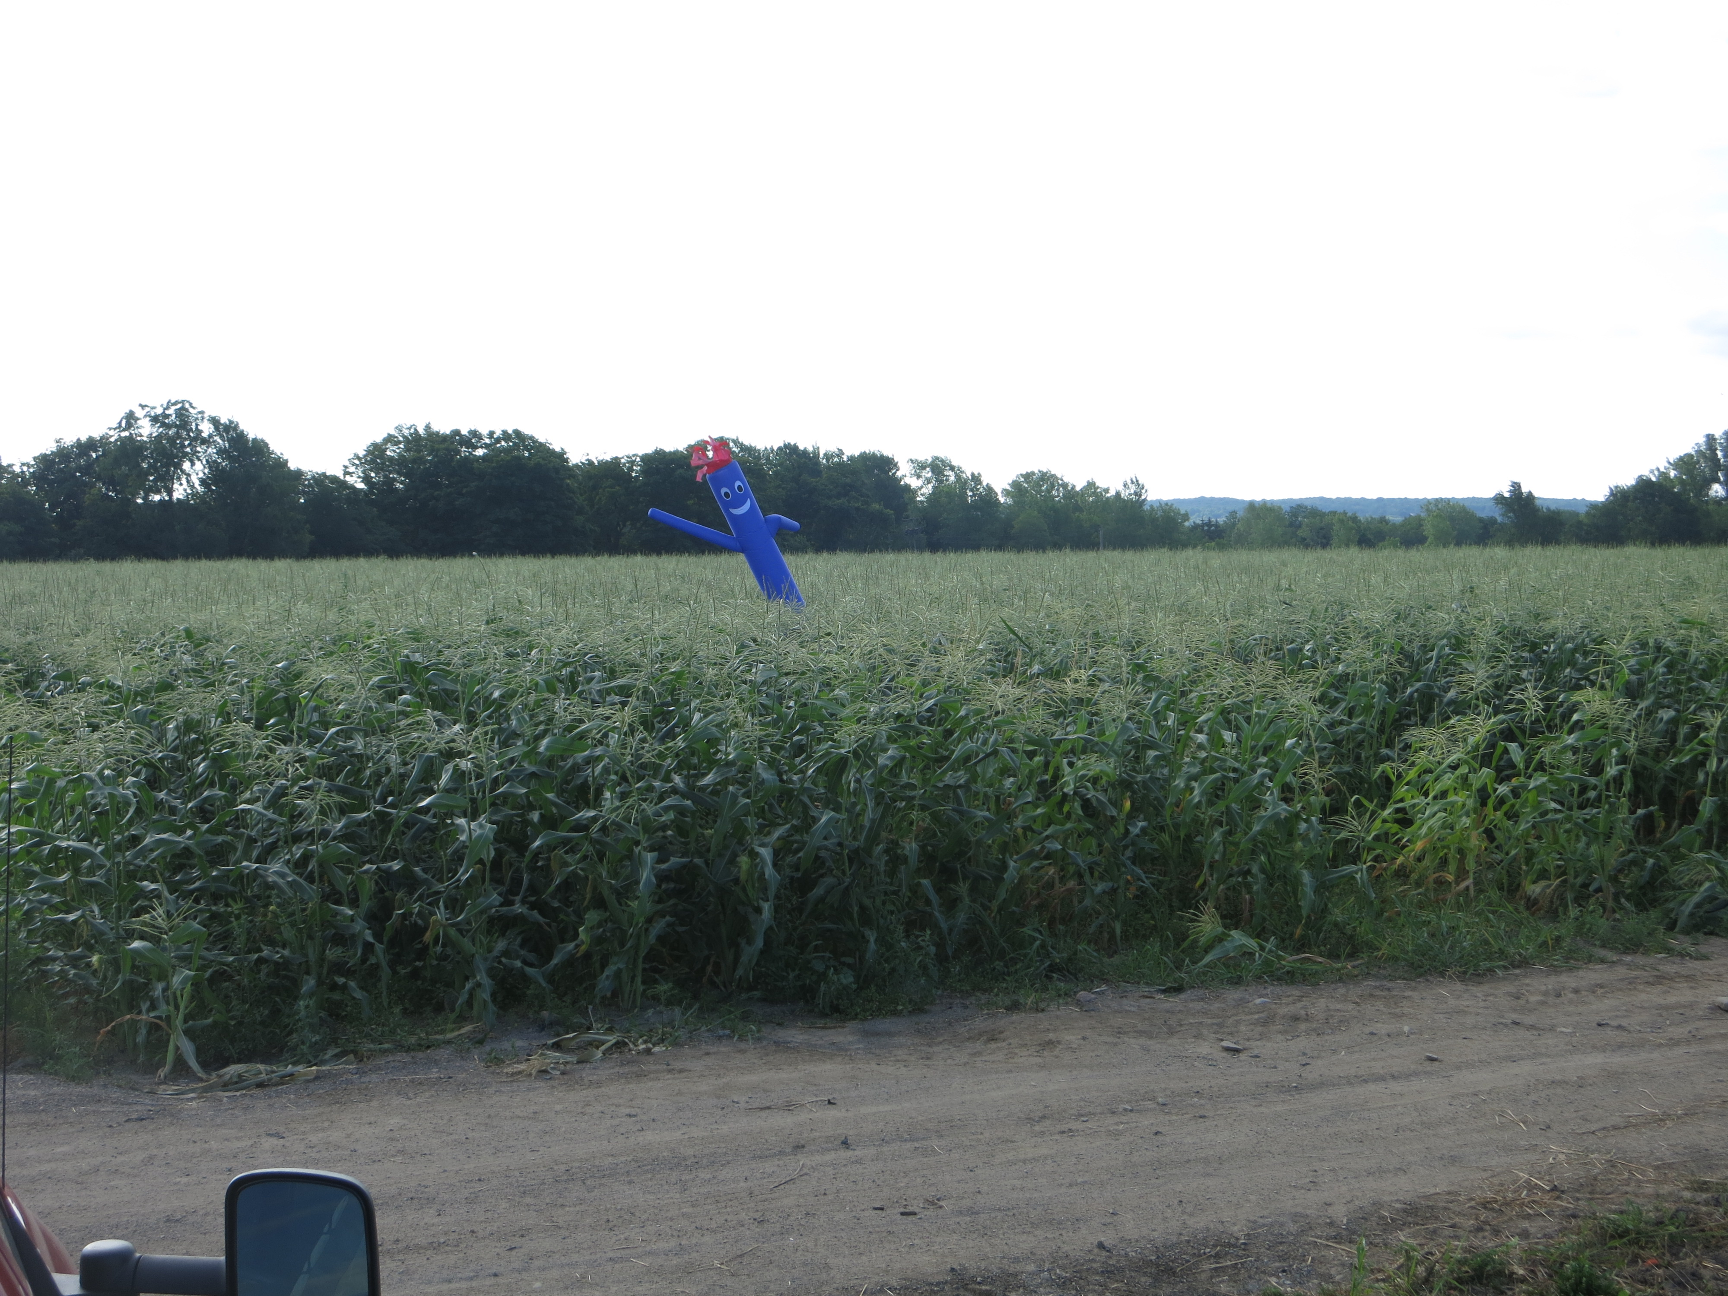
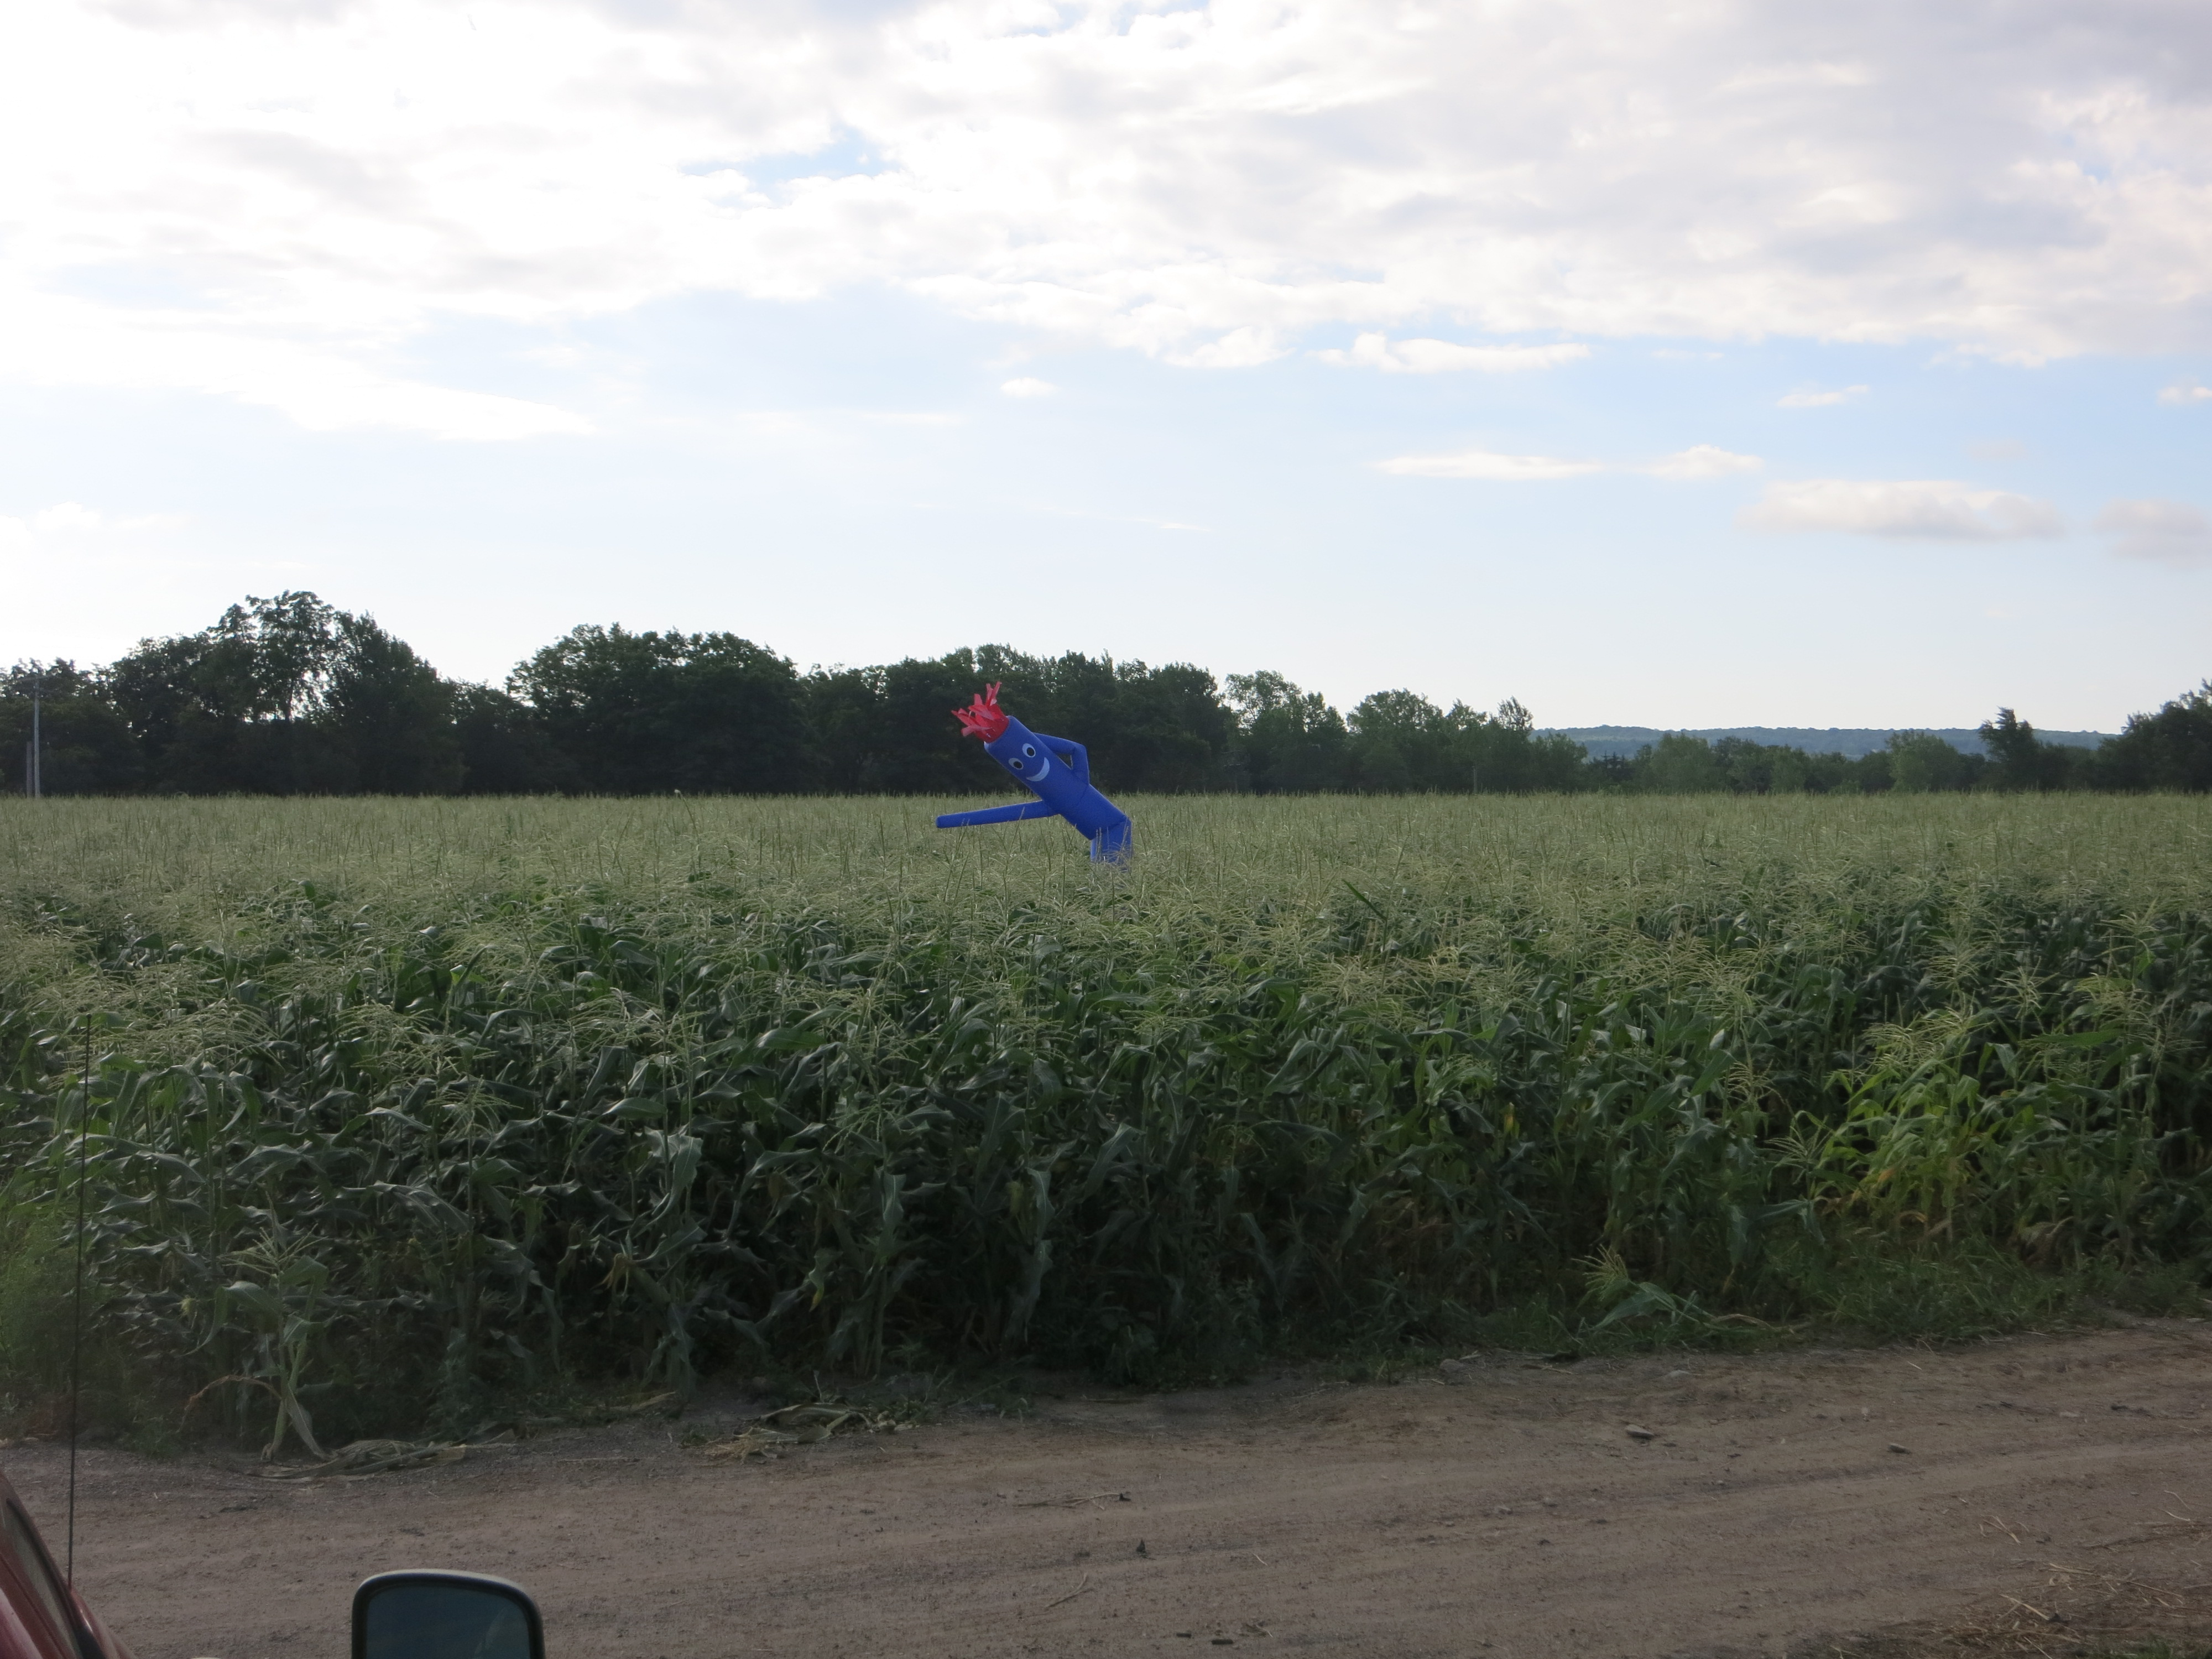
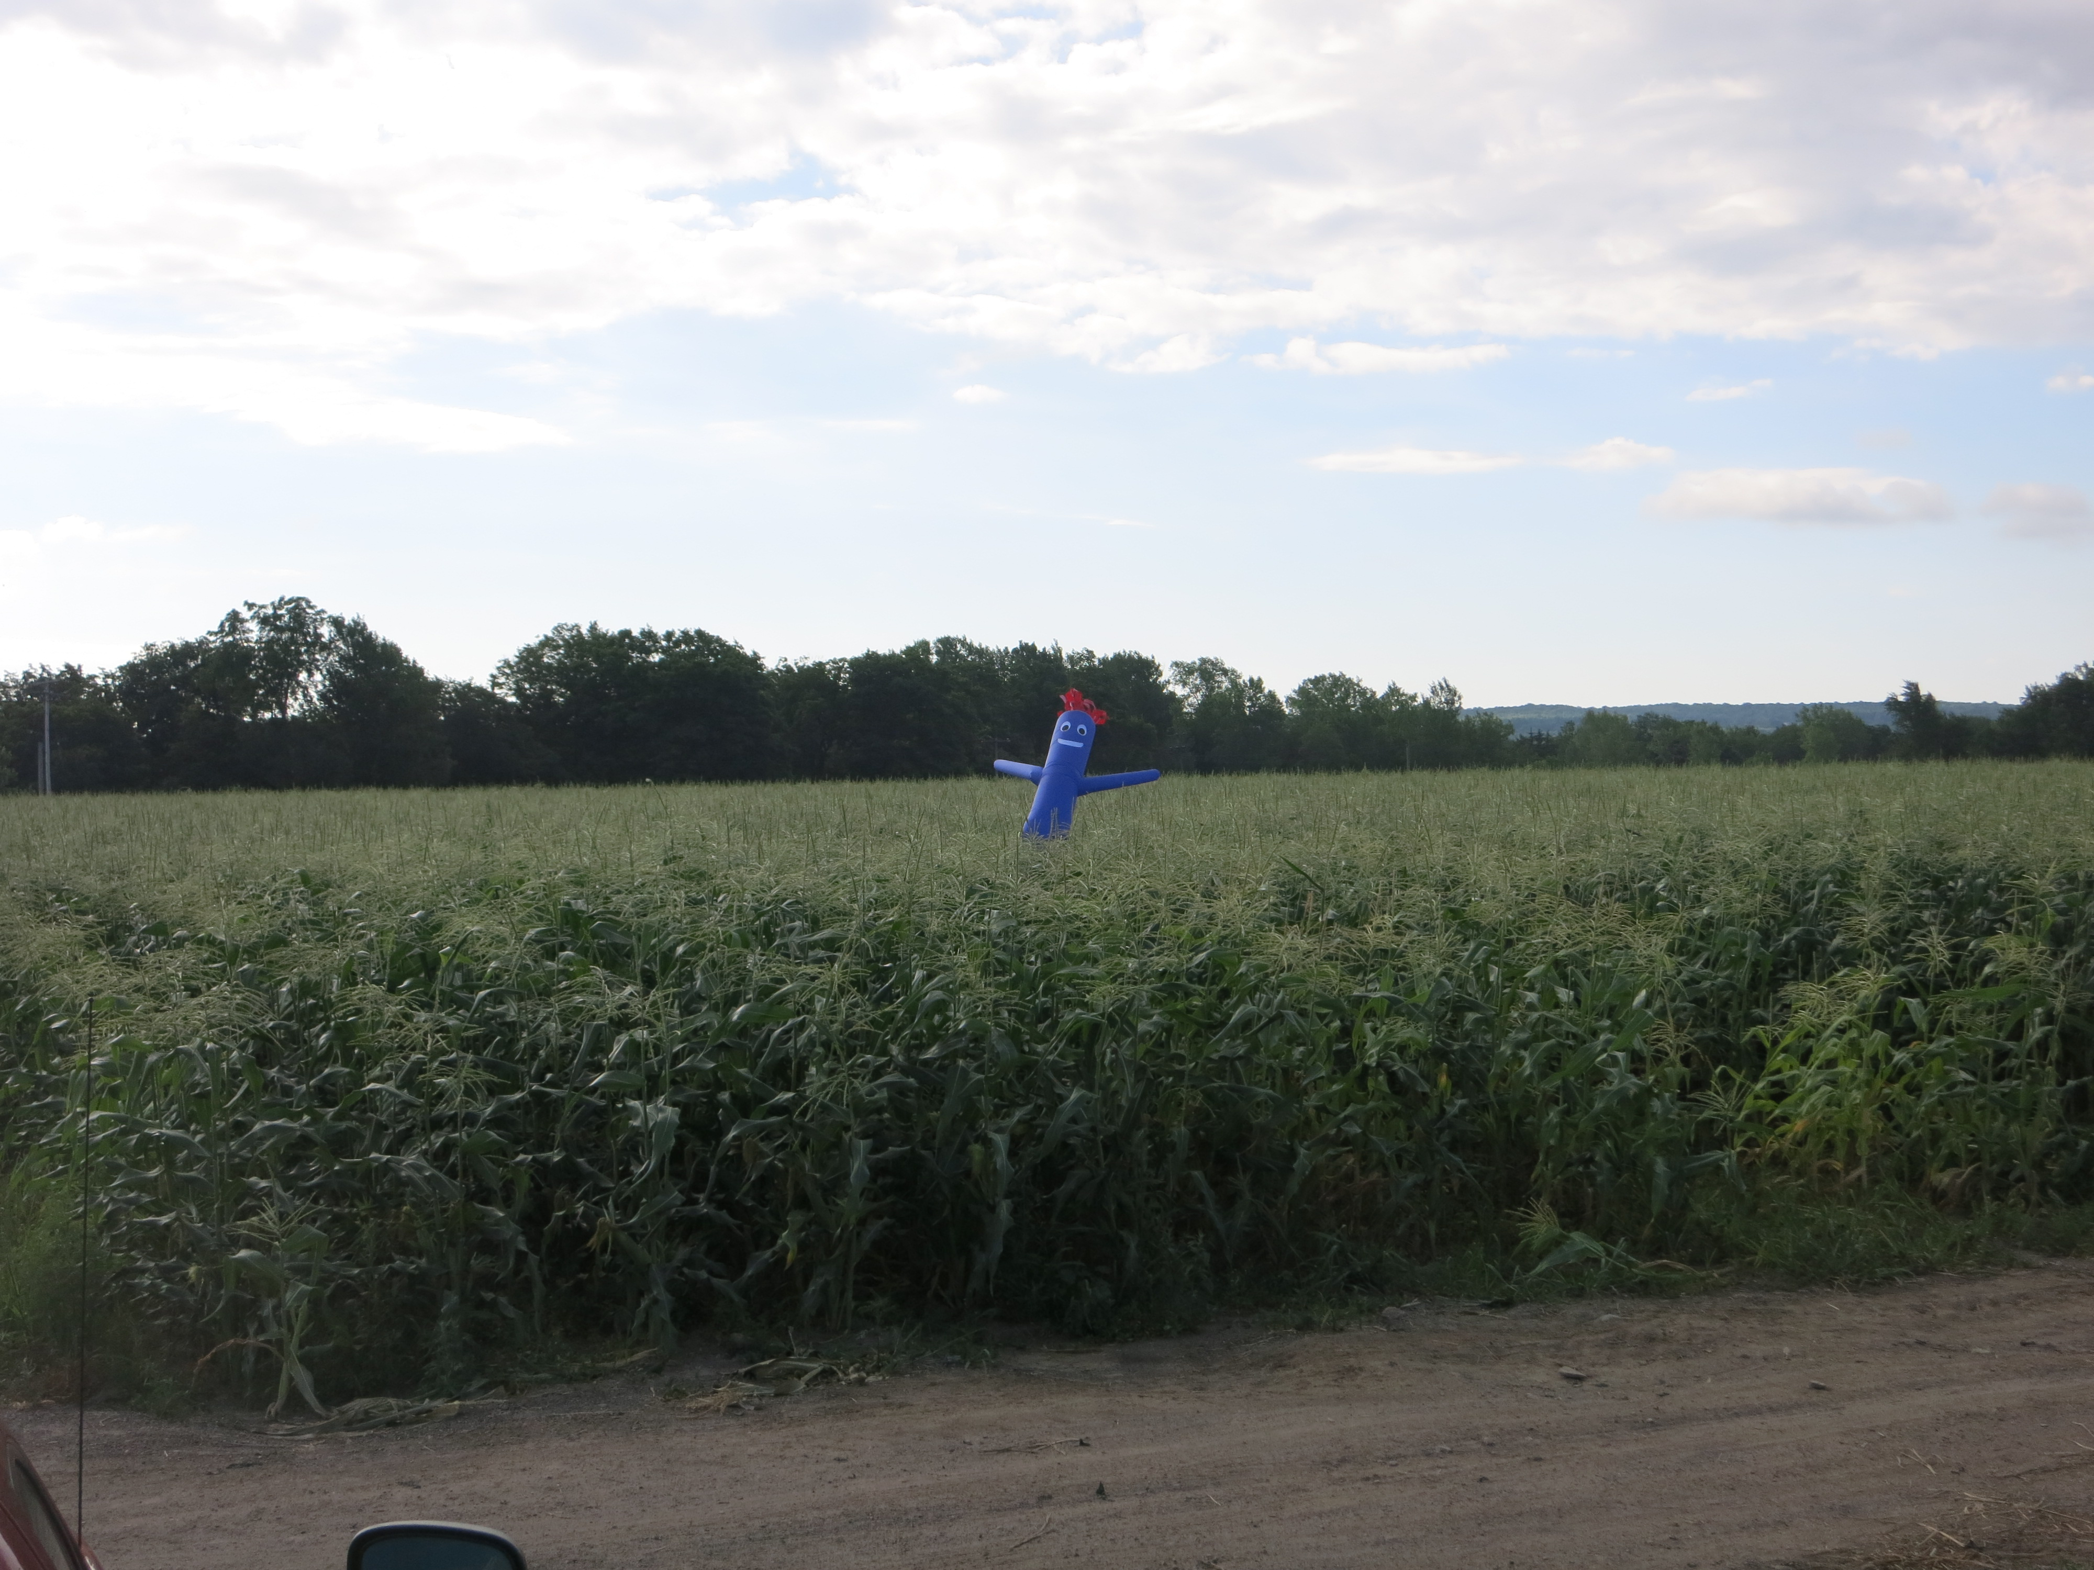

Slide 9
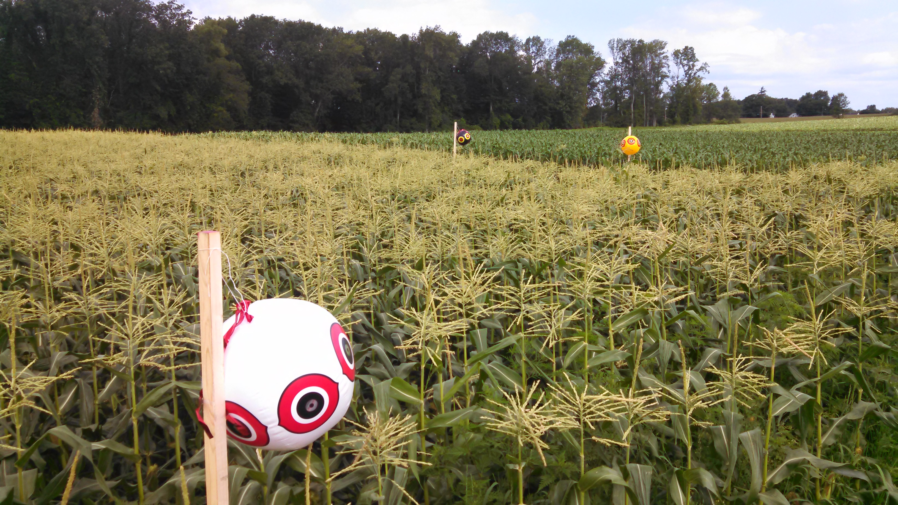

Slide 10
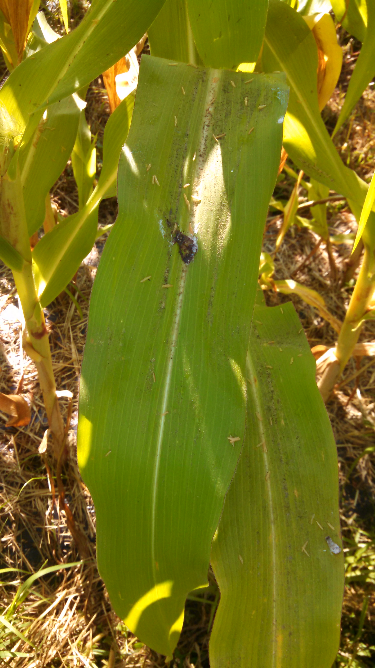
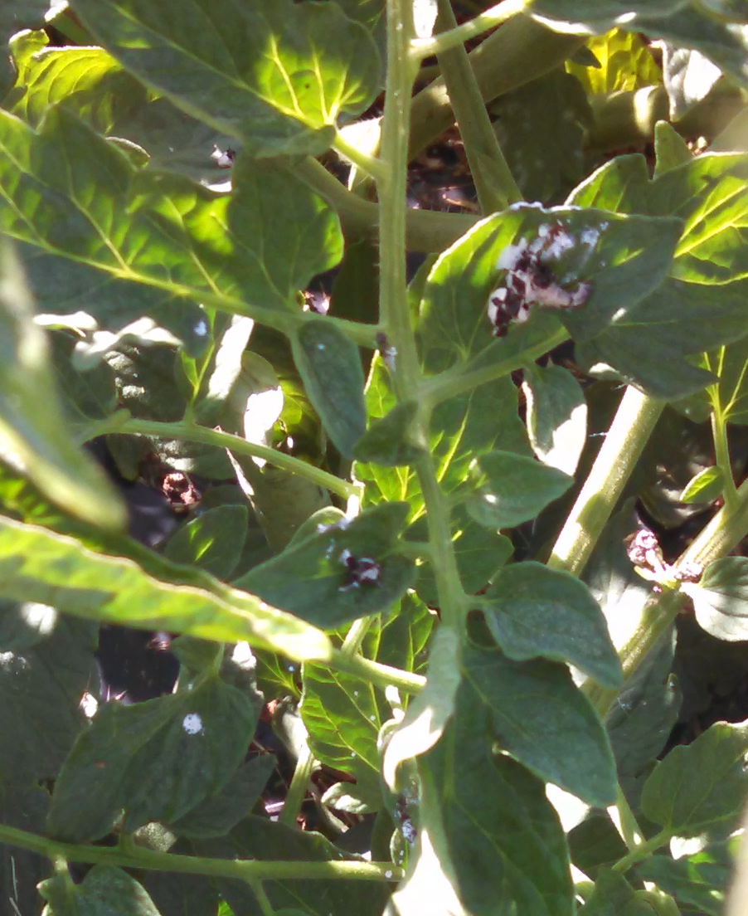
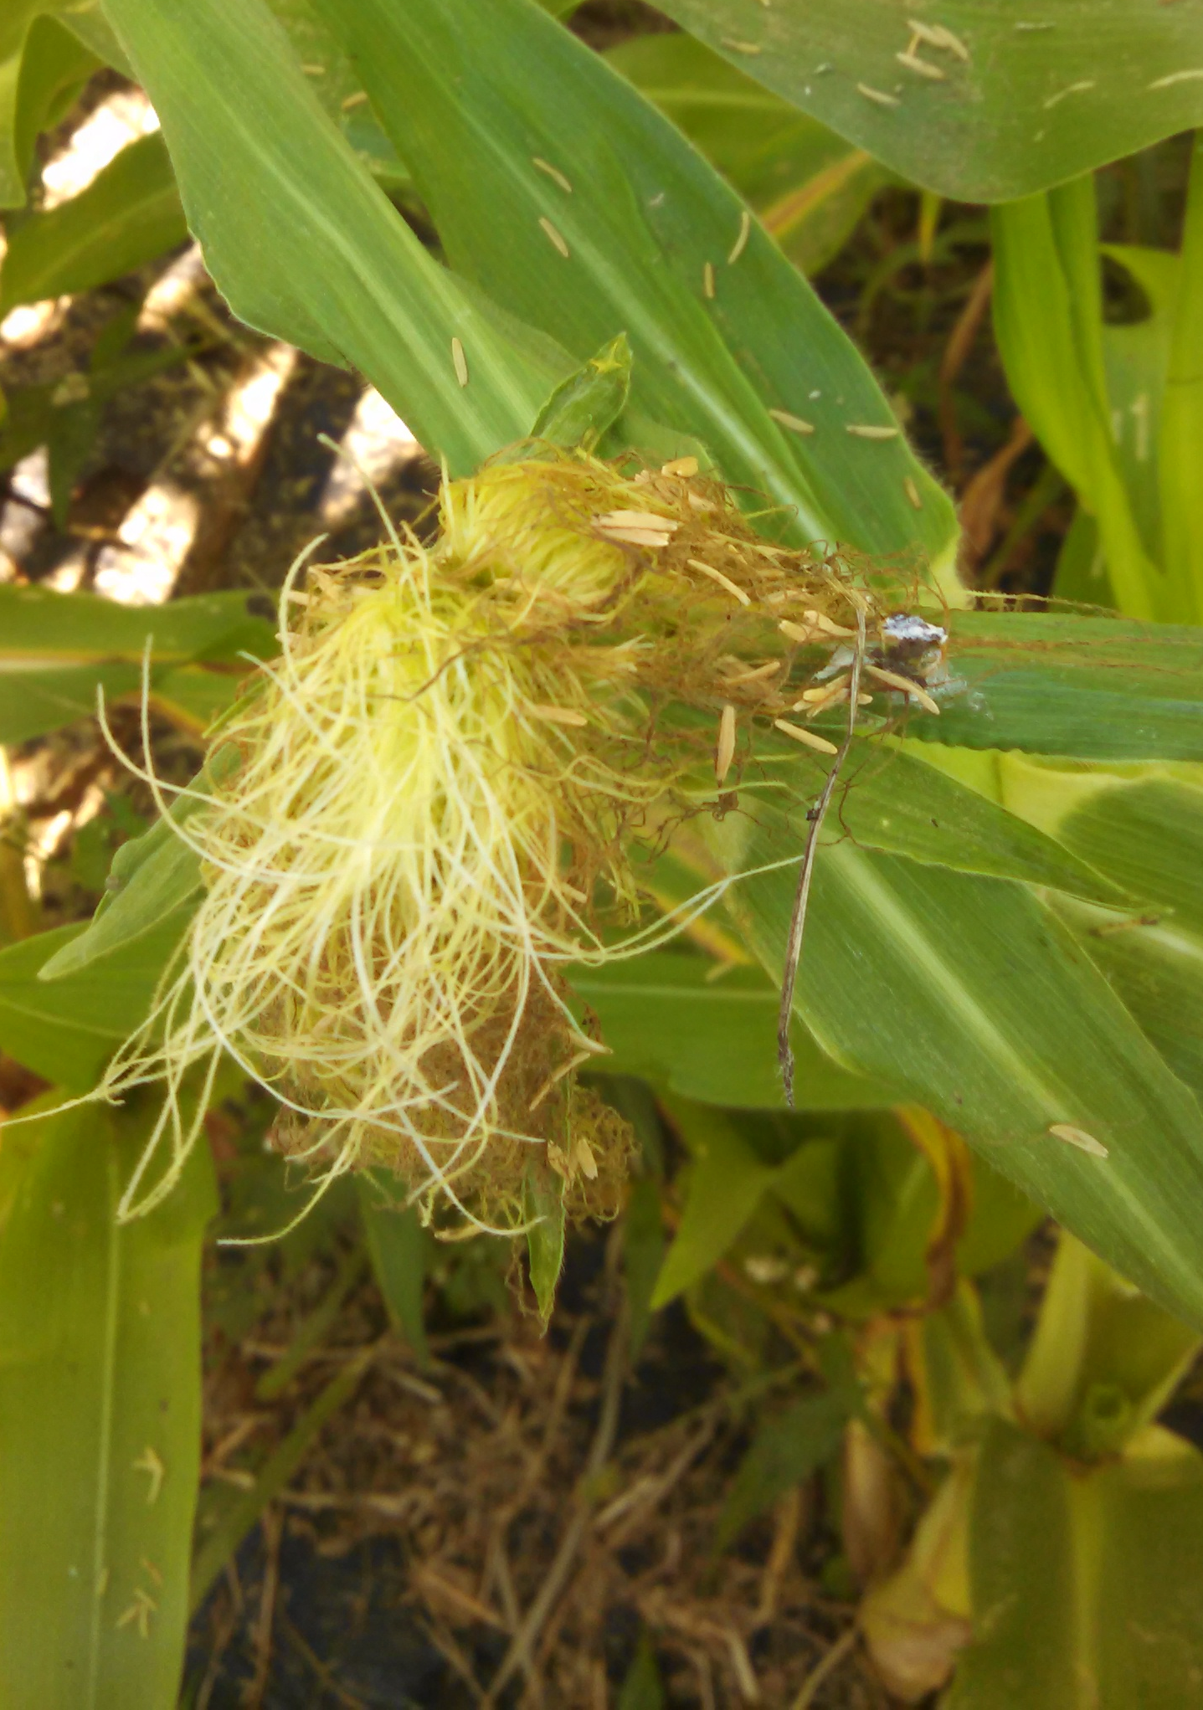
Bird Droppings

Slide 11
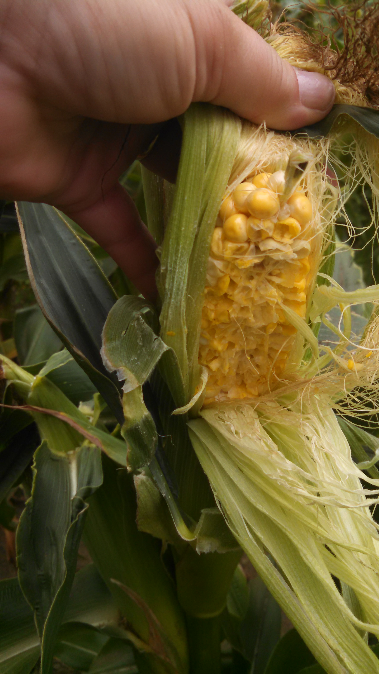
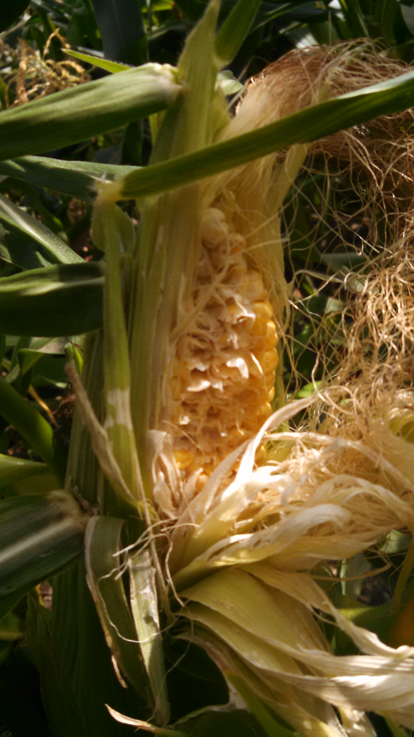
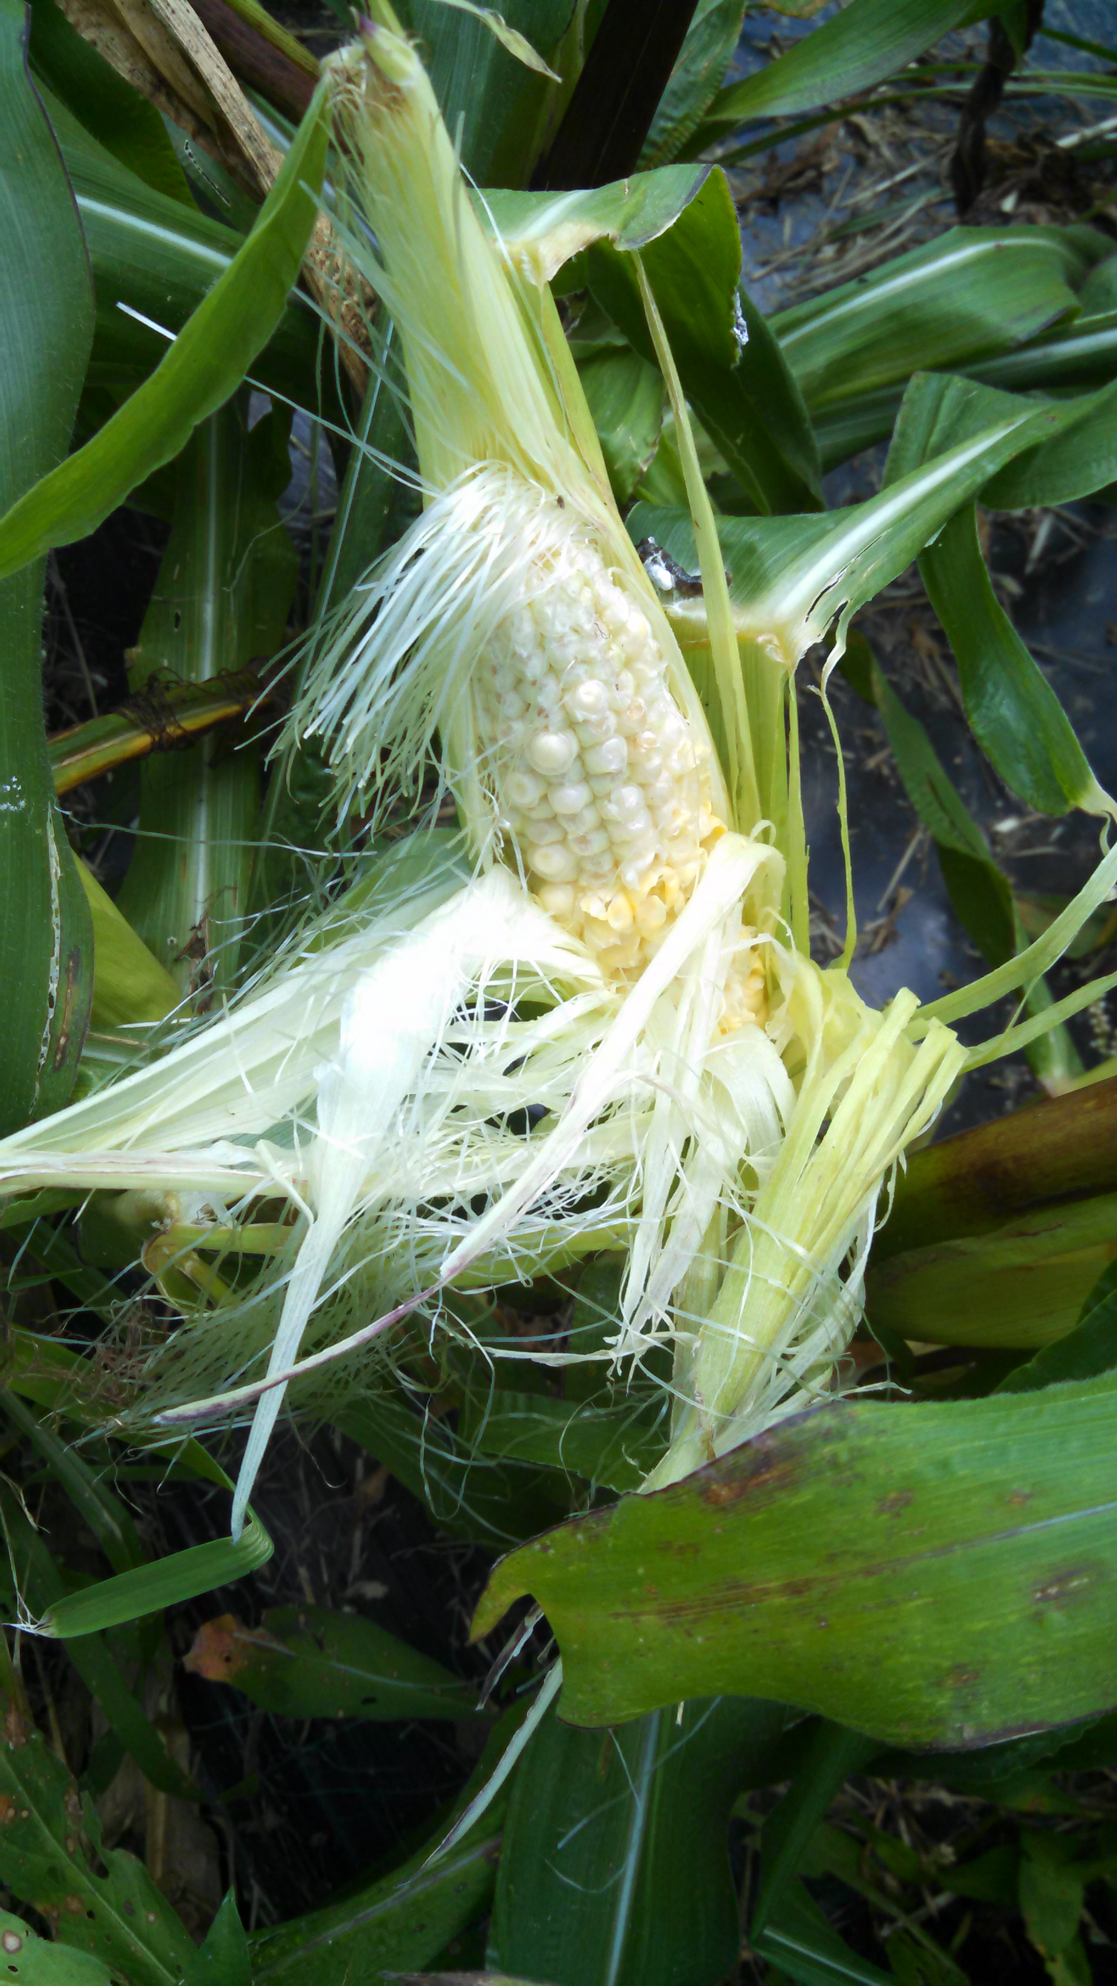
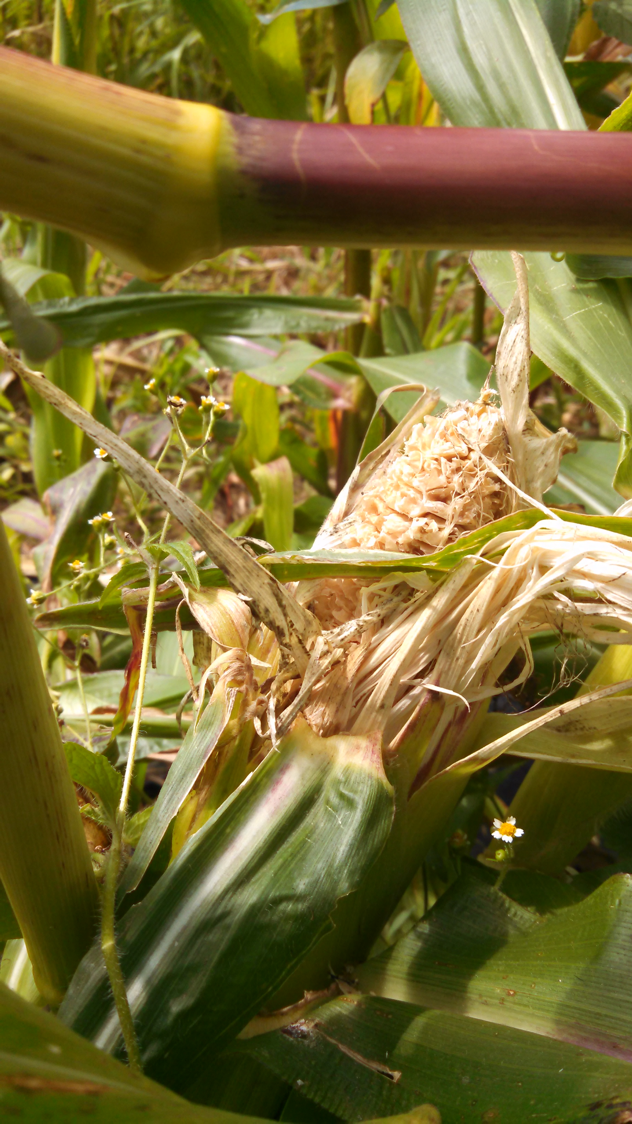
Damage

Slide 12
Results – Erie County Farm 1
Birds moved in over night and cause 86% damage in one location on first picking of sweet corn prior to treatment application
All treatments reduced damage
Balloons and air-dancer are only effective in limited area
Two application of Avian Control
1.5 to 2% increase in harvestable ears over untreated

Slide 13
Results – Erie County Farm 1
Grower excited about Avian keeping birds out of troublesome fields, test in two other locations
Avian Control reduced bird damage in both additional sites
2 and 6% increase in harvestable ears
Air-dancer moved

Slide 14
Results – Erie County Farm 2
All treatments reduced damage
Balloons and air-dancer are only effective in limited area
Two application of Avian Control
1 to 2.5% increase in harvestable ears over untreated
It was noted that the birds flew across trial site and into another field where 10% damage was noted by grower employing gas-canon and nuisance permit

Slide 15
Results – Niagara County
Only 1 application of Avian Control less than 1 week prior to harvest
Avian Control treatment near farm pond
14% decrease in yield with Avian Control, believe application wasn’t applied in time to inhibit the birds
Both the air-dancer and balloon treatments increased yield 6%

Slide 16
Results – Niagara County
Two application of Avian Control applied prior to harvest
Avian Control increased harvestable ears 17%
Air-dancer 19% increase in harvestable ears
Timely applications of Avian Control important to deter birds

Slide 17
Results – Allegany County
Small scale farm – lost 25% of harvest in an untreated field
At this location a small group of birds perched above site (sparrows, black birds)~30
1.4 to 3.3% increase in yield with Avian Control and Balloons

Slide 18
Summary
Initial bird damage was high 86% damaged ears in one location – migration happened over night
10% damage where other tactics were being deployed – air cannon and nuisance permit
Bird flew over research site to other ripe fields
Untreated plots experience 2 to 30% damage
Average harvestable ears were increased 4.2% with two applications of Avian Control
Air-dancer will work on small scale 9% increased yield compared to untreated plots
Avian Control and the “air-dancer” successfully dissuaded birds at all farms increasing yield 1 to 19% at $22-$418/A
Success was highly dependent on application timing, placement, and crop maturity
Growers will be implementing one or a few techniques in future seasons

Slide 19
Future Research
Refine BMP’s for Avian Control – best timing and number of applications for optimum deterrence
Avian Control has an expanded label to now include root and tuber vegetables, leafy vegetables, brassica leafy vegetables, legumes including soybean, cucurbits and many others
Determine best location for air-dancer – middle of field vs. edge’s where wildlife movement in may occur
Look to see if these can be used for other wildlife to deter damage after planting or reduce impacts on contamination for new FSMA and GAP’s regulations

Slide 20
