Slide 1
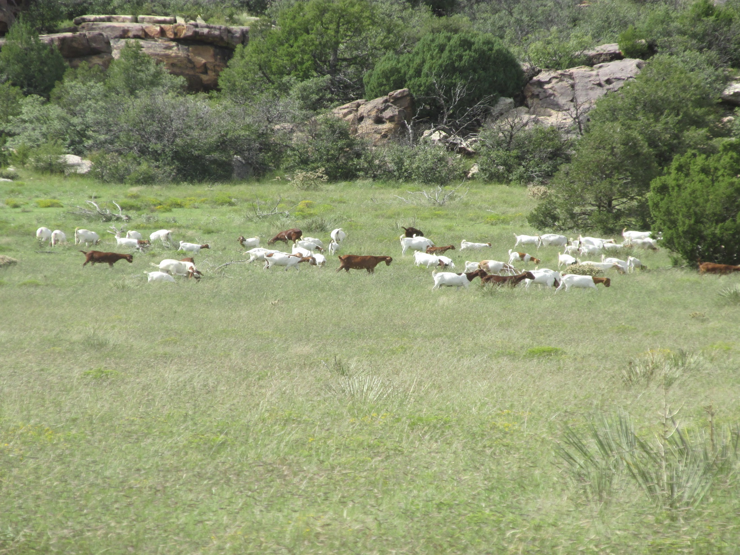

The use of goat herding techniques to reduce the effects of predation while improving rangeland health in the high plains of New Mexico
Or
How to reintroduce Multi-Species Grazing
in North East New Mexico

Slide 2
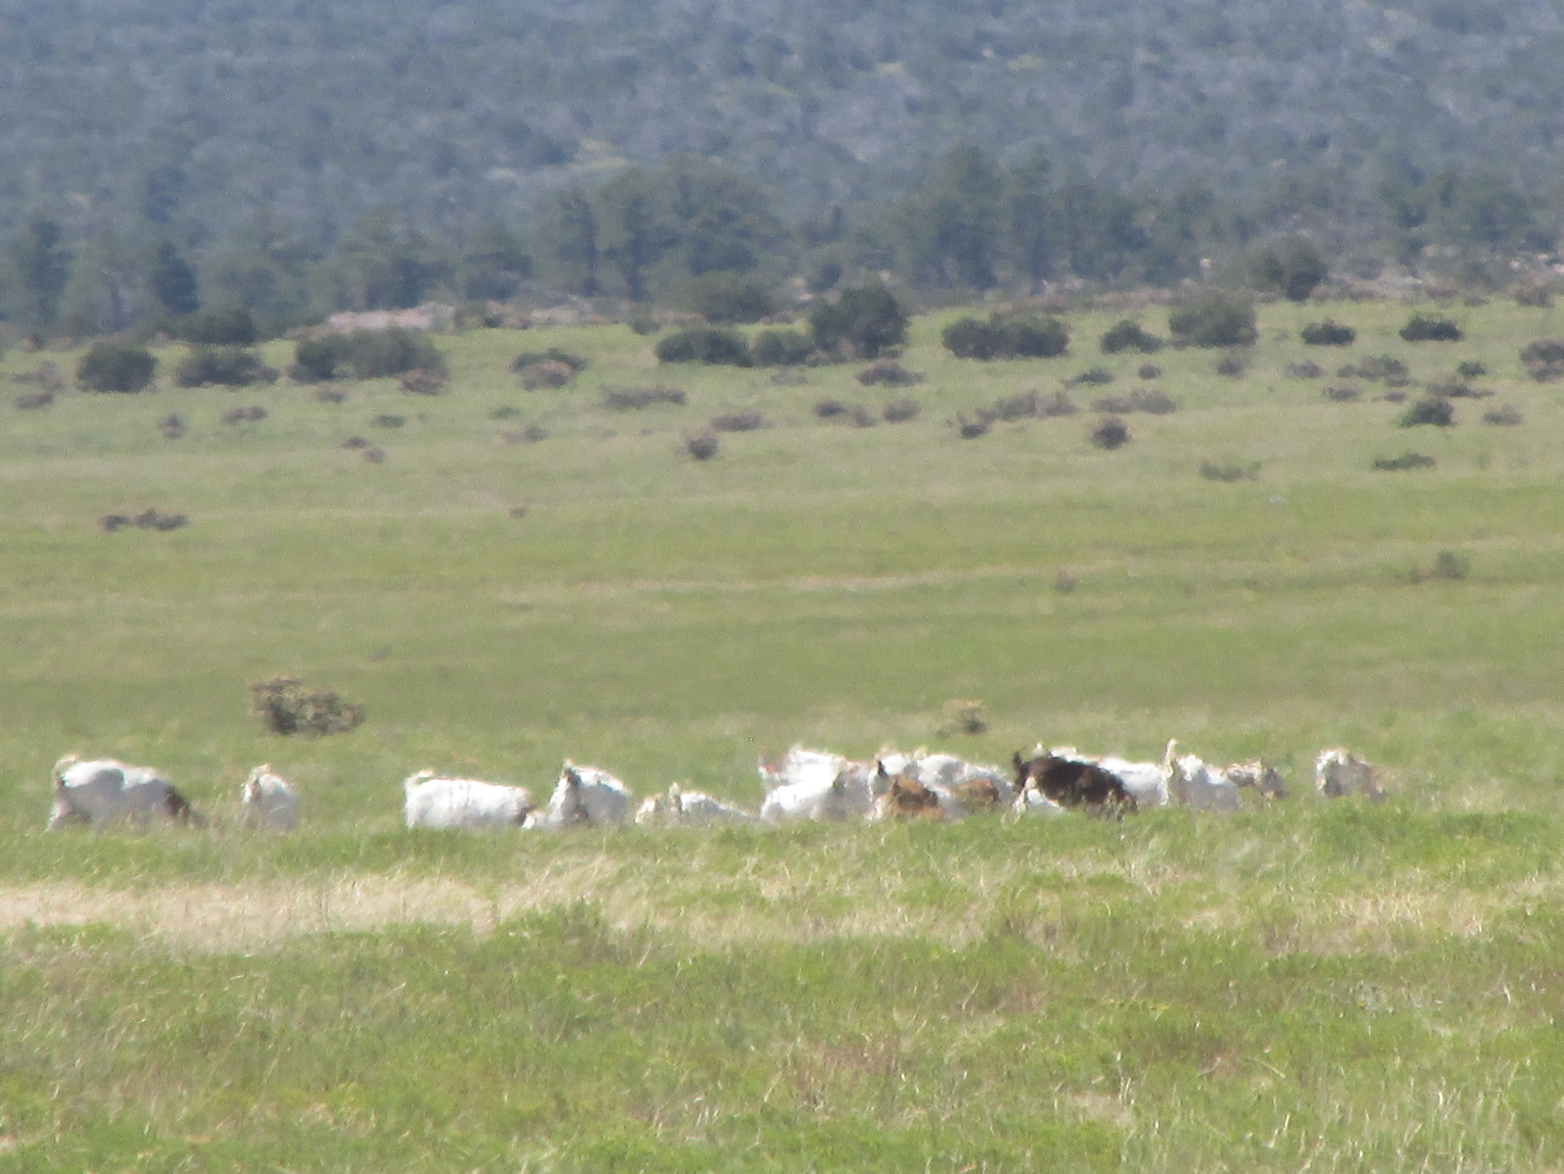
Years of drought and the abuse the lands of NE New Mexico suffered from farming during the early 1900’s have facilitated the encroachment of invasive woody plant species throughout the high plains of New Mexico. This increase of Juniper, Snakeweed, Oak Brush and other woody plant life in pastures that were previously fertile grasslands has reduced the carrying capacity of many pastures.

Slide 3
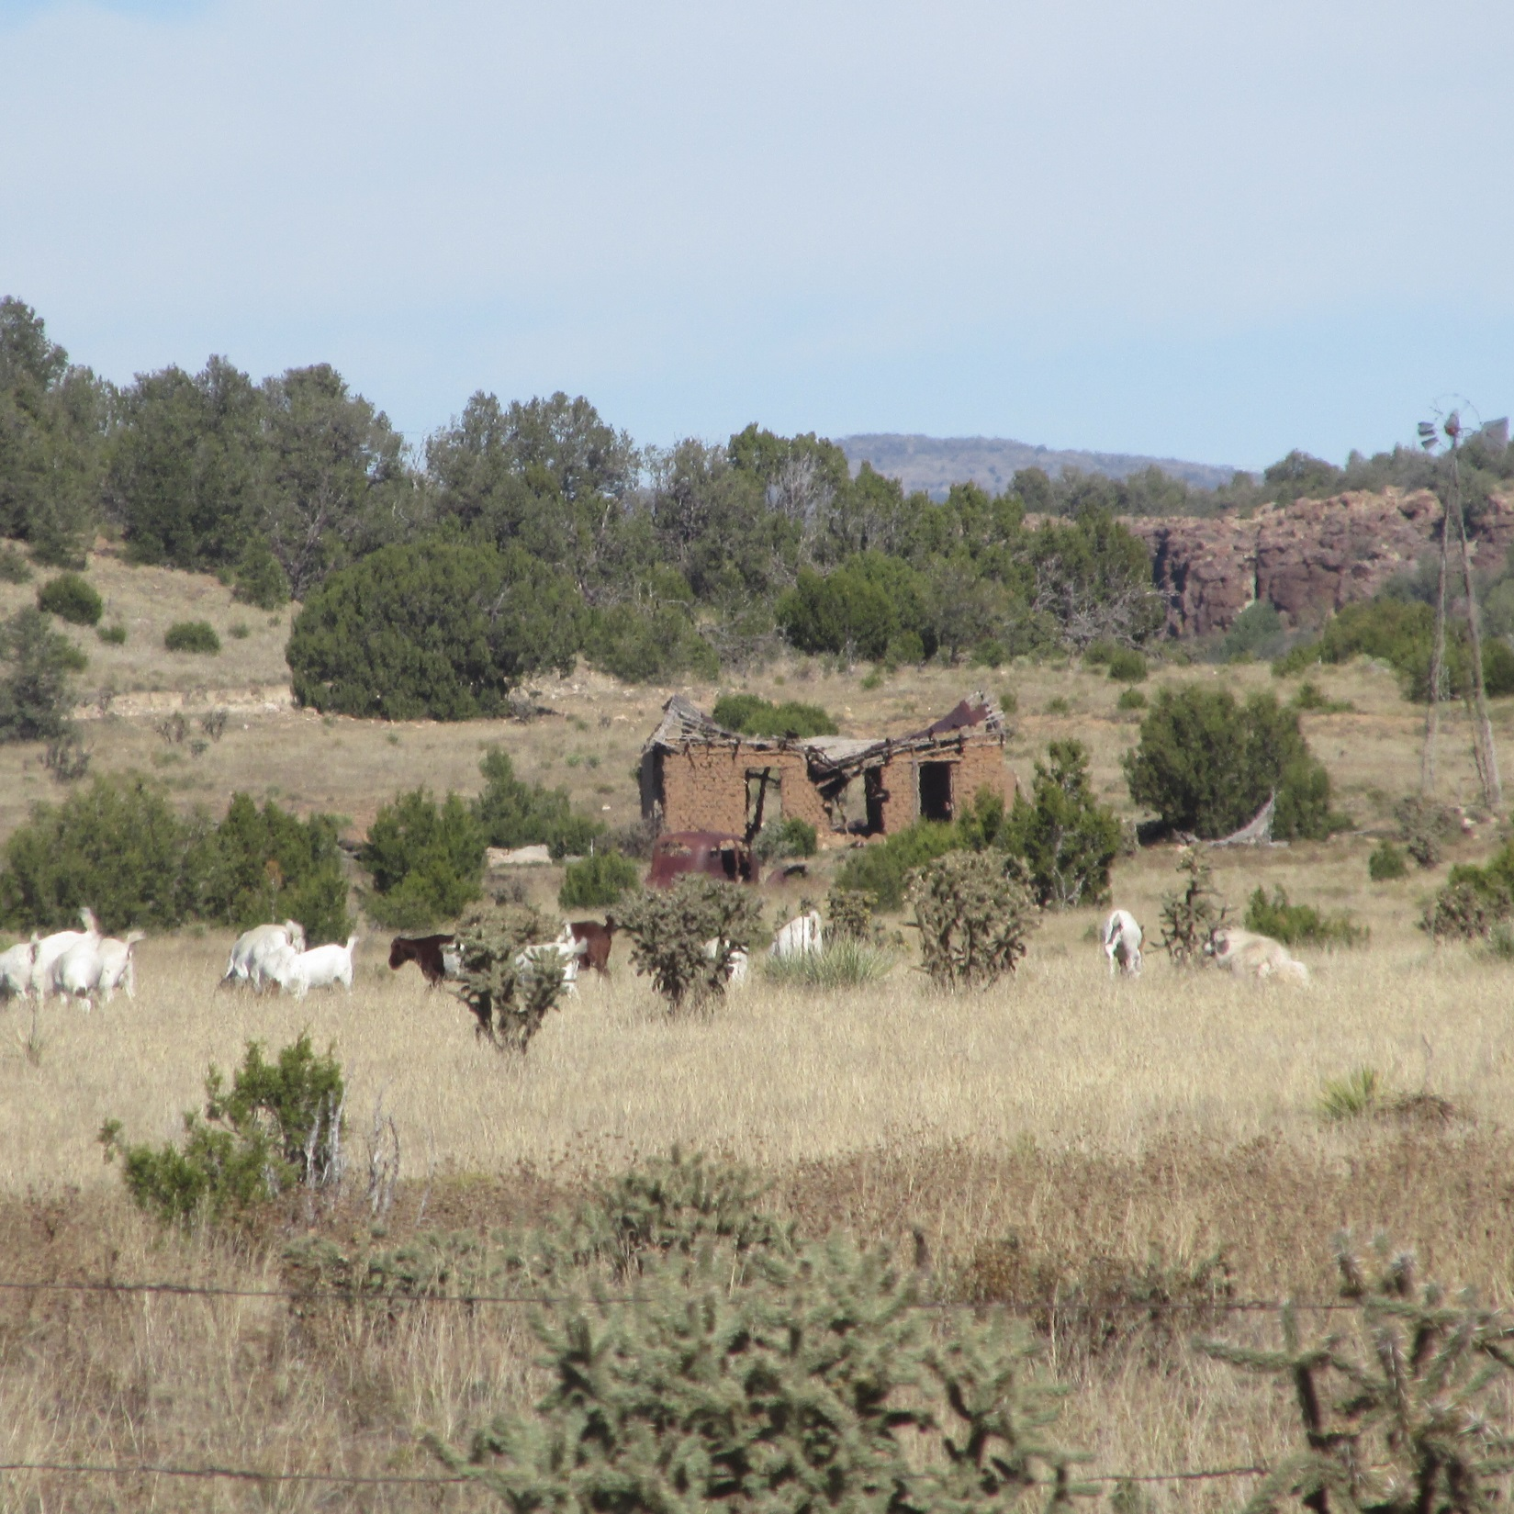
Remnants of homesteads scattered through the countryside testify to farming operations in the area during the early 1900’s. Homes and land were abandoned to the elements. Precious top soils blew or washed away facilitating the encroachment of woody species such as Juniper, Broom Weed (Snakeweed) Oak Brush and other invasive woody species. High Plains Prairie grasses were no longer the dominant species and the carrying capacity of pasturelands diminished.

Slide 4
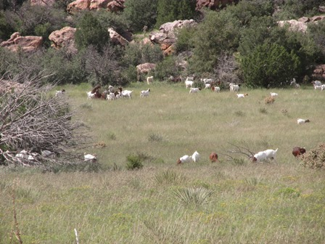
In 2014, Turner Ranch of Wagon Mound, NM partnered with K&C Boer Goats of Texas in an effort to introduce multi-species grazing back into NE New Mexico. Goats were determined to be the small ruminant to best address and reduce the weeds/woody species on the ranch. Also, the market for Goats was high and holding strong offering another source of income.

Slide 5
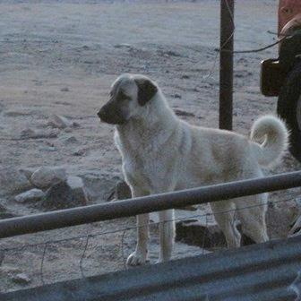
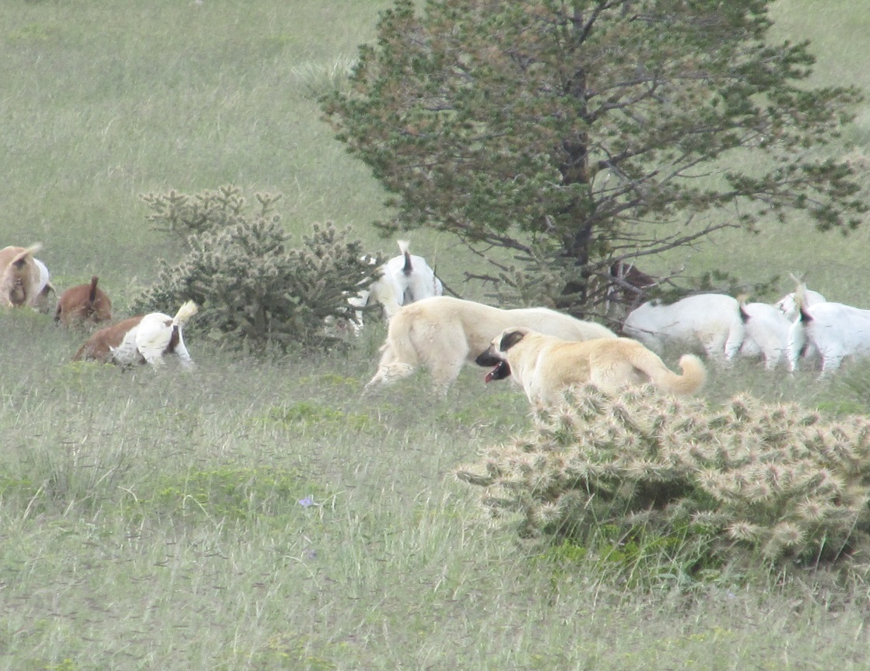
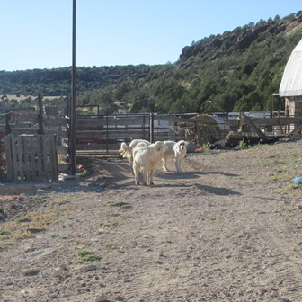
Livestock Guardian Dogs
To keep the herd safe, LGD’s were brought in with the goats. The pastures ranged from one thousand to three thousand acres and were free range accessed. Seven dogs are currently being used.
Kangal, Great Pyrenees and Anatolian Shephard dogs were used for herd protection

Slide 6
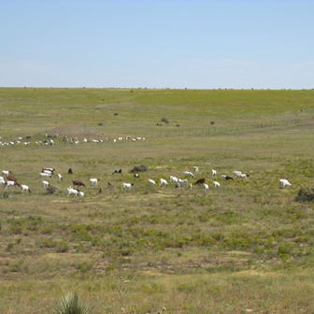
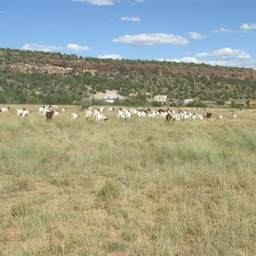
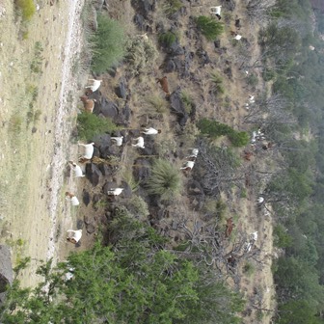
While the goats did a great job of reducing woody species/browse, unfortunately….
the herd started splitting into smaller groups going in different directions making it difficult for the LGD’s to do their job.
Groups that did not have a dog fell prey to Mt. Lions and Coyotes in the area.

Slide 7
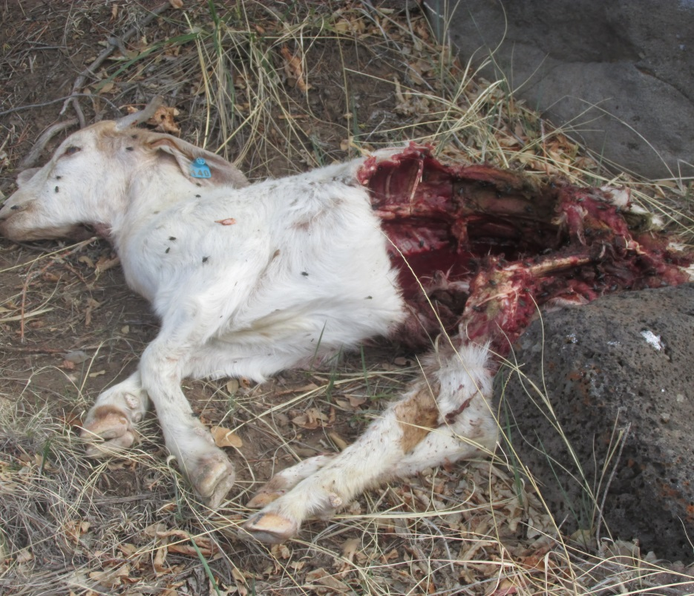
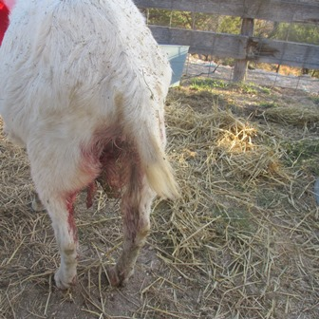
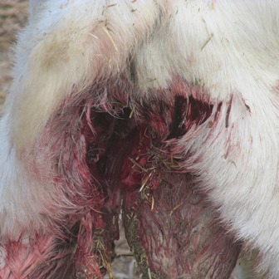
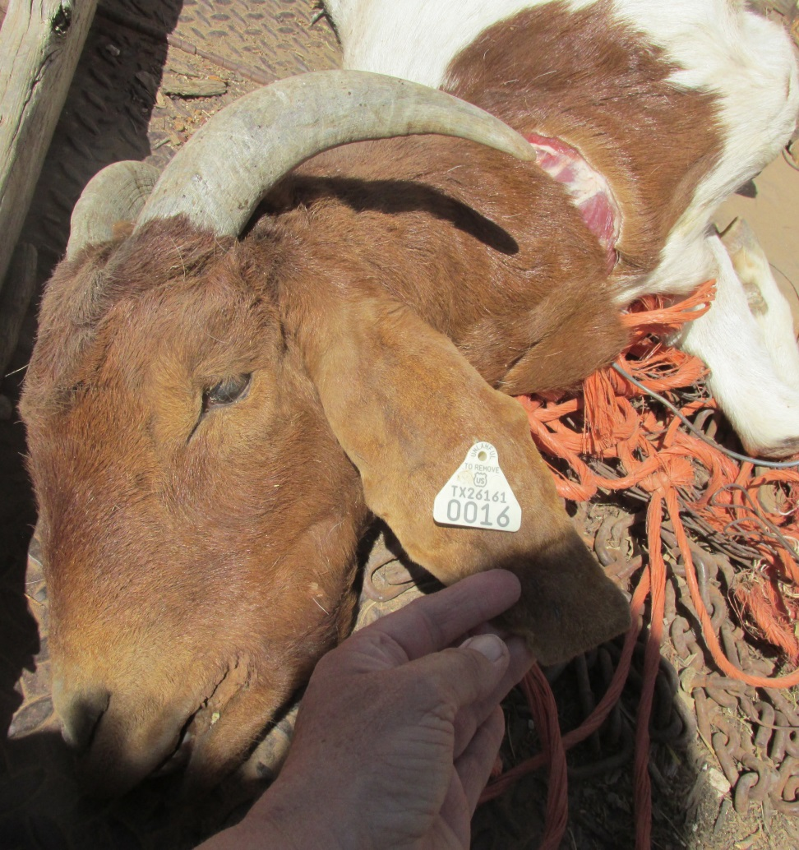
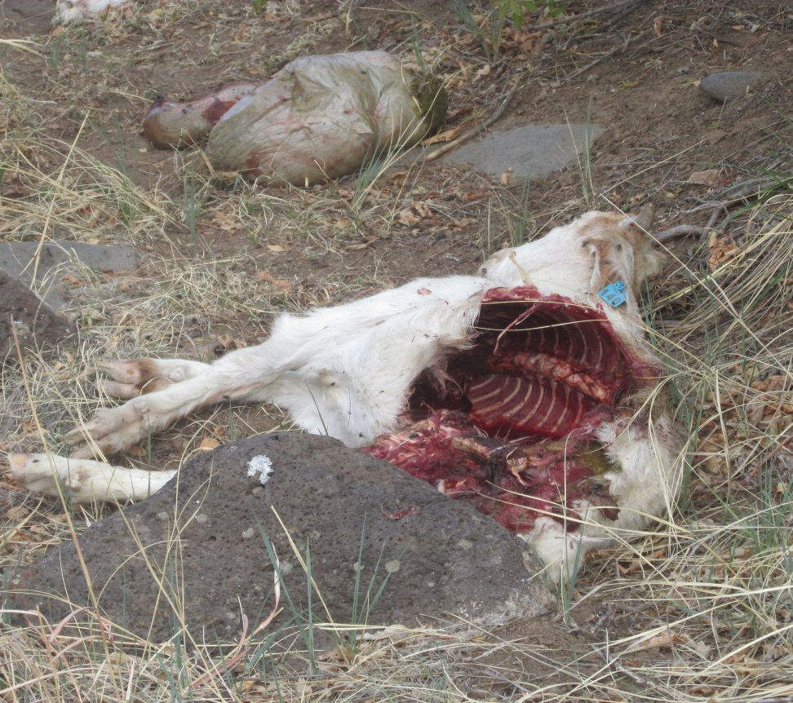
Resulting in….
Devastation…

Slide 8
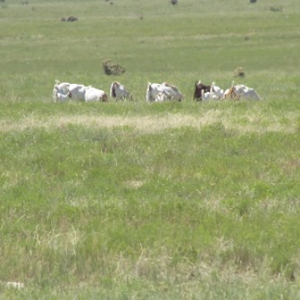
In 2017, Emily Cornell realized the benefits of using rotational Multi-Species Grazing in NE New Mexico. Emily, Syd Franz (K&C Boer Goats) and Sarah Banghert applied for and received a WSARE grant to hire a herder in an effort to reduce the predation rate of the goats to a sustainable number thus allowing for the use of small ruminants in a multi-species grazing operation.

Slide 9
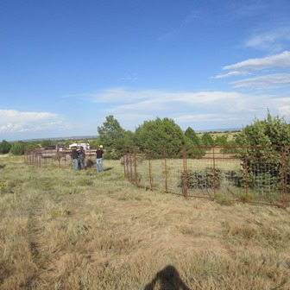
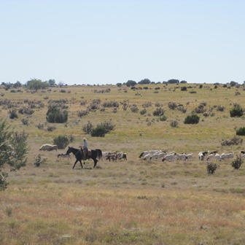
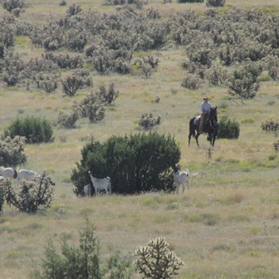
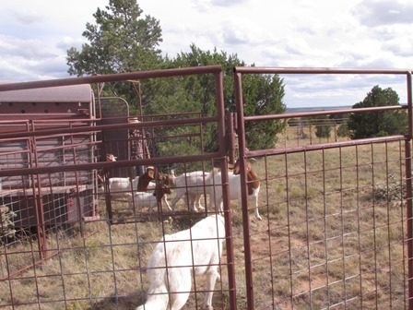
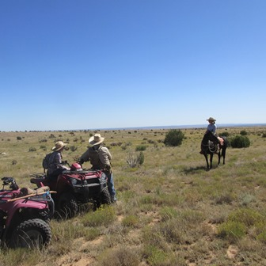
Herder managing browsing of the herd
Setting up night pen
First group of test goats and LGD
Happy Land Owner, Goat producer and Herding Professional
Hitting the Juniper

Slide 10
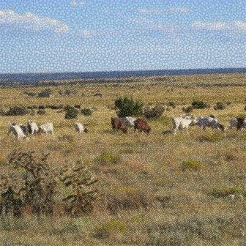
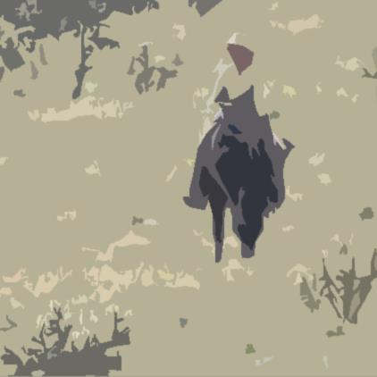
This project, funded by a Western Sustainable Agriculture Research and Eductional Grant, is supplying Land Owners, Livestock Producers and Professional Grazers with information and multiple options that will enable them to enlist the use of Multi-Species Grazing into their ranching operations. Producing a sustainable, marketable product from forage not used by cattle can increase revenues, job opportunities as well as reducing the woody species encroachments of pasture lands throughout NE New Mexico. Come join us as we work to make a better way and better land.

