Slide 1

Sexuality & Sustainable Agriculture: Queer Farmers in the Northeastern U.S.
Michaela Hoffelmeyer
Rural Sociology
Thesis Defense
September 23, 2019

Slide 2
Acknowledgements
This material is based upon work supported by the National Institute of Food and Agriculture, U.S. Department of Agriculture, through the Northeast Sustainable Agriculture Research and Education program under subaward number GNE18-174.

Slide 3

Background
Heterosexism: Oppression and prejudice against queer people (Jackson 2006)
  Rather than homophobia
  Queer oppression is socially constructed (Weston 1991)

Slide 4
Bodies of Literature
Sustainable Agriculture
Gender & Agriculture
Queer Scholarship

Slide 5
Literature Review
Sustainable Agriculture
Foundation of environmental, economic & social (Madden 2007)
Critiqued for continued inequality based on identity (Leslie and White 2018)
Gender & Agriculture
Gendered barriers in farming (Sachs et al. 2016)
Gender and sexuality intricately related, but sexuality undertheorized (Gaard 1997)
Queer Scholarship
Challenges power structures (Seidman 1996)
Maintains “anti-ruralist” position (Herring 2010) called “metronormativity” (Halbersam 2005)

Slide 6
Sexuality in Agriculture
Construction of the “farmer” white, male, heterosexual (Little 2003)
Heteronormativity in the family farm
  1930s 4-H & USDA promoted “economic and biological union between a revenue-producing male ‘farmer' and a nurturing ‘farmer's wife’” (Rosenberg 2016)
  Family farm is the “natural” way to farm (Leslie et al. 2019)
Agriculture is relational (Leslie et al. 2019)
  Previously unquestioned relationships based on patriarchy and heteronormativity

Slide 7
Taking A Queer Approach
Queer sexualities thought of as private matter restricted to the bedroom (Dilley 1999)
Heteronormativity allows the dominant sexuality to be acceptable in public spaces
Heterosexuality is institutionalized and embedded in all aspects of life (Jackson 2006)
Queerness is “commonly understood as an identity that infuses the entire self”
  Opposed to an activity in which any self can participate (Weston 1991: 79)
Notes:
The obfuscation of queerness in public life is deeply rooted in power asymmetries which perpetuates the marginalization of queer people. In this way, a queer approach aims interrogate culturally boundaries and reveal the ways in which heteronormativity influences queer livelihoods (Jackson 2006).

Slide 8
Queer Farmers Today
Queer farmers unable to confront heterosexism in fear of losing access to resources (Leslie 2017)
Queer women farmers felted othered & built own queer-centric relations (Wypler 2019)
Structural barriers for queer farmers in loans, land tenure, alternative household units (Wypler 2019)

Slide 9
Methodology

Slide 10
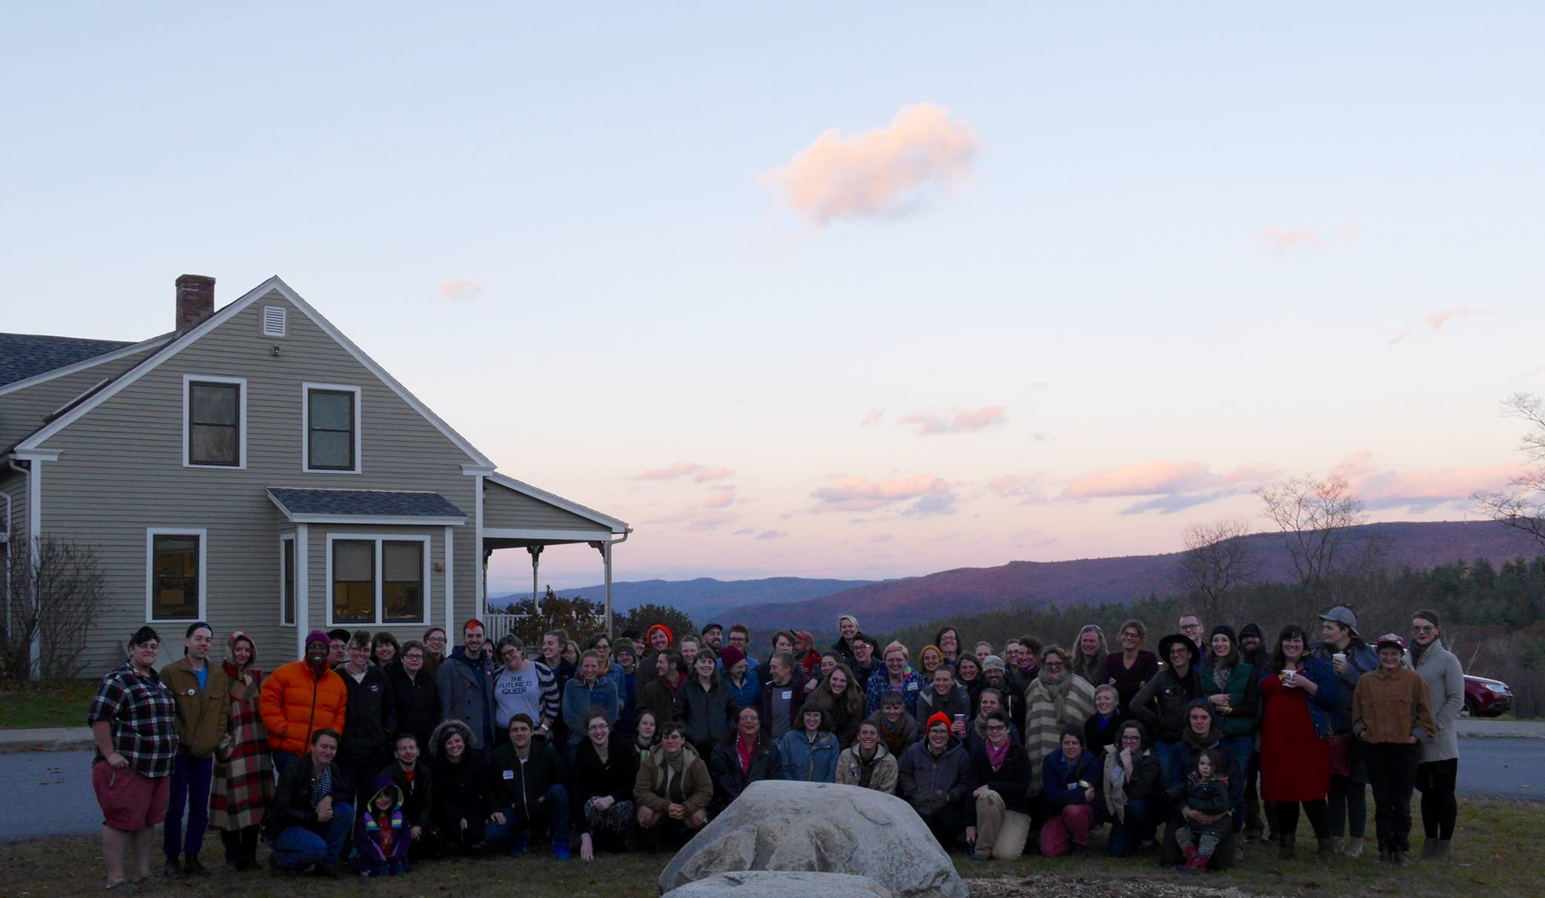
Finding Queer Sustainable Farmers
Distributed recruitment letter via PA WAgN & PASA listservs
Attended Out Here Summit for rural LGBTQ folks (VT)
1st Annual Northeast Queer Farmer Alliance Meeting (NY)
Snowball sampling
Self-identification of queer, sustainable & farmers

Slide 11
Interview Information
In-person (13) & phone (5)
Semi-structured and recorded
45 minutes to 3 hours
  Some included farm tour
Topics:
  (1) background/entry into farming
  (2) sexuality within farming spaces
  (3) sustainable agriculture and
  (4) community
Interviews transcribed and coded
Assigned gender appropriate pseudonyms

Slide 12
Sample Characteristics
Interviews (18) with 20 farmers, representing 17 farms
Location: Rural (16), Suburban (2), Urban (2)
Race/Ethnicity: White (19), Latinx (1)
Farm owner (12) Farm employee (8)
Gender: Cis-women (12), Non-binary (4) Cis-men (2), Transgender woman (1), Transgender men (1)
Sexuality: Queer (7), Lesbian (6), Bisexual/Pansexual (4), Gay (3)

Slide 13
Findings

Slide 14
Key Findings
Constructing and implementing sustainable agriculture
Socio-Spatial Relations
Heterosexism in Agriculture
Gender, Sexuality, & Performance
Race, Social Justice, & Sexuality

Slide 15

(1) Constructing Sustainable Agriculture
Mirrored SA discourse by emphasizing environmental aspects of sustainability then economic and social
Environmental
  Closed-looped, limiting degradation, soil health
Economics
  Devaluation of food and challenging of earning a living on farming
Social
  Physical health, mental health, migrant justice, indigenous land protection

Slide 16
Sustainable Agriculture Relation to Sexuality
Queer draw to SA for environmental and social reasons
Political ethos associated with SA
  Assumption SA more inclusive of diverse identities
“I feel like working the sustainable ag world is also a method of self-selection. I'm not walking into the most hostile environments. I'm walking into spaces where people generally have an understanding of the benefits of diversity and inclusion. We're really working against the monoculture. To draw those connections between our ecological practices and our social practices and to show that diversity in hiring is also important.”
—Ash, transgender non-binary, queer, employee

Slide 17
Sustainable Agriculture Relation to Sexuality
SA as an entry point to challenging dominant structures of oppression in connection with queer identity
Queer as a verb or “queering”
  “[I]nterrogating relations of knowledge and power by which certain "truths" about ourselves have been allowed to pass, unnoticed, without question" (Sandilands 1994: 22).
I think there is just a political energy toward sustainable agriculture. It’s like fighting against the system of the way that things have been done for so long and fighting against the traditional...and I guess it's kind of going back to traditional in a way...that kind of makes sense with my queer identity.
—Jess, cis-gender woman, bisexual, employee
Notes:
Queering as a verb, because queer people othered standpoint in the world they are positioned to question in particular gender and sexual norms which oppress them. In terms of agriculture, they may question these same relations as well as the entire structure of the agrifood system “truths”

Slide 18
Summary: Constructing & Queering SA
Farmers drawn to SA for environmental and social reasons
Align with broader SA community, but bring new insights and approaches
Finding creative and non-traditional ways to farm

Slide 19

(2) Socio-Spatial Relations
Geographical imaginaries: individuals and groups, constructing “our” spaces/places versus “others” (Gilley 2010)
“[P]eople learn where they fit into the world that they perceive” (Gilley 2010: 1222)
Queer farmers viewed rural/farming as “others” places, but rejected displacement

Slide 20
Mapping Imaginaries
Queer Imaginary
“Metronormativity” (Halberstam 2005)
Rural dangerous & inhospitable (Weston 1995)
Urban is authentic
Queer Farmers
Farming Imaginary
“Rural Idyll”
(Bell 2006)
Repository of traditional norms
Creates rural “others”

Slide 21
Expressing Imaginaries
Most queer farmers expressed uncertainty, fear, and isolation associated with rurality
  Mirrors dominant queer and rural discourse
“[I]f you don’t conform to a certain way of small-town life, it’s hard to interject yourself there. It’s possible, but definitely, there are some times where everyone leaves each other alone mostly, but then they gossip a lot behind your back. You might say it’s violence, but you might not. But, definitely everyone will give you weird looks and talk about you and make it feel like you are unwelcome. I feel that way more than a physical threat because it’s intimidating in this area.”
  —Mason, non-binary queer, employee

Slide 22
Conflicting Imaginaries
Simultaneously, expressed connected to land, nature, and rurality
“What’s idyllic is the land….There is land in the city, but it’s so hidden, it’s very hard to feel it in the same way.”
—Paige, cis-gender woman, bi-sexual, owner

Slide 23
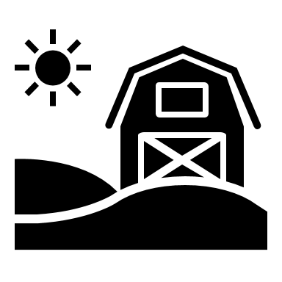
(3) Heterosexism in Agriculture
Perceptions of heterosexism associated with rurality mirrored in SA spaces
  Maneuver visibility, outness, and relationships
Queer farmers developed strategies to live rurally and farm
  Politics of rural recognition
  Selective outing to gain acceptance
  Chosen family farm model

Slide 24
Perceiving Heterosexism in SA
“[E]ven at [sustainable agriculture conferences] it was just kind of a survival thing to not talk about it (sexuality). Even now, I tend to catch myself calling [Gale] a partner when she’s really wife now. Partner is open because it could just be partners on the farm. I think that’s been my own fear out of the rest of my world, not the farming world because there was always that fear of being harassed.”
—Nancy, cis-gender woman, lesbian, owner
Being “out” makes you a target
Expectation of pushback
Could prevent farming goals

Slide 25
1) Rural Politics of Recognition
Queer people may assert their sameness as “just another local” (37) to gain acceptance (Grey 2009)
Contrasts “out and proud” or visibility politics
“[I]f we’re talking about cows, we’re good…but when it comes to this other stuff (sexuality)—it’s not about this other stuff. I try and keep it here. Over time, they get to know me. Then let’s say, which I could give a shit, but let’s just say they find out I'm gay. Well, by this time, we’re already both pounding on the table about monopoly in the dairy industry. They’re like, “Oh, well, whatever.” Then they’re not interested in that anymore, surprise! And then the next time it comes up, they’re like, “Wait. Well, I care more about this (farming topic) than I care about that (being gay).”
—Gale, cis-gender woman, lesbian, owner

Slide 26
2) Selectively Outing
Assumption that “coming out” as a single event
Come out to the people who may be necessary or beneficial
Weigh potential benefits and consequences of becoming visible
“At this point, I’m really upfront about my queer identity with new farms…Outing myself is one strategy that I have and that I can expect that people will self-select. If that’s a real reason that they’re not willing to hire me, then that’s a great reason for me to not work there.”
—Ash, transgender non-binary, queer, employee

Slide 27
But, politics of rural recognition & selectively outing linked to certain “passing privileges”

Slide 28
Example: Diane
“I probably would have stayed (on the farm). I really love it, but the neighbor next to us…would harass me a lot…that’s what finally made me stop and move….[H]e started harassing me in particular. He’d be blowing kisses and whistling catcalls at me….I did contact the law enforcement, the sheriff’s department, and there was nothing they could do. That’s what they said, and they had never heard of a transgender person, so I had to educate, at least that particular officer, about this is why it says female on my driver’s license.”
—Diane, transgender woman, lesbian, owner
Location of farm and identity intersect
Limited rural and farming resources for LGBTQ support
Non cis-gender farmers may have less flexibility in terms of visibility

Slide 29
3) The Chosen Family Farm
Family farm gendered and sexualized (Rosenburg 2016)
Chosen family in queer scholarship (Weston 1991)
  Queer populations rejected by birth families
  Develop chosen family as support systems
  Include partners, ex-partners, friends, biological/nonbiological children, etc.

Slide 30
The Chosen Family Farm Model
Communal, small-scale, cooperative, intentional
  Romantic and non-romantic partner(s)
Shared resources, labor, equipment
Queer farmers enacting & envisioning
“We have always approached this idea of purchasing land with land partners who would then kind of be our first ripple of community and then the layer out from that…”
—Whitney, cis-gender woman, bisexual, employee

Slide 31
Extending the Chosen Family: Farm Employees
Queer farm owners and employees build knowledge and skill sharing relationships
Contradicts family farm model in which the “pipeline” is intergenerational based on bloodlines and marriage
Geographic and financial constraints of the chosen family farm model
Entry to farming outside inheritance
“I do wonder sometimes if I hadn’t had that kind of entry point if I would still be doing it (farming) or still be pursuing it… being able to talk about my queerness openly and have that support where….My parents aren’t not supportive but [the queer couple I used to work for] are in their 30s and so having my young gay moms to process shit with has been super important and formative.”
—Grey, non-binary, queer, employee

Slide 32
Summary: Heterosexism in Agriculture
Most farmers were not facing obvert discrimination, but this mitigated by relationship building and identity concealing
Heterosexism present in agriculture
Non-cisgender farmers experienced the most obvert forms of heterosexism

Slide 33
(4) Gender, Sexuality, & Performance
Gender can be more easily “read” than sexuality
All genders positioned themselves next to hegemonic masculinity

Slide 34
Sexism & Feminized Bodies
Farmers expressed SA inclusion of gender minorities
Many women farmers emphasized that gender was a more salient
Gendered barriers
  Not respected
  Excluded training
  Marginalized from resources
“I’ve experienced bullshit from men who think I’m not strong enough; they think I don’t know enough, they call me sweetheart. [T]he way that I look, I don’t feel very feminine and the fact that they call me sweetheart….That’s just really inconsiderate, and when I get misgendered, whatever…”
—Rae, non-binary, queer, owner

Slide 35
Hegemonic Masculinity
“I felt uncomfortable a lot of the times because of people assuming that I felt a certain way about women or felt a certain way about politics that was kind of a tough place to navigate sometimes because also there’s this customer’s always right attitude, and it can be really hard to challenge that.”
—Skyler, transgender man, queer, employee
Women farmers disrupts norms (Trauger 2004)
Gendered institution of farming slow to change (Smyth et al. 2018)
Queer men, non-binary, and transgender farmers also subvert gender expectations
  Heterosexuality essential to hegemonic masculinity (Donaldson 1993)

Slide 36
Summary: Gender & Sexuality
Women’s agricultural organizations confronting sexism by supporting women’s participation.
How can these groups support other gender minorities?
Heterosexism and sexism intimately related

Slide 37

(5) Race, Social Justice, & Sexuality
Racism & white privilege is documented in the U.S. food system
Structural inequalities afford white people greater access to economic and social resources, land, and capital (Alkon and Norgaard 2009; Slocum 2006)
Connecting sexuality & race
  Several respondents—without prompting—noted their white race
  Discussed inequalities in agrifood system & sustainable agriculture
  Expressed desire to confront racism in agri-food system
Outcome of Food Justice Movement and farmers of color

Slide 38
Acknowledging white privilege
“First of all, it’s important to say that I can pass in a lot of different ways, and I’m white. So there are so many things that I don’t experience because people can look at me and talk to me and not notice anything or think anything.”
—Jess, cis-gender woman, bisexual, farm employee

Slide 39
Queer Standpoint
Queer experiences of heterosexism may offer insight to other forms of oppression
Queer farmers may be ideally positioned as allies
“[It’s] not that as a white queer person, [I] totally get someone else’s experience as a person of color, but I feel strongly that I can witness and be present, connected to an experience that I’ve had, and stand in solidarity.”
—Paige, cis-gender woman, bisexual, farm owner

Slide 40
Key Takeaways
Queer farmers perceived & experience heterosexism
  Developed strategies
When farmers were visible, resulted in beneficial connections with farmers and customers
Neglect of LGBTQ equity in agriculture burdens individuals
Queer farmers require additional support and visibility

Slide 41
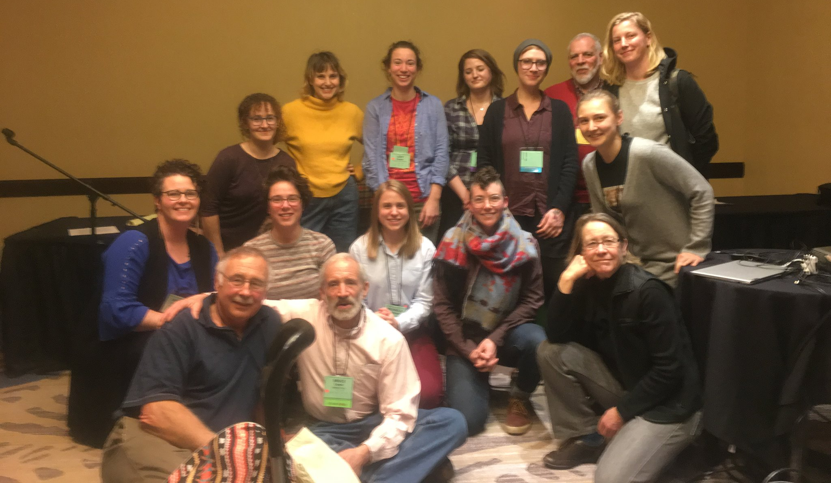
Disseminated Findings
PASA
Other farming conferences
Farming for Justice Webinar November
Journal articles
Recommendations Report

Slide 42
Policy Recommendations
Census of Agriculture collect data on sexual orientation and diverse gender identities
LGBTQ farmers should be added to the list of the USDA’s Minority and Women Farmers and Ranchers program
USDA should increase efforts to support rural LGBTQ populations
Continued support for women farmer organization
Agricultural apprentice programs should include “LGBT” or “LGBTQ friendly” to allow mentees to identify these farms
Farming organizations should utilize pronouns, gender-neutral bathrooms, and queer-centered programming at events

Slide 43

Future Research
Farm Laborers (Sexualidades Campesinas Project)
Urban Farmers
Queer farmers in conventional agriculture or agribusiness (Cultivating Change Foundation)
Queer issues/acceptance in youth agricultural education programs (4-H, FFA, etc.)
Queer farmers of color
Regional variations

Slide 44

Thank you

Slide 45
References

Slide 46
References

Slide 47
Questions

