Slide 1
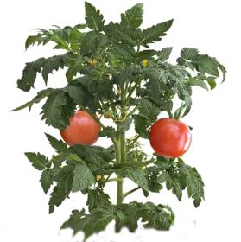
2018-2019 G. diazotrophicus Inoculated Tomato Trial
1 2 3 4 5 6 7 8 9 10 11 12
13 14 15 16 17 18 19 20 21 22 23 24
25 26 27 28 29 30 31 32 33 34 35 36
37 38 39 40 41 42 43 44 45 46 47 48
Levels:
N fertilization: 6
Inoculation: 2 Total Units: 48
Reps: 4
30”
12”
18”
12”
18”
30”
PI: Ryan Sebring C: 814-404-7477 Email:RLS246@psu.edu

