Slide 1
Assessing In-Field Soil Moisture Variability Using the Decision Support System for Agrotechnology Transfer (DSSAT) Model
B. Hodges, J.O. Paz, M.L. Tagert, and Q. Meng
2020 Tri Societies Annual Meeting
November 9 - 13, 2020
Notes:
Hello, my name is Blade Hodges and this presentation will be about Assessing In-Field Soil Moisture Variability Using the Decision Support System for Agrotechnology Transfer (DSSAT) Model. This project is funded by Mississippi Soybean Promotion Board and a Southern SARE graduate student grant.

Slide 2
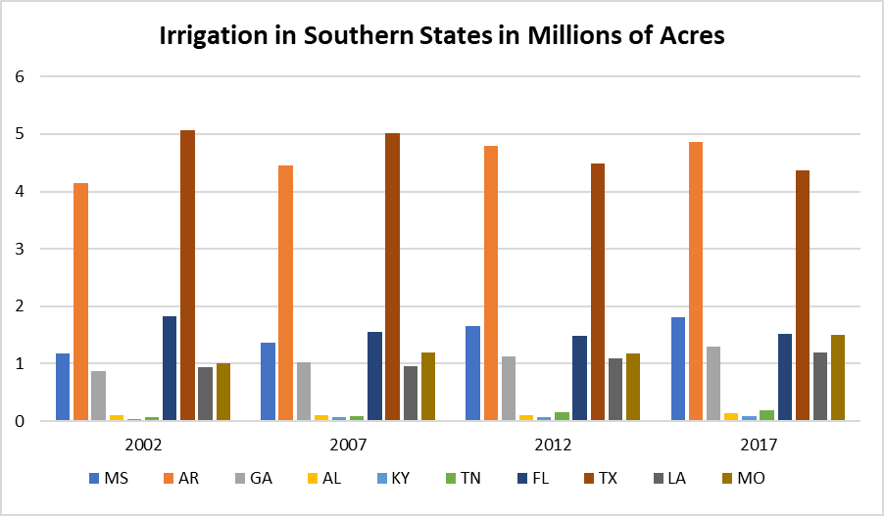
Background
Reference: 2018 Irrigation and water management survey
Irrigation in southeastern states has been increasing from 2002-2017, with Mississippi having the third largest number of irrigated hectares of all Mid-South and Southeastern states.
Reason for increase in irrigation - less rainfall during the growing season; periodic drought
Notes:
So, I’ll start with a little Background information. Irrigation plays a major role in agriculture in the Southern region of the United States, and especially in Mississippi. Here you can see that the number of irrigated acres has increased every time the Farm and Ranch Irrigation Survey (now the Irrigation and Water Management Survey) has been conducted since 2002. Of the 10 states on this graph, Texas is the only one that has experienced a decrease in the number of irrigated acres. Mississippi has the 3rd largest area of irrigated acres of these 10 states in the most recent survey.

Slide 3
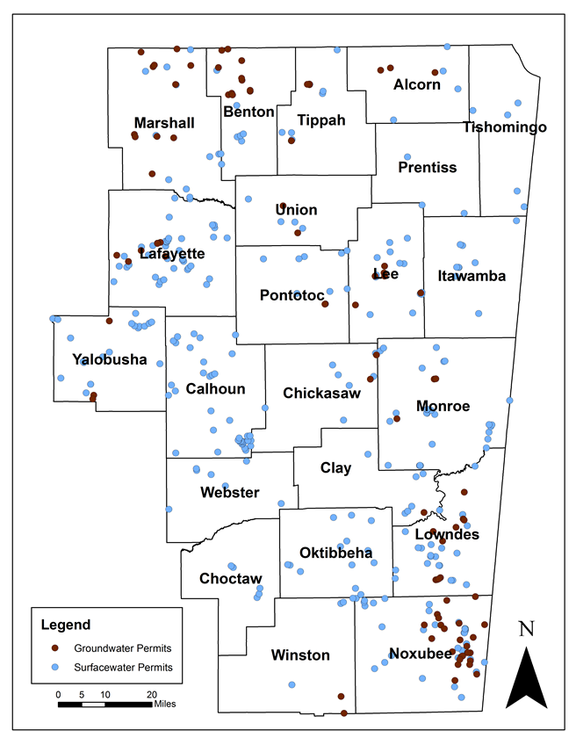
Background
Mississippi receives an average 56 (142.2 cm) inches rainfall annually (70% in winter and spring).
East Mississippi – historically dryland production due to high cost of drilling wells (depth to reach water). However, more producers irrigating using surface water and center pivots.
Notes:
Mississippi receives an average of 56 inches or 142.2 cm of rainfall per year with only about 30% coming during the growing period which is why there is a steady increase in irrigated acres as represented in the previous slide. In east Mississippi, there is an agricultural region known as the Blackland Prairie, and it has been historically in dryland production, but more producers are irrigating now using surface water and center pivots. You can see that surface water permits make up the majority of the permits in this map of east MS because it is more economical to build surface water ponds than to dig wells for ground water due to the depth of the ground water, so most producers build ponds and use the surface water paired with pivots for the rolling topography.

Slide 4
Objectives
Improve recommendations for sensor placement within a field, and evaluate less invasive, surrogate methods for estimating soil moisture, thus improving irrigation efficiency.
Measure in-field spatial and temporal variability of soil moisture in the active rooting zone using Watermark GMS sensors.
Evaluate the correlation of root zone soil moisture to soil texture, soybean leaf area index (LAI), and plant height.
Use DSSAT crop model to determine if the variability of in-field soil moisture is great enough to indicate a different irrigation schedule for different areas of the field.
Notes:
This presentation covers one objective in a larger study to improve recommendations for sensor placement within a field, and evaluate less invasive, surrogate methods for estimating soil moisture, thus improving irrigation efficiency. I’ll be discussing Objective 3: how we used the DSSAT crop model to determine if the variability of in-field soil moisture is great enough to indicate a different irrigation schedule for different areas of the field.

Slide 5
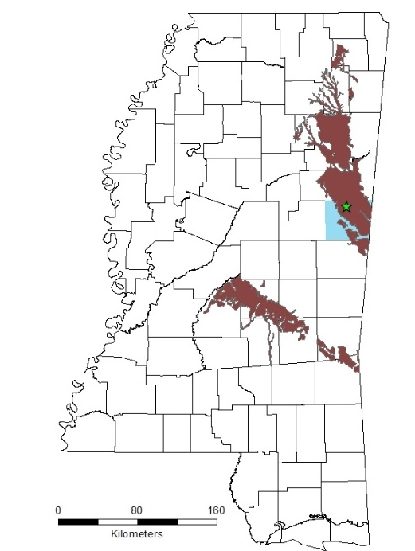
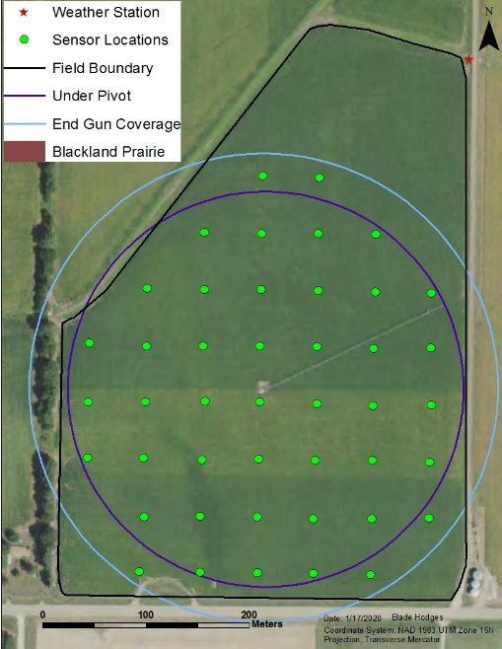
Study Area
Brooksville, MS
18-ha center pivot irrigated production field
Soybean/corn rotation
Notes:
The study area is an 18-hectare center pivot irrigated production field in Brooksville, MS which is located in the Blackland Prairie. This field has been in a soybean corn rotation since 2013. We started this project the Summer of 2018 and completed it in the fall of 2020.

Slide 6
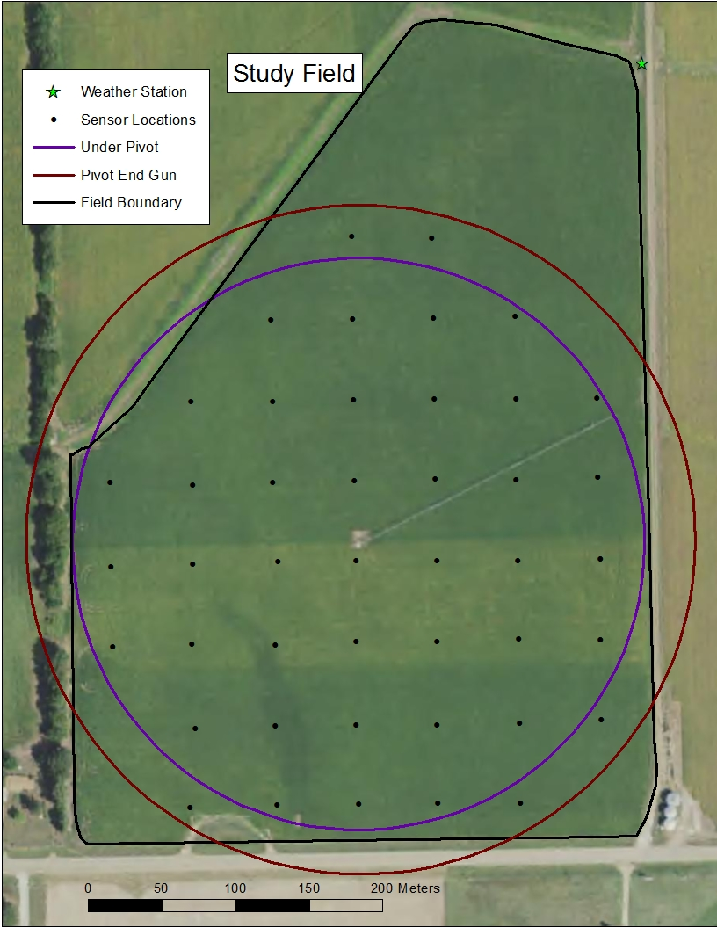
Methods
A 55-m grid was created in ArcGIS over an 18-ha soybean field, planted on May 3, 2018 and May 4, 2020.
Resulted in 44 grid points under the pivot.
Field monitored with weather station in NE corner.
Notes:
A 55-meter grid was created in arc GIS which resulted in 44 grid points that are under the pivot or hit by the end gun. There is also a weather station in the northeast corner of the field that we used to record weather data. Soybeans were planted May 3, 2018 and May 4, 2020.

Slide 7
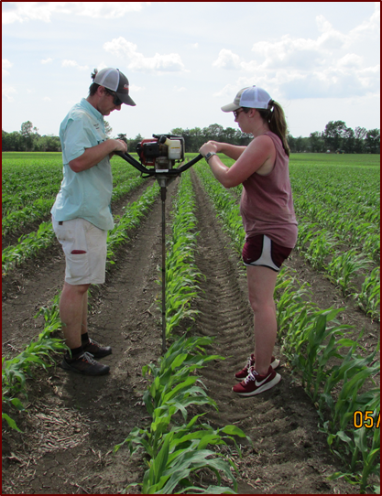
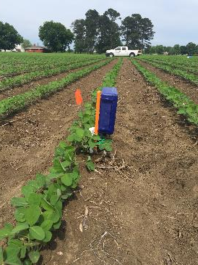
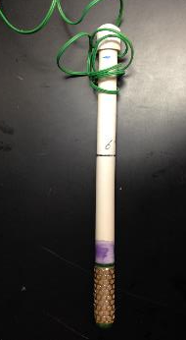
Methods
At each point, Watermark 200SS GMS sensors were installed at depths of 31 and 61 cm and connected to a 900M Watermark data logger. Sensors were cycled and installed wet with good soil/sensor contact.
Notes:
At each point, Watermark 200SS GMS sensors were installed at depths of 31 and 61 cm and connected to a 900M Watermark data logger, which was set to log hourly. Sensors were cycled and installed wet with good soil/sensor contact.

Slide 8
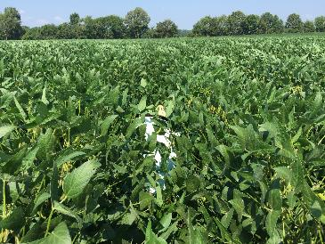
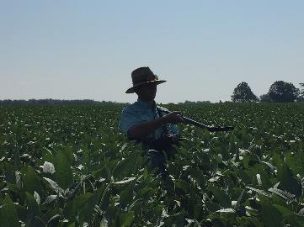
Methods
LAI and plant height measurements were taken weekly during the growing season each year using an LAI-2200 Plant Canopy Analyzer.
This resulted in 9 sampling dates in 2018 and 10 dates in 2020.
Notes:
LAI and plant height measurements were taken weekly during the growing season each year using an LAI-2200 Plant Canopy Analyzer. This resulted in 9 sampling dates in 2018 and 10 dates in 2020.

Slide 9
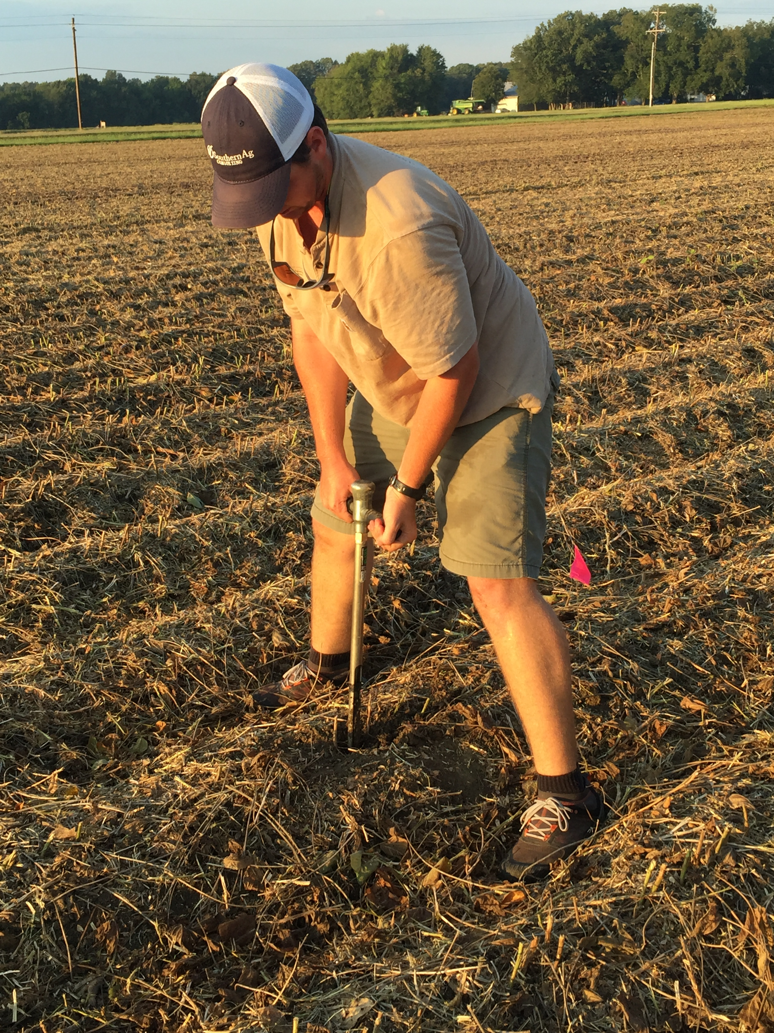
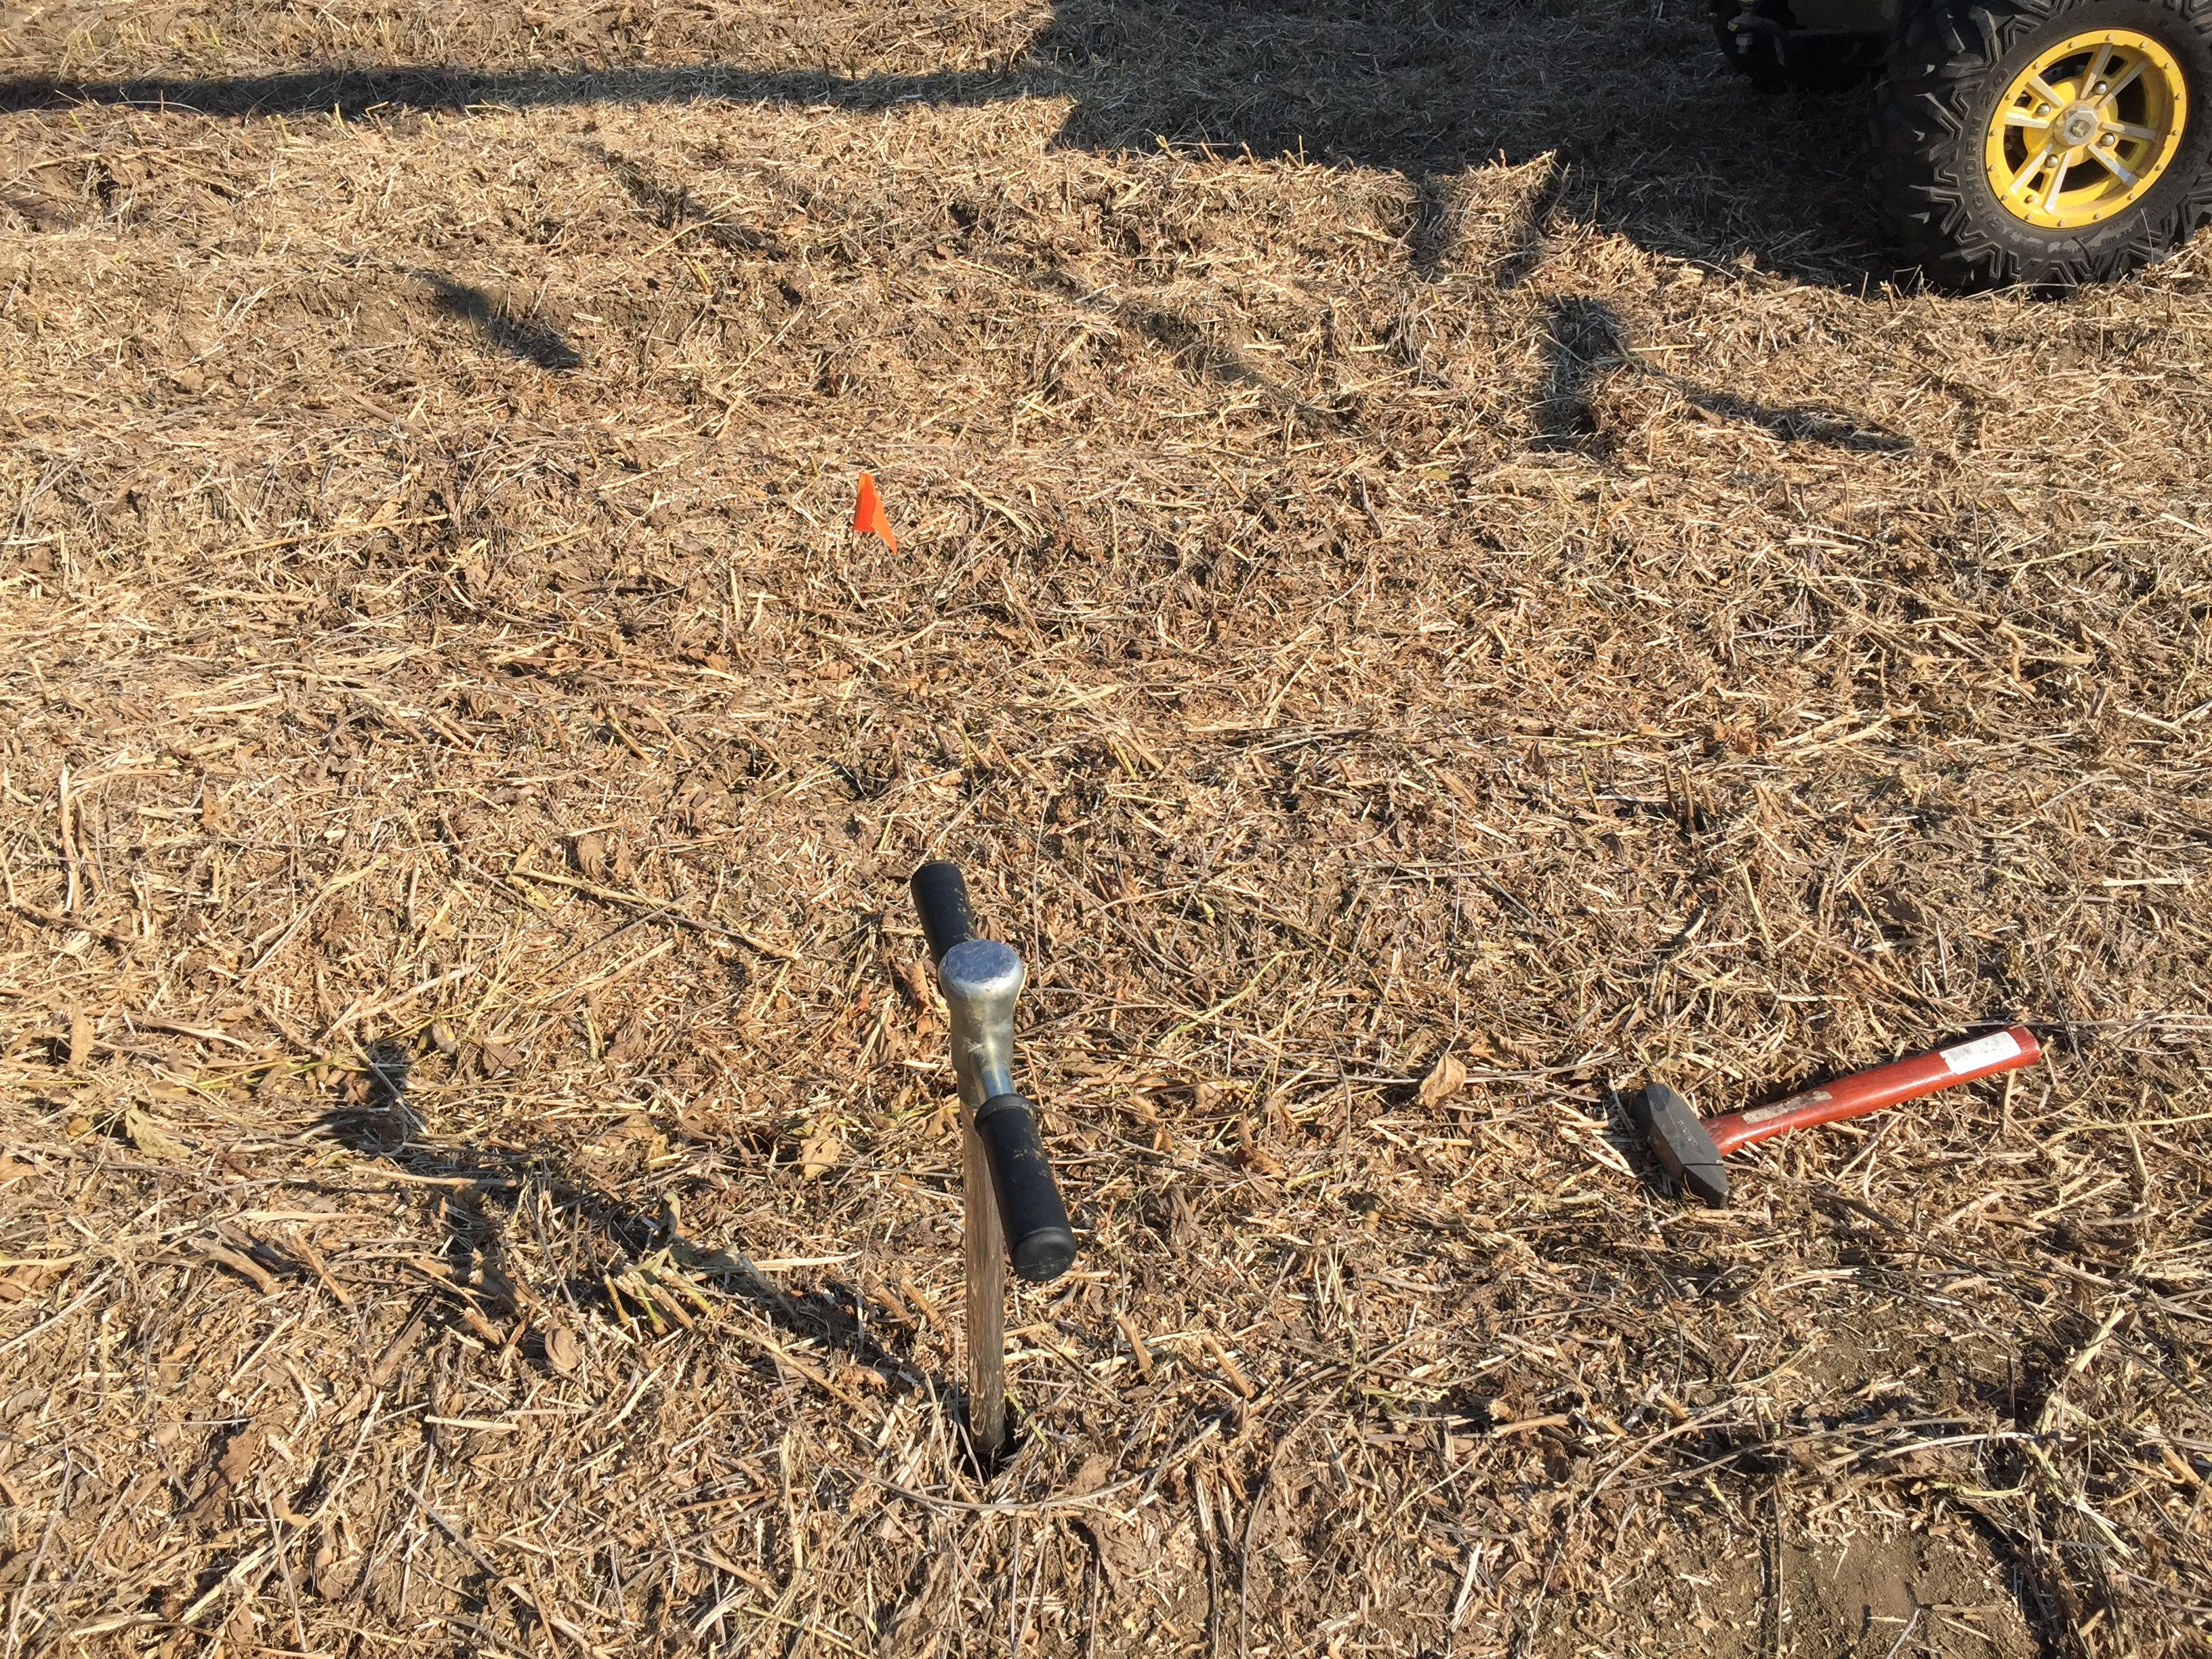
Methods – Soil Texture
Field was harvested on Sept. 19, 2018, and soil samples were pulled on Sept. 20, 2018
2-3 pulls per grid cell until enough soil was collected
Soil samples were pulled at a depth of 61 cm.
Notes:
Soil samples were pulled at 61 cm deep, and 2-3 cores were pulled from each grid cell for a total of 44 soil samples. Soil texture was analyzed at the MS state soil lab.

Slide 10
Decision Support System for Agrotechnology Transfer (DSSAT)
Crop modeling ecosystem
A suite of models that help users predict growth, development and yield of various crops grown around the world.
The results are based on crop genetics, weather, and management practices.
CROPGRO-Soybean was used in this study for the 2018 and 2020 growing seasons.
Notes:
DSSAT is a crop modeling ecosystem comprised of multiple models that help users predict growth, development, and yield of many crops grown around the world. The results are based on crop genetics, weather, and management practices. CROPGRO-Soybean was the model used in this study for the 2018 and 2020 growing seasons.

Slide 11
DSSAT Minimum Data
Daily weather – T_{max}, T_{min}, Precipitation, Solar Radiation
Soil data – permanent wilting point, saturation, field capacity, percent clay, percent silt, bulk density, soil root growth distribution factor, and soil type.
Crop management information – plant date, irrigation dates and rates, harvest date, cultivar, plant population, fertilizer dates and rates, etc.
Notes:
There is a minimum data set that is needed to run the models in DSSAT. They include Daily weather which consists of max and min daily temperature, daily precipitation, and daily solar radiation; Soil data for both the surface and the profile including permanent wilting point, saturation, field capacity, percent clay, percent silt, bulk density, soil root growth distribution factor, and soil type; and crop management information such as plant date, irrigation dates and rates, harvest date, cultivar, plant population, fertilizer dates and rates.

Slide 12
DSSAT Model Flow Chart
Experimental Data
.SBT
Model
Output
Databases
CROPGRO-Soybean
SoilWat.OUT
Weather (.WTH)
PlantGro.OUT
Soil
(.SOL)
Experiments
(.SBX)
Genetics
(.CUL)
Notes:
This image is a simplified version of a flow chart for the DSSAT model, specifically for what was used in this study. We have weather files for the whole year for both years. We input the data for the soil, and we input the needed data for the experiment files for both years. The genetics were from the file already in the database for soybean maturity groups. Once we had all of the data in the databases, we also had to input our measured experimental data (LAI, plant height, soil moisture content). The data was put into the CROPGRO-Soybean model in DSSAT, which gives the user multiple output files. The two of interest in this study were SoilWat.OUT and PlantGro.OUT. The soil data for both the silty clay loam and silt loam were input into the soil file separately and were assigned to each grid cell in the experiment file (.SBX).

Slide 13
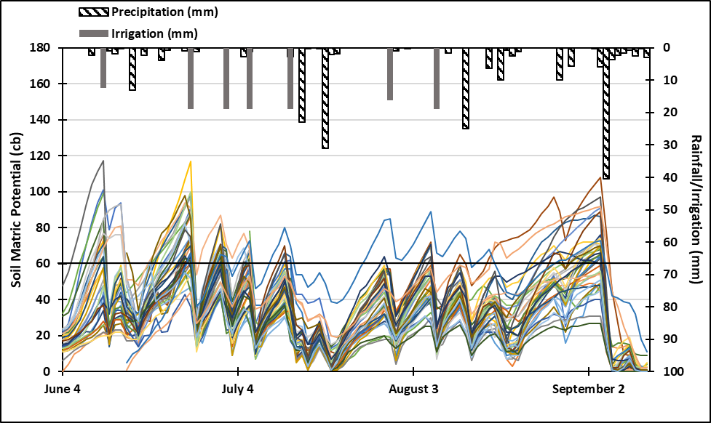
Temporal Variability Results - 2018
Started averaging the 31 and 61 cm sensors on June 15.
June 11 has the largest range/variability across the field. (126 cb)
Applied a season total of 4.83 inches (123 mm) of irrigation and received a total of 10 inches (255 mm) of rain from May 3 to September 19 (Planting date to removal of sensors ). A total of 14.8 inches (378 mm) of total water was received by the field.
Notes:
In 2018, there were 7 irrigation events as shown in the solid gray bars resulting in a total of 123 mm of irrigation, and the field received a total of 255 mm of rainfall from plant date until the sensors were removed for 378 mm of total water received by the field. Also, you can see the daily root zone average for each set of sensors represented by the lines on the graph. Keep in mind here that as the Soil Tension increases the soil profile is getting drier. The black line across the figure is the approximate irrigation trigger throughout the year. You can also see that there is more variability on the drier days, so as they get drier, the distance between the lines usually gets larger.

Slide 14
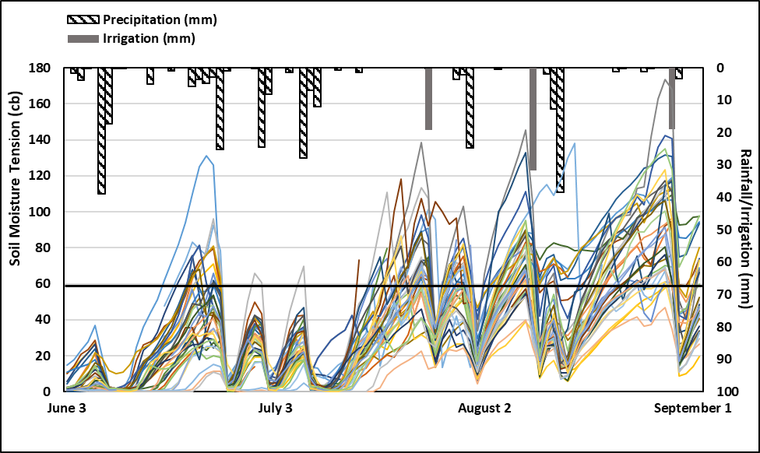
Results-2020
Started averaging the 30.5 and 61 cm sensors on July 20.
August 28 has the largest range/variability across the field. (133 cb)
Applied a season total of 3.15 inches (80 mm) of irrigation and received a total of 14 inches (355 mm) of rain from March 4 to September 2 (Planting date to removal of sensors). A total of 17.15 inches (435 mm) of total water was received by the field.
Notes:
In 2020, the farmer irrigated 4 times which resulted in 80 mm of irrigation, and the field received a total of 355 mm of rainfall. More rainfall was received during the 2020 growing season, so less water was applied through irrigation this year than in 2018. These last two graphs show that each year, as time went on and sensors dried out, the variability across the field increased as well. They also show that irrigation scheduling can be very different year to year, and even in a wet year, there may be a short drought that would trigger an irrigation event that could save yield over the life of the crop.

Slide 15
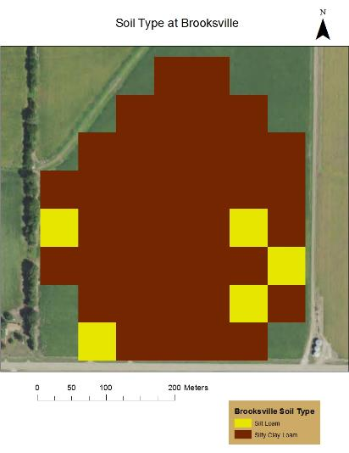
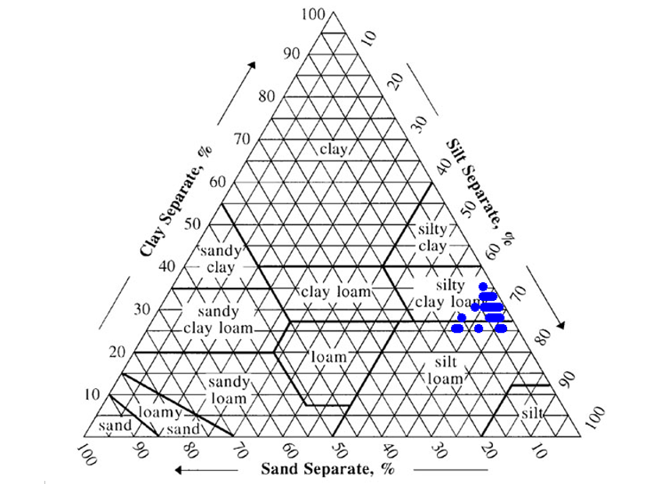
Results – Soil Texture
Notes:
The soil texture was mostly silty clay loam with only 5 of the 44 grids being silt loam. On the graph on the right, you can see just how close those 5 grid cells are to the others in terms of percent sand, silt, and clay.

Slide 16
Model Calibration
Calibrated genetic coefficients by testing results for maturity groups IV, V, and VI against the measured data for LAI and plant height.
Maturity group IV had the most similar results.
Notes:
Genetic coefficients were calibrated by testing the model results for maturity groups 4, 5, and 6 against the measured data for LAI and plant height, with maturity group 4 having the most similar results.

Slide 17
Model Evaluation
RMSE$= \sqrt{\frac{\sum_{i=1}^{n}{ }{\left(P_{i} −O_{i}\right)}^{2}}{n}}$
nRMSE$= RMSE∗ \overline{X}/100$
d$=1−\frac{\sum_{i=1}^{n}{ (P_{i} − O_{i} )^{2}}}{\sum_{i=1}^{n}{( }{\left|P_{i}\right. −\left.\overline{O}\right|+ \left|O_{i}\right.}_{ }− {\left.\overline{O}\right|)}^{2}}$
Where Pi is predicted value, Oi is observed value, n is number of observed values, and ($\overline{\text{Oi}}$) is mean of observed values.
nRMSE <10%, 10 – 20%, 20 – 30%, and > 30% = excellent, good, fair, and poor respectively
Plant growth outputs d ≥ 0.75 is acceptable.
Soil water outputs d ≥ 0.60 is acceptable.
Notes:
Our evaluation of the model results was made based on the Root mean square error (RMSE), normalized RMSE, and the d statistic or Wilmott’s index of agreement. The RMSE is used as a normalized value to eliminate the use of units. An nRMSE <10%, 10 – 20%, 20 – 30%, and > 30% = excellent, good, fair, and poor, respectively. The d statistic is considered acceptable for plant growth outputs if d is greater than or equal to 0.75 and acceptable for soil water outputs if d is greater than or equal to 0.6.

Slide 18
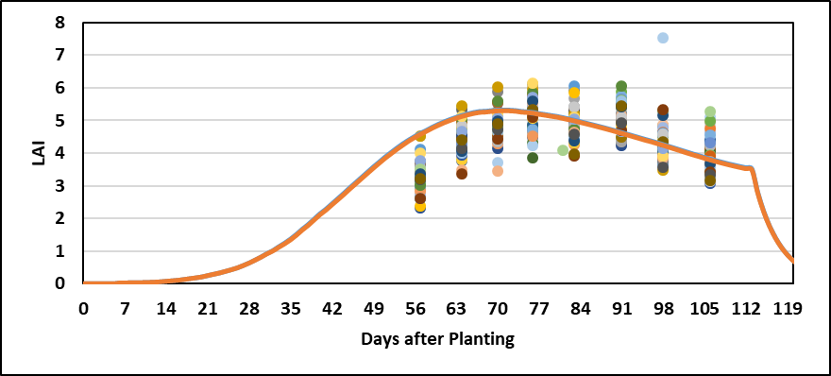
Model Results - 2018
Notes:
In these two graphs, the measured data are represented by the points on the graph, and the model predictions are represented by the lines. Here we see that the model predictions for every grid cell are the same. There is no variation in the predictions for plant height and LAI, even with the two soil types being slightly different. Also, we can see that the model does a good job of predicting soybean plant height and LAI from the graphs. The d statistics for plant height ranged from 0.8 to 0.98, so all of the grid cells met the standard. For LAI, d stat ranged from 0.02 to 0.89 over the 44 grid cells, with only 11 of the 44 cells meeting the minimum of 0.75 d stat.

Slide 19
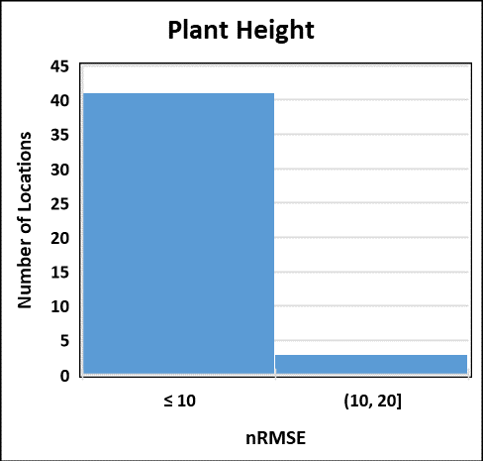
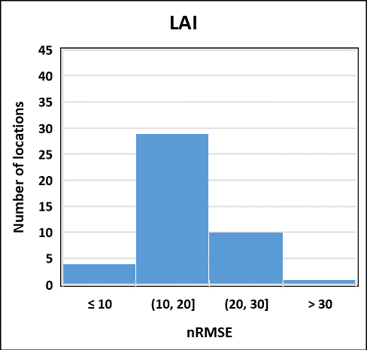
Model Results - 2018
LAI:
Excellent = 4 out of 44
Good = 29 out of 44
Fair = 10 out of 44
Poor = 1 out of 44
Plant height:
Excellent = 41 out of 44
Good = 3 out of 44
Notes:
Again in these two graphs we see that the model predicts plant height better than LAI. For plant height, there were 41 out of 44 grid cells in the excellent range and the other 3 in the good range. LAI only had 4 in the excellent range and 29 in the good range, along with 10 in the fair range and 1 in the poor range.

Slide 20
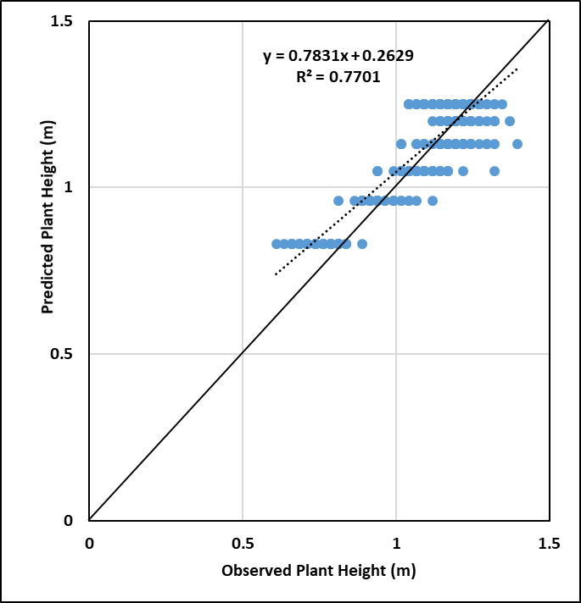
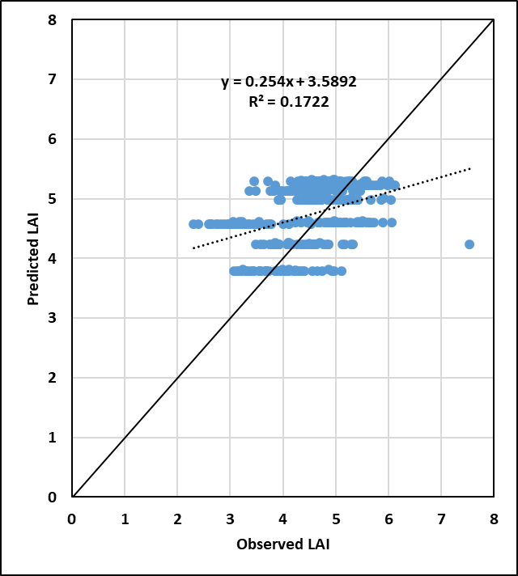
Model Results - 2018
Notes:
These graphs show the relationship between the predicted and measured plant height and LAI values for the 2018 season. The results show that the model did a better job of predicting plant height more so than LAI, with the slope being closer to 1 (0.78) for plant height versus 0.25 for LAI. The observed and predicted values also have a tighter fit for plant height (R² = 0.77) than for LAI (R² = 0.17).

Slide 21
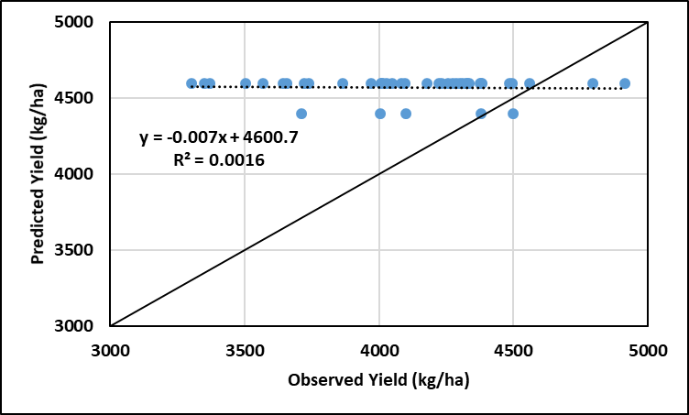
Model Results - 2018
The model predicted the yield to be 4,596 and 4396 kg/ha for silty clay loam and silt loam, respectively.
Notes:
Here we see the yield is over predicted by the model for most of the data points, with the two soil types apparent by the predictions of the model. It predicted the silty clay loam to have a higher yield by 200 kg/ha.

Slide 22
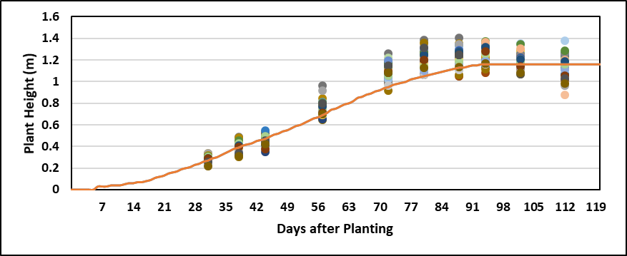
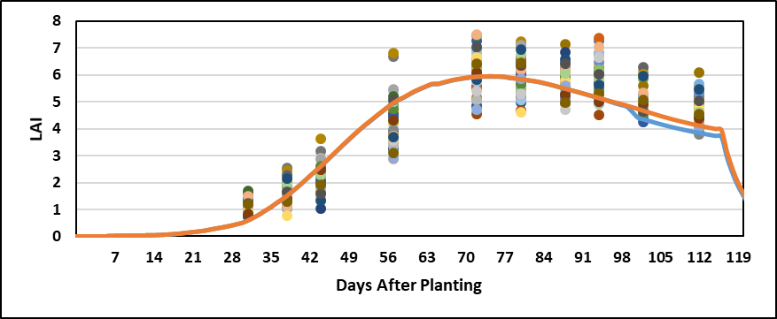
Model Results - 2020
Notes:
Here are the DSSAT results for 2020 plant height and LAI. The model predictions for every point are the same. There is no variation in the predictions even with the soil types being slightly different except at the end of the season for LAI, but it is very minute. The minimum criteria of 0.75 for the d statistic was met by all grid cells for both LAI and plant height in 2020, with the d stat values ranging from 0.93 to 0.99 for LAI and 0.91 to 0.99 for plant height. Again, plant height still performed slightly better although this season, both variables were predicted very well.

Slide 23
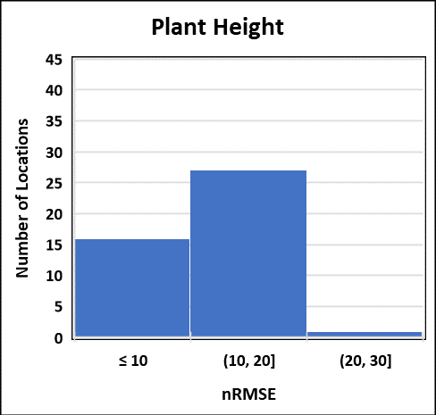
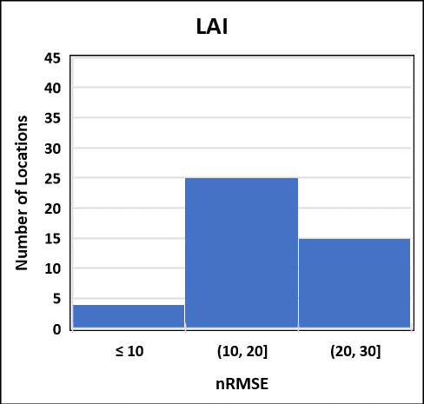
Model Results - 2020
Plant height:
Excellent = 16 out of 44
Good = 27 out of 44
Fair = 1 out of 44
LAI:
Excellent = 4 out of 44
Good = 25 out of 44
Fair = 15 out of 44
Notes:
Again in these two graphs, we see that the model predicts plant height better than LAI with regard to nRMSE. For plant height, there were 16 out of 44 grid cells in the excellent range, 27 in the good range, and only 1 in the fair range. LAI only had 4 in the excellent range, 25 in the good range, and 15 in the fair range.

Slide 24
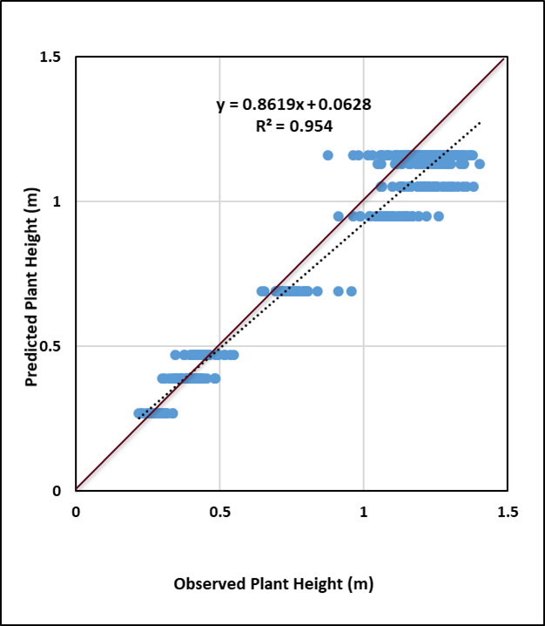
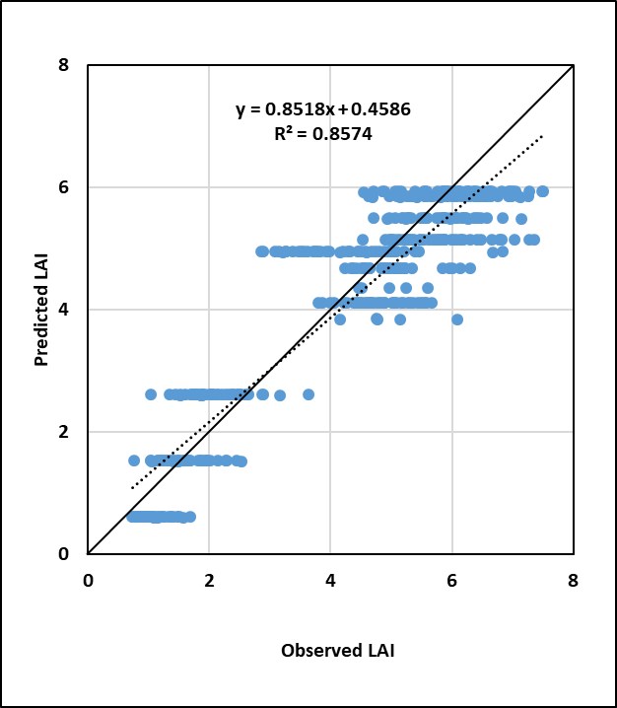
Model Results - 2020
Notes:
These graphs show the relationship between the predicted and measured plant height and LAI values for the 2020 season. The results show that the model predicted plant height and LAI about the same, with slopes of 0.86 and 0.85, respectively. The observed and predicted values also have a tighter fit for plant height (R² = 0.95) than for LAI (R² = 0.86).

Slide 25
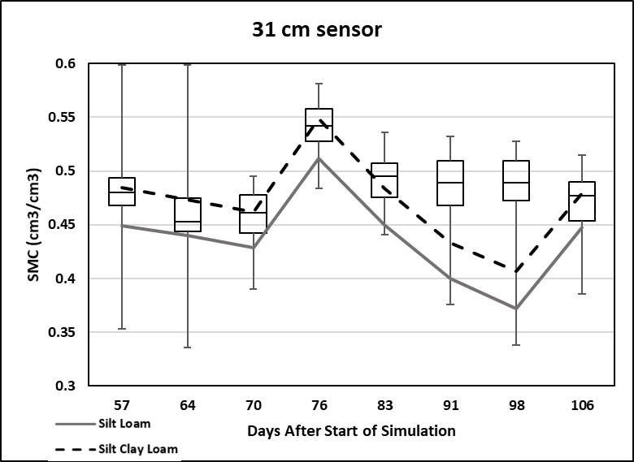
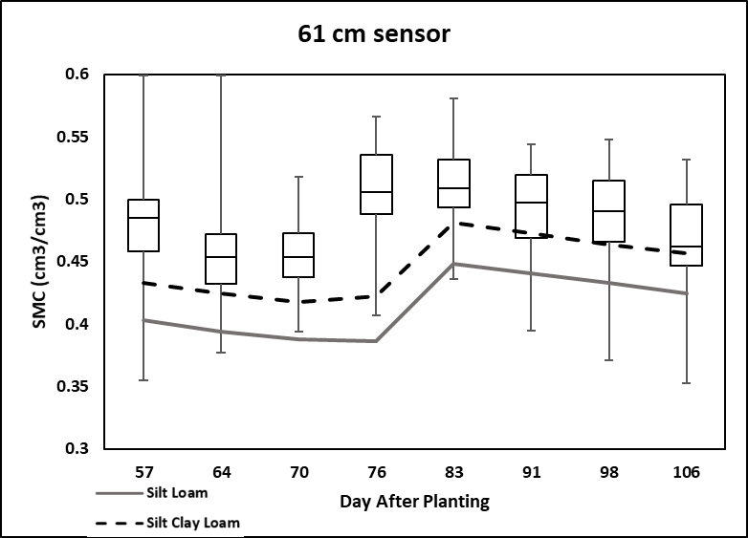
Model Results - 2018
Notes:
We have seen that the model did a good job of predicting plant height and LAI throughout both years. Now we will look at the soil moisture results from the model. Here, we are showing volumetric water content because that is what DSSAT uses to represent soil moisture content. So as the lines on the graph decrease, the profile is drying out. The soil tension data was converted to volumetric water content by using soil moisture release curves that were generated from soil samples from the field. We see that on growing season days 91 and 98 at the 31-cm depth, the model is under predicting the soil moisture content, but overall it looks like the model did a good job at this depth. At the depth of 61 cm, the model is underpredicting the soil moisture content the whole growing season, but it does react the same way as the measured data.

Slide 26
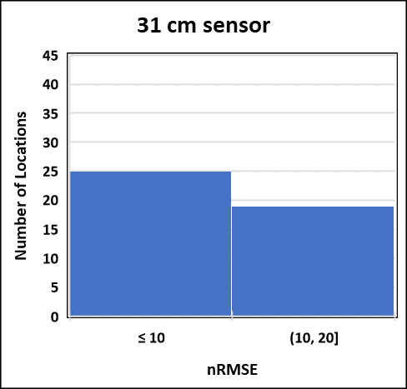
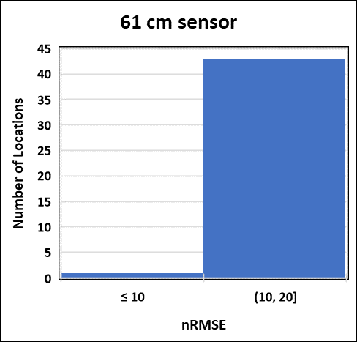
Model Results - 2018
31 cm sensor:
Excellent = 25 out of 44
Good = 19 out of 44
61 cm sensor:
Excellent = 1 out of 44
Good = 43 out of 44
Notes:
In these two graphs, we see that soil moisture at 31 cm is predicted by the model better than at 61 cm in terms of nRMSE. At the 31-cm depth, there are 25 out of 44 grid cells in the excellent range and 19 in the good range. At the 61-cm depth, only 1 grid cell was in the excellent range and 43 in the good range.

Slide 27
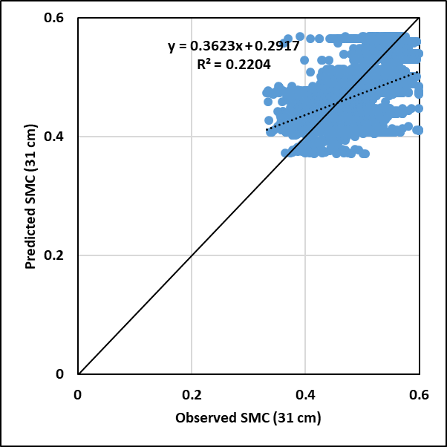
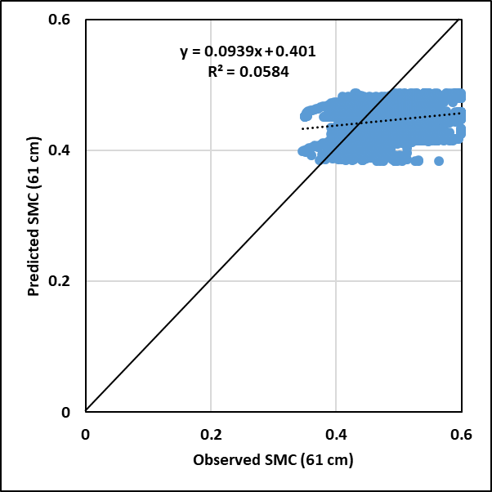
Model Results - 2018
Notes:
In these graphs, we see that soil moisture at 31 cm is predicted better than at 61 cm. The slope being closer to 1 at 0.36 for the 31-cm depth vs 0.09 for the 61-cm depth. Also, the R² values for both depths are low, but the R² value is higher for the 31-cm depth (R² = 0.22) than for the 61-cm depth (R²= 0.06). Also, the d statistics show that 36 of 44 grid cells meet the criteria for greater than 0.6 at the 31-cm depth and none were greater than 0.6 at the 61-cm depth.

Slide 28
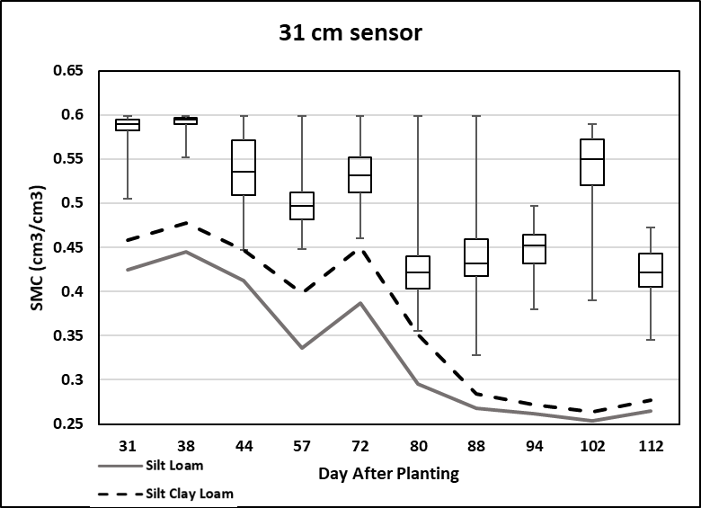
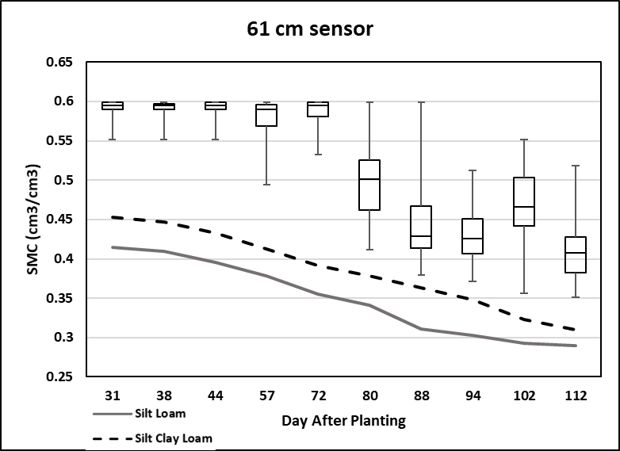
Model Results - 2020
Notes:
For the 2020 growing season, the model-simulated soil moisture at both depths of 31 and 61 cm are not as responsive to rainfall and irrigation events as the measured data on certain days, and the model under predicts soil moisture for the majority of the 2020 season at both depths. The modeled soil moisture and the measured soil moisture do however follow the same trends except for a few days towards the end of the season when there is an irrigation or rainfall event and the model doesn’t appear to respond.

Slide 29
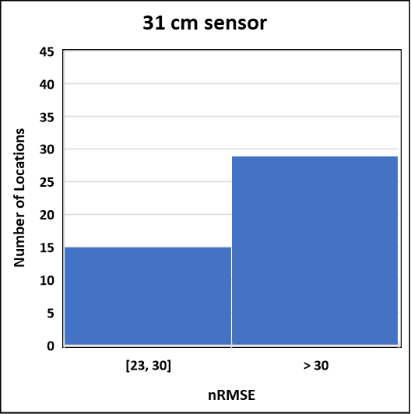
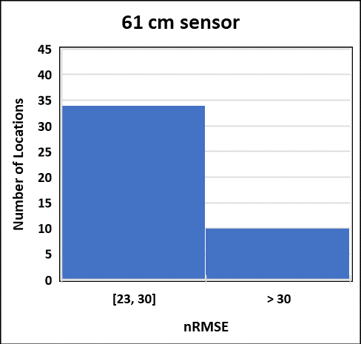
Model Results - 2020
31 cm sensor:
Fair = 15 out of 44
Poor = 29 out of 44
61 cm sensor:
Fair = 34 out of 44
Poor = 10 out of 44
Notes:
In these two graphs we see that the model predicts soil moisture at 61 cm better than at 31 cm, according to the nRMSE values. At 61 cm, there were 34 out of 44 grid cells in the fair range and the other 10 in the poor range. At the 31-cm depth, there were 15 grid cells in the fair range and 29 in the poor range.

Slide 30
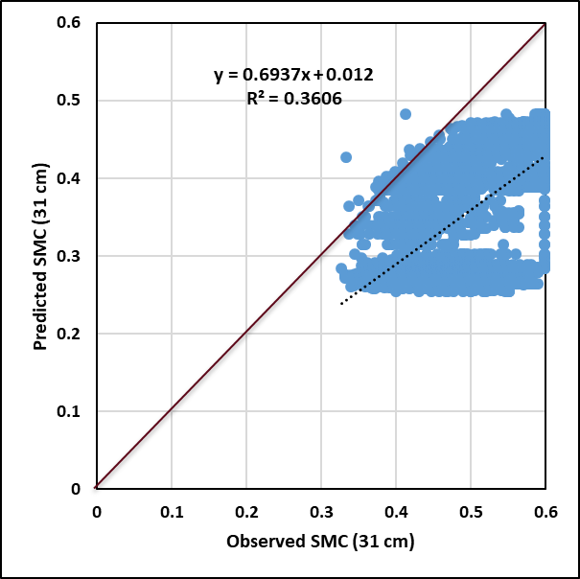
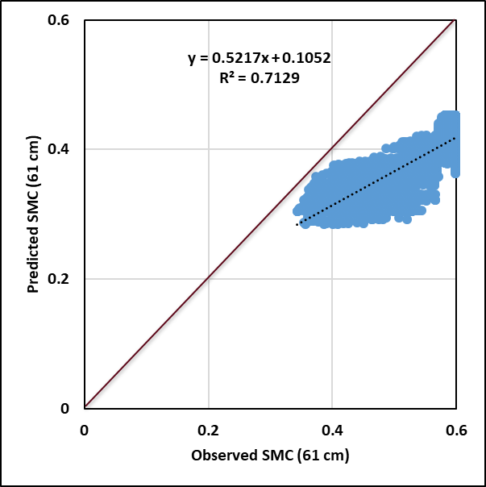
Model Results - 2020
Notes:
In these graphs, we see that modeled versus measured soil moisture at 31 cm has a slope closer to 1 (at 0.69) than soil moisture at 61 cm (0.52). However, the R² values are opposite in that the soil moisture at 61 cm has a higher R² at 0.71 vs 0.36 for soil moisture at 31 cm. Also, the d statistics show that only 3 of 44 grid cells meet the criteria for greater than 0.6 at the 31-cm depth, and 11 were greater than 0.6 at the 61-cm depth.

Slide 31
Conclusions
CROPGRO-Soybean model does a good job of predicting crop variables (LAI and plant height) for both years.
Plant height results were better than LAI comparisons both years.
2020 was the best year overall for the crop variable predictions.
2018 was the best year overall for the soil moisture content predictions.
The model did not predict much variation in the field at all in the plant variables, but it did predict some variability for the soil moisture content.
Modeled soil moisture on some of the dates, especially in 2020, did not respond to rainfall or irrigation events like the measured data did.

Slide 32
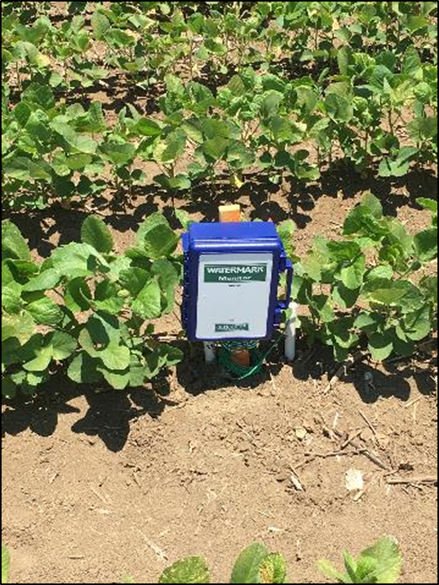
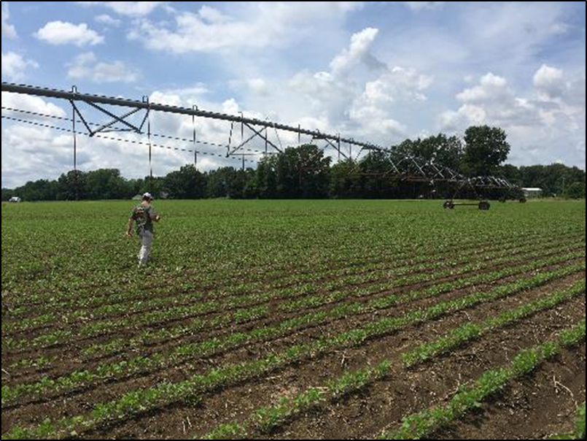
Questions?
Notes:
Thank you all for listening to my presentation. I would like to thank the Mississippi soybean promotion board and USDA Southern SARE for funding this work. Without them, the project would not have been possible.

