Slide 1
Prevention of avian pathogenic E. coli (APEC) infections in poultry using novel probiotics
10/17/19

Slide 2
Objectives
Conduct preliminary clinical trial to measure the efficacy of probiotics and probiotics microcapsules to prevent APEC infection in chickens
Co-ordinate with Cooper Farms and test the most effective treatments in farms having history of previous and recent APEC infection (field trial)

Slide 3
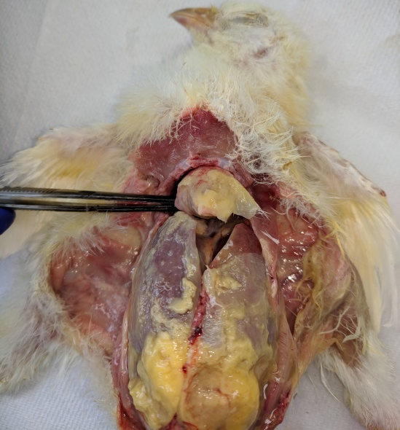
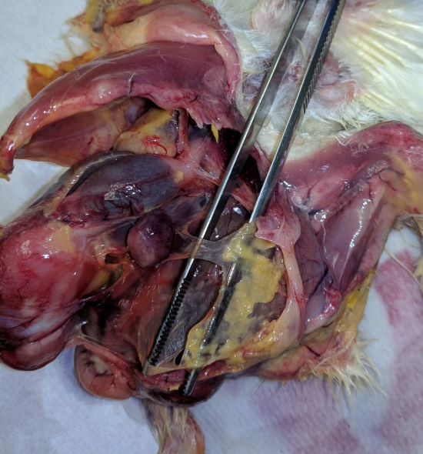
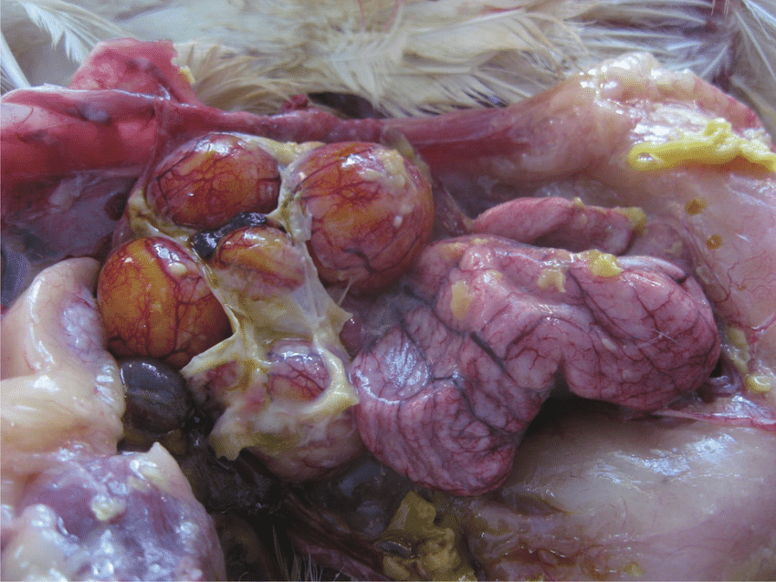
Avian pathogenic E. coli (APEC)
Most common bacterial pathogen of poultry worldwide
30% of commercial flocks in US
Cause multiple localized and systemic infections; Colibacillosis
Foodborne human uropathogen

Slide 4
Impact of APEC on poultry industry
High morbidity and mortality (up to 20%), up to 53.5% in young chickens
Decreased meat (2%) and eggs production (up to 15%)
Carcasses condemnation (up to 43%)
US broiler industry- $40 million annual losses only due to carcasses condemnation
US egg industry- $1.15 million annual losses per flock of 450,000 layers

Slide 5
Current APEC control measures
Antibiotics routinely used
Resistance to multiple antibiotics already reported worldwide
In US, FDA recommends limited use of medically important antibiotics in food-producing animals (guidance for industry #209, #213)
Vaccine (Poulvac® E. coli) used (infrequently)
Limited protection against heterologous APEC infections
Development of non-antibiotic therapies is crucial for effective management of APEC infections in poultry

Slide 6
LGG & Bb12 killed APEC in vitro
In co-incubation, Lactobacillus rhamnosus GG (LGG) & Bifidobacterium lactis Bb12 (Bb12) completely killed the APEC by 24 h
LGG & Bb12 supernatants (or secreted products) are responsible for killing APEC
*
*
*
*
*P<0.01

Slide 7
LGG significantly reduced APEC load in cecum of chickens
Administration of LGG orally for 14 days reduced the APEC load in cecum by ~1.6 logs
LGG also increased the body weight (~12 g in 2 weeks old layers)
*
PC: untreated chickens
*P<0.01

Slide 8
LGG secreted small peptides killed APEC in vitro
Three small peptides (P-1, P-2, & P-3) completely killed APEC, including antibiotic-resistant APEC, by 12 h

Slide 9
Future plans
Objective 2. Co-ordinate with Cooper Farms and test the most effective treatments in farms having history of previous and recent APEC infection (field trial)
Farm
(chickens or turkeys)
Flock 1
Flock 2
Flock 3
Treatment
(4 wks)
LGG
LGG
No
Weekly collection of feces samples
APEC quantification by plating and rtPCR

Slide 10
Future plans
Workshop to poultry farmers
Objective: to disseminate the project results and share the knowledge on antibiotics, antibiotic resistance, antibiotic alternatives, and sustainable poultry production

