Slide 1
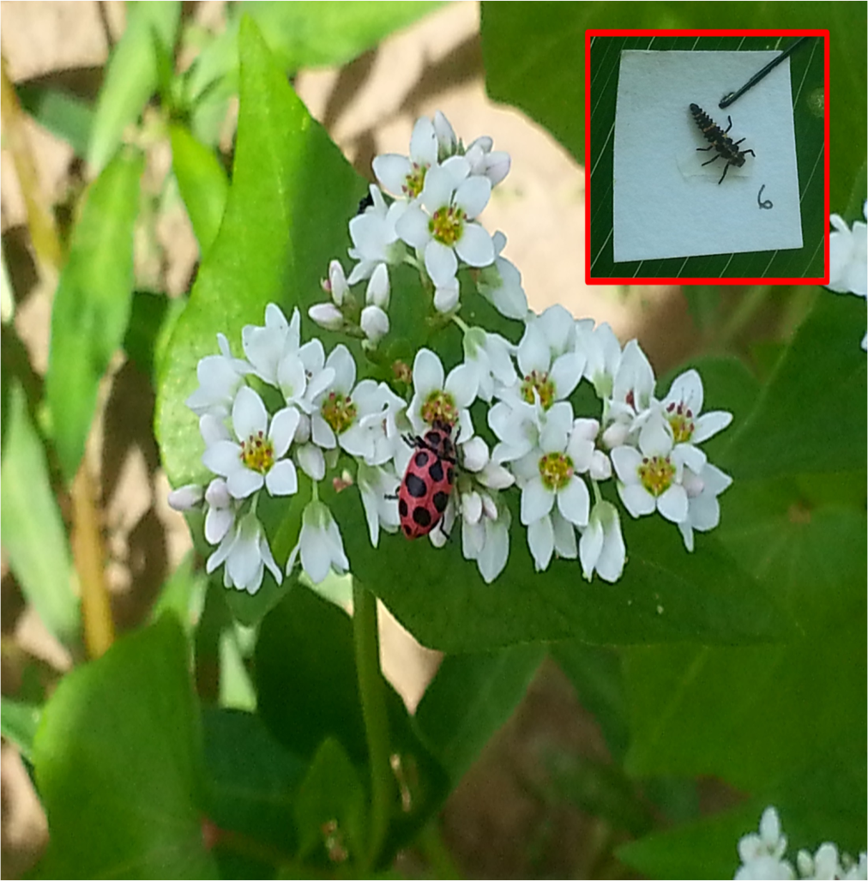
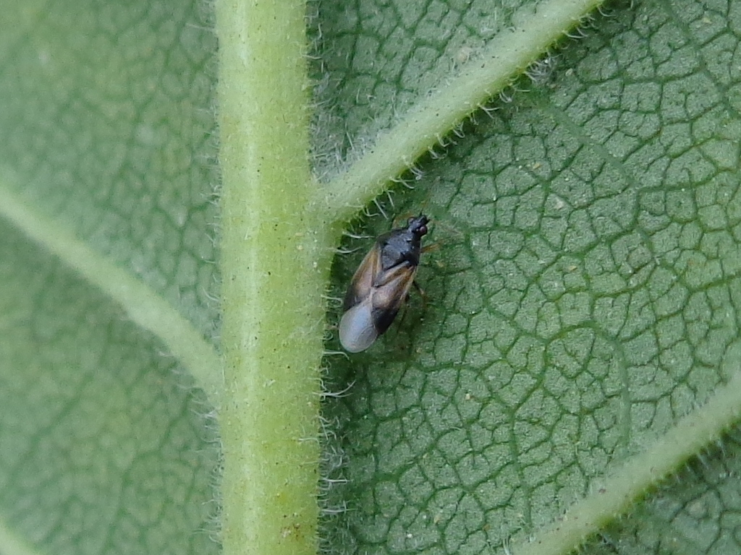
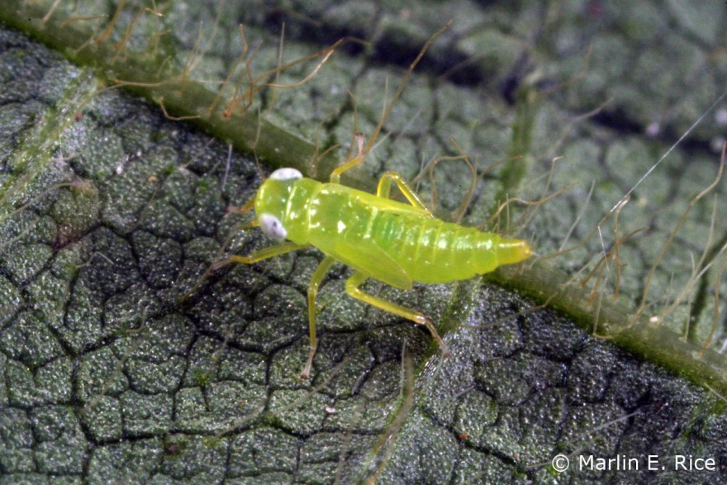
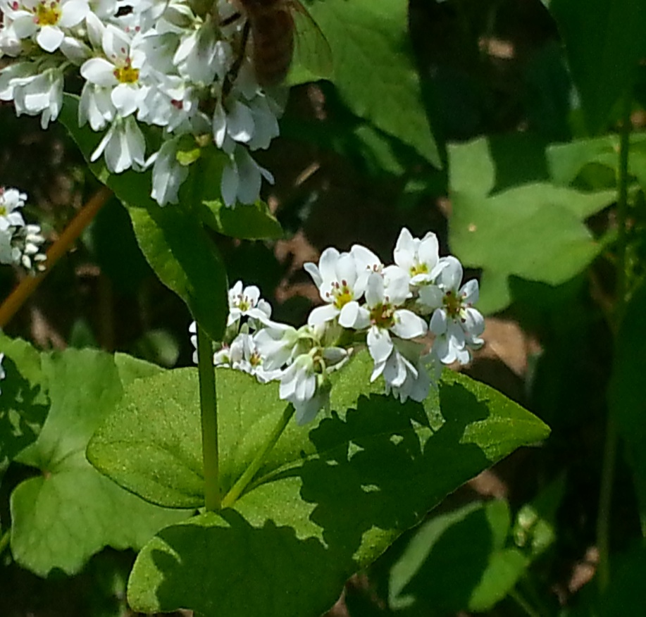
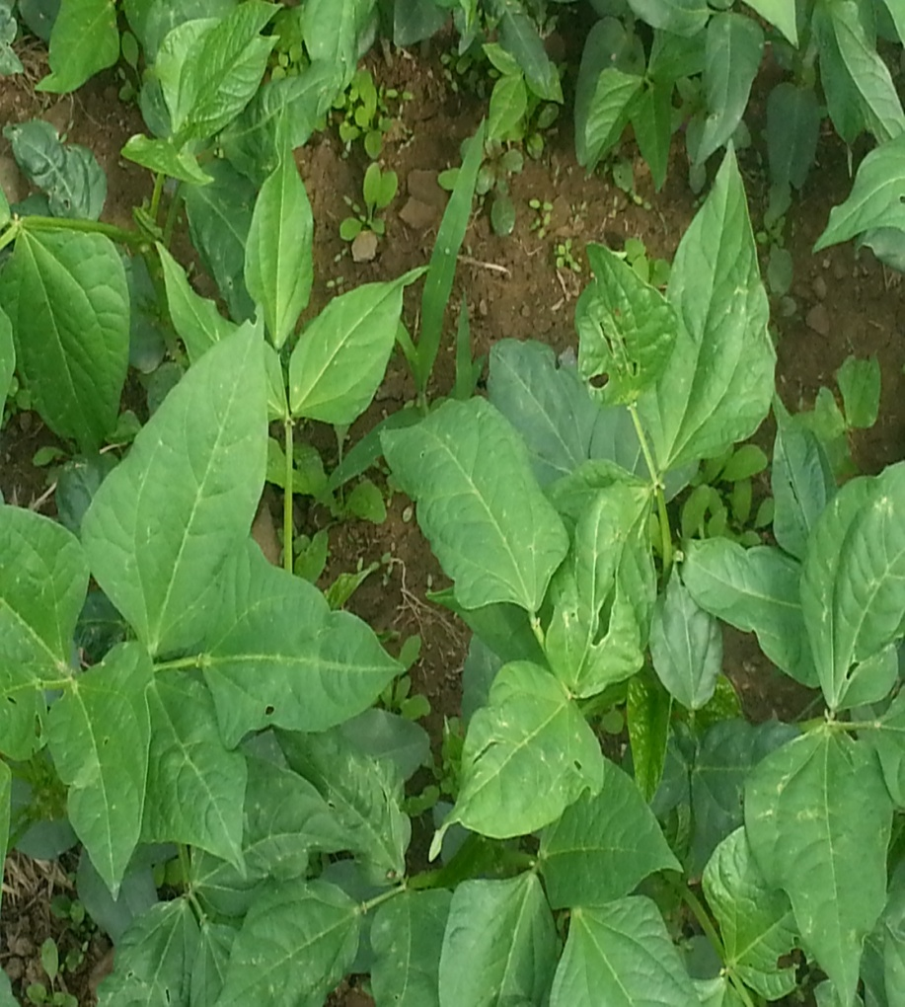
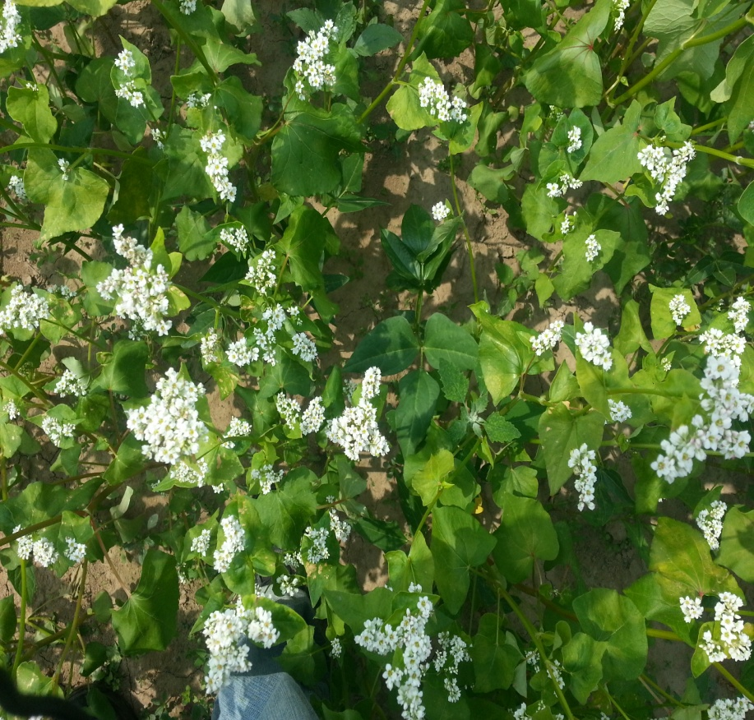
Floral resources support higher abundances of beneficial insects
Jermaine Hinds
Department of Entomology, Pennsylvania State University, University Park, PA 16802 E-mail: jxh557@psu.edu
Introduction
Most Abundant Insects
Results - Predation
Generalist predators are important contributors to pest suppression in agroecosystems. In addition to prey items, predators largely depend on plant-provided nectar and pollen for nutrients when prey items are scarce. Agronomic crop farms are often highly disturbed and lacking in floral resources to support predators; therefore introducing floral resources into the farmscape can attract generalist predators. However, because of their feeding preferences, predators are differentially attracted by flowers. Therefore providing complementary floral resources in a mixture through plant species diversification can potentially attract a wider range of generalist predators. In a recent field study I investigated the role of resource plant diversification on beneficial insect attraction .
Despite high numbers of predators, mortality due to predation low across all treatments
From left to right: Predators: Ladybeetle adult and larvae, minute pirate bug adult. Herbivores: Aphid adult, Potato leafhopper nymph.
Results – Sweep Net Sampling
Predator abundance is higher in the presence of flowers, increases over time, and further with increasing numbers of inflorescences.
Hypothesis and Objectives
Providing complementary resource plants will not only attract greater numbers of beneficial insects but also a greater diversity of predatory insect species.
Objectives:
Determine the role of resource plant diversification on beneficial insects.
Monitor plant development and record growth and flower production.
Survey insect community in monoculture buckwheat, cowpea, and buckwheat cowpea mixture.
Monitor predation within resource patch
Conclusions and Future Directions
Predatory ladybeetles and minute pirate bugs appear to be highly attracted to buckwheat blooms.
Cowpea did not consistently attract any specific predators, possible due to poor stand establishment.
Buckwheat and cowpea can be attractive aphids and potato leafhoppers.
Predators appear to be “distracted” by flowering plants as suggested by low egg predation in all treatments.
Future Directions
Future studies will further examine the impact of these plant species as resources for beneficial insects. Repeating this study with better cowpea establishment, will allow me to better test its influence on predators. Additionally future studies will investigate the potential for resource plants to act as sinks for predators and termination methods to “push” predators into crops where pest suppression is needed
Herbivorous insects can also benefit from the presence of resource plants.
Treatments and Sampling Methods
Acknowledgements
From left to right: Buckwheat monoculture, cowpea monoculture, buckwheat cowpea mixture were established in 80 x 20ft. field plots. Insects were sampled via sweep net sampling. Predation was monitored using European corn borer sentinel eggs
I would like to sincerely thank the farm staff at Rock Springs and Mac Burgess for help with plot establishment and field operations. This research is funded by a USDA-SARE grant.

