Slide 1
UDC Beginning Farmers Rototilling using the BCS
BCS Operation
Loves Gardens LLC

Slide 2
Courtesy and Community
Equipment makes the work go easier and we must share and care for it together!
First come first serve – If the BCS is being used please check with the operator by asking how long they will need the equipment. Check the equipment sign out sheet to determine when the equipment is available.
The person checking out the equipment is responsible for the safe operation of the tools and that the equipment is cleaned and in working condition for the next user.
If you believe the equipment was damaged, please contact Mike Whyte, Larry Sears or Lavell Merritt. You can take a picture to document the damage. UDC will make sure equipment is repaired in a timely manner.
Communication between all farmers is important. Please let each other know if equipment is damaged or missing. We must share responsibility of the equipment and keep it working for all our benefit. We will be meeting every two weeks as a farm to discuss irrigation and other farm activities.

Slide 3
To till or not to Till ? – That is the question!
Rototilling is a great option to get your space cultivated and ready to go for planting.
The soil should be dry. Wet soil can be damaged from tilling.
The space should be cut down and all debris removed that could damage the equipment. Anything larger than a pencil and all stones should be removed including any irrigation tape or other debris.
The operator must be ready to the do the work. Stretch out, be hydrated and you should now how to operate the machine. This is a serious piece of heavy equipment. Ask for help if you are unsure of how to operate the BCS. Mike, Larry or Lavell can assist you if needed.

Slide 4
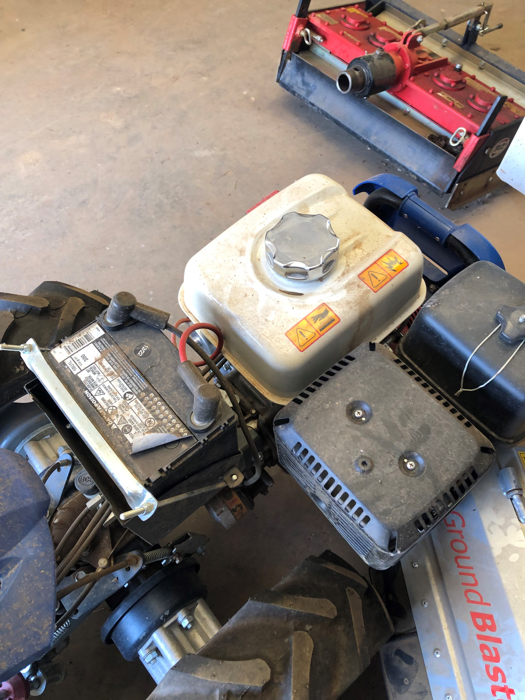
BCS is kept in the Red Barn
Check the oil
Check that the roto-tines are cleared of debris
Check the gas
Make sure all bolts are tight and in place

Slide 5
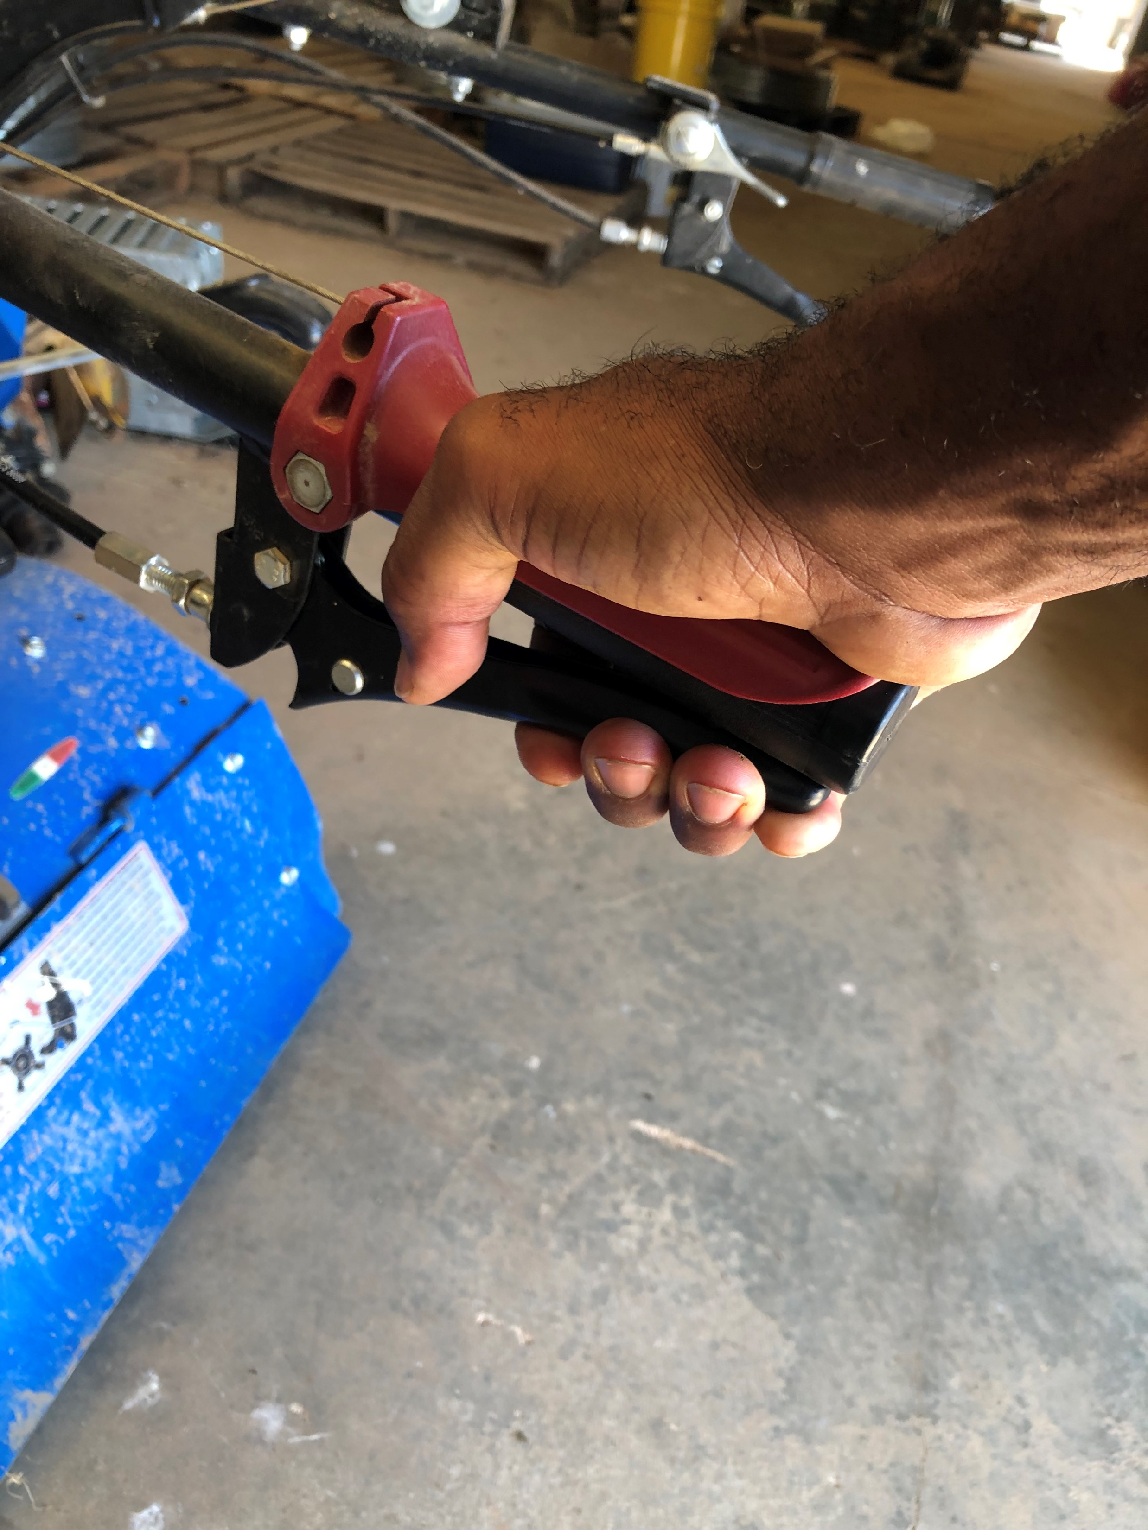
1.Turn the machine on.
Important Note- make sure equipment log is utilized and you are with a designated operator.

Slide 6
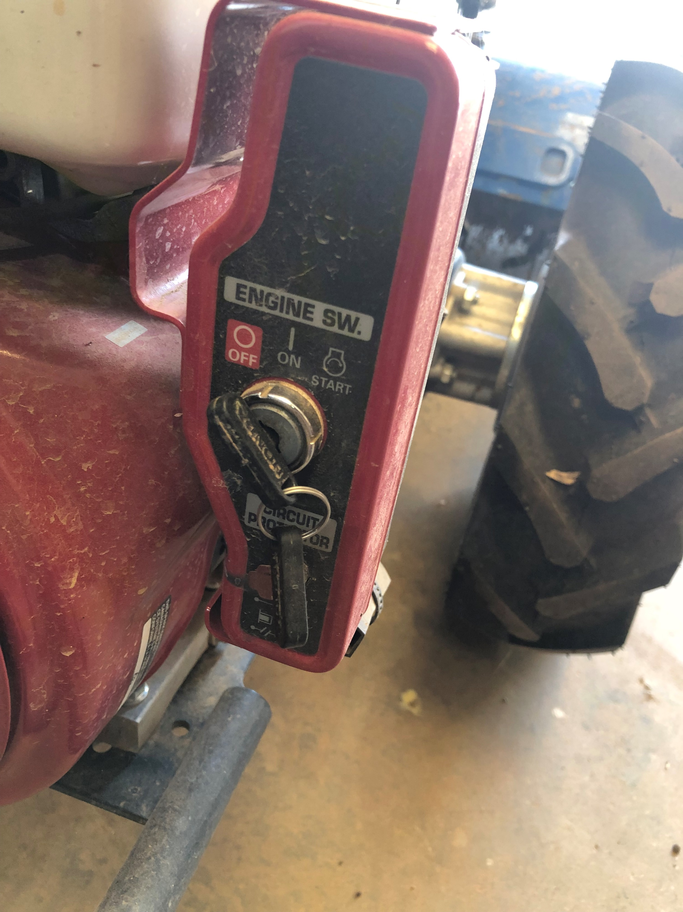
2.Use the key start to start the BCS.

Slide 7

4.Hold down the safety mechanism and place the BCS in gear. Drive to your gardening area.

Slide 8
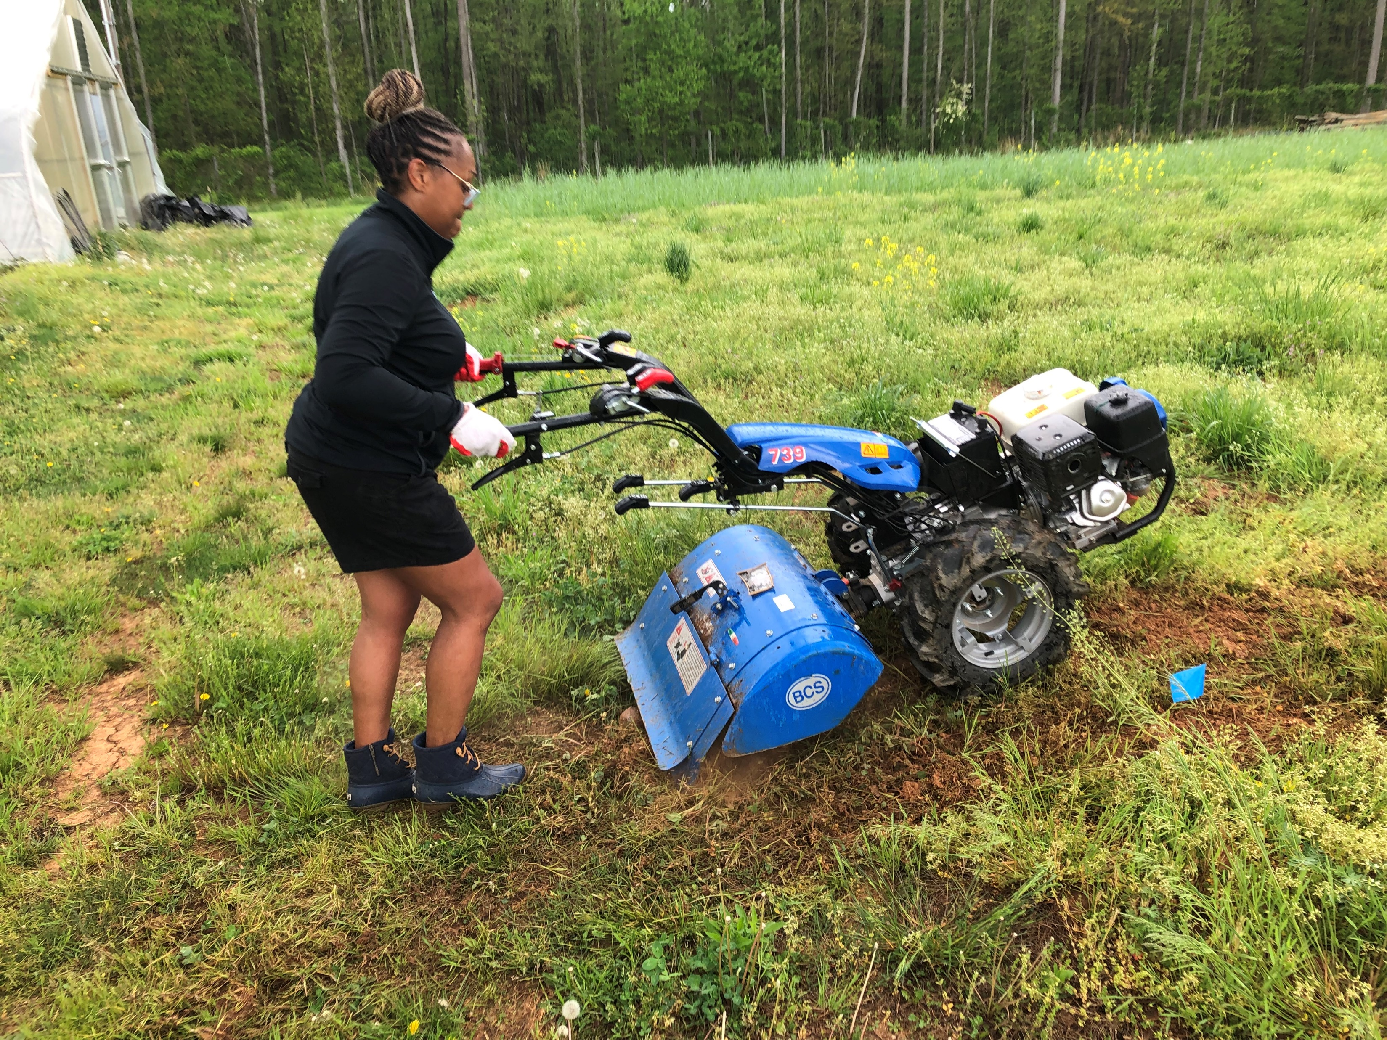
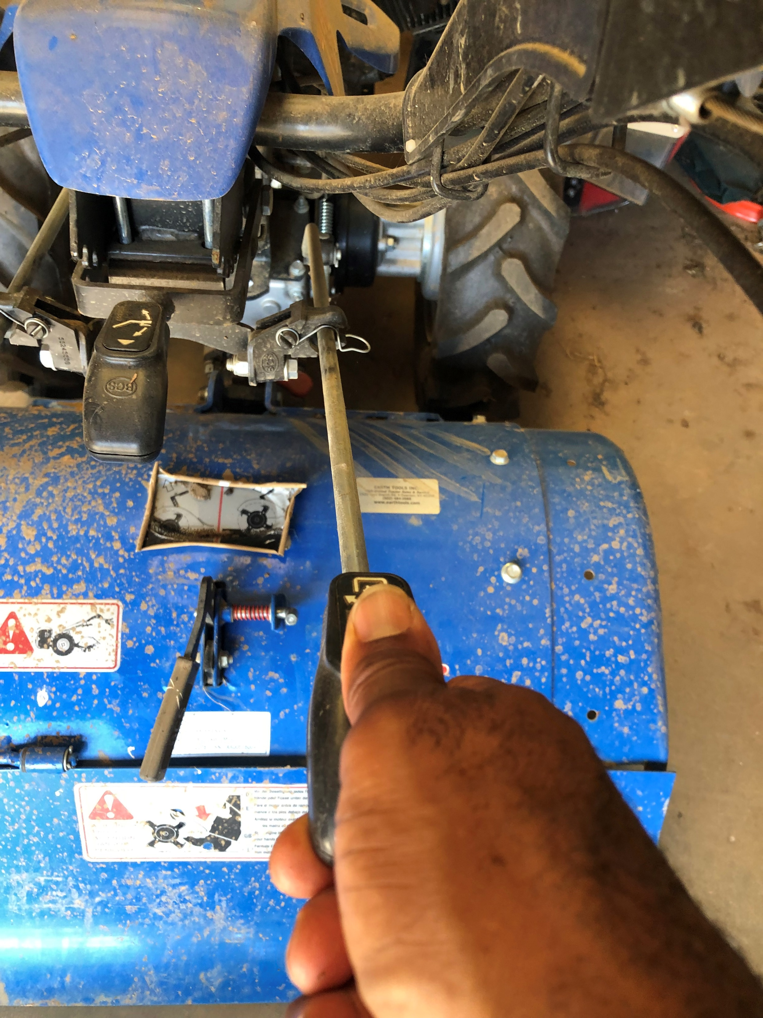
5. Hold down the safety mechanism and place the PTO in gear. Then place the BCS in first gear. Lock the wheel differential in place. Begin tilling.

Slide 9
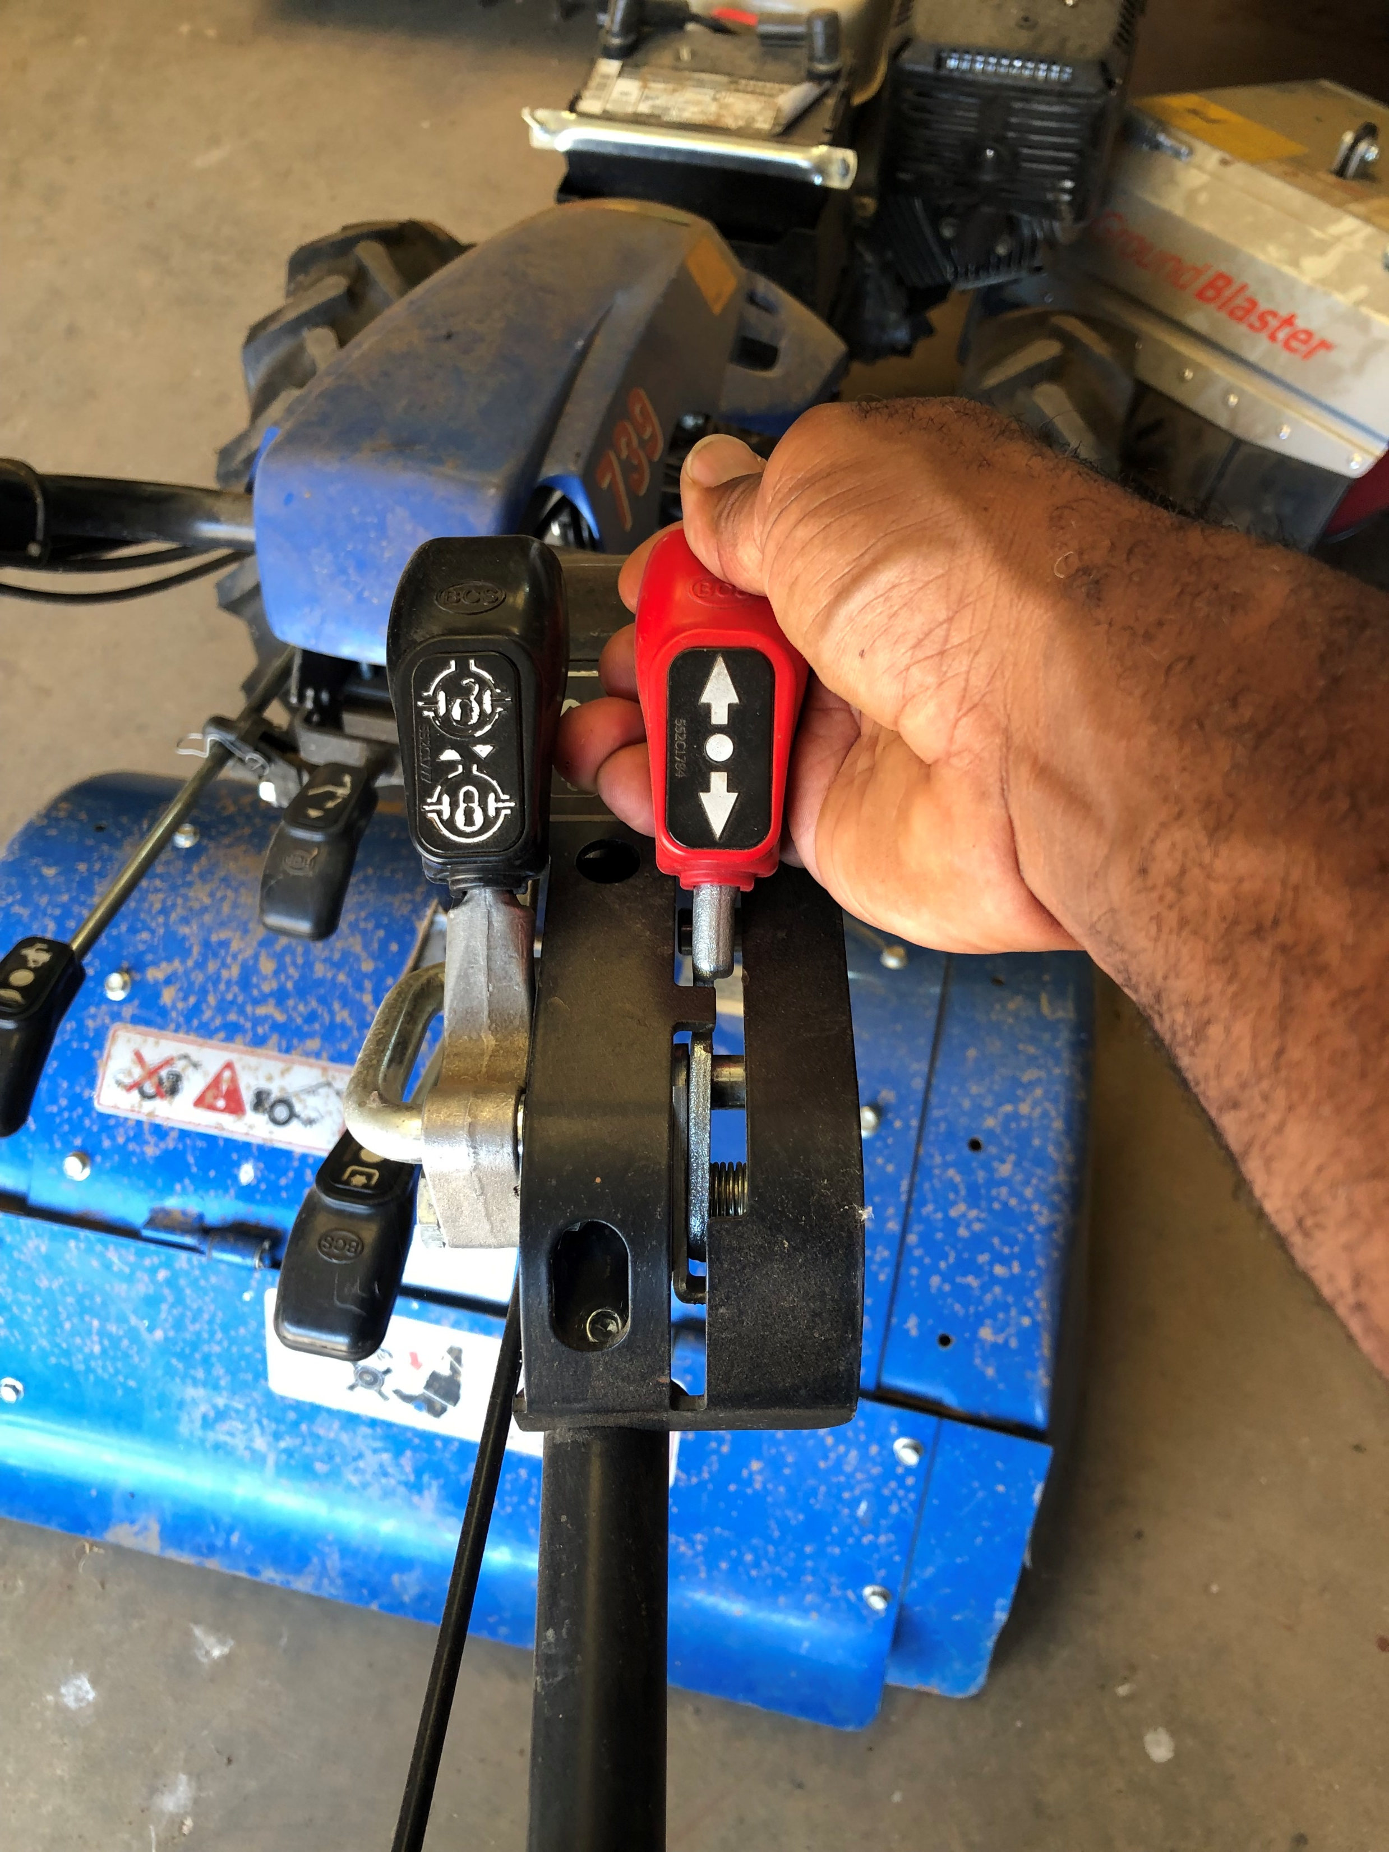
6. If the tiller gets bogged down or is off your line stop. Take it out of PTO and reverse to set the BCS in a line. Start tilling again.

Slide 10
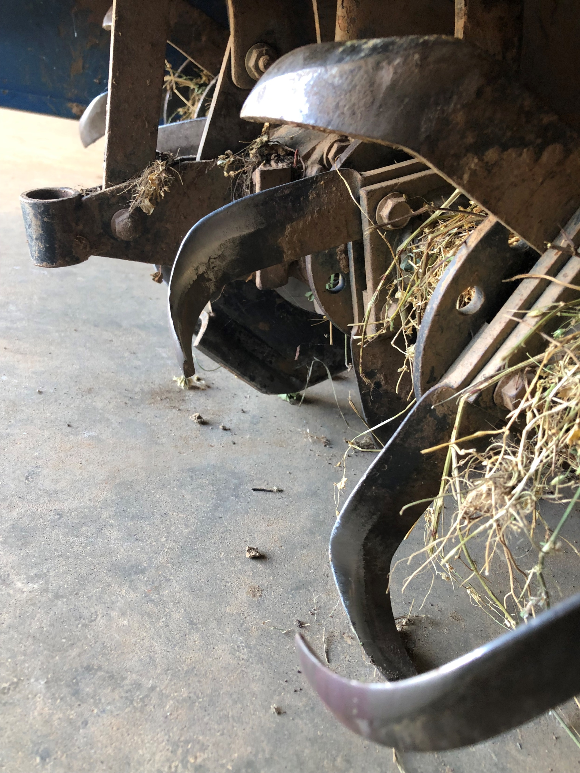
7. Return the tiller to the shed. If anything is clogged in the tiller remove it. The tiller will be cleaned every week. We will assign a beginning farmer to be responsible for spraying down the BCS with water, clearing any debris from the machine, oiling the machine and filling the BCS with fuel each week.

Slide 11
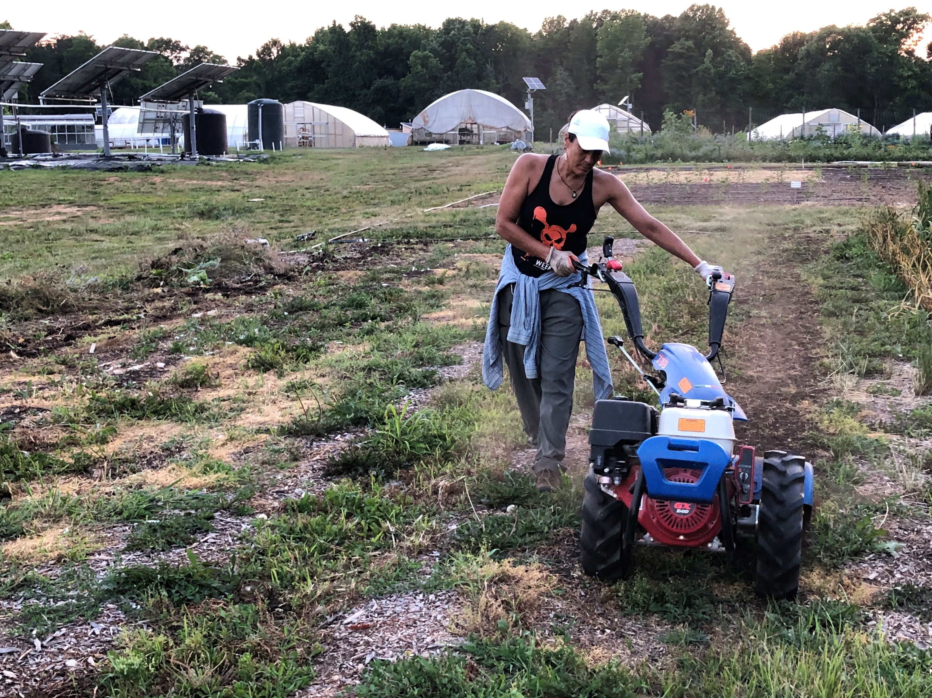
7. Damages must be reported to UDC Staff immediately.
Please complete the weekly tools and machinery report after cleaning the equipment.

