Slide 1
UDC Beginning Farmers Irrigating Beginning Farmers beds near Red Barn
Irrigation Systems
Loves Gardens LLC

Slide 2
Curtesy and Community
Water is needed by all
First come first serve – If the water is on locate the person that is irrigating and ask them how long they will need the water. Once you arrive the person watering has one hour to water until the next person should be expected to use the water.
If you believe water is being wasted please contact Mike Whyte or Lavell Merritt. You can take a picture to document the wasting of water. Lets make sure we are understanding and kind with each other at all times. We will make sure all crops receive water.
All crops in each field can be watered. Communication between all farmers is important. Please let each other know when you have watered. Too much water can damage crops and be wasteful. We will be meeting every two weeks as a farm to discuss irrigation and other farm activities.

Slide 3
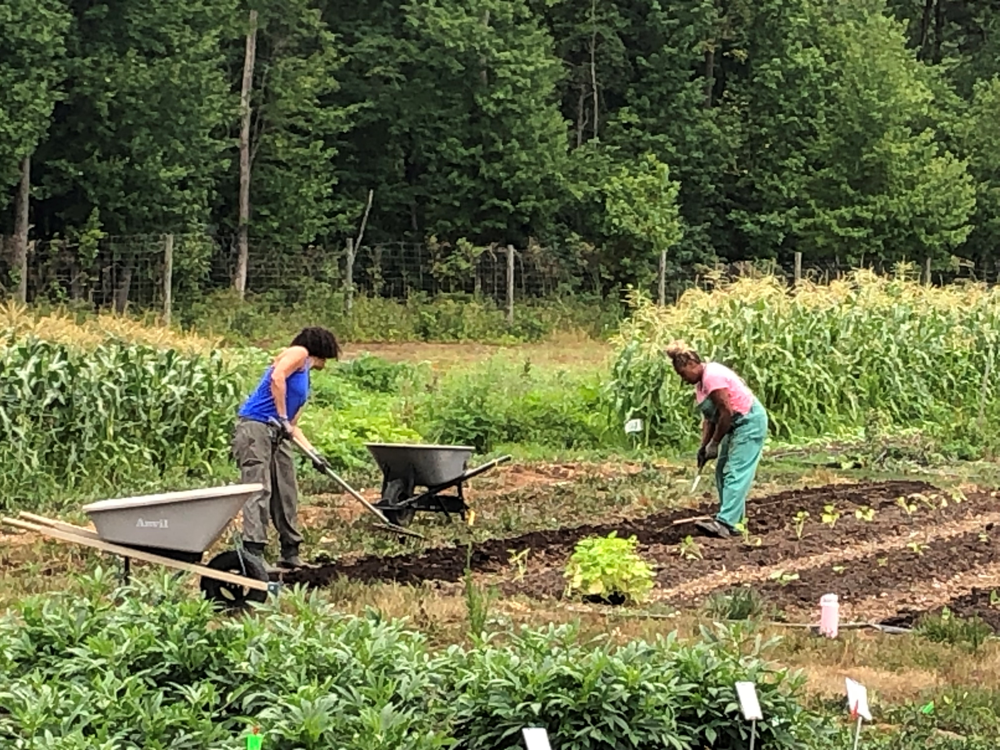
Irrigating Beginning Farmers beds near Red Barn

Slide 4
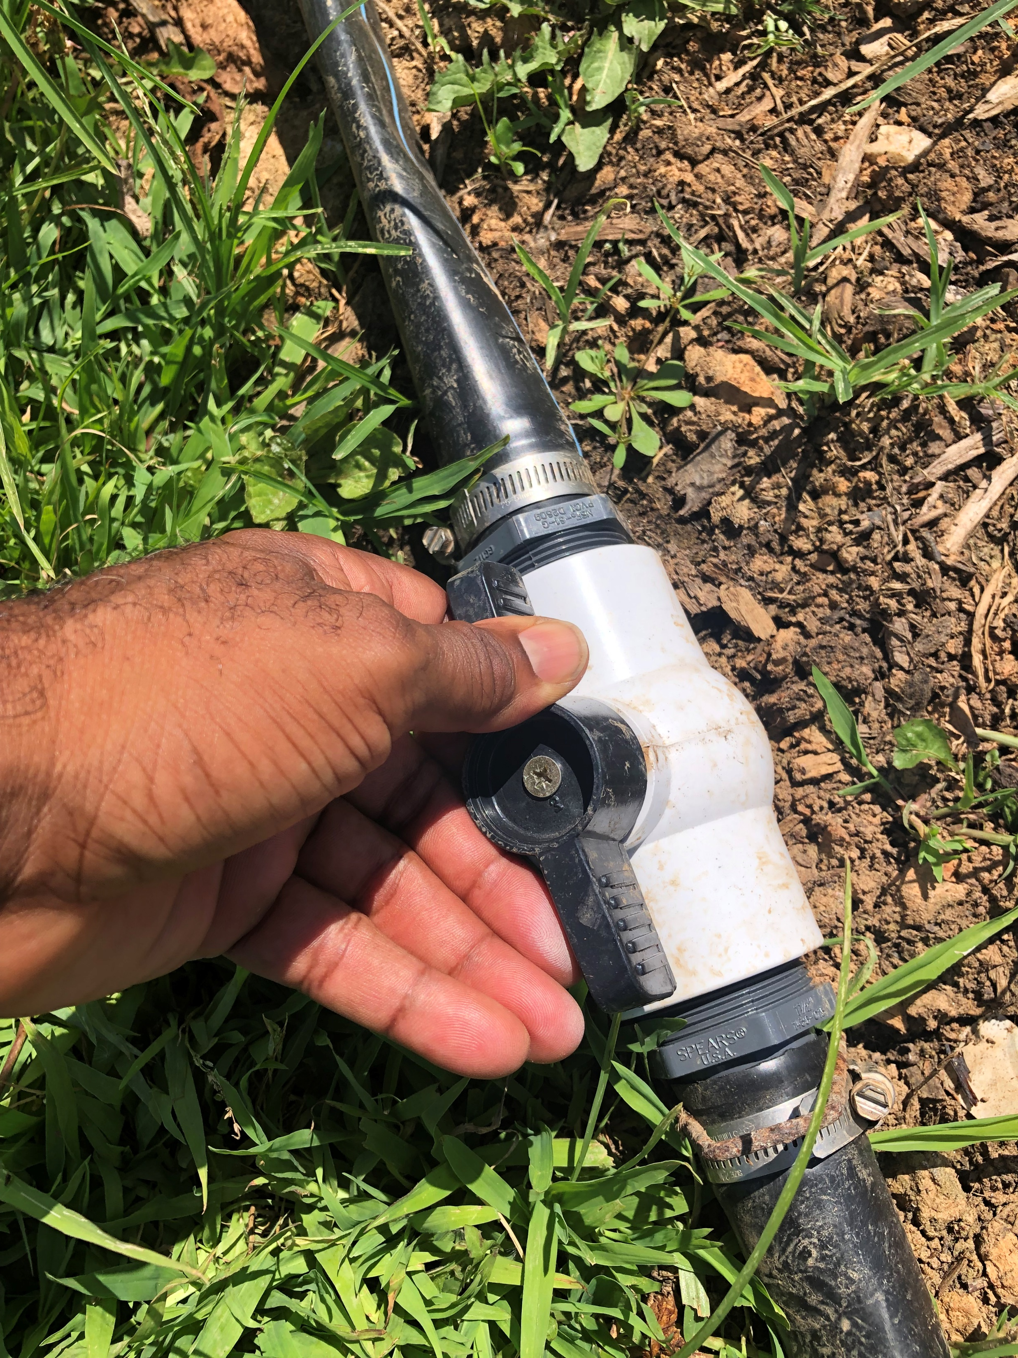
1. Walk to the first junction and turn the water on sending water to the Beginning Farmer Bed. Turn off the water line that sends water to the Beginning Farming Beds

Slide 5
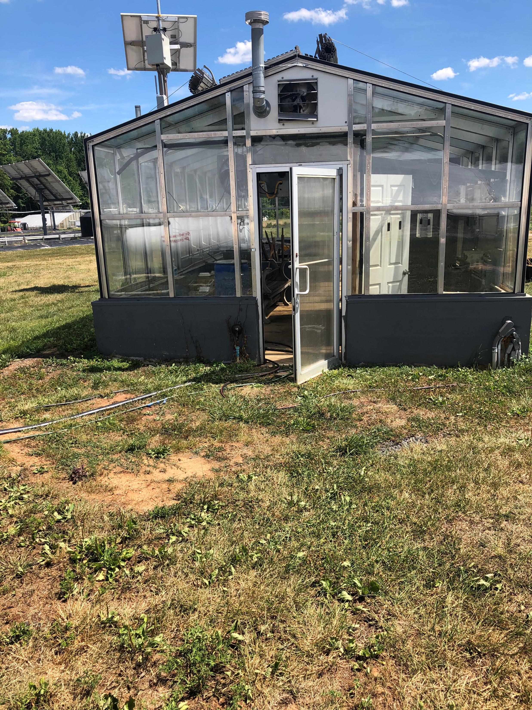
1. Inside the glass green house turn on the water.

Slide 6
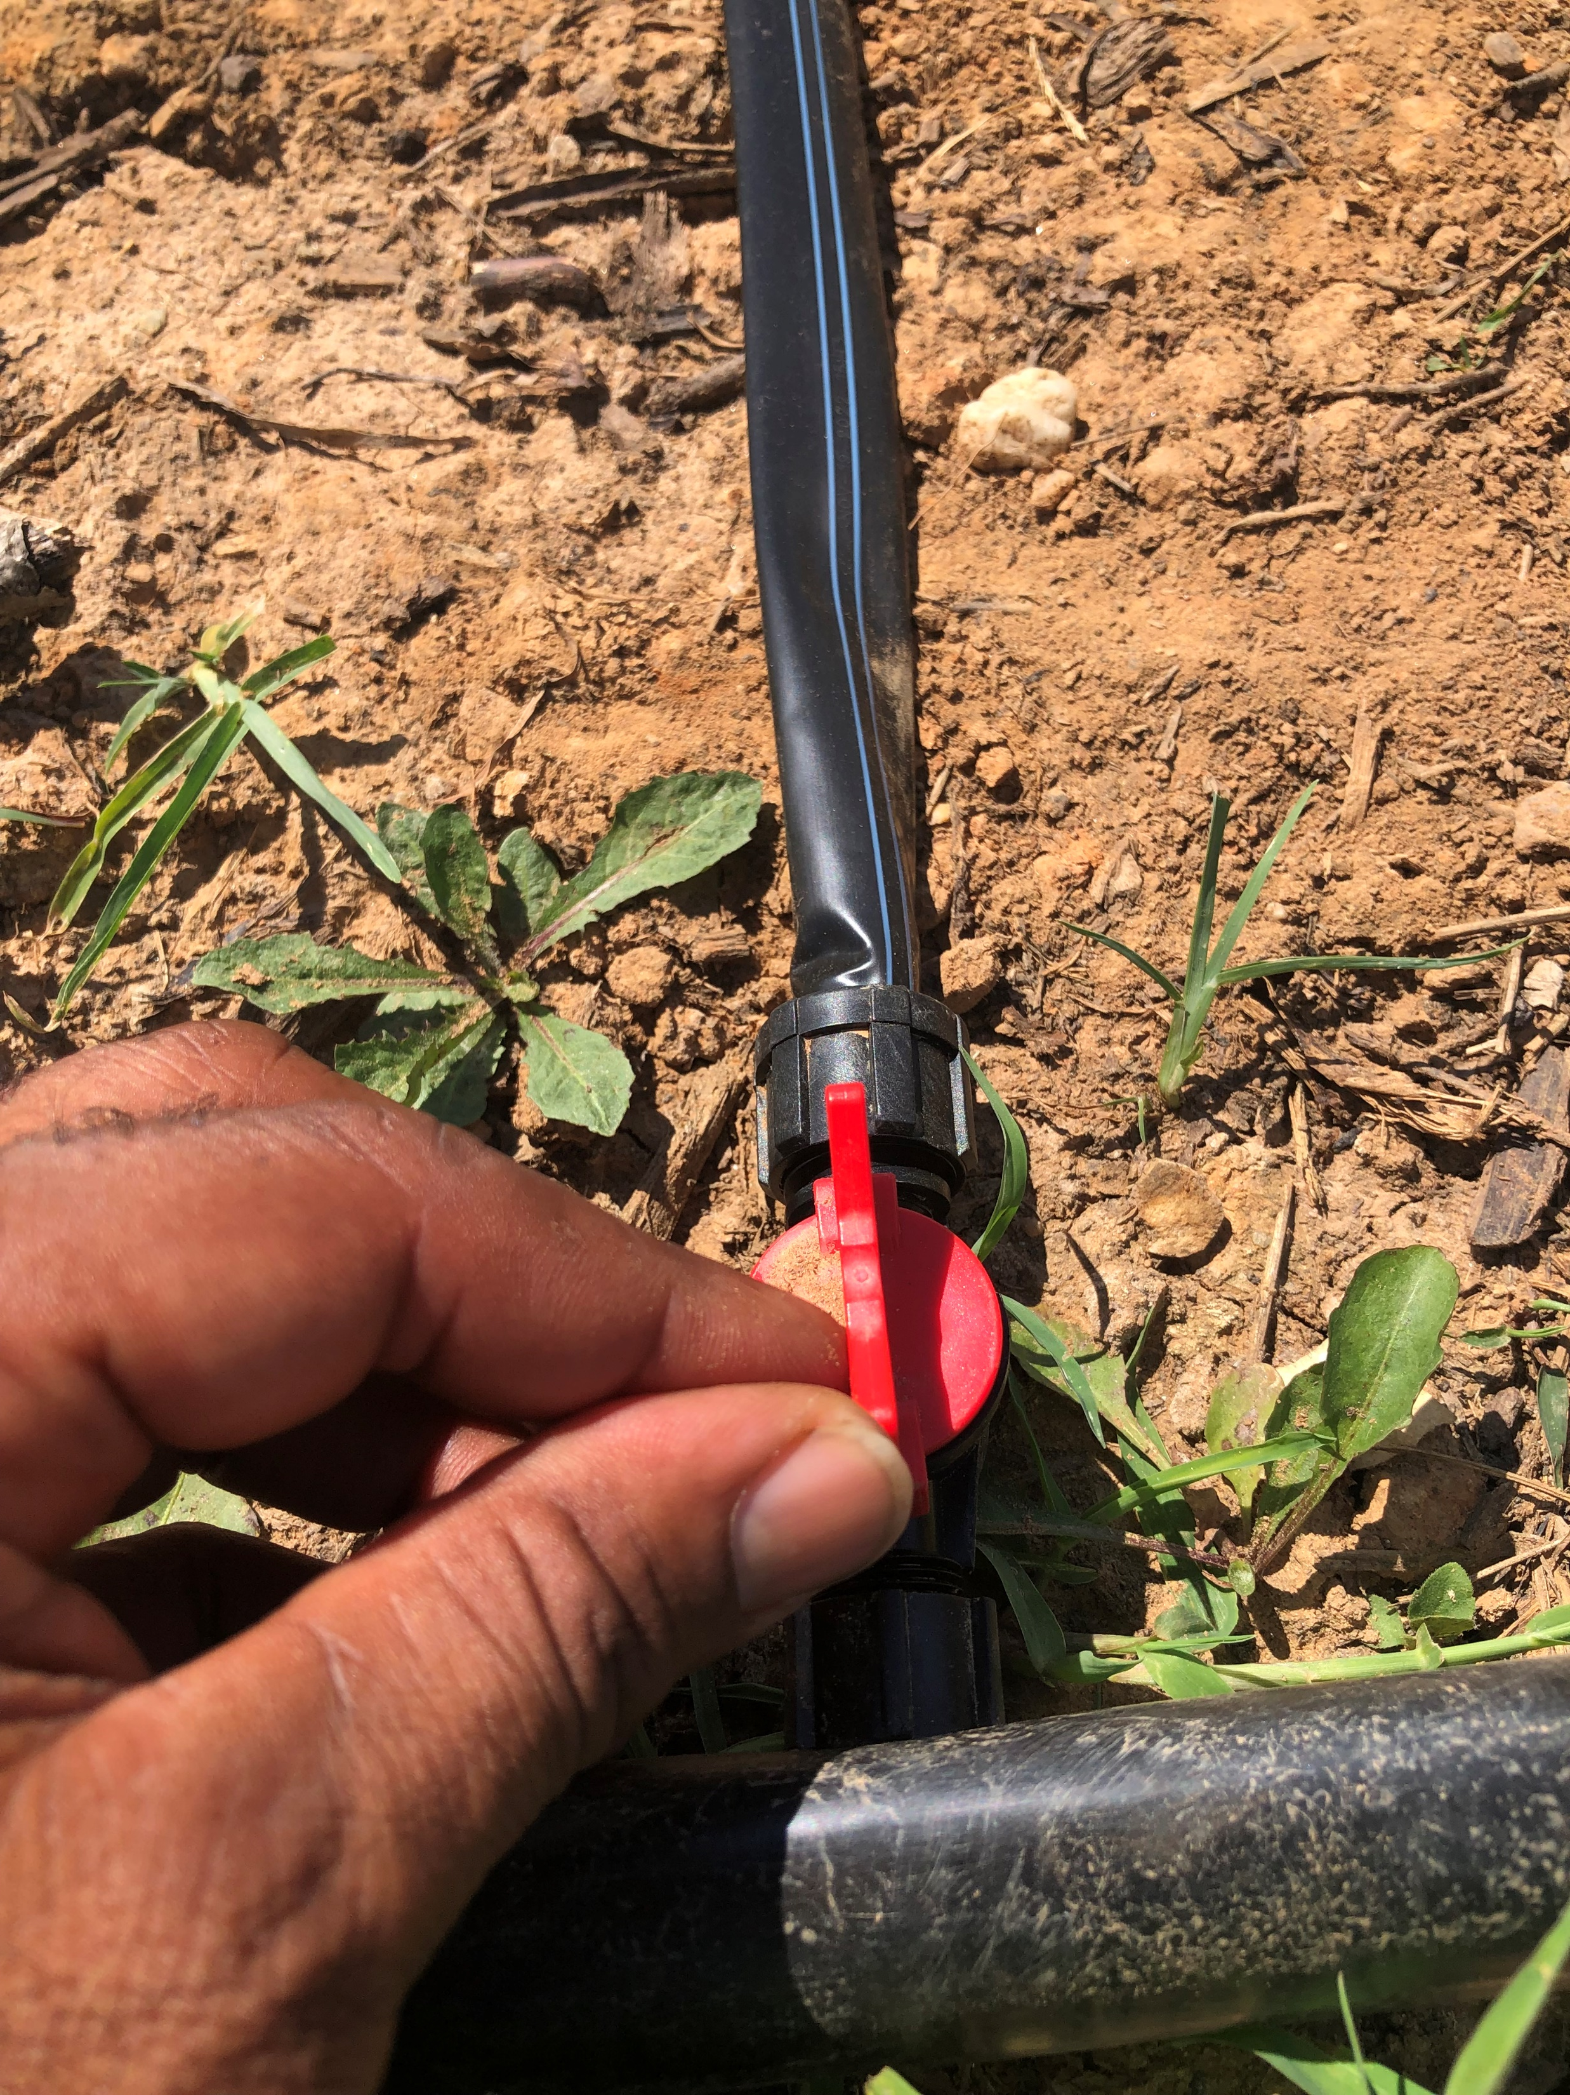
2. Check the emitters in the field. Turn on the emitters you want to water your space. Turn off emitters you don’t water delivered.

Slide 7
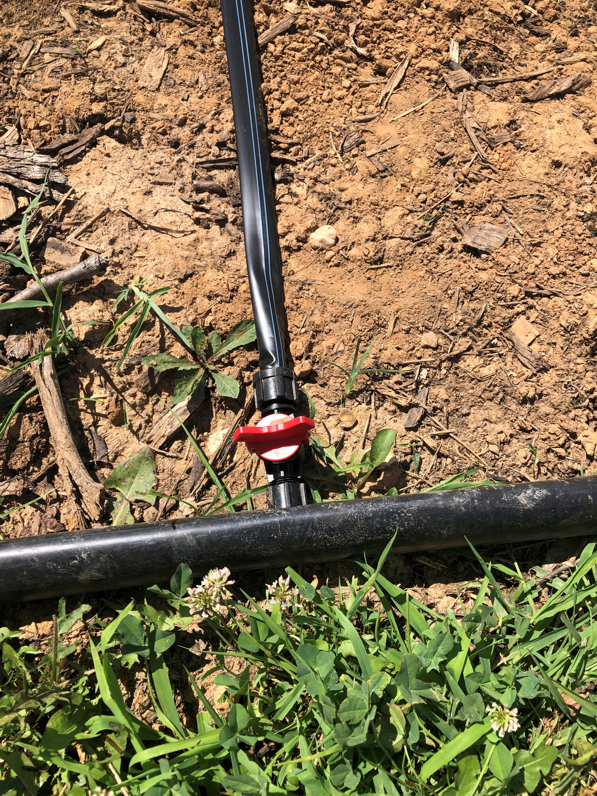
3. Open the irrigation line to the farm beds you want to water.

Slide 8
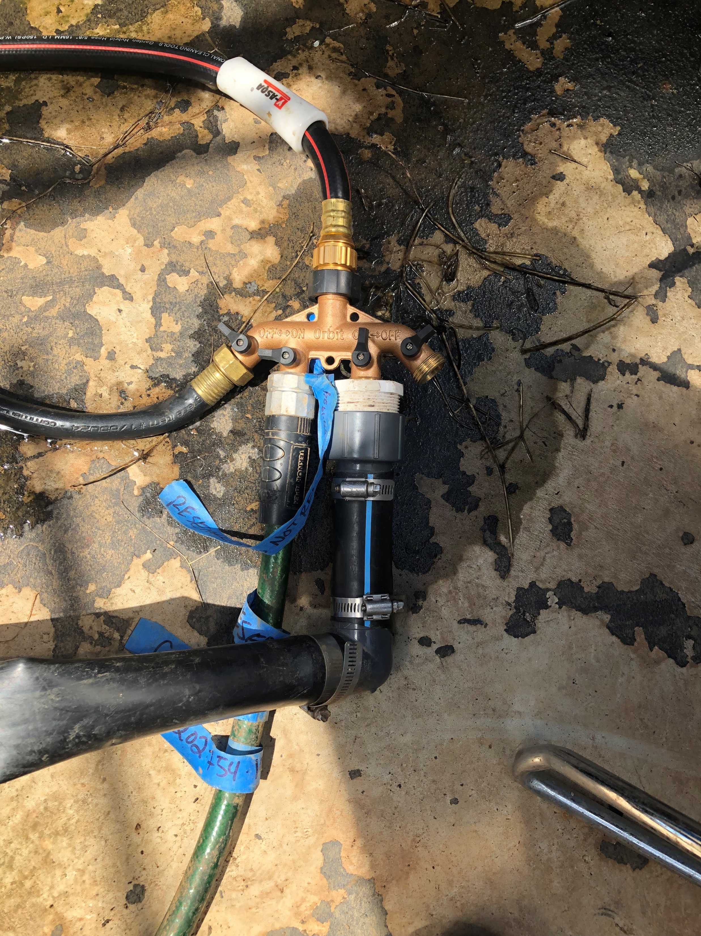
4. Turn the spigot on sending water to your hose. Water will be flowing through the system.

Slide 9
5. The spigot does not need to be turned on full blast. If the pressure is too high your lines will burst. Check the lines after turning the water to make sure the system in working properly

Slide 10
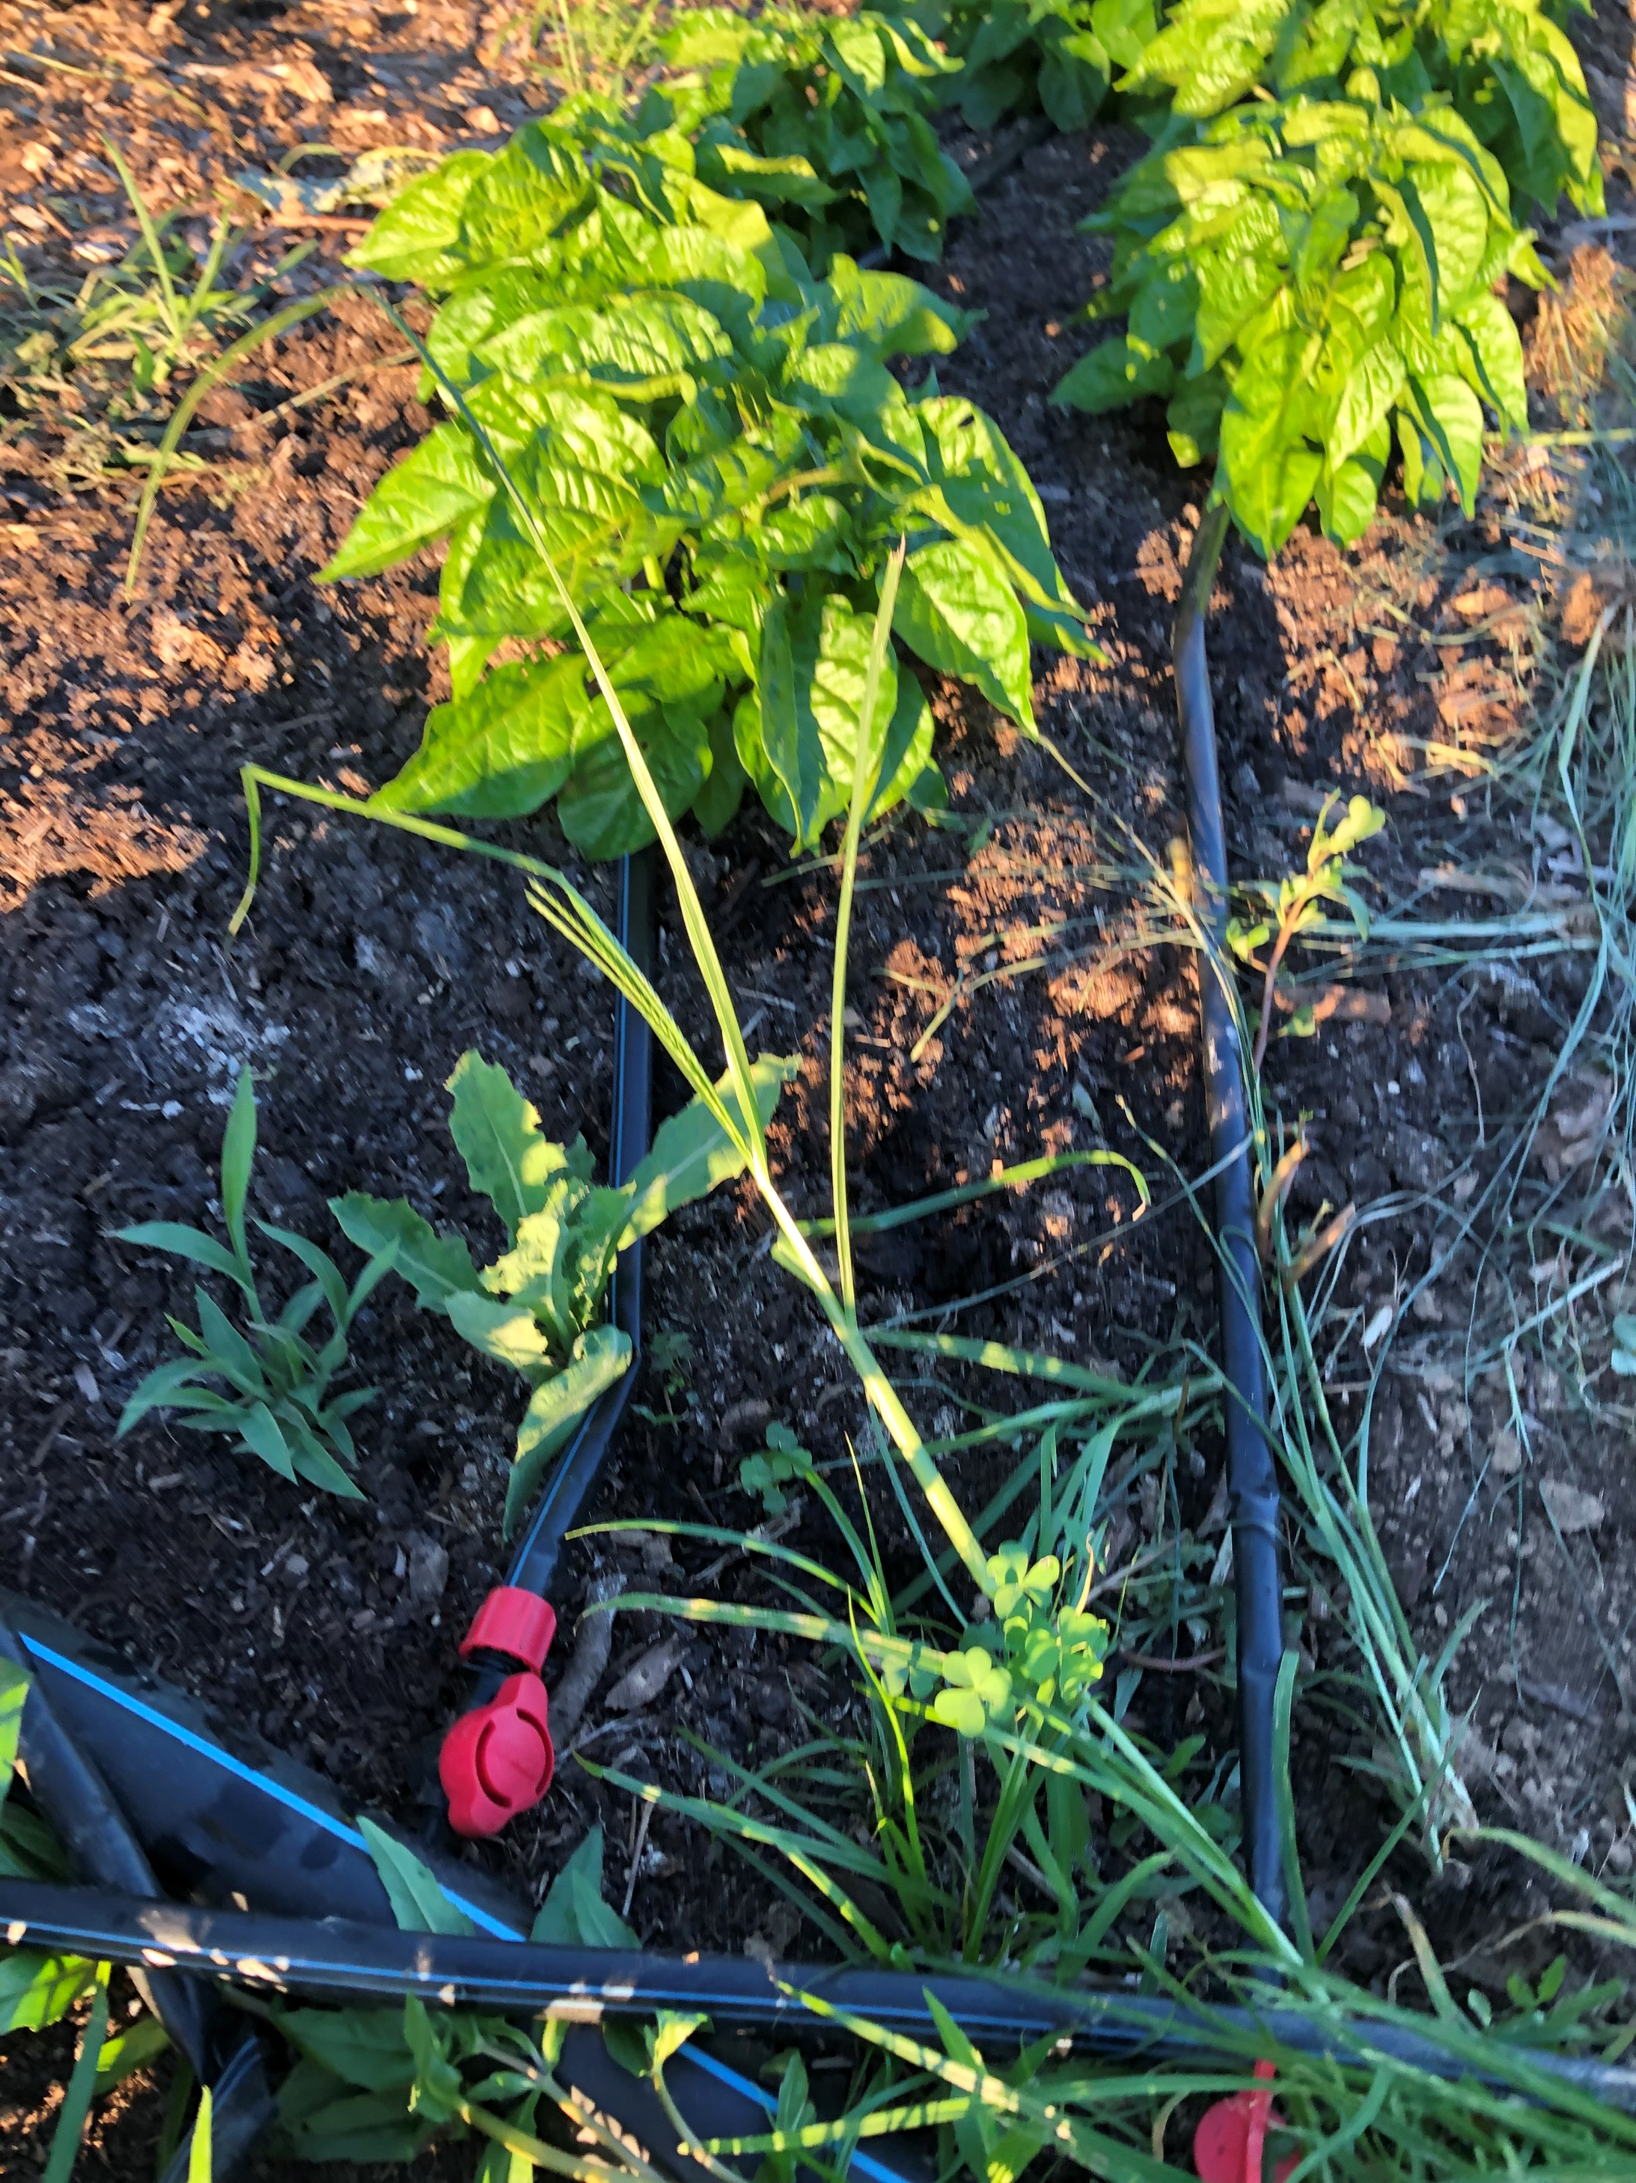
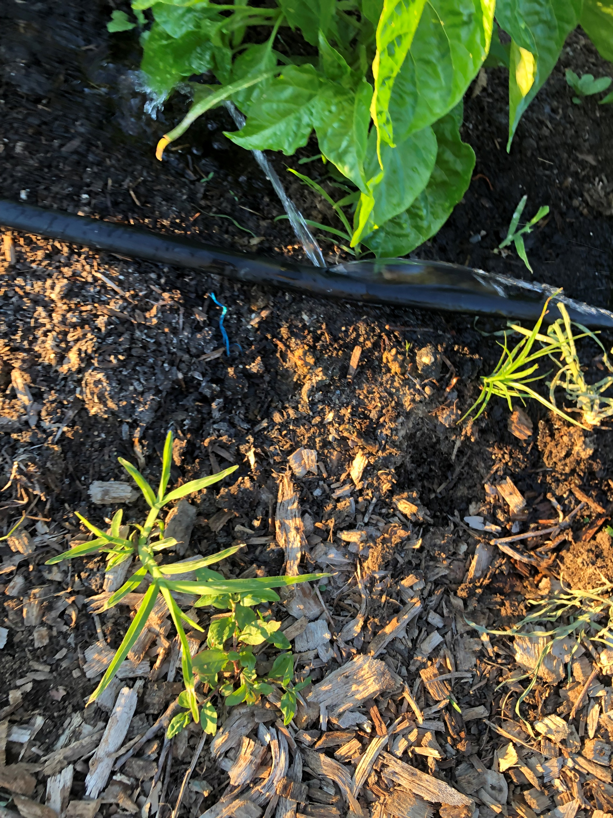
6. Walk along the farm plots to assure water is flowing. Check the water ends of the water lines to make sure they are not leaking or otherwise losing water.

Slide 11
7. Irrigating should take about 1 hour every other day. If it has rained 2 inches do not water.

Slide 12
Turn off the water line from the municipal water by turning off the spigot.

