Slide 1
Pest Management
Loves Gardens

Slide 2
Integrated Pest Management (IPM)
A holistic approach to pest control that combines various strategies to minimize pest damage while minimizing environmental impact.

Slide 3
Pest management is crucial for farming due to several reasons
Crop Protection: Pests, including insects, weeds, and diseases, can severely reduce crop yields and quality. Effective pest management helps protect plants from these threats, ensuring food security and farmer livelihoods.
Economic Impact: Damage from pests results in significant economic losses. They can infest farms, rangelands, and forests, obstruct streams, and damage crops, leading to financial consequences.
Environmental Sustainability: Proper pest control prevents contamination by rodents, cockroaches, and pests that damage fruits and vegetables. Sustainable farming practices, such as integrated pest management (IPM), keep harmful chemicals out of our bodies and environment.

Slide 4
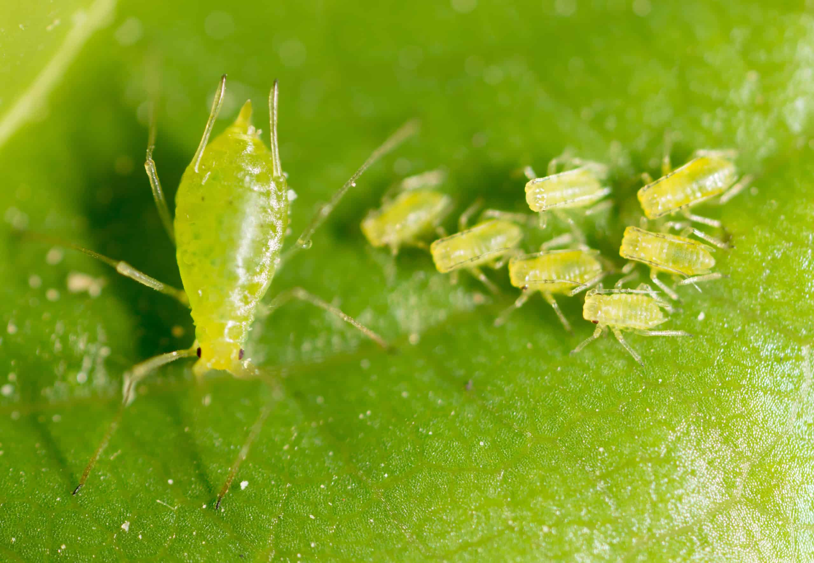
Aphids:
These small, soft-bodied insects can quickly reproduce and suck sap from plants, causing stunted growth and distorted leaves. Control measures include using insecticidal soap or introducing natural predators like ladybugs.

Slide 5
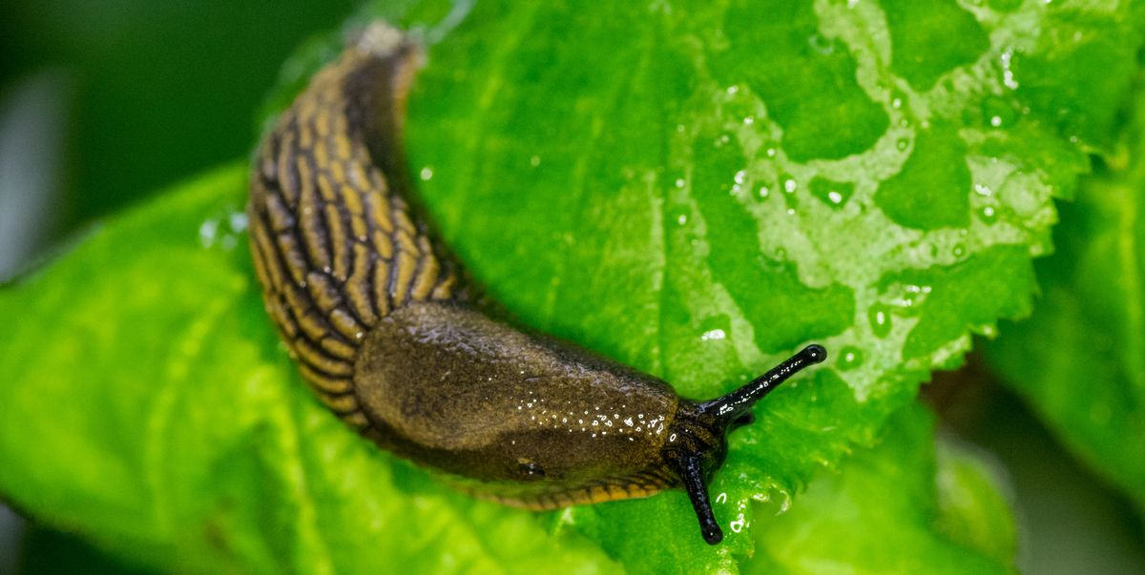
Slugs:
Slugs feed on tender plant tissue, leaving behind slime trails and holes in leaves. Control options include handpicking, using barriers like copper tape, and applying iron phosphate baits.

Slide 6
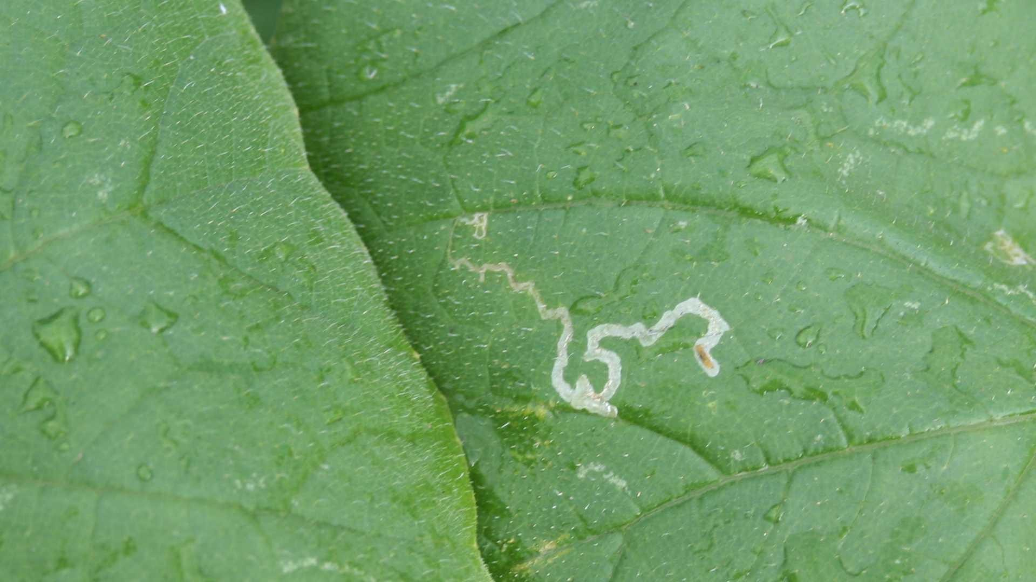
Leafminers –
Insects (flies) that feed between the surfaces of leaves during their juvenile (larval) stage of life.

Slide 7
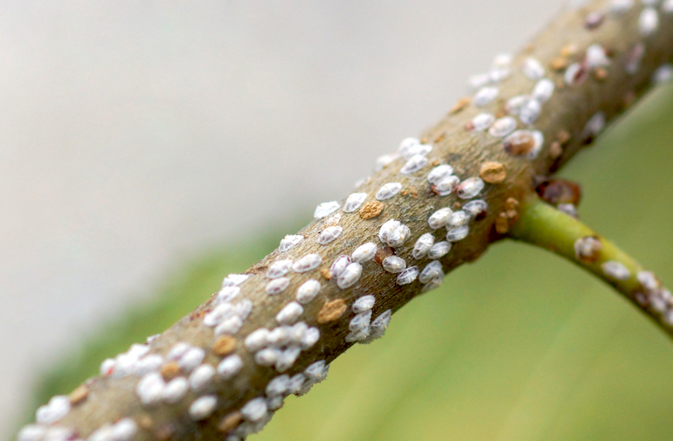
Scale Insects:
Scale insects can infest a variety of plants, causing yellowing, wilting, and leaf drop. Pruning infested branches and applying horticultural oil can help manage scale populations.

Slide 8
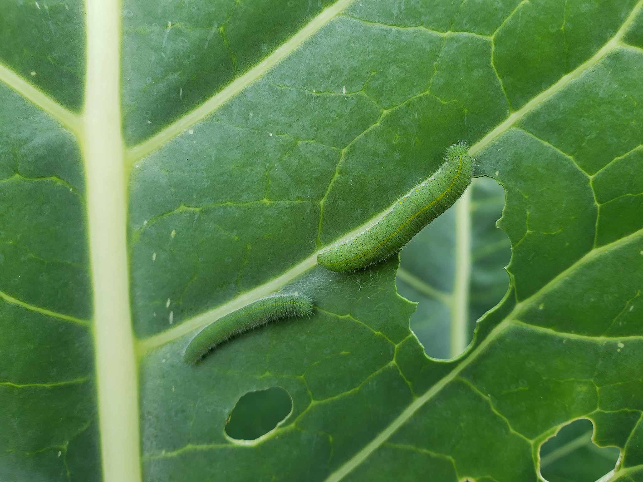
Cabbage Worms:
These caterpillars feed on cabbage family crops, leaving behind chewed leaves. Control methods include handpicking and using floating row covers.

Slide 9
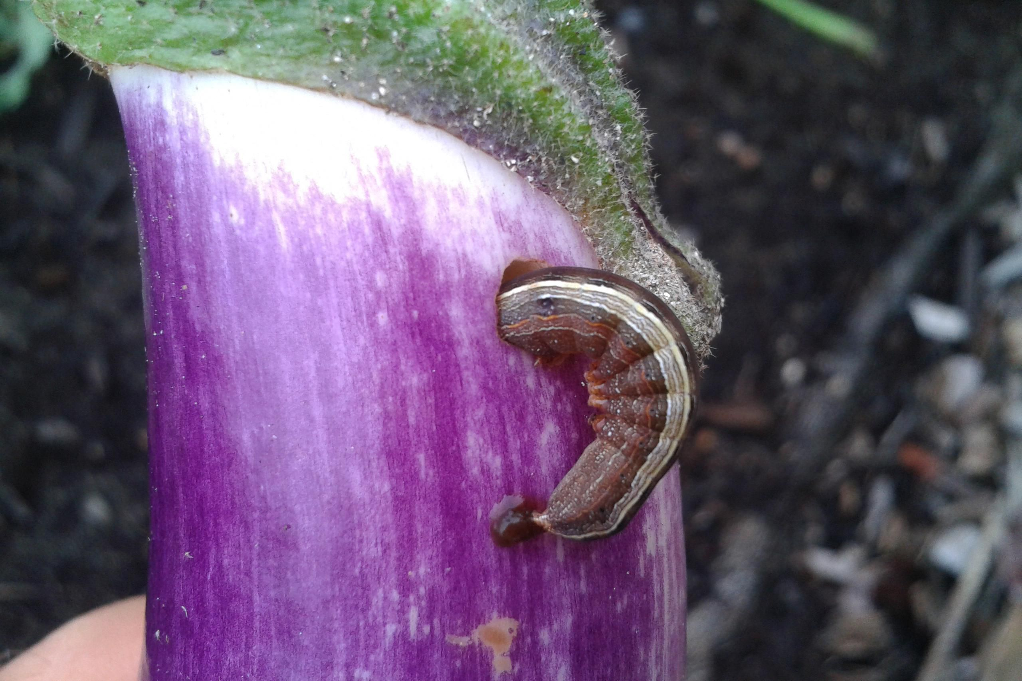
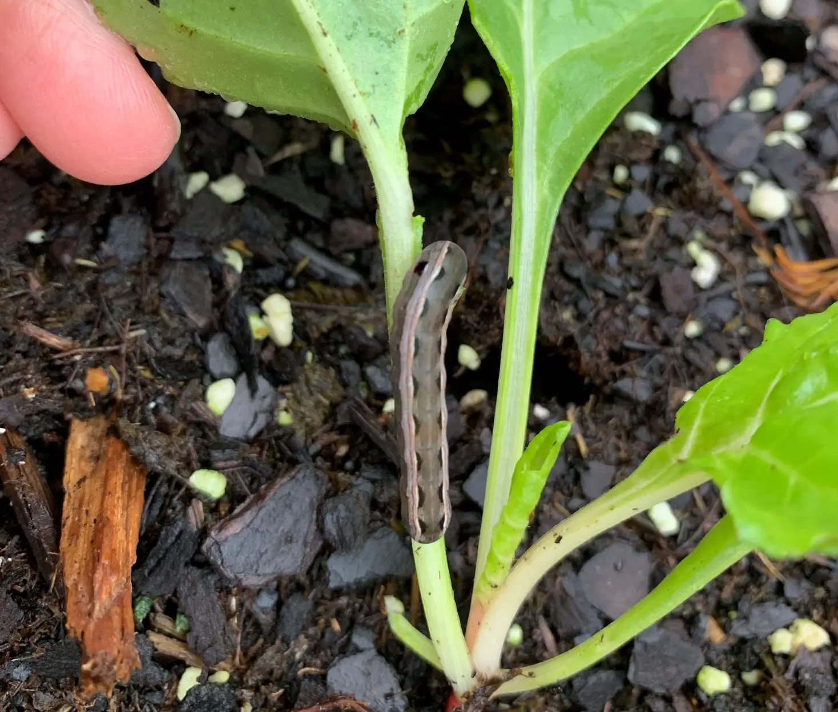
Cutworms:
Cutworms feed on young seedlings, cutting them off at the soil surface. Preventive measures include using collars around seedlings and cultivating the soil to expose cutworm pupae.

Slide 10
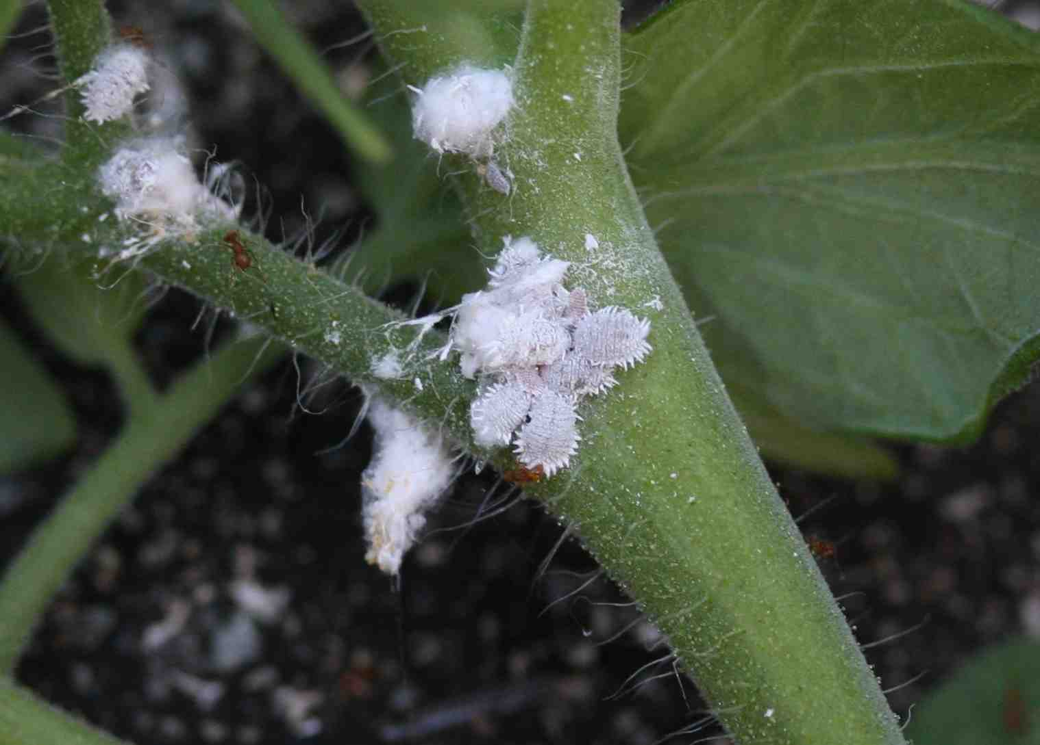
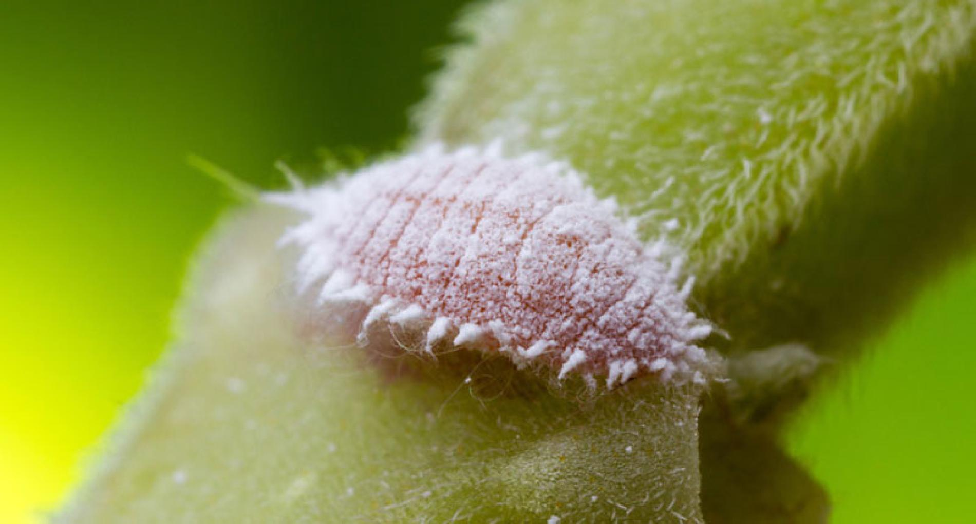
Mealybugs:
Mealybugs are small, white, cottony insects that feed on plant juices, causing yellowing and wilting. Control options include spraying plants with neem oil or introducing beneficial insects like parasitic wasps.

Slide 11
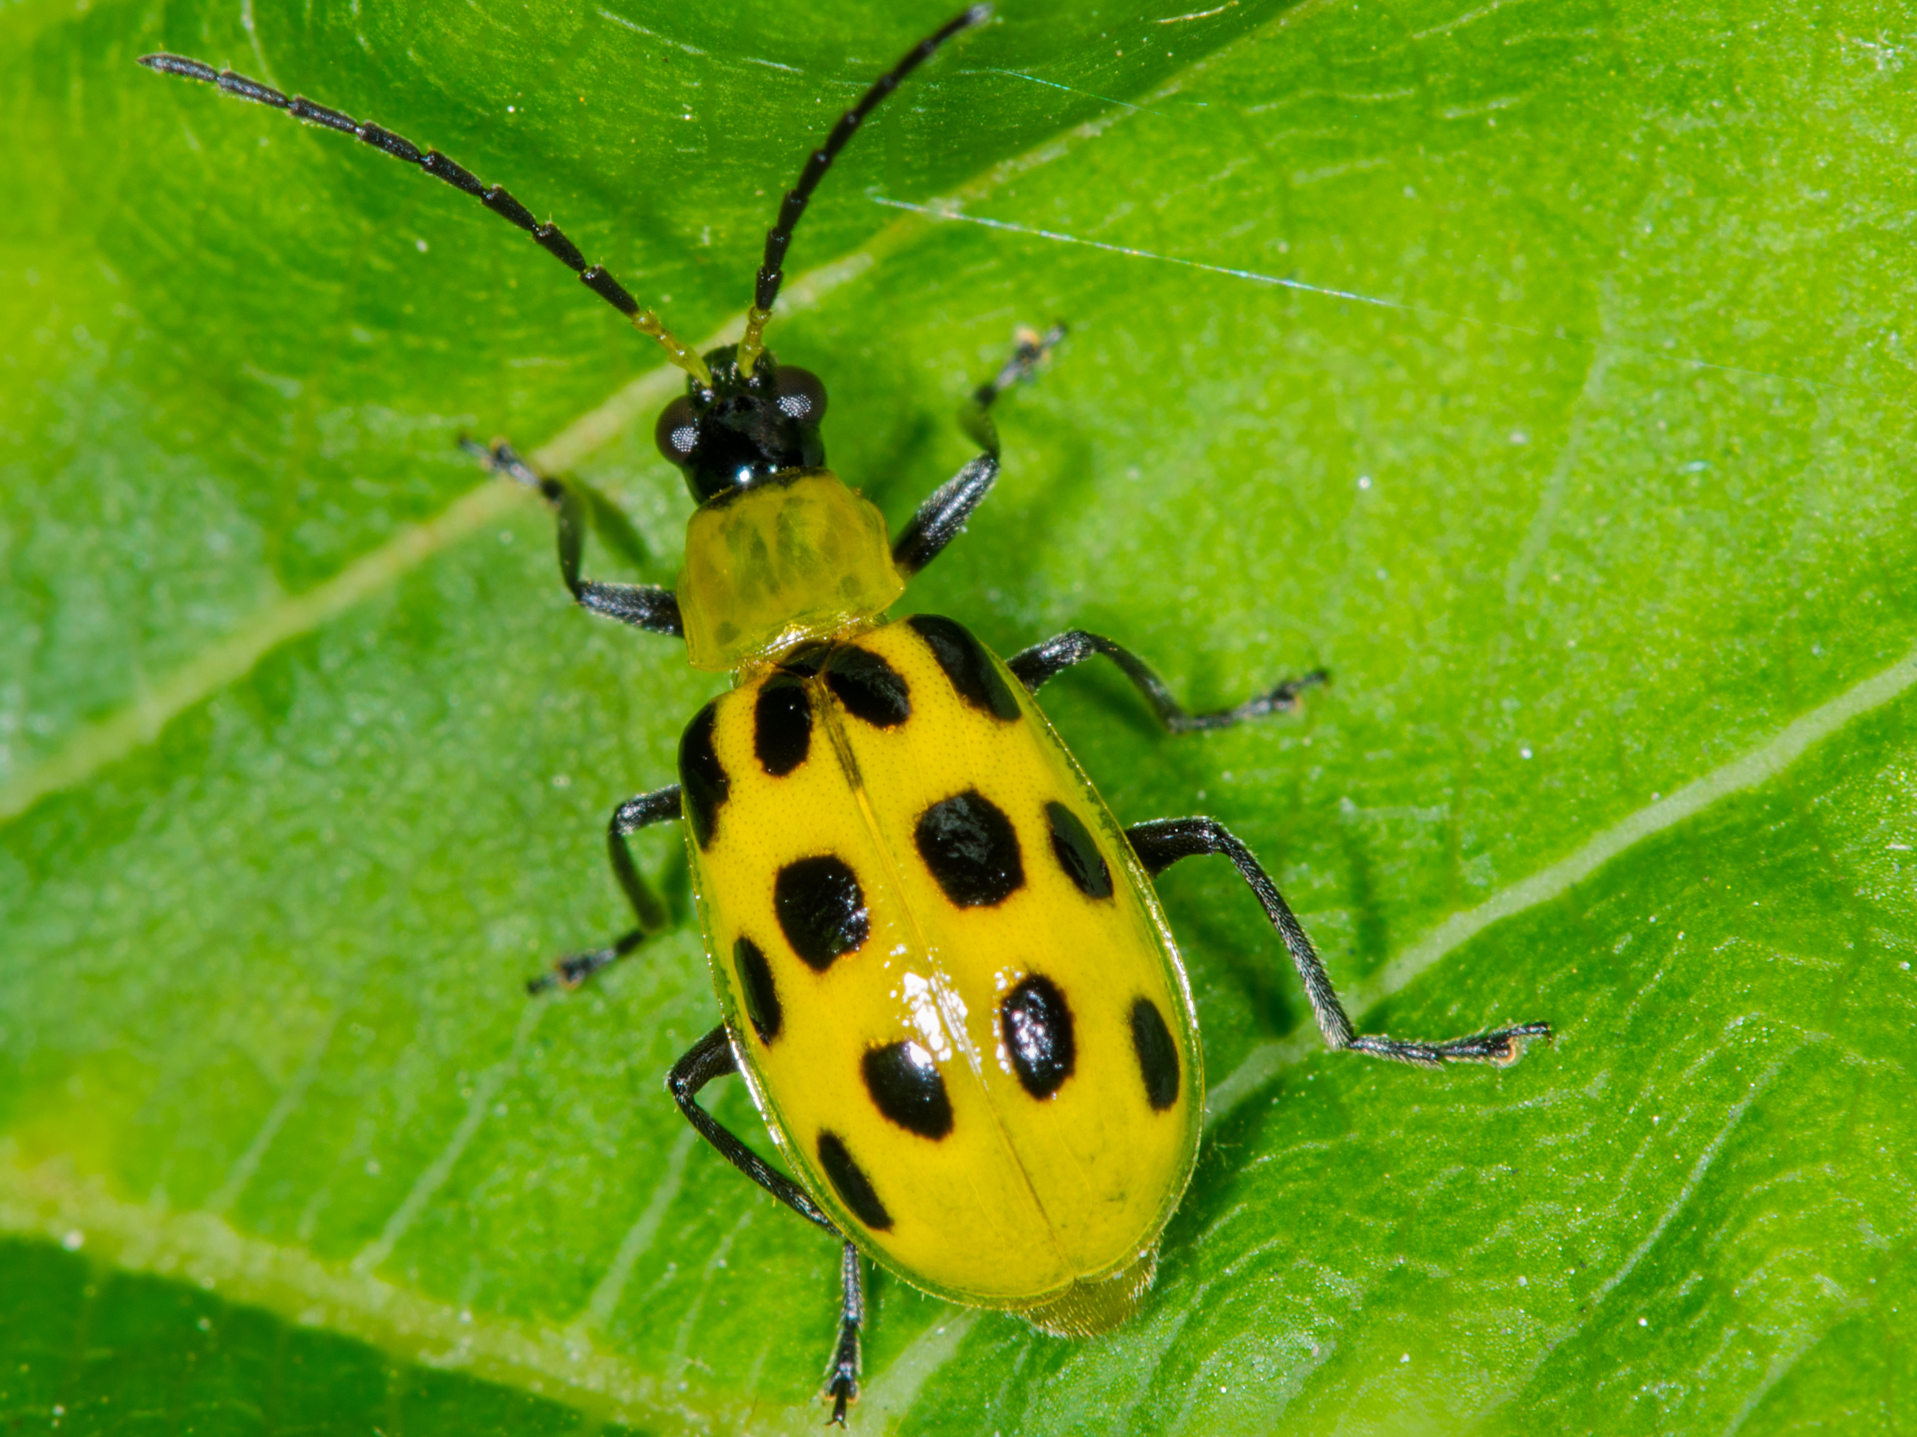
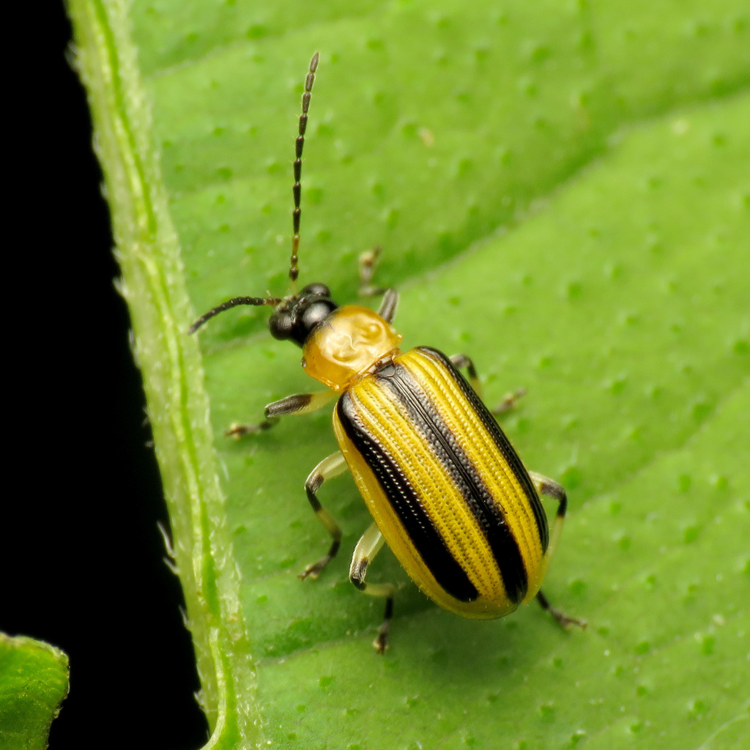
Cucumber Beetles –
Cucumber beetles actually come in two varieties. While the two varieties look different, their damage is the same. The striped cucumber beetle is either yellowish-green or orangeish-green with three black stripes down its back. The spotted cucumber beetle is also either yellowish-green or orangeish-green with 12 black spots on its back

Slide 12
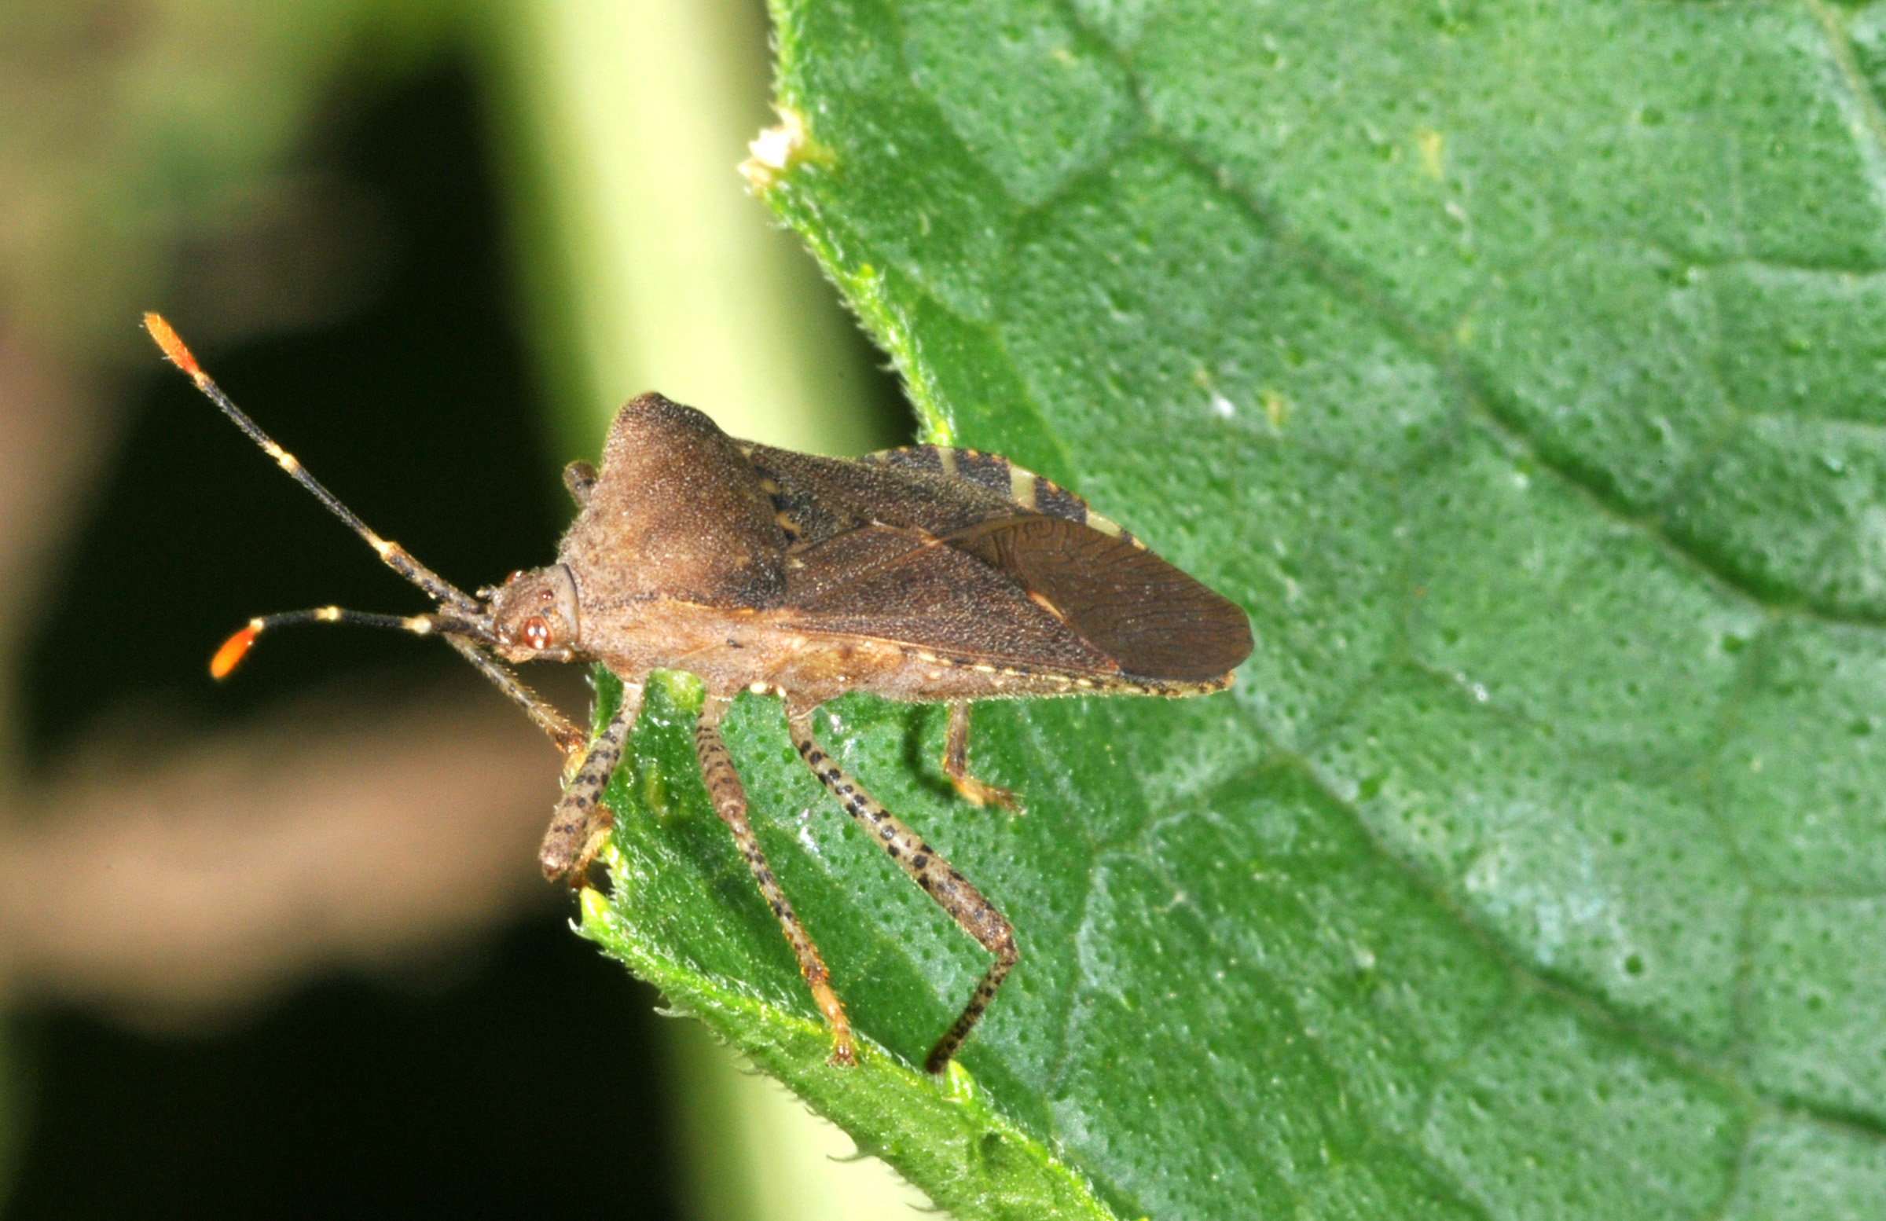
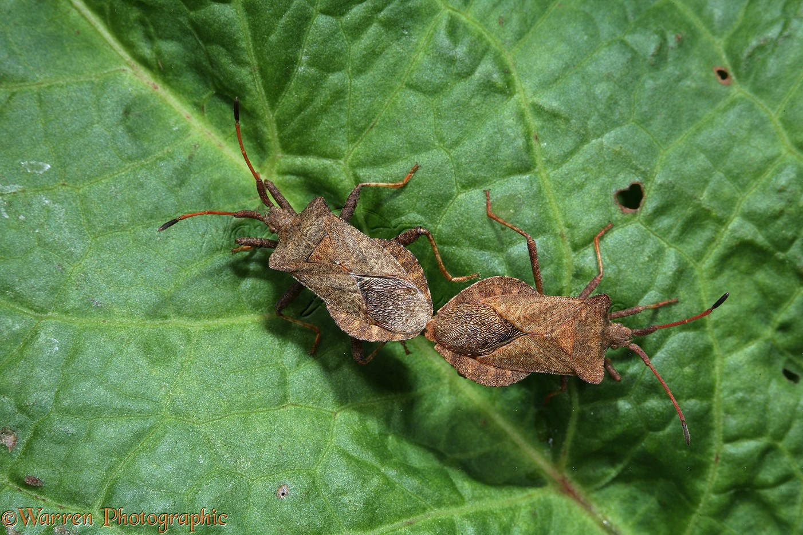
Squash Bugs:
These pests can decimate squash and pumpkin plants by feeding on sap and transmitting diseases. Handpicking and using row covers are effective control methods.

Slide 13
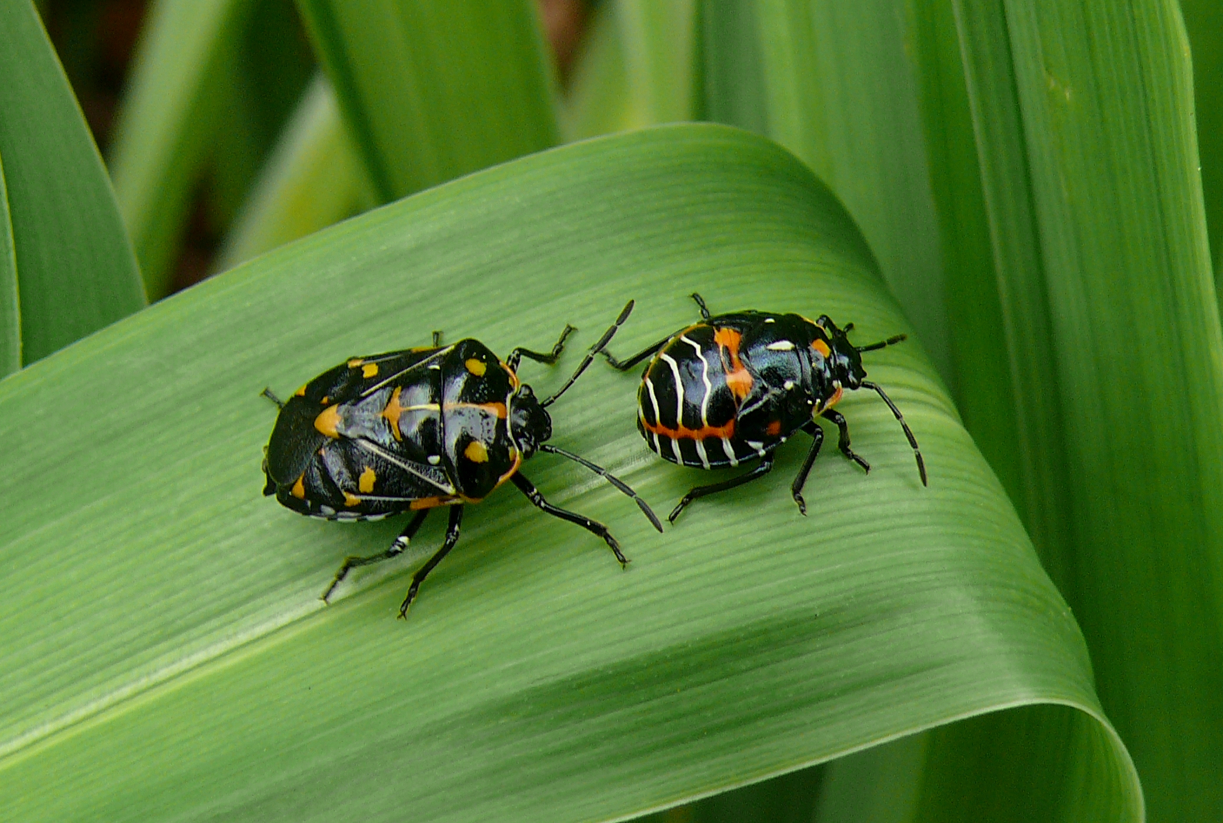
Harlequin Beetles:
These colorful beetles feed on cruciferous vegetables, causing significant damage. Handpicking and planting trap crops can help manage their populations.

Slide 14
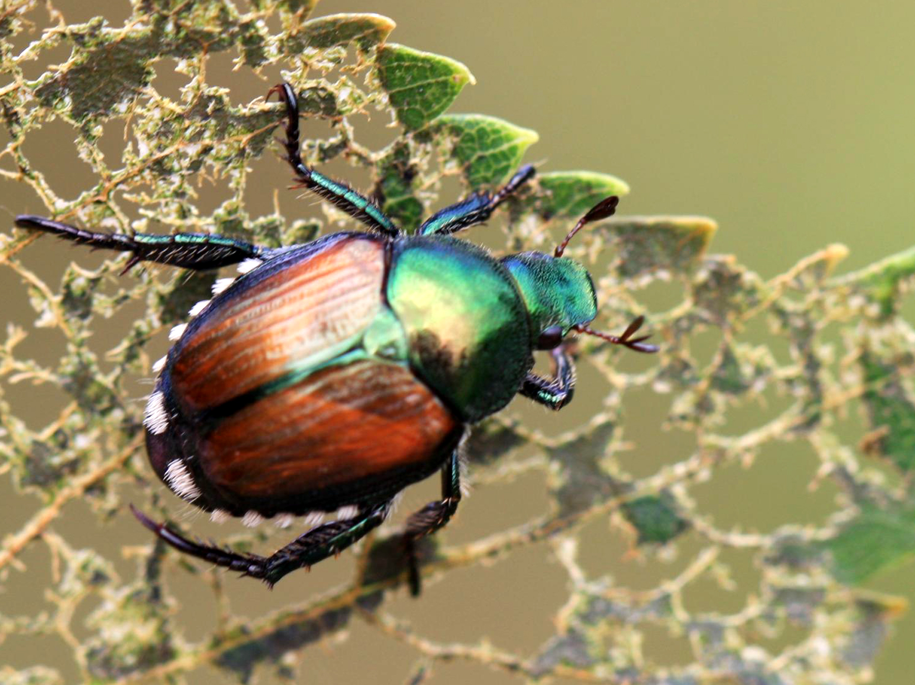
Japanese Beetles:
Japanese beetles feed on a wide range of plants, skeletonizing leaves and causing defoliation. Strategies for control include handpicking, pheromone traps, and applying neem oil.

Slide 15
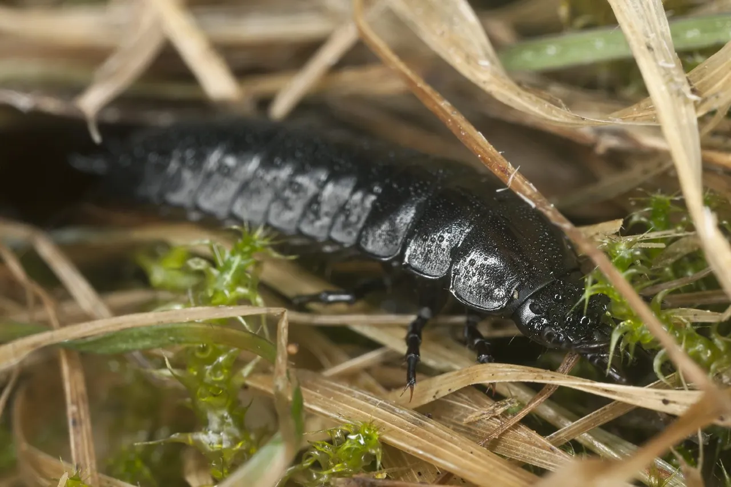
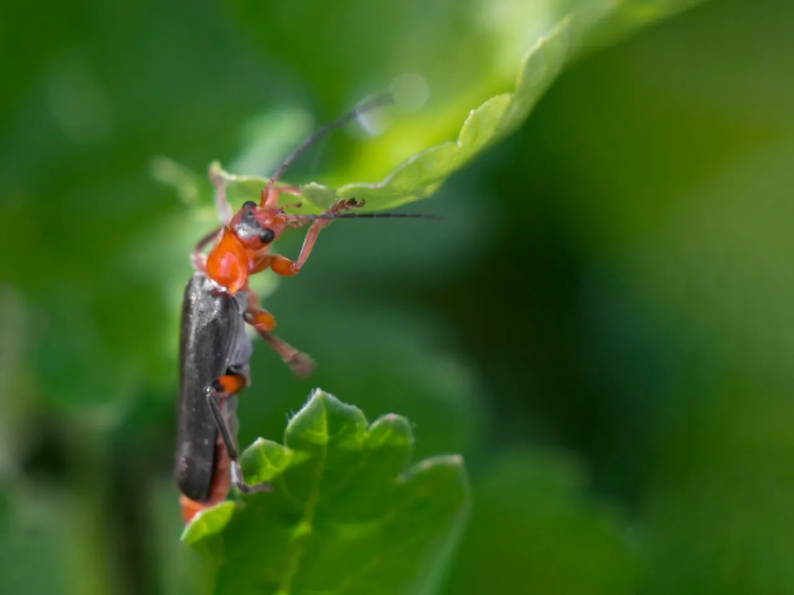
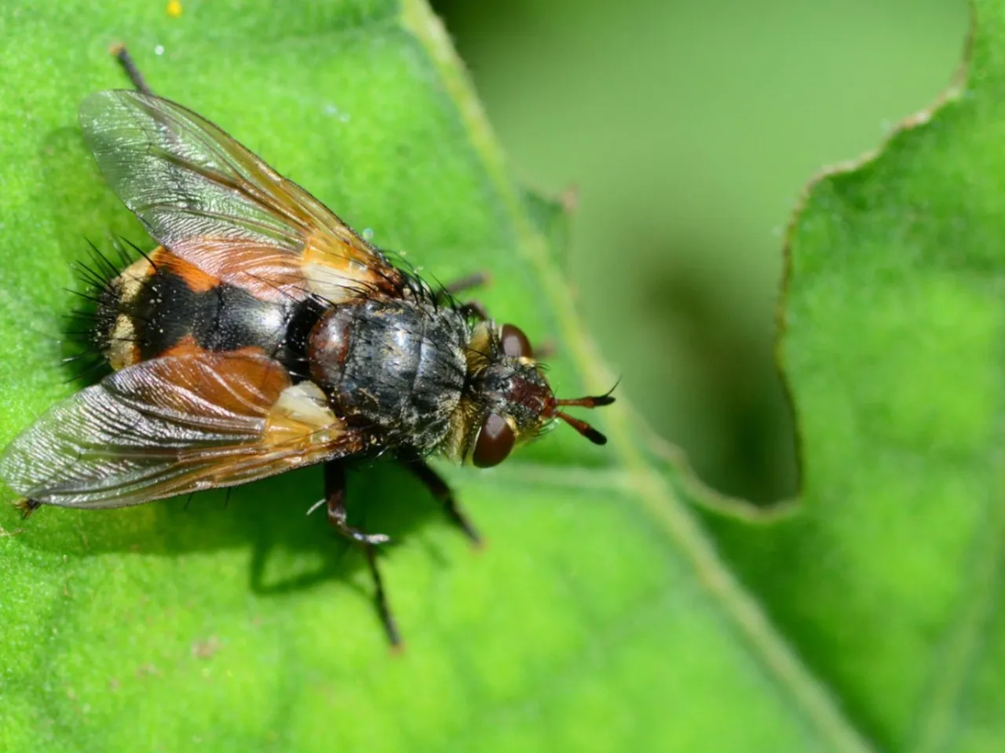
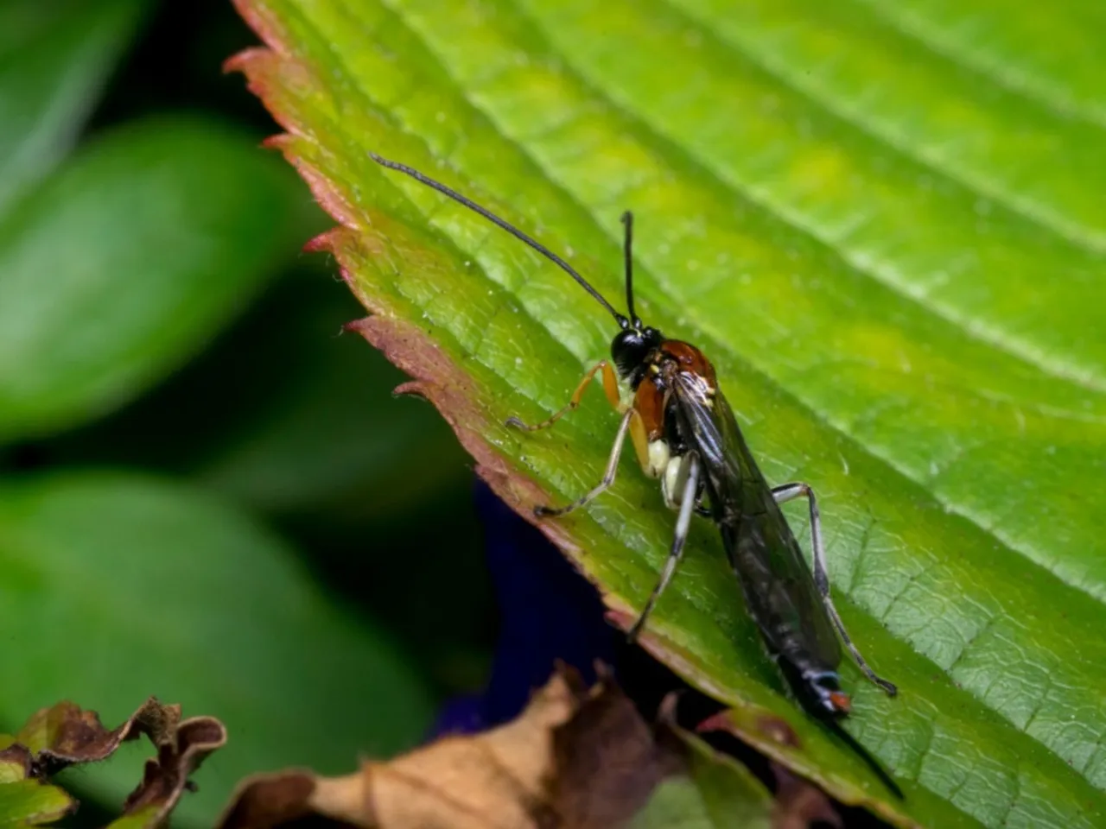
Beneficial Insects –
There are many beneficial wildlife helpers in the garden. From natural predators that feed on pests and good garden bugs that pollinate plants to other garden friends likes frogs and birds.
Soldier beetles
Tachinid flies
Ground beetles
Entomopathogenic nematodes
Braconid wasps
Lady Bugs
Praying Mantis
Lace Wing

Slide 16
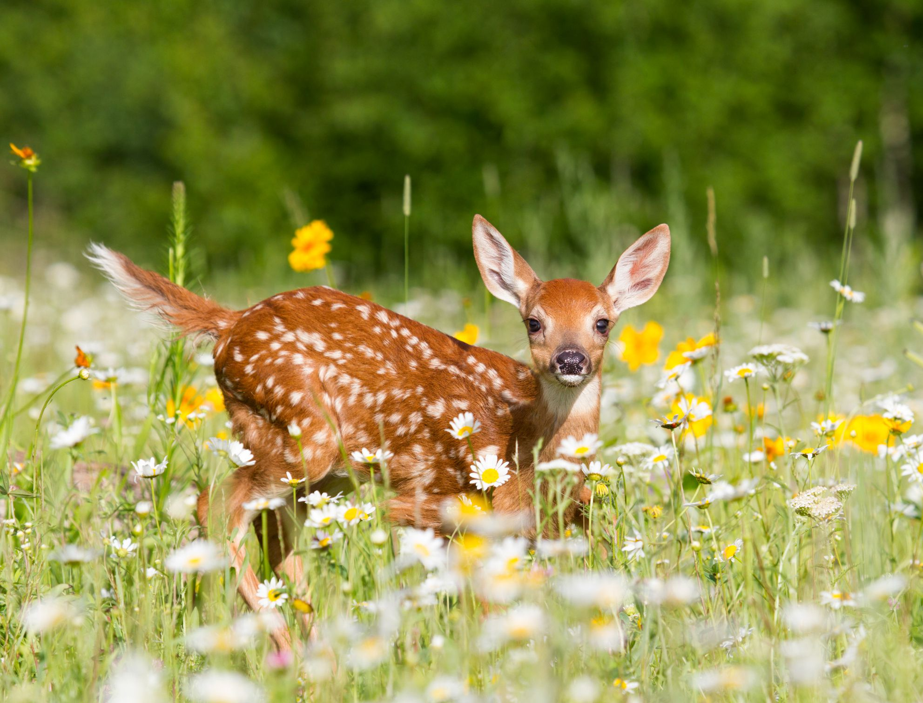
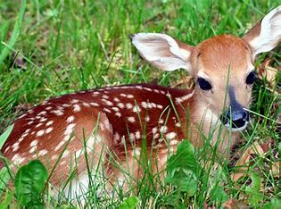
Deer: Deer can cause extensive damage to garden plants, especially during the growing season. Fencing, repellents, and planting deer-resistant plants are effective control measures.

Slide 17
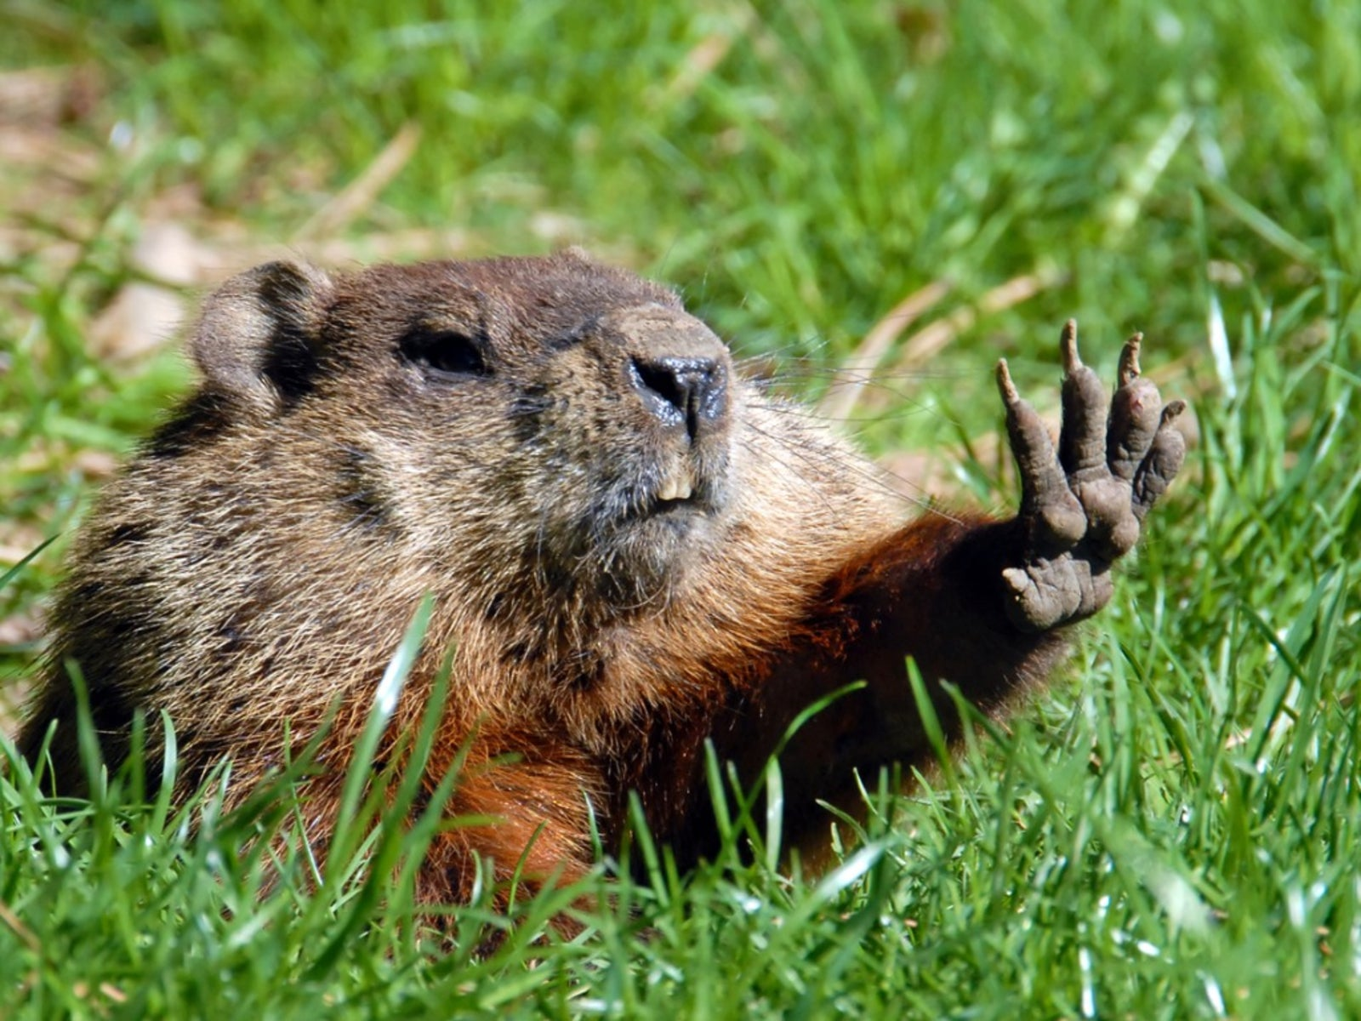
Groundhogs:
Groundhogs can eat a wide variety of garden plants and are skilled diggers. Fencing and trapping are common methods for managing groundhog populations.

Slide 18
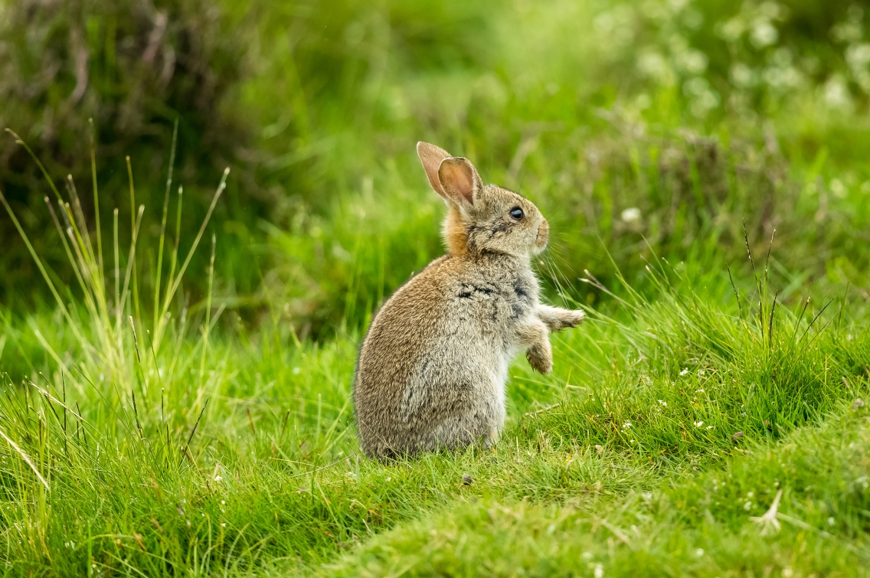
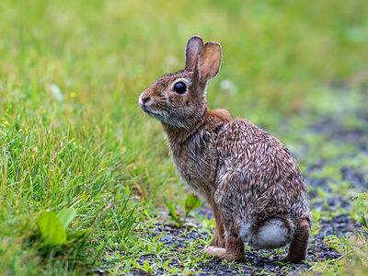
Rabbits: Rabbits feed on a range of garden plants, particularly tender young growth. Fencing and repellents can help protect plants from rabbit damage.

Slide 19
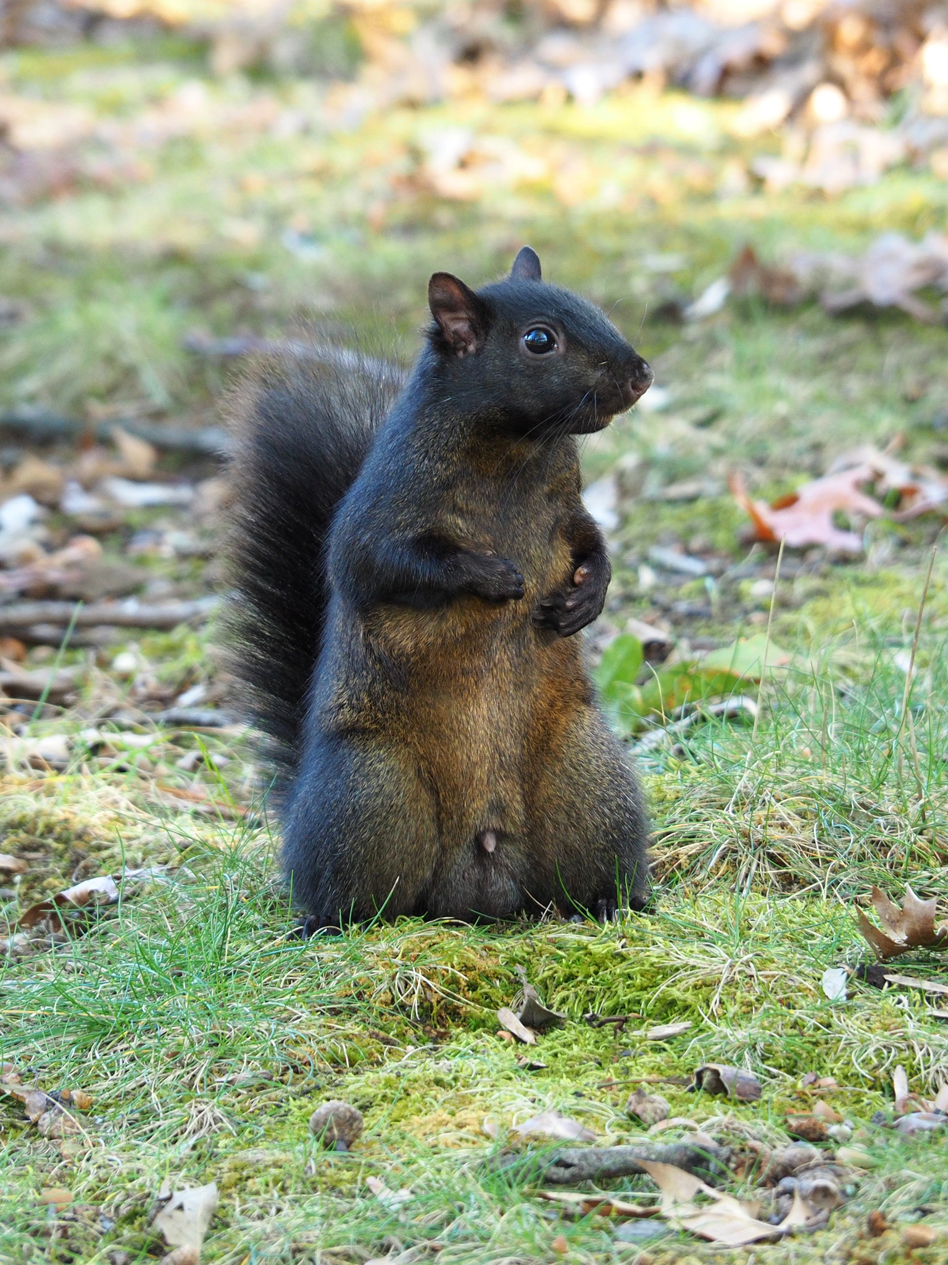
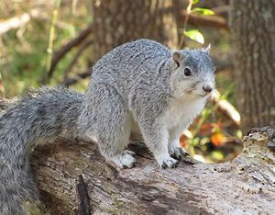
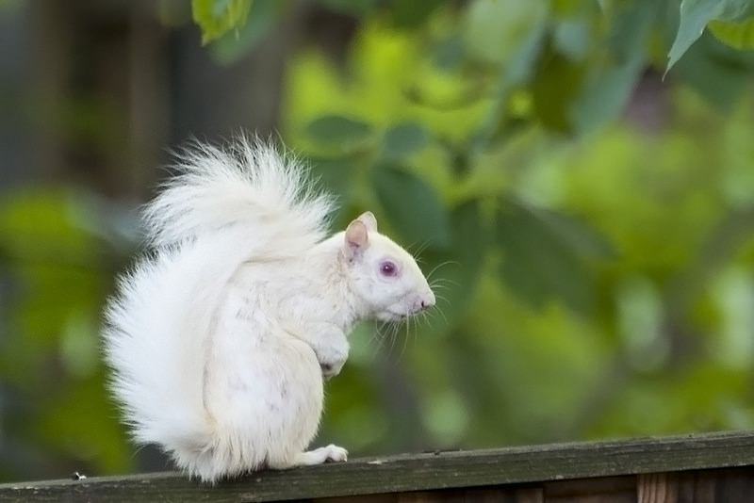
Squirrels:
Squirrels can damage plants by digging up bulbs, raiding bird feeders, and chewing on fruits and vegetables. Exclusion methods and deterrents like motion-activated sprinklers can help deter squirrels.

Slide 20
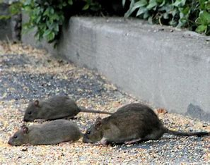
Rats and Mice:
Rodents can cause damage to garden plants and structures, as well as spread disease. Eliminating food sources, sealing entry points, and using traps are effective control measures.

Slide 21
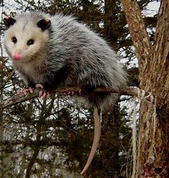
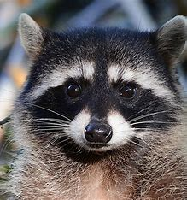
Raccoons and Possums:
These nocturnal pests can raid gardens for fruits and vegetables. Fencing and securing compost bins can help prevent access to food sources.

Slide 22
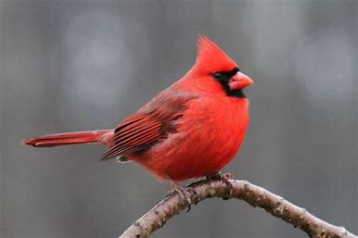
Birds – Birds peck fruit for food and moister. Bird Netting, Bird Repellent Spray, Reflective Tape and Shiny Objects, Decoys and Predatory Bird Figures, and Motion-Sensing Water Sprayers.

Slide 23
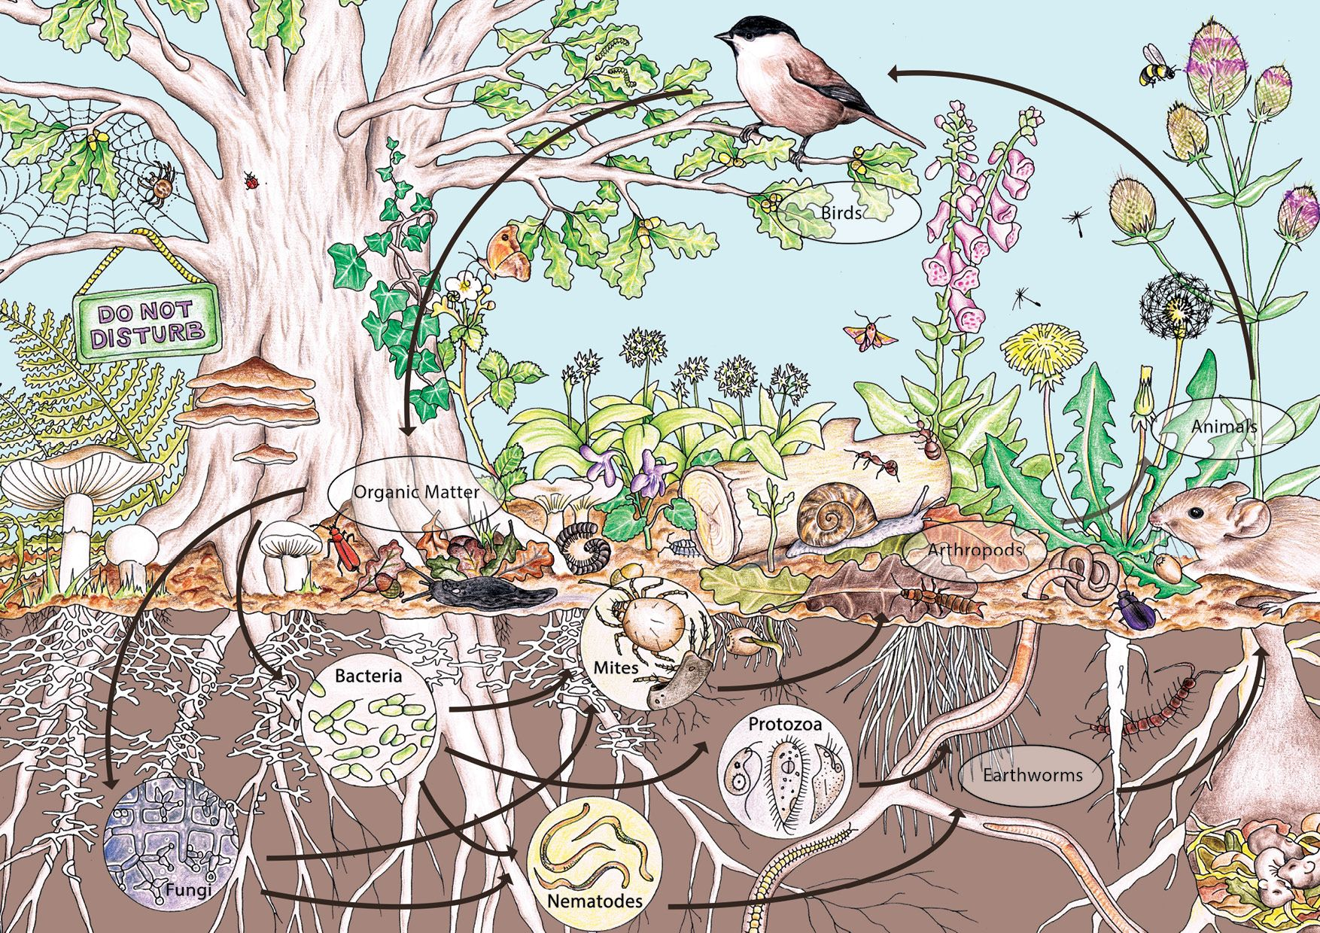
Integrated Pest Management (IPM)
-A sustainable approach to managing garden pests in the DC, MD, VA area.

