Slide 1
Feeding Hazelnuts to Pigs and a little poultry
UMHDI Conference March 4-5, 2022
Pete Lammers,
University of Wisconsin-Platteville
lammersp@uwplatt.edu

Slide 2
Thank you to collaborators
Krista Eiseman and Ryan Pralle, UW-Platteville
Chris Beedle, Iowa State University
Jim Magolski, Niman Ranch
Jason Fischbach, UW-Extension
Jeff Jensen, Iowa Nut Growers Association
Upper Midwest Hazelnut Development Initiative

Slide 3



https://projects.sare.org/sare_project/onc19-056/
Project Number ONC19-056
Jason Fischbach Bayfield County, UW-Extension
Notes:
Hazelnut-Finished Pork in the Upper Midwest: A new high-value product from a sustainable production system

Slide 4
Midwest Hazelnut (Corylus spp)
Processing can be a challenge
Undersized (<10 mm)
Incomplete separation

Slide 5

Preparing Hazelnuts
2 HP Roller Mill
~ 60 bushels of barley/hour
Apollo Machine https://www.apollomills.com/

Slide 6
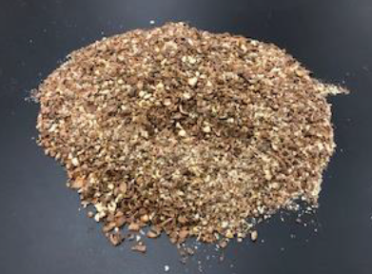
Preparing Hazelnuts
200 lb of hazelnuts/ton of feed
2 passes
15 minutes
1772 microns

Slide 7
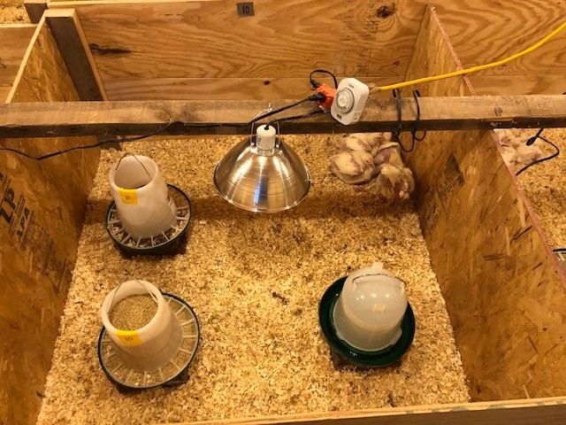
Feeding In-shell Hazelnuts to Broilers
ANSCI 4090 Nonruminant Nutrition F2021
12 pens of 5 broilers
4 ft × 4 ft
Fed 1 of 3 diets
1.6 lb → 5.4 lb, 19 d

Slide 8
Broiler Diets, fed 16 days pre-harvest
Control (commercial crumble)
90% Control + 10% in-shell hazelnuts
Control + Free Choice in-shell hazelnuts (2 feeders)
Hazelnuts ground to 1,800 microns

Slide 9
Hazelnut products did not impact broiler growth (1.6 lb – 5.5 lb)
Diet | Control | Free Choice | 10% Hazelnut |  | SEM | P-value
ADG, g/d | 94 | 97 | 97 |  | 9 | 0.95
ADFI, g/d | 217 | 214 | 217 |  | 12 | 0.98
Gain:Feed | 0.43 | 0.45 | 0.45 |  | 0.03 | 0.85

Slide 10

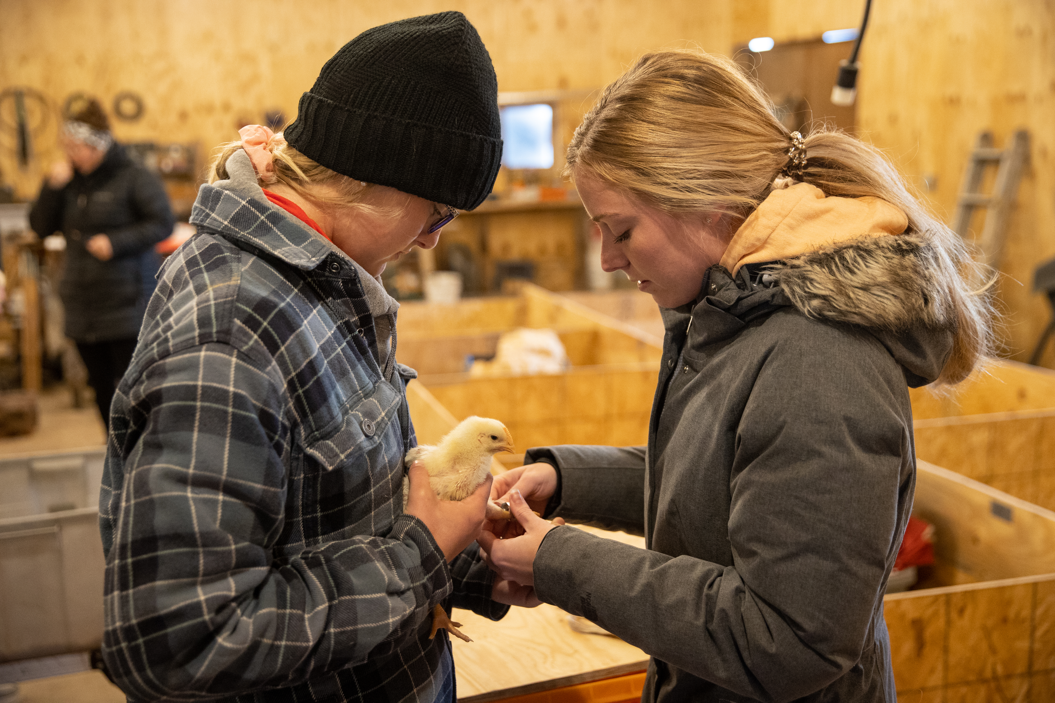
Growth rate and performance not impacted by adding in-shell hazelnut
Birds fed 10% in-shell hazelnuts consumed 21.7 g/d in-shell hazelnuts = 0.9 lb over 19 day trial… Commercial diet $0.25/lb
Birds fed free choice refused to consume ground in-shell hazelnuts

Slide 11
Nutrient Profile of Hazelnut products
Samples from 2019 | Kernels | Shells | < 10 mm in-shell hazelnut
Crude protein, % | 18.4 | 1.3 | 7.6
Crude fat, % | 61.2 | < 0.1 | 21.1
Neutral detergent fiber, % | 12.2 | 96.8 | 68.7
Acid detergent fiber, % | 9.9 | 81.3 | 56.7
NDF can be used to predict feed intake… ↑NDF = ↓ Feed Intake
ADF can be used to predict digestibility… ↑ADF = ↓ Digestibility

Slide 12
Nutrient profile of selected pig feeds
 | Corn | Soybean Meal | Roasted Soybeans | < 10 mm in-shell hazelnut
Crude protein, % | 9.3 | 53.0 | 35.2 | 7.6
Crude fat, % | 3.9 | 1.7 | 19.6 | 21.1
Neutral detergent fiber, % | 10.3 | 9.1 | 11.7 | 68.7
Acid detergent fiber, % | 3.3 | 5.9 | 6.9 | 56.7
NDF can be used to predict feed intake… ↑NDF = ↓ Feed Intake
ADF can be used to predict digestibility… ↑ADF = ↓ Digestibility

Slide 13
Fatty acid profile of three products
 | Hazelnut kernels | In-shell hazelnuts | Soybeans
Crude Fat, % | 61.2 | 21.1 | 19.6
 | % of fat | % of fat | % of fat
Palmitic (16:0) | 4.0 | 3.8 | 10.5
Oleic (18:1) | 77.1 | 74.9 | 21.8
Linoleic (18:2) | 16.0 | 18.0 | 49.8
Saturated FA | 6.0 | 6.2 | 14.5
Unsaturated FA | 93.5 | 93.6 | 78.0

Slide 14
Fatty acid profile of three products
 | Hazelnut kernels |  | In-shell hazelnuts |  | Soybeans
Crude Fat, % | 61.2 |  | 21.1 |  | 19.6
 | % of fat | g/kg | % of fat | g/kg | % of fat | g/kg
Palmitic (16:0) | 4.0 | 24 | 3.8 | 8 | 10.5 | 21
Oleic (18:1) | 77.1 | 472 | 74.9 | 158 | 21.8 | 43
Linoleic (18:2) | 16.0 | 98 | 18.0 | 38 | 53.1 | 98
Saturated FA | 6.0 | 37 | 6.2 | 13 | 15.5 | 30
Unsaturated FA | 93.5 | 572 | 93.6 | 197 | 84.5 | 166

Slide 15
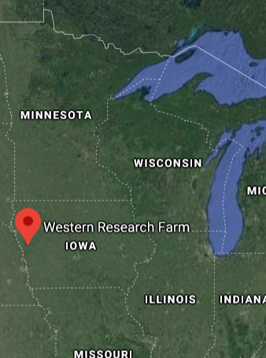

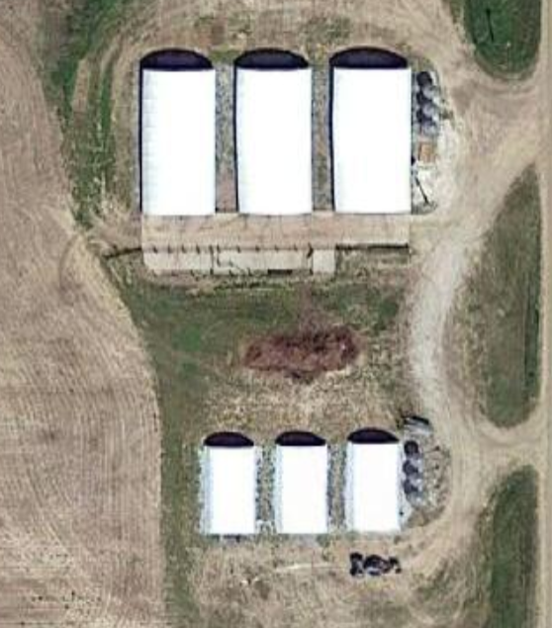
Iowa State Univeristy
Western Research Farm
36515 Hwy E34 Castana, IA 51010
Deep bedded hoop barns for pigs
gfg

Slide 16

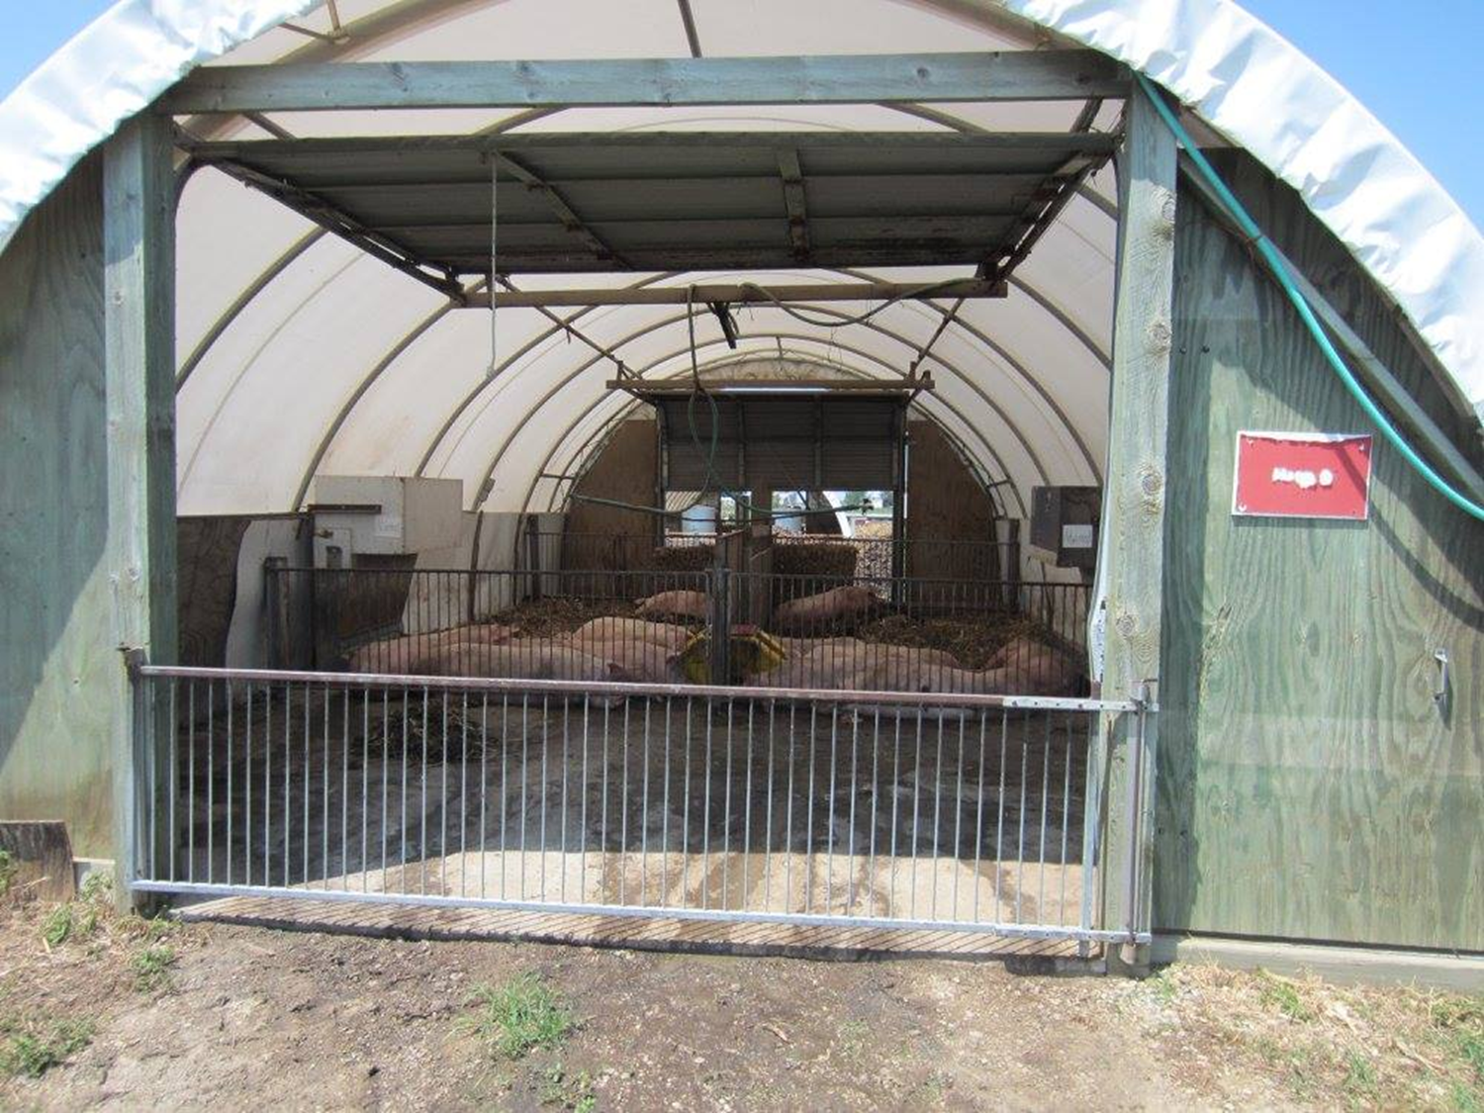
Three mini-hoop barns
3 barns ~ 20 ft × 36 ft
2 pens/barn ~10 ft × 28.8 ft
6 barrows/pen ~ 48 ft²/pig
Notes:
Typically we would stock these hoop barns at 10 pigs/pen or slightly more than 28 ft2/pig… we reduced numbers in order to match available hazelnuts

Slide 17
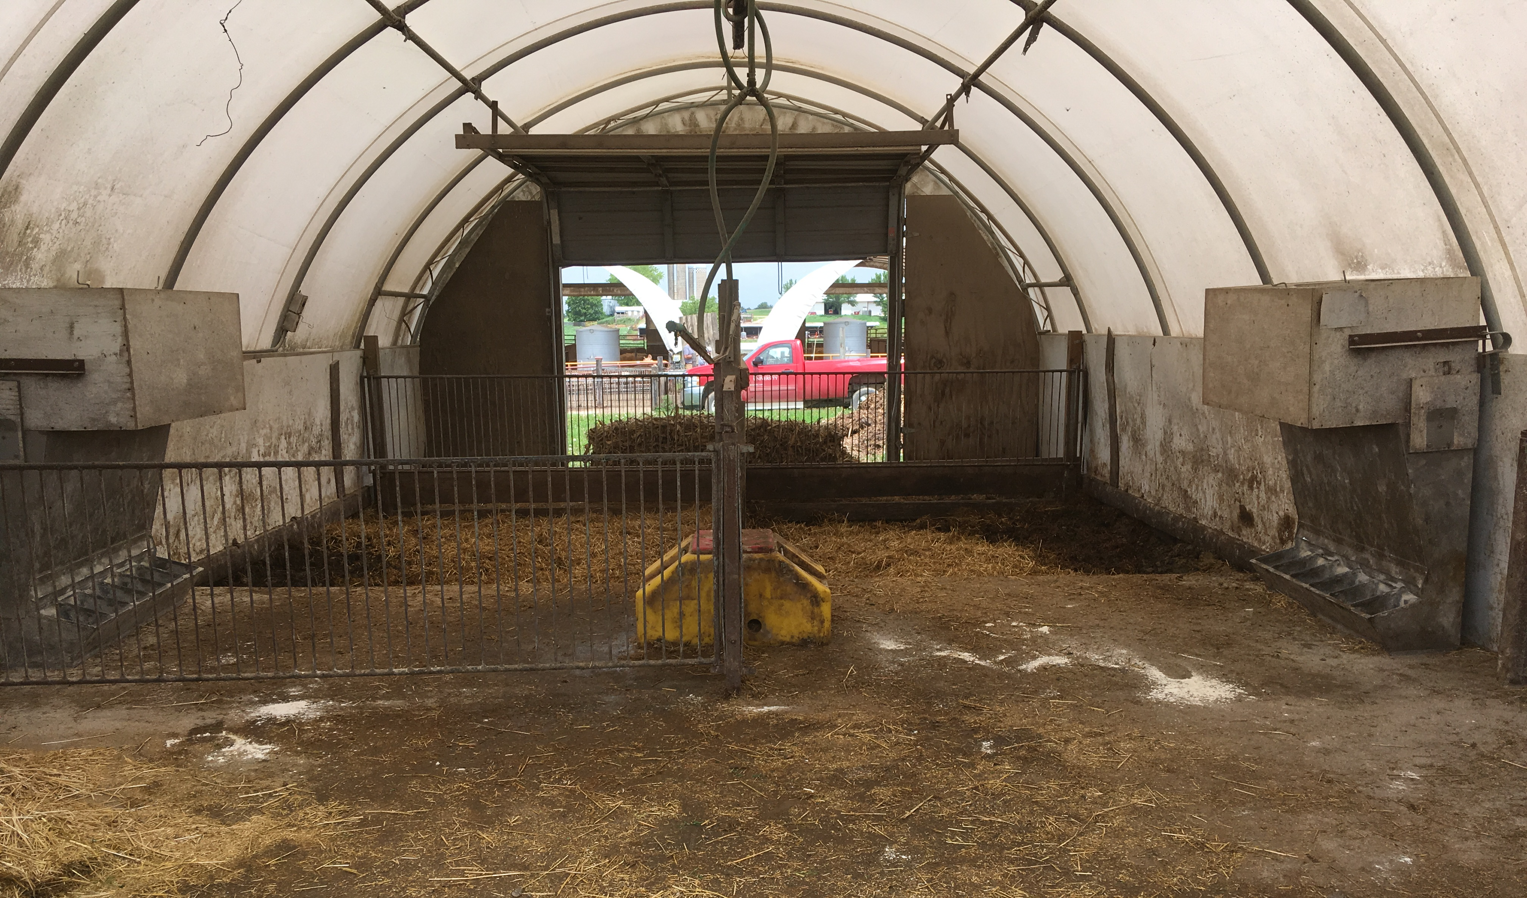
2 Replicated Feeding Trials
36 barrows, 6 pens of 6
Start weight 128 lb
All pigs marketed 69 days later
Corn-SBM control diet
Control + 10% in-shell hazelnuts

Slide 18
Growth and performance
 | Dietary Treatment
 | Control | 10% Hazelnut | SEM | P-value
End wt, lb | 286.6 | 284.5 | 3.1 | 0.44
ADG, lb/d | 2.3 | 2.3 | <0.1 | 0.37
ADFI, lb/d | 8.2 | 8.6 | <0.1 | 0.36
F:G, lb/lb | 3.5 | 3.8 | < 0.1 | 0.03
G:F g/kg | 286 | 263 | --- | ---

Slide 19
Pigs grew and similar rates
Pigs consumed similar amounts of feed
Control grew slightly more efficiently
 | Dietary Treatment
 | Control | 10% Hazelnut | SEM | P-value
End wt, lb | 286.6 | 284.5 | 3.1 | 0.44
ADG, lb/d | 2.3 | 2.3 | <0.1 | 0.37
ADFI, lb/d | 8.2 | 8.6 | <0.1 | 0.36
F:G, lb/lb | 3.5 | 3.8 | < 0.1 | 0.03
G:F g/kg | 286 | 263 | --- | ---

Slide 20
Dietary treatment did not impact carcass attributes
 | Dietary Treatment
 | Control | 10% Hazelnut | SEM | P-value
Hot carcass wt, lb | 216 | 217 | 3.5 | 0.79
Fat depth 10th rib, in | 1.52 | 1.52 | 0.1 | 0.97
Last rib, in | 1.35 | 1.30 | < 0.1 | 0.41

Slide 21
Dietary treatment did not impact chop quality attributes
 | Dietary Treatment
 | Control | 10% Hazelnut | SEM | P-value
Color score | 3.01 | 3.01 | 0.04 | 0.93
pH | 5.75 | 5.78 | 0.02 | 0.17
Marbling, % | 1.80 | 1.71 | 0.09 | 0.70
WB shear force | 3.51 | 3.51 | 0.11 | 0.99
Cook loss, % | 17.00 | 16.70 | 0.60 | 0.75

Slide 22
Dietary treatment impacted fatty acid profile of pork fat
 | Dietary Treatment
 | Control | 10% Hazelnut | SEM | P-value
Palmitic (16:0) | 25.60 | 24.60 | 0.25 | 0.01
Oleic (18:1) | 41.00 | 43.30 | 0.47 | < 0.01
Saturated fatty acids | 42.00 | 39.80 | 0.55 | < 0.01
Monounsaturated fatty acids | 45.40 | 47.50 | 0.49 | 0.01

Slide 23
Take Home Results
Feeding 10% in-shell hazelnuts for 10 weeks
Pig growth and pork quality maintained
Fatty acid profile of pork fat impacted in the desired direction…

Slide 24
Nutrient Profiles of Hazelnut Products are Variable!
 | Kernels |  | Shells | Shells | In-shell hazelnut
Year | 2019 | 2021 | 2019 | 2021 | 2019 | 2021
Crude protein, % | 18.4 | 20.9 | 1.3 | 4.1 | 7.6 | 7.9
Crude fat, % | 61.2 | 60.2 | < 0.1 | 8.8 | 21.1 | 27.6
Neutral detergent fiber, % | 12.2 | 55.9 | 96.8 | 80.5 | 68.7 | 55.9
Acid detergent fiber, % | 9.9 | 46.9 | 81.3 | 70.1 | 56.7 | 46.9

Slide 25
Summer 2021…
Demonstration
24 pigs 6 pens of 4 pigs
Start weight 150 lb
77 day feeding trial
Corn-soybean meal diet with Hazelnut products

Slide 26
Six Demonstration Diets (no replication)
Corn-SMB Control Diet
Control + 10% hazelnut kernels
Control + 10% hazelnut shells
Control + 10% in-shell hazelnuts
Control + 20% in-shell hazelnuts
Control + 30% in-shell hazelnuts

Slide 27
Pig Performance Similar
 | Control | Kernel | Shells | In-shell Hazelnuts
% Control Diet | 100 | 90 | 90 | 90 | 80 | 70
%Test Ingredient | 0 | 10 | 10 | 10 | 20 | 30
Predicted ME, kcal/kg | 3867 | 3954 | 3514 | 3624 | 3507 | 3376
CP:ME , g:Mcal | 38.0 | 38.9 | 39.6 | 38.4 | 37.4 | 38.2
Average daily gain, lb/d | 2.0 | 2.0 | 2.1 | 2.1 | 2.0 | 2.1
Average daily feed intake, lb/d | 7.0 | 6.8 | 7.3 | 7.7 | 7.9 | 7.5
Gain:Feed | 3.5 | 3.4 | 3.5 | 3.7 | 4.0 | 3.6
Hot carcass weight, lb | 232 | 227 | 238 | 236 | 236 | 236

Slide 28
Intriguing trend in fatty acid profile
 | Control | Kernel | Shells | In-shell Hazelnuts
% Control Diet | 100 | 90 | 90 | 90 | 80 | 70
%Test Ingredient | 0 | 10 | 10 | 10 | 20 | 30
Crude fat, % | 2.8 | 8.2 | 2.9 | 4.3 | 6.3 | 7.8
CP:ME , g:Mcal | 38.0 | 38.9 | 39.6 | 39.2 | 37.4 | 32.7
Palmitic (16:0) | 25.1 | 21.7 | 25.0 | 23.6 | 22.2 | 20.1
Oleic (18:1) | 41.3 | 46.8 | 41.9 | 44.1 | 45.7 | 48.4

Slide 29

Pigs are Robust!
Perform well on a wide range of diets…
Interesting trend…
Is 18:1 marketable?!?
% 18:1
% in-shell hazelnuts in diet

Slide 30

Acorn Fed Iberian Ham https:www.tienda.com
13-16 lb $1,400 Feb 19, 2021 $88-108 per pound
15-16.5 lb $1,099 Feb 23, 2022 $67-73 per pound

Slide 31
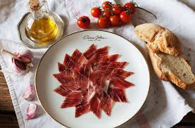
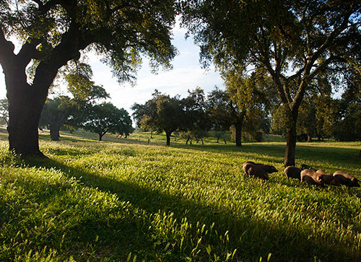
Jamón Ibérico de bellota aka acorn fed ham from Iberia
Specific region
Specific breed
Specific process
High Value Niche

Slide 32
Pork fatty acids are impacted by diet
Dietary Treatment | Days | C 16:0 | C 18:1
Corn-soybean meal control, | 69 | 25.6 | 41.0
10% in-shell hazelnuts, | 69 | 24.6 | 43.3
30% in shell hazelnuts | 77 | 20.1 | 48.4
Acorn-fed, free range* | 117 | 18.9 | 51.3
Commercial diet* | 117 | 21.8 | 45.0
*Daza et al. 2007 DOI: https://doi.org/10.22358/jafs/66797/2007

Slide 33
Valuing hazelnuts based on Dietary Energy for Growing Pig
Chemical analysis of feed sample
Use prediction equation to estimate energy
Start collecting data in field
  Pig performance, Feed Processing, Carcass Quality

Slide 35
Enter information about feed 1
Enter information about feed 2
Interpret Results

Slide 36
Predicted energy value of feedstuffs
Feedstuff |  | Digestible Energy kcal/kg DM |  | Metabolizable Energy, kcal/kgDM
Corn Grain |  | 3994 |  | 3930
Soybeans |  | 4921 |  | 4645
Soybean hulls |  | 1631 |  | 1554
Hazelnut kernels |  | 6556 |  | 6408
Hazelnut shells |  | 1360 |  | 1330
In-shell hazelnuts |  | 3155 |  | 3098

Slide 37


Grain market reports…
Corn Grain… $6.50/bushel
1 bushel = 56 lb @ 15.5% moisture
Soybeans… $16.50/bushel
1 bushel = 60 lb @ 13% moisture

Slide 38

$/bushel… is not a fair comparison

Slide 39
Comparative Price Generator

Slide 40
Comparative Price Generator
If corn grain is $6.50/bushel may be worth willing to pay about $0.102/lb for in-shell hazelnuts

Slide 41
Relative Value as fed basis…
Corn Grain | Corn Grain | In-shell hazelnuts |  | Hazelnut :Corn Grain
$/bushel | $/cwt | $/cwt |  | cwt:bu
$4.50 | 8.04 | 7.07 |  | 1.57
$6.50 | 11.61 | 10.21 |  | 1.57
$8.50 | 15.18 | 13.35 |  | 1.57
$10.50 | 18.75 | 16.49 |  | 1.57
$12.50 | 22.32 | 19.64 |  | 1.57

Slide 42
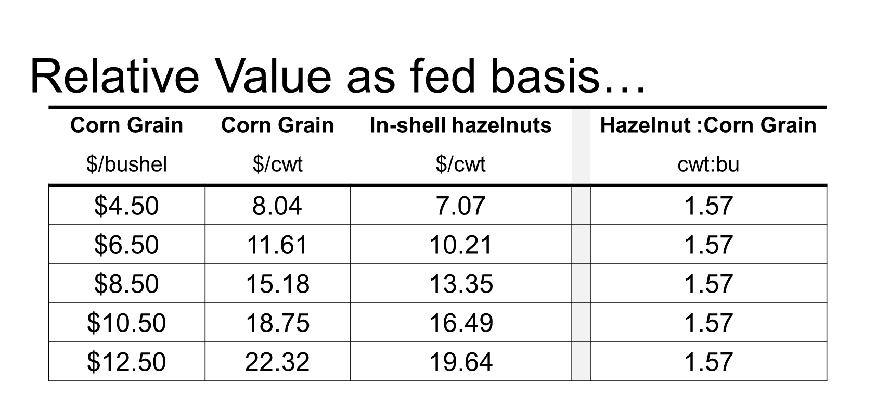
If we know the price of corn/bushel…
multiply by 1.57 to estimate what 100 lb of hazelnut is worth???
Best to analyze the hazelnuts first!

Slide 43
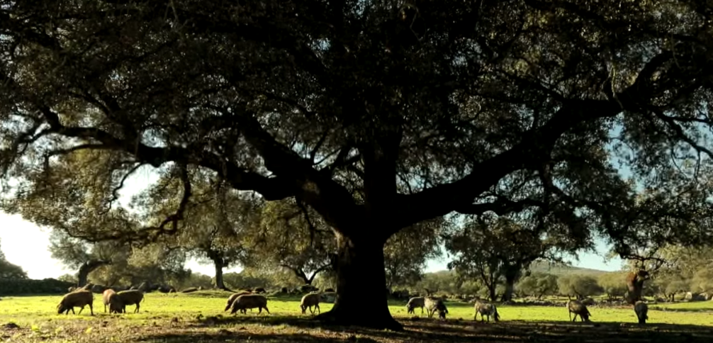
Dr. Pete Lammers
lammersp@uwplatt.edu
608-342-7650

