Slide 1
Effect of biochar addition on H₂S production in an anaerobic digester
Abhinav Choudhury, PhD Candidate, abhinavc@terpmail.umd.edu
Advisor:
Dr. Stephanie Lansing, Associate Professor, slansing@umd.edu
Department of Environmental Science and Technology, University of Maryland, College Park, MD
Notes:
Hello everyone, my name is Abhinav Choudhury and I am a PhD candidate at the University of Maryland, College Park. Started working with biochar a year ago. Not an expert and very much interested in getting feedback from everyone here today, Talking about the use of biochar as an additive in an AD system for H2S removal

Slide 2
Biogas Constituents
Compound | Chemical | Range %
Methane | CH₄ | 50-75
Carbon Dioxide | CO₂ | 25-50
Nitrogen | N₂ | 0-10
Hydrogen | H₂ | 0.01-5
Oxygen | O₂ | 0.1-2
Water Vapor | H₂O | 0-10
Hydrogen Sulfide | H₂S | 10-30,000 ppm
Ammonia | NH₃ | 0.01 – 2.5 mg/m³
Notes:
Biogas consists of Methane, CO2 and H2S and traces of H2O, Ammonia, Hydrogen, etc. CH4 Can vary from 50 – 75 % and H2S can vary from 10 – 30000 ppm, depending on the feed, digester conditions, etc. Dairy manure between 1000-4000 ppm

Slide 3
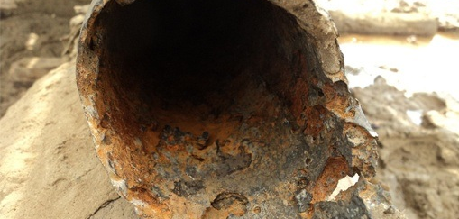
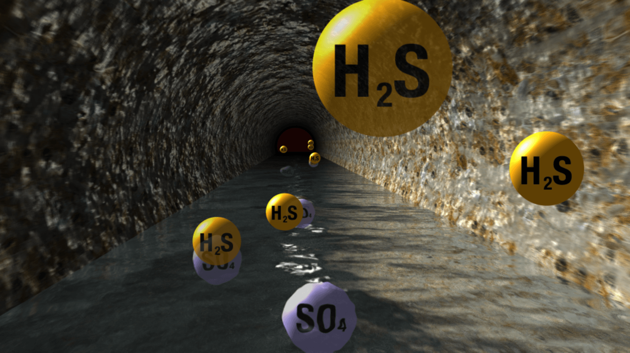
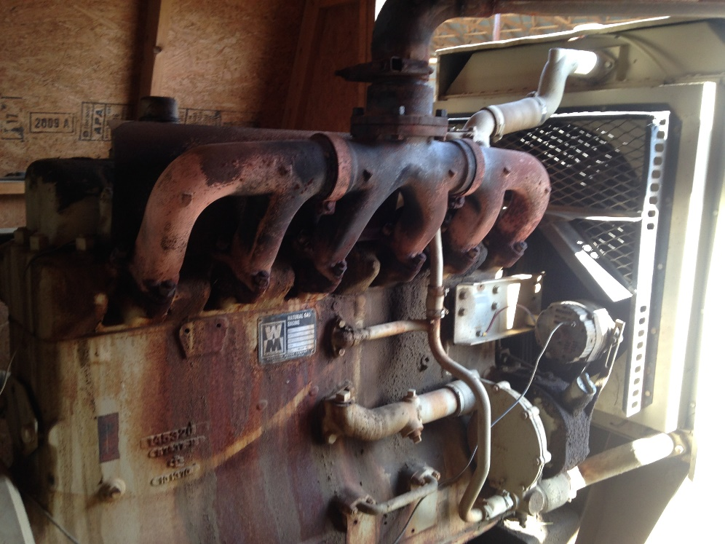
Formation of H₂S and its effects
Reduction of sulfur-containing compounds under anaerobic conditions by sulfate reducing bacteria (SRB) –> H₂S production
H₂S is corrosive and damages pipelines, compressors, engine generator sets (EGS) and gas storage tanks
Corrosion after-effects
Corroded engine generator at a dairy farm
H₂S generated from sulfates in waste water
Notes:
SRB produces H2S from dissolved SO4 in the feed in reducing conditions. Talk about picture

Slide 4
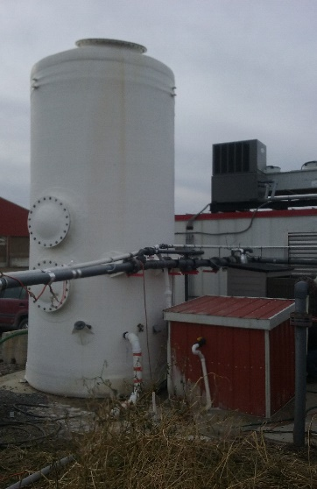
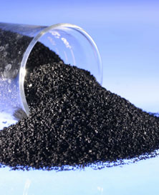
Hydrogen Sulfide Limits and Control Technologies
Technologies | Hydrogen Sulfide Limits (ppm)
Heating (Boilers) and Stirling Engines | < 1,000
Internal Combustion Engines | < 500 (depending on the engine type, it can be < 50 ppm)
Fuel Cells | < 1
Natural Gas Upgrade | < 4 (variations among countries)
Biological Desulfurization
Iron Oxide Scrubbing
Activated Carbon Adsorption
Air Injection/Microaeration
Chemical Addition to the digester
Iron Oxide Scrubber
Biological Scrubber
Activated Carbon
Notes:
Here, we have some limits on H2S for some systems such as boilers, IC engines, Fuel Cells and Upgraded biomethane and some of the tech that is in use for h2s removal. Talk about farm stories, farmers are great at farming, and experienced farmers that have AD systems on farms have a good understanding on how to operate it but face difficulties when it comes to troubleshooting and managing these systems. Especially when it comes to scrubbers, farmers have another technology that they have to understand and sometimes it can be hard for them to devote time and effort because their primary goal is farming. So these solutions can fail quite often. And sometimes the cost of service and repair may not be economically feasible.

Slide 5
Biochar as an additive for H₂S reduction
Managing and operating external scrubbing systems require technical expertise and manpower that may be unavailable on smaller-scale farms.
Biochar could be a possible low-cost and less labor intensive solution for H₂S removal, if added directly into a digester
Previous work on direct biochar addition has shown some positive effects on CH₄ production and CO₂ sequestration in waste water sludge digesters
Biochar has also been shown to be comparable or even better than activated carbon at H₂S adsorption from a biogas stream in an external scrubber
SEM images of Douglas fir wood, bark and poplar wood. Suliman et al. (2016)
Notes:
So, trying to find a solution that can be comparatively low cost, and more manageable for a farmer, we thought about direct biochar addition for h2s removal. Talk about point 3 and 4

Slide 6
Objectives
Investigate the effect of direct addition of two types of biochar on in-situ CH₄ and H₂S production in lab-scale anaerobic digestion systems
Research Questions
Does increasing the concentration of added biochar lower the volume of produced H₂S?
Does the biochar particle size and total surface area affect H₂S removal?
Does increasing the iron content in biochar enhance H₂S removal compared to unmodified biochar?

Slide 7
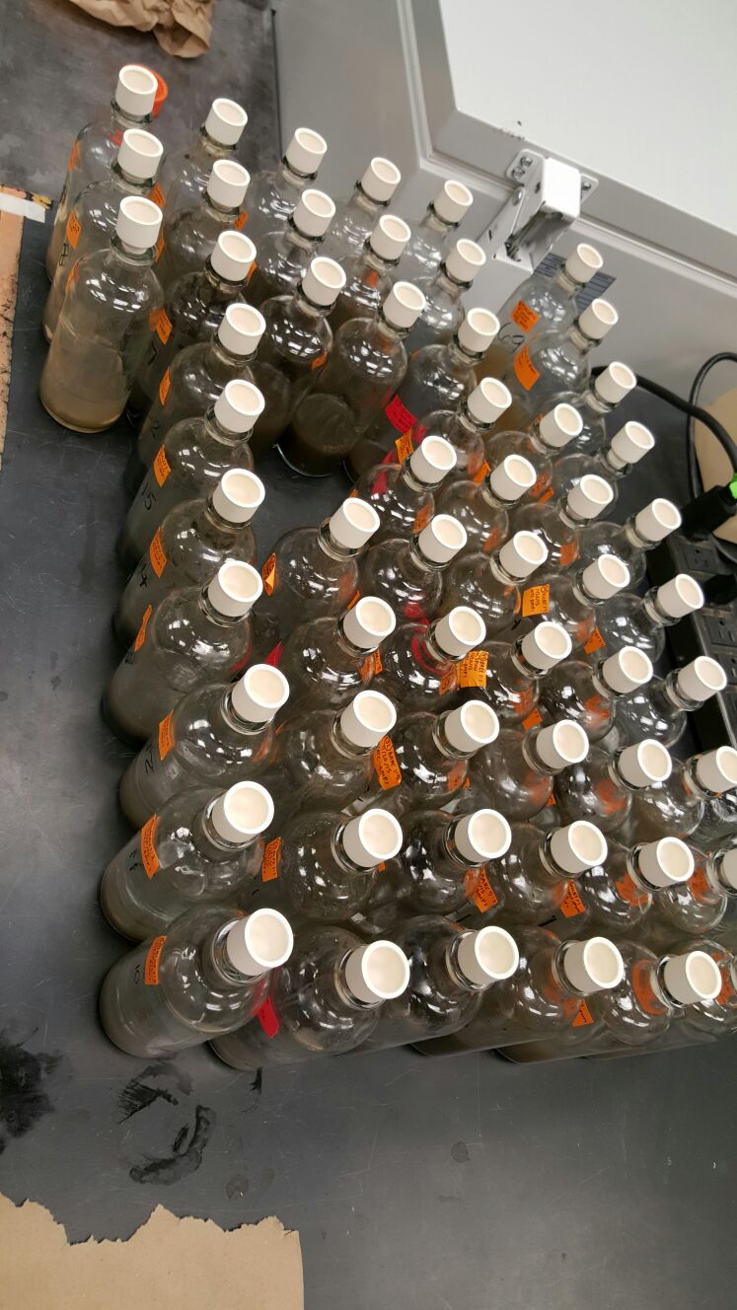
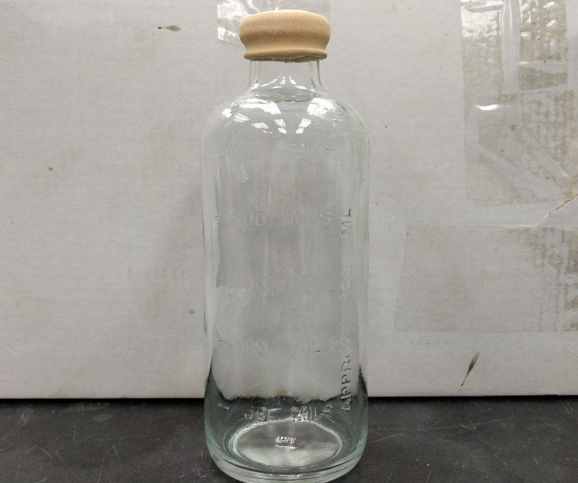
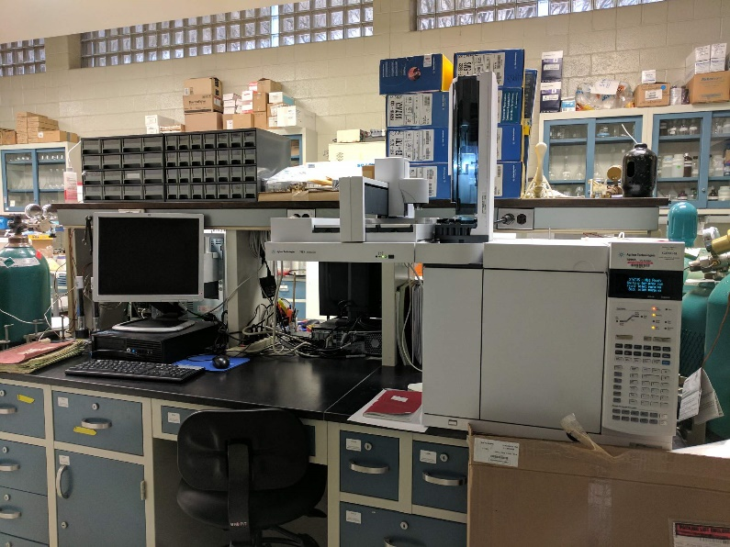
Lab Scale Reactor Tests
Substrate + Biochar
Purge using N₂
Incubate
Measure
Gas Chromatography
Inoculum
Lab Scale reactor bottle
Full set of experimental units
Notes:
Inoculum is basically the effluent taken from a functioning digester that contains the microbes that are essential for methane production, and it helps lower the initial start up time for biogas production

Slide 8
Experimental Design (effect of biochar concentration)
CONTENTS | Biochar amount added (mg)
Inoculum Control
Manure Control (DM)
0.1 g Corn Stover Biochar : 1 g TS of manure (0.1 CSB) | 55
0.5 g Corn Stover Biochar : 1 g TS of manure (0.5 CSB) | 277
1 g Corn Stover Biochar: 1 g TS of manure (1 CSB) | 554
1.82 g Corn Stover Biochar: 1 g TS of manure (1.82 CSB) | 1007
0.1 g Maple Biochar : 1 g TS of manure (0.1 MB) | 55
0.5 g Maple Biochar : 1 g TS of manure (0.5 MB) | 277
1 g Maple Biochar: 1 g TS of manure (1 MB) | 554
1.82 g Maple Biochar: 1 g TS of manure (1.82 MB) | 1007
3 replicates for each treatment
Total volume of manure and inoculum: 200 mL
Biochar obtained from ArtiChar prepared at 600 C and a 20 min residence time
An inoculum : substrate (manure) ratio (ISR) of 2:1 was used on a volatile solids basis.
Notes:
The corn stover is ground with a hammermill 1/2" screen and dried to less than 15% moisture.
biochar from sawdust that as another treatment. It is Maple Sawdust, ground 1/4" screen over a hammermill (previously debarked, it is pure wood).
ISR is important because you don’t want to add too much substrate because then the microbial consortium may get affected because of acidification.
The abbreviations for each treatment are in brackets

Slide 9
Biochar Mineral Results
 | Corn Stover Biochar (CSB) | Maple Biochar (MB)
Total N (%) | 1.16 | 0.79
Phosphorus (% P₂O₅) | 0.55 | 0.19
Potassium (%K₂O) | 2.98 | 0.57
Sulfur (%S) | 0.04 | 0.02
Calcium (% Ca) | 1.33 | 1.22
Magnesium (% Mg) | 0.33 | 0.14
Sodium (% Na) | 0.04 | 0.02
Zinc (ppm) | 51 | 67
Iron (ppm) | 6194 | 2659
Moisture (%) | 1.67 | 1.82
pH | 10.3 | 9.6
Notes:
Important to note the differences in biochar composition and we know that every biochar is different. Previous research on biochar with different pH’s for H2S adsorption in a gaseous phase have shown that pH plays an important role in the amount of H2S adsorbed.

Slide 10
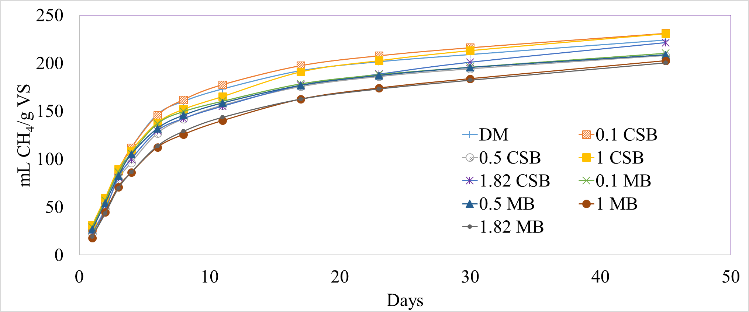
Results: CH₄ Production
No significant differences in CH₄ concentration, yield
Cumulative CH₄ production varied from 200 – 231 mL/g VS, with 1CSB having the highest and 1MB having the lowest CH₄ volume.
Notes:
VS – it is a useful parameter for normalizing the methane production because it represents the organic compounds that are available for microbial degradation. There have been results that show that biochar addition to a digester has a positive effect on methane production but we did not see that in our experiments but there were no adverse effect either.

Slide 11
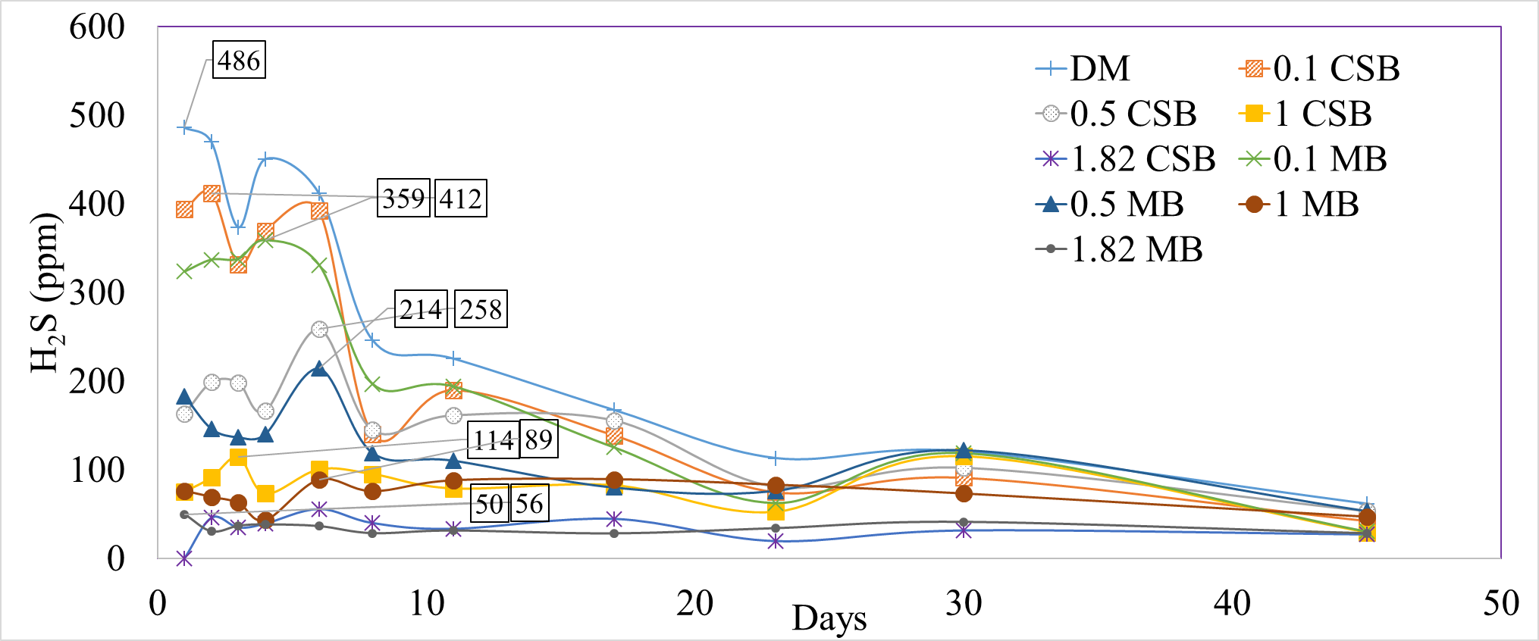
Results: Daily H₂S Production
DM had the highest H₂S concentration during the study period
Concentration of H₂S gradually decreased as the concentration of biochar increased
H₂S concentrations at the end of the study were below 100 ppm for all treatments
The labels denote the maximum H₂S concentration for each treatment
Notes:
H2S concentration profile in the biogas over the duration of the experiment. Talk about the points. Lower concentrations at the end for all treatment due to the scarcity of sulfur compounds that the microbes can use and it is typical results in batch digester systems.

Slide 12
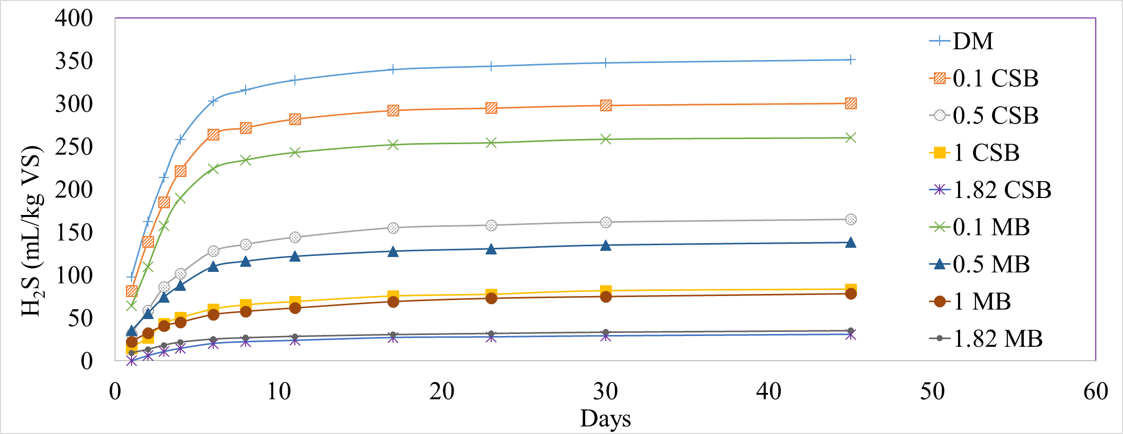
Results: Cumulative H₂S Production
DM had the highest H₂S volume after the study period (351 ± 9 mL H₂S/kg VS)
Volume of H₂S generated decreased as the concentration of biochar increased
At the highest dose of biochar added (1.82 g biochar/g Manure TS), the % reduction in H₂S was 91.1% and 90.0% for CSB and MB, respectively
Notes:
At the lowest concentrations, there is a difference between the treatments but our hypothesis is that this is due to the very small amount of biochar that was added into the system and some of it get attached to the walls of the reactor and the error margins can be large when we are dealing with such low amounts. But at higher concentrations, the results are almost the same.

Slide 13
Results: Biochar Adsorption
Treatment | H₂S volume reduction* (uL) | Normalized H₂S reduction (uL/g biochar) | Adsorption (mg H₂S/g biochar)
0.1 CSB | 17.87 | 322.90 | 0.45
0.5 CSB | 65.43 | 236.41 | 0.33
1 CSB | 94.08 | 169.97 | 0.24
1.82 CSB | 112.62 | 111.80 | 0.16
0.1 MB | 32.00 | 578.19 | 0.81
0.5 MB | 74.91 | 270.66 | 0.38
1 MB | 95.89 | 173.25 | 0.24
1.82 MB | 111.02 | 110.21 | 0.16
*When compared to DM control
Notes:
Because manure is a complex material that contains organic matter, nitrogen, phosphorus, different inorganic cations and anions, increasing the amount of biochar increases the possibility of the biochar reacting with these other components and not just h2s. AT higher doses, similar results.

Slide 14
Conclusions
Biochar was effective in reducing H₂S in biogas and the % reduction increased with increasing amounts of added biochar
There were no significant differences in % CH₄ and yield between treatments
H₂S adsorption capacity decreased as the amount of added biochar increased
H₂S reduction efficiency increased to >90% for each biochar type (CSB and MB) at the highest dosage (1.82 g biochar/g manure TS)
There were no significant differences in H₂S reduction between the two biochar types at higher doses

Slide 15
Current Projects and Research Questions
How does particle size of the biochar affect the sorption of H₂S onto the biochar surface?
Can a surface modified biochar increase the amount of H₂S adsorbed?
Can biochar be used for N and P adsorption from dairy manure along with H₂S reduction in biogas?
Is it better to add biochar directly into a digester or should it be used in an external gas filter column for H₂S removal?
Notes:
3rd point is important because it should become a more valuable product for farmers because AD cannot reduce the amount of N and P and in this region, nutrient management is an important constraint for farmers. If the biochar can successfully sequester N and P, farmers should be able to spread more liquid manure (that will have lower dissolved N and P) after solid separation of manure with the biochar particles, thus reducing the amount of storage required for the liquid digestate. The concentration of N and P in the solid biochar may also add more value to the manure solids that can be composted or directly used as a fertilizer.

Slide 16
Thank You

