Slide 1
Research Updates from Rutgers University
Quality Assessment of Hops Grown in New Jersey
Megan Muehlbauer

Slide 2
Project Background

Slide 3
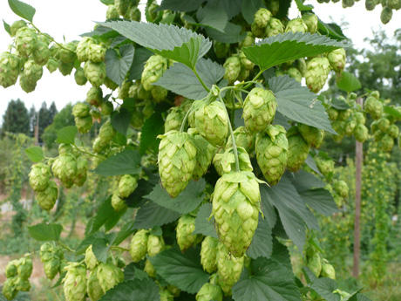
Project Background
Interest in Sourcing Local Ingredients
68 Craft Breweries in NJ
Can they meet quality standards???

Slide 4
Project Goals
*Establish a demonstration plot
Utilize/adopt best management practices (conventional methods)
Control for chemistry quality analysis
*Collect and analyze hops from growers around the state
Assess/develop a better understanding of NJ grown hop quality
Quality -> alpha and beta acids (to a lesser extent aromatics)
*Survey NJ Breweries (Interest in sourcing locally, demand, price points)

Slide 5
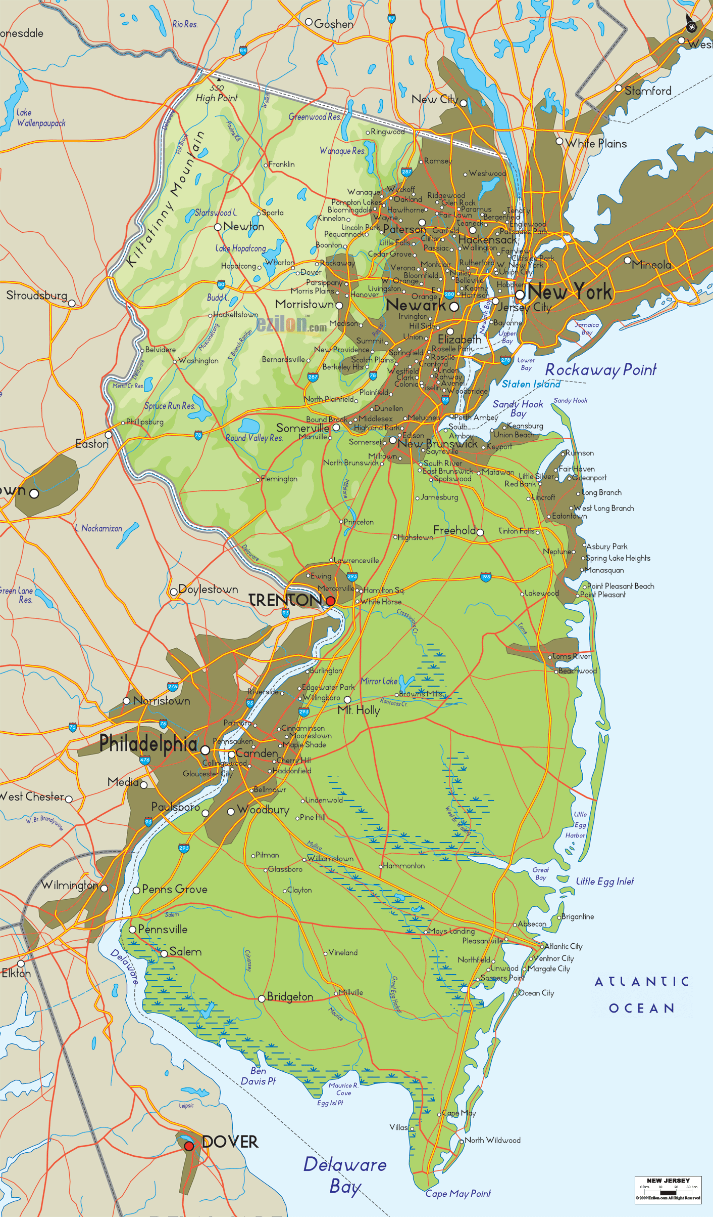
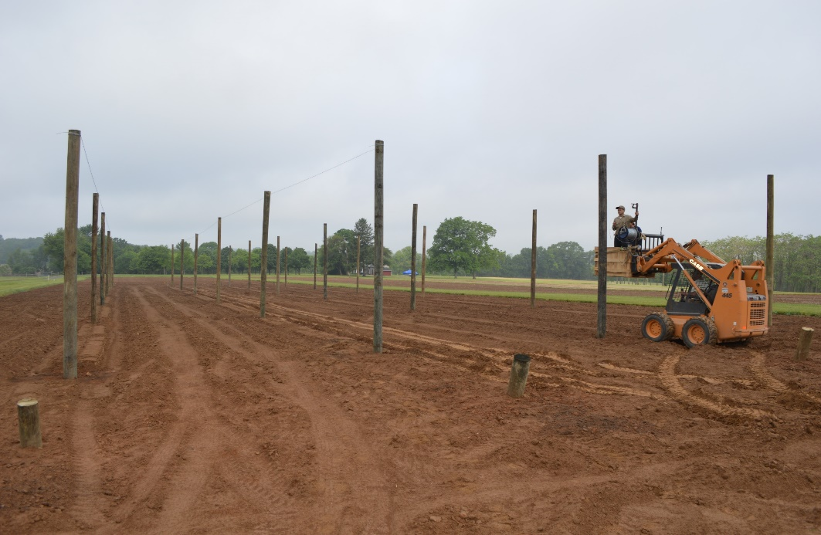
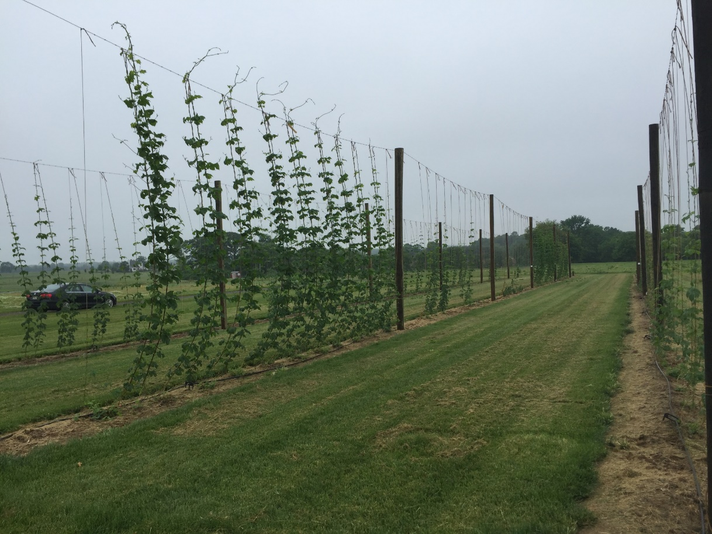
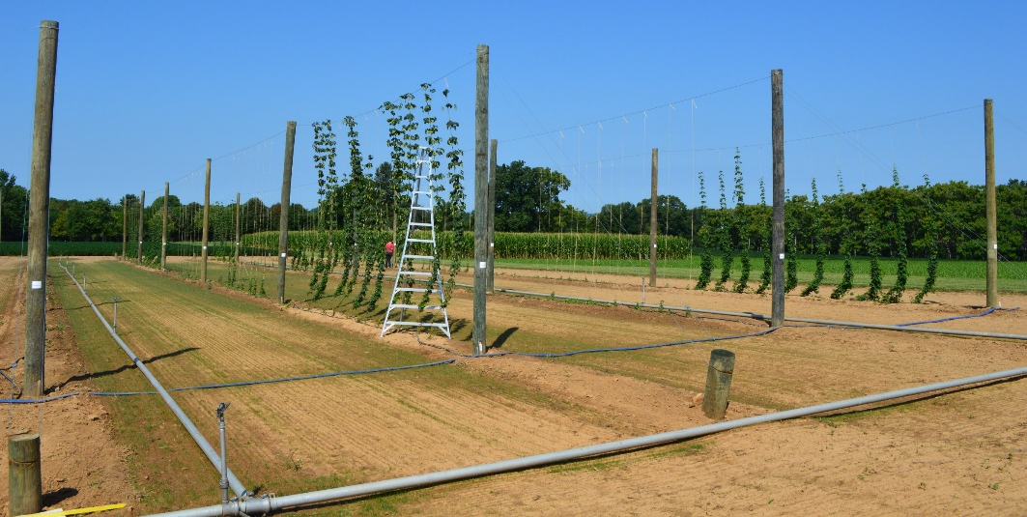
Demonstration Plot
200 ft rows
40 ft between poles
20 ft between row centers
30” beds
10 varieties (Cascade, Centennial, Chinook, Mt. Hood, Newport, Nugget, Saaz, Sorachi Ace, Ultra, Willamette)

Slide 6
Demonstration Plot

Slide 7
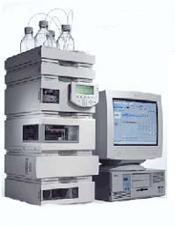
Quality Assessment
Alpha and Beta Acids

Slide 8
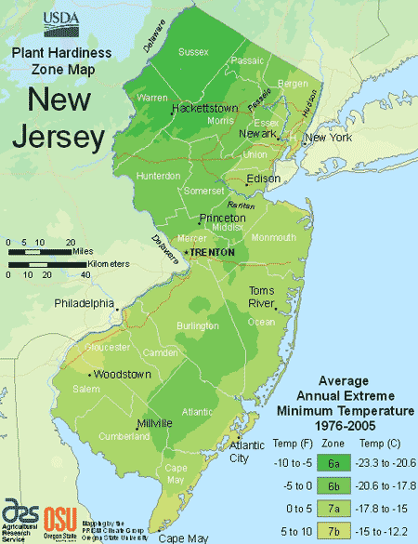
Quality Assessment
Sampling Procedure
Dry down to 8-10% moisture
Thus far 4 farms have submitted samples but interest is growing quickly.

Slide 9
Quality Assessment
Alpha Acids (cohumulone, n+adhumulone)
Protocol ASBC method Hops-14 using International Calibration Extract 3 (ICE-3)

Slide 10
Quality Assessment
Beta Acids (colupulone, n+ adlupulone)
Protocol ASBC method Hops-14 using International Calibration Extract 3 (ICE-3)

Slide 11
Future Goals
Improve upkeep and maintenance of the demonstration hopyard
Continue to collaborate with more hop growers in NJ
Work with growers to improve hop quality
Possibly develop more complex experiments that involve correlation of environmental conditions to hop quality…

Slide 12
Questions, Comments, Interest in Collaboration?
E-mail:
Megan Muehlbauer
meganmu@rutgers.edu
James Simon
jesimon123@gmail.com

