Slide 1
Sustaining the Sugar Bush in a Tribal Community to Educate, Reduce Fuel Usage and Increase Marketable Maple Sap Products.
Eric dupuis, fond du lac, maple syrup producer
Nikki crowe, fond du lac, fond du lac tribal conservation coordinator
Notes:
Miigwech, thank you for having us here today. We are going to talk about a MN SARE Grant Project Eric and I are working on. First we will tell you about Eric’s sugarbush.

Slide 2
What is a sugar bush? Tapping Trees for Maple Syrup Products
Tapping trees for 17 years.
Eric’s sugarbush (maple trees) 350 trees, 300 on tubing, and ~80 on taps and bags
Sap flow is weather dependent
Fun Facts: other trees that can be tapped are red maple, box elder, birch or walnut. (MN does not have walnut)
Notes:
What is a sugarbush and what does it mean to tap trees for maple syrup. Eric is the expert in all things having to do with maple syrup.

Slide 3
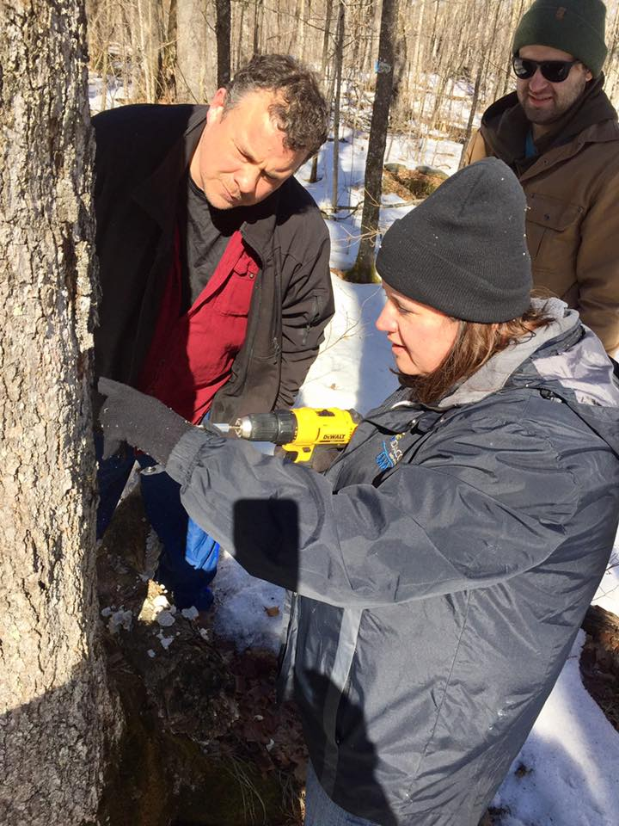
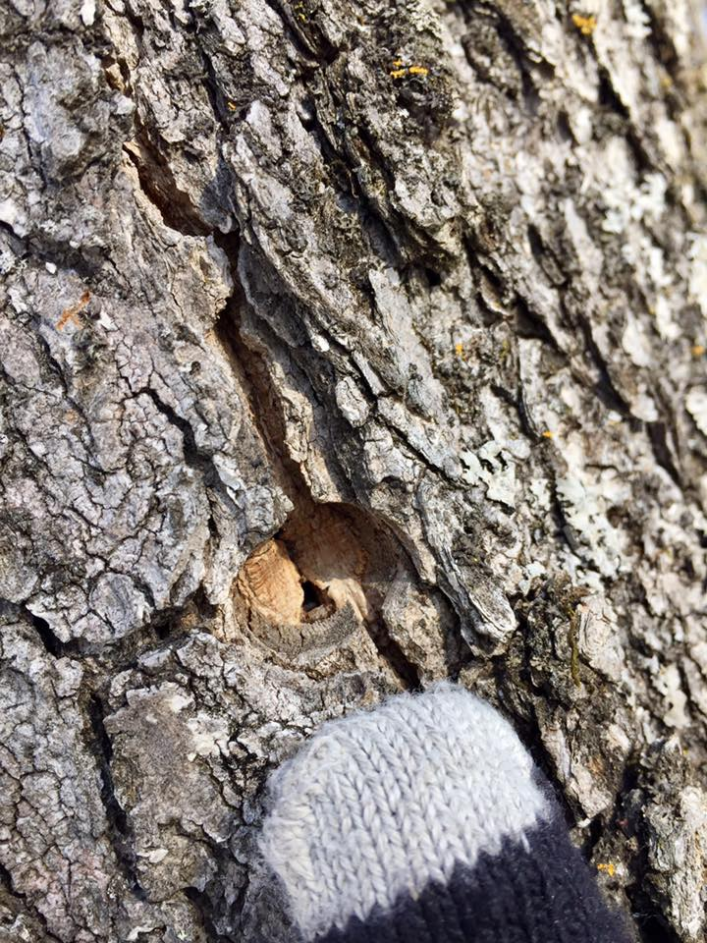
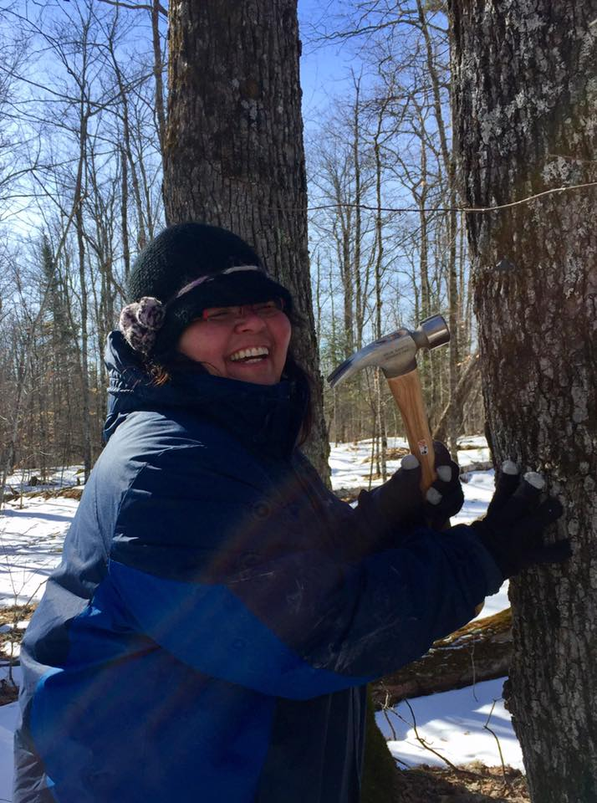

Slide 4
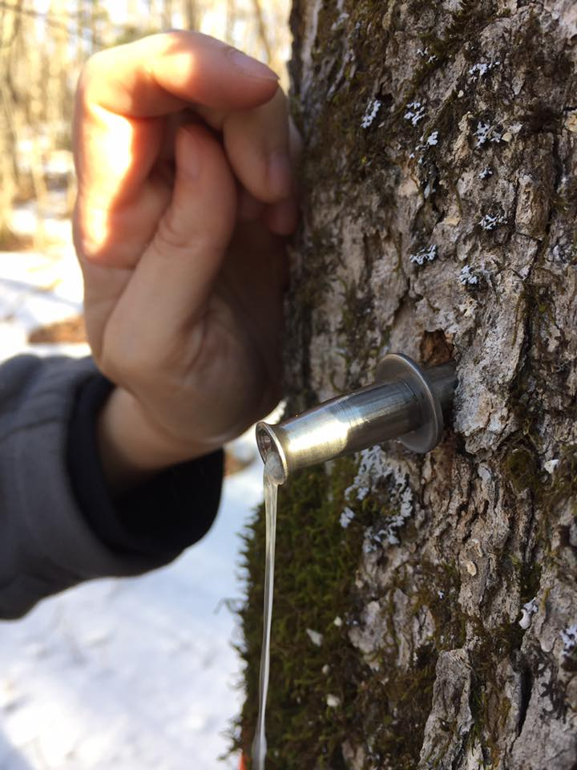
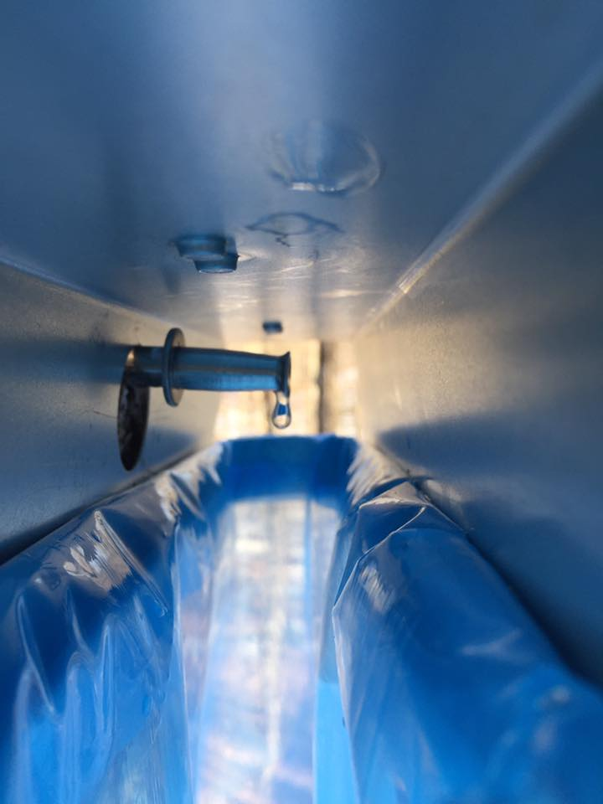
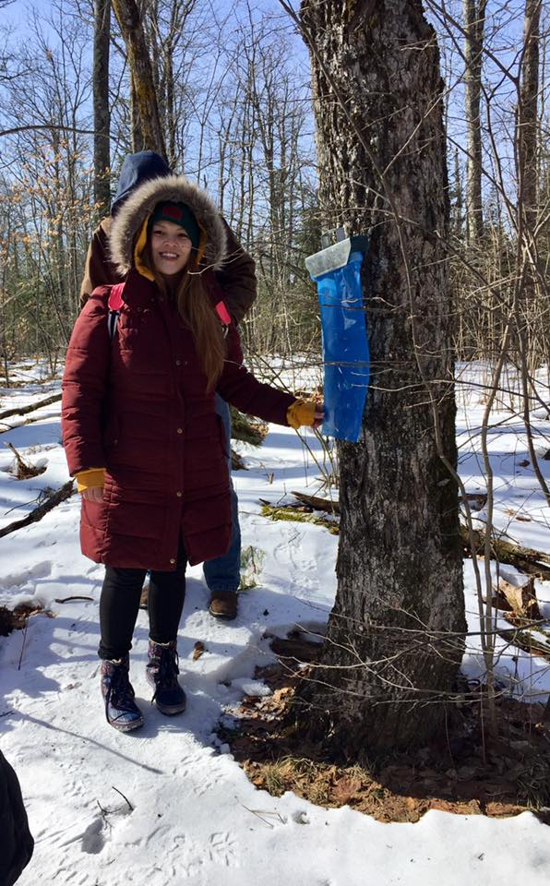

Slide 5
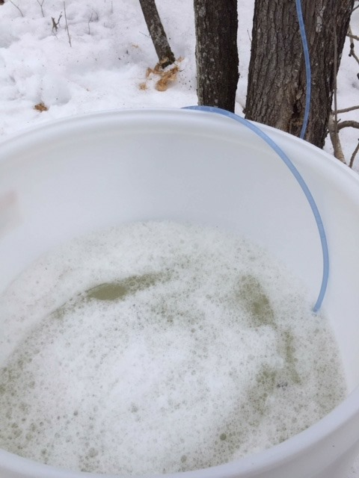
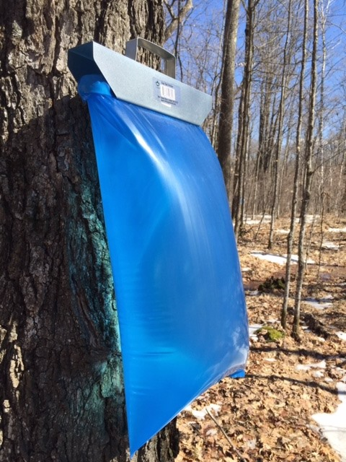
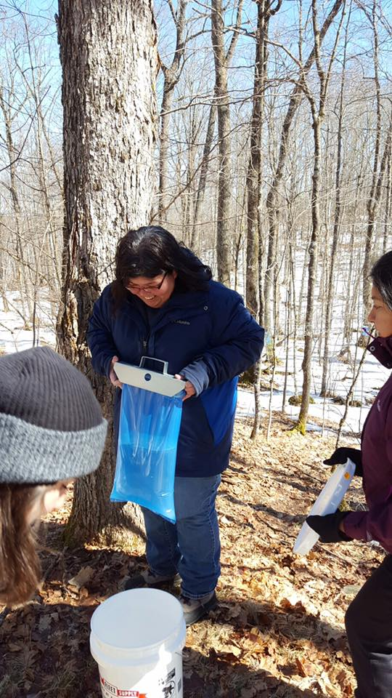
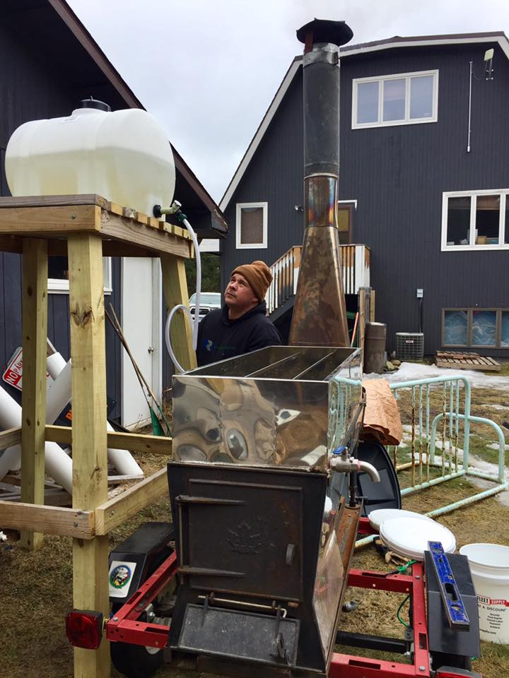

Slide 6
Collaboration with tribal college extension
5 years of working together through the sugarbush and Fond du Lac Tribal & Community College Extension Program

Slide 7
Workshops & Events
Winter Tree Identification
Tapping Trees and Tubing
Boiling Sap
Canning and Bottling

Slide 8
Addressing a Need
Expanding the sugarbush and promoting value added products required additional funding a small producer may not have on hand. We helped Eric apply for funding to MN SARE grant program to help reduce fuel load, add electricity, and cut time in half to process sap.

Slide 9
Filter Press
Cleans out sediments and impurities,
https://projects.sare.org/sare_project/fnc19-1160/

Slide 10
updating the evaporator to reduce fuel and Time & adding a filter press to improve quality of the maple syrup products

Slide 11
Making Maple Sugar! A very valuable Value added product
Maple Sugar and Candy are value added products but require more time, energy, and supplies.
Grant funding assisted in providing time and resources for maple candy, maple sugar, maple cream, maple butter, and maple vinegar.

Slide 12
Challenges & Opportunities
Challenges
Weather is always a challenge, does not always allow for a set schedule of events
Covid-sugar bush was minimized due to quarantine and social distancing in meetings
Opportunities
Extending the grant period to complete projects
Applying for more grants
Networking with new customers with new products

Slide 13
Miigwech
Eric Dupuis ericdupuis13@yahoo.com
Nikki Crowe nikkicrowe@fdlrez.com

