Slide 1

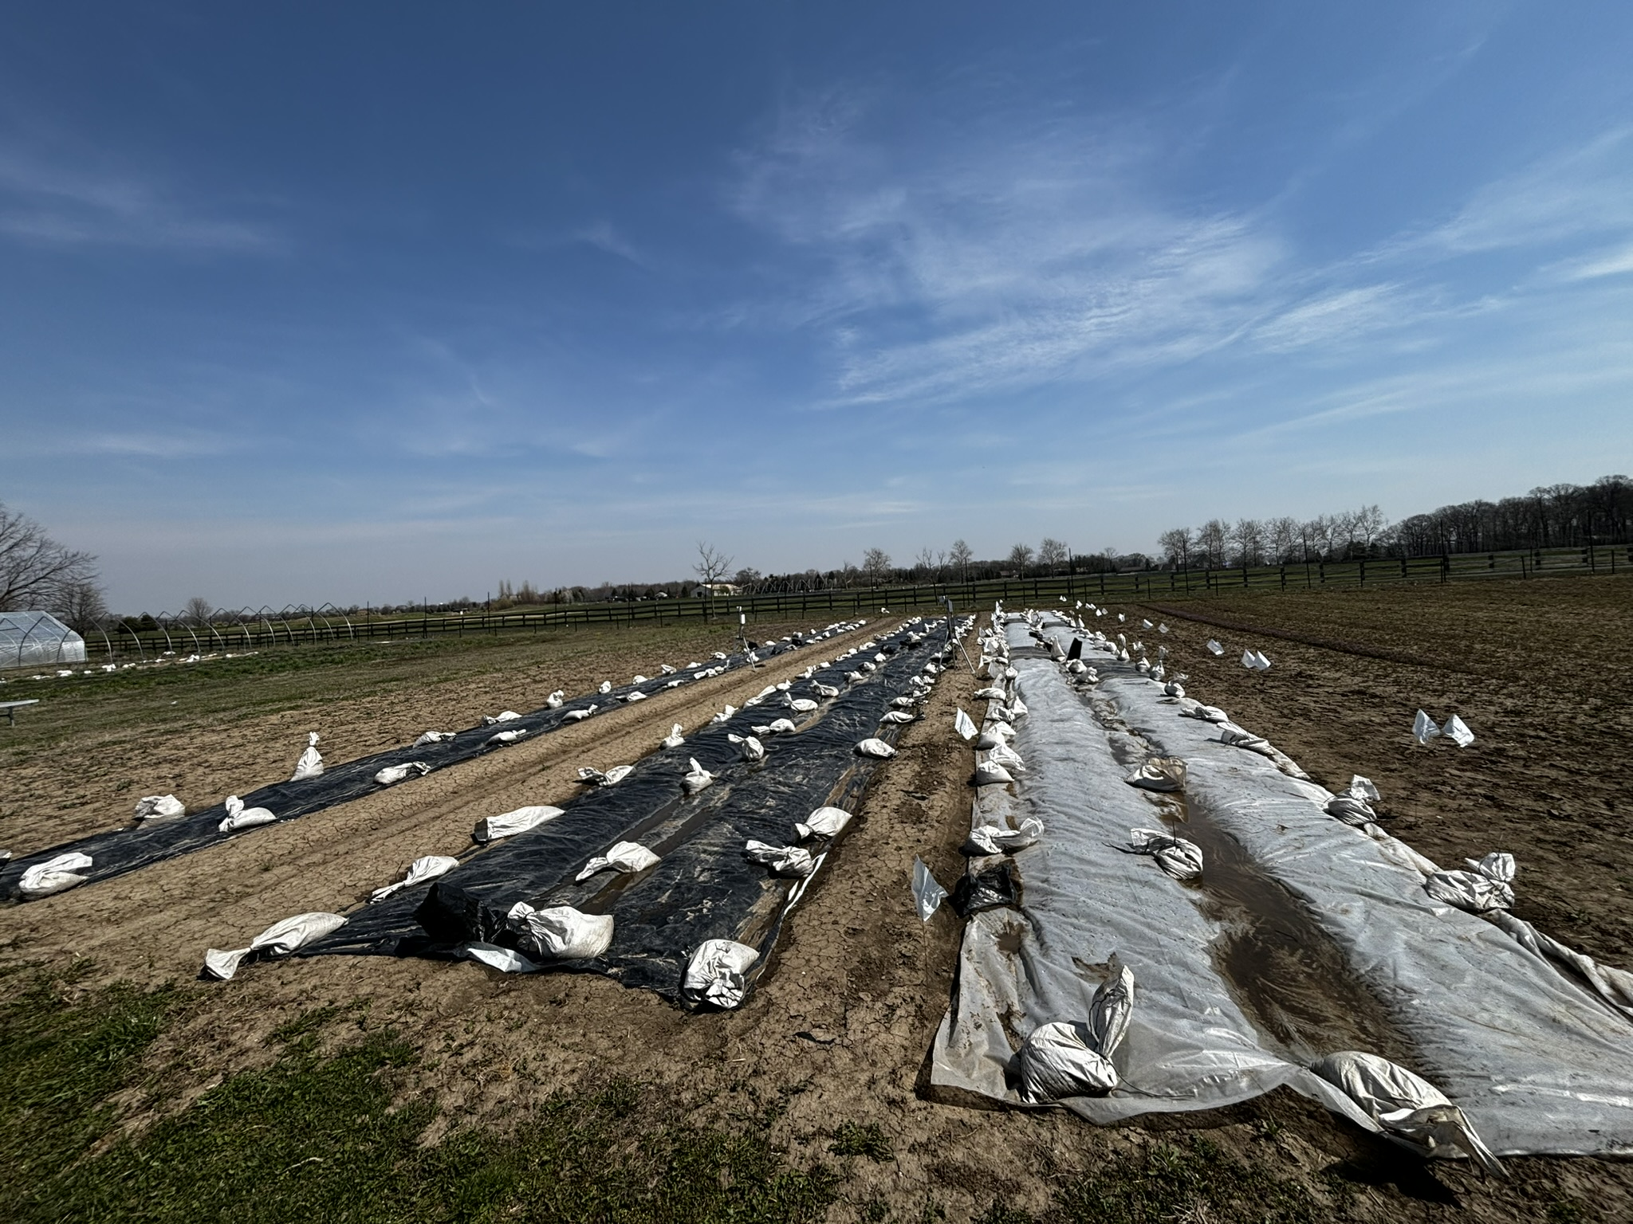
Using Silage Tarps for Weed Control in Small-Scale Farming
Josué D. Cerritos-Garcia and Celia Corado

Slide 2
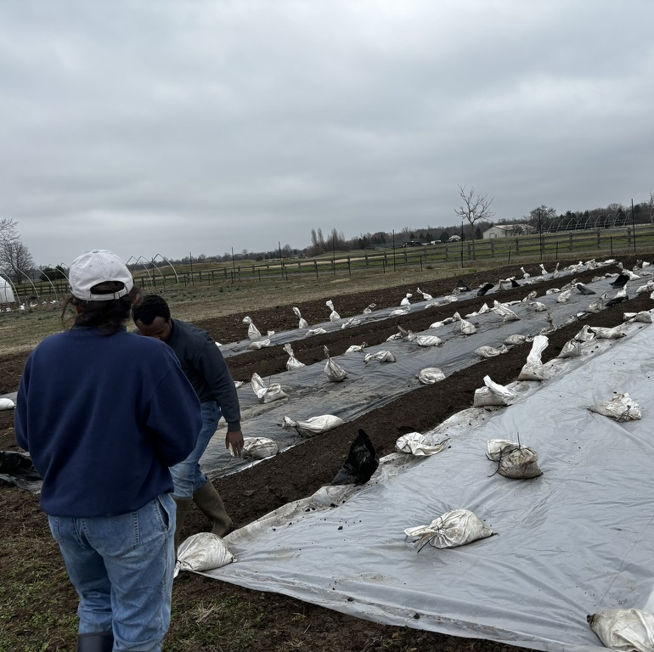
Outline
Creating stale seedbeds with silage tarps in onions
Early season weed management in potatoes with silage tarps
Non- utilized methods for weed management (use of silage tarps and clear plastic in onions)

Slide 3
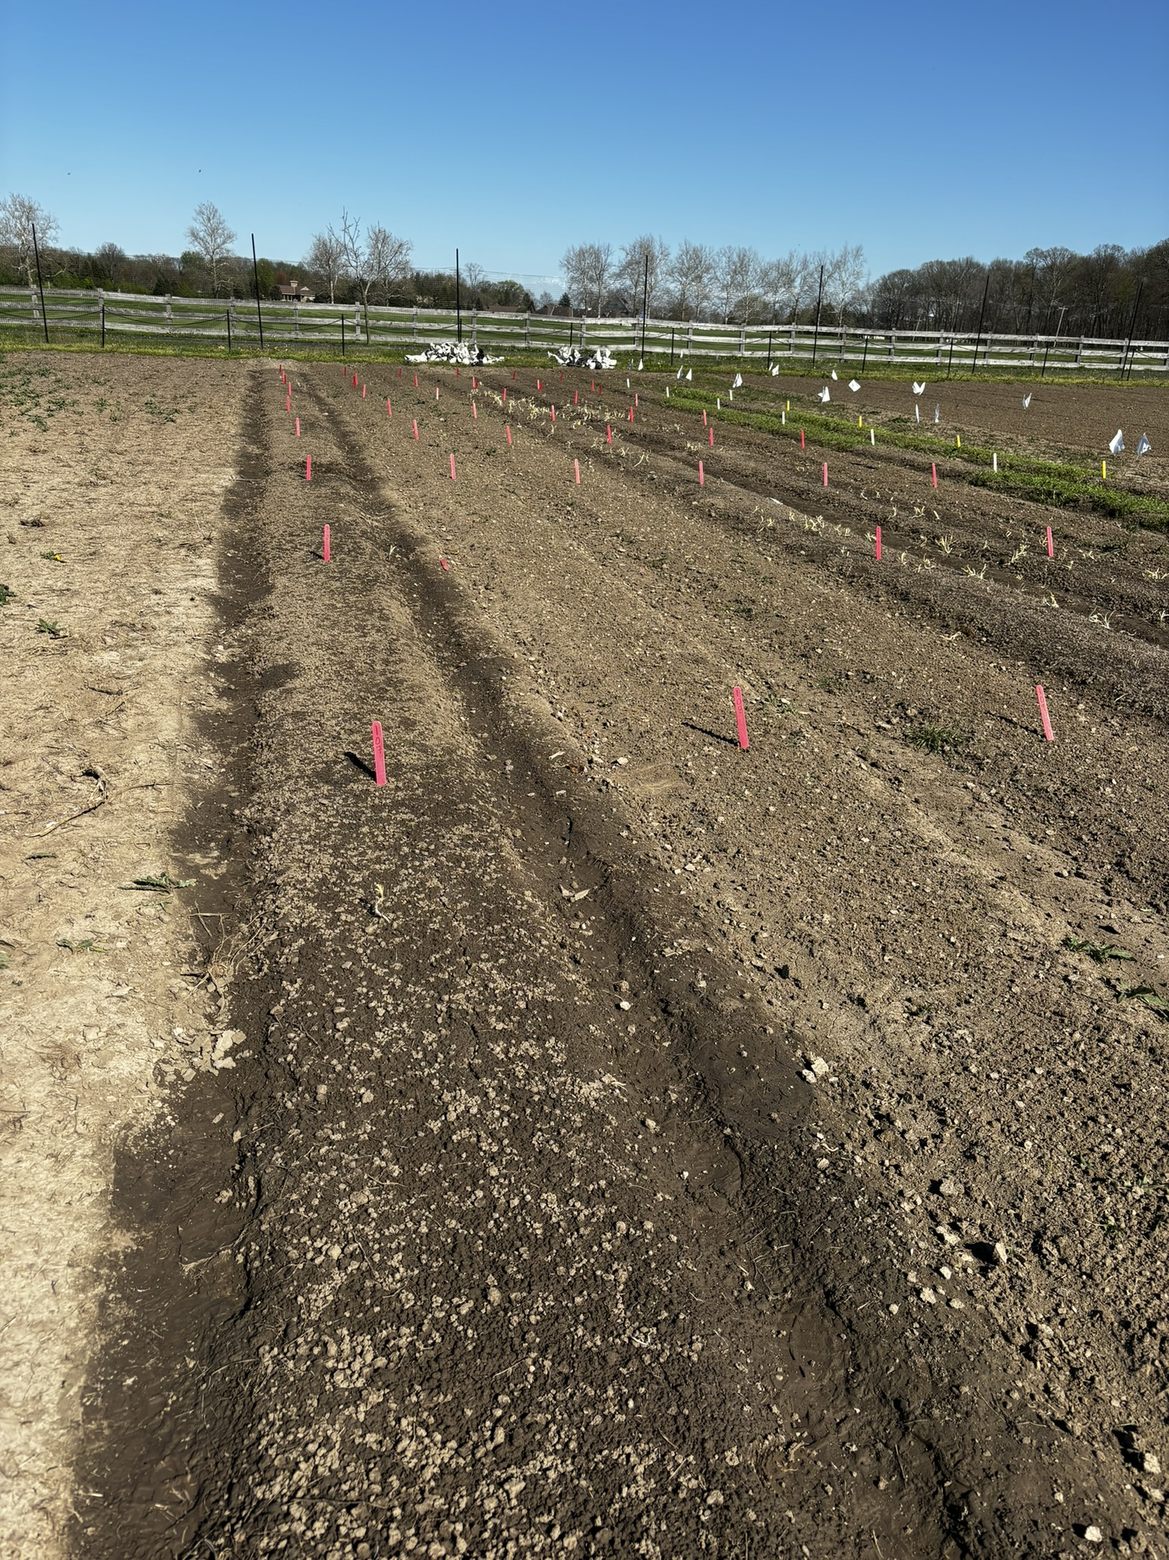
Silage tarps and stale seedbedding
Silage tarps are commonly used to create a stale seedbed before planting a cash crop
Process involves soil preparation and bed formation, followed by the immediate application of tarps into the field
Could be use as in-between crop rotation groundcover on a no-till system where tarps are used until next crop cycle

Slide 4
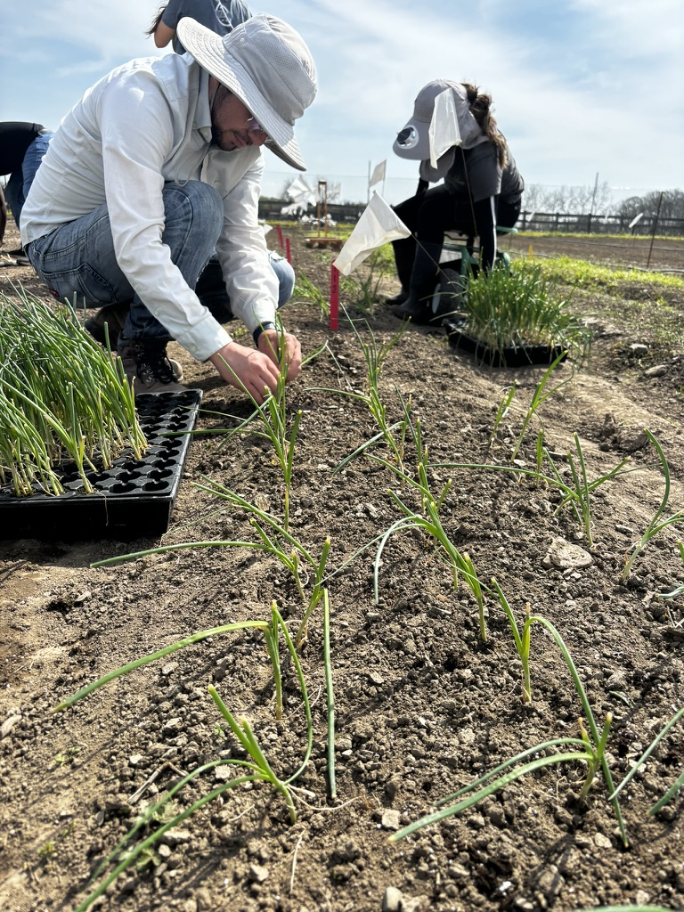
Integrating silage tarps in onions
Onions are known as a crop that don’t compete well against weeds
The trial aimed to determine if tarping was more effective than tillage in enhancing weed suppression both at the start and throughout the entire crop cycle.
In May, tarps were laid on the ground for five weeks. Afterward, the beds covered by the tarps were ready for planting, while the remaining beds were prepared by tilling.

Slide 5
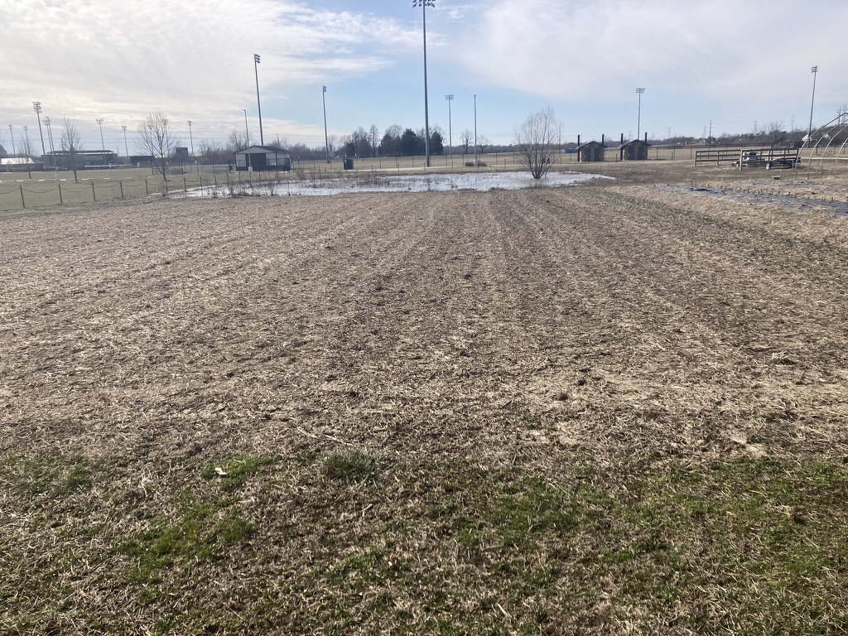
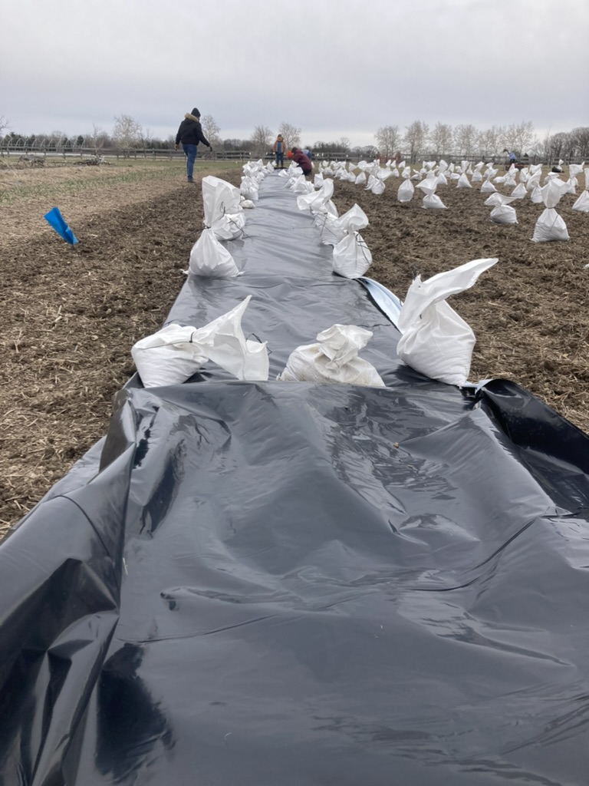
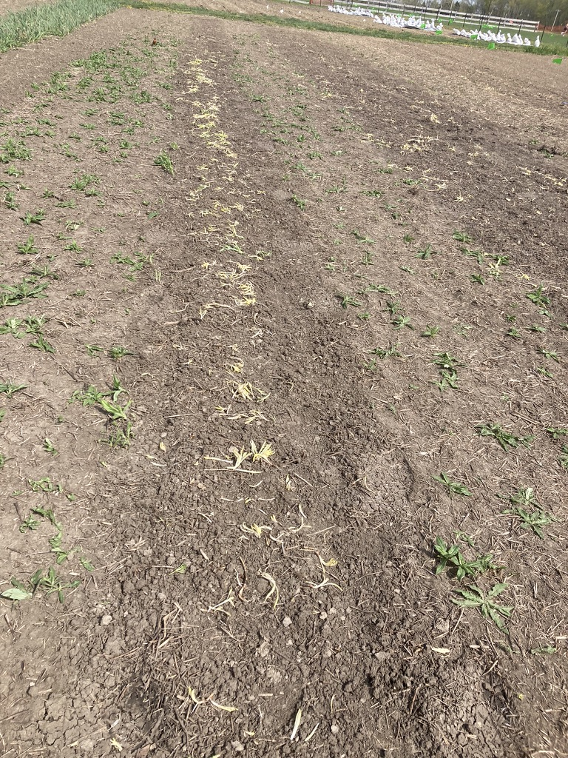

Visual timeline of tarping and planting onions
Prepare soil
Place tarps and sandbags
Lift tarp after 5 weeks
Plant onions

Slide 6
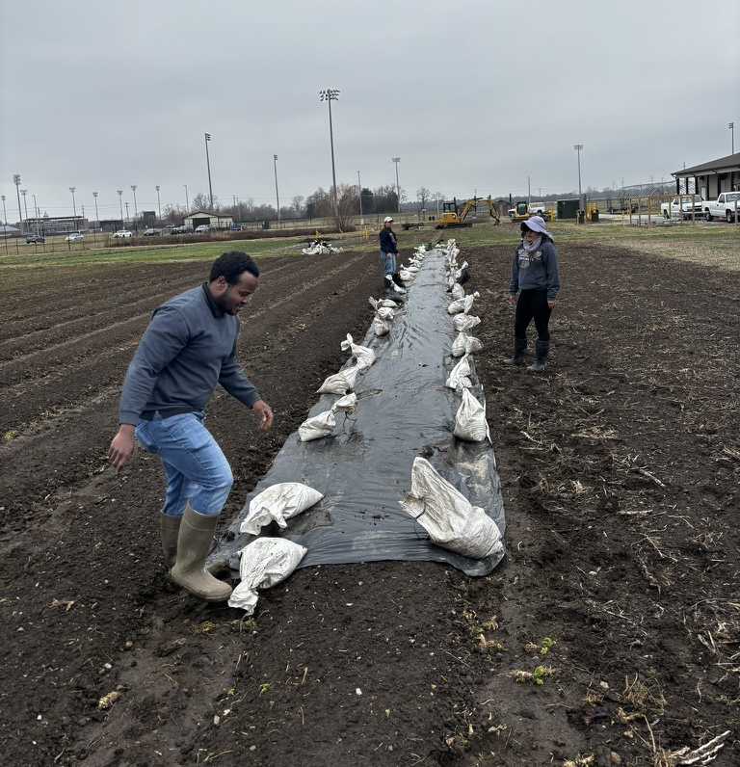
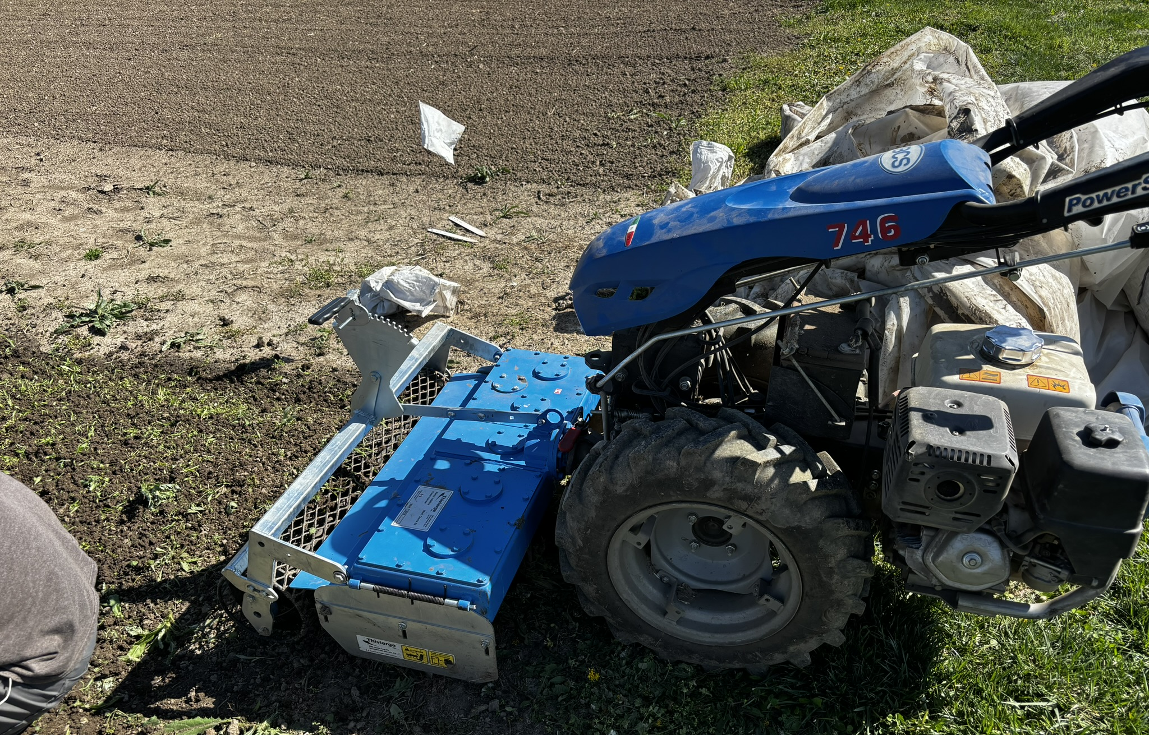
Findings on weed control “tillage vs. tarping”
After 5 weeks, the tarps were lifted, and the beds that were tarped would have appeared clean if not for the presence of thistles.​
Tarps demonstrated no effect on perennial weeds like thistles. ​
There were no noticeable differences in weed control between beds that were tarp or tilled across all treatments during the initial three-week period. ​

Slide 7
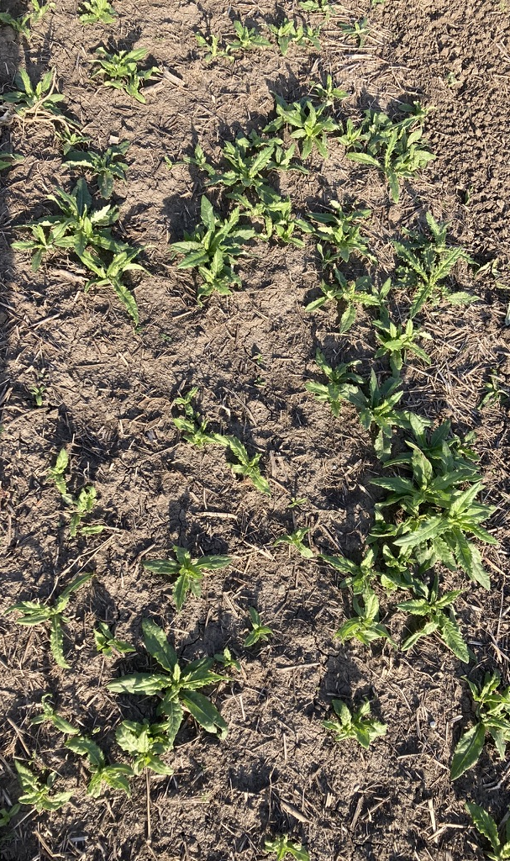
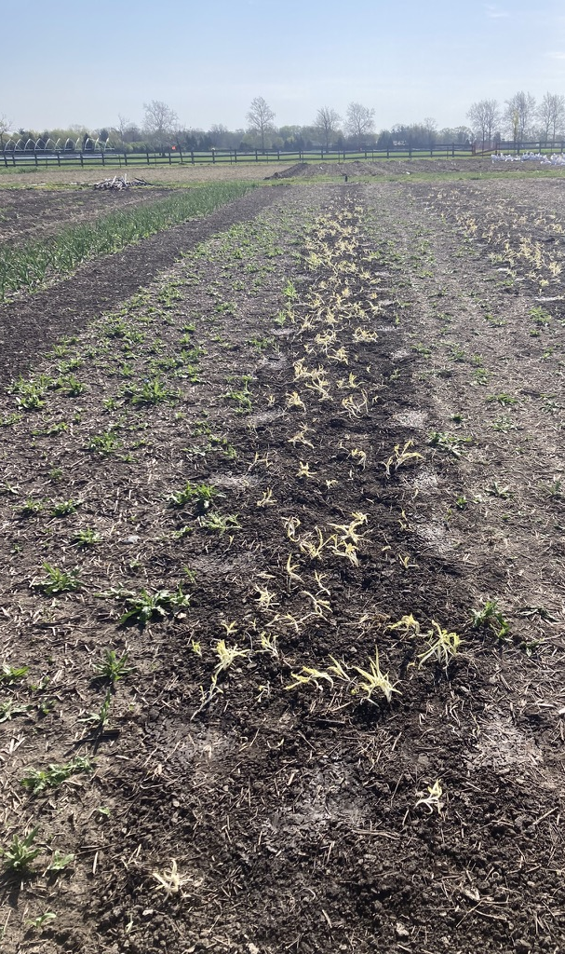
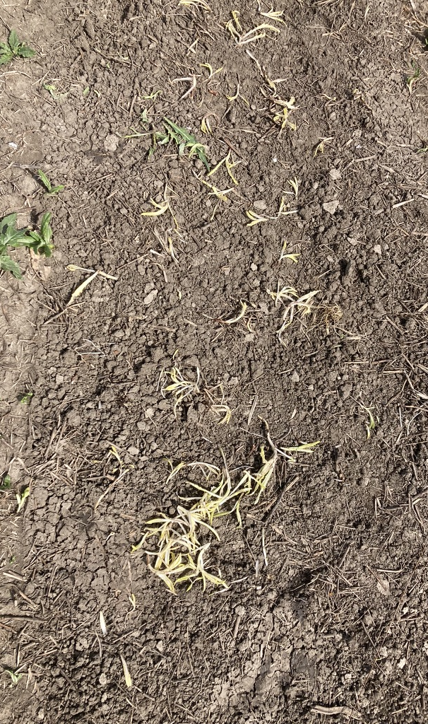

Slide 8
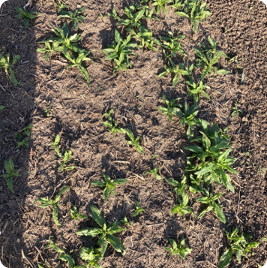
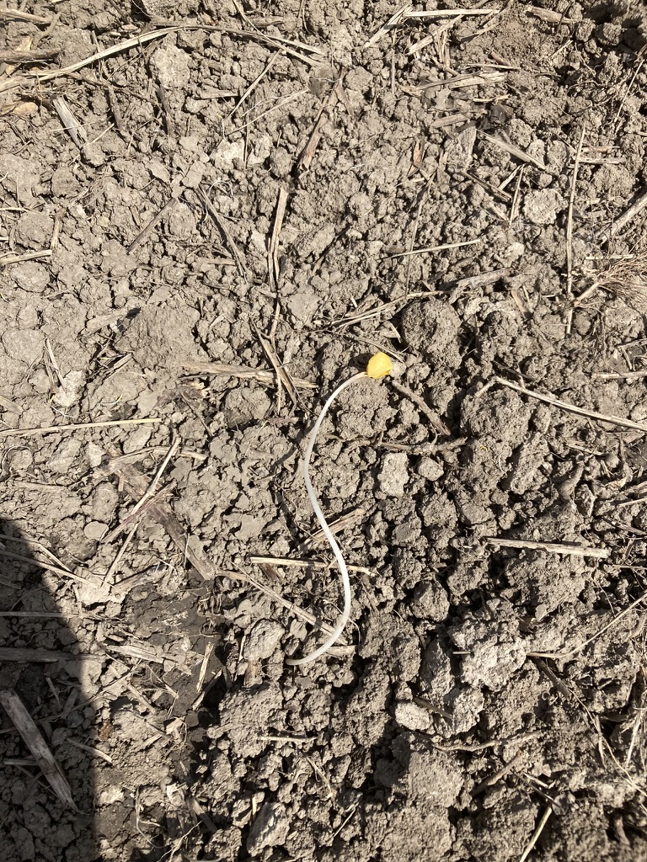
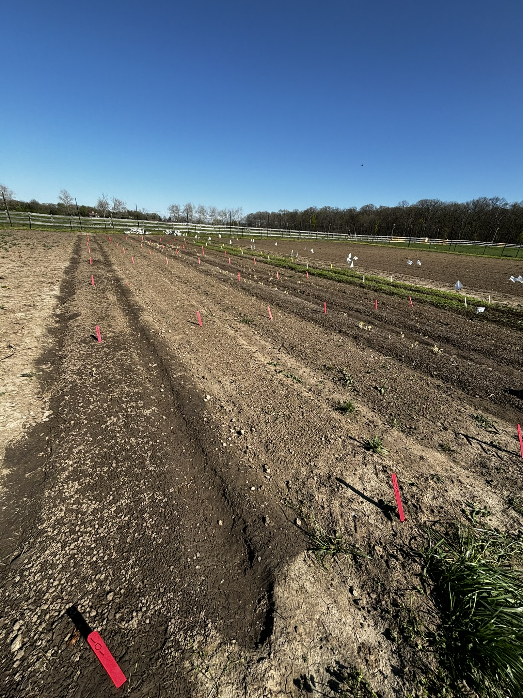
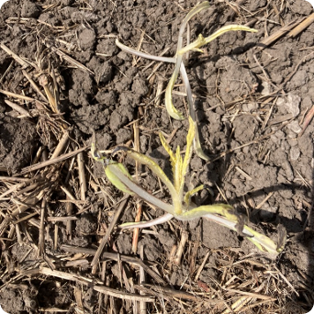
Not Tarped
Tarped
Tarped
Tilled
Fatal germination on a dead white thread stage weed

Slide 9
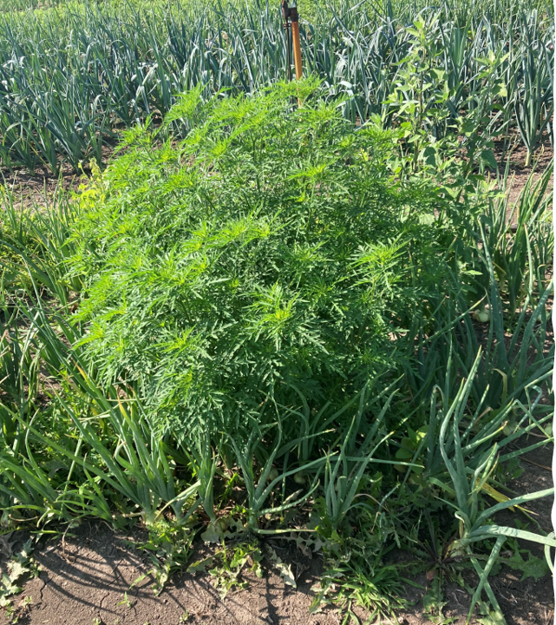
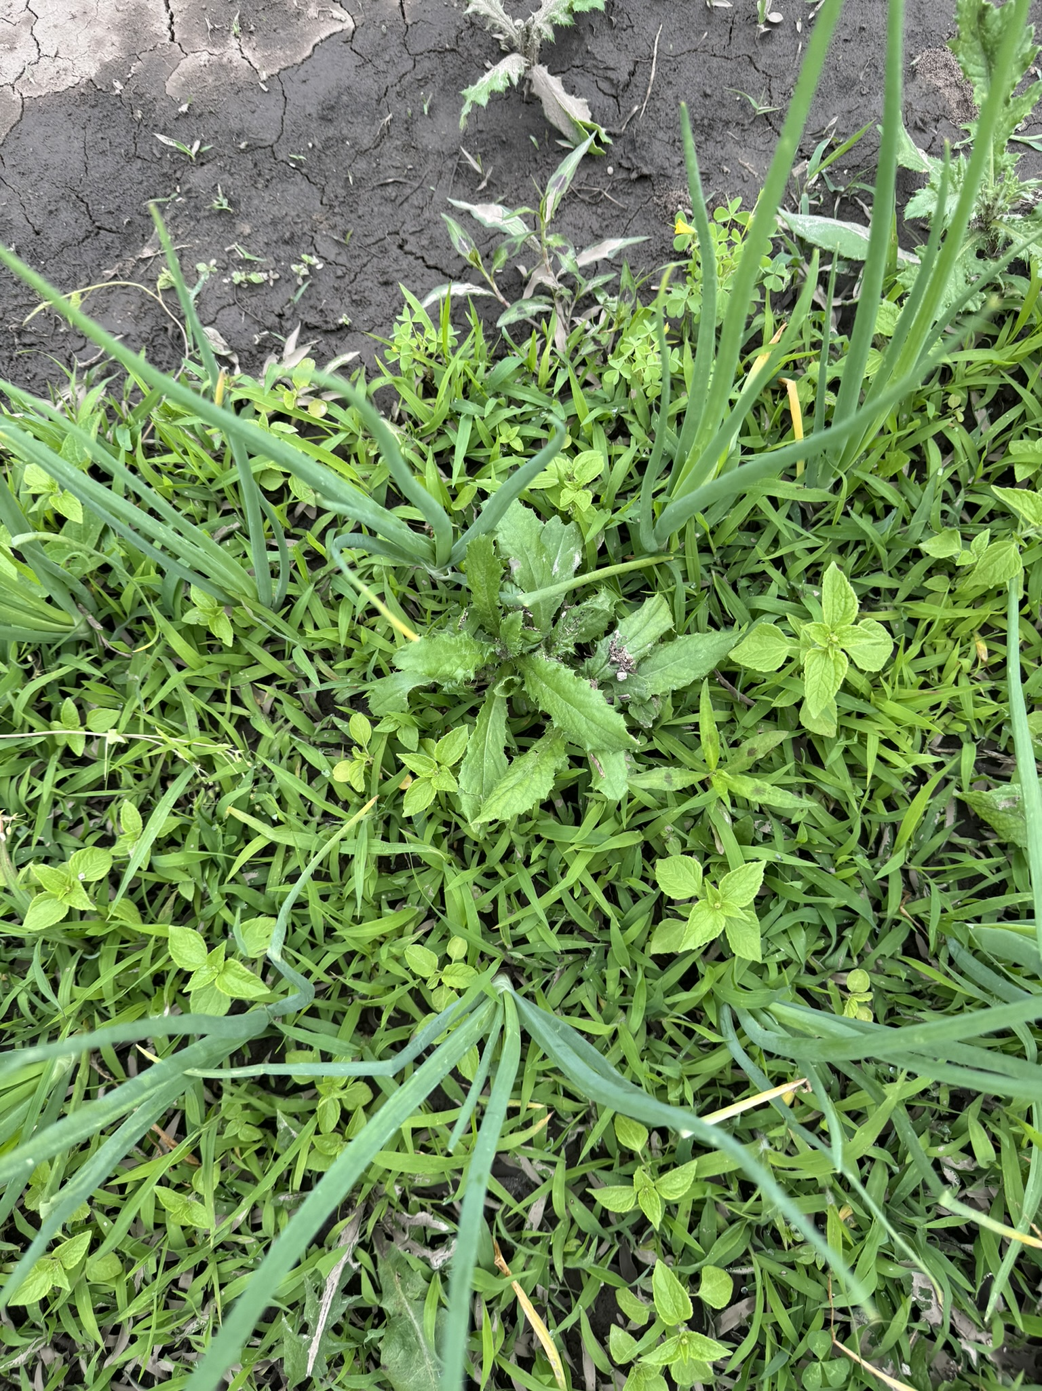
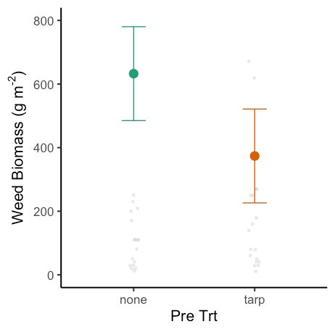
More findings…
Weed biomass was recollected two days prior harvest and we found that treatments with tarping had less above ground weed biomass than those treatments with tillage.

Slide 10
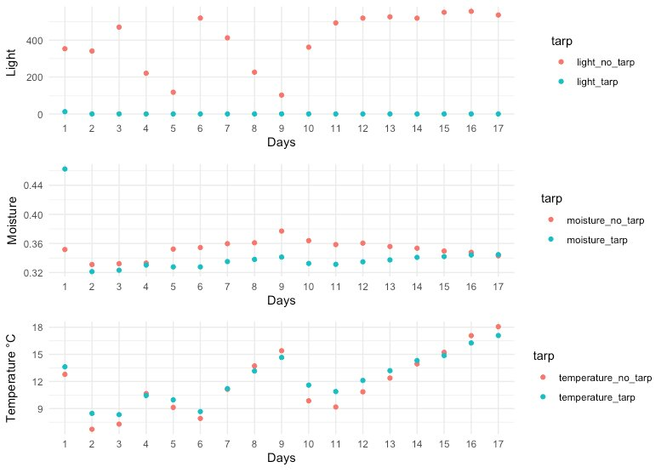
Sensor data showed some differences between tarped and bare ground

Slide 11
Outline
Creating stale seedbeds with silage tarps in onions
Early season weed management in potatoes with silage tarps
Non-utilized methods for weed management (use of silage tarps and clear plastic in onions)

Slide 12

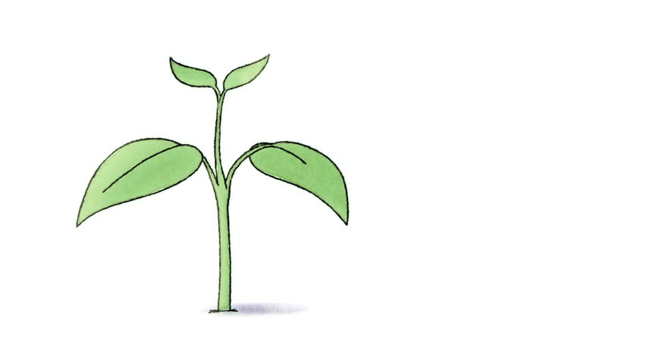
Occultation and Solarization
Occultation is the practice of blocking all light from reaching the soil surface.
Solarization is the practice of trapping the suns radiation in order to heat the soil above ambient temperatures.

Slide 13
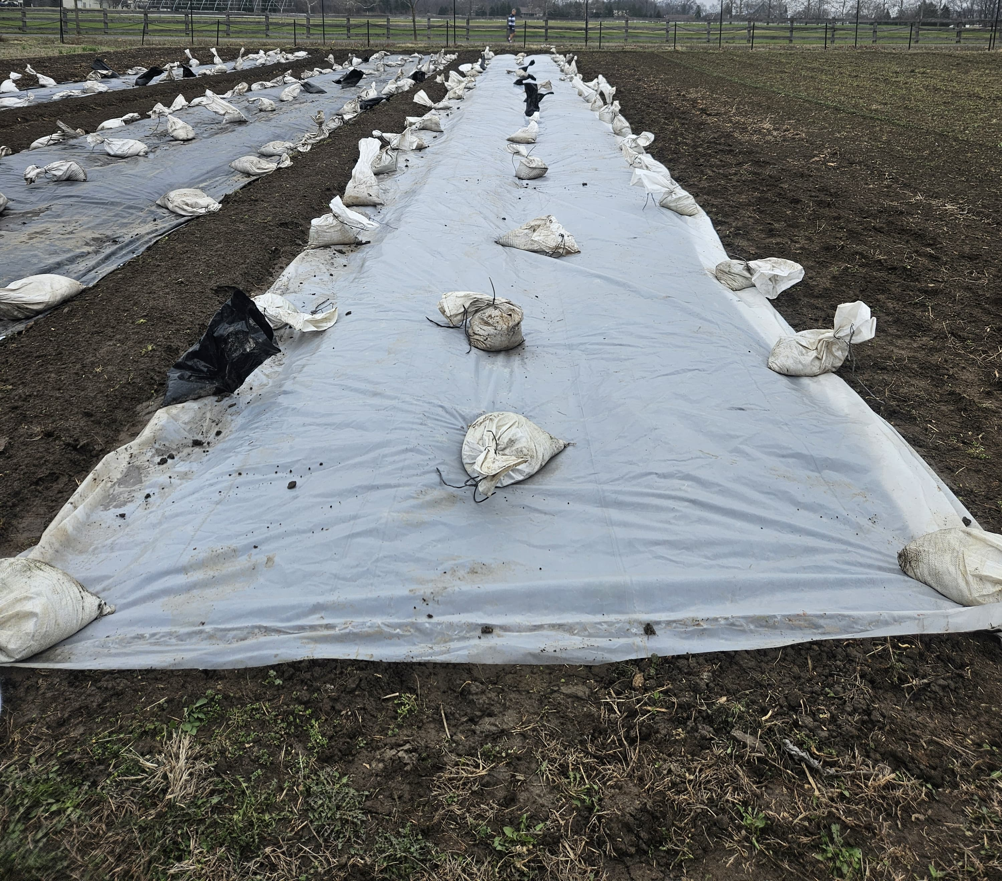
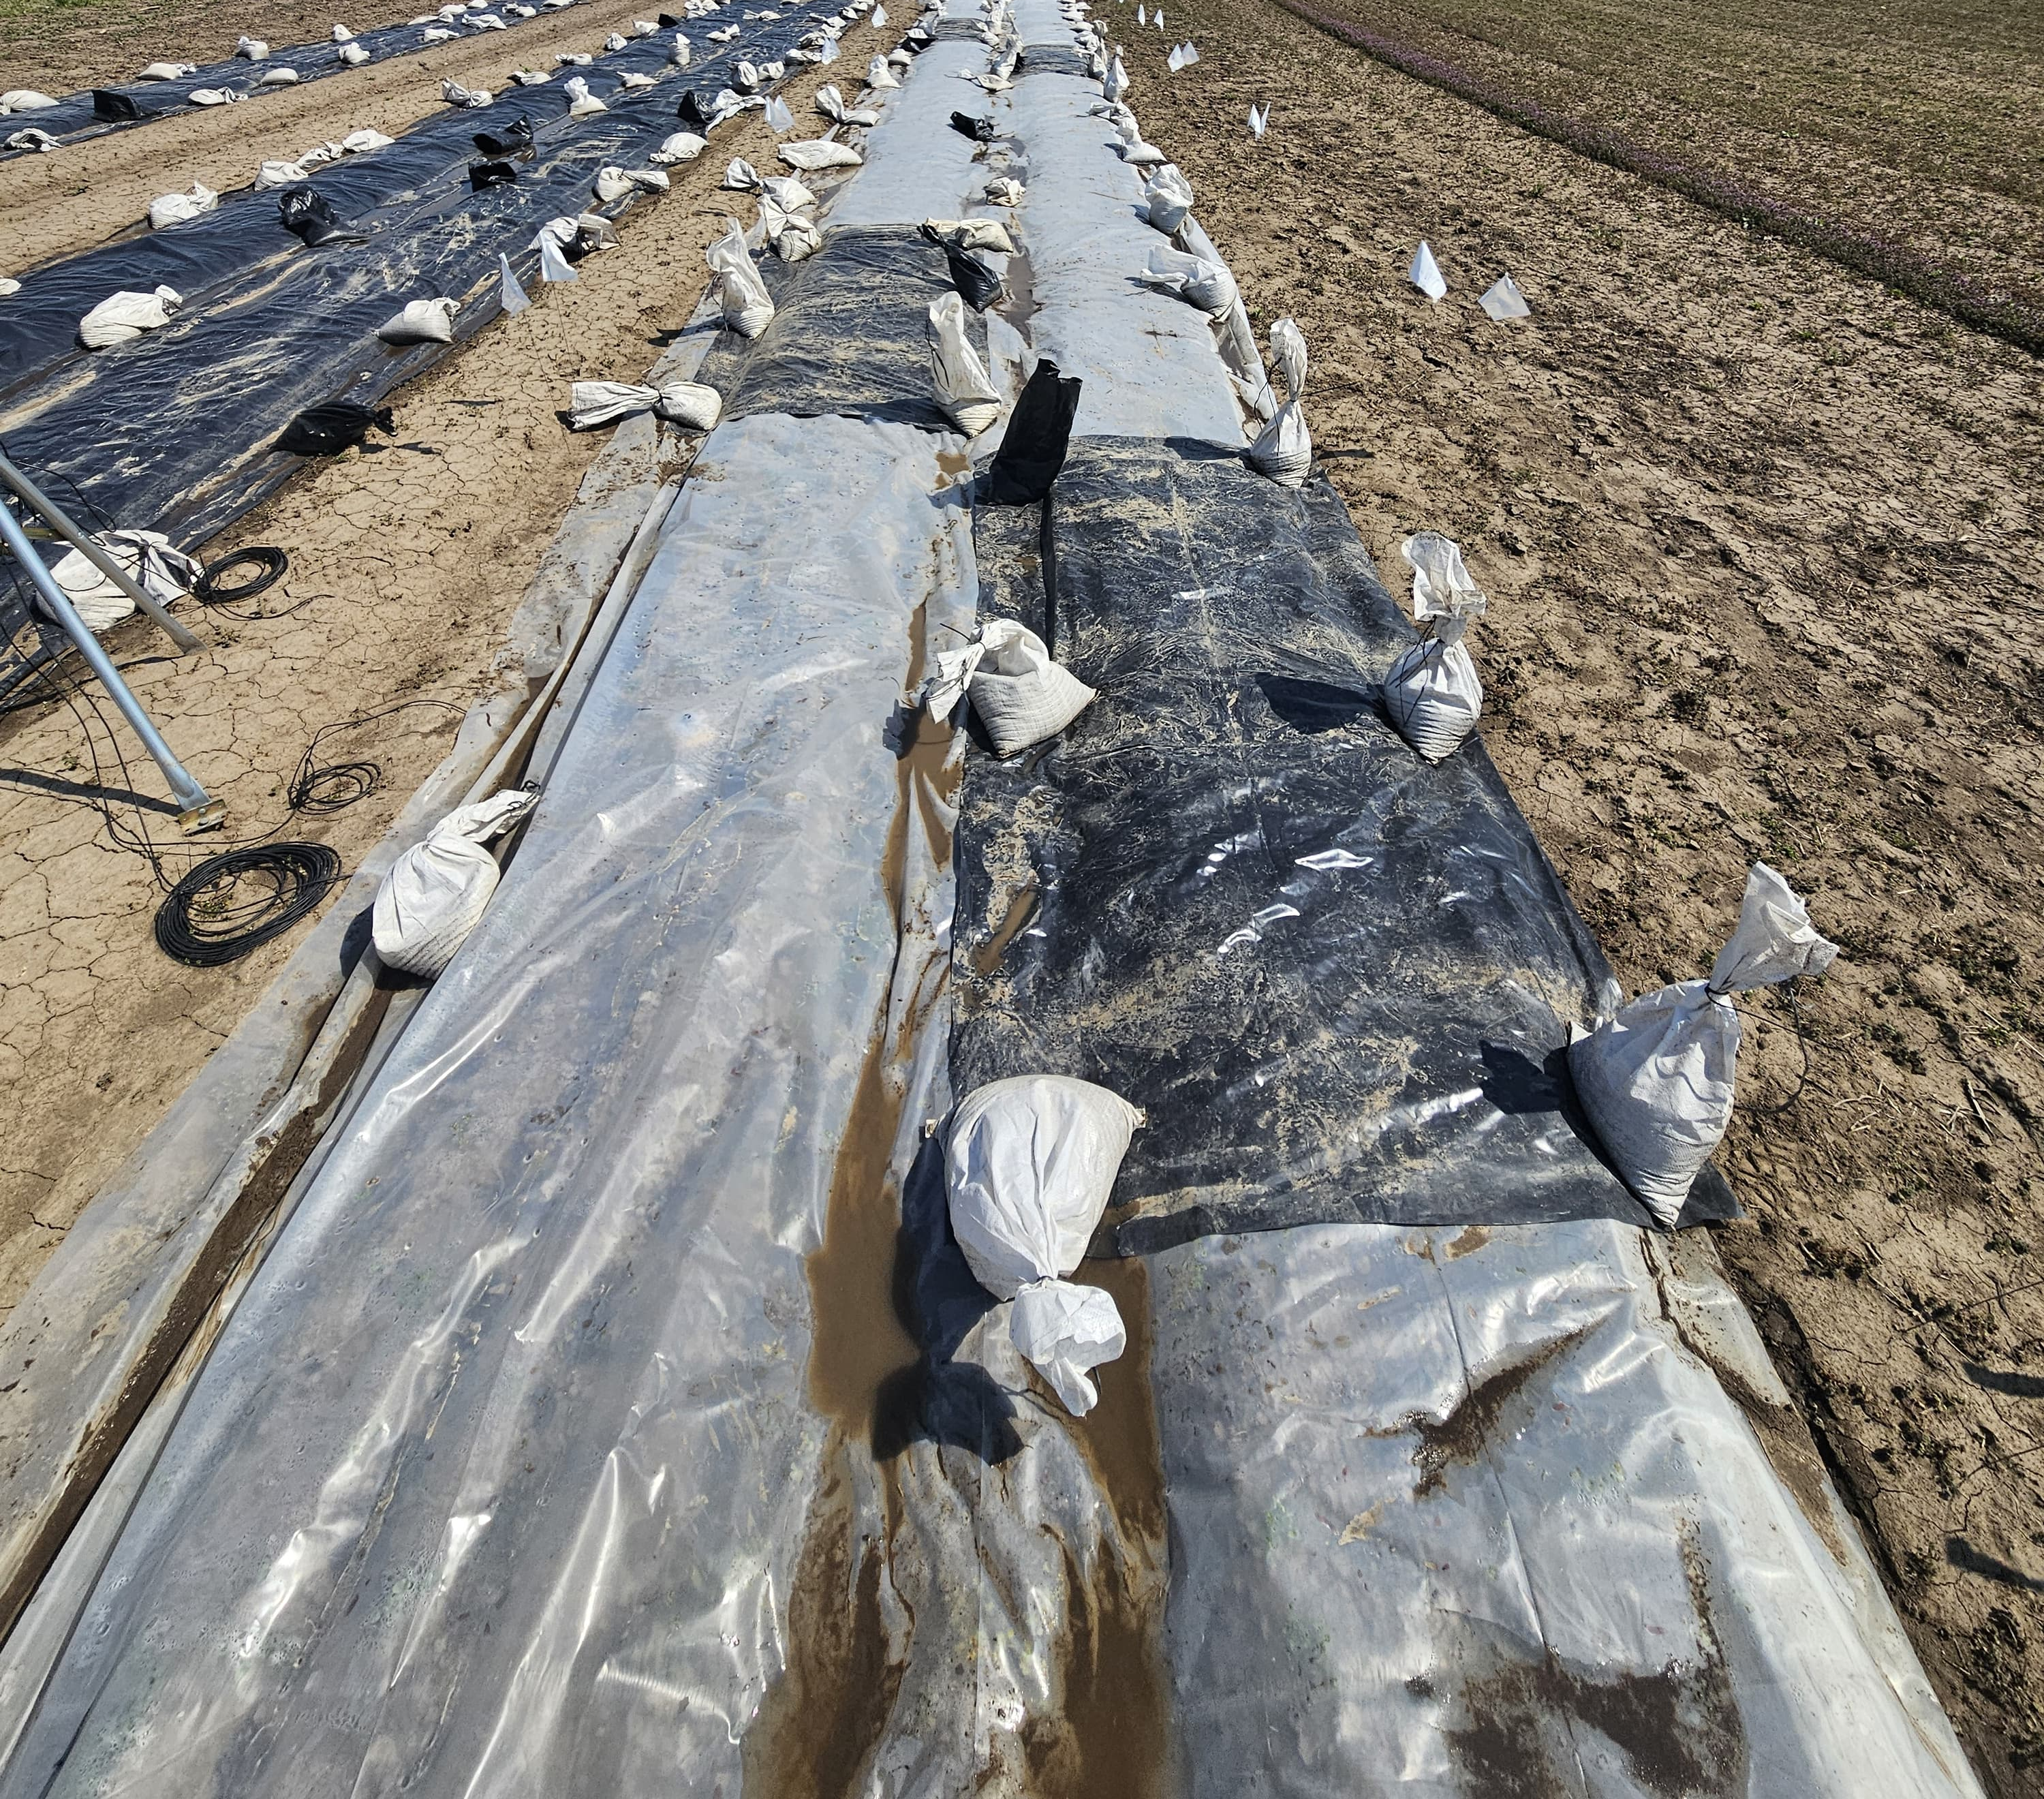
March 7, 2024
3 weeks later
March 29, 2024

Slide 14
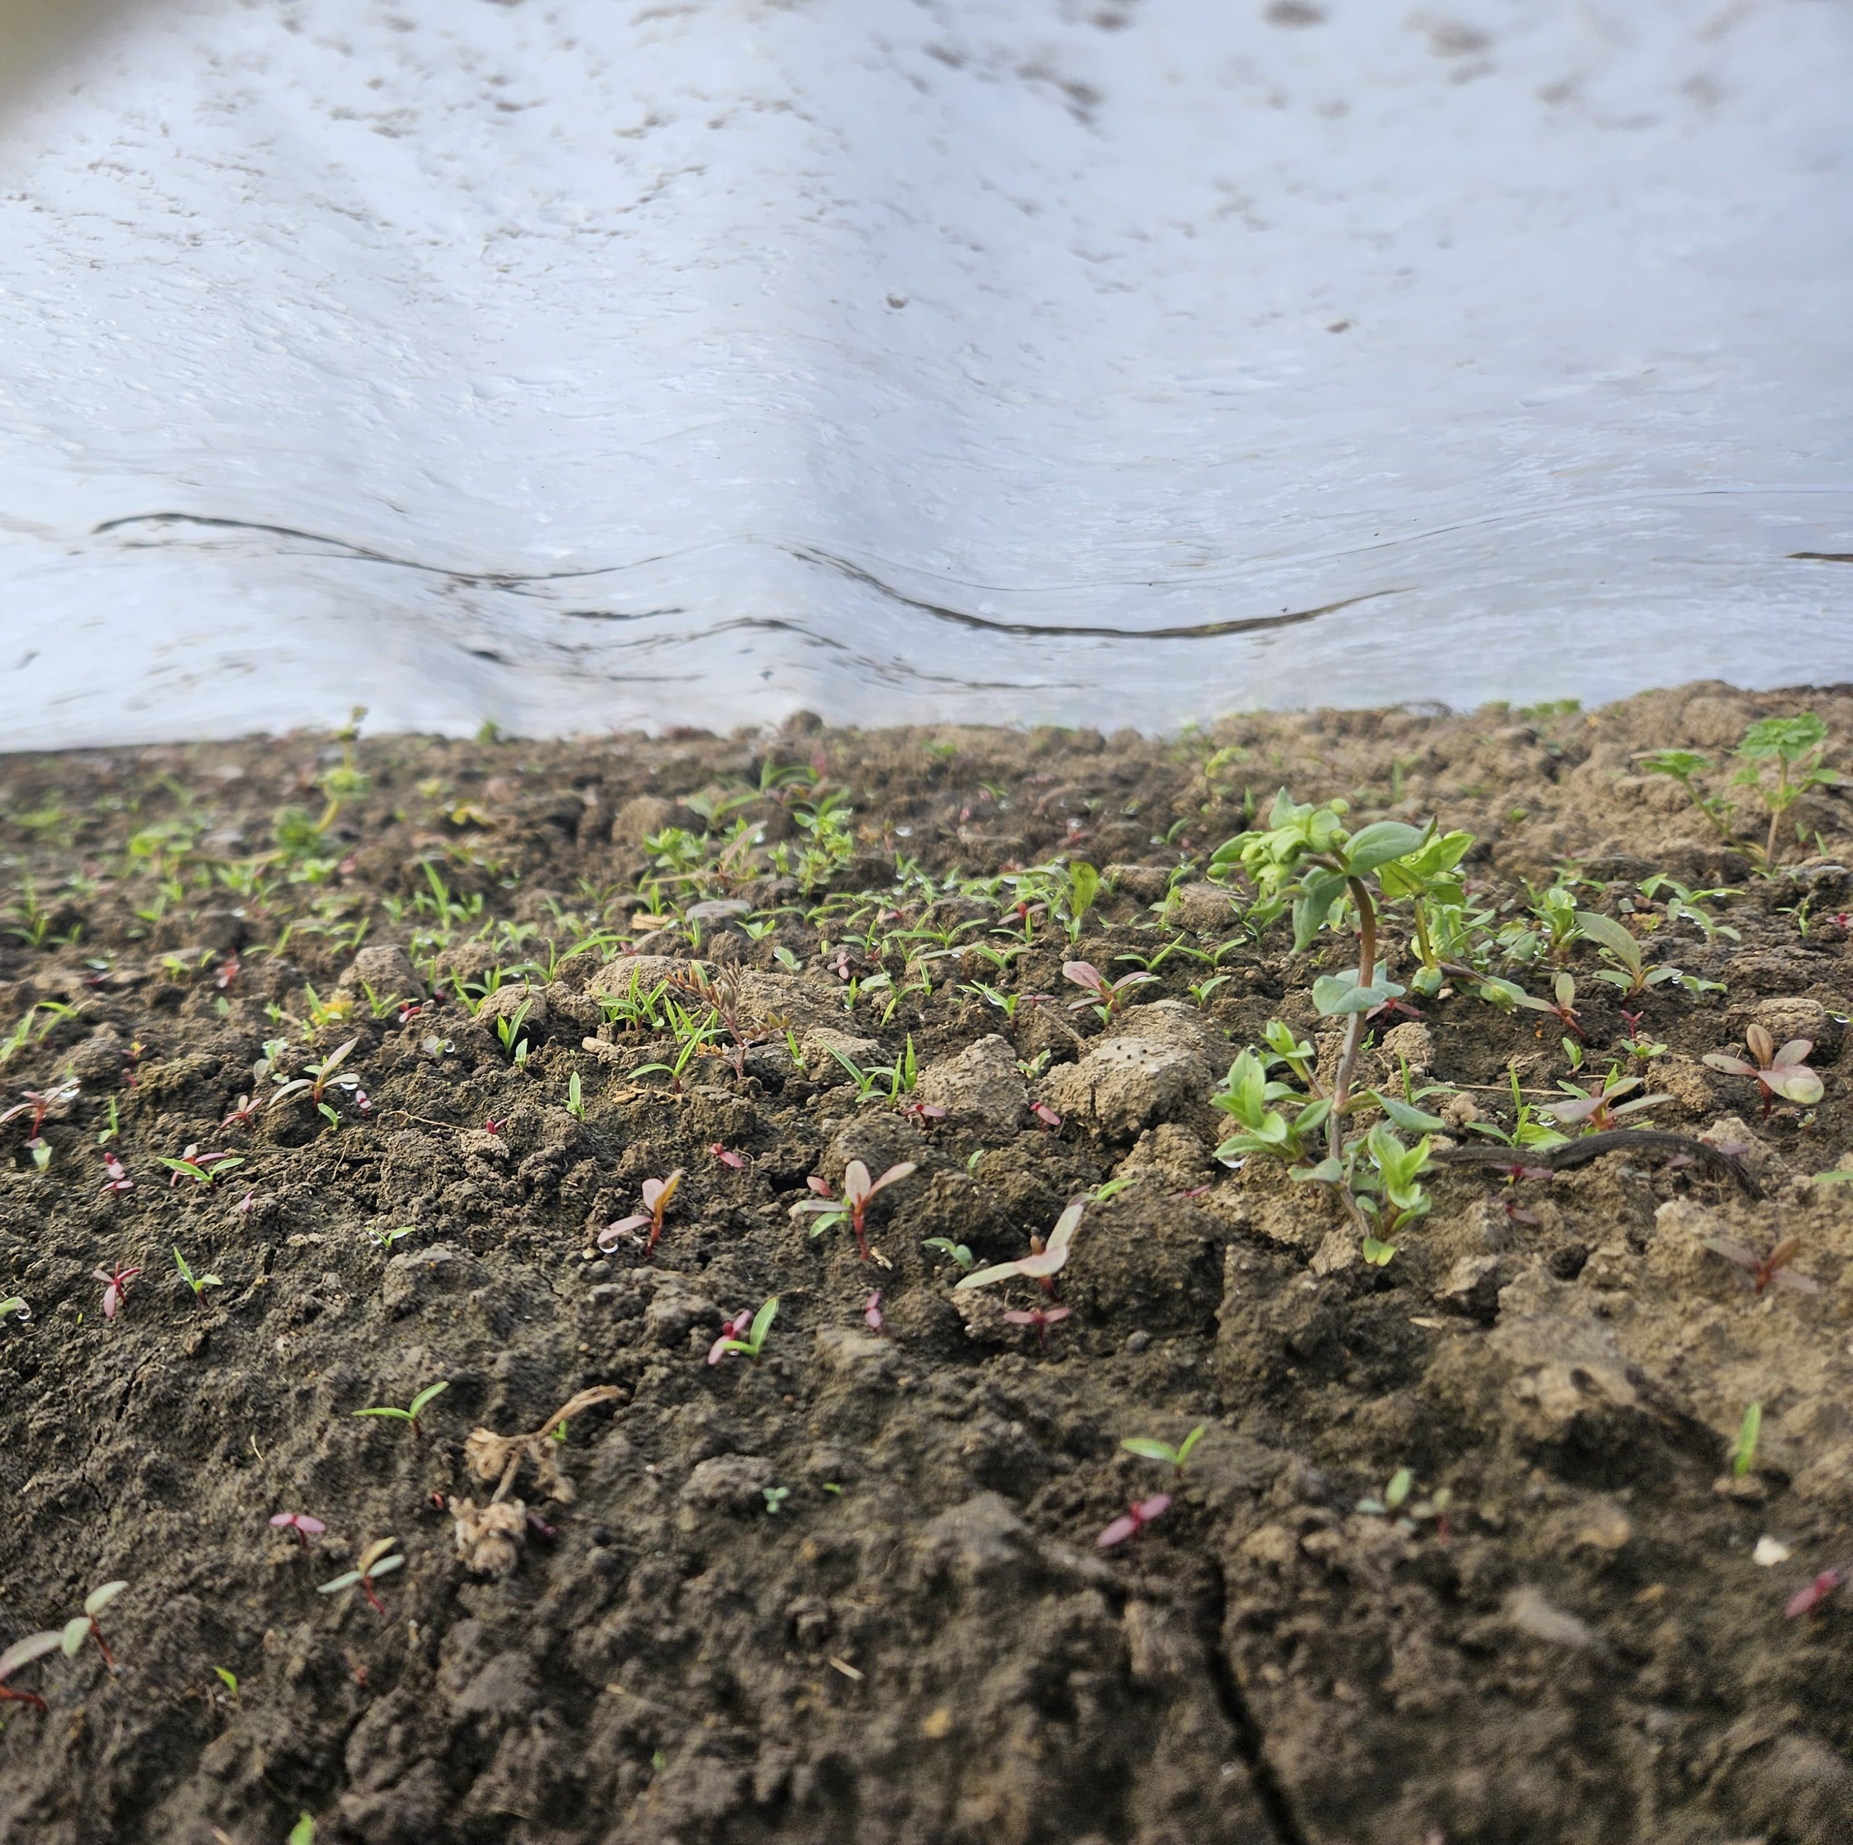
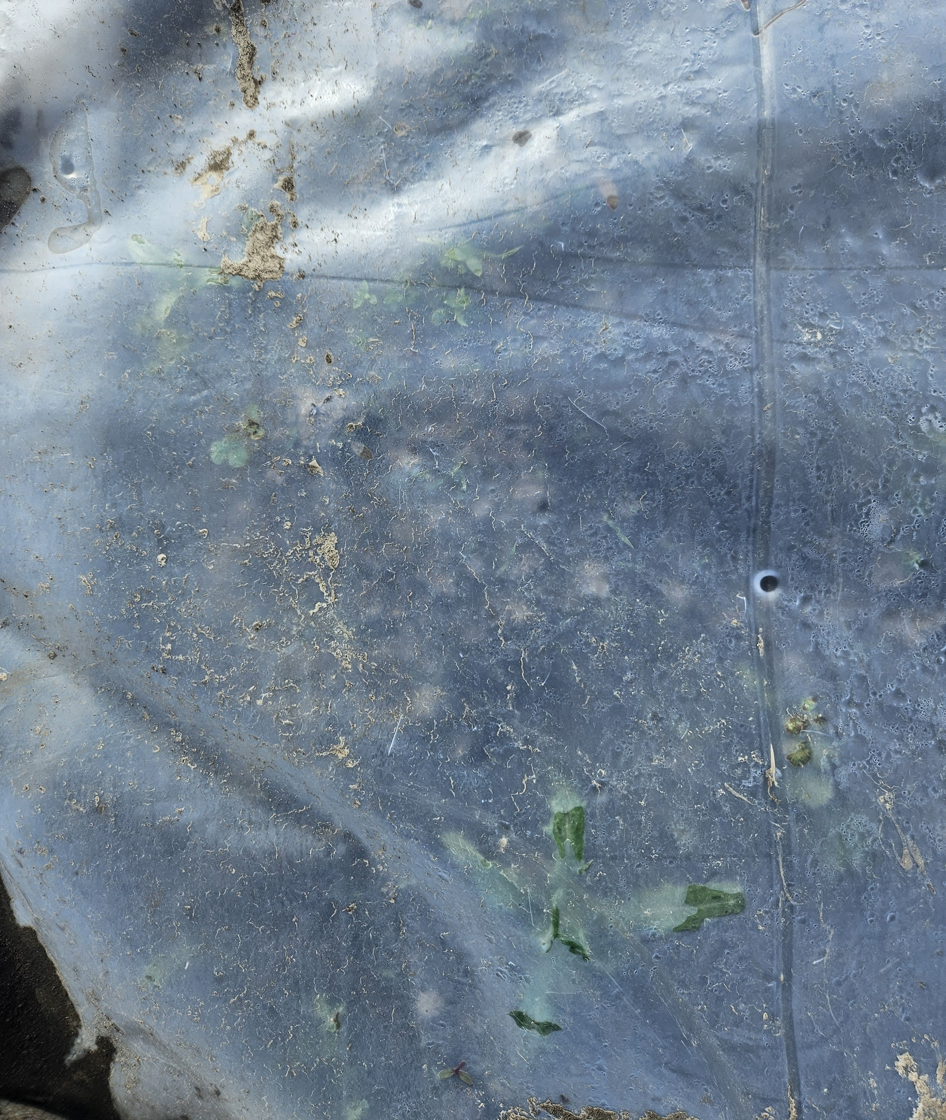


Slide 15
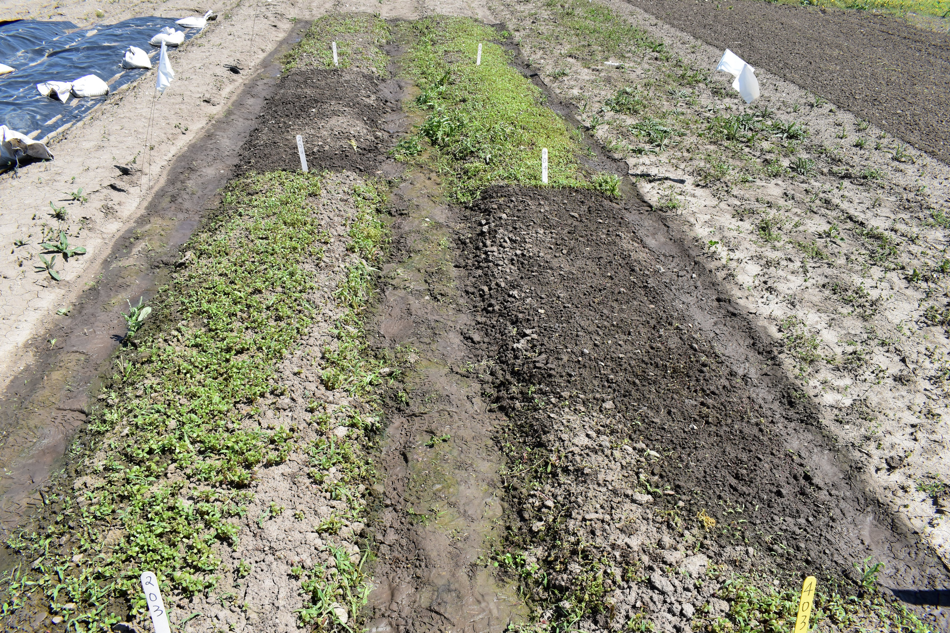
ORGANIC HERBICIDE
GLYPHOSATE
TARP

Slide 16
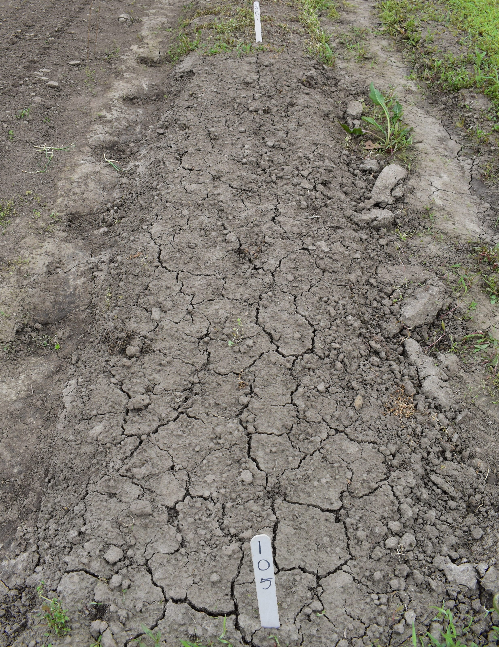
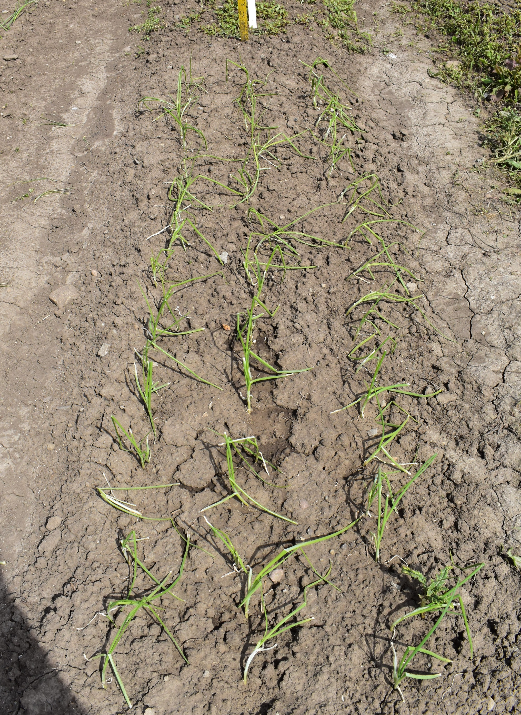
TARP

Slide 17
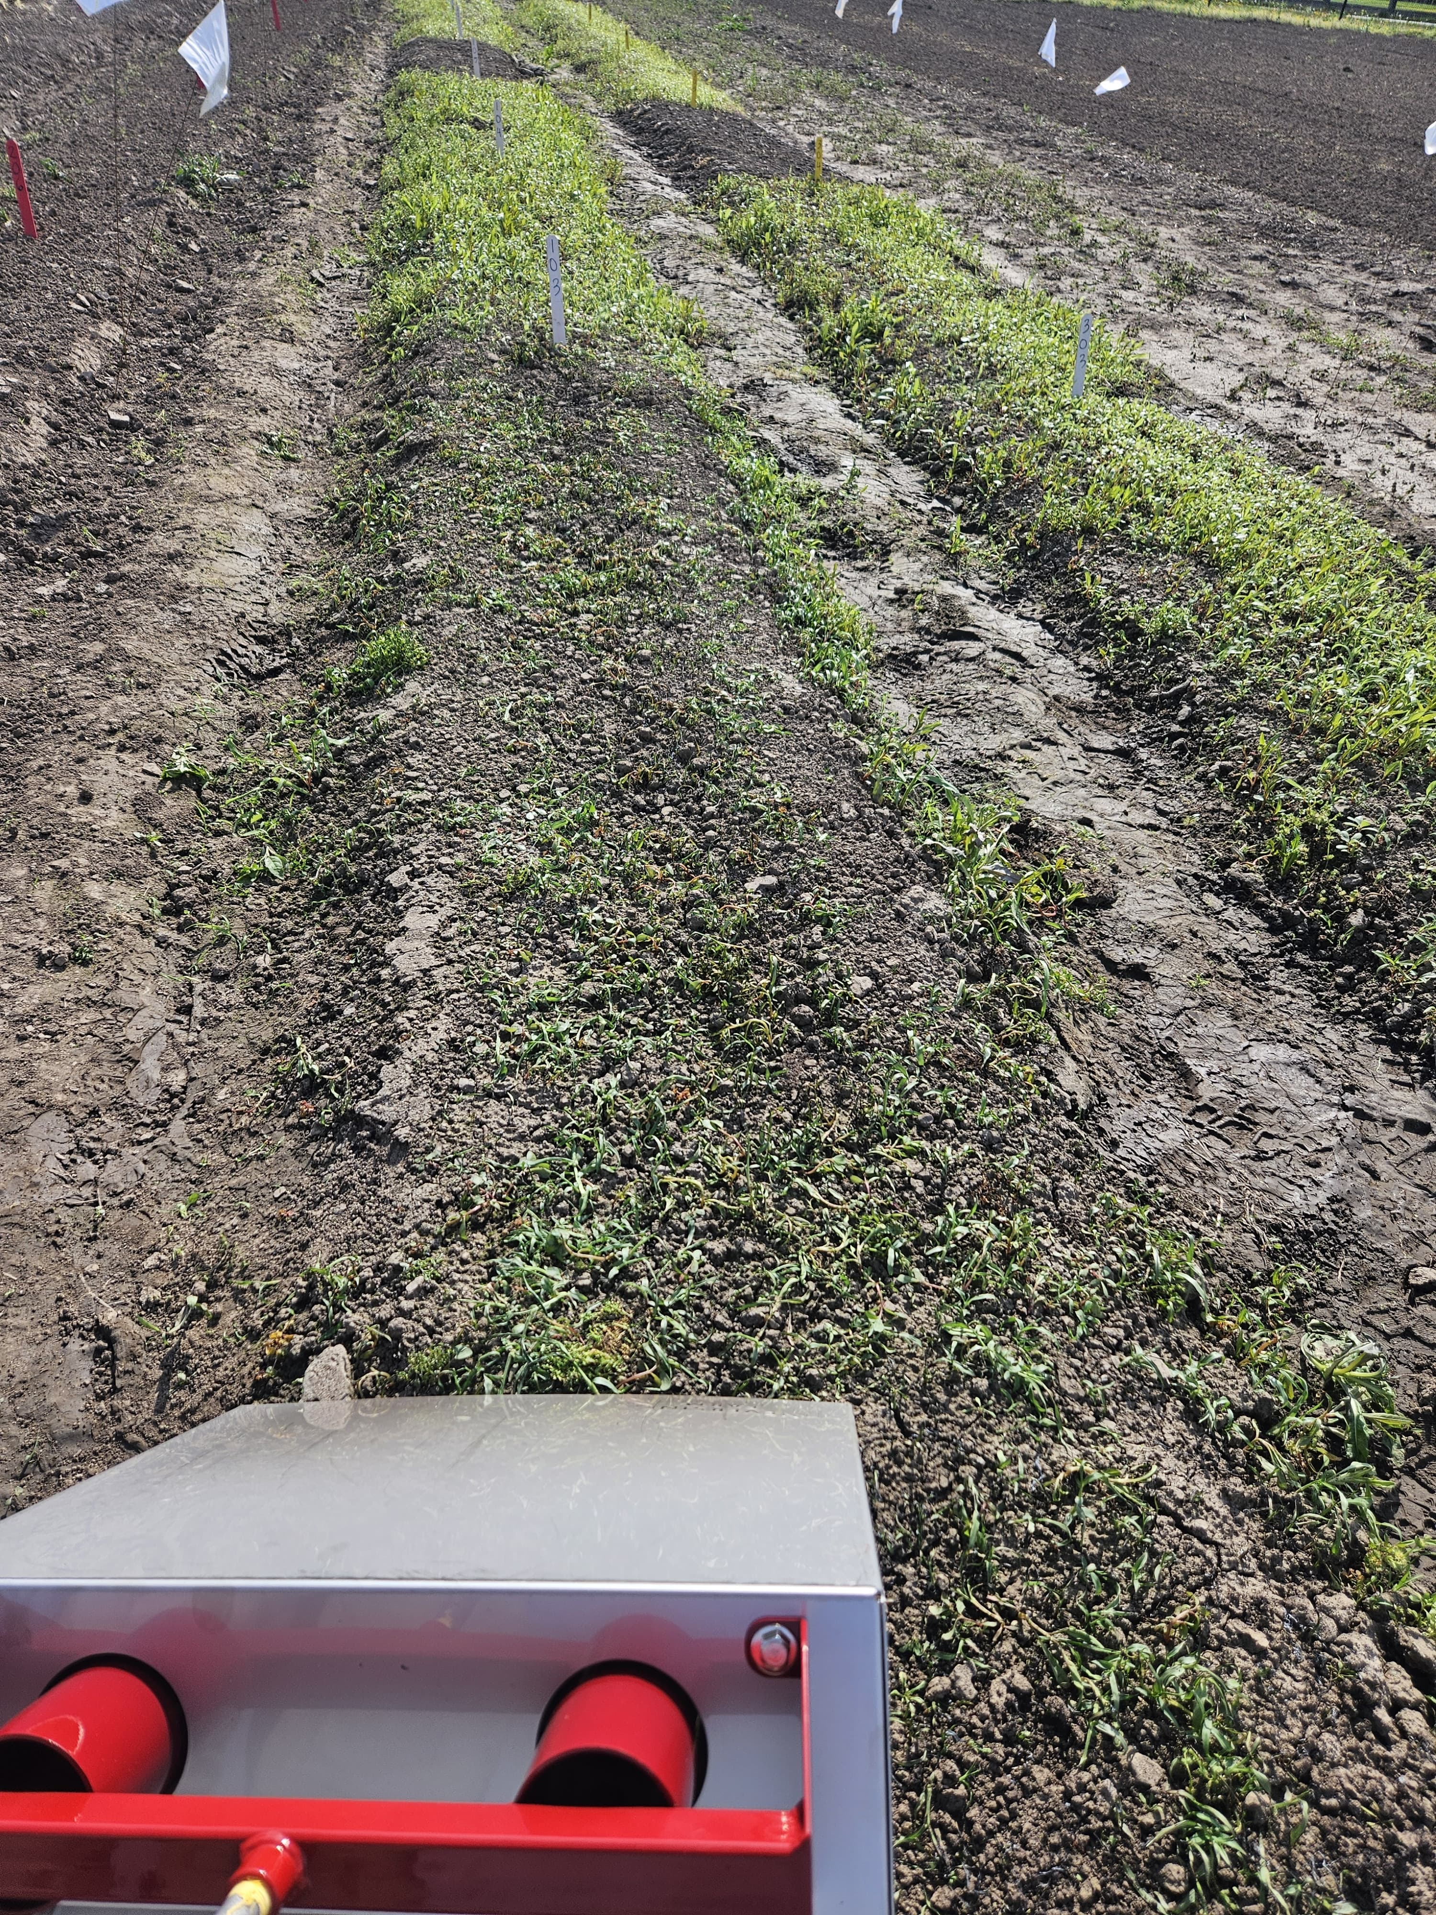
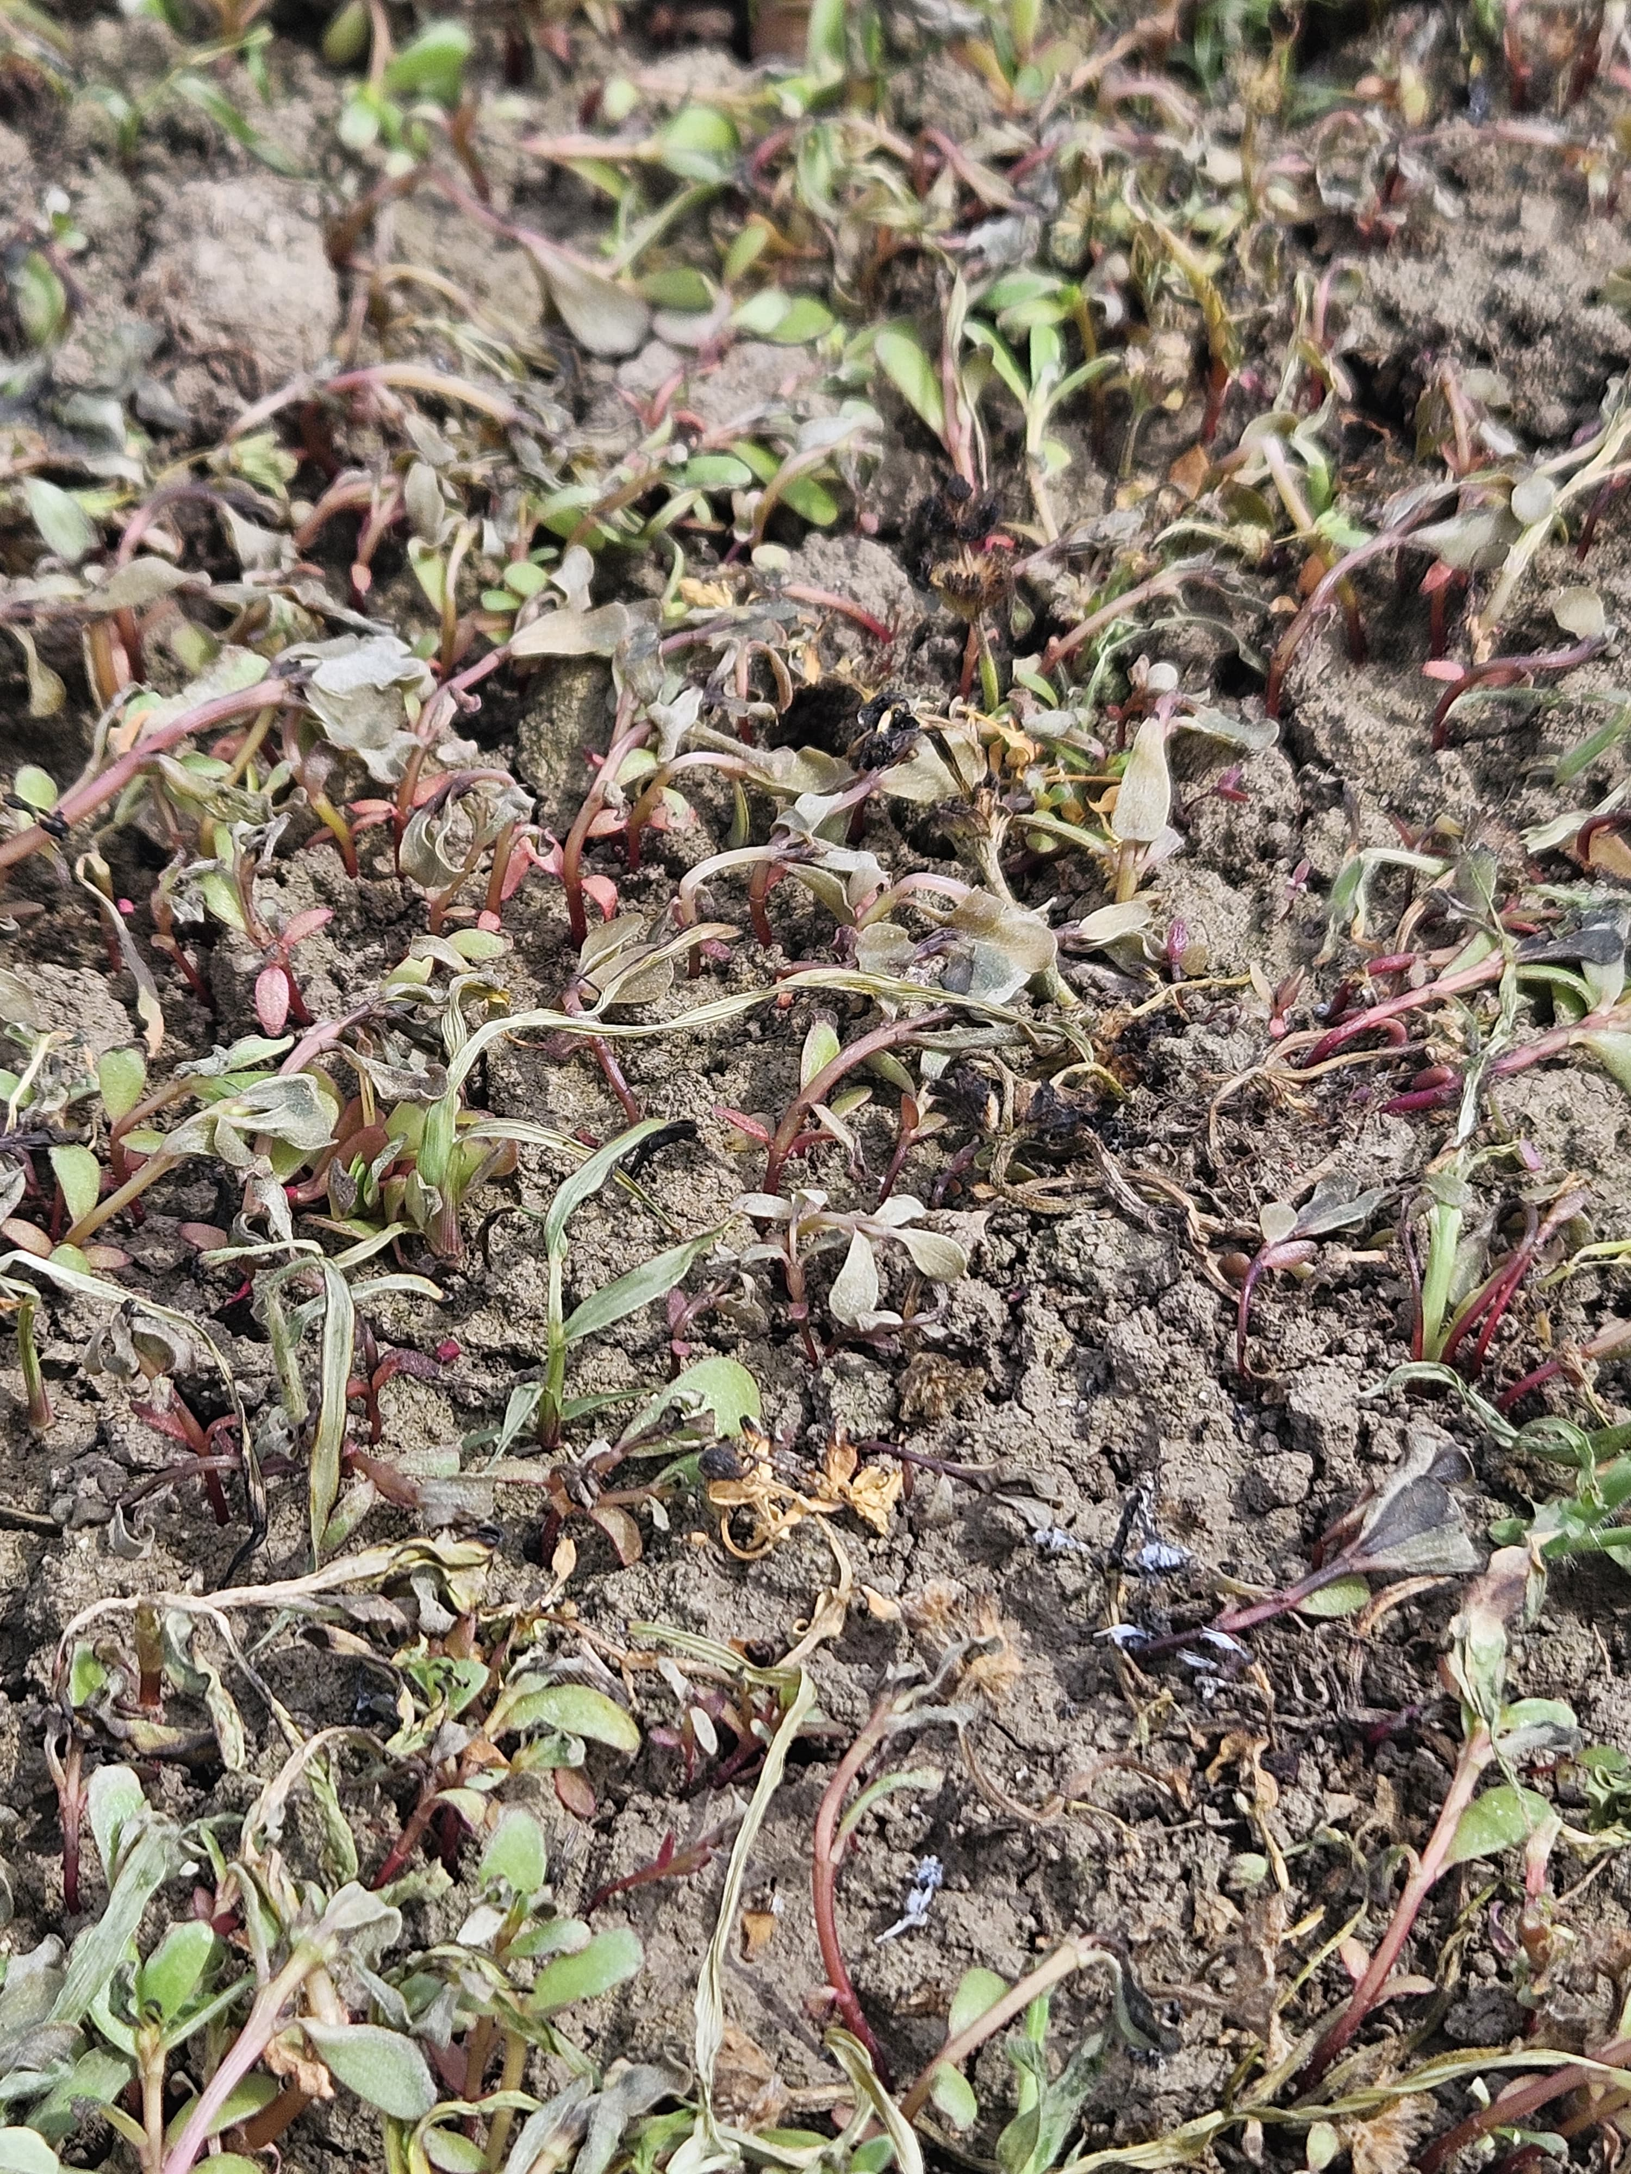
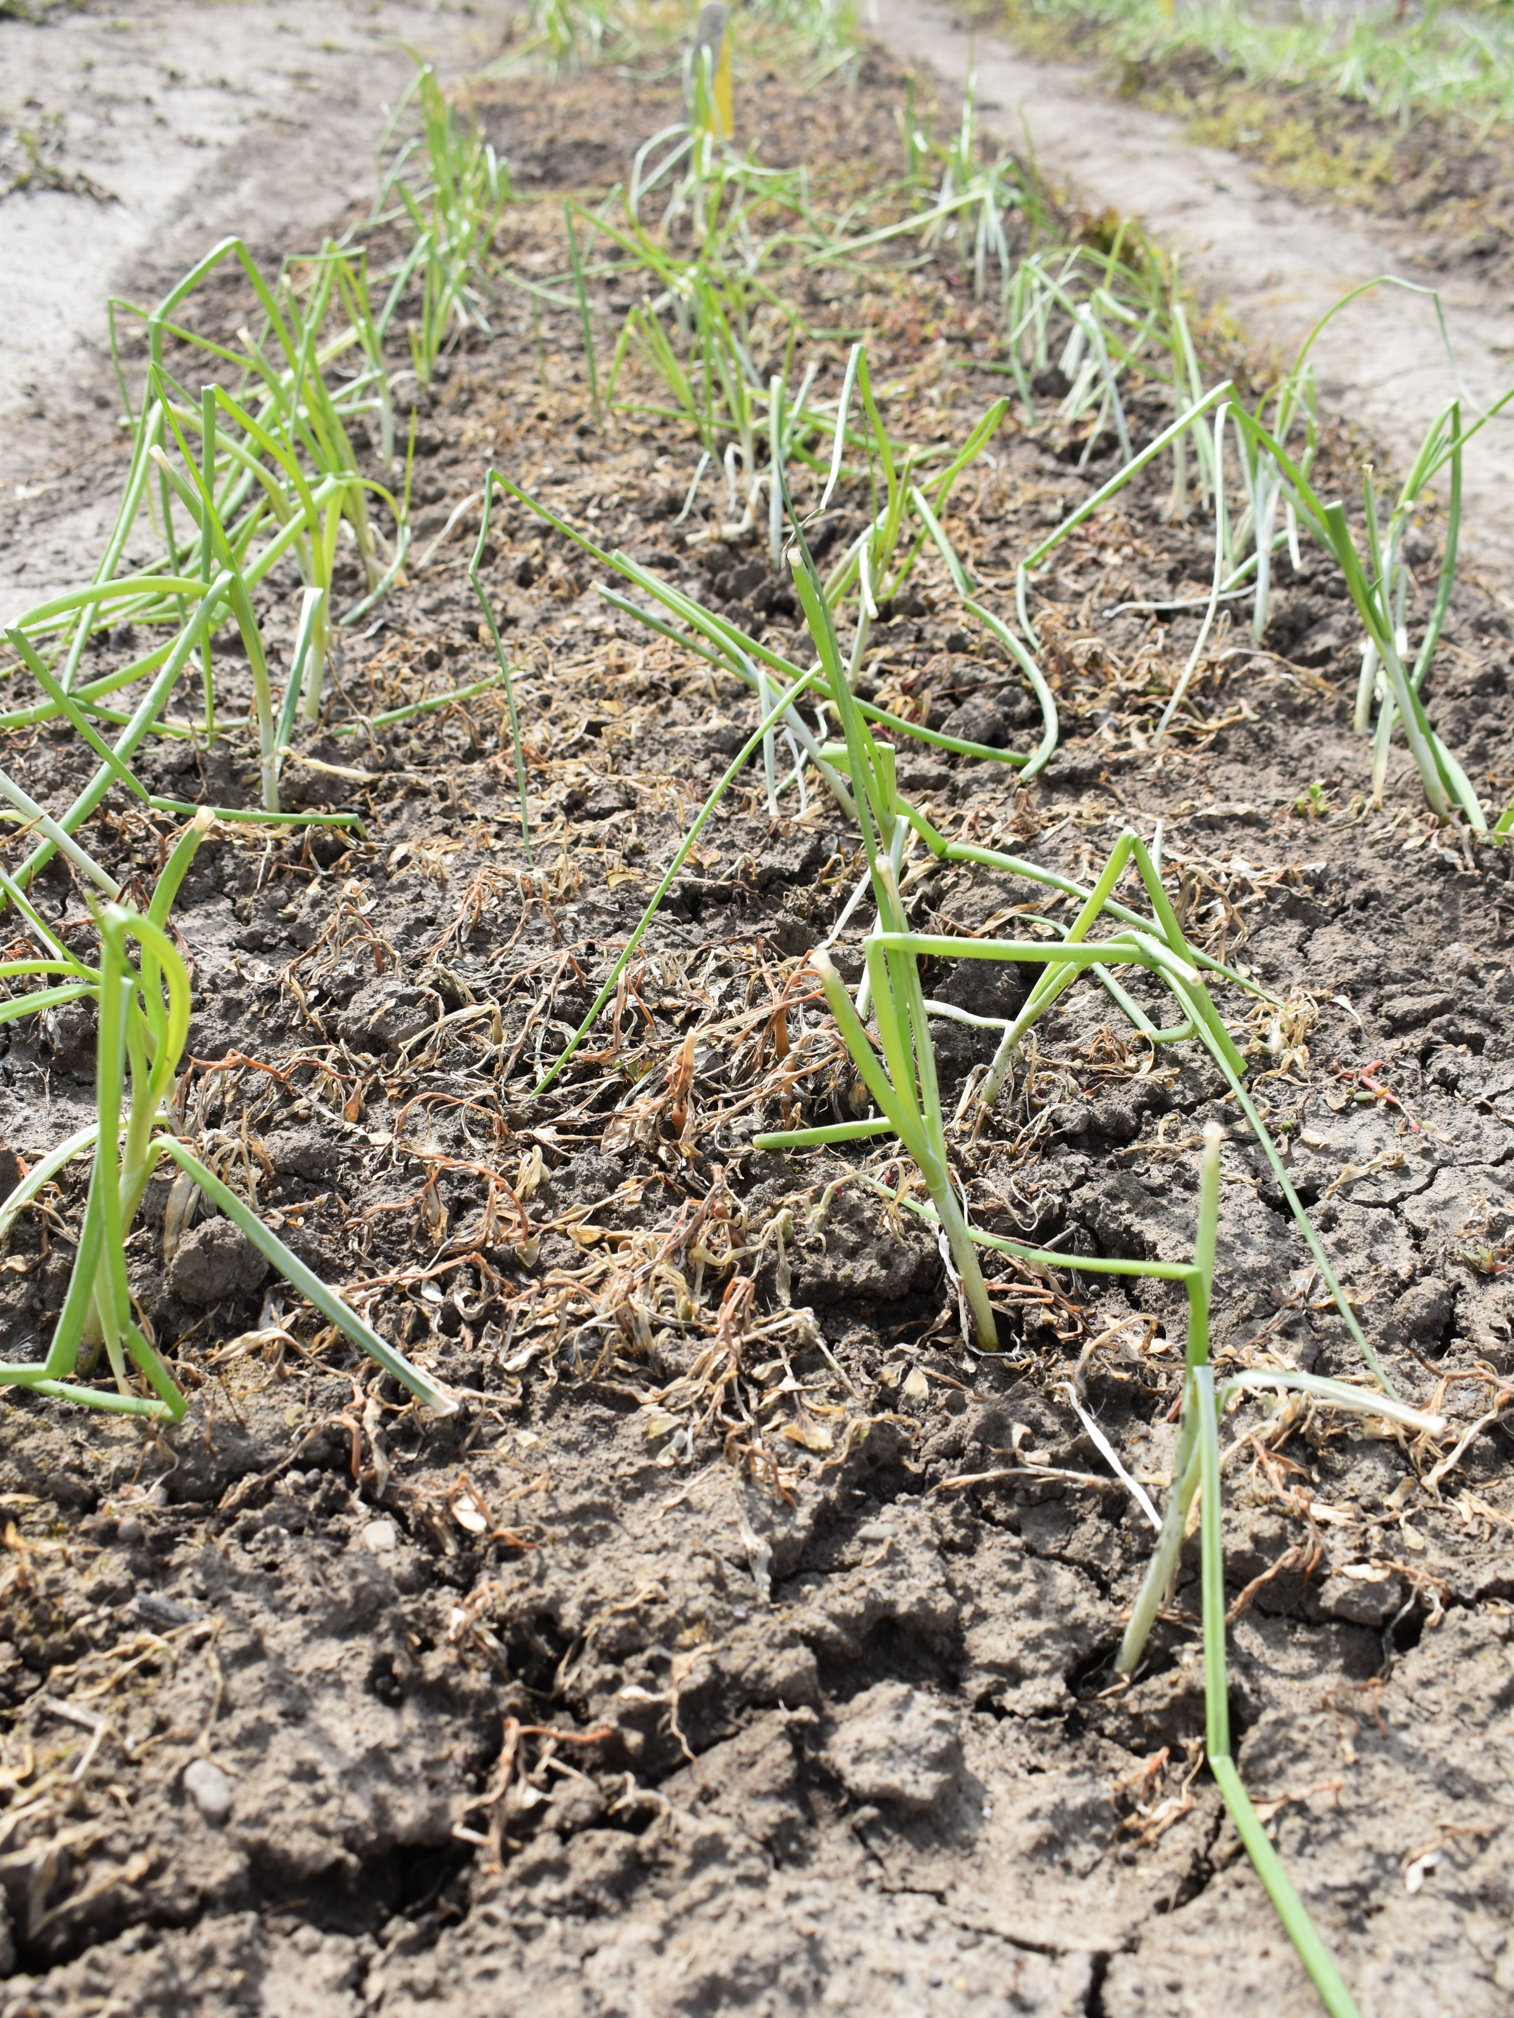
Flaming

Slide 18
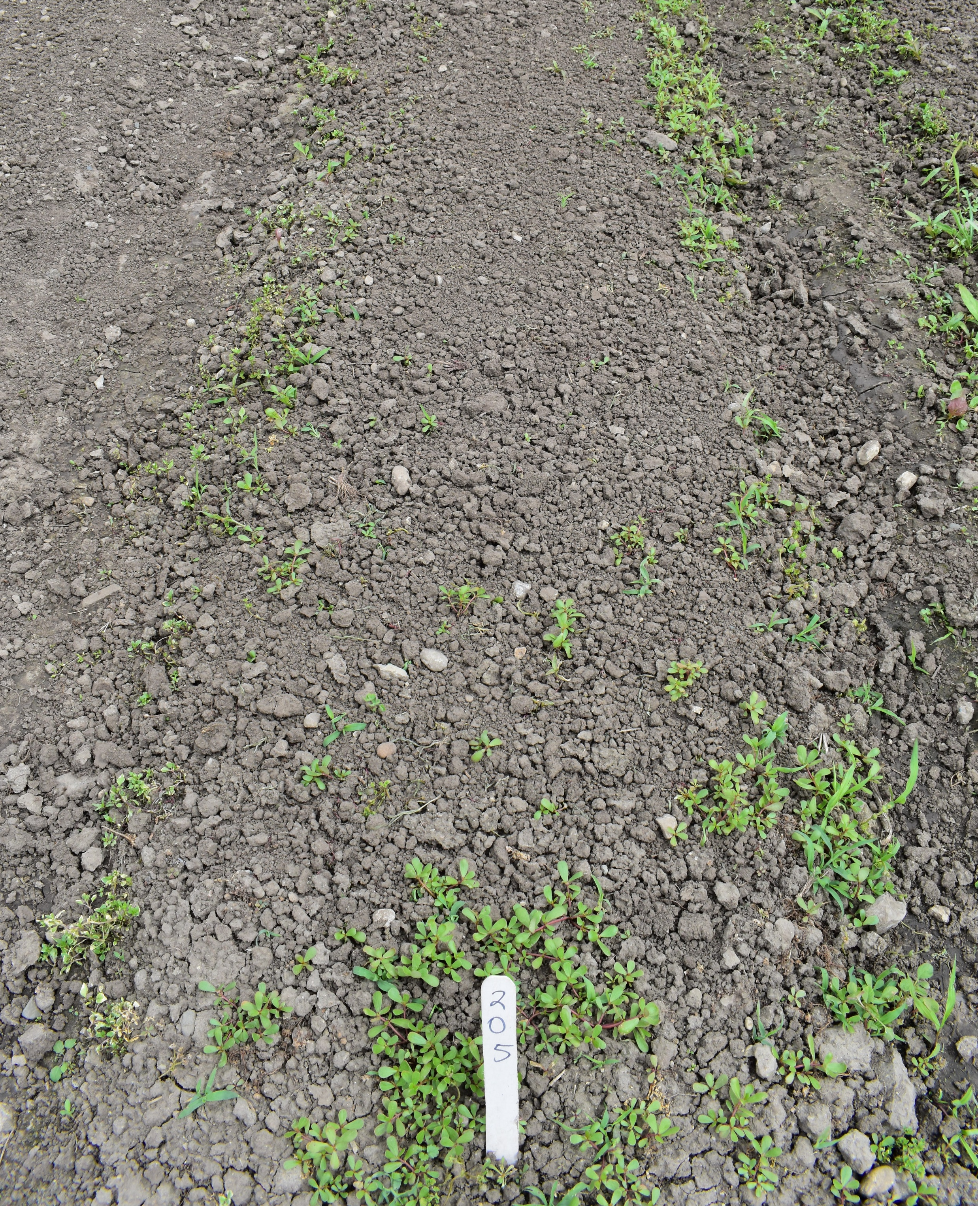
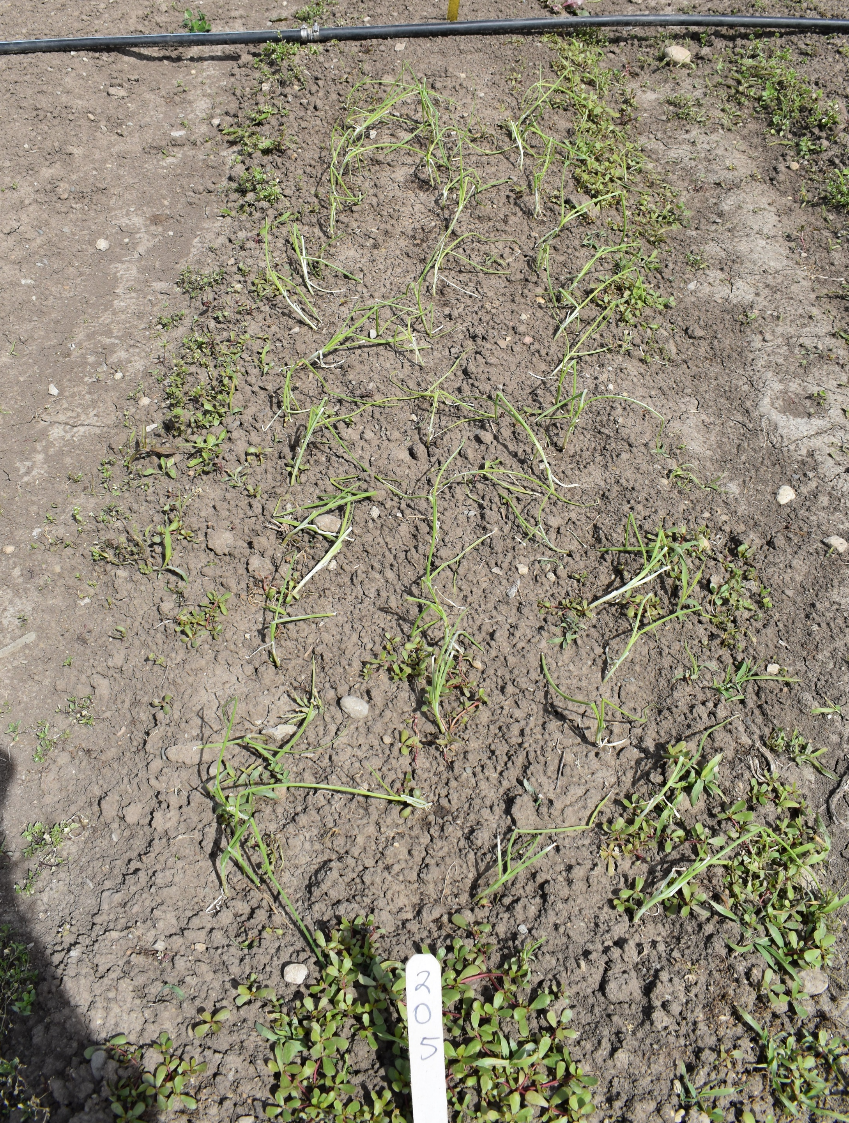
Shallow Harrowing

Slide 19
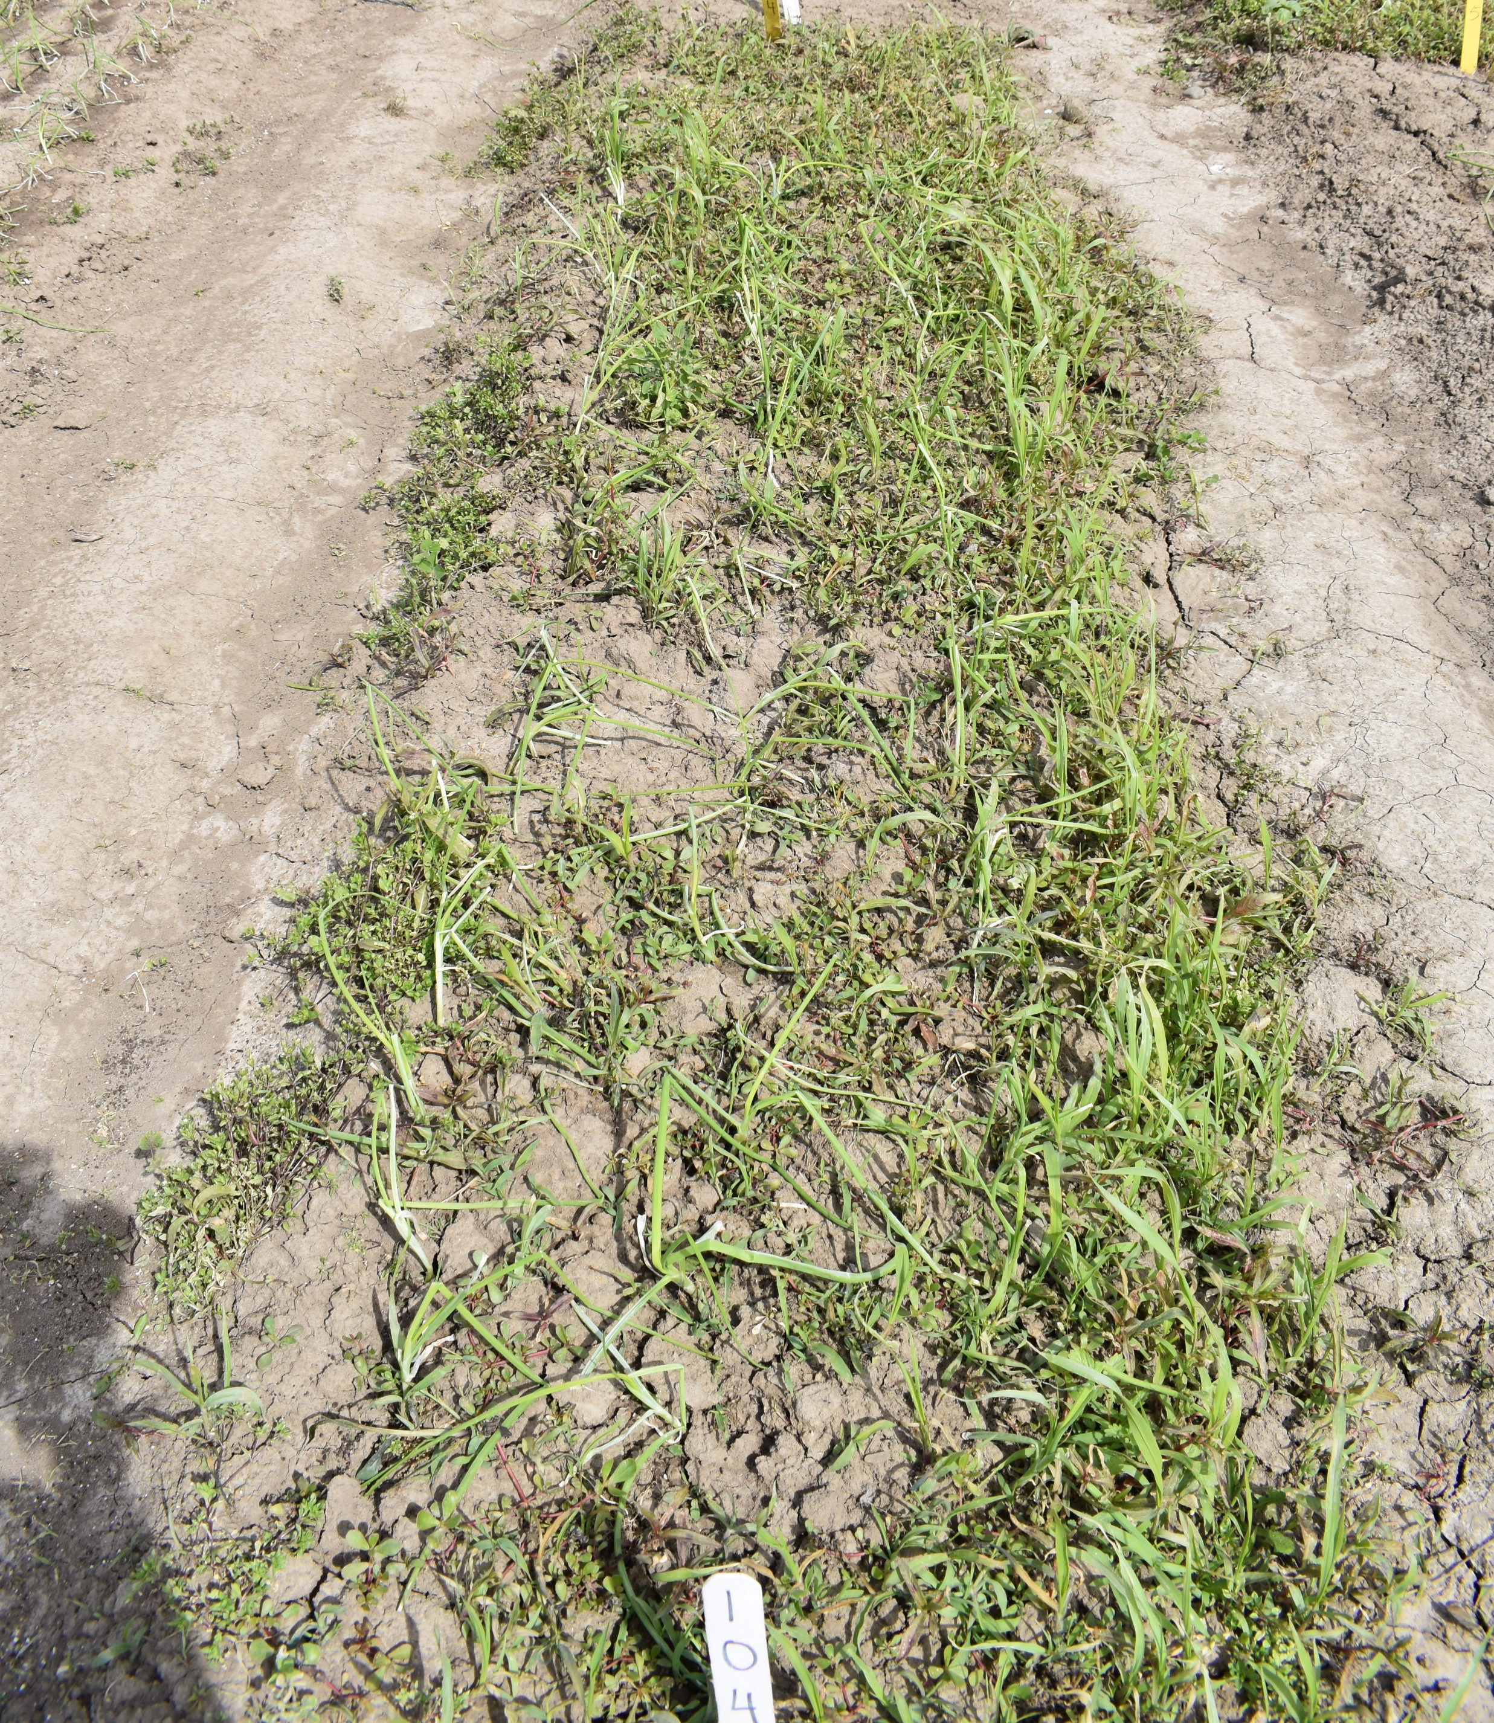
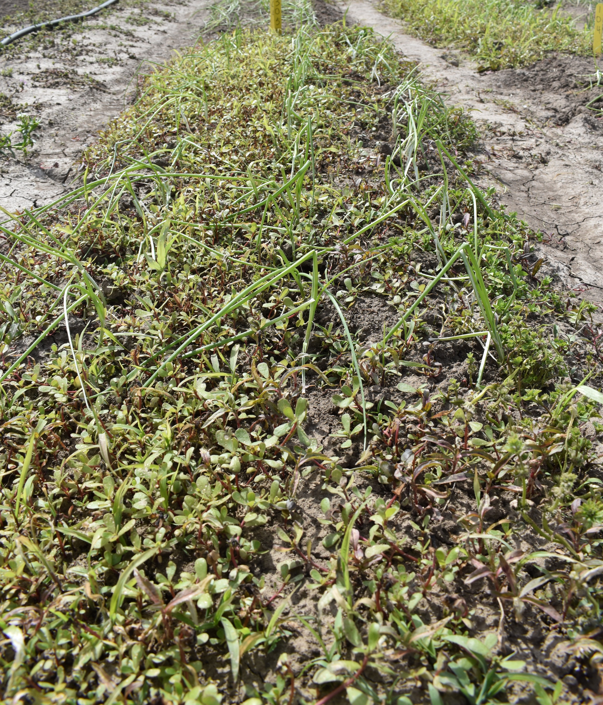
Organic Herbicide

Slide 20
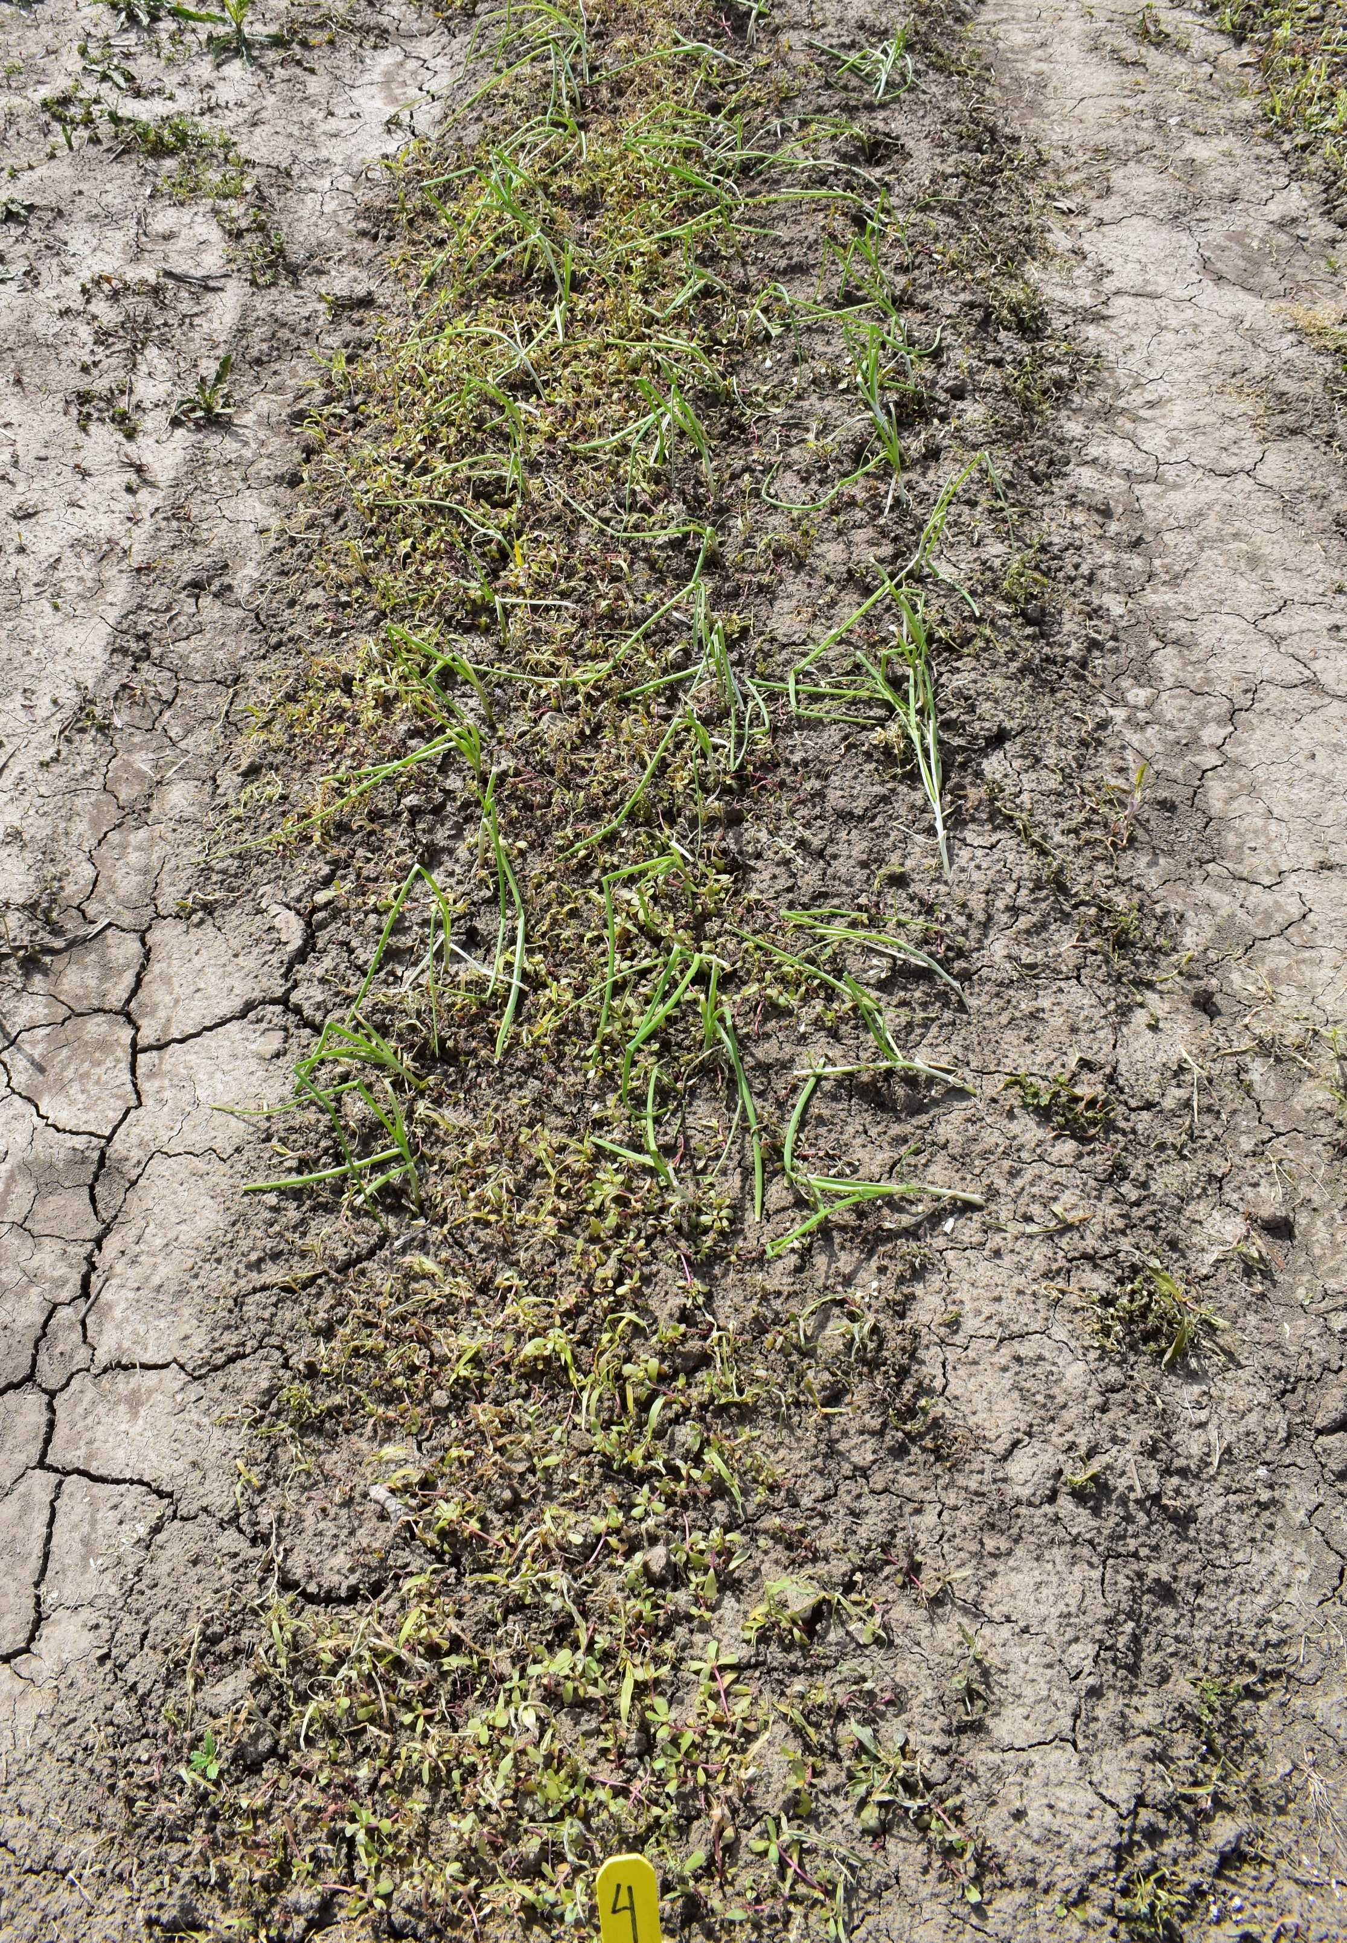
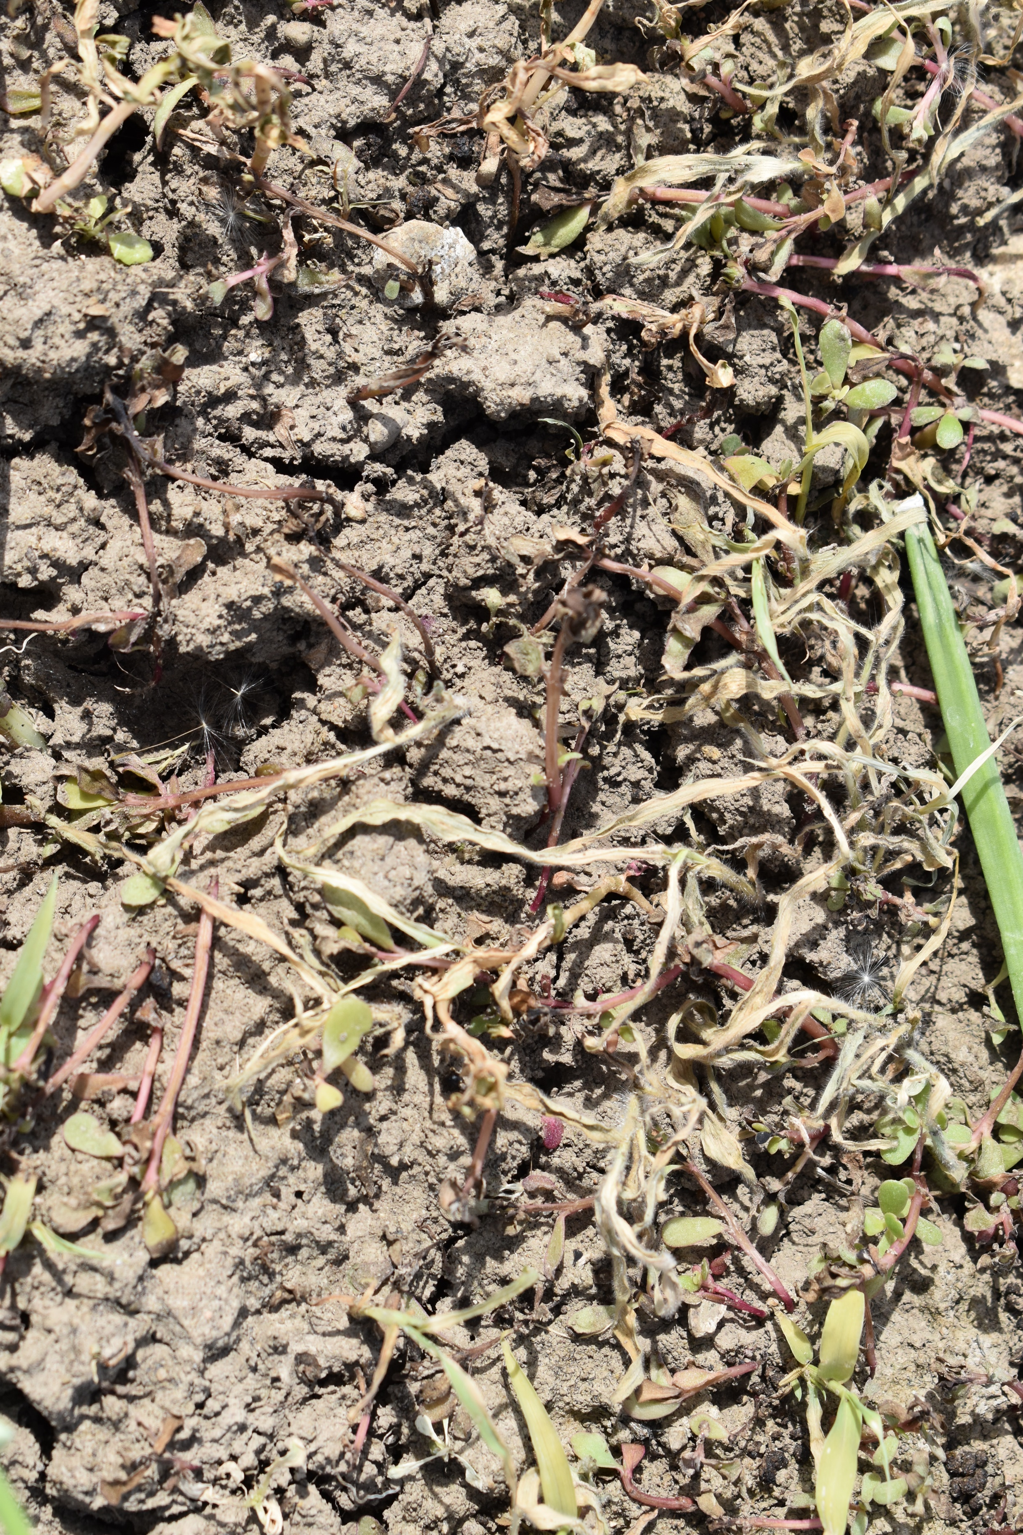
Glyphosate

Slide 21
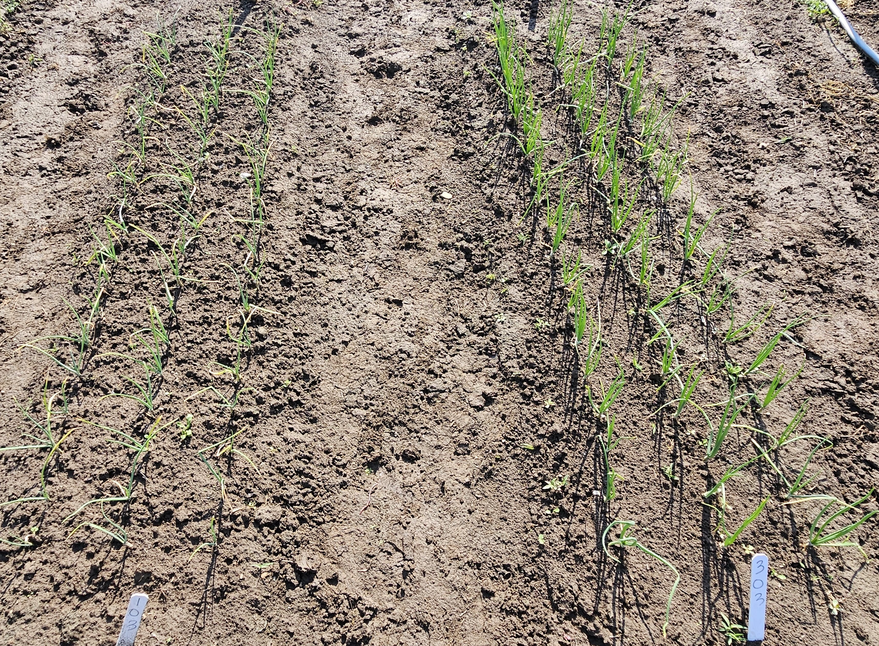
GLYPHOSATE
FLAMING

Slide 22
Outline
Creating stale seedbeds with silage tarps in onions
Early season weed management in potatoes with silage tarps
Non-utilized methods for weed management (use of silage tarps and clear plastic in onions)

Slide 23
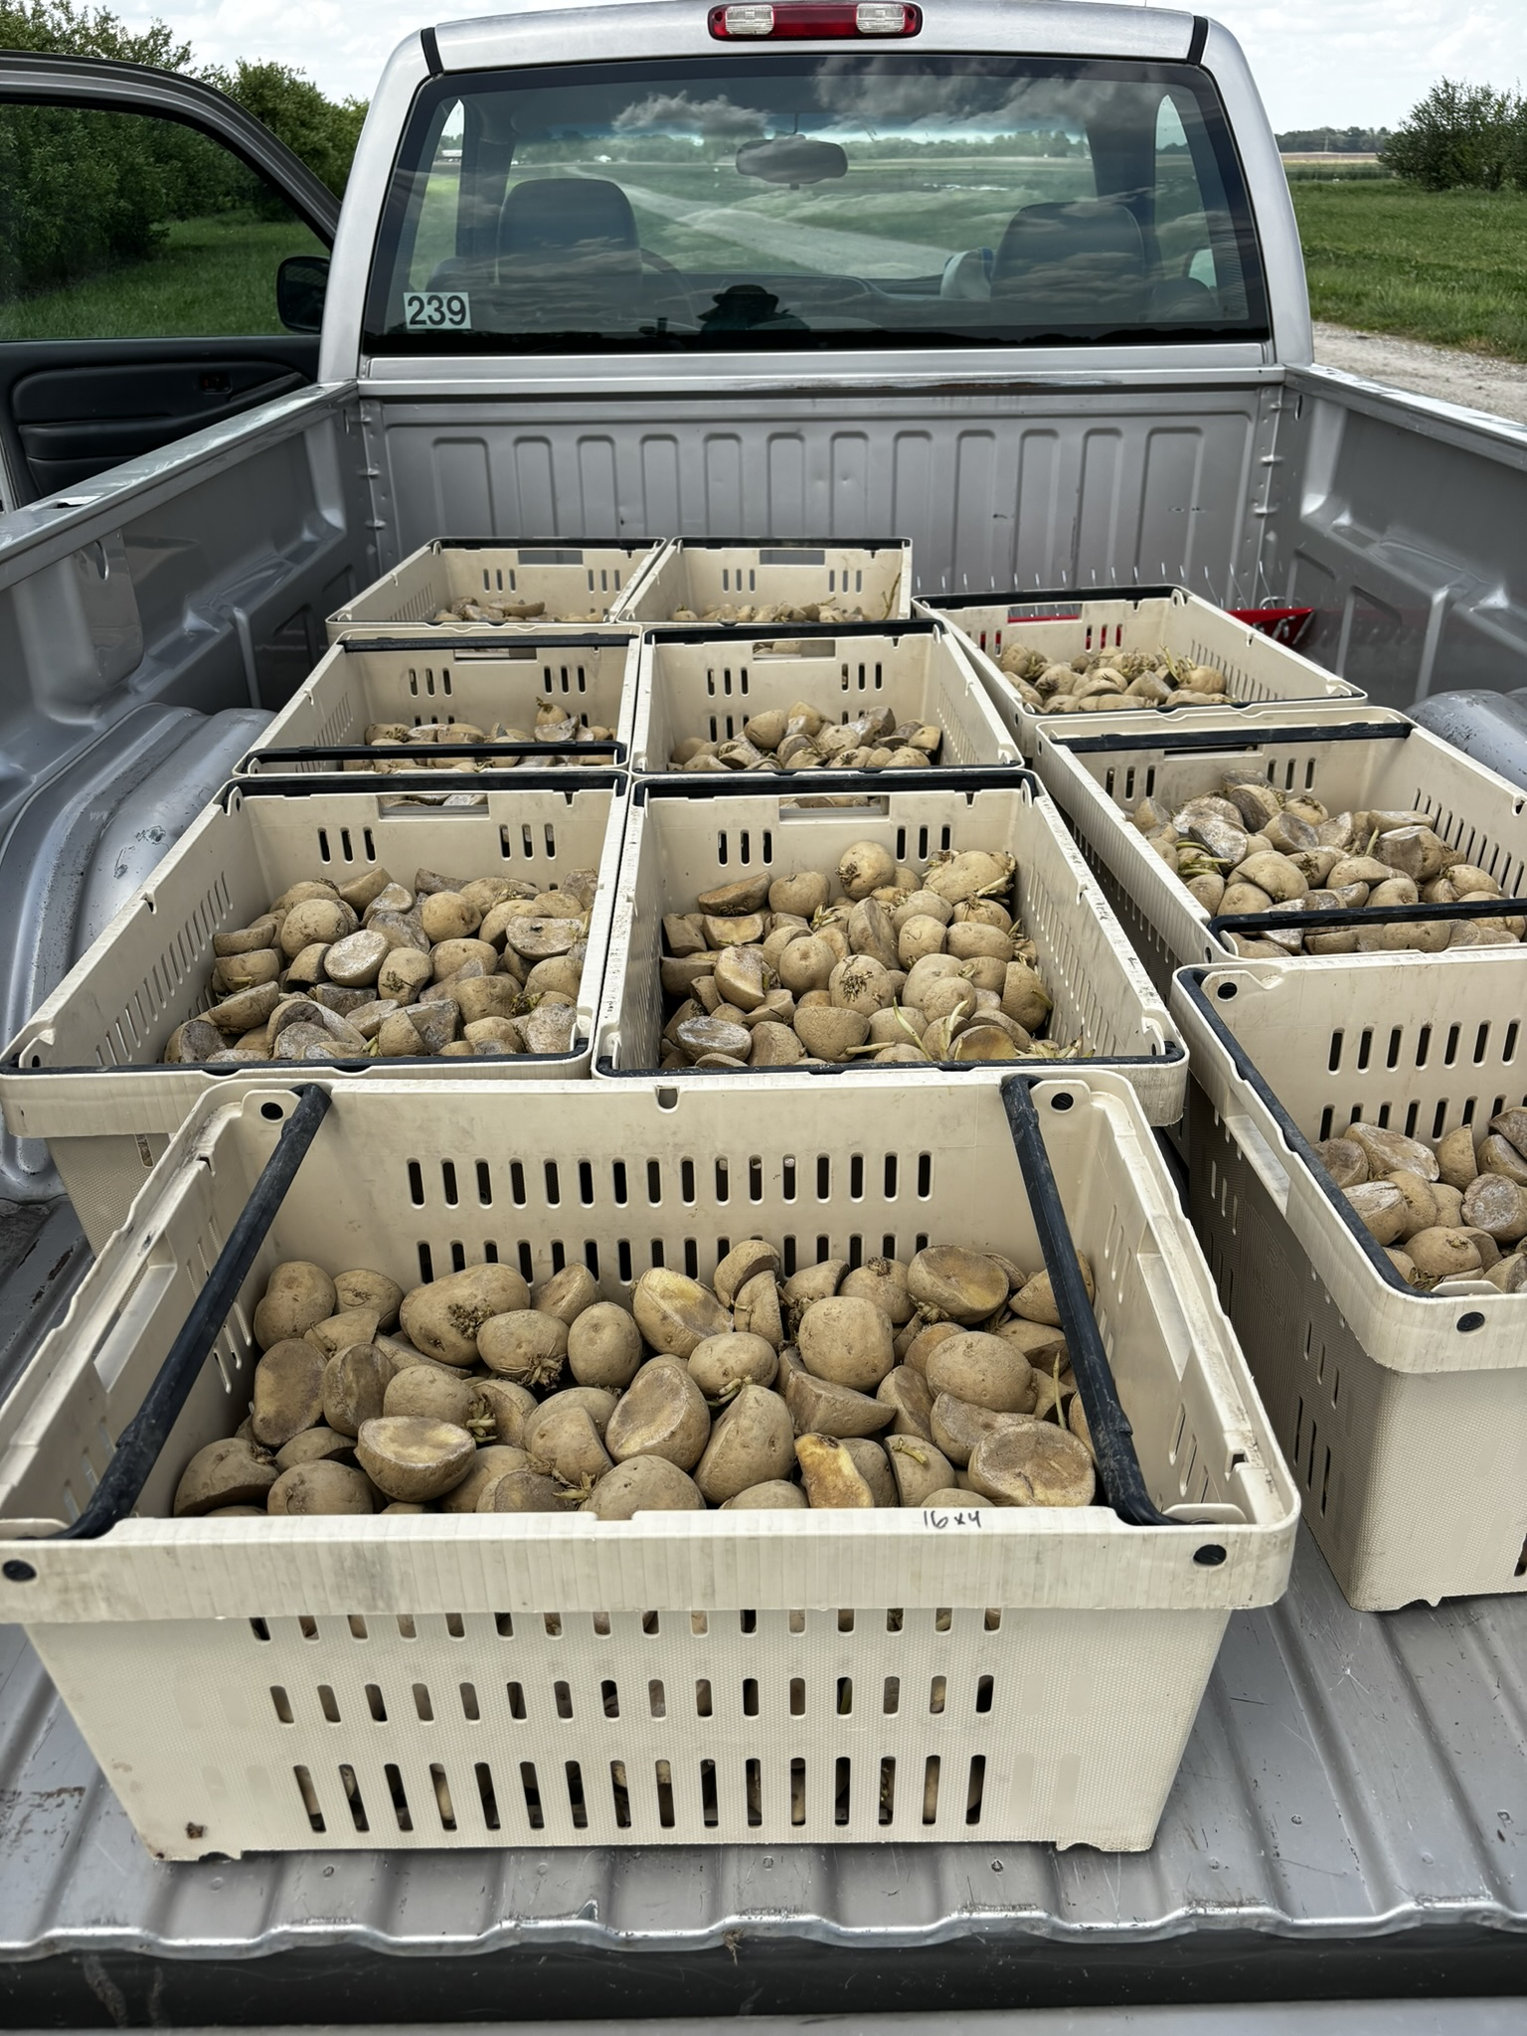
Use of silage tarps on slow germinating crops
We explored if tarps on a slow-emerging crop like potatoes could be incorporated for early-season weed management.
Some research done with carrots before.
The aim of this trial was to assess whether silage tarps could serve as an alternative to PRE emergence herbicide applications for weed management in potato production

Slide 24
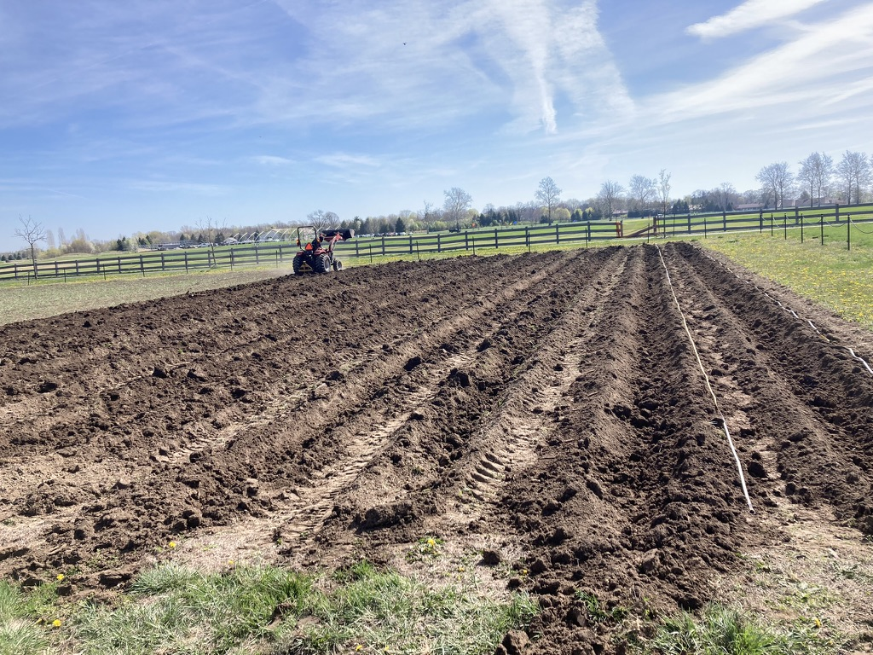
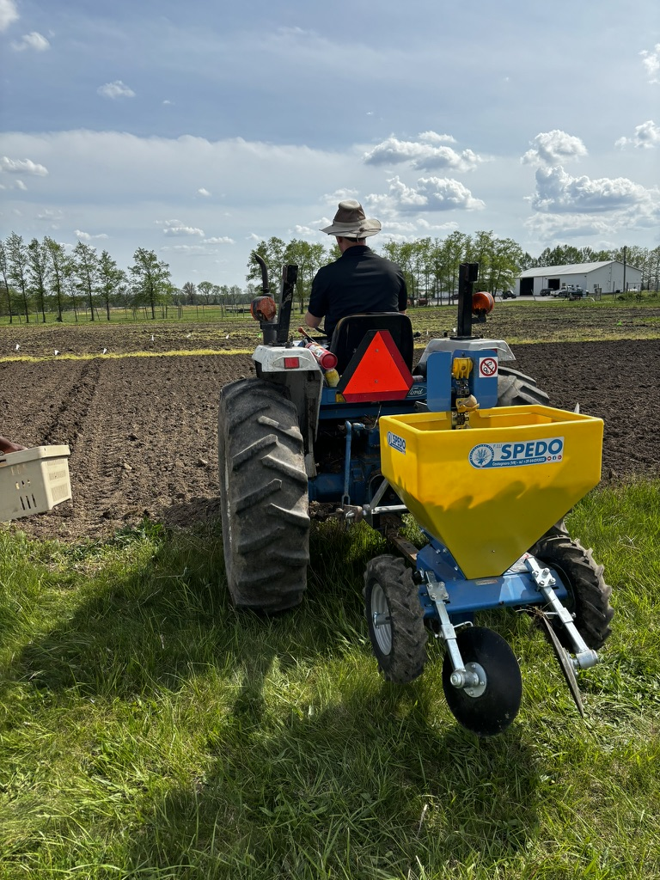
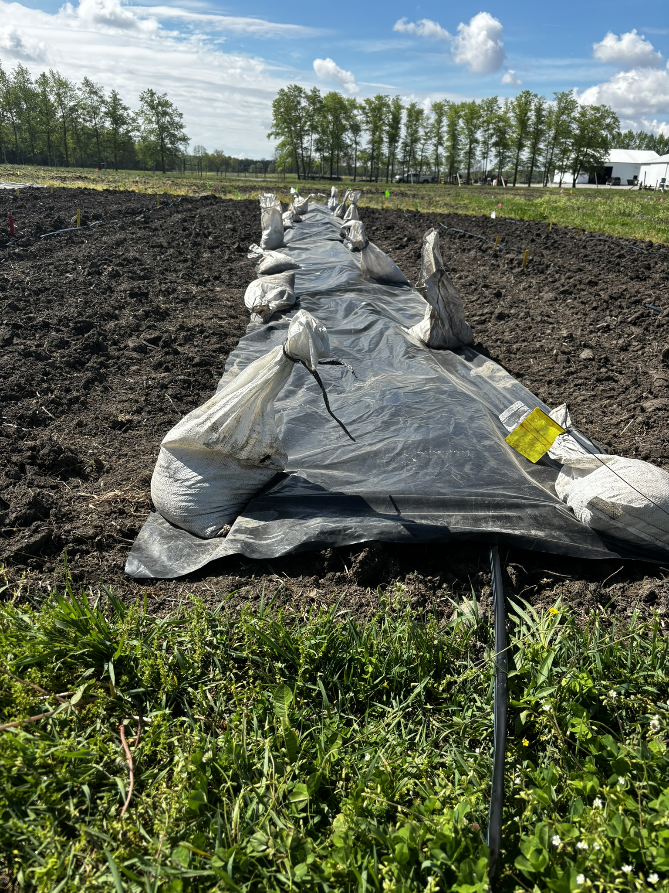
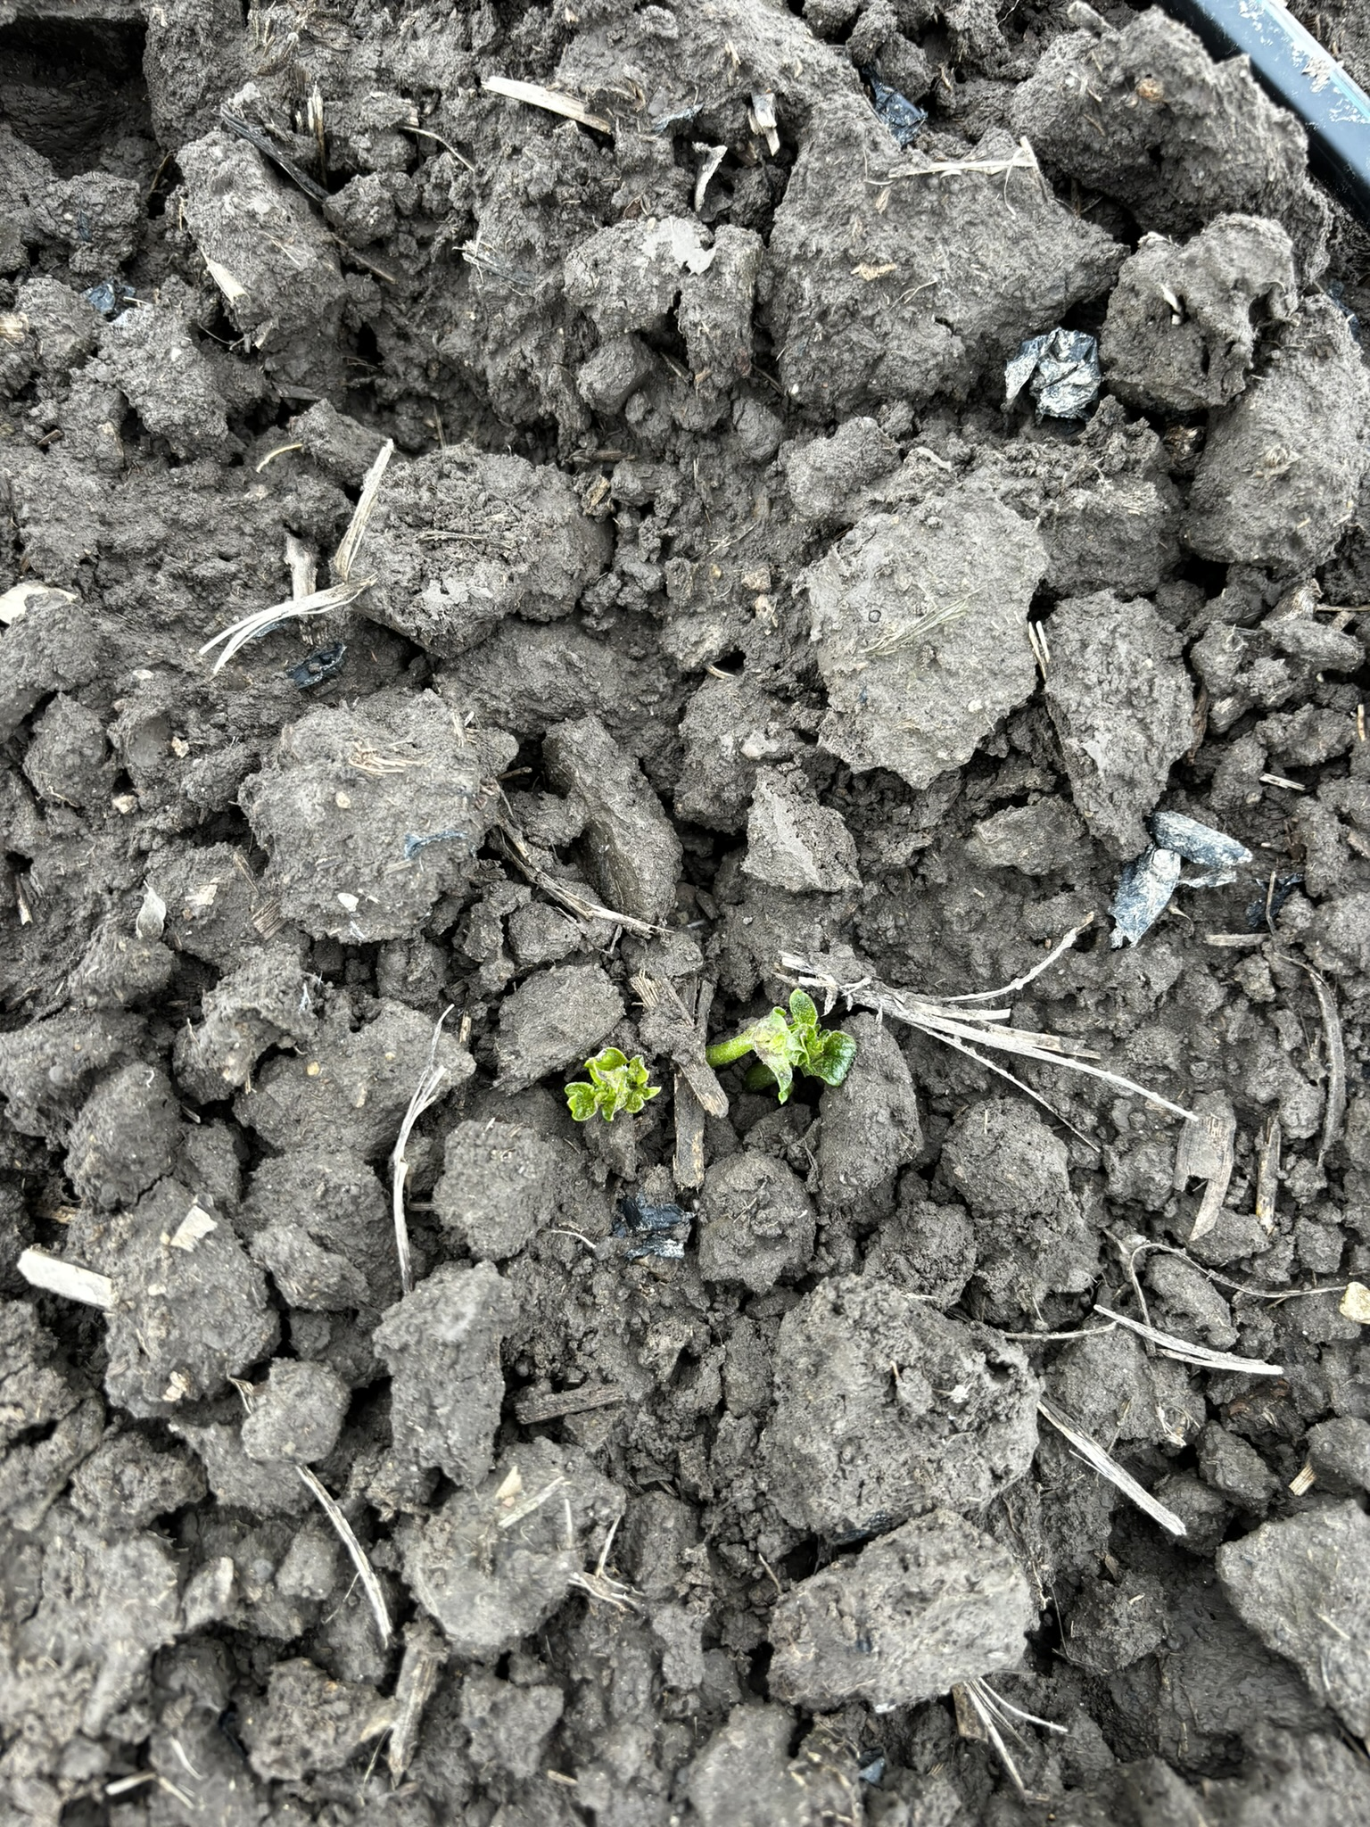
Visual timeline of tarping in potatoes
Prepare soil
Plant potatoes
Place tarps after planting
Check for emergence and lift tarps after >50% emergence

Slide 25
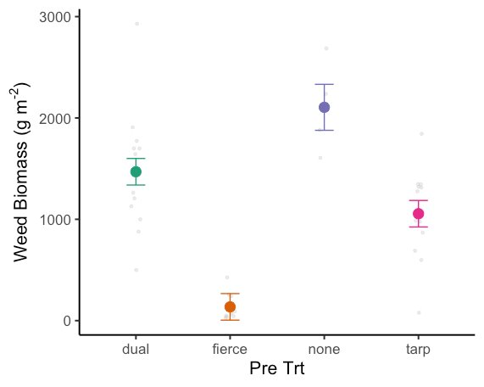
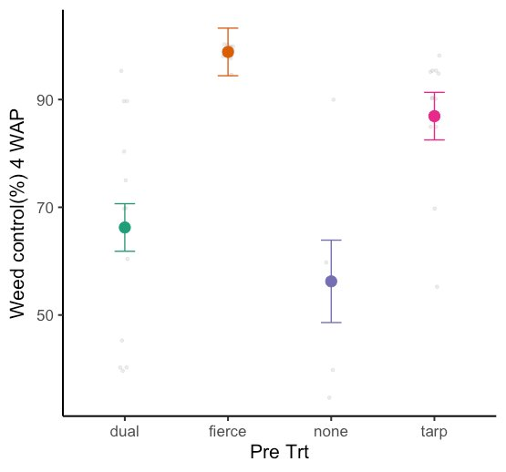
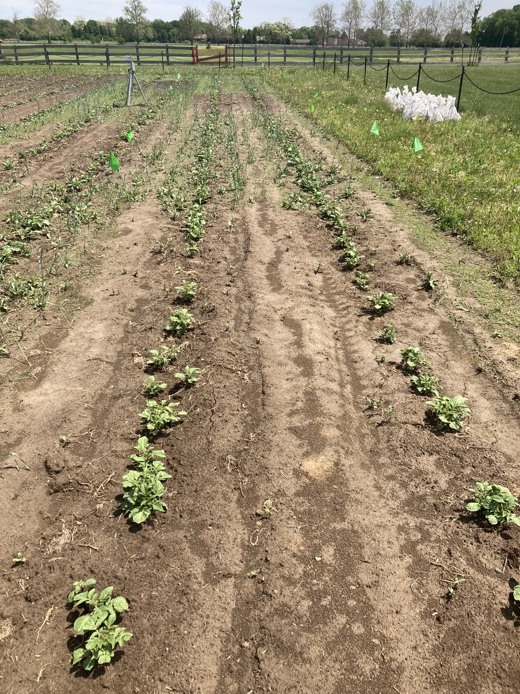
Findings
Compared to one of the pre-emergence herbicides tested, tarping provided superior overall weed control and resulted in less above-ground weed biomass.

Slide 26
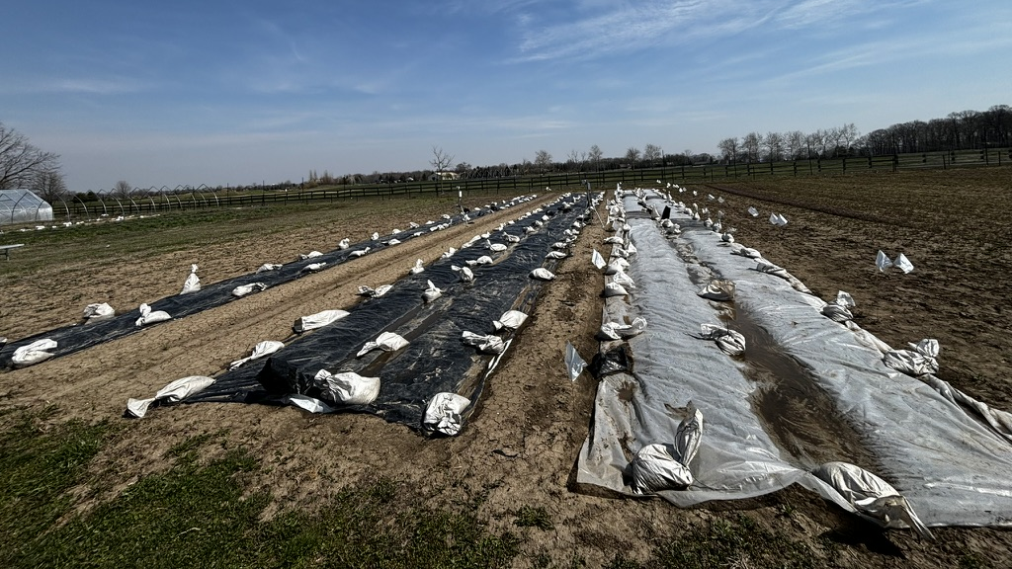
Key findings and final takeaways
While silage tarps hold potential as a valuable tool for weed management on small farms, their effectiveness is dependent upon various factors (crops planted, weather conditions, timing, weed species).
Tarping alone isn't sufficient; it should be combined with other weed control practices for optimal results.
Logistically, handling plastic and sandbags can be challenging and labor-intensive. However, their use has the potential to significantly reduce the time and effort required for hand weeding.
Tarping can delay weed emergence, resulting on less weed biomass and increase weed control.
The use of silage tarps can reduce the need for multiple tillage passes by creating a stale seedbed, which helps crops establish early and gain a competitive edge over weeds during their initial growth phase.

Slide 27

Contact information:
Josué D. Cerritos-Garcia
Email: jcerrito@purdue.edu
Celia Corado
Email: ccoradom@purdue.edu
Thank you!​

