Slide 1

Using EBVs from NSIP
Rusty Burgett, NSIP Program Director

Slide 2


Importance of Genetic Selection
Need to produce more lamb and wool from a smaller national flock
  Productivity Improvement
    Wider adoption of Quantitative Genetic Selection
  U.S. Sheep Industry Roadmap
Genetics are the foundation to build upon

Slide 3
Value of a Ram
Profit is determined by pounds of lamb(wool) sold per ewe.
  Number of lambs born
  Number of lambs weaned
  Birth, weaning and post weaning weight of lambs
  Wool yield and quality

Slide 4
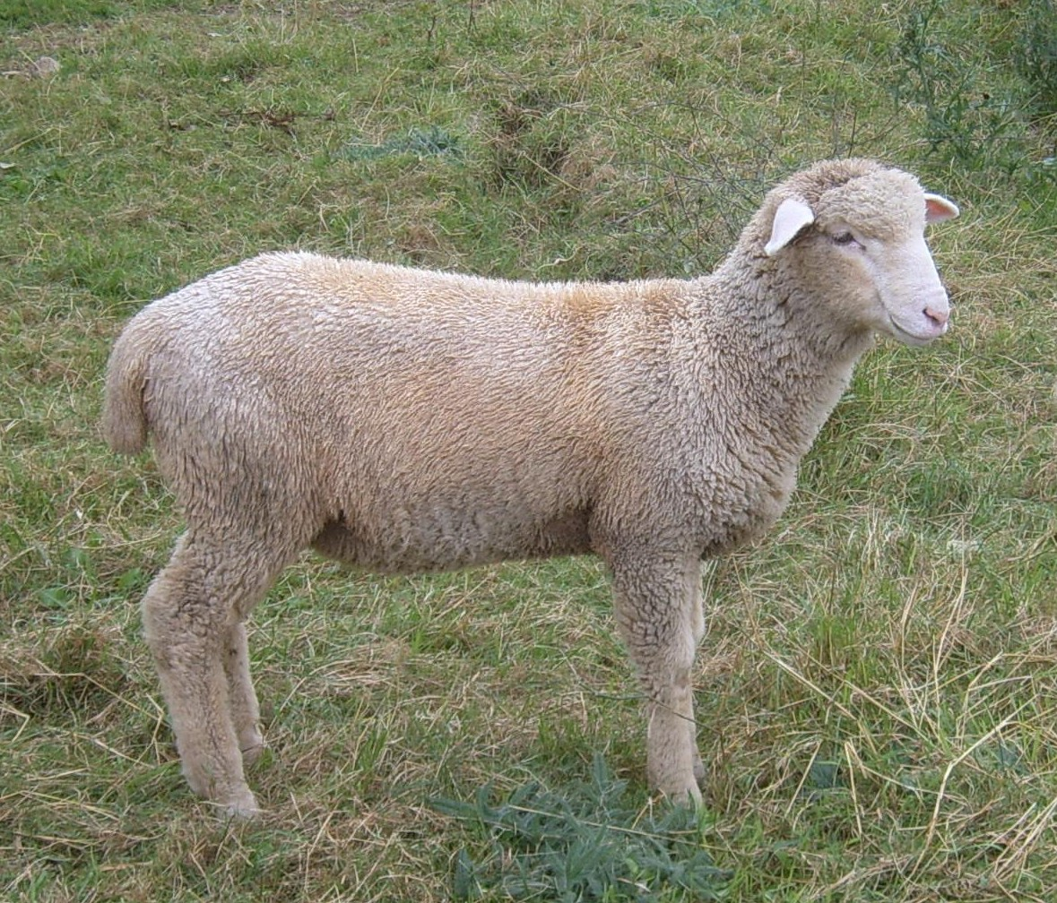
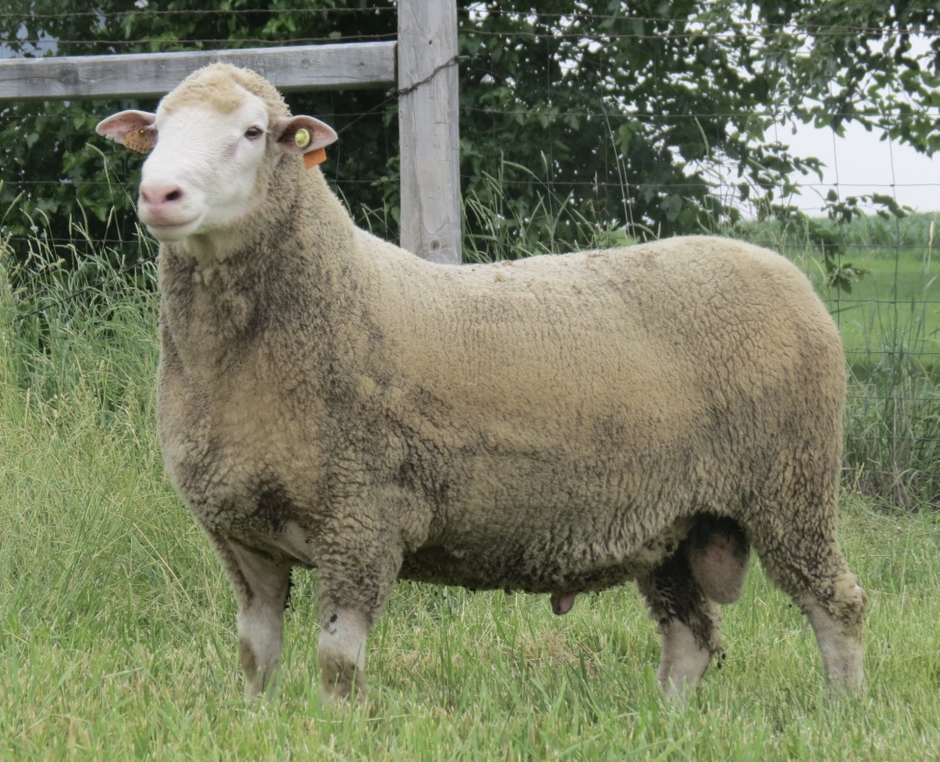
Which Ram?

Slide 5
Estimated Breeding Values
EBVs are tools that:
  Minimize guesswork of ram selection
  Assign number values to genetic merit
  Allows for quick, easy comparison
  More powerful than actual performance data, adjusted means...
  Focused on economically important traits

Slide 6
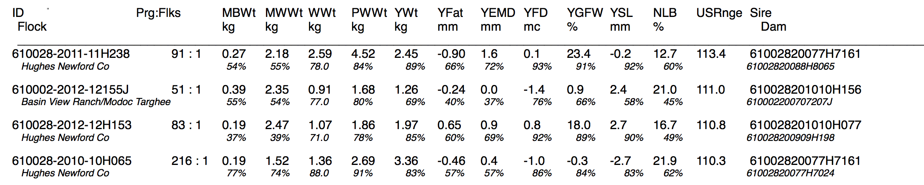
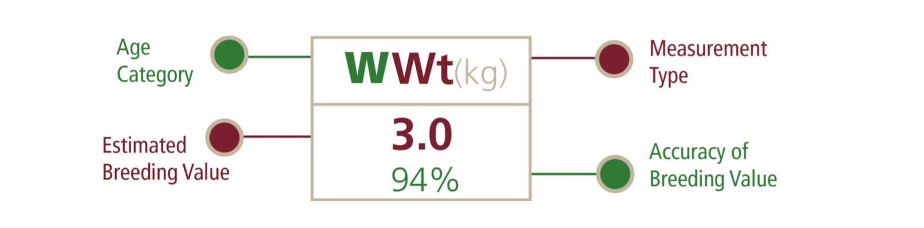
Interpreting EBVs

Slide 7
New Tool for Ram Selection
NSIP Ram Buying Guide
3-step tool to select rams for productivity
  Fine-tuned for each flock
  Commercial
  Purebred

Slide 8
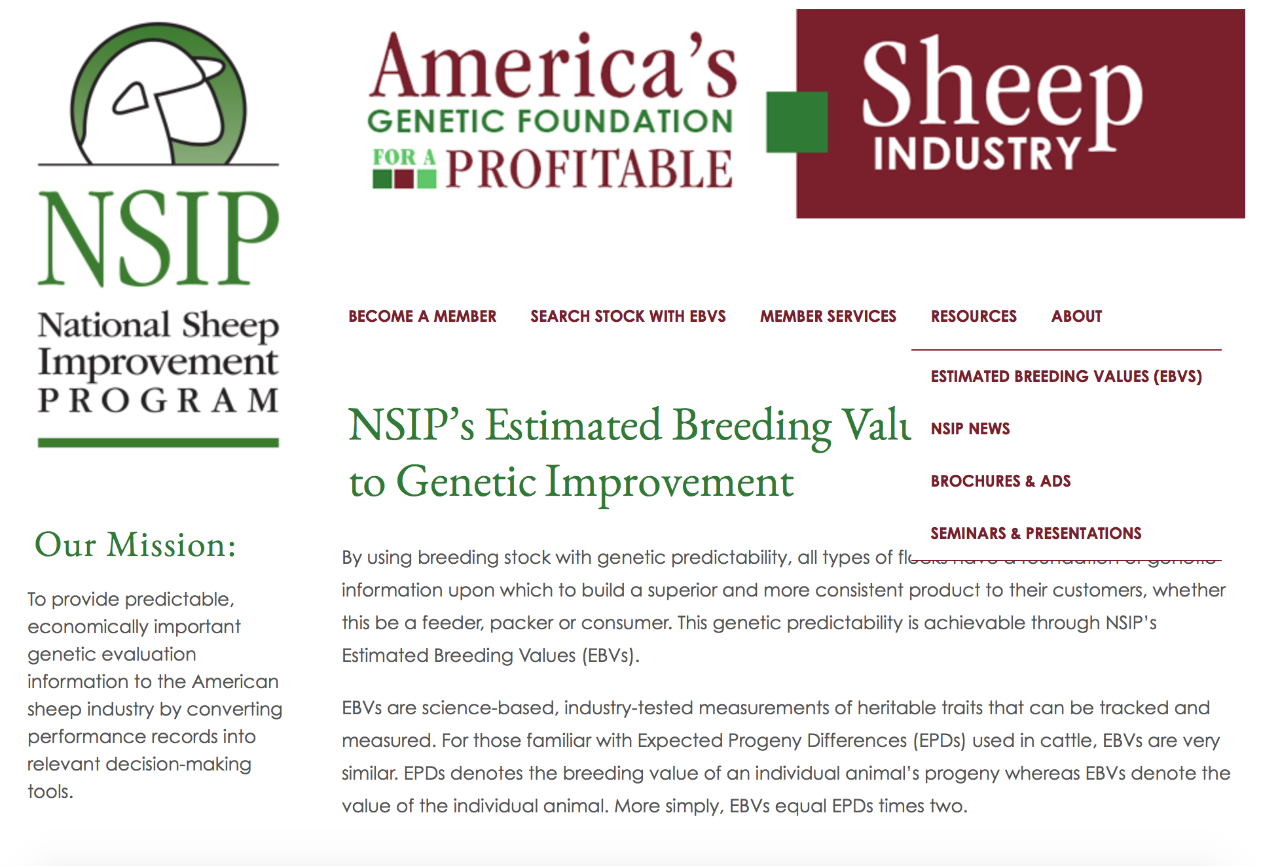
www.NSIP.org

Slide 9
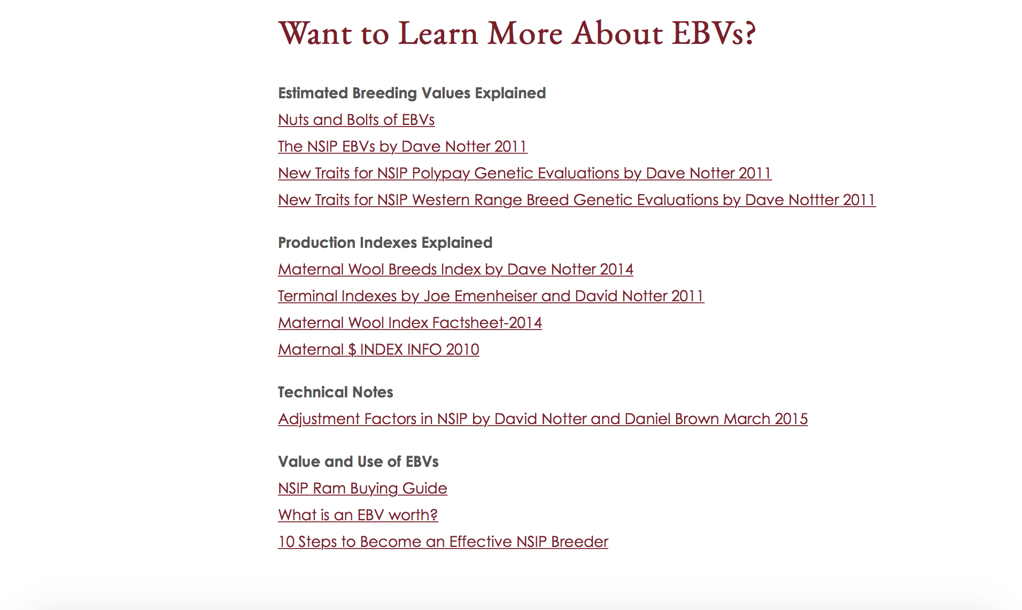

Slide 10
Analyze Production
Quantify current production level:
  Number of lambs born/ewe
  Number of lambs weaned/ewe
  Average weaning weight of lambs
  Average post weaning growth (ADG)
  Example: Polypay flock, producing own replacements
NLB | 1.2
NLW | 0.8
WWT | 62
GFW | 6.5

Slide 11
Set Goals
Establish a goal for improvement of each trait
Prioritize importance of each goal for profit
Trait | Current | Goal | Priority
NLB | 1.2 | 2.0 | 2
NLW | 0.8 | 2.0 | 1
WWT | 62 | 68 | 3
GFW | 6.5 | 8.5 | 4

Slide 12
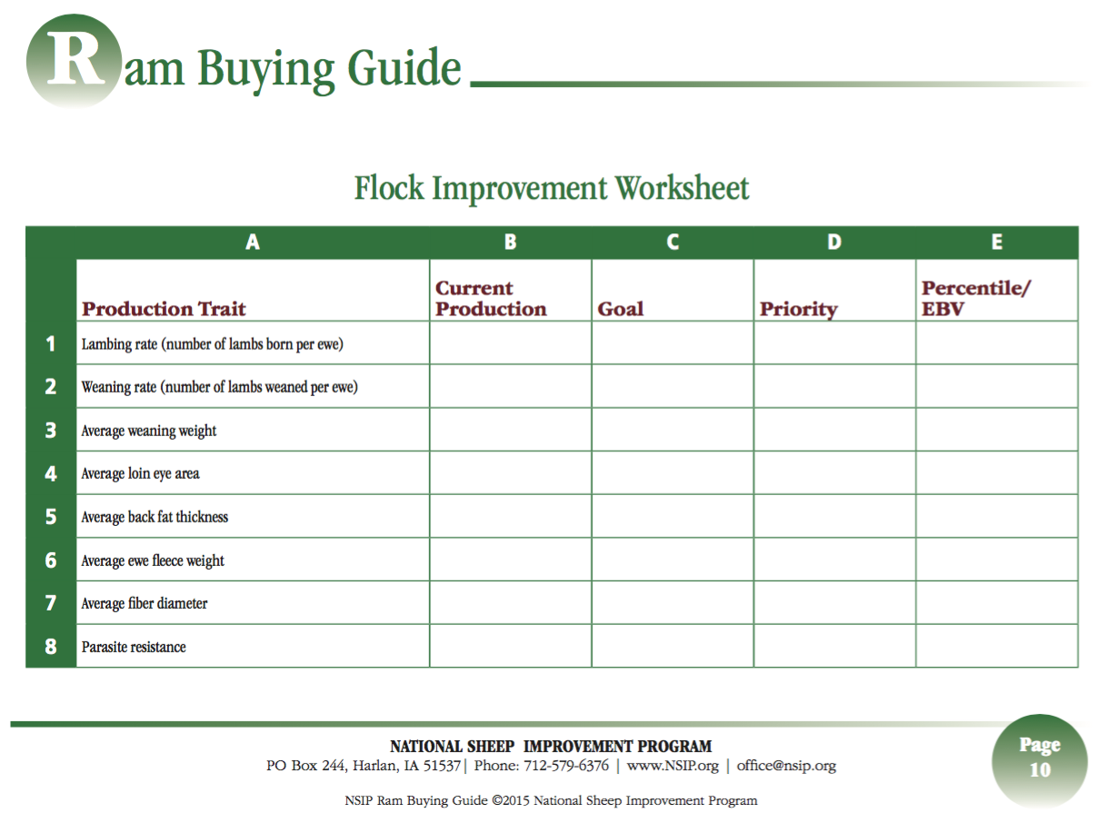

Slide 13
Use EBVs in Selection
Start with Production Indexes
  Combine multiple traits into one value
  Maternal-USA Maternal
  Terminal-Carcass Plus
  Range-USA Range
  Hair-USA Hair
  Select from top 60% of the index

Slide 14
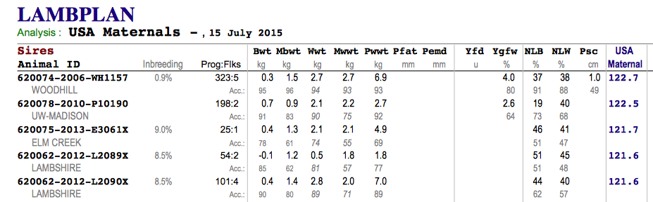

Slide 15
Step 3. Use EBVs in Selection
Select for individual traits
  Based on priority of goals
Priority 1.-select ram in top 10% of breed for that trait
Priority 2.-select ram in top 20% of breed
Priority 3.-select ram in top 25% of breed

Slide 16
Step 3. Use EBVs in Selection
Trait | Current | Goal | Priority | Percentile
NLB | 1.2 | 2.0 | 2 | Top 20%
NLW | 0.8 | 2.0 | 1 | Top 10%
WWT | 62 | 68 | 3 | Top 25%

Slide 18
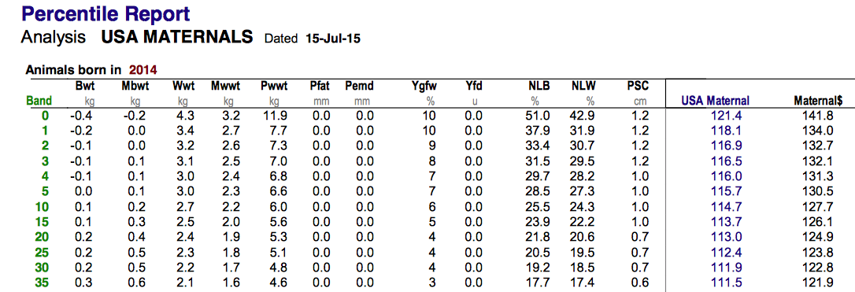
http://nsip.org/wp-content/uploads/2015/07/62-Percentiles.pdf

Slide 19
Top 10% have 24.3 or higher

Slide 20
Step 3. Use EBVs in Selection
Trait | Current | Goal | Priority | Percentile
NLB | 1.2 | 2.0 | 2 | Top 20%
NLW | 0.8 | 2.0 | 1 | Top 10%
WWT | 62 | 68 | 3 | Top 25%

Slide 21
http://nsip.org/wp-content/uploads/2015/07/62-Percentiles.pdf

Slide 23
Step 3. Use EBVs in Selection
Trait | Current | Goal | Priority | Percentile
NLB | 1.2 | 2.0 | 2 | Top 20%
NLW | 0.8 | 2.0 | 1 | Top 10%
WWT | 62 | 68 | 3 | Top 25%

Slide 24
http://nsip.org/wp-content/uploads/2015/07/62-Percentiles.pdf

Slide 26
Use EBVs in Selection
Prioritizing selection pressure on individual traits will expedite genetic progress
Priority should be placed on economically important traits

Slide 27
“Common Sense Traits”
Visual appraisal of ram for:
  Sound feet and legs, free of foot rot
  Correct mouth structure
  Breeding soundness exam
  Health status and susceptibility
    Scrapie
    OPP
    Spider

Slide 28
Not a Silver Bullet
Does not replace good management
  Breeding Program
    Including cross breeding!
  Nutrition
  Marketing

Slide 29

Thank you!
Questions?
Paid for in part by the American Sheep Industry
Website: www.nsip.org
email: info@nsip.org phone:515-708-8850
Facebook

Slide 30
Does it Work?

Slide 31
Genetic Progress
14 extra lambs/100 ewes lambing!
1.75 pounds heavier @ 60 days=201 more lbs of lamb!

Slide 32
Genetic Progress

Slide 33
Conclusion
This method is designed to:
  Reduce risks associated with ram selection
  Expedite genetic progress
  Increase productivity
  Visit www.nsip.org for more information including percentile and elite sire reports

Slide 34
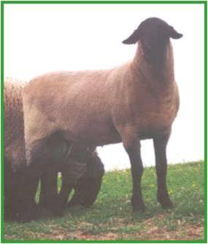
Where we’ve been, where we are, & where we are going!
CULHAM
&
STEVENS
NSIP

Slide 35
Where we’ve been…
Culham & Stevens
Webberville, MI

Slide 36
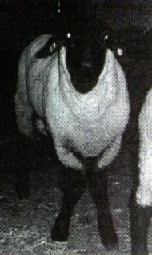
1987 CROSSROADS
Spider Gene
Tax laws change

Slide 37
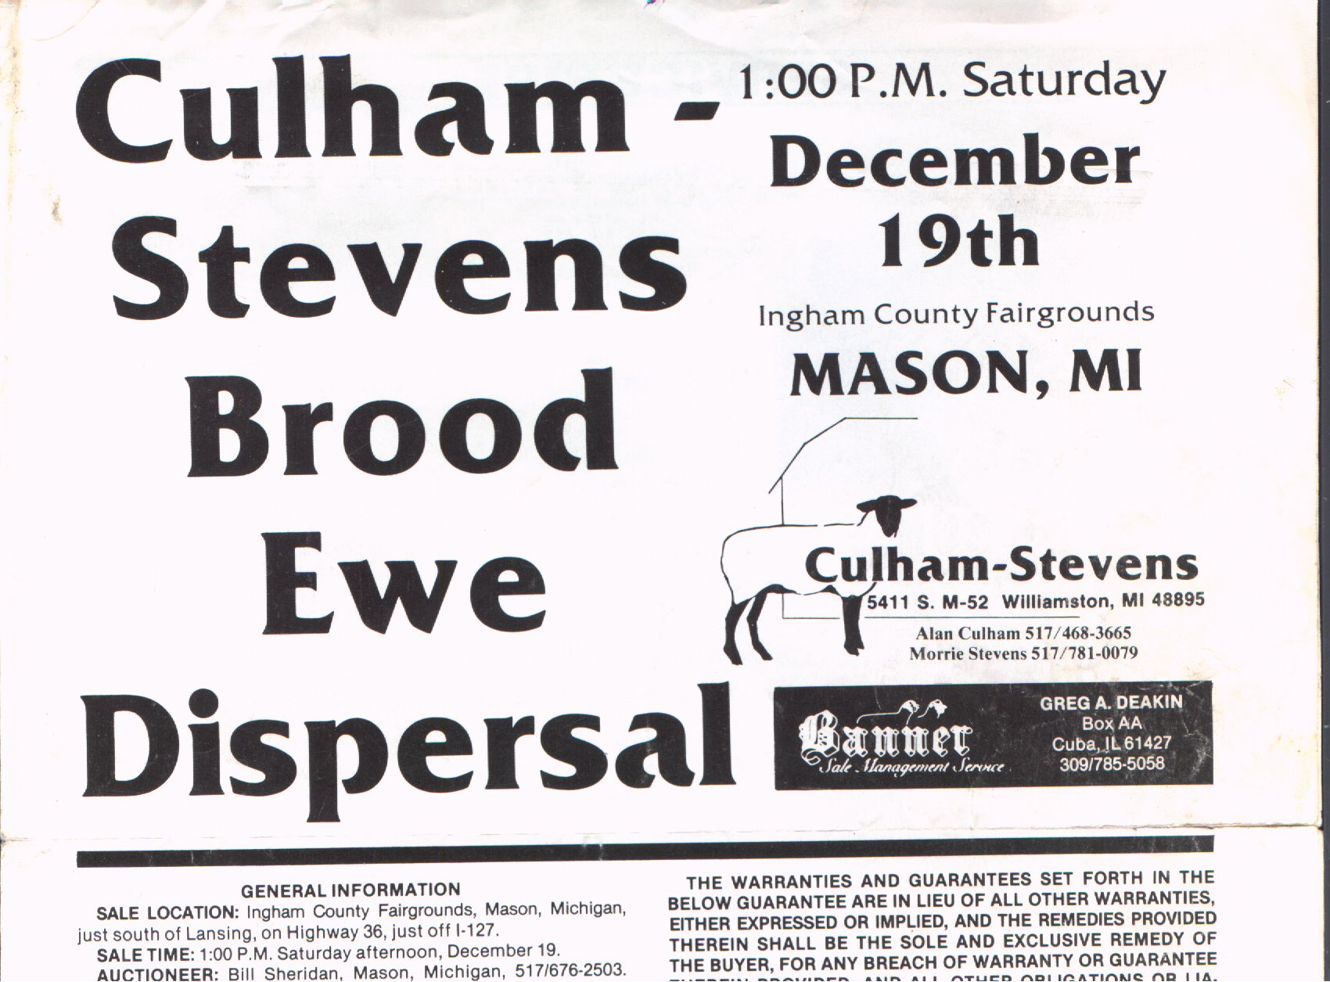

Slide 38
Previous mistakes
Abandoned performance for “Pretty”
Made excuses for sheep
“Worked for sheep, rather than sheep working for me”
Selected for the wrong things

Slide 39
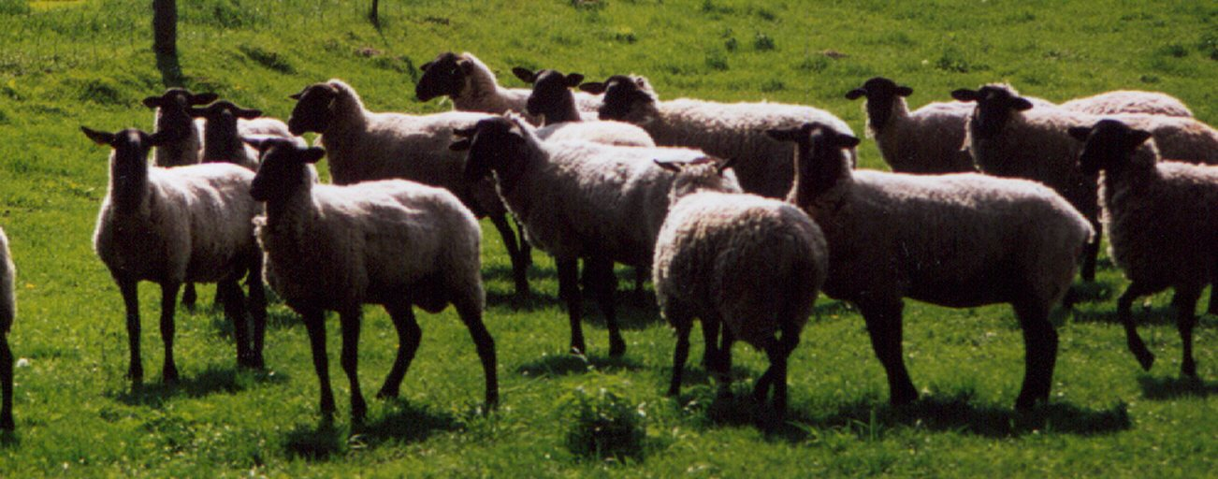
Where to boss?
Rebuilt flock with bloodlines free from “spider” gene
New labor agreement

Slide 40
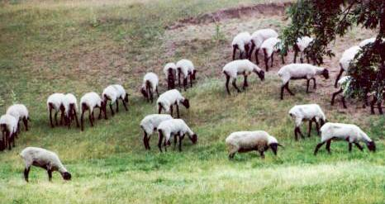
HOW ?

Slide 41

1989 enrolled in
NSIP

Slide 42
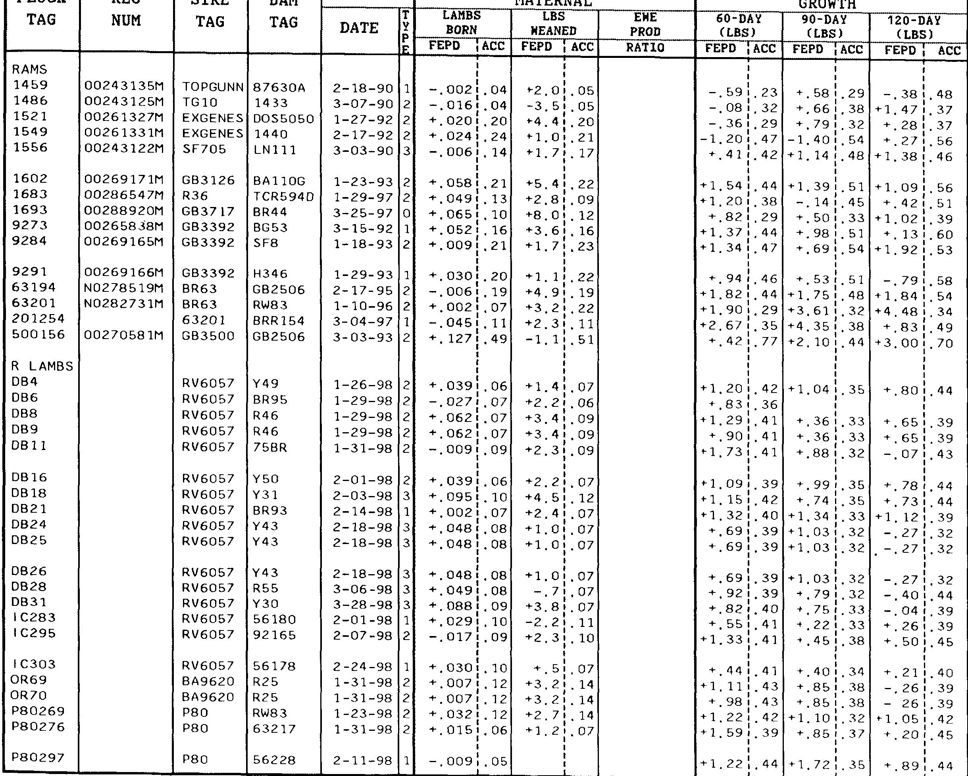

Data Shock!

Slide 43
“The Bell Curve”
1995 Suffolk Sire Summary
25
.
N
20
o
.
o
15
f
S
10
i
r
e
5
s
0
-7
-6
-5
-4
-3
-2
-1
0
1
2
3
4
5
6
7
8.
120 day wt. EPD (lbs.)
EPD = Expected Progeny Difference
EBV = Expected Breeding Value = EPD x 2

Slide 44
“EPDs”
Express expected performance of offspring compared to breed average
EPDs are expressed as a deviation from the breed average
FEPDs are expressed as a deviation from the flock average
Expressed in same unit as measured

Slide 45
1473

Slide 46
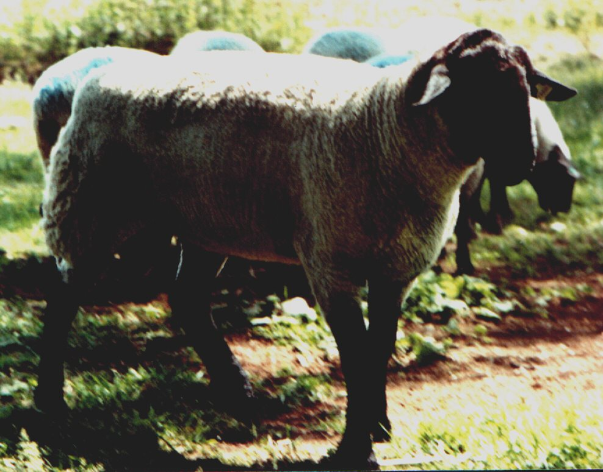
IN THE DARK when selecting outside sires without EPDs
Rams purchased could not be compared to ours
Few breeders on NSIP
New sires were near “0” for most traits

Slide 47
S-p-i-n-n-i-n-g our wheels
Genetic trend
Selection only on dam side by culling & replacement ewe selection
No progress!

Slide 48
Leap of faith
Use the data!

Slide 49
Faith rewarded
Started EPD Sire selection

Slide 50
Genetic trend changes
Red - before EPD sire selection
Blue - after EPD sire selection

Slide 51

1996
across
flock
Enough genetic links between flocks to compare individuals in different ones
Provides ability to directly compare animals raised in different flocks

Slide 52
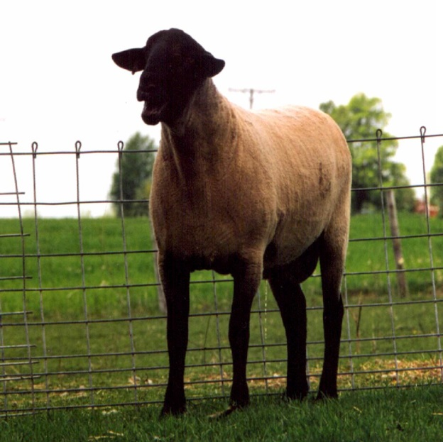
1996 - more challenges
6 of 7 sires of our 1996 lambcrop tested “QQ” at Codon 171
Transferred embryos from our top “QR” ewe bred to “RR” ram with no EPDs
Produced stud ram to use in 1997
Culham & Stevens ET
“P-80”
Culham & Stevens ET
“P-80”
PWW EPD +3.5
“RR” at Codon 171

Slide 53
Had to add “R” gene

Slide 55
Moving the population

Slide 56
Then
NOW

Slide 57
Breed the best to the best to achieve the best results

Slide 58
STACKING pedigrees
+2.9
+5.9
+2.2
-1.4
-1.6
+4.5
-1.0
+3.2
+6.2
+5.6
+10.1
+2.7
+5.3
+3.5
+8.8
+3.1
+2.0
+5.8
+2.8
-0.5
+2.2

Slide 59
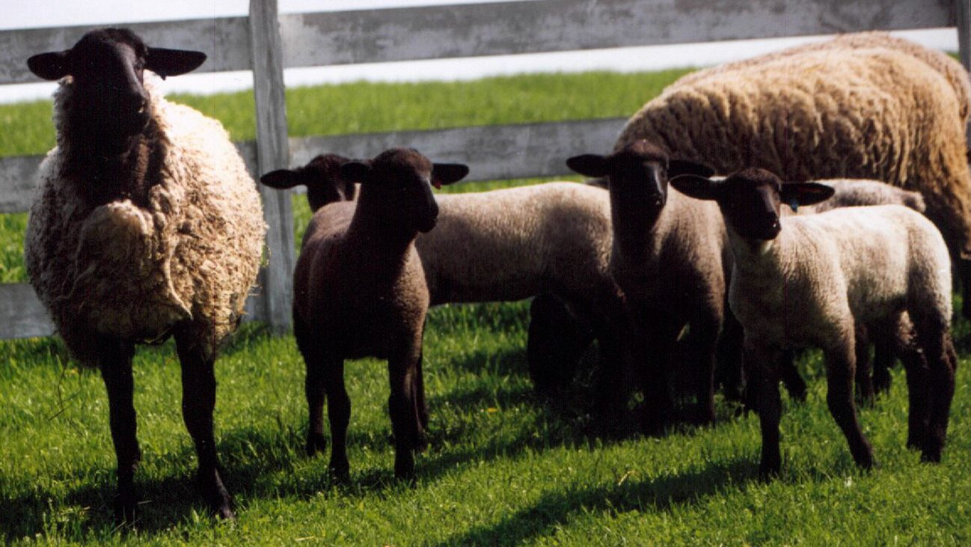
Decrease generation interval
Breed ewe lambs
Use young stud rams

Slide 60
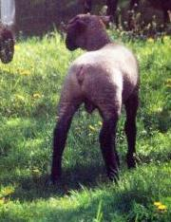
1999 RAM LAMB from
1998 born sire & 1998 born dam

Slide 61
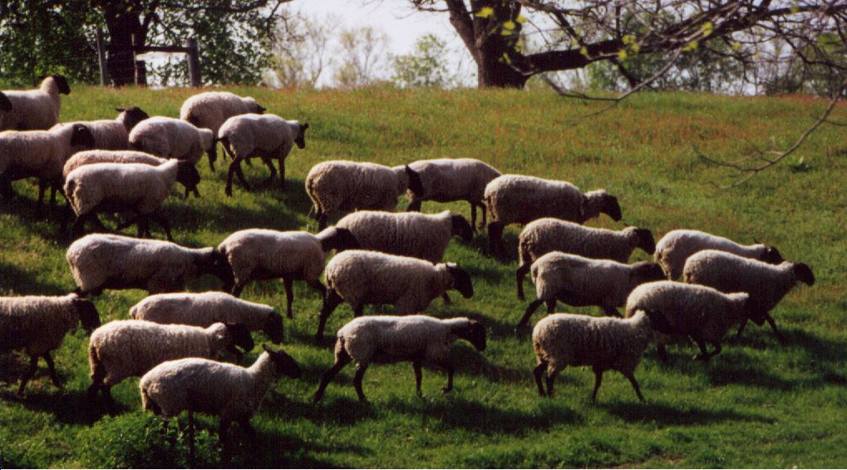
Where we are going…
We have a direction in mind!

Slide 62
PREDICTABLE PERFORMANCE
1.8
0
(Sire EPD + Dam EPD)/2 = Offspring EPD
Sire selection is critical
What would the offspring be if you selected ram with no breeding value?

Slide 63
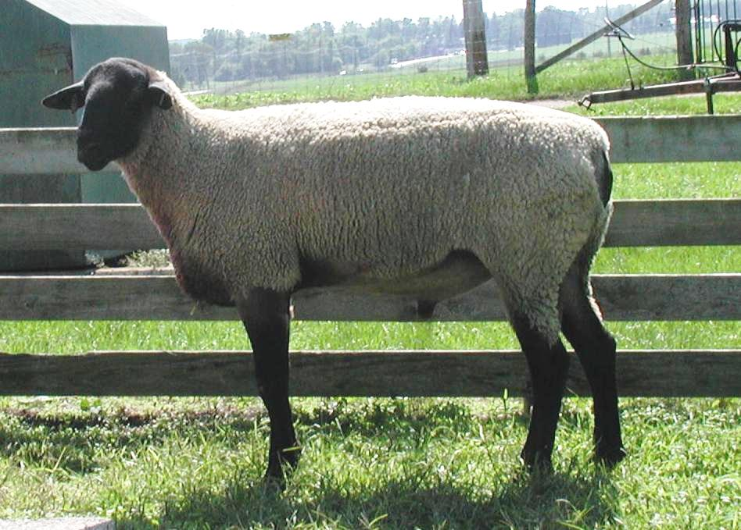
Culham & Stevens 5BR155
2005

Slide 64
Sired World’s Fastest Growing Sheep in 2008 for Michigan State University
Breed trait leading sire for Weaning weight and post weaning weight 2008

Slide 65
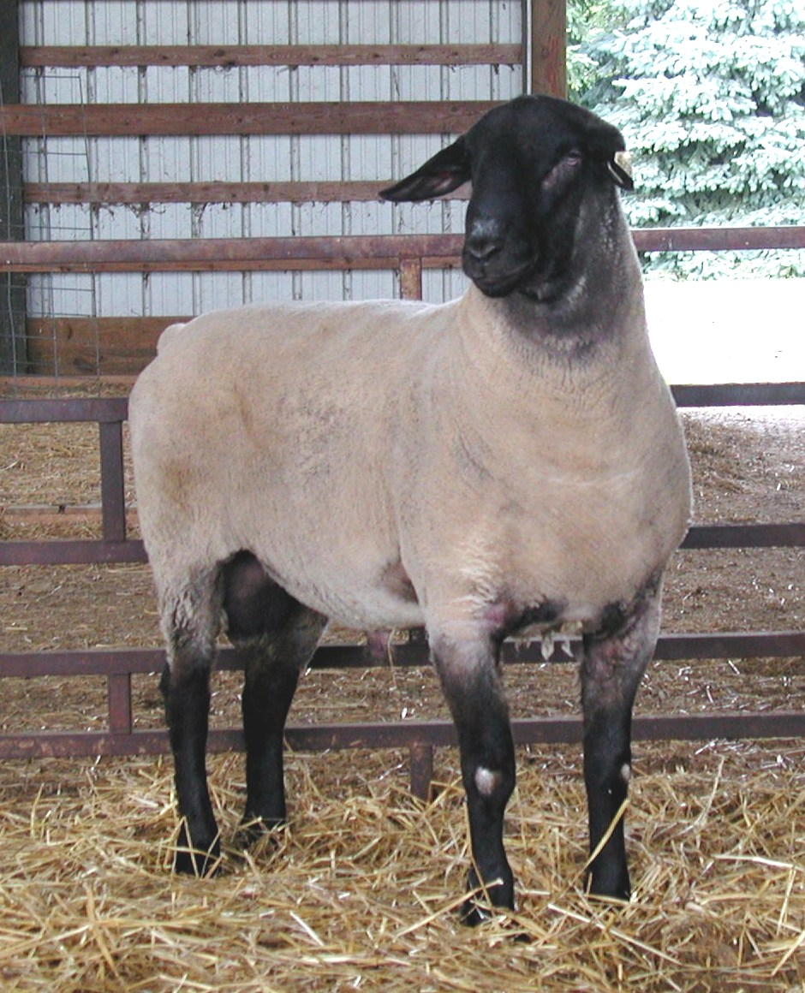
Culham & Stevens 5BR155 sired
Top selling ram 2010 Center of the Nation Sale
“Sparty” MSU 9170
June 2015 Suffolk trait leading proven sire for Carcass Plus Index

Slide 66


Culham & Stevens 5BR155 can be found in the pedigree of:
The top 12 elite proven suffolk sires for Carcass Plus Index.
All 32 elite young suffolk sires listed for Carcass Plus Index.
The top 21 proven sires for post weaning weight
Top 26 proven sires for weaning weight

Slide 67
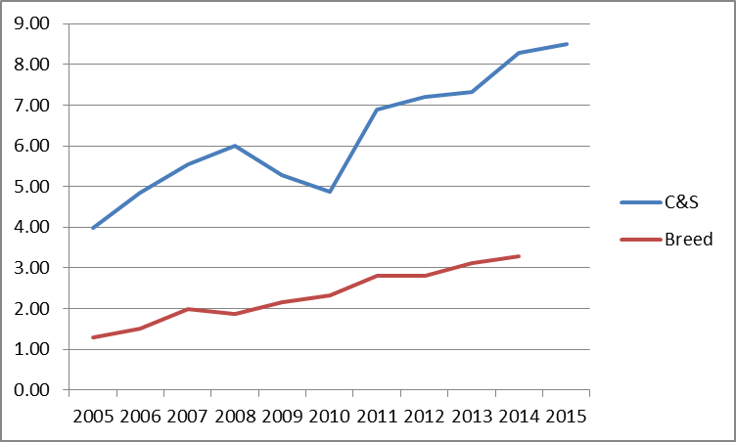
Post weaning growth trend

Slide 69
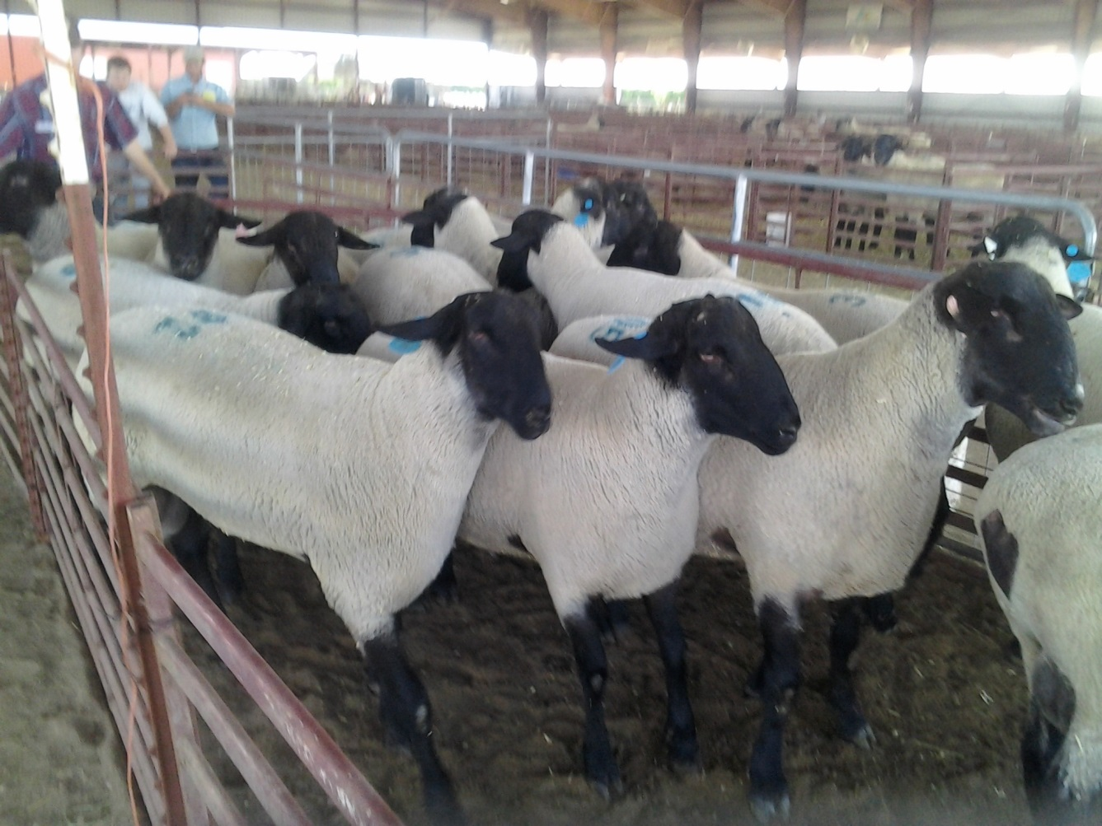
Selecting by visual appraisal = no change

Slide 70
1st across flock EPD run

Slide 71
NSIP Postweaning WT EPD Distributions for Suffolk Sires
“The Bell Curve”

Slide 72
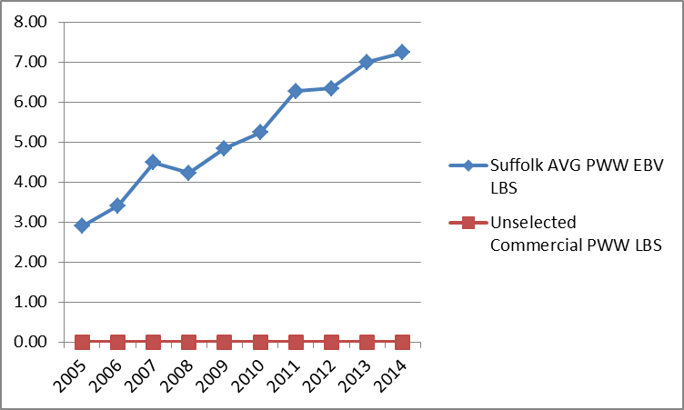
Using unselected rams
Opportunity Lost!

Slide 73
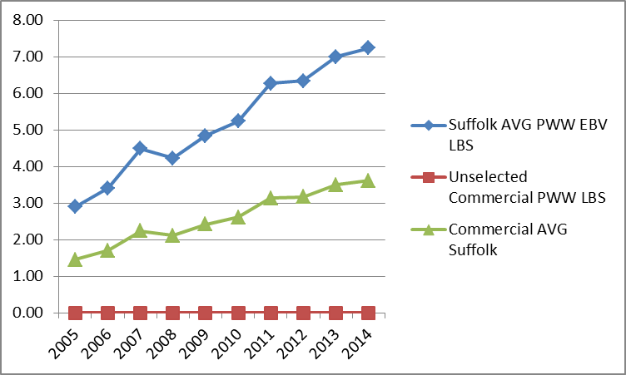
Using AVG Suffolk NSIP Sires
Opportunity Lost!
3.62 LBS

Slide 74
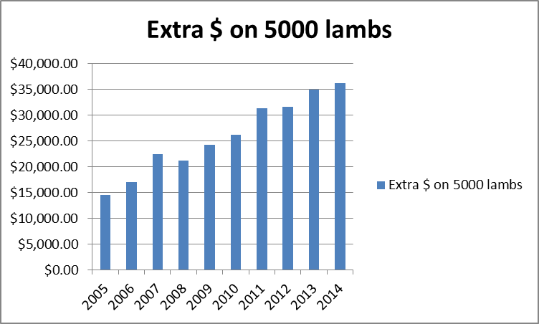
Using AVG Suffolk NSIP Sires
$21,000.

Slide 75
Using AVG Suffolk NSIP Sires
$259,710

Slide 76
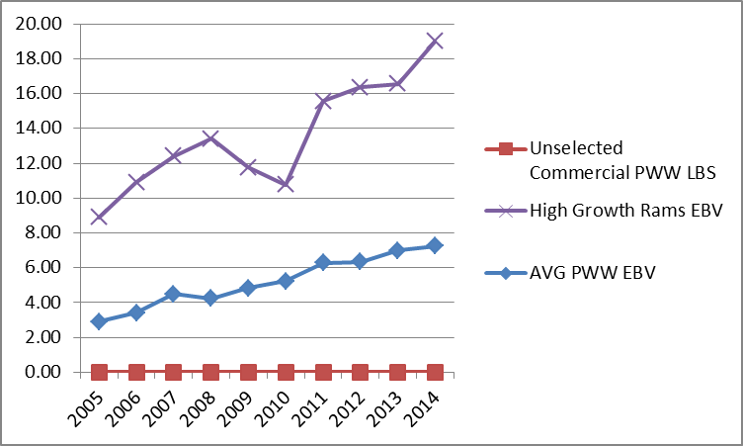
Using highly selected NSIP sires

Slide 77
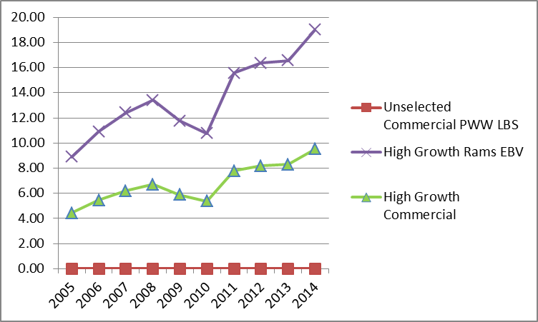
Using highly selected NSIP sires
9.50 LBS

Slide 78
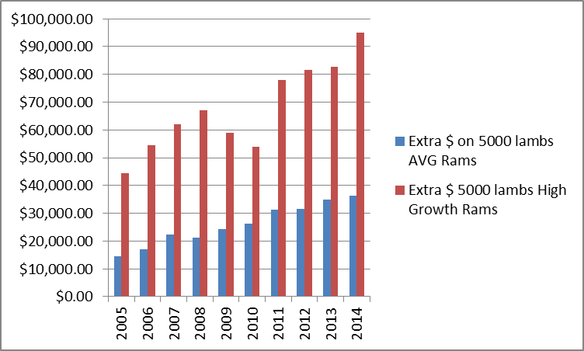
Using highly selected NSIP sires
$50,000.

Slide 79
Using highly selected NSIP sires
$418,550

Slide 80
Premium over unselected sires
$678,260

Slide 81
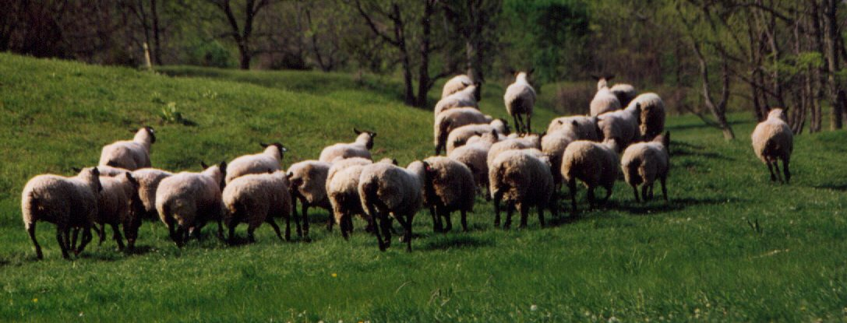
NSIP allows us to:
know where we have been,
where we are,
& where we are going!
THE END

Slide 82
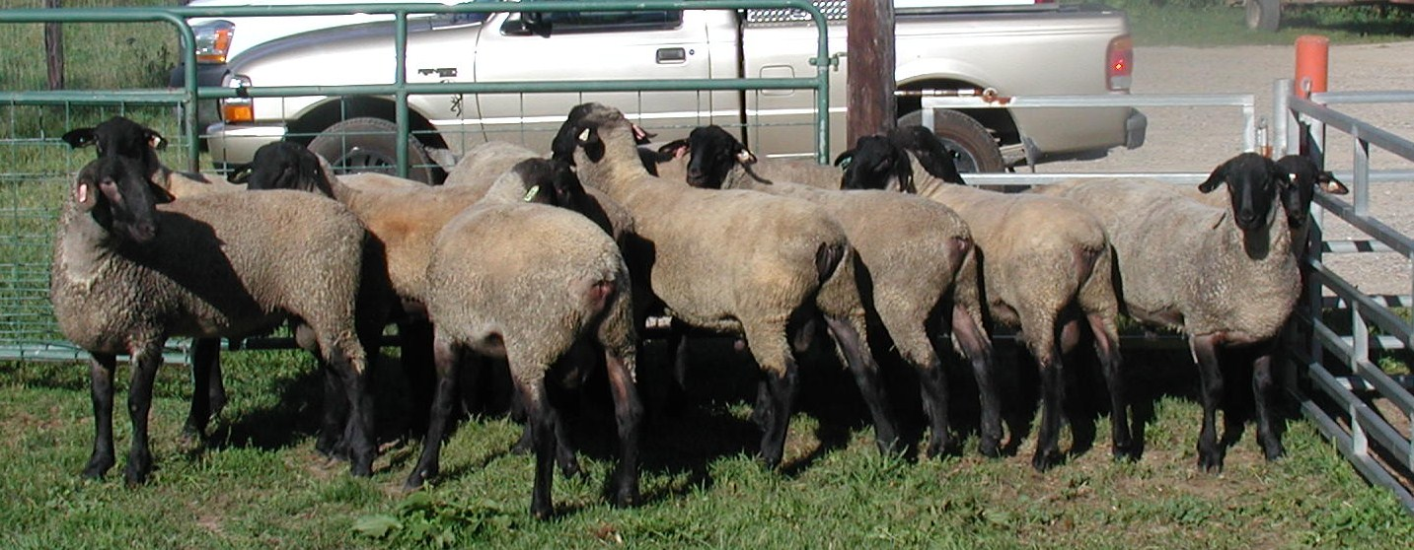
Questions?
Alan Culham
alan@sheepusa.org
517/896-7378

Slide 87
Step 3. Use EBVs in Selection
Trait | Current | Goal | Priority | Percentile
NLB | 1.2 | 2.0 | 2 | Top 20%
NLW | 0.8 | 2.0 | 1 | Top 10%
WWT | 62 | 68 | 3 | Top 25%

Slide 88
http://nsip.org/wp-content/uploads/2015/07/62-Percentiles.pdf

