Slide 1
Vetiver Grass for the Virgin Islands
Supported by a grant from Southern SARE EDS 24-069 and
A Climate Smart Hub Grant
Laura Martin
June 2024

Slide 2
Vetiver Grass
Three stages in the project
  General information presentation
  Hands on workshop to learn and practice vetiver maintenance, propagation, and planting. Vetiver slips will be given to the participants. (20-40 slips)
  Develop Vetiver Nursery both St Thomas and St Croix (Guayacon Farm)
  Evaluation – Phone call to review the planting and any problems. Farm visit to see if the plantings have been successful

Slide 3
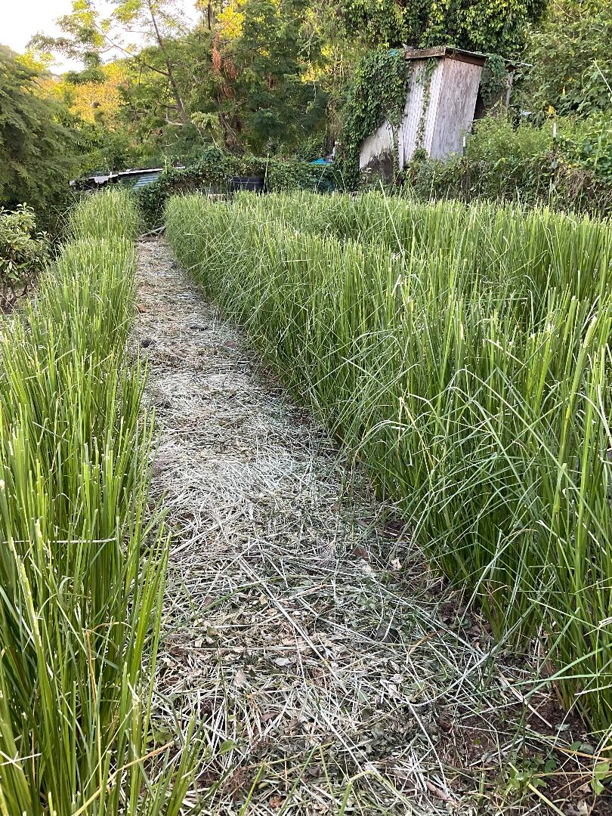
Vetiver Grass

Slide 4
Vetiver Grass
Chrysopogon zizanioides (L.) Roberty (1)
Family: Poaceae
Cultivar: Sunshine
Common Local Names
Jamaica: khus khus
Puerto Rico: pachuli
Haiti: herbe vetivert
India: khas khas

Slide 5
Vetiver Grass
Native to India, is a fast-growing noninvasive tropical perennial bunch grass
It is related to Sorghum and has some similarities to other aromatic grasses such as lemongrass (Cymbopopogon citratus) and citronella (Cynbopogon nardus). (2)
There are four types of Chrysopogon zizanioides the domesticated type which originated in southern India and is sterile and the wild type from northern India that is fertile. (1)
The wild type which is found in Africa, China, and Australia can become an invasive weed. In particular the wild type in Africa grows along riverbanks and is easily confused with the sterile variety.
Chrysopogon zizanioides (L.) Roberty is sterile and one cultivar Sunshine that was initially cultivated in Sunshine, Louisiana is now the primary cultivar found worldwide. (2) All of the sterile cultivars have been studied and have been found to be genetically the same. (2) The USDA has listed the Chrysopogon zizanioides (L.) Roberty Sunshine cultivar as being noninvasive.

Slide 6
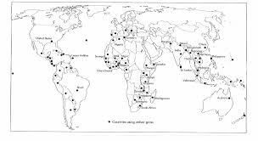

Slide 7
Vetiver for Soil and Water Conservation
https://www.youtube.com/watch?v=FzzB0G2_Aoc

Slide 8
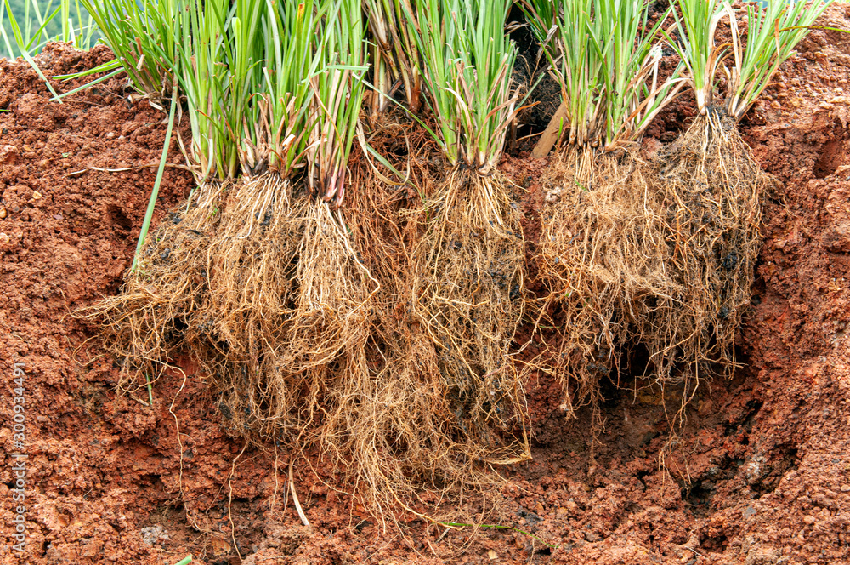
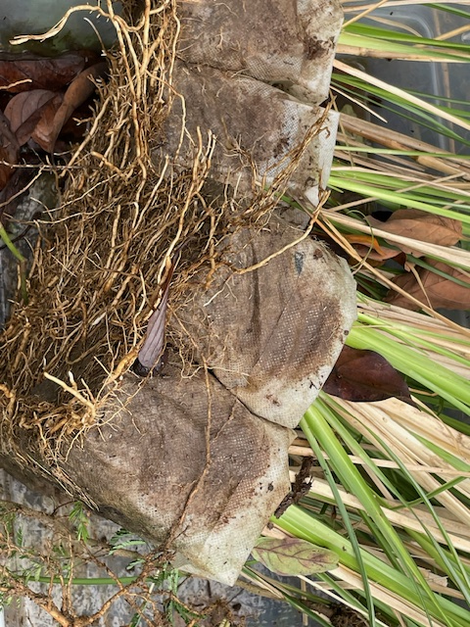
Vetiver Grass
Develops an extensive dense and deep root system.
This root system does not produce lateral roots therefore the bunches do not spread laterally.
It has associated nitrogen processing mycorrhiza, that explains its green growth throughout the year
In the first two years following planting this root system can extend up to 3 m deep creating a dense underground wall that stabilizes the soil.(3)
The roots have a tensile strength of 1/6 that of mild steel, and when planted in hedges they will increase soil sheer strength by up to 45%.
When the grass is planted very closely it produces a dense hedge up to 7 feet tall

Slide 9
Growing
Very adaptable
Prefers sunny, hot, and humid tropical climate
Tolerates:
  Acid, alkaline, or saline soils,
  Drought or flooding,(4) and
  High levels of heavy metals such as lead, aluminum, cadmium, arsenic, zinc, and manganese. (1)
It is also able to survive freezing and fire. (4)

Slide 10
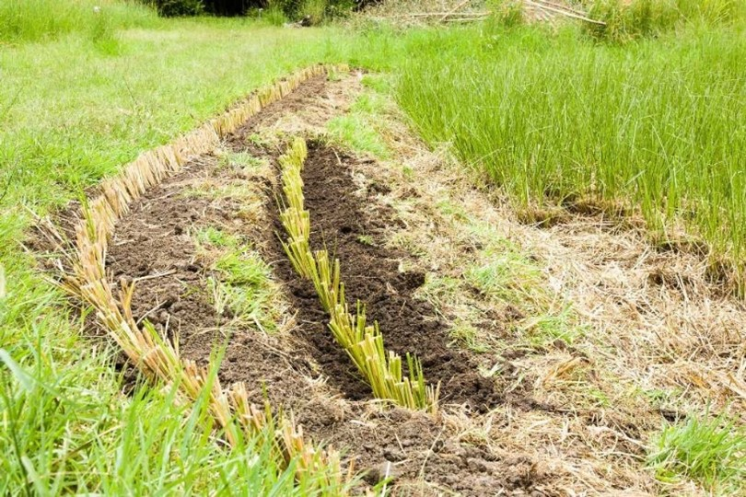

Vetiver Grass - Planting
Prepare slips – cut to 6-12 inches
Plant in furrows or holes along the contour
Apply manure (200 lbs) or fertilizer (20lbs) per 300 feet
Plant 6-9 inches apart
Water and weed initially (3)

Slide 11
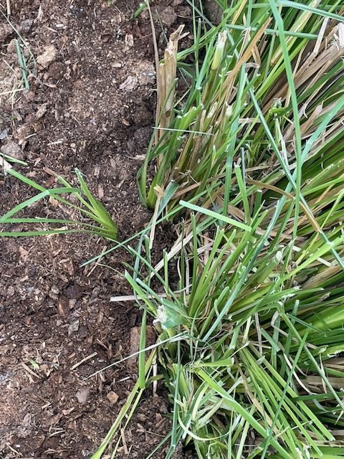
Management
Older plants will tolerate weeds except vines that may cover it.
When the plant is 2-3 feet high prune it to 10 to 12 inches.
Use the prunings for mulch.
To propagate:
  Take slips from the lower edge of the bunch
  Soak for 24 hrs
  Plant or pot
Cut back yearly – remove dried shoots

Slide 12
Pests
Very few pests
Termites and ants in the roots
Stem borer but only mild reduction of the crop
Appears to be repellant to other pests
Possibly may be a trap crop for Chilo partellus – maize stem borer

Slide 13
Vetiver system
Promoted by Vetiver Network International
Used in 100 countries
Agriculture
  Erosion control
  Water conservation
  Mulch
  Forage
  Pest control
  Soil fertility
Engineering
  Slope stabilization
  Roads
  Dams and ponds
  Drains, Guts, and Gullies
Disaster Mitigation
  Landslide Prevention
  Land Rehabilitation – phytoremediation
  Water Rehabilitation
  Watershed Protection
  Coastal Protection
Other
  Oil
  Roofing
  Crafts

Slide 14
Vetiver in the Virgin Islands
Agriculture
  Erosion control
  Water conservation
  Mulch
  Forage
  Pest control
  Soil fertility

Slide 15
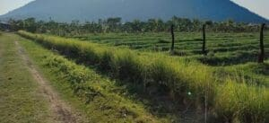
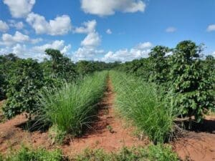

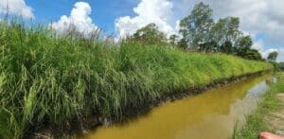
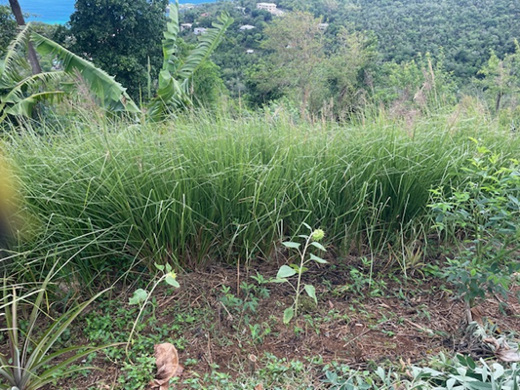
Uses on a Farm
Boundaries
Erosion control
Crop management
Remediation
Vetiver Network International

Slide 16
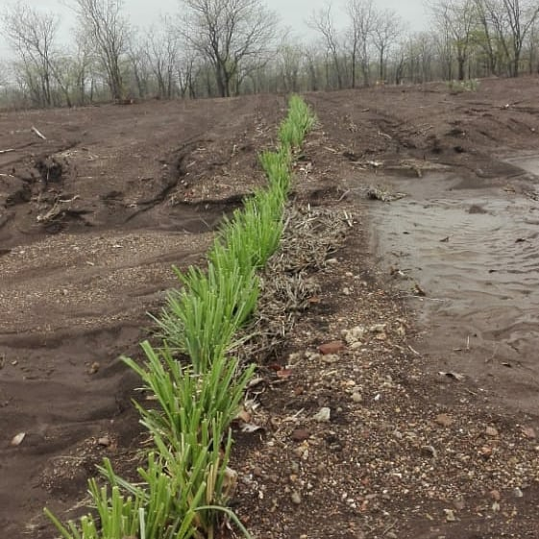
Erosion Control and Bioterracing
Planted as a hedge along a contour line, forms a filter barrier this
  slows down the flow of rainfall runoff water so that the erosive velocity of water is halted, and
  traps sediment carried by the runoff on the upslope side of the hedge.
The sediment depositions increase and the slope gradient becomes less,
  further slowing the velocity of run off
  Vetiver continues to grow and maintains effectiveness as these natural terrace risers gain height.
Able to reduce soil erosion by up to 90%
Reported soil loss reductions of over 100tons/ha have been reported (CIAT, Colombia)
Also acts as a windbreak,
Picture of erosion control in Zimbabwe

Slide 17
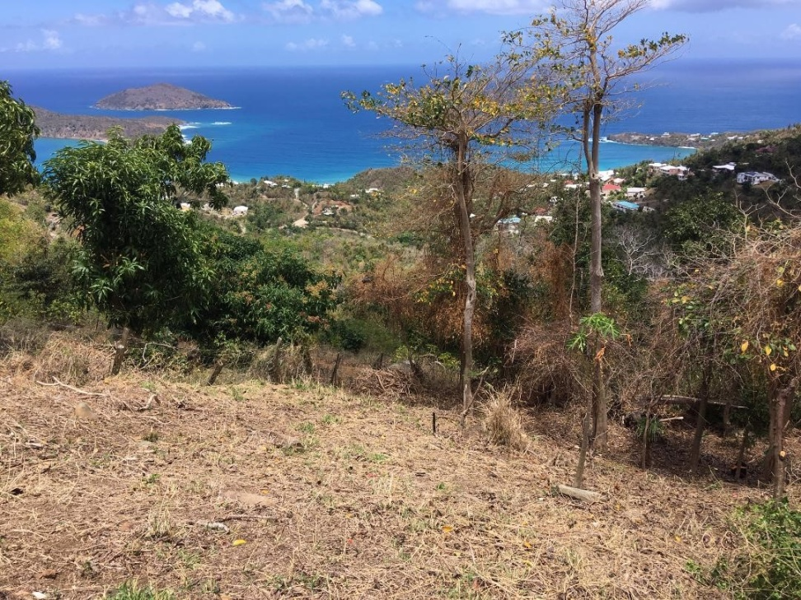
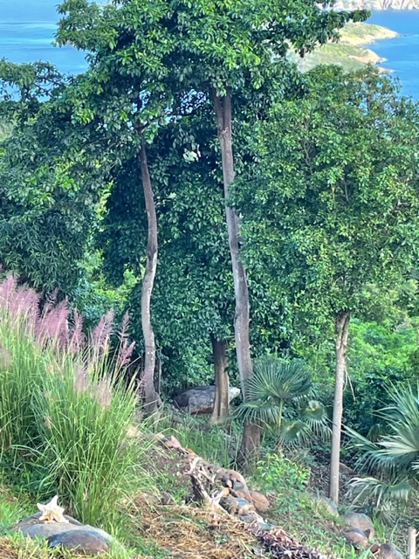
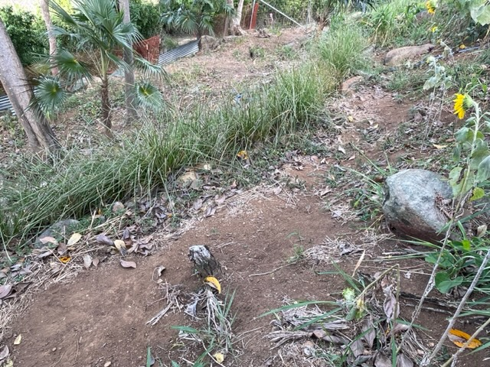
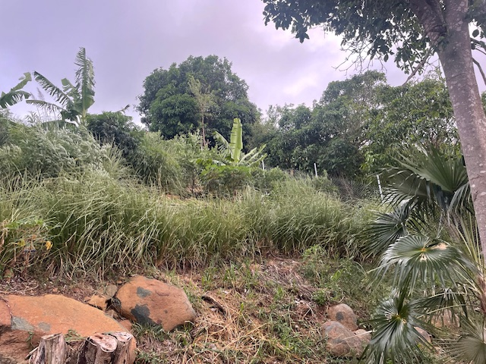
Erosion Control

Slide 18

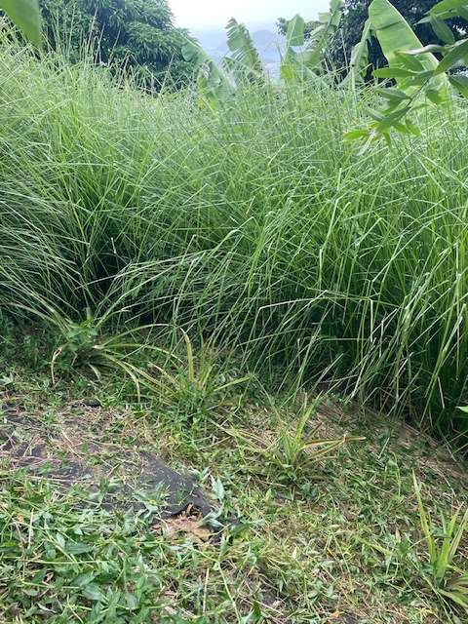
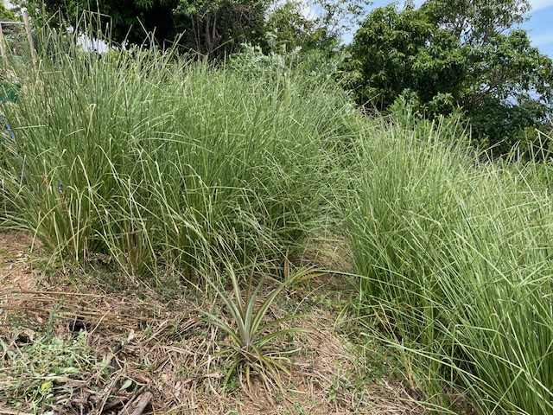
Erosion Control and Bioterracing
Filled behind hedgerow 8 inches

Slide 19
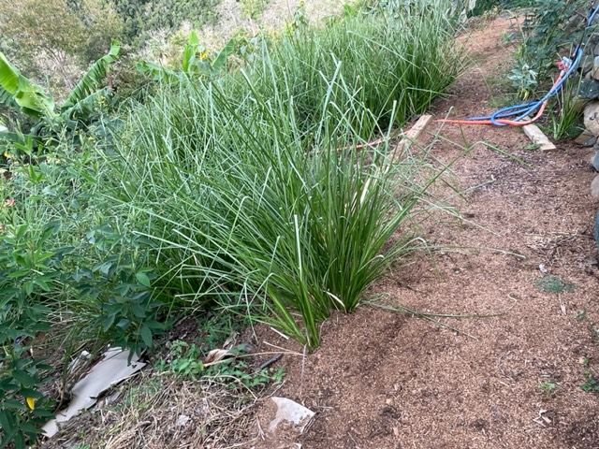
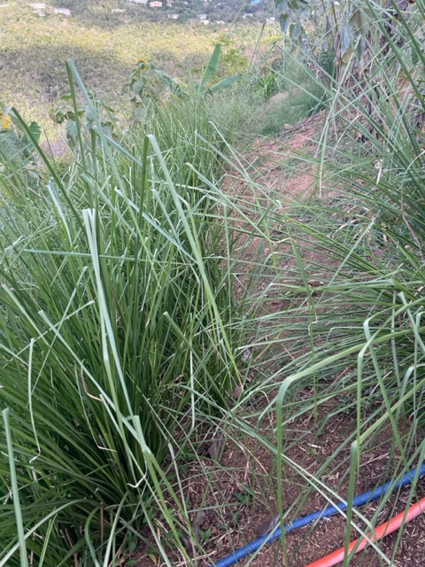
Erosion Control and Bioterracing

Slide 20
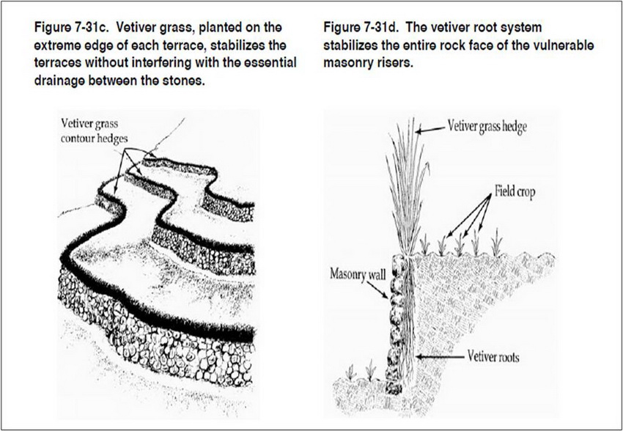

Slide 21
Water conservation
Vetiver hedgerows will:
  Reduce water runoff by as much as 70% particularly in extreme rainfall events
  Improve water infiltration, and
  increase soil moisture enhancement
Vetiver hedgerows generally planted on the contour and every 6 feet of vertical distance.
The runoff is slowed and spread over a larger area.
Experimental works in India with vetiver grass showed significant increase of soil moisture and crop yields (10)

Slide 22
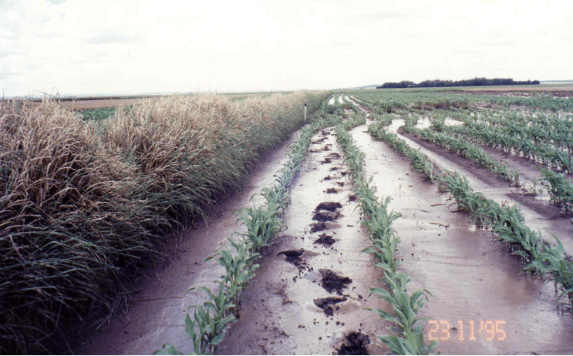
Water Conservation

Slide 23
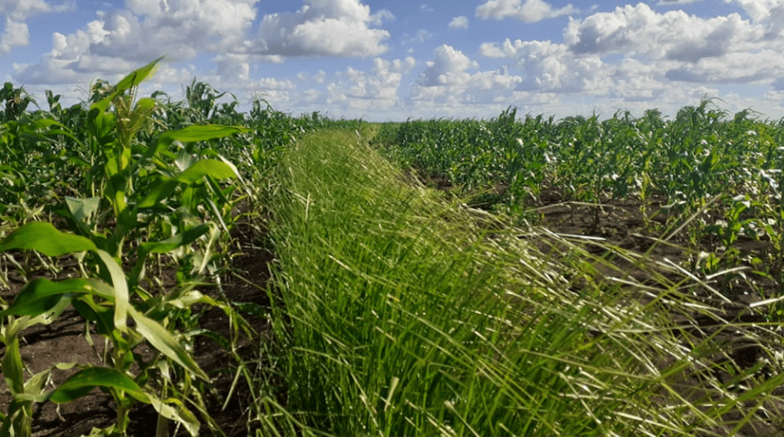
Water Conservation

Slide 24
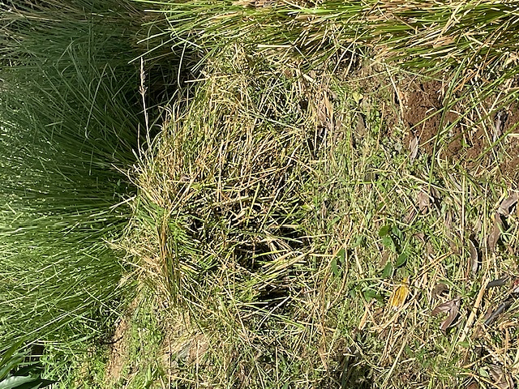
Mulch, Forage
Vetiver grass when used as a mulch further reduces soil loss from erosion and increases soil moisture. The mulch reduces soil temperature by as much as 15⁰C under extreme heat conditions; mulch degradation improves soil organic matter, enhancing soil micro flora and fauna activity, recycles soil nutrients, and reduces weed growth.
Vetiver Hay is easily sun dried in a few hours, and produces up to 32 dry-tons per acre
As it decomposes adds SOC

Slide 25
Pest control,
Nonhost for nematodes – roots repellant to southern root knot, Meloidogyne incognita
Dead-end trap plant for stem borer, Chilo suppressalis
Vetiver grass is a habitat for beneficial parasitoid wasps

Slide 26
Vetiver in the Virgin Islands
Engineering
Slope stabilization
  Roads
  Dams and ponds
  Drains, Guts, and Gullies

Slide 27
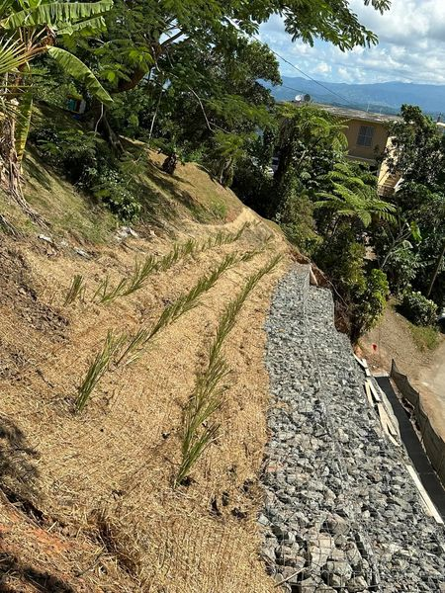
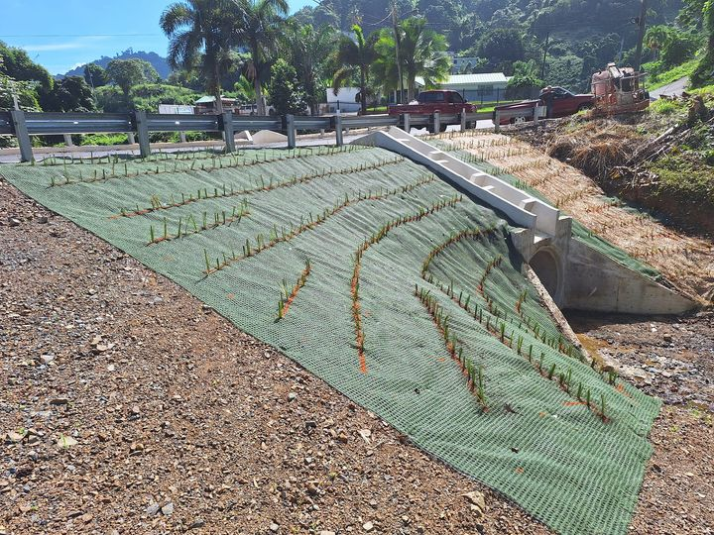
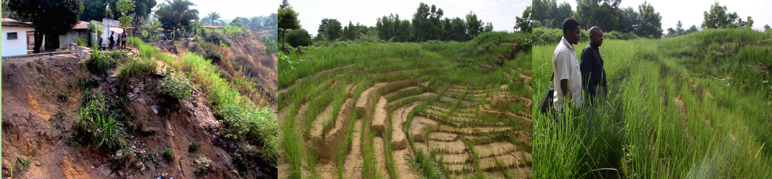
Slope stabilization
  Drains, Guts, and Gullies
2,100 plants in total. Vetiver system Puerto Rico. Samuel Hernandez
Bioseed Puerto Rico Inc
Vetiver International

Slide 28
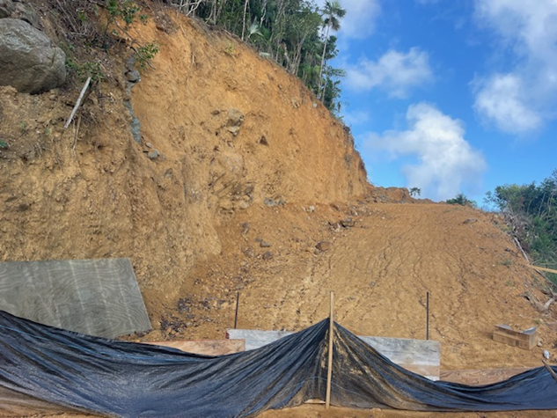
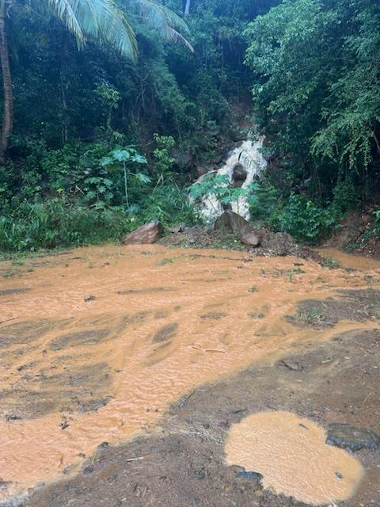
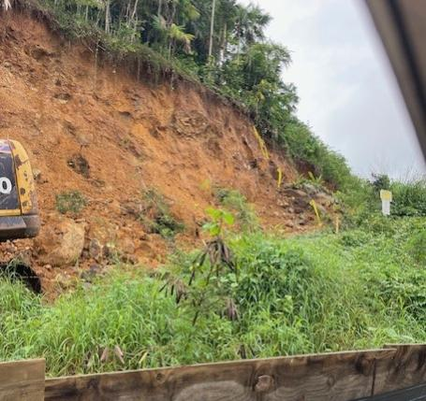
Roads
Picture by Cristina Chanes Nov 2024 Recent rains on St Thomas

Slide 29
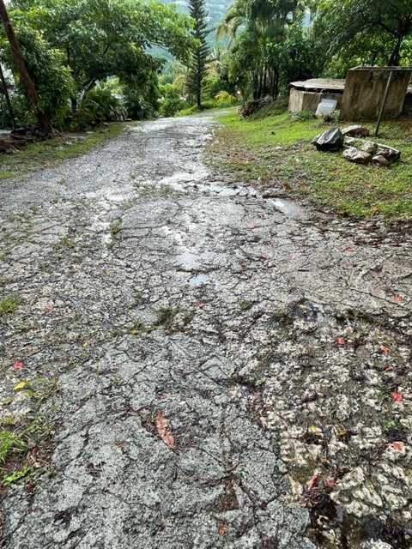
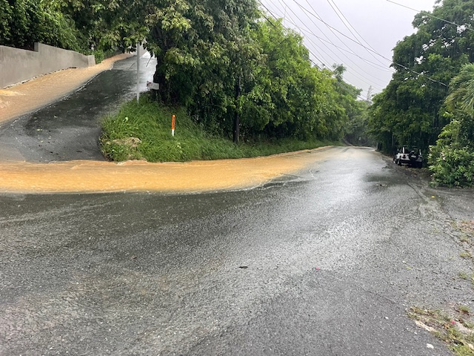
Roads
Used to protect roads from the effects of water runoff

Slide 30
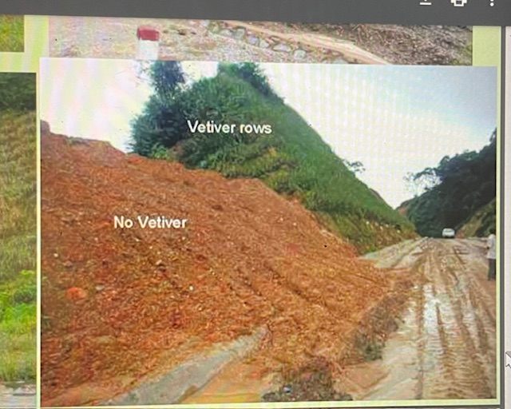
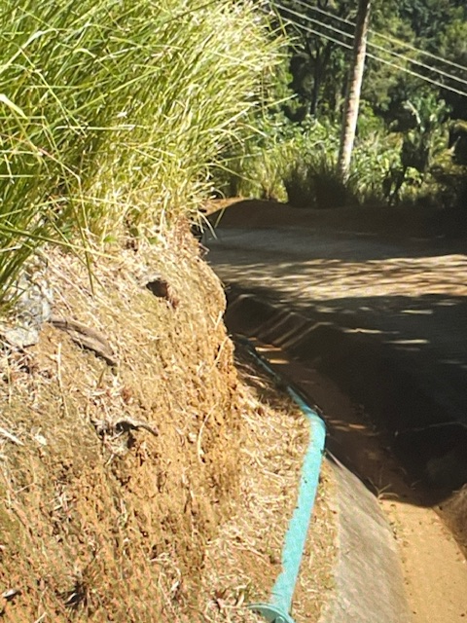
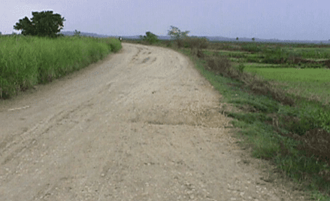
Roads

Slide 31
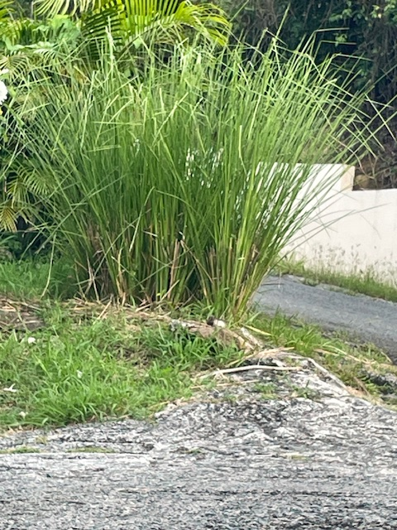
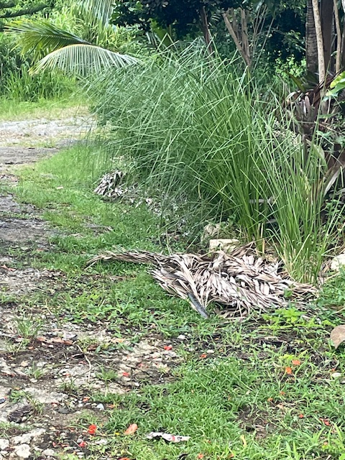
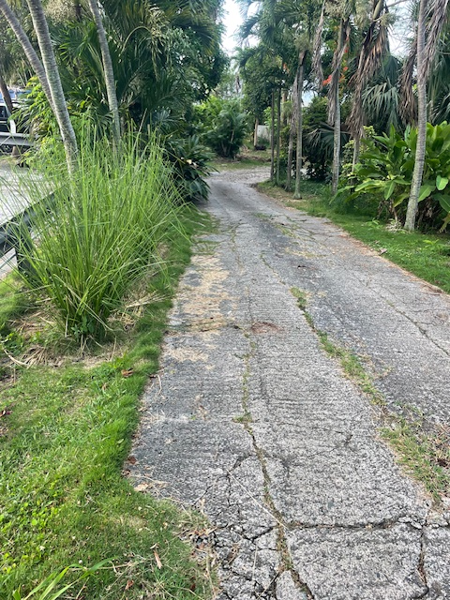
Roads

Slide 32
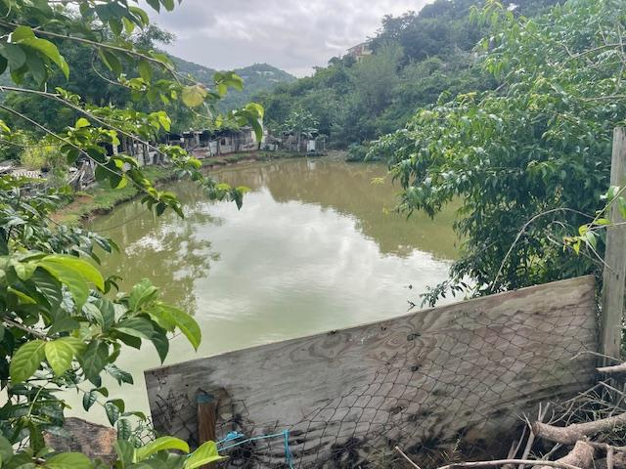
Ponds and Dams
Pond banks are affected by erosion and sedimentation decreasing capacity
Banks and spillways overflow
Contamination from run-off

Slide 33
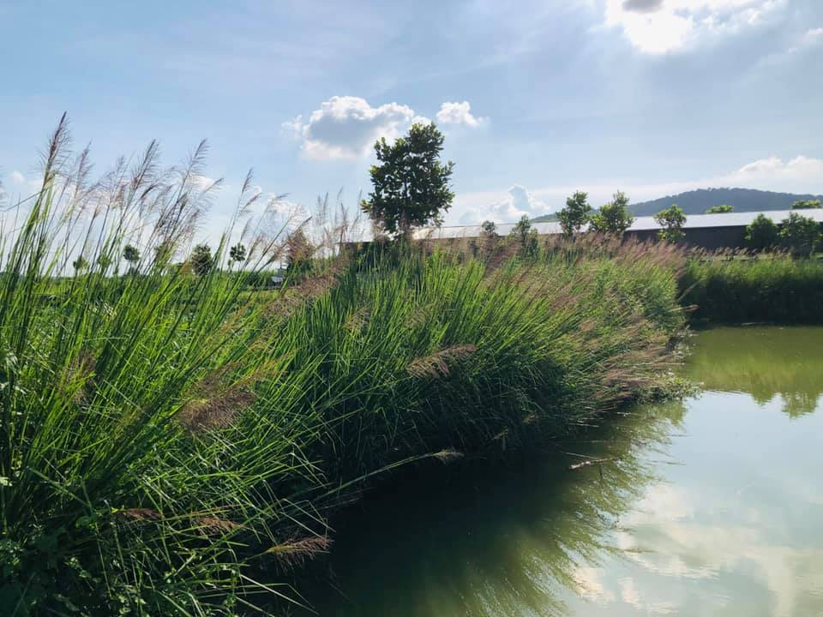
Dams and ponds

Slide 34
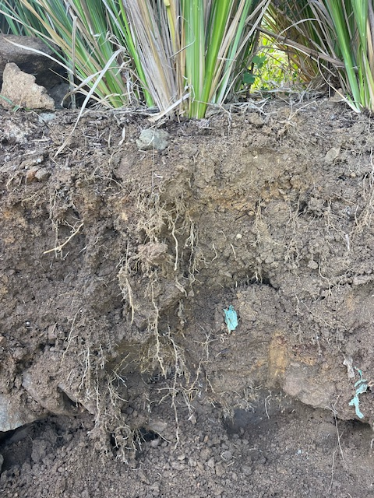
Vetiver in the Virgin Islands
Disaster Mitigation
Landslide Prevention
Land Rehabilitation
Watershed Protection
Coastal Protection

Slide 35
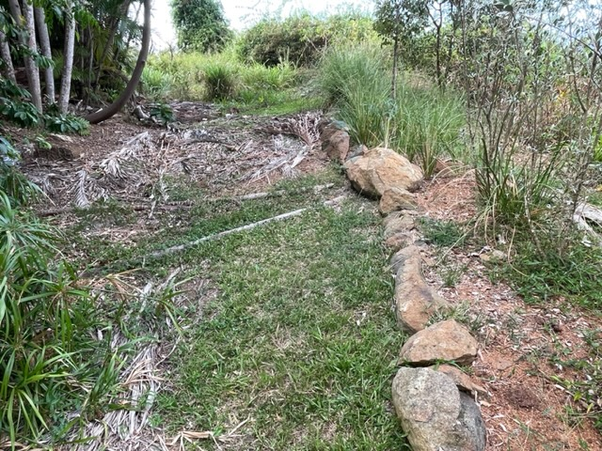
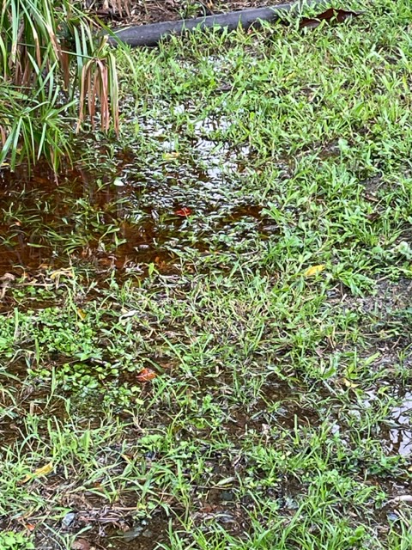
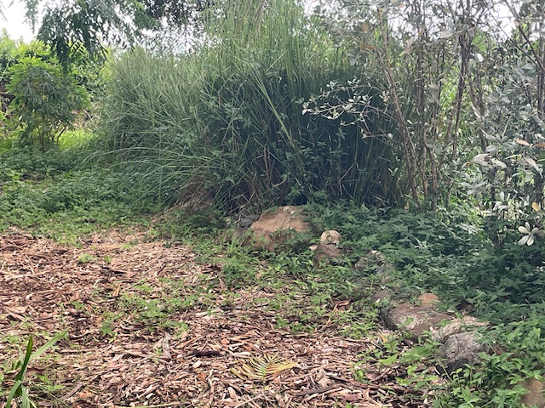
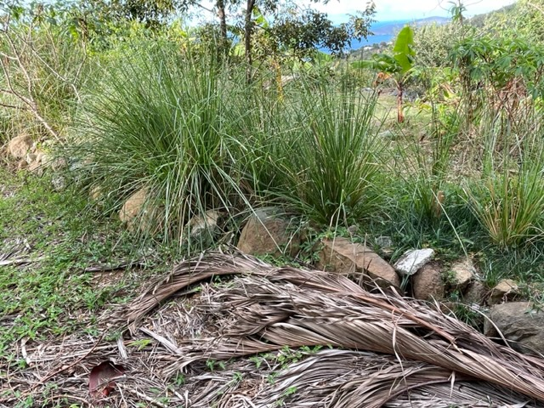
Flood-Storm Water Control

Slide 36
Land and Water Rehabilitation
Otunola BO, Aghoghovwia MP, Thwala M, Gómez-Arias A, Jordaan R, Hernandez JC, Ololade OO. Improving capacity for phytoremediation of Vetiver grass and Indian mustard in heavy metal (Al and Mn) contaminated water through the application of clay minerals. Environ Sci Pollut Res Int. 2023 Apr;30(18):53577-53588. doi: 10.1007/s11356-023-26083-5. Epub 2023 Mar 2. PMID: 36859642; PMCID: PMC10119195.
Phytoremediation basically refers to the use of plants and associated soil microbes to reduce the concentrations or toxic effects of contaminants in the environment.
Vetiver's roots absorb heavy metals from soil and water, and the plant produces chelators and organic acids to bind with the toxic metal ions. The metal and chelator complex is then sequestered by the plant's cells, inactivating the metal ions. Phytodegradation
3 year study on reducing nitrogen and phosphorous runoff on sloping cropland in China with Vetiver Grass Hedgerows(VGH)(14)
5 fertilization treatments studied
  VGH plus organic fertilizer
  VGH plus inorganic fertilizer
  either organic or inorganic fertilizer without VGH, and
  no VGH or fertilizer (Control).
Runoff pollutants were significantly reduced with the VGH 98% inorganic and 94% organic fertilizers
Crop yields were increased

Slide 37
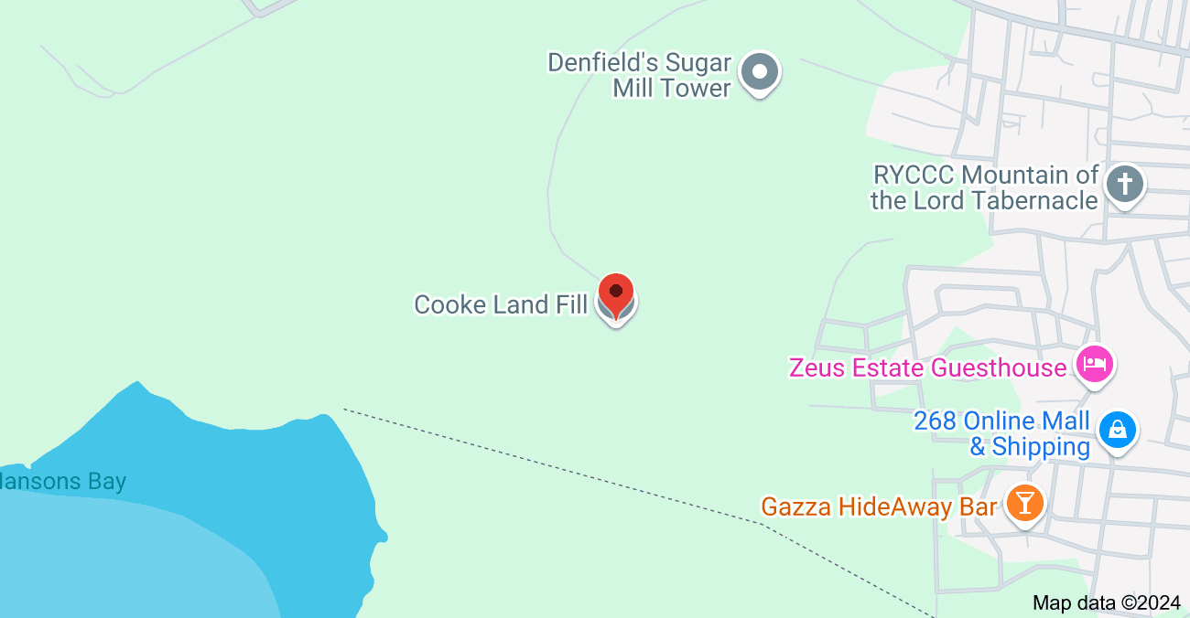
Land and Water Rehabilitation
In Antigua and Barbuda, Vetiver grass is being used to ameliorate and rehabilitate the Cooks Landfill, which borders one of the country’s largest mangrove swamps.
Google Maps

Slide 38
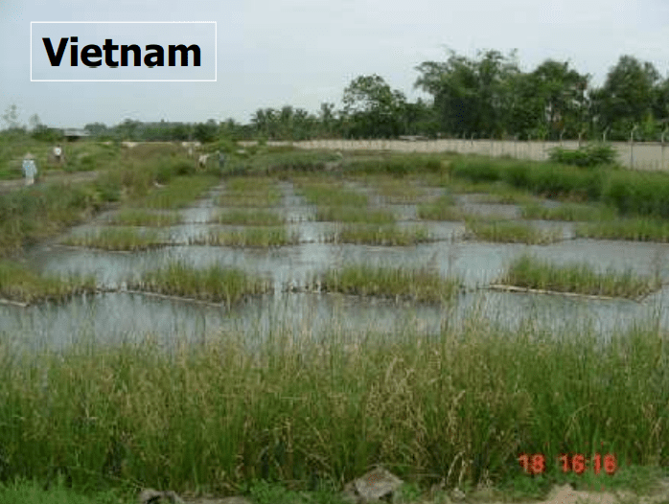
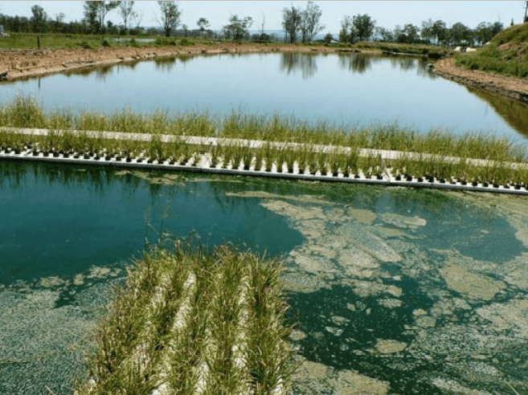
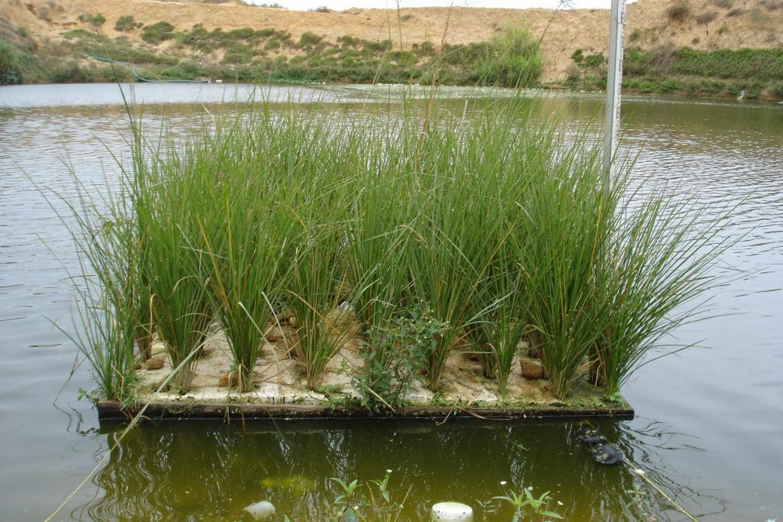
Land and Water Rehabilitation
May also be used to treat water:
Agricultural chemicals – N, P, Pesticides
Effluent – fish, animals, human – reduces coliforms
Industrial heavy metals

Slide 39
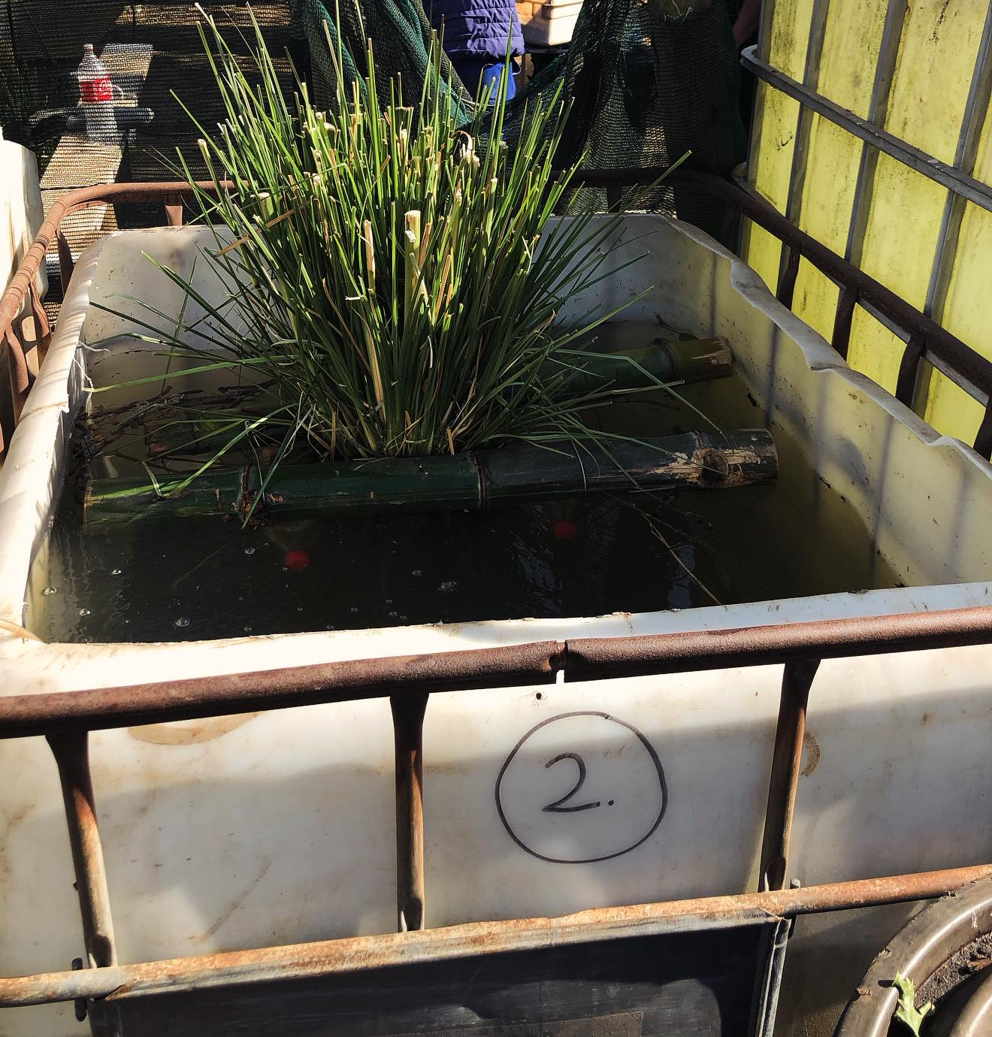
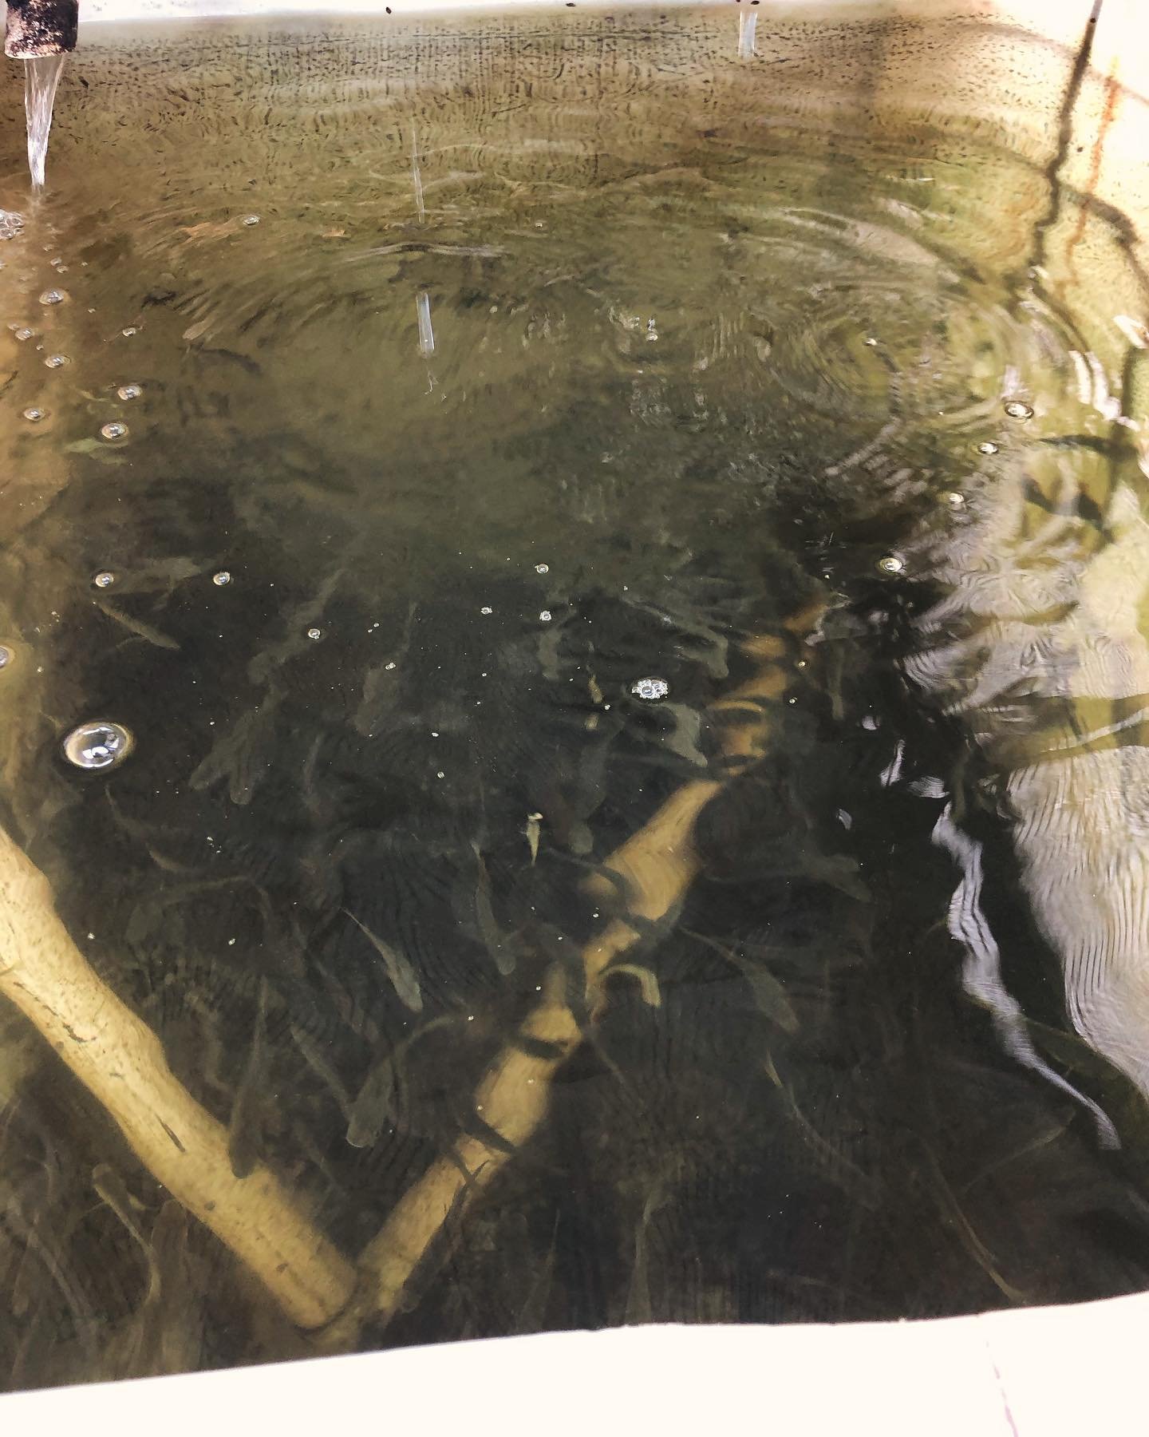
Water remediation

Slide 40


Slide 41

Coastal Protection
Prevents drifting of sand
Prevents erosion of the beach
Protects the coast, mangroves, and reefs from pollution

Slide 42
Other
Oil – 90% of all perfumes based on vetiver oil
Primarily produced in Haiti and Indonesia remainder in India
2 years to harvest – the harvest increases erosion
On an average one hectare of vetiver plantation yields 3-4 ­­ tones of roots which on distillation yield 15 to 16 kg of oil or 33 lbs $16335
55 gallons=400lb sells for $198,000
15 to 16 kg of oil or 33 lbs = $16335
55gallons= 209 liters 6967 oz retail $243,845
15 to 16 kg of oil yields 17.25 liters 574.75 oz $20,000
$35-$100 fl oz retail

Slide 43
Other
Vetiver oil is antimicrobial particularly against Staphylococcus and antifungal
Kenya uses an infusion water - it is used for bathing to prevent and treat skin infections
Several countries make shoes using the roots for the soles to help prevent infection

Slide 44

Other

Slide 45



Other

Slide 46


Other

Slide 47
Vetiver Resources
ETHIOPIA WATER CONSERVATION
https://www.youtube.com/watch?v=At7XQSw6ixY
EL VETIVER, SU MANEJO Y FUNCIONAMIENTO EN LA AGRICULTURA | Jairo Restrepo Rivera https://www.youtube.com/watch?v=TghgiekDo00&t=978s
GROUP
Facebook – International Vetiver Group

Slide 48
References
Rojas-Sandoval. Chrysopogon zizanioides (vetiver). CABI Compendium. Feb 11, 2020. https://www.cabidigitallibrary.org/doi/full/10.1079/cabicompendium.18528934.
S. Barnard, V. Diedericks, K.R. Conradie. Genetic diversity of vetiver isolates (Chrysopogon zizanioides/nigritanus) available in South Africa based on ITS, ndhF and rbcL sequencing analyses. South African Journal of Botany Volume 86, May 2013. https://www.sciencedirect.com/science/article/pii/S0254629913000318
Vetiver Grass Technology. The vetiver Network International. https://www.vetiver.org
Tropical Plants Database, Ken Fern. tropical.theferns.info. 2023-03-12. <tropical.theferns.info/viewtropical.php?id=Chrysopogon+zizanioides
Truong P, Van TT, Pinners E, 2008. Vetiver system applications technical reference manual. The Vetiver Network International.
The Vetiver Network West Indies. https://www.tvnwi.org
Datta R, Quispe MA, Sarkar D. Greenhouse study on the phytoremediation potential of vetiver grass, Chrysopogon zizanioides L., in arsenic-contaminated soils. Bull Environ Contam Toxicol. 2011 Jan;86(1):124-8. doi: 10.1007/s00128-010-0185-8. Epub 2010 Dec 29. PMID: 21190015
Truong, Paul. The global impact of vetiver grass technology on the environment
Proceedings of the Second International Conference on Vetiver. Jan 2000

Slide 49
References
B. Deesaeng, J. Pheunda, C. Onarsa and A. Boonsaner. Vetiver Potential For Increasing Groundwater Recharge. Watershed Research Division, Watershed Conservation and Management Office, National Park, Wildlife and Plant Conservation Department, Phaholyothin Rd., Chatuchak, Bangkok, Thailand 10900
J. Van den Berg 1 , C. Midega 2 , L. J. Wadhams 3 , and Z. R. Khan2 1. Can Vetiver Grass be Used to Manage Insect Pests on Crops? 1 School of Environmental Sciences, Potchefstroom University for Christian Higher Education, Private Bag X 6001, Potchefstroom, South Africa 2 International Center for Insect Physiology and Ecology, P.O. Box 30772, Nairobi, Kenya 3 Chemical Ecology Group, Rothamsted Research, Harpenden, Herts, AL5 2JQ, United Kingdom. https://www.vetiver.org/ICV3-Proceedings/SA_stem%20borer.pdf
P. Nopmalai, A. Sukhkasem, K. Kanjanathanaset, K. Wattanaprapat and I. Meesing. Study on Carbon Storage and Carbon Balance in Vetiver Grass Cultivation Areas in Northern Thailand. Land Development Department,Chatuchak, Bangkok, Thailand, 10900
Panja S, Sarkar D, Datta R. Removal of antibiotics and nutrients by Vetiver grass (Chrysopogon zizanioides) from secondary wastewater effluent. Int J Phytoremediation. 2020;22(7):764-773. doi: 10.1080/15226514.2019.1710813. Epub 2020 Jan 15. PMID: 31941351.
Oshunsanya SO, Li Y, Yu H. Vetiver grass hedgerows significantly reduce nitrogen and phosphorus losses from fertilized sloping lands. Sci Total Environ. 2019 Apr 15;661:86-94. doi: 10.1016/j.scitotenv.2019.01.129. Epub 2019 Jan 14. PMID: 30665135.
Tessema B, Wilson B, Daniel H, Kristiansen P, Baldock JA. Functional Links between Biomass Production and Decomposition of Vetiver (Chrysopogon zizanioides) Grass in Three Australian Soils. Plants (Basel). 2022 Mar 15;11(6):778. doi: 10.3390/plants11060778. PMID: 35336660; PMCID: PMC8950612.

