Slide 1
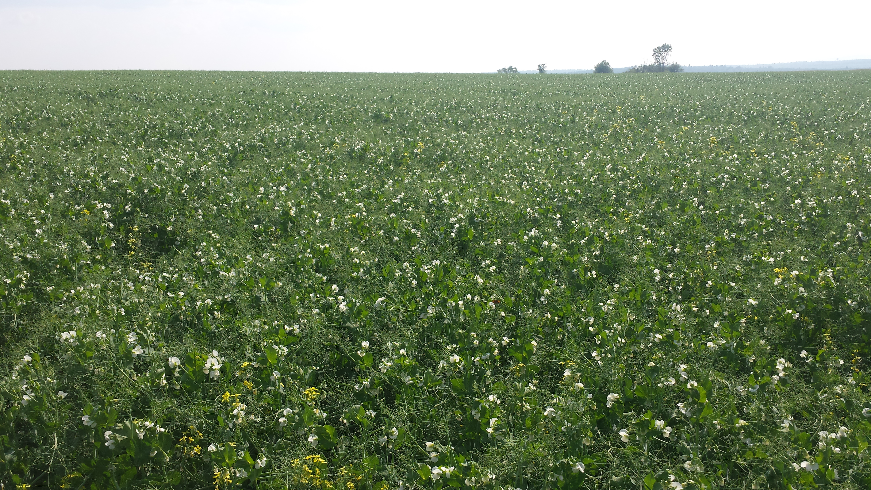
Viability of Integrating Field Peas into Organic Cereal Grain Rotations in Maine
Jake Dyer
Benedicta Grain Co.
Benedicta, ME 04733
USA

Slide 2

Partial Funding Provided by:
USDA Sustainable Agriculture Research and Education Program

Slide 3
Why Peas?
Need for non-grain cash crop to diversify rotation and reduce disease risk
Annual legume with low fertilizer requirements (soil P & K sufficient for crop production) and provides N credit to next crop
No additional equipment purchases
Timing of harvest allows for fall planted crop
New markets
2 years of variety trial data suggesting strong yield potential

Slide 4
Field Information
Thorndike shaly silt loam
pH 6.2
4.7% OM
Field history of fall and spring cereals and cover crops killed prior to flowering
Relatively low weed pressure
Fairly flat and mostly well drained

Slide 5
Varieties
Variety | Maturity | P. Mildew | Fus. Wilt | Mycospherella | Seed Source
AC Agassiz | Med-Late | R | MS | S | Meridian¹
Jetset | Med | R | MS | S | Meridian
SW Midas | Early – Med | R | MS | S | Pulse USA²
Nette 2010 | Early – Med | R | MS | S | Pulse USA
¹Meridian Seeds LLC - Casselton, ND
²Pulse USA, INC. – Bismark, ND

Slide 6
Seeding Rate
Target Population / (1-% stand loss)
SPP X % Germination
Recommended planting density is 9 plants/ft² (394,040 PLS/A).
Trial Planting density was 8 plants/ft² (348,480 PLS/A) to ensure enough seed for experiment.
Variety | Seeds/# | Germination | Bushel/A | #/A
AC Agassiz | 1953 | 84% | 3.9 | 236
Jetset | 1830 | 92% | 3.8 | 230
SW Midas | 2168 | 94% | 3.2 | 190
Nette 2010 | 1930 | 97% | 3.5 | 207

Slide 7
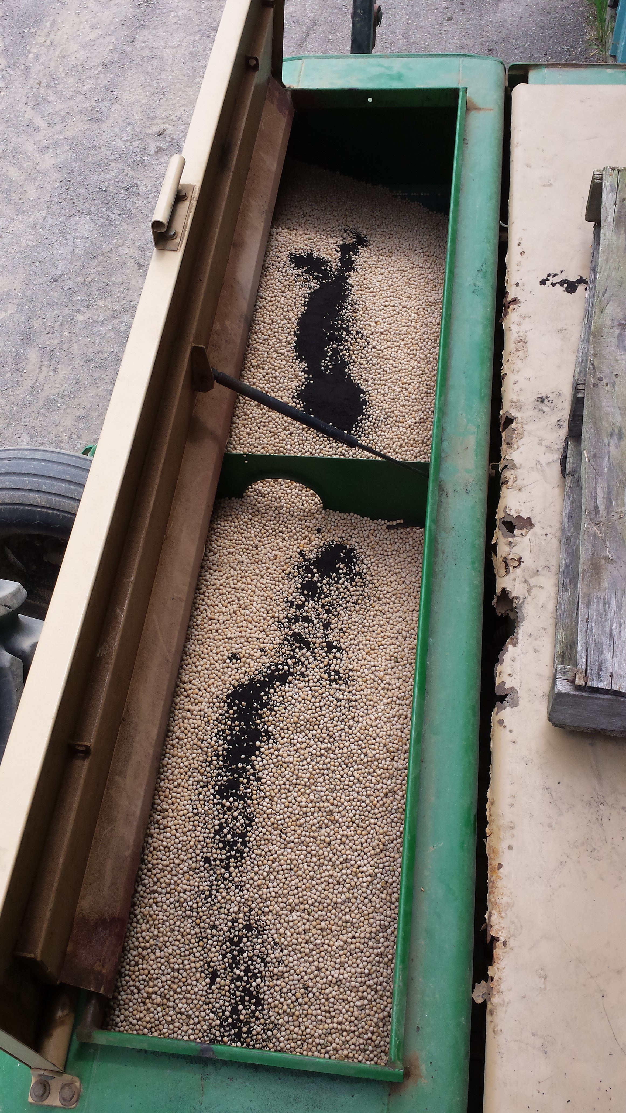
Inoculant
OMRI Approved – Peat based
Rhizobium leguminosarum biovar viceae
Specific to pea-lentil-vetch
10.72 oz/cwt (>2x rate)

Slide 8
Trial Design
240’
60’
1293’
RCBD w/4 Treatments – Replicated 3X
Block Dimensions: 240’ x 1293’
Treatment Dimensions: 60’ x 1293’
BLOCK A
BLOCK B
BLOCK C

Slide 9
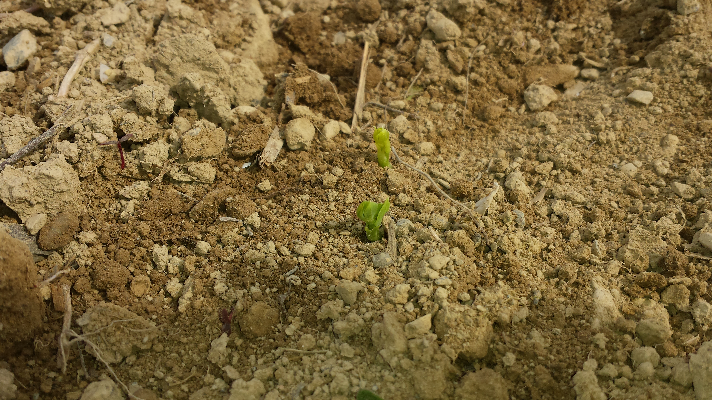
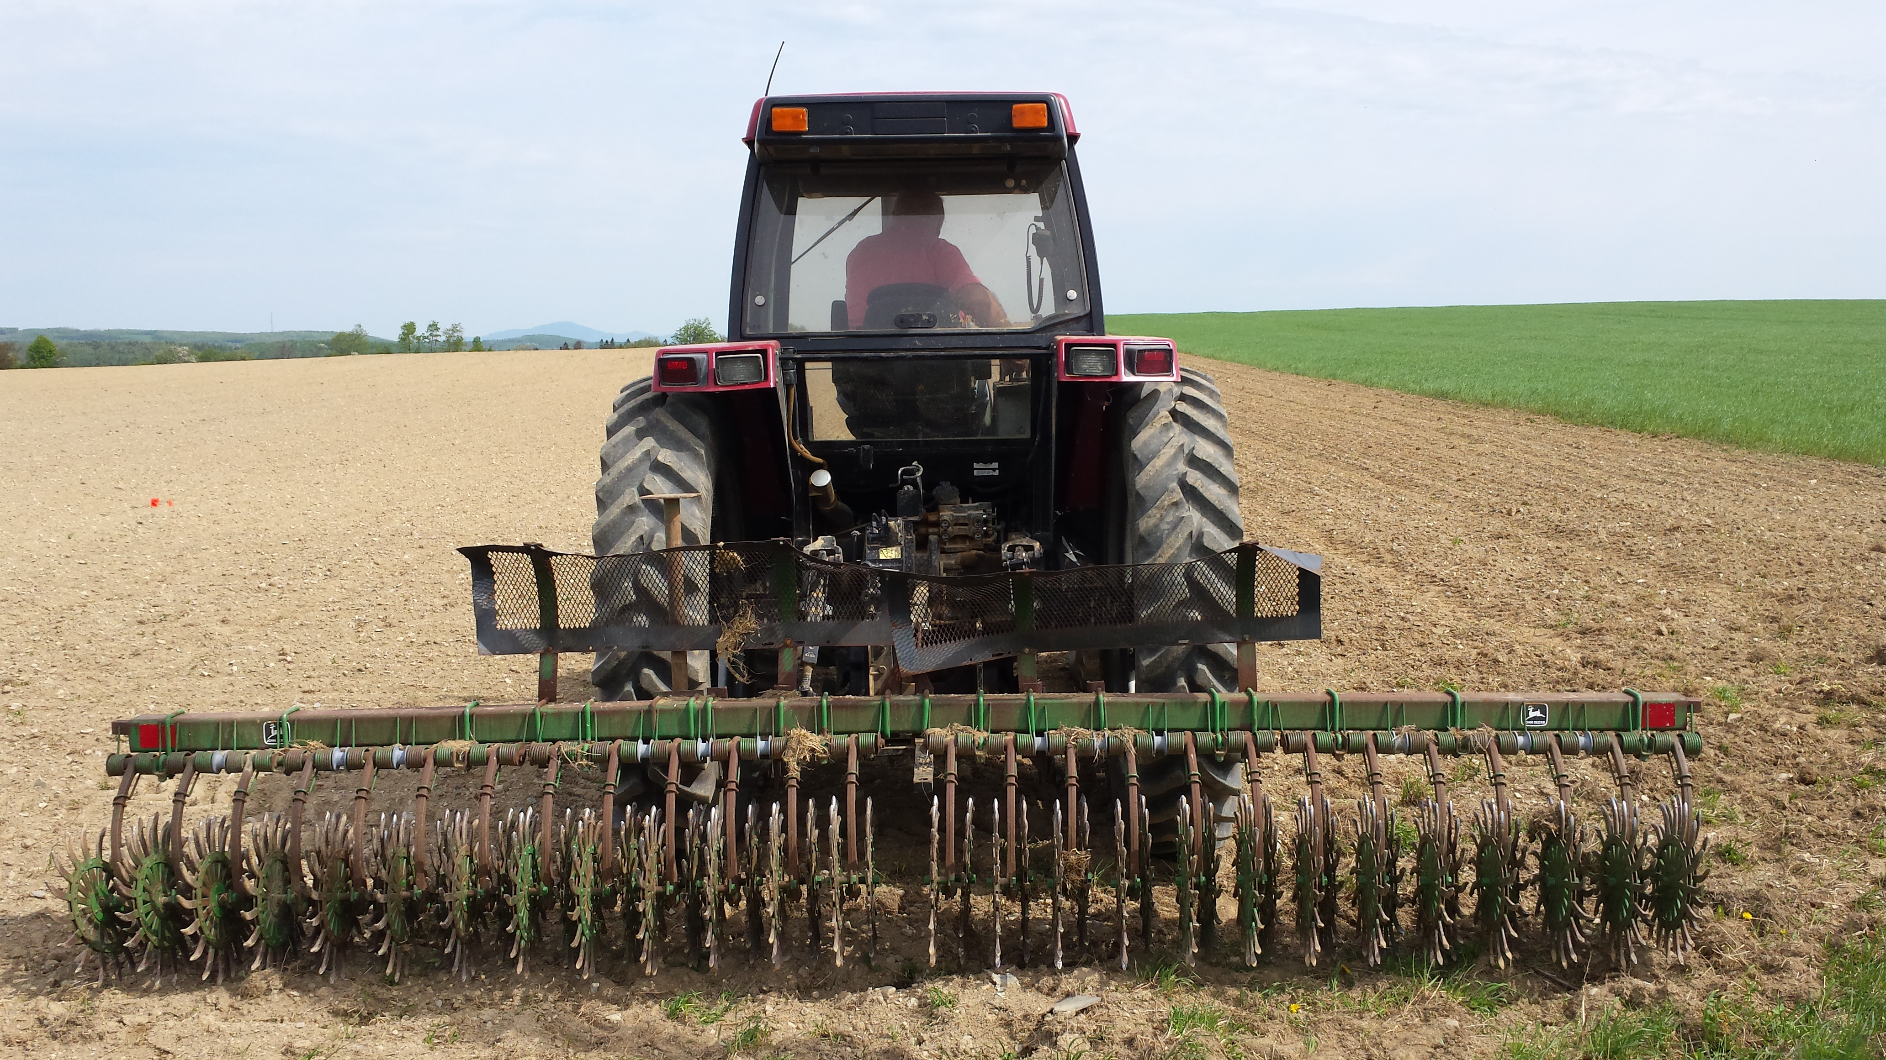
Planting and Cultivating
Planted on May 15 and 16
Emergence on May 25 (9-10 DAP)
Rotary hoe at spike on May 25
Hypogeal emergence = cultivation flexibility

Slide 10
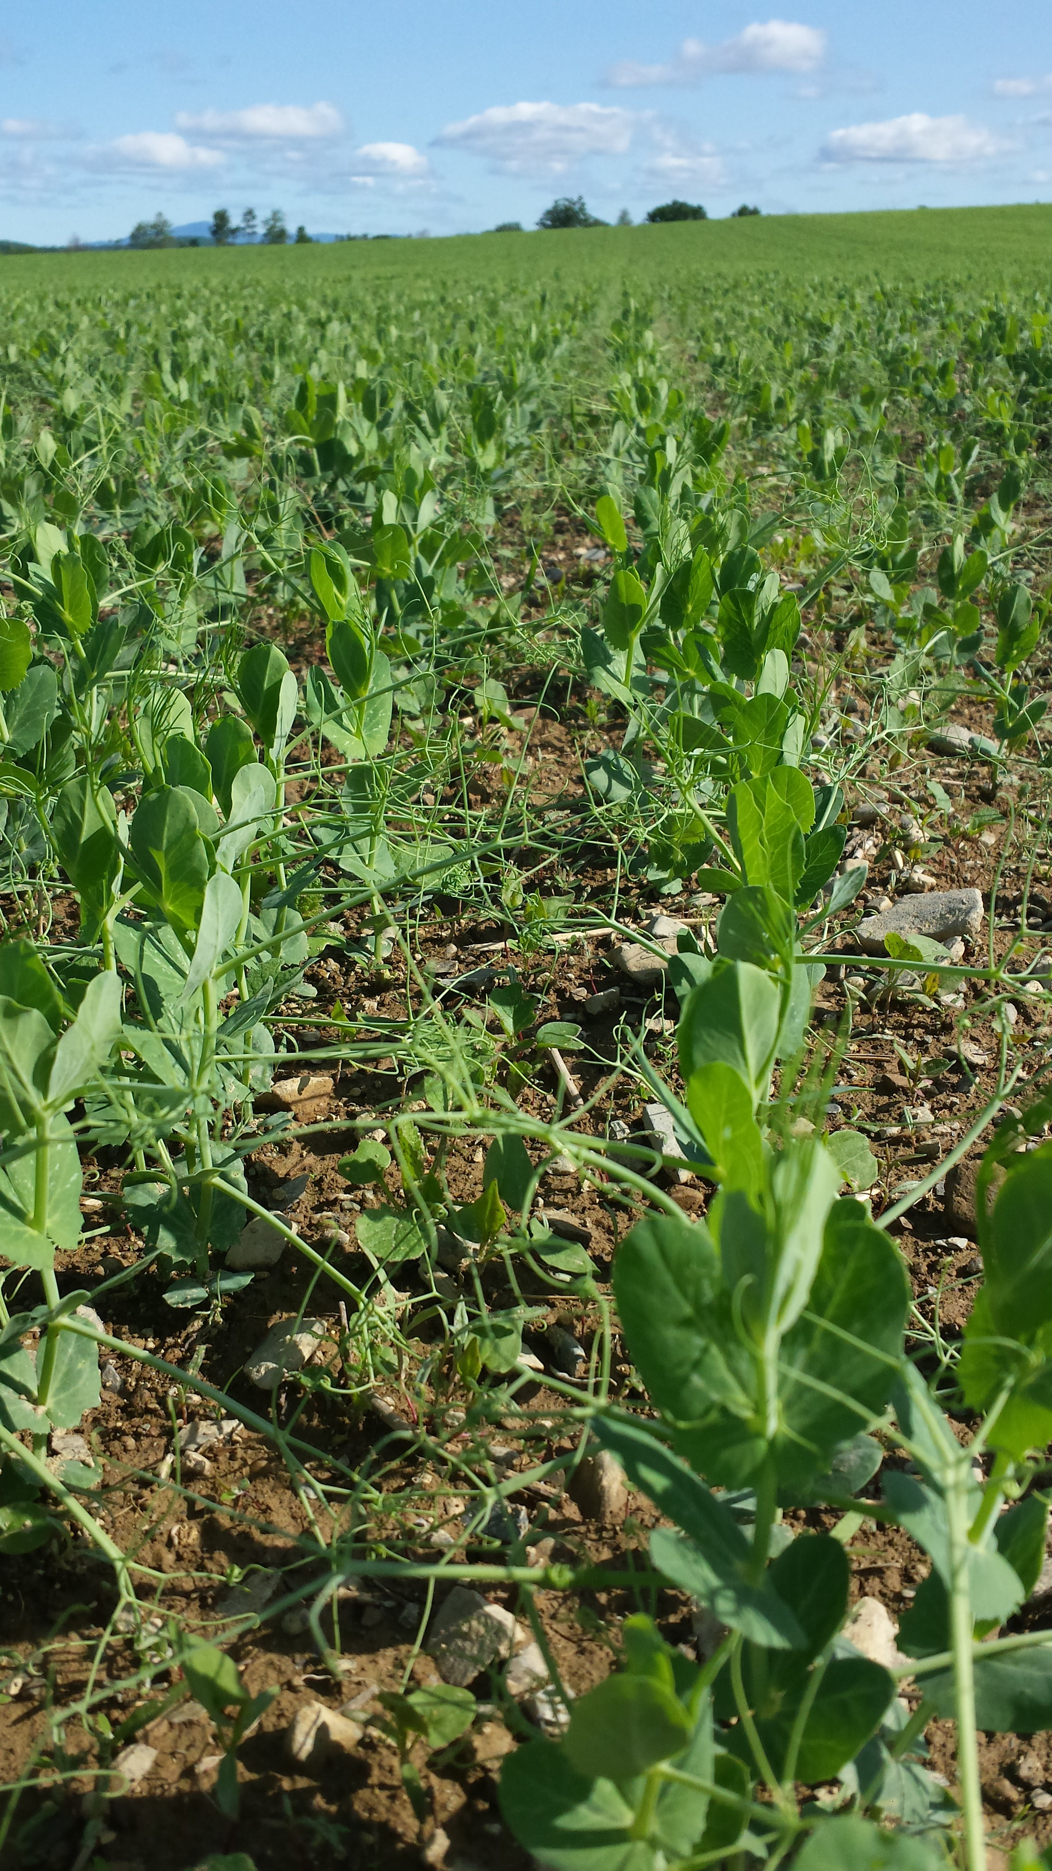
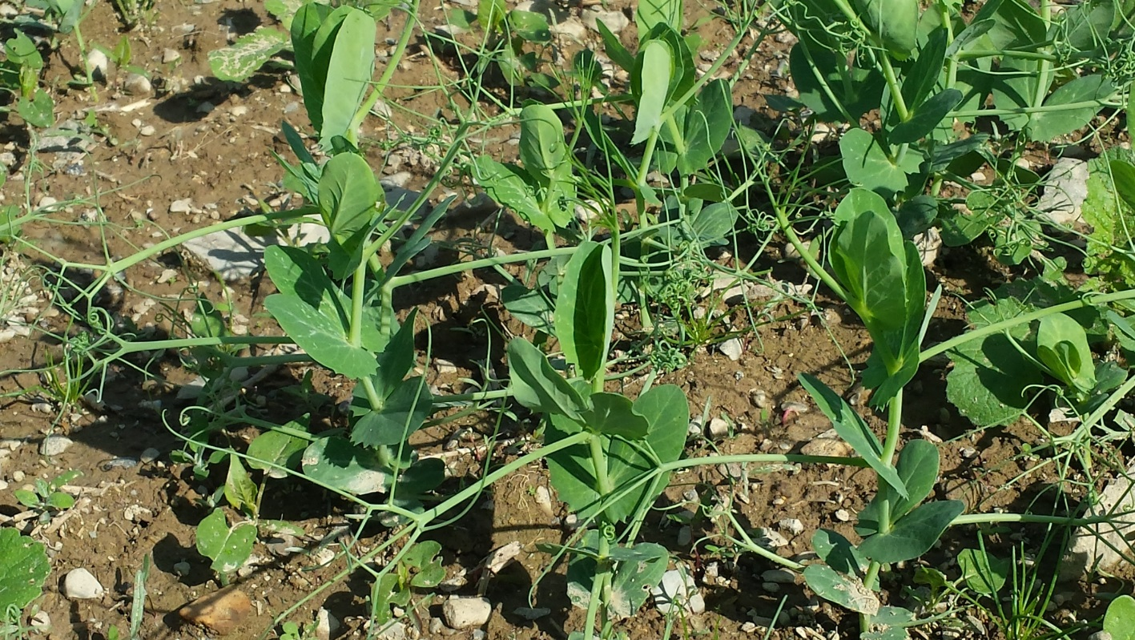
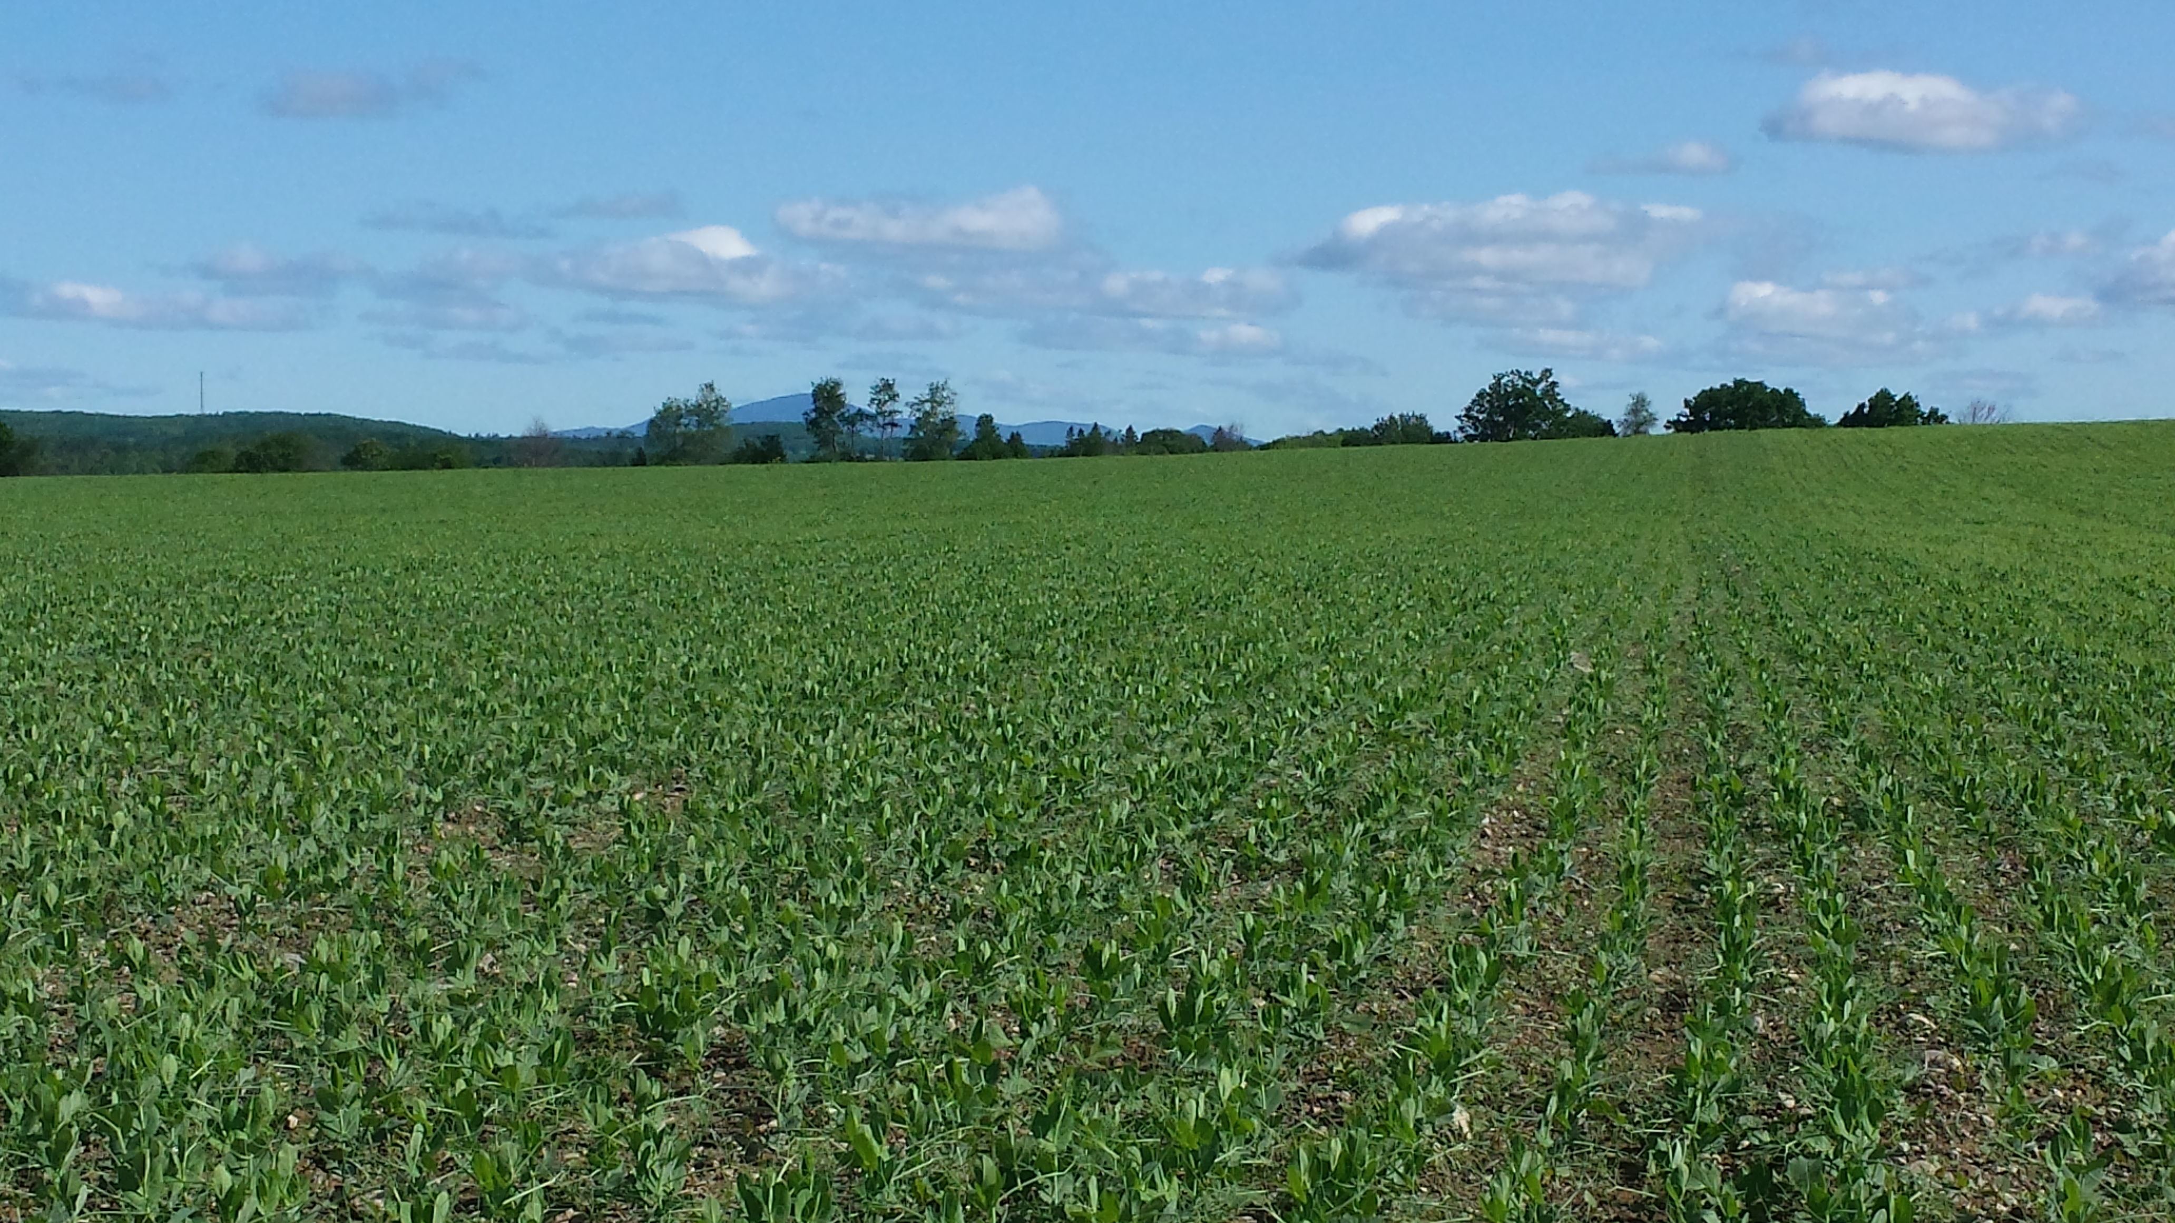
June 14
5-6 Leaf Stage
29-30 DAP

Slide 11
June 30 Field Notes
 | June 30, 2015
Variety | Height¹ | Disease² | Weeds³
AC Agassiz | 17 | 0 | 3
Jetset | 22 | 0 | 3
SW Midas | 18 | 0 | 3
Nette 2010 | 22 | 0 | 3
¹Height measured in inches
²Disease scale (0-9) 0 = none noted, 9 = severe
³Weed Pressure scale (0-9) 0 = slight, 9 = severe

Slide 12
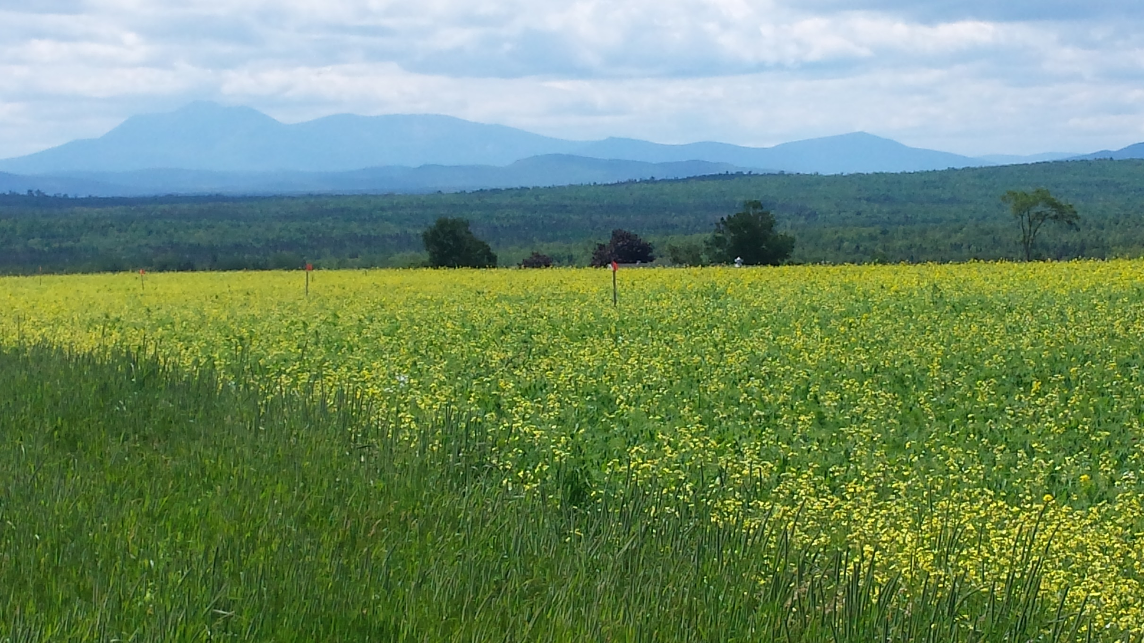
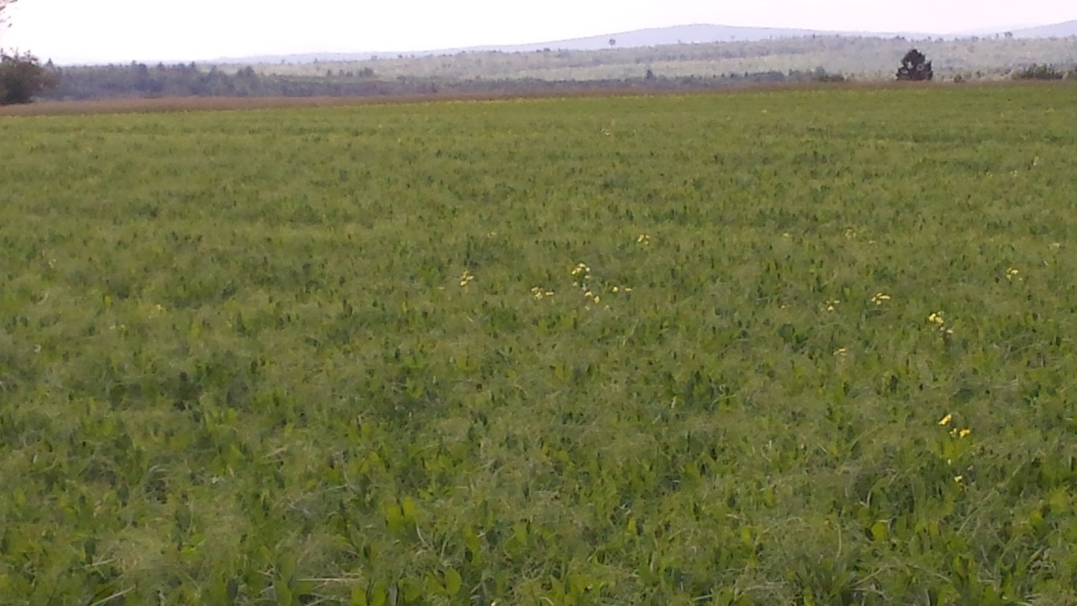
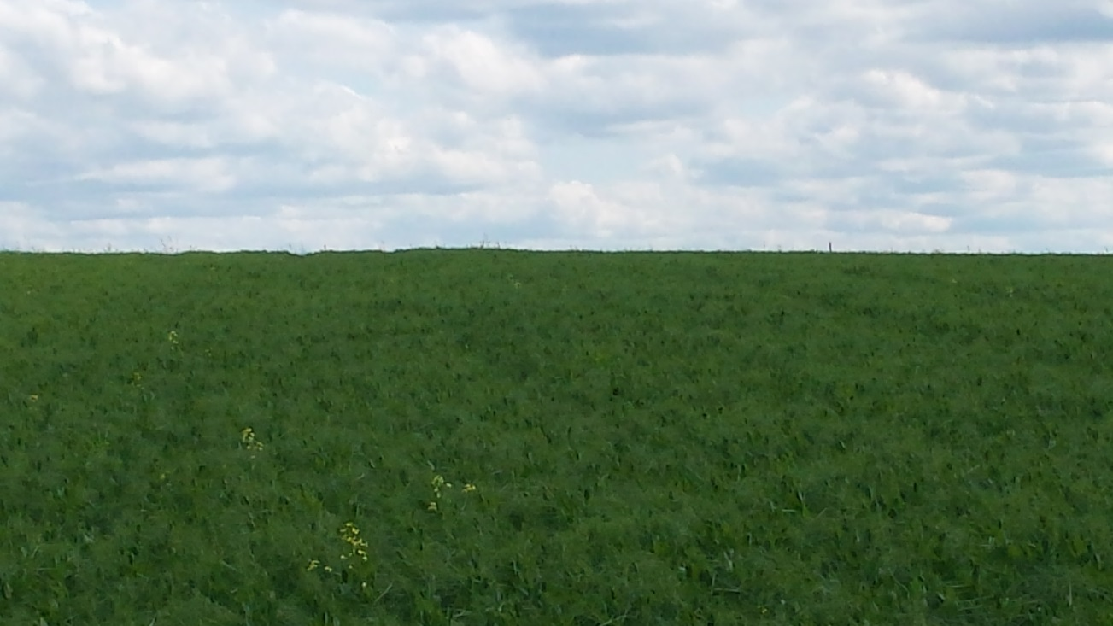
Wild Radish
July 02
North end of field
July 02
South end of field
July 02
North end of field

Slide 13
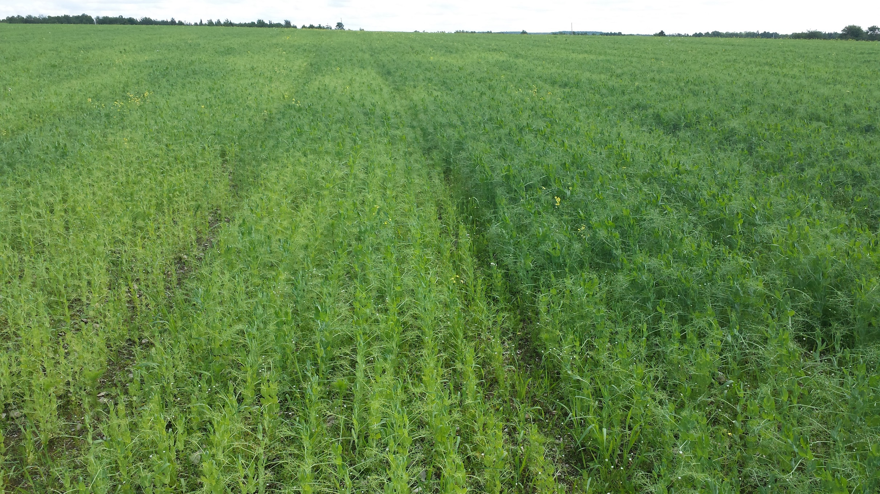
Wet Spot
July 02

Slide 14
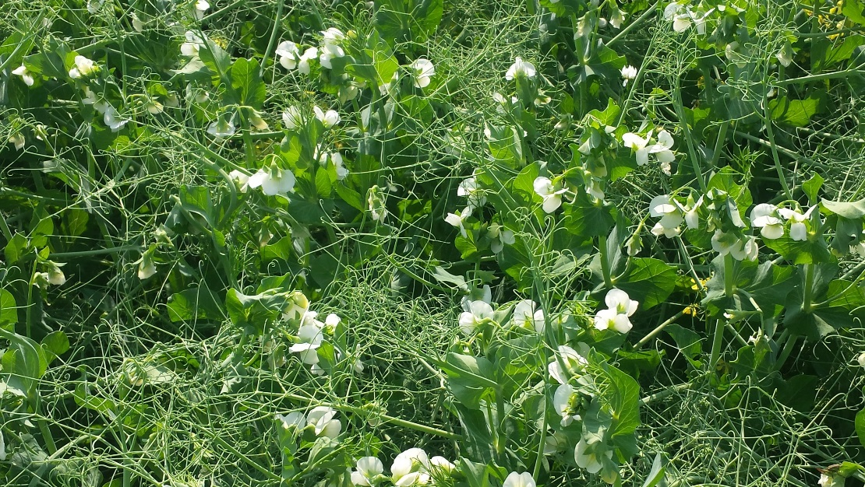
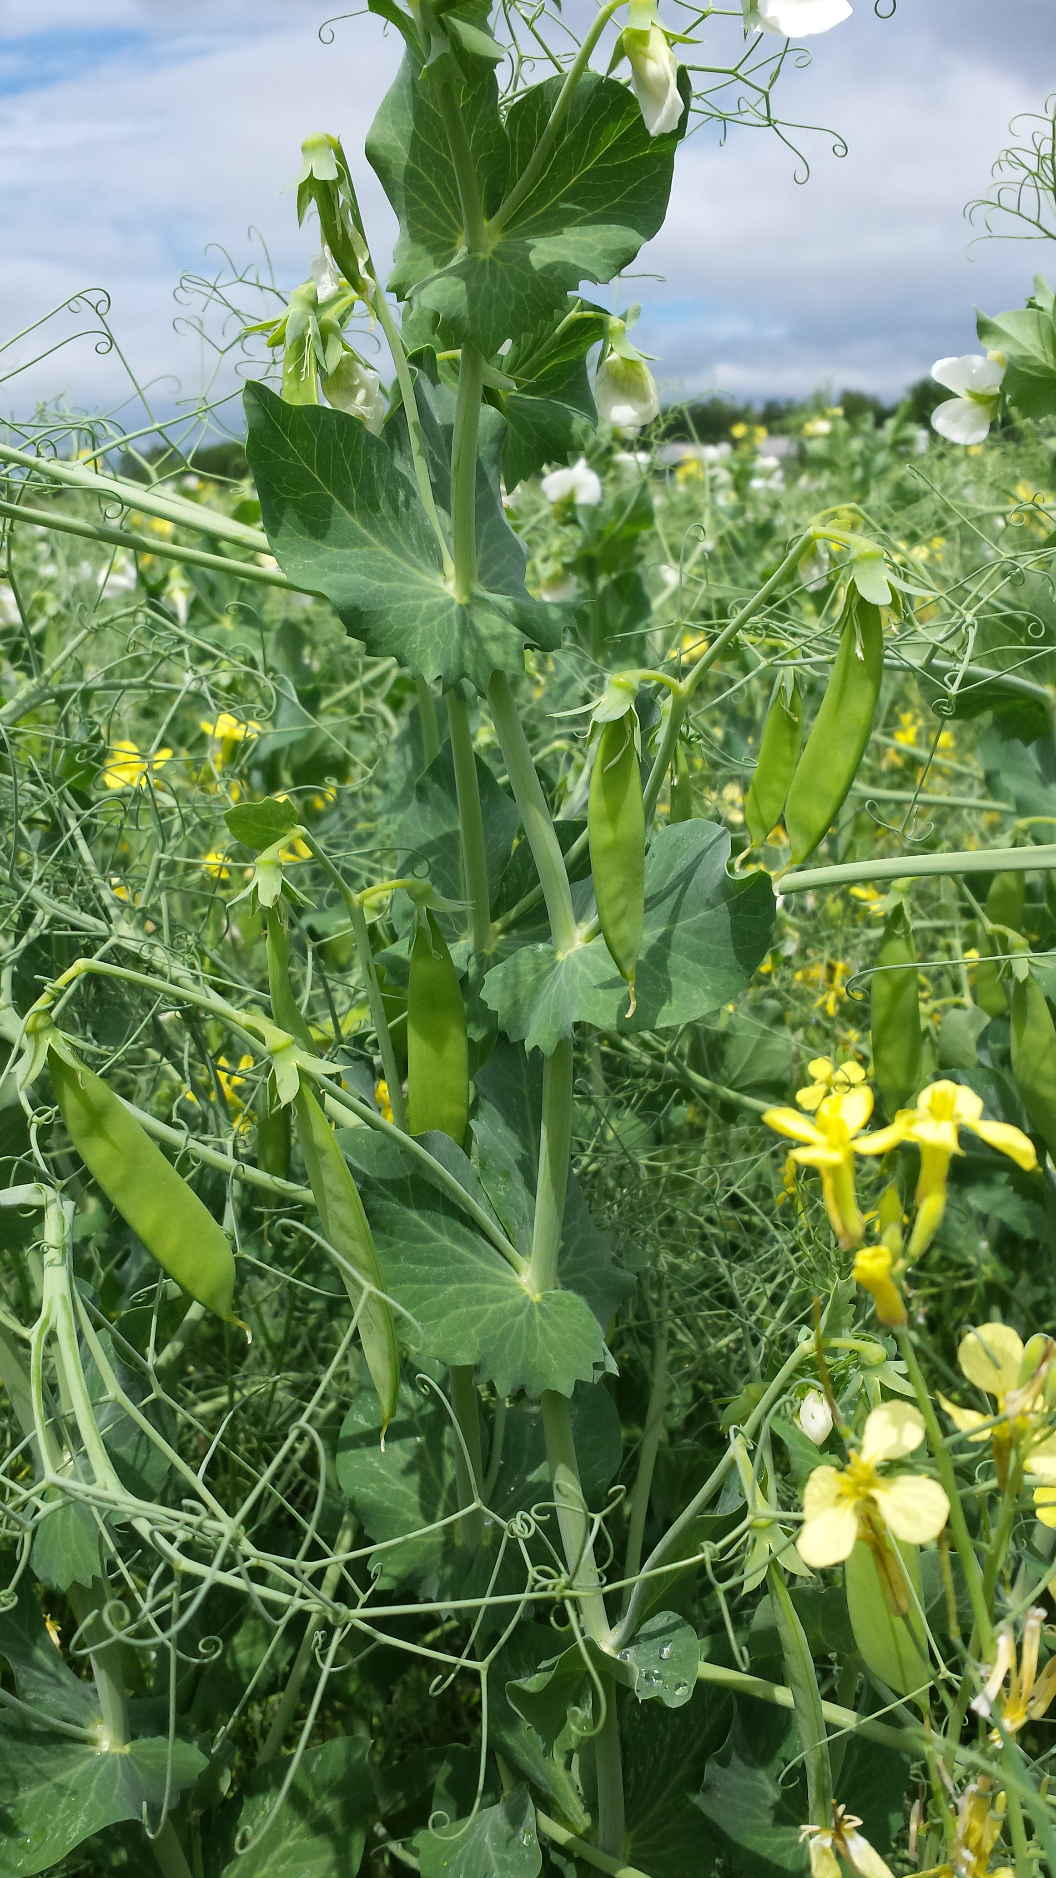
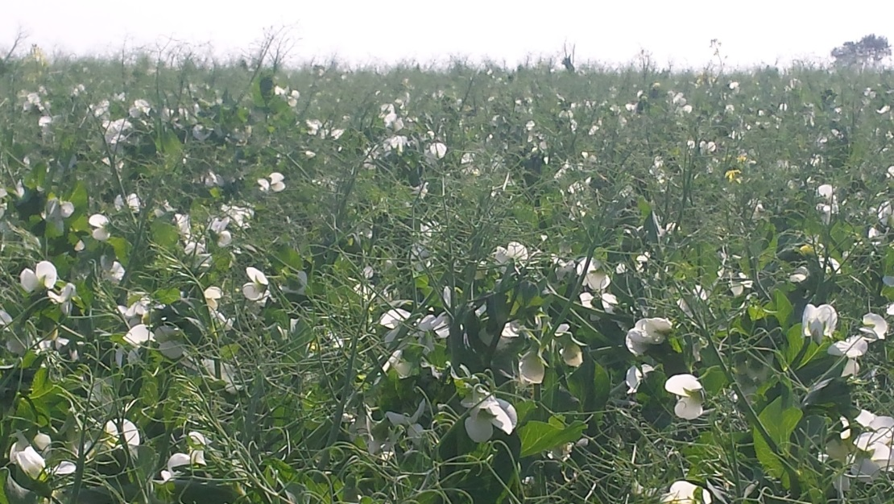
FLOWERING
July 08 (54 DAP) - July 18 (64 DAP)
July 10
July 10
July 15

Slide 15
July 25 Field Notes
 | July 25, 2015
Variety | Height¹ | Disease² | Weeds³
AC Agassiz | 36 | 0 | 3
Jetset | 42 | 0 | 3
SW Midas | 34 | 0 | 3
Nette 2010 | 31 | 0 | 3
¹Height measured in inches
²Disease scale (0-9) 0 = none noted, 9 = severe
³Weed Pressure scale (0-9) 0 = slight, 9 = severe

Slide 16
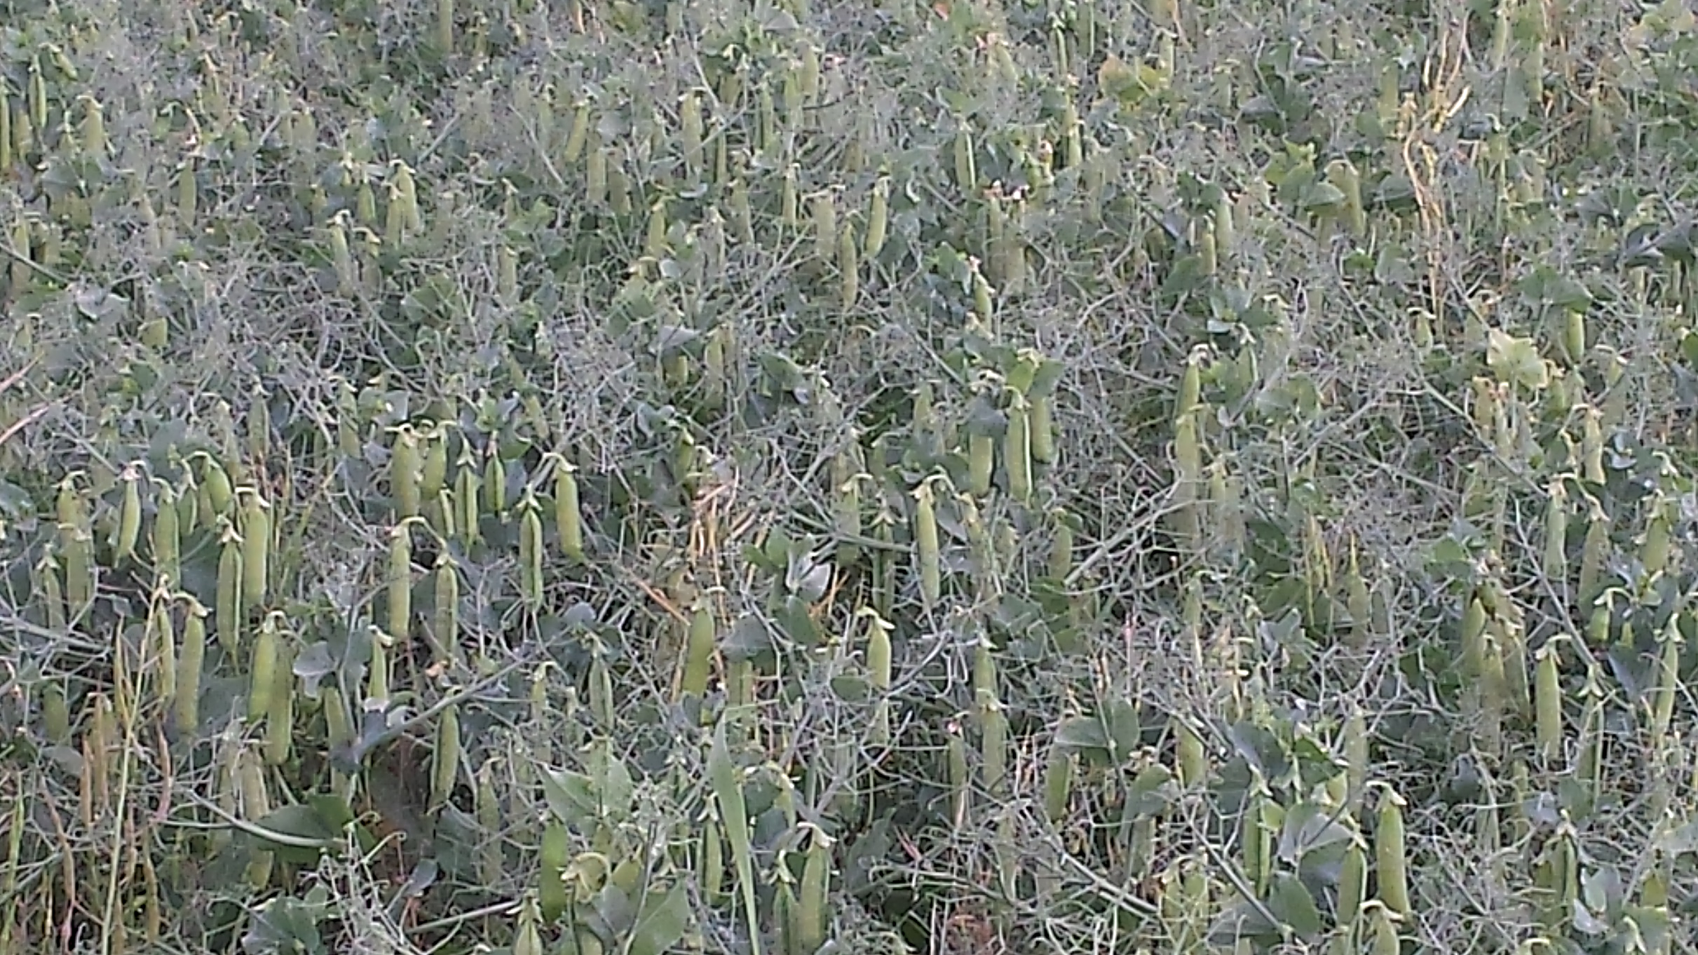
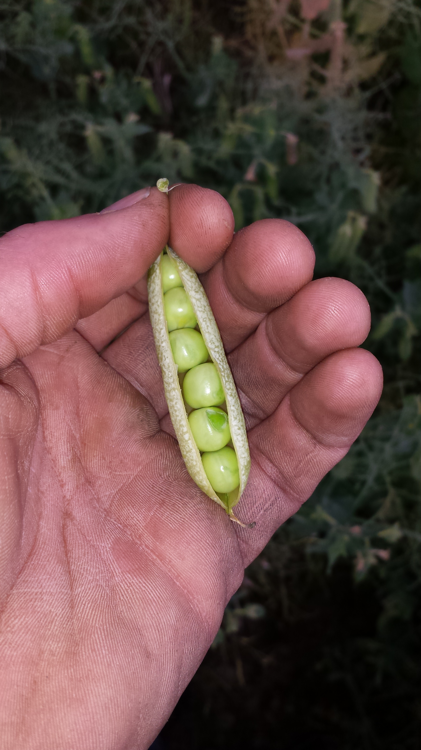
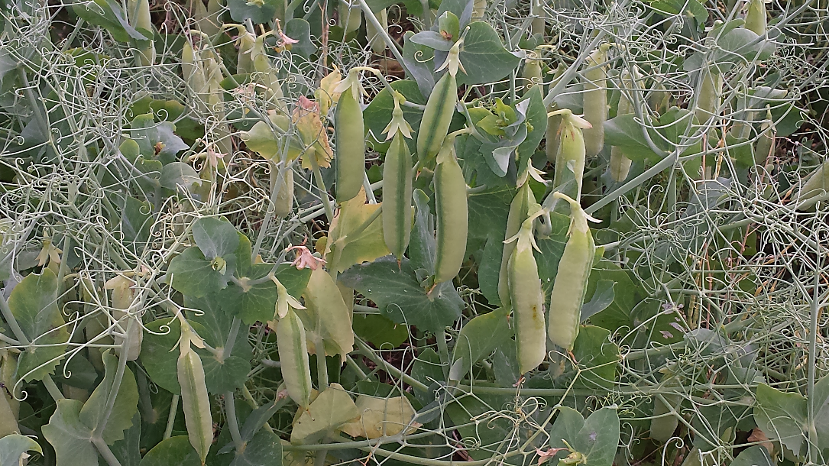
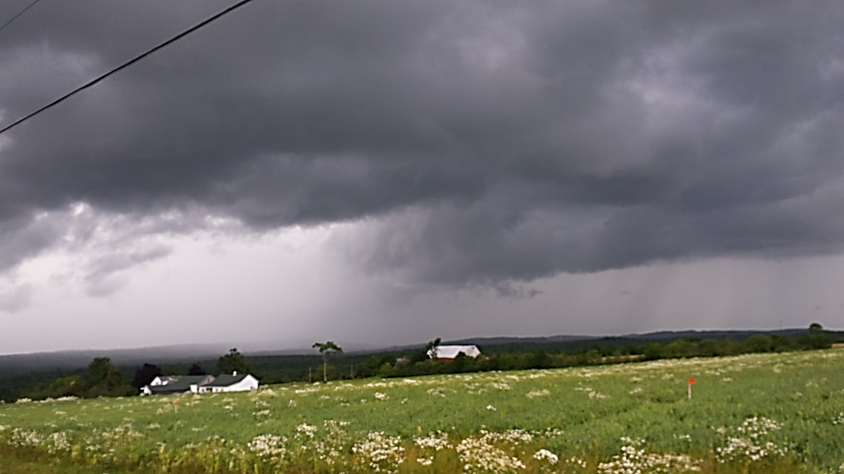
August 01

Slide 17
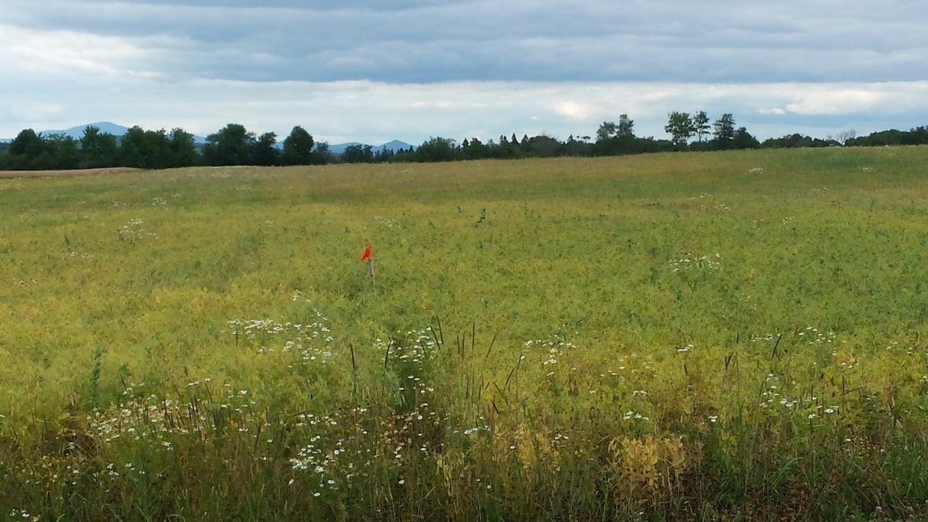
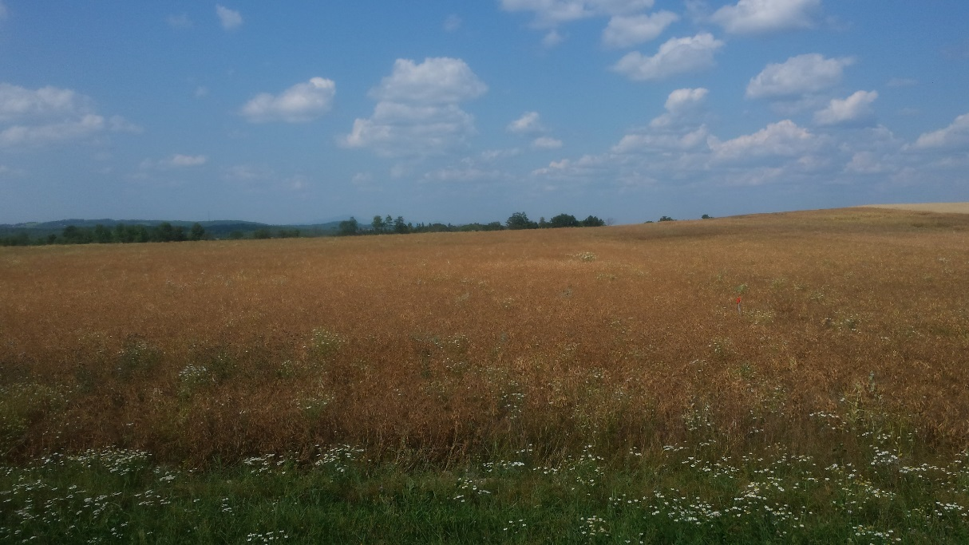
Drying down…
August 09
August 19

Slide 18
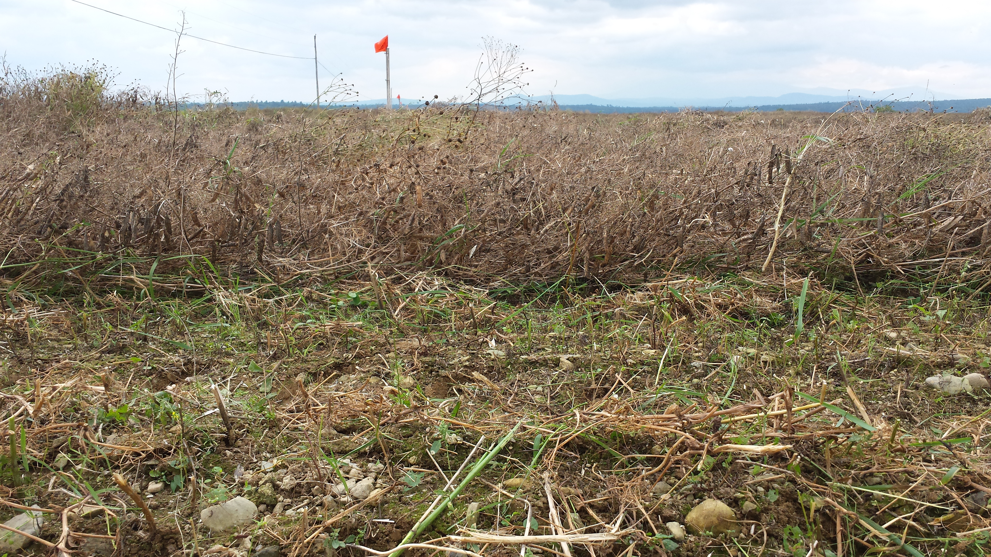
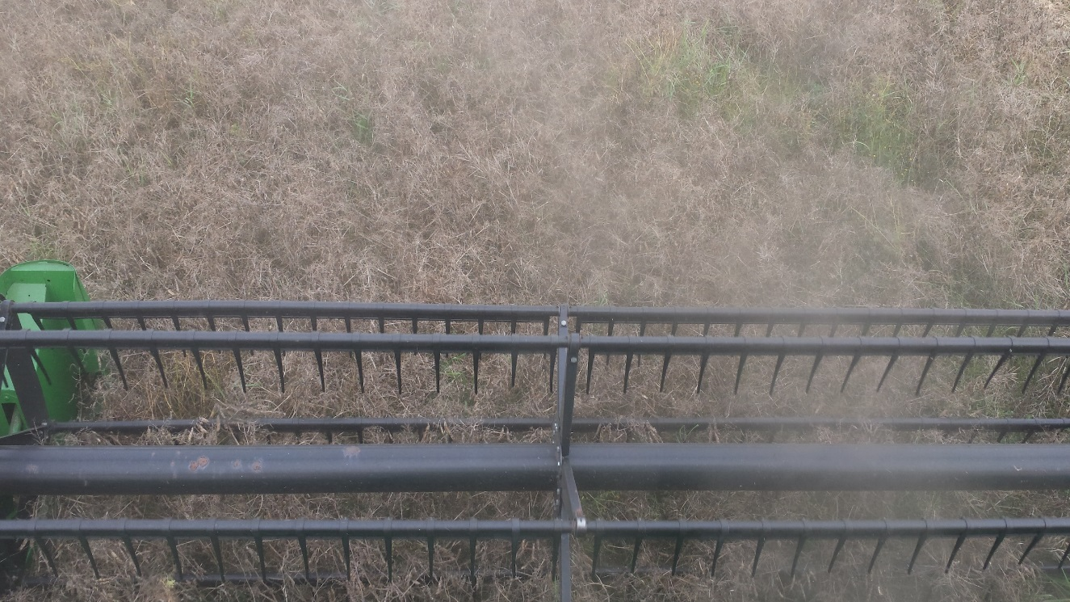
Harvest
Lodged
Lodged 08/27 – wind and rain
Ground speed 1.5 mph
Vines very brittle
Shatter loss ≈ 5-7% (est.)
Upright

Slide 19
240’
60’
Data Collection
2 - 20’W x 1293’L strips harvested from treatments
in Blocks B & C.
Harvested area per treatment = 1.187 Acres
Methods
Harvested section of Block A to “prime the combine”
Used Massload™ portable weighpads
Recorded empty truck weight
Recorded weight of truck + treatment
Recorded moisture with Dickey-john M3G™
1293’
NOT USED FOR DATA
BLOCK A
BLOCK B
BLOCK C

Slide 20
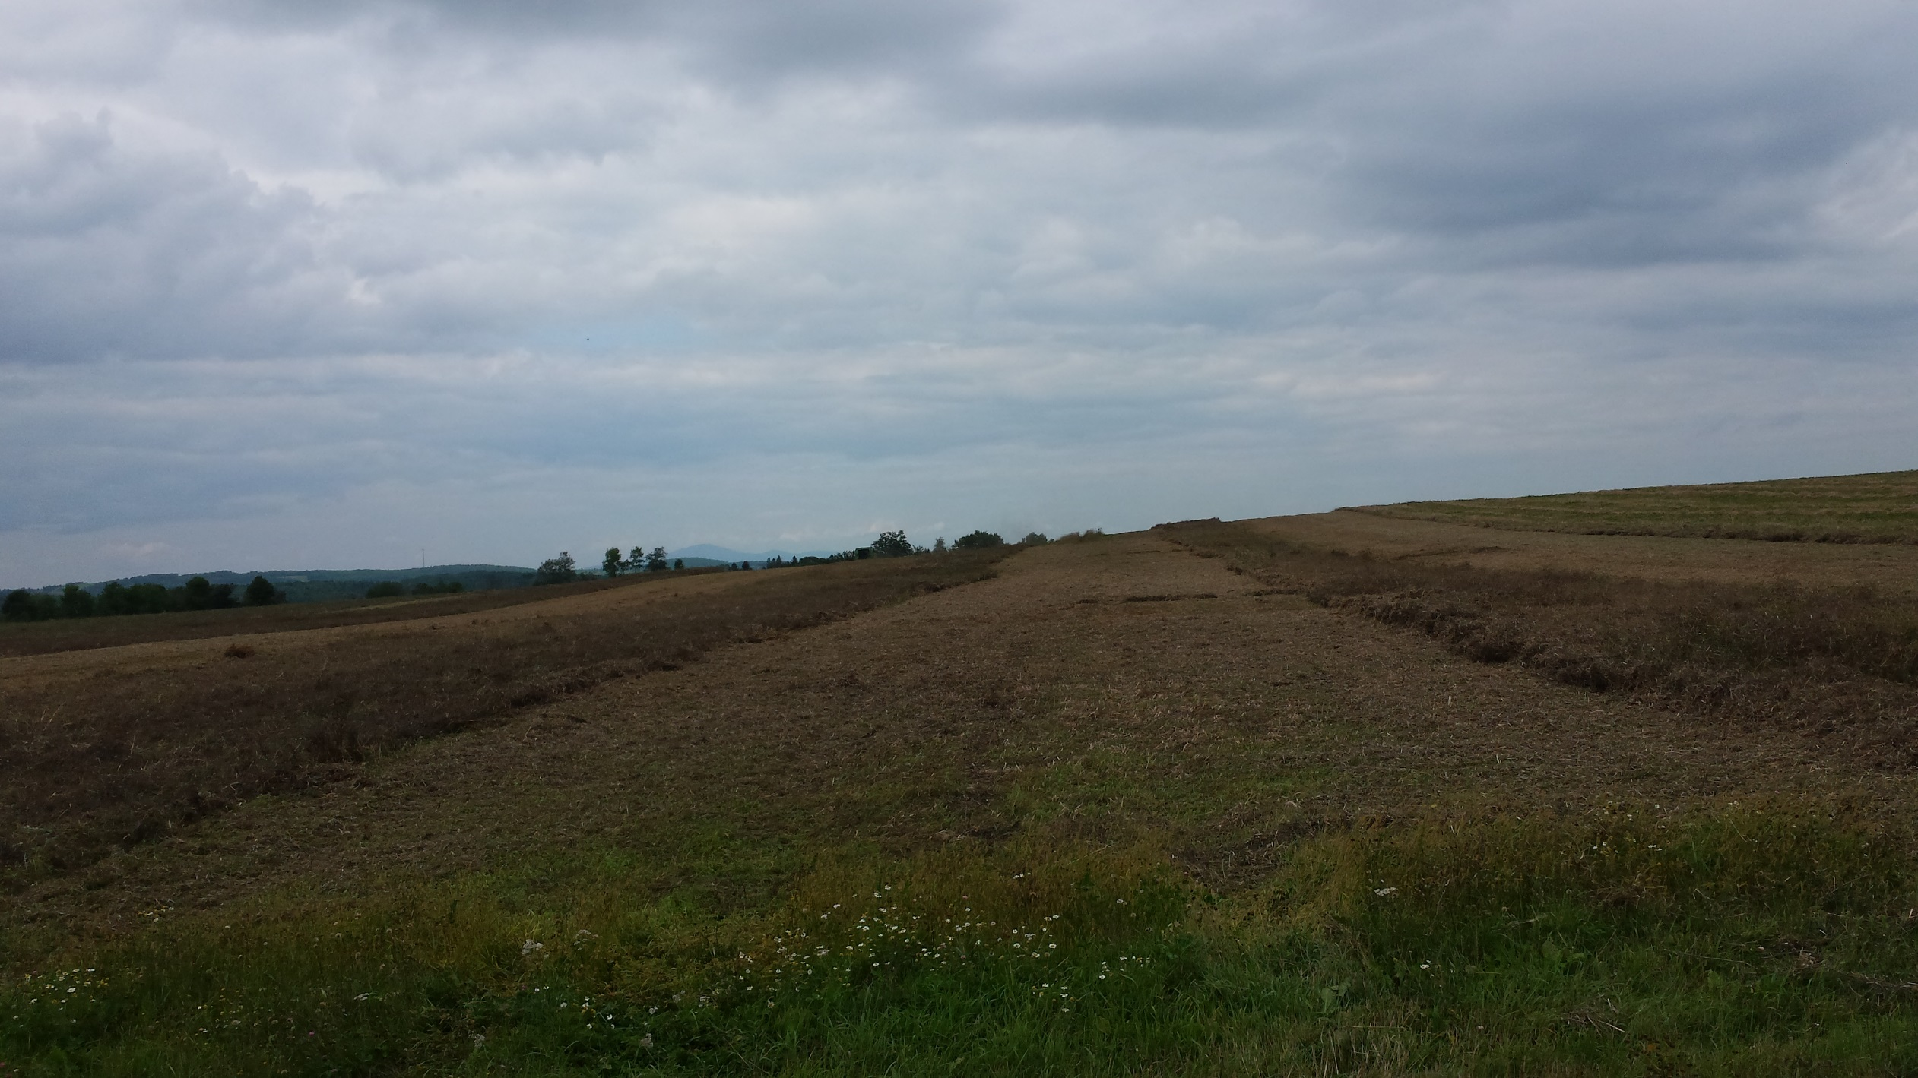
Harvest Strips

Slide 21
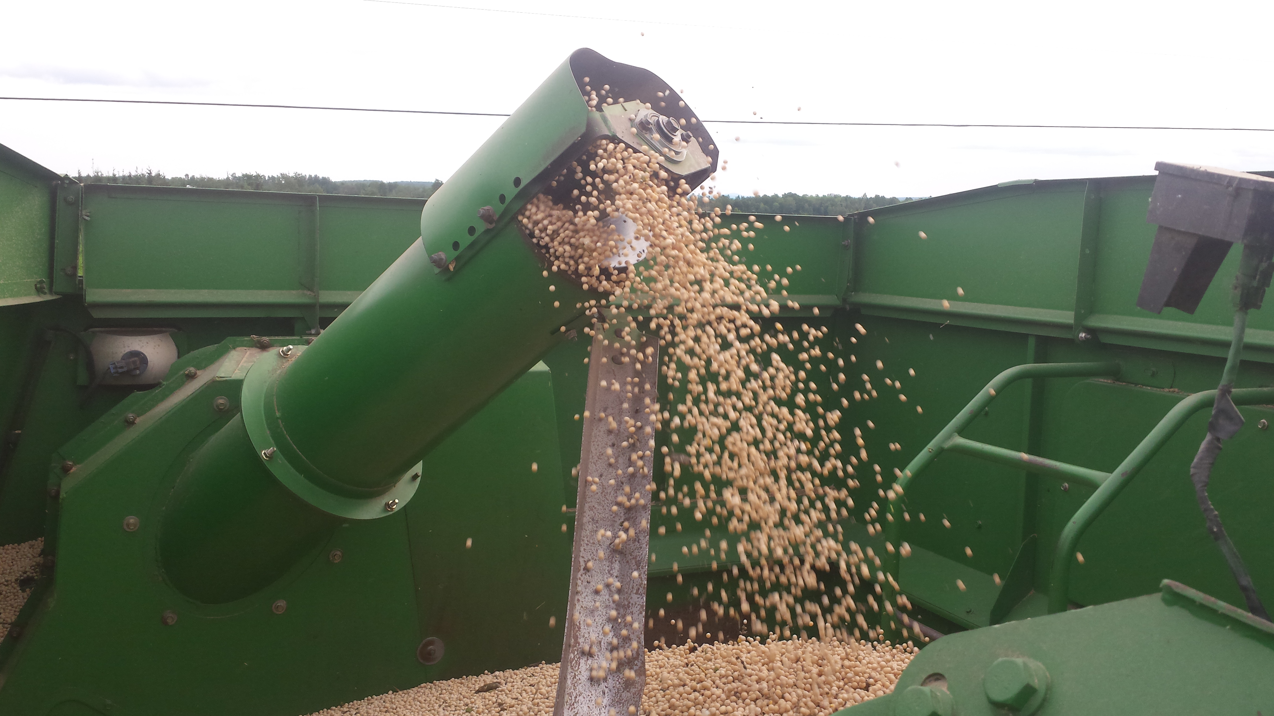
Yield Data
Variety | Harvest Moisture % | Yield (#/A) | Yield @ 14% | Bushels/A
AC Agassiz | 15.9 | 3151 | 3081 | 51.4
Jetset | 13.9 | 4078 | 4082 | 68.0
SW Midas | 15.7 | 3791 | 3716 | 61.9
Nette 2010 | 14.1 | 4094 | 4090 | 68.2
AVE
14.9
3779
3742
62.4

Slide 22
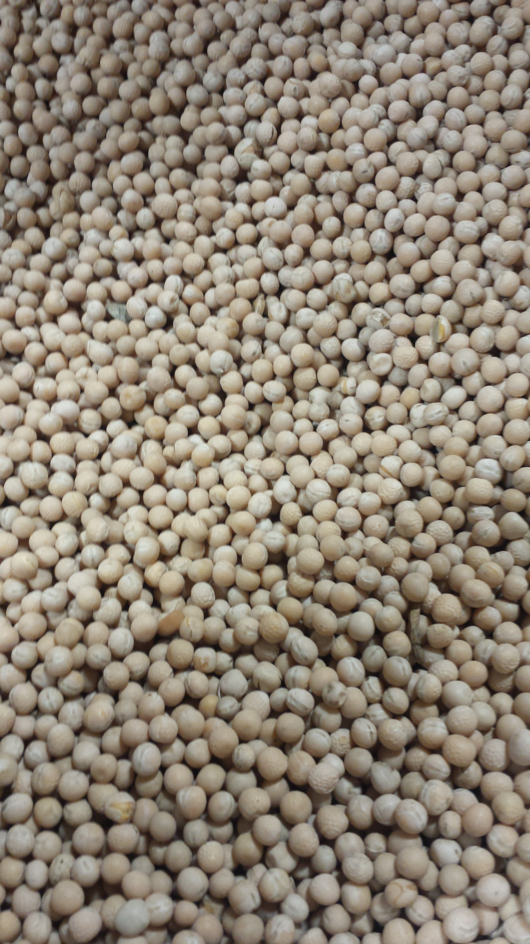
Feed Analysis
 | % CP | % NFC | % TDN | % ADF | % NDF
PEAS | 23.9 | 60.2 | 79.8 | 6.9 | 10.5
BARLEY | 12.9 | 46.9 | 78 | 16.3 | 29.3
G. CORN | 9.8 | 75.1 | 90 | 3.3 | 10.8
SBM | 48 | 29.4 | 78 | 5.3 | 7.1
Total Protein
Starch, sugar, pectin
Highly digestible energy
High NFC = High carb digestibility
High NDF = lower intake potential
Estimate of energy content
High TDN = high energy density
High ADF = lower digestibility

Slide 23
Conclusion….. Success!
Field peas can be grown successfully in Maine as a monocrop
High yields - similar to small plot research results
Low input costs if pH and nutrients are adequate in soil
Fall crop can be planted post-harvest
2015 provided excellent growing conditions for peas
    May - warm soil w/sufficient moisture = rapid germ and emergence & timely cultivation
    June - cool weather = vegetative growth and canopy closure = reduced weed pressure
    July/August - sufficient rain to maintain yield potential but not excessive as to favor disease
    August - Dry conditions favorable for harvesting
CAUTIOUSLY OPTIMISTIC OF LONG TERM SUCCESS

Slide 24
Management Tips
Use clean disease free seed with high germination %
Determine seeding rate based on population – Need to know SPP and % Germ.
Use 2 – 3 times the recommended rate of inoculant
Plant into warm moist soil to encourage rapid germination and emergence
Avoid poorly drained fields
Select fields with low weed pressure and use stale seedbed for pre-plant weed control
Use soil sampling to scout for white mold sclerotia
Harvest as early as possible (16-18%) in attempt to avoid lodging and excess shatter
Be prepared – nearly identical growing season as spring cereals – harvest windows are narrow

Slide 25
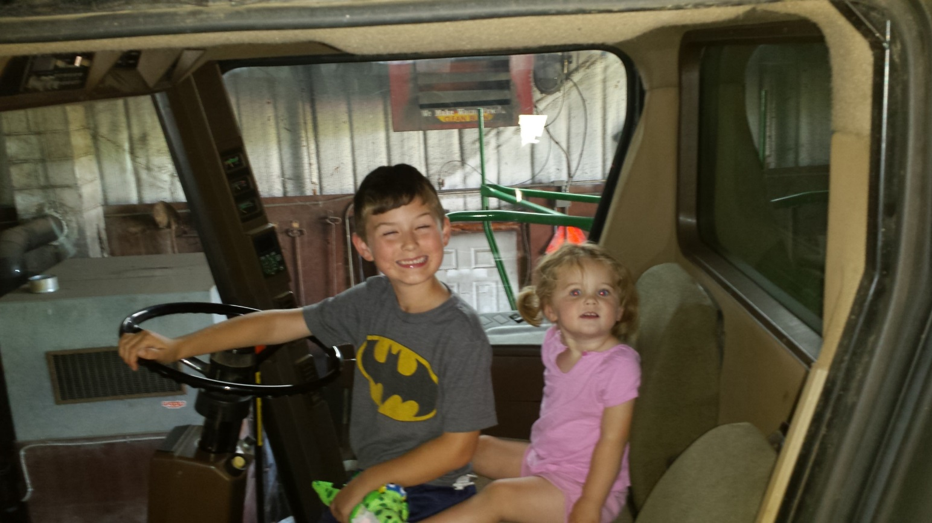
THANK YOU!
Northeast SARE
Tom Molloy – University of Maine
Ellen Mallory – University of Maine
Andrew Plant – University of Maine
Jay Hao – University of Maine
Brad Hertel – Meridian Seeds
Byron Lannoye – Pulse USA
Leo Vojta – Glenham, SD
Mark Stiegelmeier – Selby, SD

