Slide 1
Economic Viability of Shared-use Kitchens
Purdue University, Agricultural Economics Department
Tomoko Hiramatsu
Dr. Maria I. Marshall
Notes:
Hello, Thank you for watching the video clip about the Economic Viability of Shared-Use kitchens.
I’m Tomoko Hiramatsu, a graduate research assistant at Purdue University Agricultural Economics department.

Slide 2
Economic Viability of Shared-Use Kitchens
Members : Jodee Ellett, Dr. Maria Marshall, Dr. Rhonda Phillips, Tanya Hall, Tomoko Hiramatsu
Funded by SARE (supported by USDA) for two years from 2015
Goals
To increase knowledge about shared-use kitchen models to help local growers increase their profitability by using kitchens effectively
To investigate the economic opportunities behind shared-use kitchens
Tasks
Literature Review
List of Shared-Use kitchens (via internet, telephone, networks)
Develop Survey Questionnaires, Distribute Survey through Qualtrics
Collect Data and Conduct Analysis
Kitchen Tour
Notes:
In this video, I will talk about our shared-use kitchen project and the survey outcomes we found.
Five members including me participated in this project, and it was funded by Sustainable Agriculture Research and Education from 2015.
The goals of this project are, first, to increase knowledge about the shared-use kitchen models to help local growers increase their profitability by using kitchens effectively, and second, To investigate the economic opportunities behind shared-use kitchens.
In order to achieve these goals, the project worked on the following tasks.
literature review, made a contact list of shared-use kitchens, developed survey questionnaires and distributing it through Qualtrics, and collected data, and done Analysis.
Also, the project hosted 3 kitchen tours in 2017.

Slide 3
Literature Review
Growth in local food systems in the US (Martinez 2010)
-> Result of environmental, community food-security, and slow food movement
-> Help rebuild the regional economy (Fisher 2013)
Barriers exist to local food-market entry and expansion(Martinez 2010)
-> Capacity constraints, lack of distribution systems, limited research
Selling value-added products by using commercial kitchens become more and more important (Alonso & O’Neill 2011)
-> One type of kitchen : Shared-use kitchen
Notes:
Now in this section, I am going to talk about the result of literature reviews.
According to a USDA report by Martinez in 2010, there is a growth in local food systems in the US, as the result of several movement such environmental movement, community food-security movement and slow-food movement.
According to Fisher, these movement help rebuilds the regional economy.
However, researchers claim that there are barriers to local food-market entry and expansion.
The barriers are such as capacity constraints, lack of distribution systems and limited research on this area.
According to Alonso & Oneil, one way to enter this local food market is through selling value-added products processed at commercial kitchens.
One type of kitchen is called “shared-use kitchens”.

Slide 4
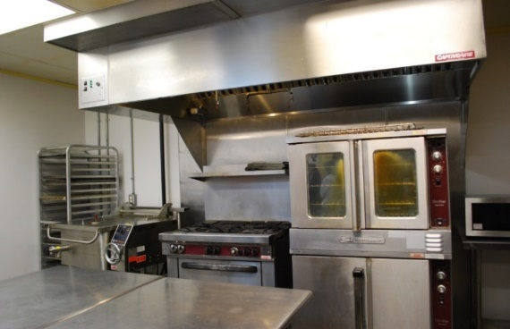
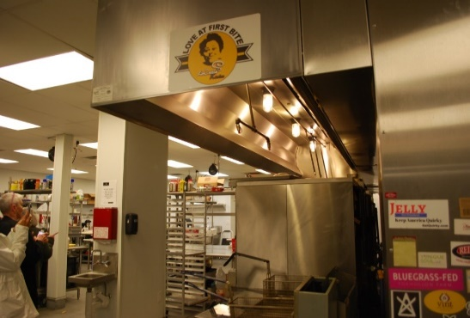
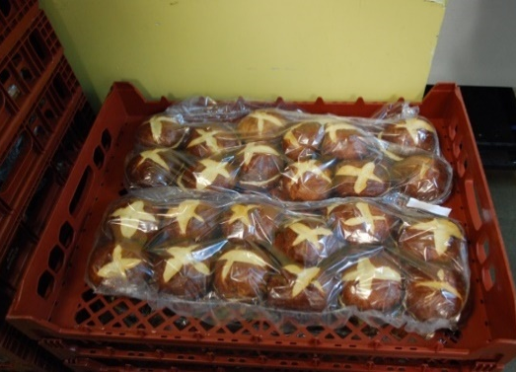
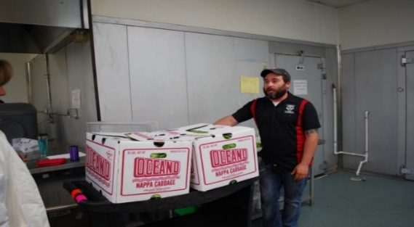
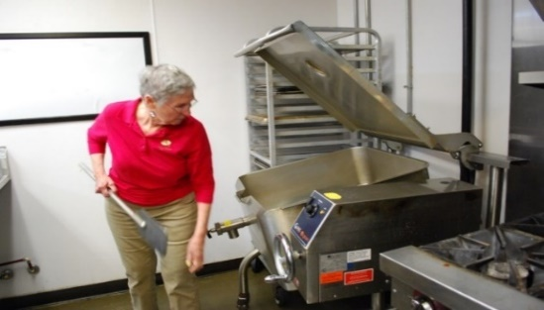
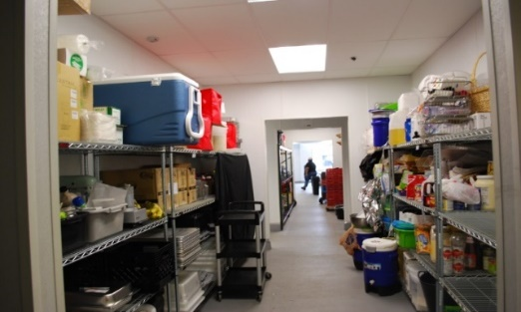
Shared-Use Kitchen
A commercial kitchen facility that farms, food businesses and community organizations can prepare and process their food products for consumer market. Generally rented by the hour (Leopold Center for Sustainable Agriculture 2014)
+ Merits to users : access to a licensed facility with minimal investment compared to the cost of opening a self-owned commercial kitchen.
+ Merits to community : help low-income, minority and immigrants by giving job opportunities and training (Econsult Solutions 2013)
Notes:
Shared-Use kitchen is a commercial kitchen facility that farms, food businesses and community organizations can prepare and process their food products for consumer market. Generally it is rented by the hour.
There are merits for using this shared-use kitchens. Users can access to a licensed facility with minimal investment compared to the cost of opening a self-owned commercial kitchen.
Also, there are merits to community as well : This kitchen help low-income, minority group and immigrants by giving job opportunities and training.

Slide 5
Challenges associated with the Shared-Use Kitchen
Hard to achieve scale economies, business service and other sources are often insufficient, sources of information and ideas could be limited (Lyons 2002, Alonso & O’Neill 2011).
Unstable because it rises and falls on the success of clients (Econsult Solutions 2013).
Overall, there are lack of quantitative information about the business.
→ We decided to collect data on shared-use kitchen.
Notes:
However, we also found some challenges that Kitchens are facing.
Some researchers say, it is difficult to achieve scale economies, and their business service and other sources are often insufficient, and sources of information and ideas could be limited.
In addition, their business performance is unstable because it rises and falls on the success of their clients.
Overall, there are lack of quantitative information about the business.
-> So for this reason, we decided to collect data on shared-use kitchen.

Slide 6
Survey for Shared-Use Kitchen
Target : Owners/Managers of Kitchens in the US
Questionnaire
Phase 1 : 48 Questions (15 minutes) : Business Characteristics, Respondents’ Demographics, Business Performance and Clients’ Information
Phase 2 : 9 Questions (25 minutes) : Economic impacts to Local Economy
Sample size
Sent out to 326 potential kitchens + extension networks
Obtained 92 responses in total
69 responses for Phase 1 (23 were not qualified)
*Small sample size issue was consistent with other national surveys (Econsult Solutions 2013, 2016)
Notes:
Now, I am going to explain about the Survey we developed.
The targets of our survey is the owners/managers of kitchens in the US.
Phase 1 : 48 Questions (15 minutes) : Business Characteristics, Respondents’ Demographics, Business Performance and Clients’ Information
Phase 2 : 9 Questions (25 minutes) : Economic impacts to Local Economy
We sent out to 326 potential kitchens and through extension networks, and obtained 92 responses.
However, 23 of them were not qualified as they were either not owner/managers.
You may think this is a small sample size, but it was consistent with other national surveys conducted by Econsult Solutions in 2013 and 2016.
In this video, I am going to talk about the result of Phase 1, which focused on the features of the business, owners/managers and their clients.

Slide 7
Result of Descriptive Statistics
Notes:
First, we asked about the definition of their organization. 32% of them answered that they are shared-use kitchens, whereas38% of them answered they are kitchen incubators.
In the Literature, we found that there are no clear definition about the categories, and often Shared-use kitchen and kitchen incubator are used interchangeably.

Slide 8
Descriptive Statistics
Notes:
We also asked the job title of respondents. 28% of them were owners and 48 % were managers, whereas 25 % of them said they have both roles.

Slide 9
Descriptive Statistics
Notes:
Here is the chart for legal structure of kitchens.
48% of them answered they are non-profit. 26% of them were Limited Liability Companies.

Slide 10
Descriptive Statistics
Notes:
In addition, we asked about the primary purpose of their business. Profit-oriented means that the primary objective of their business is to make profit.
On the other hand, community-oriented means that their primary objective is for community development. in the survey, we found that 30% answered they are profit oriented, and 60% of them said were community oriented.

Slide 11
Descriptive Statistics
Notes:
Next, this result is showing how many years the owners/managers worked in food industry. Almost 20% of the respondents had les than 5 years of experience. Interestingly, it was evenly scattered from less than 5 years to over thirty years.

Slide 12
Descriptive Statistics
Notes:
We also asked when the kitchen was established. The Majority of the kitchens, (76%) of them were established after 2009. This was consistent with some literature which pointed out that this local food movement is the result of food-price crisis in 2008.

Slide 13
Descriptive Statistics
Notes:
In addition, we asked where they get information from.
Small business development centers where the most frequently used source.
In addition, about half of the respondents used university and university extension service as their information source.

Slide 14
Descriptive Statistics
Notes:
A chart to the left shows the perception about their kitchen equipment: Whether they have basic, specialized or highly specialized equipment. (The definition of the basic, specialized, highly specialized is from list of equipment that ACEnet ohio’s kitchen had on their website. )
52% of them answered they have basic equipment whereas 42% of them had specialized one.
A chart to the right shows whether the kitchen business is the main source of income for the respondents.

Slide 15
Descriptive Statistics
Notes:
In addition, we asked how many clients do kitchens have.
18 kitchens said they had less than 20 clients, whereas 12 kitchens said they had between 40 – 60 clients.

Slide 16
Descriptive Statistics
Notes:
In addition, we asked what kind of technical assistance kitchens do provide for clients.
65% of them supported their clients by helping with licenses/certifications.
Almost 57% of them provided business counseling and food safety regulation advices.

Slide 17
Descriptive Statistics
Notes:
How their clients sell their products. 82% of them answered through “direct to consumer” whereas 73% of the kichens answered their clients use intermediate and 63% of them use wholesale channels.
Direct to consumer : Selling directly to the person eating/cooking food.
Intermediated : Selling to a business that sells to the consumer, either prepared or not.
Wholesale : Selling to distributor or large retailer where your product is sold in multiple locations.
Other : internet aggregator

Slide 18
Descriptive Statistics
Notes:
We also asked the percentage of clients who are women or racial minorities.
More than 56% of the kitchens answered that the women/racial minorities consisted of more than half of their clients.

Slide 19
Descriptive Statistics
Notes:
We also asked how their funds were secured to start their kitchen businesses.
Government funding was the top source, that 38.6% of the kitchens used.

Slide 20
Descriptive Statistics
Notes:
This question asked the dependence on grant funding to run the core kitchen facility.
50% of them were not at all dependent, whereas the rest were dependent on the grant funding to some degree.

Slide 21
Descriptive Statistics
Notes:
Lastly, we asked how the kitchen owners/managers perceive their business success today. More than 77% of the respondents answered they are more than moderately successful.
40% moderately successful
30% very successful
7.14% extremely successful

Slide 22
T-test and Chi-square test
Variables | With Grant | Without Grant
 | Mean | Mean
Owner/manger's Perception of Success | 3.11 | 3.29 | t=0.7209, df=54
Average Total Revenue | 223,641.40 | 165,507.70 | t= -0.6333, df=49
Average Total Expense | 267,705.70 | 144,465.90 | t = -1.5310, df=49
Average Total Profit | -39,650.37 | 21,041.77 | t = 1.7396*, df=48
Percentage of Clients' profitability | 56.86 | 48.83 | t = -0.7581, df=37
Age | 45.30 | 46.96 | t =0.4748, df=50
 | Percent | Percent
Community-oriented goal | 0.76 | 0.43 | chi2(1)=6.4474**
Profit-oriented goal or both | 0.24 | 0.57
Not profitable last year | 0.59 | 0.30 | chi2(1)=4.7553**
Profitable last year | 0.41 | 0.70
Not Main Source of Income | 0.45 | 0.68 | chi2(1)= 3.0684*
Main Source of Income | 0.55 | 0.32
Male | 0.52 | 0.48 | chi2(1)=0.0745
Female | 0.48 | 0.52
Notes:
Since we had relatively small sample, we conducted T-test and chi-square test to see if there are statistically significant differences between certain groups. First, I grouped the kitchen by businesses with grant vs. without grant.
It turned out that kitchens with grant funding had lower average profit.
In addition, they tended to have community-oriented goal, tended to be not profitable last year, and the kitchen business tended to be their main source of income.

Slide 23
Variables | Main source of Income | Not main source of income
 | Mean | Mean
Owner/manger's Perception of Success | 3.46 | 3.00 |  | t = -1.8812*,df=54
Average Total Revenue | 296,554.80 | 122,219.50 |  | t = -1.9316*, df=49
Average Total Expense | 315,904.80 | 127,158.60 |  | t = -2.3821**, df=49
Average Total Profit | -12,817.5 | -4,939.096 |  | t = 0.2149, df=48
Percentage of Clients' Profitability | 52.14 | 53.57 |  | t = 0.1335, df=37
Age | 46.95 | 45.52 |  | t = -0.4023, df=50
 | Percent | Percent
Without Grant | 0.36 | 0.59 |  | chi2(1)=3.0684*
With Grant | 0.64 | 0.41
Community-oriented Goal | 0.60 | 0.59 |  | chi2(1) = 0.0023
Profit-oriented Goal or Both | 0.40 | 0.41
Not Profitable Last Year | 0.48 | 0.42 |  | chi2(1) = 0.2060
Profitable Last Year | 0.52 | 0.58
Male | 0.54 | 0.47 |  | chi2(1) = 0.3000
Female | 0.46 | 0.53
Notes:
In this table, I grouped the kitchens by whether the business is the main source of income or not.
For the group who answered their kitchen is the main source of income, owner/managers perception of success were higher. In addition, average revenue & expenses were also higher.
They tended to receive grant funding.

Slide 24
Variables | Community-oriented goal | Profit-oriented goal or both
 | Mean | Mean
Owner/manger's Perception of Success | 3.26 | 3.09 | t = 0.6850, df=54
Average Total Revenue | 186,752.80 | 204,364.30 | t = -0.1882, df=49
Average Total Expense | 192,020.80 | 224,805.70 | t = -0.3892, df=49
Average Total Profit | -3,335.29 | -15,223.2 | t = 0.3244, df=48
Percentage of Clients' Profitability | 52.06 | 54.10 | t = -0.1905, df=37
Age | 41.52 | 52.86 | t = -3.5484***, df=50
 | Percent | Percent
Without Grant | 0.35 | 0.70 | chi2(1) = 6.4474**
With Grant | 0.65 | 0.30
Not Profitable Last Year | 0.44 | 0.45 | chi2(1) = 0.0097
Profitable Last Year | 0.56 | 0.55
Not Main Source of Income | 0.56 | 0.57 | chi2(1) = 0.0023
Main Source of Income | 0.44 | 0.43
Male | 0.48 | 0.52 | chi2(1) = 0.0779
Female | 0.52 | 0.48
Notes:
In this table, I grouped the kitchens by businesses with community-oriented goal vs group with profit-oriented / both.
The average age of owners were lower, and they tended to receive grant.

Slide 25
Main Results of T- and Chi-Square tests
Kitchens with community oriented goals tended to..
receive grants, and have younger owner/managers.
Kitchens with grant funding tended to be..
less profitable, tended to have community-oriented goals for their business, and their business tended to be their main source of income.
Kitchens whose businesses were their main source of income tended to have..
higher perception of success, higher mean of annual revenue and expense, and tended to rely more on grant funding to operate their core kitchen businesses.
Notes:
Now, here are the main results from T-test and chi-square tests.
Kitchens with community oriented goals tended to receive grants, and the average age of owners/managers were younger.
Kitchens with grant funding tended to be..
less profitable, tended to have community-oriented goals for their business, and their business tended to be their main source of income.
Kitchens whose businesses were their main source of income tended to have..
higher perception of success, higher mean of annual revenue and expense, and tended to rely more on grant funding to operate their core kitchen businesses.
Although this results maybe capturing only part of the kitchen features because we only tested the association between only two factors.

Slide 26
Implications about Kitchens
Community-oriented Kitchens
More kitchens received grants (with 64.70%, without 35.29%)
Owners/Managers are younger
Clients are mainly farmers
Equipment: Basic (50%), Specialized/Highly specialized (50%)
Profit-Oriented Kitchens/Both goals
Less kitchens received grants (with 30.43%, without 69.56 %)
Clients are mainly Food businesses
Equipment: Basic (57.69%), Specialized/Highly specialized (42.30%)
Notes:
So.. what can we say about community-oriented /profit –oriented kitchens?
Here are some implications we found from the survey outcome.
More kitchens with Commnuity-oriented goals tended to receive grants. In fact, 65% of them were with grant) .
In addition, the Owners/Managers were younger.
The clients were mainly farmers.
Also, half of the kitchens had Basic level equipment, whereas the rest had Specialized/Highly specialized (50%).
On the other hand, for the group of kitchens with Profit-Oriented Kitchens/Both goals,
Less kitchens received grants. Only 30% of them were with grant.
Also, Clients are mainly Food businesses.
Compared to the community-oriented kitchens, more kitchens had Basic level equipment.
These are the findings we can share from our survey!

Slide 27
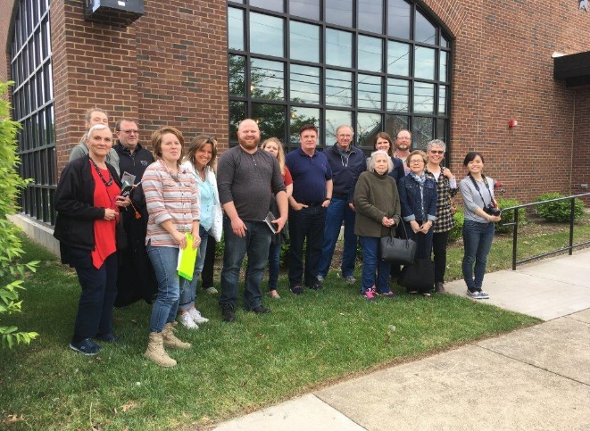
Thank you for watching!
For more information:
https://www.purdue.edu/dffs/localfood/sharedkitchen/
Kitchen Tour at Chef’s Space, Louisville, KY
Notes:
Thank you for watching! We hope this video will contribute as the first step to comprehend the complexity of Shared Use Kitchen Business.
For more information, please visit our project website at Purdue extension.

