Slide 1

Sustainable Irrigation Demonstration Project:
Demonstrating Irrigation Efficiency in California Wine Grapes through Advanced Practices and Technologies
Vineyard Team Tailgate
August 3, 2017
Zabala Vineyards
Notes:
We (we being Zabala Vineyards and our partners listed at the bottom of the slide) received a grant in 2015 from the USDA SARE Program
The program promotes Sustainable Agriculture through Research and Education
FDS, ITK Vintel, Verizon are technology partners
Vineyard team is our outreach partner
And Larry Bettiga from UC Cooperative Extension is our technical advisor

Slide 2
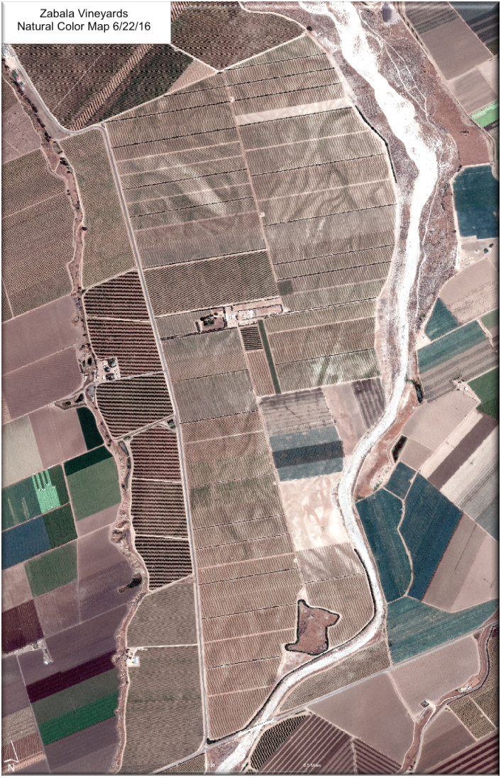
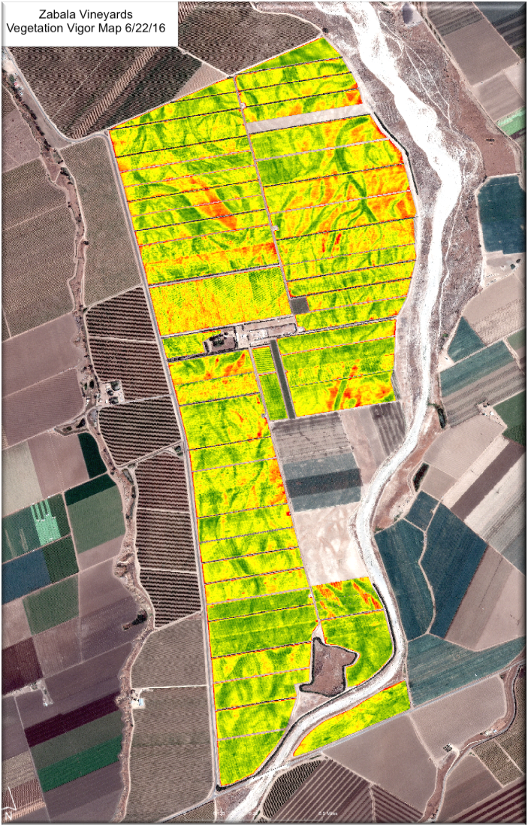
Notes:
A little bit about Zabala Vineyards
Established 1972
I started working here full time in 2015
Approx. 1100 acres in the Arroyo Seco AVA
Various stages of production, development, open/fallow and native
Varieties include Chardonnay, Pinot Noir, Sauvignon Blanc, Riesling, Syrah and soon to be
Grenache
Some 60 different irrigation units
Move to next slide

Slide 3
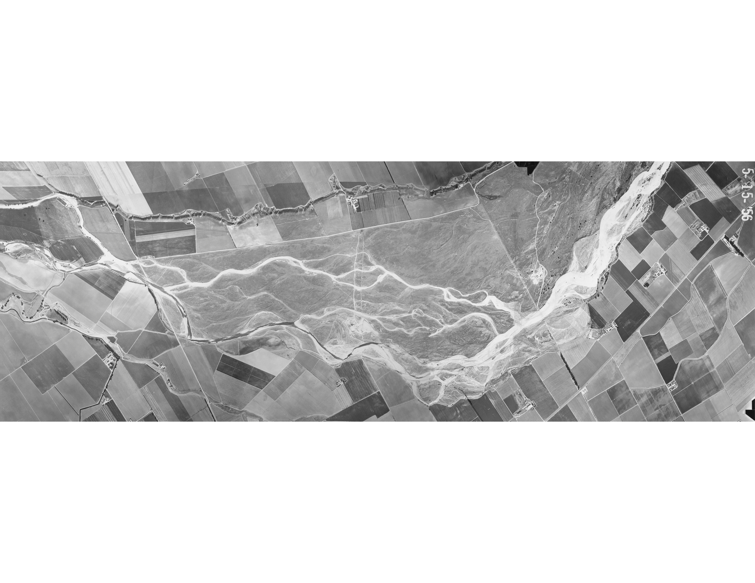
Notes:
Soils consist of varying degrees of sand and rocks ranging from less snad and rock to more sand and rock
This is because we are literally located in the Arroyo Seco River bed
This picture from 1956 shows the river flowing through the heart of what is now planted

Slide 4
Notes:
Result is inconsistent growth due to differences in water and nutrient availability
The 60 distinct irrigation blocks could be as many at 120 or 180 depending on the data analysis
Our current practices consist of applying water uniformly across the field based on average field requirements and the result is that some areas/vines receive perfect amount of water, some too little and others too much.
How do I make accurate irrigation decisions with such a high level of variability? Increase field uniformity? Increase water use efficiency? Cost effective? Timely?

Slide 5
Current Tools
Visual assessment
ET
PAW
LWP
Imagery
Solution = Modeling
Notes:
Primarily point solutions that give limited snapshot and do not represent reality in the vineyard

Slide 6
Project Overview
Demonstrating Irrigation Efficiency In California Wine Grapes Through Advanced Practices And Technologies
3 year project
Compare existing grower practice of ET-based irrigation scheduling with the use of a vineyard-specific irrigation model
Demonstrate the benefits of using a crop-specific model in vineyard management
Develop a blueprint for the implementation of such models
Notes:
And that gets us back to the SARE project

Slide 7
Current Grower Practice
Visual assessment
  Shoot tips
  Leaf/petiole angle
  Leaf color
  Soil moisture
ET
  CIMIS weather data
  Larry Williams’ degree day based Kc
Notes:
What is the current grower practice?
In our case it involves the following:
The aforementioned sand and rocks make make manual soil assessment rather challenging

Slide 8
Hardware: CIMIS Weather station
Notes:
Conveniently CIMIS Station 114 is located on the property

Slide 9
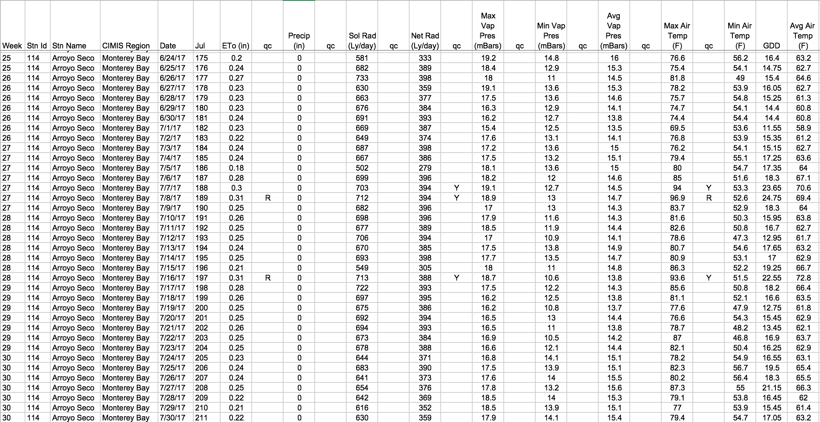
CIMIS Data
Notes:
Every Monday I receive an automated email from CIMIS which I copy to my excel spreadsheet
Important data is ET, Max temp, min temp (used to calculate GDD) and precipitation

Slide 10
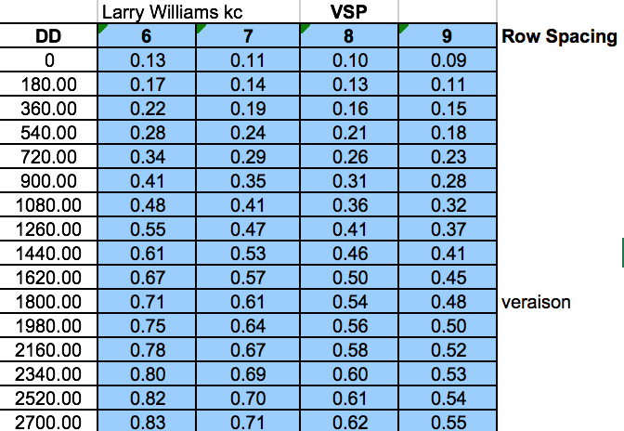
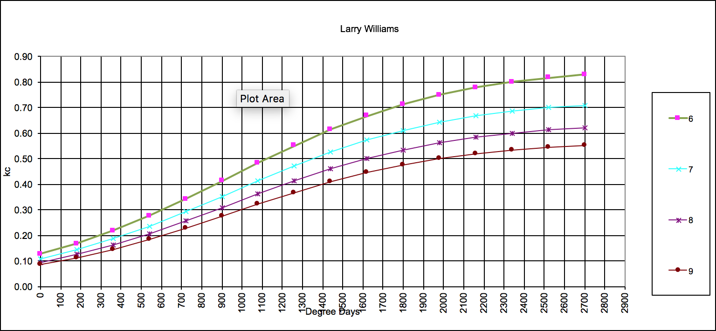
Kc from Larry Williams

Slide 11
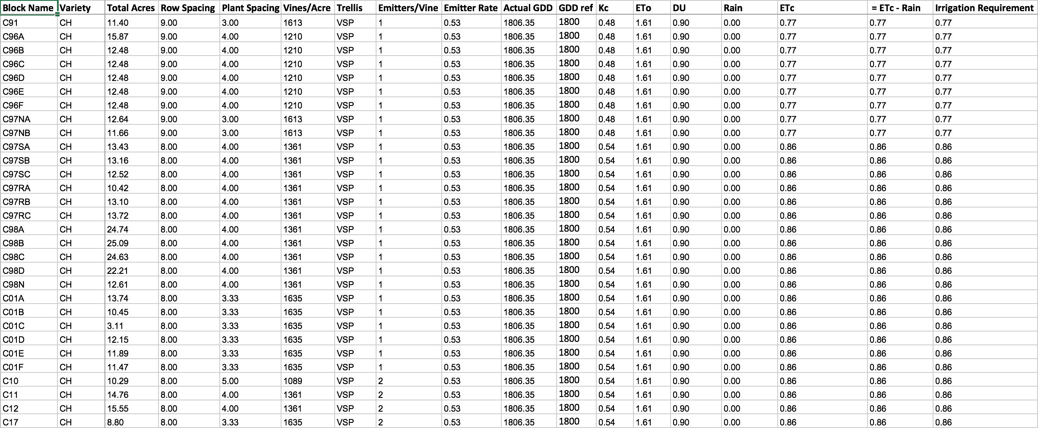
ETc Calculation

Slide 12
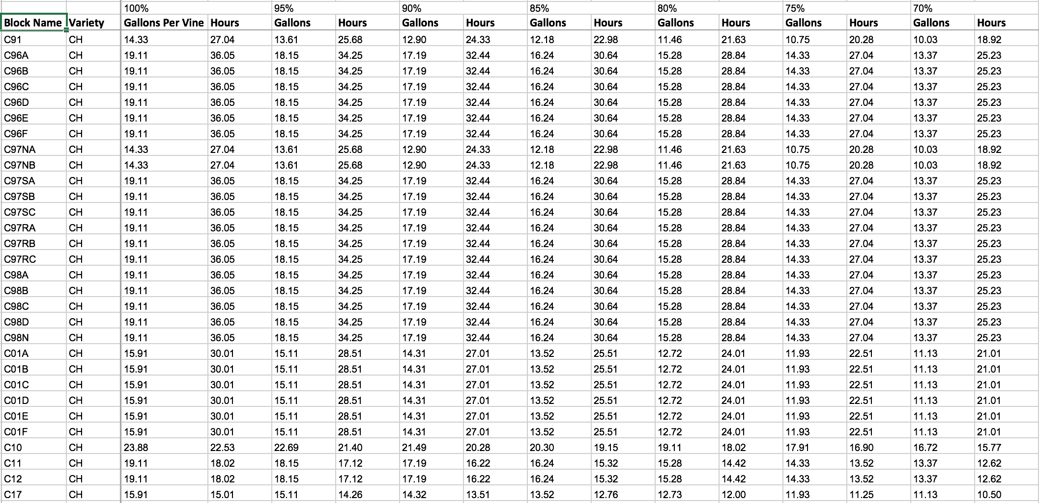
Irrigation amounts based on ETc
Notes:
Use this information
Use visual cues from plant
Use visual assessment of soil moisture
Talk to ranch supervisor and irrigator
Look at forecast for upcoming week
Make final determination on irrigation quantity
It is an educated guess BUT it is still a guess

Slide 13
Vineyard-Specific Irrigation Model
ITK Vintel™
  Marketed as Verizon AgTech Vineyard (VAV) in the US
Mechanistic model which computes plant water status as LWP and provides an irrigation recommendation based on target/desired plant water status
  Vineyard design
  Vine structure
  Soil structure
  Weather
  Irrigation data
  Grower defined parameters
    Growth stages
    Quality
    Stress
Notes:
And now a little bit about the model
A mechanistic model works off premise that each component of a complex system (in this case the system is movement of water through the soil-plant-atmosphere) can be modeled separately using the physical properties of each component. The model then describes the interactions of these components and how those interactions affect the entire system.
The benefits of such a model are:
the point solutions (ET, LWP, PAW, etc.) are now integrated giving a more complete picture of the system
does not require soil or physiological sensors/measurements reducing need for expensive hardware
The result is an irrigation recommendation based on the entire system (soil-plant-atmosphere) rather than an individual component.

Slide 14
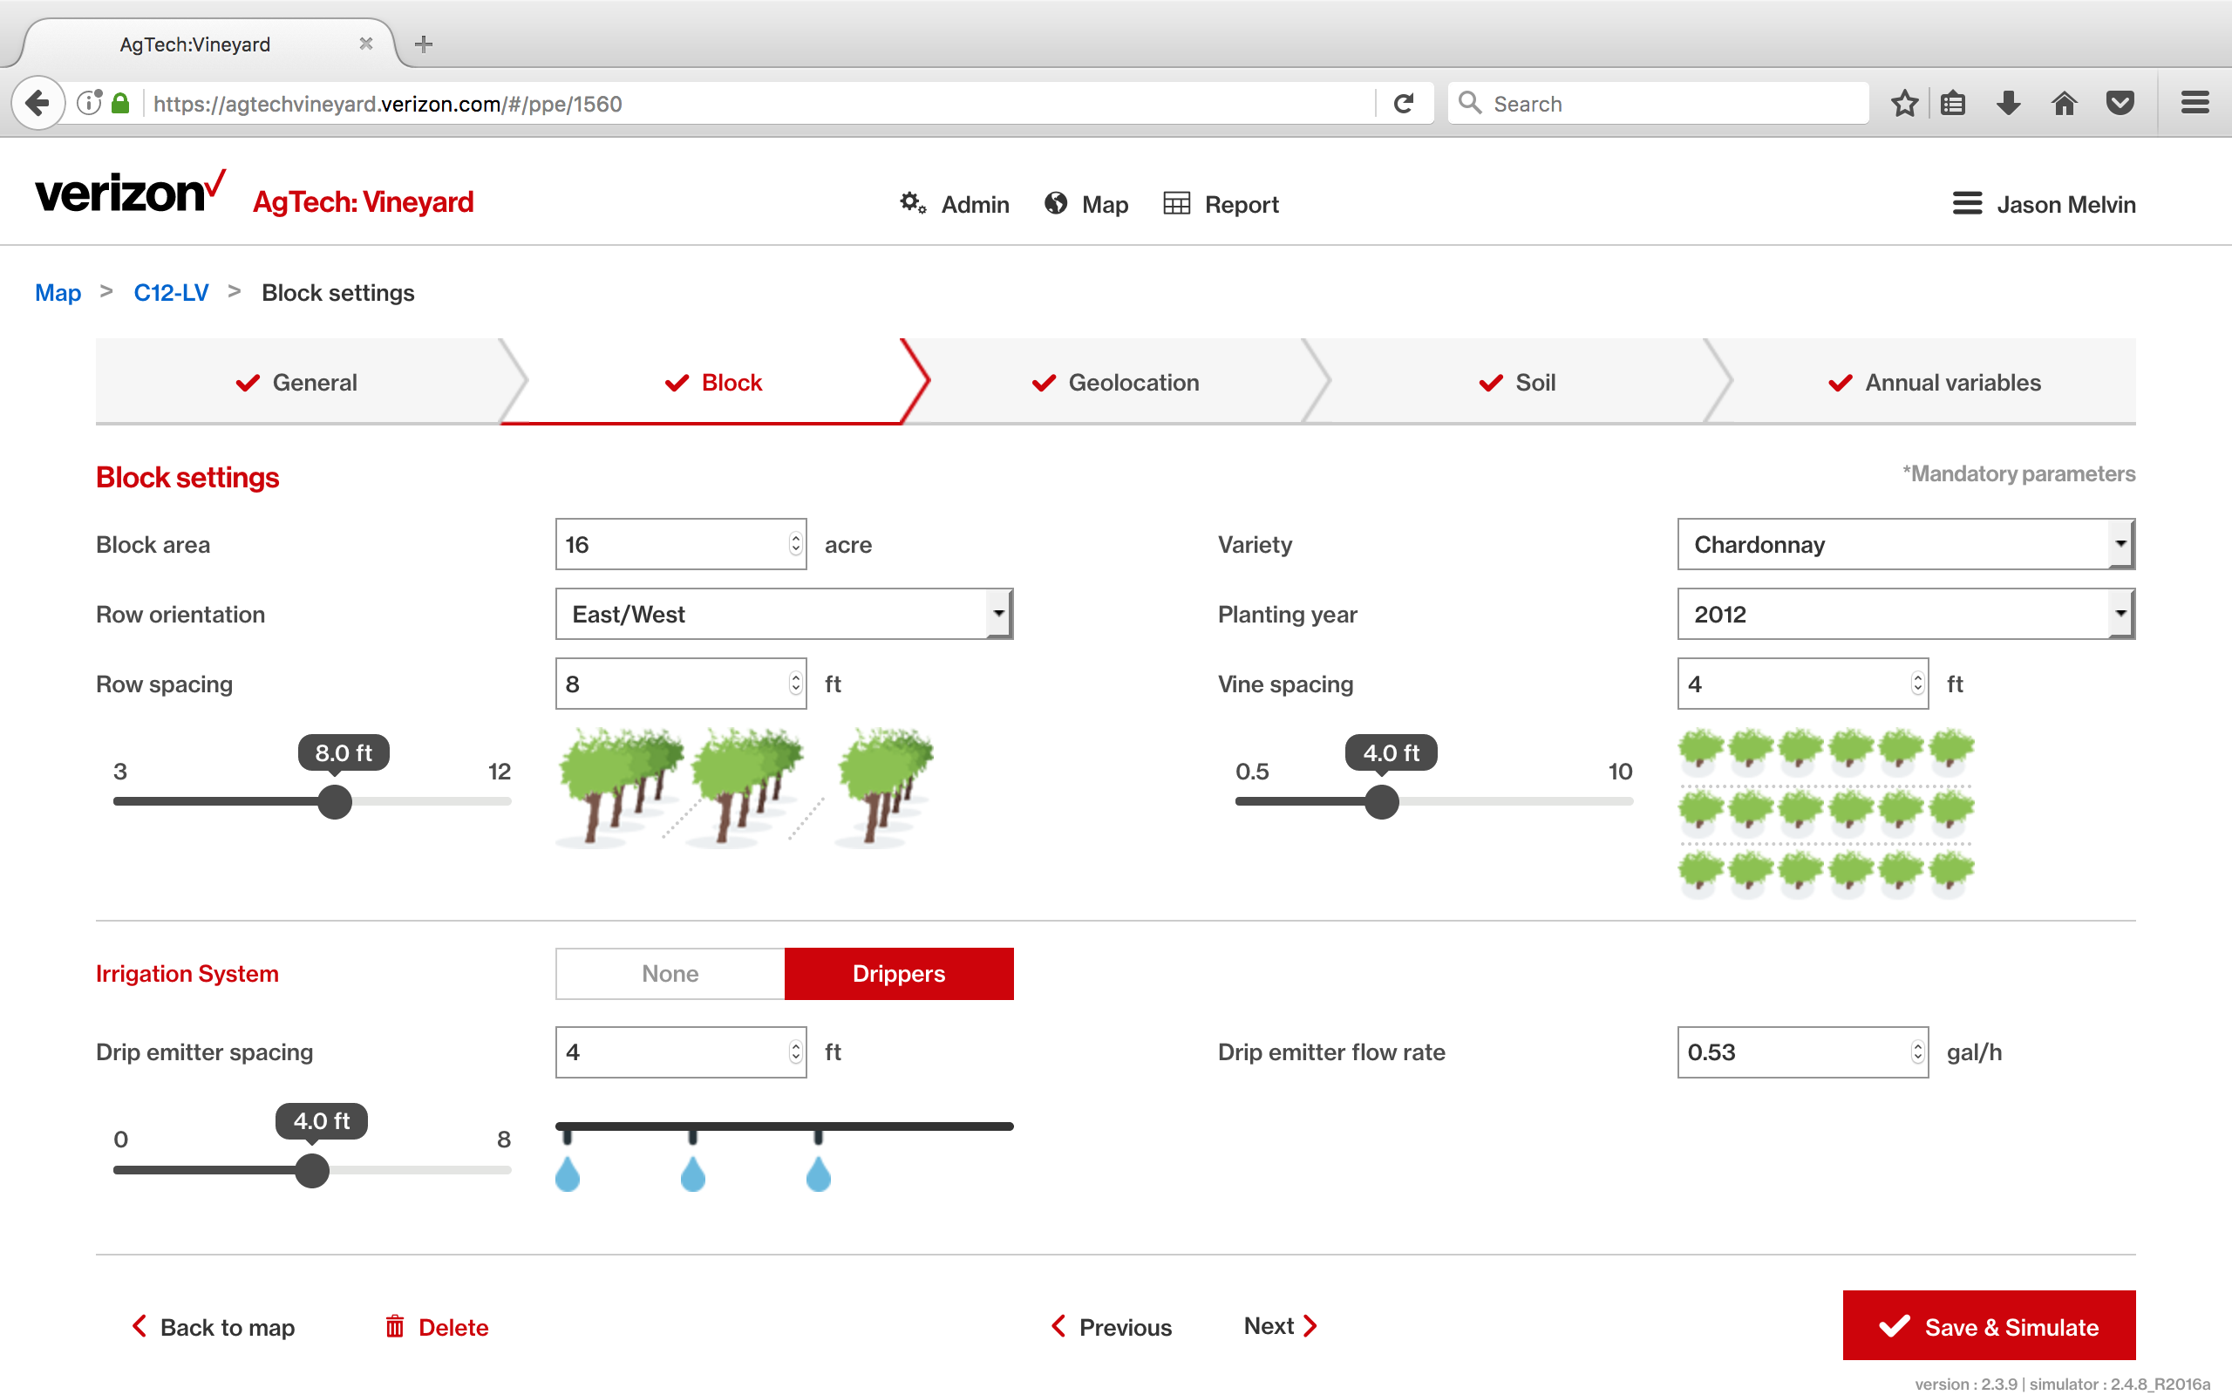
Block Details
Notes:
Next several slides show the model inputs

Slide 15
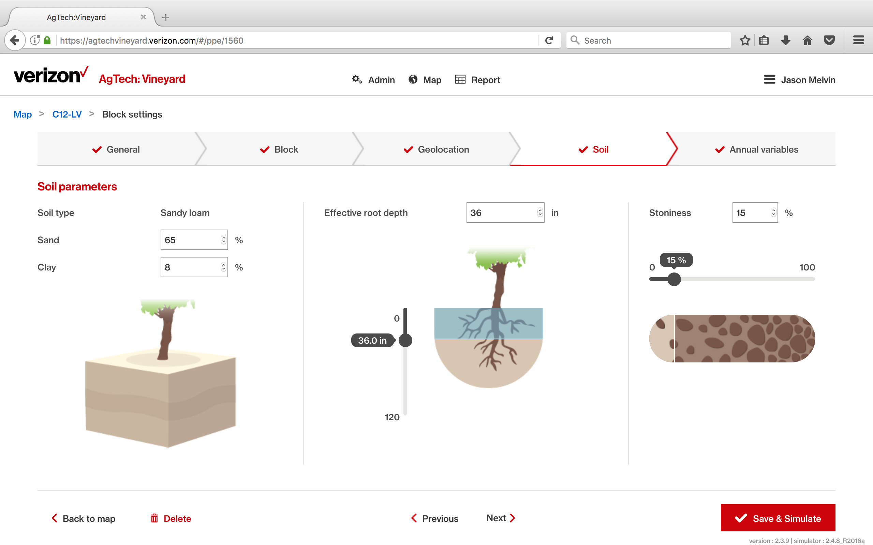
Soil Parameters

Slide 16
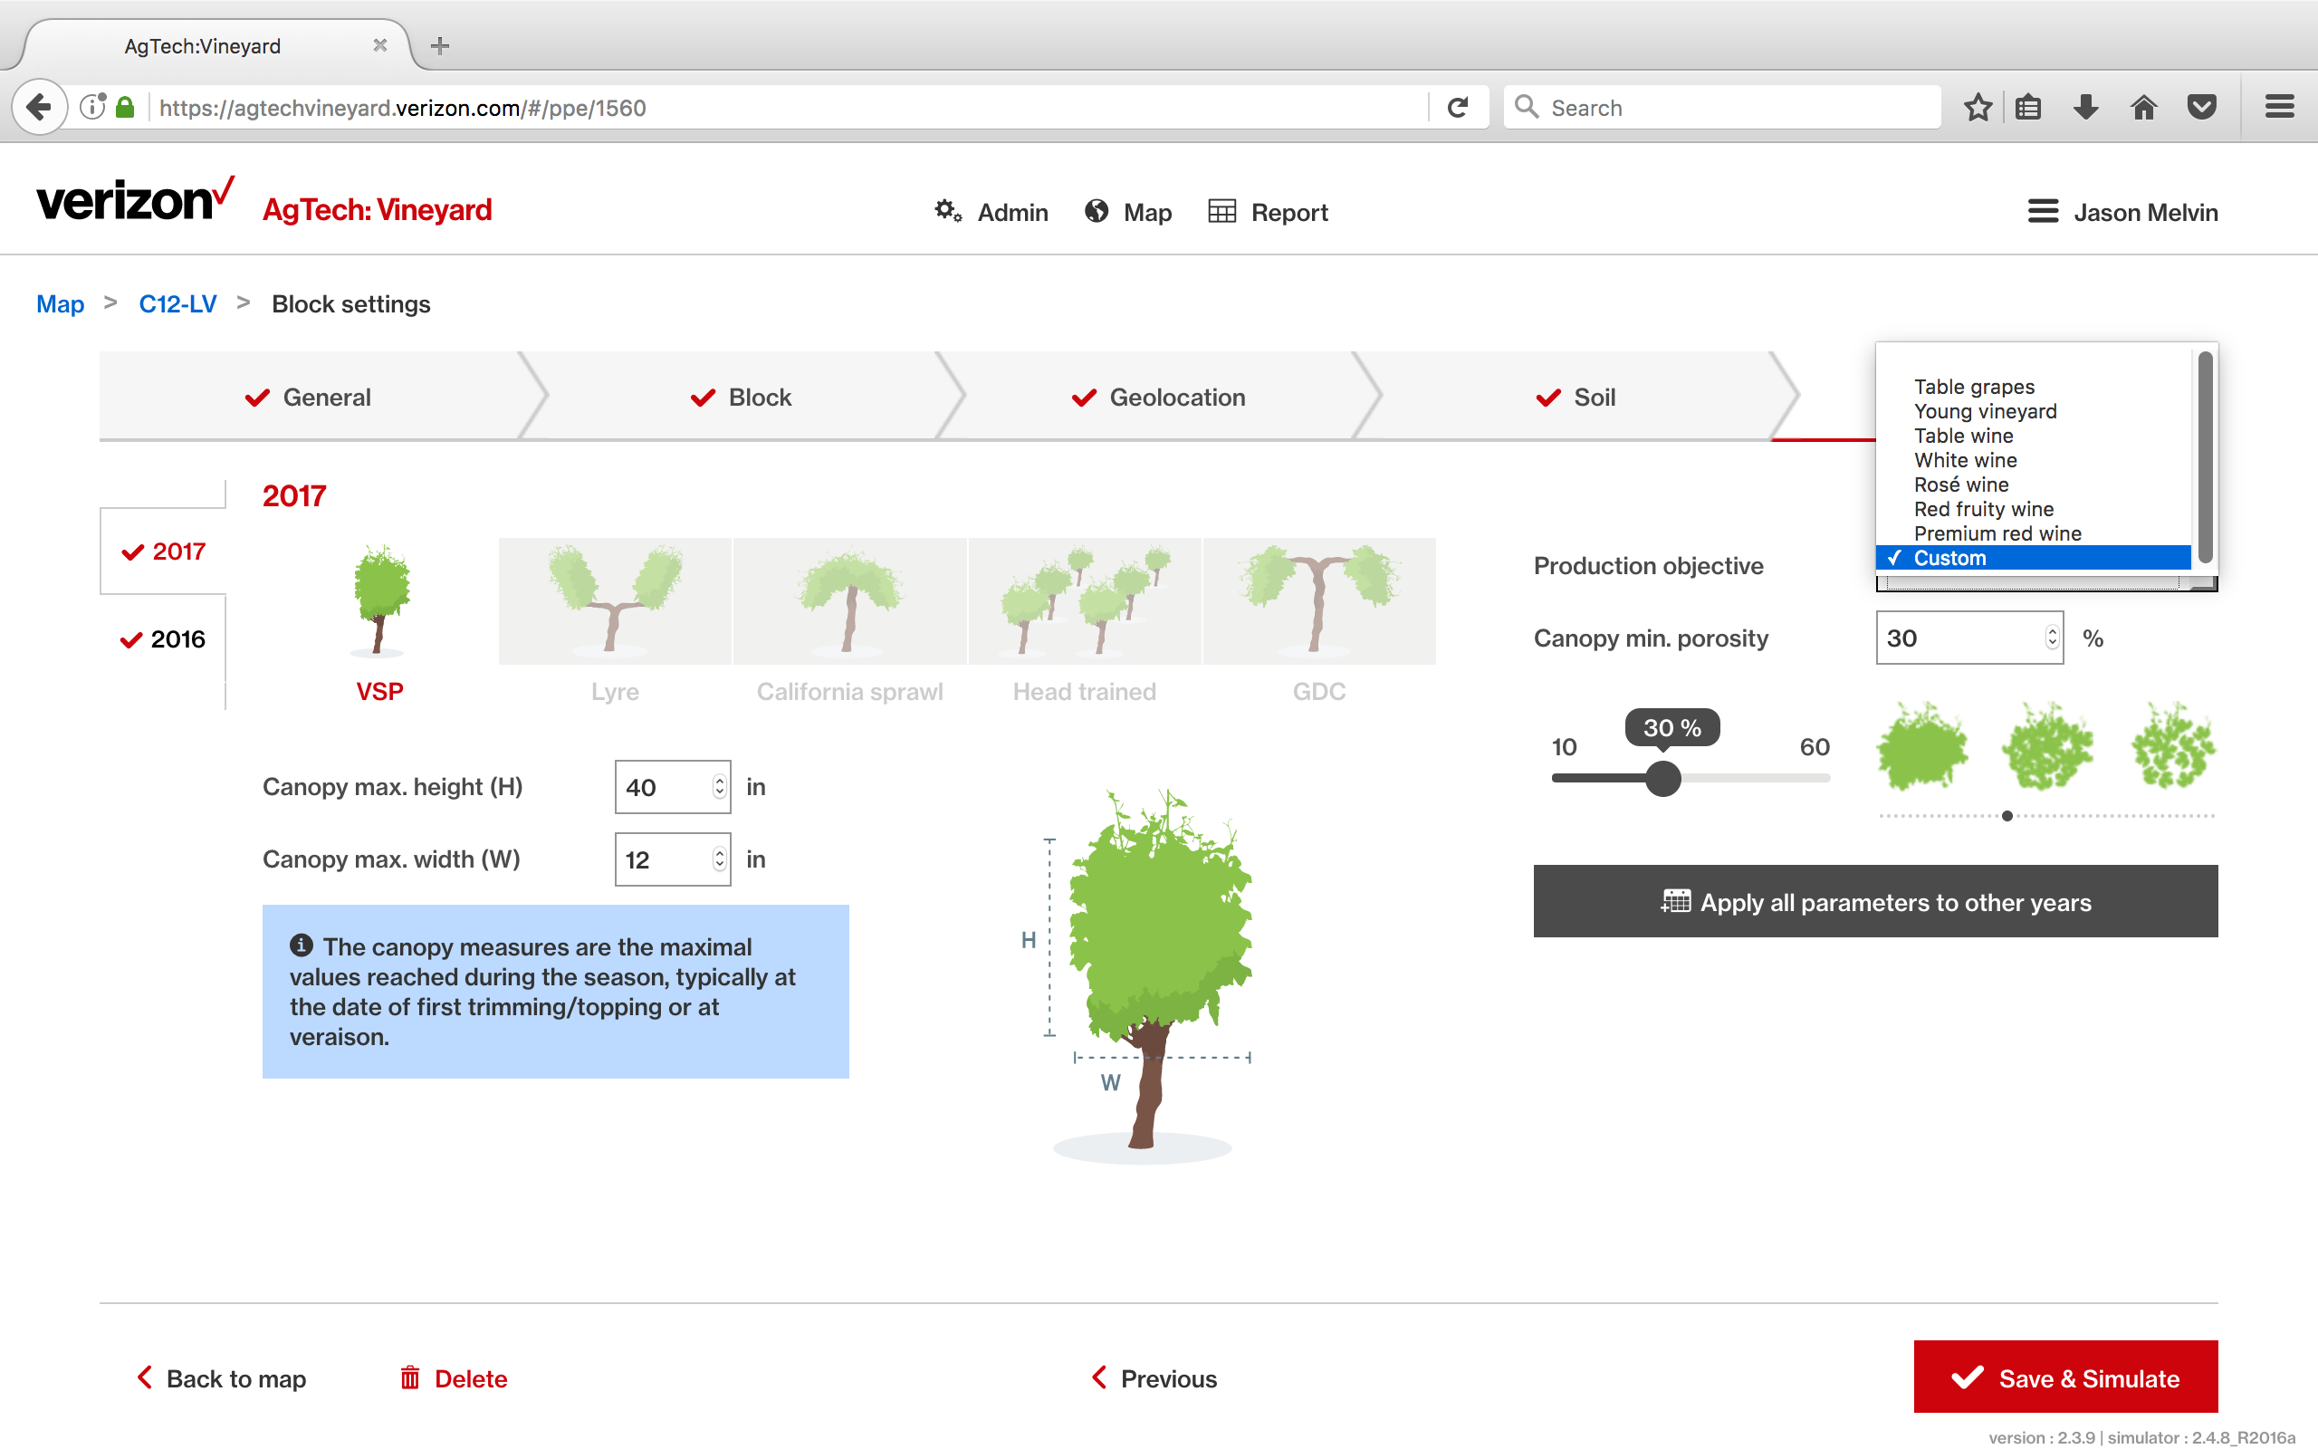
Annual Variables
Notes:
Point out production objectives

Slide 17
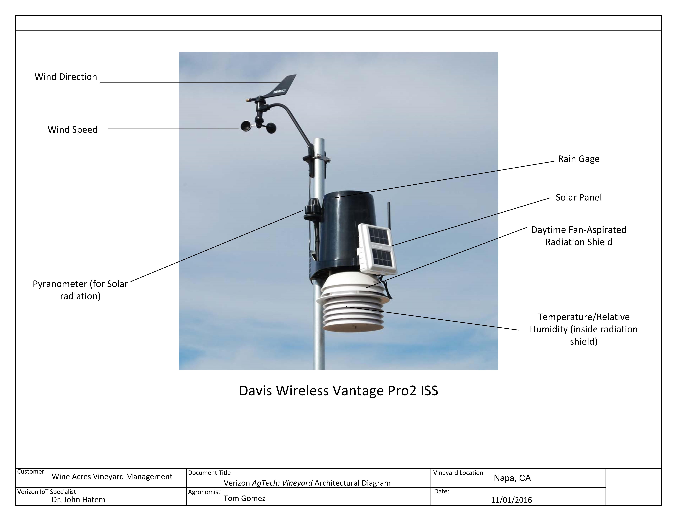
Hardware: VAV Weather station

Slide 18
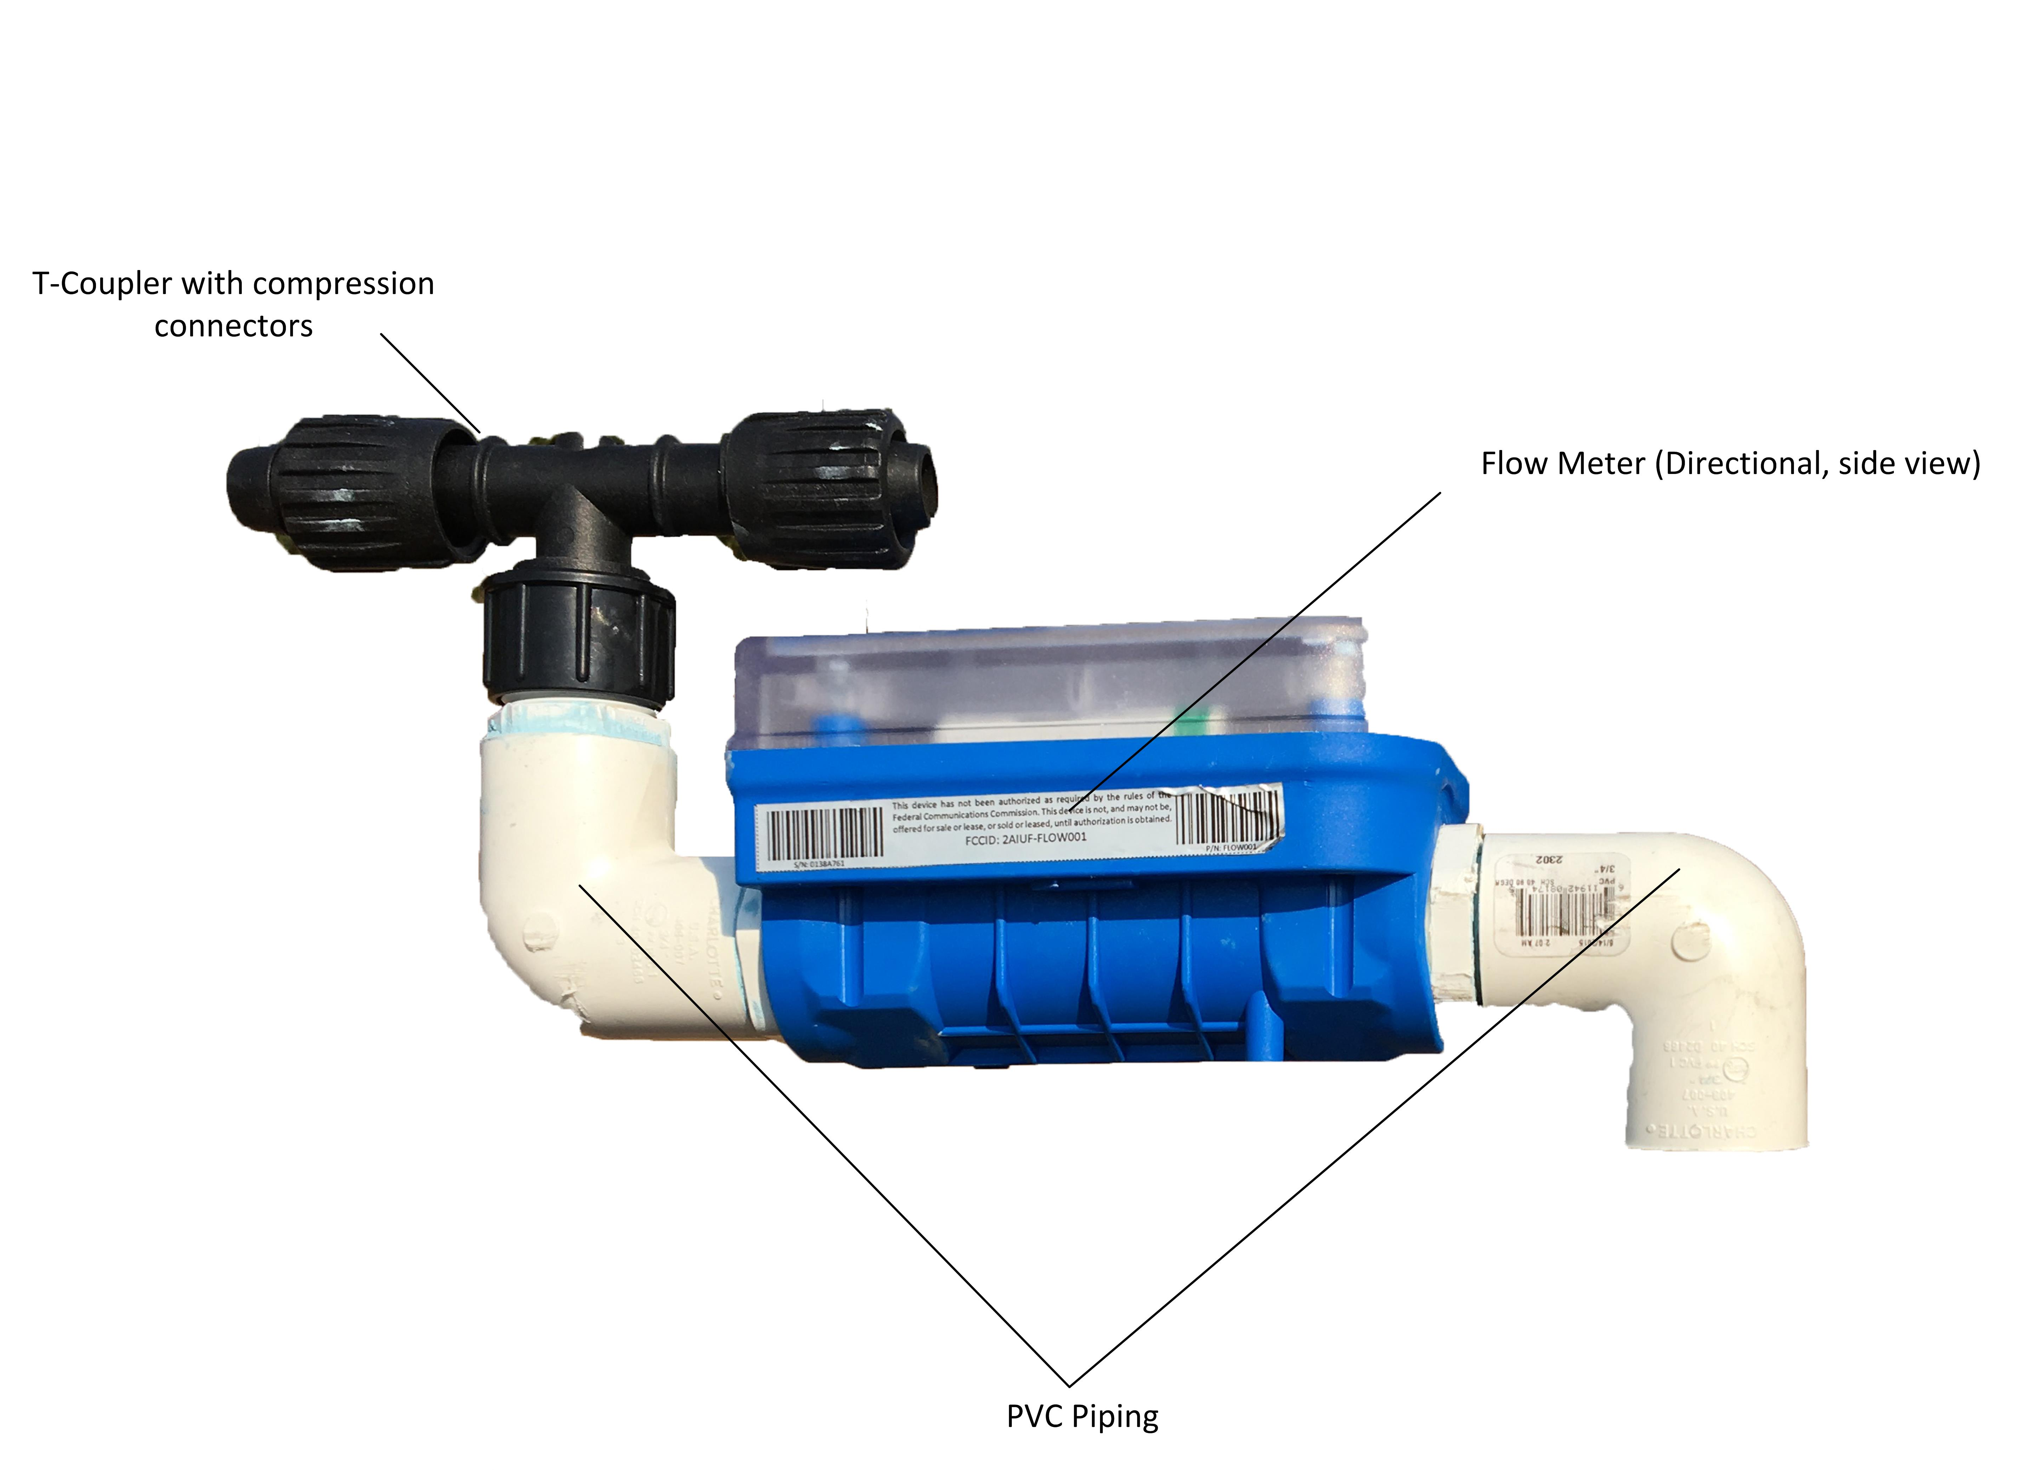
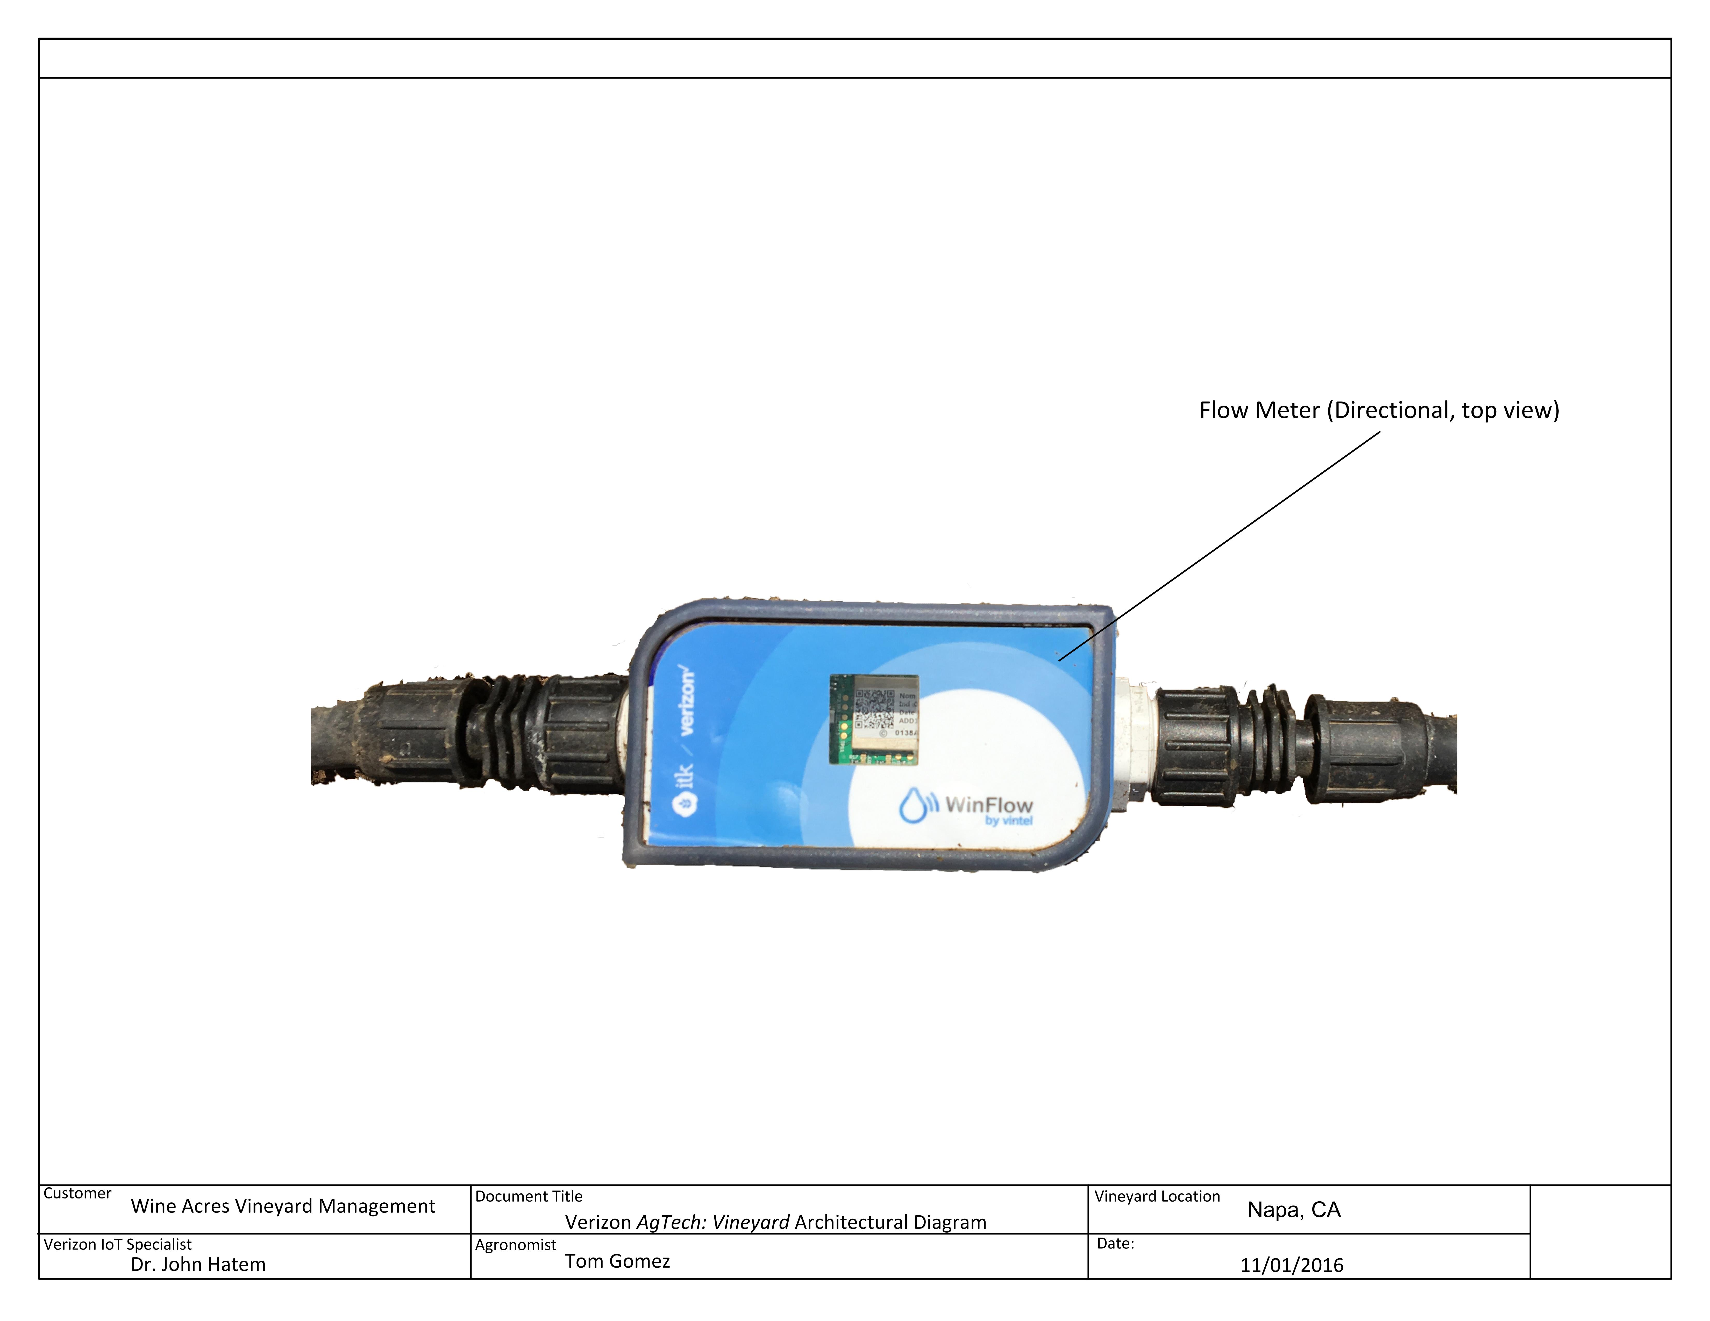
Hardware: VAV Flowmeter

Slide 19
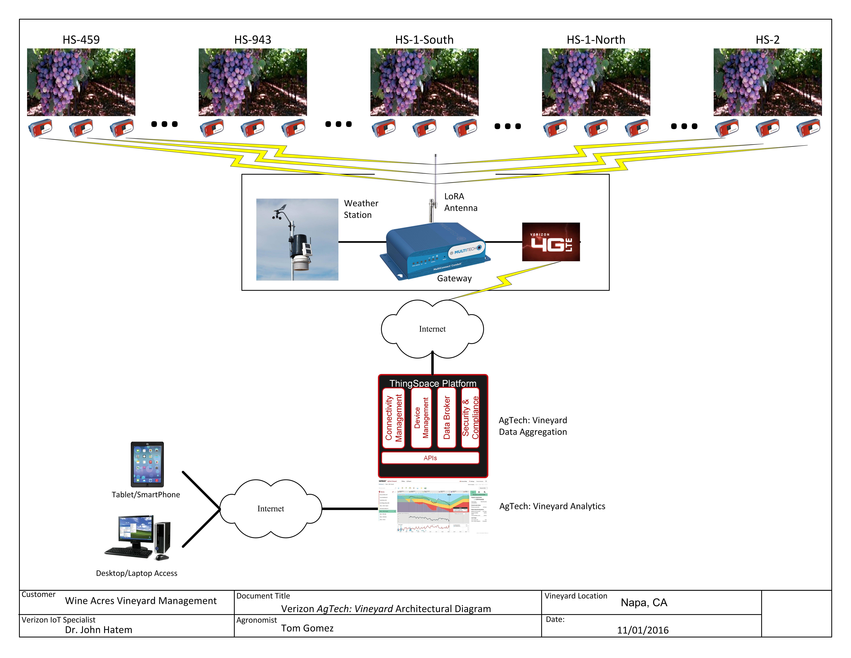
Network

Slide 20
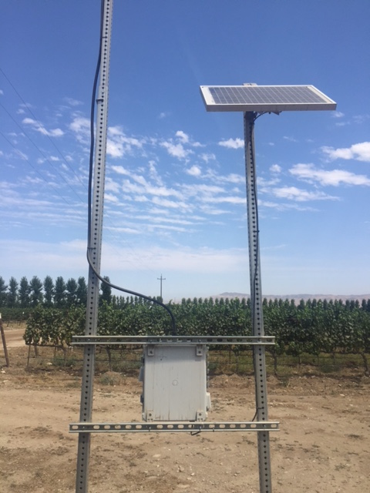
Hardware: Gateway and Antenna

Slide 21
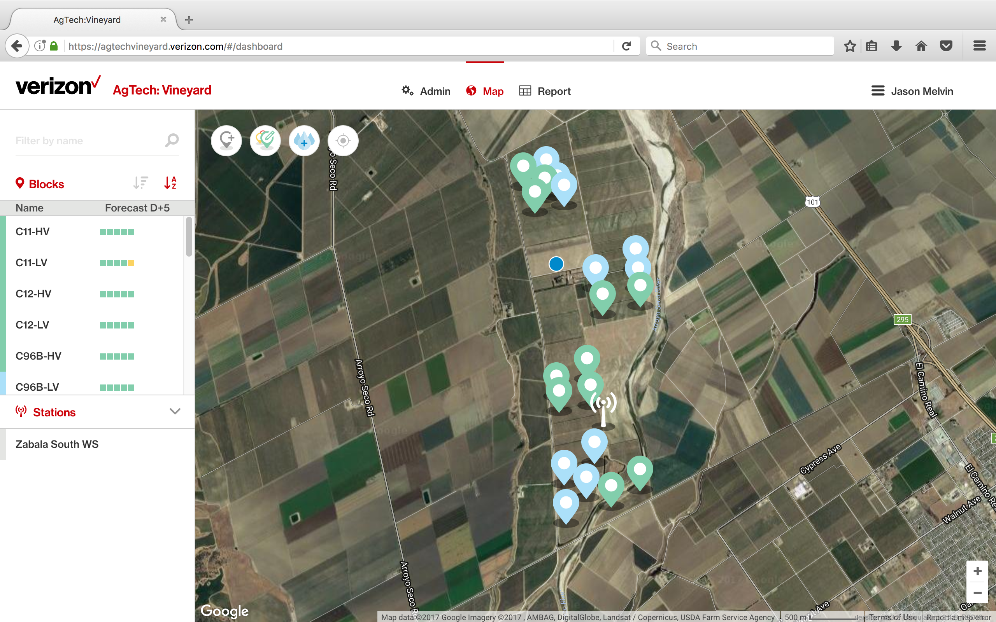
Map view
Notes:
Now I am going to show the user interface

Slide 22
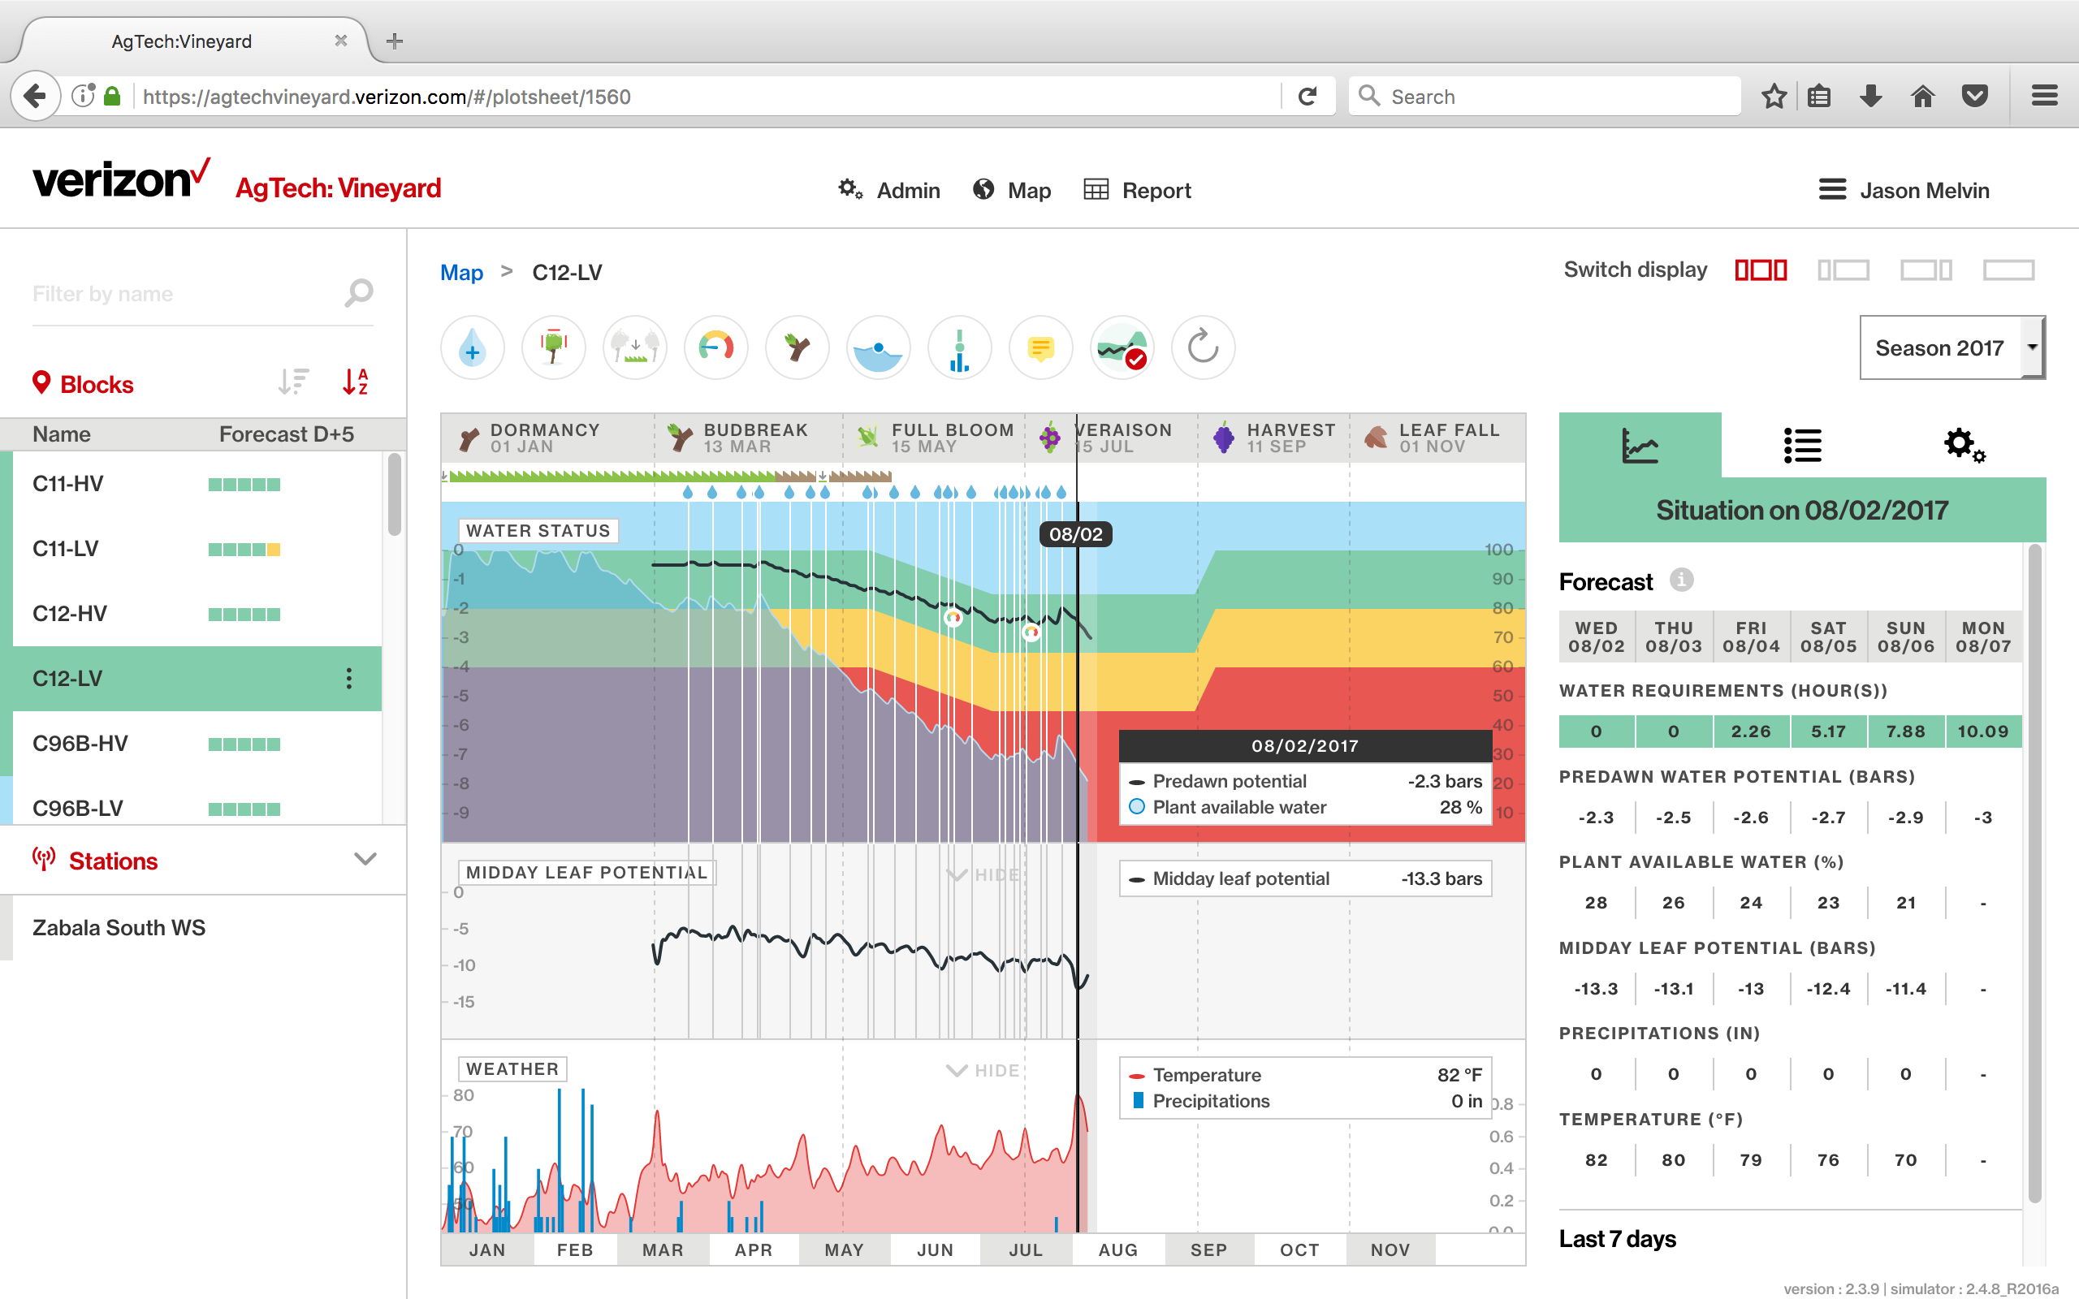
Dashboard

Slide 23
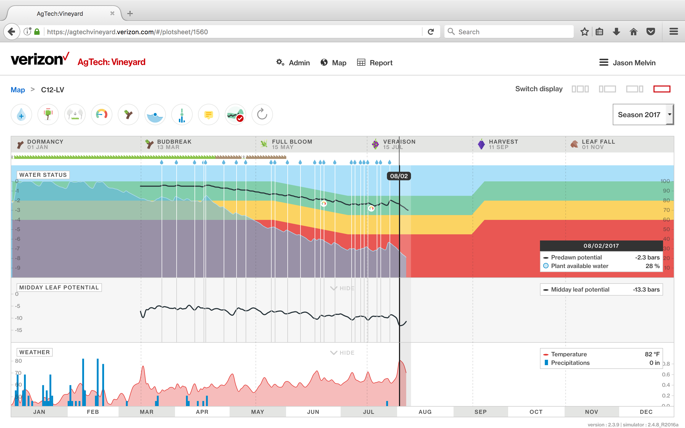
Graph
Notes:
Black line represents the modeled water status
Green zone determined by production objective selected previously as well as phenology
The irrigation recommendations based on the maintaining water status in middle of the green zone
Mention use pressure chamber to obtain actual LWP measurements
Used to confirm accuracy of model
Few actual measurements required
Only performed during critical periods (2-3 times per year max)

Slide 24
Project Year 1 Objectives
Selected monitoring sites
Characterized the site specific parameters
Calibrated model
Compared model to grower standard (ET model)
Notes:
2016 was the first year of the project
Focused on setup and calibration

Slide 25
Site Selection
Notes:
21 monitoring sites selected based on variety and vigor

Slide 26
Site Specific Parameters
Block name | Ranch | Weather station | Block area (acre) | Variety | Row orientation | Planting year | Row spacing (ft) | Vine spacing (ft) | Drip emitter flow rate (gal/h) | Drip emitter spacing (ft) | Sand (%) | Clay (%) | Soil type | Effective root depth (in) | Stoniness (%) | Canopy max. height (in) | Canopy max. width (in) | Production objective | Canopy min. porosity (%) | Cover crop | Germination date | Weeding / Senescence date | Cover crop width (%)
C11-HV | Zabala Vineyards | ARROYO_SECO_MDA | 15 | Chardonnay | East/West | 2011 | 8 | 4 | 0.53 | 4 | 67 | 10 | Sandy loam | 48 | 5 | 40 | 12 | White Wine | 10 | All rows | 1/1/16 | 6/1/16 | 38
C11-LV | Zabala Vineyards | ARROYO_SECO_MDA | 15 | Chardonnay | East/West | 2011 | 8 | 4 | 0.53 | 4 | 65 | 8 | Sandy loam | 24 | 15 | 40 | 12 | White Wine | 20 | All rows | 1/1/16 | 5/15/16 | 38
C12-HV | Zabala Vineyards | ARROYO_SECO_MDA | 16 | Chardonnay | East/West | 2012 | 8 | 4 | 0.53 | 4 | 67 | 10 | Sandy loam | 24 | 3 | 40 | 12 | White Wine | 25 | All rows | 1/1/16 | 5/1/16 | 38
C12-LV | Zabala Vineyards | ARROYO_SECO_MDA | 16 | Chardonnay | East/West | 2012 | 8 | 4 | 0.53 | 4 | 65 | 8 | Sandy loam | 36 | 15 | 40 | 12 | White Wine | 30 | All rows | 1/1/16 | 5/5/16 | 38
C96B-HV | Zabala Vineyards | ARROYO_SECO_MDA | 12 | Chardonnay | East/West | 1996 | 9 | 4 | 0.53 | 4 | 70 | 11 | Sandy loam | 36 | 5 | 40 | 12 | White Wine | 20 | All rows | 1/1/16 | 6/1/16 | 33
C96B-LV | Zabala Vineyards | ARROYO_SECO_MDA | 12 | Chardonnay | East/West | 1996 | 9 | 4 | 0.53 | 4 | 78 | 9 | Sandy loam | 30 | 20 | 40 | 12 | White Wine | 40 | All rows | 1/1/16 | 6/1/16 | 33
C96C-HV | Zabala Vineyards | ARROYO_SECO_MDA | 12 | Chardonnay | East/West | 1996 | 9 | 4 | 0.53 | 4 | 70 | 11 | Sandy loam | 24 | 5 | 40 | 12 | White Wine | 25 | All rows | 1/1/16 | 5/10/16 | 33
C96C-LV | Zabala Vineyards | ARROYO_SECO_MDA | 12 | Chardonnay | East/West | 1996 | 9 | 4 | 0.53 | 4 | 78 | 9 | Sandy loam | 24 | 17 | 36 | 12 | White Wine | 35 | All rows | 1/1/16 | 5/1/16 | 33
C96E-HV | Zabala Vineyards | ARROYO_SECO_MDA | 12 | Chardonnay | East/West | 1996 | 9 | 4 | 0.53 | 4 | 70 | 11 | Sandy loam | 24 | 10 | 40 | 12 | White Wine | 25 | All rows | 1/1/16 | 5/15/16 | 33
C96E-LV | Zabala Vineyards | ARROYO_SECO_MDA | 12 | Chardonnay | East/West | 1996 | 9 | 4 | 0.53 | 4 | 78 | 9 | Sandy loam | 24 | 25 | 40 | 12 | White Wine | 30 | All rows | 1/1/16 | 5/1/16 | 33
PN00A-HV | Zabala Vineyards | ARROYO_SECO_MDA | 15 | Pinot noir | East/West | 2000 | 8 | 3.3 | 0.53 | 3.3 | 75 | 8 | Sandy loam | 24 | 5 | 48 | 16 | Premium Red Wine | 20 | All rows | 1/1/16 | 5/1/16 | 38
PN00B-LV | Zabala Vineyards | ARROYO_SECO_MDA | 14 | Pinot noir | East/West | 2000 | 8 | 3.3 | 0.53 | 3.3 | 73 | 8 | Sandy loam | 24 | 15 | 48 | 16 | Premium Red Wine | 20 | All rows | 1/1/16 | 5/8/16 | 38
PN00C-HV | Zabala Vineyards | ARROYO_SECO_MDA | 16 | Pinot noir | East/West | 2000 | 8 | 3.3 | 0.53 | 3.3 | 74 | 8 | Sandy loam | 36 | 5 | 48 | 16 | Premium Red Wine | 20 | All rows | 1/1/16 | 5/1/16 | 38
PN00D-LV | Zabala Vineyards | ARROYO_SECO_MDA | 16 | Pinot noir | East/West | 2000 | 8 | 3.3 | 0.53 | 3.3 | 73 | 8 | Sandy loam | 36 | 25 | 48 | 16 | Premium Red Wine | 30 | All rows | 1/1/16 | 5/16/16 | 38
PN13-HV | Zabala Vineyards | ARROYO_SECO_MDA | 19 | Pinot noir | East/West | 2013 | 8 | 4 | 0.53 | 4 | 69 | 10 | Sandy loam | 24 | 5 | 36 | 12 | Young vineyard | 35 | All rows | 1/1/16 | 5/1/16 | 38
PN13-LV | Zabala Vineyards | ARROYO_SECO_MDA | 19 | Pinot noir | East/West | 2013 | 8 | 4 | 0.53 | 4 | 73 | 8 | Sandy loam | 36 | 15 | 36 | 12 | Young vineyard | 50 | All rows | 1/1/16 | 5/1/16 | 38
SB07A-HV | Zabala Vineyards | ARROYO_SECO_MDA | 12 | Sauvignon | East/West | 2007 | 8 | 4 | 0.53 | 3.3 | 76 | 7 | Sandy loam | 48 | 4 | 48 | 18 | White Wine | 20 | All rows | 1/1/16 | 5/16/16 | 38
SB07B-LV | Zabala Vineyards | ARROYO_SECO_MDA | 12 | Sauvignon | East/West | 2007 | 8 | 4 | 0.53 | 3.3 | 78 | 5 | Sandy loam | 36 | 25 | 40 | 18 | White Wine | 30 | All rows | 1/1/16 | 5/1/16 | 38
SB07C-HV | Zabala Vineyards | ARROYO_SECO_MDA | 12 | Sauvignon | East/West | 2007 | 8 | 4 | 0.53 | 3.3 | 76 | 7 | Sandy loam | 36 | 10 | 40 | 18 | White Wine | 20 | All rows | 1/1/16 | 5/16/16 | 38
SB13-HV | Zabala Vineyards | ARROYO_SECO_MDA | 21 | Sauvignon | East/West | 2013 | 8 | 4 | 0.53 | 4 | 76 | 7 | Sandy loam | 30 | 10 | 40 | 18 | White Wine | 15 | All rows | 1/1/16 | 5/15/16 | 38
SB13-LV | Zabala Vineyards | ARROYO_SECO_MDA | 21 | Sauvignon | East/West | 2013 | 8 | 4 | 0.53 | 4 | 78 | 5 | Loamy sand | 36 | 15 | 40 | 20 | White Wine | 40 | All rows | 1/1/16 | 5/1/16 | 38
Notes:
The data for each monitoring site was collected and input into the model

Slide 27

Model Calibration
Notes:
To calibrate the model I irrigated using my standard ET based method and input this irrigation data into the model on a weekly basis.
Performed LWP measurements throughout season.
If actual LWP outside accepted variance of modeled LWP reviewed site parameters and adjusted as required.

Slide 28
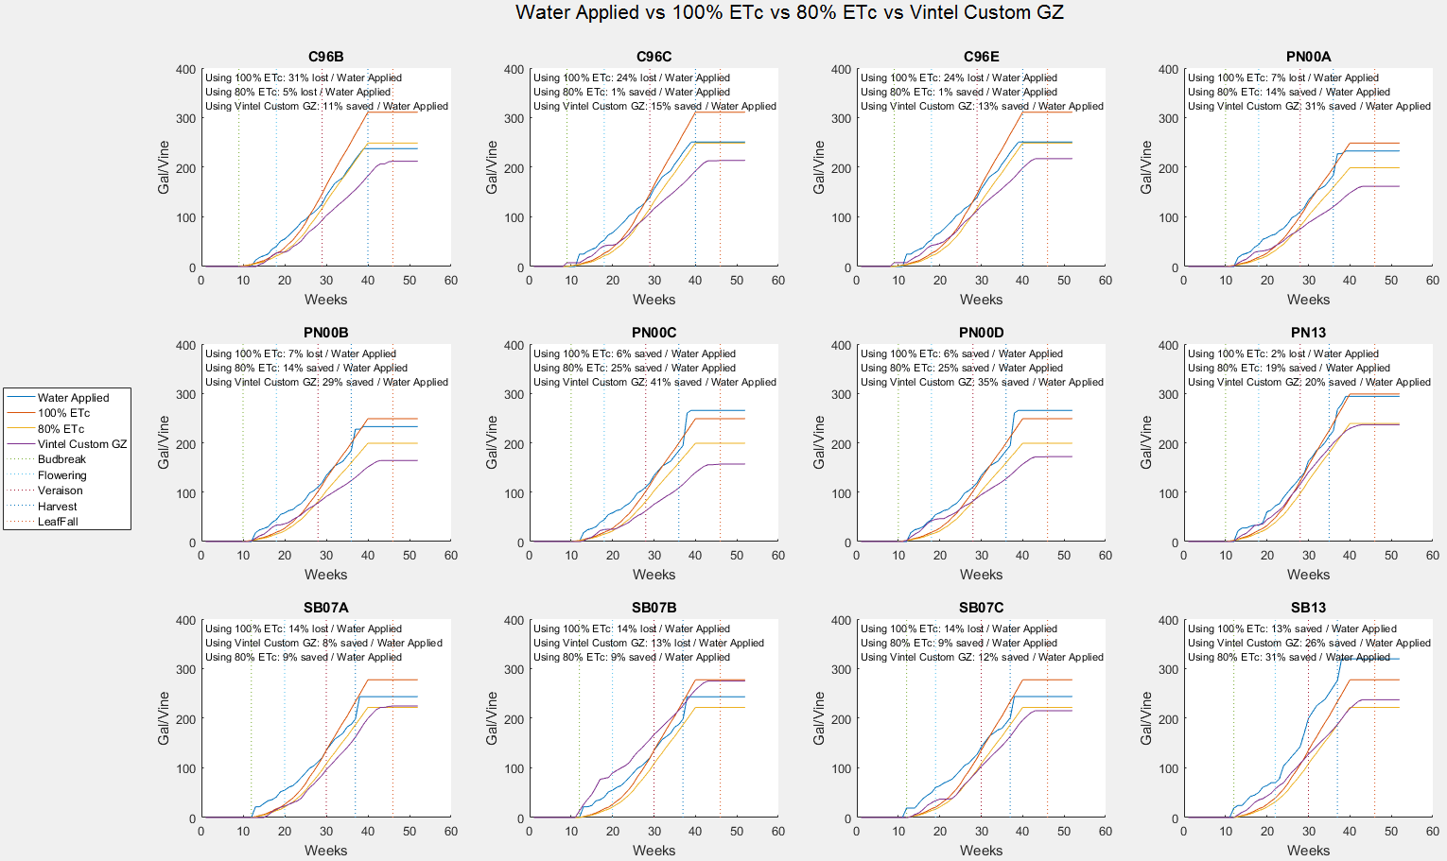
Comparison
Notes:
Ran model in parallel to grower irrigations and compared predicted water usage from model to actual water used for each monitoring location
Many blocks showed potential water savings early and late

Slide 29
Project Year 1 Summary
We showed that the VINTEL model provided an accurate estimation of vine water status at the block level under our growing conditions
Irrigating based on the model’s recommendation has the potential to save 10-30% compared to the grower’s current practice of ET based deficit irrigation.

Slide 30
Project Year 2
During year two (2017 growing season) we have been irrigating based on the model recommendations
Installed flowmeters to get more accurate irrigation data
Installed a few soil moisture probes to better define active root zone
Saved water early
Custom green zones require some adjustment
Data Analysis
Notes:
In 2016 we input irrigation by hand
Soil moisture probes also provide another data point that confirms accuracy of model
Saved water early because of better understanding of soil moisture (Rain did not hurt either)
Some of the blocks did not handle high heat events as well as I would like as a result we need to refine customs green zones
At the end of season we will do an analysis of actual water applied and what the model called for because in some cases I went off model based on visual assessment of vines

Slide 31
Project Year 3
Continue to refine model inputs
Continue to refine green zones
Cost analysis
Water use analysis
Notes:
I expect that it will take 3-5 years of use before model is optimized for a site

Slide 32
Acknowledgments

