Slide 1
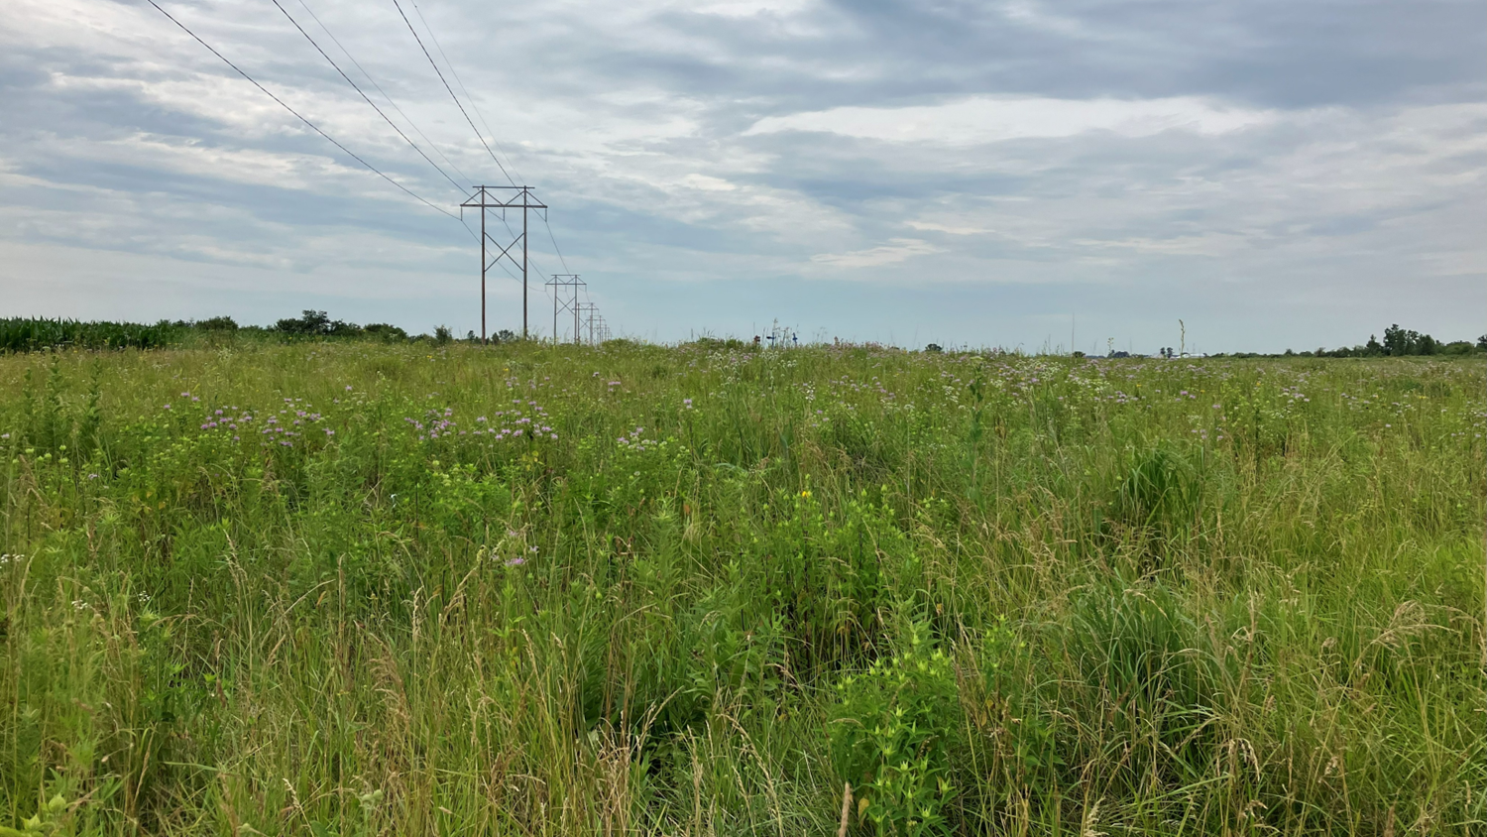

Parasites and agroecosystems: Determining the status of bumble bee parasites in Illinois Conservation Reserve Program CP42 lands
Symposium: A Multi-Faceted Exploration of Bee Symbioses in the Wake of Global Change
Annaliese Wargin, Alexandra Harmon-Threatt
University of Illinois Urbana-Champaign
Entomology 2025

Slide 2
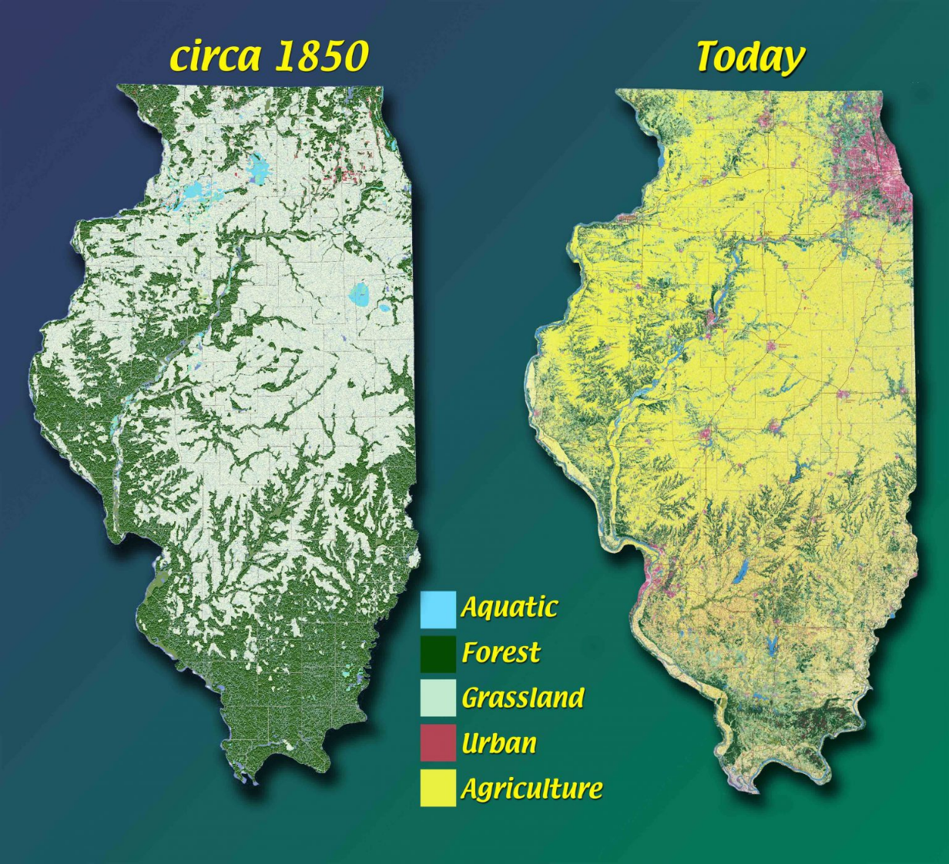
Image: Illinois Natural History Survey
Notes:
Add pesticide increase/agricultural increase throughout the USA so you can move it out of Illinois? Jon will send it

Slide 3
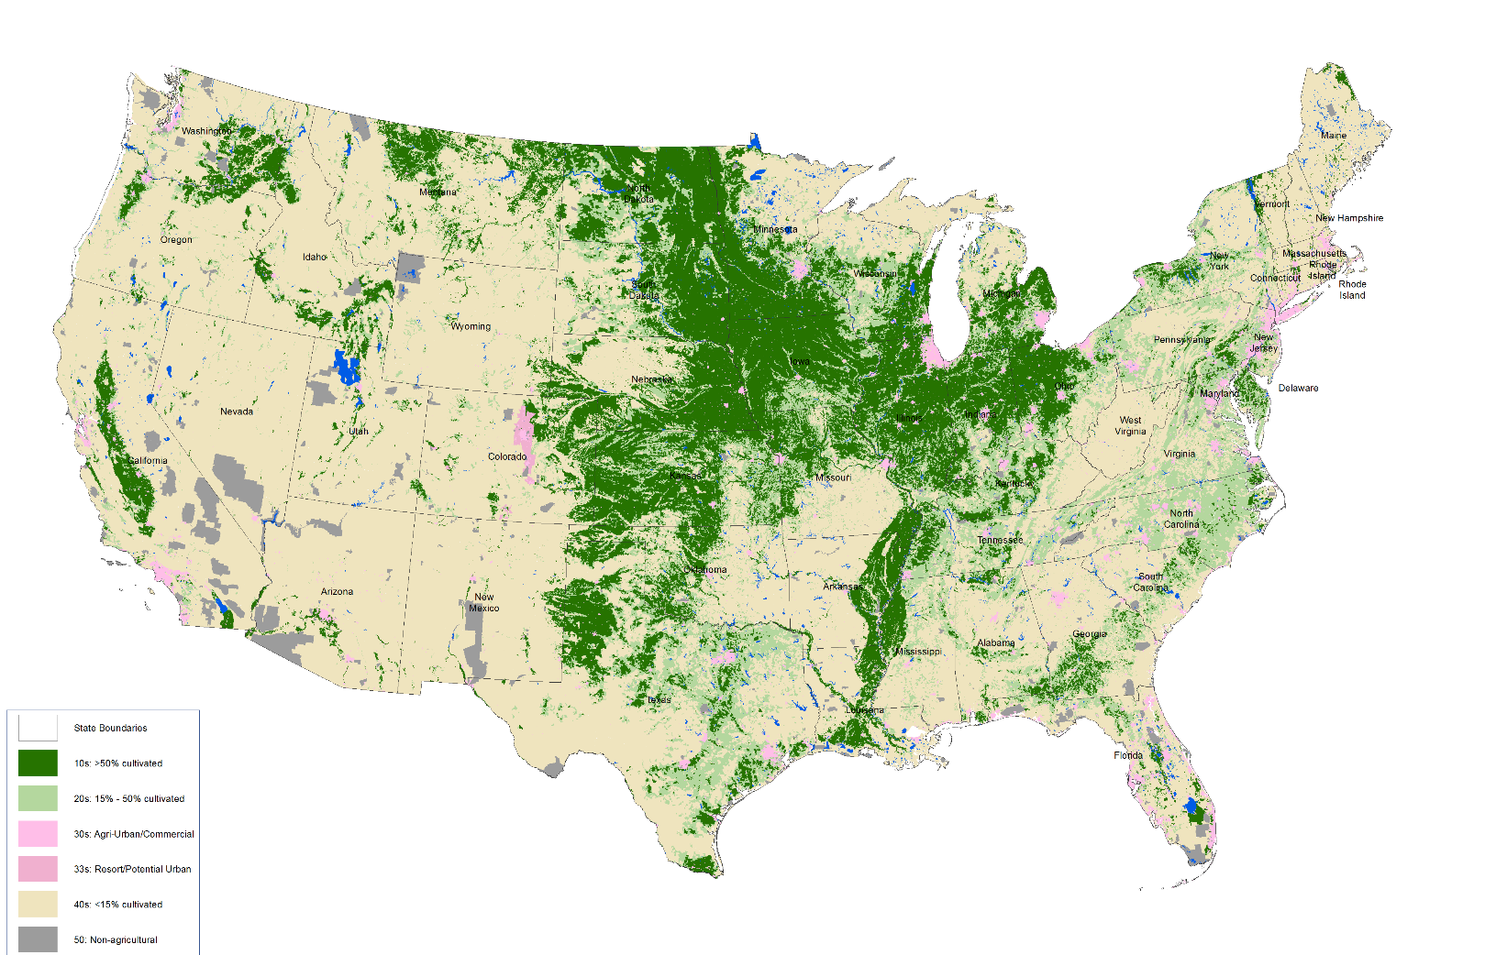
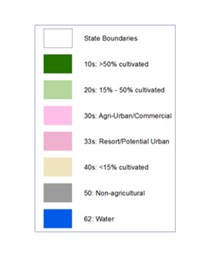

Slide 4
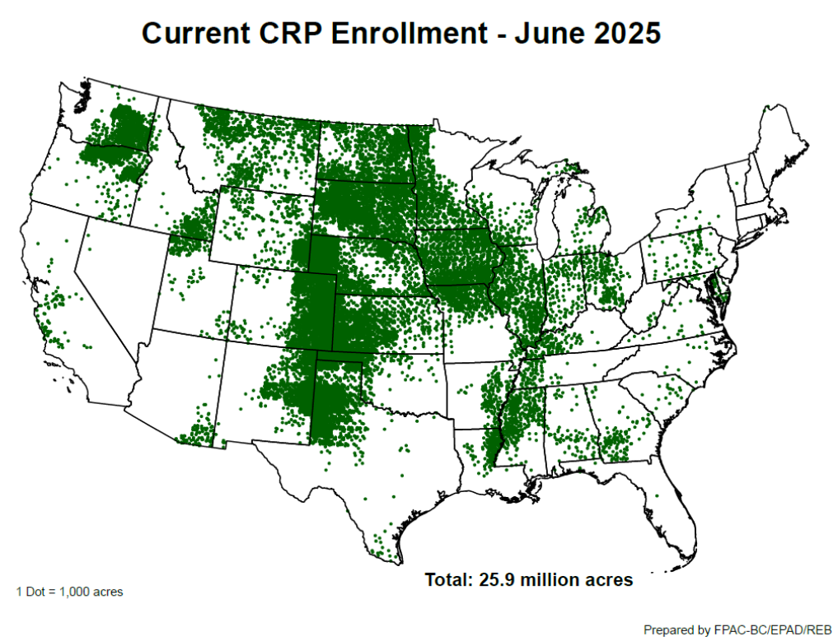
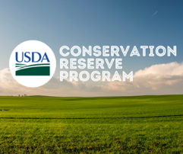
USDA FSA Conservation Reserve Program Statistics Report, June 2025

Slide 5
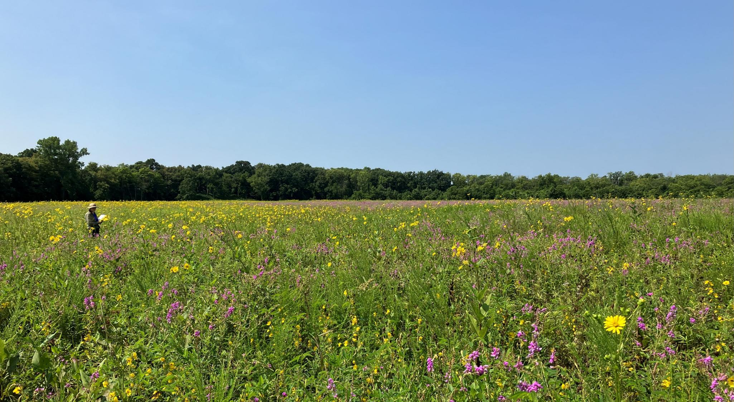
CP42: Pollinator Habitat
CP42 introduced in 2012
Contract lasts 10 years
“Customizable”
Where to plant
Seed mixes
Mowing
Fire Management
Understudied
Notes:
Seed mixes depend on region (sold by USDA and private vendors), mowing management optional depending on landowner’s preference, funding + manpower for regular fire management (every ~3 years) provided by local SWCD, although there were USDA funding cuts this year

Slide 6
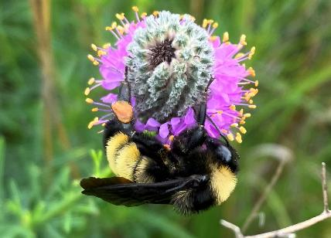
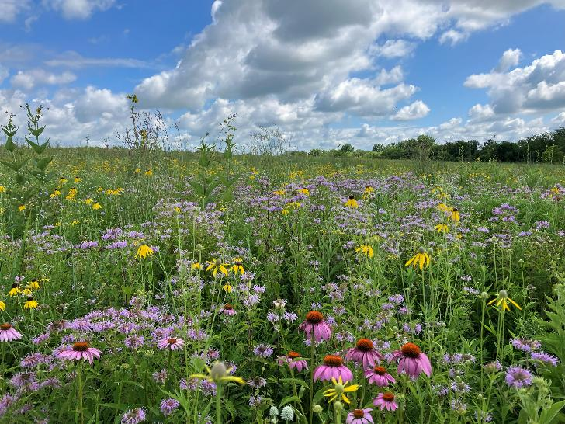
CP42: Pollinator Habitat
USDA FSA Conservation Reserve Program Statistics Report, June 2025
Only includes states with > 5000 enrolled acres

Slide 7



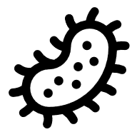
CP42: Pollinator Habitat
CP42 habitats are not regularly assessed via follow-up surveys, so it is unknown if they are achieving their goals.
In IL, CP42 habitats exist as habitat fragments embedded in a high-intensity agricultural matrix
Potential as ecological traps:
Pesticide exposure via drift (Cheng unpub., personal communication)
Increased transmission of parasites and pathogens (Angelella et al. 2025)

Slide 8
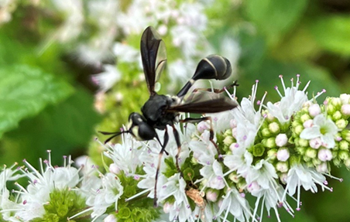
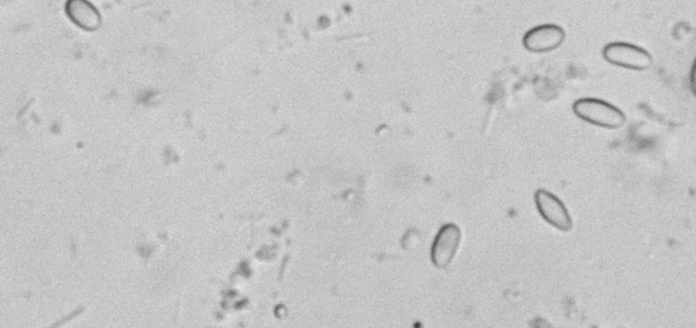
Bumble Bee Parasites
Endoparasitoids: Thick-headed flies (Diptera, family Conopidae)
Microbial gut parasites
Nosema bombi – also present in honey bees
Crithidia bombi
Apicystis bombi
Microbial parasites often cited as a potential driver of bumble bee population declines (Cameron & Sadd 2020)
Parasite prevalence affected by:
Surrounding land use (Gratton et al. 2023)
Floral resources and habitat quality (McNeil et al. 2020)
Time of year (Graystock et al. 2020)

Slide 9
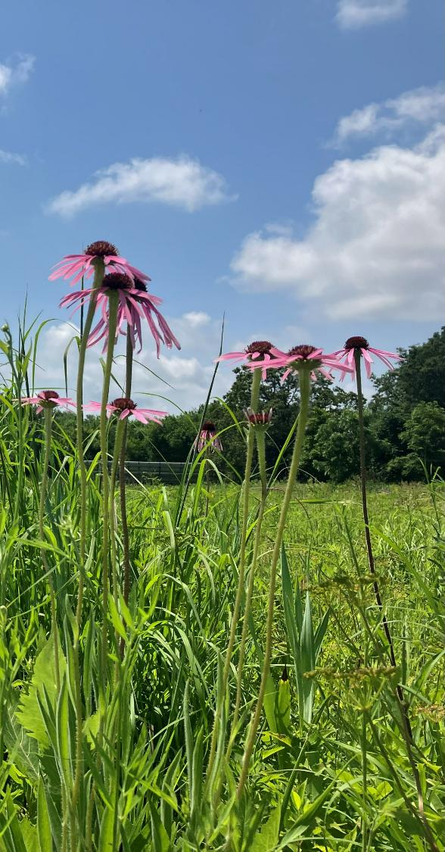
Research Objectives
Contribute to current body of bumble bee parasite literature by investigating bumble bee parasite incidence in unique habitats embedded in an agricultural matrix
What is the status of conopid endoparasitioids and microbial parasites like Nosema bombi, Apicystis bombi, and Crithidia bombi in IL CP42 habitat?
What local and landscape-level factors drive prevalence of parasites, if at all?

Slide 10
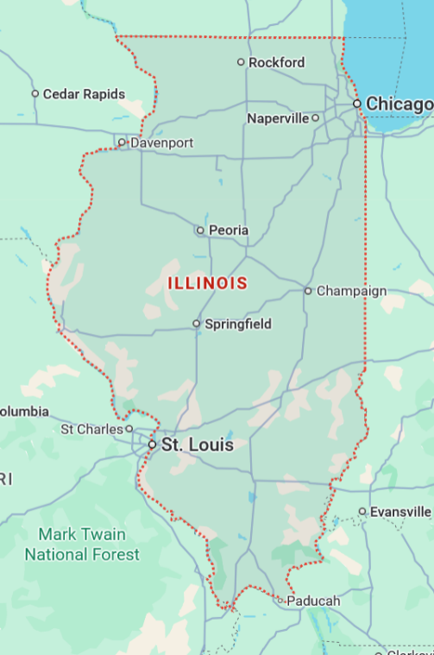
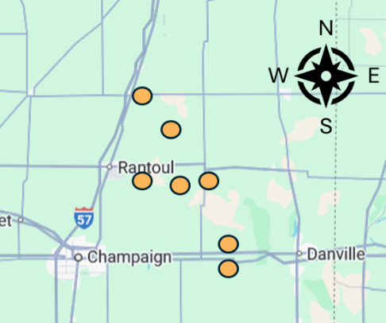
Methods
7 sites sampled in Year 1
Gathered information on surrounding land use within 2km buffer via GIS
Sites chosen along a “landscape gradient”

Slide 11
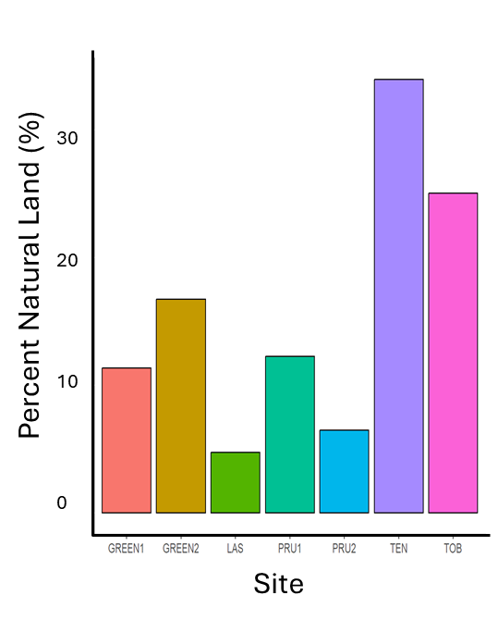
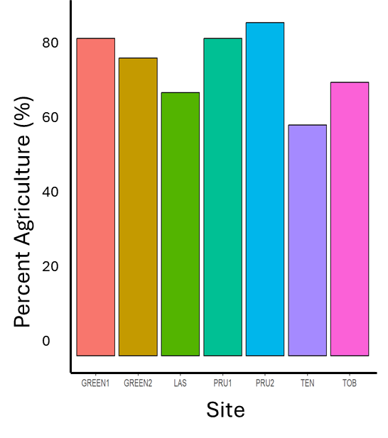
Methods
Row crop agriculture dominates central Illinois land use

Slide 12
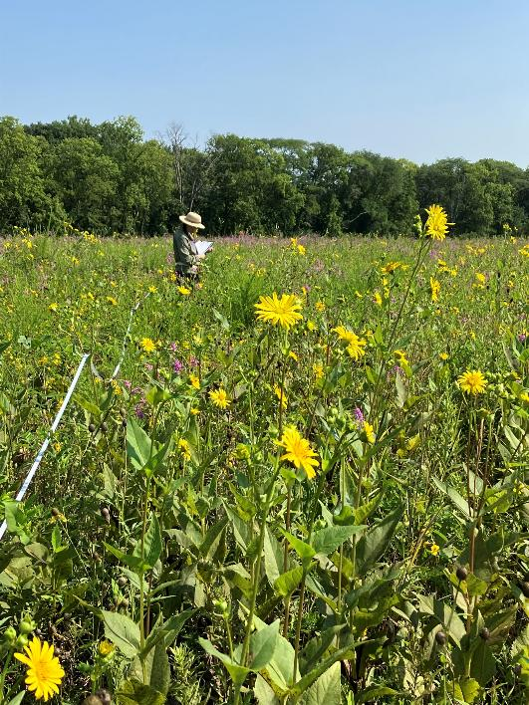
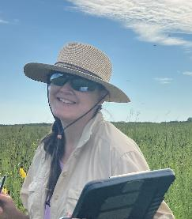
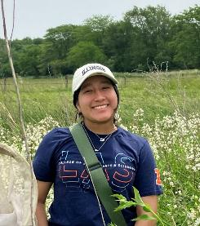
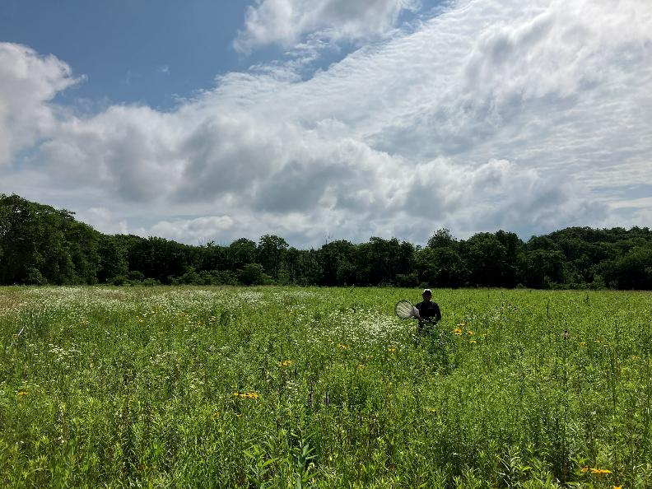
Methods
Within each site, we sampled a 30mx30m plot 3x during summer
Ran 2 30m transects through the plot
Recorded:
Floral Abundance
Number of inflorescences
Collected bees for 60 person-minutes between 10am-12pm
Bees stored in cooler in the field, stored at -20C in the lab
Alia Frickensmith
Alin Oritz-Hernandez

Slide 13
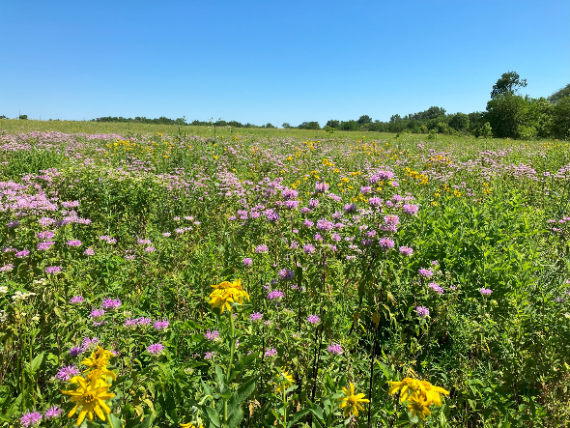
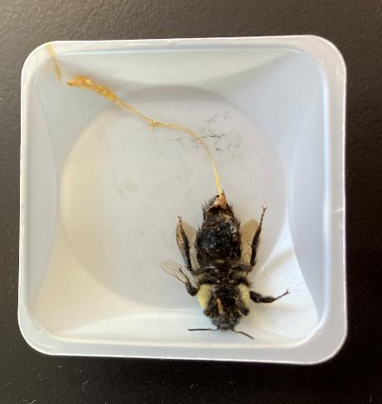
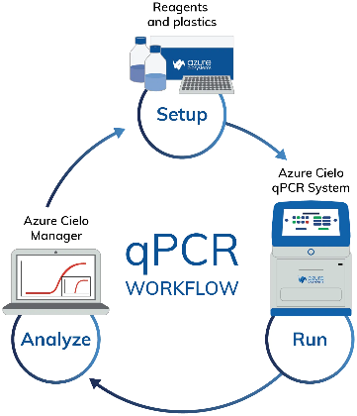
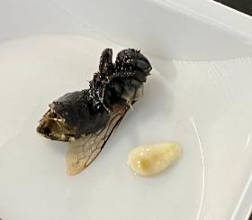
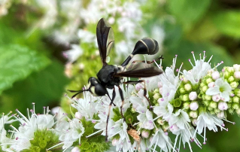
Methods
Capture bees in field
Pollinator Habitat (CP42)
Dissect in the lab & measure body size
PCA & GLMM with AIC model selection to analyze local & landscape-level factors on parasites
qPCR with detection threshold to determine presence/absence of microbial parasites
Quantify conopids after removing from body cavity

Slide 14
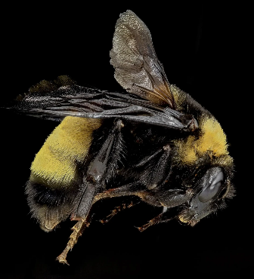
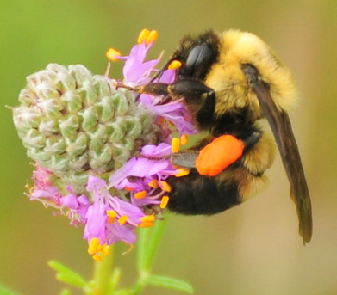
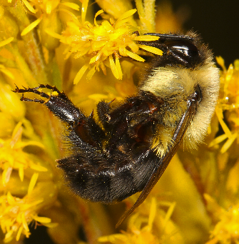
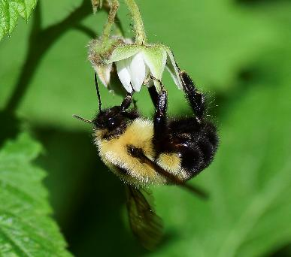
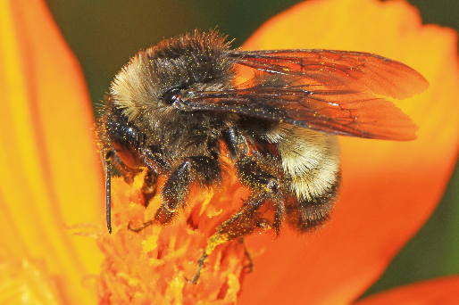
Results – Bumble Bees
B. griseocollis
B. impatiens
B. bimaculatus
B. auricomis
B. pensylvanicus
In 2024, we caught a total of 309 bees from 5 Bombus species. We only kept 2 species for dissection: Bombus impatiens and Bombus griseocollis
Capture rates across sites highly variable
Notes:
Add more data to this slide – visuals, etc.

Slide 15
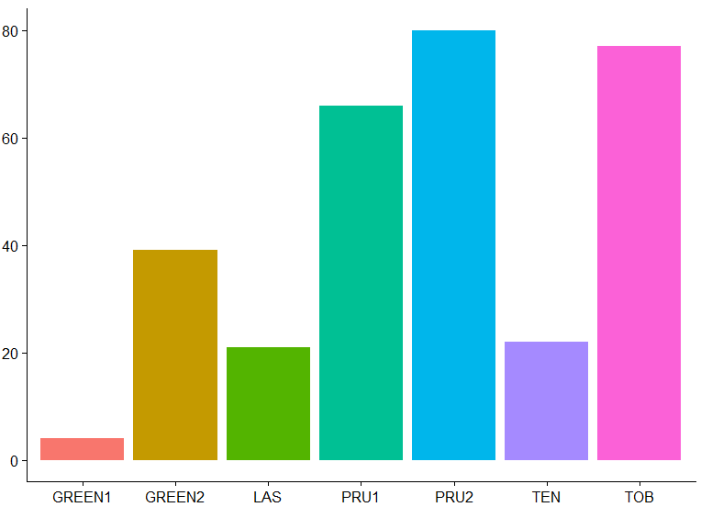
Results – Bumble Bees
Capture rate was highly variable across sites
Total Bee Abundance (all months)
Site

Slide 16
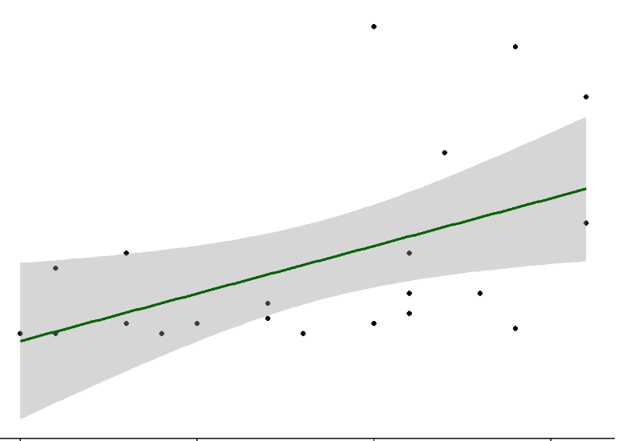
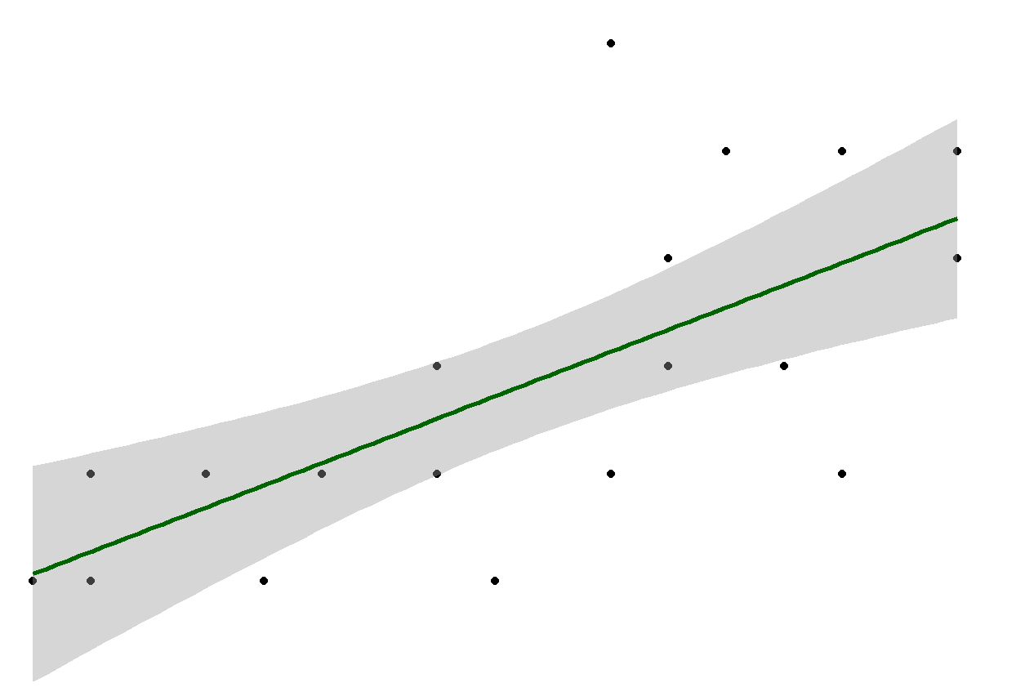
Results – Bumble Bees
60
5
4
40
3
Bee Abundance
Bee Richness
20
2
1
0
0
-20
-1
5
10
15
20
5
10
15
20
Floral Richness
Floral Richness
Landscape analyses suggest that corn and soy are best for bees
Best sites were in areas where agriculture was >80% of surrounding land use
These sites, due to landowner enthusiasm for the project, had higher floral richness and FQI

Slide 17

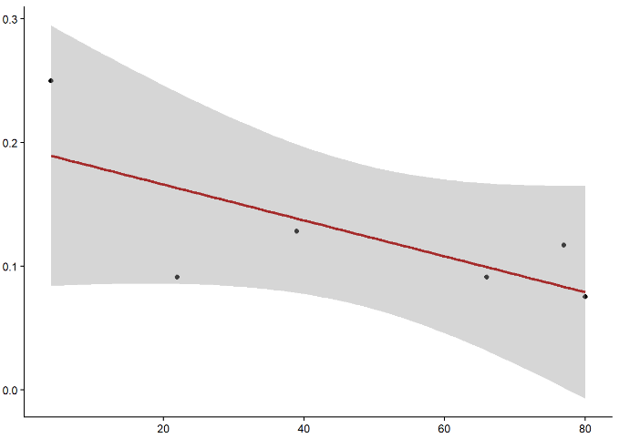
Results – Endoparasitoids (Conopidae)
Conopids were found at every site sampled in June 2024. Average parasitism rate was 12.5%
Conopid presence was positively associated with bee abundance (p = 0.0052), but proportion of bees parasitized was not (p = 0.5)
Conopid presence was not associated with bee body size (IT span or marginal cell length) in neither B. impatiens (p = 0.076) nor B. griseocollis (p = 0.186), contradicting current literature
Proportion parasitized
p = 0.12
Bee Abundance
17

Slide 18
Results – Microbial Parasites
(Nosema, Apicystis)
 | Bombus impatiens | Bombus griseocollis
Avg. Nosema frequency | 11.43% | 10.86%
Avg. Apicystis frequency | 44.08% | 26.29%
No Crithidia data at the current moment
Nosema infection frequency consistent across sites, species, and time, average of 10-11% prevalence for both species
Apicystis
Higher frequency in B. impatiens
Did not change throughout the summer

Slide 19
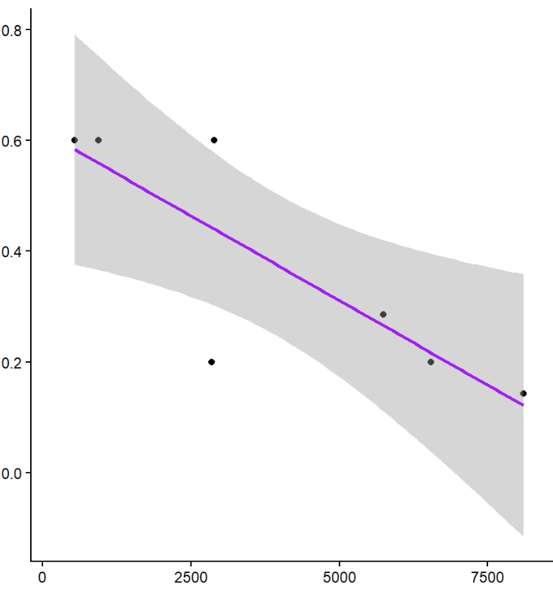
Results – Landscape & Local Factors
Surrounding land use does not influence the presence of Nosema, Apicystis, or conopid endoparasitoids, as many measurements are similar across habitats
Apicystis presence affected by local factors
Negative association with increased inflorescence number
Dilution effect of many flowers at a single site: Graystock et al. 2020
Apicystis Prevalence, B. impatiens
p = 0.0218
Inflorescence Number

Slide 20
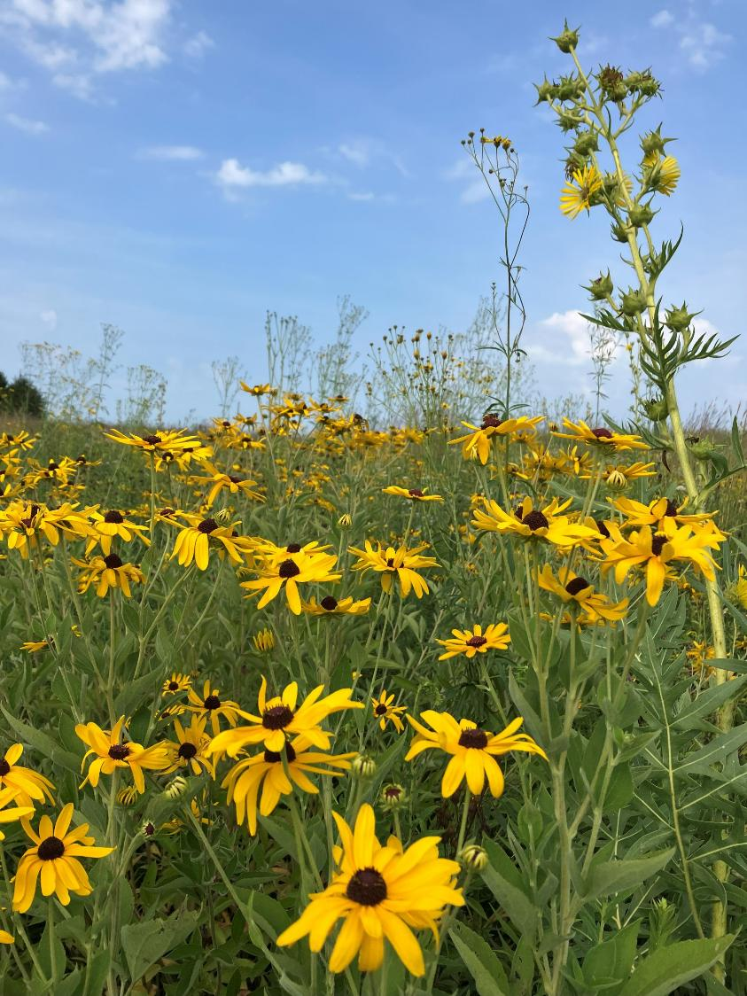
Conclusions
Some parasites fairly consistent across CP42 sites in East-Central Illinois
Apicystis bombi in Bombus impatiens influenced by the number of inflorescences in a site: potential dilution effect
Landscape surrounding CP42 sites had no apparent effect on bee abundance, richness, or parasite prevalence
Local effects seemed to have the strongest impact – Important for restoration and management

Slide 21
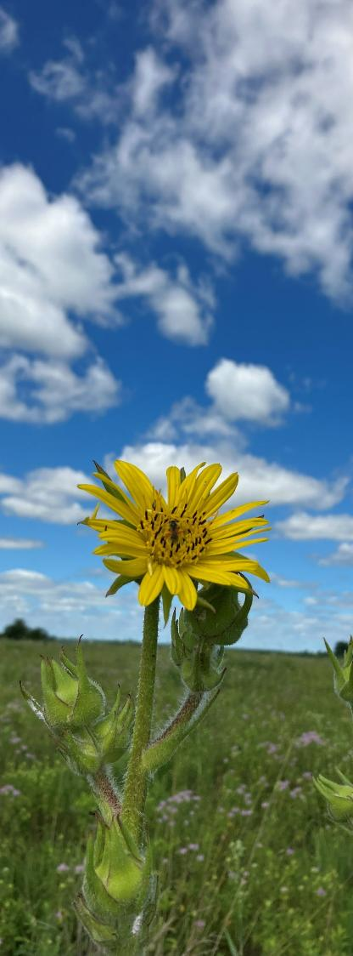
Future Directions
Crithidia results!
Continue with sampling at more sites
Year 2 sampling this summer in 6 additional sites that had >25% forest within 2km of each site
Investigating/modeling connectivity between CP42 sites
A potential reason for consistent Nosema frequency is that habitats are more connected than assumed
Bruns et al. (2024) found little genetic differentiation between populations of B. grisecolllis in new CP42 habitats in Iowa – possible connectivity for gene flow could transfer to parasite transmission

Slide 22




Acknowledgements
Harmon-Threat Lab: Alex Harmon-Threatt, Jon Tetlie, Adrien Seabloom, Timo Wayman, Jenaya Wilder, Alia Frickensmith, Alin Oritz-Hernandez, Sarah Rodriguez
UIUC Department of Entomology
Collaborators
Dr. Ben Sadd – Illinois State University
Dr. Shiloh Lueschow-Guijosa, Dr. Christopher Dunlap - USDA
CP42 Landowners
Funding: GNC24-403, NCR SARE

Slide 23
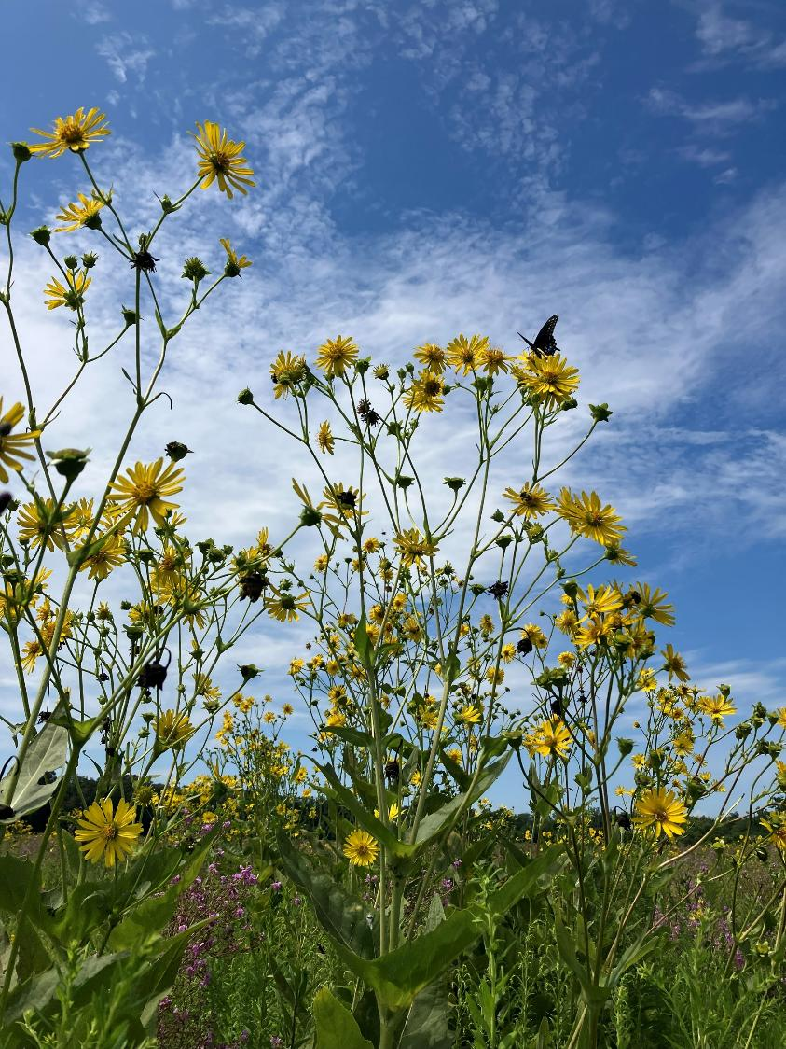
Thank you!
Questions?
Contact: awargin2@illinois.edu

