Slide 1
Livestock Drinking Water Quality
Eve Brantley, Ph.D., Extension Water Specialist
Kim Mullenix, Ph.D., Extension Beef Specialist

Slide 2
Livestock Water Quality
Water quantity and quality are important for overall maintenance of herd health and productivity
If water is suspected of causing a health problem, seek veterinary assistance to determine a diagnosis

Slide 3
How much water do cattle need?
Between 7-20 gal / day Depends on:
Forage dry matter
Season
Physiological State

Slide 4
Water Needs of Cattle
 | Daily water needs gallons/head
Size class | 50°F | 90°F
400 lb calf | 4 | 10
1,000 lb steer | 8 | 17
Mature cow (1,200 lb) | 8 | 20

Slide 5
Forage Dry Matter
Green forage is higher in moisture than dry forage
Water consumption increases when cattle consume hay compared to fresh forage

Slide 6
Season
Higher temperatures increase water consumption
High humidity reduces daily consumption

Slide 7
Physiological State
Water consumption increases with age, weight, pregnancy and lactation
A general rule of thumb is livestock need 2 gallons of water per 100 pounds of body weight each day

Slide 8
Water Quality
Drink More Water + Ability to Consume More Feed = Weight Gain
If drinking water has high levels of contaminants, livestock will drink less of it (less feed, less weight)

Slide 9
Water Supply Considerations
Water Source | Grazing | Resting | Loafing | Drinking time
 | ---------------------------------30 min. increments------------------------------ |  |  | ---sec/day---
Clean water* | 18 | 8 | 1 | 77
Pond – pumped | 16 | 9 | 2 | 80
Pond - direct | 16 | 10 | 2.5 | 85
*Clean Water – Well, spring, or river – pumped to trough
Source: Willms et al., 2002

Slide 10
Temperature
Cattle prefer water between 40°and 65° F
Consumption reduced if water is warmer than 80° F

Slide 11
Salinity / Total Dissolved Solids (TDS)
Salinity includes sodium chloride (common salt), magnesium (Epsom salt), calcium, and sulfate
Levels of salinity <1,000 mg/L are considered safe to drink
Above this level, livestock may limit water intake and experience adverse health effects such as diarrhea

Slide 12
Nitrate
Safe levels for livestock drinking water are below 100 mg/L
Nitrate levels above 300 mg/L may result in severe health problems and death
Be aware of nitrate levels in water and feed to ensure a balanced diet

Slide 13
Why Worry About Nitrate?
Nitrate is reduced to nitrite in the rumen
Nitrite limits amount of oxygen that can be carried in blood
Special concern during drought when certain forages may accumulate high concentrations of nitrate - summer annual grasses, bermudagrass, and Johnsongrass under conditions of high nitrogen fertilization

Slide 14
Pathogens
Pathogens are disease-causing organisms that may be introduced by untreated animal waste
Consuming untreated waste can lead to health concerns

Slide 15
Cyanobacteria (blue-green algae)
Excess nutrients and stagnant water can stimulate harmful algae growth, such as cyanobacteria, also called blue-green algae
Cattle can become sick from toxins (microcystins) released by blue-green algae

Slide 16
Protect Drinking Water
Test drinking water source annually
Auburn University Soil and Water Test Lab can screen water samples for 16 parameters of interest including nitrates, pH, and total dissolved solids
http://www.aces.edu/anr/soillab/ (new page when we know)

Slide 17
Protect Drinking Water
Limit livestock loafing in ponds or wet soils
Infections from soil borne bacterium, such as fusobacterium or foot rot, may be transmitted with increased exposure to stagnant water and wet soils

Slide 18
Protect Drinking Water
Manage access of livestock to ponds or streams
Keep a healthy streamside forest to protect streams and rivers
Protect water source watershed by maintaining plants and limiting chemicals and manure transport into the water

Slide 19
Protect Drinking Water
Pipe water to a quality water trough or other waterer
Freeze proof troughs (examples include floating ball top waterers) work well in cold weather and keep water cool in the summer - they also keep water relatively clean and free of algae

Slide 20
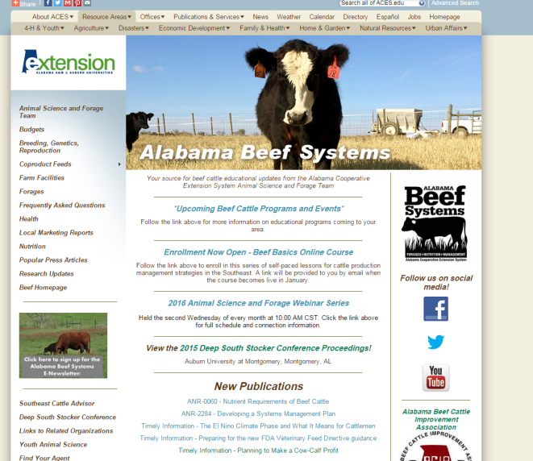
Protect Drinking Water
For more information, check out these websites:
www.aces.edu/beefsystems
www.aces.edu/anr/soillab

Slide 21
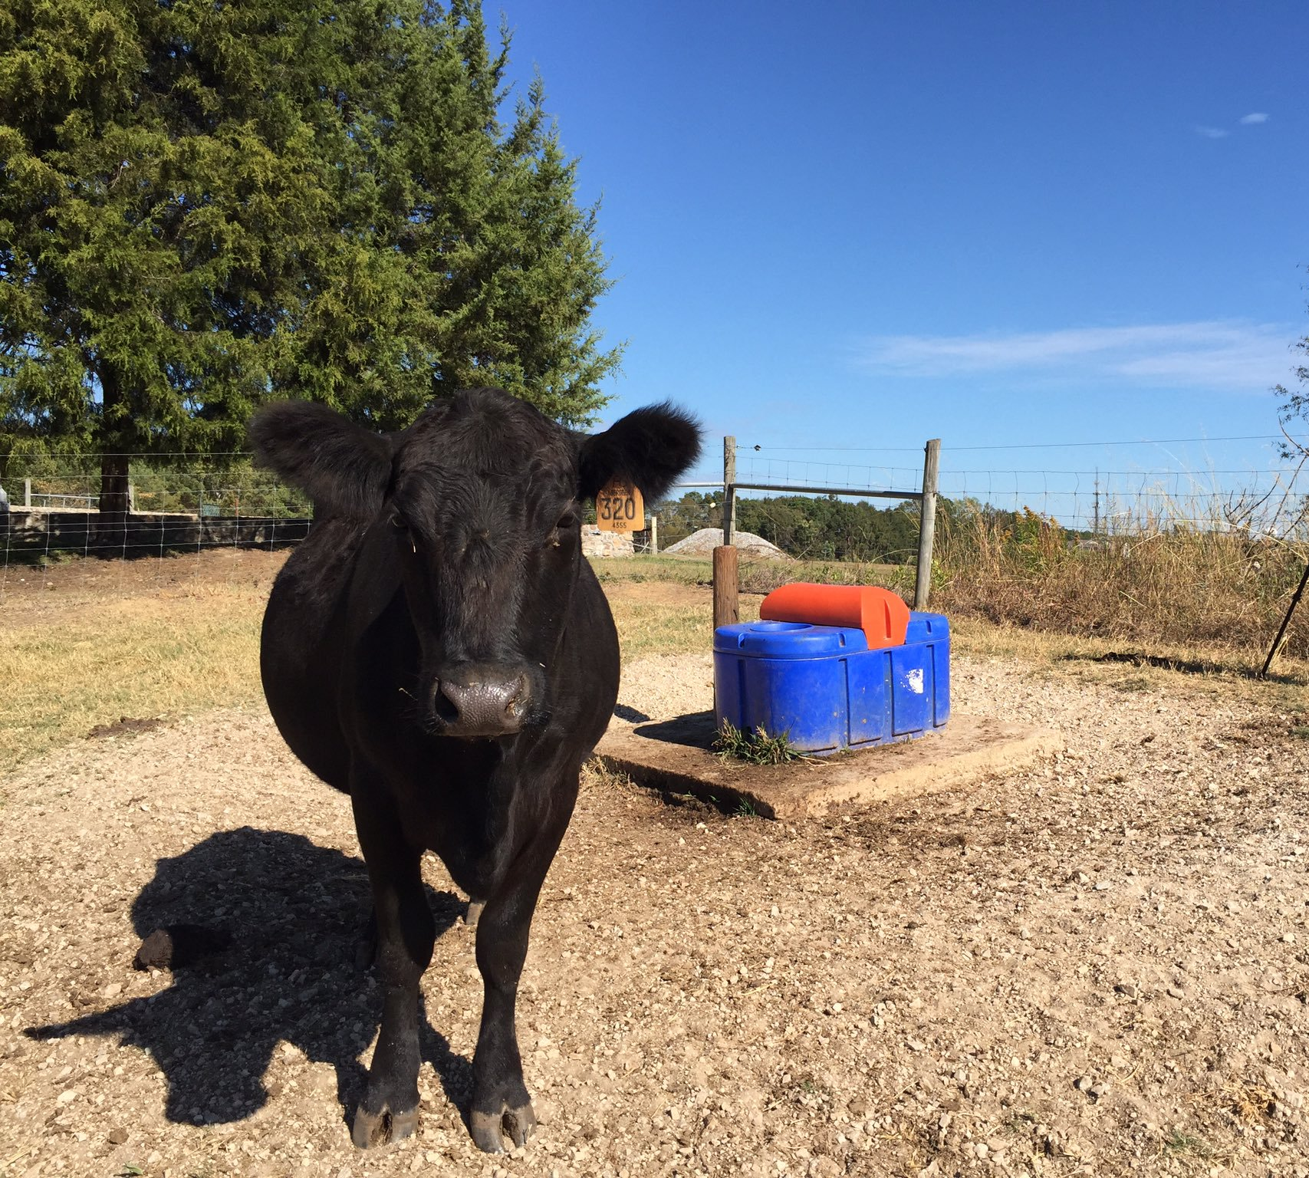
Questions?

