Slide 1
Water Quality

Slide 2
Growth and health of fish in the cages will be reliant on a healthy environment
If fish are stressed or poorly fed they are more likely to get sick
In general our seawater is free of pollutants and clean in Micronesia

Slide 3
Water Quality Parameters
Salinity – amount of salt in the water
Ammonia – waste product of the fish
Turbidity – amount of small particles in the water
Dissolved oxygen
For the most part proper site location and stocking densities will avoid problems with water quality issues.
Rabbitfishes can withstand low salinities and high turbidity for short periods of time. These a most likely to be caused by heavy rainfall

Slide 4
Dissolved Oxygen (D.O.)
This is the most critical water quality parameter for cage culture.
If the water stops moving through the cage and/or it is too densely stocked the D.O. can drop really rapidly.
Seawater at 29 C only holds 6.5 parts per million (ppm) of D.O.
Fish start to become stressed when the D.O. drops below 5 and start dying when it drops below 2 ppm.
When fish are stressed they stop eating or develop diseases more easily

Slide 5
Think of a fish cage as a car full of people
At low densities and with the windows open, everyone is happy
Think what would happen if you closed the windows and stop the car?

Slide 6
What if you overstock your cage?
It is stressful you would run of air much faster if you roll the windows up.

Slide 7
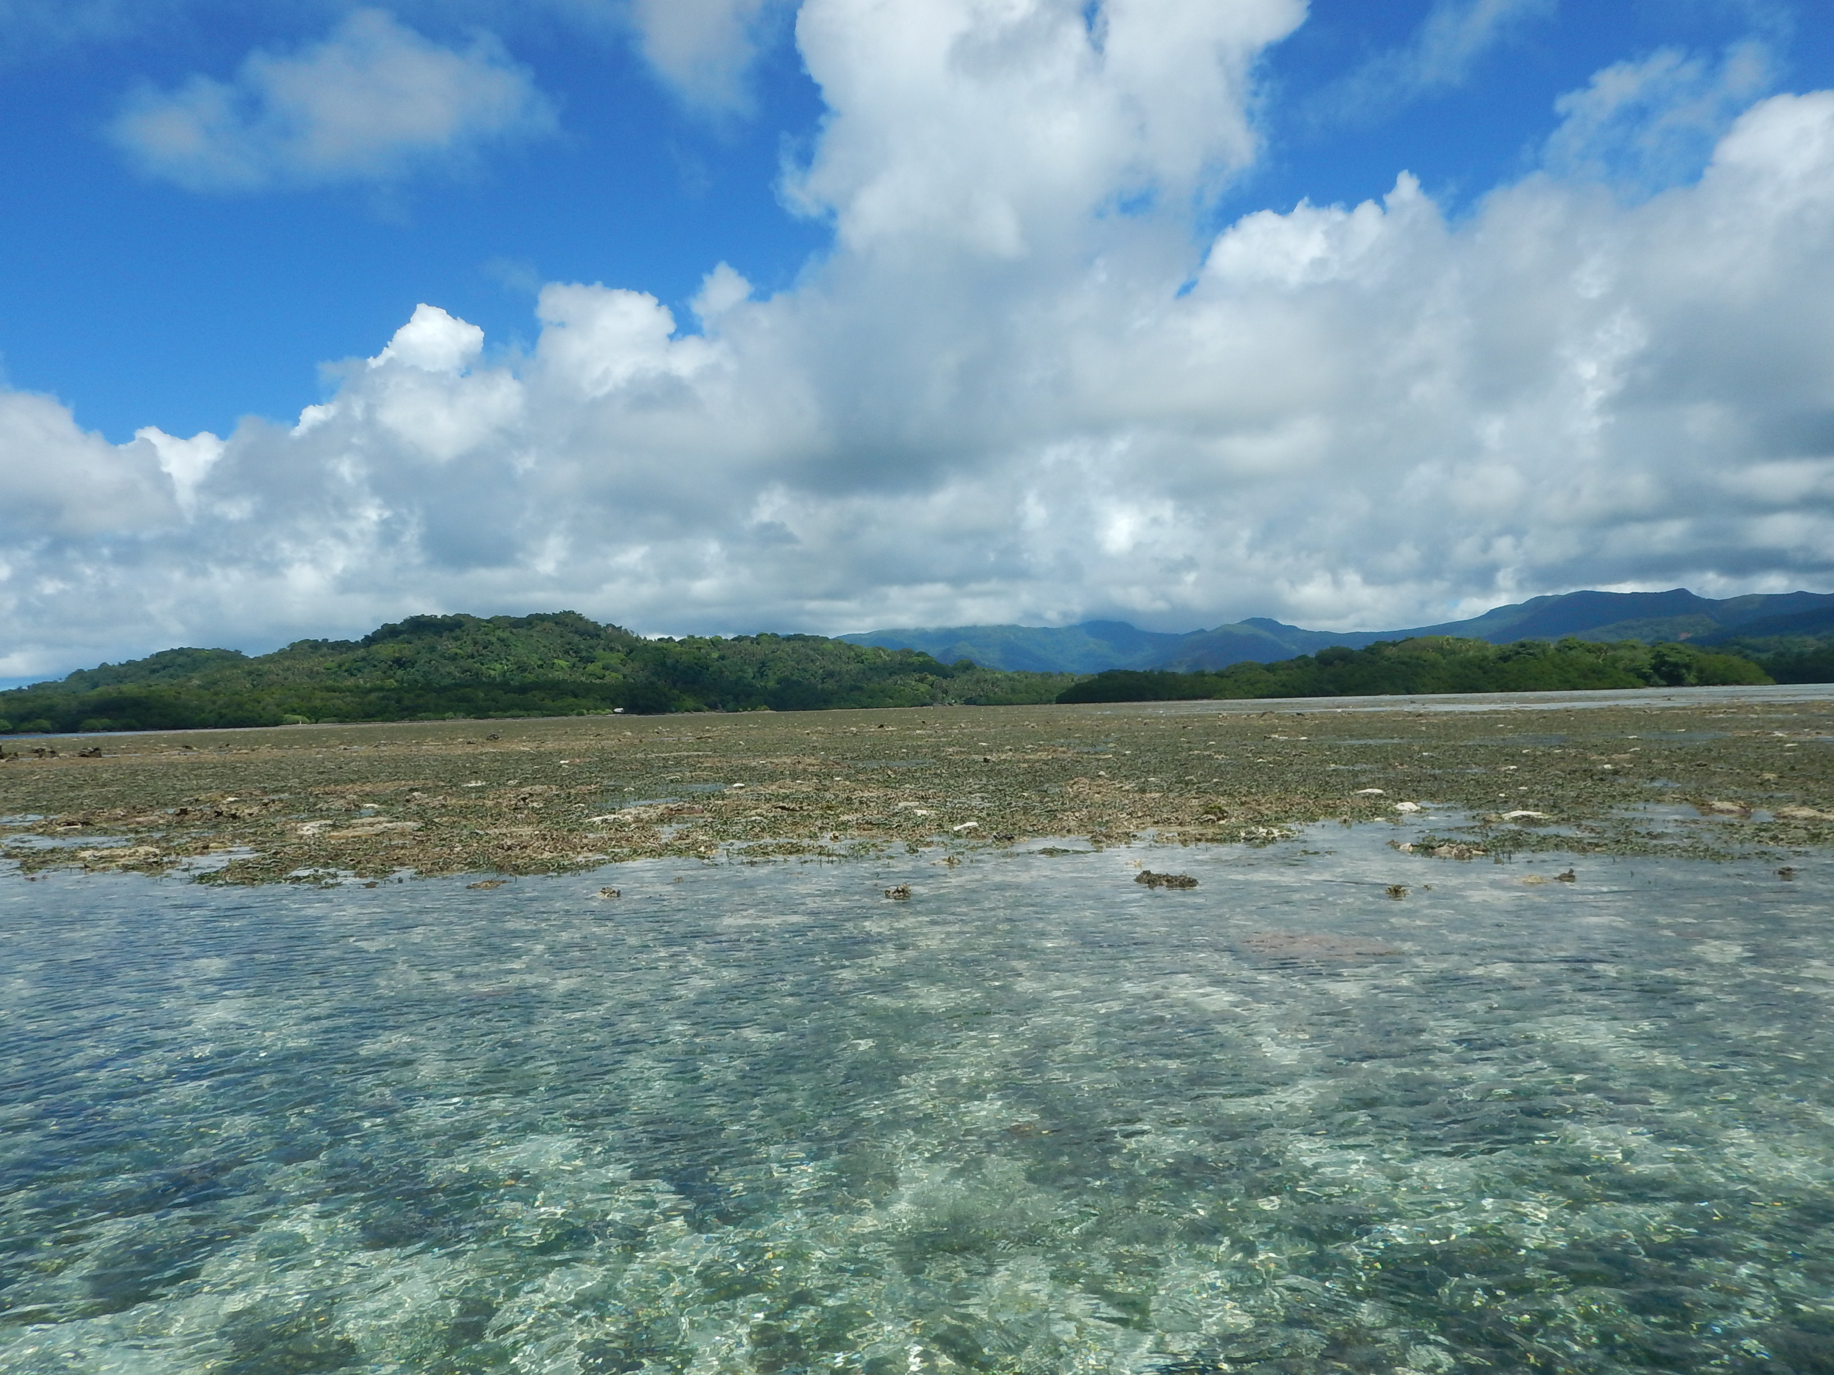
Like us fish needs oxygen constantly
If your cages are in low D.O. conditions for just one 30 minutes period in a whole year it can
kill your fish.
Need conditions with
good water flow nearly
all the time.

Slide 8
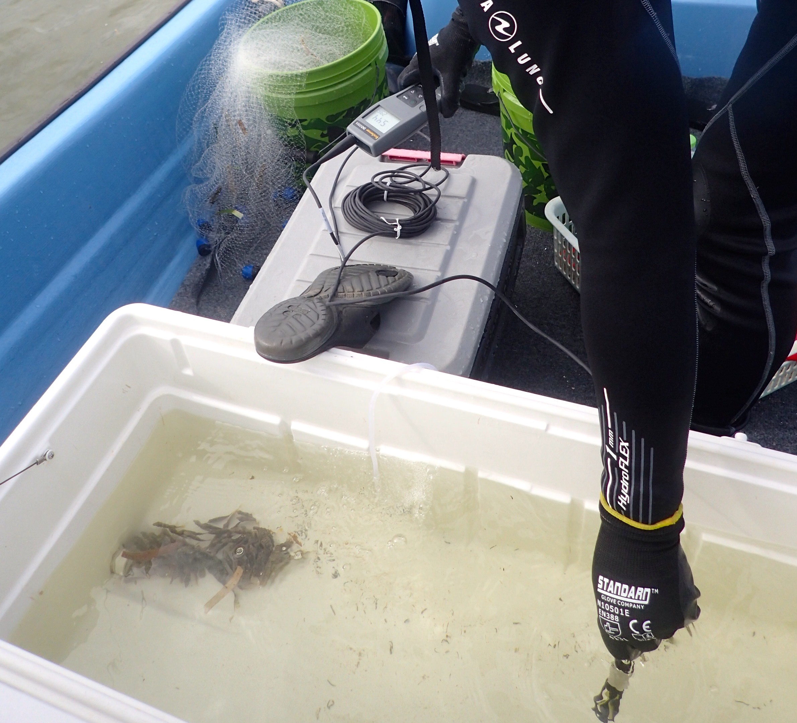
Dissolved Oxygen Meter
Can be used to measure oxygen during low tides or times of slow water movement

Slide 9
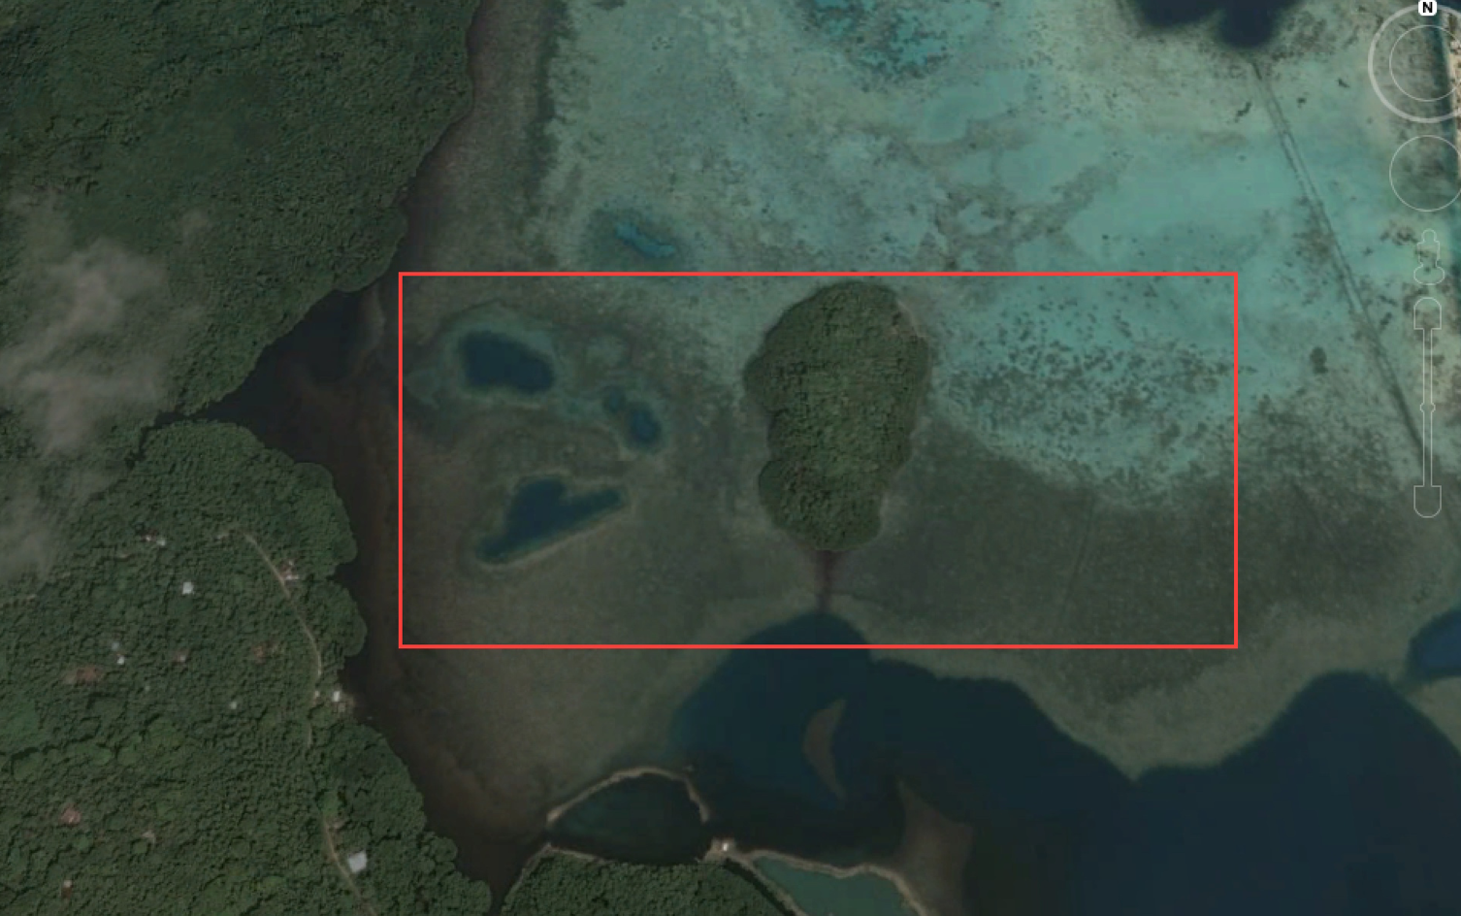
Conditions at MERIP cages
So far no fish die offs and no signs of stress
Conditions are clean and stocking densities are low
Water ranges from clear to moderately turbid
No nearby streams or rivers to lower salinity
Water flow across the cages is good

