Slide 1


Exploring HIVES: what is involved in a therapeutic beekeeping program
History of Beekeeping with Veterans
Therapeutic Beekeeping: What is involved
HIVES Program- benefits and outcomes
Q&A

Slide 2

By the end of the Webinar, you'll be able to:
Explain what is needed for successful implementation of a HIVES Therapeutic Beekeeping Program.
List specific equipment, skills and knowledge needed to facilitate a program.
Identify the benefits and outcomes of facilitating a HIVES program.

Slide 3





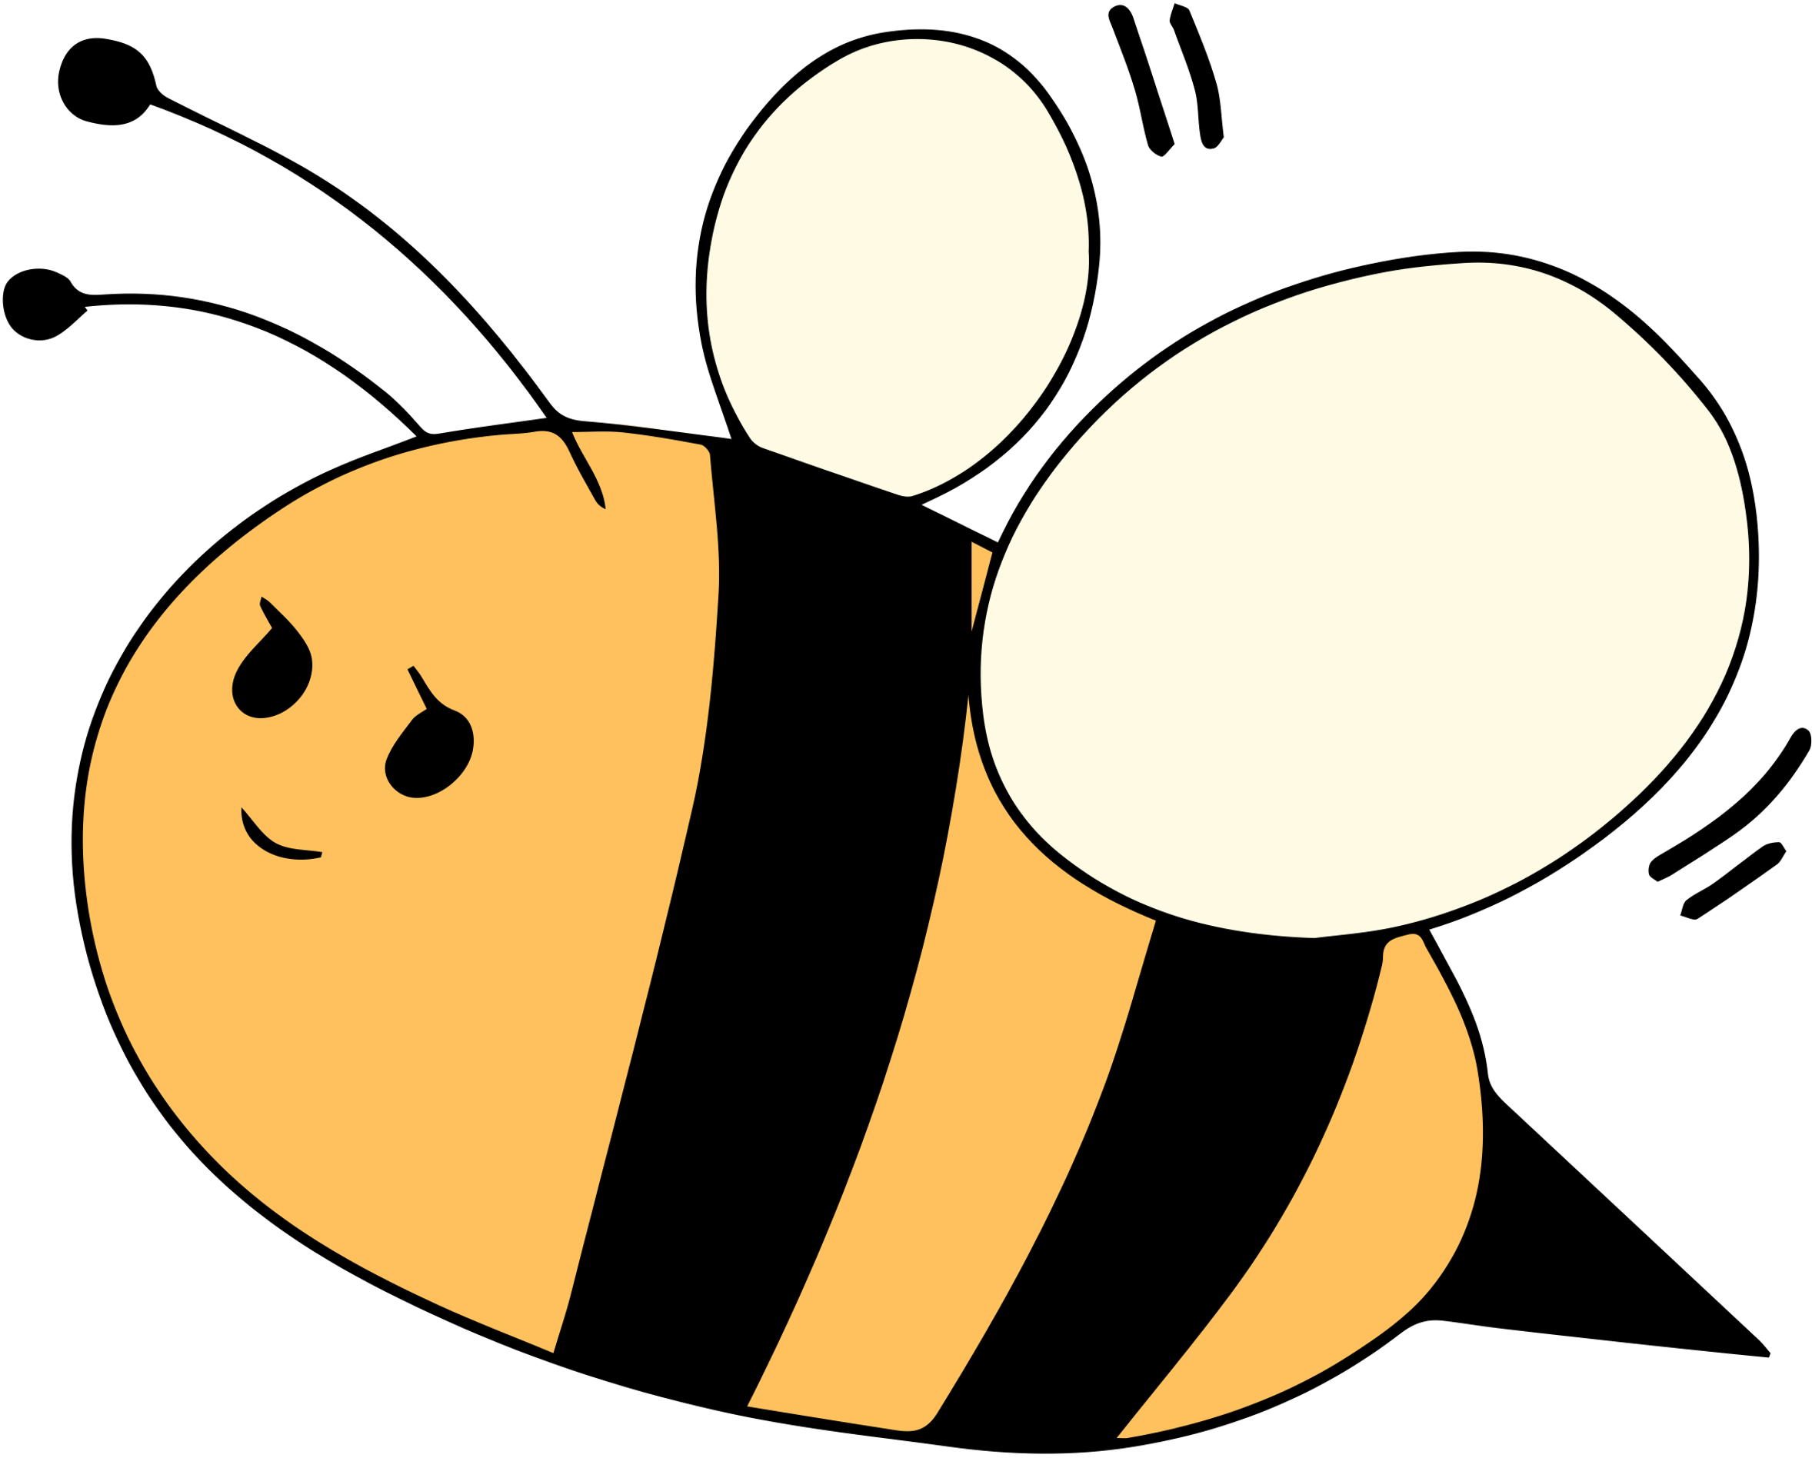

Adam Ingrao, PhD
Valerie Carter, MS, CTRS/L
Manchester VA Healthcare System

Slide 4







Disclosures
We, have not had any personal financial relationships in the last 12 month with the manufacturer of products or services that could be discussed in the following presentation.
This material is based upon work that is supported by the National Institute of Food and Agriculture, U.S. Department of Agriculture, under agreement number 2023-38640-39573 through the North Central Region SARE program under project number ENC23-229. USDA is an equal opportunity employer and service provider. Any opinions, findings, conclusions, or recommendations expressed in this publication are those of the author(s) and do not necessarily reflect the view of the U.S. Department of Agriculture.
Disclaimer: Provided resources in this presentation is not an all-inclusive list and does not signify endorsement or approval of any particular education, training, company, or organization.
Reference from this presentation or from any of the information services sponsored by the VA to any non-governmental entity, product, service or information does not constitute an endorsement or recommendation by the VA or any of its employees. We are not responsible for the content of any “off-site” web pages referenced.
c

Slide 5
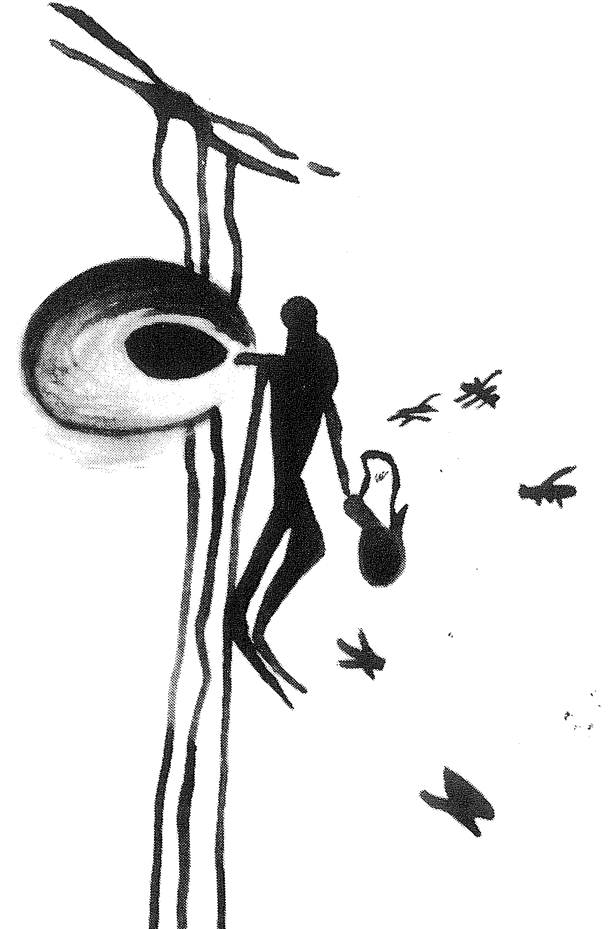
History of beekeeping and therapeutic beekeeping for Veterans
6000BC- Wild honey collection in Spain
1851
Movable frame hive invented by Lorenzo Langstroth
2600BC- Beekeeping in Egypt
First honeybees in America
1919 US veterans recruited as beekeepers
1622

Slide 6
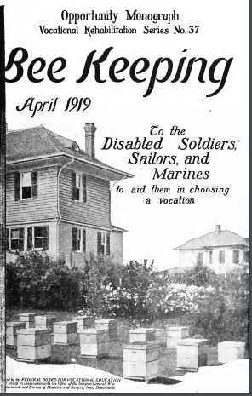
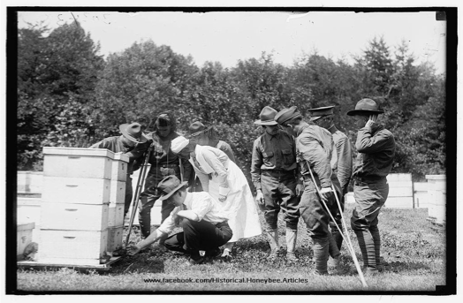
In 1919 as troops returned from World War I, the federal government began recommending beekeeping as a profession for soldiers, especially disabled veterans.
EF Phillips led training of veterans through USDA (later went on to Cornell Univ.)
Beekeeping was important part of the war effort
Sugar rationing
Wax for munitions and arms
Wax for Navy ropes
(Federal Board, 1919)

Slide 7
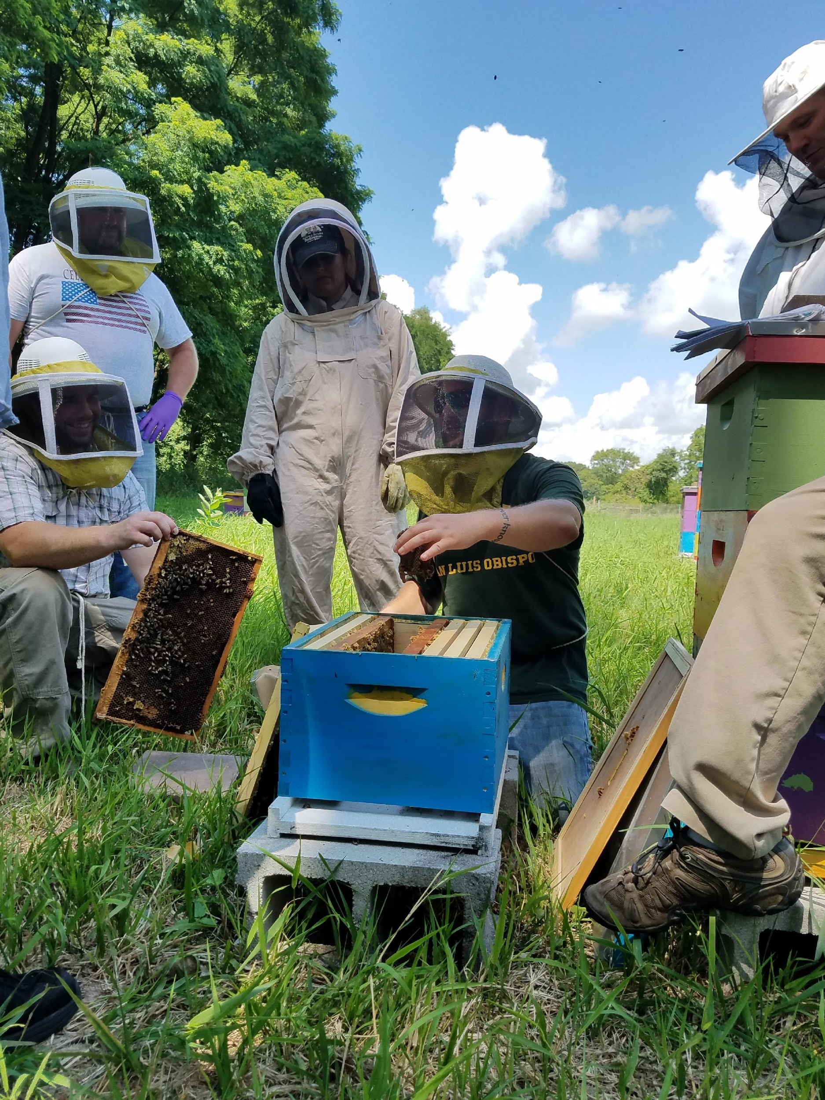
Heroes to Hives
Est. 2015
9-month science-based beginning beekeeping education course
Free to service members, their dependents, Gold Star families, VA staff, and VSOs
Over 15,000 trained

Slide 8

Established 2019
Currently at 4 facilities and VISN 19 Clinical Resource Hub
Manchester, NH
Oklahoma City, OK
Kansas City, KS
Palo Alto, CA
Spreading to at least 3 more in 2025
Shark Tank Promising Practice October 2024, with facilitated replication to Northern CA VA in 2025
Manchester VA Healthcare System

Slide 9





Beekeeping
Equipment, Supplies, and Bees
Hive Maintenance and Colony Care
Safety for the Bees and the Beekeepers

Slide 10



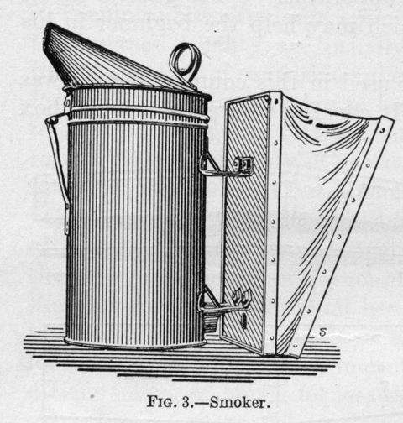

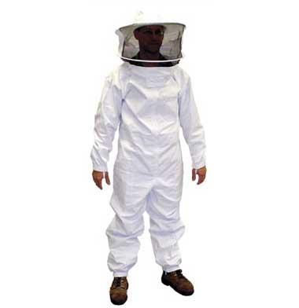
beekeeping equipment
Tools every beekeeper should have
Smoker
Hive Tool
Bee Suit

Slide 11
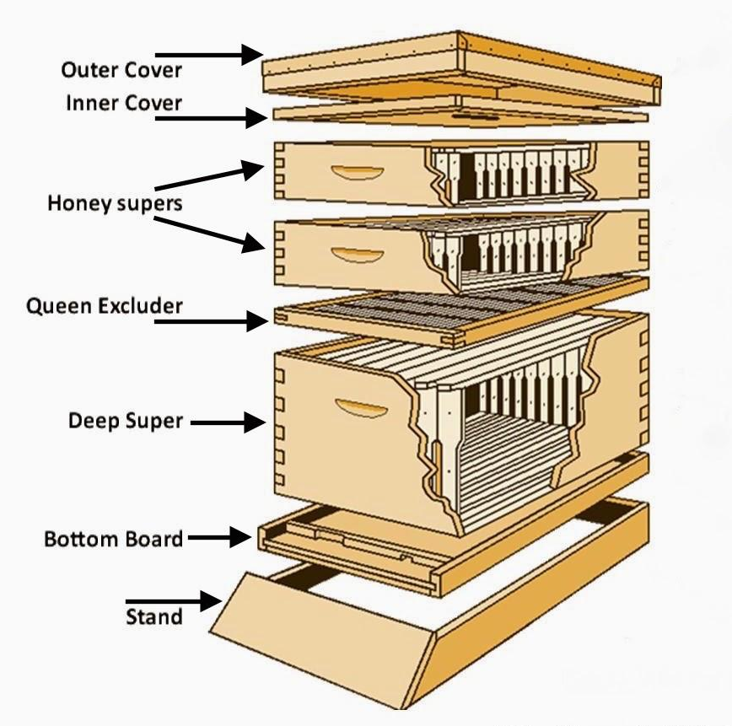
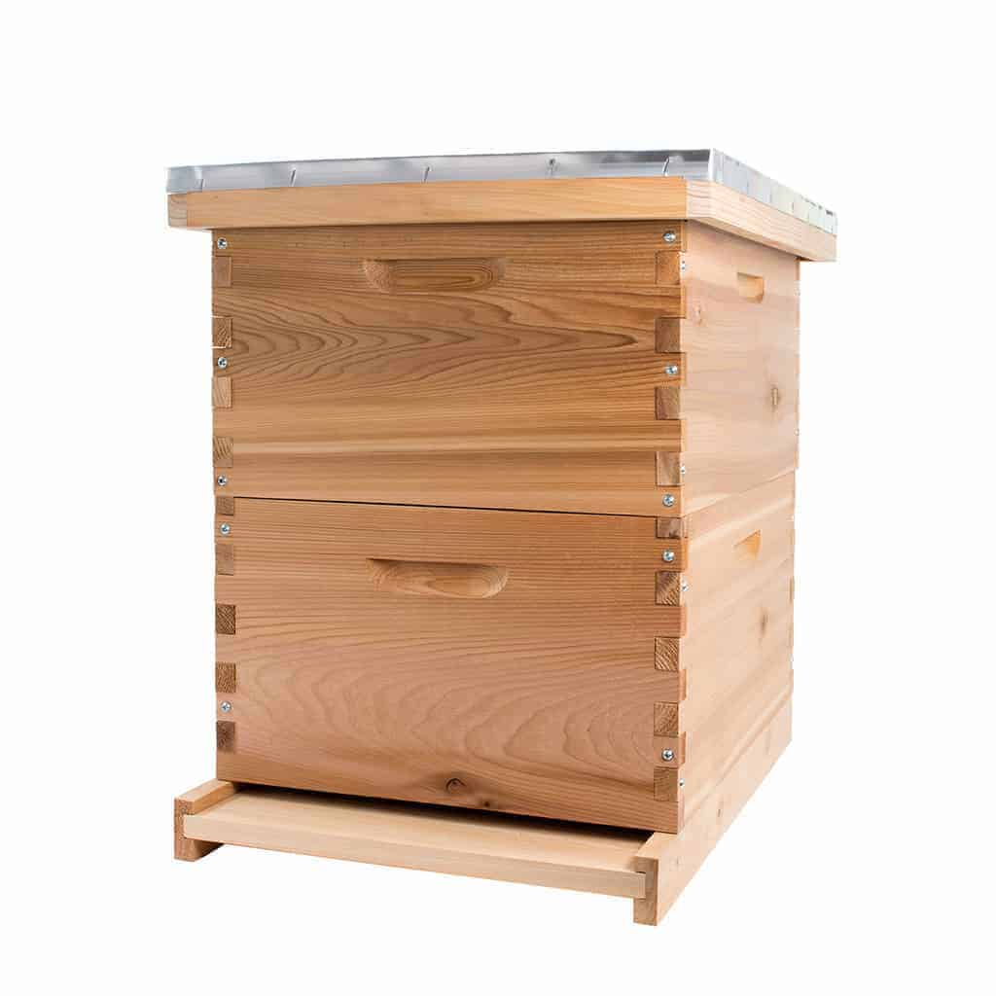
The beehive
Langstroth Hive is the most commonly used in the US

Slide 12
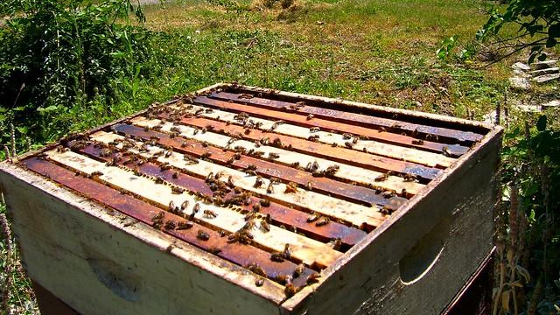
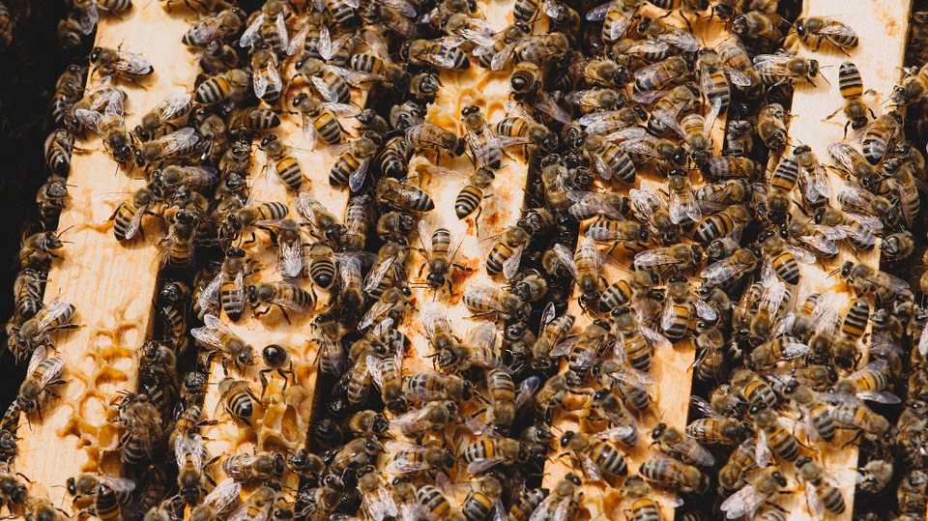
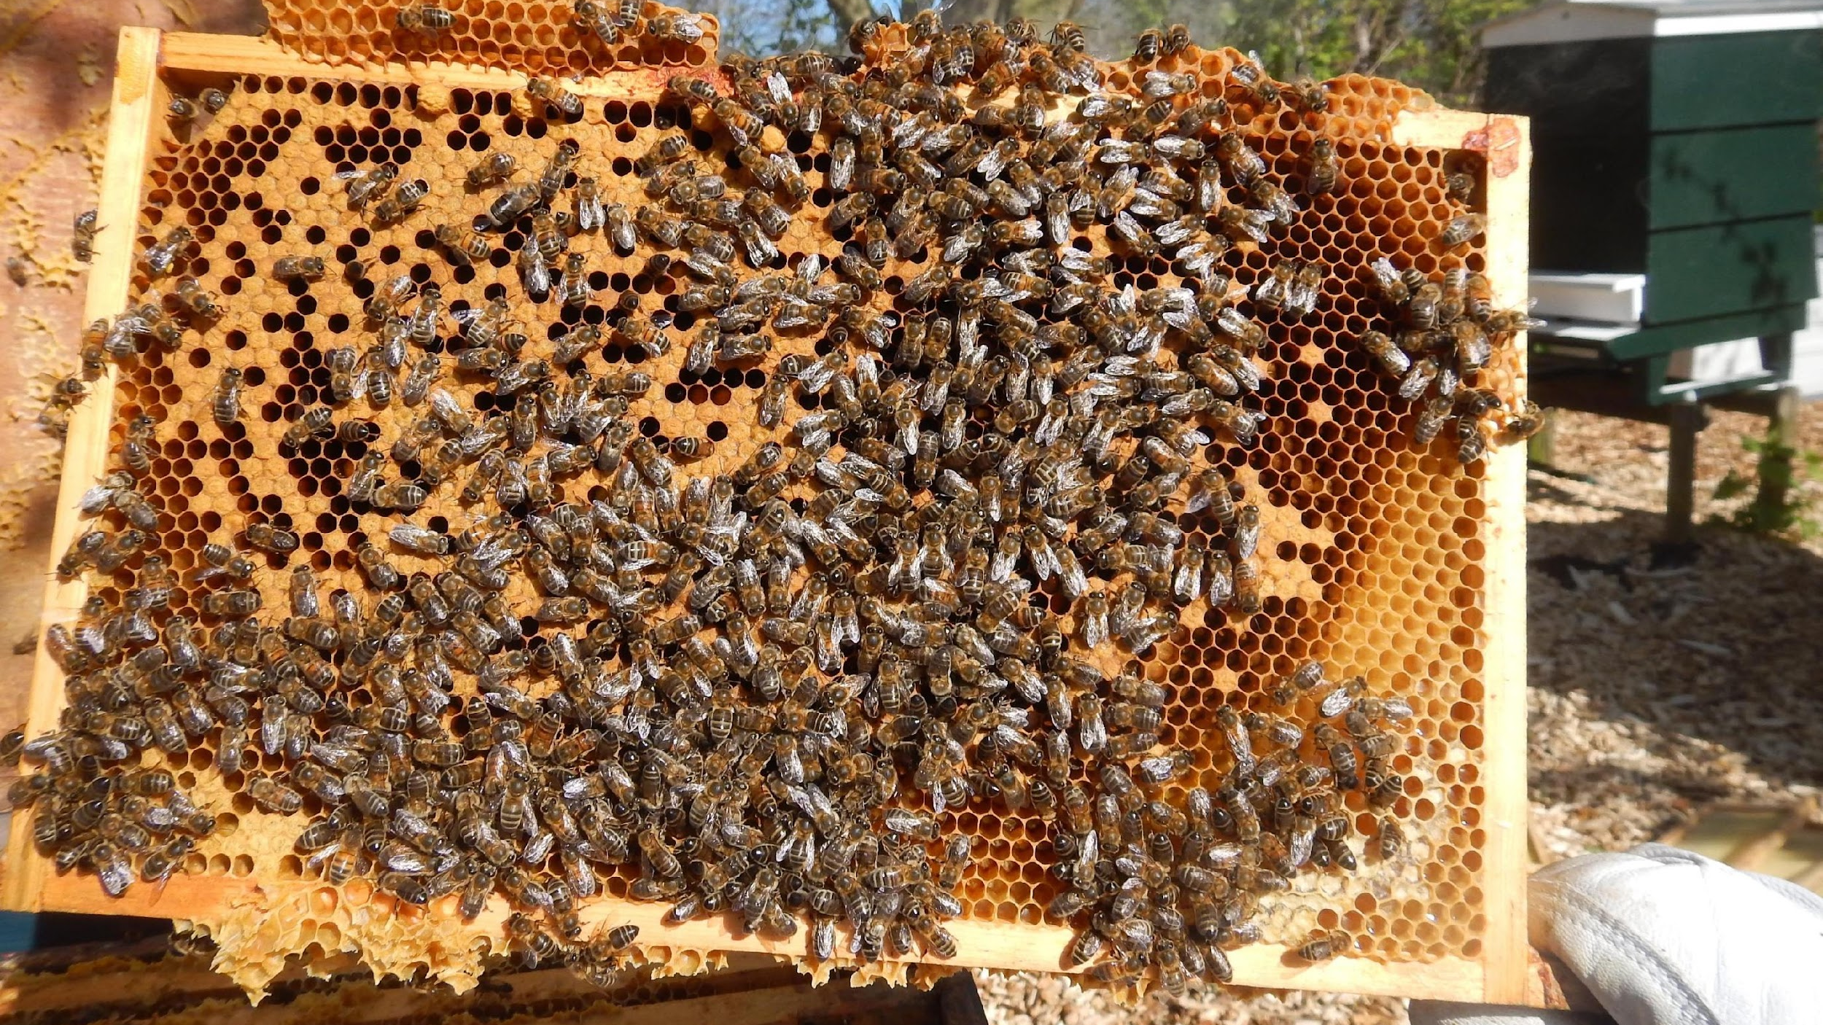
Langstroth bee hive

Slide 13
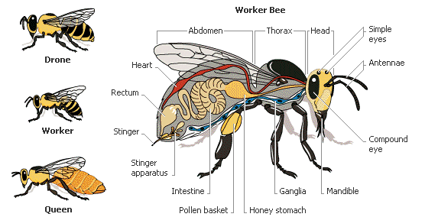
(Anatomy Note, 2019)

Slide 14
beekeeping is year round
Winter
Monitor the hive entrance and keep clear of snow and dead bees
Check for honey stores
Emergency feeding
Clean, repair and maintain equipment
Order any new equipment
Order bees if desired for next year
Try a bee related hobby

Slide 15
beekeeping is year round
Spring
Early season- quick inspections (50+ degrees no wind)
Check for signs of queen once it’s warm enough
Feed colony if needed and monitor food stores
Reverse hive bodies if appropriate
Anticipate colony growth and add supers if necessary
Clean entrances and bottom boards
Requeen failing queens
Split colonies
Manage swarm behavior
Monitor for mites, diseases, and other pests

Slide 16
beekeeping is year round
Summer
Monitor for queen health, brood patterns, colony health
Check for diseases, mites and pests
Add supers
Control swarming/splits
Extract honey
Feed if necessary during dearth
Treat for mites if needed

Slide 17
beekeeping is year round
Fall
Monitor food stores/feed for winter storage
Test mite levels/treat for mites
Check for disease
Requeen or combine weak hives
Put on entrance reducers and mouse guards
Prepare hive for winter
Extract honey

Slide 18
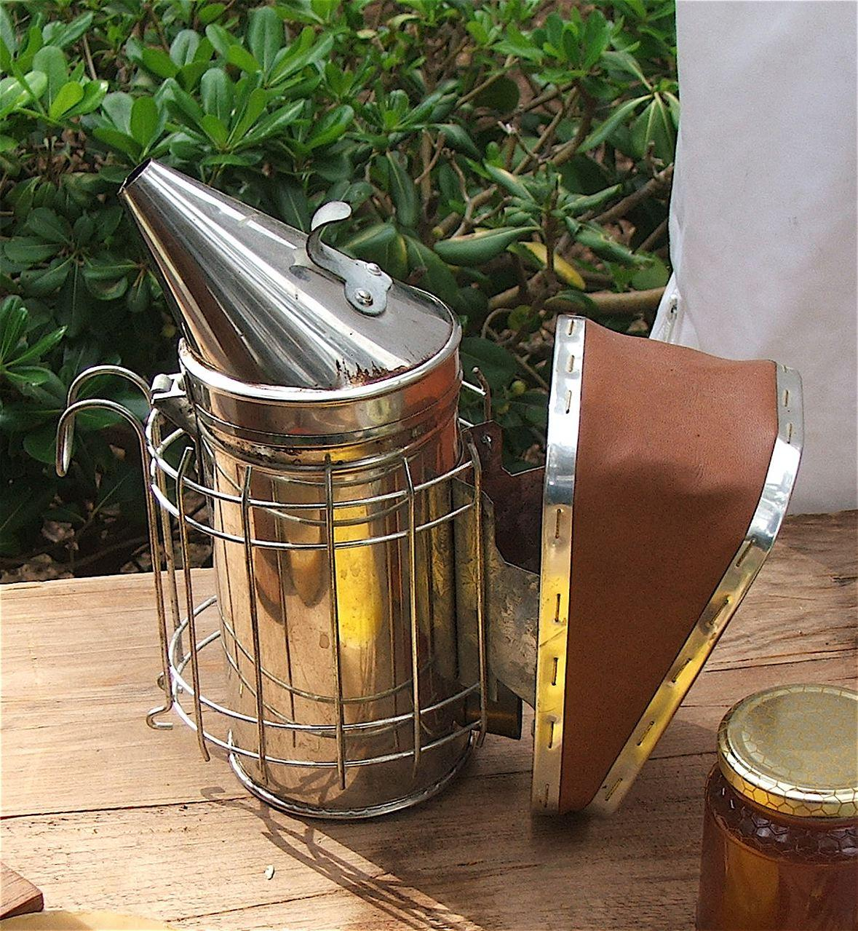
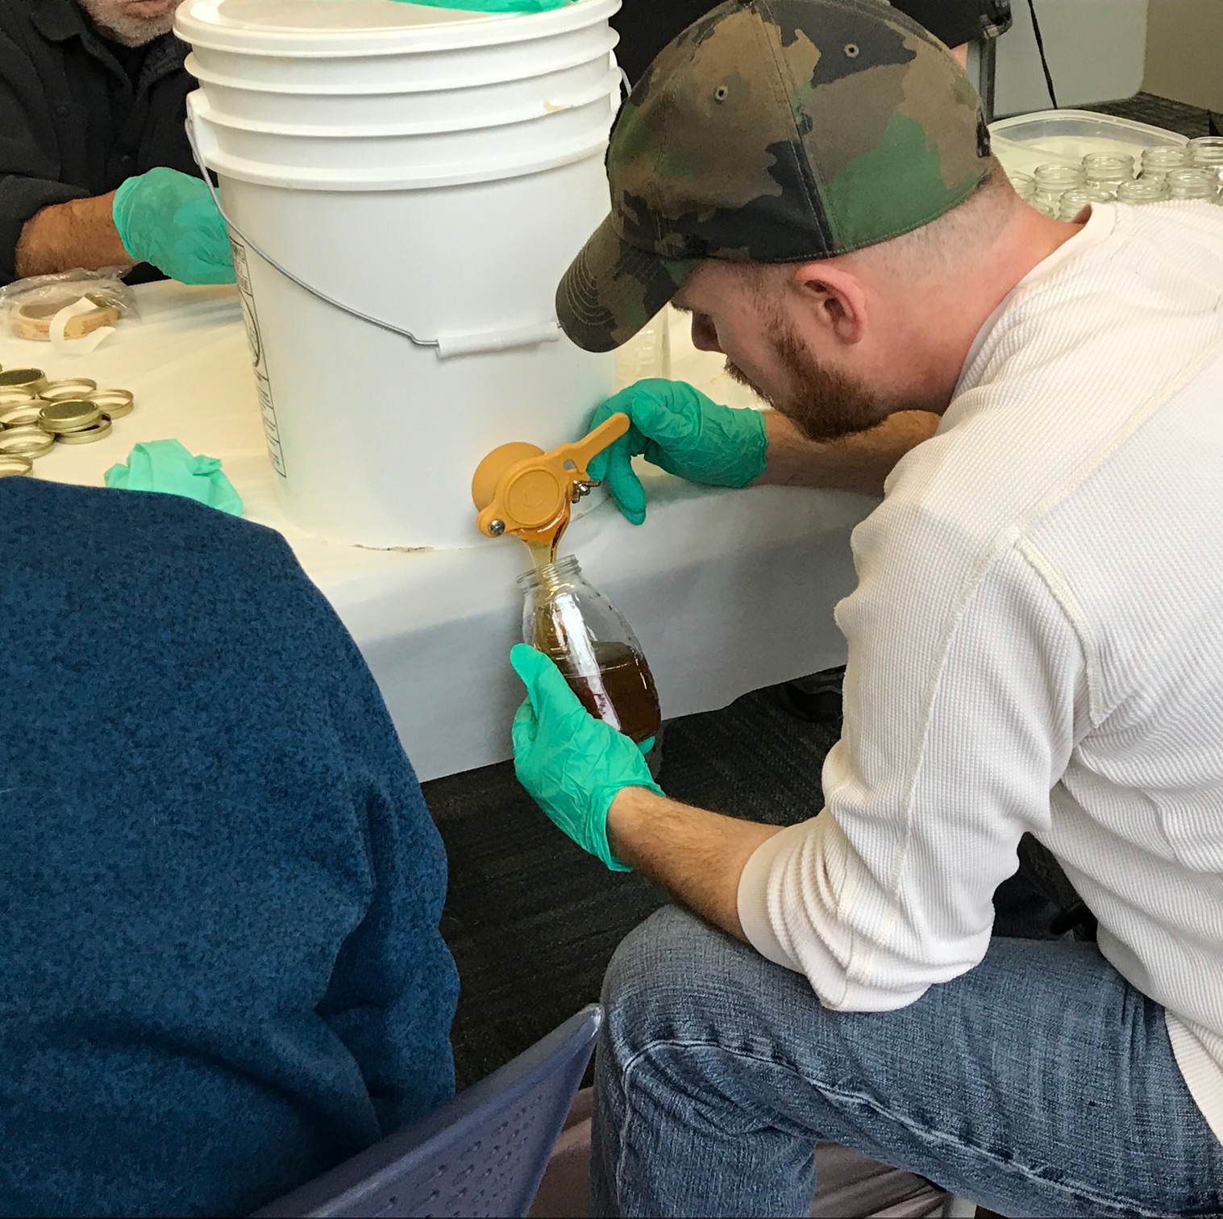
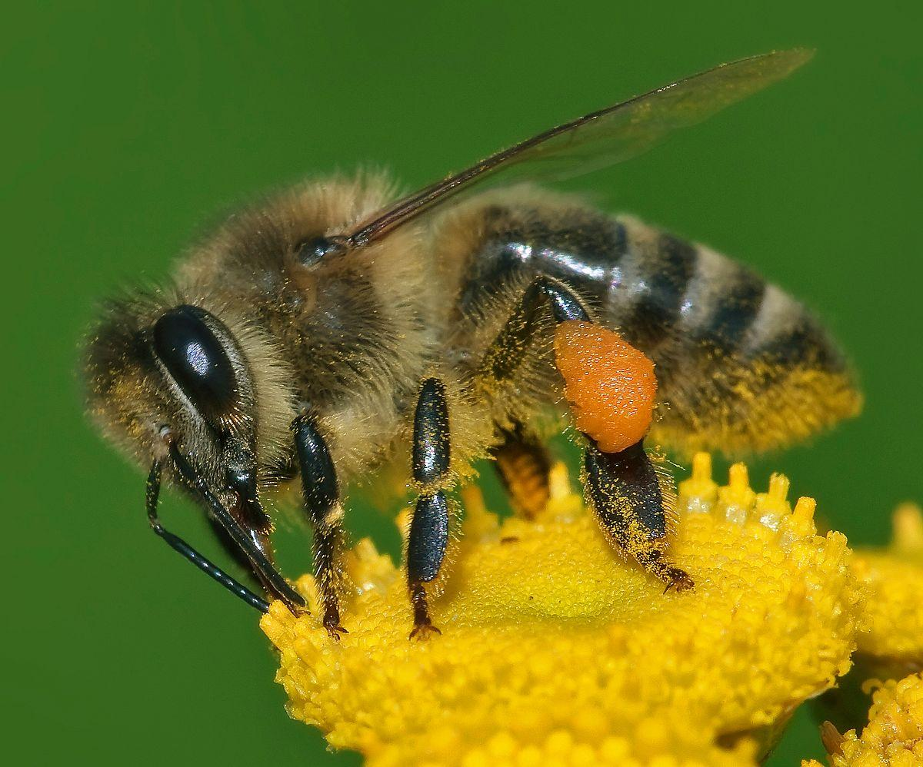
Beekeeper Safety
Bee Stings
Smoker
Honey Bottling

Slide 19
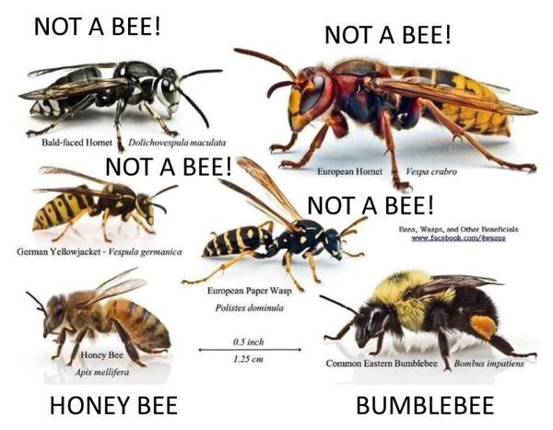
Bees and other stinging insects
(Eco Bee Supply, n.d.)

Slide 20
safety for honeybees
If you are not an experienced beekeeper you will need to partner with a beekeeper with at least 5 years of experience, preferably a master beekeeper
Bees are live animals and should be treated as you would any other animal.
Bees need food, shelter, medicine, and protection.

Slide 21
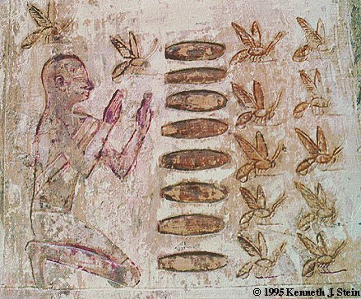
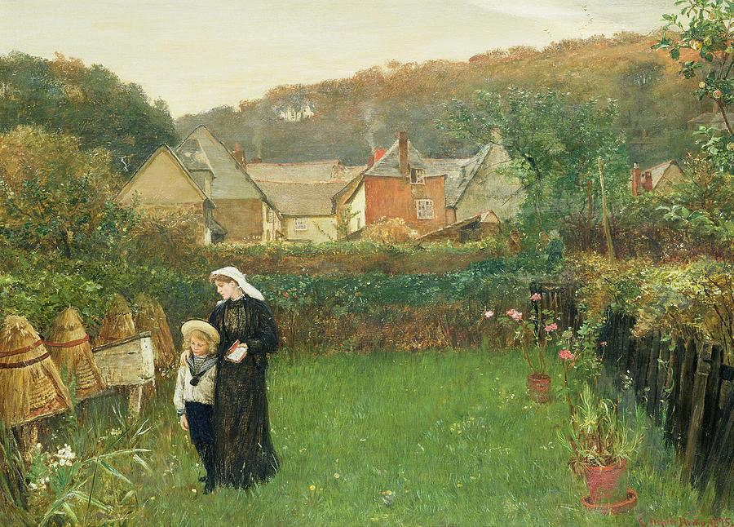
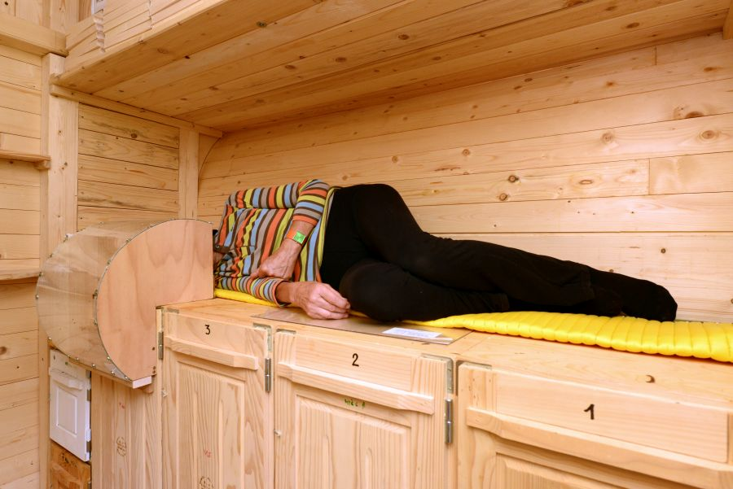
Historical Context of Therapeutic Beekeeping
Manchester VA Healthcare System
Egyptian traditions
Bees are gift from Ra
Celtic traditions
Bees are intermediaries between the world of dead and living
Slovenian traditions
Bees as a healer
Relief with beekeeper at hives
Tomb of Pabesa, Egypt 664 BCE
Apitherapeutic practices in Slovenia
The Widow by Charles Napier Hemy
1895

Slide 22
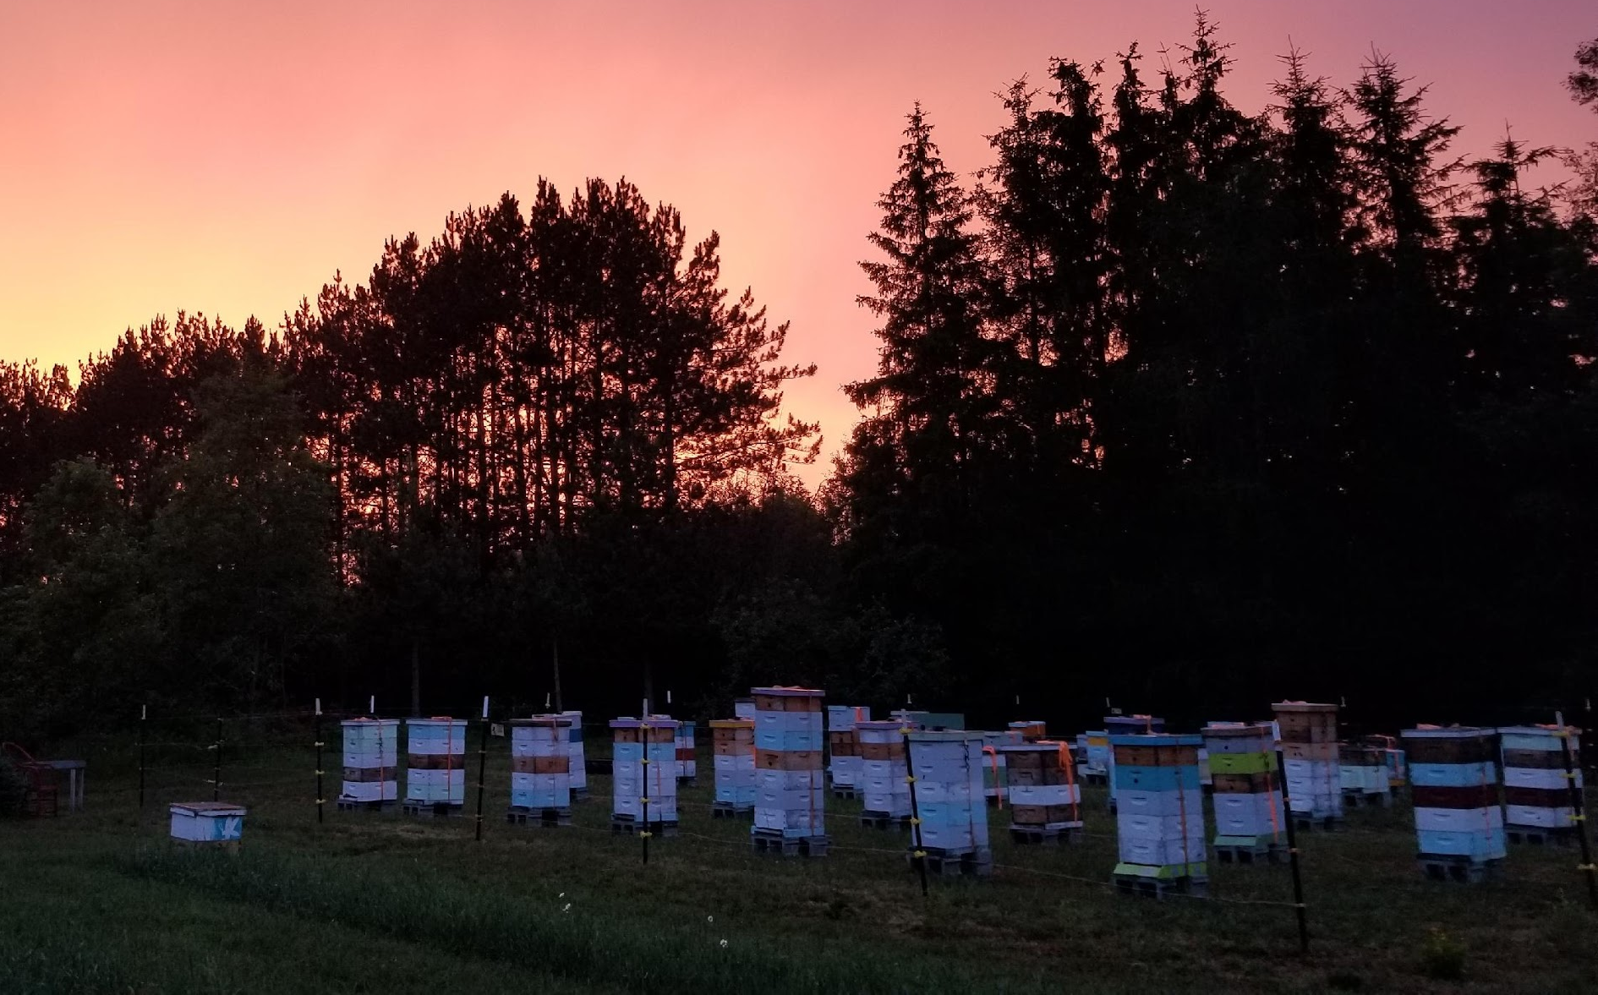
Therapeutic Beekeeping Practices
Practices are rooted in connection with the natural world
Cycles of nature
Stewardship
Gratitude
Interconnection
The world beyond the self
Working beyond the limits of personal identity to engage in a deeper way with our bees
Service and generosity
Gratitude
Refining awareness
Cultivating wisdom
Redirecting motivation
Managing emotions
Improve mental health!
Manchester VA Healthcare System

Slide 23
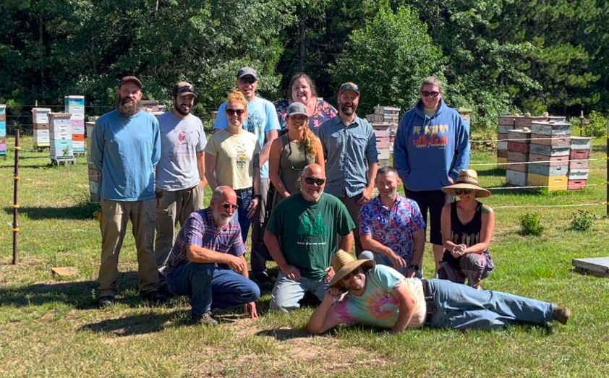
Therapeutic Beekeeping Practices
Breathing and grounding
Guided imagery
Sensory exploration (5 senses)
Yoga for beekeepers
Creating and crossing a threshold
Bee bathing
Communing with bees
Active meditation
Steps of gratitude
Manchester VA Healthcare System

Slide 24
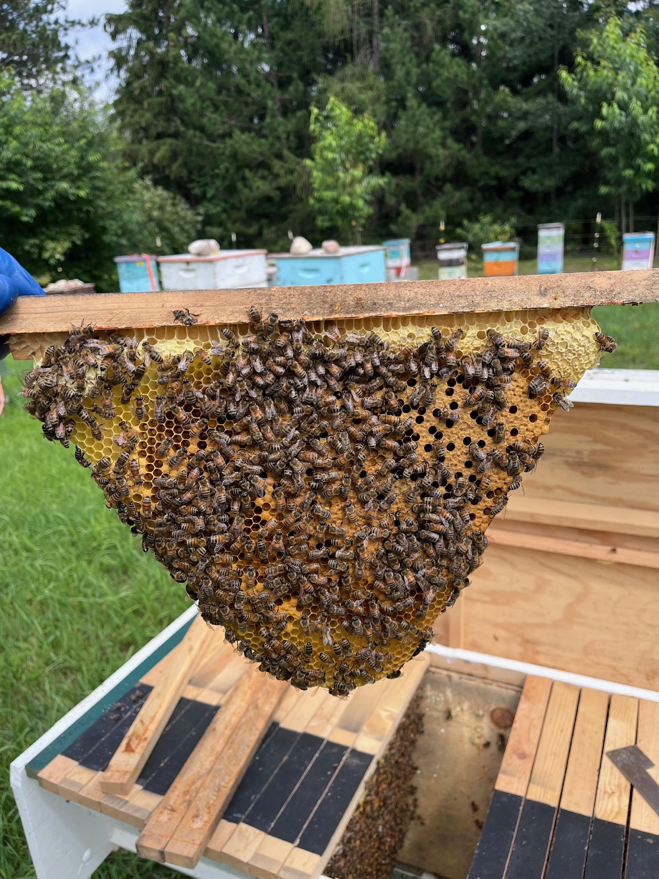
Therapeutic Beekeeping
Heroes to Hives and VA HIVES
Lots of anecdotal evidence that beekeeping helps veterans with anxiety/depression, isolation, sense of purpose… but no peer-reviewed research
Animal therapy is a well-established intervention
Collaboration sought to establish beekeeping as an evidence-based therapy
Manchester VA Healthcare System

Slide 25
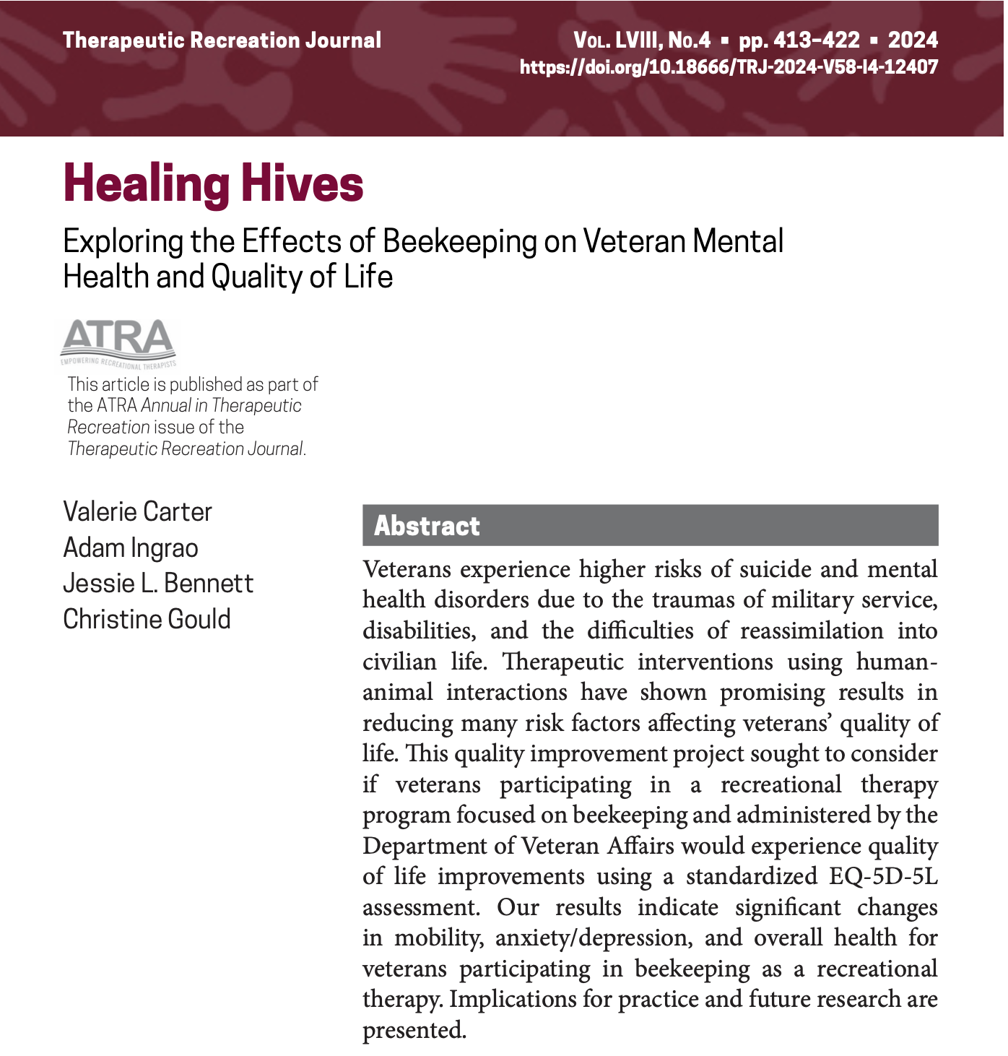
Mental Health Outcomes
Manchester VA Healthcare System

Slide 26
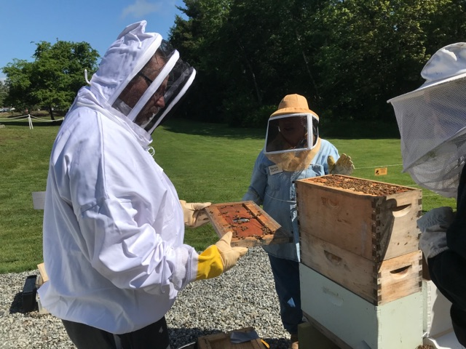
Methods
2022 Beekeeping season conducted pre- and post-surveys of veterans participating in VA therapeutic beekeeping program (HIVES)
Program goals
Learn/improve skills for beekeeping
Improve quality of life and overall wellness
Increase self-esteem through building leisure/recreation skills
Connect with communities (beekeepers) and use common interests to increase social connections.
Decrease feelings of isolation by connecting with other veterans
Increase coping skills for stress, anxiety, and depression through program participation
Evaluation: EQ-5D-5L
Measures 5 health dimensions + overall health
Mobility
Self-care
Usual activities
Pain/discomfort
Anxiety/depression
Manchester VA Healthcare System

Slide 27
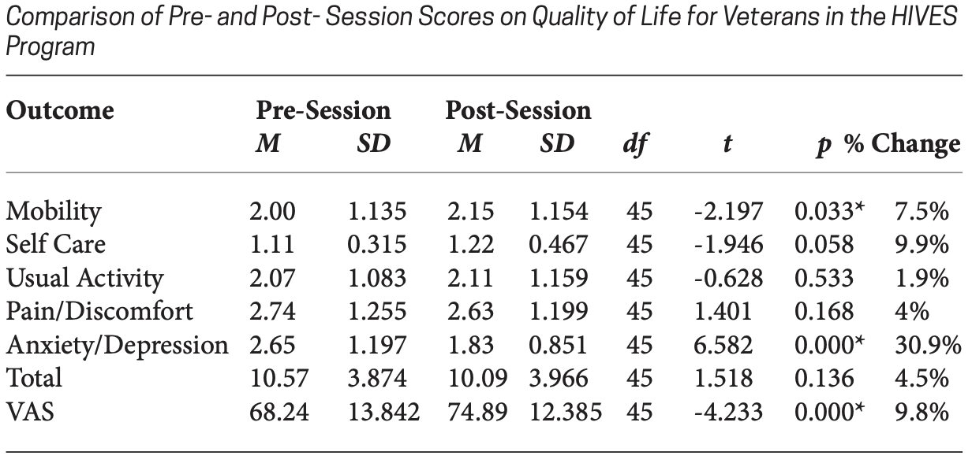
Results
Carter et al., 2024

Slide 28
Results
Carter et al., 2024

Slide 29
Results
Carter et al., 2024

Slide 30

Conclusions
Therapeutic beekeeping interventions reduce anxiety/depression in veterans
Beekeeping as an intervention may decrease mobility – alternative hive styles?
Veterans see improvements in overall health through therapeutic beekeeping
Need for more research
Do we see the same results outside of the VA?
Professional training is needed for clinicians and professional beekeeping educators
Manchester VA Healthcare System

Slide 31
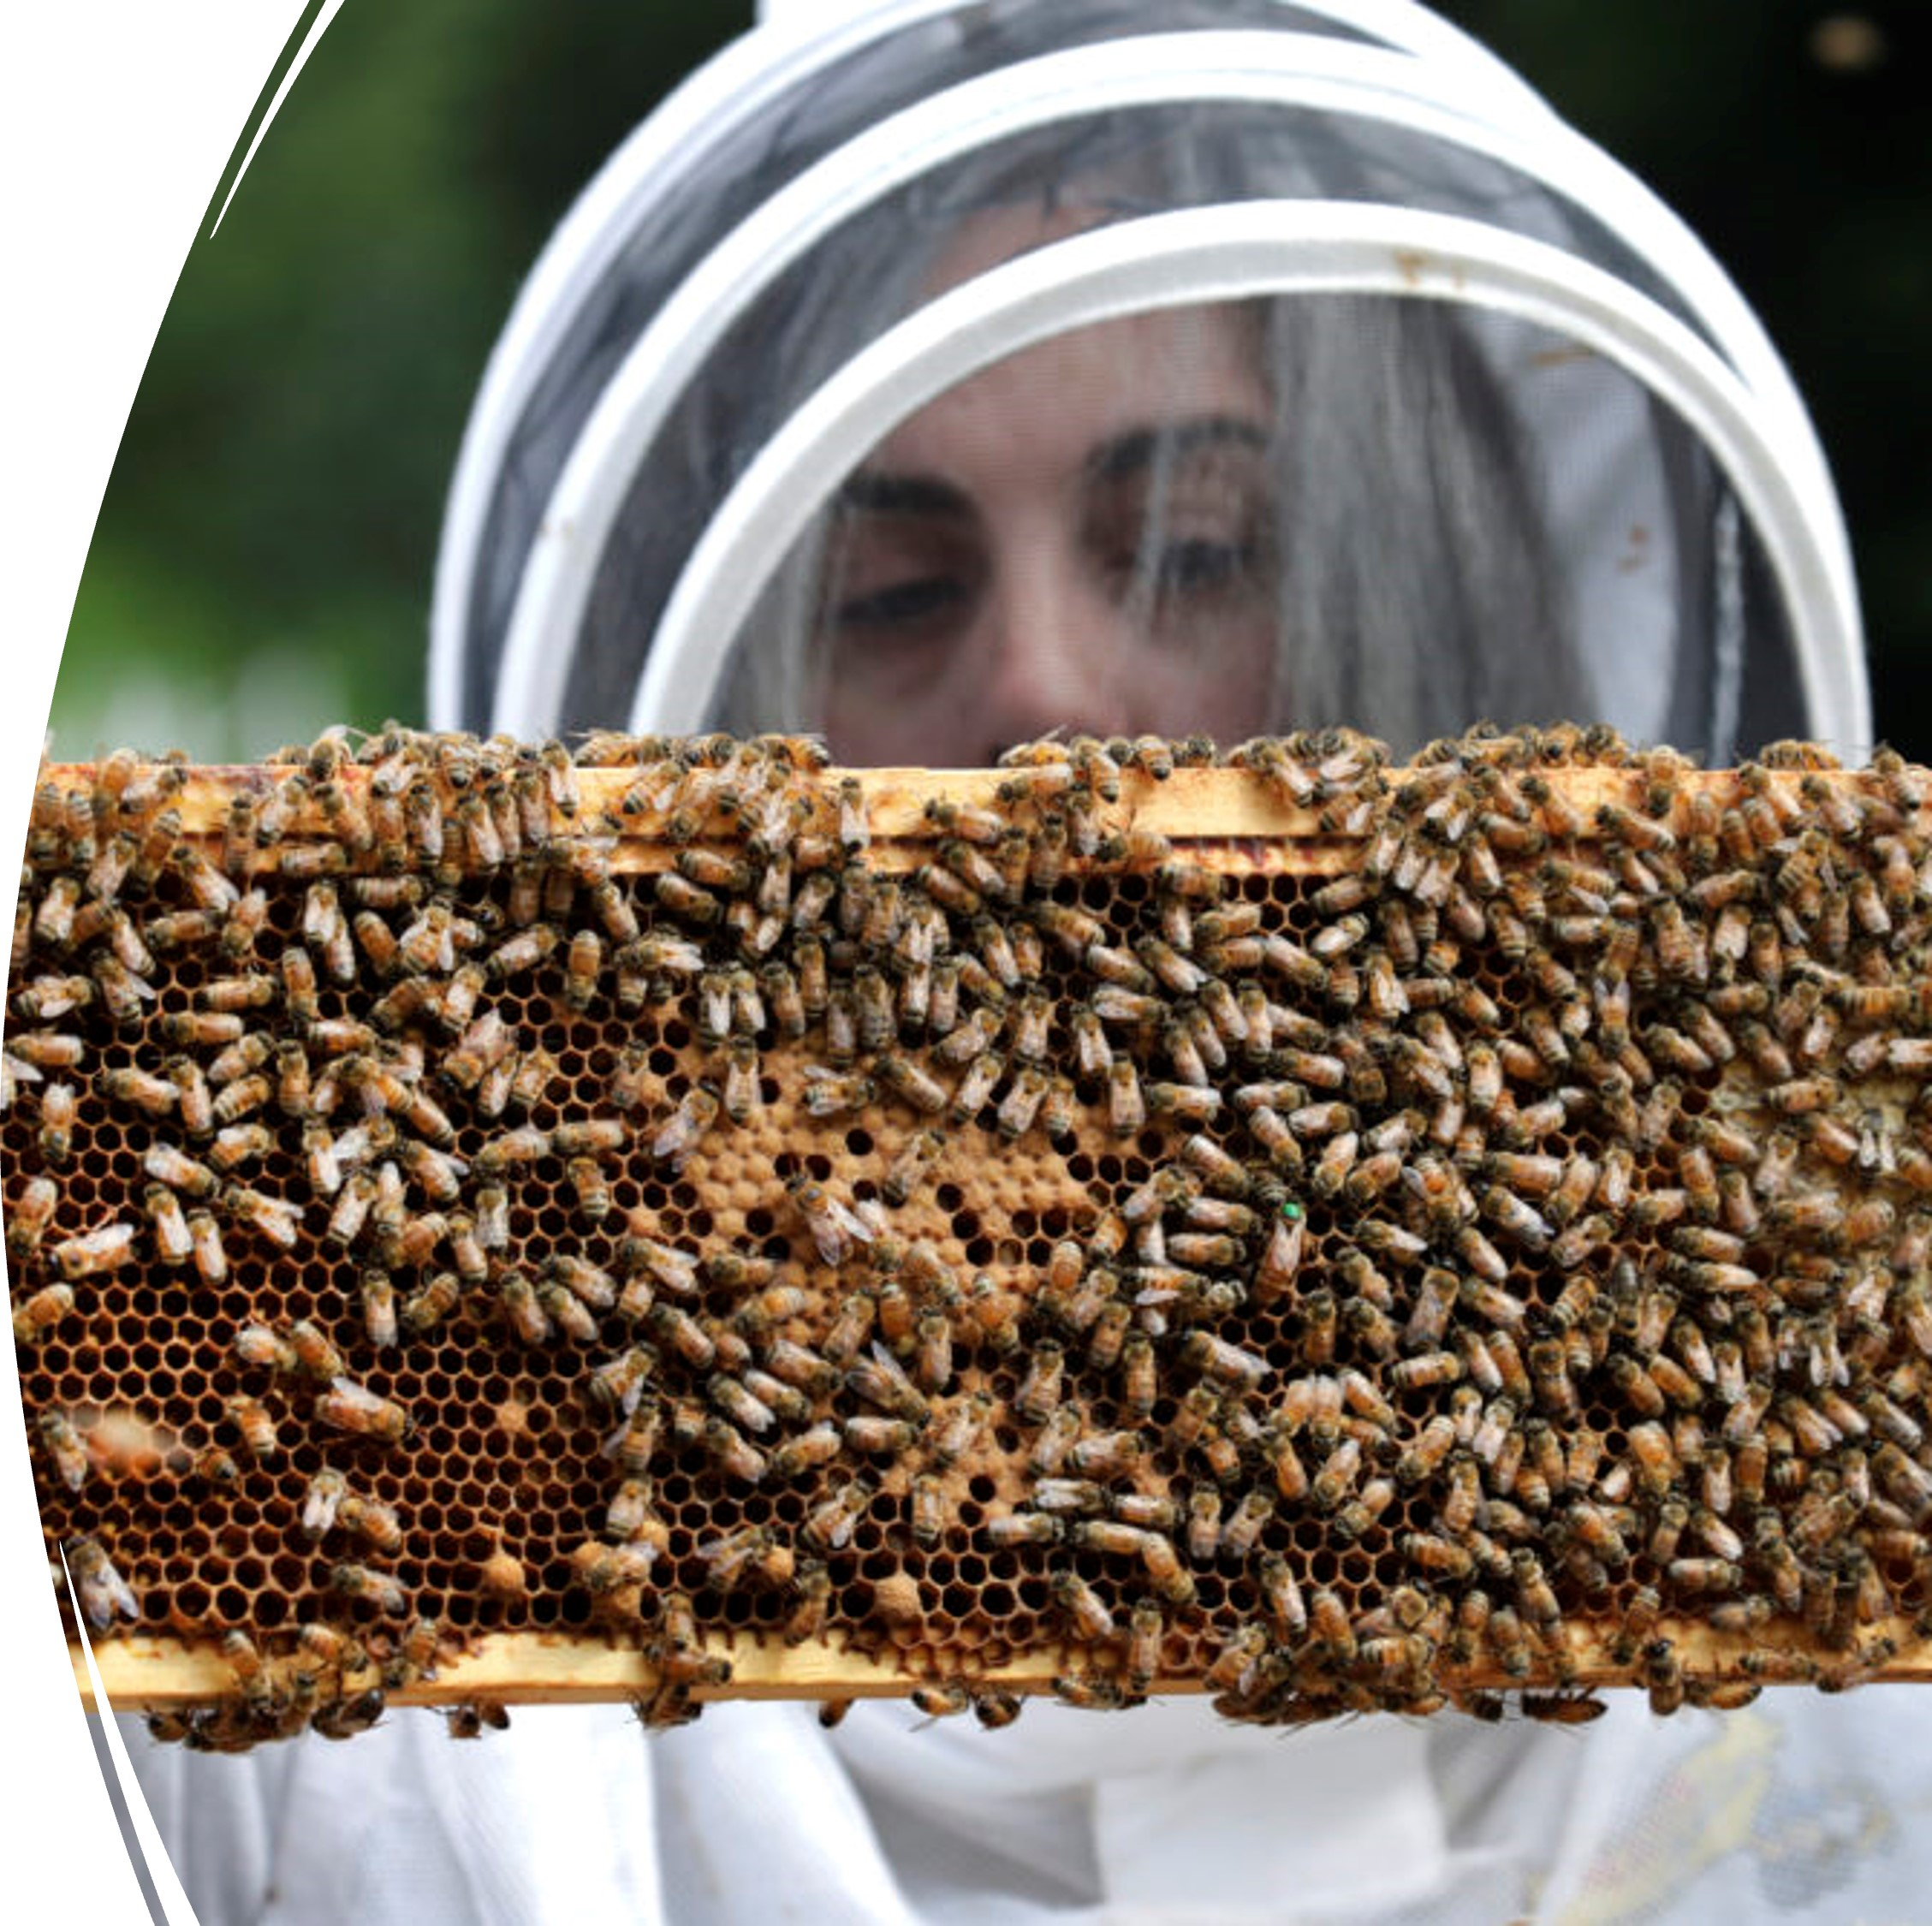
Replication of the HIVES Program
Quality beekeeping education
Therapeutic beekeeping practices
Accessible hands-on beekeeping experiences
Assessment and evaluation
Manchester VA Healthcare System

Slide 32
Bee Calm Bee Well Training
TMS Webinars
HIVES Webinar 1- February 19 at 2PM Eastern:
What is involved in a therapeutic beekeeping program
HIVES Webinar 2- March 19 at 2PM Eastern:
Partnerships and Program Management
HIVES Webinar 3- April 16 at 2PM Easter:
Accessibility at the HIVES for all Veterans
Bee Calm Bee Well- 2 Day Training in person
June 25-26 – Manchester, NH
Manchester VA Healthcare System

Slide 33
VA HIVES Resources
Training- TMS and Webinars available in Feb 2025
Sharepoint- currently under construction https://dvagov.sharepoint.com/sites/vhamanhives/SitePages/ProjectHome.aspx
Diffusion Marketplace HIVES Diffusion Marketplace
Best Practices Monthly Call- First Thursday of the month at 1PM EST
Education-
Heroes to Hives: www.heroestohives.org
Mission Beelieve: www.missionbeelieve.com
Great Plains Master Beekeeping: www.gpmb.unl.edu
Manchester VA Healthcare System

Slide 34
Contact information
Valerie Carter, MS, CTRS/L
VAMC Manchester
603-315-6358
valerie.carter2@va.gov
Adam Ingrao, PhD
Heroes to Hives
adam@miffs.org
Manchester VA Healthcare System

Slide 35




Bee Well!
This material is based upon work that is supported by the National Institute of Food and Agriculture, U.S. Department of Agriculture, under agreement number 2023-38640-39573 through the North Central Region SARE program under project number ENC23-229. USDA is an equal opportunity employer and service provider. Any opinions, findings, conclusions, or recommendations expressed in this publication are those of the author(s) and do not necessarily reflect the view of the U.S. Department of Agriculture.
VA Manchester Health Center

