Slide 1












Exploring Hives: Accessibility for all Veterans
Valerie Carter and Dr. Adam Ingrao
VA Medical Center-Manchester

Slide 2



Disclosures
We, have not had any personal financial relationships in the last 12 month with the manufacturer of products or services that could be discussed in the following presentation.
This material is based upon work that is supported by the National Institute of Food and Agriculture, U.S. Department of Agriculture, under agreement number 2023-38640-39573 through the North Central Region SARE program under project number ENC23-229. USDA is an equal opportunity employer and service provider. Any opinions, findings, conclusions, or recommendations expressed in this publication are those of the author(s) and do not necessarily reflect the view of the U.S. Department of Agriculture.
Disclaimer: Provided resources in this presentation is not an all-inclusive list and does not signify endorsement or approval of any particular education, training, company, or organization.
Reference from this presentation or from any of the information services sponsored by the VA to any non-governmental entity, product, service or information does not constitute an endorsement or recommendation by the VA or any of its employees. We are not responsible for the content of any “off-site” web pages referenced.

Slide 3
At the conclusion of this Webinar program, learners will be able to: 1. Describe the elements to consider when determining where to place an apiary and how to make sure it is accessible
2. List 2 ways to adapt beekeeping for the physical health needs of the Veterans
3. Identify two ways that Veterans can learn about beekeeping without attending an in person program.

Slide 4
Questions from the last 2 Webinars?

Slide 5

MENTAL HEALTH
COGNITION AND BRAIN INJURIES
Making Therapeutic Beekeeping Universally Accessible
Facilitation for Veterans with PTSD, anxiety, depression, and trauma history
Providing material in formats for all learners
SOCIAL ISOLATION AND COMMUNITY
PHYSICAL DISABILITIES
Reaching rural Veterans and those that are isolated or far from a community
Location, facilities, and equipment
Notes:
Review of mental health accommodations, brain injury and cognition accommodation, sns rural veteran accommodations

Slide 6
Bio-Psycho-Social Assessment
Physical Limitations
Mental Health and Cognitive Limitations
Social and Environmental Limitations
Musculoskeletal
Previous injuries
ROM limitations
Vision
Hearing
Smell
Anxiety
PTSD
MST
Memory
Executive Functioning
Communication
Location
Financial Situation
Transportation
Internet/Computer
Social Support

Slide 7
Intake Assessment
Diagnosis:
Reason for Referral:
Beekeeping Experience:
Goal for Participation:
PHQ2
GAD 7
Well Being Signs or PROMIS 10
Bee Sting Allergy
Strengths and Weaknesses in the following areas:
Physical
Psychological
Cognitive
Environmental

Slide 8
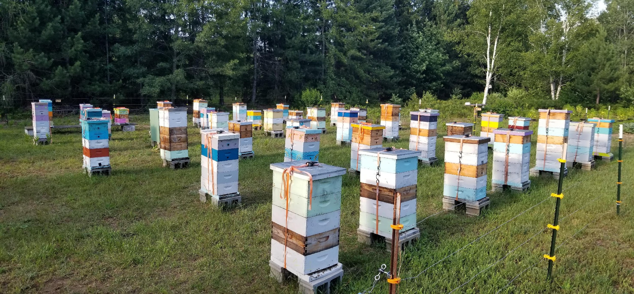
Setting up the Apiary

Slide 9
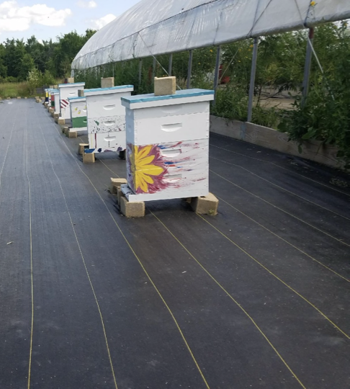
Getting to and Around the Apiary
Parking
Pathways
All Terrain wheelchairs
Terrain and Soil
Spacing of the hives

Slide 10

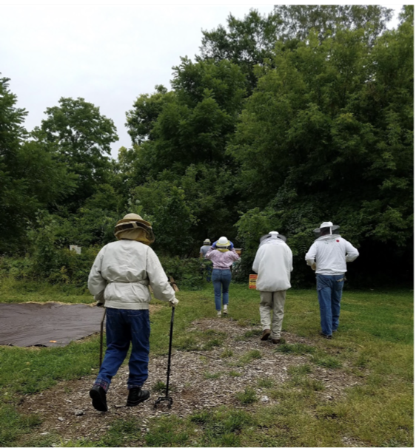
Facilities
Educational Classrooms
Restrooms
Potable water
Seating
Shade
Signage
First Aid Kit
Fire Safety

Slide 11
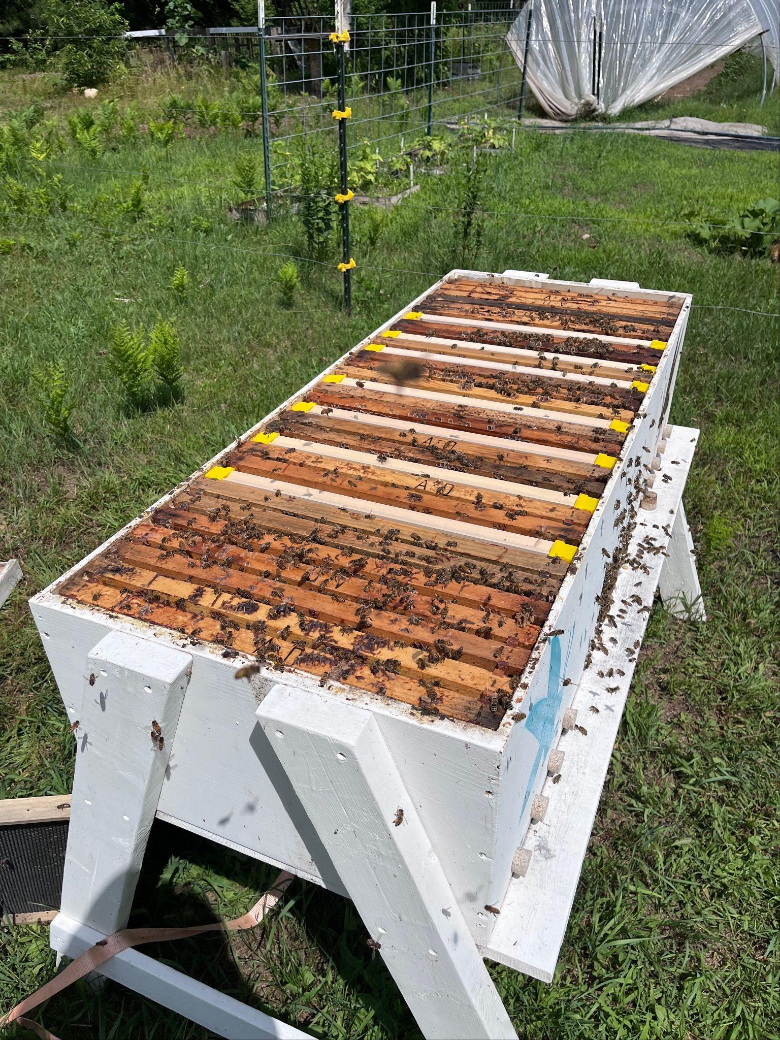
Equipment
Hive stands
Hive styles
AZ HIVES
Top Bar Hives
Long hives
Langstroth Hives
8 Frame
All medium boxes
Hive Lifters
Magnifying glasses

Slide 12
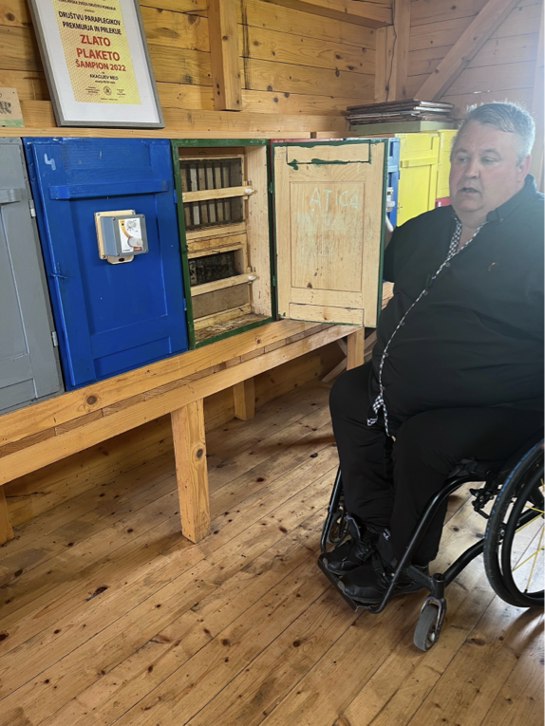
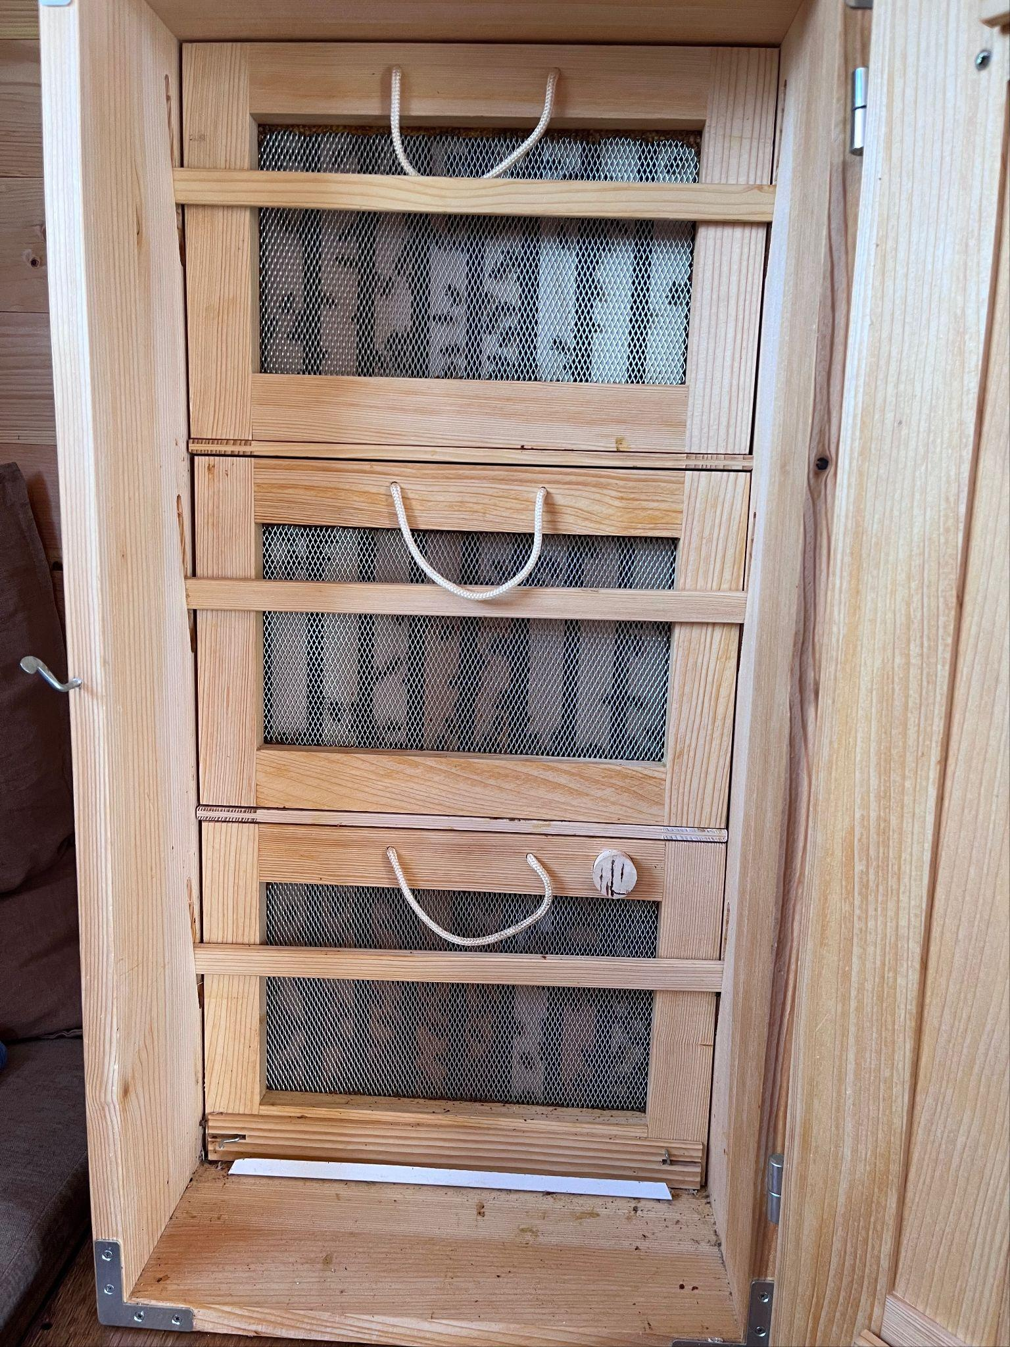
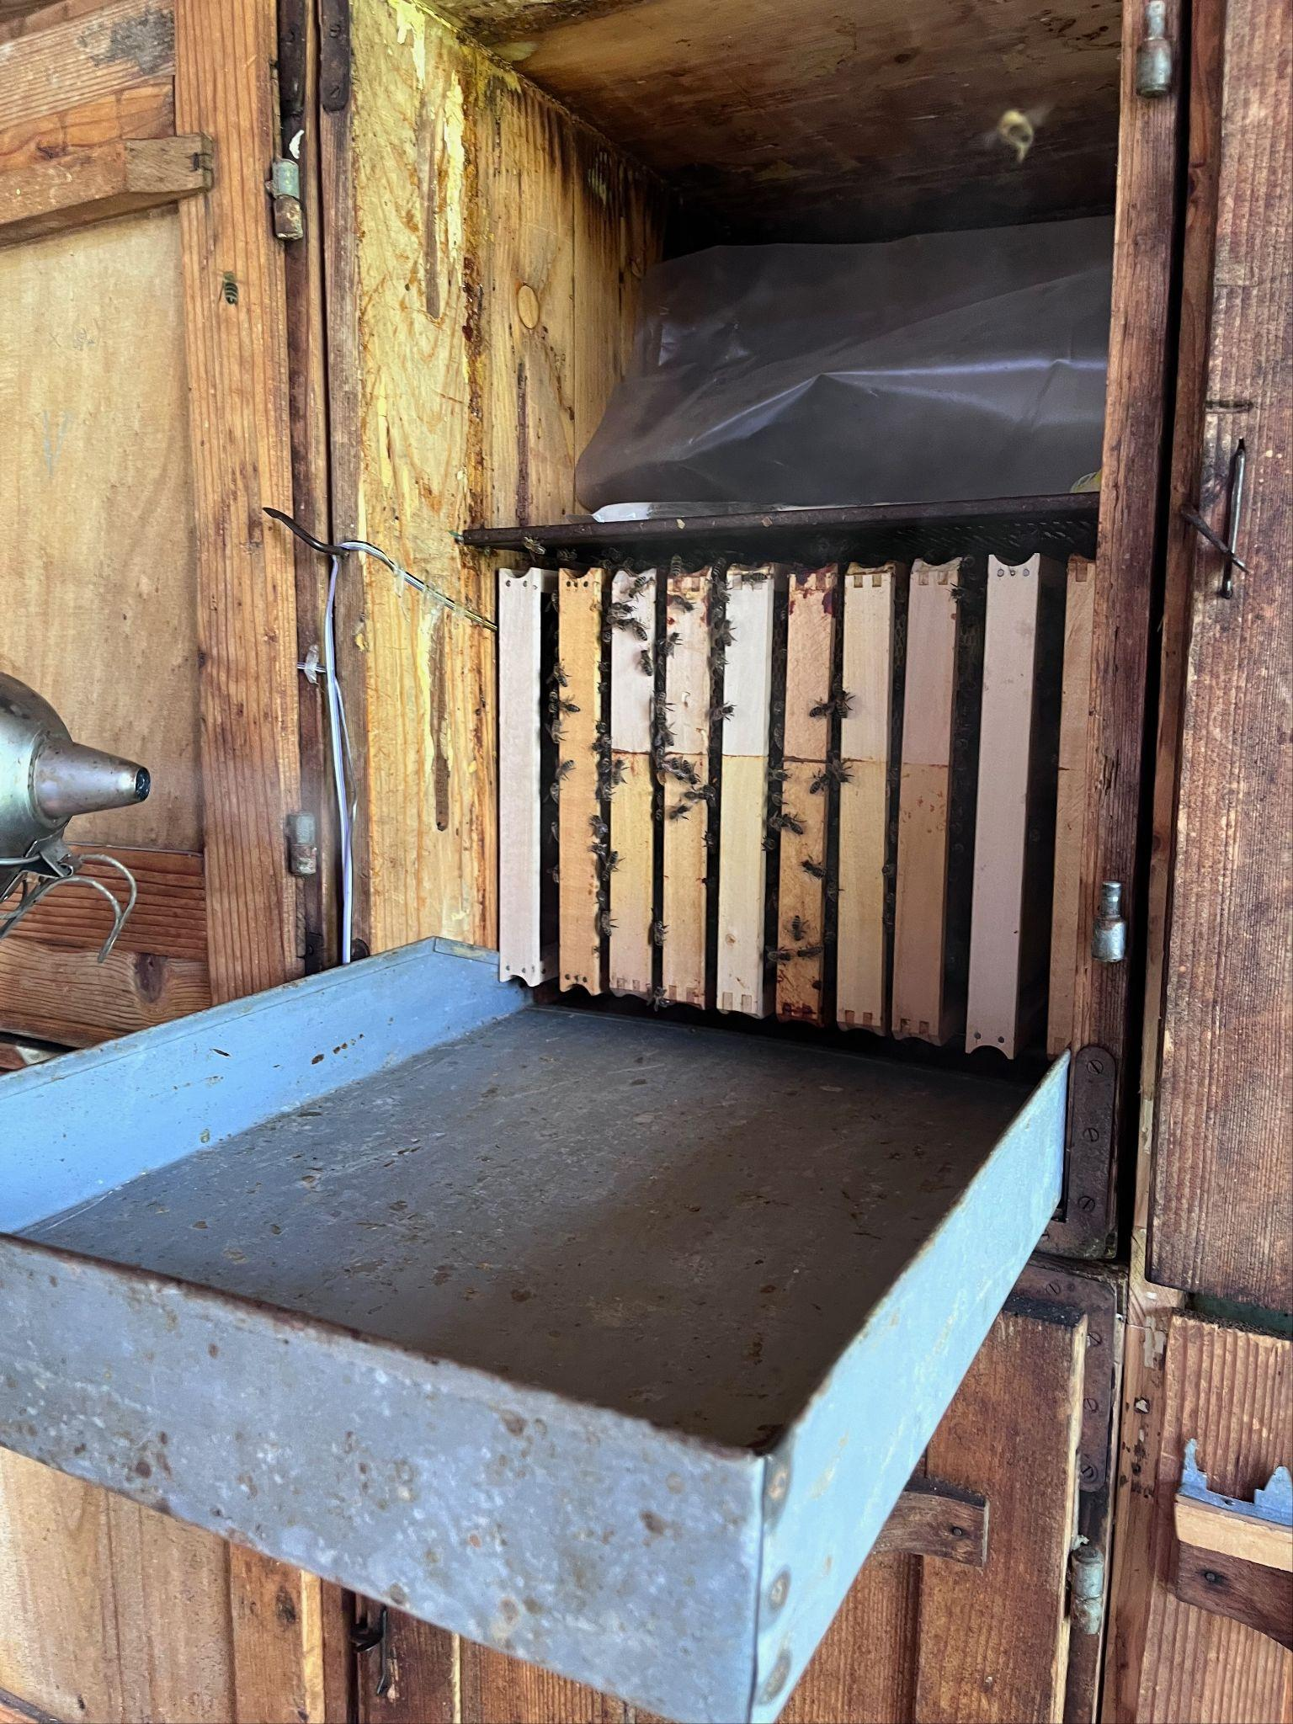

AZ Hive

Slide 13
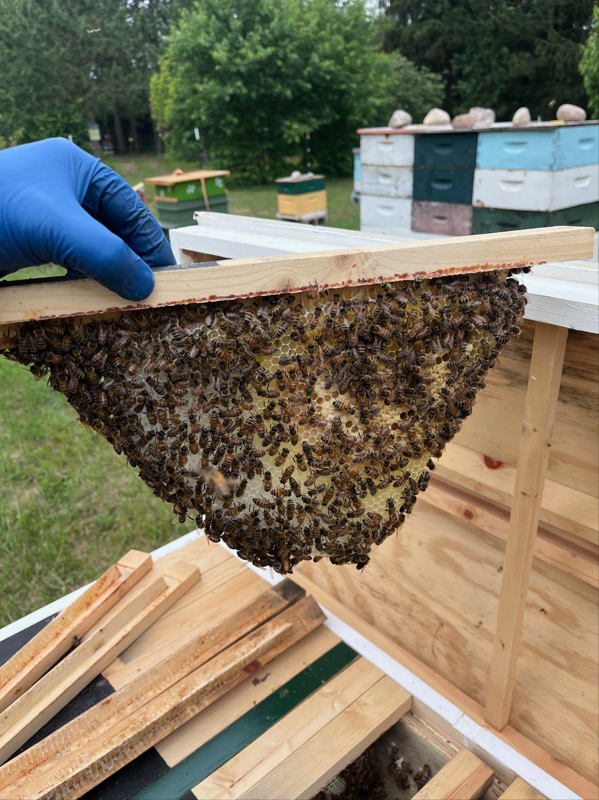
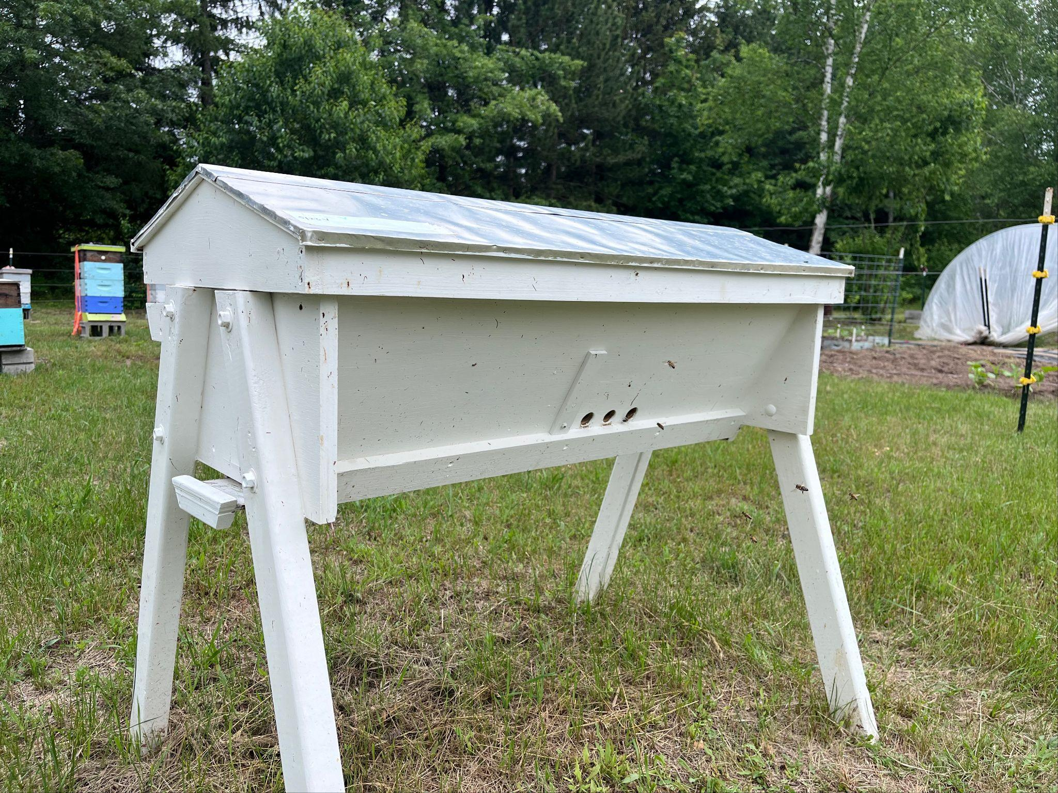
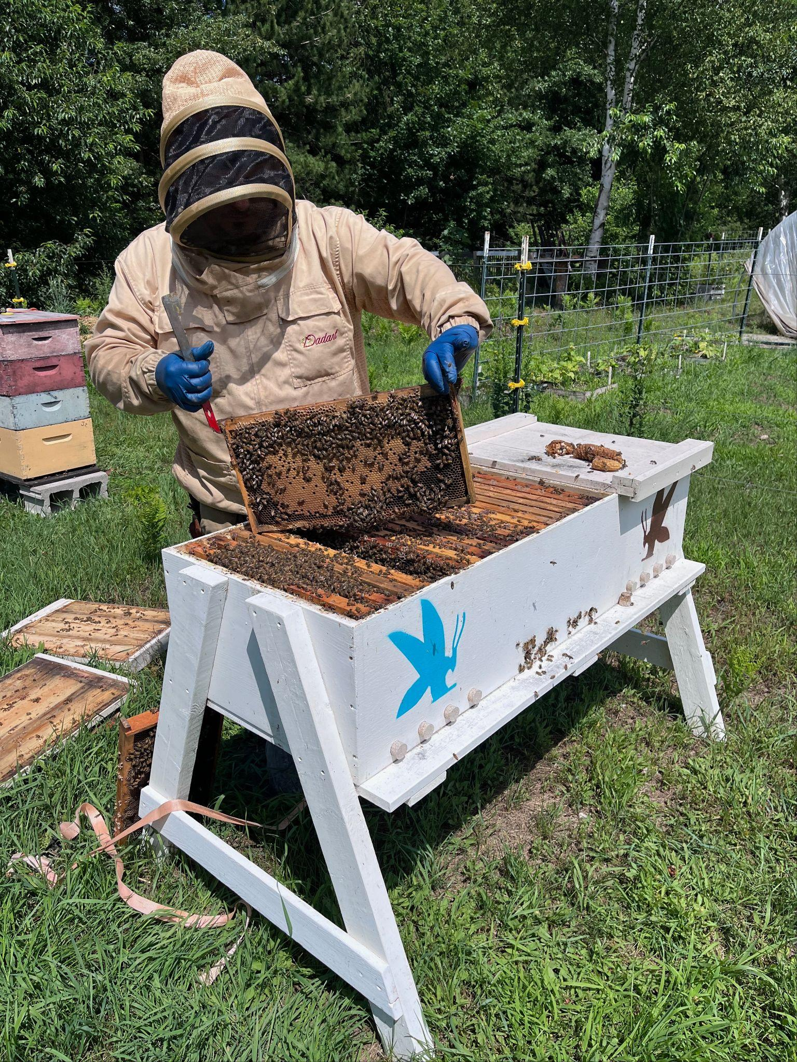
Top Bar/Long Langstroth Hive

Slide 14
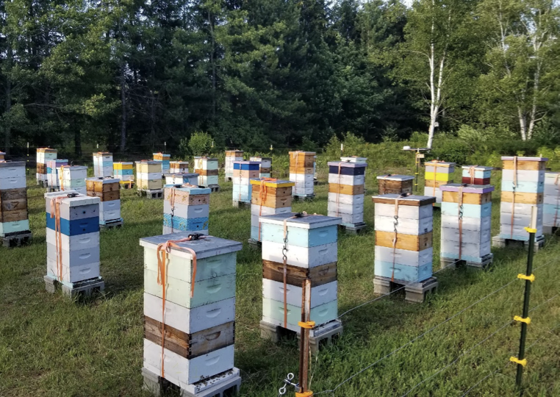
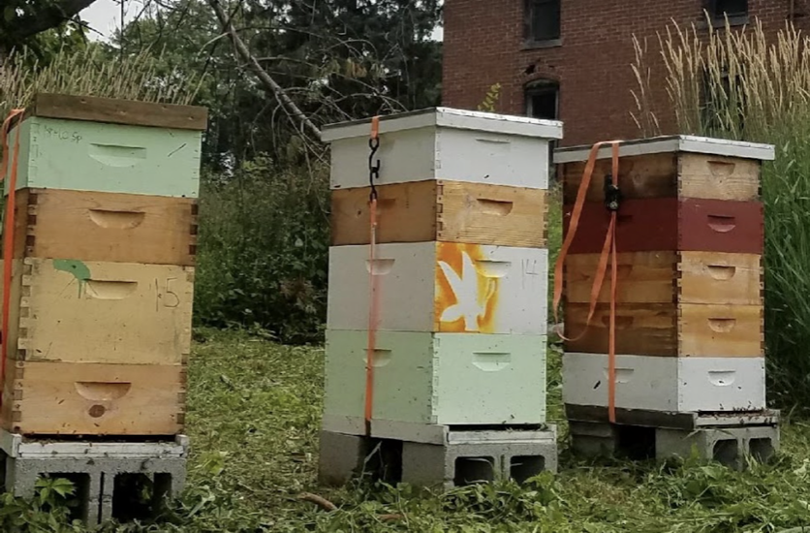
Langstroth Hive

Slide 15
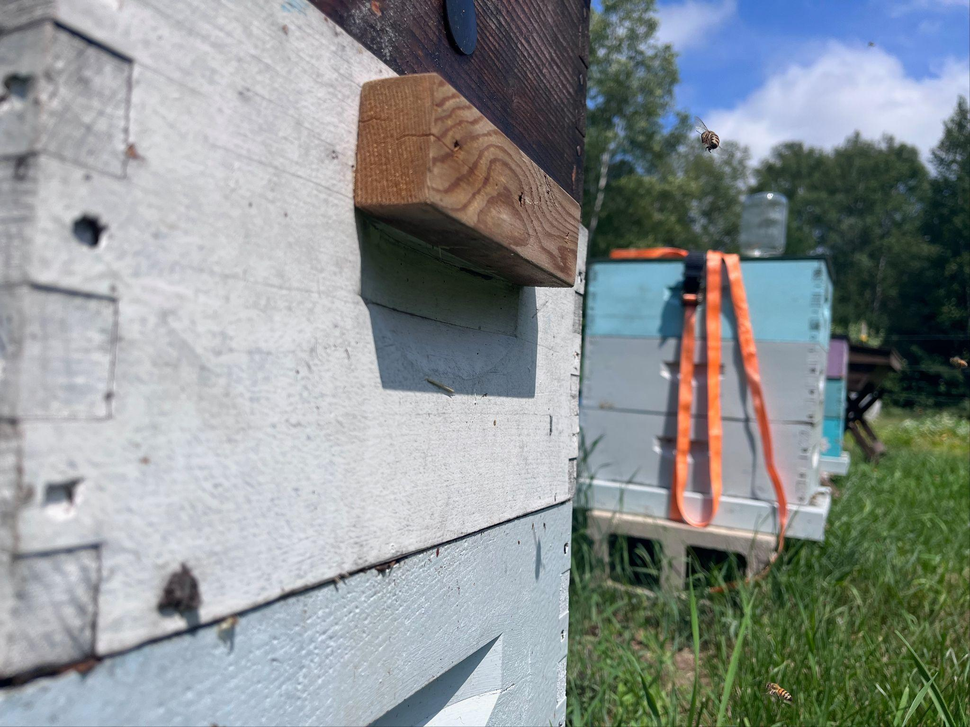
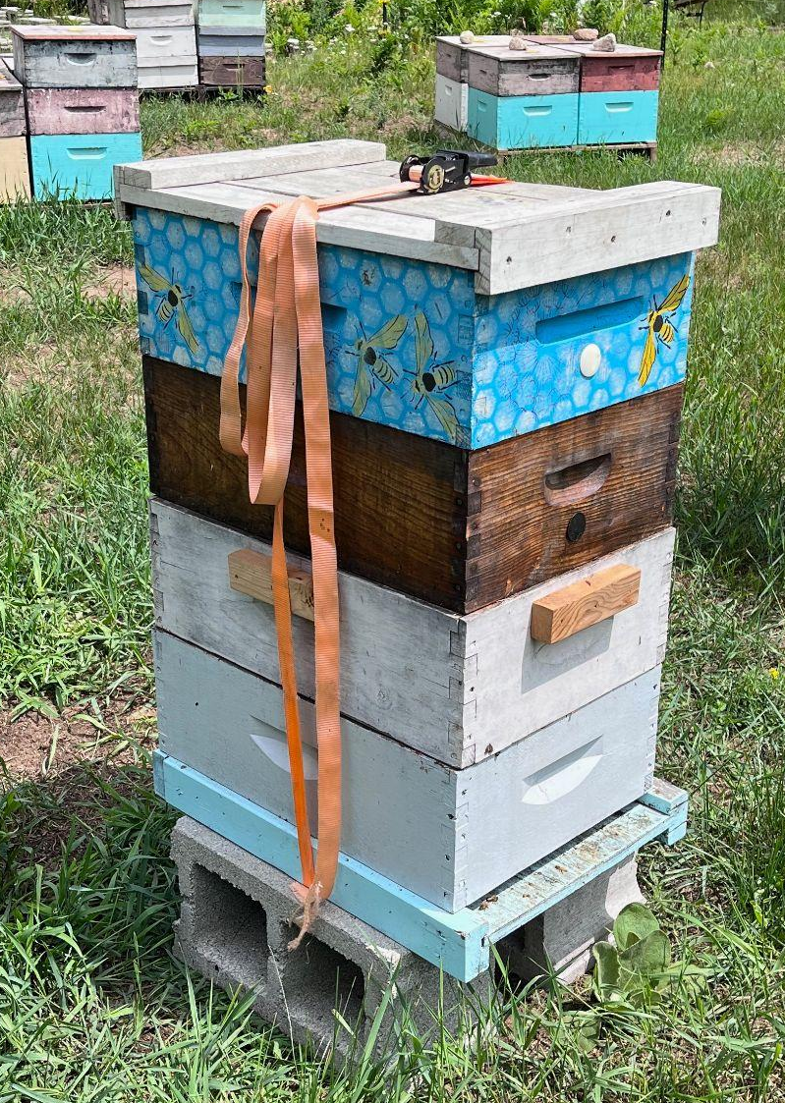
Ergonomics
Extended hand holds
8 frame vs 10 frame
Deep hive bodies vs medium hive bodies

Slide 16
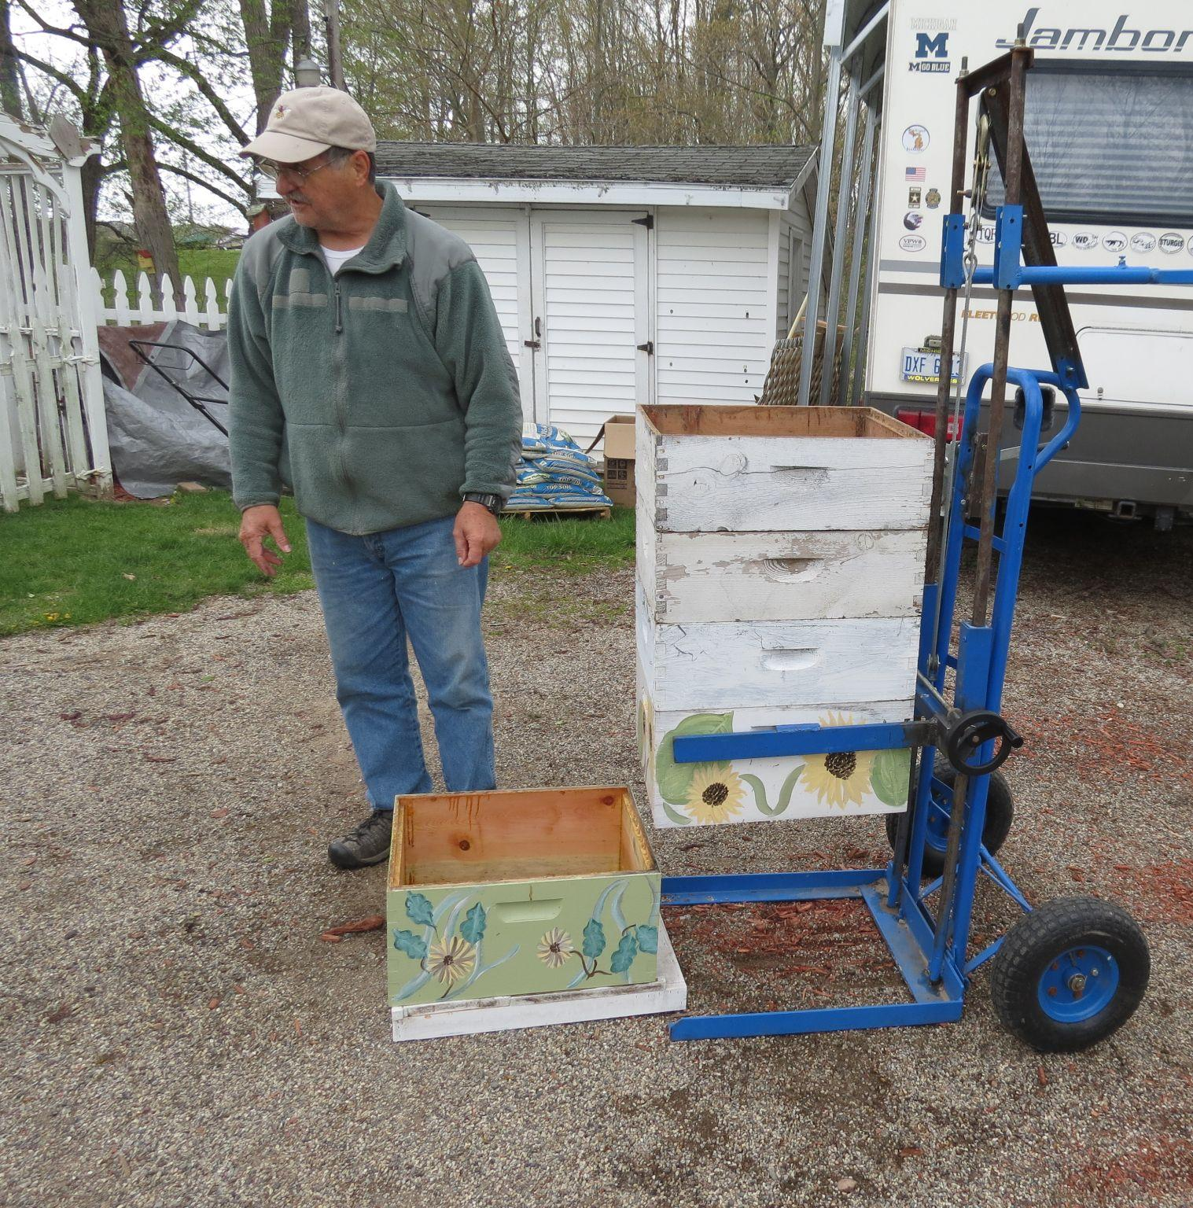
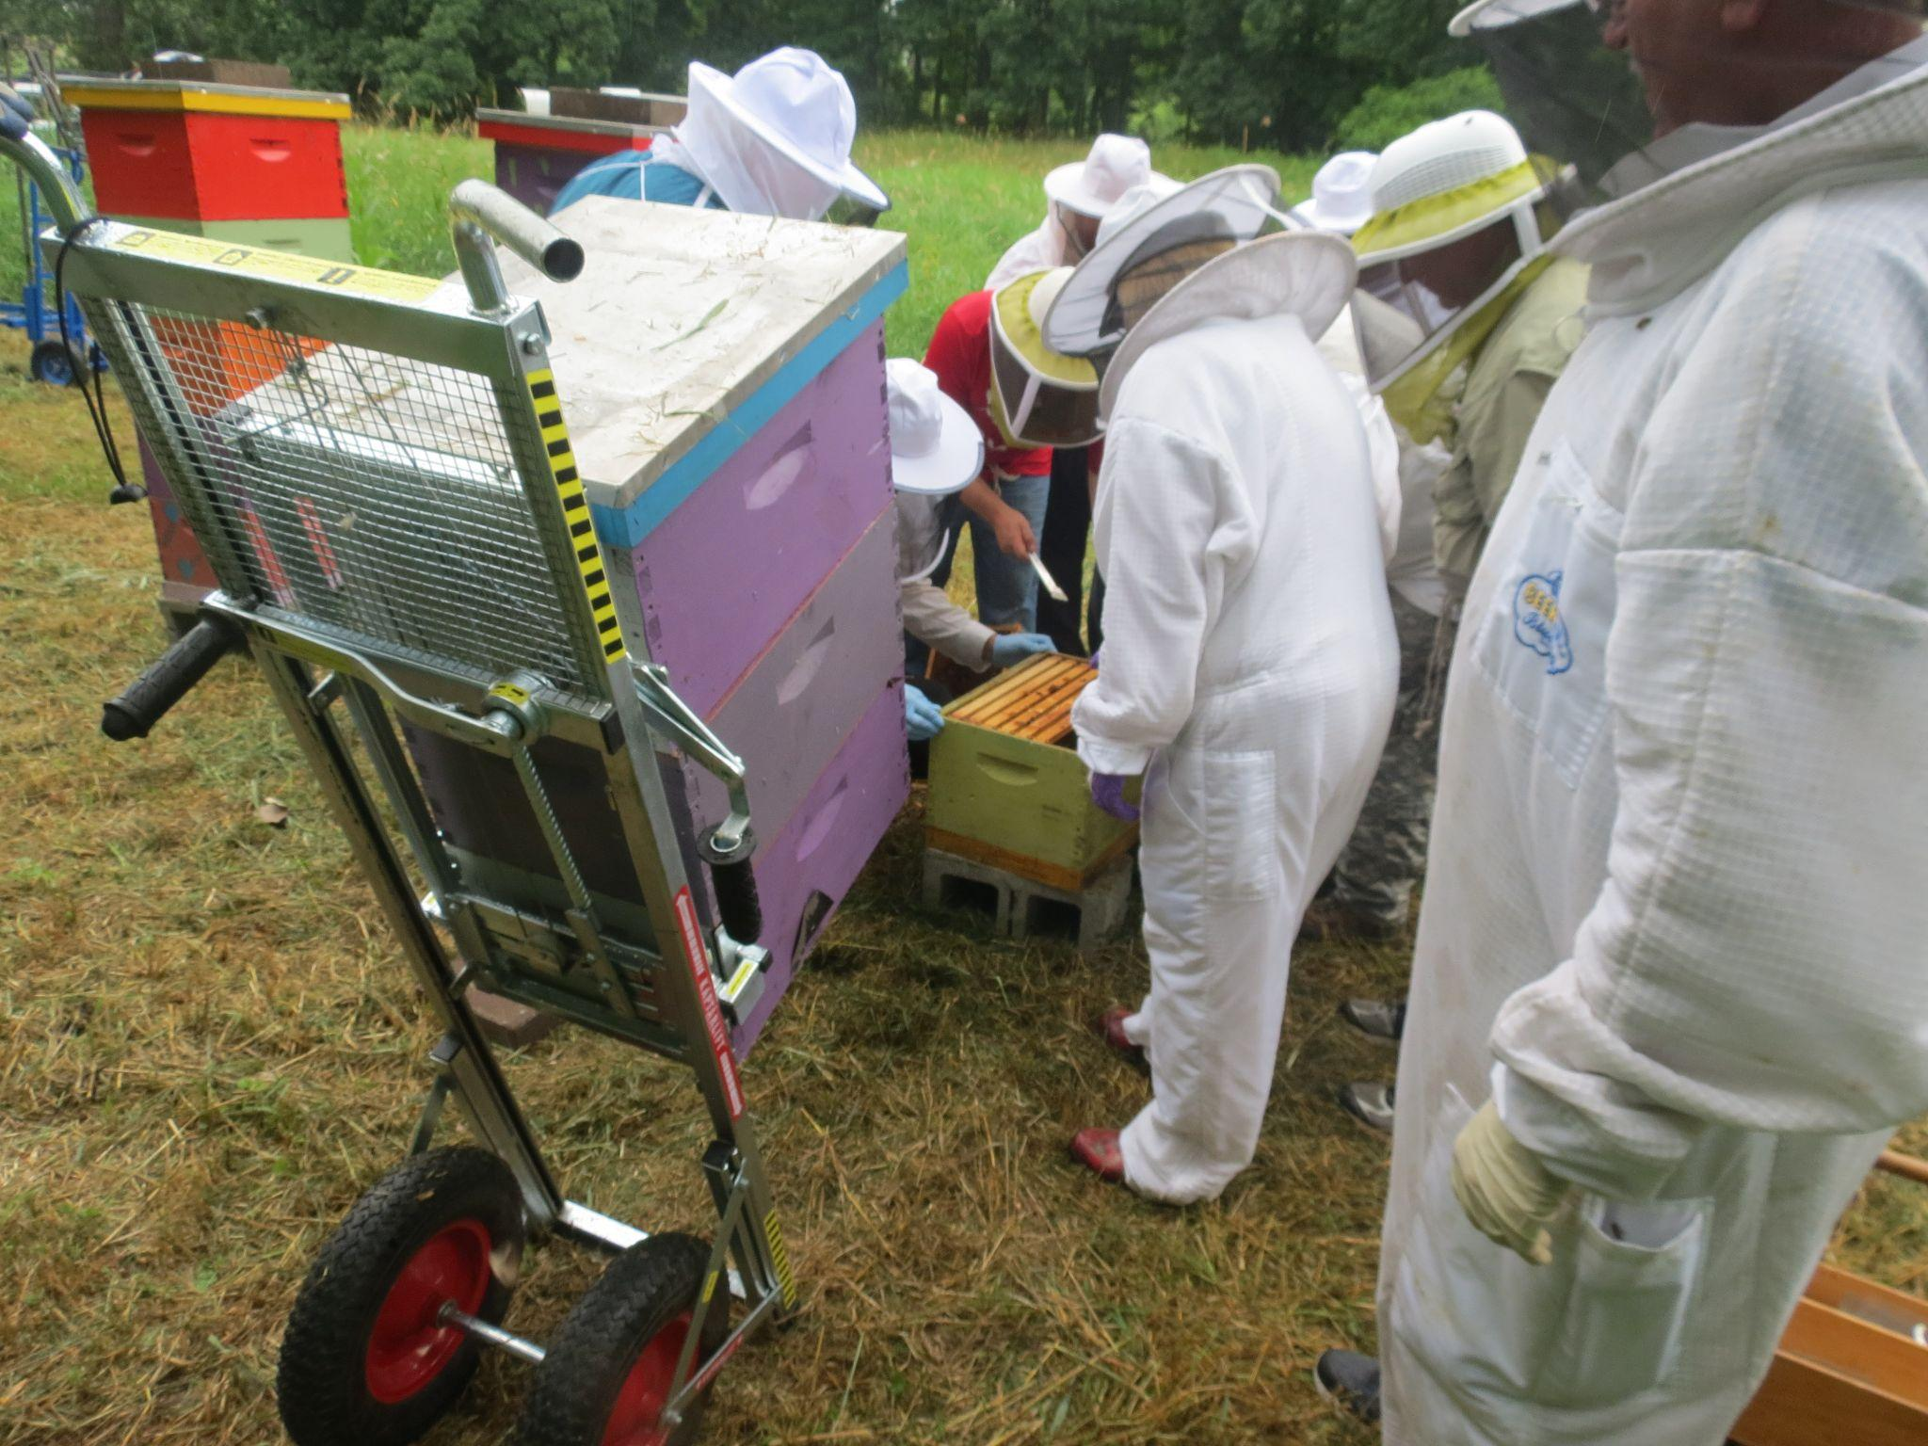
Hive Lifters

Slide 17
Sensory Impairments
Vision
Hearing
Smell
Magnifying glass
BROS referral for assistive devices
Taking photo and asking for assistance
Accessible beekeeping app
Taking recordings
Augmentative devices
Closed captions
Working with another person
Knowing what to look for when smell is not an option

Slide 18
Virtual Classes
Educational Sessions
Synchronous Skills and Inspections
Virtual Reality Learning
VA HIVES
Heroes to Hives
Mission Beelieve
Great Plains Master Beekeeping
Local Bee Clubs
In development via VR Chat and possible other opportunities
VA HIVES
Local Bee Clubs

Slide 19


Bee Calm Bee Well Training
TMS Webinars
HIVES Webinar 1- February 19 at 2PM Eastern:
What is involved in a therapeutic beekeeping program
HIVES Webinar 2- March 19 at 2PM Eastern:
Partnerships and Program Management
HIVES Webinar 3- April 16 at 2PM Easter:
Accessibility at the HIVES for all Veterans
Manchester VA Healthcare System

Slide 20
VA HIVES Resources
Training- TMS and Webinars available in Feb 2025
Sharepoint- currently under construction https://dvagov.sharepoint.com/sites/vhamanhives/SitePages/ProjectHome.aspx
Diffusion Marketplace HIVES Diffusion Marketplace
Best Practices Monthly Call- First Thursday of the month at 1PM EST
Education-
Heroes to Hives: www.heroestohives.org
Mission Beelieve: www.missionbeelieve.com
Great Plains Master Beekeeping: www.gpmb.unl.edu

Slide 21
Questions?
Contact information
Valerie Carter, MS, CTRS/L
VAMC Manchester
603-315-6358
valerie.carter2@va.gov
Adam Ingrao, PhD
Heroes to Hives
adam@miffs.org
Manchester VA Healthcare System
Manchester VA Healthcare System

Slide 22

BEE WELL!
This material is based upon work that is supported by the National Institute of Food and Agriculture, U.S. Department of Agriculture, under agreement number 2023-38640-39573 through the North Central Region SARE program under project number ENC23-229. USDA is an equal opportunity employer and service provider. Any opinions, findings, conclusions, or recommendations expressed in this publication are those of the author(s) and do not necessarily reflect the view of the U.S. Department of Agriculture.
VA Manchester Health Center

