Slide 1
What’s in it for me? Farmers and Local Government
Judy Chambers, chambers@psu.edu
Notes:
Welcome to this presentation on farmers and local government. We talk a lot about how to encourage local governments to be more responsive to agriculture. Today we’re going to look at the other side – encouraging agriculture to be more involved in local government.

Slide 2
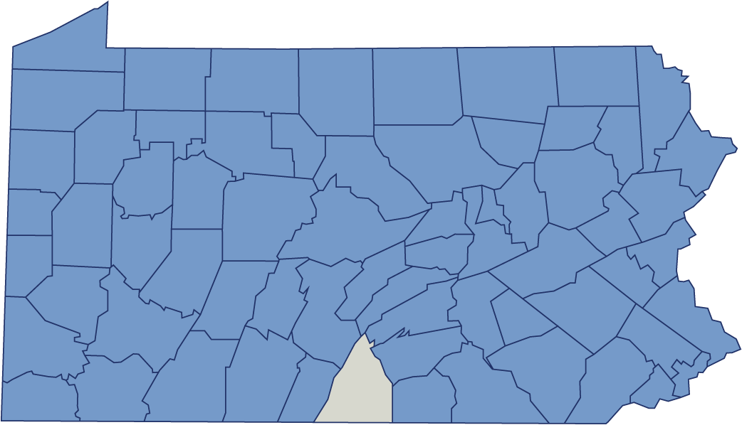
What is “local government?”
Notes:
Before we get started, let’s define what we mean by local government. It’s basically any level of government below the state level. In Pennsylvania, there are 67 counties which are considered to be local governments. In each county (except Philadelphia) there are boroughs and townships – and sometimes cities – along with school districts. All of these are local governments.

Slide 3
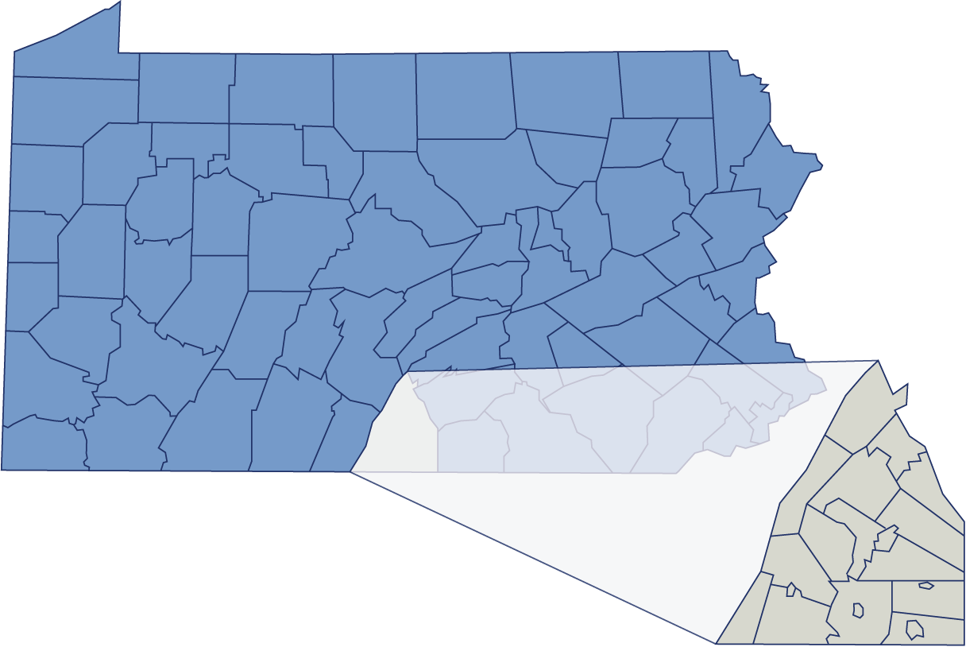
Townships and Boroughs
Notes:
They provide services such as road maintenance and snow removal, garbage and recycling, parks and recreation, land use, law enforcement and sometimes even libraries or cemeteries. Not every local government provides all of these services – and school districts have their own list of services related to education.

Slide 4
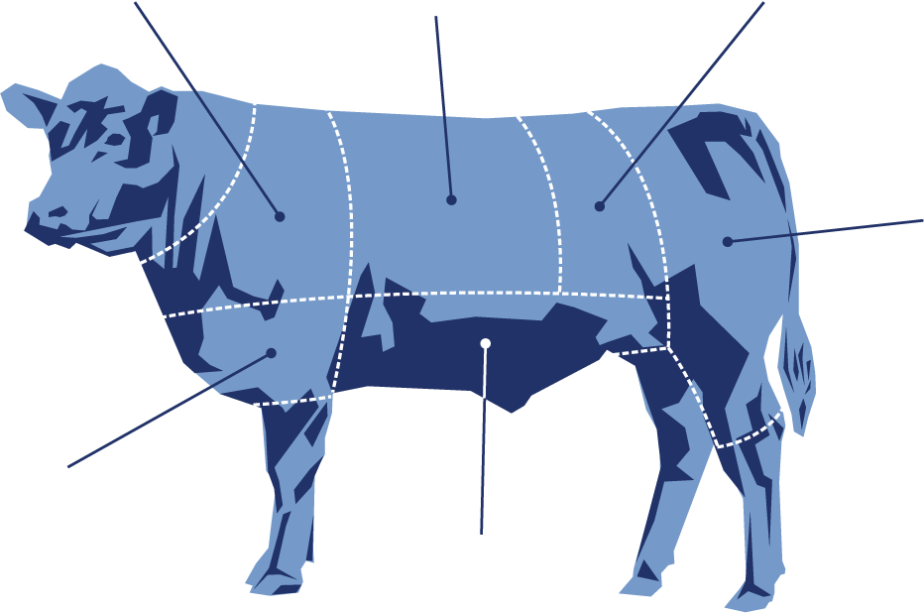
How local governments affect your farm
Types of Operations
Land Use
Signage
Building
Permits
Taxes
Highway
Occupancy
Notes:
Local governments have laws and regulations that affect many aspects of your farm operation – from the size and placement of signs to where you can put buildings and what they can be used for. Local governments levy the bulk of the property taxes you pay, and probably own the local road next to your farm. With the power to regulate these and many other aspects of your farm operation, local governments can directly impact your livelihood.

Slide 5
Farm-friendly communities
Understand changing farm practices and needs
Actively seek farmer involvement when considering local policy
Encourage agricultural expansion
Support next generation and new farmer activities
Notes:
Many local governments recognize the importance of agriculture to their community, their way of life, and their tax base. They understand agriculture and try to keep pace with changing practices, such as the increase in on-farm retail activities. They plan for agricultural expansion in land use and zoning regulations. They welcome new farms and new farmers to their community. And most importantly, they make sure their actions don’t create problems for agriculture.

Slide 6
Our premise
Local government can get in the way of farmers (whether it means to or not)
One solution is to get more farmers into local government
But first we need to understand the challenge
Local Government
Notes:
Many communities think they are farm-friendly, but because they don’t really understand the needs of agriculture they sometimes cause more problems than they solve. For instance, a township may think it can help sustain farms by requiring a minimum of 100 acres. The township doesn’t understand that 20 acres can be a viable agricultural operation for a vegetable grower or other specialty crop producer. The township’s size regulation can actually make it harder for smaller operators to farm.

Slide 7
Our project–funded by NE SARE
(Northeast Sustainable Agriculture Research and Education)
Focus group research
Curriculum development
Outreach and education
Notes:
So how do we help townships and boroughs understand agriculture? Get more farmers into local government! To make sure we understand the challenge, Penn State Extension conducted research through focus groups, developed a workshop and webinar curriculum, and presented our findings to several agricultural organizations.

Slide 8
Our goals
BIG goal
Increase farm friendly local policy
LITTLE goal
Increase farmer involvement in local government
Notes:
Why this project? Ultimately we want to create more local governments that are farm-friendly and will support agricultural operations. We hope to do that by getting more farmers involved in local government.

Slide 9
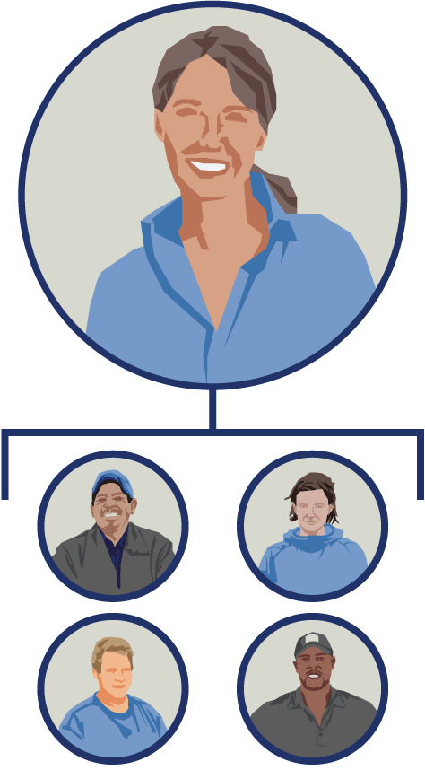
Voila! A webinar!
Based on what you told us
PA Farm Bureau
Young Farmers & Ranchers
PA Association for Sustainable Agriculture
Mid-Atlantic Young Growers Association
Women’s Agriculture Network
Cattlemen’s Association
PA State Council of Farm Organizations
Notes:
In our focus group research we listened to farmers, growers and producers. Many of them hadn’t given much thought to their local government. We learned that unless there was a specific issue, usually around permitting, local government just wasn’t on their radar screen – they didn’t see the value in getting involved. They asked “what’s in it for me?” – which became the title for this webinar.

Slide 10
We don’t know how many farmers are involved in local government
Feels like less than in the past
Some areas still have lots of farmers involved
Used to be a family tradition
Notes:
There isn’t any hard data on farmer involvement in local government, but many of the farmers in our focus groups told us the numbers are down. Many spoke of the involvement of their grandparents and parents but said the tradition of public service often doesn’t continue to their own generation.

Slide 11
Why aren’t more involved?
Critical mass – fewer farmers to draw from
Influx of new residents, especially retirees, with time and interest
Local government is a lot of work, takes more time than it used to
Notes:
There are a lot of reasons for this. In many areas the number of farms has decreased so there are fewer farmers in the community. When residential development occurs in farming country, new residents often have specific issues that they want local government to address – and more time to get involved, especially if there is an influx of retirees. Local government is more complex than it used to be and some farmers just don’t feel they have the time to devote to it.

Slide 12
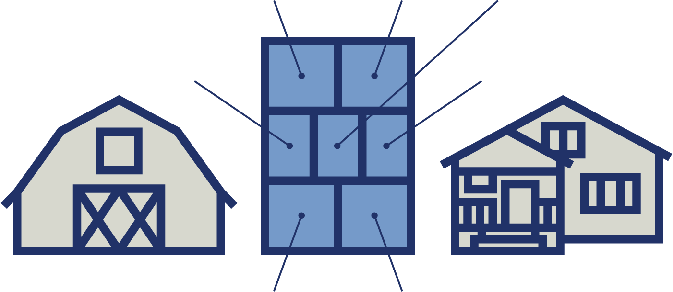
Lots of barriers – what you told us
Community conflict
Lack of civility
Complexity of local government
Time and schedules
Competition from newcomers
Good ole boys’ club
Impact on business relationships
Notes:
Finding enough time to get involved is a major factor. Monthly township or borough meetings are hard to fit on the calendar during growing season. But there are other barriers too: many farmers told us they don’t want to get involved in controversial issues that could put them in conflict with neighbors and customers. They are uncomfortable with the confrontational tone of many local governments. And young farmers in particular feel like ‘outsiders’ at township and borough meetings.

Slide 13
Why should you care?
Concentrated livestock operations
Business ventures
Value-added, agritainment and retail
Urban fringe issues
Noise, odors, air quality
Natural gas drilling
Activists
Notes:
Many farmers told us they don’t think local government affects their operations directly. And that may be true – until you try to spread manure, spray fruit trees, increase herd size, or open a retail farm venture. It may not be your own farm that’s affected, but if enough of your neighbors are impacted, the local farming community may shrink In today’s world more than ever, farmers need to know their communities will support them. Listen to a few real farm stories – could these things happen to you?

Slide 14
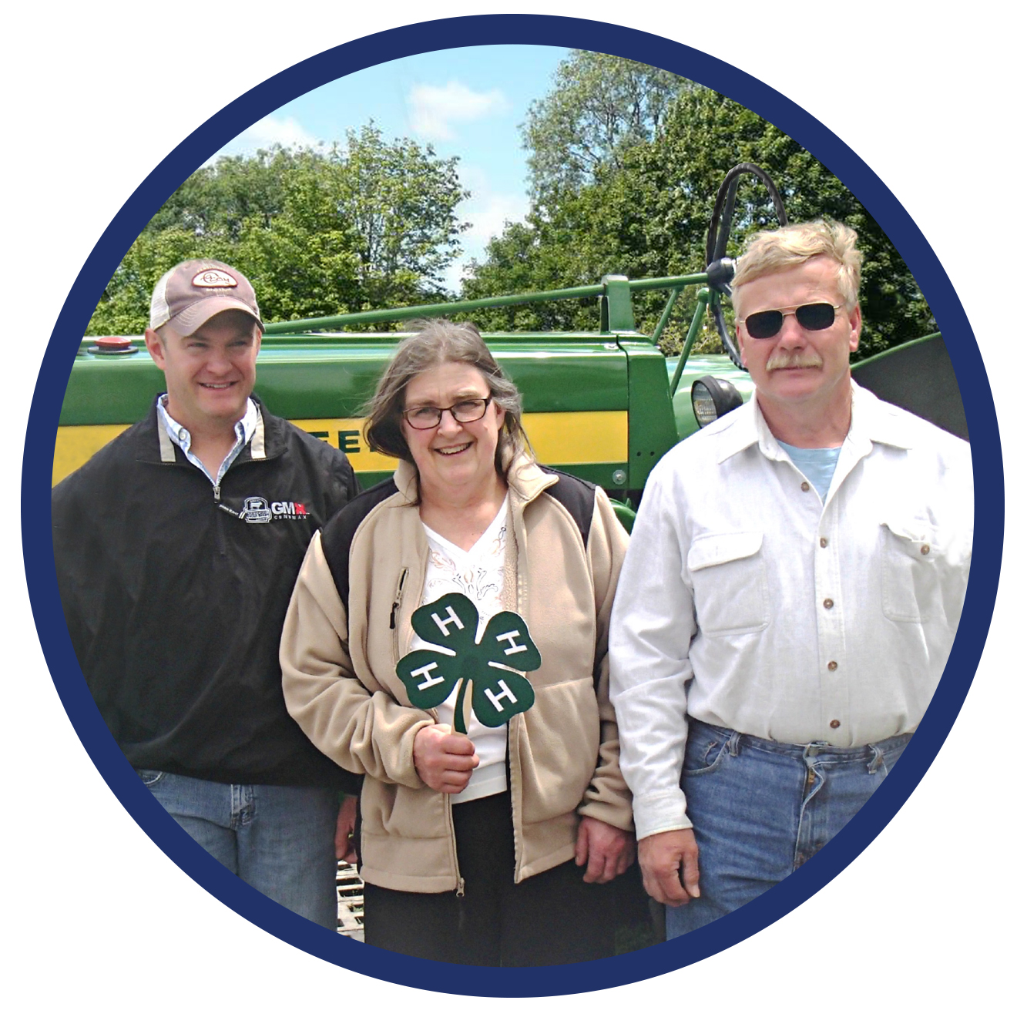
The Jeffcoats
Notes:
This is the Jeffcoat family. Their beef operation has been in the family for over 60 years, and they’re very active in 4H and other local ag organizations. A big part of their operation is Reichart’s Meats, which sells freezer beef direct to consumers. Business has been good, and the Jeffcoats decided to build a new butcher shop on another portion of their farm.

Slide 15
The Slaughter Shop
Reichart’s Slaughter Shop
Notes:
When they applied for a permit, the township treated the new shop as a commercial enterprise rather than a farming operation, which would have been exempt from many regulations. After nearly a year and thousands of dollars, the Jeffcoats were finally able to build the
shop, but not until they dealt with stormwater management, industrial waste, accessible bathrooms and other regulations.

Slide 16
The township likes our project…
. . . they just didn’t know how to treat us.
Notes:
Chris Jeffcoat said the township liked the proposed new butcher shop and tried to be as cooperative as possible. “If there were something in the ordinances that recognized that farmers need to be involved in direct sales, they could have made it much easier for us to expand.”

Slide 17
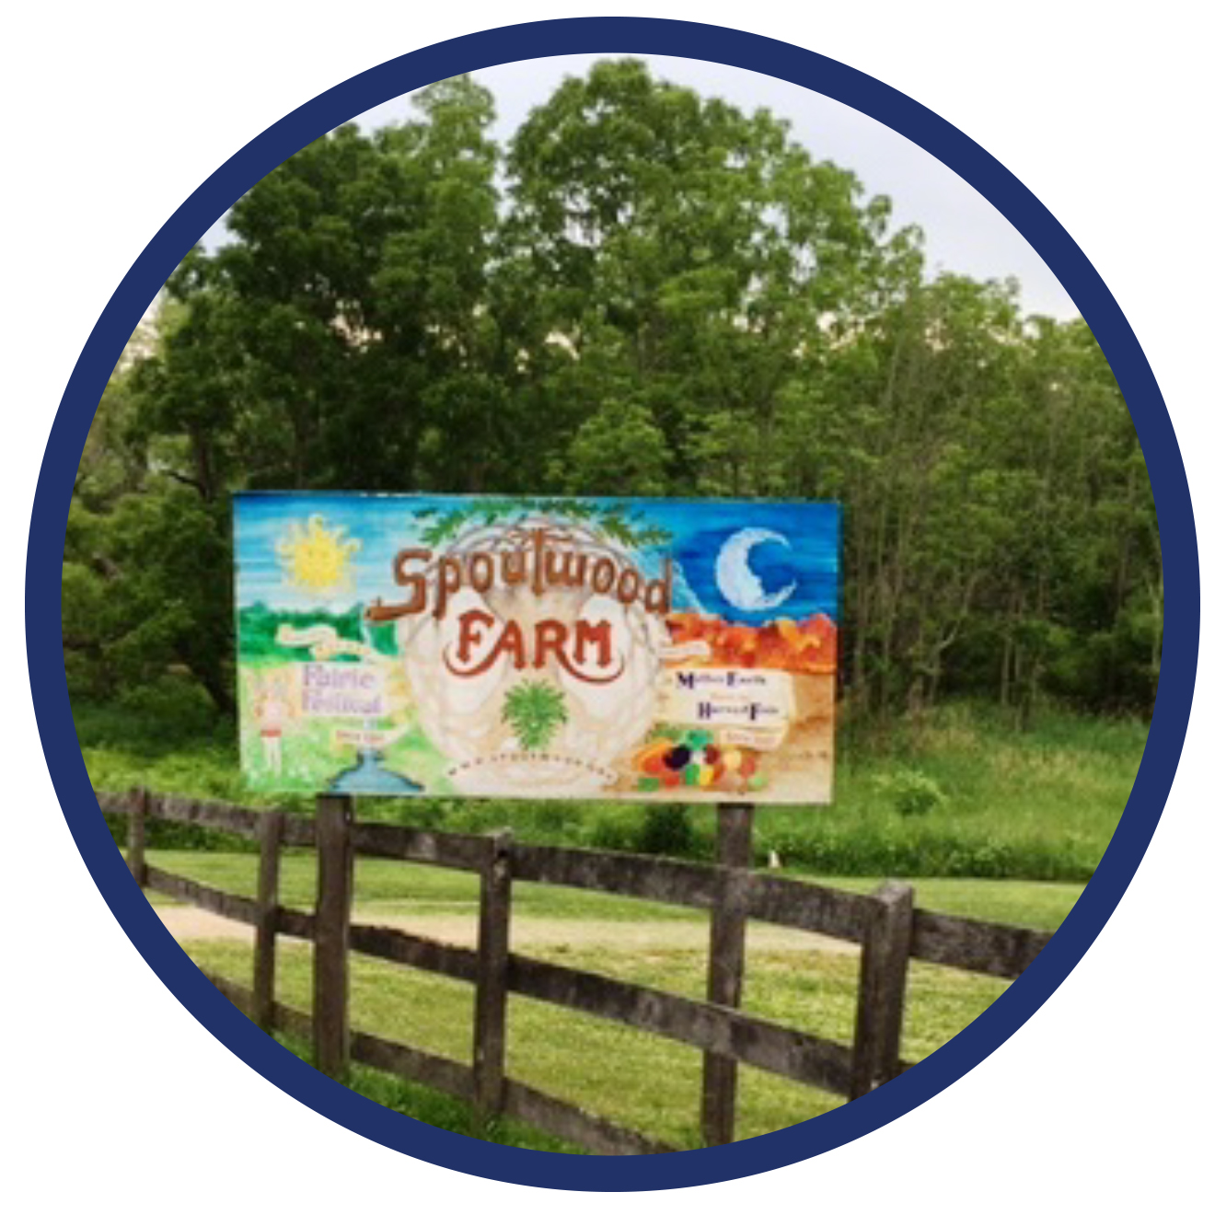
Spoutwood Farm
Notes:
Here’s another example: Spoutwood Farm is a non-profit educational farm. Its mission is to serve as a resource on natural farming methods in harmony with the environment. Spoutwood has a CSA and offers many other opportunities for hands-on learning such as workshops and
tours.

Slide 18
The Faerie Festival
Notes:
Their annual Faerie Festival has grown into a major event, attracting over 15,000 visitors and providing significant operational revenue for the farm. But as township regulations changed over the years, the festival could not comply with stricter requirements for police, parking, and porta-potties. In 1998, after long negotiations, Spoutwood signed a Memorandum of Agreement with the township to address these and other issues. So the Faerie Festival is alive and well.

Slide 19
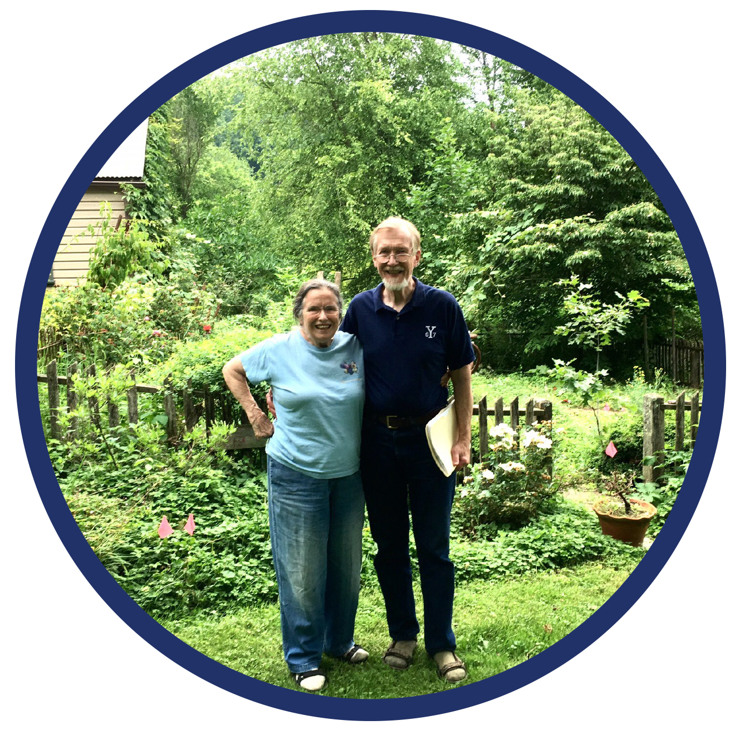
Value-added educational workshops
Notes:
But now Spoutwood’s educational mission is causing new headaches – the township wants to regulate the organization as a school, and the farm would once again be out of compliance. For owners Rob and Lucy Wood, educating people is a farm operation just like growing vegetables. As Rob puts it, “Our message and our approach are holistic”. So the traditional zoning approach of evaluating activities separately will likely
continue to cause friction between the township and the farm.

Slide 20
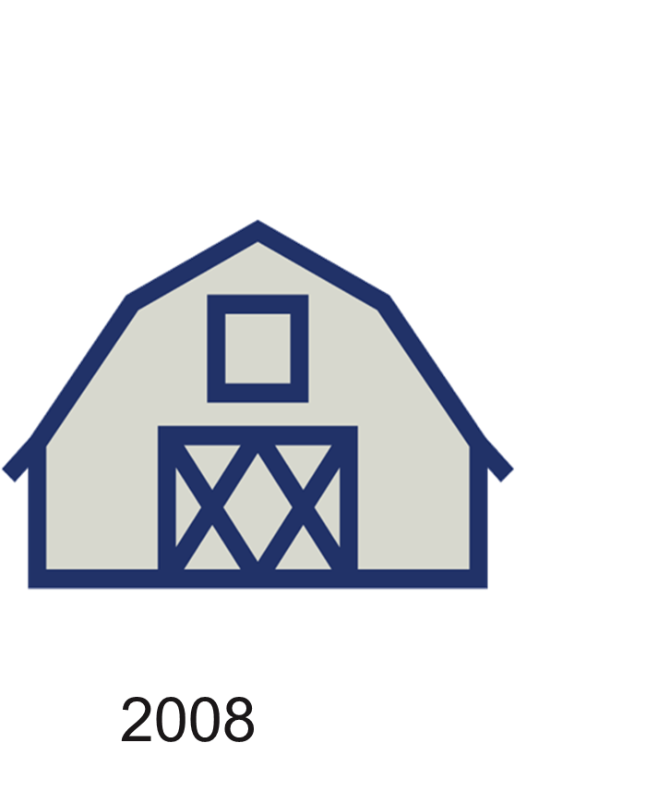
Dairy farm expansion
2008 2012
Notes:
Here’s one more story, about a family dairy operation that’s been around since 1942. The family has always had a good relationship with the township. When they wanted to add a cow barn in 2008 and again in 2012, it was a simple process – sketch plans were reviewed and approved in about a week each time.

Slide 21
It’s different now
Notes:
But last year when they applied for another cow barn, things had changed because the township had experienced a lot of development. Instead of taking a week, the review process is taking months. The dairy’s owner said “I need to be under roof by the end of the summer. The supervisors don’t understand that farming is a time-sensitive operation”.

Slide 22
Farm-friendly government
Notes:
There are also good examples of farm-friendly local government. Bill Naugle works for a township as the Zoning and Code Enforcement Officer. His interpretation of the Uniform Construction Code, which is used by Pennsylvania local governments, is different from some of the examples we just heard.

Slide 23
Ag business – worm composting
1. Raise worms
2. Harvest worm castings
3. Sell kits through online site
Notes:
Bill applies a broad interpretation of the code and of his township’s zoning ordinance, which enables farmers to generate revenue from related businesses. For example, he has approved a bus barn, a small excavating business and a worm compost business, all located on active farms, as part of the farming operations.

Slide 24
The supervisors have a real interest in supporting farming in the township…
they recognize the importance of supplemental and accessory operations in sustaining farms.”
This is a farm-friendly township!
Notes:
Why is his township’s approach to permitting so different? Bill says it’s because “the township supervisors recognize the importance of supplemental operations in supporting and sustaining farms – they have a real interest in supporting farming in the township.”

Slide 25
What’s in it for you? Take the first step
Find your passion (or at least your interest)
Improve your business
Improve your community
Make it a family affair
Notes:
When a local government understands and values agriculture, it’s much more likely to have farm-friendly policies. It’s up to farmers like you to help make that happen. And it’s not just about your farm business – it’s part of being a good citizen and sets a great example for your children.

Slide 26
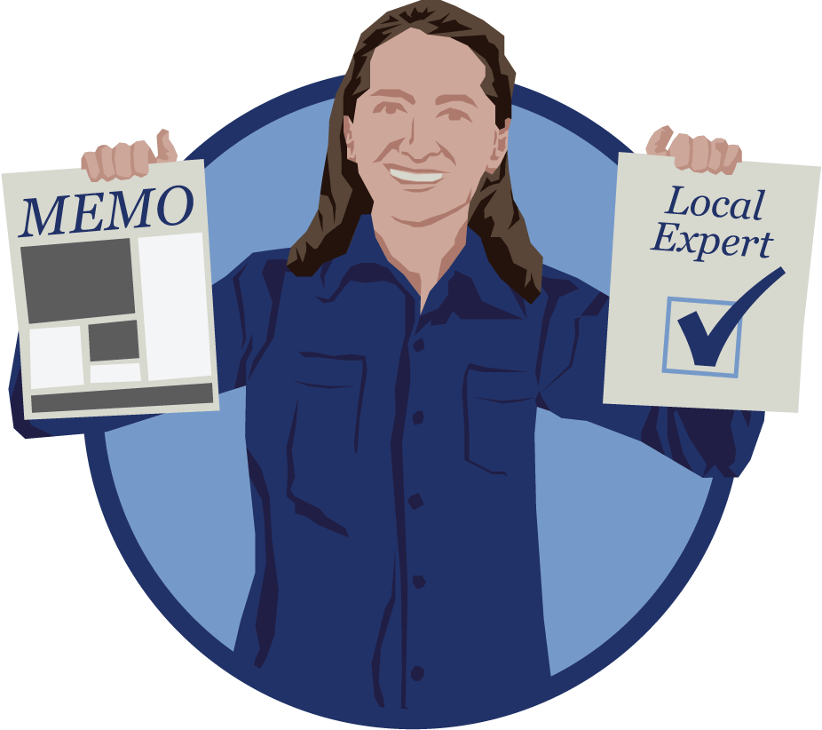
Level 1: Good citizenship
Be the go-to farmer
Stay informed
Be an advocate
Be a local expert
Attend meetings
Ask questions and give feedback
Notes:
You can jump right into public office – or take it slow. Just being an informed citizen and following local government issues can make a difference. If elected officials know you care about local policy, they may come to value your opinions. Let them know that you’re happy to talk farming with them. You might even invite them out for a farm tour.

Slide 27
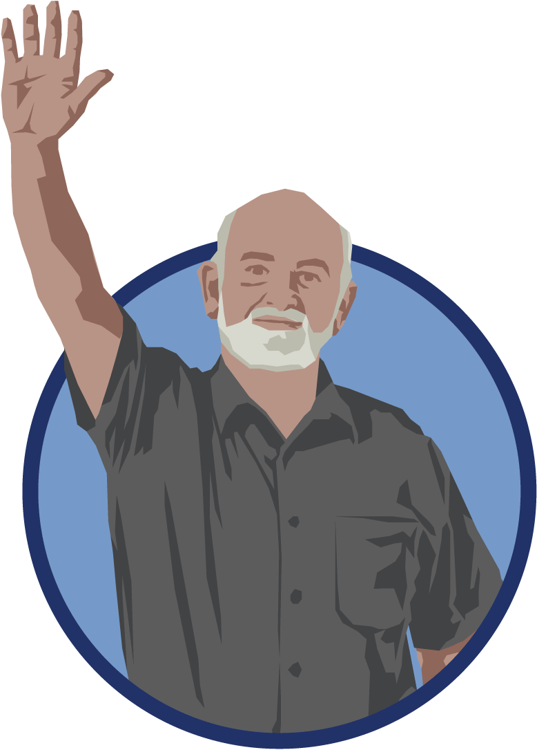
Level 2: Appointed offices
Planning commission
Zoning hearing board
Water or sewer authority
Other boards and commissions
Notes:
You can volunteer to serve on a local government board or commission – known as an appointed office. Planning and zoning is where the action is that will have the biggest impact on most farms, but water and sewer authorities also have a major impact on where growth will occur in your community. Find the board that fits your interest, such as parks and recreation or historic preservation.

Slide 28
Ready for appointed office?
Let someone know
Send an email or letter
Timing
Whenever there’s a vacancy
After the November elections
New appointments are typically made in January
Notes:
There is no standard process for appointing citizens to boards – so you need to ask your township or borough how they find interested citizens. Many local governments struggle to find people willing to serve, so your offer to volunteer will probably be well-received.

Slide 29
Level 3: Elected offices
Township supervisor
Township commissioner
Borough Council member
Mayor
School board director
Notes:
The most effective way to directly impact local government policy is to run for office and get elected to a position of governance – township supervisor or borough council member. Many rural township and borough seats go unfilled because there aren’t enough people interested in running for office – and even more seats go to the incumbent because no one runs against him or her.

Slide 30
From a long-time township supervisor and beef producer
When a farmer runs for public office he is not doing it for personal gain. Farmers are trying to preserve their living and the rural area where they live.”
Notes:
Remember – when you run for office, you’re helping to preserve farming as a way of life.

Slide 31
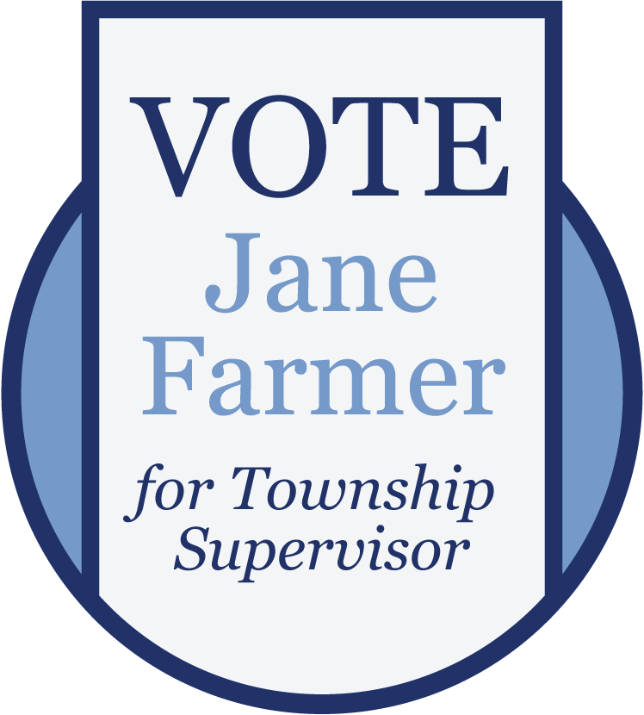
Ready for elected office?
In Pennsylvania, municipal elections are in odd-numbered years
File a petition to run (Feb – March)
Primary is in the spring
General election is in November
Take office in January
Notes:
Local government officials are elected every 2 years in Pennsylvania. Make your decision by January and you’ll be in good shape for the primary elections in May.

Slide 32
Qualifications to serve
Live in municipality at least 1 year
Age 18 or older
Registered voter
Just about everyone learns on-the-job.
Notes:
If you’re registered to vote, you can run for office. It’s that easy. There’s no special training to be a local government official – once you’re elected you can take advantage of workshops, conferences, webinars, newsletters and other opportunities to learn and network with fellow elected officials.

Slide 33
Optional but recommended
Motivation
Open mind
Willingness to learn
Time for a few meetings each month
Time to prepare for meetings
True interest in the future of your community
Notes:
Here are some qualities we’d all like to see in elected officials. Are you a good listener? Do you really care about your community? Can you keep an open mind about issues? Then you’d make a great candidate!

Slide 34
Ready to get started?
Step 1: Go to a meeting of your local government
Notes:
Your first step is to get to know your local government. Have you been to a township or borough meeting? You might be surprised how many local officials get elected without ever having attended a meeting of their local government. Show up for a few meetings: Find out what the biggest challenges are in your community. Do officials work well together? Would you be a good fit?

Slide 35
Ready to get started?
Step 2: Follow issues
Newspapers
Websites
Social media
Notes:
We talked earlier about being an informed citizen. Follow your local government in the news. You might also find a website, Facebook page or twitter feed, too. Most local governments who have websites post their meeting minutes so be sure to look for them.

Slide 36
Ready to get started?
Step 3: Learn how to run
Penn State Extension
County elections office
Fellow citizens
Notes:
It’s not hard to run for office – and usually not expensive either at the local government level. Check out resources like Penn State Extension and your county elections office to learn the nuts and bolts of running for office. Do you know a township supervisor or borough council member – or someone who used to serve? Those people can be a great source of information too.

Slide 37
Final thought – pass the tradition on
“I’d consider serving if it wasn’t a life sentence.”
Encourage other farmers to participate
Sustain a farm-friendly community
Show off your civic pride
Notes:
We heard a lot about the tradition of public service in our focus groups, and about how it died out in many families. Is it time to start a new tradition in your family and your community? A farm-friendly community is a great legacy – we hope you’ll be a part of it.

Slide 38
The University is committed to equal access to programs, facilities, admission and employment for all persons. It is the policy of the University to maintain an environment free of harassment and free of discrimination against any person because of age, race, color, ancestry, national origin, religion, creed, service in the uniformed services (as defined in state and federal law), veteran status, sex, sexual orientation, marital or family status, pregnancy, pregnancy-related conditions, physical or mental disability, gender, perceived gender, gender identity, genetic information or political ideas. Discriminatory conduct and harassment, as well as sexual misconduct and relationship violence, violates the dignity of individuals, impedes the realization of the University’s educational mission, and will not be tolerated. Direct all inquiries regarding the nondiscrimination policy to Dr. Kenneth Lehrman III, Vice Provost for Affirmative Action, Affirmative Action Office, The Pennsylvania State University, 328 Boucke Building, University Park, PA 16802-5901, Email: kfl2@psu.edu, Tel (814) 863-0471.
Graphic design and illustration: Brian Yohn, brianyohndesign.com
Notes:
Thank you for listening to this webinar – we hope it has sparked your interest to get more involved in your local government. Our thanks also to USDA and Northeast SARE for making this project possible. For more information, contact Penn State Extension.

