Slide 1
Wheat and Barley Production Trials
Goals
Compare agronomic performance of ‘heritage’ and modern varieties of wheat and malting barley
Compare quality aspects of ‘heritage’ and modern varieties of wheat and malting barley
Marketing among consumers and industry representatives of local capacity for specialty grain production

Slide 2
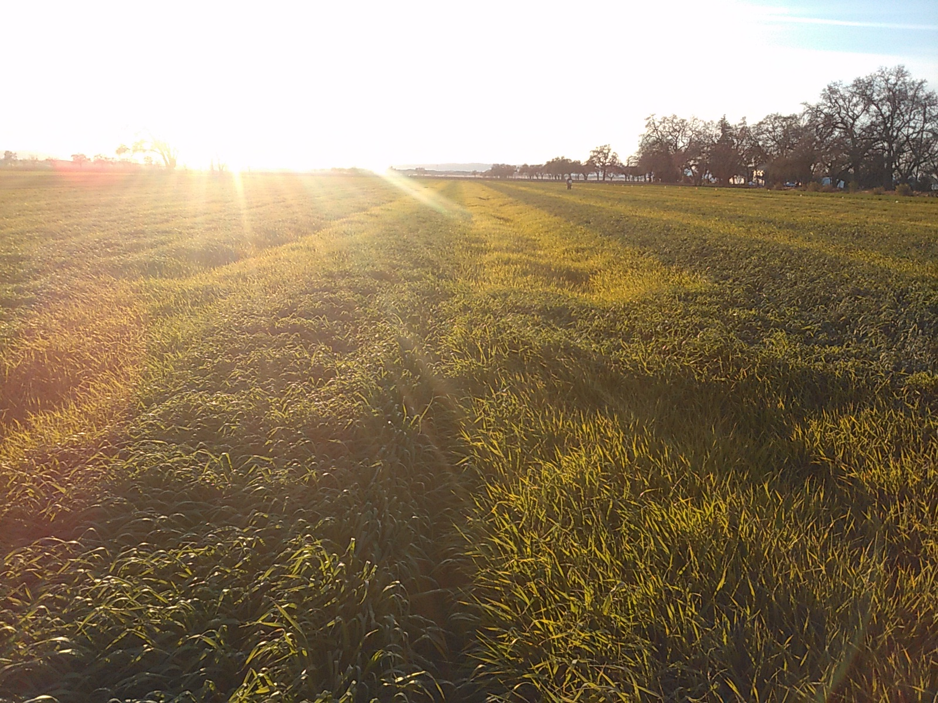
Vine Ray Farms, Woodland, CA

Slide 3
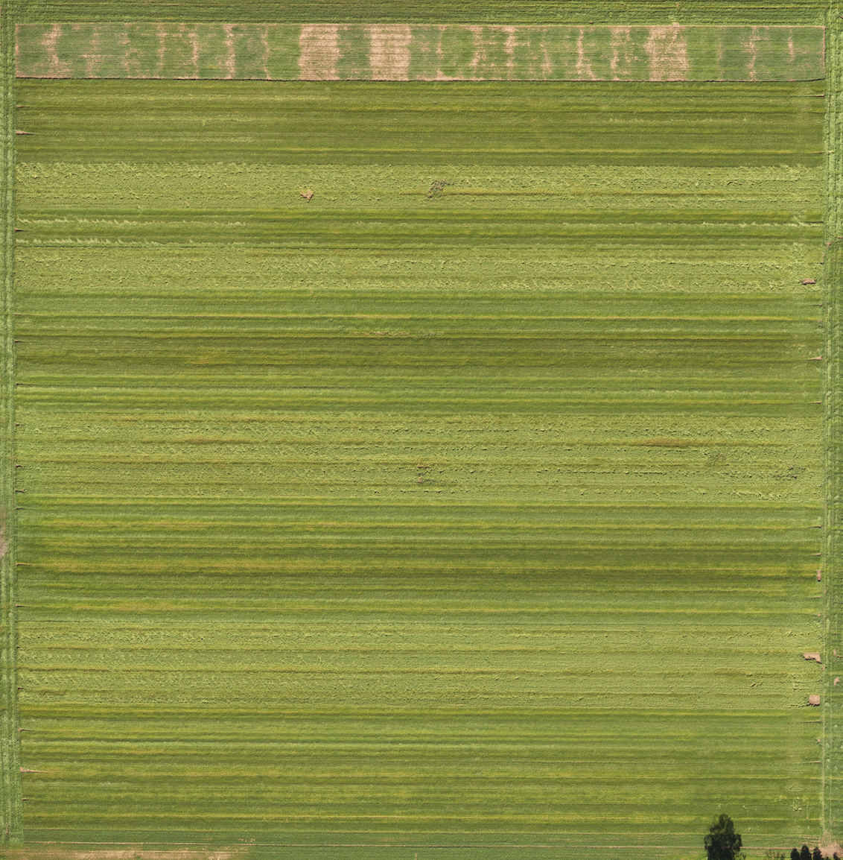
Øland, Chiddam Blanc de Mars, Yecoro Rojo, Edison, Red Fife, Sonora
Øland | Chiddin Blanc | Yecoro Rojo | Edison | Red Fife | Sonora | Alturas | Red Fife | Alturas | Øland | Sonora | Yecoro Rojo | Chitin Blanc | Edison | Edison | Chitin Blanc | Alturas | Sonora | Red Fife | Øland | Øland
Odyssey (Purple)
Full Pint (Blue)
Klages Low Planting Density (Orange)
Tahoe (Green)
Klages (Red)
Genie (White)
Odyssey (Purple)
Tahoe (Green)
Klages Low Planting Density (Orange)
Klages (Red)
Genie (White)
Full Pint (Blue)
Genie (White) 1.1 million, 104lbs/ac
Klages (Red) 1.31 million*, 85 lbs/ac
Klages Low Planting Density (Orange) 1.05 million*, 106 lbs/ ac
Tahoe (Green) 1.25 milion, 101lb/ac
Odyssey (Purple) 1.11 million, 98.77 lbs/ac
Full Pint (Blue) 1.06 million, 114 lbs/ac
Merced Rye (Tall, border edge)

Slide 4
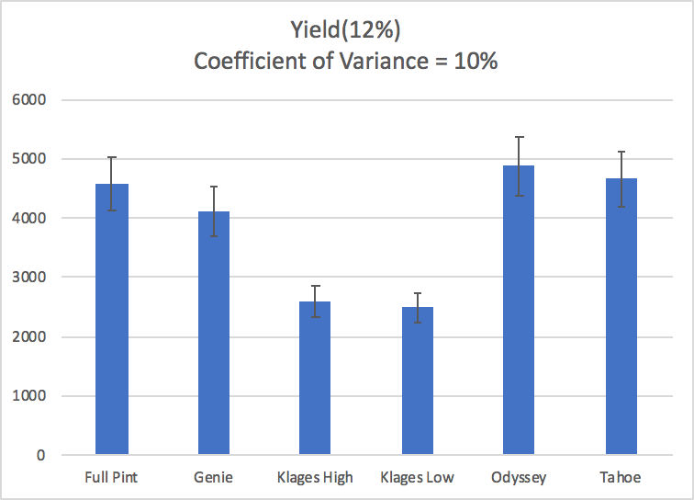
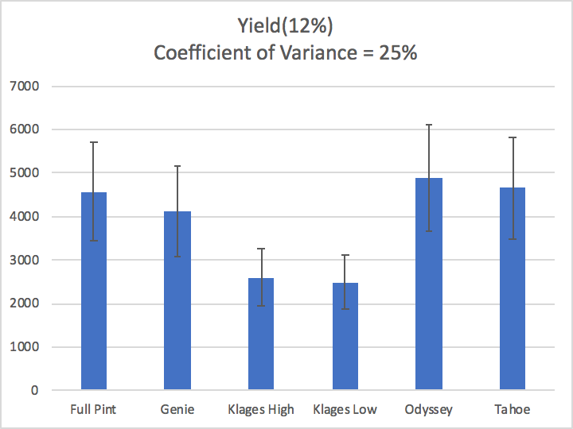
Barley

Slide 5
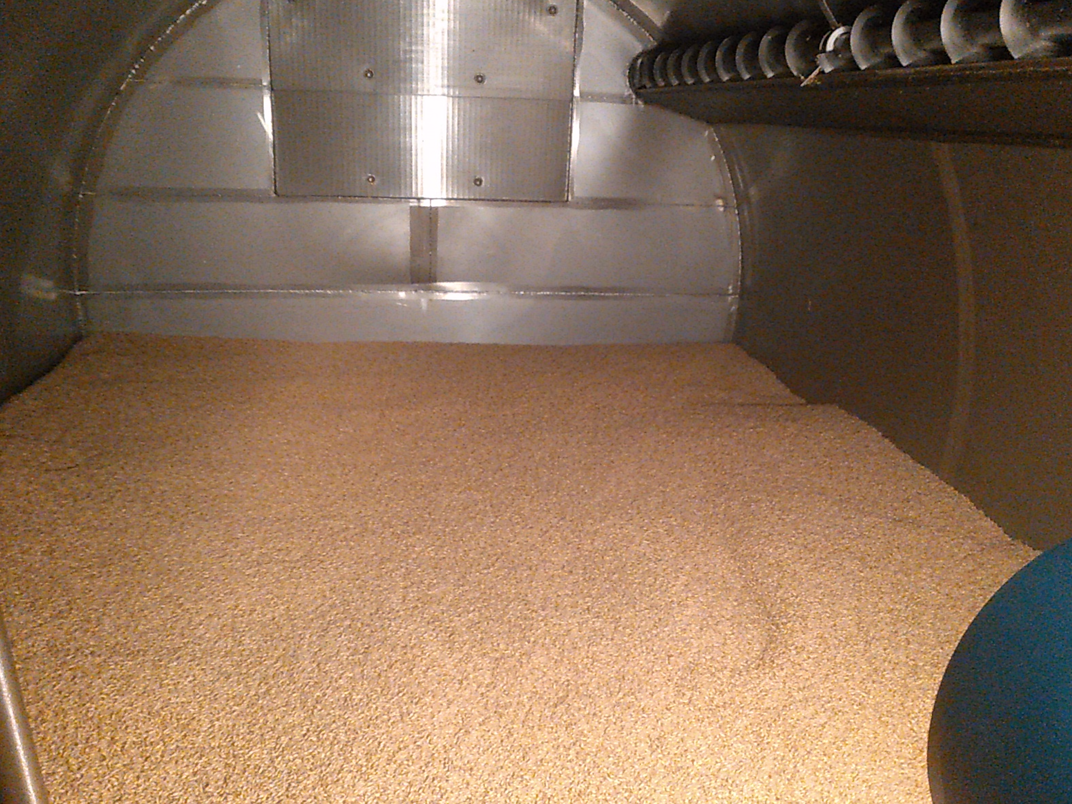

Slide 6
2018 Grower and Producer Feedback and Resources
Malting barley website (beta version)
Notes on malting characteristics from maltster
Lab results from Hartwick College

Slide 7
Brewing Trials
“Smash” brews with Sierra Nevada and other participating brewers
Sensory panel from Sierra Nevada will evaluate difference in flavor between beers
Consumer preference trials at local breweries (Yolo, New Helvetia, Bike Dog)
Release of beers to wider public at State Fair or during beer week?

Slide 8
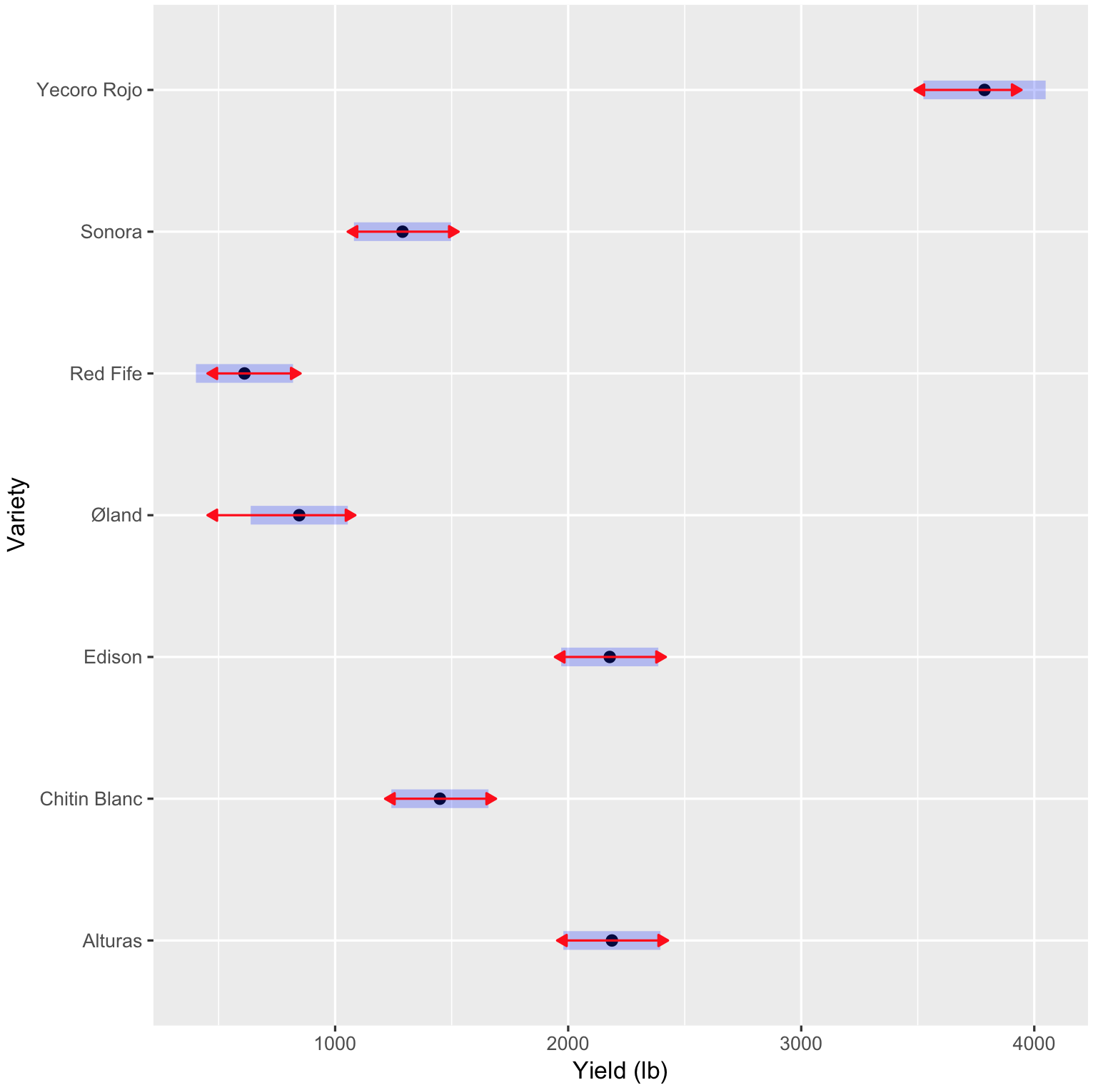
Wheat
a
cd
de
e
b
c
b

Slide 9
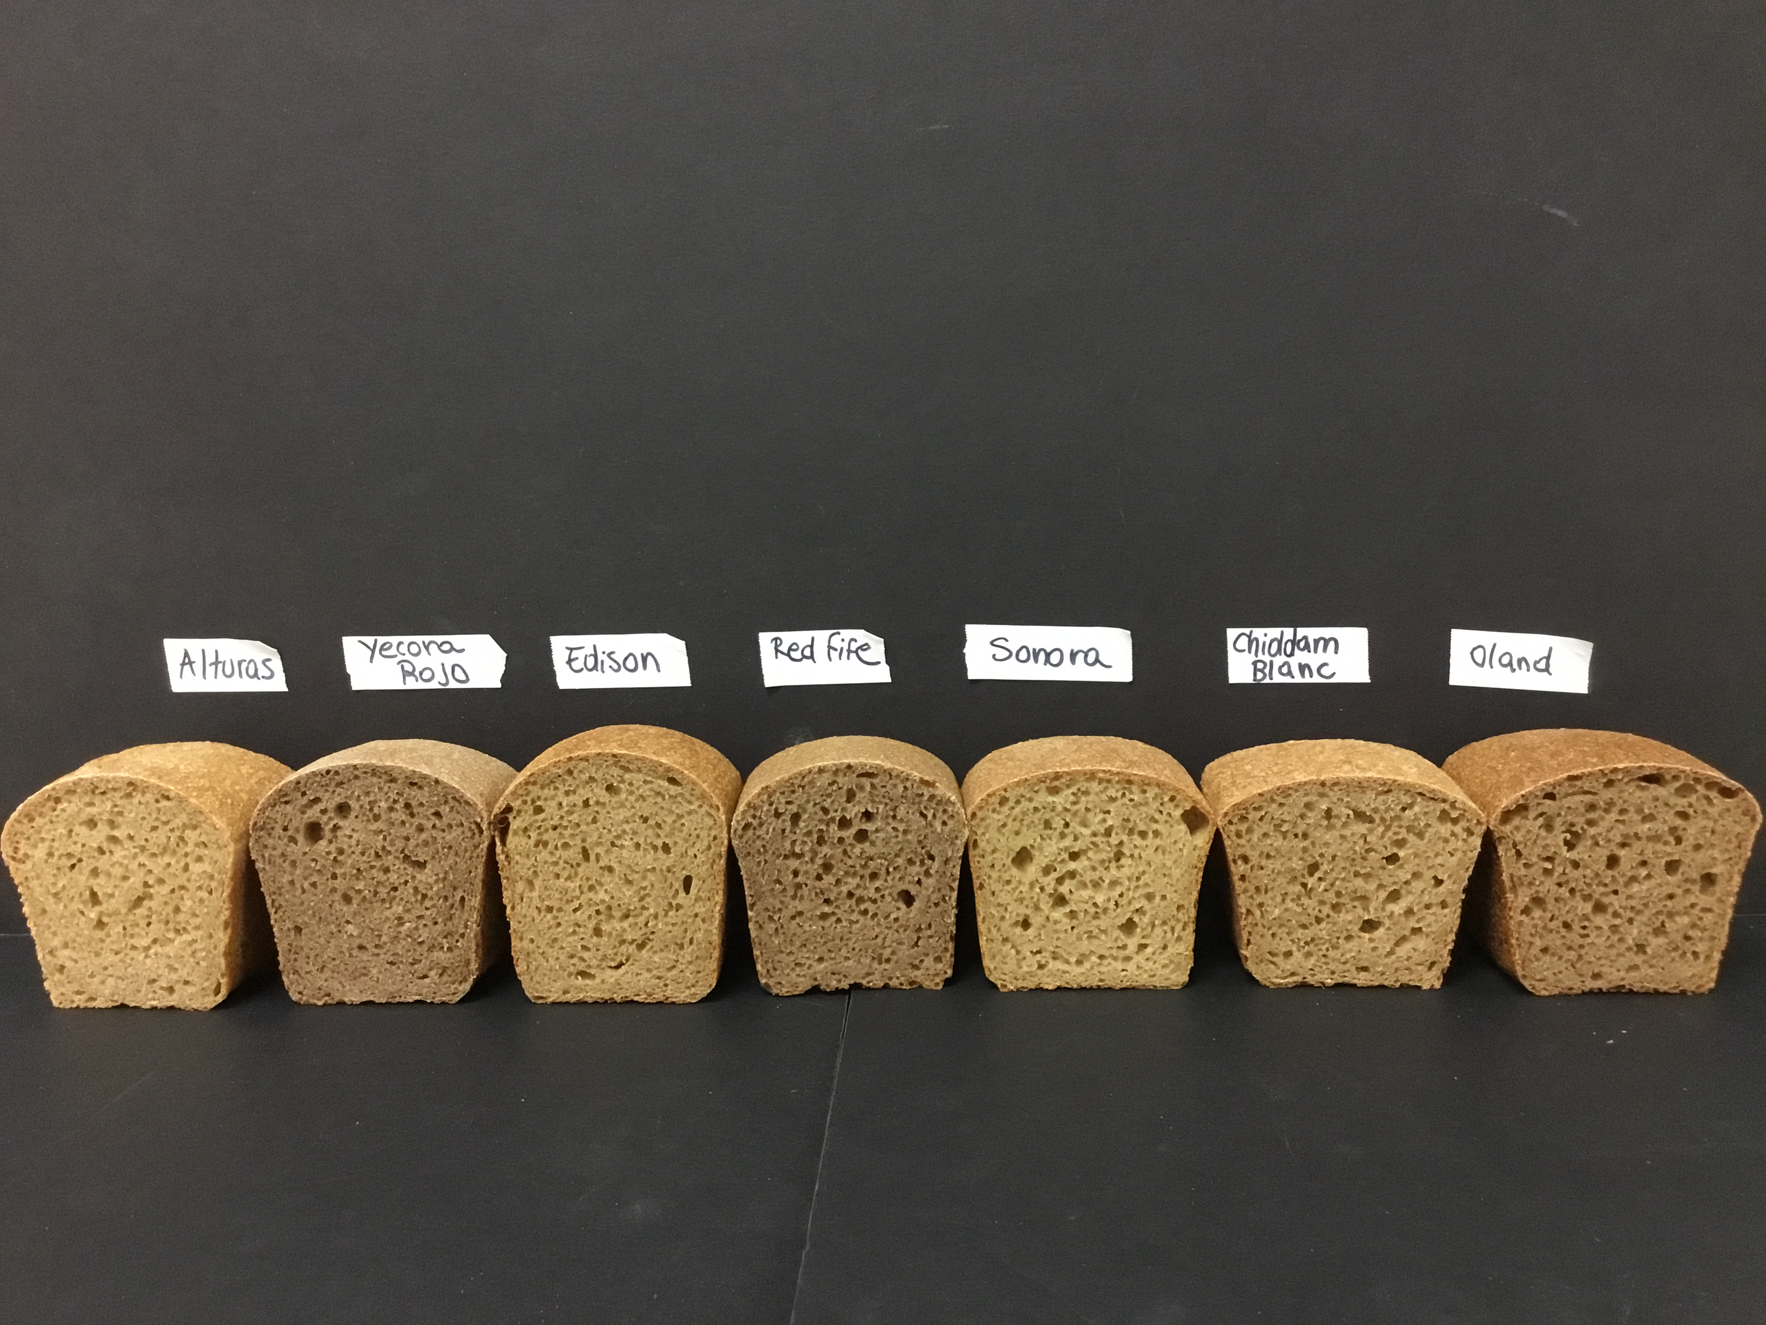

Slide 10
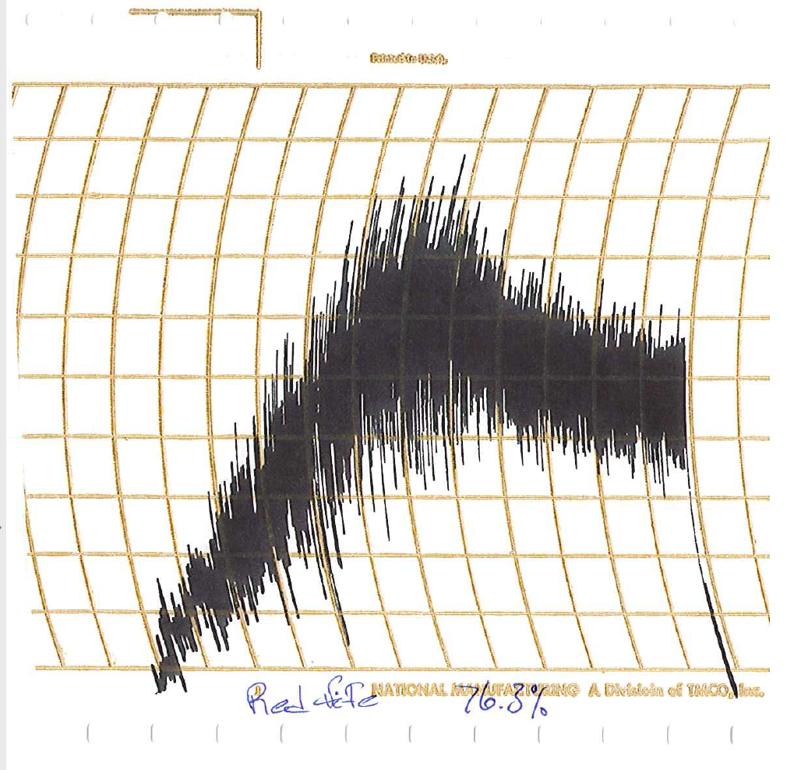
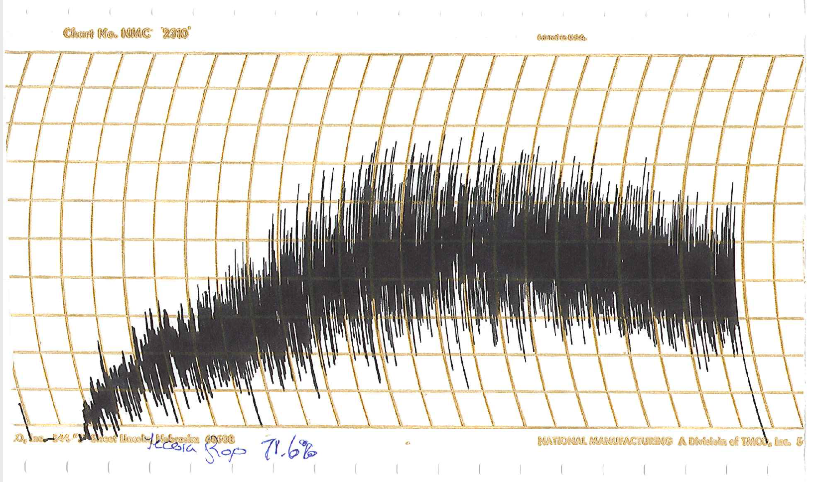
Red Fife
Yecoro Rojo

