Slide 1
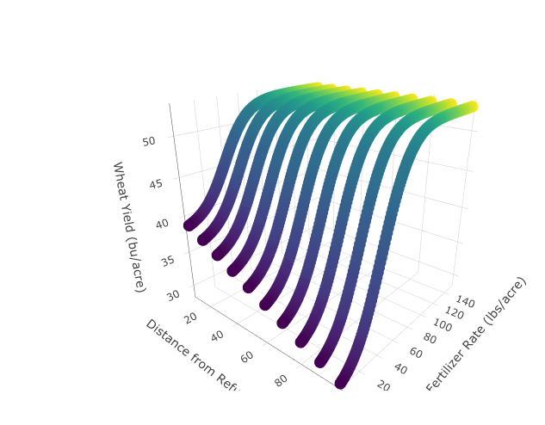
Wheat Yield with Distance from Refuge and Nitrogen Fertilizer Rate on Farm 2
Wheat Yield (bu/acre)
Nitrogen Fertilizer Rate (lbs/acre)
Distance from Refuge (m)

