Slide 1
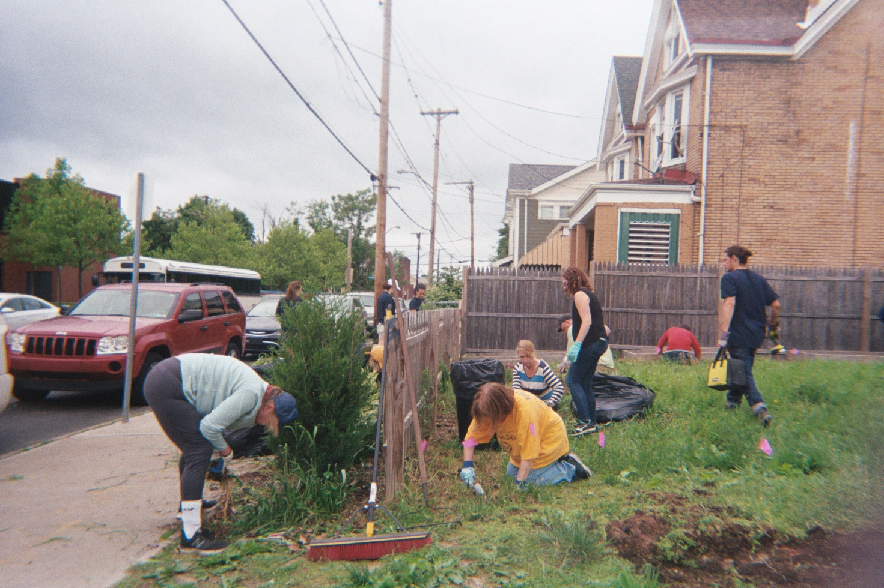
Supporting Historically Underserved Urban Agriculturalists: What do growers want to see?
Hannah Whitley M.S. Student, Rural Sociology and Women’s, Gender & Sexuality Studies The Pennsylvania State University 7th Annual Rural Studies Student Conference November 8, 2019 The Pennsylvania State University
This research is based upon work supported by the National Institute of Food and Agriculture, U.S. Department of Agriculture, through the Northeast Sustainable Agriculture Research and Education program under subaward number GNE18-190-32231 and was made possible with support from the Pennsylvania Women’s Agricultural Network (PA-WAgN).

Slide 2
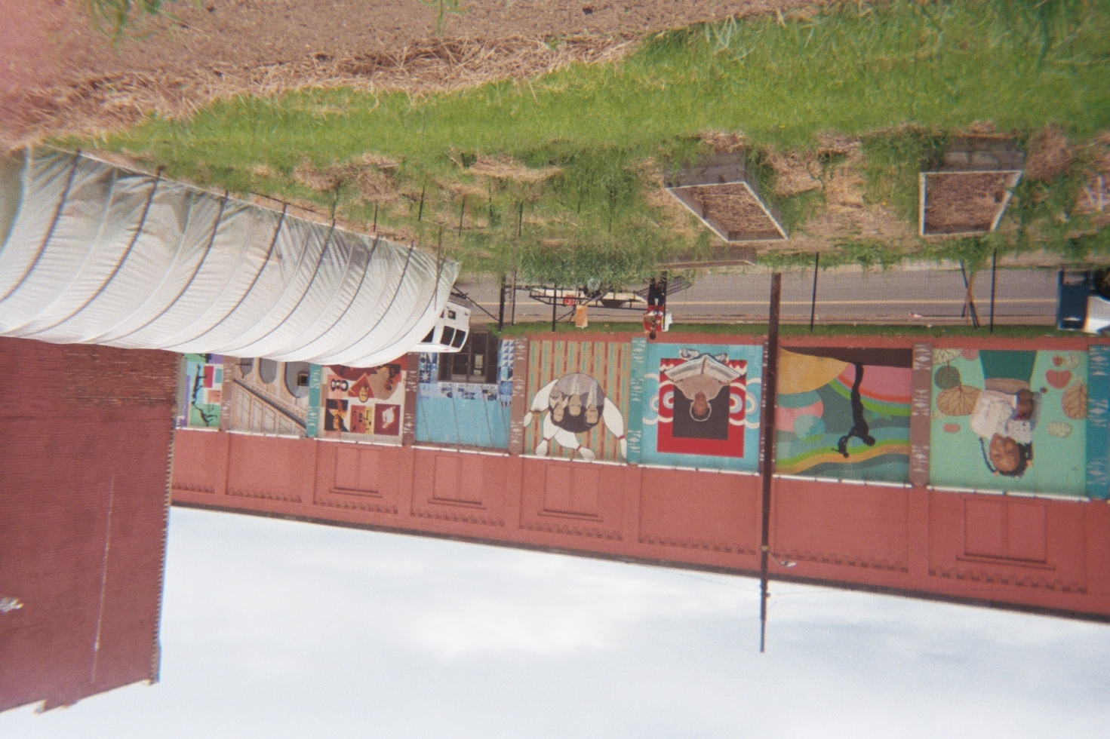
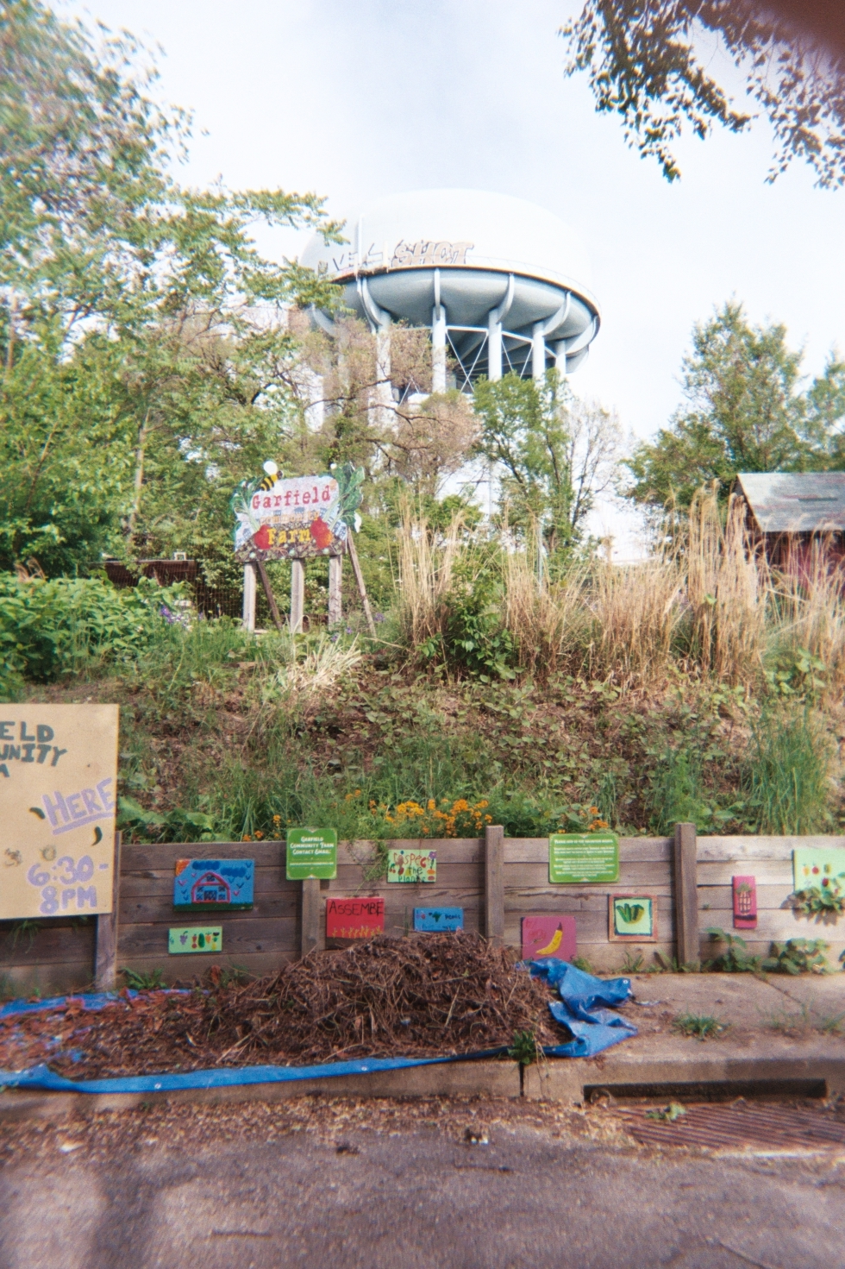
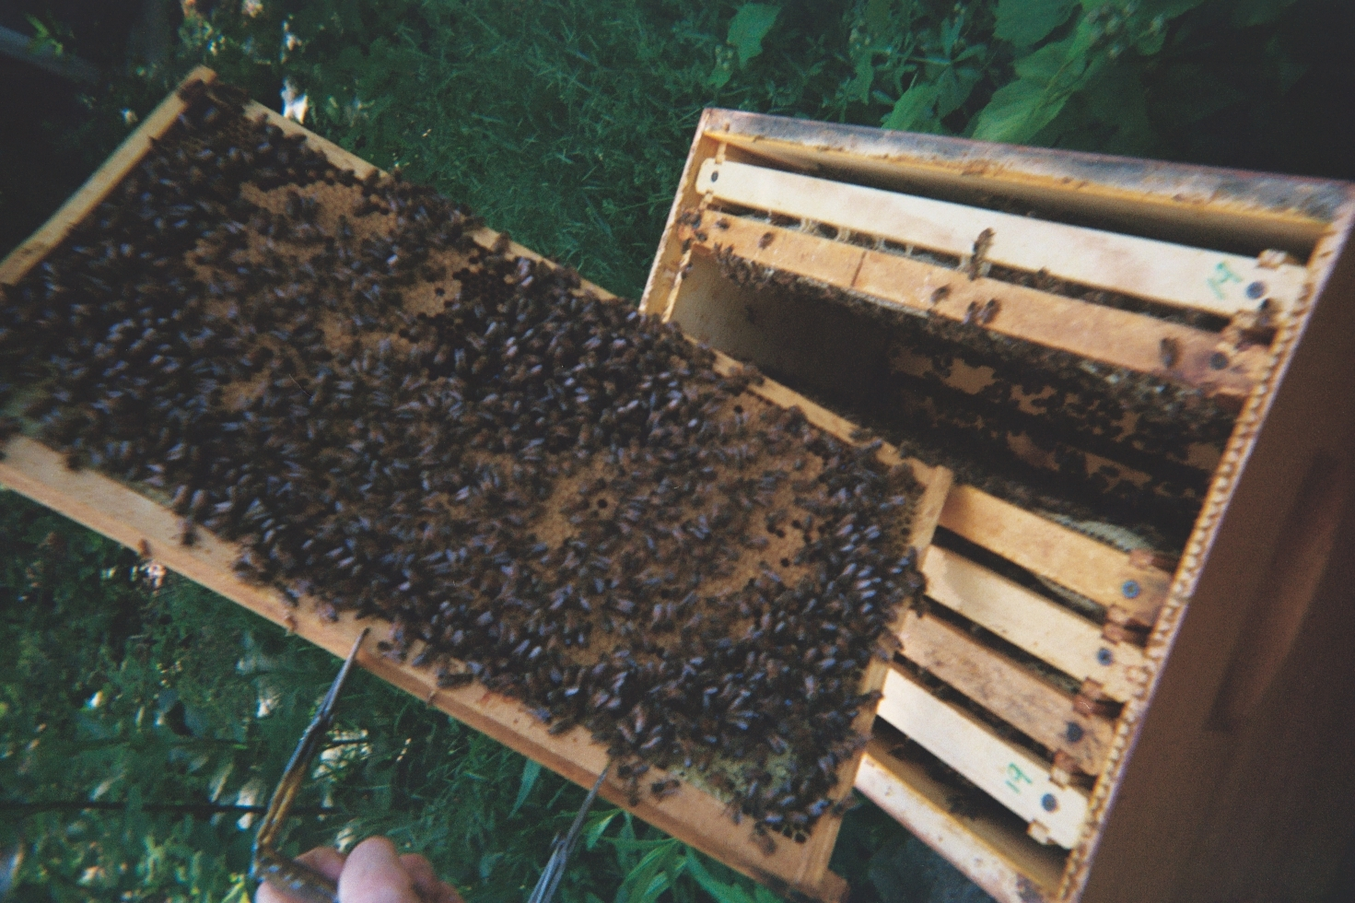
Background
Defining Urban Agriculture (UA)
“The growing of plants and the raising of animals with and around cities” (RUAF 2018)
Widespread and practiced globally, but limited statistics and no consistent definition
Practiced by more than 800 million people worldwide (FAO 2018) across 1.7 million square miles (Doward, Mulliniz, and Schutzbank 2013)
© NaTisha Washington The Female Farmer Photovoice Project 2019
© AJ Monsma The Female Farmer Photovoice Project 2019
© Christina Neumann The Female Farmer Photovoice Project 2019

Slide 3
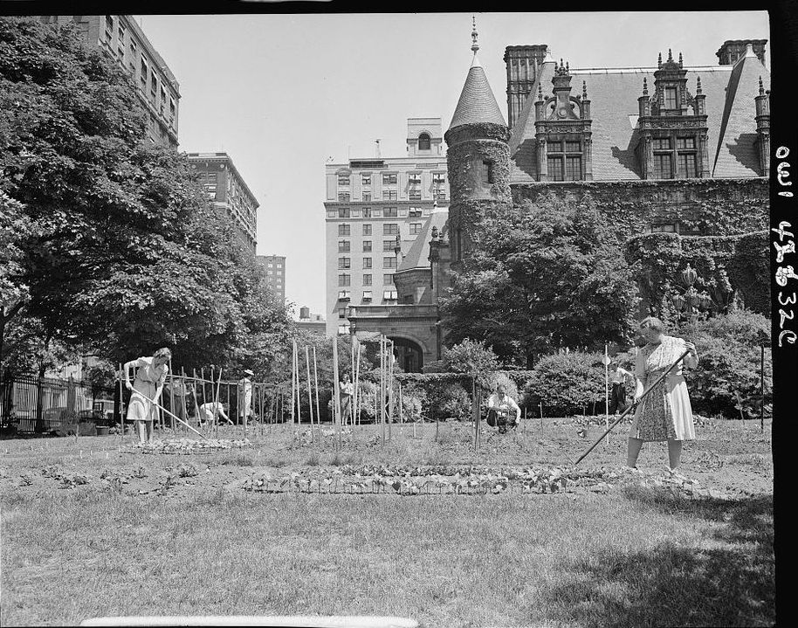
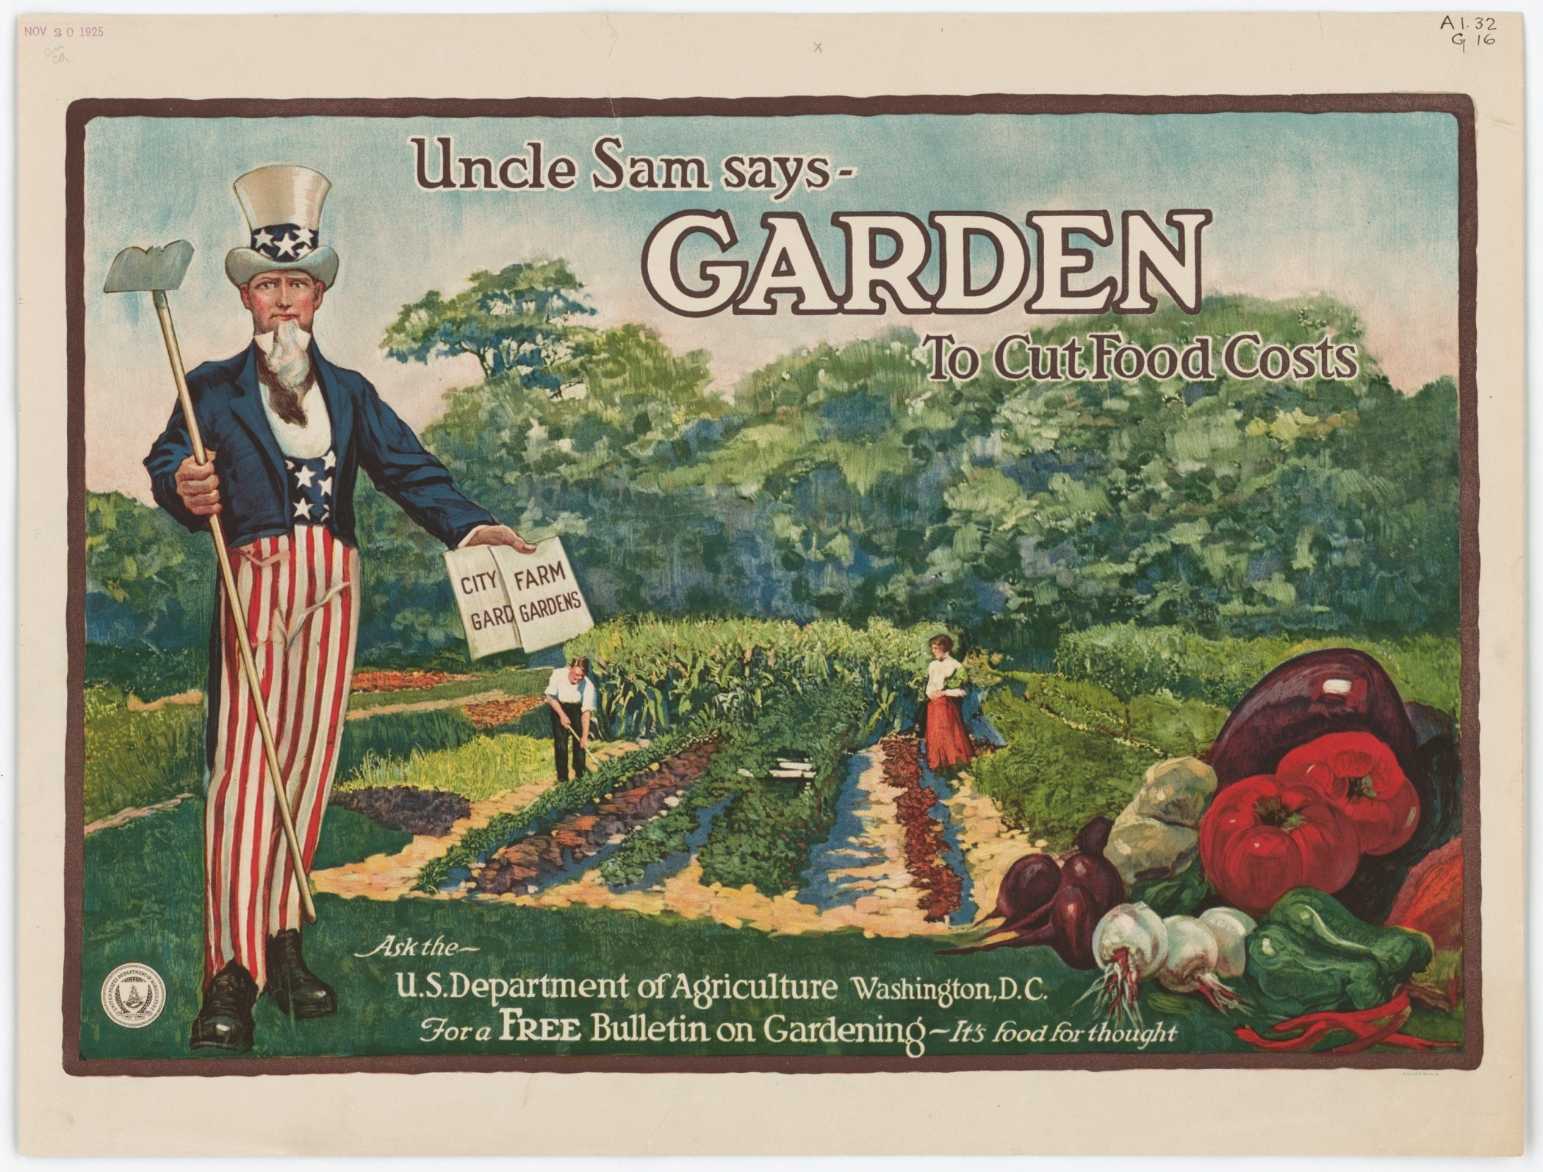
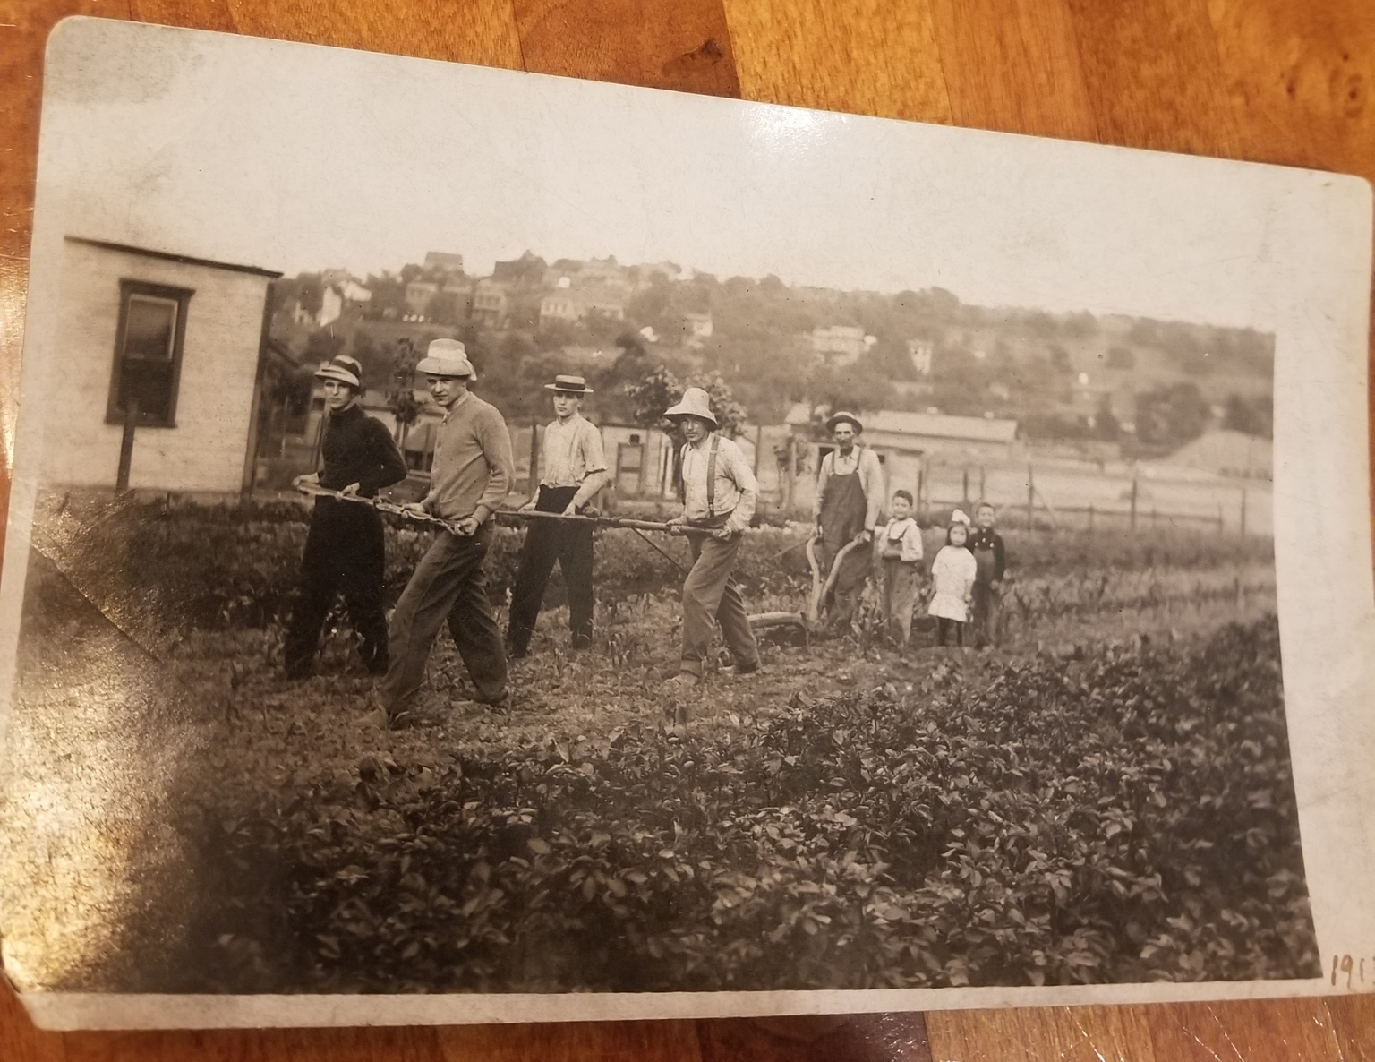
Background
UA in the United States
Early 1900s – urban gardening projects grew into national social programs rooted in oppression and paternalism (“Americanize” immigrants, stop crime and alcoholism)
Gained media notoriety for the Victory Gardens of World Wars I & II
1990s – Dramatic expansion within academic literature (focus on social, economic, and community benefits)
Beginning with the 2008 Farm Bill – millions in federal funding for UA research, programs, and incentives
Circa. 1940; New York City Library of Congress
Uncle Sam Says, Garden to Cut Food Costs, 1917. Library of Congress.
Circa. 1920; Pittsburgh, PA Photo courtesy of Christina Neumann

Slide 4
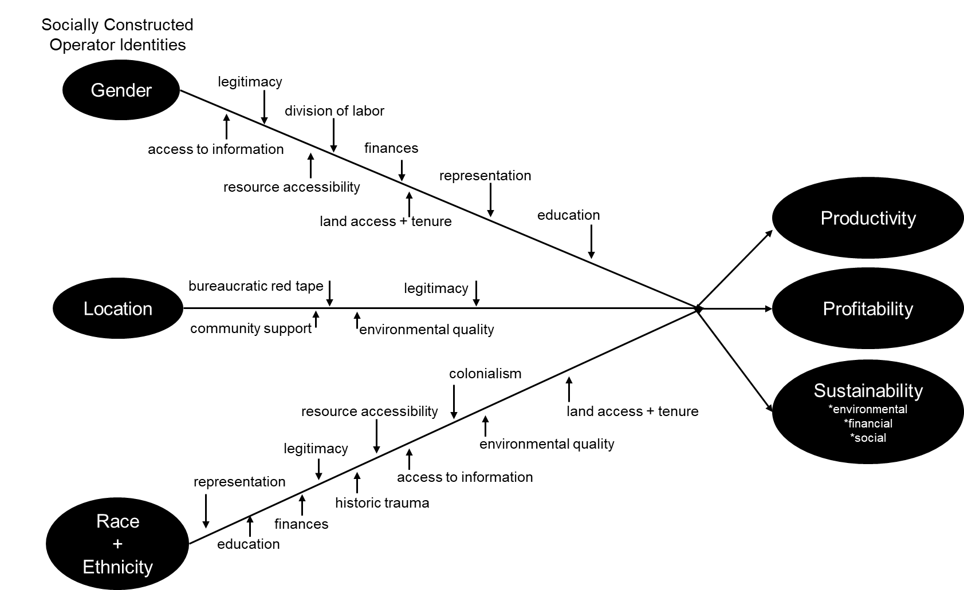
Conceptual framework from my review of the literature

Slide 5
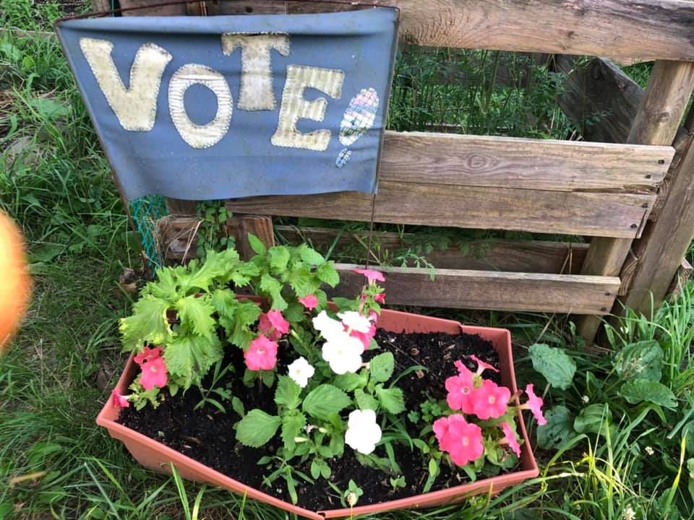
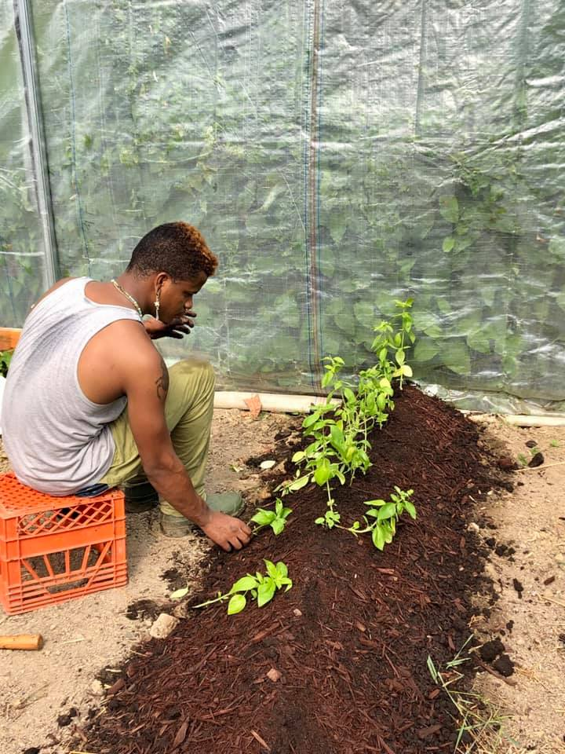
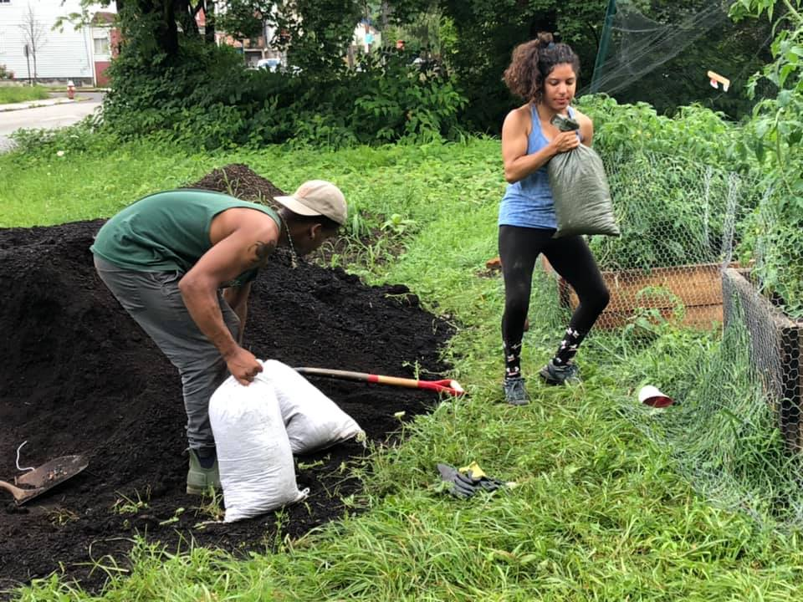
Background
Applying an Intersectional Analysis to UA
Past research on UA has typically existed in a single-variable, linear vacuum
Structural racism, gender inequity, and economic disparities disproportionately affect “socially disadvantaged” urban growers
Contemporary scholarship calls for a focus on the intersectional issues which lie at the core of social justice in agriculture & connect to broader institutional inequities that perpetuate these problems
Thesis seeks to address this gap in the literature
Hannah Whitley 2019; Pittsburgh, PA.

Slide 6
Research Questions
Motivations to grow in urban spaces?
Challenges experienced while faming, gardening, and organizing in urban spaces?
Strategies to develop and maintain sustainable operations?
1.
2.
3.
Work with non-profit organizers, extension services, government programs, and fellow agriculturalists?
Experiences connected to broader structural inequities? How can institutions better support?
4.
5.

Slide 7
Research Questions
How are historically marginalized urban farmers and gardeners’ experiences connected to broader social inequities that perpetuate socio-cultural problems for urban growers? How can institutions such as NGOs, extension, academic research, and federal programs better support historically marginalized urban farmers and growers?
Experiences connected to broader structural inequities? How can institutions better support?
5.

Slide 8
Research Questions
How are historically marginalized urban farmers and gardeners’ experiences connected to broader social inequities that perpetuate socio-cultural problems for urban growers? How can institutions such as NGOs, extension, academic research, and federal programs better support historically marginalized urban farmers and growers?
Experiences connected to broader structural inequities? How can institutions better support?
5.

Slide 9
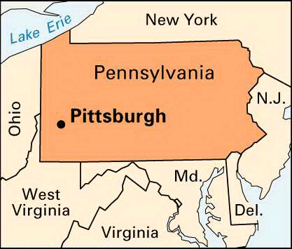
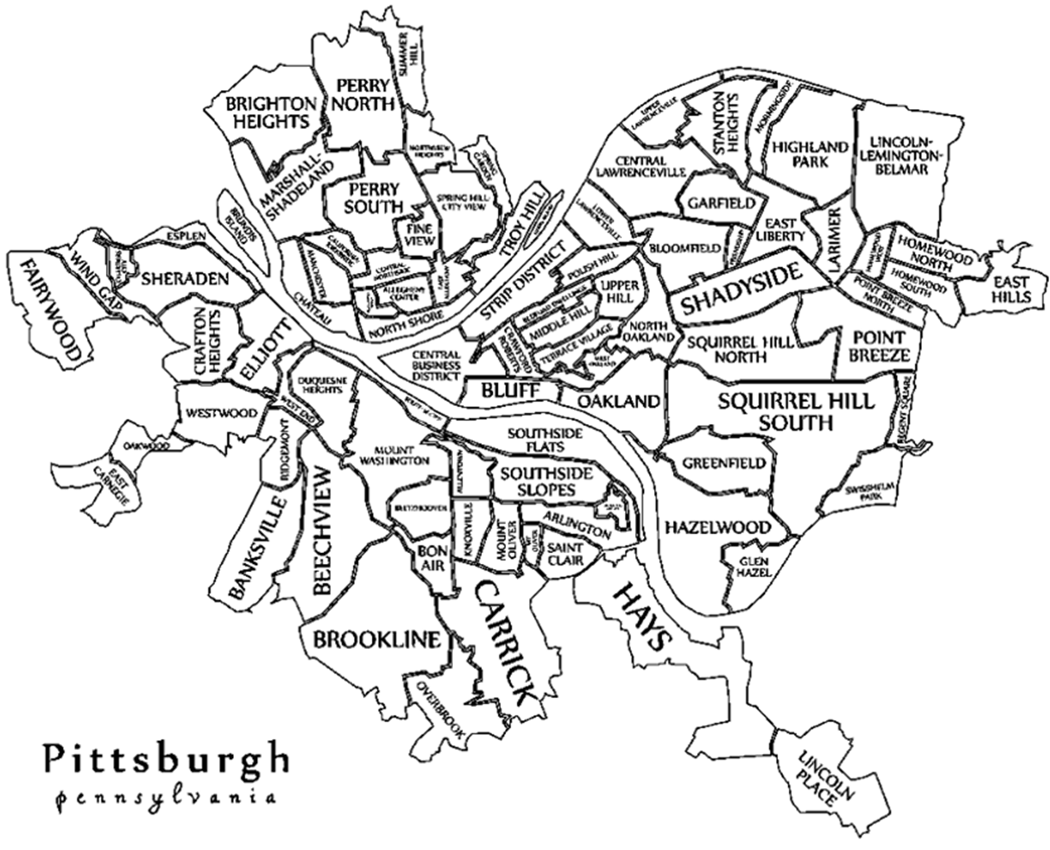
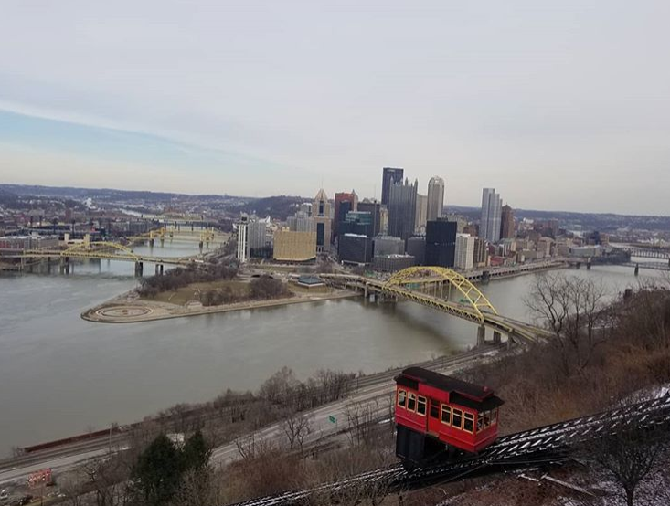
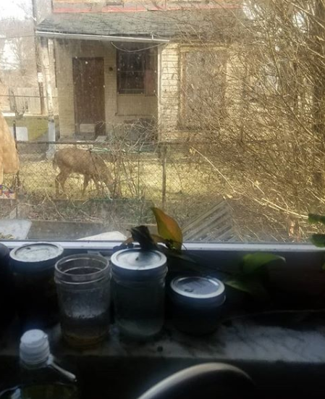
Study Location
8,000 farms comprising over 908,000 acres of farmland (Rogus and Dimitri 2014:4)
Consistently named one of the top 10 American cities with progressive UA policies (Haywood 2017; Lawson 2005)
Hilltop Urban Farm, Food Policy Council, Grow Pittsburgh
Convenience

Slide 10
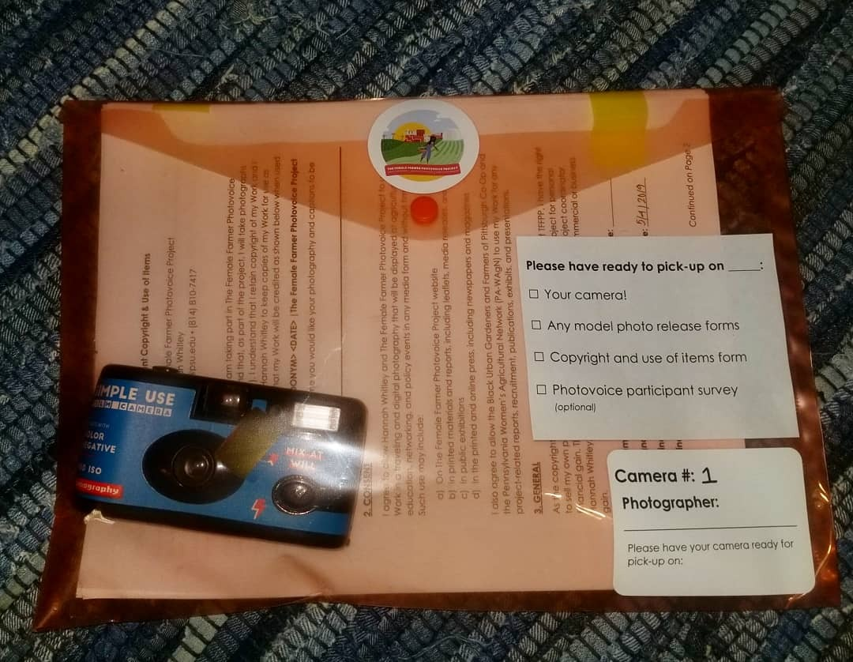
Methods
A
Photovoice is…
A method that asks participants to use photography to represent and reflect on lived experiences and use their images to document needs, promote dialogue, and influence policymakers.
Semi-Structured Interviews 30 participants
Photovoice 18 participants Observation Notes & Content Analysis
Participant Observation 15 weeks in the field
Urban Farmer & Grower Survey 23 participants 73% response rate

Slide 11
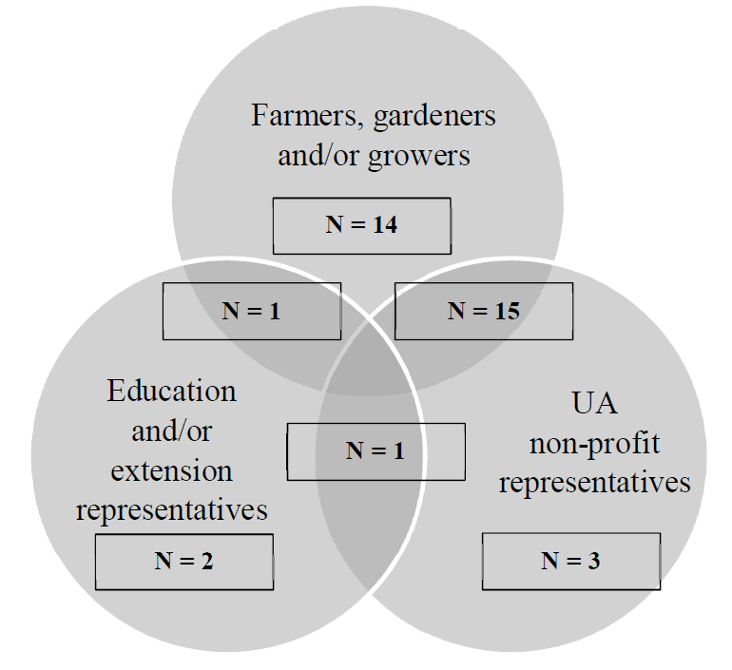
Three categories of participants
Between 18 and 85 years; reside in the Pittsburgh MSA
To highlight the experiences of historically marginalized growers, specifically looked to recruit women of color
50% grow in Homewood or Braddock
Research Sample
Description of Participants Total N=36

Slide 12
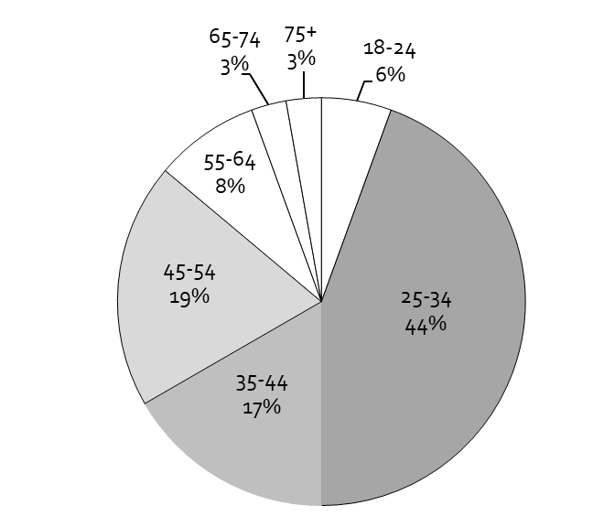
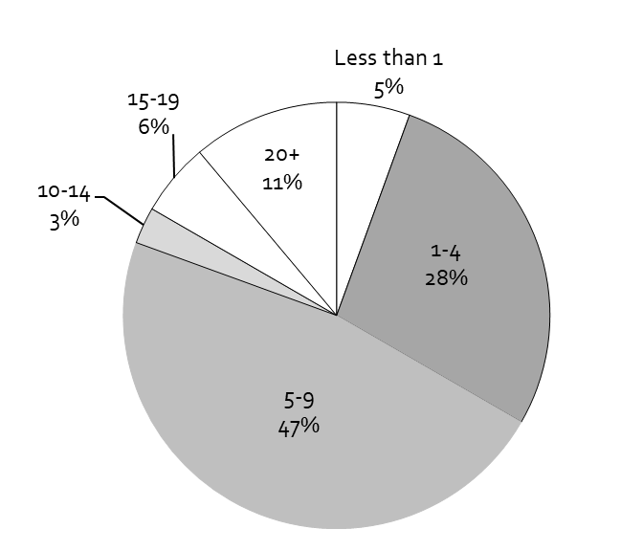
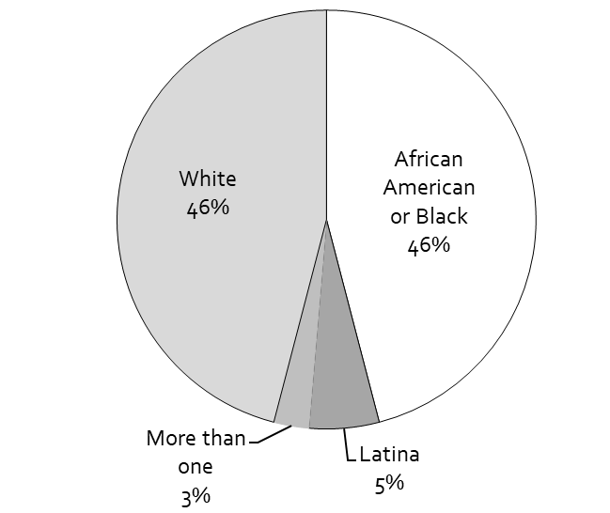
Participant Characteristics
N=36
11 respondents chose participated in both an individual interview and in the photovoice project
Race/Ethnicity
Age
Years Associated with UA in Pittsburgh

Slide 13
My daughter stands in front of our car loaded with plants that we grew in our basement for the Dormont Elementary School second annual Mothers' Day plant sale. The plant sale raises money to sustain the school vegetable garden, which was established in 2017.
Do you think there is a role for academic research to support your work in urban agriculture?
© Lisa Freeman | The Female Farmer Photovoice Project | 2019
“Collaboration” We work not as an island; we work in partnership with many allies. We receive donations from private individuals and gifts of time, labor, and in-kind resources.

Slide 14
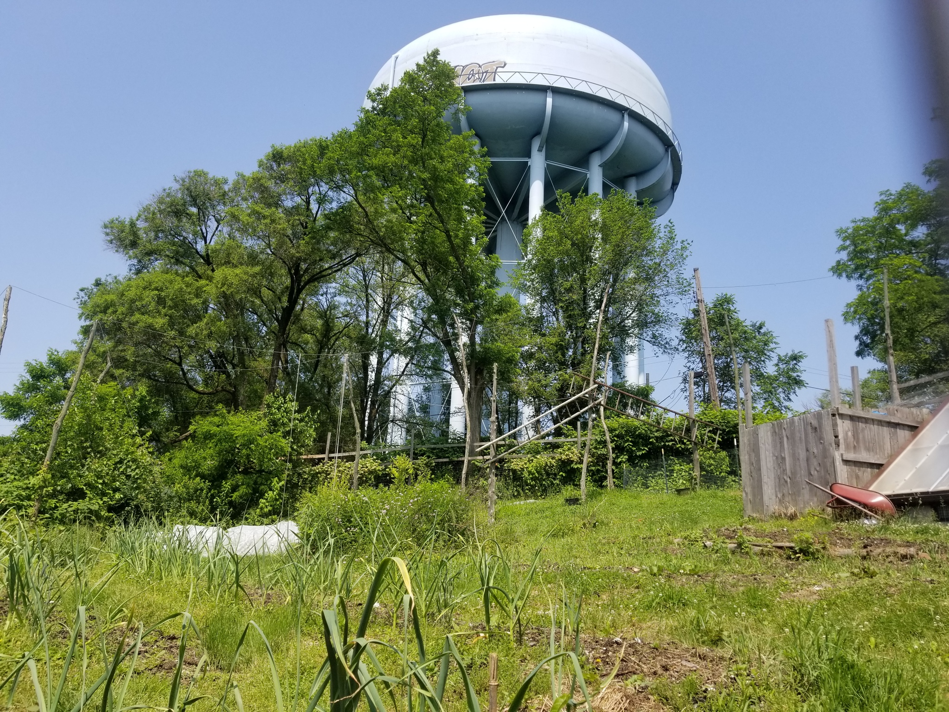
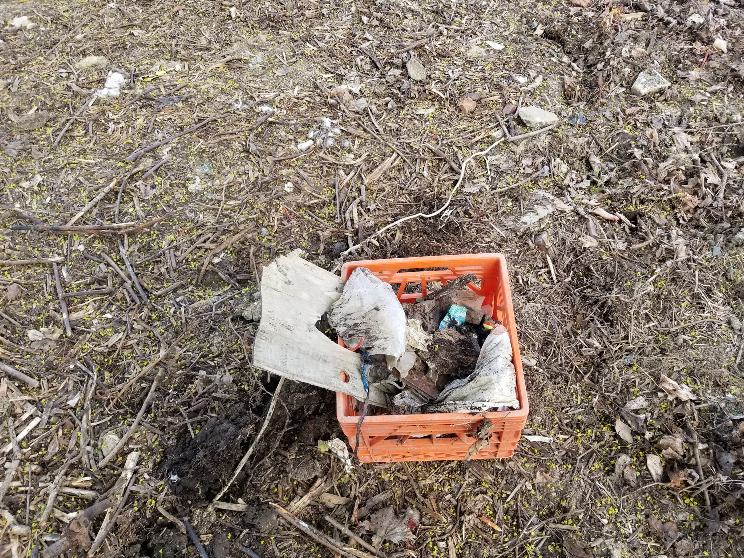
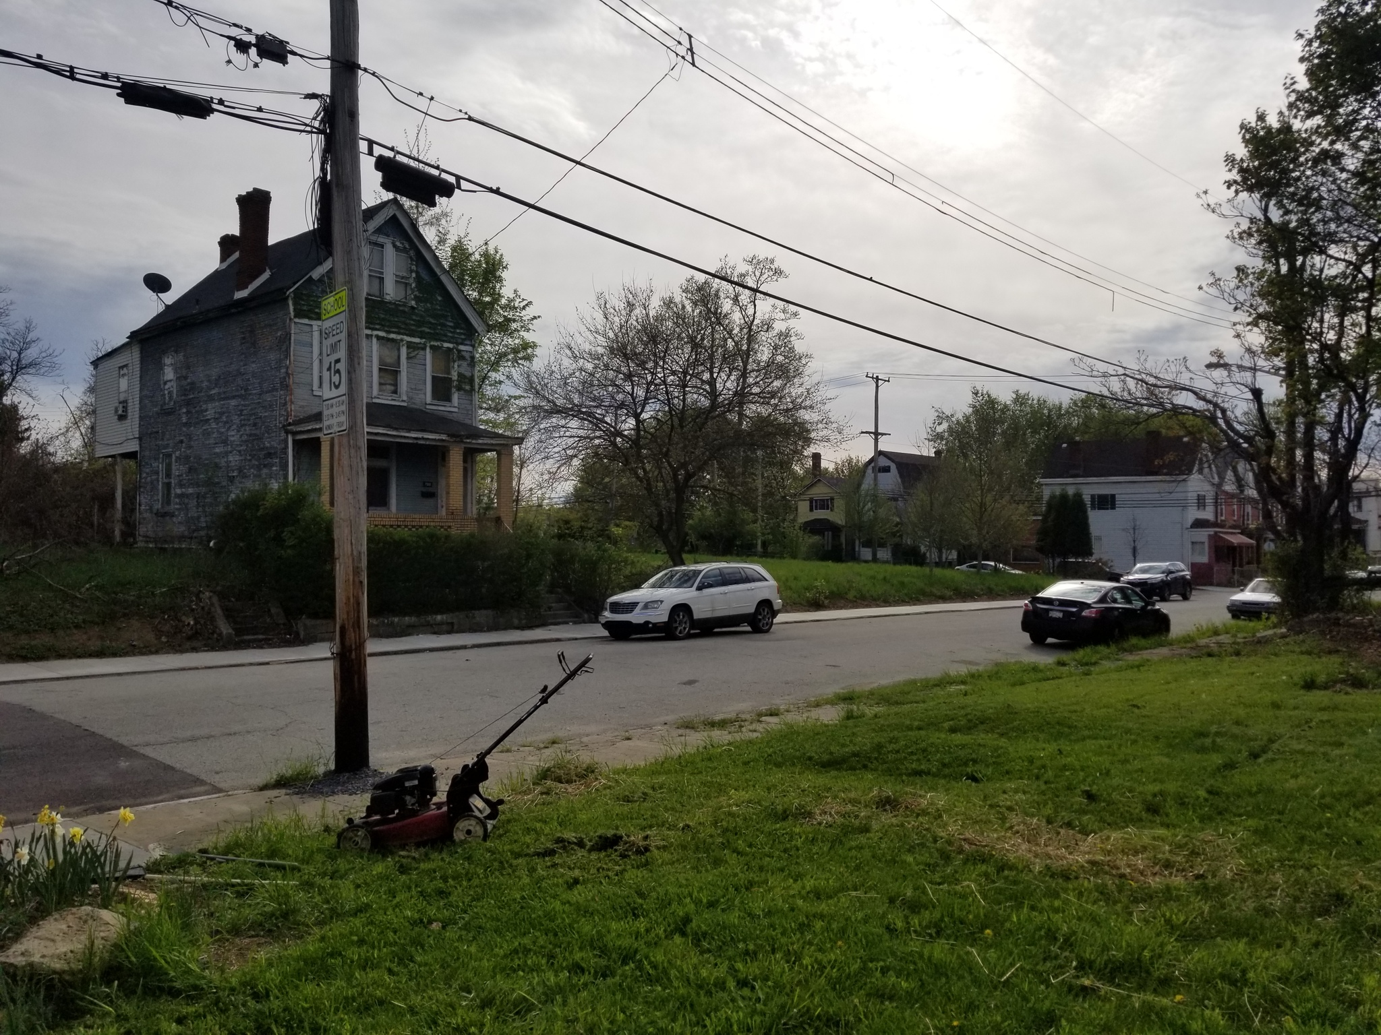
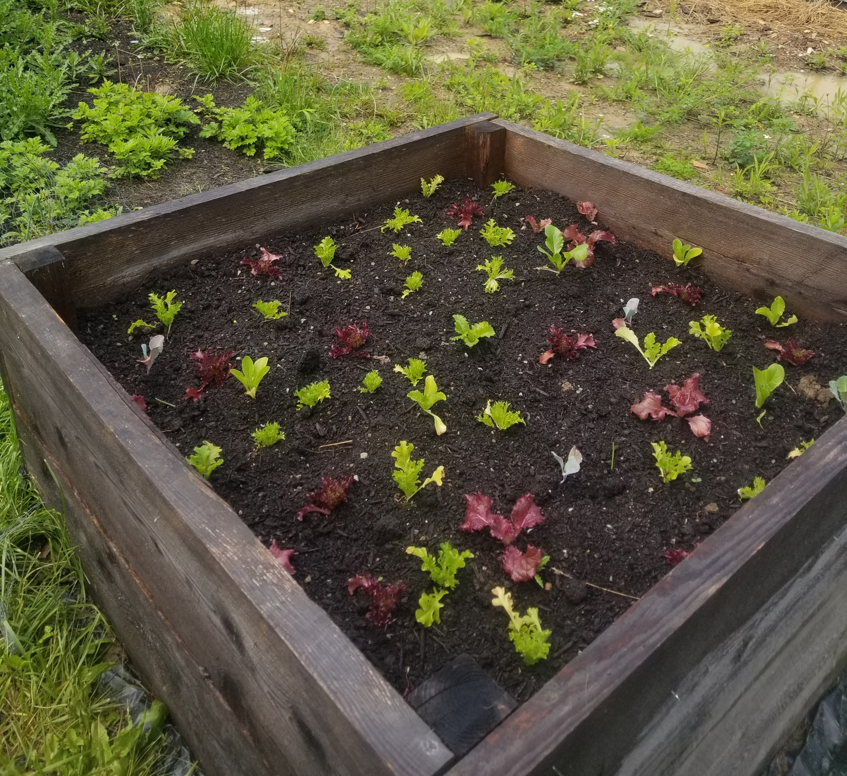
Majority of respondents (86%) identified this as a concern warranting further research
Need for location-specific and solution-oriented experiments
Some want research to happen in the spaces where they grow
Willing to work with local universities to identify and implement low-cost and organic ways of restoring the soil
Raised beds praised as a short-term solution, but what is something more sustainable?
Soil health and remediation

Slide 15
Marketing & distribution strategies for small-scale farms
Specifically requested by growers operating adjacent to the city
Needs varied based on years of experience
“I need help identifying more sustainable practices that make [urban] farming easier and more affordable” – Nessa, Black grower & UA non-profit rep, operating 1-4 years
“Something that talks about the best cover crops for operations that exclusively utilize raised beds” – Mariann, white grower, operating 1-4 years
“What are the appropriate prices I should be charging for wholesale products?” – Jaqueline, white grower, operating 5-9 years
“Something that demonstrates the efficacy of farmers markets versus distributing to grocery stores” – Talia, white grower & UA non-profit rep, operating 5-9 years
“How can we most effectively store and distribute produce on a small scale?” – Fay, white grower & UA non-profit rep, operating 5-9 years

Slide 16
Baseline info on UA policies, programs, services, & their effects on participants
Zoning laws, livestock allowances, data on current land- and agriculture-related policies
“Just being able to put [the information] all in one place so it’s kind of like a cheat sheet on how to start your own small scale urban farm” – Kenzie, white grower and UA non-profit rep, 5-9 years
Urban agriculture-specific census
Who is growing food? What are they growing? Where are they located?
Without, difficult for UA non profits to lobby for grants, state, and national UA policies
Citywide network analysis
“There’s no baseline information. We don’t know how many trees need to be cut down. We don’t know where the stormwater problems are. We don’t know where the air pollution is. We don’t know where the community stands.”
- Natasha, Black grower and UA non profit rep, 5-9 years

Slide 17
Discomfort with past research projects
Disregarded community requests
Did not provide compensation for time or knowledge
Did not share findings
Uneasiness with studies not based upon partnerships with local organizations
Participatory and community-led academic studies
“I think the researchers who come in need to make sure that, A, they’re doing their own homework to understand the community they’re coming into. Do not come in and tell me what to do and tell me what I need or tell me how things are going to work. Researchers have to come in after doing some background work of understanding.
- Júlia, Latina grower and UA non profit rep, 5-9 years

Slide 18
Implications for Practice & Policy
Continue to incorporate community wants and needs within city- and state-level policy decisions
Need for an urban agriculture-specific census… or, more realistically, city-level surveys
Education and extension programming that meets the unique circumstances of urban growers
To create more accessible and equitable spaces, acknowledge and amend the historic, institutional, and cultural inequality endemic to UA systems
Some growers are open to working with scholars, but first consider partnering with local organizations/coalitions
Future academic scholarship should meet the needs of growers – utilize participatory and community-led studies

Slide 19
Implications for Practice & Policy
Continue to incorporate community wants and needs within city- and state-level policy decisions
Need for an urban agriculture-specific census… or, more realistically, city-level surveys
Education and extension programming that meets the unique circumstances of urban growers
To create more accessible and equitable spaces, acknowledge and amend the historic, institutional, and cultural inequality endemic to UA systems
Some growers are open to working with scholars, but first consider partnering with local organizations/coalitions
Future academic scholarship should meet the needs of growers – utilize participatory and community-led studies

Slide 20
Implications for Practice & Policy
Continue to incorporate community wants and needs within city- and state-level policy decisions
Need for an urban agriculture-specific census… or, more realistically, city-level surveys
Education and extension programming that meets the unique circumstances of urban growers
To create more accessible and equitable spaces, acknowledge and amend the historic, institutional, and cultural inequality endemic to UA systems
Some growers are open to working with scholars, but first consider partnering with local organizations/coalitions
Future academic scholarship should meet the needs of growers – utilize participatory and community-led studies

Slide 21
Implications for Practice & Policy
Continue to incorporate community wants and needs within city- and state-level policy decisions
Need for an urban agriculture-specific census… or, more realistically, city-level surveys
Education and extension programming that meets the unique circumstances of urban growers
To create more accessible and equitable spaces, acknowledge and amend the historic, institutional, and cultural inequality endemic to UA systems
Some growers are open to working with scholars, but first consider partnering with local organizations/coalitions
Future academic scholarship should meet the needs of growers – utilize participatory and community-led studies

Slide 22
Implications for Practice & Policy
Continue to incorporate community wants and needs within city- and state-level policy decisions
Need for an urban agriculture-specific census… or, more realistically, city-level surveys
Education and extension programming that meets the unique circumstances of urban growers
To create more accessible and equitable spaces, acknowledge and amend the historic, institutional, and cultural inequality endemic to UA systems
Some growers are open to working with scholars, but first consider partnering with local organizations/coalitions
Future academic scholarship should meet the needs of growers – utilize participatory and community-led studies

Slide 23
Implications for Practice & Policy
Continue to incorporate community wants and needs within city- and state-level policy decisions
Need for an urban agriculture-specific census… or, more realistically, city-level surveys
Education and extension programming that meets the unique circumstances of urban growers
To create more accessible and equitable spaces, acknowledge and amend the historic, institutional, and cultural inequality endemic to UA systems
Some growers are open to working with scholars, but first consider partnering with local organizations/coalitions
Future academic scholarship should meet the needs of growers – utilize participatory and community-led studies

Slide 24
Questions? Comments? Feedback?
Check out the photovoice exhibit from 12-1 in Galbraith Lounge!
Hannah Whitley M.S. Student, Rural Sociology and Women’s, Gender & Sexuality Studies The Pennsylvania State University
htw3@psu.edu
www.thefemalefarmerphotovoiceproject.org

Slide 25
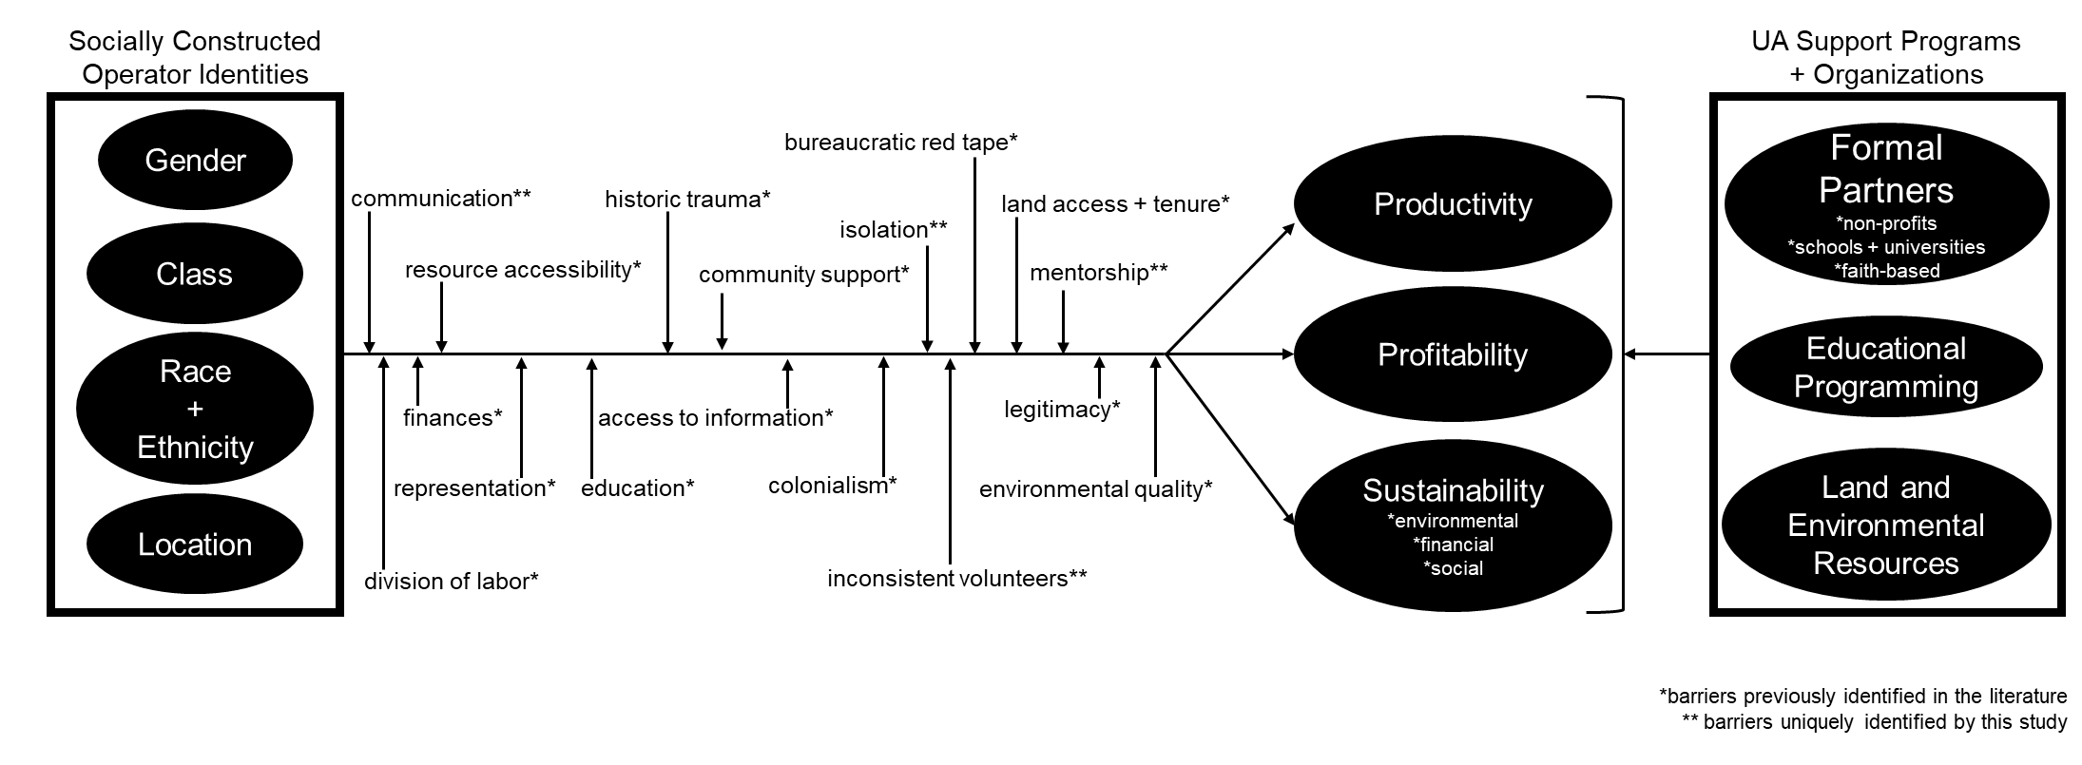
Revised Conceptual Framework

Slide 26
Theoretical Framework
Intersectional Theory
Critical Food Studies
Feminist Agri-Food Systems Theory
Critical Race Theory
My goal: Embed urban agriculture within critical, feminist, anti-racist, intersectional frameworks that elevate marginalized voices to the forefront of social sustainability and encourage broader dialogues related to agricultural policy, landownership, capital acquisition, and institutional structural inequity.

Slide 27
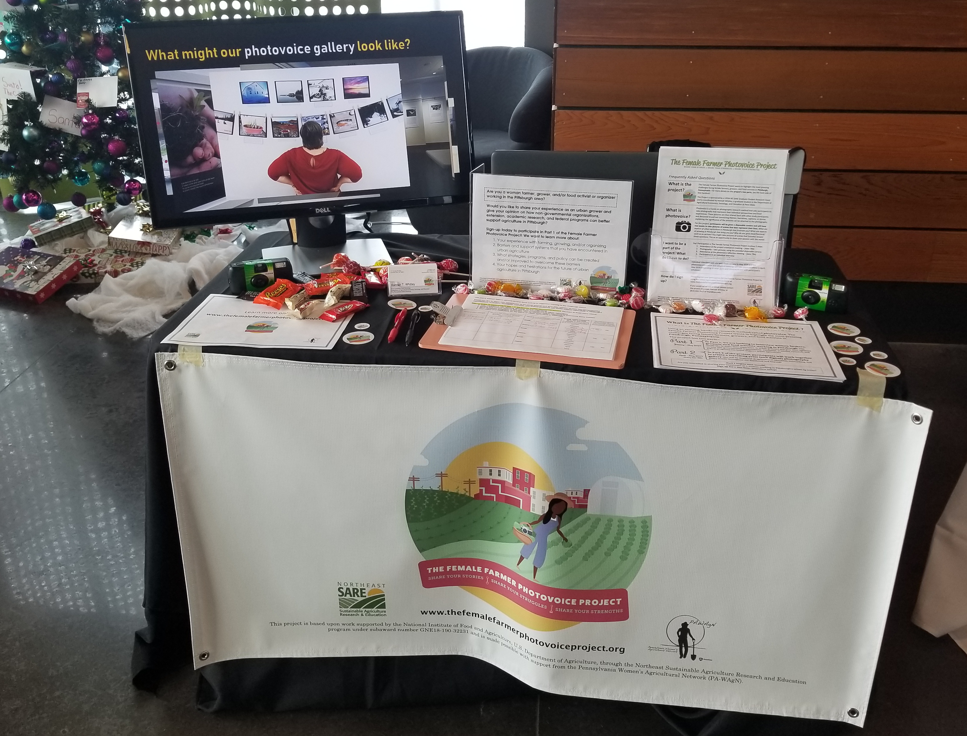
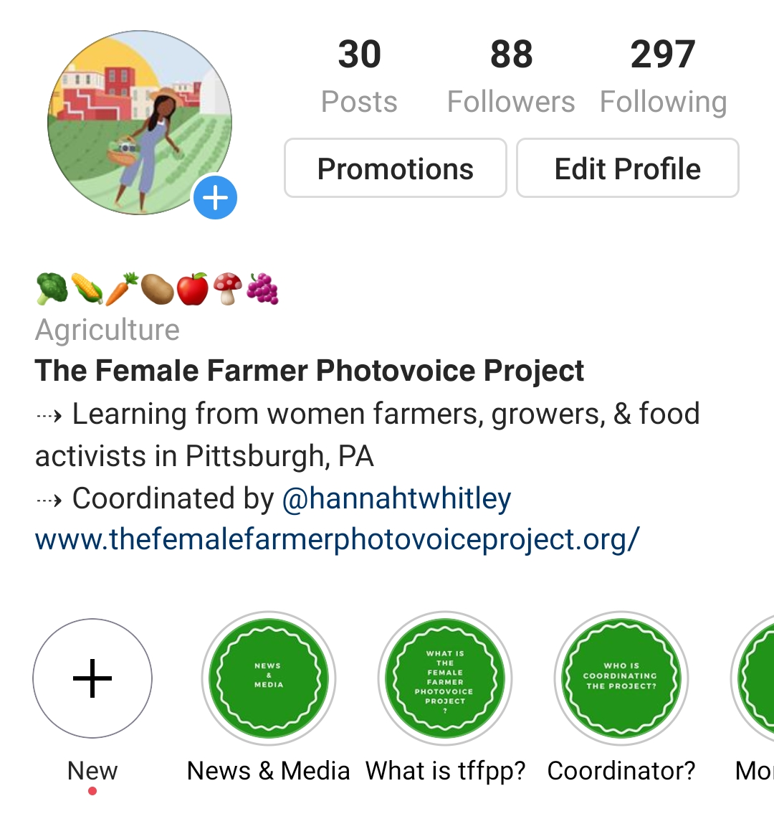
PA-WAgN Annual Symposium
Interview Participants
Organization Listservs
Instagram @femalefarmerphotovoice
Photovoice Recruitment

Slide 28
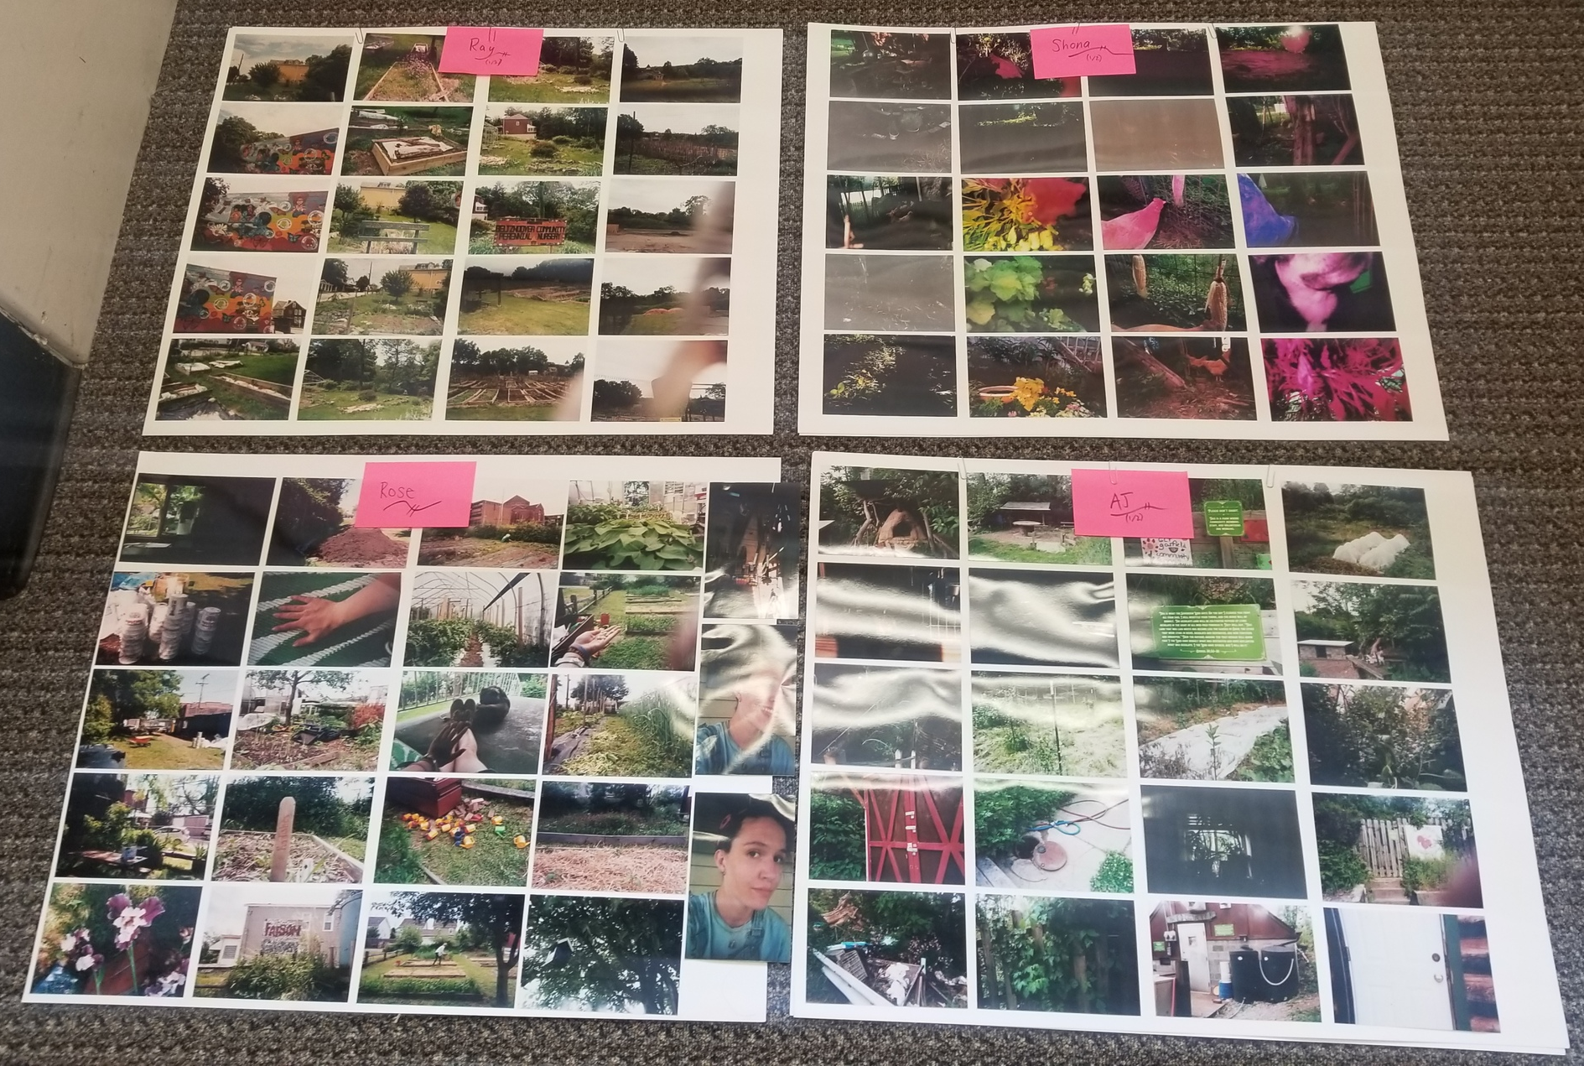
Photovoice Data Collection
Participant reflection meetings
1.5 hours, unstructured discussion circles
Observation notes
Content analysis of participant-written captions and titles
Tell the story of your experiences with urban agriculture

Slide 29
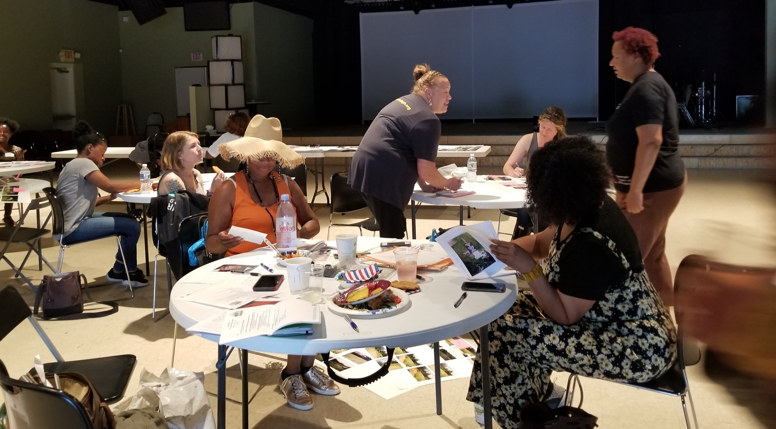
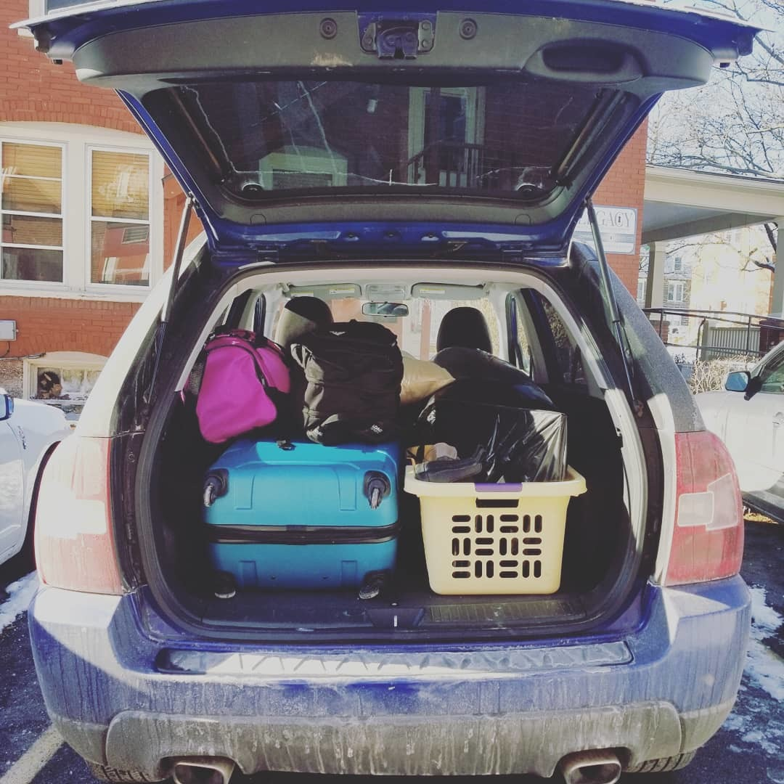
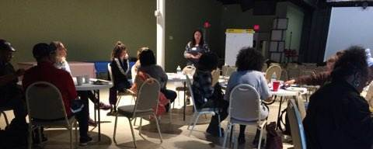
Time for photography
May 4-26, 2019
Photovoice Timeline
PA-WAgN Annual Symposium
Photovoice Reflection Meetings
December 11, 2018
Formal photovoice registration begins
June 1 & 3, 2019
Mid-March 2019
OCT
NOV
DEC
JAN
FEB
MAR
APR
MAY
JUNE
JUL
AUG
SEP
OCT
2018
2019
Community Gallery Reception
Fieldwork begins
Photovoice Information Session
January 14, 2019
Mid-September 2019
May 4, 2019
Fieldwork ends
June 5, 2019

Slide 30
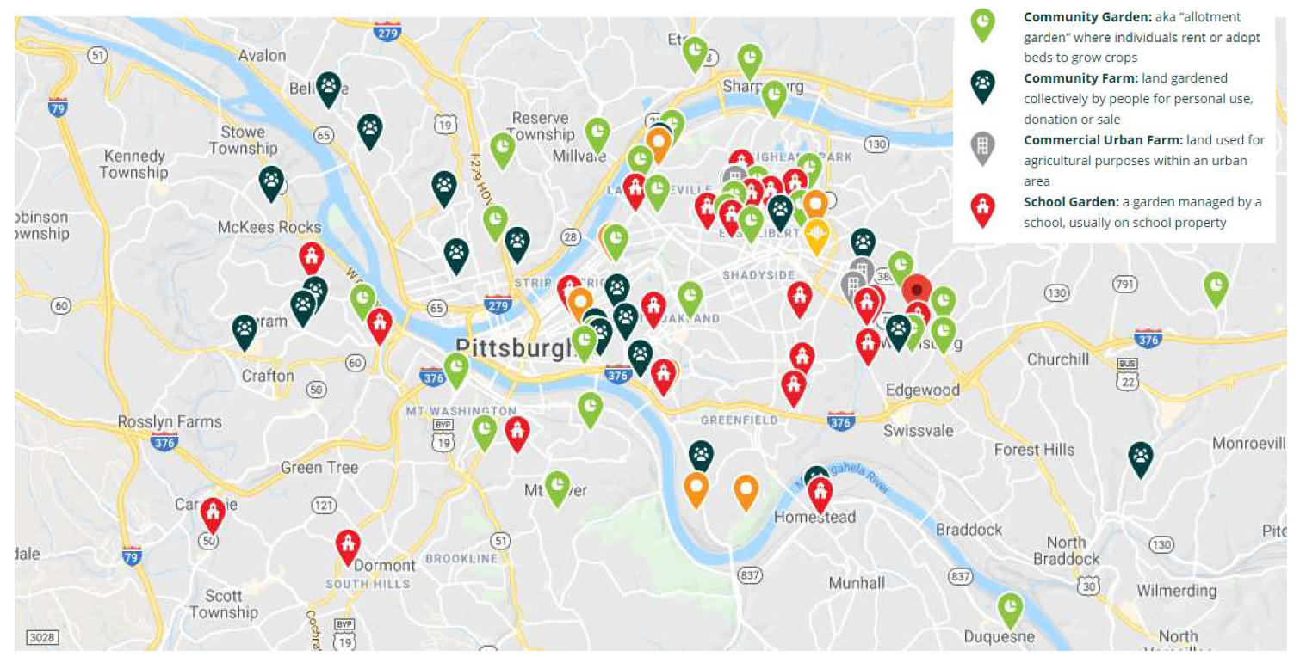
Study Location
No definitive list of UA operations or operators
Map is user-generated
“Backyard farmers/gardeners” not included
Urban Agriculture Sites Identified by the Grow Pittsburgh Grower’s Map as of March 2019 (Grow Pittsburgh 2019)

