Slide 1
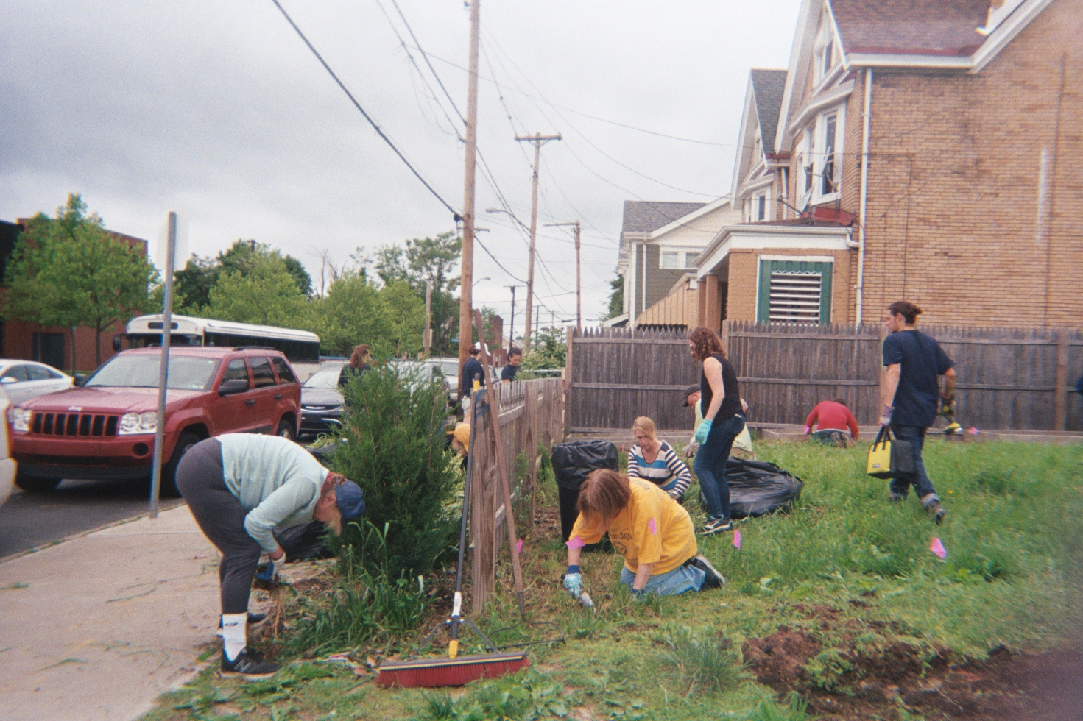
Using Photovoice to Learn from Women Farmers, Growers, Food Activists and Advocates in Pittsburgh, PA
Hannah Whitley M.S. Student, Rural Sociology and Women’s, Gender & Sexuality Studies The Pennsylvania State University 83rd Annual Meeting of the Rural Sociological Society Richmond, VA August 7-10, 2019

Slide 2
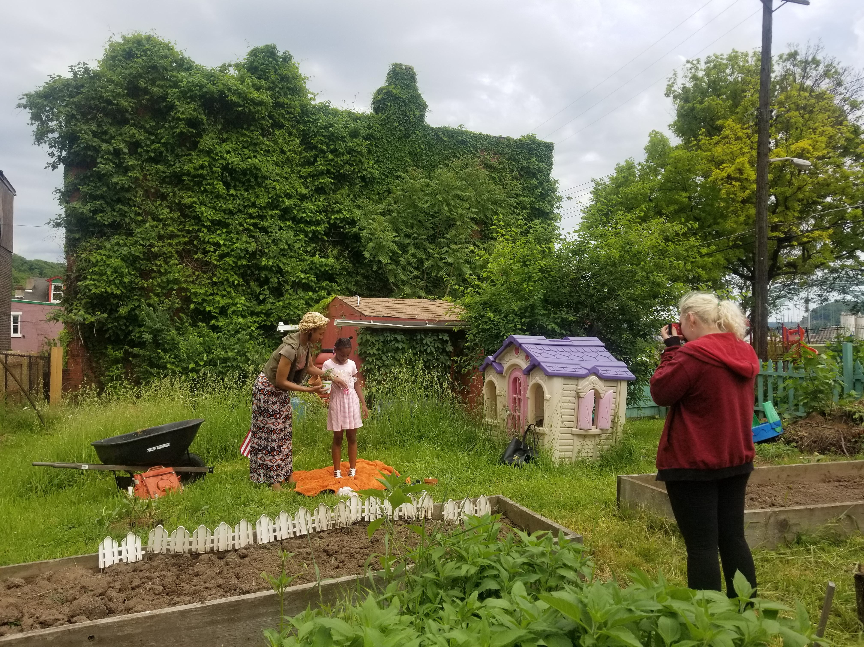
This research is based upon work supported by the National Institute of Food and Agriculture, U.S. Department of Agriculture, through the Northeast Sustainable Agriculture Research and Education program under subaward number GNE18-190-32231 and was made possible with support from the Pennsylvania Women’s Agricultural Network (PA-WAgN).

Slide 3
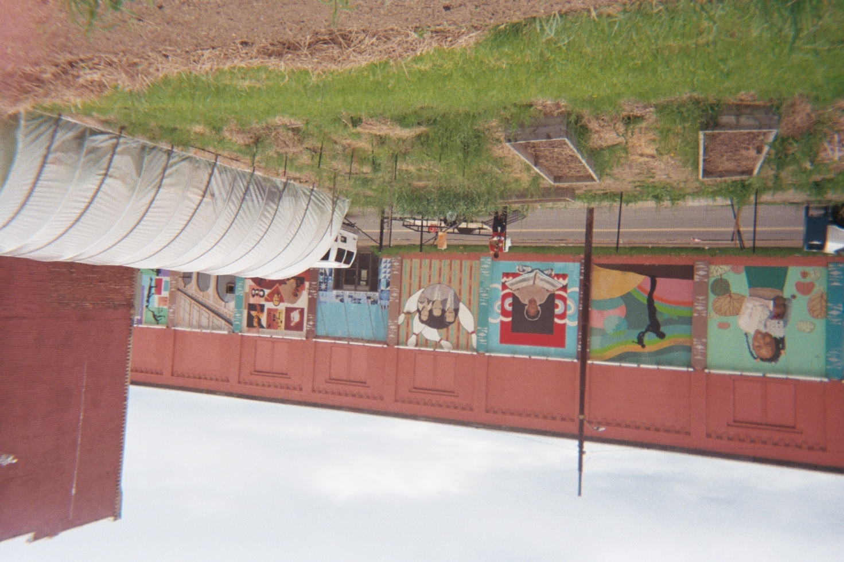
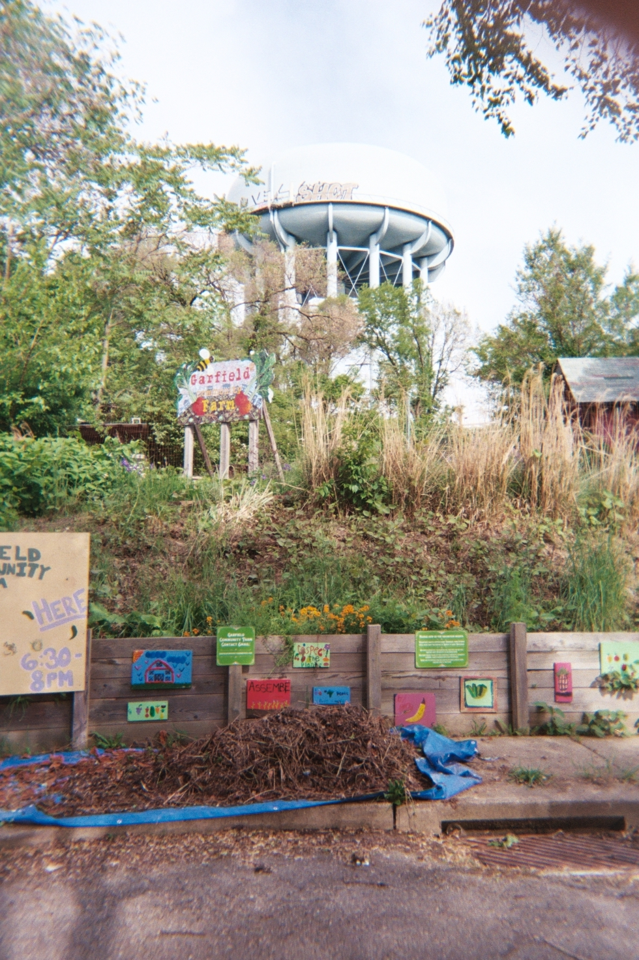
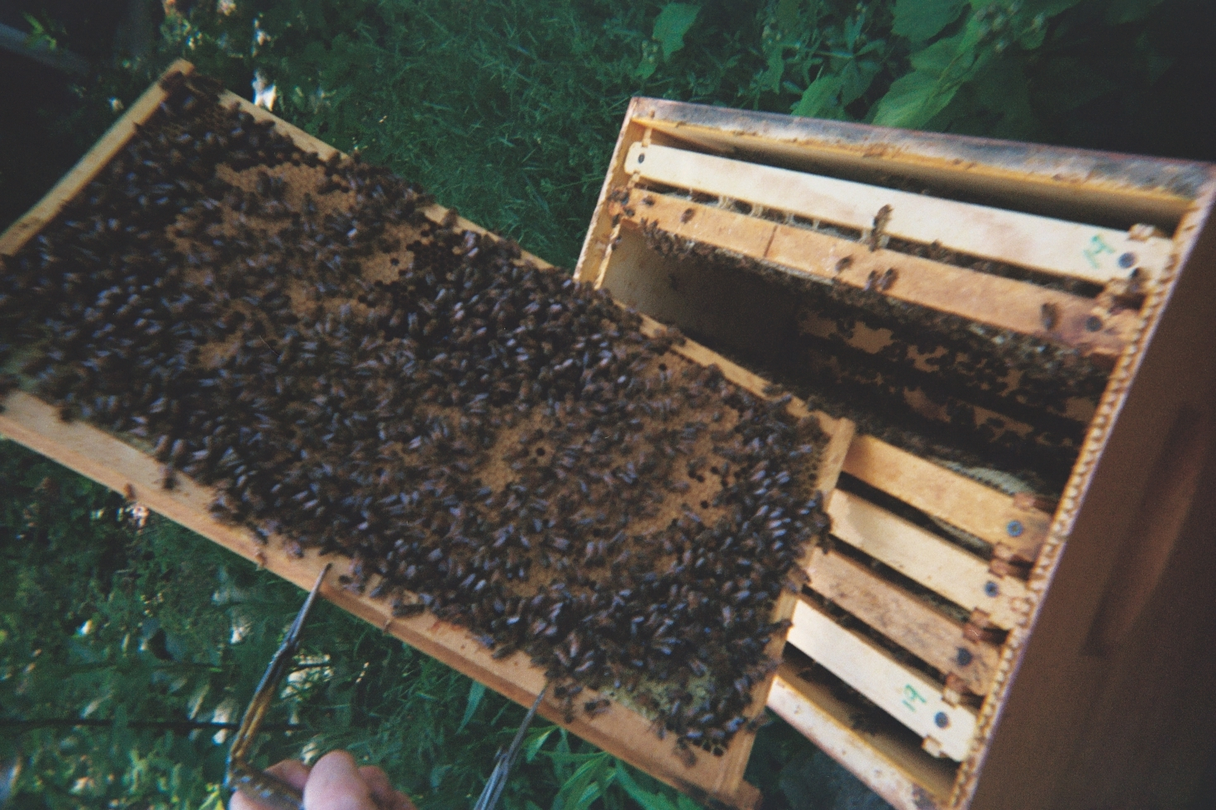
Background
Defining Urban Agriculture (UA)
“The growing of plants and the raising of animals with and around cities” (RUAF 2018)
Includes operations who participate in crop cultivation, animal husbandry, aquaculture, agroforestry, urban beekeeping, and horticulture activities
Practiced by more than 800 million people worldwide (FAO 2018)
© NaTisha Washington The Female Farmer Photovoice Project 2019
© AJ Monsma The Female Farmer Photovoice Project 2019
© Christina Neumann The Female Farmer Photovoice Project 2019

Slide 4
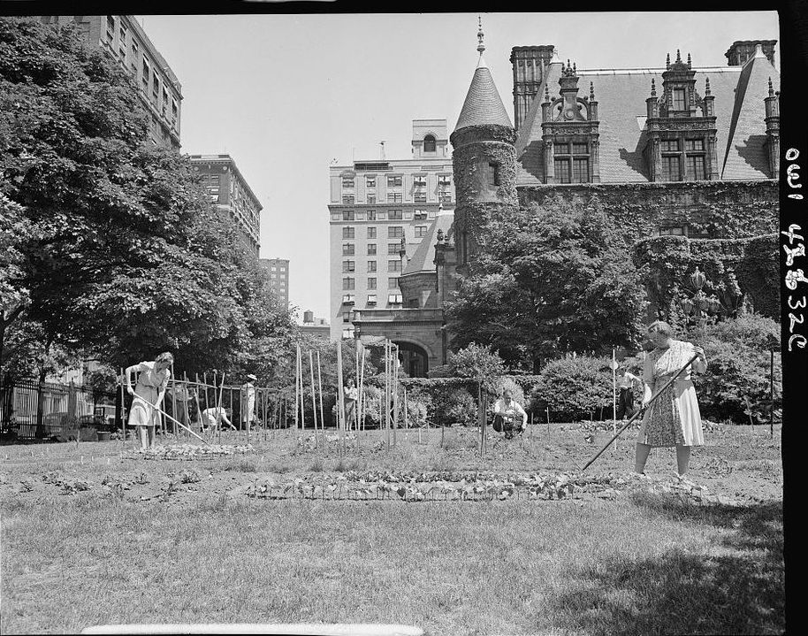
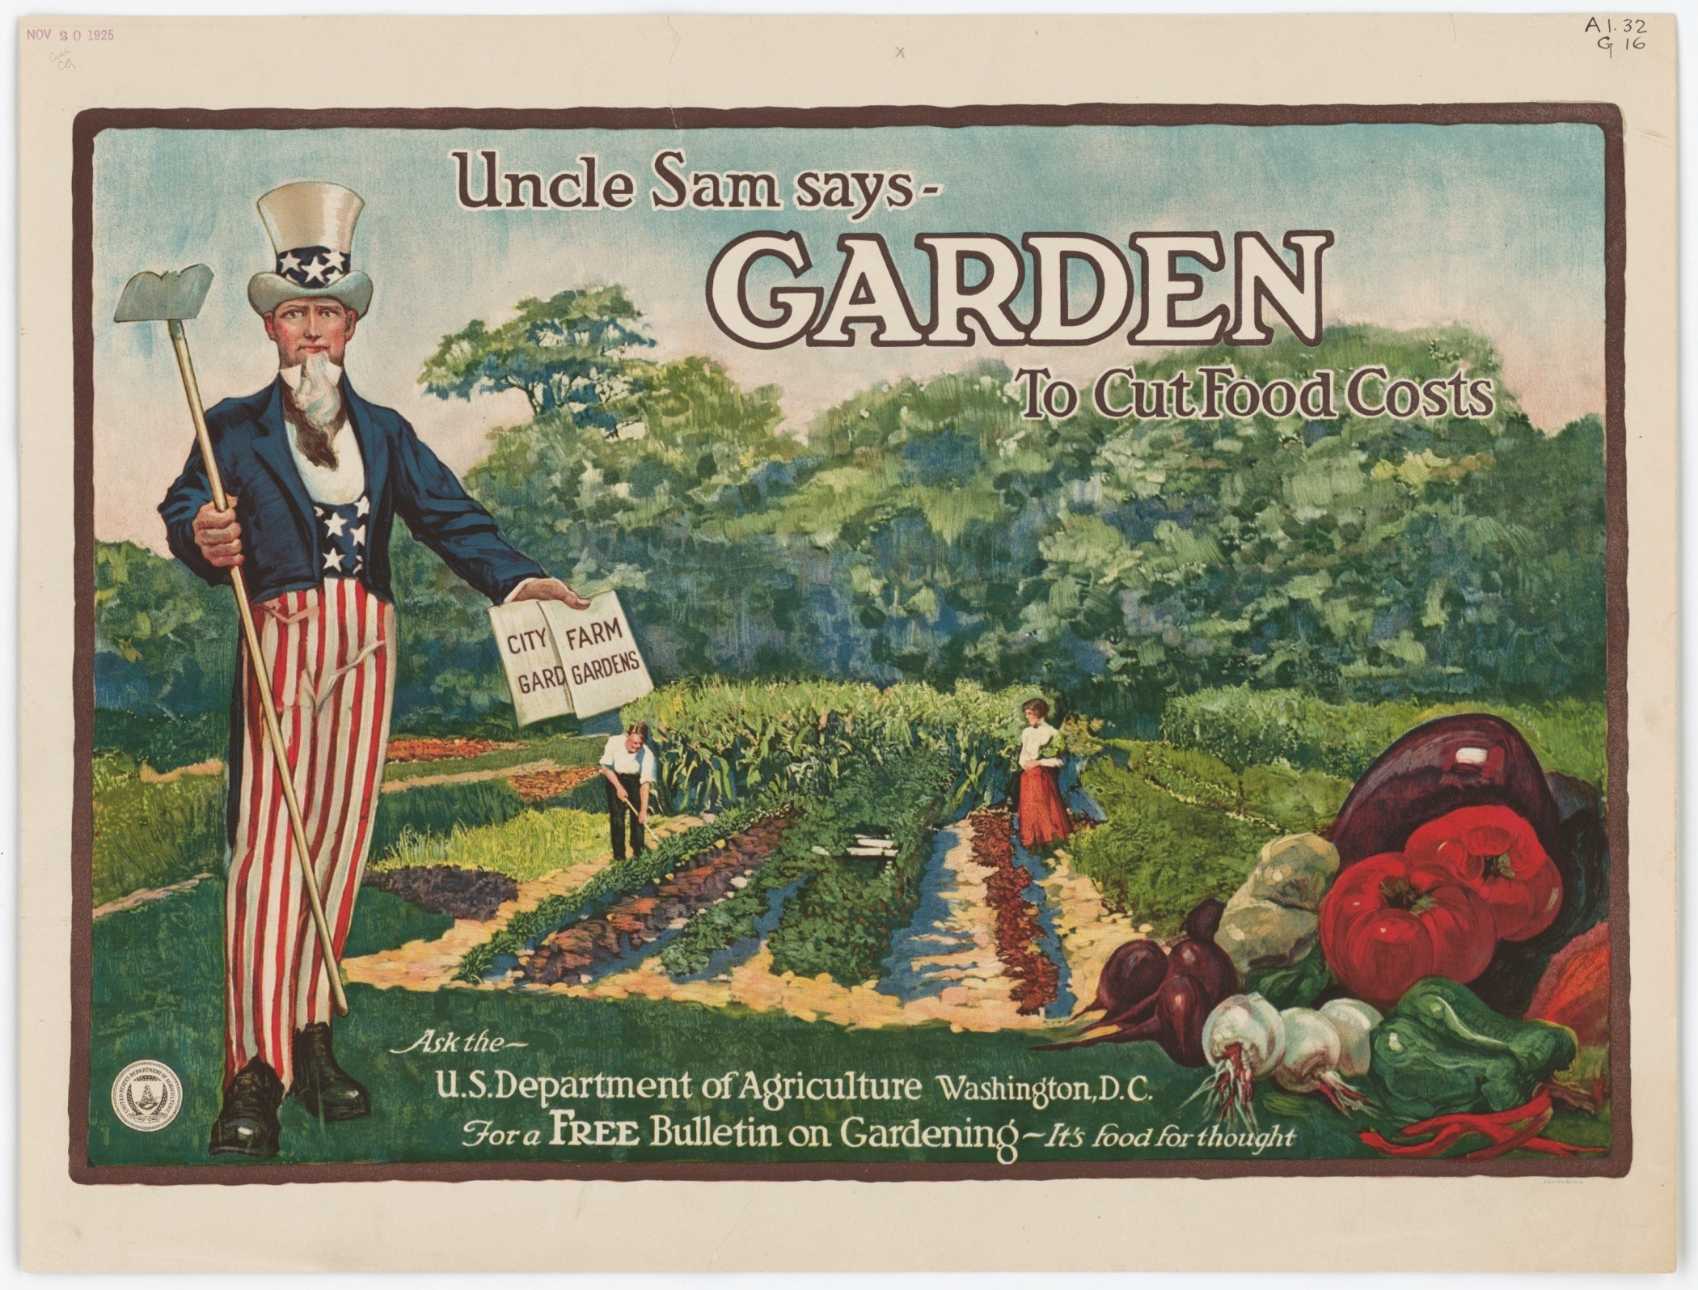
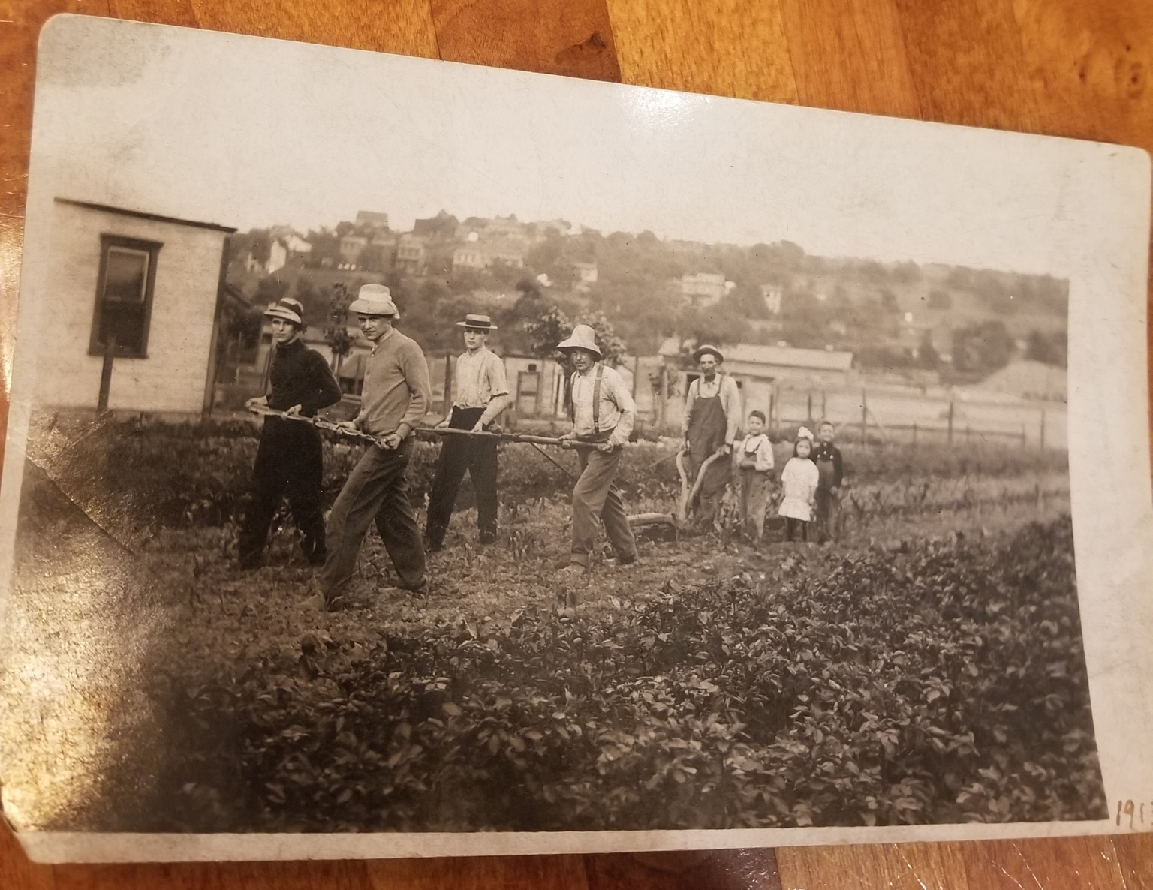
Background
UA in the United States
Early 1900s – urban gardening projects grew into national social programs (nutrition, unemployment, “back to the land”)
Gained notoriety for the Victory Gardens of World Wars I & II
Heightened awareness of urban food system & environmental inequalities, along with the recognition of UA’s multiple benefits, has led many city planners & government officials to see UA as a solution to various urban problems
Circa. 1940; New York City Library of Congress
Uncle Sam Says, Garden to Cut Food Costs, 1917. Library of Congress.
Circa. 1920; Pittsburgh, PA Photo courtesy of Christina Neumann

Slide 5
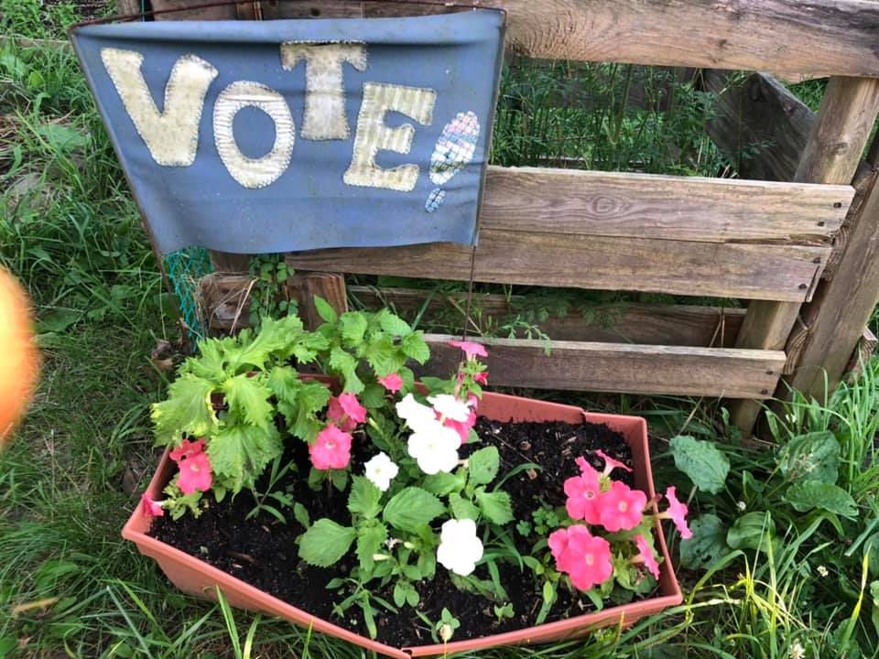
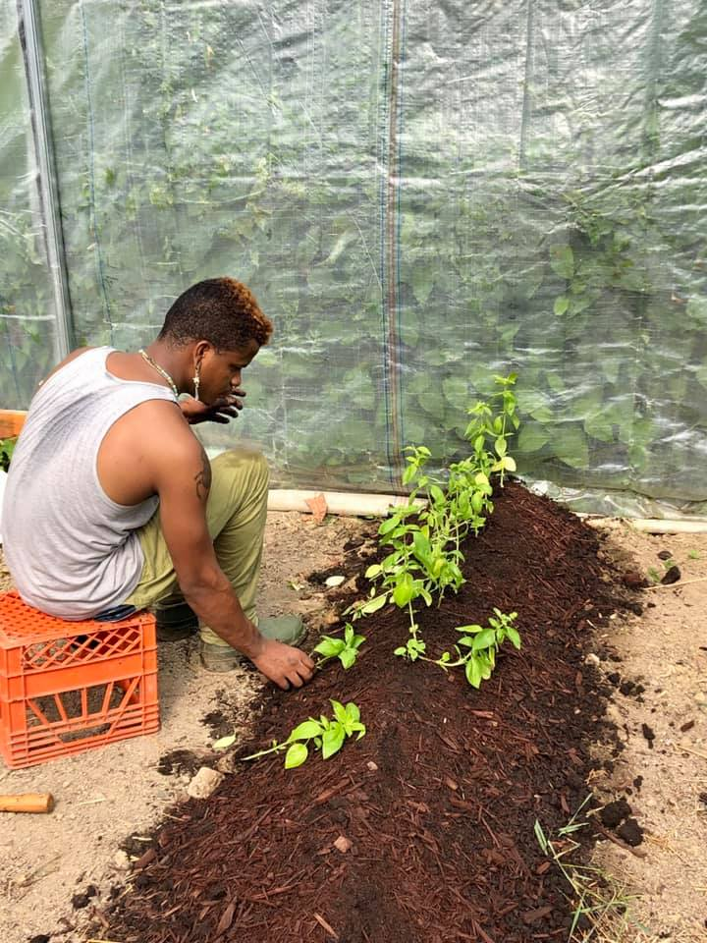
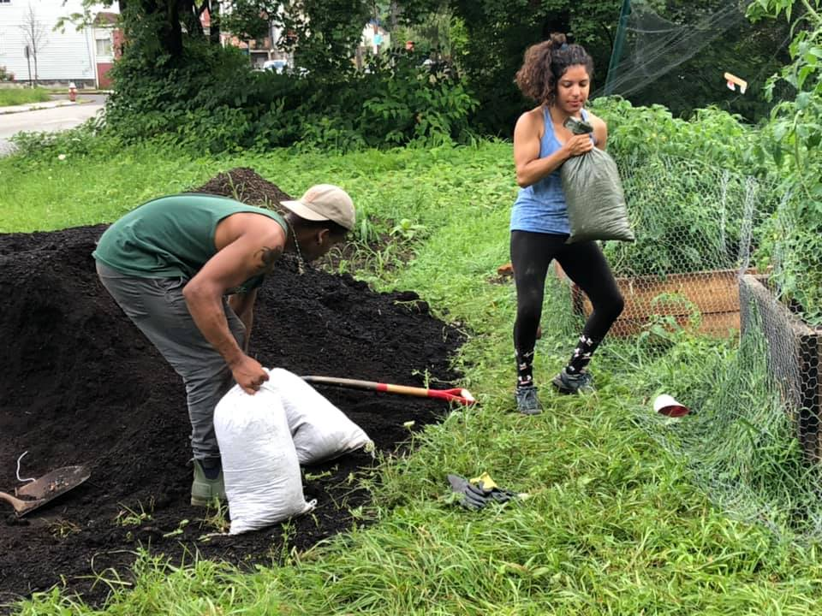
Background
Applying an Intersectional Analysis to UA
Contemporary scholarship calls for a focus on the intersectional issues which lie at the core of social justice in agriculture
Structural racism, gender inequity, and economic disparities disproportionately affect “socially disadvantaged” urban growers
Experiences of Black and Brown growers are largely absent from UA academic research
Photos courtesy of the author, 2019; Pittsburgh, PA.

Slide 6
Theoretical Framework
Intersectional Theory
Critical Food Studies
Feminist Agri-Food Systems Theory
Critical Race Theory
My goal: Embed urban agriculture within critical, feminist, anti-racist, intersectional frameworks that elevate marginalized voices to the forefront of social sustainability and encourage broader dialogues related to agricultural policy, landownership, capital acquisition, and institutional structural inequity.

Slide 7
Research Questions
What are the strategies that historically marginalized urban farmers and gardeners use to develop and maintain sustainable operations? To what extent do these strategies lead to positive community development, improved business networks, and enhanced local leadership that can be linked to broader outcomes of community activism and liberatory education?
How do historically marginalized urban farmers and gardeners work with nonprofit organizations, extension services, government programs, and fellow agriculturalists to create and sustain their operations?
How, if at all, have dominant social hierarchies manifest within urban agriculture operations and the institutional, community, and regional organizations that support them?
1.
2.
How are historically marginalized urban farmers and gardeners’ experiences connected to broader structural inequities that perpetuate socio-cultural problems for urban growers? How can institutions such as non-governmental organizations, extension, academic research, and federal programs better support historically marginalized urban farmers and growers?
3.

Slide 8
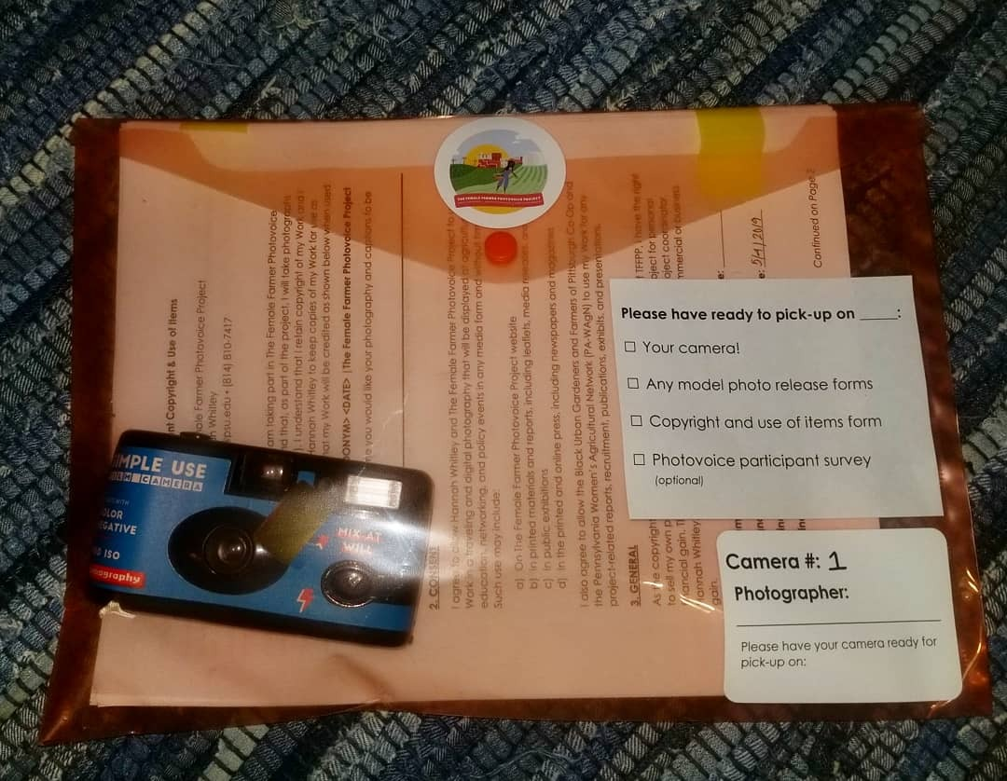
Methods
A
Photovoice is…
A method that asks participants to use photography to represent and reflect on lived experiences and use their images to document needs, promote dialogue, and influence policymakers.
Semi-Structured Interviews 30 participants
Photovoice 18 participants Observation Notes & Content Analysis
Participant Observation 15 weeks in the field
Urban Farmer & Grower Survey 23 participants 73% response rate

Slide 9
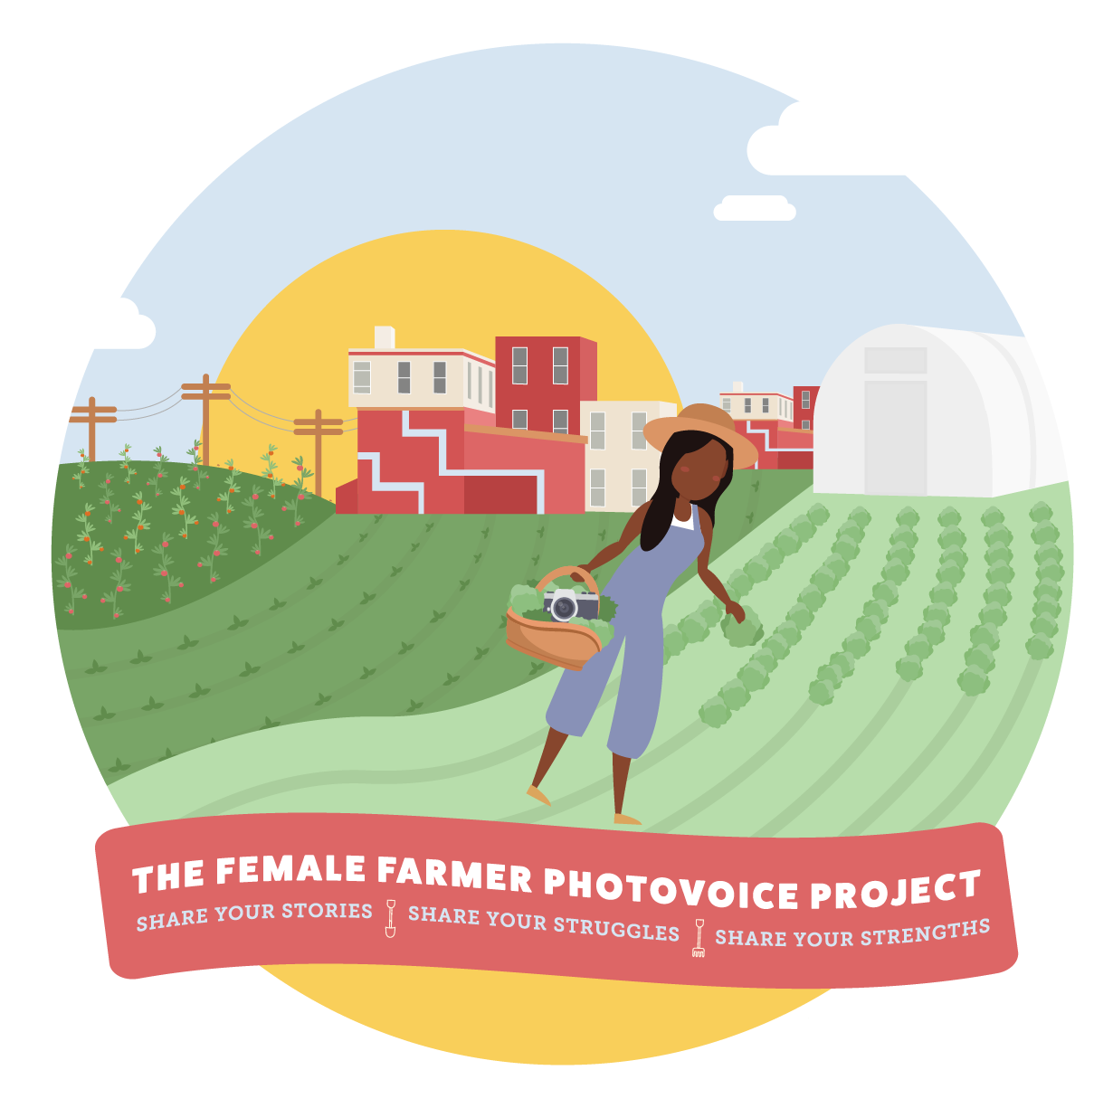

Slide 10
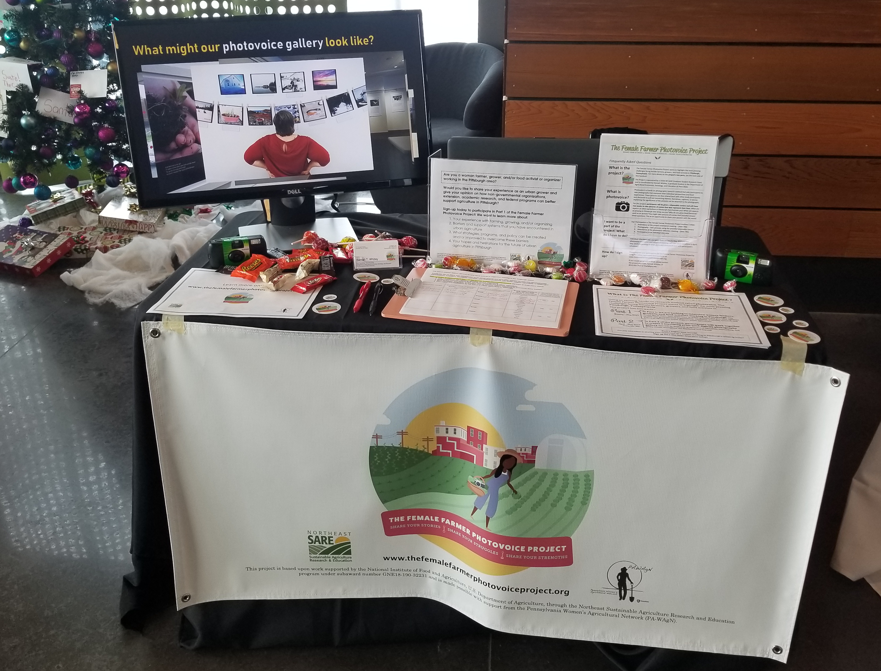
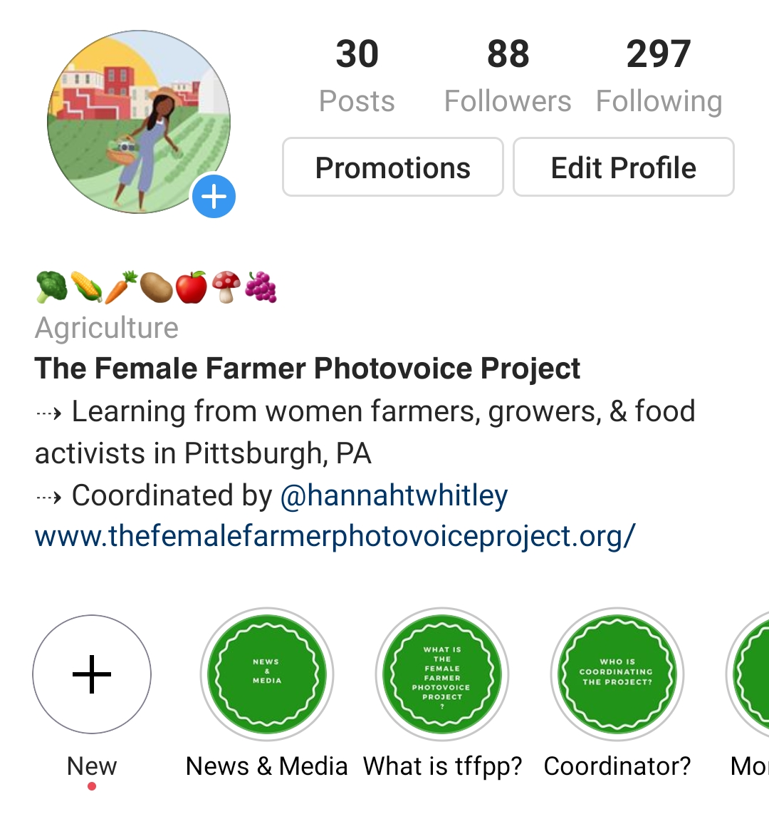
PA-WAgN Annual Symposium
Interview Participants
Organization Listservs
Instagram @femalefarmerphotovoice
Recruitment

Slide 11
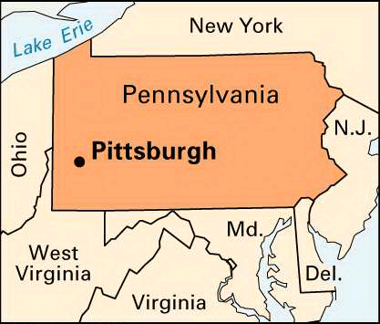
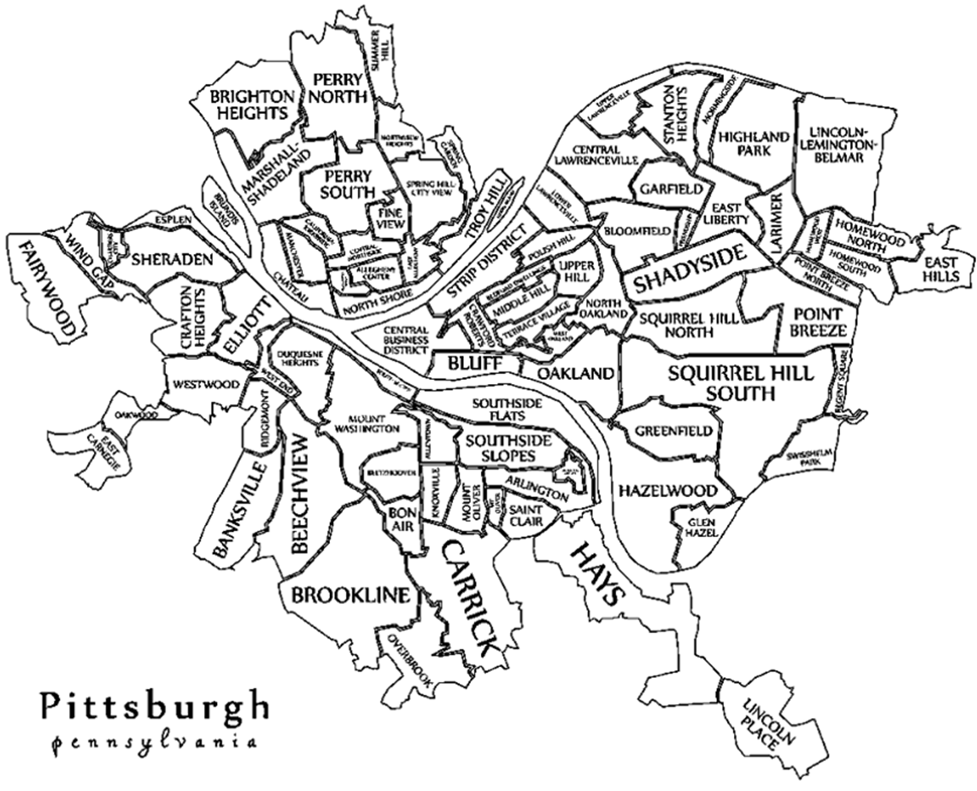
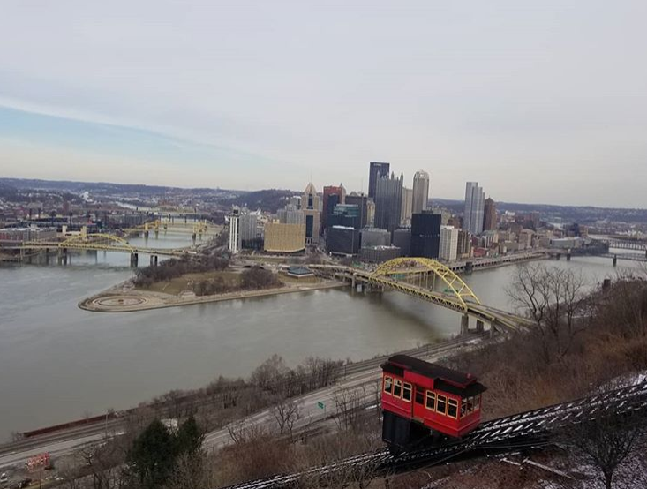
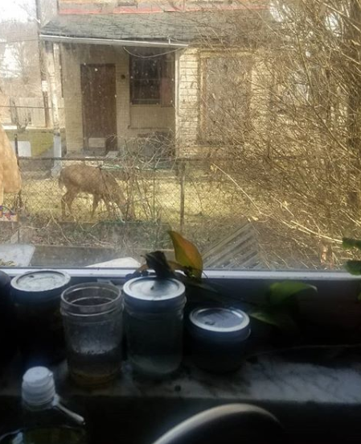
Photovoice Participant Demographics
20 participants (2 withdrew)
All identify as women farmers, growers, and/or food activists who live in Pittsburgh
80% grow in Homewood or Braddock
75% identify as Black, Indigenous, or Bi-racial

Slide 12
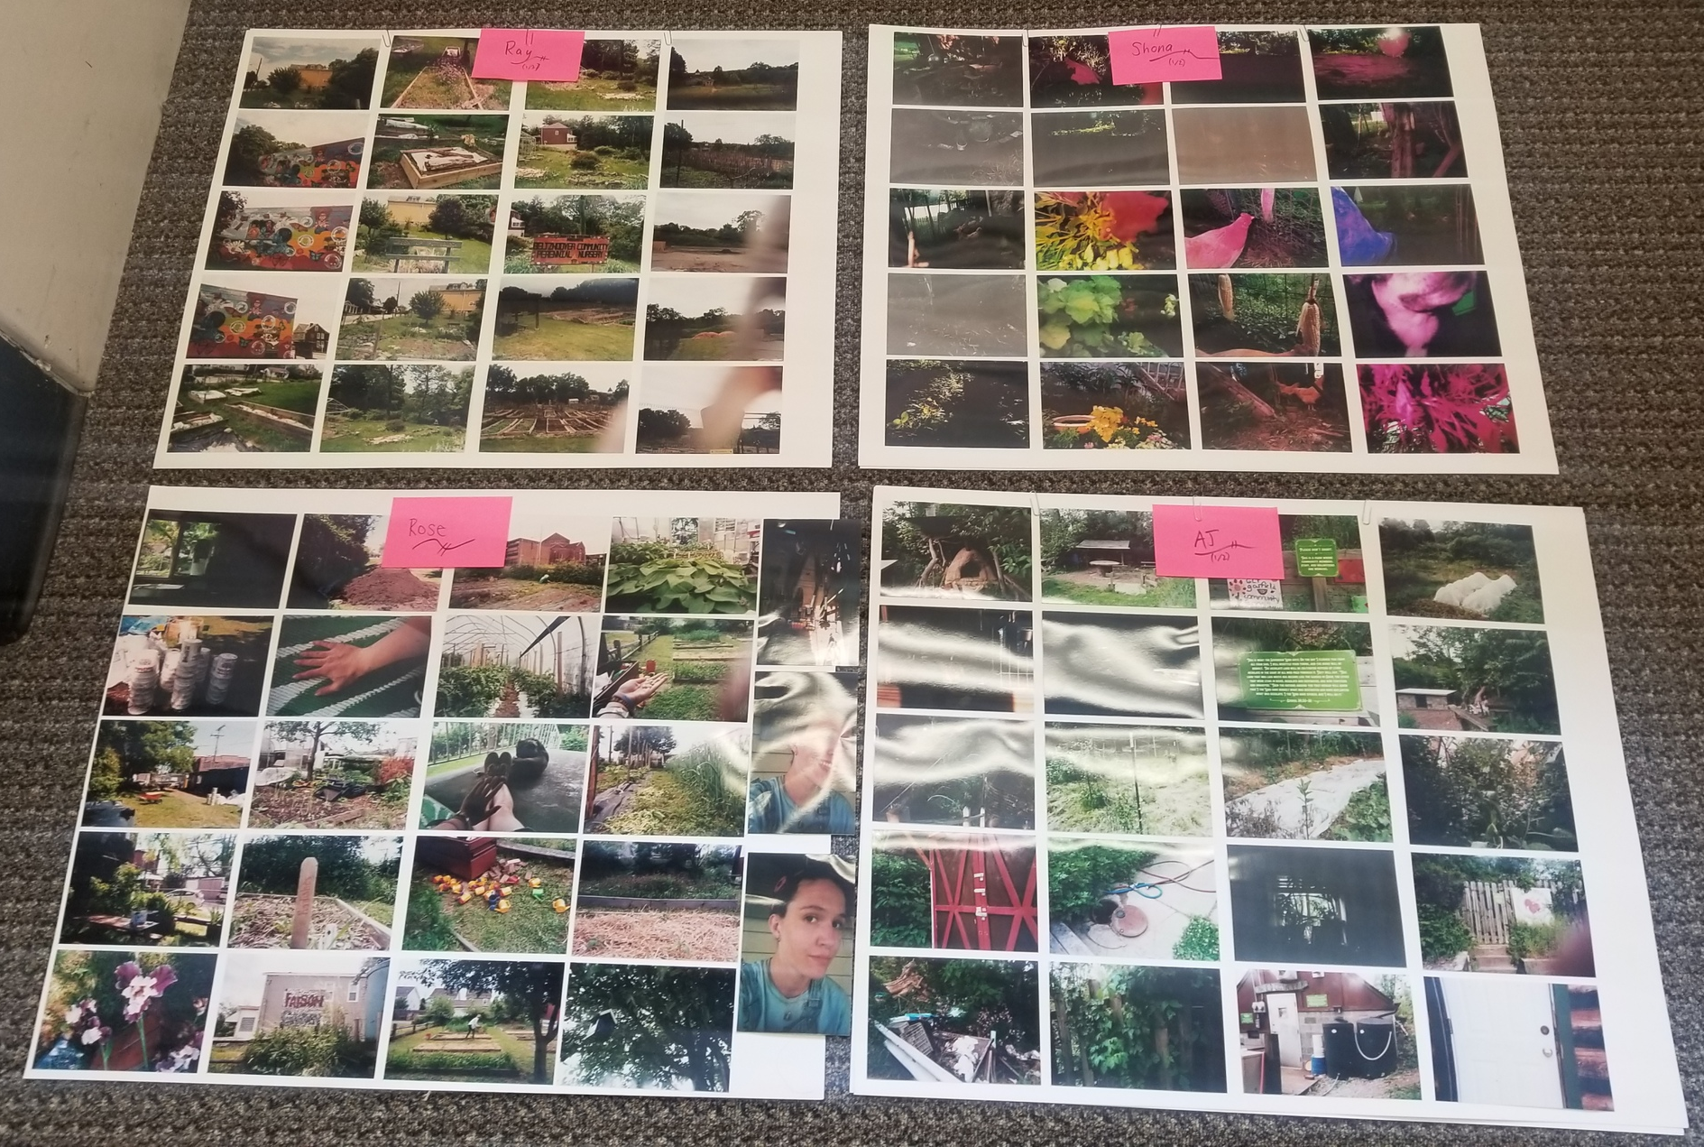
Photovoice Data Collection
Participant reflection meetings
1.5 hours, unstructured discussion circles
Observation notes
Content analysis of participant-written captions and titles
Tell the story of your experiences with urban agriculture

Slide 13
My daughter stands in front of our car loaded with plants that we grew in our basement for the Dormont Elementary School second annual Mothers' Day plant sale. The plant sale raises money to sustain the school vegetable garden, which was established in 2017.
Findings
© Lisa Freeman | The Female Farmer Photovoice Project | 2019
“Collaboration” We work not as an island; we work in partnership with many allies. We receive donations from private individuals and gifts of time, labor, and in-kind resources.

Slide 14
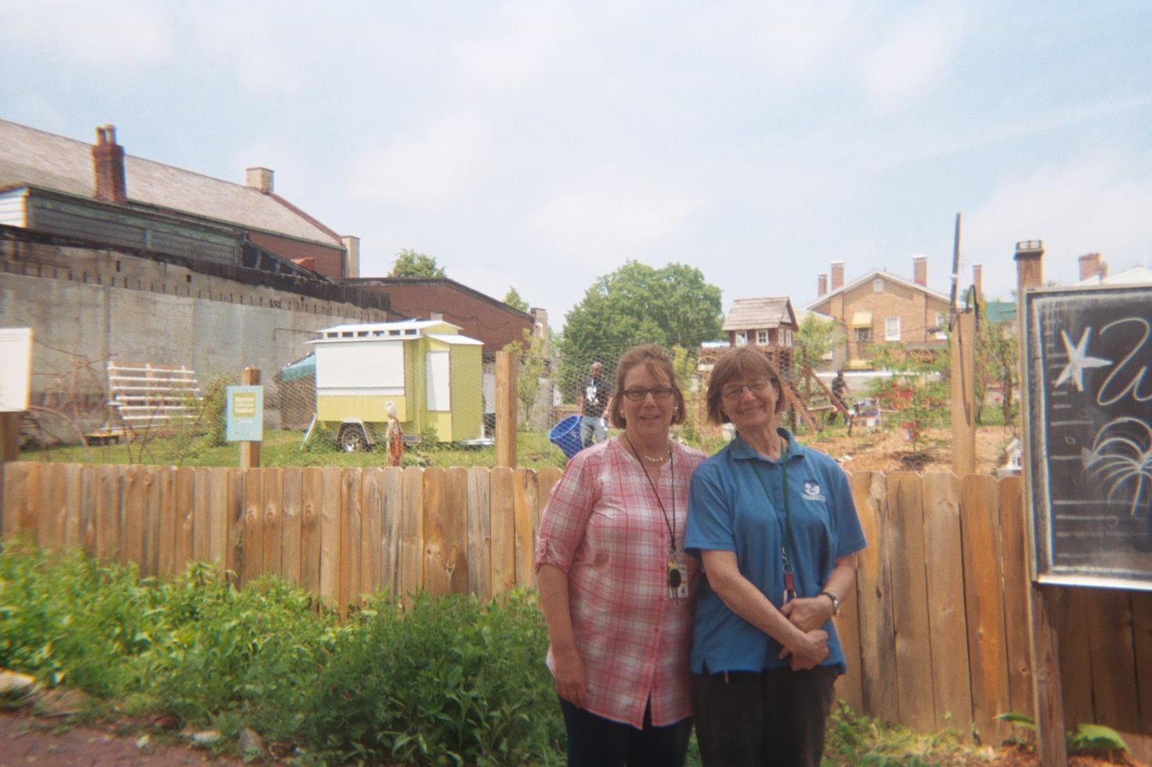
My daughter stands in front of our car loaded with plants that we grew in our basement for the Dormont Elementary School second annual Mothers' Day plant sale. The plant sale raises money to sustain the school vegetable garden, which was established in 2017.
Rather than growing solo, some women establish community gardens and create formal partnerships with local non-profits, elementary schools, universities, and/or faith-based institutions.
© Lisa Freeman | The Female Farmer Photovoice Project | 2019
“Collaboration” We work not as an island; we work in partnership with many allies. We receive donations from private individuals and gifts of time, labor, and in-kind resources.

Slide 15
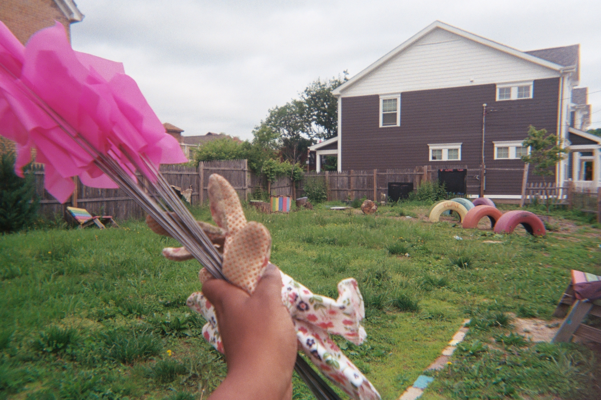
My daughter stands in front of our car loaded with plants that we grew in our basement for the Dormont Elementary School second annual Mothers' Day plant sale. The plant sale raises money to sustain the school vegetable garden, which was established in 2017.
Rather than growing solo, some women establish community gardens and create formal partnerships with local non-profits, elementary schools, universities, and/or faith-based institutions.
© NaTisha Washington | The Female Farmer Photovoice Project | 2019
“Time to Work” How I prep for all volunteer events: mark and direct in my flower gloves..

Slide 16
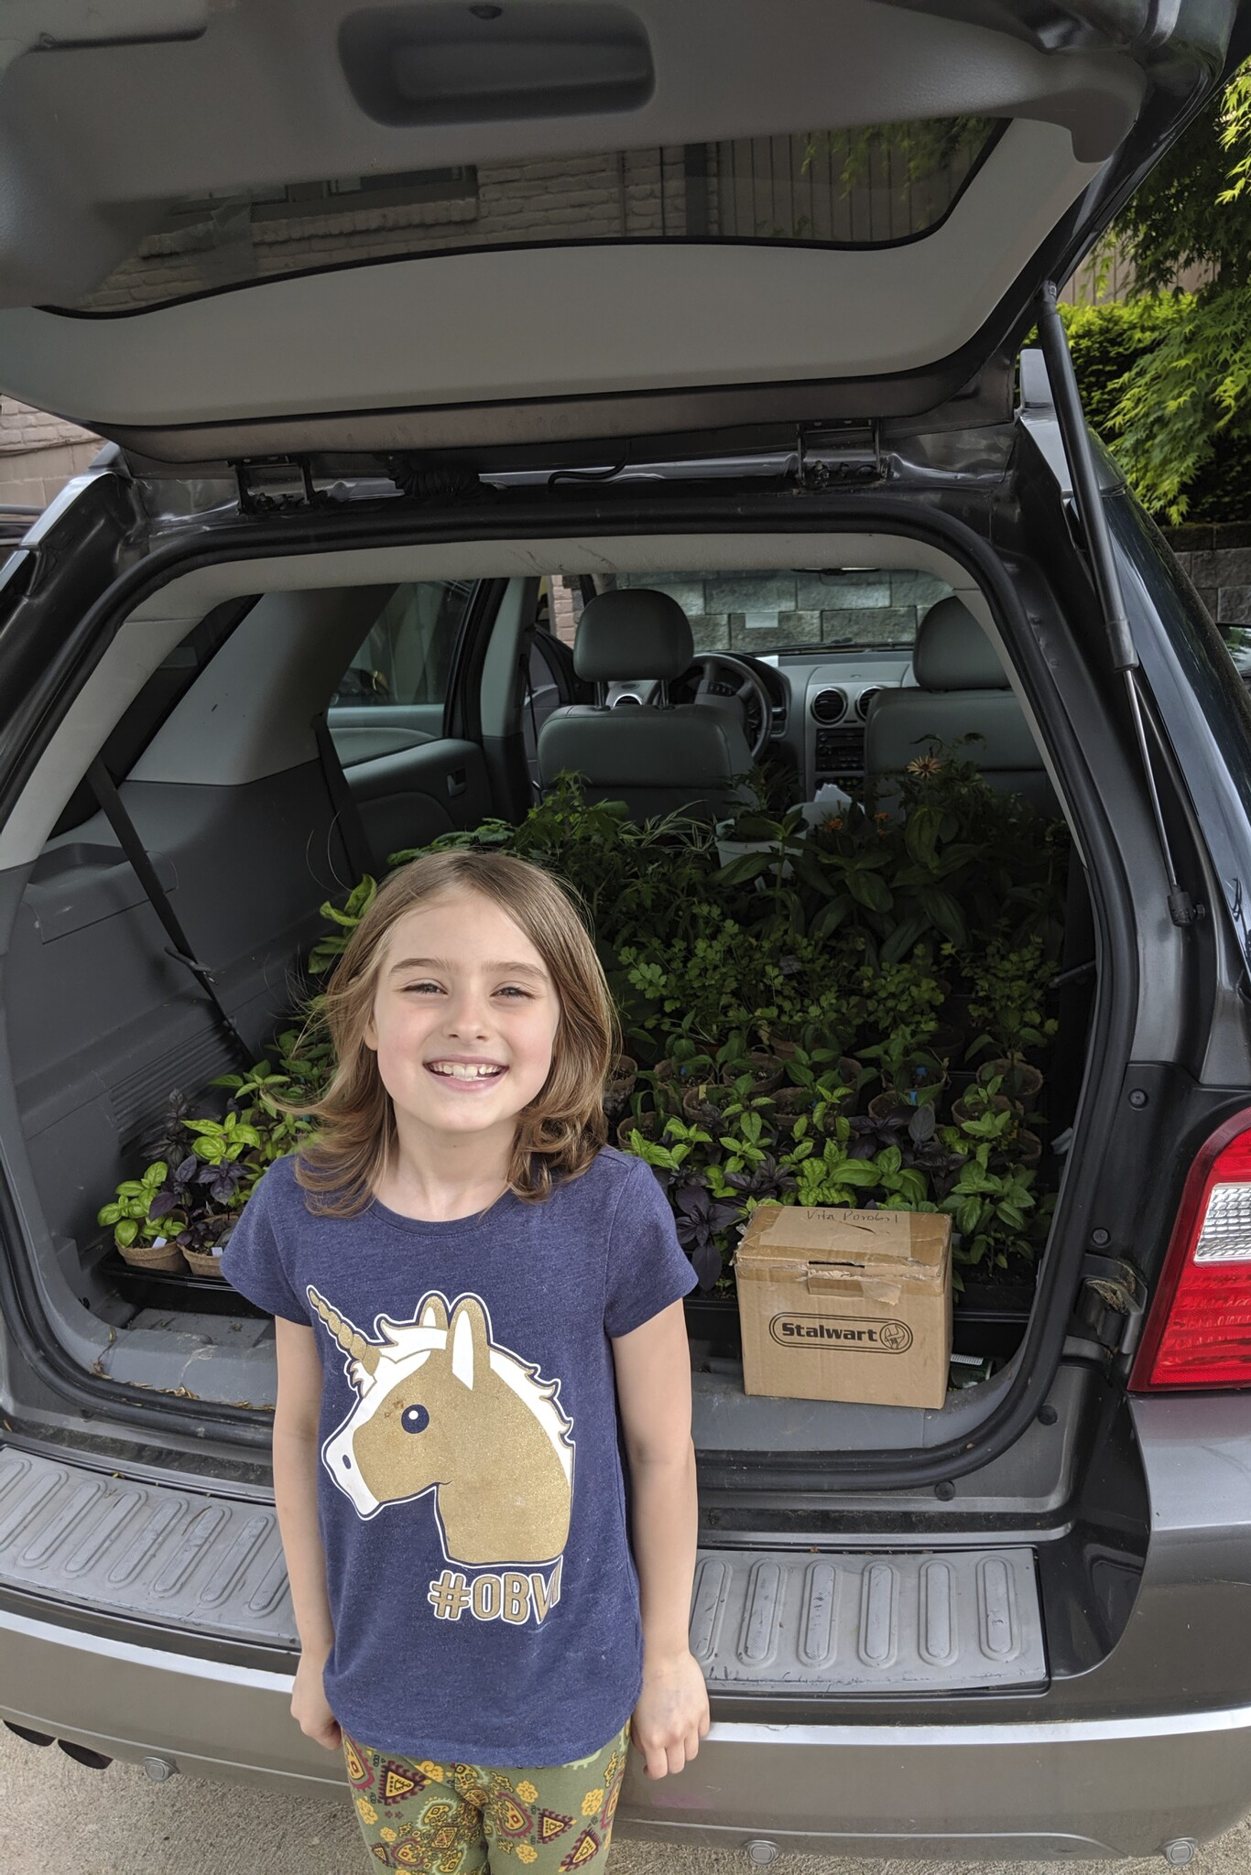
My daughter stands in front of our car loaded with plants that we grew in our basement for the Dormont Elementary School second annual Mothers' Day plant sale. The plant sale raises money to sustain the school vegetable garden, which was established in 2017.
Rather than growing solo, some women establish community gardens and create formal partnerships with local non-profits, elementary schools, universities, and/or faith-based institutions.
“Ready to Grow” My daughter stands in front of our car loaded with plants that we grew in our basement for the Dormont Elementary School second annual Mothers' Day plant sale. The plant sale raises money to sustain the school vegetable garden, which was established in 2017.
© Vita Porobil | The Female Farmer Photovoice Project | 2019

Slide 17
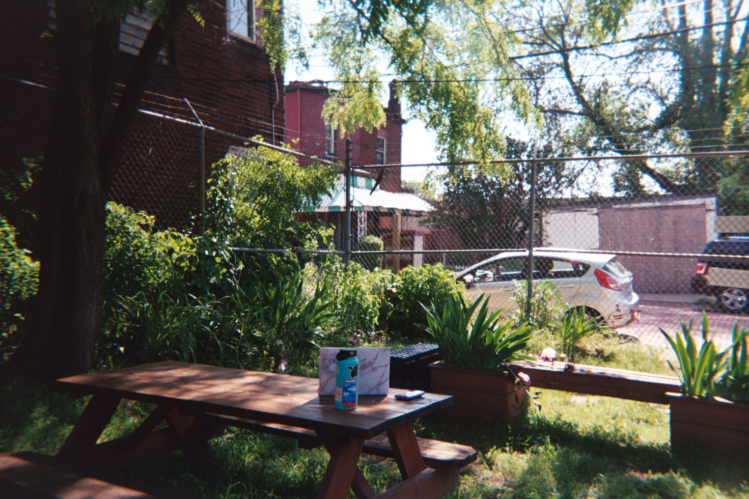
My daughter stands in front of our car loaded with plants that we grew in our basement for the Dormont Elementary School second annual Mothers' Day plant sale. The plant sale raises money to sustain the school vegetable garden, which was established in 2017.
Educational programs and services offered by UA non-profits provide supportive spaces for women growers to build community and gain confidence in their roles as farmers, gardeners, and food activists/advocates.
© Rose Osburn | The Female Farmer Photovoice Project | 2019
“Outdoor Office” On a very rare day of the Garden Resource Center being quiet on a Saturday due to the Open Streets PGH event, I was able to enjoy working outside of he shipping container. There is something about the GRC that is so welcoming. It has become one of my favorite places in Pittsburgh.

Slide 18
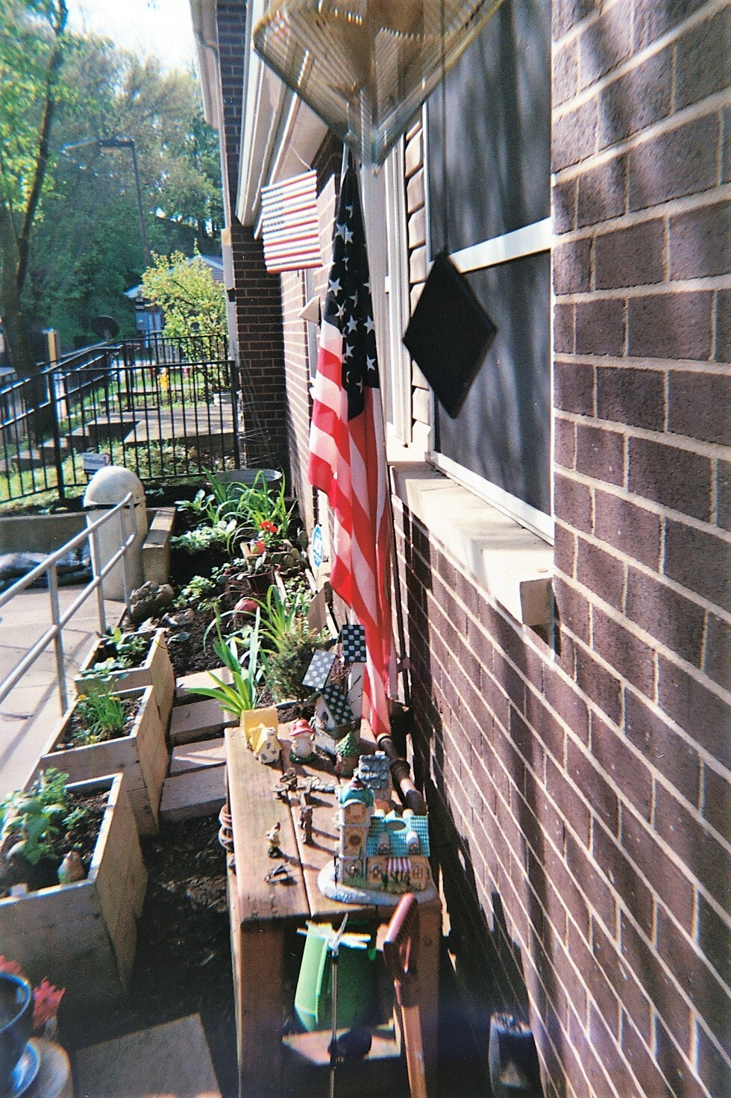
My daughter stands in front of our car loaded with plants that we grew in our basement for the Dormont Elementary School second annual Mothers' Day plant sale. The plant sale raises money to sustain the school vegetable garden, which was established in 2017.
Educational programs and services offered by UA non-profits provide supportive spaces for women growers to build community and gain confidence in their roles as farmers, gardeners, and food activists/advocates.
“Limited Space” When you have limited space to work with but love fresh vegetables, what do you do? You plant anyway.
© Fatima Gibson-Henley | The Female Farmer Photovoice Project | 2019

Slide 19
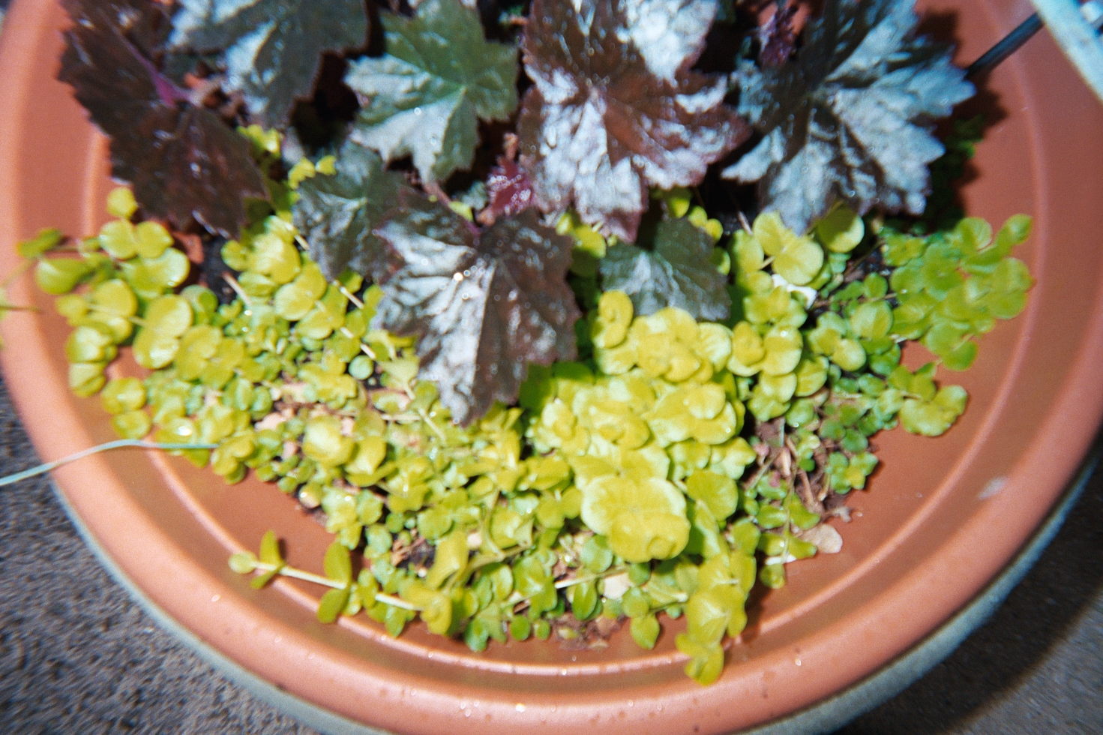
My daughter stands in front of our car loaded with plants that we grew in our basement for the Dormont Elementary School second annual Mothers' Day plant sale. The plant sale raises money to sustain the school vegetable garden, which was established in 2017.
Educational programs and services offered by UA non-profits provide supportive spaces for women growers to build community and gain confidence in their roles as farmers, gardeners, and food activists/advocates.
© Khadijah Bey | The Female Farmer Photovoice Project | 2019
“Bowl of Life!” Plants that I thought were dead and they came back.

Slide 20
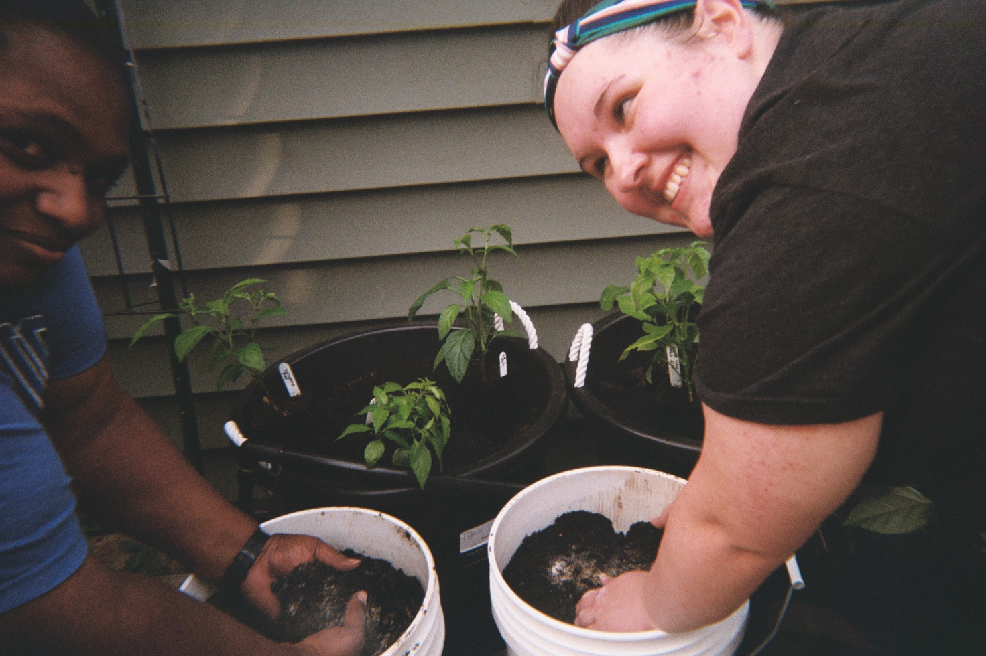
My daughter stands in front of our car loaded with plants that we grew in our basement for the Dormont Elementary School second annual Mothers' Day plant sale. The plant sale raises money to sustain the school vegetable garden, which was established in 2017.
Educational programs and services offered by UA non-profits provide supportive spaces for women growers to build community and gain confidence in their roles as farmers, gardeners, and food activists/advocates.
© Trina Goggins | The Female Farmer Photovoice Project | 2019
“Building Together”

Slide 21
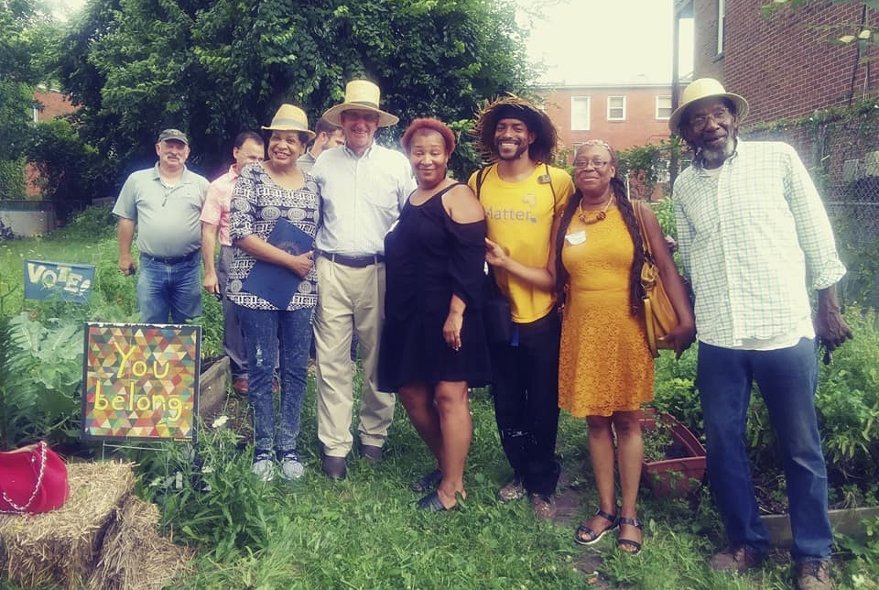
My daughter stands in front of our car loaded with plants that we grew in our basement for the Dormont Elementary School second annual Mothers' Day plant sale. The plant sale raises money to sustain the school vegetable garden, which was established in 2017.
Women growers are at the forefront of efforts to lobby local and state politicians for progressive urban agriculture policy.
© Raqueeb Bey | The Female Farmer Photovoice Project | 2019
“The Gang All Here!” This is when PA Secretary of Agriculture Russ Redding gave BUG-FPC [Black Urban Growers and Farmers of Pittsburgh Co-Op] a proclamation for Urban Ag via Governor Tom Wolf.

Slide 22
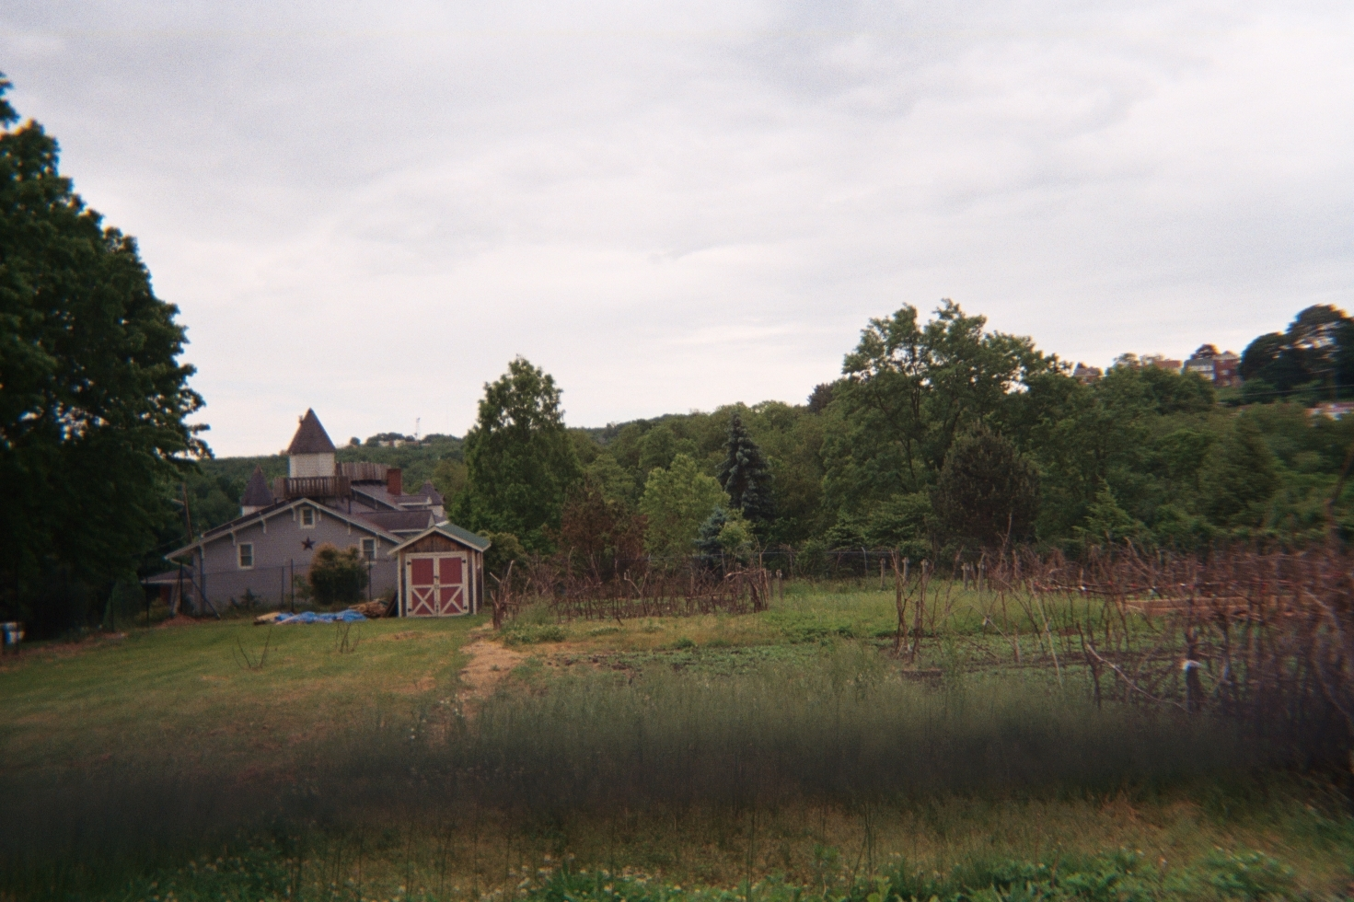
My daughter stands in front of our car loaded with plants that we grew in our basement for the Dormont Elementary School second annual Mothers' Day plant sale. The plant sale raises money to sustain the school vegetable garden, which was established in 2017.
Women growers are at the forefront of efforts to lobby local and state politicians for progressive urban agriculture policy.
© Raynise Kelly | The Female Farmer Photovoice Project | 2019
“If I Grew Up On a Farm” I imagine this is what my farm would look like! Not just this one picture, but all of them. All of these places, spaces, techniques, traditions also influence me to wonder… What if I had access to land to farm? What if my ancestors were able to pass down traditions of survival? What if I were a farmer? Beltzhoover showed me I can still be that farmer I never knew about!

Slide 23
2.
How do historically marginalized urban farmers and gardeners work with nonprofit organizations, extension services, government programs, and fellow agriculturalists to create and sustain their operations?
Photovoice Findings
Rather than growing solo, some women establish community gardens and create formal partnerships with local non-profits, elementary/secondary schools, universities, and/or faith-based institutions
- Sources of land, labor, built and financial capital
Educational programs and services offered by UA non-profits provide supportive spaces for women growers to build community and gain confidence in their roles as farmers, gardeners, and food activists/advocates
Women growers are at the forefront of efforts to lobby local and state politicians for progressive urban agriculture policy

Slide 24
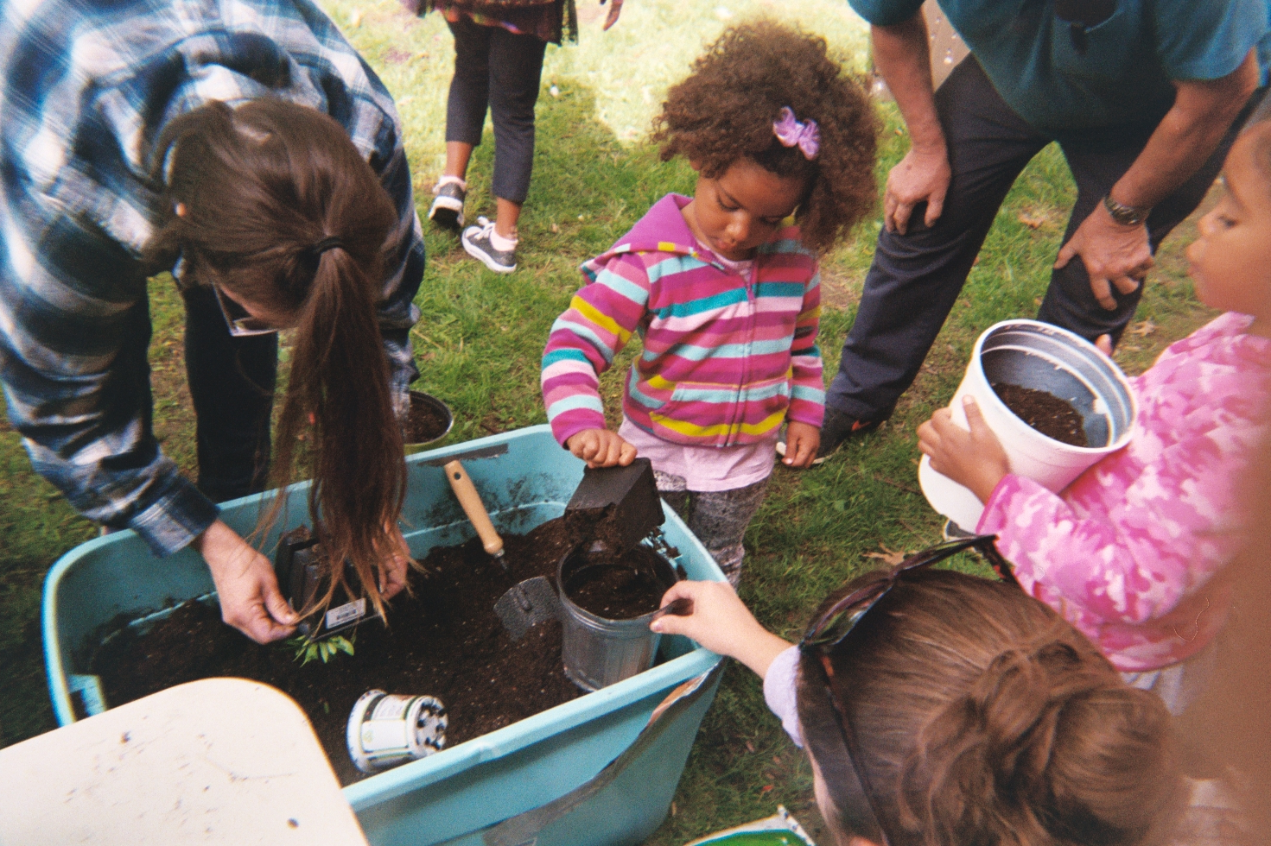
"There's power in playing in the dirt. It's important that people see what we're doing, take that work seriously, and make growing food possible for everyone. It doesn't matter where we live, what we look like... Give us ladies space, we'll make it happen."
– Lisa, urban farmer and community activist, Pittsburgh, PA

Slide 25
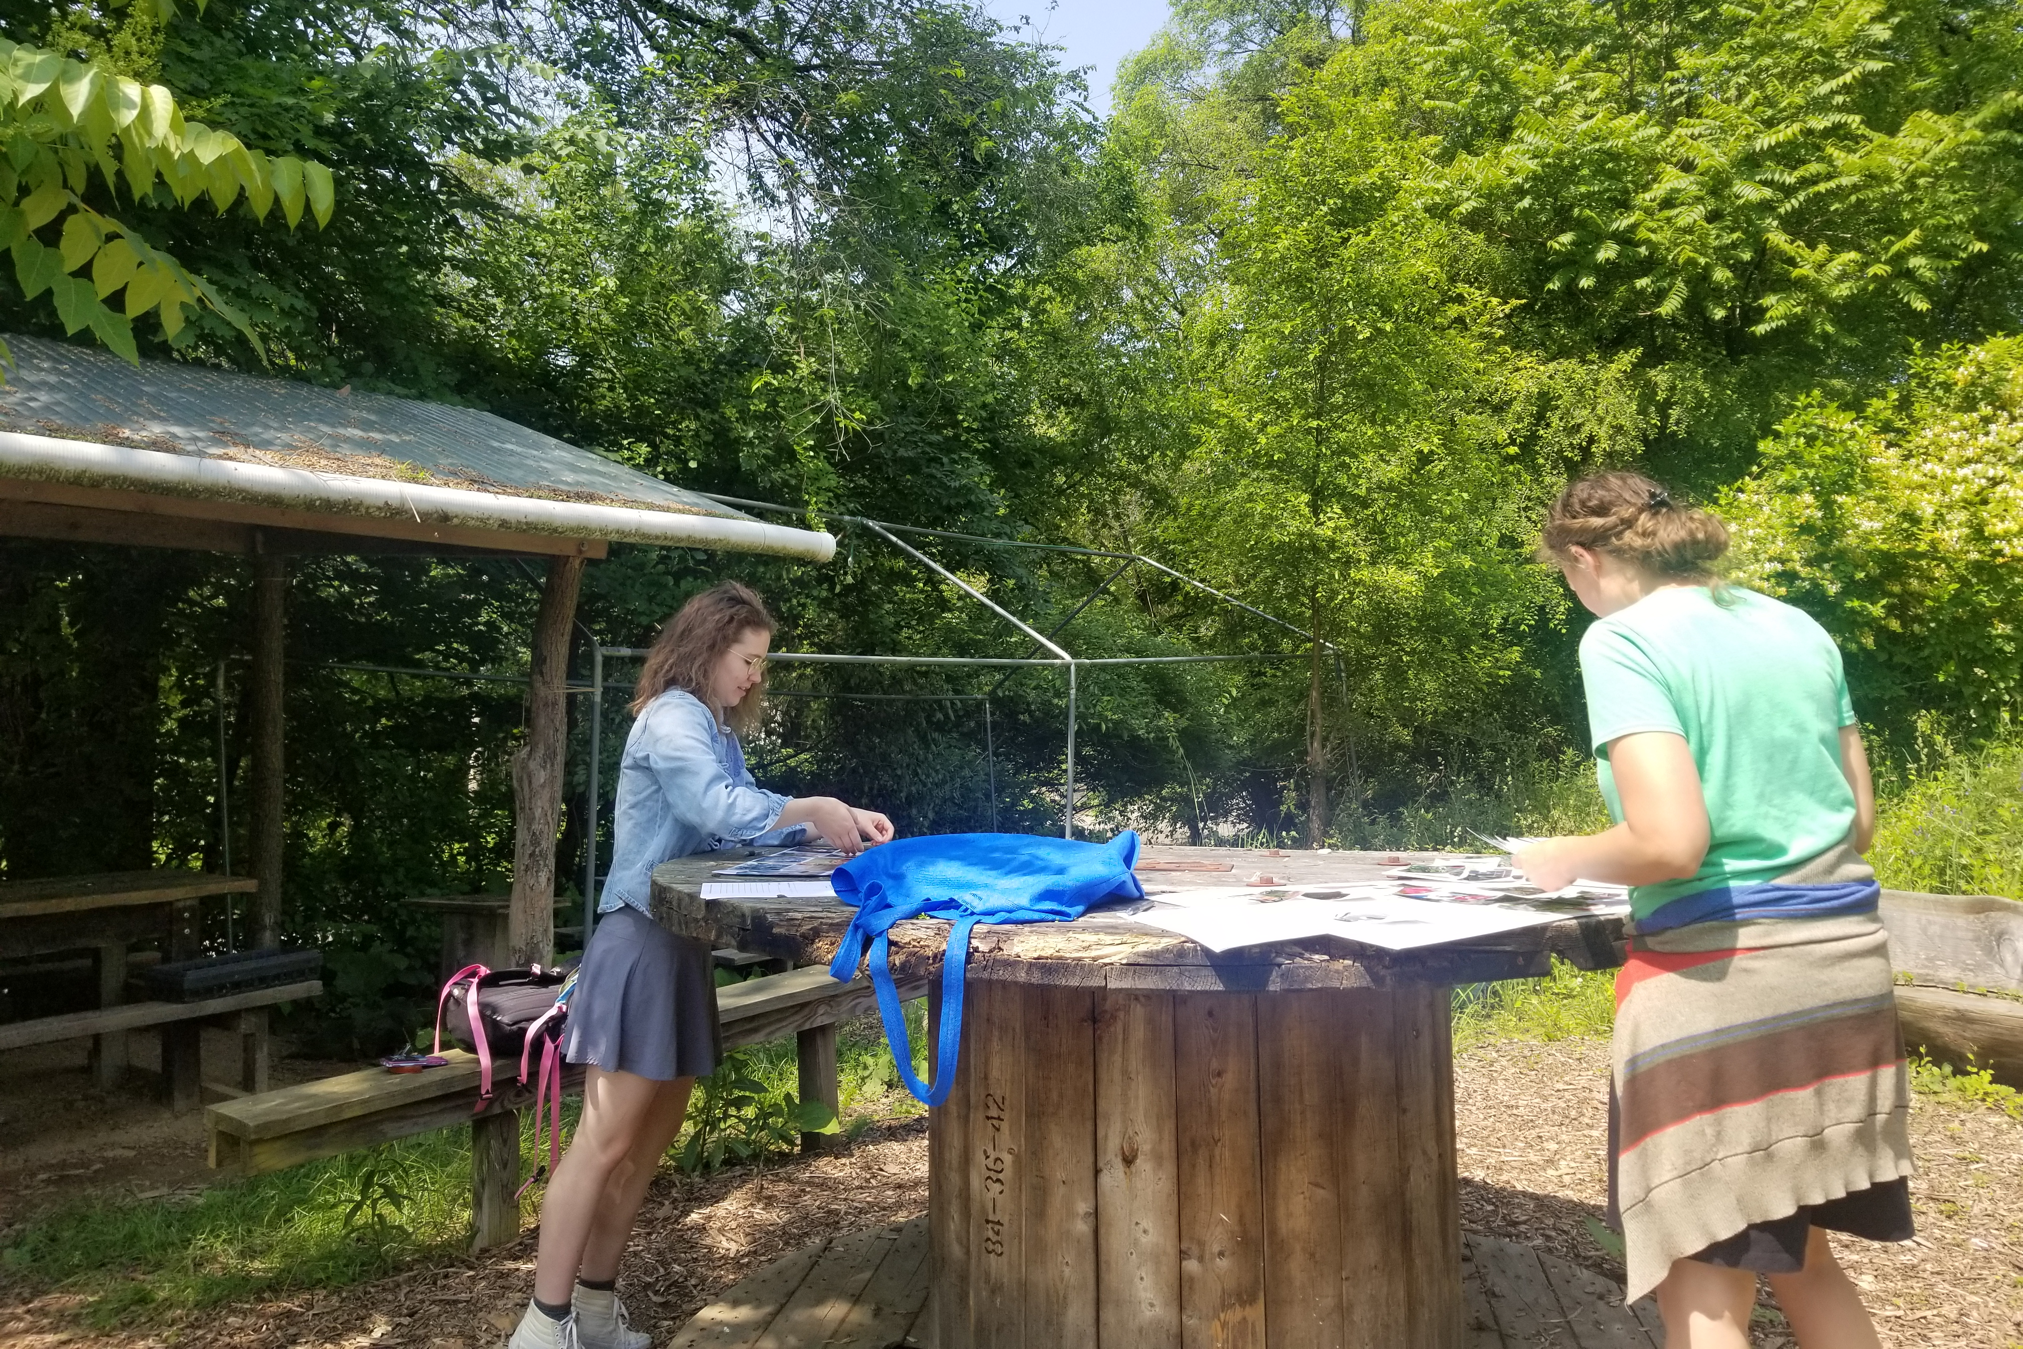
A special thank you to all participants of The Female Farmer Photovoice Project
AJ Monsma Lisa Freeman
Amy Bloxson Mischelle McMillan
Celeste Taylor NaTisha Washington
Christina Neumann Raqueeb Bey
Dana Harris Yates Raynise Kelly
Elaine James Rose Osburn
Essence Muhammed Trina Goggins
Fatima Gibson-Henley Vespera Barrow
Khadijah Bey Vita Porobil

Slide 26
Thank you!
Scan me to access these slides on your own device
Hannah Whitley M.S. Student, Rural Sociology and Women’s, Gender & Sexuality Studies The Pennsylvania State University
htw3@psu.edu
www.thefemalefarmerphotovoiceproject.org

Slide 27
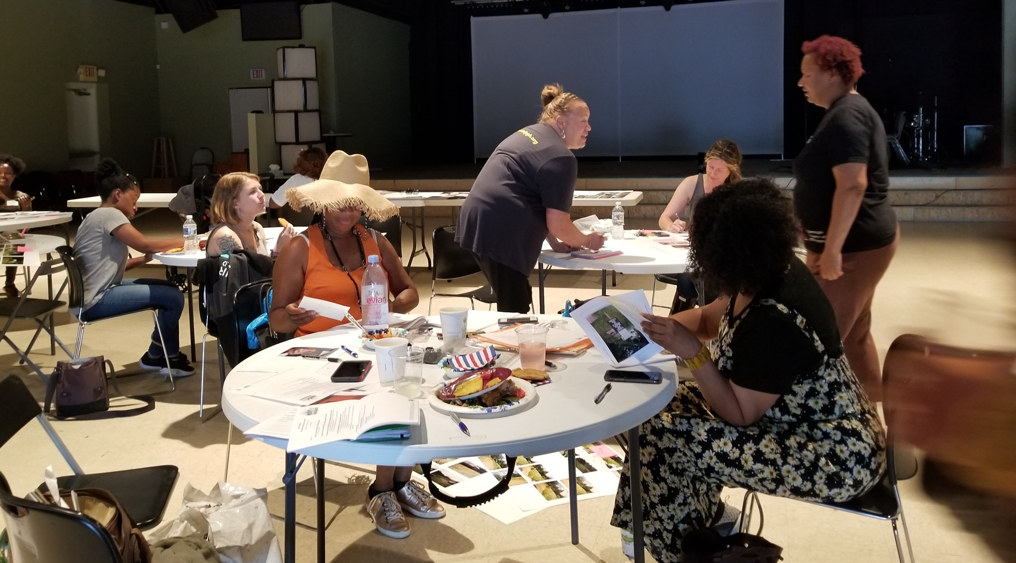
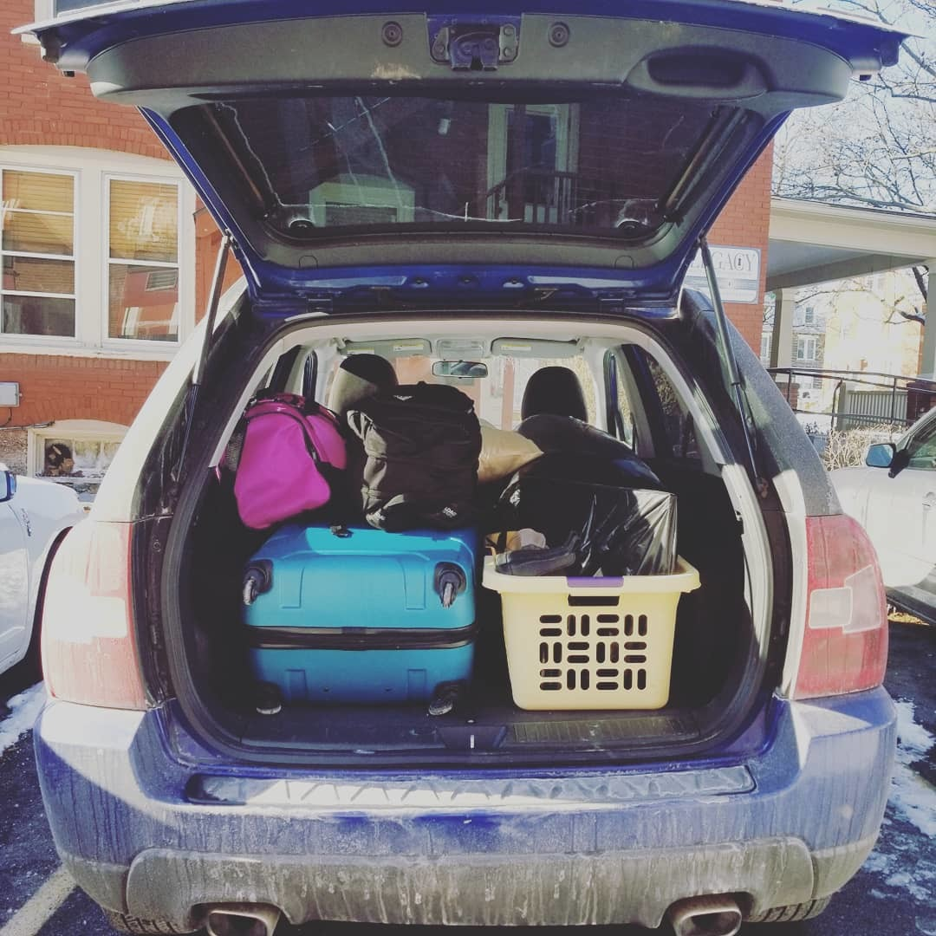
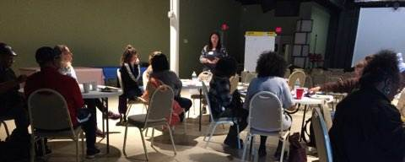
Time for photography
May 4-26, 2019
Photovoice Timeline
PA-WAgN Annual Symposium
Photovoice Reflection Meetings
December 11, 2018
Formal photovoice registration begins
June 1 & 3, 2019
Mid-March 2019
OCT
NOV
DEC
JAN
FEB
MAR
APR
MAY
JUNE
JUL
AUG
SEP
OCT
2018
2019
Community Gallery Reception
Fieldwork begins
Photovoice Information Session
January 14, 2019
Mid-September 2019
May 4, 2019
Fieldwork ends
June 5, 2019

Slide 28
Next steps
Community exhibition & reception in Homewood (September 2019)
White papers and project reports
Submitted directly to the USDA, PA Department of Agriculture, and the Pittsburgh Food Policy Council
Planned photovoice exhibits at…
My thesis defense! (August 2019, University Park, PA)
Pittsburgh Urban Agriculture Tour (September 2019, Manchester Growing Together Farm)
Pennsylvania Women’s Ag Network Annual Symposium (December 2019, Philadelphia, PA)
Pennsylvania Association for Sustainable Agriculture “Farming for the Future” Conference (February 2020, Lancaster, PA)
Sharing findings at…
Rural Studies Student Conference (November 2019, University Park, PA)
Northeast Sustainable Agriculture Working Group annual meeting (November 2019, Jersey City, NJ)
Ag & Human Values Annual Meeting (May 2020, Athens, GA)
Urban Food Systems Symposium (June 2020, Kansas City, MO)

