Slide 1
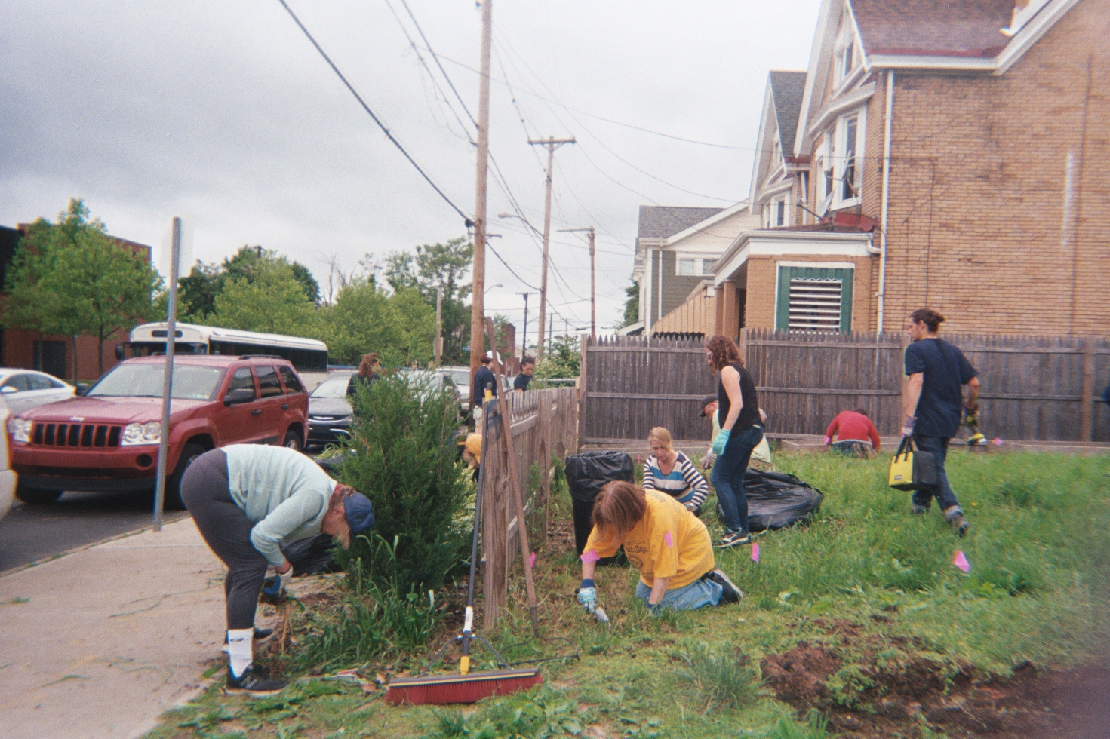
A Research & Extension Agenda for Learning from Historically Underserved Farmers, Growers, Food Activists, and Agricultural Educators
Hannah Whitley PhD Student, Department of Agricultural Economics, Sociology, and Education The Pennsylvania State University PA-WAgN Annual Networking Symposium December 17, 2019 Temple University
This research is based upon work supported by the National Institute of Food and Agriculture, U.S. Department of Agriculture, through the Northeast Sustainable Agriculture Research and Education program under subaward number GNE18-190-32231 and was made possible with support from the Pennsylvania Women’s Agricultural Network (PA-WAgN).

Slide 2
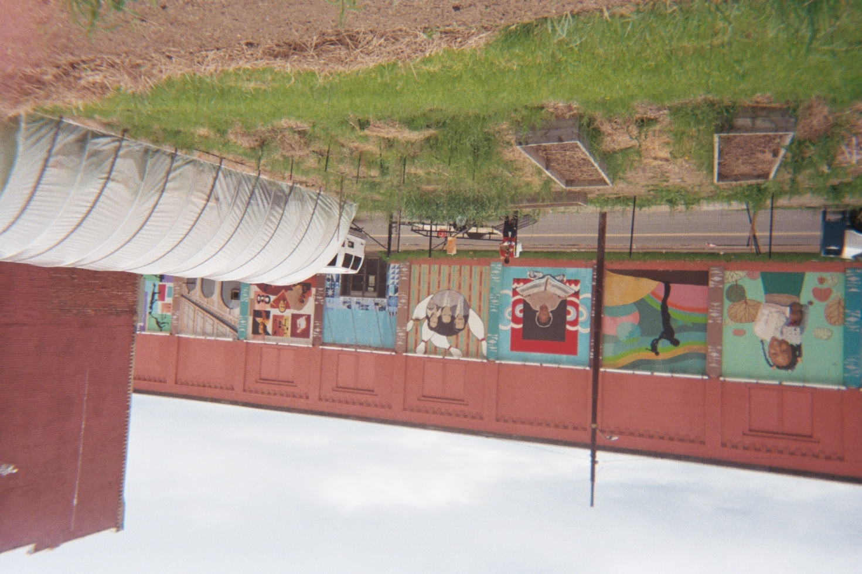
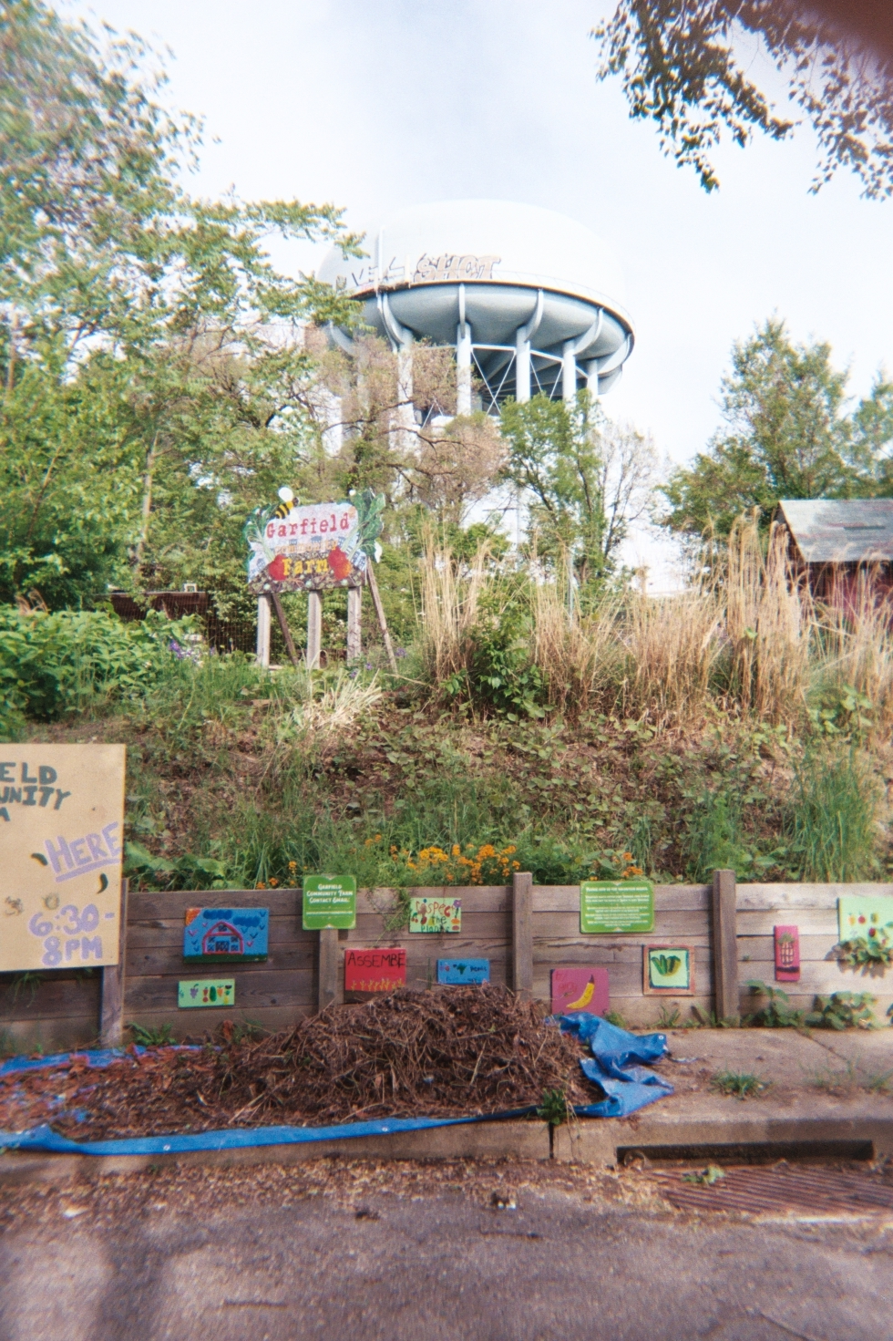
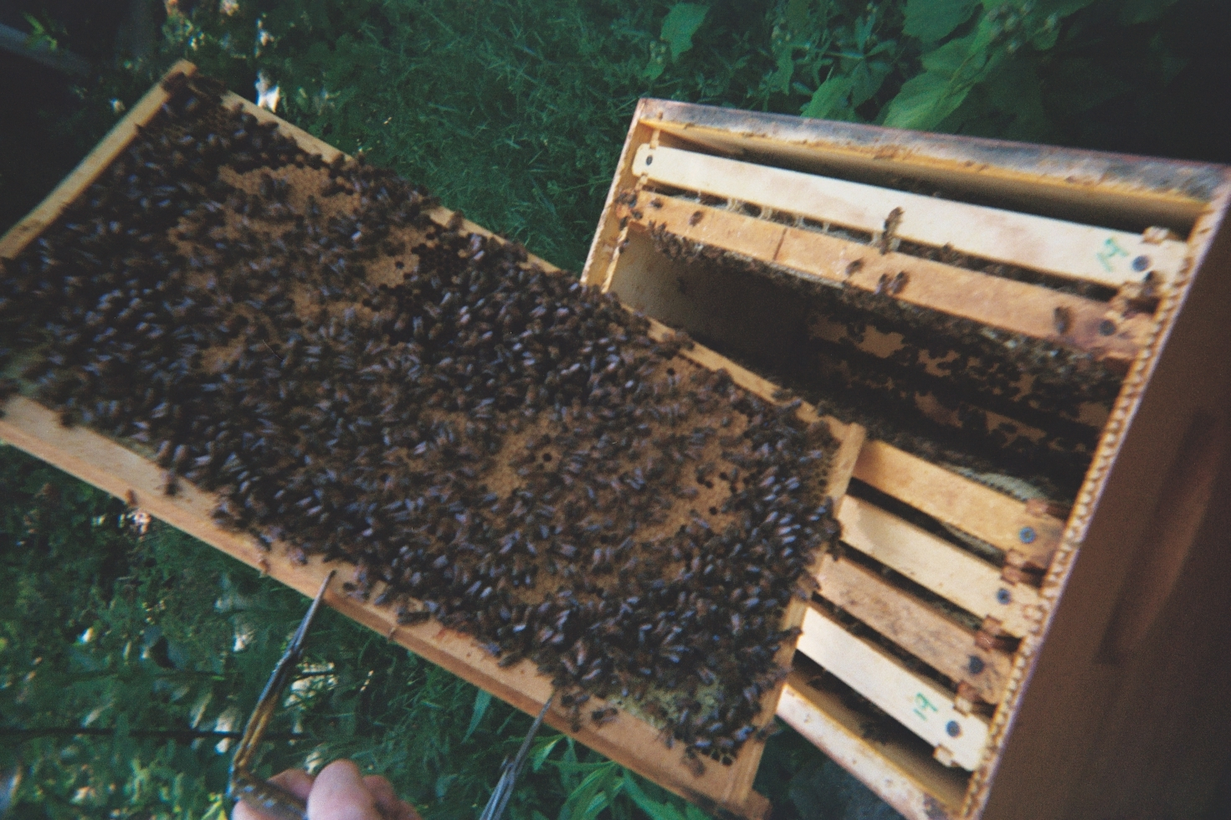
Background
An Intersectional Approach to Urban Agriculture
Past research on UA has typically existed in a single-variable, linear vacuum
Structural racism, gender inequity, and economic disparities disproportionately affect “socially disadvantaged” urban growers
Contemporary scholarship calls for a focus on the intersectional issues which lie at the core of social justice in agriculture & connect to broader institutional inequities that perpetuate these problems
Thesis sought to address this gap in the literature
© NaTisha Washington The Female Farmer Photovoice Project 2019
© AJ Monsma The Female Farmer Photovoice Project 2019
© Christina Neumann The Female Farmer Photovoice Project 2019

Slide 3
Research Questions
Motivations to grow?
Challenges experienced while faming, gardening, and organizing?
Strategies to develop and maintain sustainable operations?
1.
2.
3.
Work with NGOs, extension, federal programs, and fellow agriculturalists?
Experiences connected to broader structural inequities? How can institutions better support?
4.
5.

Slide 4
Research Questions
How are historically underserved urban farmers and gardeners’ experiences connected to broader social inequities that perpetuate socio-cultural problems for urban growers? How can institutions such as NGOs, extension, academic research, and federal programs better support historically underserved urban farmers and growers?
Experiences connected to broader structural inequities? How can institutions better support?
5.

Slide 5
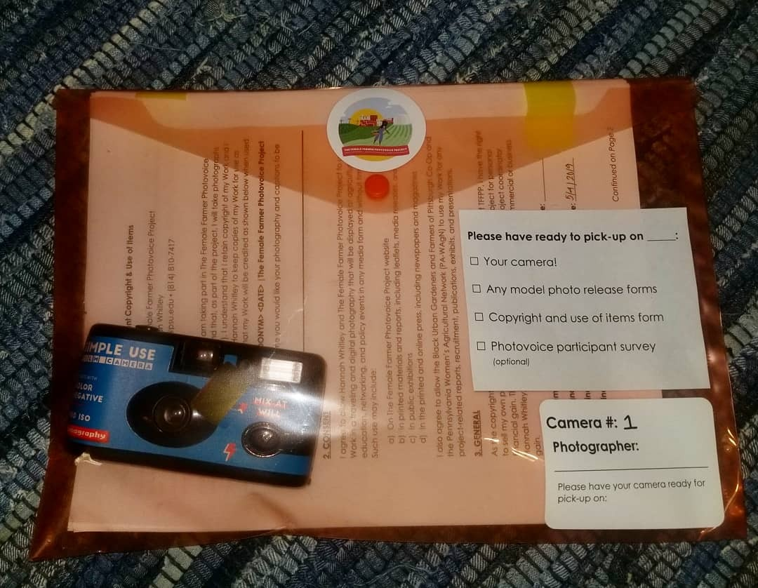
Methods of learning
A
Photovoice is…
A method that asks participants to use photography to represent and reflect on lived experiences and use their images to document needs, promote dialogue, and influence policymakers.
Semi-Structured Interviews 30 participants
Photovoice 18 participants Observation Notes & Content Analysis
Participant Observation 15 weeks in the field
Urban Farmer & Grower Survey 23 participants 73% response rate

Slide 6
My daughter stands in front of our car loaded with plants that we grew in our basement for the Dormont Elementary School second annual Mothers' Day plant sale. The plant sale raises money to sustain the school vegetable garden, which was established in 2017.
Do you think there is a role for academic research to support your work in urban agriculture?
© Lisa Freeman | The Female Farmer Photovoice Project | 2019
“Collaboration” We work not as an island; we work in partnership with many allies. We receive donations from private individuals and gifts of time, labor, and in-kind resources.

Slide 7
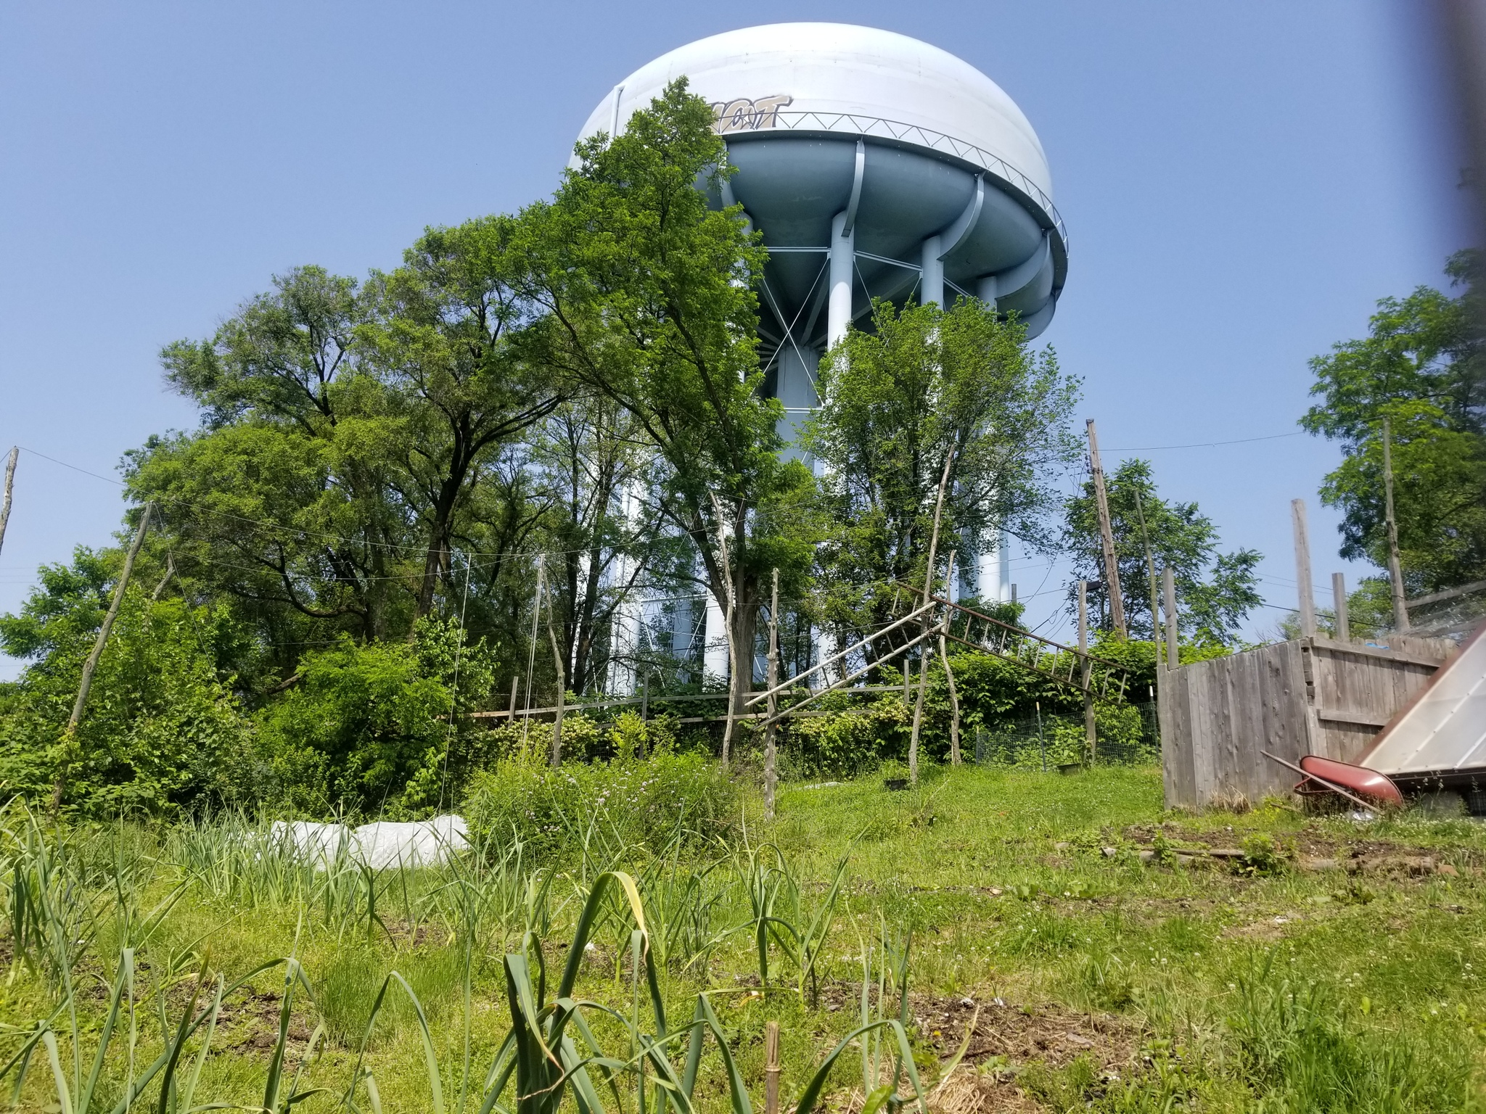
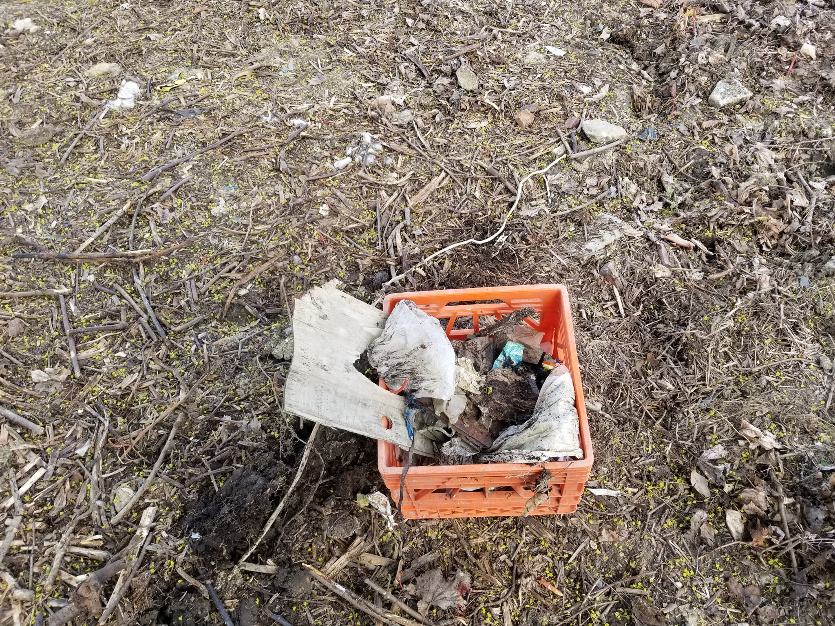
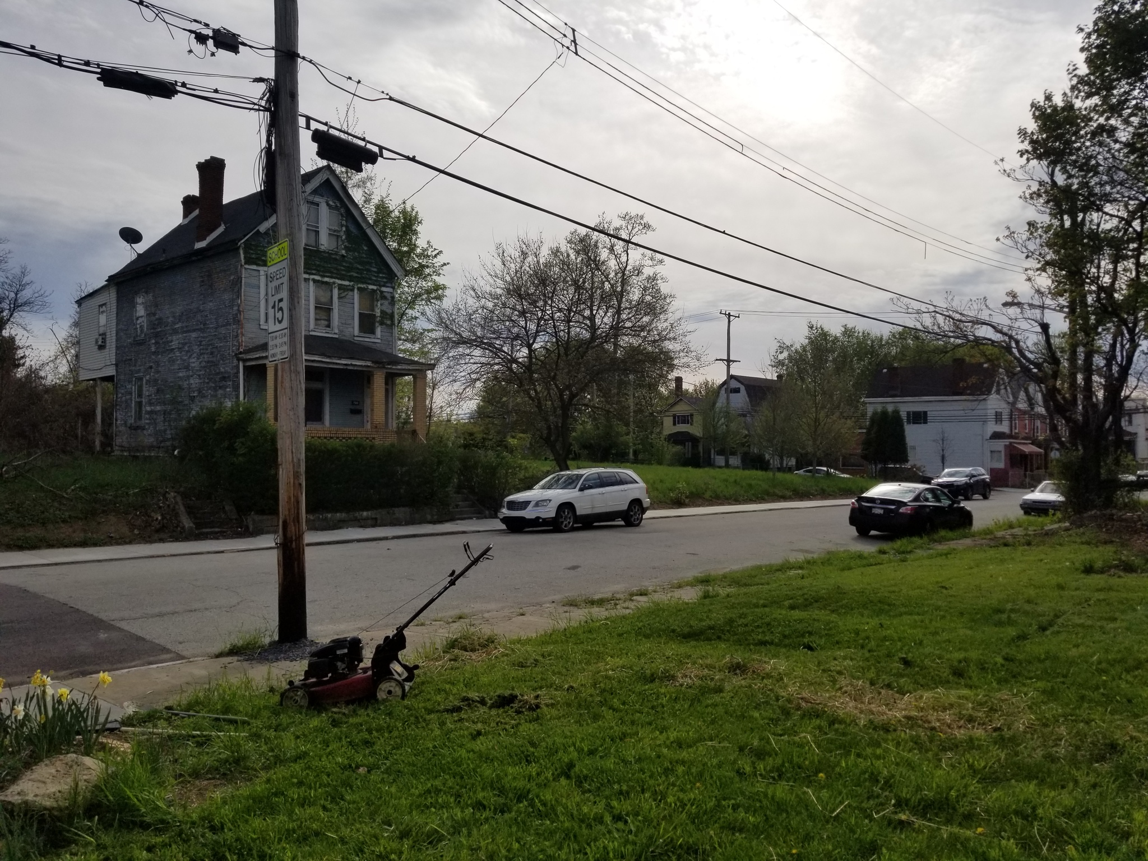
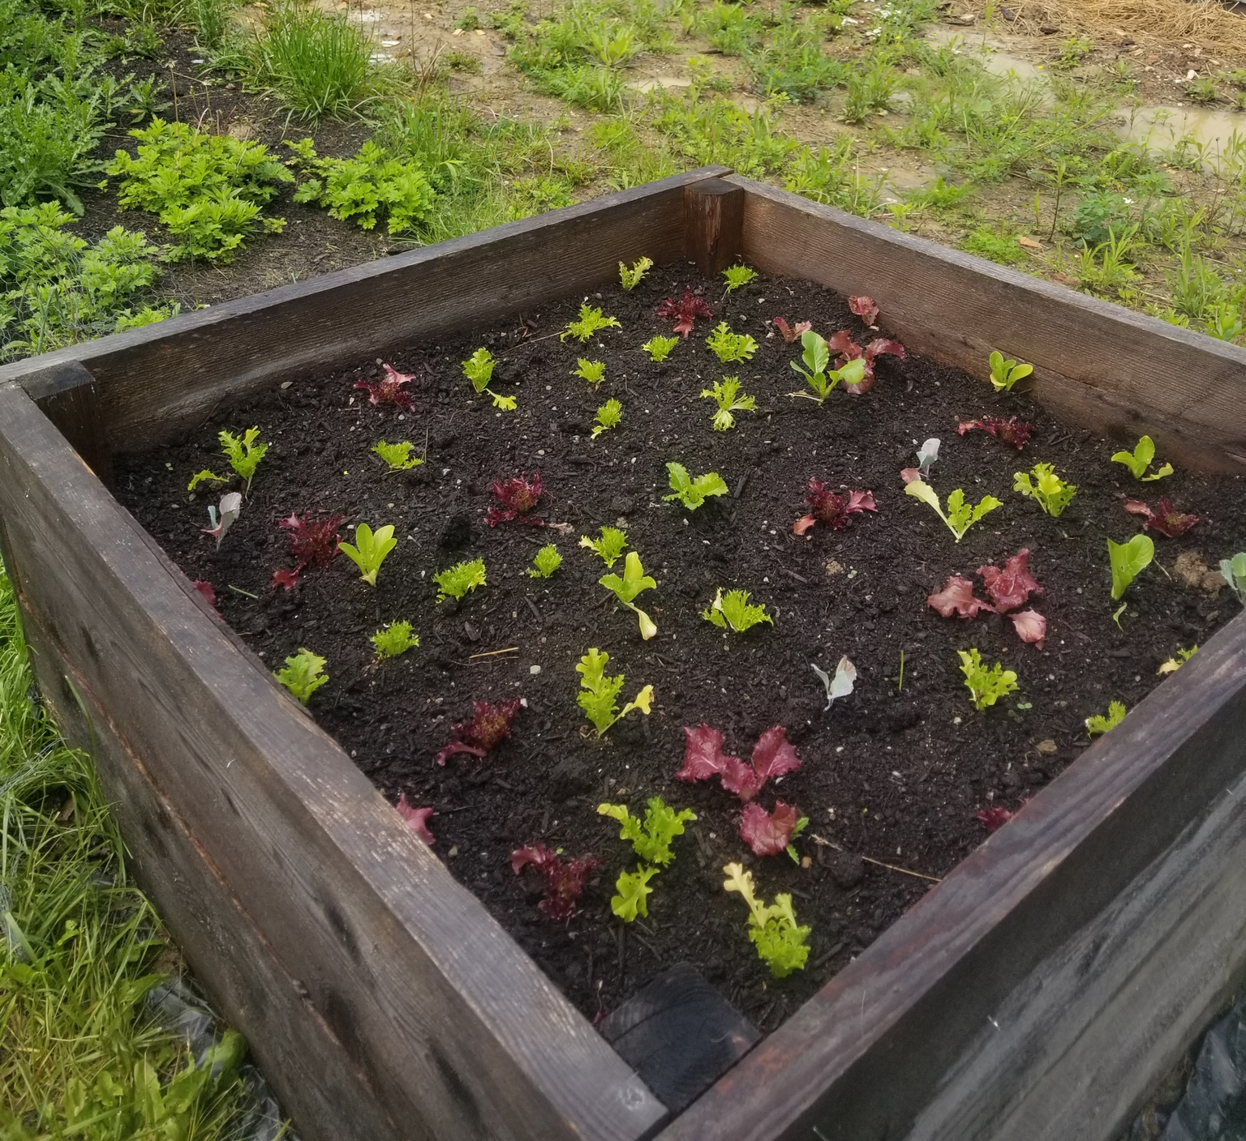
Majority of respondents (86%) identified this as a concern warranting further research
Need for location-specific and solution-oriented experiments
Some want research to happen in the spaces where they grow
Willing to work with local universities to identify and implement low-cost and organic ways of restoring the soil
Raised beds praised as a short-term solution, but what is something more sustainable?
Soil health and remediation

Slide 8
Marketing & distribution strategies for small-scale farms
Needs varied based on years of experience
“I need help identifying more sustainable practices that make [urban] farming easier and more affordable” – Nessa, Black grower & UA NGO rep, operating 1-4 years
“Something that talks about the best cover crops for operations that exclusively utilize raised beds” – Mariann, white grower, operating 1-4 years
“What are the appropriate prices I should be charging for wholesale products?” – Jaqueline, white grower, operating 5-9 years
“Something that demonstrates the efficacy of farmers markets versus distributing to grocery stores” – Talia, white grower & UA NGO rep, operating 5-9 years
“How can we most effectively store and distribute produce on a small scale?” – Fay, white grower & UA NGO rep, operating 5-9 years

Slide 9
Baseline info on UA policies, programs, services, & their effects on growers + communities
Zoning laws, livestock allowances, data on current land- and agriculture-related policies
“Just being able to put [the information] all in one place so it’s like a cheat sheet on how to start your own small urban farm” – Kenzie, white grower and UA NGO rep, 5-9 years
Urban agriculture-specific census
Who is growing food? What are they growing? Where are they located?
Without, difficult for UA non profits to apply for grants, state, and national UA policies
Citywide network analysis
“There’s no baseline information. We don’t know how many trees need to be cut down. We don’t know where the stormwater problems are. We don’t know where the air pollution is. We don’t know where the community stands.”
- Natasha, Black grower and UA non profit rep, 5-9 years

Slide 10
Discomfort with past research projects
Disregarded community requests
Did not provide compensation for time or knowledge
Did not share findings
Uneasiness with studies not based upon partnerships with local organizations
Participatory and community-led academic studies
“I think the researchers who come in need to make sure that, A, they’re doing their own homework to understand the community they’re coming into. Do not come in and tell me what to do and tell me what I need or tell me how things are going to work. Researchers have to come in after doing some background work of understanding.
- Júlia, Latina grower and UA NGO rep, 5-9 years

Slide 11
“There’s power in playing in the dirt. It’s important that people see what we’re doing, take that work seriously, and make growing food possible for everyone. It doesn’t matter where we live, what we look like… Give us space, we’ll make it happen.” -- Lonnie, urban grower and community activist, Pittsburgh, PA
Hannah Whitley PhD Student, Department of Agricultural Economics, Sociology, and Education The Pennsylvania State University
htw3@psu.edu
www.thefemalefarmerphotovoiceproject.org

Slide 12
Implications for Practice & Policy
Continue to incorporate community wants and needs within city- and state-level policy decisions
Need for an urban agriculture-specific census… or, more realistically, city-level surveys
Education and extension programming that meets the unique circumstances of urban growers
To create more accessible and equitable spaces, acknowledge and amend the historic, institutional, and cultural inequality endemic to UA systems
Some growers are open to working with scholars, but first consider partnering with local organizations/coalitions
Future academic scholarship should meet the needs of growers – utilize participatory and community-led studies

