Slide 1

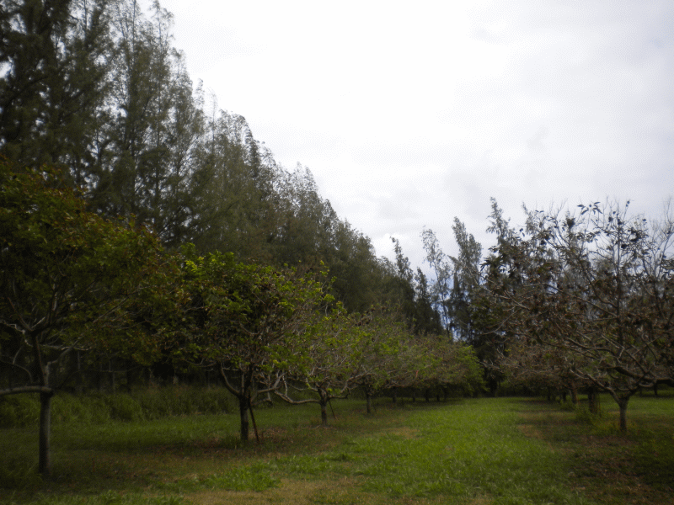
Windbreak Basics
Prepared by:
Mark Acosta, Joe Tuquero, L. Robert Barber, Frank Cruz, and Christine Laurent
Guam Cooperative Extension & Outreach

Slide 2
What is a Windbreak?
Single or multiple rows of plants strategically placed to protect an area from winds that may hinder crop & livestock production, including potential damage to structures
Filters and slows the wind that enters the area
Also known as shelterbelts
Can consist of living vegetation and/or structural wind barriers from non-living materials

Slide 3
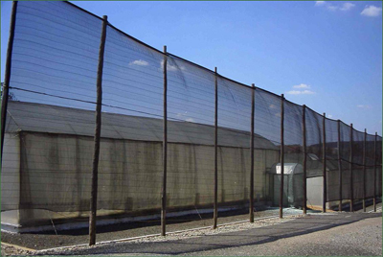
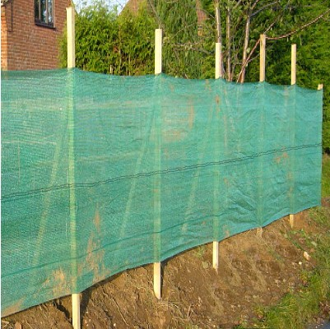
Structural Windbreak
http://www.crec.ifas.ufl.edu/extension/windbreaks/florida/examples/nursery.shtml
http://premiernetting.co.uk/catalog/knitted-windbreak-netting-fence-p-421.html

Slide 4
What is a Multipurpose Windbreak?
Provides multiple functions and/or products, in addition to wind protection
  Fruits
  Timber (lumber, arts and crafts, and fuel)
  Animal fodder
  Wildlife habitat
  Medicine
  Mulch and organic matter

Slide 5
Protecting Against the Wind
Why do we want to protect our crops from wind?
  Wind stresses (physical damage, leaf burn) plants
  Winds remove moisture
  Erodes soil
  Carries salt

Slide 6
Protecting Against the Wind
Why do we want to protect our structures from wind?
  Winds can damage structures
    Homes
    Barns
    Storages
    Fences
    Trellis
    Etc.

Slide 7
Additional Benefits
Improvement of crop/pasture quality
Conserves moisture
Reduce erosion
Intercepts potential salt spray, dust, and chemical drift
Can limit damage from storms
Reduce noise levels
Increase on-site resources (mulch, organic matter, wood products, plant material)
Reduce unpleasant odors
Provide as visual screens/living barrier

Slide 8
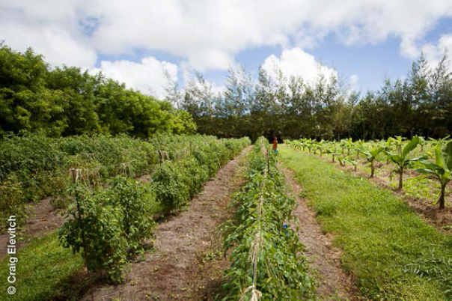
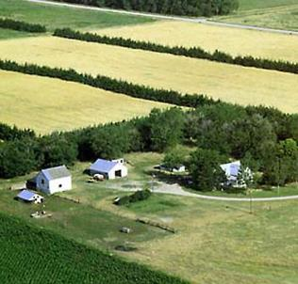
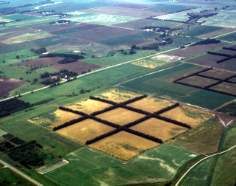
Field Windbreaks
Notes:
Different conservation needs require different windbreak designs.

Slide 9
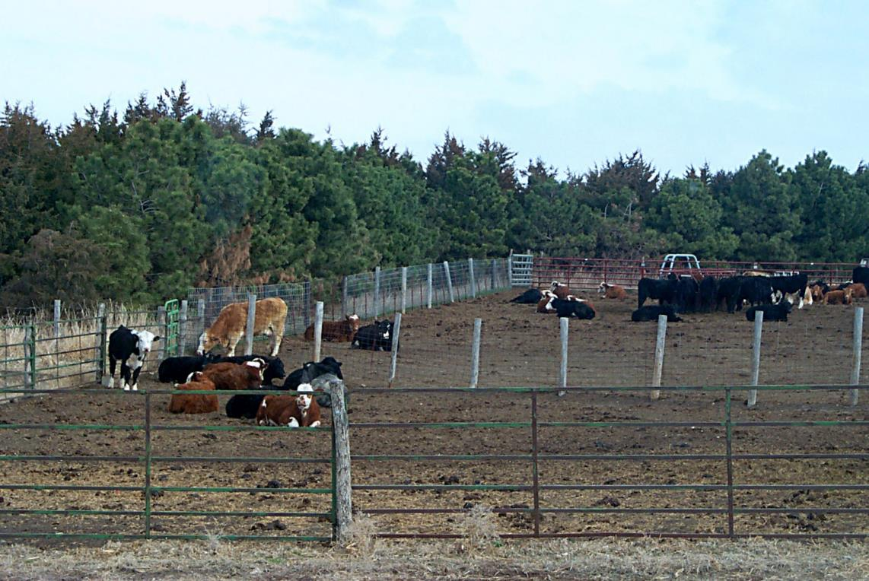
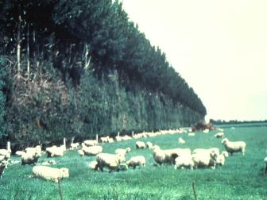
Livestock Windbreaks

Slide 10
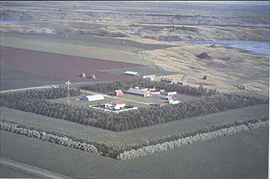
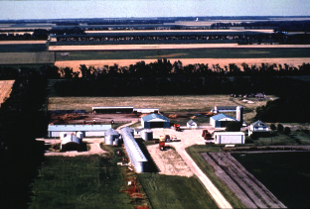
Farmstead (Structure) Windbreaks

Slide 11
Disadvantages of Windbreaks
If managed incorrectly can create concentrated wind tunnels
Takes up space
Can cause competition with crops (extended roots in fields, nutrients, water, over-shading)
If installed improperly can interfere with:
  Overhead and Underground utility infrastructure
  View planes
  Neighbors’ borders

Slide 12
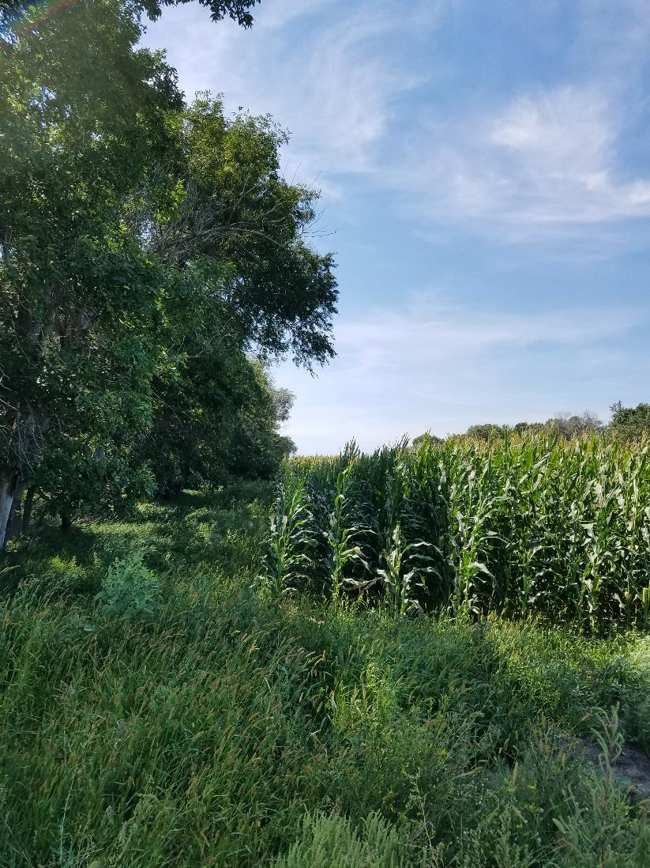
Disadvantages of Windbreaks
Over-shading
Competition
Reduction of Crop Space
Notes:
Corn field near Bismarck, ND

Slide 13
Windbreak Design Considerations
Planning your windbreak is necessary to optimize it’s effectiveness and avoid future problems
Key physical factors:
  Species
  Spacing
  Orientation
  Height
  Length
  Density
  Continuity

Slide 14
Species
Selected Species should be:
  Wind-strong
  Long-Lived
  Adapted to site conditions
Species can also be selected to provide:
  Timber/Fiber
  Food
  Fodder
  Floral Production
  Wildlife Habitat
  Medicinal uses

Slide 15
Species
Understand Growth Characteristics of desired species for proper spacing and proper densities
  Invasiveness
  Potential of competition with field crops
  How fast they grow
  Canopy widths
  Average heights
  Deciduous, Semi-deciduous or Evergreen
Type of maintenance required for specific species
  Pruning
  Irrigation
  Fertilizing
  Weeding

Slide 16
Species
Species can also be selected to provide:
  Timber/Fiber
  Food
  Fodder
  Floral Production
  Wildlife Habitat
  Medicinal uses

Slide 17
Species - Heights
Short Species: 20 feet and under
  - Calamansi - Noni
  - Soursop - Lemon china
  - Surinam Cherry - Pomegranate
  - Saba/Palau banana - Other Citrus
Medium to Large Species: over 20 feet
  - Dwarf coconut
  - Avocado
  - Mango
  - Breadfruit
  - Tamarind

Slide 18
Spacing - Recommendations
Fruit Trees: | Windbreak: | Orchard:
Calamansi | 5-8 feet | 8-10 feet
Soursop | 5-8 feet | 8-14 feet
Pomegranate | 5-8 feet | 8-14 feet
Surinam Cherry | 8-10 feet | 10-15 feet
Noni | 6-10 feet | 10-15 feet
Lemon China | 6-10 feet | 8-14 feet
Avocado | 12-18 feet | 20-40 feet
Saba Banana | 8-14 feet | 12-18 feet
Dwarf Coconut | 10-12 feet | 15-20 feet
Breadfruit | 12-16 feet | 15-40 feet
Mango | 10-16 feet | 15-40 feet
Tamarind | 8-15 feet | 15-30 feet

Slide 19
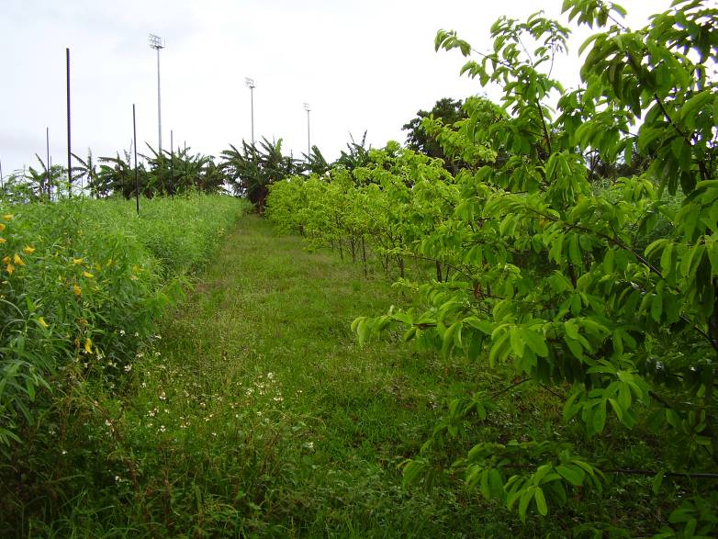
Species
Gågu
Banana and Soursop

Slide 20
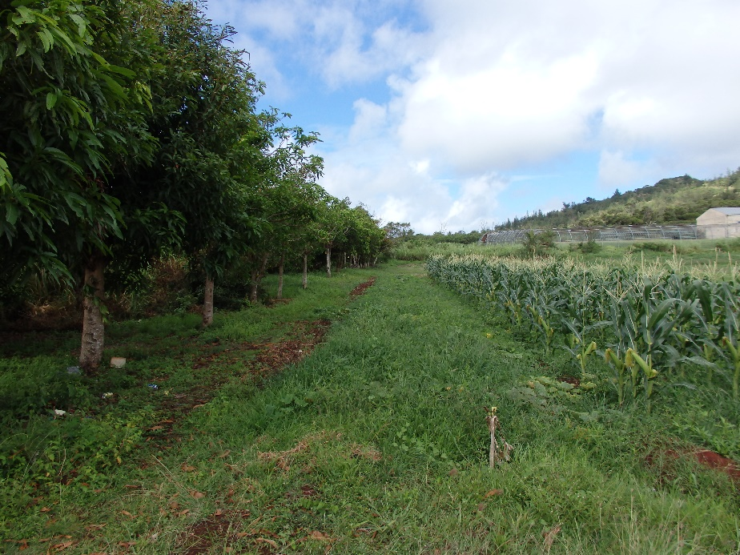
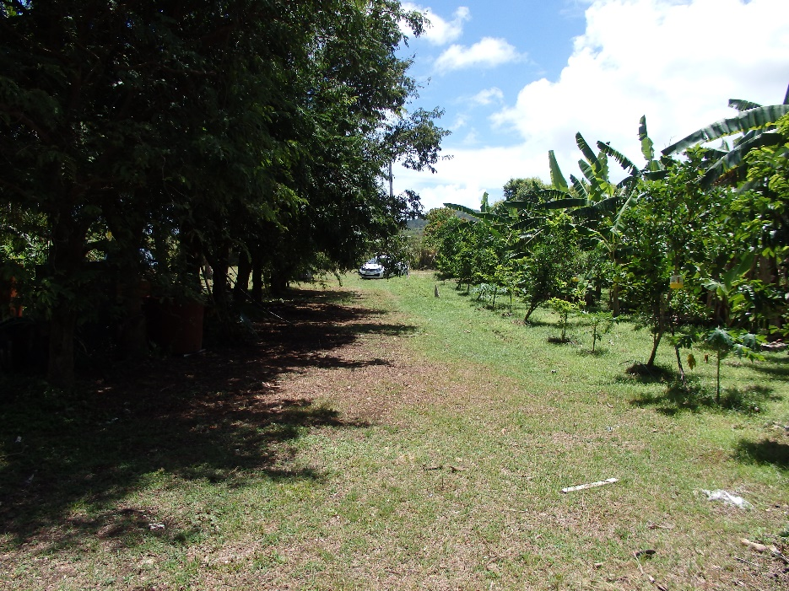
Species
Mango
Tamarind

Slide 21
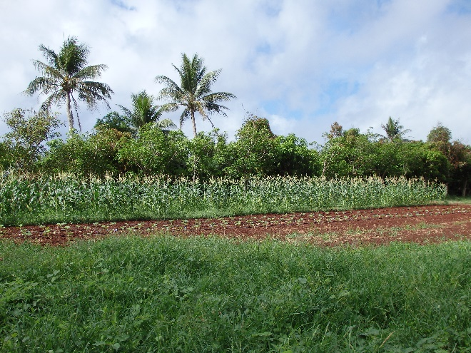
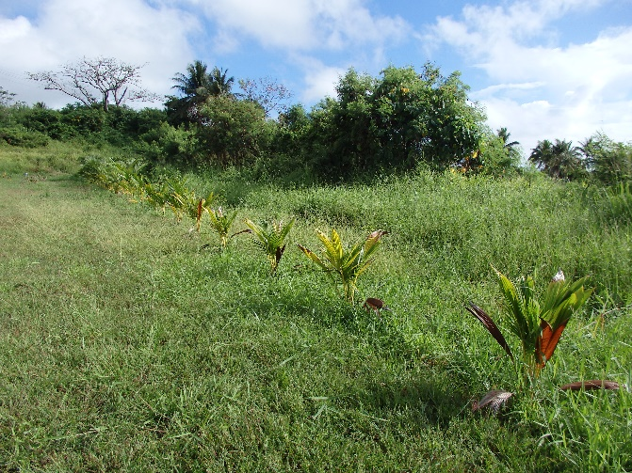
Species
Coconut and Mango
Coconut

Slide 22
Staggered spacing filters and slows the wind
WIND
DIRECTION

Slide 23
Even spacing creates gaps that can accelerate wind

Slide 24
Orientation
Essential for effective protection
Perpendicular to the prevailing wind direction (at the least)
On Guam and most Pacific islands, most fields require protection from all directions as trade winds may shift from all directions throughout the year

Slide 25
Correct Orientation
WIND
DIRECTION

Slide 26
Wrong Orientation
WIND
DIRECTION

Slide 27
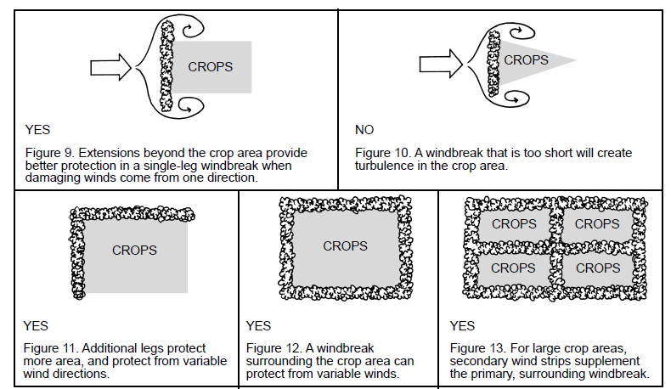
Orientation

Slide 28
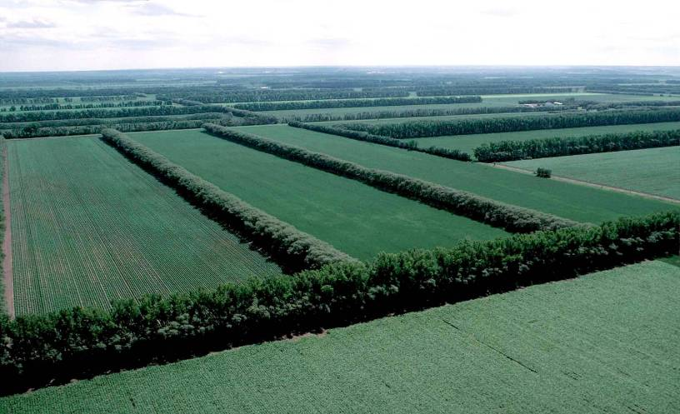
Windbreak Orientation
Troublesome
Wind(s)??
Orient windbreaks perpendicular to troublesome winds
Plan multiple windbreaks for whole field protection
Notes:
The area of protection is greatest when the wind encounters the windbreak at 90 degrees or when it is perpendicular to the windbreak. As the angle of approach decreases the zone of protection decreases.
*Does the predominate wind direction vary through the seasons?
*During which season is wind the biggest problem?
*Plan the windbreak orientation to be as close as possible to the troublesome wind.

Slide 29
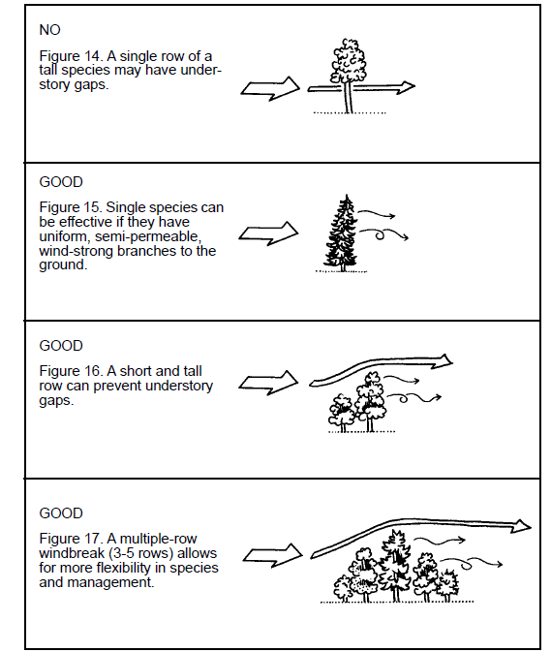
Windbreak Orientation

Slide 30
Single Row Windbreaks
Use only if the species has uniform wind strong branches from the ground up
  - Limited species, which meet this criteria
High risk of losing entire row
Single row takes up less space

Slide 31
Multiple Row Windbreaks Consist of Two or More Rows
Multiple rows require more land
If multiple species, more harvest opportunities
Greater species selection available
Decreased risk of losing entire investment

Slide 32
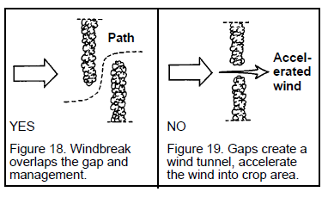
Windbreak Orientation

Slide 33
Windbreak Height
Can reduce wind speed for a distance of 10 times their height
Large fields, should have secondary wind strips
Small areas can use smaller and lower growing species
Height of windbreak should be determined by the expected height of your crop
Windbreaks ideally should be twice as tall as your crops

Slide 34
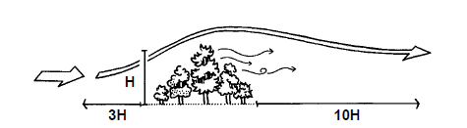
Windbreak Height
Windbreak protects crop area to about 10 times the height of the windbreak

Slide 35
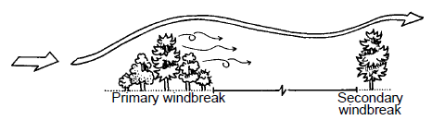
Windbreak Height
If crop area is longer than 10 times the height of the windbreak, add secondary windbreaks

Slide 36
Windbreak Length
Prevent winds from coming around the ends
  Additional lengths past the protected area
  Additional legs that prevent wind from whipping around
Length of windbreaks should extend about five times the height (5H) of the windbreak
For large crop areas:
  secondary wind strips should be used to supplement the surrounding windbreaks

Slide 37
Windbreak Length

Slide 38
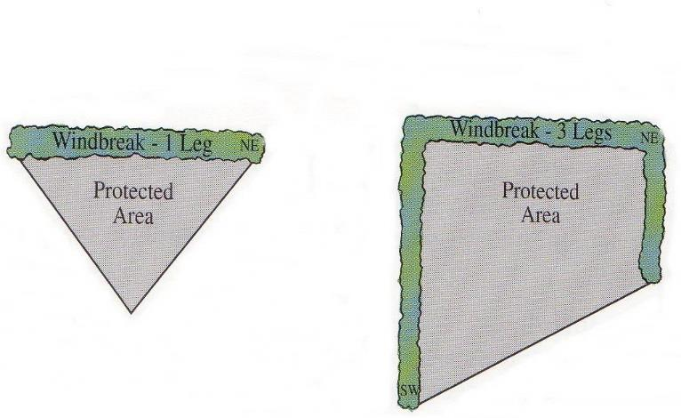

Windbreak Length and Orientation
Notes:
When troublesome winds will cross windbreaks at a significant angle. Use the wind angle calculator provided in NRCS PIA Veg. Spec. located in the Planner’s area of the IR template for Windbreak/Shelterbelt Establishment Implementation.

Slide 39
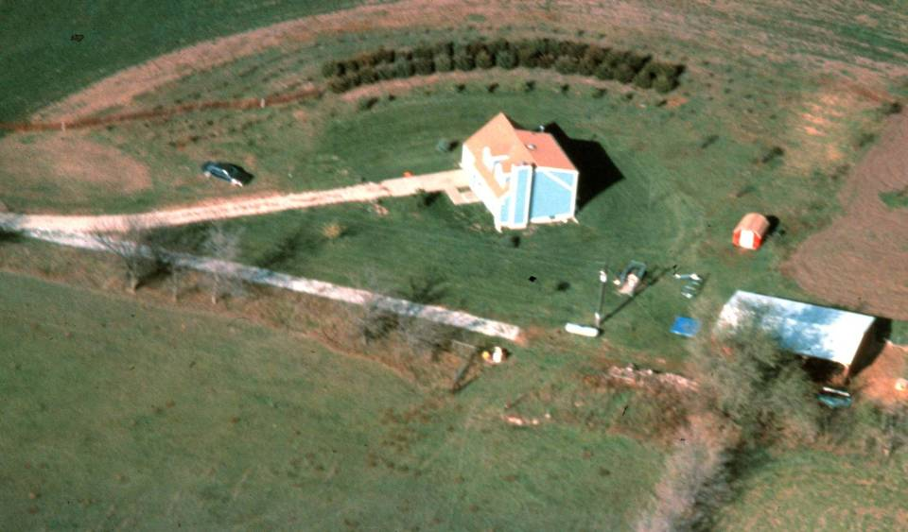


Windbreak Length and Orientation
Notes:
This example shows an original windbreak that was too sort to provide adequate protection to the house and living space. The windbreak was later extended on both ends.

Slide 40
Windbreak Density
Should slow the wind, not completely block it
Crops
  - 40-60% density
Noise Reduction, Structures & Livestock
  - At least 65% density
Air Quality (foul odors, dust, chemical drift)
  - At least 50-65% density

Slide 41
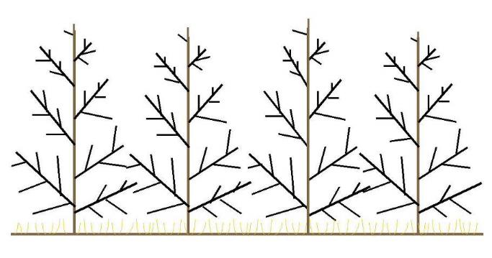
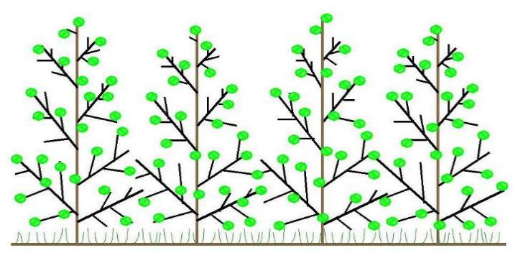
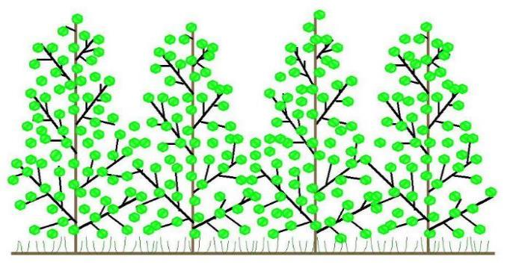
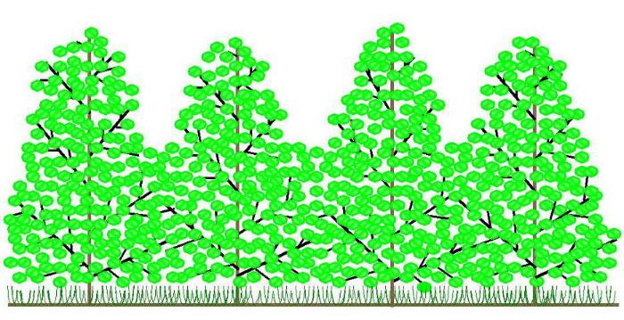
Windbreak Density
Notes:
Height and density are the two most important specifications to consider when planning for effective windbreaks.
Density - is the ratio of the solid portion of the barrier to the total area of the barrier. Wind flows through the open portions of a windbreak, thus the more solid the windbreak, the less wind passes through. By adjusting windbreak density different wind flow patterns and areas of protection are established

Slide 42
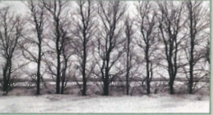
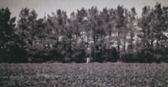
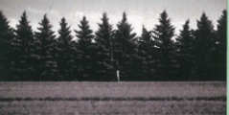
Density - Visuals
25- 50% density
50-65% density
65+% density

Slide 43
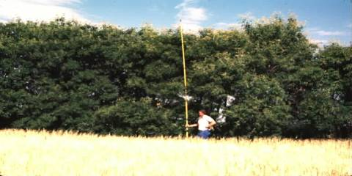
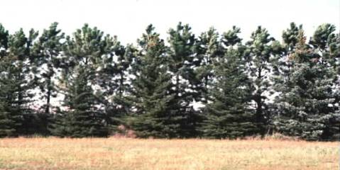
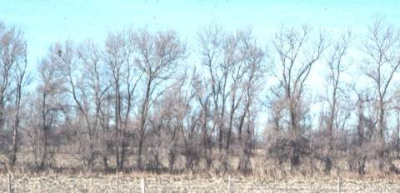
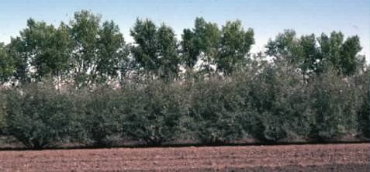
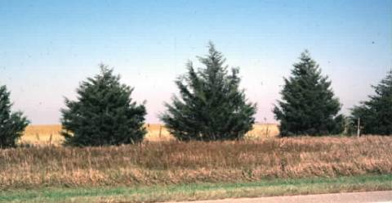
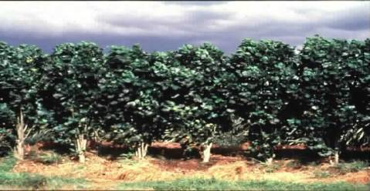
Notes:
Density - The density level is manipulated by the choice of plant materials (e.g. deciduous trees versus conifers) and the way the plants are arranged in the windbreak. By combining low growing shrubs with medium and tall deciduous trees, dense plant material is provided at three levels (low, middle and upper) of the windbreak during the growing season. However, during the winter, the density would decrease due to the loss of foliage. Consequently, a conifer component would be desirable for year-round protection.
*How would you describe the density of the bottom left picture?
For practical application purposes density is dealt with on a gross scale of low, medium and high density.
Low density is 25-40% dense
Medium density is 40-60% dense
High density is greater than 60% dense
100% density is not possible with vegetation.
Remember that density will likely vary from the bottom to the top of the windbreak.

Slide 44
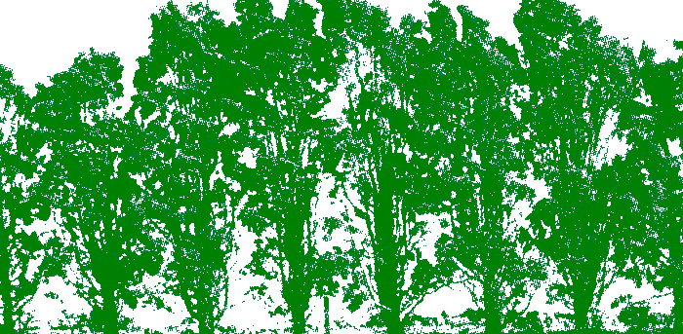
Windbreak Density
Windbreak density is the percentage of the solid portion of the barrier to the total area of the barrier.
Notes:
Density - is the ratio of the solid portion of the barrier to the total area of the barrier. Wind flows through the open portions of a windbreak, thus the more solid the windbreak, the less wind passes through. By adjusting windbreak density different wind flow patterns and areas of protection are established.
Sometimes people or literature on windbreaks will refer to porosity instead of density. Remember that a 60% dense windbreak can also be considered to be 40% porous.
We usually estimate the density on an optical basis.
Q-How dense is this picture?
A-40% dense

Slide 45
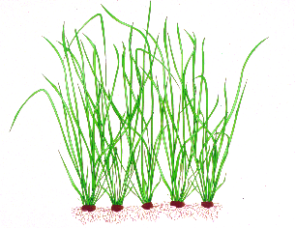
Windbreak Density
50 to 60 % density
25 to 40 % density
Notes:
Density - is the ratio of the solid portion of the barrier to the total area of the barrier. Wind flows through the open portions of a windbreak, thus the more solid the windbreak, the less wind passes through. By adjusting windbreak density different wind flow patterns and areas of protection are established

Slide 46
Continuity
Noticeable gaps can become wind tunnels
Openings for access should be staggered
WIND DIRECTION
WIND IS ACCELERATED
WIND DIRECTION
YES
NO

Slide 47
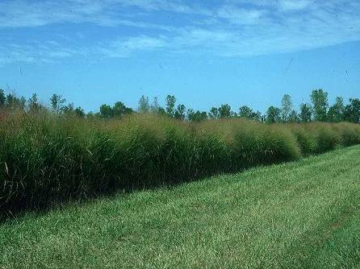
Windbreak Continuity
Gaps in the windbreak can result in damage downwind
Notes:
It is critical that the wind barriers do not have any gaps. The wind velocity through a gap can actually accelerate to 120% of open wind velocity resulting in damage as shown in the photo.
Some plants are damaged by blowing wind as well as by windborne sediment. Also, establishing seedlings in a gap can be difficult because the microenvironment is harsh.
The fewer the number of rows in the windbreak the more important it is to have a high seedling survival rate.

Slide 48
Land Preparation
If planting on new or overgrown land, clear unwanted vegetation but do not remove topsoil
  If using heavy equipment, do not scrape the soil
  Steeply sloping land should not be stripped of plant cover due to susceptibility to erosion
  Consider using sheet mulching
Do not operate any machinery on wet soil; this can compact the soil and negatively impact plant growth and development and also increases soil erosion

Slide 49
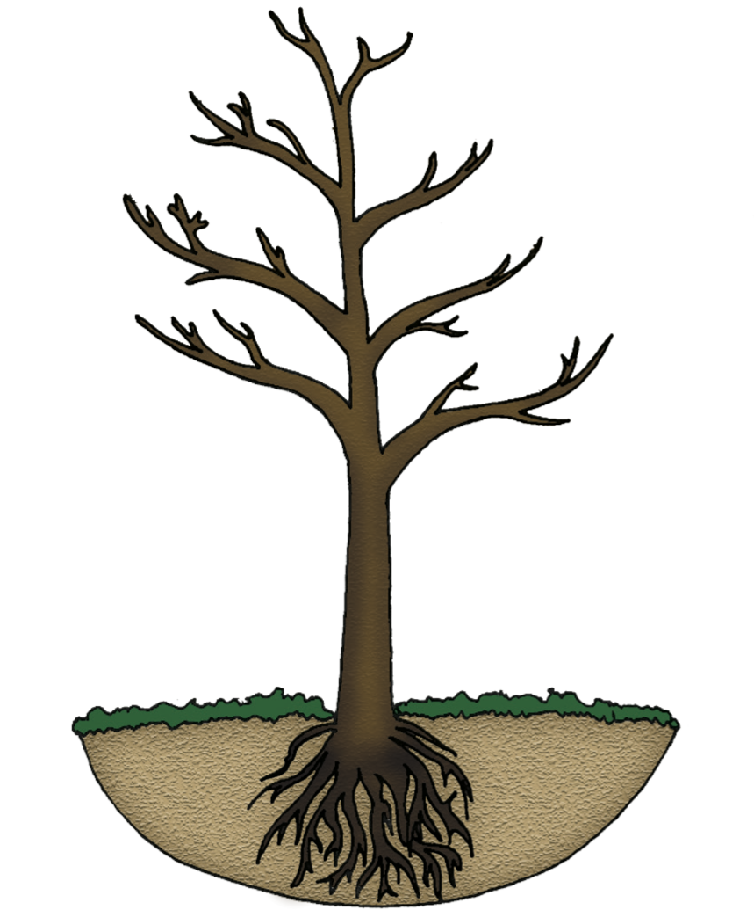
Planting and Care
Site preparation
  - Dig a hole at least the same depth and twice as wide as the root ball
  The crown (point where root & stem meet) should be level with the ground surface

Slide 50
Planting and Care
Maintenance
  Weeding
  Pest & disease control
  Irrigation
  Fertilizing
  Pruning
  Mulch if possible
  Replace dead plants as soon as possible
  Close gaps as soon as possible

Slide 51
Supporting Government: Extension & Outreach (UOG)
Consultation/Technical Advice/Education
  Appropriate/Desired species
  Design
  Maintenance topics
  CONTACT: 735 -2080

Slide 52
Supporting Government Program: EQIP
Through participation in the NRCS EQIP farmers can:
  - Receive cash reimbursements for establishment costs of recommended conservation practices
    Must be enrolled in program prior to implementing the practice
    Must follow all program requirements
  - Windbreaks are one of the many recommended practices
For more information on EQIP contact your local NRCS field office at 734-2111

Slide 53
Final Pointers
Design windbreaks for the whole farm if possible
Protect from prevailing winds at the very least
Select several site-appropriate species to use
Replant early to prevent gaps
Control height and density as needed over the windbreak life.
Maintenance
Never too late to install windbreaks. Best to install at the beginning of your operation.

Slide 54



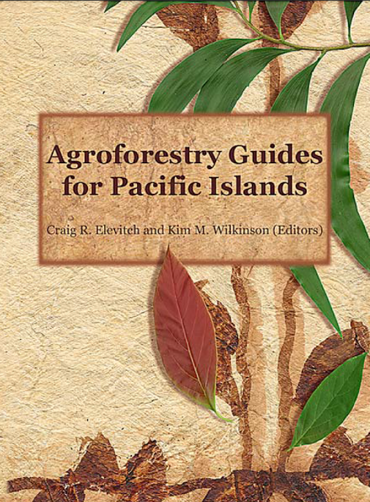
Sources of Information

