Slide 1
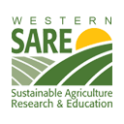
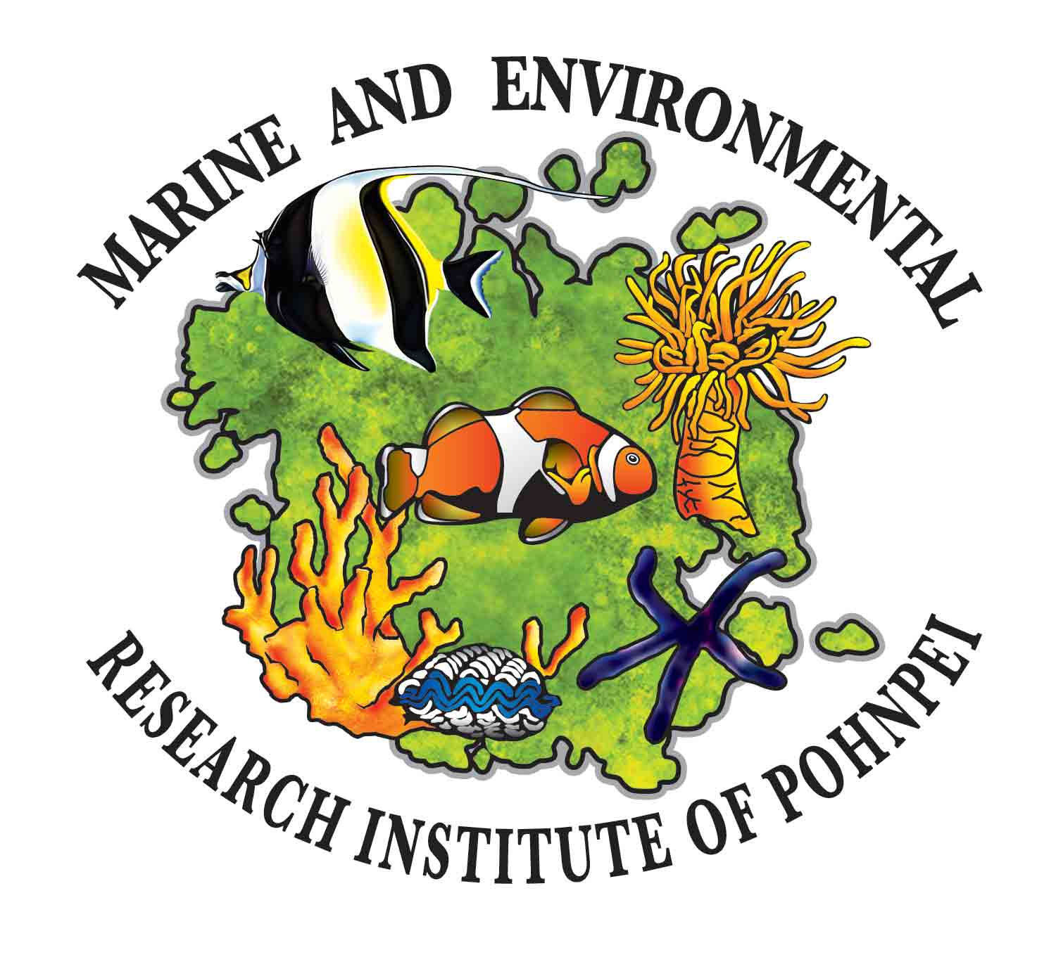
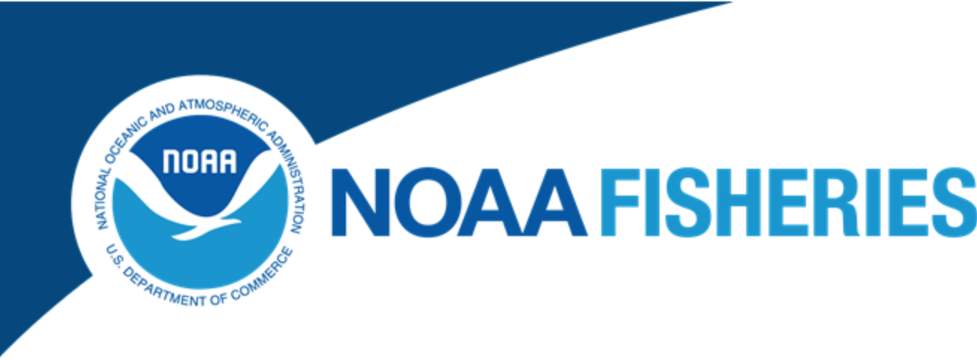
Sustainable Capture-based Aquaculture of Siganids (rabbitfishes) in Pohnpei. Lessons learned to date and potential for expansion to other areas of Micronesia and the broader Pacific

Slide 2
Capture versus Culture
According to the FAO 20% of aquaculture world wide is still based on capture.
Capture-based generally means young animals are taken from the wild rather than being raised in a hatchery
Any type of aquaculture that relies of some form of capture of wild stock, including breeding stock, is capture-based.
Sustainable – capable of being maintained at a steady level.

Slide 3
Capture-based Aquaculture
Pros
Cheaper
More suitable for developing environments
Removes the most difficult stages of development
Cons
Competes with, and can deplete, local fisheries
Cannot control genetics such as size and growth rate
Dependent on natural cycles and changes such as climate change
Generally harder to control

Slide 4
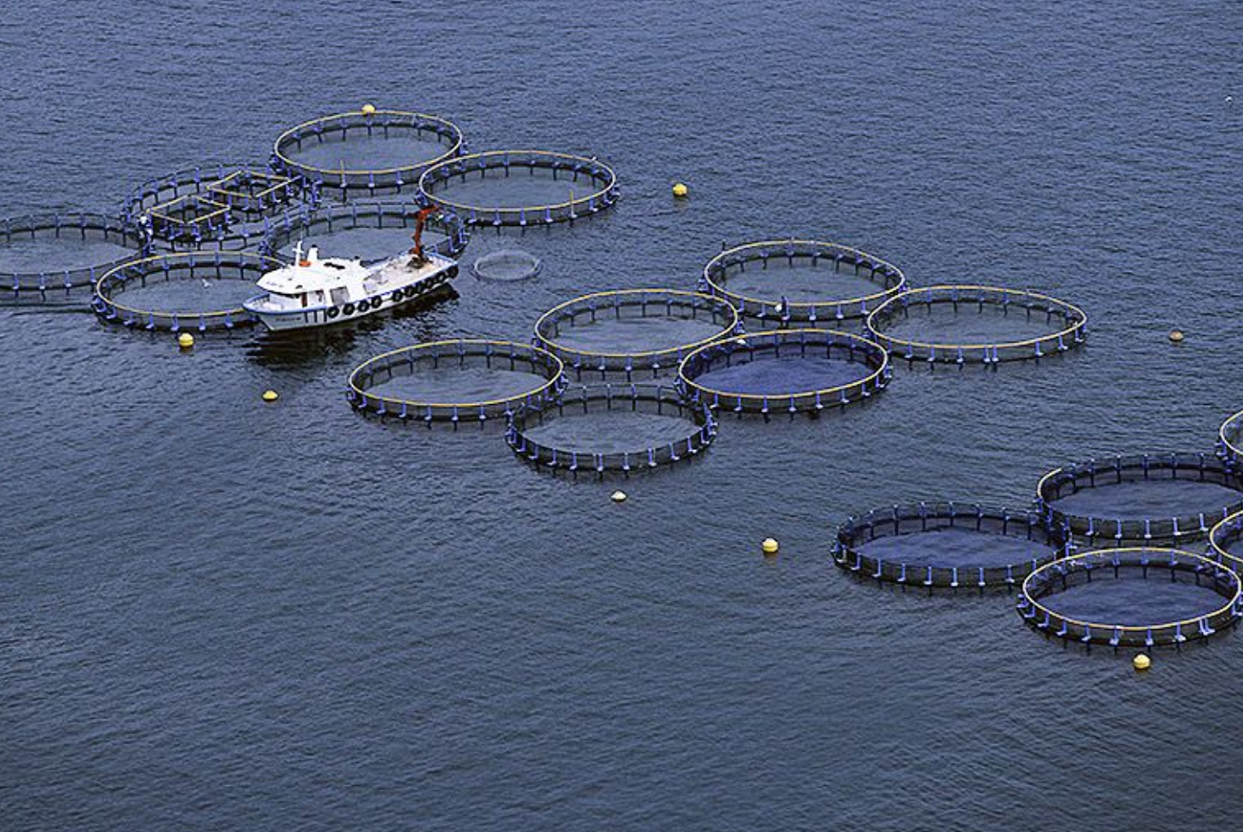
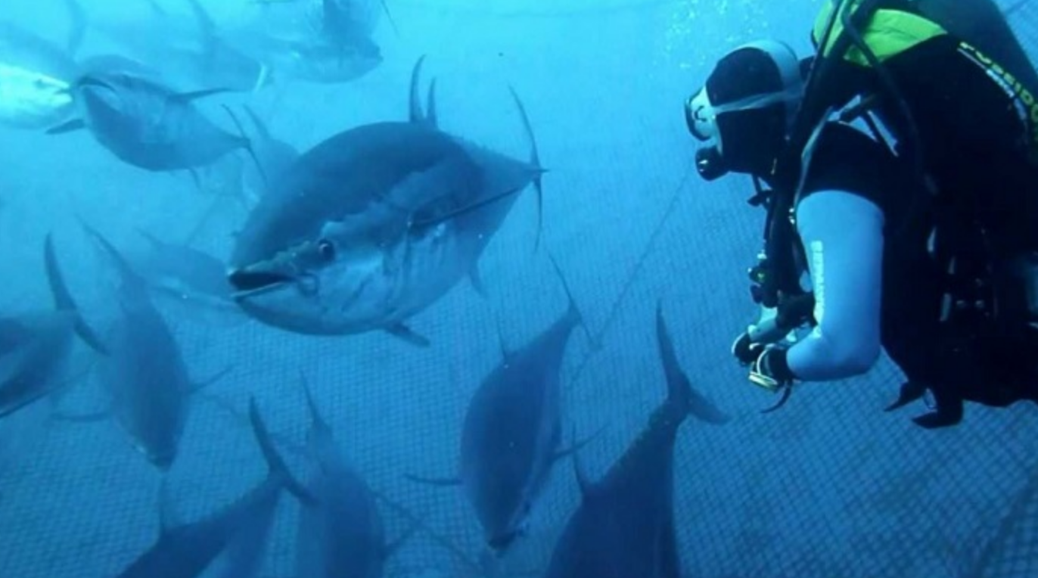
Examples of Capture-based Aquaculture
Blue fine tuna farming

Slide 5
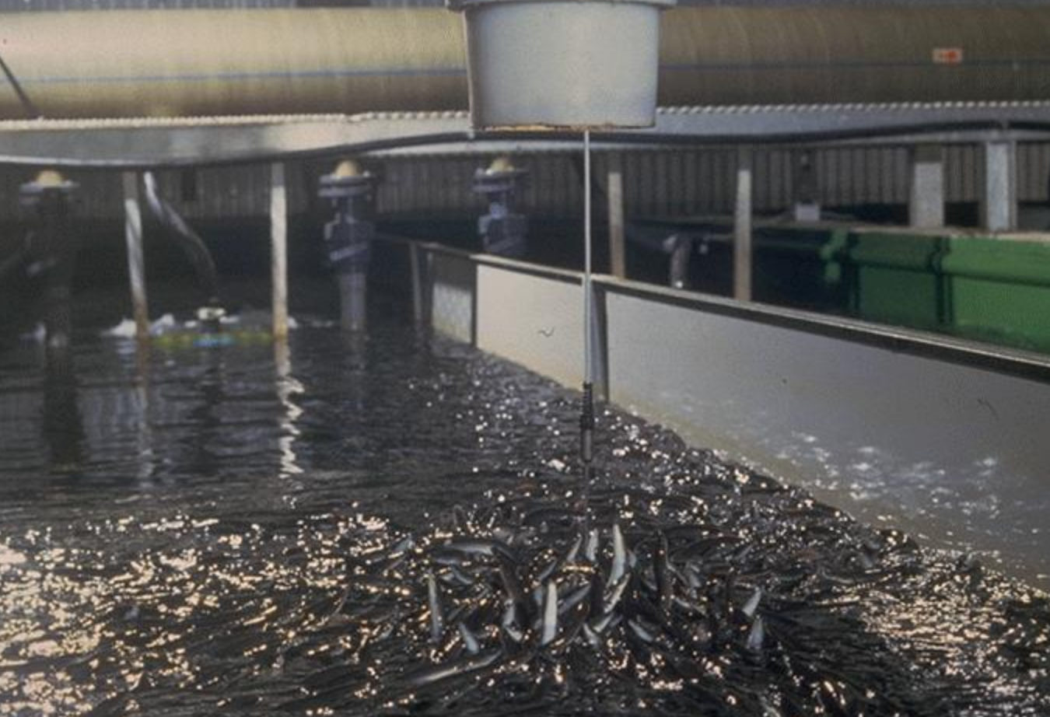
European and American Eels

Slide 6
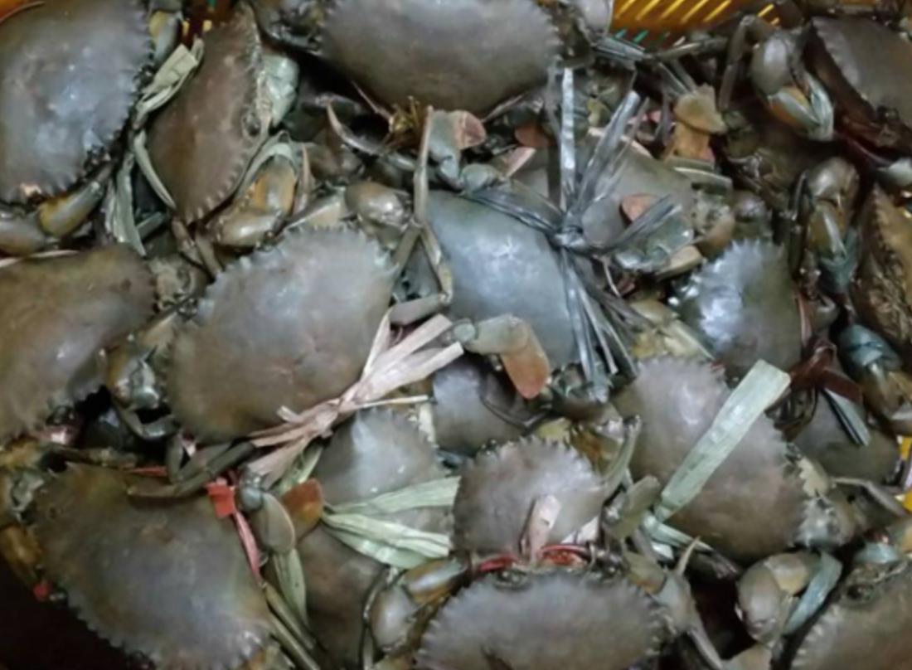
Mangrove Crab Fattening

Slide 7
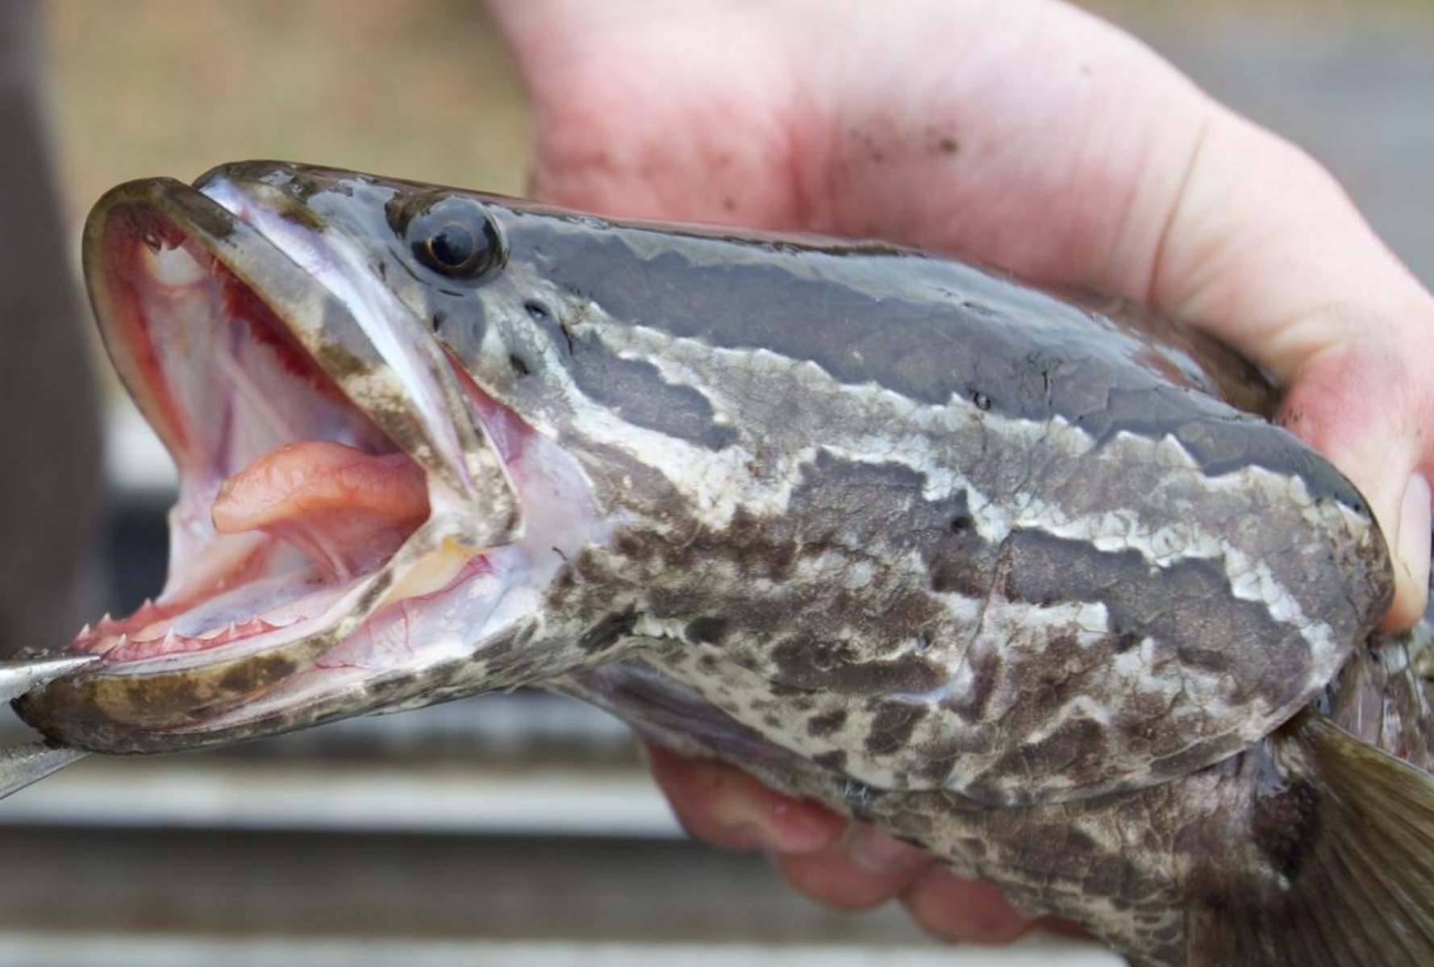
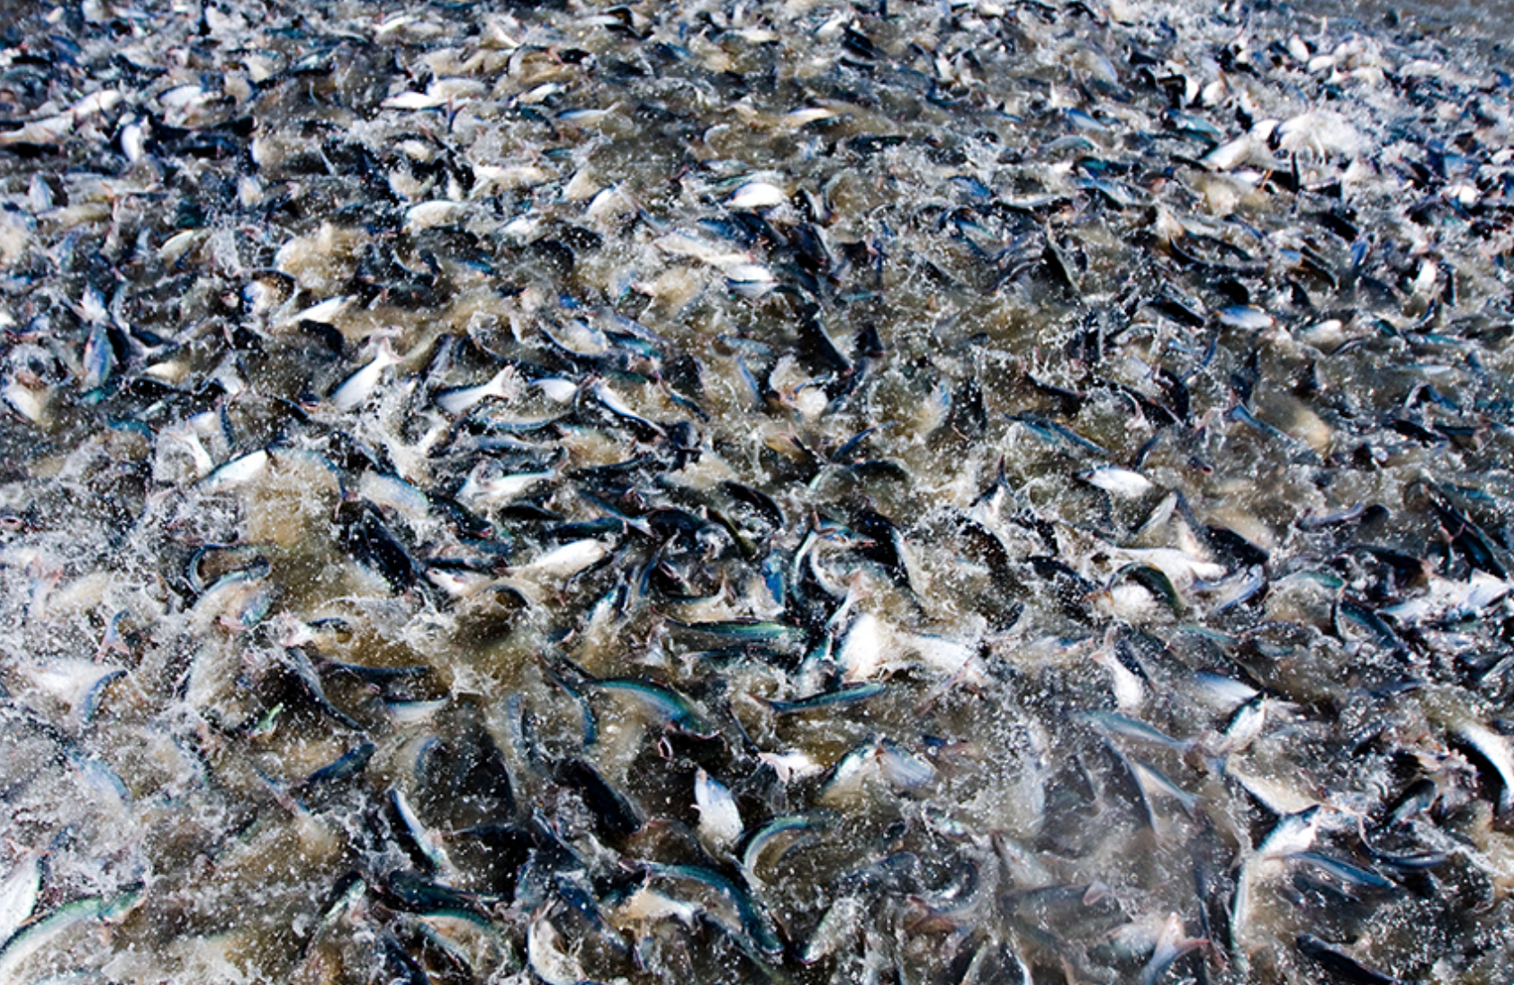
Other Examples
Milkfish in Pacific and Asia
Mullets in Africa
Groupers in Asia
Snakeheads and Pangasius catfish in Asia

Slide 8
MERIP Research and Development Program – Rabbitfish 2018-2019
Document annual settlement times for key species of Siganids onto seagrass beds in Pohnpei.
Refine and demonstrate sustainable capture and grow-out methods of post-settlement Siganid species in Pohnpei.
Transfer farming and capture technologies to fishing communities and establish pilot farms.
Strengthen institutional capacity for rabbitfish farming in Pohnpei and the broader Pacific
Conduct market research for farmed Siganids in Pohnpei and the neighboring island of Guam.
Develop a simple demonstration marine fish hatchery on the MERIP facility in Pohnpei with a view to moving from capture-based aquaculture to hatchery-based aquaculture for future work on Siganids and other marine fishes in Pohnpei.

Slide 9
Workshop Goal and Activities
Goal: Strengthen institutional capacity for rabbitfish farming in Pohnpei and the broader Pacific
Rabbitfish biology and current status of farming
Theory and practice behind sustainable capture
Methods of capture
Results of capture and grow-out efforts to date
Cages and grow-out methods used for rabbitfish at MERIP
Discuss collaborations and possible next steps

Slide 10
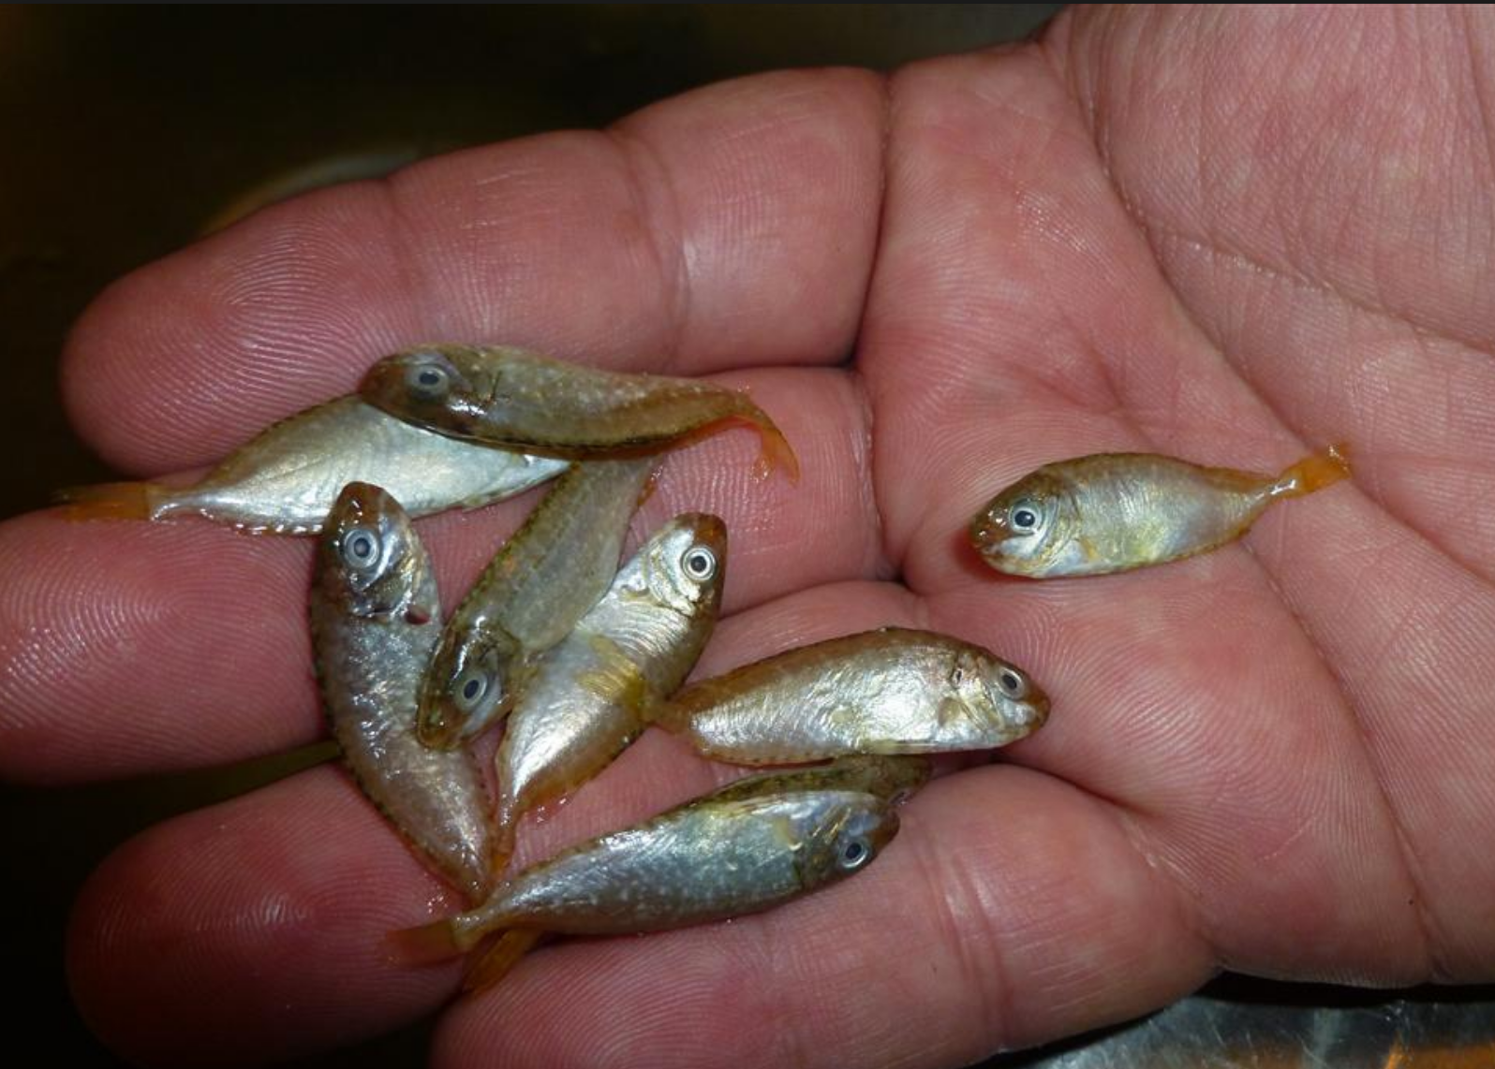
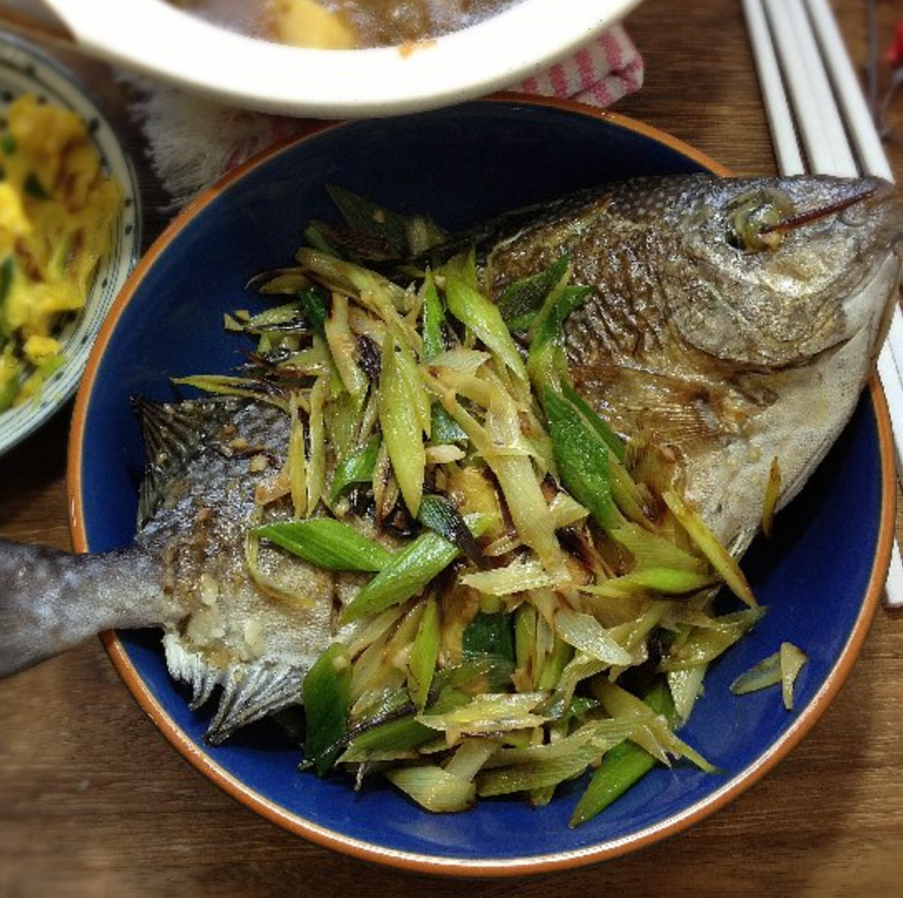
Desired Outcome

