Slide 1
Wrap-Up Webinar to Celebrate SFA’s Two SARE-PDP “Networking for Soil Health” Grants
November 21, 2019
1:30 P.M.

Slide 2
Webinar Agenda: Welcome and Introductions Summary of Activities and Feedback from Scholarship Recipients Jennifer Hahn Introduces the MN Soil Health Coalition Anna Cates Introduces MN Office of Soil Health Wayne Martin Discusses NC-SARE Programs Theresa Keaveny Describes SFA’s new Silvopasture Grant Wayne Monsen Details on Upcoming SFA Silvopasture Events Final Thoughts and Sign-0ff

Slide 3
Summary of Activities:
Scholarship Recipients: 108
Downstream Education Events 67 Over 1,000 Attendees!
Midwest Soil Health Summits 4 624 Attendees!
Café Chats 16 208 Attendees!
Dirt Rich Field Days 4 218 Attendees!
Totals 91 2,050 Attendees!

Slide 4
Minnesota Soil Health Coalition
Partnering for our resources
Notes:
introductions

Slide 5
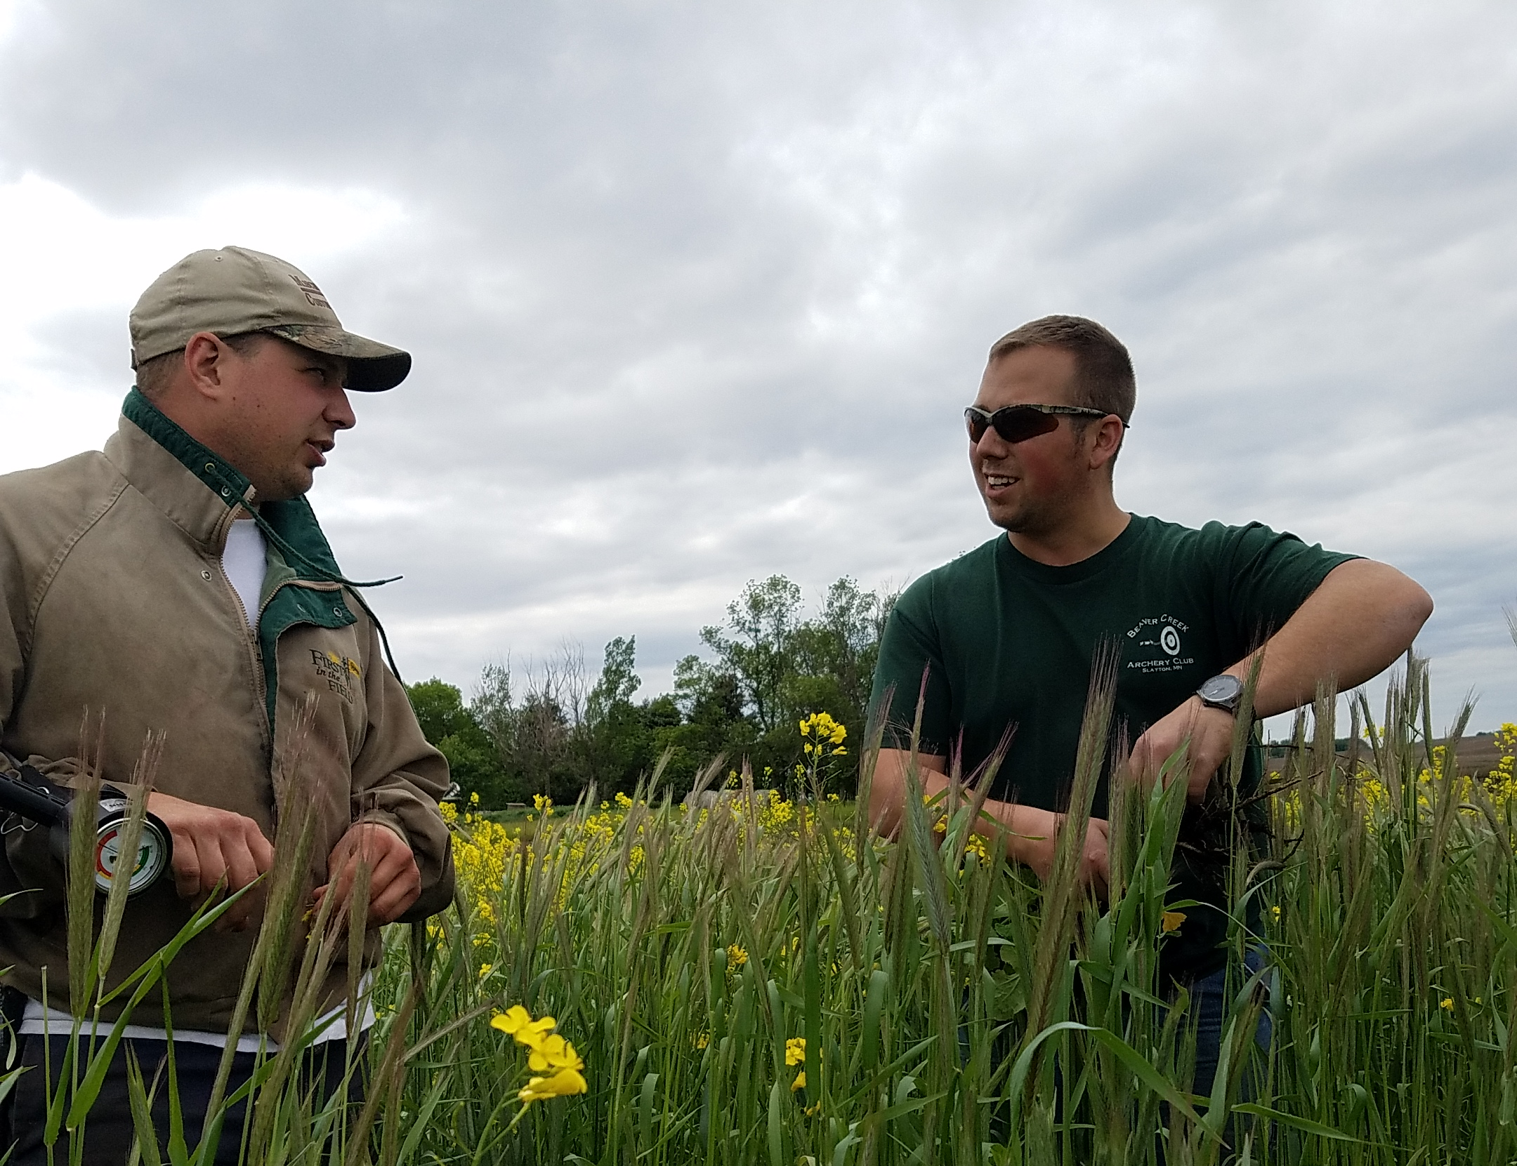
Mission
Producer driven education, outreach, and adoption utilizing information exchange to promote the principles of Soil Health practices
Notes:
Jennifer

Slide 6
Goals of the Coalition
Provide education, training, and logistical information to farmers, agency staff, and the general public
Unite conservation agencies, farmers, and industry to advocate for large scale adoption of soil health principals
Develop and maintain the farmer to farmer mentor program
Create and maintain a statewide soil health forum
Organize and collaborate on events, trainings, field days, and meetings with producers and other entities
Establish research base-Ag Center at MN College for a minimum of 5 year agreement for testing, data, and information exchange of soil health practice implementation in Minnesota
Develop agreements with MN farmers and monitor management, soil health, and economics
Develop and maintain a website with information about the organization, relevant technical information, links to information, calendar of events, and contacts for the organization
Leadership development, education, and training opportunities
Promote large scale adoption of soil health practices, making a measurable positive impact on soil erosion, surface water quality, and soil infiltration for Minnesota

Slide 7
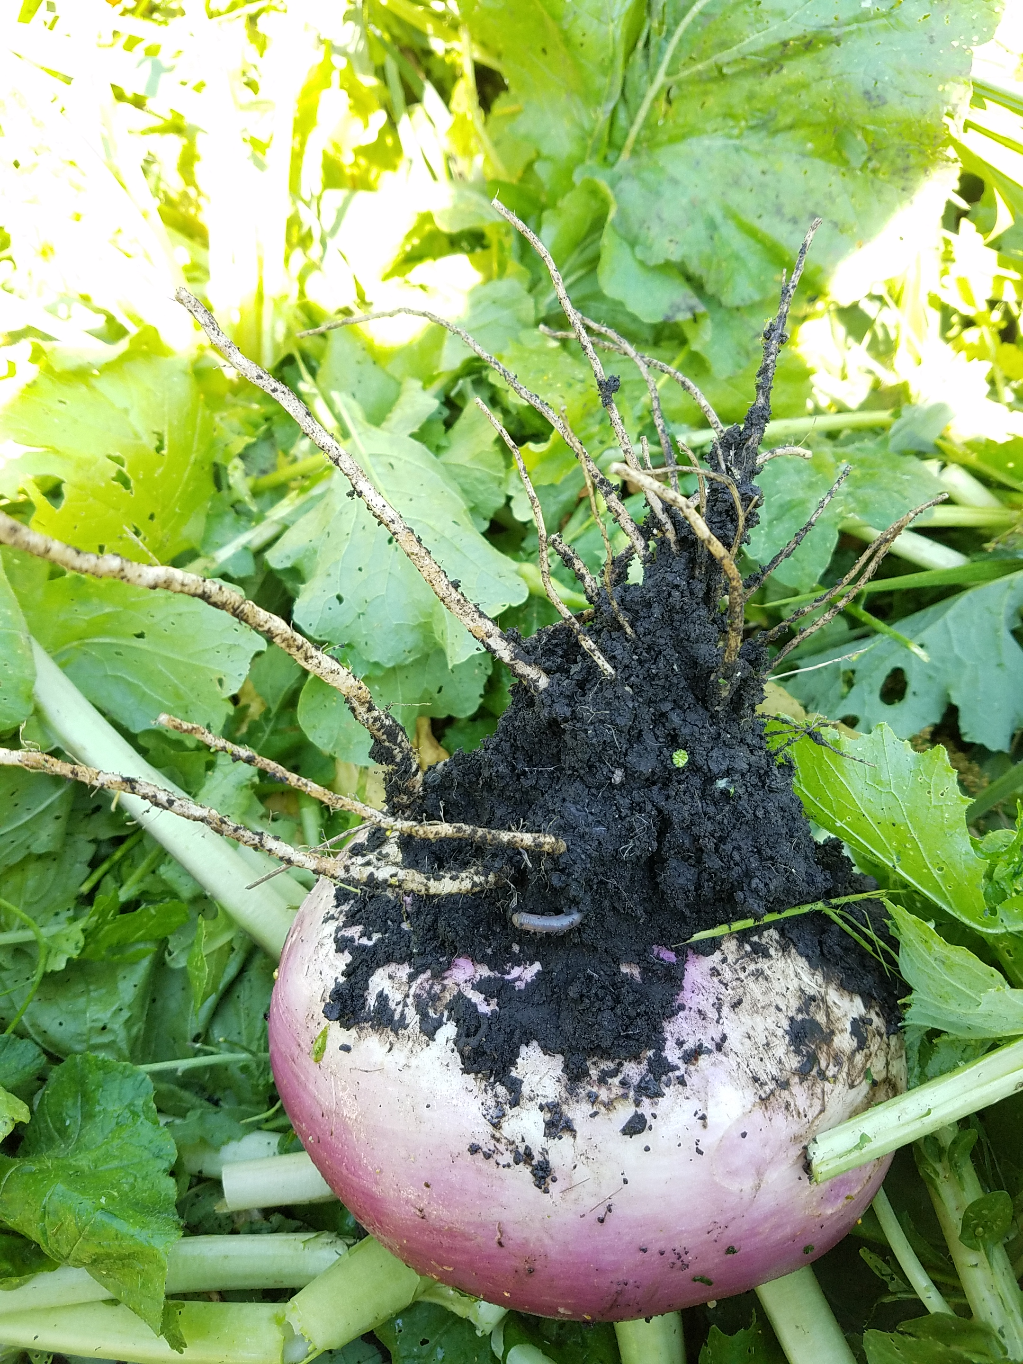
What Makes Us Unique
Farmer motivated Soil Health education
Farmer to Farmer mentorship network
Statewide Soil Health forum
Unite conservation agencies, farmers, and industry
Practical field scale Soil Health research
Education and training opportunities
Customer driven conservation
A ready group of experienced farmers to provide agencies, other producers, and organizations with technical information
Education, trouble-shooting, and logistics provided by farmers
Notes:
Holly
Additional benefits:
· Promote large scale adoption of Soil Health practices
· Leadership development opportunities
· Promotion of Best Management Practices on working lands
Customer driven conservation- the coalition will set goals and priorities based on real farmers and current customers needs and wants

Slide 8
Education & Outreach
Children’s Water Festival 2019
Water Storage Forum Soil Health & Water Storage
MOSH Stakeholder Meeting
5th Grade Field Day at Gilfillan
Women Caring for the Land – New Ulm
TUNE Camp Soil Health Youth Event
Prevent Plant Meeting – Sleepy Eye
Prevent Plant Meeting-Wabasso
Cover Crop “How To”
Family Night at the Farm
4R Technology Review Field Day
Farm Fest Cover Crop Plots
Kickoff Event
Cover Crop Logistics - teaching staff
Cover Crops for Soil Health, Forage, & the Bottom Line
LINC Education
Life in the Pits
Women Conserving the Land
Soil Health & Cover Crop Field Day
3rd Annual Liepold Farms Field Day
Soil Geomorphology and Management - youth
Annual Environmental Fair – Lake Shetek
Le Sueur River Watershed Meeting
McKnight Success Stories
Minnesota State Technical Committee Meeting
SFA Conservation Highlights
Radio spots
November 2019 Successful Farming
Soil health research with the University of MN
Board member and mentor on KEYC
Women in Ag KNUJ radio program
Website with technical information, mentor network, events, and news www.mnsoilhealth.org

Slide 9
Anna Cates, catesa@umn.edu, 612-625-3135 @MNSoil
Notes:
Initiated and funded by our state conservation agency, BWSR, and the WRC.
Mission is to
expand outreach to local government, private consultants, and private organizations.
Coordinate research
Expand networking to support the diverse and dispersed practitioners.

Slide 10
Framing Soil Health
Andrew McGuire, WSU

Slide 11
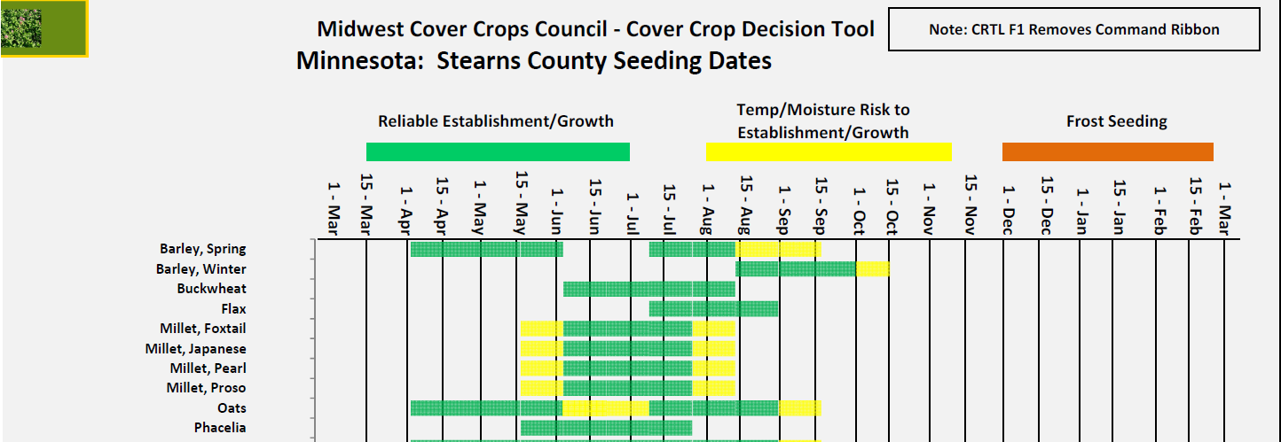
Resources: Midwest Cover Crop Council Decision Tool for MN

Slide 12
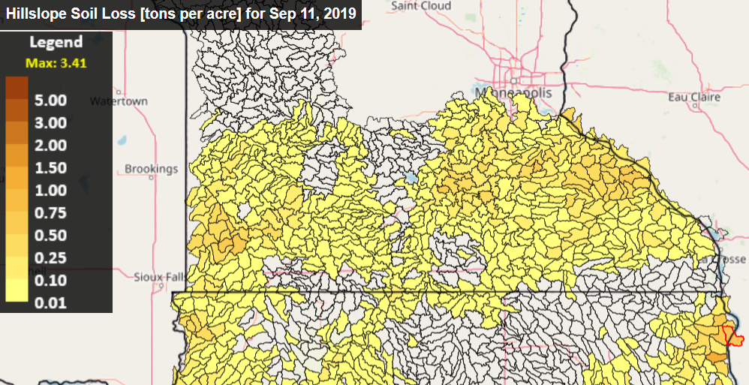
Resources: Daily Erosion Project

Slide 13
Anna Cates, catesa@umn.edu, 612-625-3135 @MNSoil
Notes:
Initiated and funded by our state conservation agency, BWSR, and the WRC.
Mission is to
expand outreach to local government, private consultants, and private organizations.
Coordinate research
Expand networking to support the diverse and dispersed practitioners.

Slide 14
Funding Opportunities through the
USDA-NIFA Sustainable Agriculture Research and Education (SARE) Program
Wayne Martin
Notes:
Beth

Slide 15
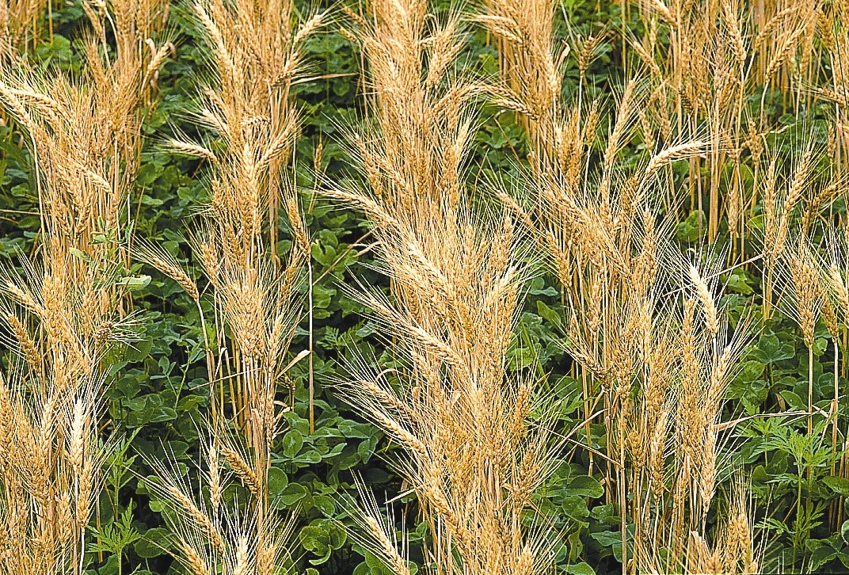
What is SARE?
Grants and outreach to advance sustainable innovations to the whole of American agriculture.
Notes:
Beth

Slide 16
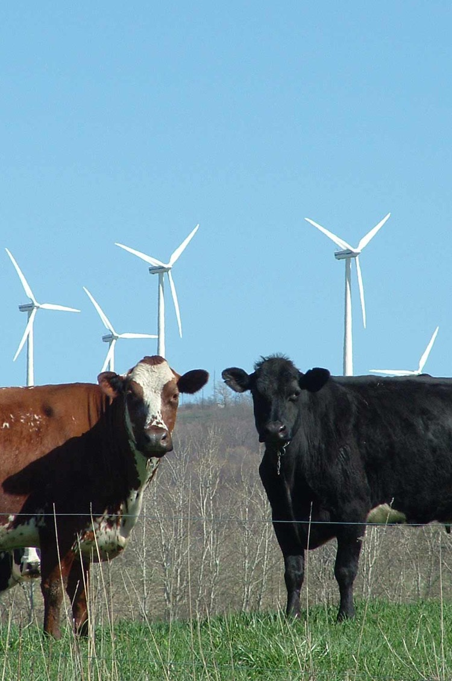
The
SARE Portfolio
Sustainable pest and weed mgmt.
Marketing and local food systems
Water quality and nutrient mgmt.
Systems research
High tunnels and season extension
Crop diversification
Cover crops and soil health
Small ruminants/poultry/cattle
Pastured livestock/grazing systems
Pollinators and biodiversity
Urban agriculture
…and much more
Photo by Troy Bishopp
Notes:
Rob

Slide 17
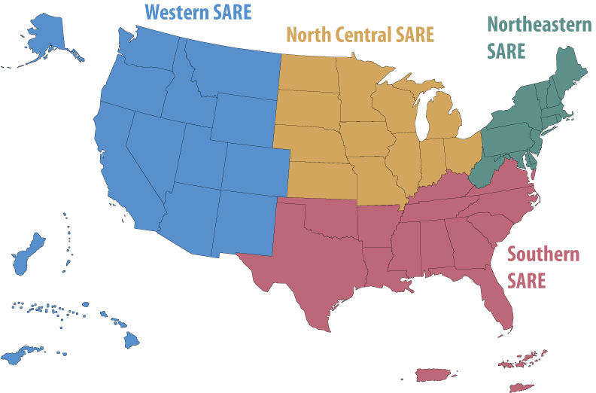
SARE
Grant Types
• Since 1988, SARE has invested in over 6,000 projects nationwide
• SARE in the North Central Region offers grants for:
Research & Education
Graduate Student
Partnership
Professional Development
Farmer/Rancher
Youth Educator
Visit www.sare.org or
www.northcentralsare.org
Photo by Carol Flaherty
Notes:
Rob

Slide 18
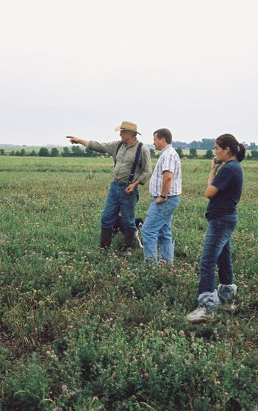
Research & Education (R & E) Program
Grants for up to $200,000 for up to 3 yrs
Can be research or education projects
Grants go primarily to organizations
Fund 14-15 grants per year
Coordinator is Beth Nelson
Photo courtesy Wayne Martin
Notes:
Beth

Slide 19
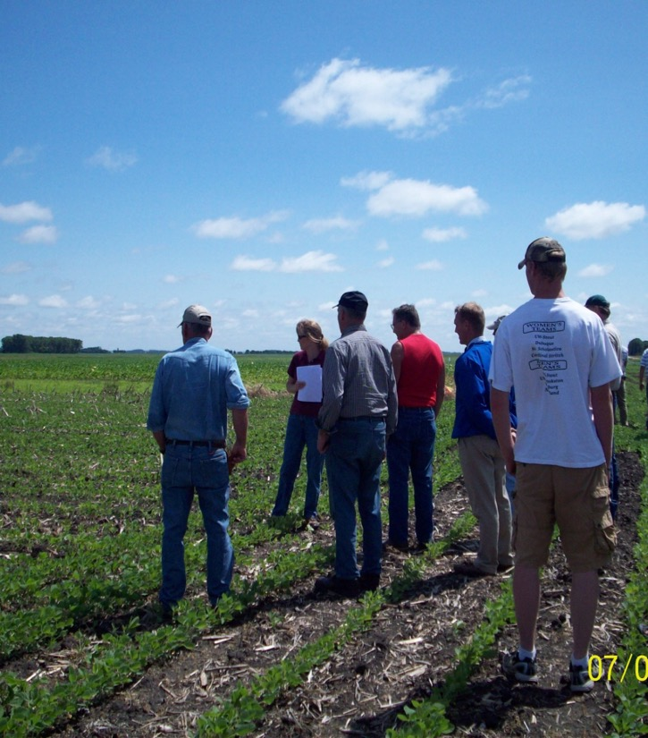
R & E Timeline
Preproposals due
Early October each year
Invited full proposals due in April
Funding decisions made in July
Funds available November
Notes:
Beth

Slide 20
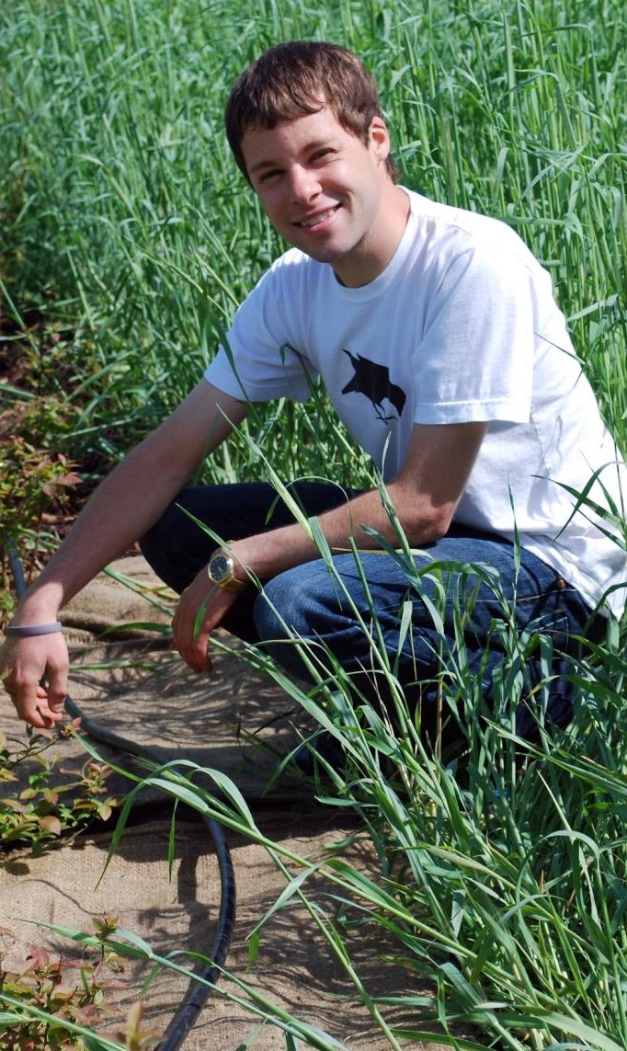
Graduate Student Grants
Grants for up to $15,000
Currently enrolled graduate students must write proposal and lead work on project
Proposals due in April, 2020
20 grants are funded per year
Funds available in Sept., 2020
Coordinator is Beth Nelson
Photo credit: Beth Stuever
Notes:
Beth

Slide 21
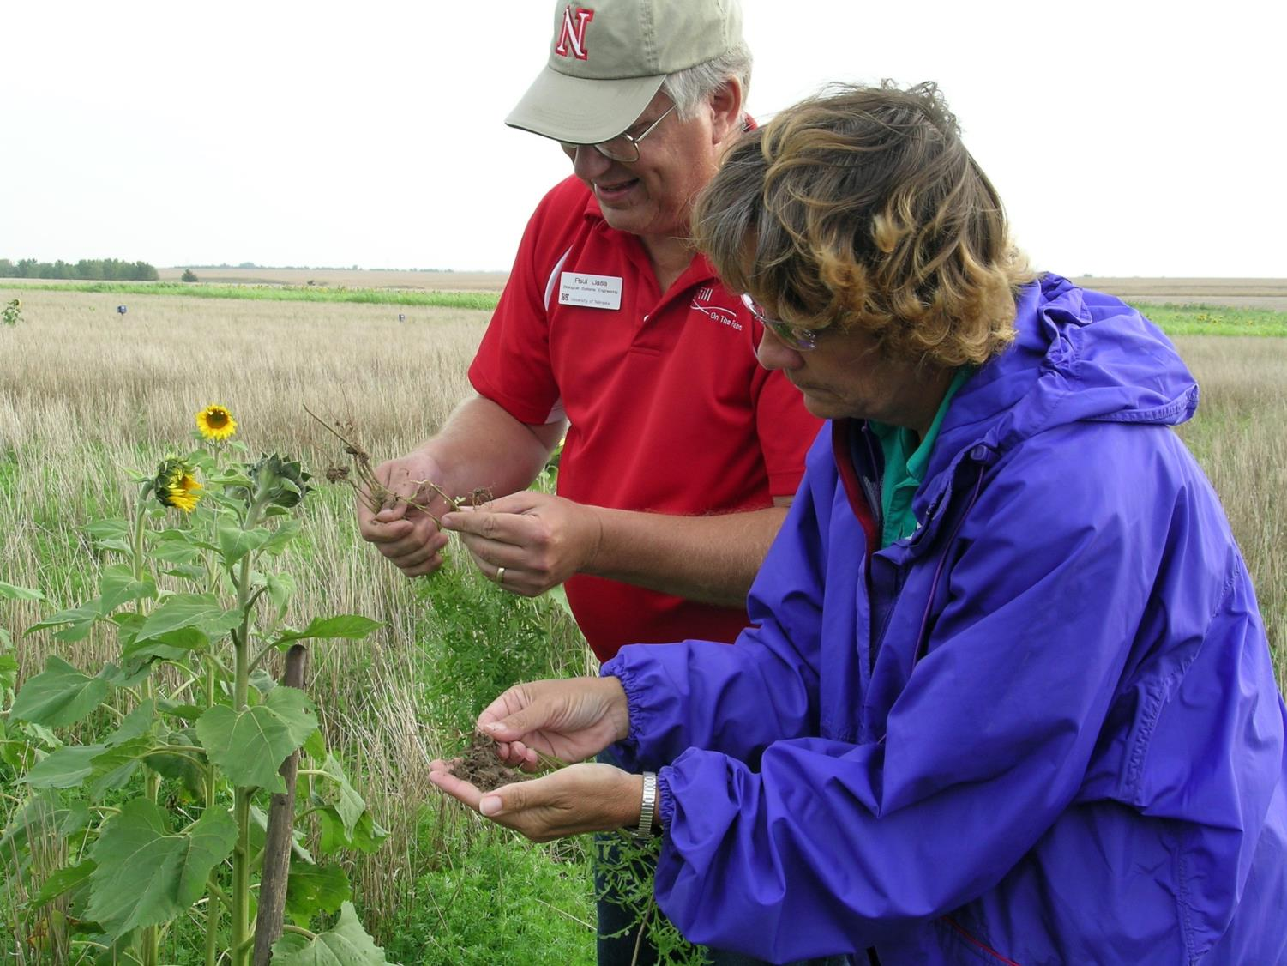
NCR-SARE Partnership Grant Program
Grants for on-farm research, demonstration, and/or educational projects for up to 24 months
Up to $40,000 per project
An Agricultural Professional is the grant applicant and principal investigator
Typically three or more farmers or ranchers involved in the project
Due late October; funds available following March
photo credit: Joan Benjamin
Notes:
Rob
Each project is to be led by an “ag professional,” such as:
Extension educators (specialist/agents)
Other university educators or researchers
Non-profit organization staff
Agency staff
Certified crop advisors
Other ag and natural resource consultants

Slide 22
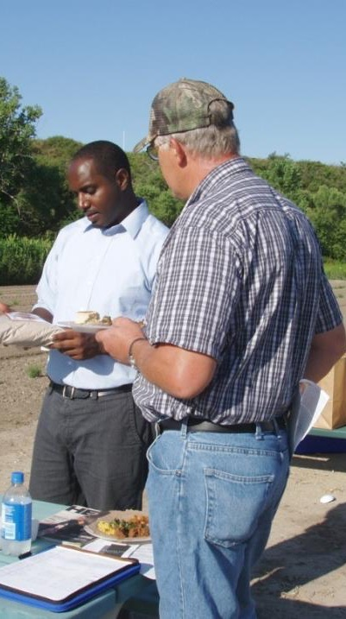
Professional Development Program
Competitive grants
Grants for ag professionals to train other ag professionals
Proposals due in early April 2020; up to $90,000 per project
Funds available in October 2020
State activities organized by State Coordinators
Minnesota SARE co-coordinators are Kate Seager and Wayne Martin both at the University of Minnesota.
Face of SARE – communicating about SARE programs
Workshops, webinars, mini-grants, travel scholarships funded by $65,000 in annual support from the SARE program
photo credit: Teresa Webb
Notes:
Rob

Slide 23
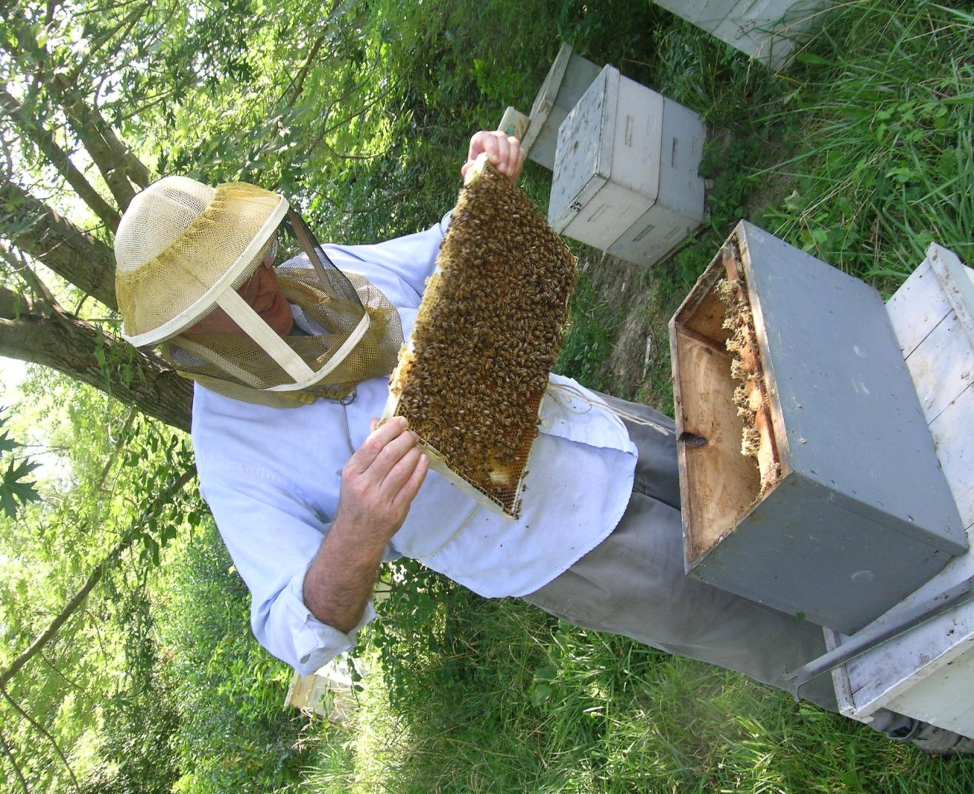
Farmer Rancher Grant Program
Directly funds farmers and ranchers who want to try innovative sustainable agriculture solutions to production, marketing, labor and other problems on their farm/ranch
Up to $9000 for individual farm, $18,000 for Team of Two, and $27,000 for Group (3 or more)
Applications due Dec. 5, 2019; Funding available in mid-April to mid-May 2020
Encouraged to link with university or non-profit partners
Outreach component required
Coordinator is Joan Benjamin
photo credit: Joan Benjamin
Notes:
Joan

Slide 24
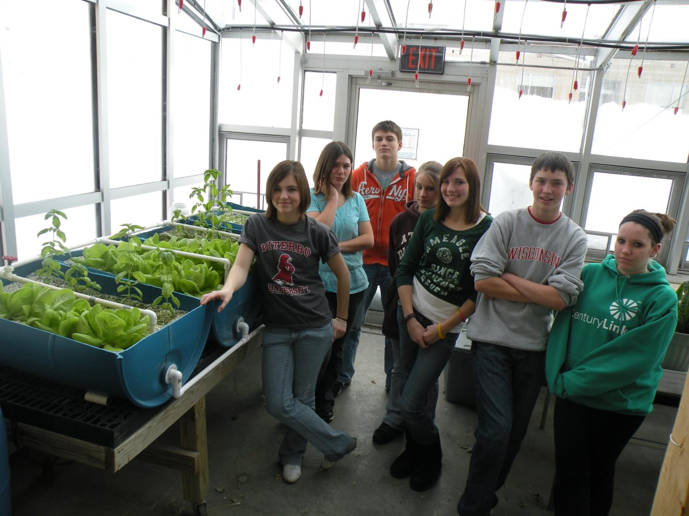
Youth Educator Program
Grants for educators to teach youth about sustainable agriculture, and to help young people and their parents see sustainable agriculture as a viable career option
Up to $4000 per project
Appropriate for vo-ag teachers and other youth educators
Applications due Nov. 14, 2019; Funding available in mid-April to mid-May 2020
10 projects funded per year
Coordinated by Joan Benjamin
photo credit: Nathan Papendorf
Notes:
Joan

Slide 25
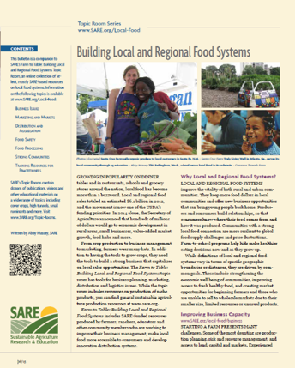
_{SARE Outreach}
a library of practical,
how-to books (in print or download for free)
media outreach
a portfolio of in-depth reports on current topics
Topic rooms for multimedia information
countless online resources, including project reports
Notes:
Joan

Slide 26
“Professional Development Program for Silvopasture Adoption” SFA’s New SARE-PDP Grant
Project Overview
How it links with other Silvopasture projects
Opportunities for training for agricultural service providers

Slide 27
Upcoming SFA Events on Silvopasture
SFA’s Annual Conference: Breakout session to introduce Silvopasture Work
Saturday February 8 at College of St. Benedict, St. Joseph
Midwest Soil Health Summit: Separate Track on Silvopasture
Thursday March 5 at the Oliver Kelly Farm, Elk River

