Slide 1
Clark State College
Ag Advisory Committee

Slide 2
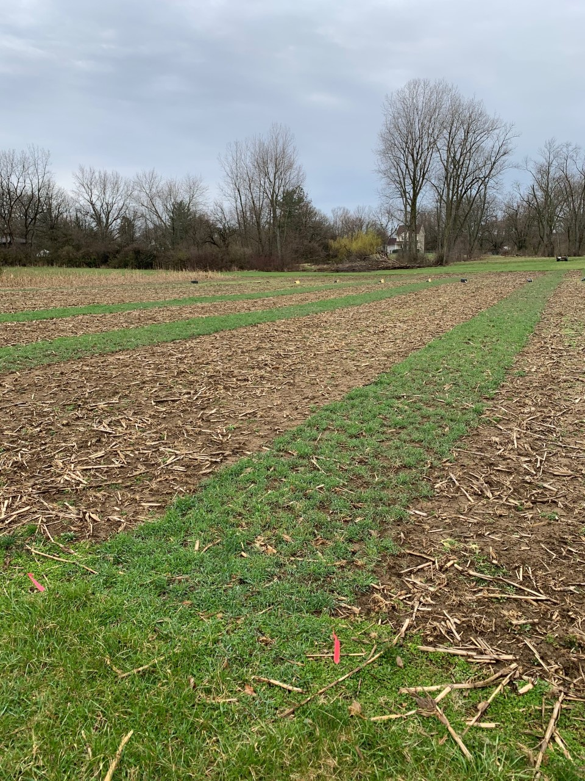
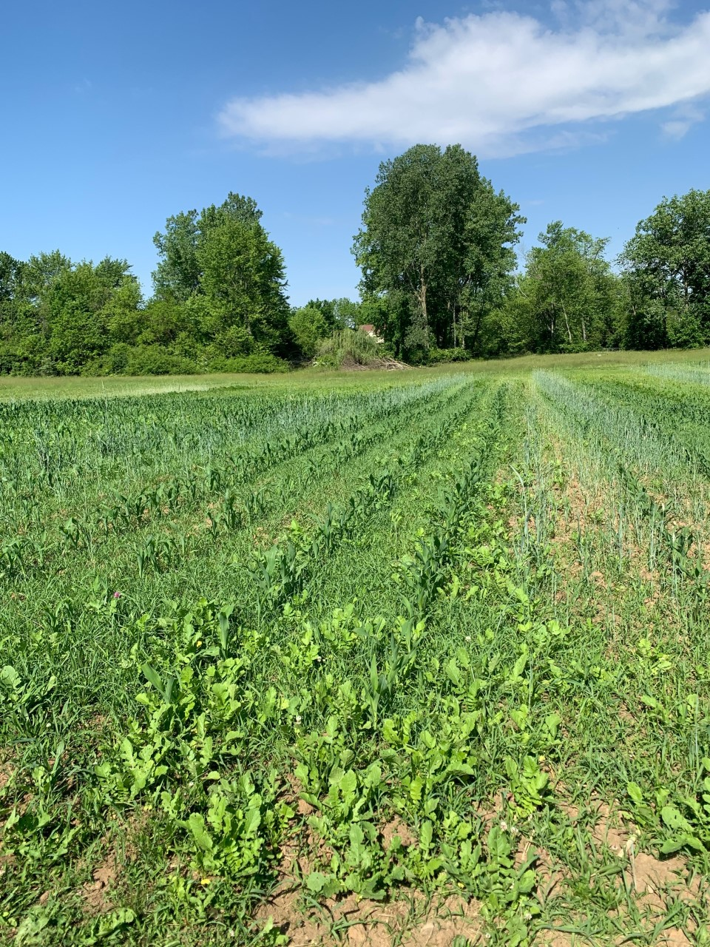
SARE Update
April 4
May 31
Rye
Notes:
White clover, radishes and rye were planted as cover crops again in early October last autumn. It appeared in April that only the rye survived, which did in fact help with weed suppression for a time. Then in May some of the radishes came up and were more a weed than anything else. This year we will plant a mixture of all three as the dump row where the planter is emptied shows promise. No differences in yield or other soil measures were noted.

Slide 3
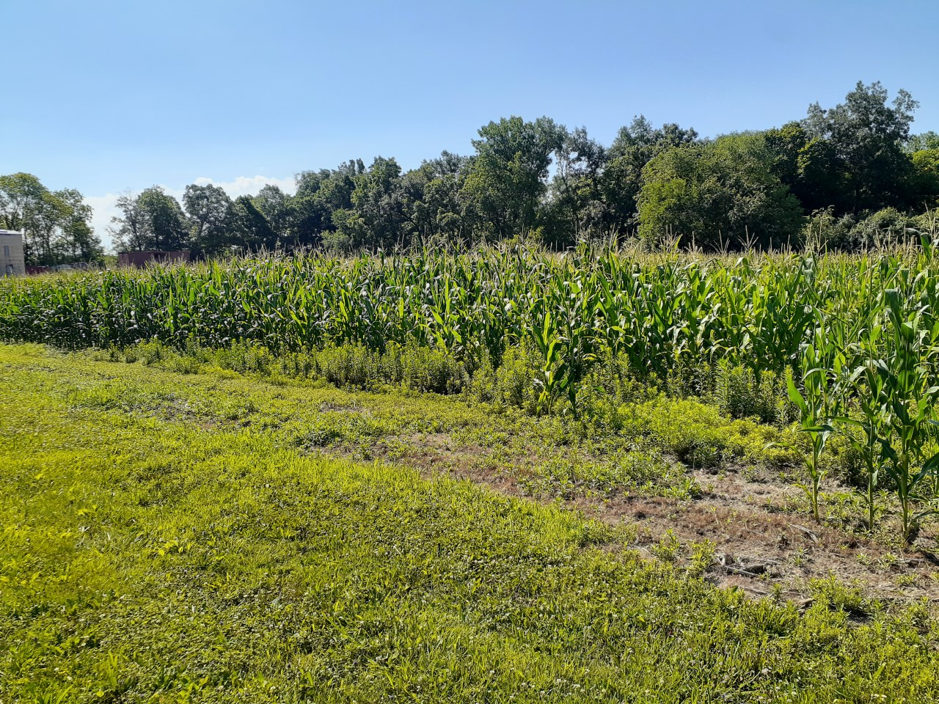
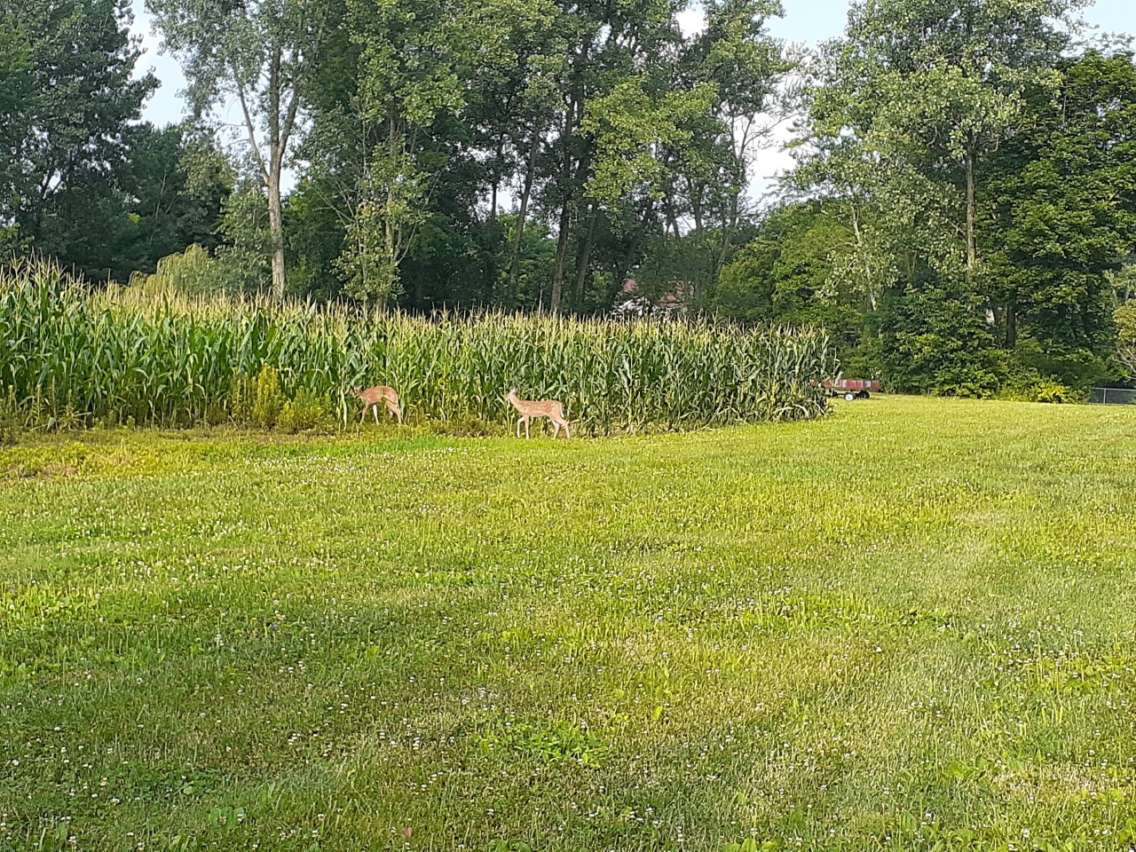
SARE Update
Notes:
Last fall we had a decent yield. We were very fortunate that we were able to plant at the end of April as it was a rough spring with rain and I believe around the end of April/start of May nationally, only about 15% of corn was planted. We were hoping for the same yield this year, but in addition to deer we now have an infestation of glyphosate-resistant marestail. The yield was poor and we had plenty of vomitoxin. This grant is coming to an end next week.

Slide 4
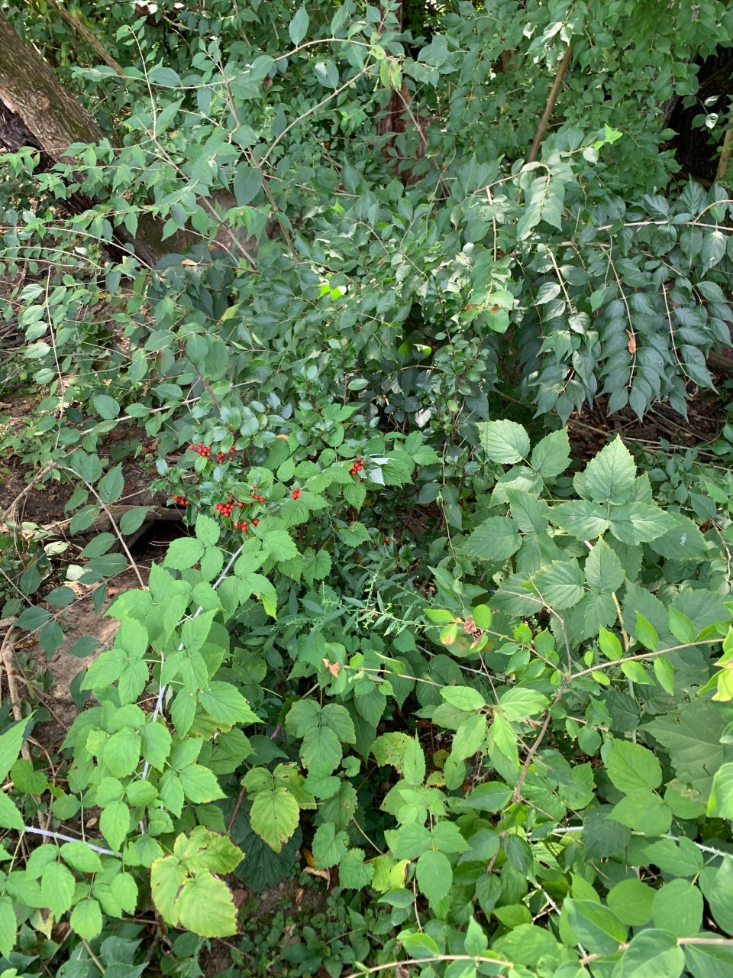
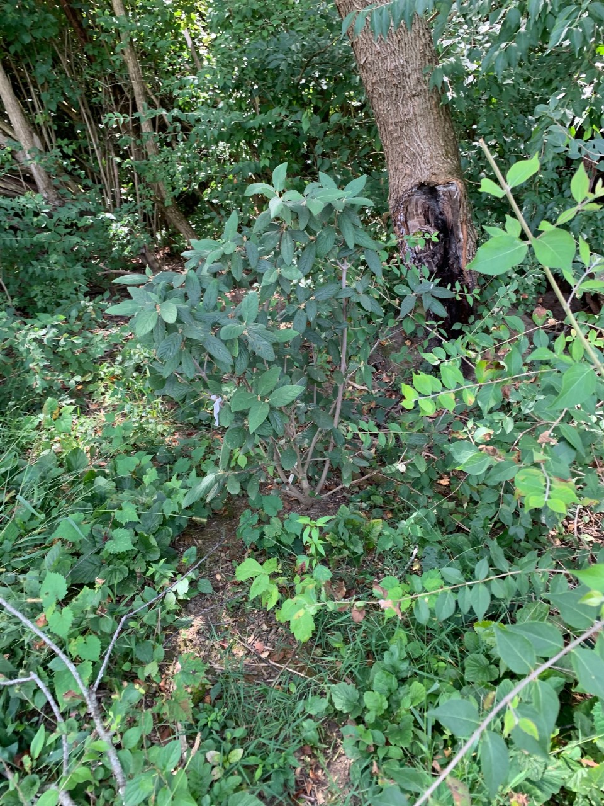
NRCS Update – Honeysuckle
Holly
Allegheny
Viburnum
Notes:
We have been planting various woody plant to compete with honeysuckle that we cut back. One of the plants utilized was holly and it is still there, but it is surrounded by honeysuckle. The rhododendrons have died. Unfortunately the euonymus was hit by a mower. There is some hope though. The Allegheny viburnums seem to be doing well at present.

Slide 5
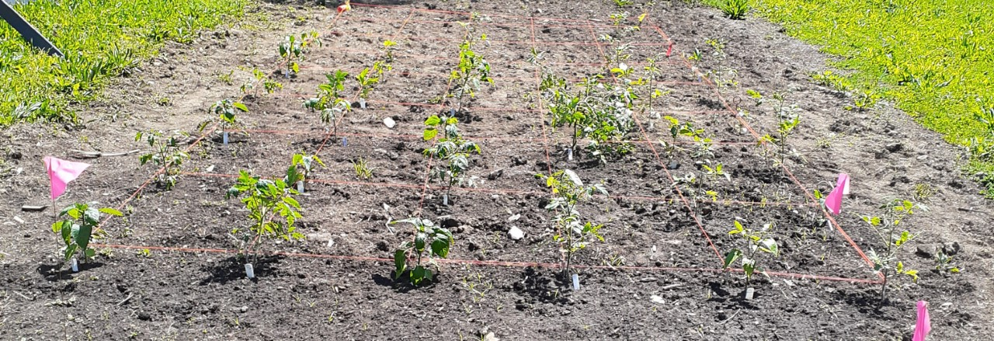
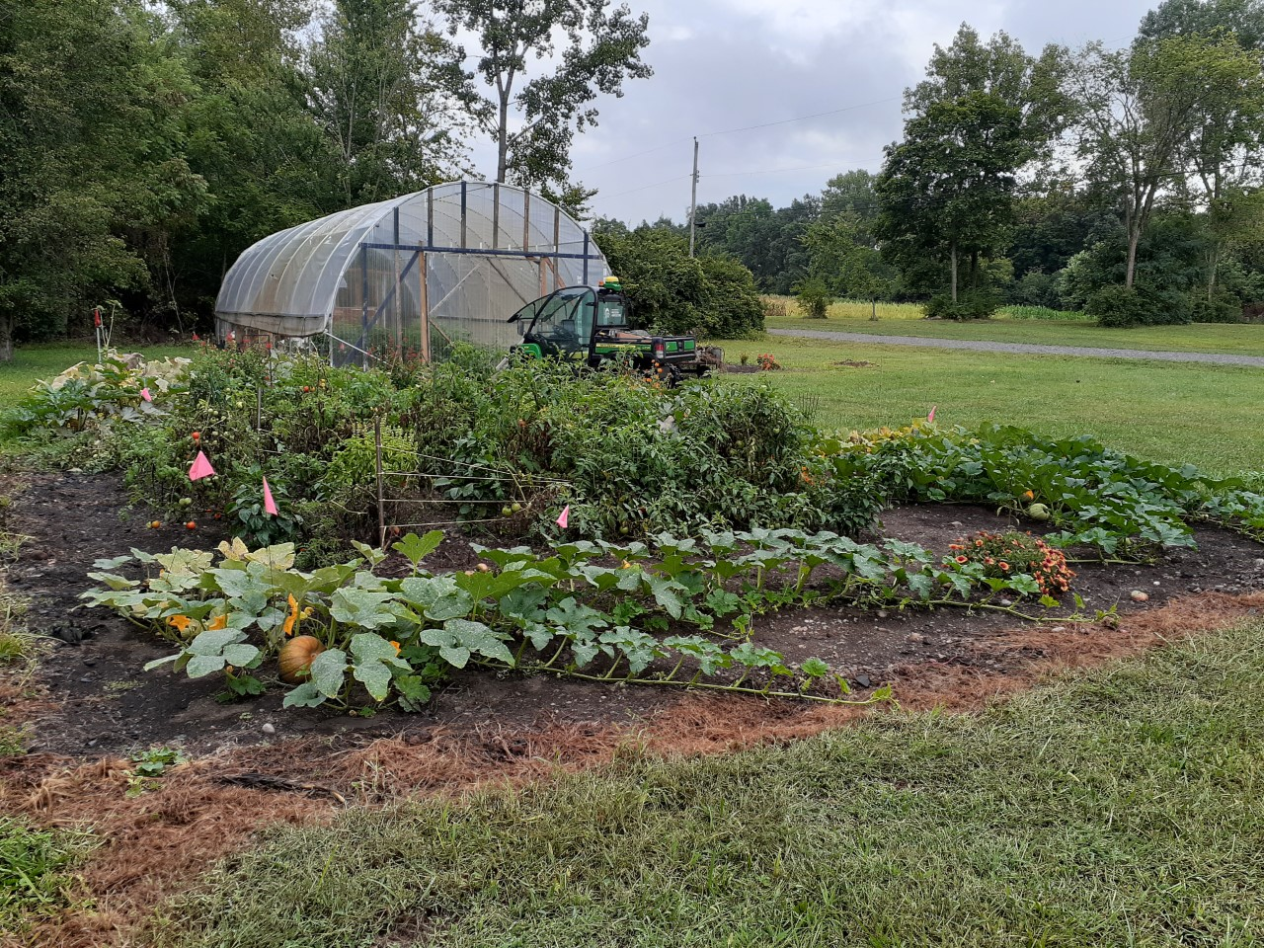
NRCS Update – High Tunnel Gardens
Notes:
The high tunnel gardens were planted in mid May and for the most part did quite well. Again, mulching seems to really help. However, one of the un-mulched beds seemed to produce the most tomatoes and I attribute that to it being the bed that receives the most sunlight. I can also say that whatever vertebrate that preys on my vegetables seems to prefer beans. I have failed to get more than a handful of beans for two years now. Cucumbers were a favorite as well.

Slide 6
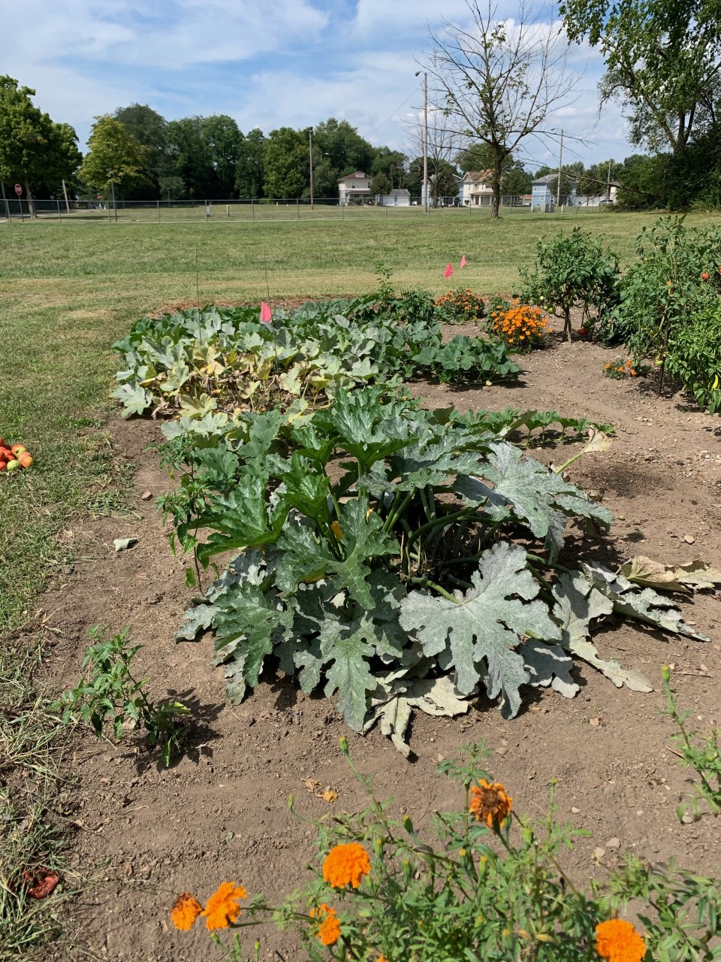
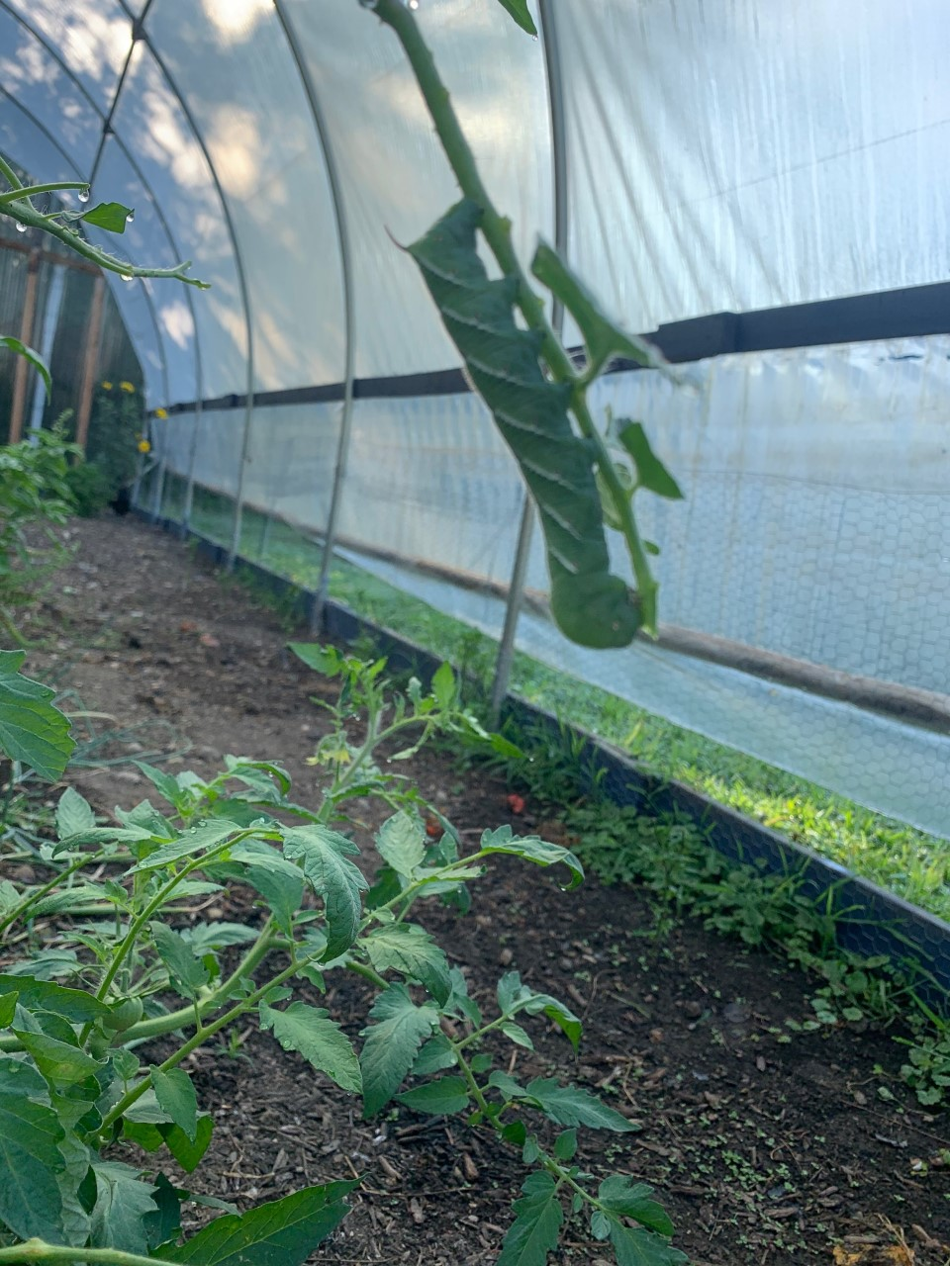
NRCS Update – High Tunnel Gardens
Notes:
In addition to vertebrate pests there were a few other issues. The cucurbits had quite a bit of powdery mildew towards the end of summer and there were some tomato hornworms.

Slide 7
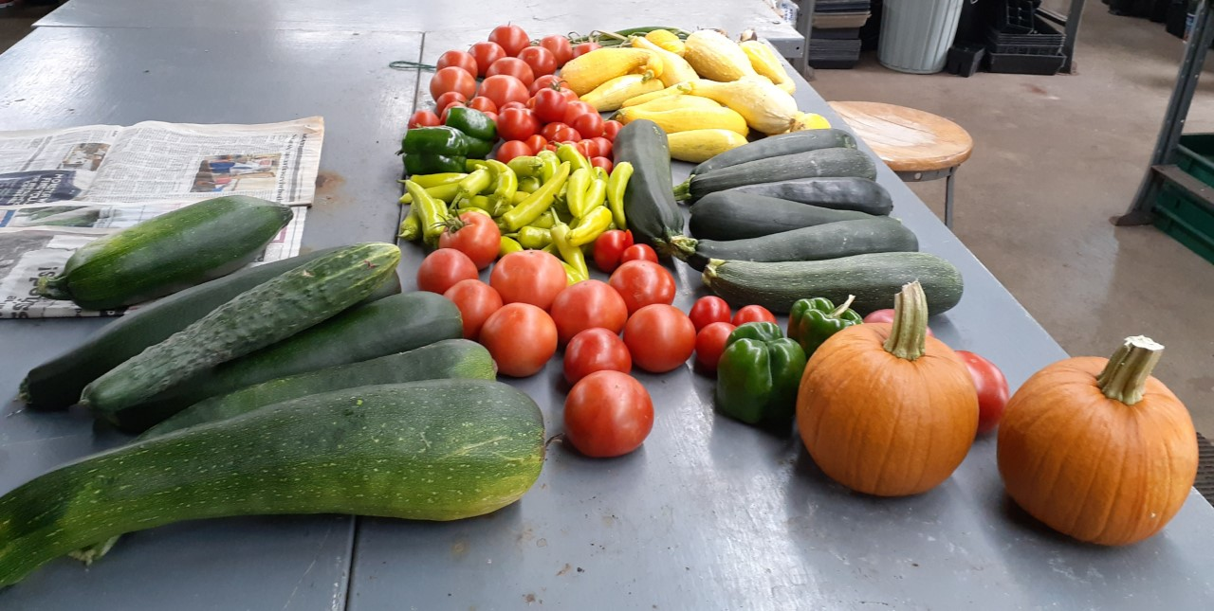
NRCS Update – High Tunnel Gardens
Notes:
We had a pretty good harvest. Pictured here is small. We estimate that we harvested about 20 pounds a day once things got going. Things are winding down now as we have begun pulling plants that don’t look so great and we have a planted a few cold season vegetables such as broccoli. As of the time this powerpoint was created, the tomatoes in the high tunnel are still going. I would like to mention that in working with NRCS and to an extent SARE, both groups give me the impression that they have very strong interest in soil health. Traditionally this means a resilient soil that has a diverse ecosystem and is able to sustain plant growth with little to no inputs. I personally concur, that soil biology and managing that is the next frontier in soil science. I also foresee potential regulations in this regard being a thing.

Slide 8
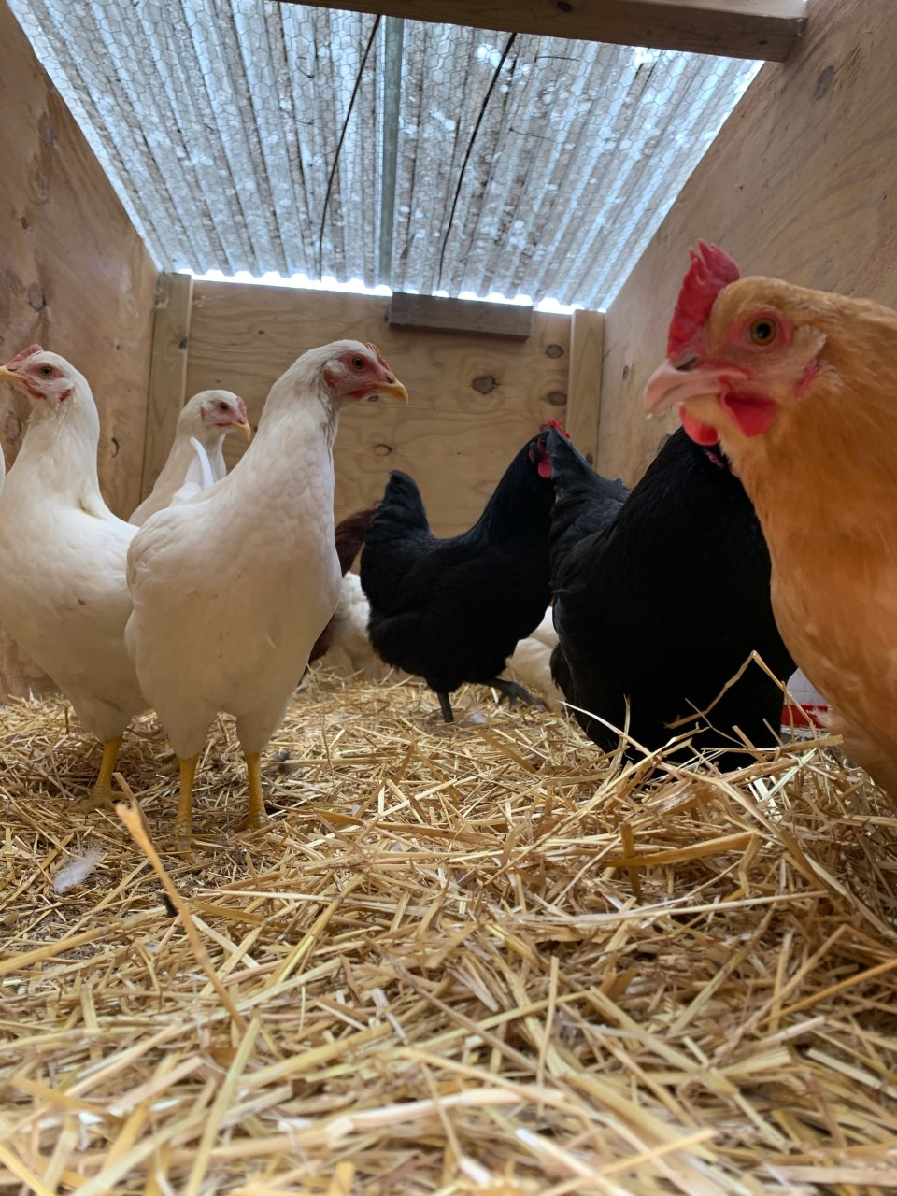
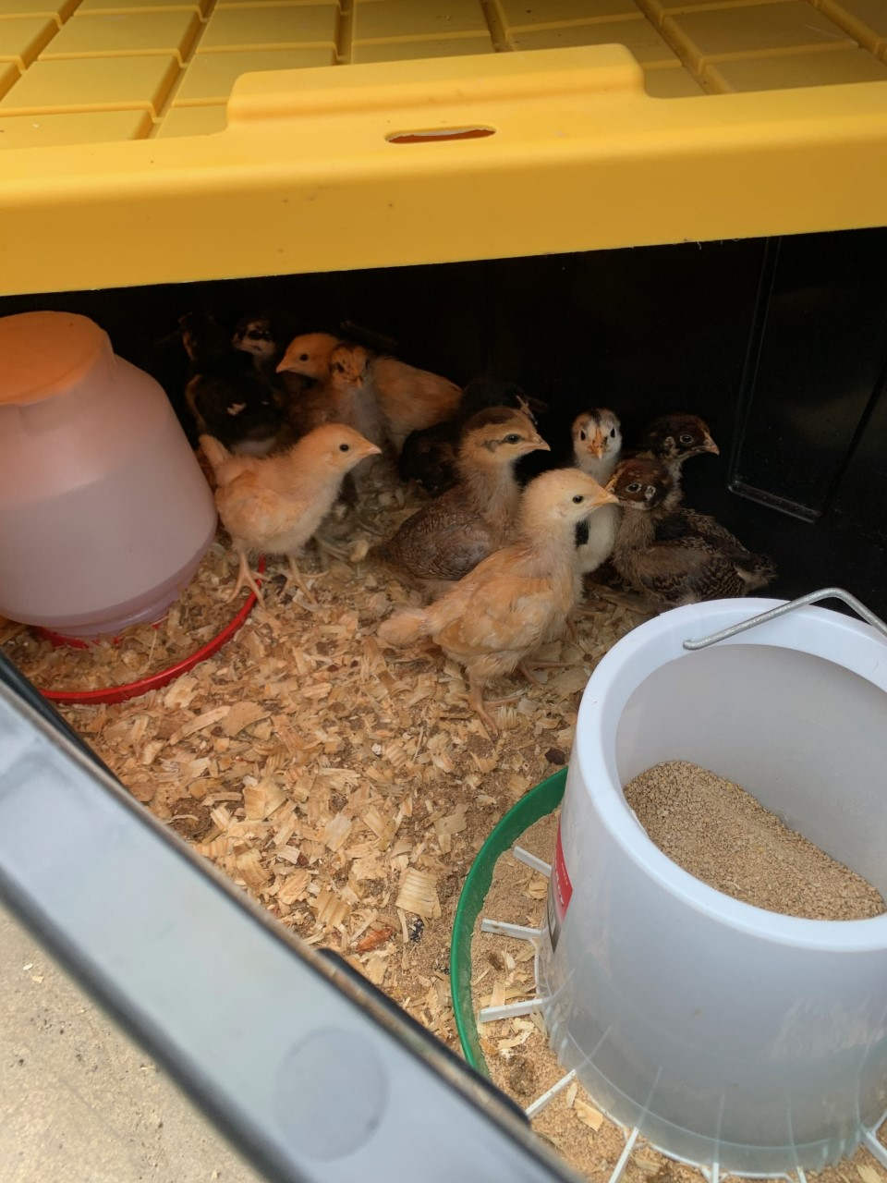
Clark State Ag Program Updates
Notes:
This past spring we acquired chickens for two reasons: we do offer a course on animal agriculture and I have noticed a trend in urban farms adding chickens to their gardens. Urban agriculture being an area of interest to the NRCS.

Slide 9
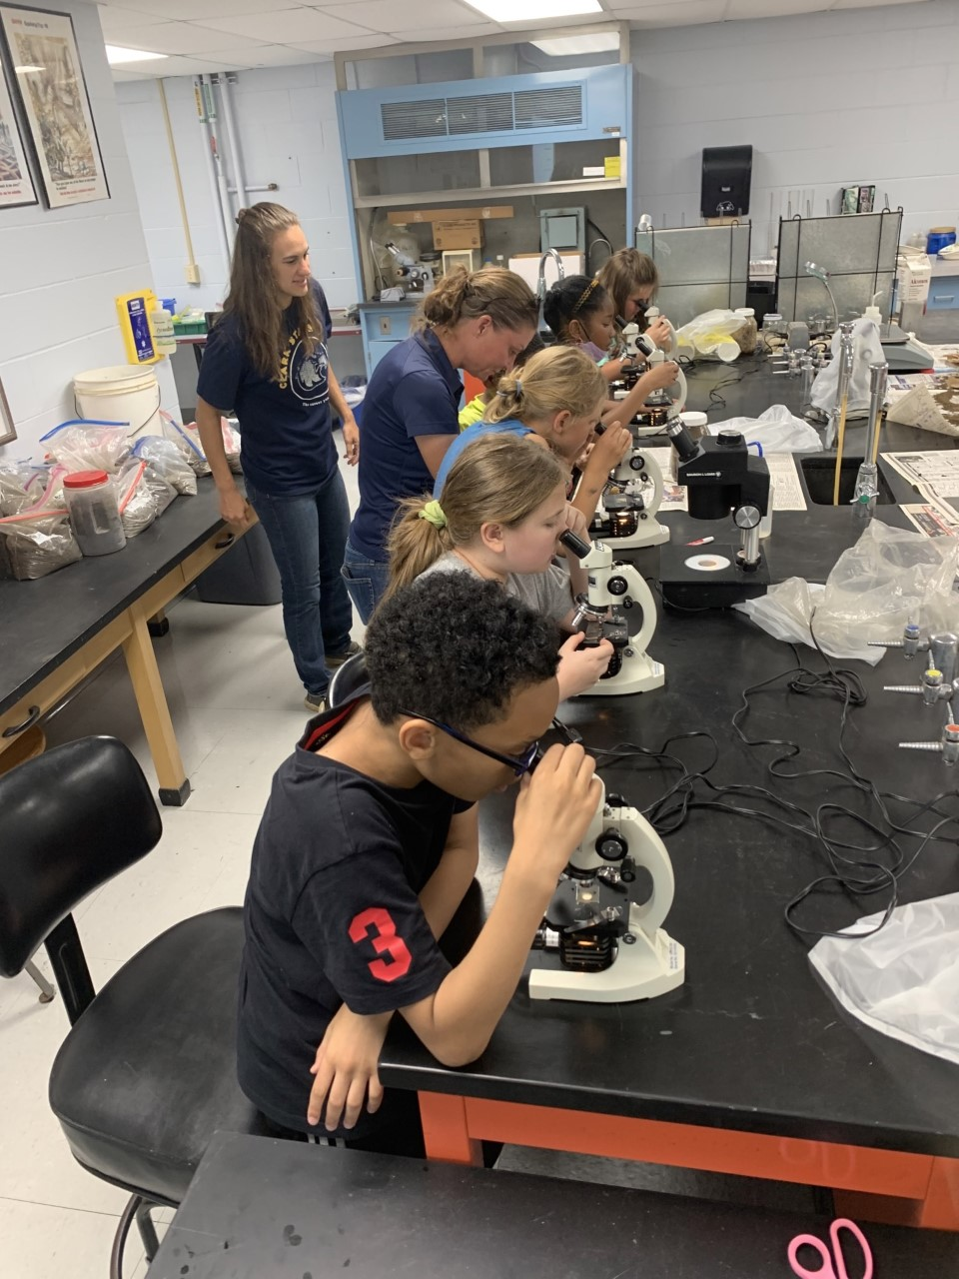
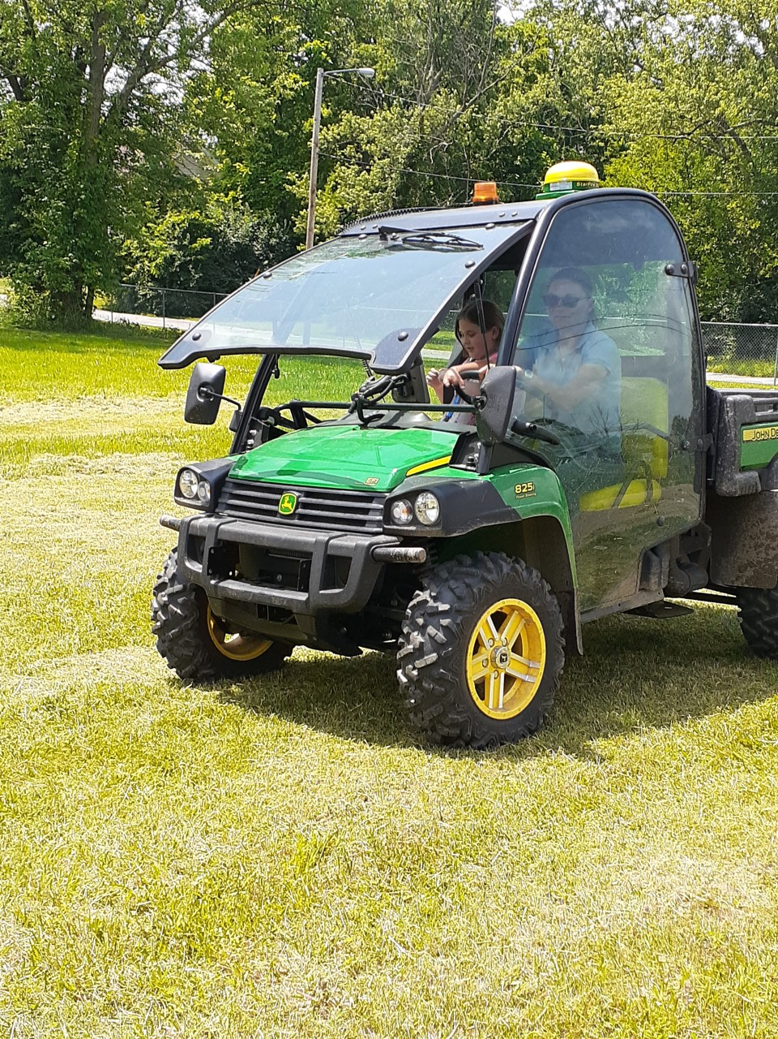
College for Kids
Notes:
Our program hosted a short summer camp called College for Kids. Hopefully we piqued the interest of a few of them. Based on this experience would like to develop a workshop on agriculture for young students where we go and visit them at local schools. So, that is something we will be working on this year and hopefully, are able to launch next year. I reached out to our state NRCS as we feel the conservation piece is also quite important and they are willing to work with us on this. A couple of questions that I have for you are 1) what grade/age should we target and 2) is there any information or the like that you feel would be important for us to include in this workshop?

Slide 10
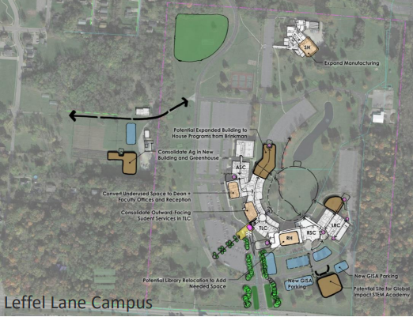
Clark State Master Planning
Notes:
The college hired a consultant to assess our space and how to best utilize it. One of their recommendations, which is in the red circle and difficult to see, is they proposed a new ag building and greenhouse. The college is not beholden to these recommendations, but there is recognition that new space would be good for the program and plans are being discussed about where to house us and what that might look like. So, nothing concrete yet, but we are glad that, that conversation is happening.

Slide 11
Questions/Feedback
Are there skills new employees are lacking that we could address?
Have you had issues attracting and retaining employees? If so, have you
found any effective tactics to attract and retain?
We have discussed altering the format of these meetings to be more like
a “field day.” Thoughts? Good idea? Bad idea?

