Slide 1
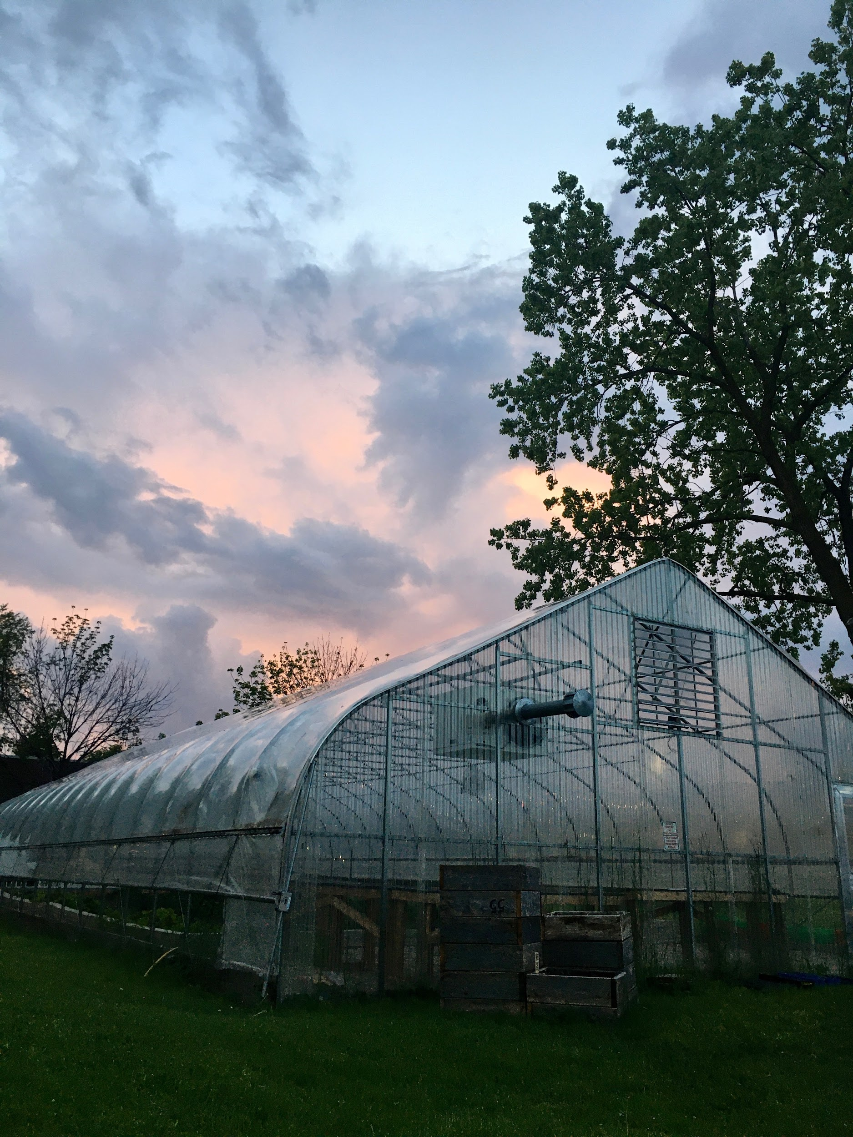
Composting, Remediation on a Small Scale
with Growing Solutions Farm
(Winter 2021)

Slide 2
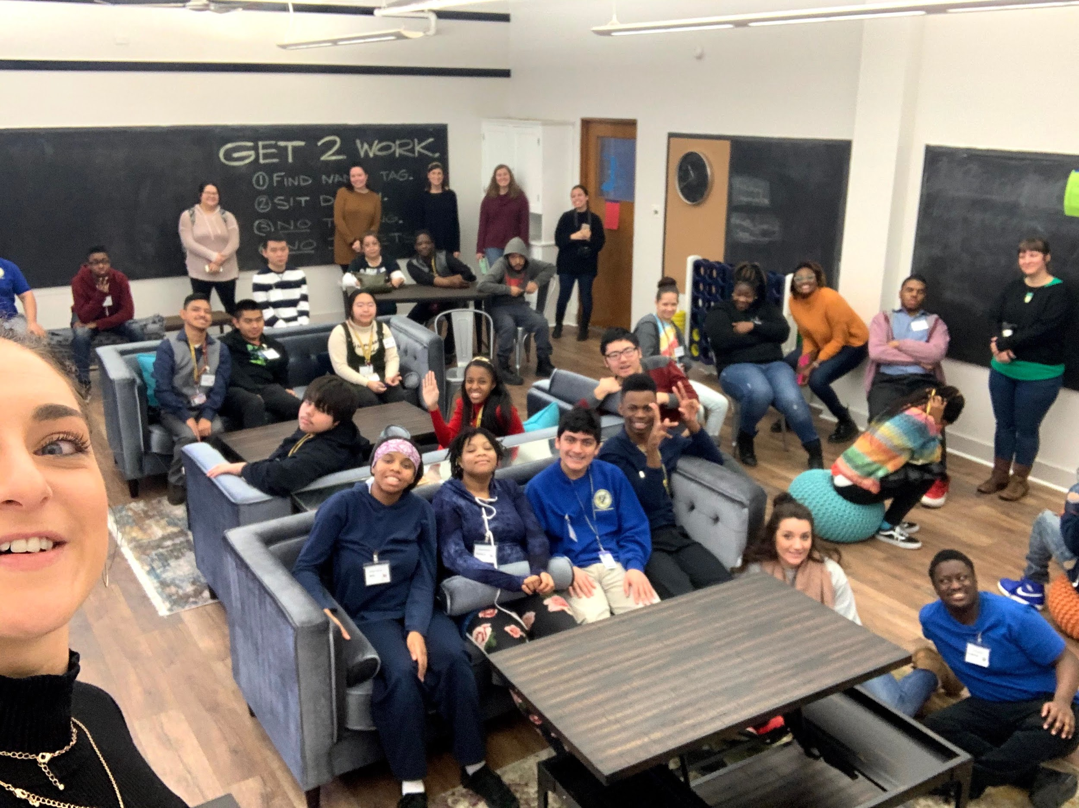
Urban Autism Solutions (UAS)
UAS is a non-profit composed of a residential treatment facility, and a number services for residents, CPS students, and members of the public.
We primarily work with young adults (16-30) with autism, but our coverage extends to those with other cognitive and physical disabilities.
We provide social-emotional, communication, and vocational services.

Slide 3
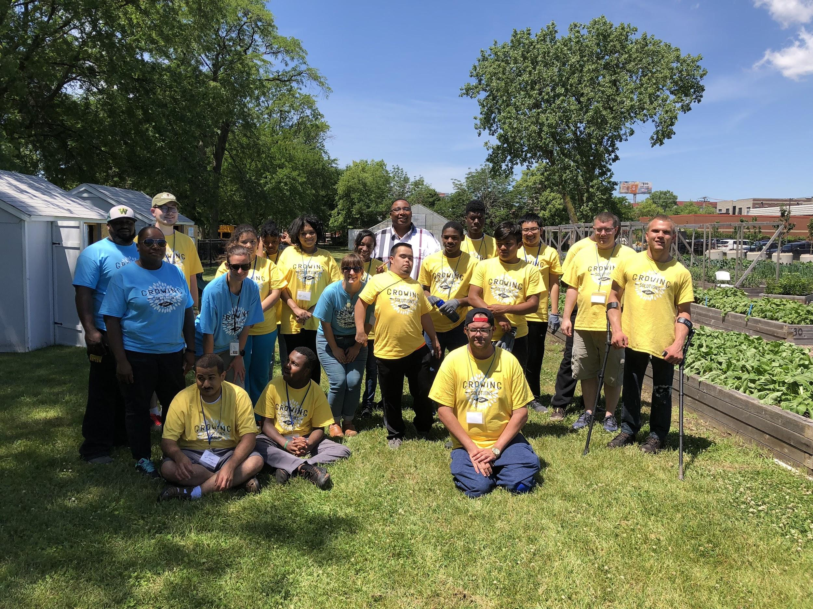
Growing Solutions Farm (GSF)
GSF has been in operation for five full growing seasons.
We primarily provide vocational training--skill building, professionalism, etc..
Our participants often find placement in landscaping, grocery stores, restaurants, hardware stores, sanitation, and more.
We are a traditional urban vegetable/fruit farm that incorporates the values of organic farming, sustainable farming, and permaculture where applicable.

Slide 4
Section One: Chicago
Contamination, Waste Management, and Soil Remediation

Slide 5
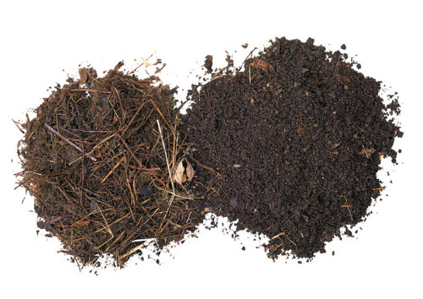
Chicago and Soil Contamination
Farmers and gardeners should assume that the existing soil within the city is contaminated with chemical, organic, or physical contaminants from industry and residential building or demolition.
Ex. Bubbly Creek and the Stockyards; gentrification in central Chicago neighborhoods; Hilco in Little Village.
When we do any building at Growing Solutions Farm, we inevitably hit glass, asphalt, sandstone, and brick. Formerly, our plot was home to single family residences, and they were demolished by knocking them into their basements.
For this reason and others, it is smart to build beds above ground, and to create or bring in your own soil.
At GSF, we raise our beds used for food production, and use a geotextile, one-way fabric at the bottom that allows water to drain out, and does not let groundwater back in.

Slide 6
Chicago and Waste Management
There are no municipal services en masse for organic waste management within the city. The closest would be Christmas tree pick-up, which require you to deliver it to a site where it is mulched.
Moreover only 8% of non-organic waste is recycled, the lowest of any major American city. Streets and Sanitation is currently doing a study on the subject of the city’s recycling record.
San Francisco, a national and global standard for waste management on the municipal level, diverts 80% of its waste to either recycling or organic waste management.
The tallest point in Illinois is called Charles Mound, a disused landfill located in northwest IL.
Without both recycling and organic waste management, we are not managing a critical part of our food system, or consumption.

Slide 7
STOP
What are two ways that we can mitigate contaminated soil?
You name examples in your own experience of environmental issues that have affected your life?

Slide 8
Section Two: Composting
Processes on a small scale

Slide 9
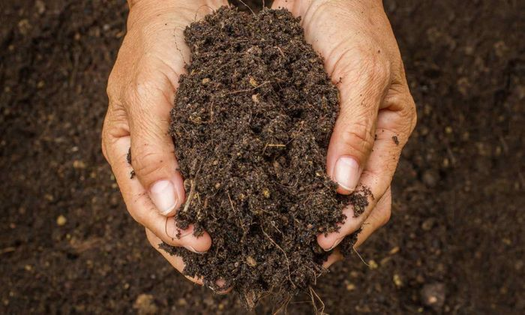
Creation and Remediation
Composting is waste management.
If you choose not to purchase soil, you can make it by composting (media).
Alternatively, if you have safe soil already, but the quality is low, you can remediate soil with compost you create (fertilizer).
Media creation and remediation are essential tenets of sustainable agriculture, and should be observed as ecologically responsible processes.

Slide 10
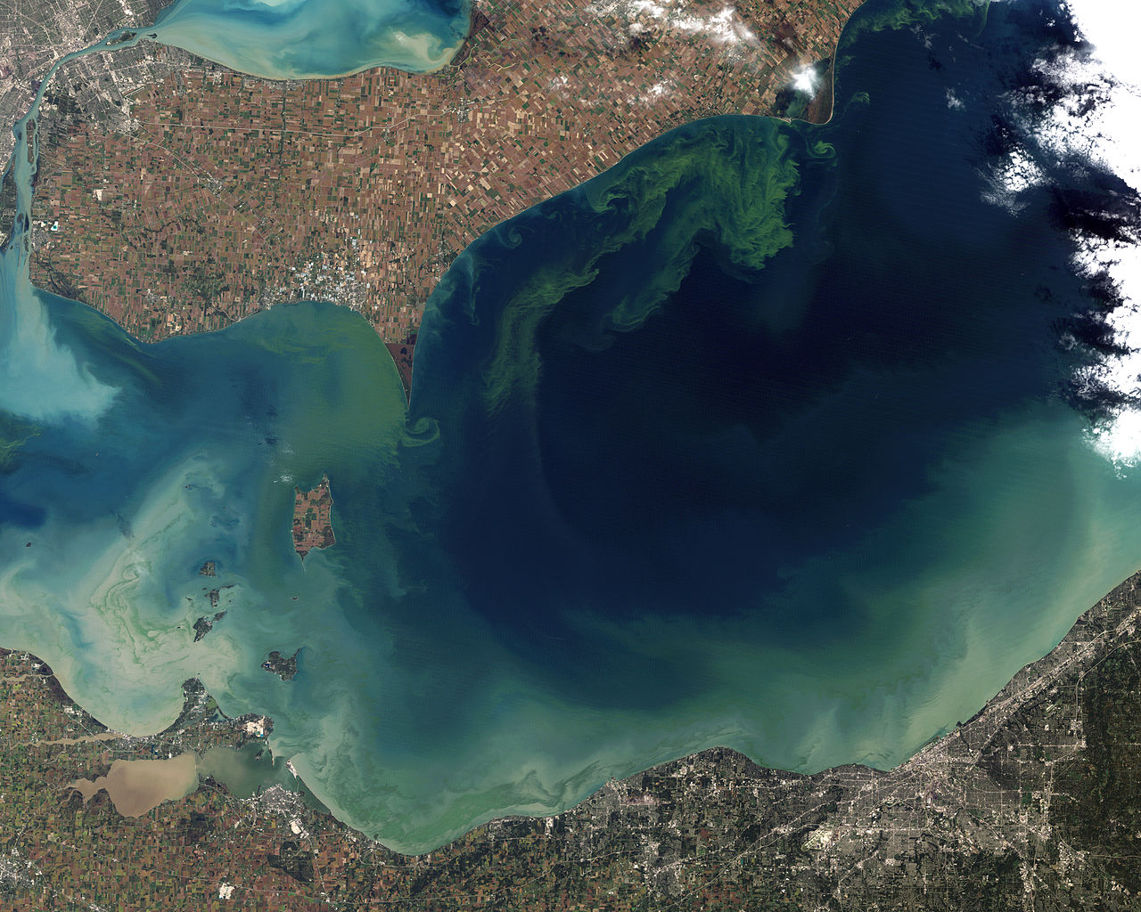
Overuse of Nitrogen-based Fertilizers
Unchecked use of fertilizer, whether organic or synthetic, causes algal blooms--rapid growth of nitrogen-loving bacteria in waterways and bodies that can destroy ecosystems.
This is one of many acts of ecological degradation directly caused by large scale agriculture.
Like waste management, this is a macro issue that can be addressed, though the onus should be on the largest culprits--industry and government.

Slide 11
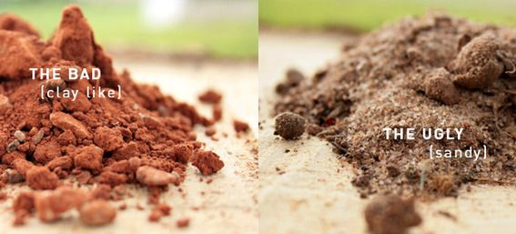
Remediation: Diagnosis
Ideal soil is the color and close to the consistency of coffee grounds.
Color: the color is due to quality bioavailable nutrients (humus).
Conditioning (texture): soil should not severely compact, impeding air flow and root growth.
Retention: Soil should retain some water. When soaked, you should be able to ball it.
Life: You need to have bugs, worms, some fungus and more in your soil. This is a sign that it is healthy.

Slide 12
Remediation: Diagnosis
At Home:
Are your plants growing to full size, on schedule, and visibly healthy?
Evaluate the color, texture, and water retention of your soil. Sandy and clay rich soils are not ideal.
Remember the coffee grounds analog.
Applying non-compost fertilizer, while helpful, is not a long-term solution. More important than applying fertilizer is fixing your soil.
In a Lab:
Companies, governmental organizations, and universities perform soil tests.
This is a lab test that provides the chemical composition of your sample, and provides a prescription.
GSF sends an annual sample to UI Extension, which is also an excellent source of information on all of your agriculture questions.

Slide 13
Composting: Process
 | Classic | Vermiculture | Anaerobic
Engine | Microbes | Worms and microbes | Microbes
Flipping | Often | Superficially (some sifting) | Rare
Internal Temperature | 135°F-160°F | 55°F-85°F | N/A
Air | Always | Always | Little
Smell | Little | Little | Malodorous
Recommended | Yes | Yes | No
Safe | Often | Often | Requires testing
Compost can be made a number of ways, but only the aerobic process can be considered compost by definition.
Composting uses microbes to complete the process in air.
Vermiculture uses worms and microbes to complete the process in air.
Anaerobic decomposition uses microbes with minimal air.

Slide 14
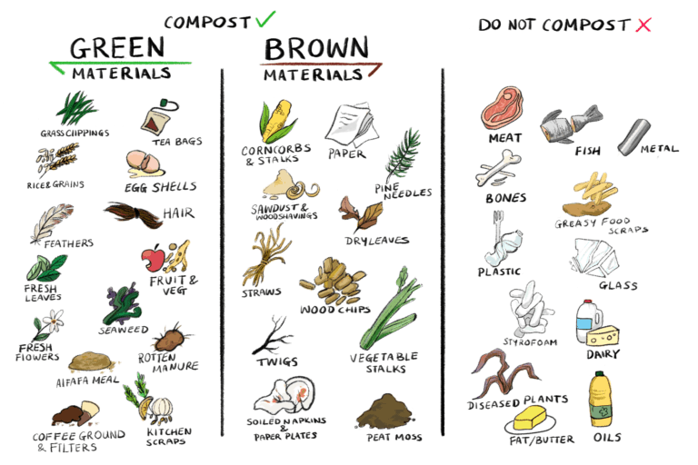
Composting: Process
For folks at home, and small-scale farmers, both classic compost and vermiculture are viable.
Do not compost materials listed here (far right) when small-scale composting.
When using vermiculture, be mindful of noxious, acidic, cooked, and compostable non-food items.

Slide 15
STOP
What are two ways that we can mitigate contaminated soil?
You name examples in your own experience of environmental issues that have affected your life?

Slide 16
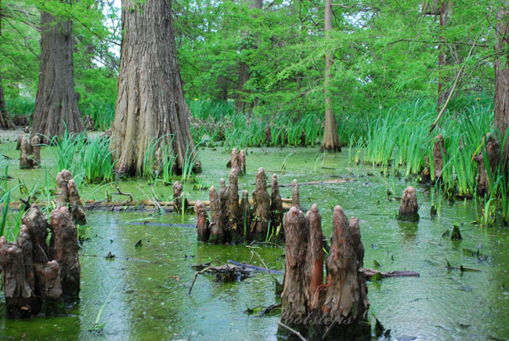
Decomposition: The Anaerobic Process
Anaerobic is a reliable method of decomposition, though it is not suggested for our purposes.
The closest analog in nature is a swamp. The process is often called putrefaction.
It requires at least a year of both anaerobic, aerobic processing and curing to ensure there are no pathogens present.
When produced, it is often covered, rarely turned, and takes over a year to produce.
Lastly, CH4 (methane) is the primary byproduct, which is smelly and harsh on the environment.

Slide 17
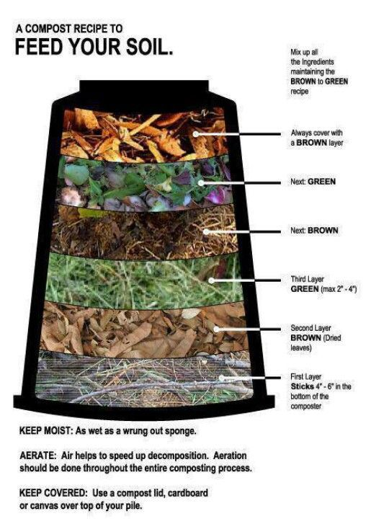
Composting: the Aerobic Process
Compost composition varies widely, but a 30:1 browns to green ratio is suggested by the USDA.
Greens are nitrogen-rich and primarily feed microbes.
Browns are carbon-rich and partially feed microbes. Browns also help condition compost for proper airflow, and limit smell.
An improper mixture, will smell, have poor aeration, leak, and will likely run acidic or alkaline.
Properly managed compost has a pH of between 6 and 8 (neutral).

Slide 18
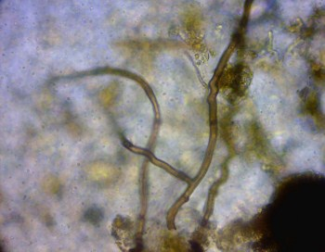
Composting: The Aerobic Process
Use the TAT (turn according to temperature) method when producing classic aerobic compost. Simply, flip the compost once it reaches ~160°F. This may be as many as 4 times in 15 days.
This method limits dangerous microbes, insures that you are aerating the pile at the correct rate, and is the fastest route to finished compost.
It is important to note that holding your compost at ~160°F for an extended period is recommended by the USDA.

Slide 19
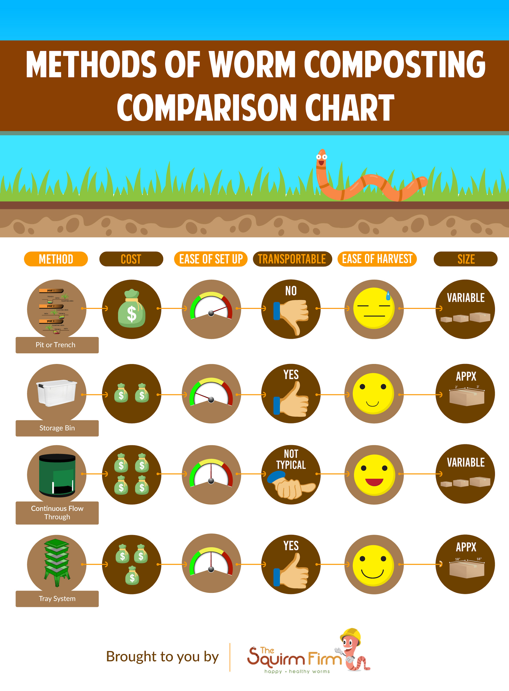
Composting: the Vermiculture Process
Vermiculture is a type of aerobic composting using specialized worms as the engine.
Worms are working effectively as livestock and should be treated as such.
They are hypersensitive to noxious and acidic foods, so feeding must be deliberate.
Additionally, temperature is important. Temperatures outside 55°-85° will stress worms, cause them to leave, or kill them.

Slide 20
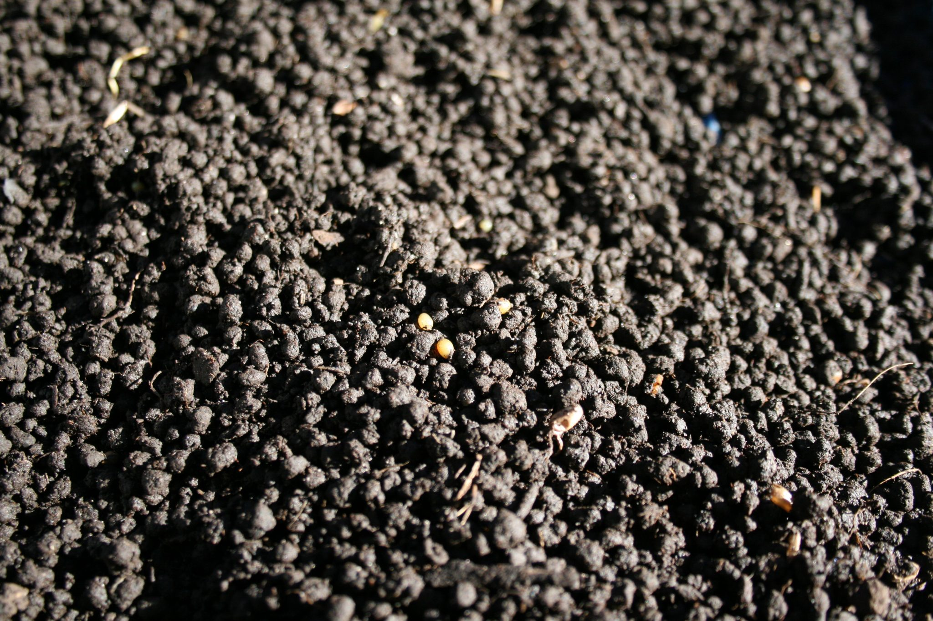
Composting: the Vermiculture Process
Vermiculture has three major benefits: it can be done indoors (in a closed container with air holes), it can be closely controlled, and worms produce worm castings.
Worm castings or vermicast is prized by organic farmers.
Castings have excellent composition--nutrients, water retention, and pH.
Harvesting vermicast can be time-intensive.

Slide 21
Composting: Curing and Application
In all cases, there is a period of curing, followed by stability.
After compost has been held at ~160°F, the compost returns to ambient temperatures. The resulting processed materials are in a bioavailable form for plants, while only beneficial microbes are left.
Worm compost produced indoors should cure for between 2-4 months.
Direct application of unfinished (uncured, unstable) compost can negatively affect plant health and may be unsafe.

Slide 22
Additional Resources
Processes on a small scale

Slide 23
Additional Resources
Reading and Listening
The Rodale Book of Composting - an excellent guide for reference on the basics, materials, chemistry, and design.
“What’s With That Demolition Dust” - an interactive article and podcast by my reporting group.
Regenerative Agriculture (John Kempf) - a podcast on all things sustainable agriculture.
Resources
UI Extension - for all agriculture-related inquiries.
Healthy Soils Compost - for organic waste management services and inquiries.
Advocates for Urban Agriculture - for advocacy and agriculture-related inquiries.
Urban Autism Solutions - for disability and agriculture services and inquires.

Slide 24
How to Connect with GSF and UAS
How to Connect
If you would like to learn more about Growing Solutions Farm, or programs offered by Urban Autism Solutions, you are welcome to reach me at tucker@urbanautismsolutions.com
You can also find us on:
Facebook
Instagram
LinkedIn
Youtube
Sales at Growing Solutions Farm
Growing Solutions Farm will be selling produce on-site on Wednesday mornings and Friday afternoons.
We offer a CSA for pick-up every other Wednesday.
We accept small amounts of yard and food waste.

