Slide 1
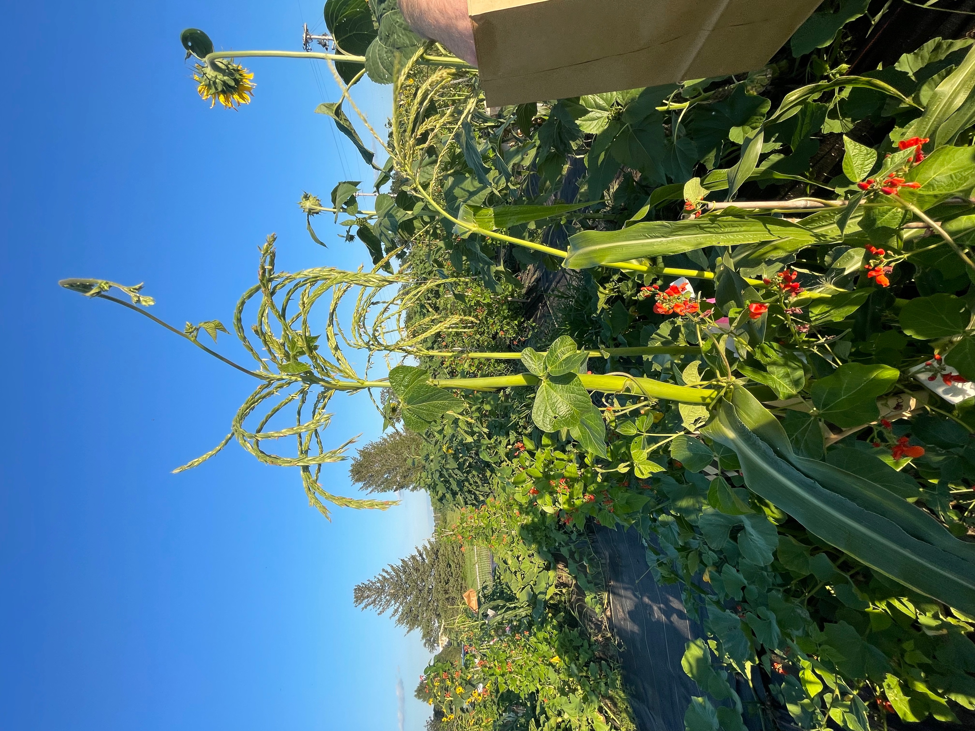
Introduction to Permaculture & Small-Scale Composting
Iowa State University – Three Sisters Project
Valeria Cano Camacho and Christina Gish Hill
Thank you to Marshall McDaniel and Ajay Nair for slide input!

Slide 2
Overview
Permaculture
Composting
What is permaculture?
Principles of permaculture
Why should we strive for this?
What really is permaculture??
How can I start?
Resources
What is composting?
Large vs small scale?
What is needed for composting?
Why does it help the soil?
Is it going to smell?
Resources

Slide 3
What is permaculture?
Permanent agriculture
Deliberately planning and building
Holistic approach (both plant and human)
Mimic nature

Slide 4
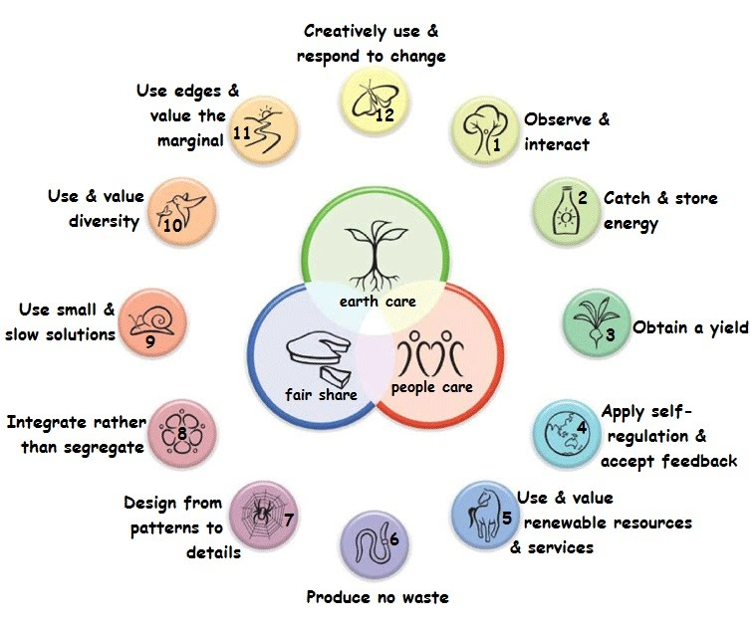
Principles of Permaculture

Slide 5
Reasons to adopt a permaculture methods
Ethics of permaculture
Earthcare
Land and nature stewardship
Environment
Peoplecare
Culture and education
Health and spiritual well-being
Fairshare
Finances and economics
Tools and technology
Soil Health
Water Use
Biodiversity
Greenhouse Gasses

Slide 6
How to start?
You probably already have!
If not… no worries, start small!
Observation and Interaction
Mindful of space and energy
Efficient use of energy in system
Produce no waste
Self Regulation
Goal to reduce physical labor

Slide 7
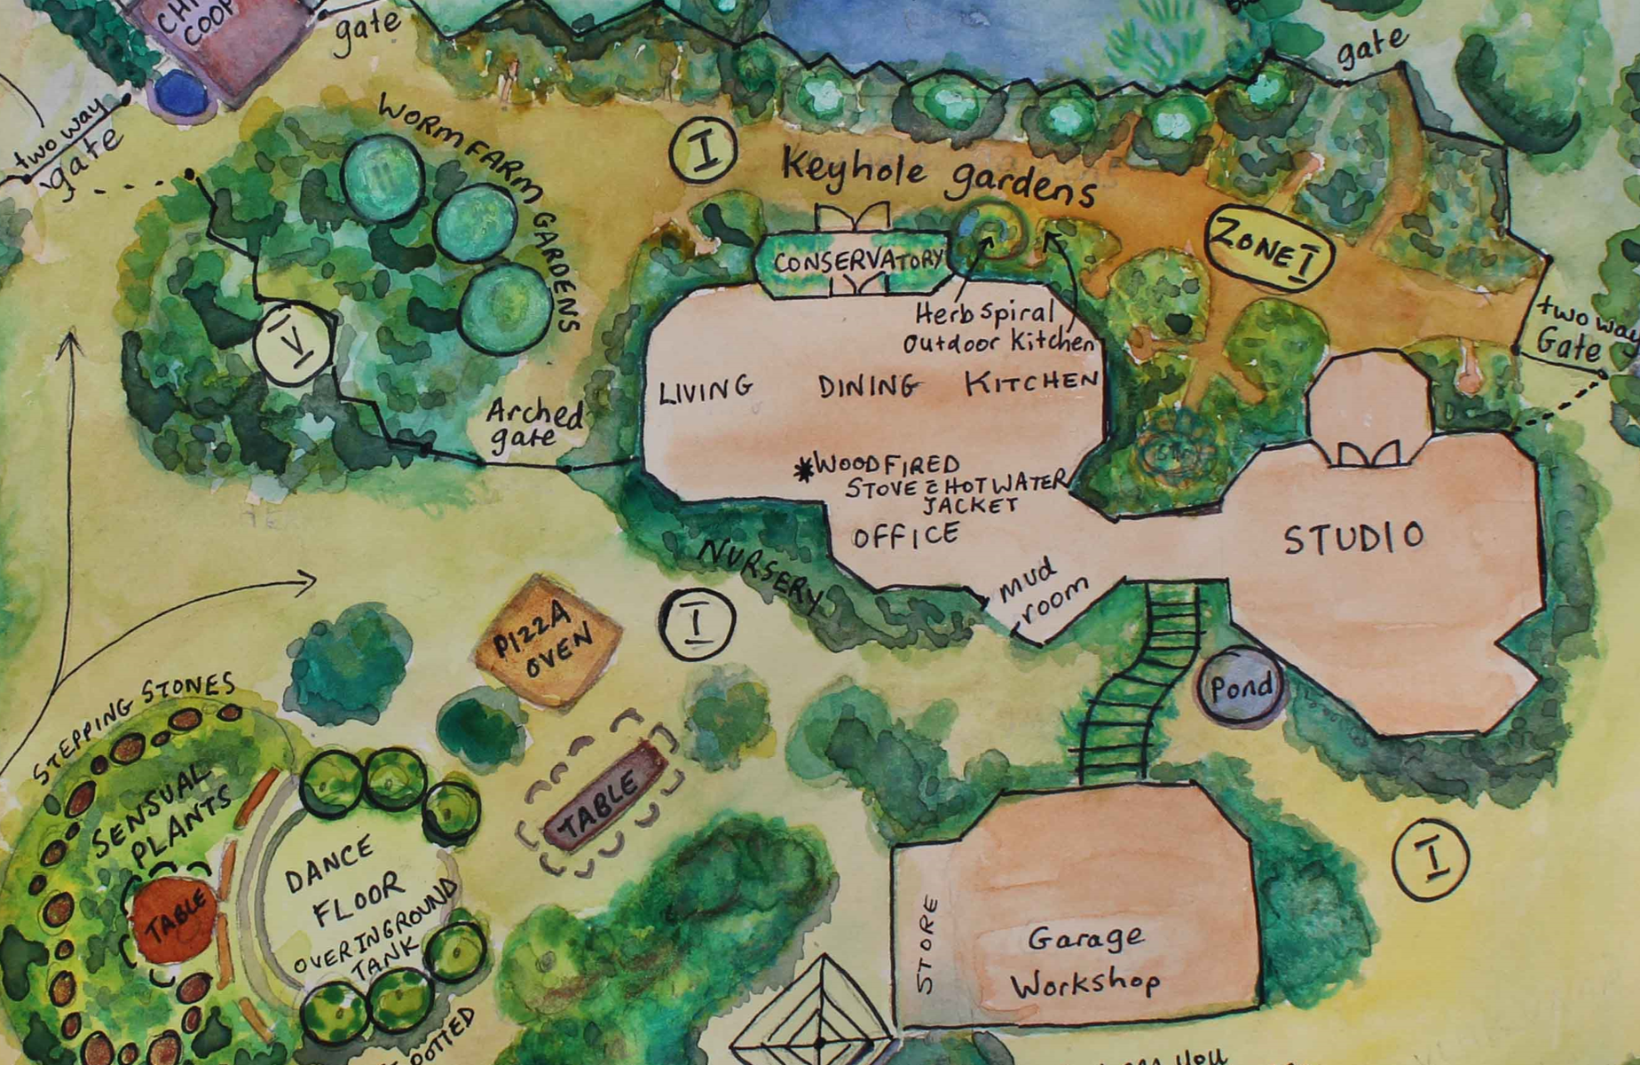

Slide 8
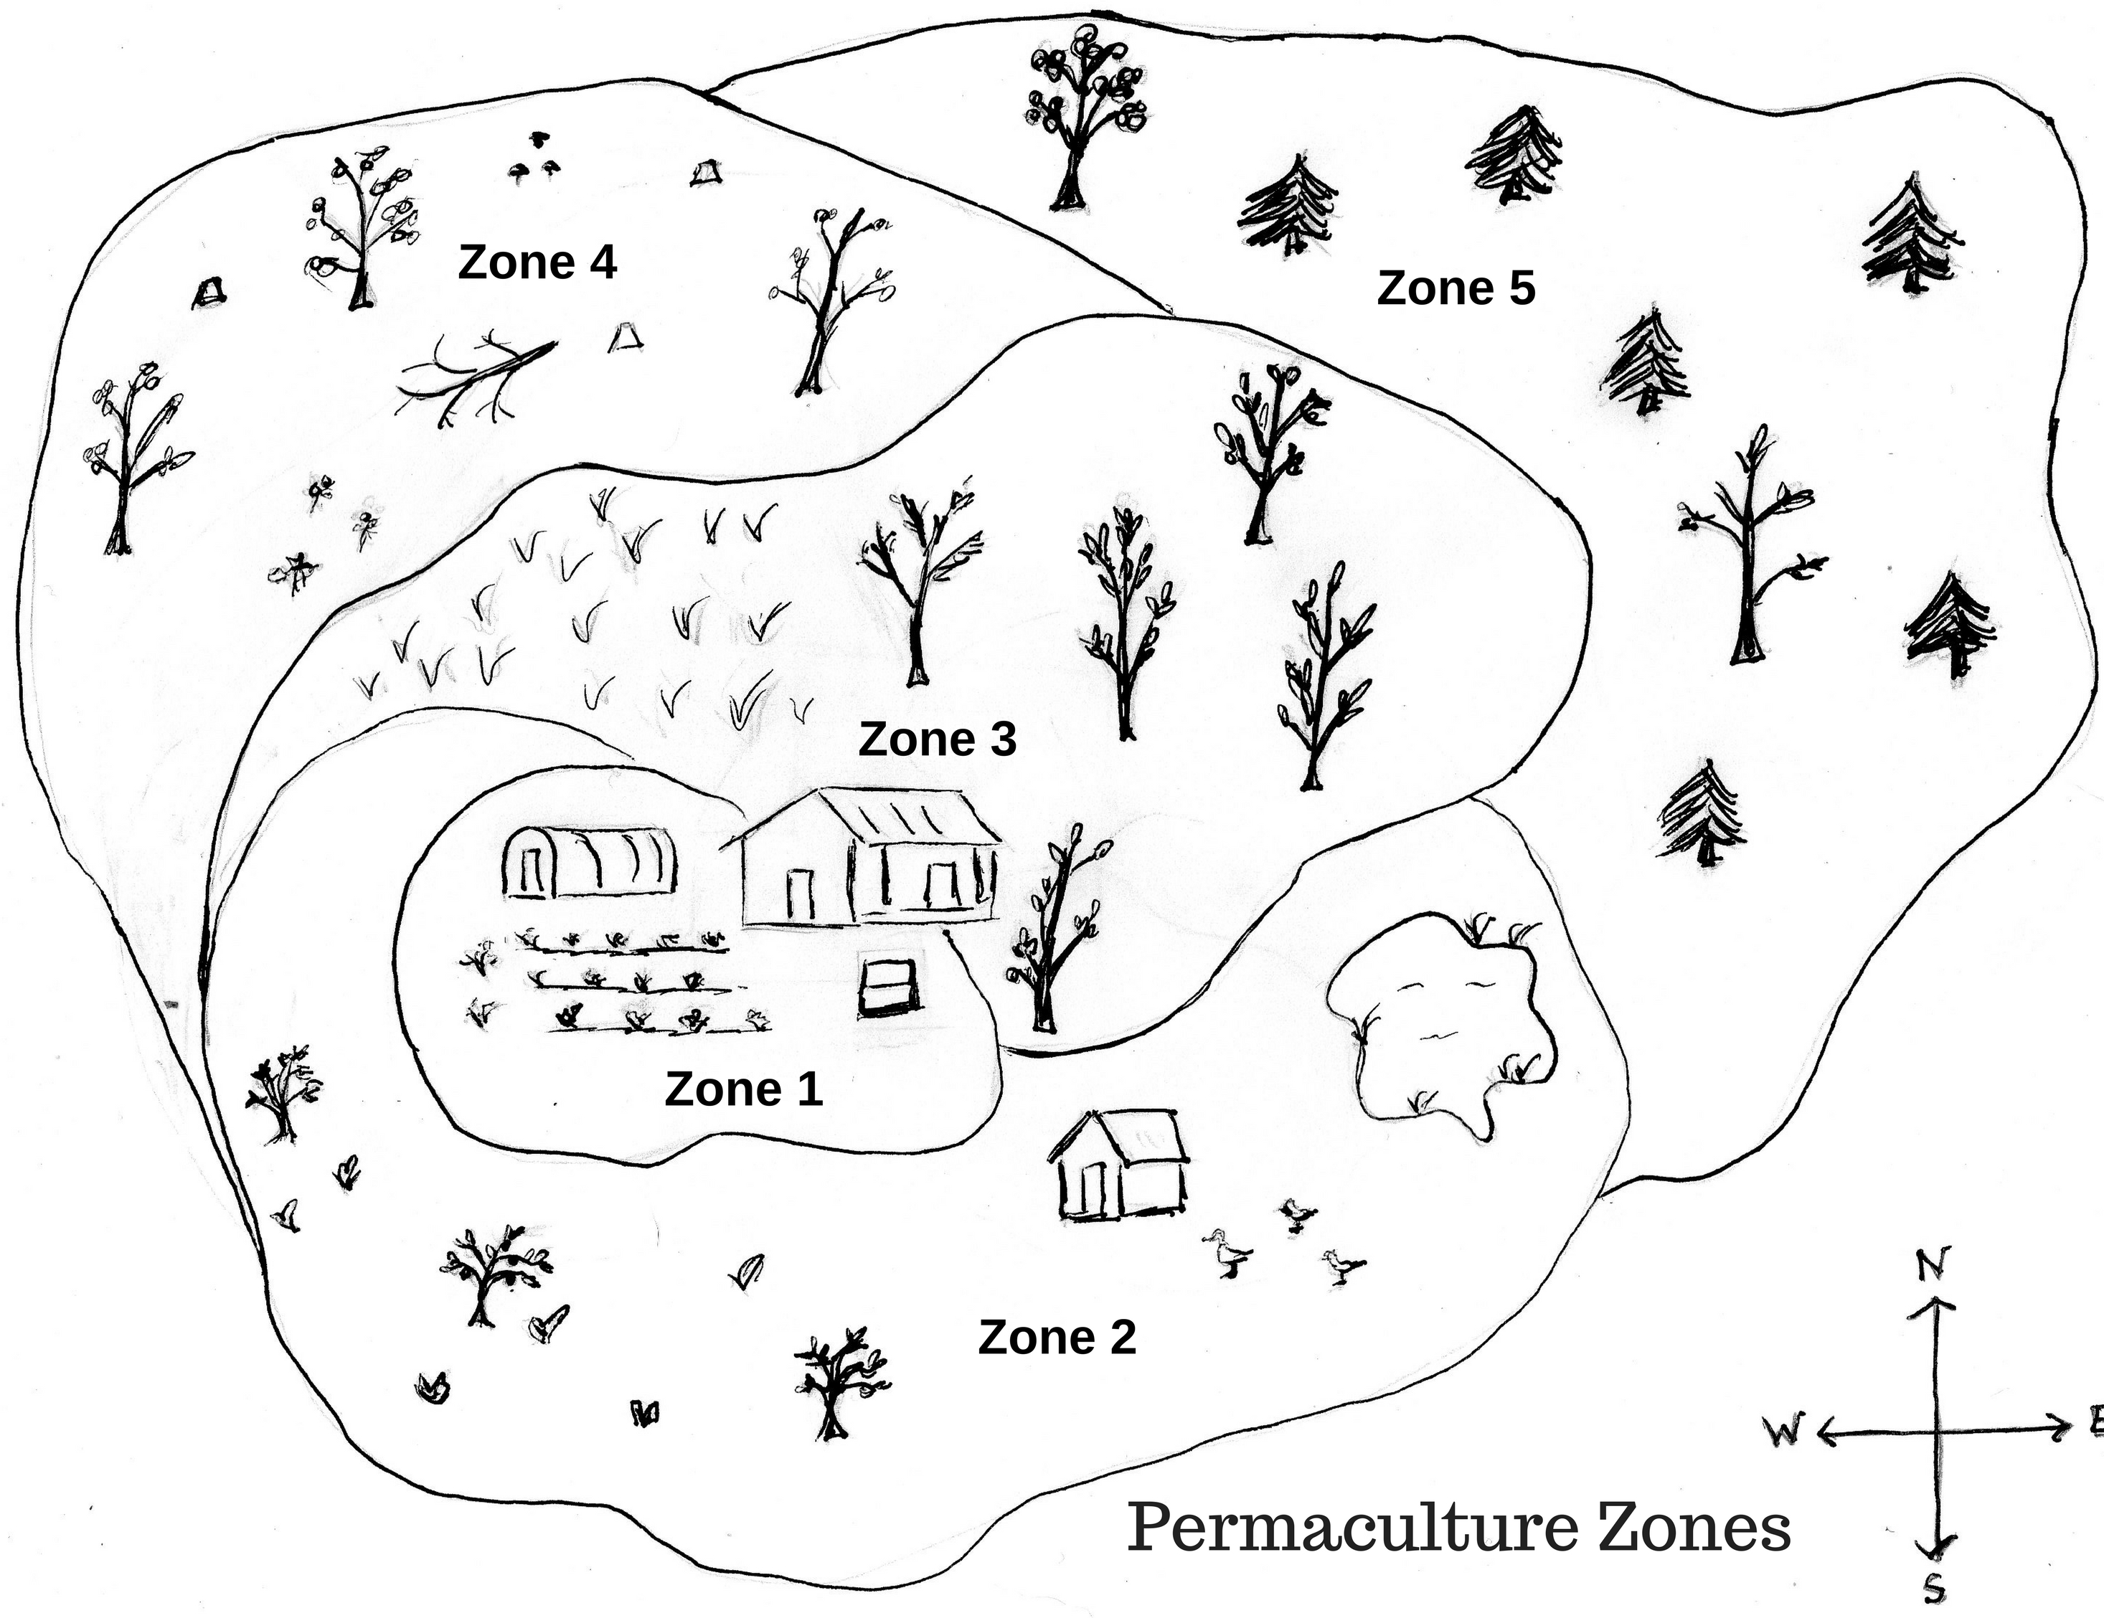

Slide 9
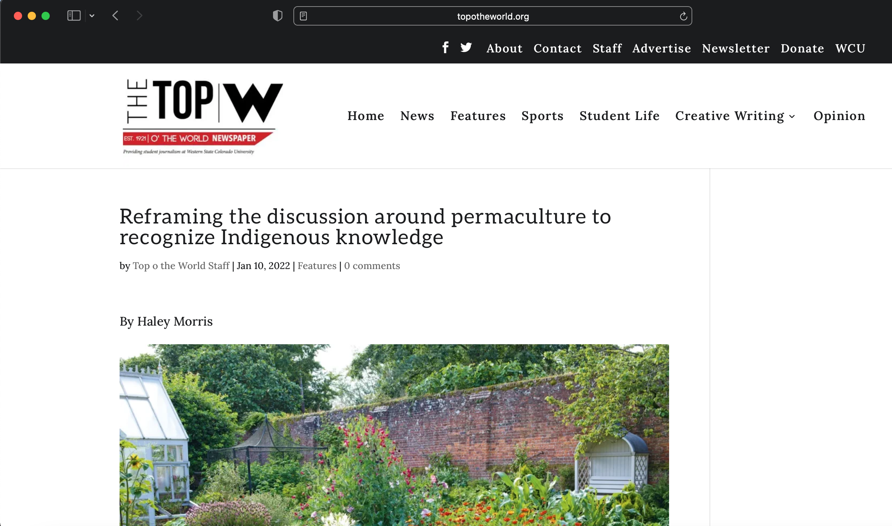
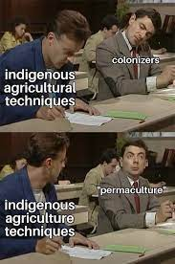

Slide 10
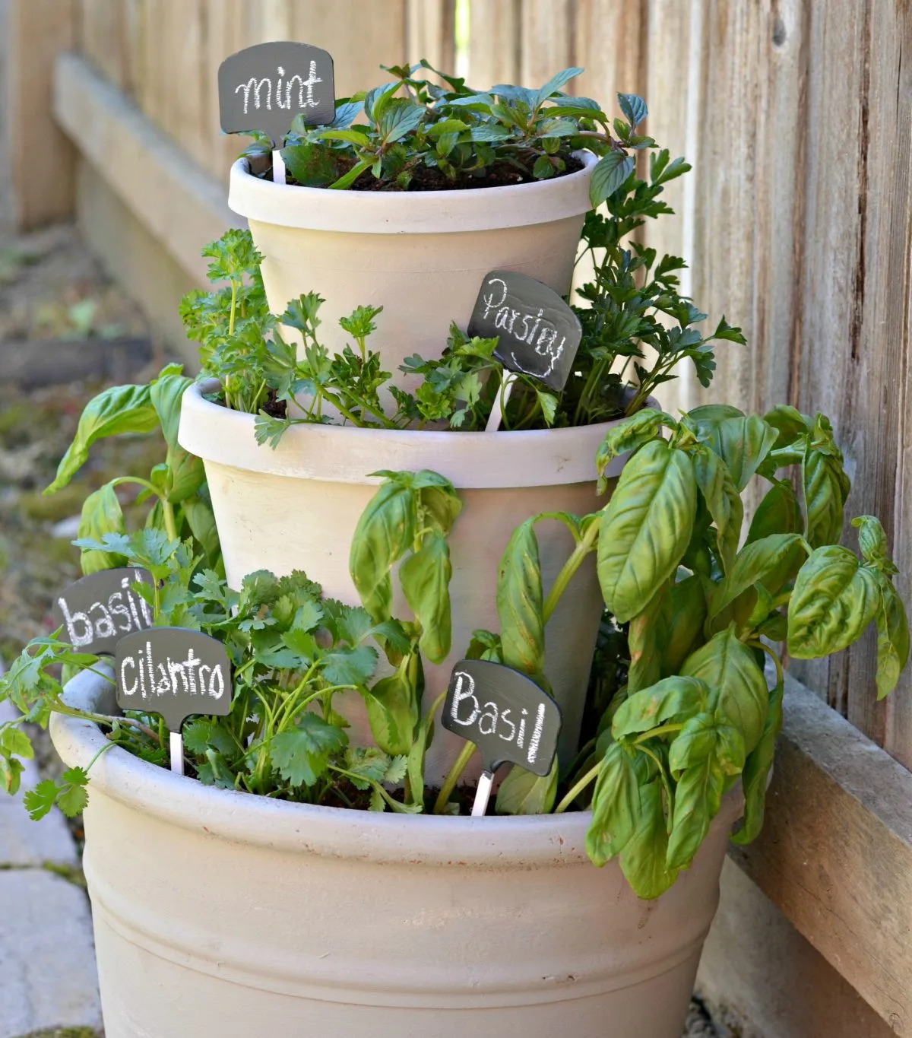
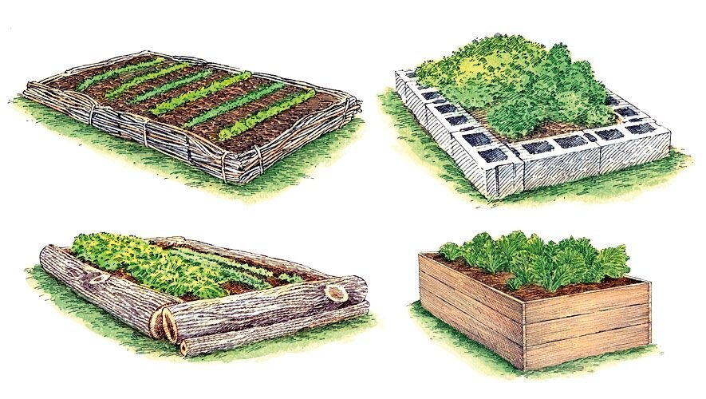
Permaculture Practices
Mulching
Manure application (compost…hint hint)
Agroforestry
Polyculture
Raised beds
Stacking
Growing perennials
Herb spirals

Slide 11
Composting !
Slide information provided by Dr. Ajay Nair

Slide 12
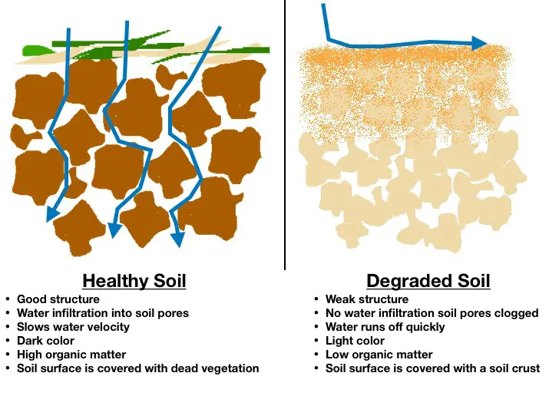
Why compost?
Composting diverts waste from our landfills, saving valuable space for non‐recyclable waste.
Compost improves soil structure and tilth.
Holds moisture.
Allows for water drainage.
Slowly releases nutrients.
Encourages beneficial microorganisms and suppresses soil‐borne diseases.
Replaces the need for commercial soil amendments and fertilizers.
In short: It will improve the quality of your soil and enhance plant growth

Slide 13
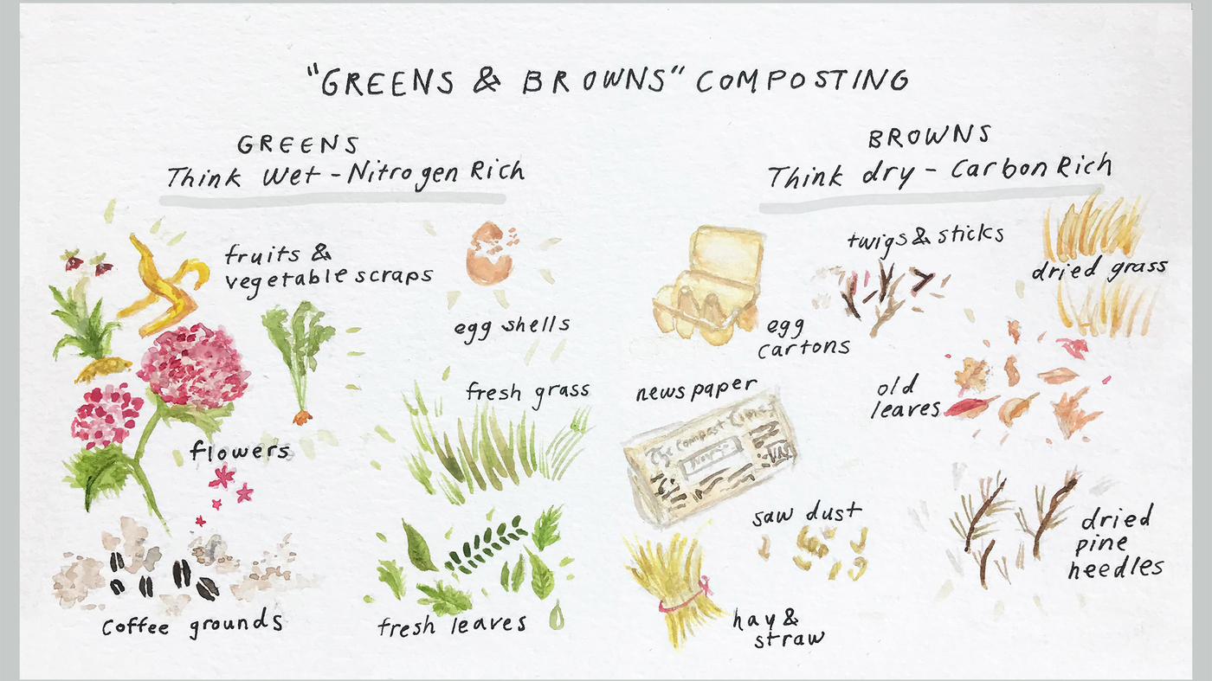
Ingredients for Composting
• Greens
Nitrogen rich, green, moist materials that will help provide heat for the decomposition process.
• Browns
Carbon rich, dry, woody materials.
• Water
Creating a moist environment for organisms to thrive.
• Oxygen
Micro-organisms need to breathe too!

Slide 14
Compostable Materials
Vegetable & fruit scraps
Coffee grounds
Teabags
Eggshells
Grass clippings
Leaves
Young weeds
Pine needles
GREENS
Fall leaves
Dry grass clippings
Cardboard/newspaper
Pine needles
Old potting soil
Paper napkins
Stale flour, cereals, spices
Paper based egg cartons
BROWNS

Slide 15
Materials to Avoid
Meat
Dairy products
Pet waste
Clay kitty litter
A lot of garden soil
Weeds with seed head

Slide 16
RECIPE = 1:2 Green to Brown
We need an adequate mix of high nitrogen (leaves, grass clippings, fruit/grain residues) and high carbon residues (branches, old grass, saw dust)
The Carbon to Nitrogen ratio (C:N) should be ~30:1 at the onset and finish between 15 to 20:1.
Roughly half of the carbon is lost as CO2 in the process and the volume reduces to about 1/3 or less
Adequate oxygen is key for the pile to heat up and is provided by coarse chunks and adequate mixing
One unit of green
One unit of brown
Grass clippings
Vegetable residues
Plant parts
Fresh leaves
Old leaves
Wood pieces
Saw Dust
Ground tree branches

Slide 17
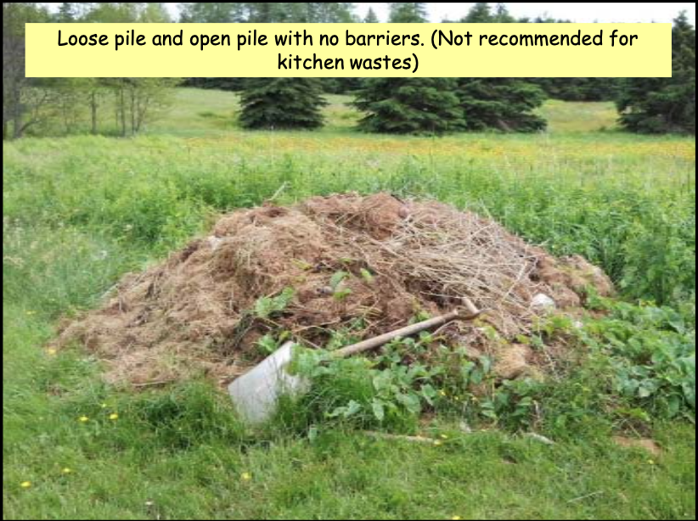
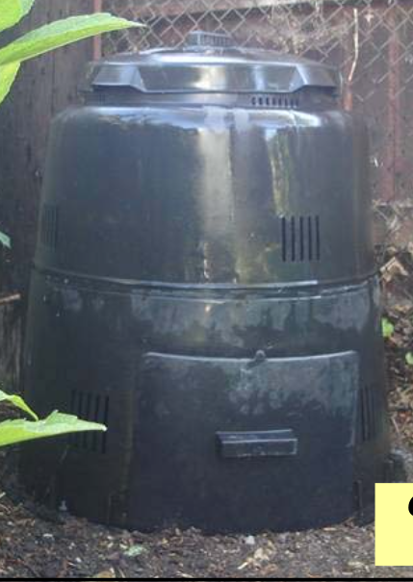
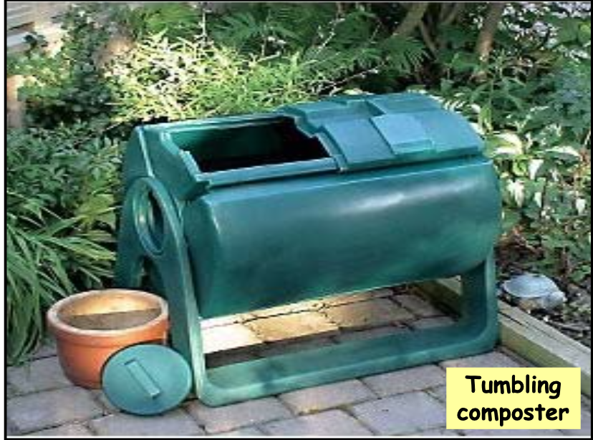
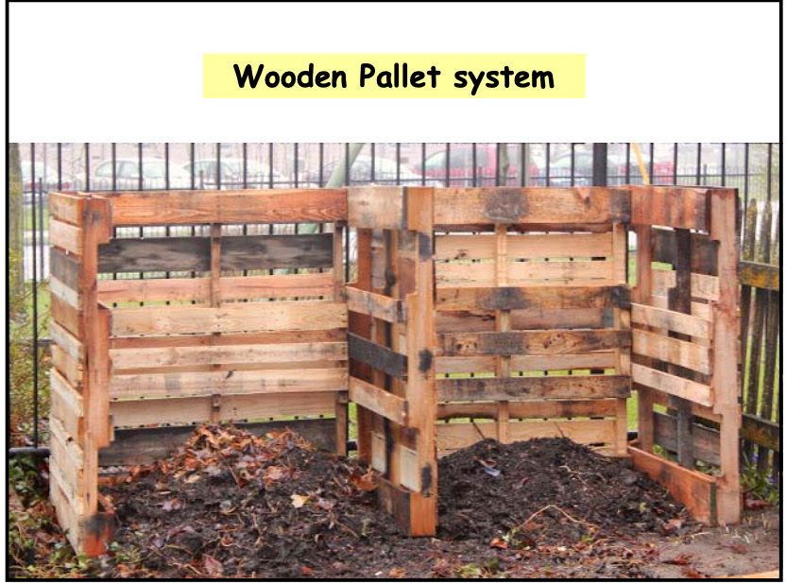
Types of Composting Systems

Slide 18
Today’s Demonstration
Today’s Materials:
Worm casting
Straw
Mulch
Paper/newspaper
Old Potting Mix
Coffee grounds
Leaves
Food scraps

Slide 19
Works Cited / Resources
Nath, M.K. (2022) Potentialities of Permaculture to Emerge as an Alternative for Intensive Agriculture- A Review. Indian Journal of Organic Farming. 1(1). Choudhary Publishing Media.
Zone Picture: https://blog.southernexposure.com/2018/01/property-planning-with-permaculture-zones/
Brain, R., Thomas, B. Permaculture. Utah State University Extension Sustainability. https://digitalcommons.usu.edu/cgi/viewcontent.cgi?article=2689&context=extension_curall
https://www.nal.usda.gov/legacy/afsic/permaculture
Permaculture Design Notes: https://permaculture.org/wp-content/uploads/2021/05/Permaculture-Design-Notes-2021-Web-Edition.pdf
North Carolina Extension: https://content.ces.ncsu.edu/extension-gardener-handbook/appendix-g-permaculture-design

