Slide 1
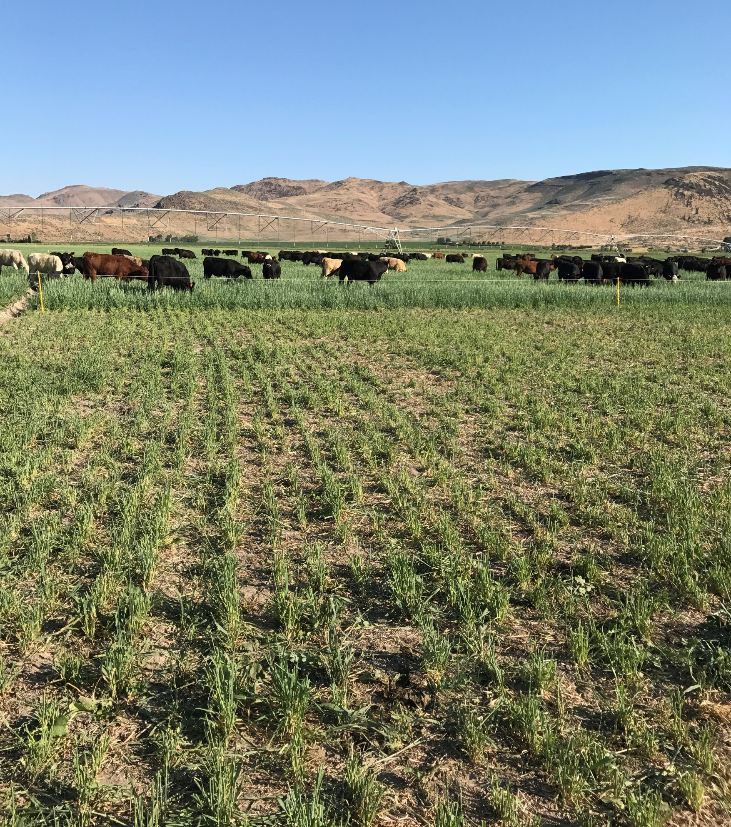
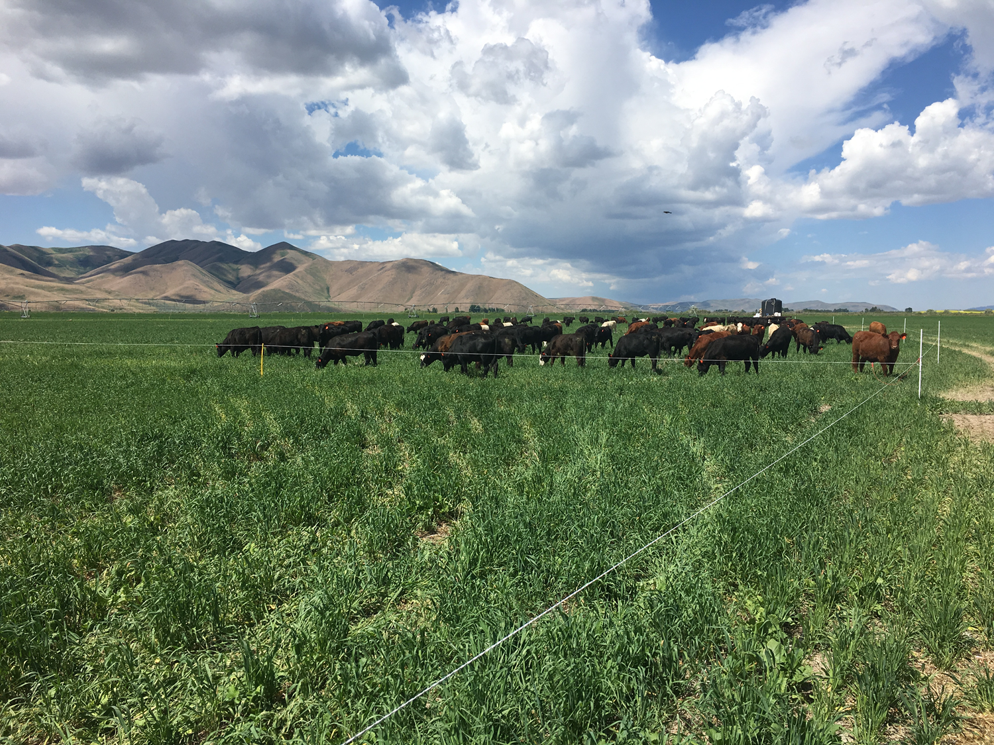
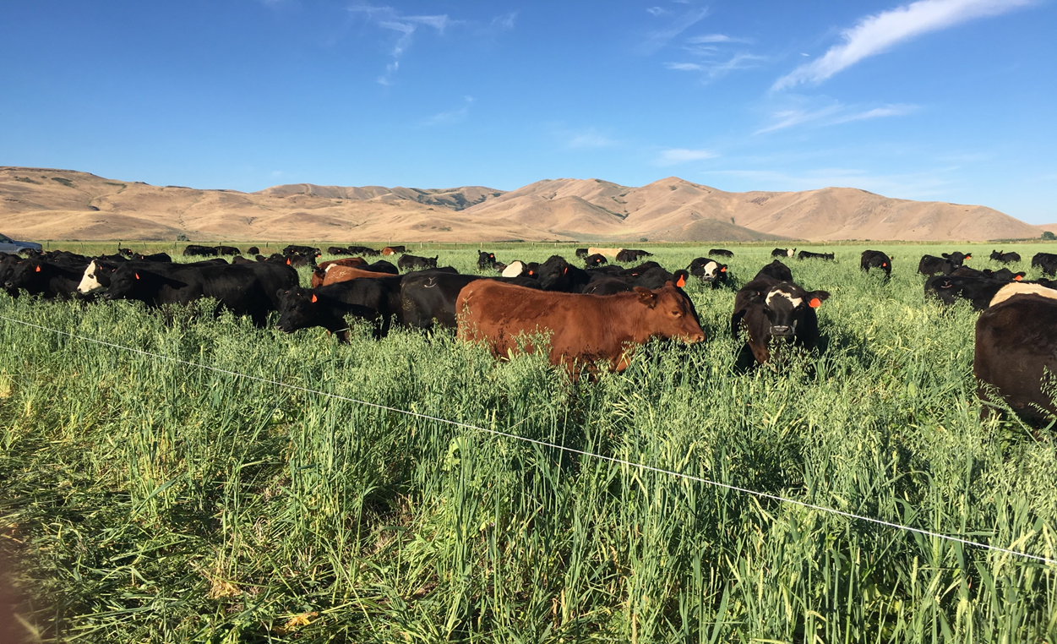
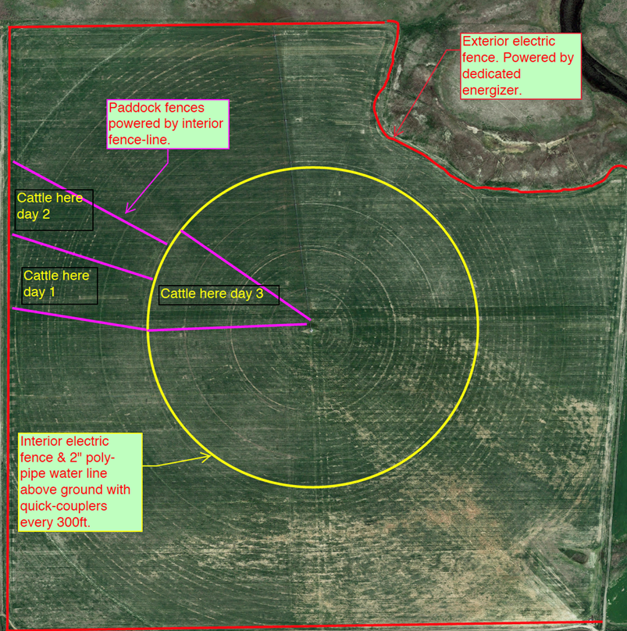
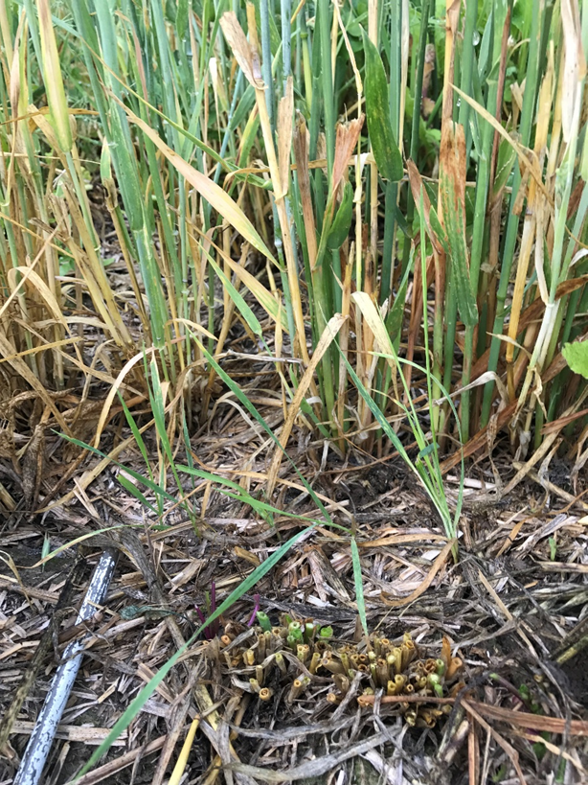
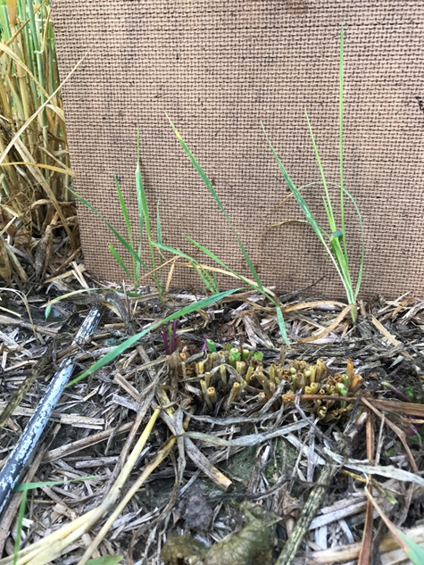
Management Intensive Grazing of Forage Cereal Cover Crops
Carmen Wilmore, Lauren Golden, Steven Hines, Joel Packham, Howard Neibling and Pat Purdy
Rationale / Need
Producers are showing a greater interest in cover crops as a forage source for grazing livestock.
Cover crops can be intensively managed as a high quality forage source, but with some caution and consideration.
Observations
Grazing Performance
Forage consumption was estimated based on available cattle, with an average 2.5% body weight consumption rate
Forage consumption per acre over the season was 2,408 lbs.. This is a low estimate due to insufficient stocking rate to effectively consume all the available forage. Total consumption was estimated at a mere 40% of what was available (Figure 2 and 3).
Researchers estimated 6,020 lbs. of forage per acre was produced by the cover crops over the growing season.
Conclusion
Although this first year resulted in a loss of $3,380, the producer is confident that this system can be profitable. Economic loss is attributed to a low stocking rate and class of cattle, implementing the MIG a week late, resulting in significant forage loss.
The $1,200 warm season cover crop blend did not provide an economic benefit in total forage production. The cover crop blends did not exceed $30/acre.
The cattle owner benefited from this system, with cattle grading above expectations. Eighty-five percent of the herd graded above choice, with 15% grading prime.
More than 213 heifers were needed to effectively graze the 148-acre cover crop using MIG. An estimated 60% of available forage was lost. A minimum of 300 higher class cattle would have been ideal to utilize the abundant forage from cover crop growth.
Where grazing was managed correctly, cattle were able to graze 4 times in the season (Figure 5).
Objective
Determine how to integrate cover crops in a crop rotation including mustard, alfalfa, and cereal grains
Determine how to management intensively graze annual cover crop species
Methods
Field Establishment
A 148-acre pivot was seeded using a no-till drill with a cool season mix (Table 1) the second week of May.
Following the first grazing of the cool-season mix the producer planted a warm-season mix (Table 2) to add additional late summer forage and to provide high-quality fall grazing. This mix was no-tilled into the grazed paddocks starting July 1.
Figure 3. Heifers grazing early in the season.
Cool Season - Species | Lbs. / Acre
Hayes Forage Barley | 30
Forage Oats | 14
Forage Peas | 12
Common Vetch | 4
Purple-top Turnip | 1
Warm Season – Species | Lbs. / Acre
Forage Wheat | 12
Sorghum Sudan | 2.5
Millet | 2.5
Forage Radish | 1
Figure 2. Post-grazed cool season mix on July 13,2017. Second time grazing this paddock with 213 head of heifers.
Table 1. Cool Season Mix planted on May 10, 2017
Table 2. Warm Season Mix planted starting July 1, 2017
Methods
Management Intensive Grazing
Spayed heifers (n=213) weighing an average of 600 lbs. were turned in 40 days after the May seeding
The producer moved the herd daily using solar powered fence with the initial goal of 1 acre sized paddocks. A week in, the producer was forced to increase paddock size to 6-8 acres in order to keep up with the maturing forage (Figure 1).
Forage samples were collected from the select paddocks prior to and immediately after grazing to determine dry matter yield and forage quality.
Observations
Cover Crop Species Response
Forage oats and barley grew quickly and provided early feed. Once grazed, both the oats and barley showed regrowth potential by producing tillers but oat was more productive in regrowth. As the days got longer the barley headed and finished. Oats headed out but continued to produce new tillers. Oats and barley also dropped seed and growth from seed drop continued into the fall, providing additional forage for grazing into September and October.
Pea and vetch responded well to grazing when grazed early. Peas were available early, while the vetch, a perennial legume, took time to germinate and grow. Turnips grew quickly providing greens and tubers which were excellent feed, especially as the cattle learned to eat them.
Cover crop growth and response to grazing indicated the warm season mix was not needed, This mix was not able to compete with the regrowth from the cool season species to significantly contribute to the forage dry matter (Figure 4).
Figure 5. Heifers grazing later season growth.
Target Audience
Crop and livestock producers throughout Idaho.
A field day was hosted in July to showcase the cover crop growth and grazing performance.
Attendants asked questions about management and the future of the project in regards to soil health, and how this will play into the crop rotation.
Future Research
Many question arouse about the significant regrowth of the spring planted winter cereal varieties. To answer questions and form better recommendations on the use of cereals in a cover crop mix the research team will be conducting a replicated study on simulated grazing and regrowth of annual cereal forage cover crops. This new study will be funded by an Innovative Project Award.
Figure 1. Pivot and paddock map. Initial cost of fencing was high using this layout.
Figure 4. Arrows indicate the warm season species, which were outcompeted by the existing cool season species. Picture taken Aug 23, 2017 approximately 45 days after no-till seeding.
Acknowledgements
The UI Extension team would like to thank the Purdy family and Picabo Livestock for including UI Extension as advisors on this Western SARE Farmer/Rancher Research and Education Grant and willingness to cooperate on this project.

