Slide 1
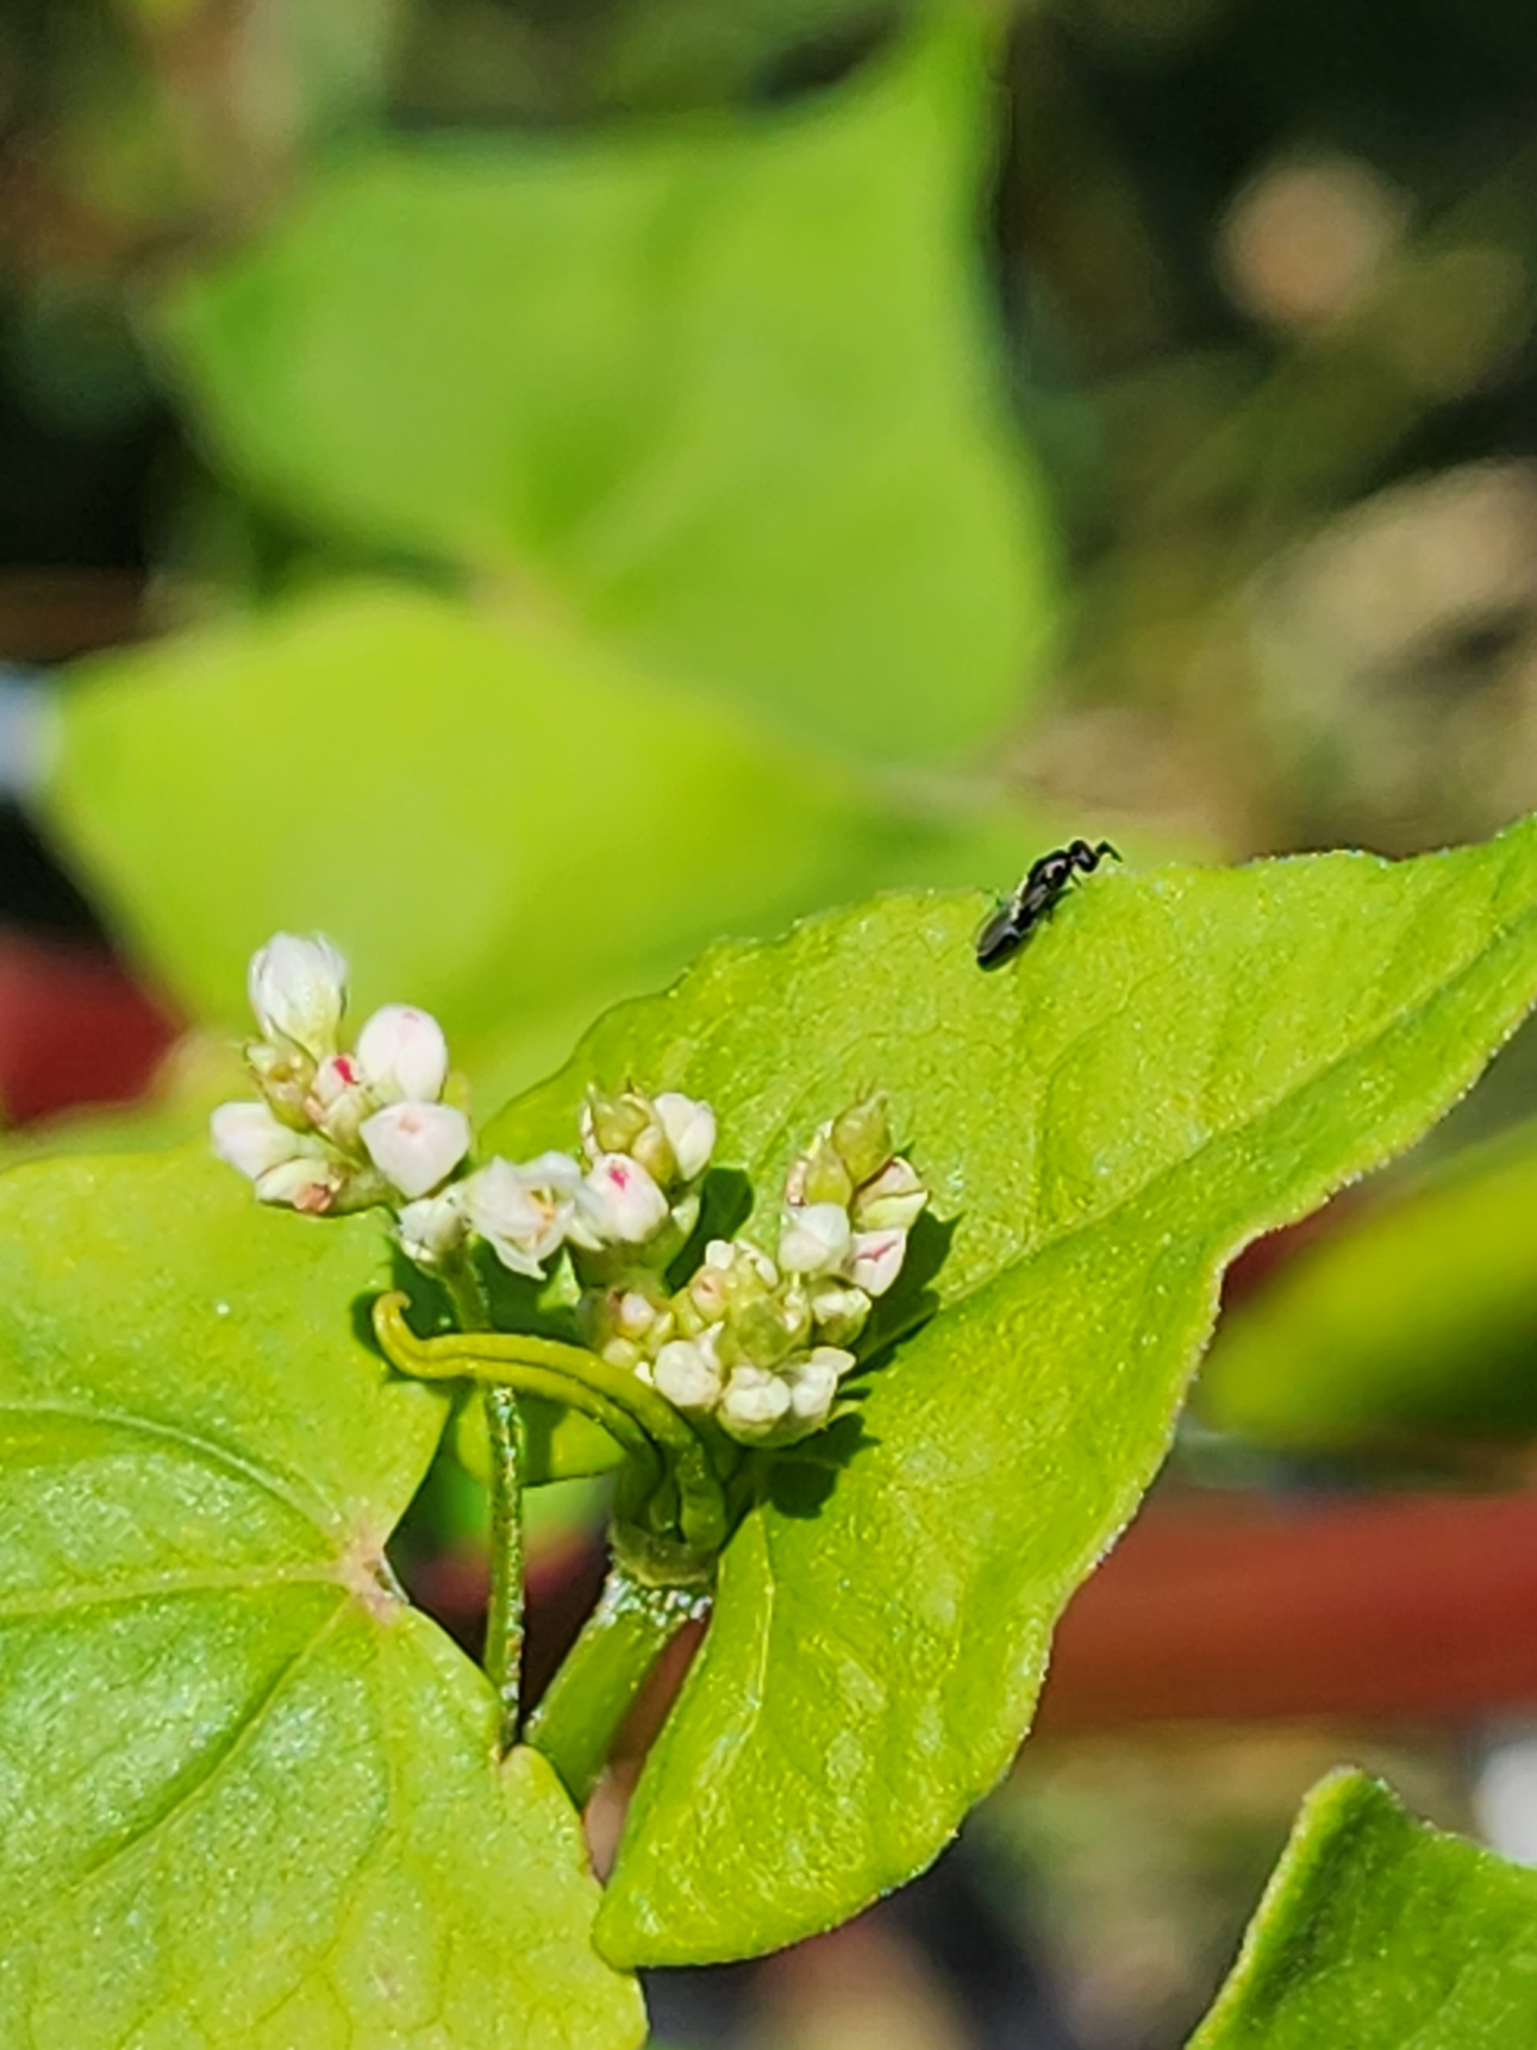
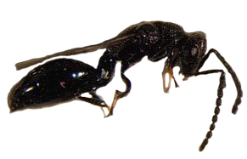
Using Parasitoid Wasps for fly control
Muscidifurax raptor
House Fly pupae
Spalangia cameroni on buckwheat
References:
Geden, C. J., Nayduch, D., Scott, J. G., Burgess IV, E. R., Gerry, A. C., Kaufman, P. E., ... & Machtinger, E. T. (2021). House fly (Diptera: Muscidae): biology, pest status, current management prospects, and research needs. Journal of Integrated Pest Management, 12(1), 39. https://doi.org/10.1093/jipm/pmaa021
Monyama, M. C., Onyiche, E. T., Taioe, M. O., Nkhebenyane, J. S., & Thekisoe, O. M. (2022). Bacterial pathogens identified from houseflies in different human and animal settings: a systematic review and meta‐analysis. Veterinary Medicine and Science, 8(2), 827-844. https://doi.org/10.1002/vms3.496
Spalangia cameroni
Filth fly parasitoids can be purchased through several vendors. The parasitoids typically are sent while they are still in the host pupae. The parasitized pupae are then distributed equally around areas of high filth fly presence. This is repeated every one to two weeks as needed.
Parasitoid wasps for filth Fly control
This brochure is supported by the National Institute of Food and Agriculture, U.S. Department of Agriculture, under agreement number H008917141 to B. H. King and E. Taylor through the North Central Region SARE program under project number GNC22-358. USDA is an equal opportunity employer and service provider. Any opinions, findings, conclusions, or recommendations expressed in this publication are those of the author(s) and do not necessarily reflect the view of the U.S. Department of Agriculture.
Parasitoid wasps provide a chemical free method of reducing fly numbers on farms

Slide 2
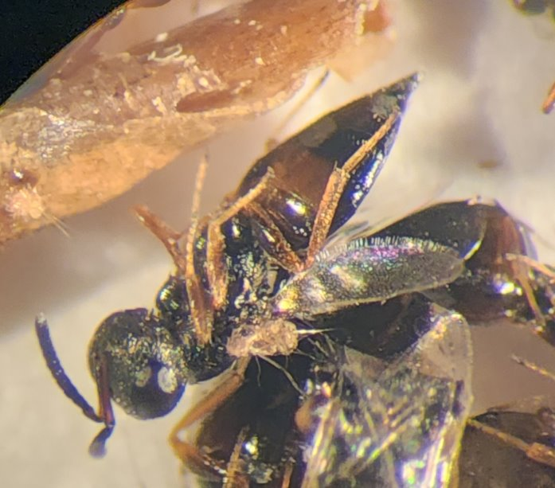
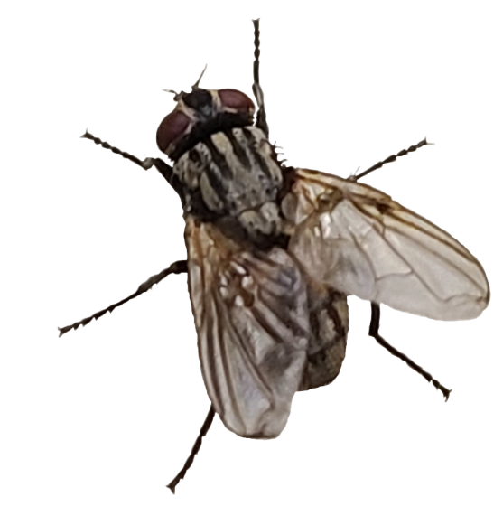
What are Parasitoid wasps?
How safe are Filth fly parasitoid wasps to humans?
Spalangia cameroni and house fly pupae
House fly parasitoid wasps do not harm humans! They harm filth flies.
Why Control House Flies?
House flies are pests and are annoying to humans, pets, and livestock. House flies are also vectors for diseases that impact humans and livestock.
Muscidifurax raptor
A few examples of filth fly parasitoids
Spalangia cameroni
Spalangia endius
Muscidifurax raptor
Muscidifurax zaraptor
Muscidifurax raptorellus
Urolepis rufipes
Parasitoid wasps are insects related to other wasps and bees, that primarily use other arthropods as a nursery for their offspring. The larval parasitoid wasps use the host for food and shelter. The host dies after serving as the parasitoid wasp's nursery.

