Slide 1
S
B
Squash (S) is planted 24 inches from center of the mound.
2 squash seeds per mound
Corn (C) is planted 6 inches from the center of the mound.
4 corn seeds per mound
24”
C
B
3”
C
6”
C
B
Bean (B) is planted 3 inches from THE CORN.
4 bean seed per mound
C
B
S

Slide 2
NOTES:
Mounds should be 3 feet apart
Squash should surround mound, not go on it
Corn is planted first, after 4 inches tall,
  then Beans are planted, after bean emergence
    Squash is planted

Slide 3
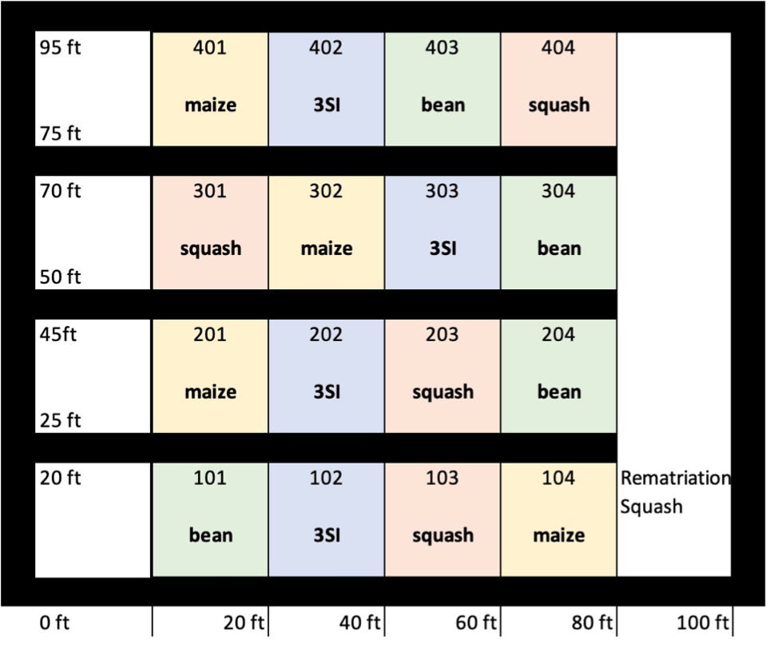
MOUND NUMBERS
PLOT NUMBERS
13
14
15
16
9
10
11
12
5
6
7
8
1
2
3
4
Each plot has 16 mounds in it, there are 16 plots total!

Slide 4
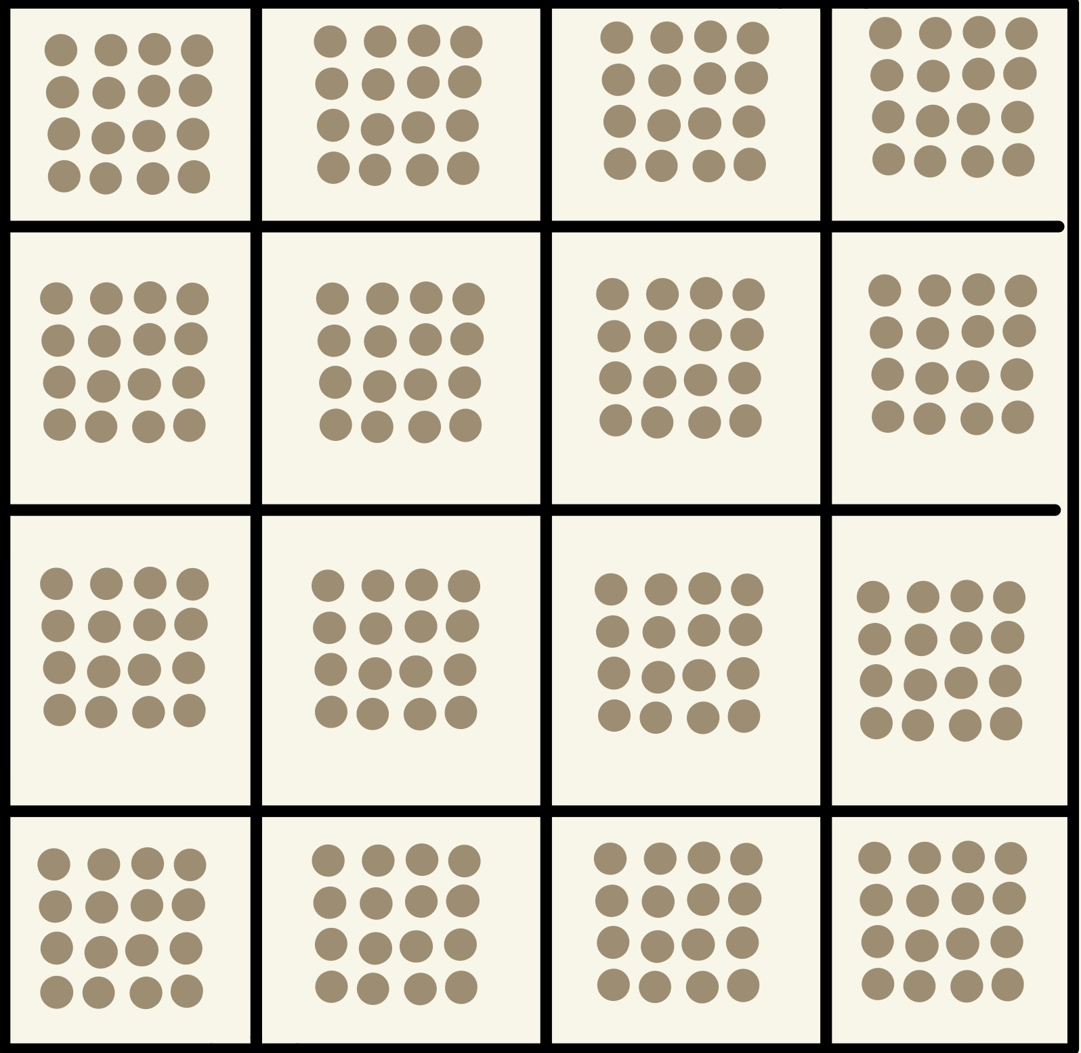
Beans layout TBD
20 ft x 60 ft
CORN
3SI
BEAN
SQUASH
SQUASH
CORN
3SI
BEAN
CORN
3SI
SQUASH
BEAN
REMATRIATION SQUASH
BEAN
3SI
SQUASH
CORN
20 ft x 20 ft

