Slide 1
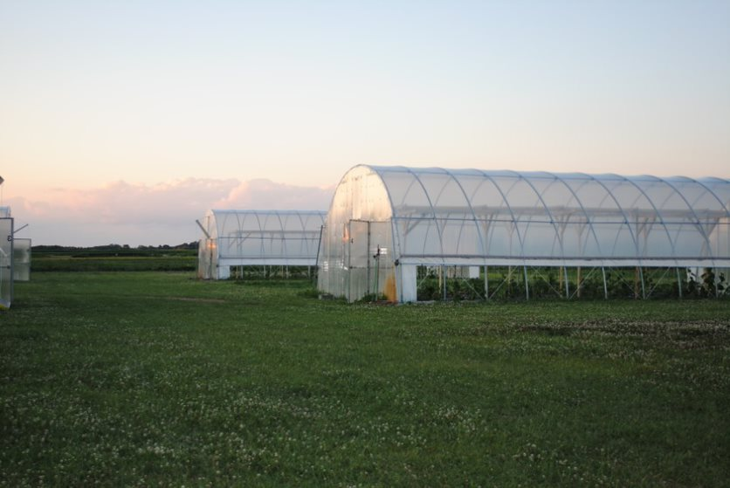


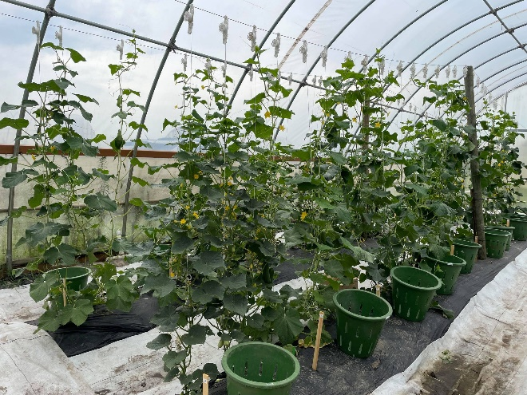
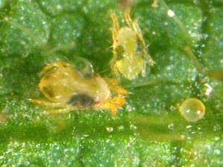
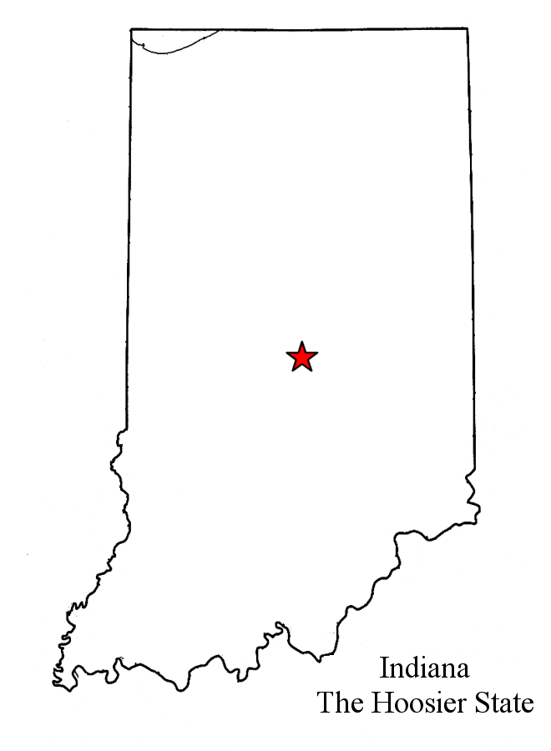
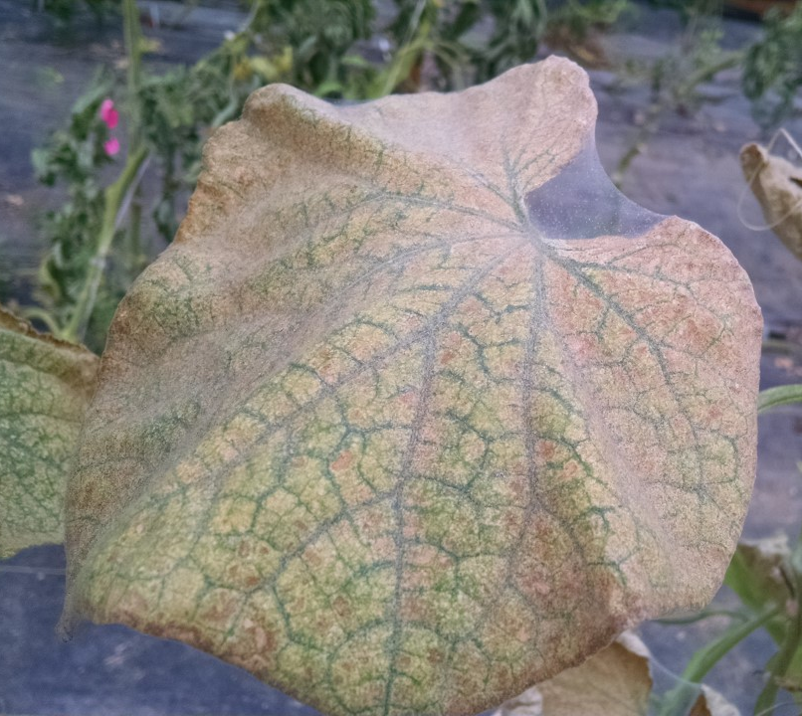


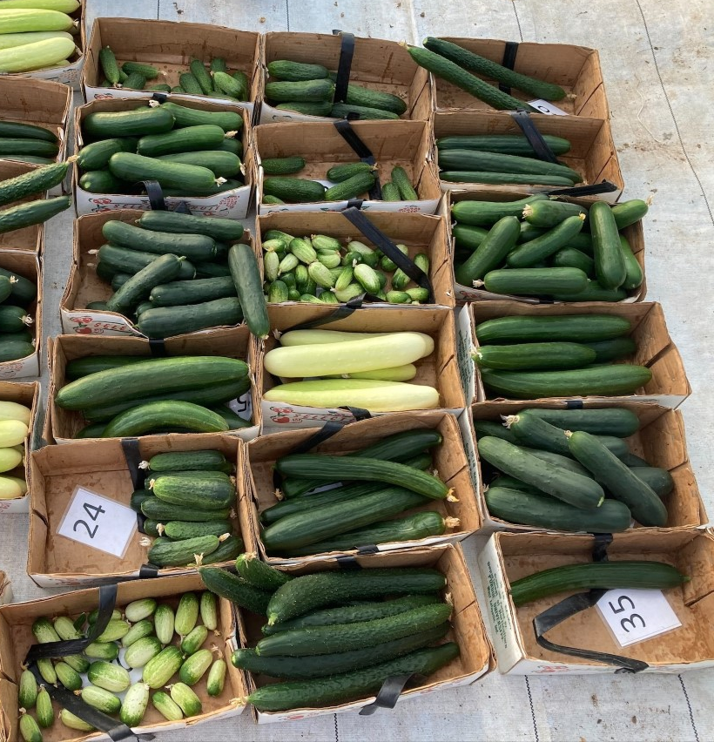
Susceptibility of high tunnel cucumber cultivars to two-spotted spider mite
Leslie Avilés and Laura L. Ingwell, Department of Entomology, Purdue University, West Lafayette, IN, USA
#LNC20-438
Background
High tunnels (HT) are a tool used for protected cultivation of food crops. Their popularity falls on the low cost of construction and increased profitability by extending the growing season and protecting crops against adverse weather conditions (Foust-Meyer and O’Rourke 2015). Cucumber (Cucumis sativa L.) are suitable for HT production because of their vertical growth pattern which optimizes space and repeated flowering, offering multiple harvest opportunities (Fig. 1a). However, two-spotted spider mite (Tetranychus urticae Koch; TSSM; Fig. 1b) is a primary pest of cucumbers in HT systems that decreases production. TSSM suck essential plant nutrients from the leaves, causing yellowed stippling symptoms and eventual leaf death (Park and Lee 2002). TSSM often goes unnoticed until the damage is irreversible, and the pest is difficult to control without conventional insecticides, which are limited in high tunnels.
Results
Variety Performance
The total yield per variety ranged from 1.08 - 6.34 lbs/plant at Meigs, 0.5 - 3.57 lbs/plant at PPAC, and 8.51 - 15.92 lbs/plant at SWPAC (Table 2). Plants were in production for 10, 7 and 9 weeks at Meigs, PPAC, and SWPAC, respectively. Overall yields at SWPAC were highest.
Table 2. Cucumber variety yield per location.
TSSM Susceptibility
Using the H-B ratings over time we calculated the Area Under the Disease Progression Curve (AUDPC), a quantitative summary of TSSM pressure over time, to compare varietal susceptibility to TSSM. There were no differences between varieties at the MEIGS location (F9,70 = 1.0715 ; P = 0.3946; Fig. 4a) and overall mite pressure was low. At SWPAC we observed differences between varieties (F9,29 = 3.9064 ; P = 0.0024; Fig. 4b) and PPAC (F9,50 = 3.4567; P = 0.0022; Fig. 4c).
Location | Meigs |  | PPAC |  | SWPAC
Variety | Weigh/plant (lb) | Fruit/plant | Weigh/plant (lb) | Fruit/plant | Weigh/plant (lb) | Fruit/plant
Adam Gherkin | 2.77 | 32.08 | 1.98 | 9.28 | 15.34 | 1.88
China Long | 3.77 | 5.67 | 2.13 | 63.72 | 11.1 | 1.48
Corinto | 5.8 | 11.21 | 0.51 | 26.56 | 11.57 | 1.49
Excelsior | 3.99 | 15.13 | 1.88 | 21.44 | 15.92 | 2.87
Itachi | 3.99 | 6.38 | 3.57 | 13.83 | 9.65 | 3.16
Poniente | 5.14 | 7.04 | 2.7 | 9.28 | 7.42 | 10.52
Quirk | 3.59 | 62.83 | 0.85 | 1.78 | 8.51 | 1.02
Socrates | 6.34 | 12.71 | 2.13 | 5.56 | 14.24 | 2.52
Tasty Jade | 1.08 | 1.88 | 1.46 | 4.83 | 13.52 | 1.72
Taurus | 5.03 | 10.25 | 2.89 | 6.11 | 9.12 | 6.1
Figure 1. Cucumber plant vertically trellised inside high tunnels (A); TSSM adult and egg; photo courtesy John Obermeyer (B).
A
B
Objective
Evaluate cucumber cultivar performance and susceptibility to TSSM in high tunnel production systems
Materials and Methods
Cucumber cultivar trials: 10 different cultivars were selected representing diverse fruit types and traits (Table 1). Cultivars were grown in a RCB design in multiple HTs at three locations across Indiana (Fig. 2). TSSM symptoms were quantified by variety using the Horsfall-Barratt scale (Horsfall and Barratt 1945; Fig. 3) and fruit were harvested, counted and weighed. Plants at PPAC and MEIGS were grown in-soil; plants are SWPAC were grown hydroponically in buckets.
PPAC
Wanatah
H-B Score | % Affected
1 | 0
2 | >0 to 3
3 | 3 to 6
4 | 6 to 12
5 | 12 to 25
6 | 25 to 50
7 | 50 to 75
8 | 75 to 87
9 | 87 to 94
10 | 94 to 97
11 | 97 to 100
12 | 100
MEIGS
Lafayette
Figure 4. TSSM susceptibility as measured by the AUDPC at MEIGS (a), SWPAC (b) and PPAC (c).
SWPAC
Vincennes
Conclusions and Future Directions
Variety trials identified a number of high-yielding varieties to integrate into high tunnels, but differences between sites emphasize the importance of nutrient management
China long and Taurus show increased susceptibility to TSSM at SWPAC and Itachi at PPAC
Trials will be repeated at all locations in 2022
A
B
Figure 2. Location of the variety trials.
Figure 3. Horsfall-Barratt mite infestation rating scale (A); Severe leaf symptoms of infestation of TSSM (B)
Table 1. Cultivar and seed source for trial
Variety | Fruit size (cm) | Seed source
Adam Gherkin | 5 to 7 | Johnny`s Selected Seed
China long | 35 to 38 | Kitazawaseed
Corinto | 15 to 18 | Johnny`s Selected Seed
Excelsior | 8 to 11 | Johnny`s Selected Seed
Itachi | 22 to 27 | Johnny`s Selected Seed
Poniente | 30 to 33 | Johnny`s Selected Seed
Quirk | 5 to 7 | Johnny`s Selected Seed
Socrates | 15 to 18 | Johnny`s Selected Seed
Tasty Jade | 27 to 30 | Reimer Seeds
Taurus | 20 to 22 | Harris Seed
References
Foust-Meyer, N. and O'Rourke, M.E., 2014. High tunnels for local food systems: Subsidies, equity, and profitability. JAFSCD, 5(2), pp.27-38.
Park, Y.L. and Lee, J.H., 2002. Leaf cell and tissue damage of cucumber caused by twospotted spider mite (Acari: Tetranychidae). Journal of Economic Entomology, 95(5), pp.952-957.

