Slide 1
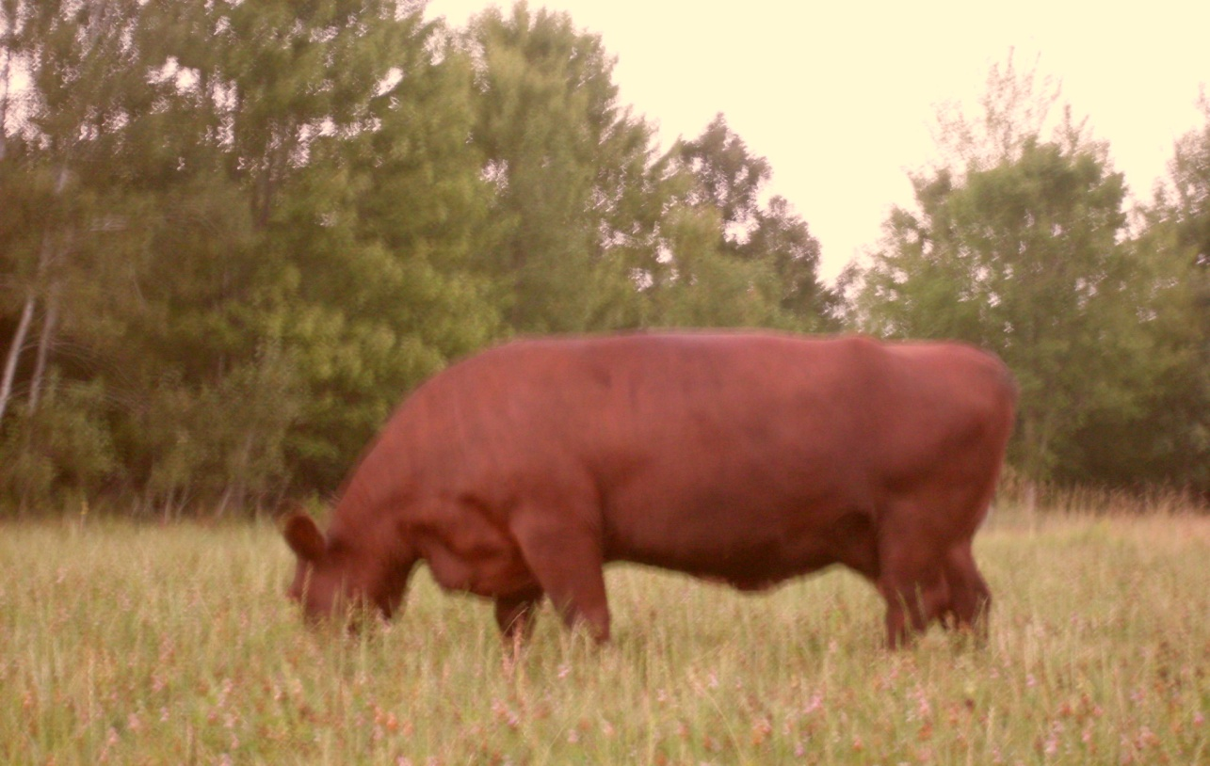
Sample Beef farm

Slide 2
Grazing Plan Components
Owner Data - goals
Land Data
Pasture info
Animal Data
Operation Data

Slide 3
Owner Data
Man hours available
Income Expectations
Type of owner
  Family farm, LLC, Inc., minority,
“Vision” or goal for operation – examples:
  Socially Responsible
  Environmentally focused
  Community oriented

Slide 4
Owner Info
Man hours
  Owners have limited time 1 hour per day
Income Expectations/goals
  For paying taxes and maintenance of farm and buildings
Type of Owner
  Family Farm
Vision
  Still working on a vision statement

Slide 5
Land Data
  Zoning
  Deed
  Other land use restrictions
  Soils
  Contours
  Utilities
  Sensitive areas
  Out-wintering or heavy use areas with pollution potential

Slide 6
Land Data
Zoning
  Wetland
  Shoreland Zoning
  Flood Plain Zoning
  Land Use – Ag, Residential, Commercial

Slide 7
Land Data
Deed
  Easements
  Setbacks
  Right of Ways
Other land use restrictions
  MFL program
  Current NRCS/FSA programs

Slide 8
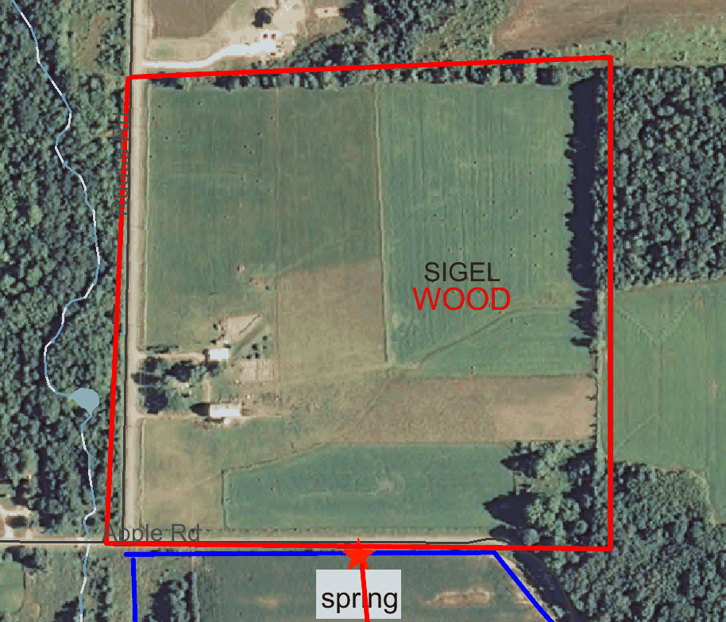
Current lay out

Slide 9
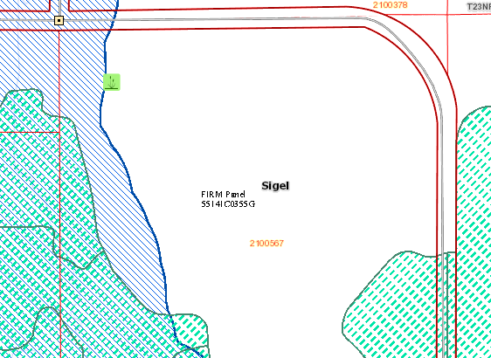
Zoning Maps

Slide 10
Land Data
Soils
Type with production information
Clay /Loam / Sand
        Depth to ground water
AU/Ac-Day

Slide 11
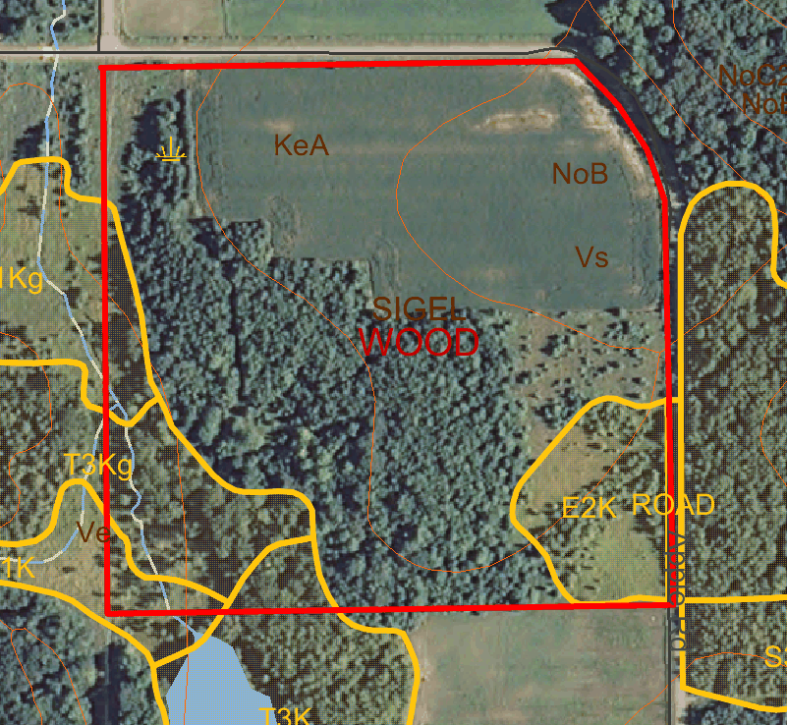
Soils

Slide 12
Soils
25.8 acres
Soil Types AUD Ton/Ac
  NoB Norgo Silt Loam 80 3.0
  Vs Vesper Silt 80 3.5
  KeA Kert Silt 130 3.5
  Soil is clay silt , poorly drained, with areas of high groundwater.
  Spring runs year-round – even in a drought year!

Slide 13
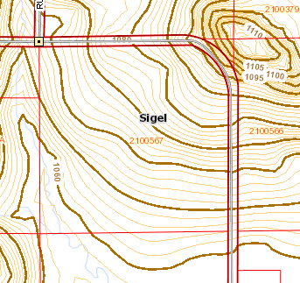
Land Data – contours

Slide 14
Land Data
Utilities -Location
  Electrical
  Telephone
  Gas
  Water
  Propane
  Barns & outbuildings
  Home

Slide 15
Operation Data
Current Resources
  Buildings
  Equipment
  Implements
  Animals

Slide 16
Animal Data
Types/Breed
Number or ratio of types
Suitable grasses for each type
Comingled

Slide 17
Operation Data
Product
  Cow/calf
  Stockers
  Horse
  Sheep/swine
  Poultry
Product type
  Grass fed?
  Organic?

Slide 18
Operation Info
Cow/calf to finish
Organic grass fed
Resources Available
  Old dairy barn with pens and headlocks
  Tractors, haybine, baler, wagon, brush hog
  Great neighbors

Slide 19
Stocking
Carrying capacity
25.8 ac X 3 ton/year/ac X 2000 lb/t = 13 AU
1000 AU X 0.04 lb/lb X 365 X 0.8
Cow = 1600 lb, Heifer/Steer = 1000 lb, Calves= 500 lb
Land can carry 4 sets of cow/heifer/calf.
Yield is 2 steers , 1 replacement heifer, one cull cow, and one heifer for sale.

Slide 20
Income
Income
  Cull cow – 1600 lb X 0.80 = $1280
  2 Steers 1200 lb X 1.50 =$3600
  1 heifer 1000 lb = $1800
  Total $6680

Slide 21
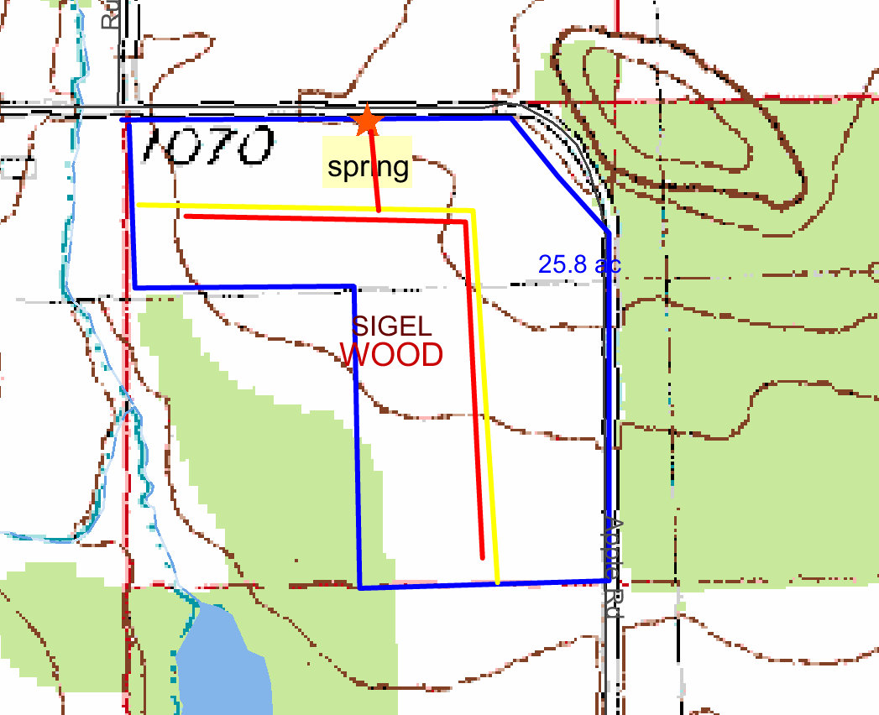
Fence and water line layout

Slide 22
Why we graze
None economic reasons
Family bonding activities
Healthy food for ourselves
Recreation
Enjoy the family pictures

Slide 23
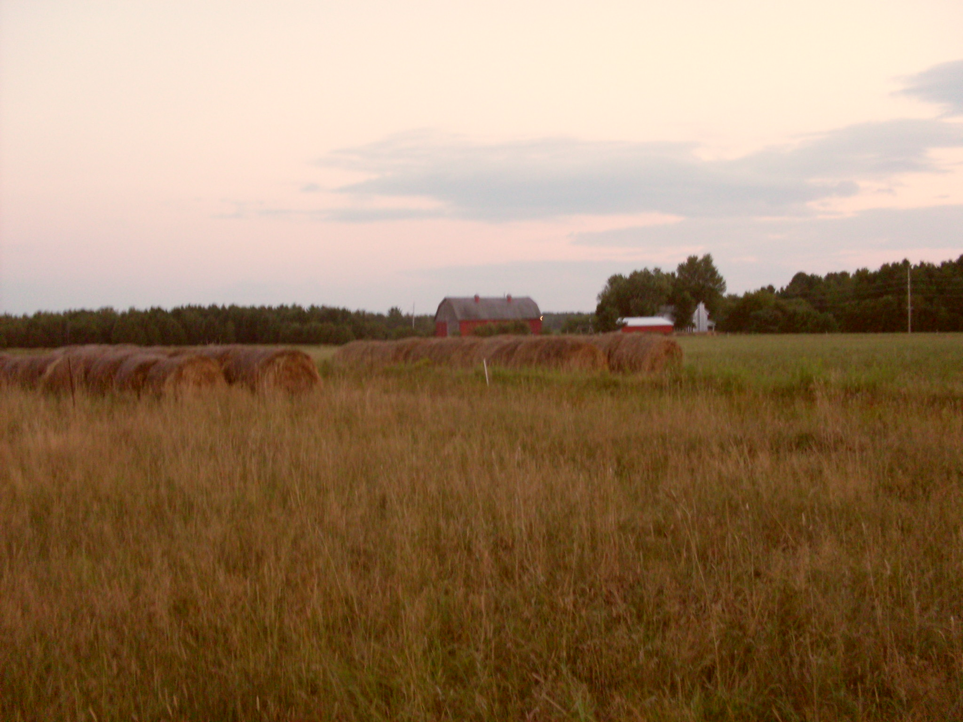

Slide 24
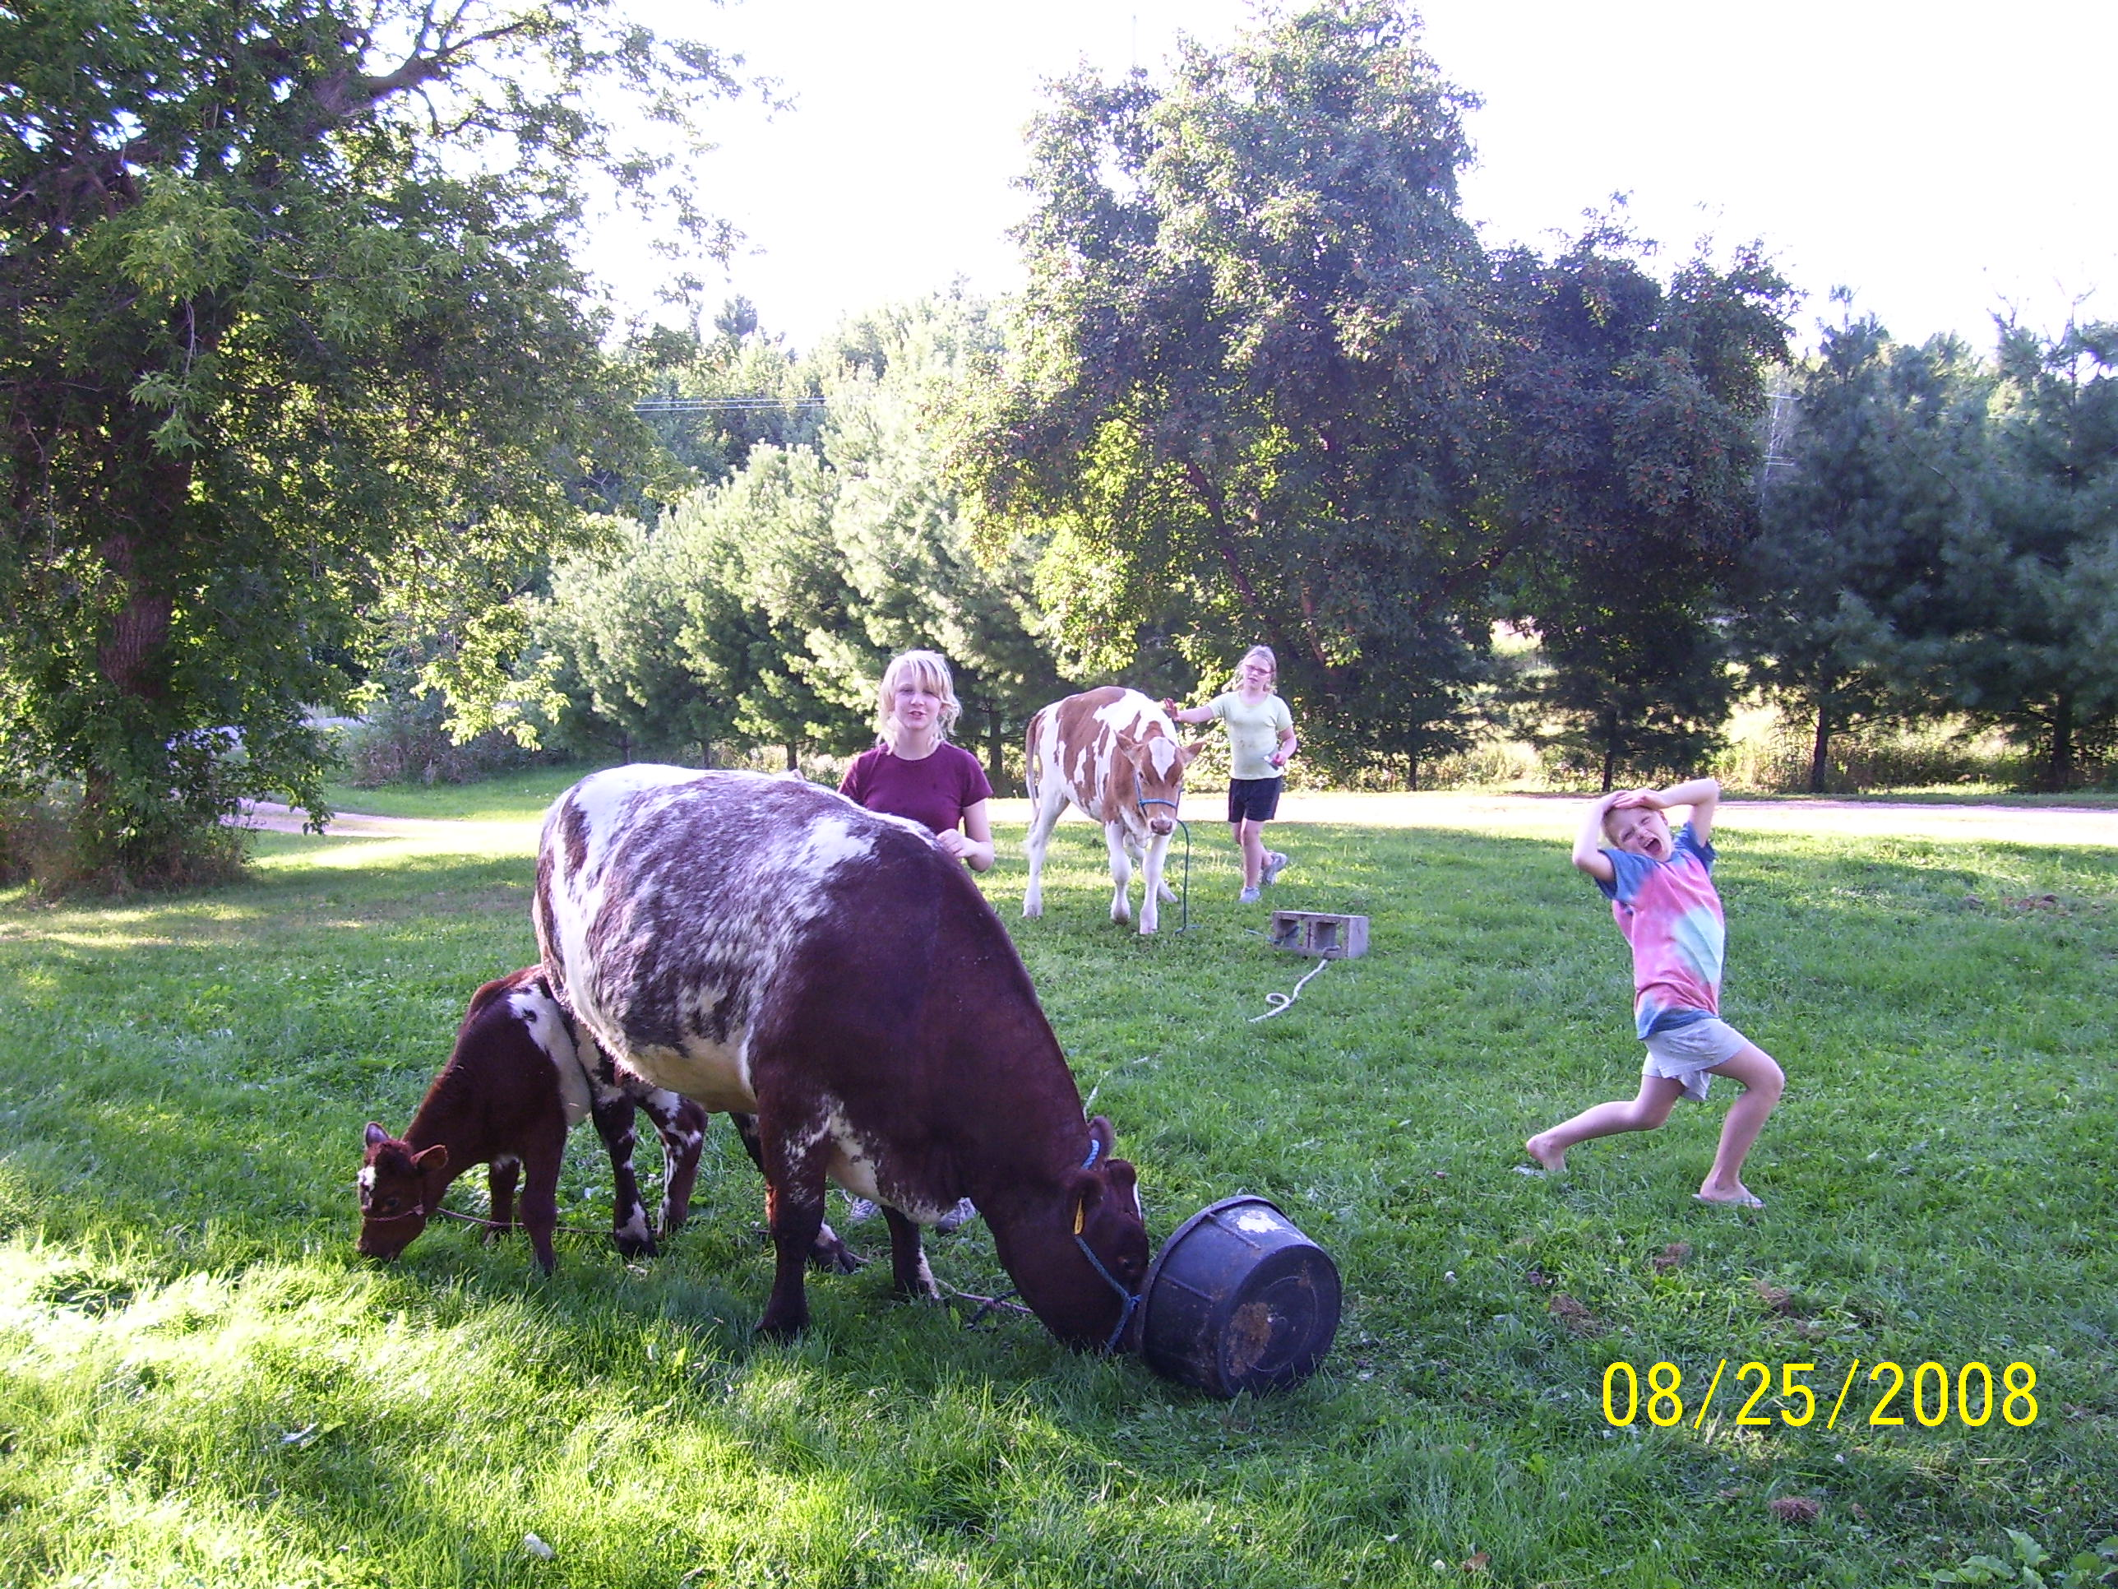

Slide 25
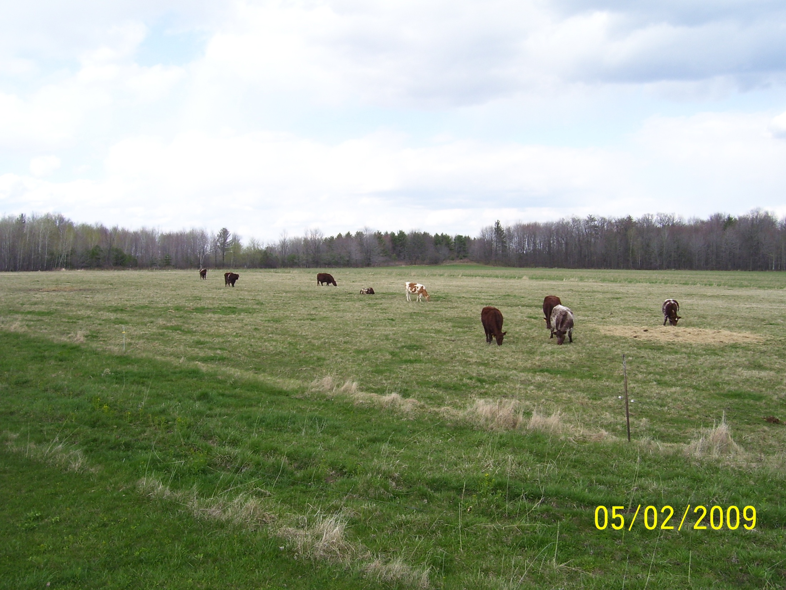

Slide 26
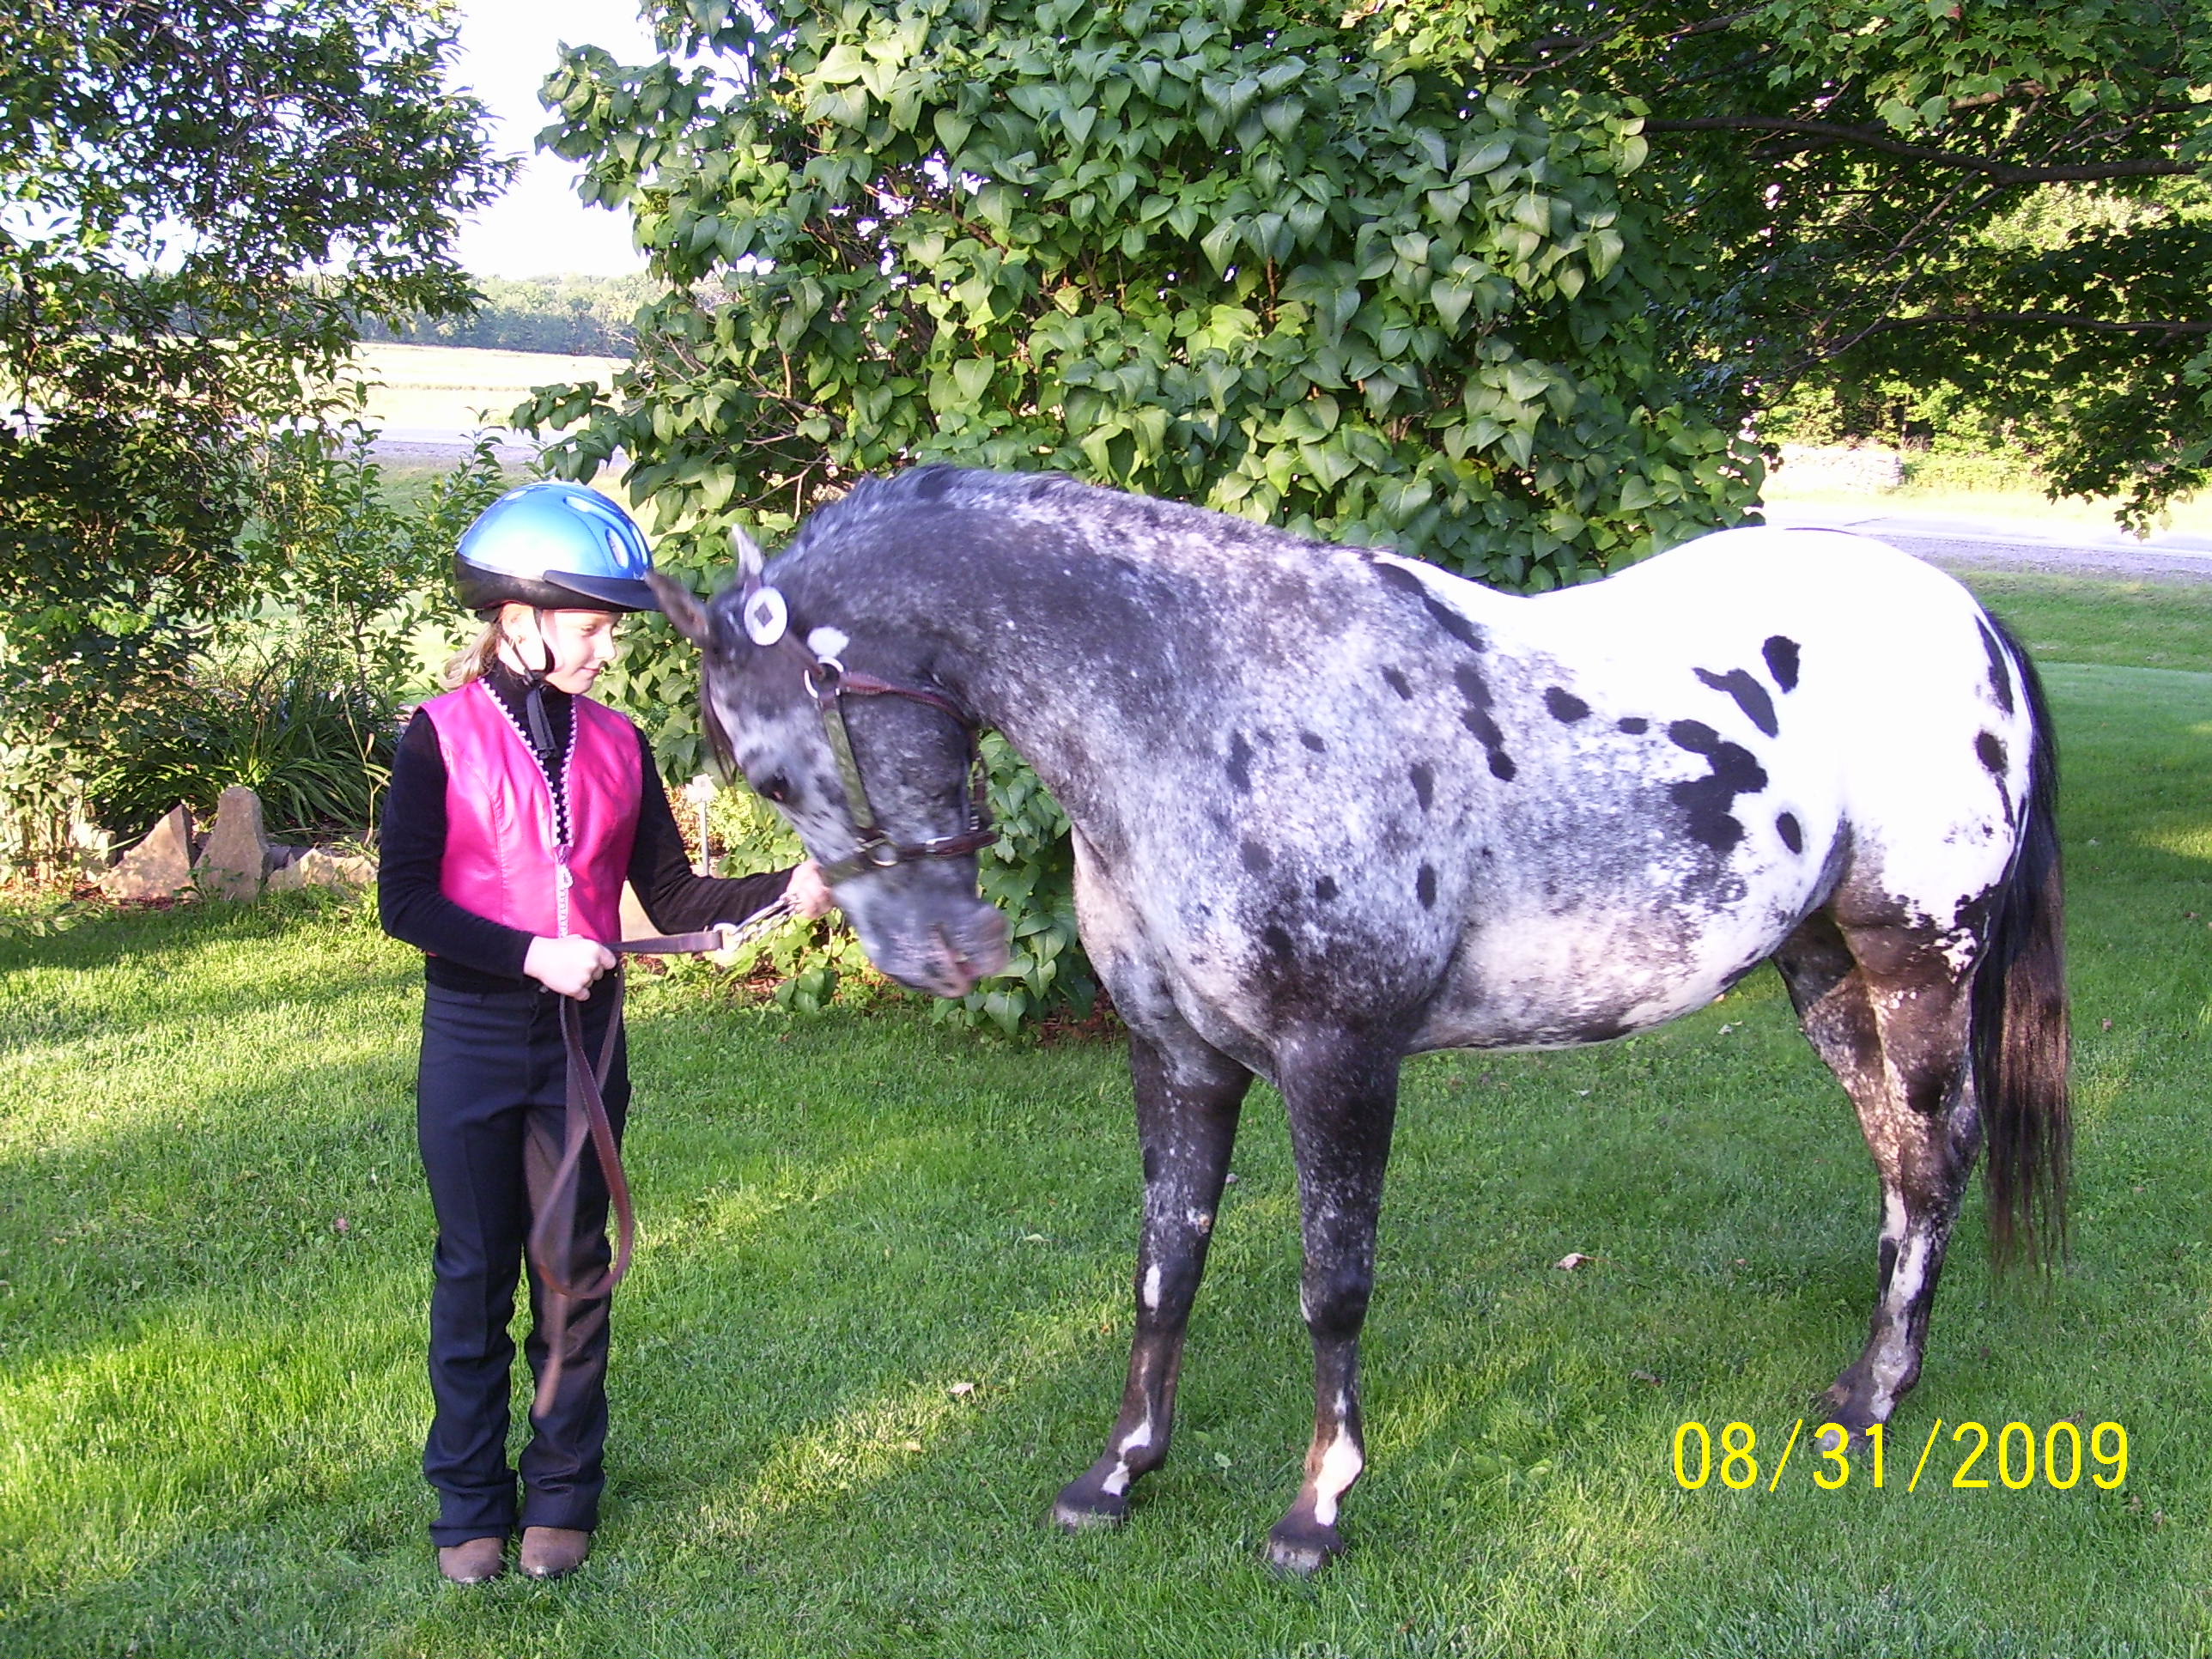

Slide 27
