Slide 1



Impacts of Rising Soil Salinity on Organic Watermelon Production
Joseph Bazzle, M. Cutulle, B. Ward
LS22-369

Slide 2
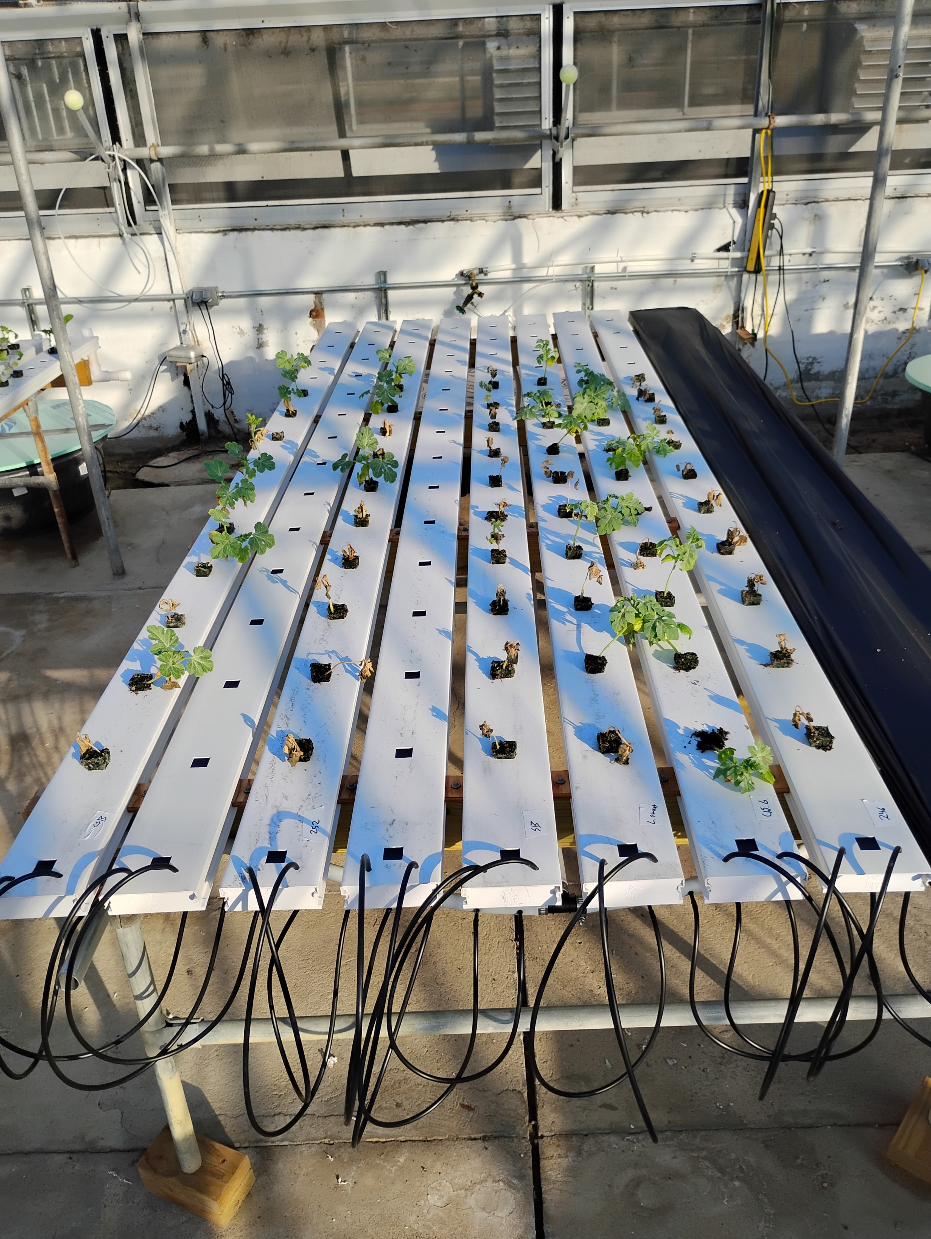
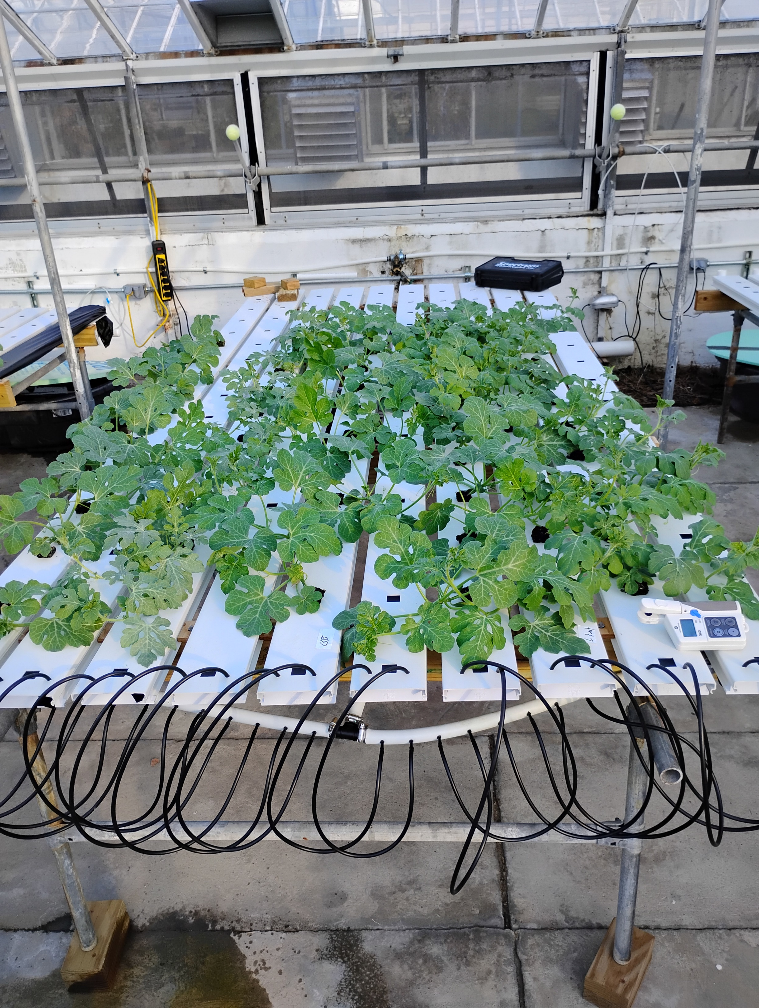
Effects of Salinity on Plant Growth
The initial symptoms of salinity stress can appear very similar to drought stress
As time passes plants can accumulate toxic levels of ions in the plant cells, further disrupting plant growth and yield.
Plants experiencing salinity stress can experience stunted or delayed growth, changes in pigmentation, and at high concentrations it will lead to plant death.
Variations in salt tolerance can result in modified crop-weed interactions and may give an advantage to certain weed species. (V. Cirillo et. al)
Left: watermelon plants grown in a hydroponic solution containing 30% artificial seawater
Right: watermelon plants grown in a hydroponic solution containing no seawater

Slide 3
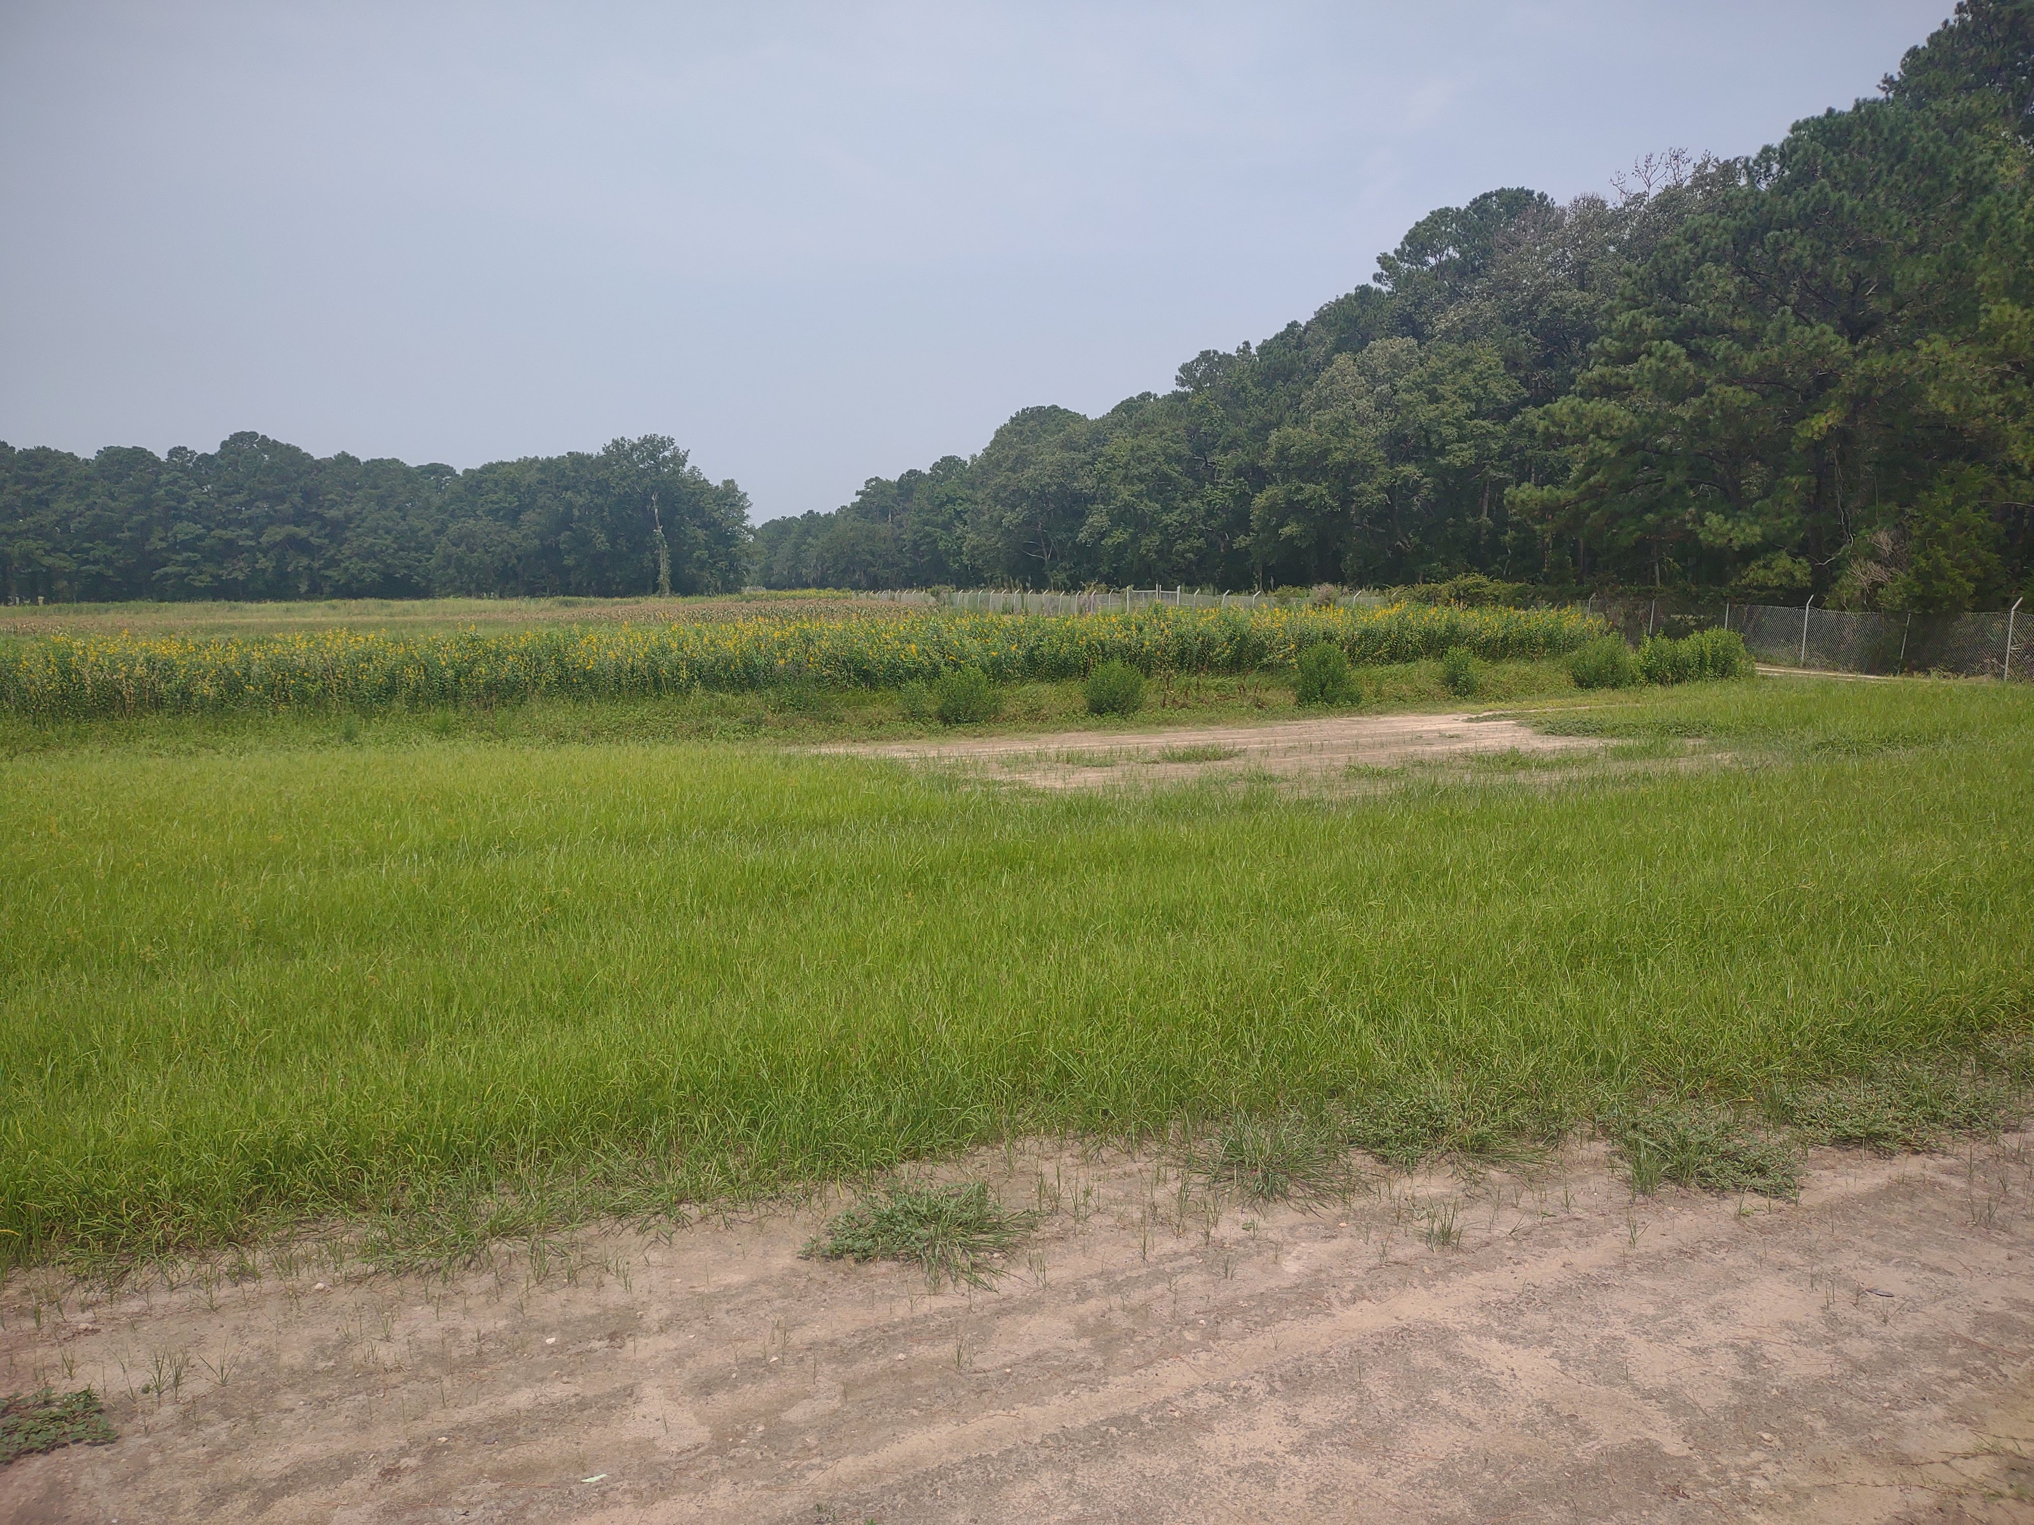
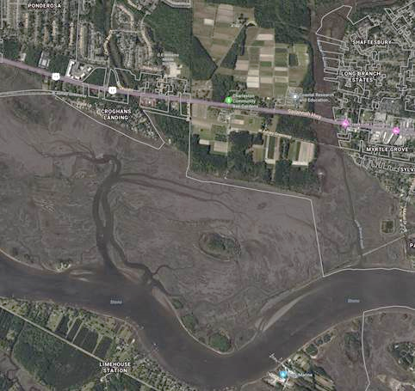
Charleston, SC
Field F16
Low points in the terrain allow water to collect and create highly saline “hotspots” in the field.
Marsh
Courtesy of Bing Maps © 2024 Microsoft

Slide 4
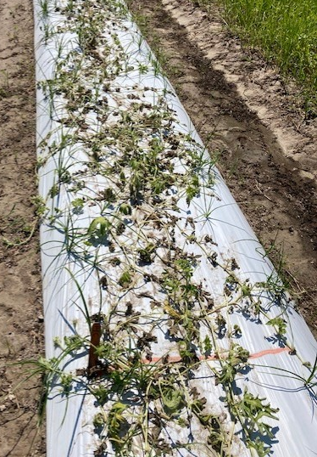
Weed Control
Plasticulture is a common method of weed control in watermelon production and is one of the most effective methods of organic weed control.
Yellow nutsedge (Cyperus esculentus) remains a major pest in watermelon production, especially in plasticulture systems.
The critical weed free period for watermelon is two to four weeks after transplant
A bed of watermelons overrun with yellow nutsedge

Slide 5
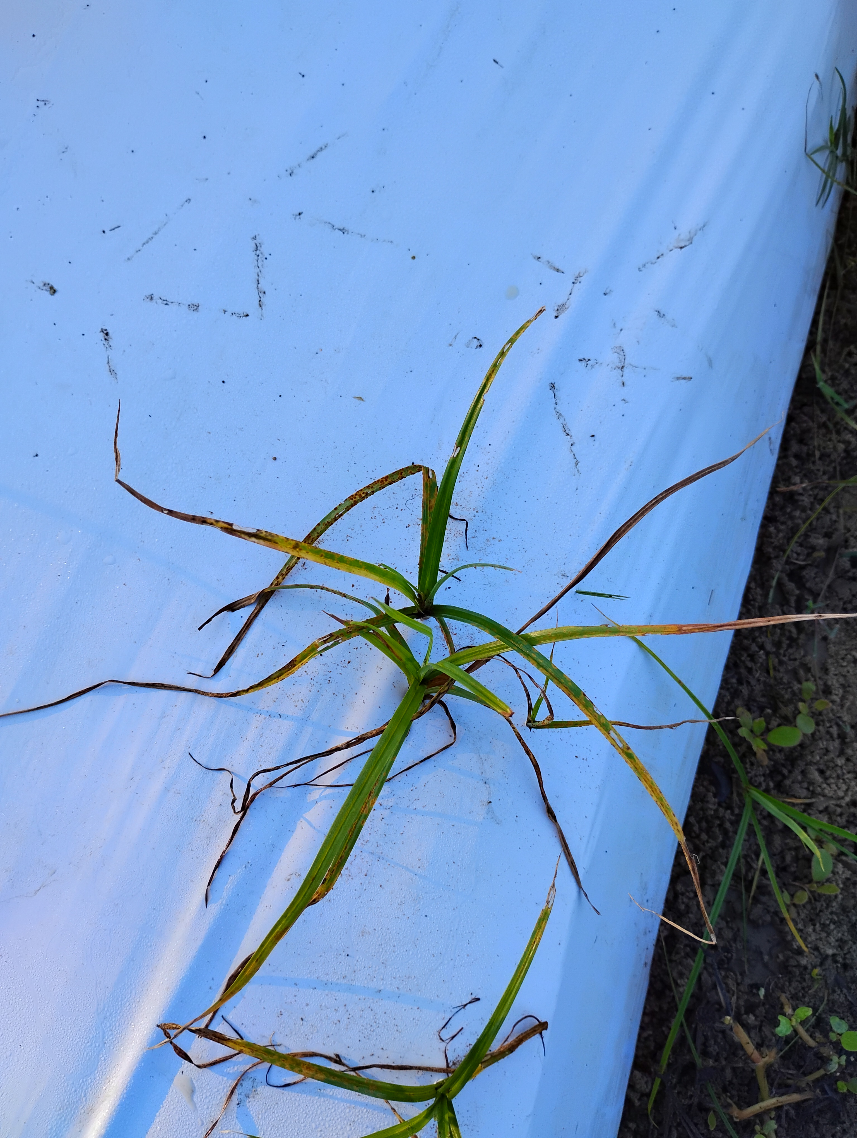
Research Objectives
Identify potentially salt resistant rootstocks.
Investigate the impact of saline soil on watermelon-weed competition.

Slide 6
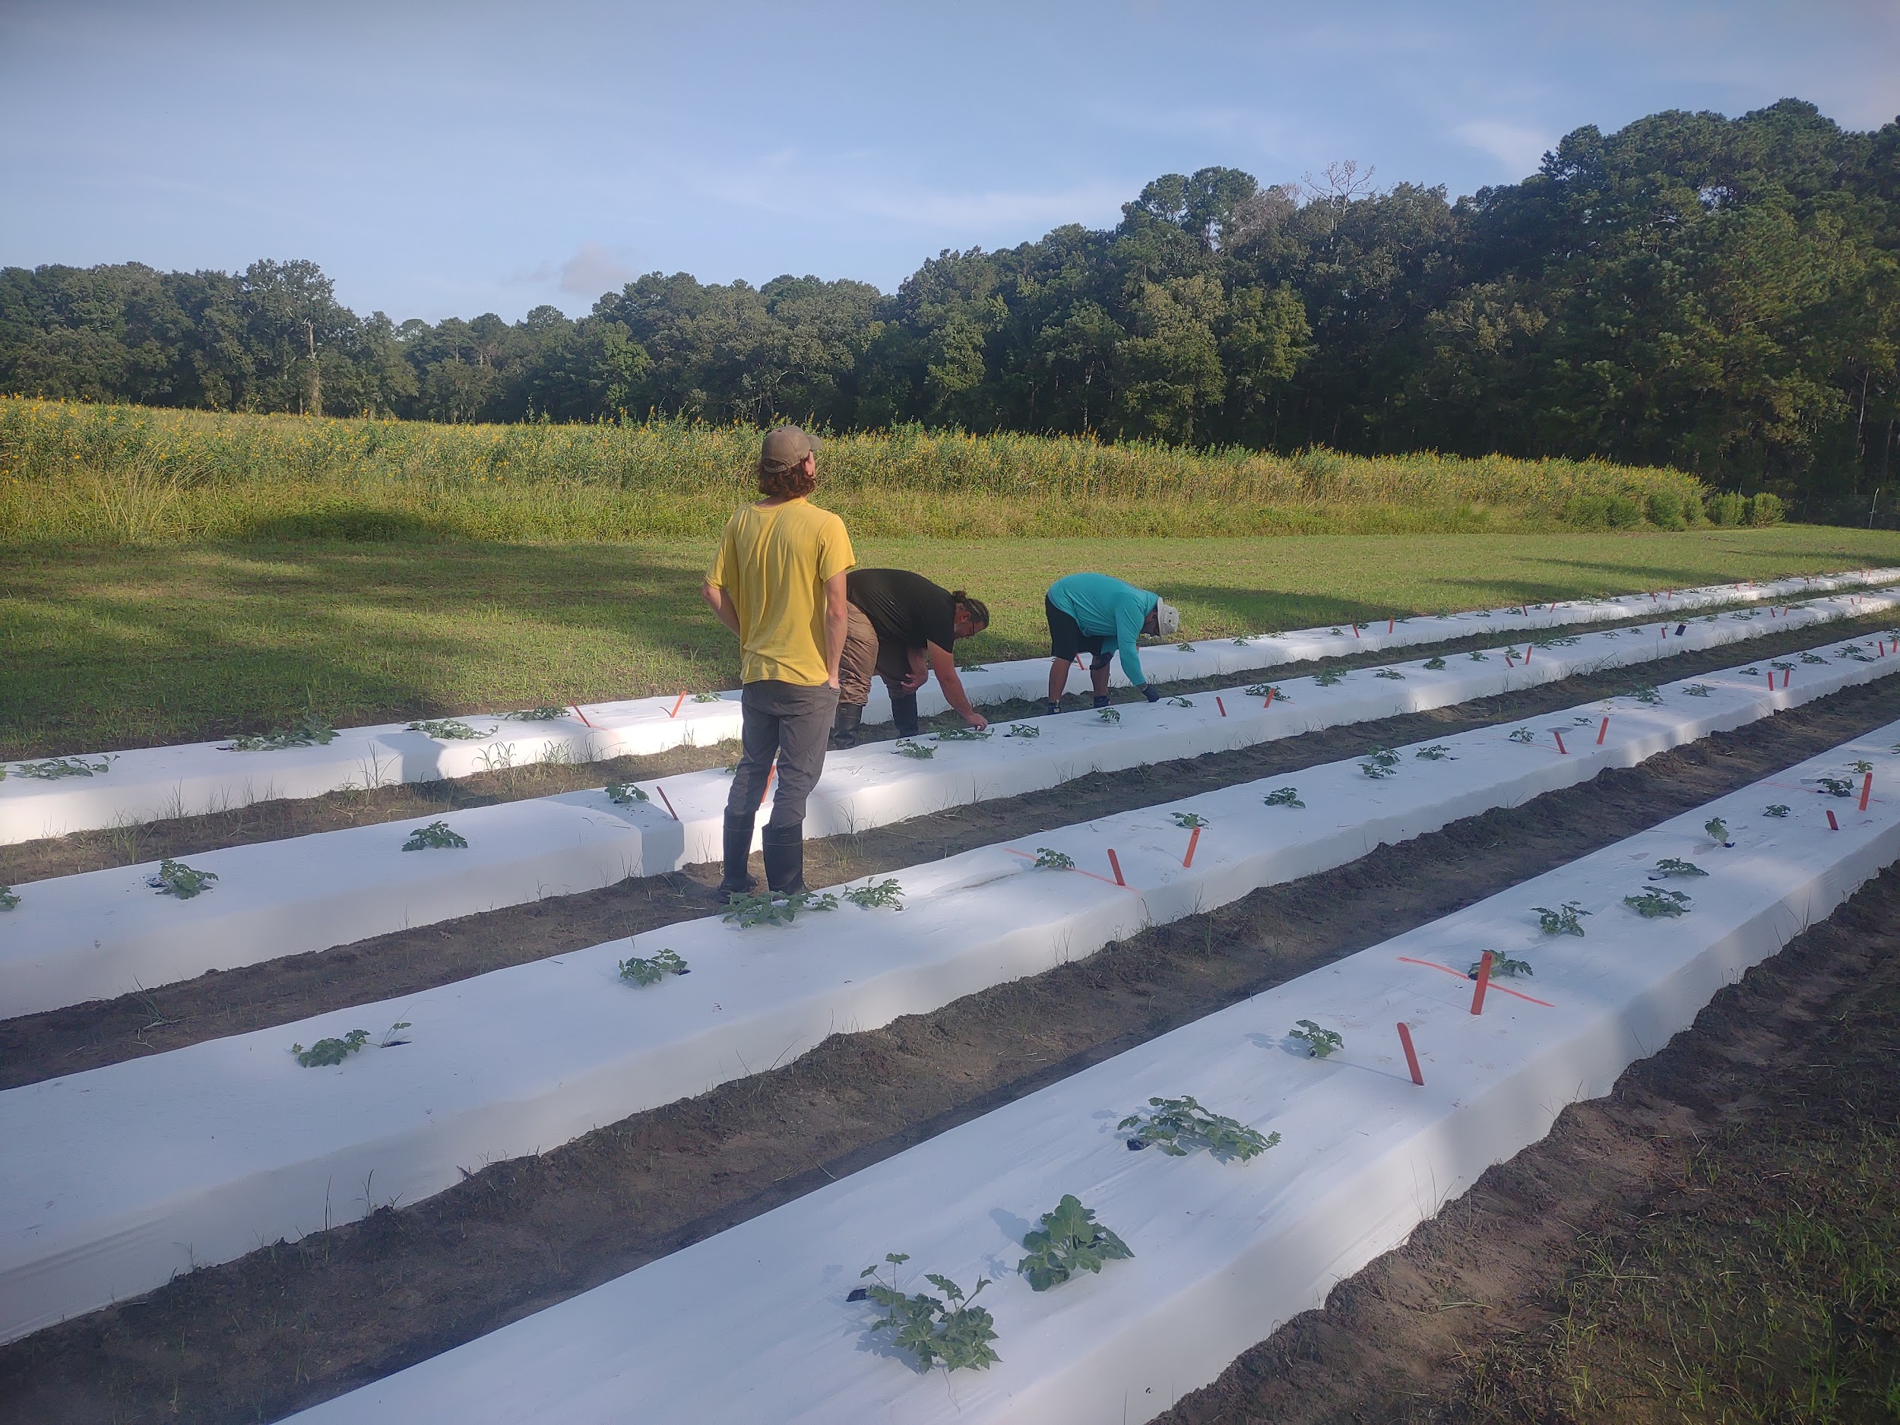
Salinity Field Trial
For this field trial, watermelons were grafted onto two rootstock varieties, along with a grafted and a non-grafted control
The scion used for all plants was Melody, a common seedless watermelon variety.
The experiment was conducted using organic techniques and plastic mulch was used for weed control.
Transplanting the watermelons into the field

Slide 7
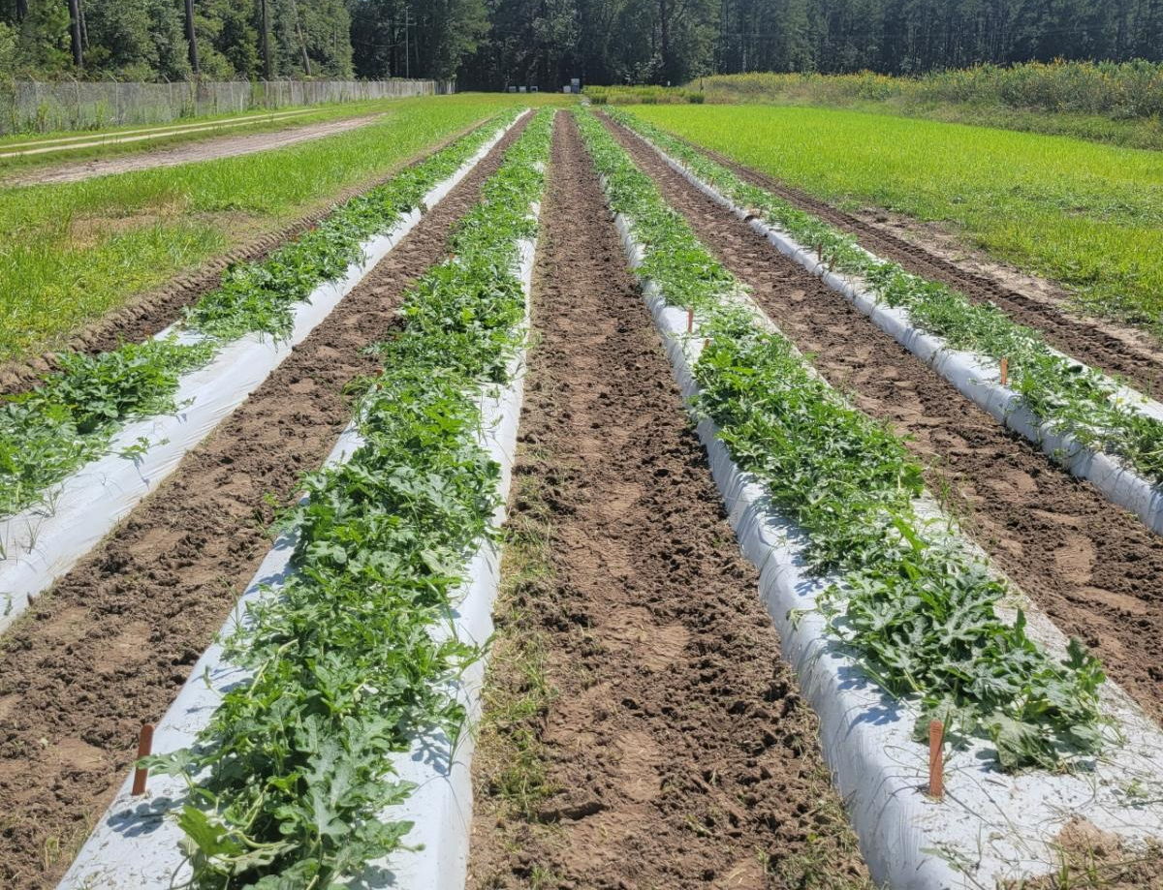
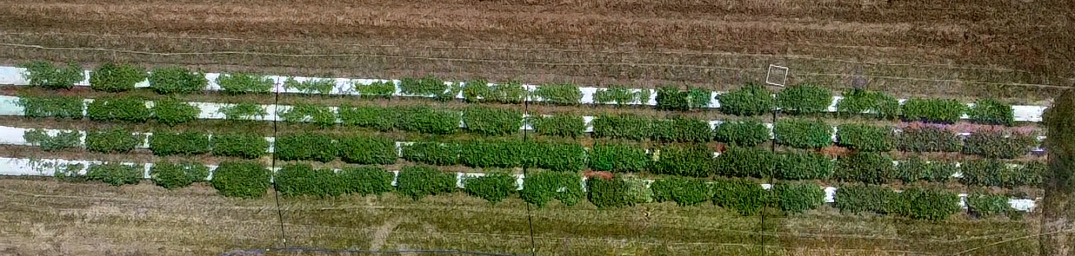
Field Layout
The field was arranged in a Latin Square Design, with each set of blocks receiving a different salinity treatment.
Sea water was obtained locally and mixed in a 250gal plastic container on site prior to irrigation.
Top: a front view of the field showing all four rows
Right: an aerial view of the field showing the irrigation setup for the field

Slide 8
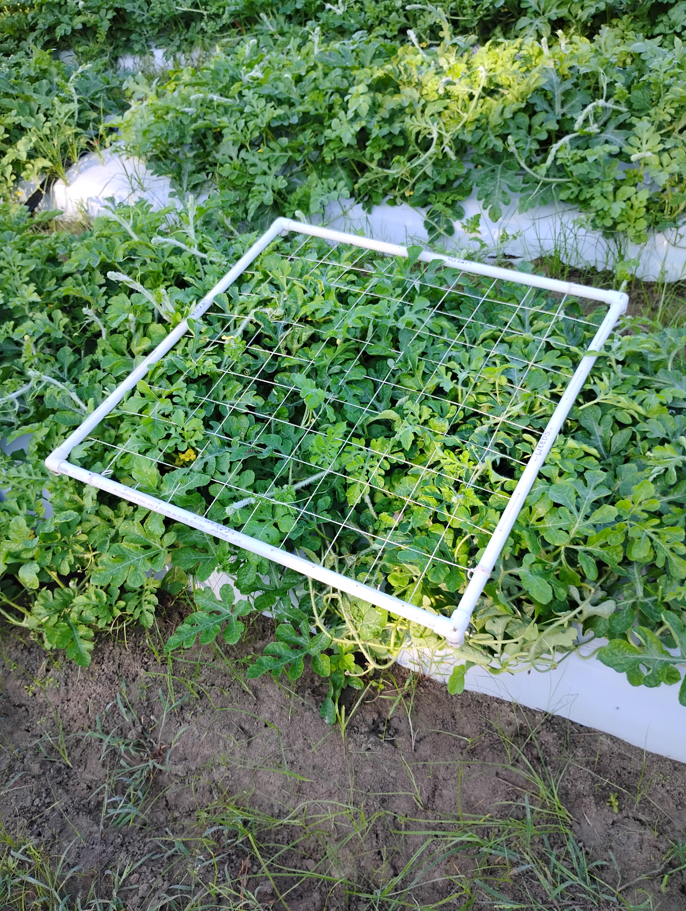
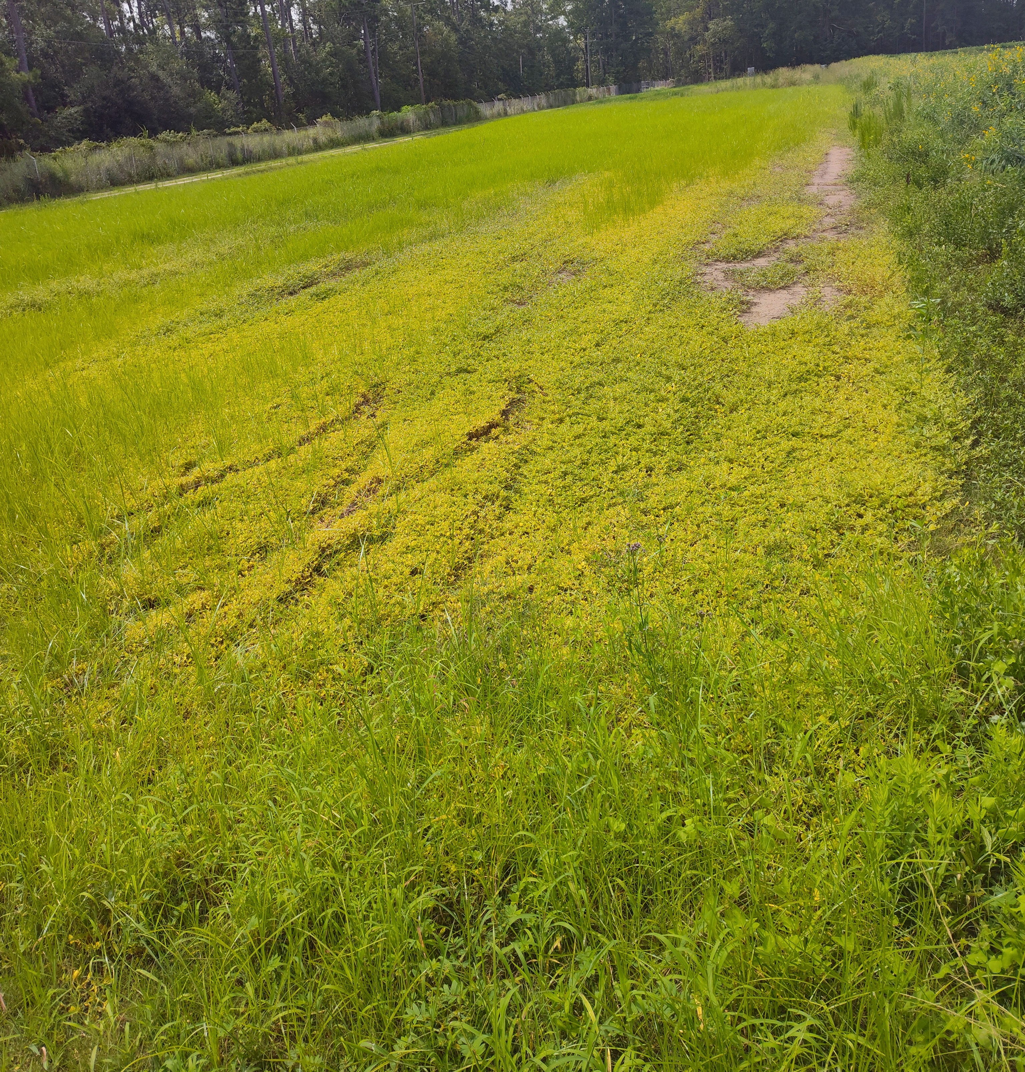
Weed Counts
The field used for this trial contained a thick stand of yellow nutsedge and was suspected to contain rice flatsedge(Cyperus iria) as well.
A one-meter quadrat was used for the weed counts
The quadrat used for nutsedge counts, placed directly over the crown root of a watermelon plant.
Weed stands prior to preparing the field. Most of the field was densely covered in yellow nutsedge, but the areas with the highest salinity would only grow purslanes.

Slide 9
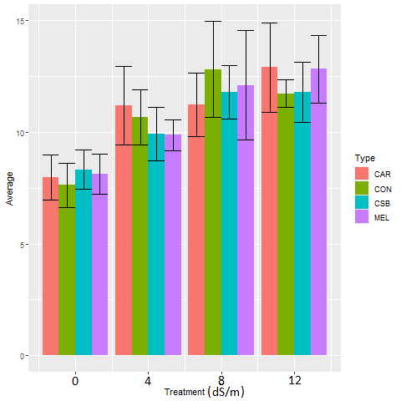
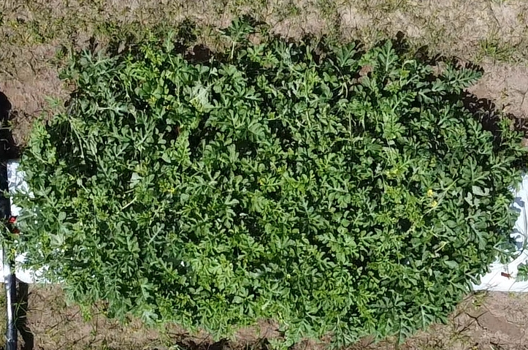
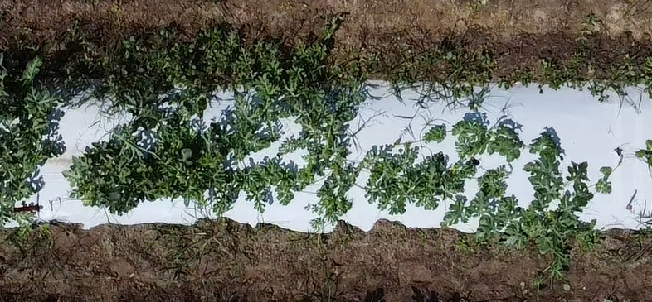
Weed Control – Early Season
During the early part of the growing season the weed counts were higher in treated areas of the field.
This effect is possibly the result of a thinner canopy in the watermelon plants
A watermelon bed irrigated with saline water(left) and freshwater(right).
Weed counts in each salinity treatment for both growing seasons

Slide 10
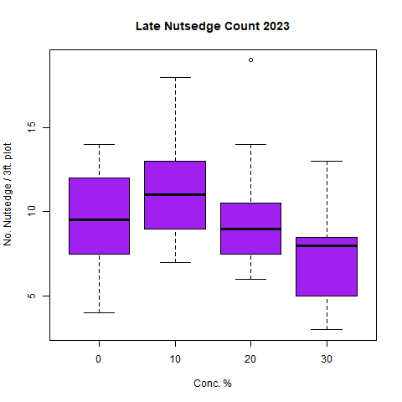
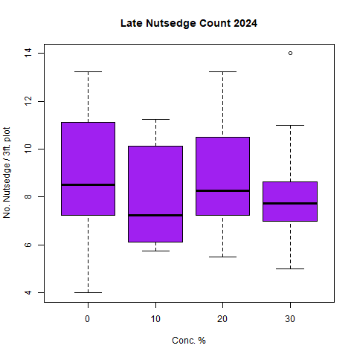
Weed Control - Postharvest
During the first field trial there was a decrease in average nutsedge counts by the end of the season, however in the second season it did not follow this pattern
The average post-harvest nutsedge counts for all plots were lower in the second season
m²
m²
Postharvest yellow nutsedge counts in 2023 (left) and 2024 (right)

Slide 11
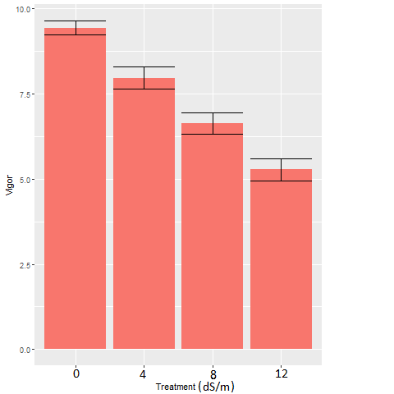
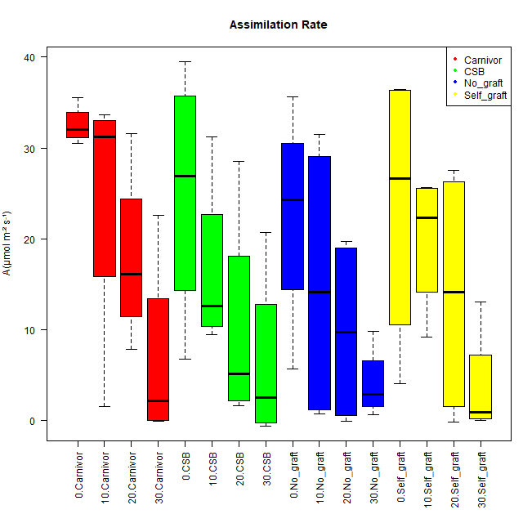
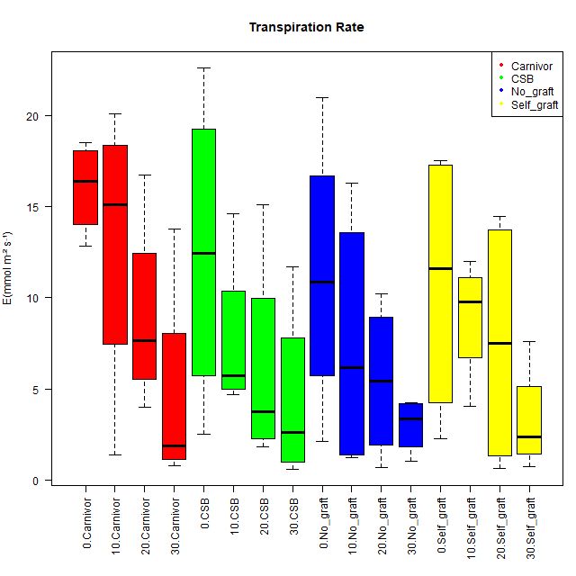
Rootstock Response
The relationship between rootstock variety and salinity response was insignificant
Plant Vigor Ratings by Salinity Treatment. There was no significant difference between rootstocks.
Conc. % x Rootstock
Conc. % x Rootstock
Assimilation (left) and transpiration (right) rates for each salinity-rootstock combination. Measurements were taken using a Licor LI-6800.

Slide 12
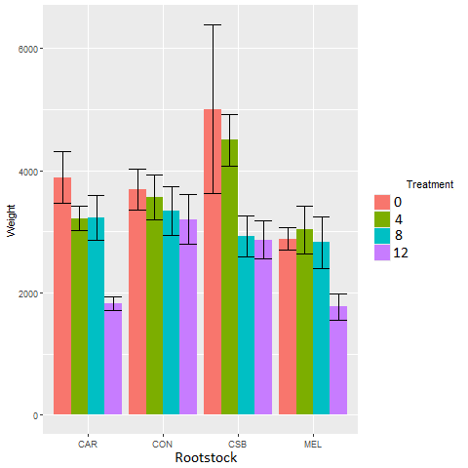
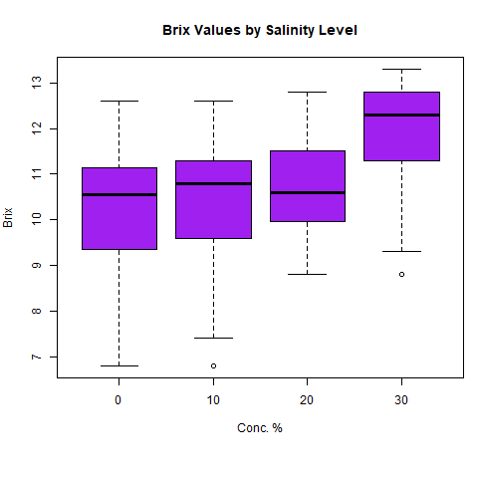
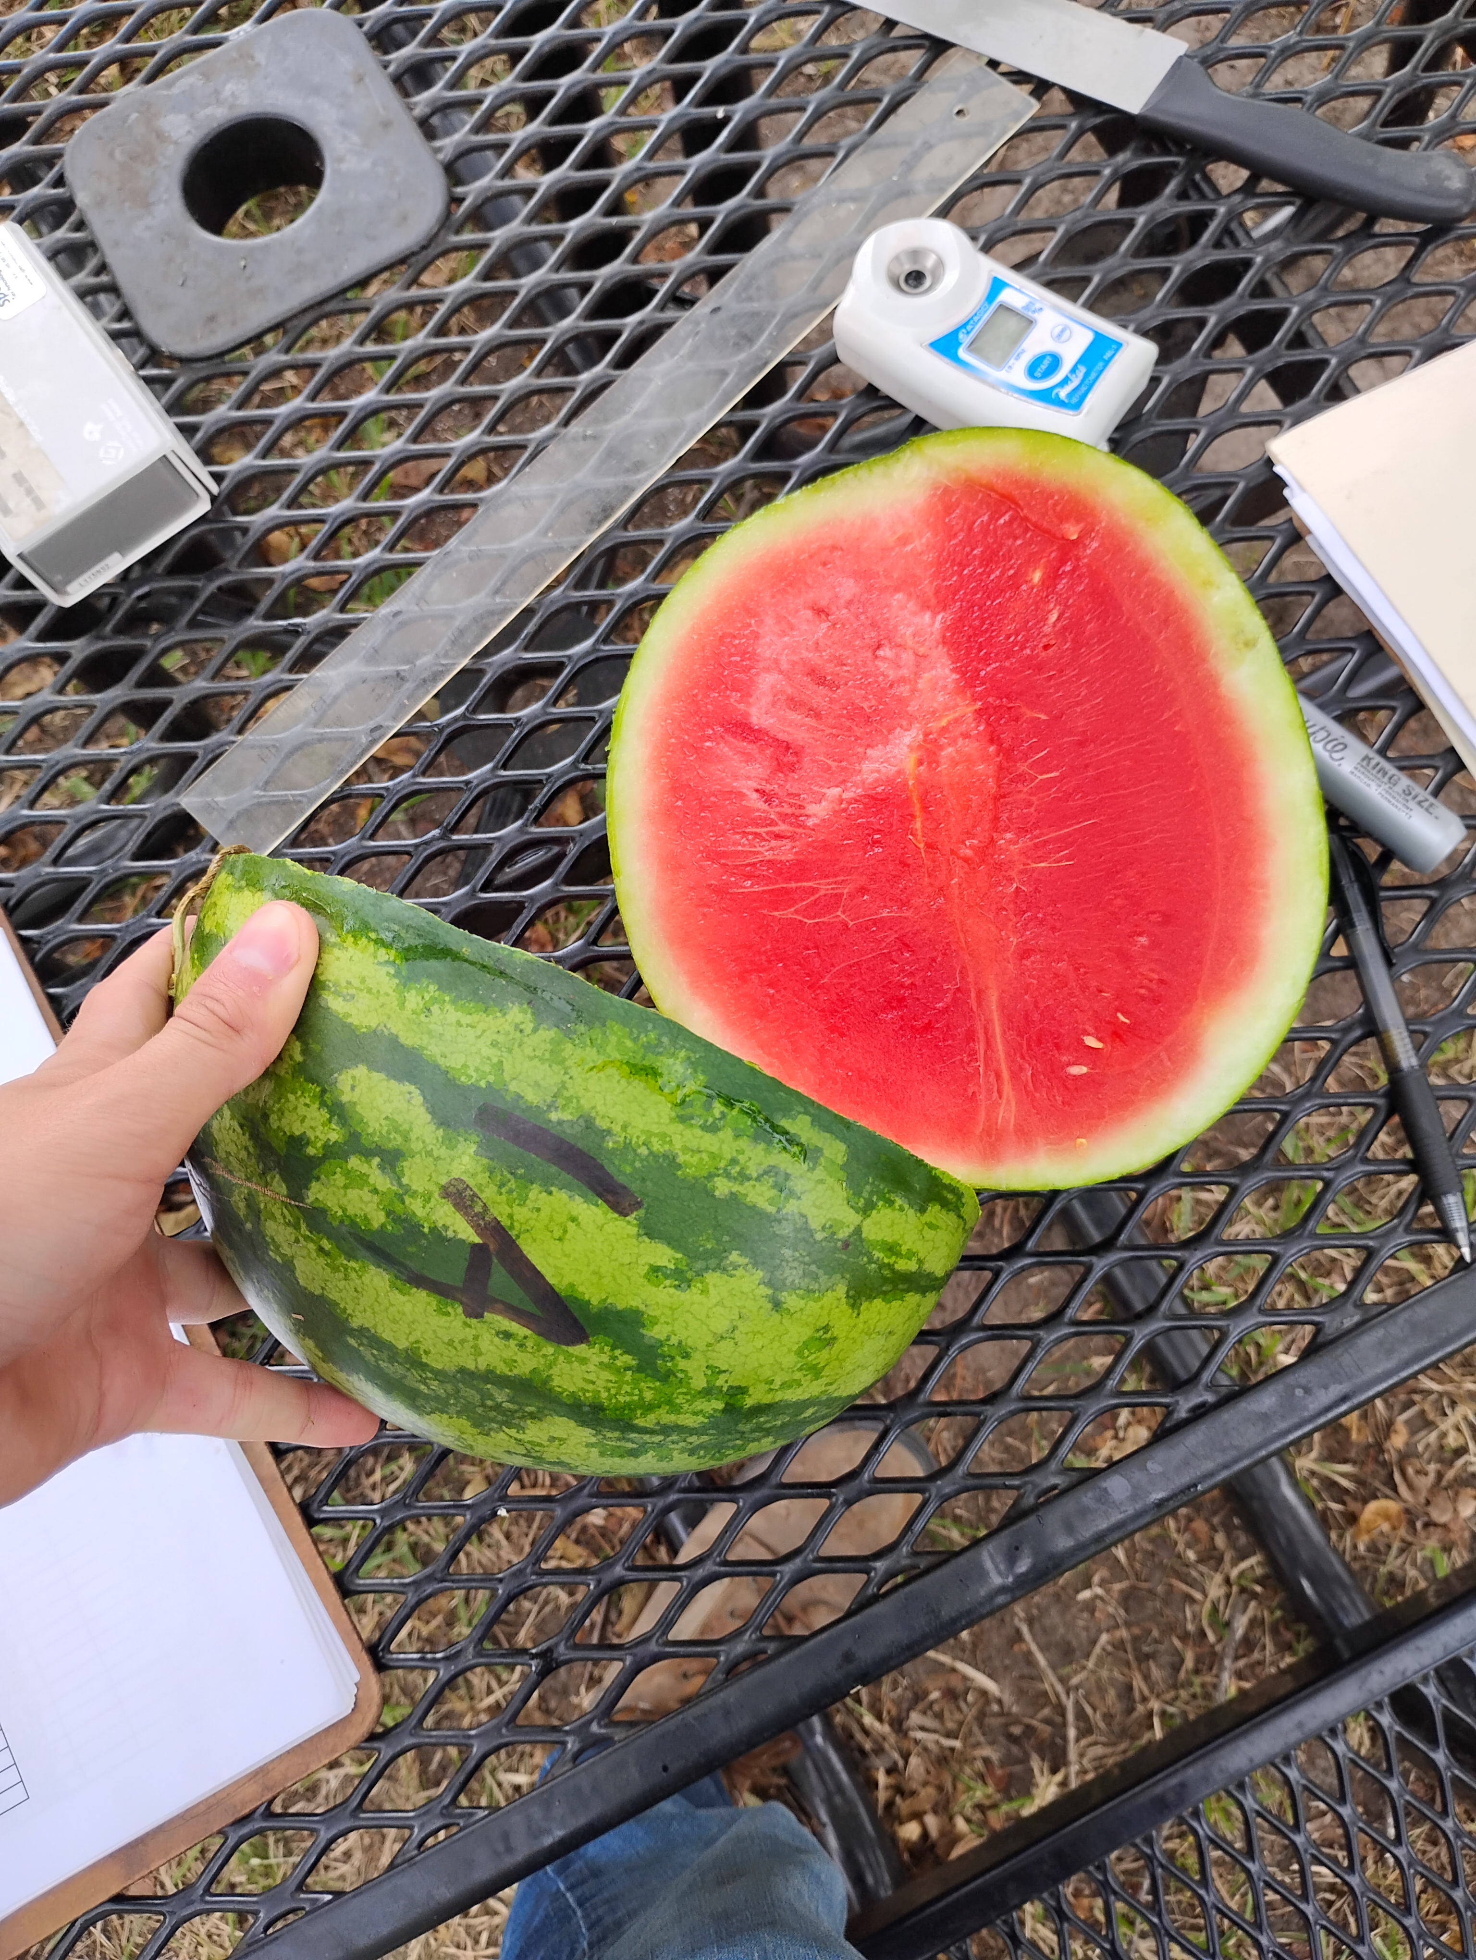
Fruit Quality
Plots treated with higher salinity produced a higher Brix value, potentially due to dissolved salts in the fruit
Fruit weights for all combinations of rootstock and salinity treatments
Fruit Brix values by salinity treatment

Slide 13
Summary
The rootstock varieties used in this trial did not have a significant impact on plant outlook.
The early nutsedge counts indicate that elevated salinity levels during the early part of the season can contribute to an increase in the number of nutsedge plants.
The results of the post harvest weed counts were different between the two seasons.

Slide 14
Future Research
Based on the results of the nutsedge counts, more work is needed to determine if there is a long-term effect on weed populations.
Additionally, since none of the rootstocks were effective in improving salinity response, there is a need to identify or develop new salinity tolerant watermelon varieties.

Slide 15
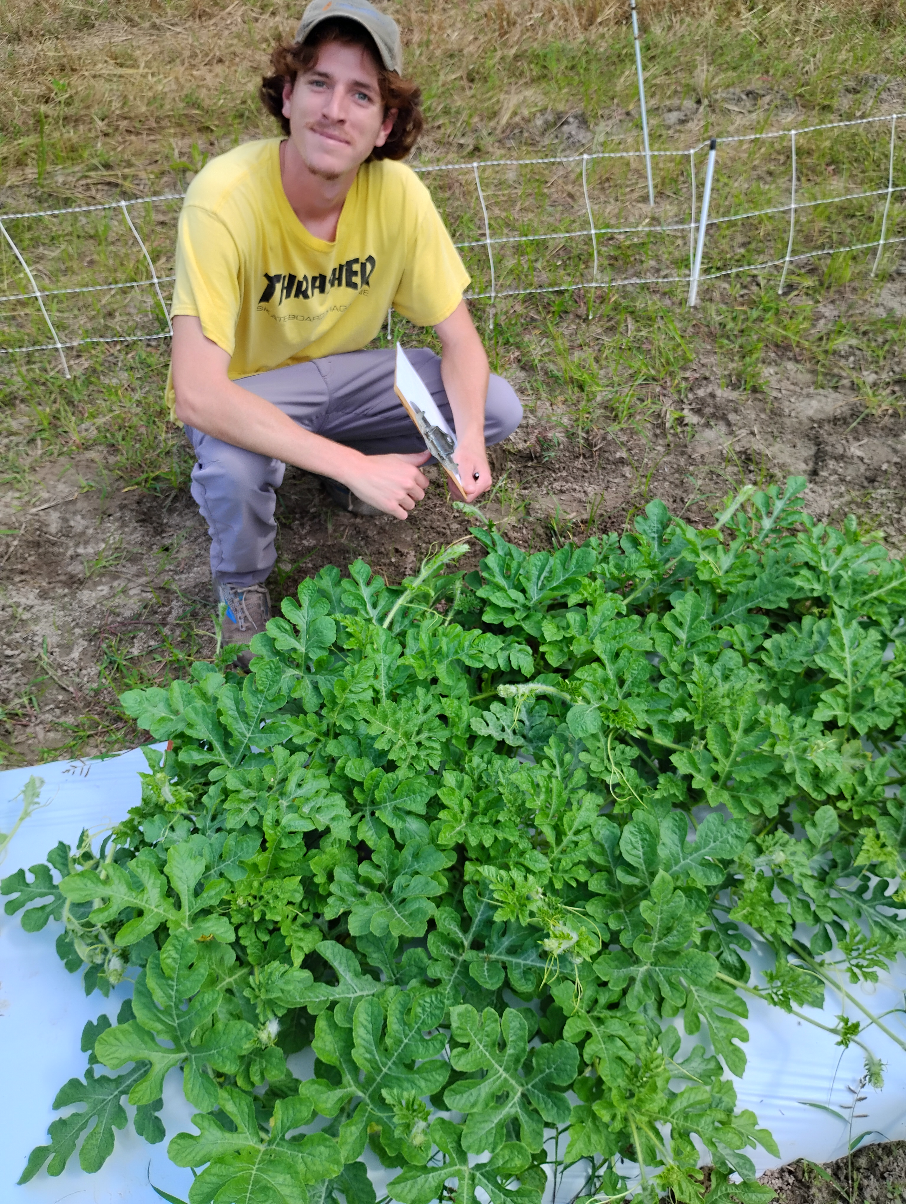
Special Thanks
Committee:
Chair – Dr. Matthew Cutulle
Co-Chair – Dr. Brian Ward
Dr. Sandra Branham
Dr. Amnon Levi
Dr. William Bridges
LS22-369

