Slide 1
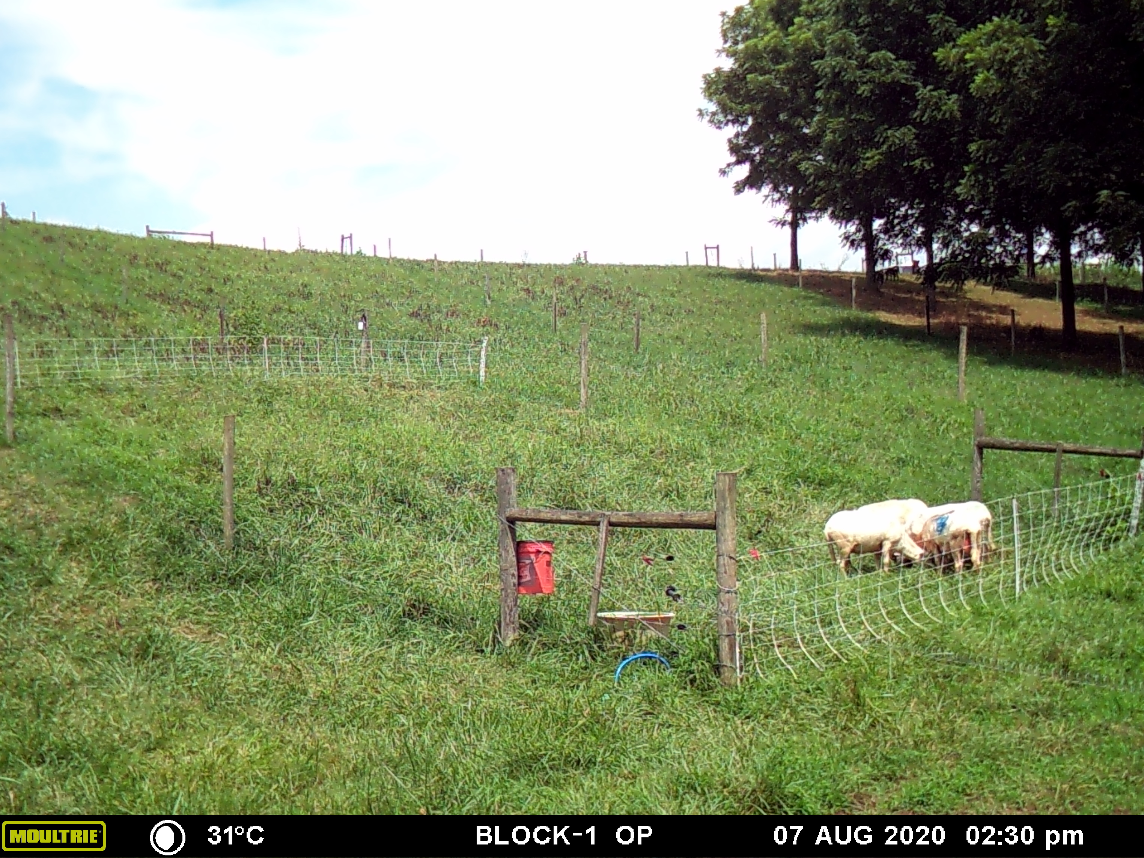
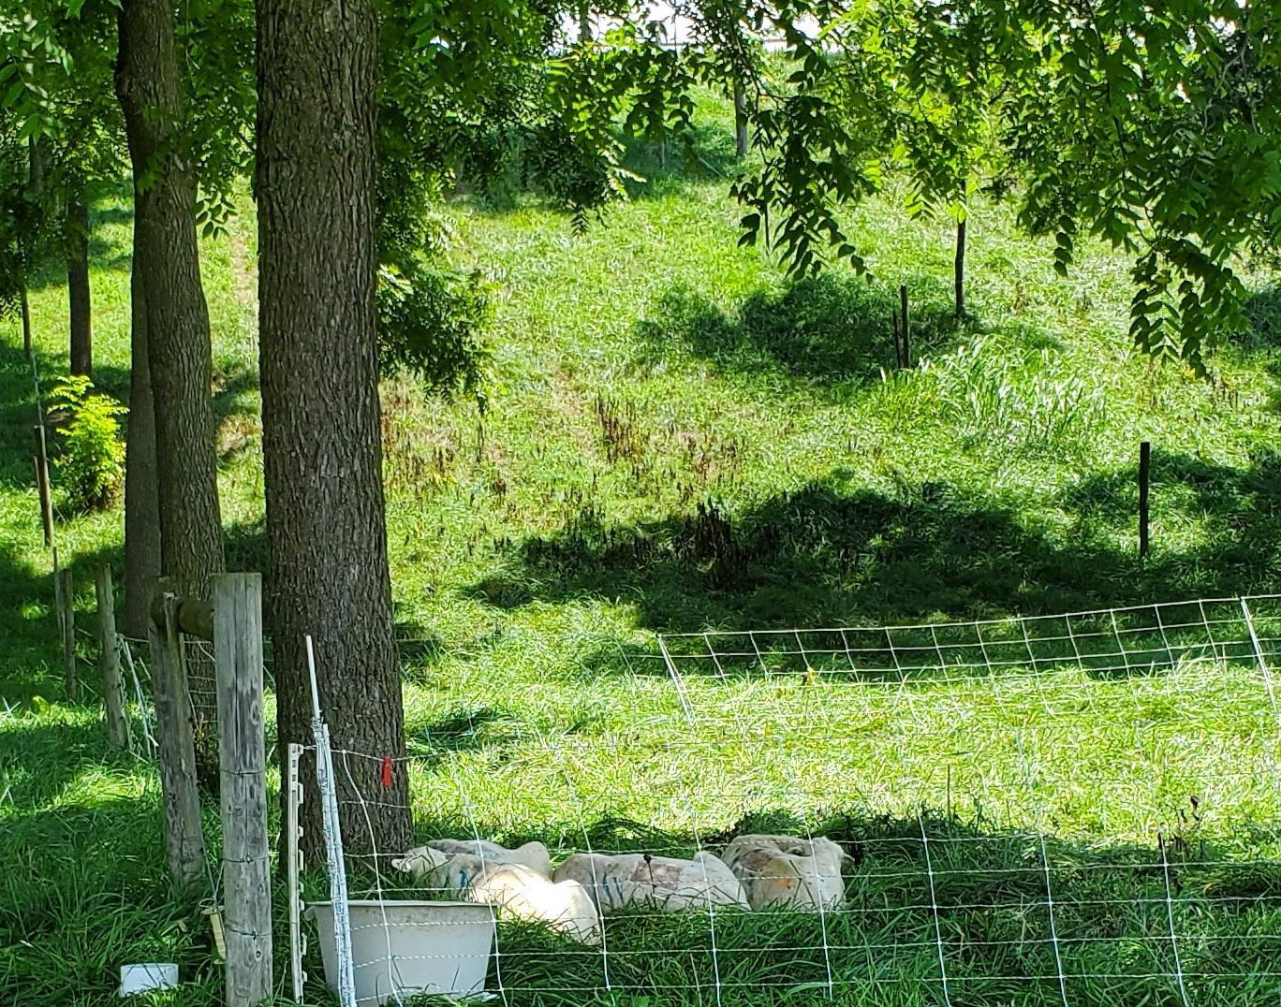
Intravaginal Temperature
0.9-1.8 °F hotter intravaginal temps between 1200 h-1700 h
P≤0.04
Ewes in OP
Ewes in BW SP
Page 13 of 17
Notes:
This resulted in 1 to 2 degrees F lower intravaginal temps during the heat of the day. And that added stress

Slide 2
Cortisol (stress hormone) levels
Higher hair cortisol in OP vs SPs
P<0.01
Hair Cortisol
Notes:
Translated to greater cortisol levels for the animals in open pastures.

