Slide 1
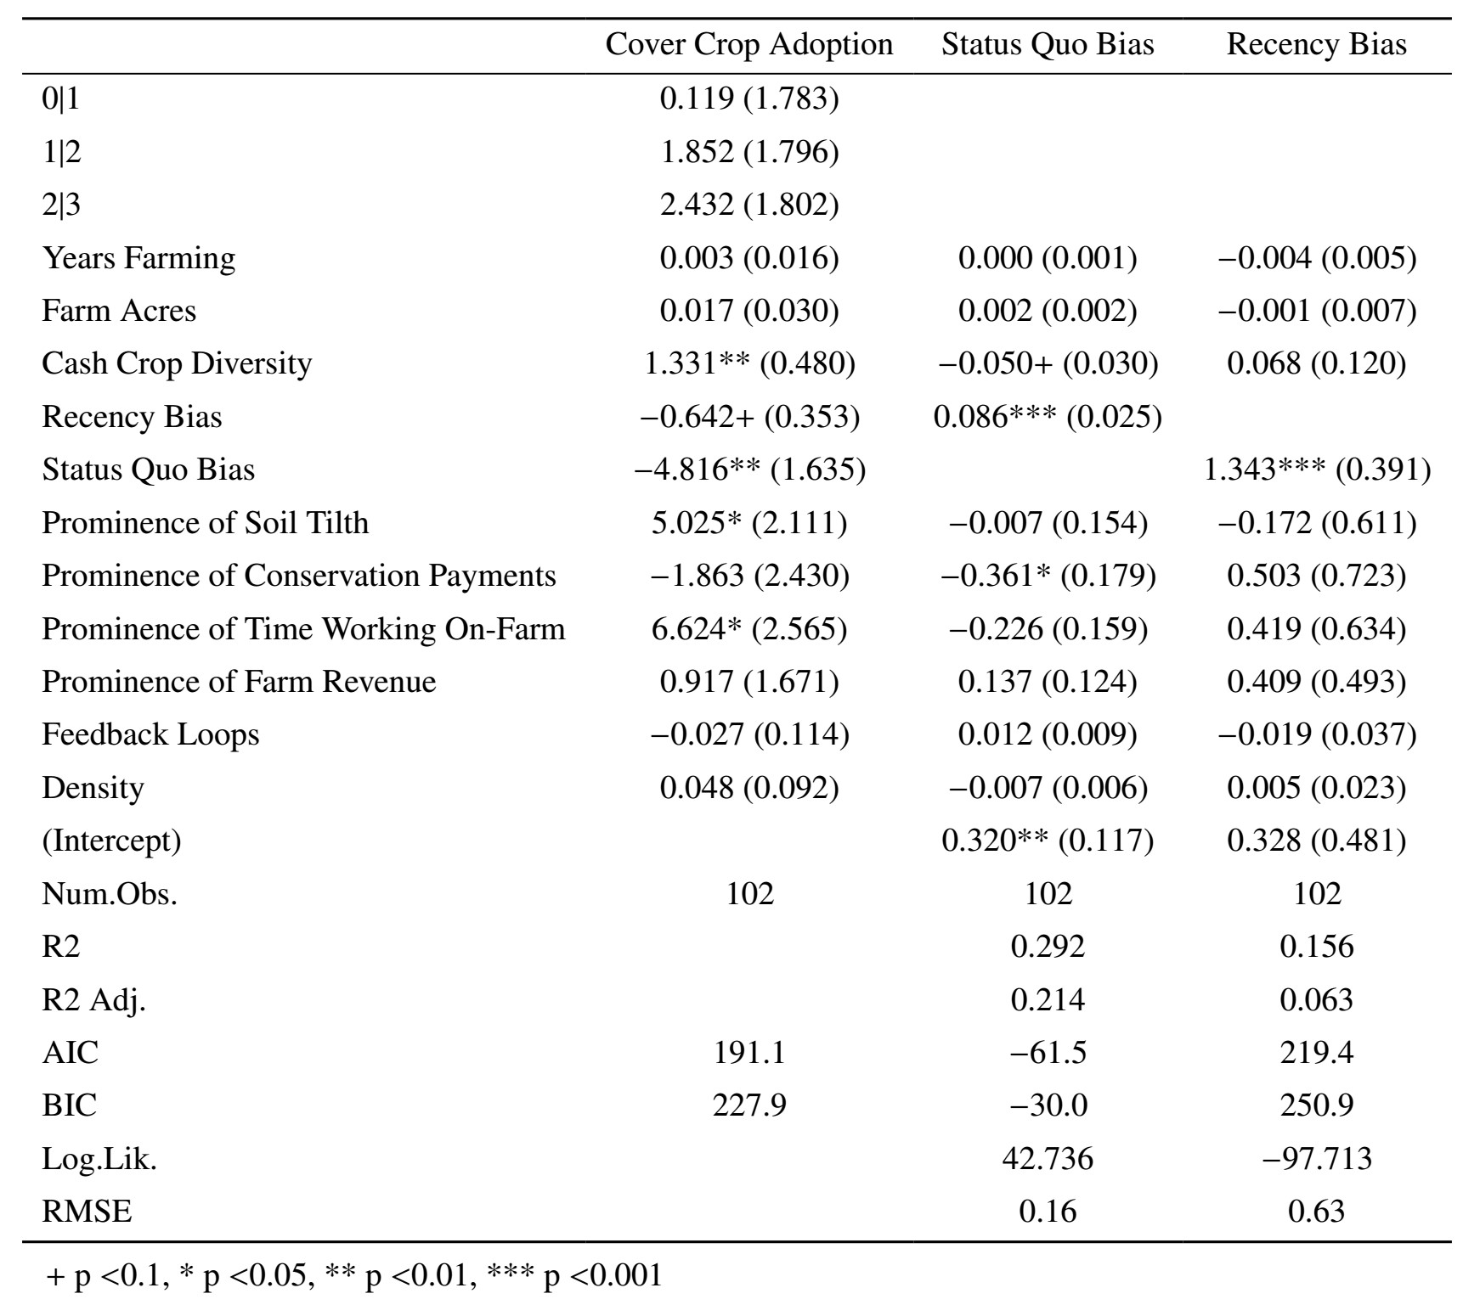
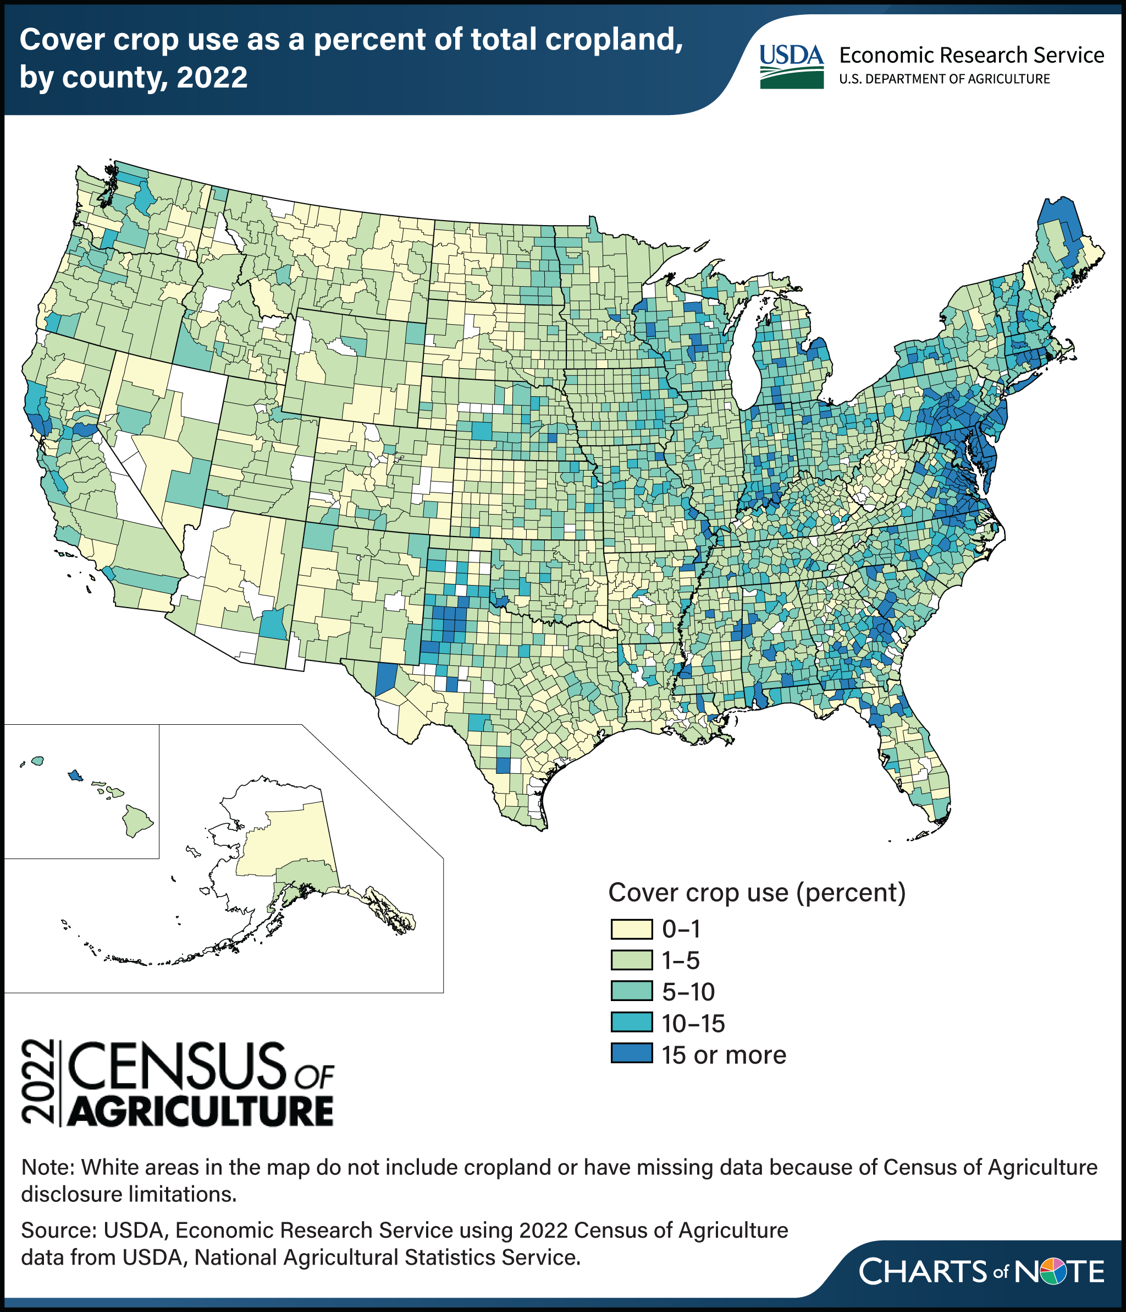
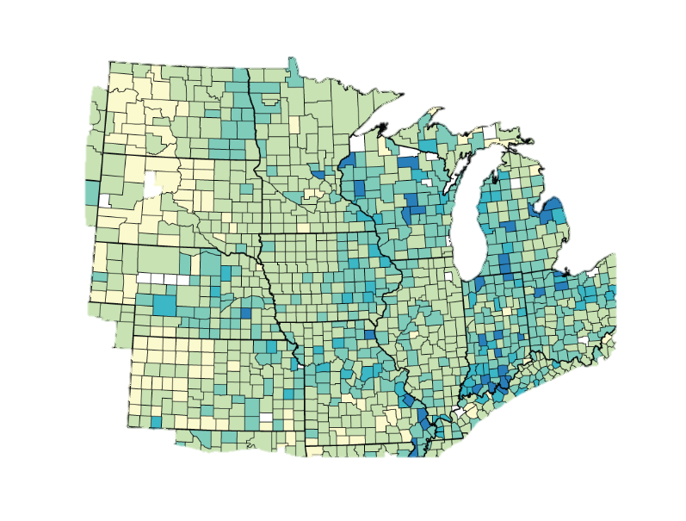
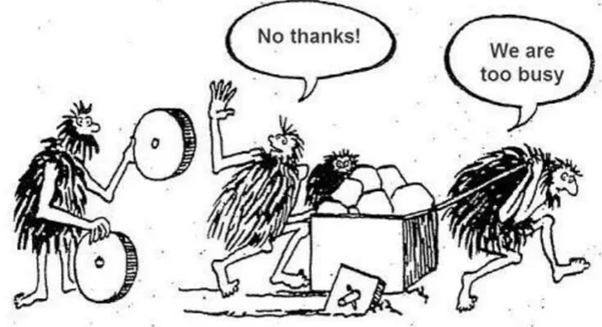
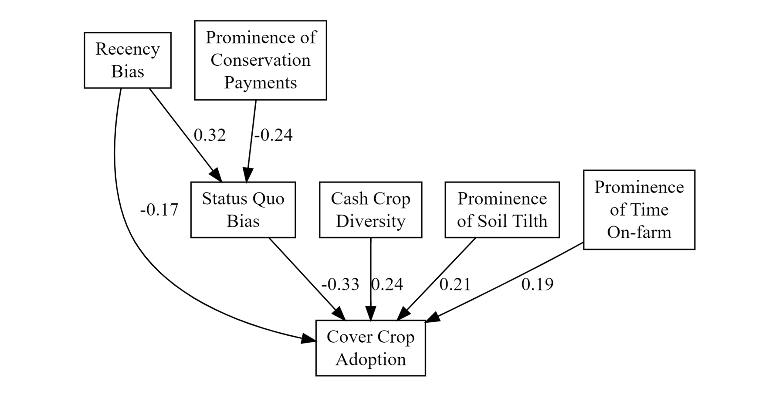
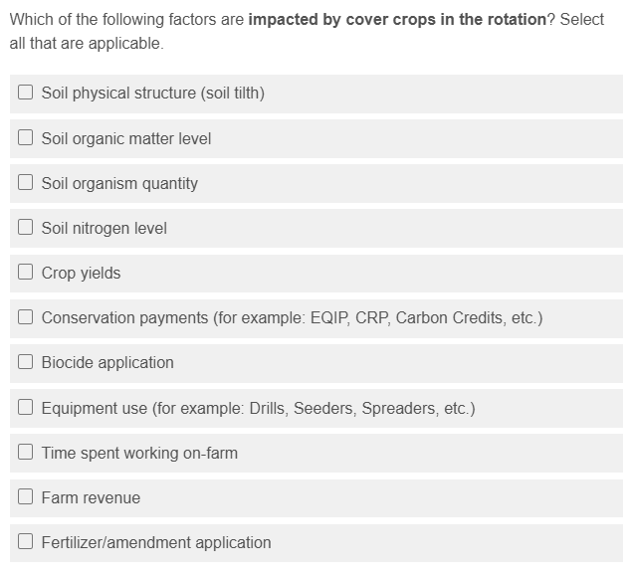
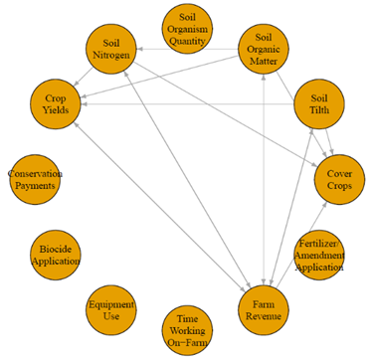
Cognition of Complexity, Cognitive Biases, and Cover Crop Adoption: Understanding Farmer Decision-Making Processes
Introduction
Prabhjot Singh and Matthew Hamilton
singh.1374@osu.edu
Regression Models
Benefits of cover crops:
Increase organic matter
Improve biodiversity
Retain soil nutrients
Suppress weeds
Reduce erosion
Improve soil aggregation & physical structure
The benefits of cover crops are well supported by research; however, they are still not widely applied across U.S. cropland. Agroecosystems are multifaceted and interconnected systems that pose complex management challenges for farmers. To better understand cover crop adoption among Midwest row crop farmers, it is crucial to examine how they perceive these systems and how that perception shapes their decisions. This study explores how farmers are grappling with uncertainties and complexities of agroecosystems and how they decide to adopt, continue, or forgo cover crops on their fields.
Objectives:
Measure farmers’ systems thinking (cognition of complexity)
Examine how levels of systems thinking are related to cover crop decisions and cognitive biases
Determine if or how farmers may be using cognitive biases during their decision-making processes
Farm/farmer Characteristics (controls)
Cognitive Biases
Cognitive Map Nodes
Complexity Indicators
Methods
A survey was distributed to row-crop farmers in the Midwest with 4 key sections:
Past, present, and future cover crop use
Demographics and farm characteristics
Scenario-based questions to assess status quo and recency biases
Pairwise comparisons of agroecological factors to construct cognitive maps
Analysis:
Cognitive maps were used to calculate complexity indicators
3 regression models predicted cover crop adoption, status quo bias, and recency bias.
A structural equation model examined relationships among significant variables from the regression analysis
Key Findings
Based on the linkages in cognitive maps, factors “soil tilth” and “time working on-farm” were positively associated with cover crop adoption.
Cover crop adoption was more likely among farmers who had greater diversity in crop rotations and was less likely among farmers with higher indicators of status quo bias.
recency bias and status quo bias were predictive of each other, both increasing the likelihood of the other
SEM supports that these relationships are significant (p < 0.05), but weak
Residual variances indicate that most of status quo bias (0.82) and cover crop adoption (0.62) are still unexplained by the model
Farmer Survey
Farm & Farmer Characteristics
Cognitive Biases
Status Quo Bias
Recency Bias
Path Model
Experiences over time
Make decisions based on most recent
Cognitive Maps
Density (connectivity)
Feedback Loop
Acknowledgements: This research was supported by the North Central Sustainable Agriculture Research and Education (NCR-SARE) program, funded by the USDA National Institute of Food and Agriculture (NIFA). We thank the SARE, USDA-NIFA, the School of Environment and Natural Resources at OSU and the Environmental Science graduate program for their continued support for this research.
Survey Response
Complexity Indicators
Cognitive Map Nodes

